Slide 1

– Unit 2 –
Stages 2, 3, and 4 of the Process: Developing and Pretesting Concepts, Messages and Materials, Implementing the Program, and Assessing Effectiveness

Slide 2
Learning Objectives of Unit 2
Stage 2 – Developing and Pretesting Concepts, Messages, and Materials:
  Explain the significance of developing and pretesting messages and materials in health communication.
  Create a comprehensive plan for developing and pretesting communication materials.
  Identify common myths and misconceptions related to pretesting materials in health communication.
Stage 3 – Implementing the Program:
  Identify potential challenges and solutions related to program implementation.
  Develop strategies for maintaining positive media relations after the launch of a communication campaign.
  Analyze the importance of monitoring and problem-solving during program implementation as well as key performance indicators
  Identify common myths and misconceptions about program implementation in health communication.
Stage 4 – Assessing Effectiveness and Making Refinements:
  Discuss the role of outcome evaluation in shaping the effectiveness of communication programs.
  Develop and modify an outcome evaluation plan for a health communication program.
  Execute and interpret the steps involved in conducting outcome evaluation, including data collection and analysis.
  Evaluate the results of the outcome evaluation and make recommendations for refining the health communication program.
  Identify common myths and misconceptions related to the evaluation of health communication programs.

Slide 3
Stage 2: Developing and Pretesting Concepts, Messages, and Materials

Slide 4
Why Developing and Pretesting Messages and Materials Is Important
Steps in Developing and Pretesting Messages and Materials
  Review existing materials
  Develop and test message concepts
  Decide what materials to develop
  Develop messages and materials
  Pretest messages and materials
Notes:
Developing and pretesting messages and materials are important because they allow you to learn early in the program which messages will be most effective with the intended audiences. Knowing this will save your program time and money by ensuring that you do not go through the entire development process with an ineffective message. Positive results from pretesting can also give you early buy-in from your organization.

Slide 5
Step 1: Review existing materials
You may find materials at the following sources:
  Health departments (in your state or other states)
  University or public libraries
  Voluntary organizations
  Health professional associations
  Community-based coalitions
  Clearinghouses, Web sites, and telephone information services relevant to the issue
  Materials produced by the National Institutes of Health, the Centers for Disease Control and Prevention, or other agencies in the U.S. Department of Health and Human Services
  Healthfinder ®, the Federal gateway to health information, to identify relevant Federal clearinghouses and other Federal information sources (www.healthfinder.gov)
See Appendix C in your textbook for additional contact information for these suggested sources.
Notes:
Message and materials development and production can be time-consuming and costly. Because this process is creative and has tangible results, it is frequently the key developmental step for a health communication program. Before you begin developing and producing new materials, however, determine whether creating them is necessary.
Using the communication strategy statement as a guide, consider the following questions: • Are the messages accurate, current, complete, and relevant? • Are the materials appropriate for the intended audience in format, style, cultural considerations, and readability level? If not, could they be modified to be appropriate?
• Are the materials likely to meet the communication objectives?

Slide 6
Step 2: Develop and test message concepts
Working With Creative Professionals
Developing Culturally Appropriate Communications
  Culturally sensitive communications should:
    Acknowledge culture as a predominant force in shaping behaviors, values, and institutions
    Understand and reflect the diversity within cultures. In designing messages that are culturally appropriate, the following dimensions are important:
      Primary cultural factors linked to race, ethnicity, language, nationality, and religion
      Secondary cultural factors linked to age, gender, sexual orientation, occupation, income level, and acculturation to mainstream
    Reflect and respect the attitudes and values of the intended audience
    Are based on concepts and materials developed with the involvement of the intended audience
    Refer to cultural groups using terms that members prefer
    Use the language of the intended audience
Notes:
The communication strategy statement and program’s needs the other planning you did in Stage 1 form the basis for developing message concepts. Message concepts are messages in rough form and represent ways of presenting the information to the intended audiences. These may include statements only or statements and visuals. If you create two or more concepts for each message, you will be able to explore which alternative works best.)

Slide 7
Step 2: Develop and test message concepts
  Choosing the Type of Appeal
    Positive emotional appeals – show the benefits intended audience members will gain when they take the action portrayed in the message.
    Humorous appeals – can work for simple messages, especially if most competing communication is not humorous.
    Threat (or fear) appeals – have been shown to be effective with “copers” (people who are not anxious by nature) and “sensation seekers” (certain youth), and when exposure to the message is voluntary
  Concept Testing
    Testing the concepts with intended audiences can help you decide on message appeals (e.g., fear-arousing versus factual), spokespersons (e.g., a scientist, public official, or member of the intended audience), and language (determined by listening to research participants’ language). Testing is especially important if the program deals with a new issue, because it will help you understand where the issue fits within the larger context of the intended audience’s life and perceptions.
Notes:
The communication strategy statement and program’s needs the other planning you did in Stage 1 form the basis for developing message concepts. Message concepts are messages in rough form and represent ways of presenting the information to the intended audiences. These may include statements only or statements and visuals. If you create two or more concepts for each message, you will be able to explore which alternative works best.)

Slide 8
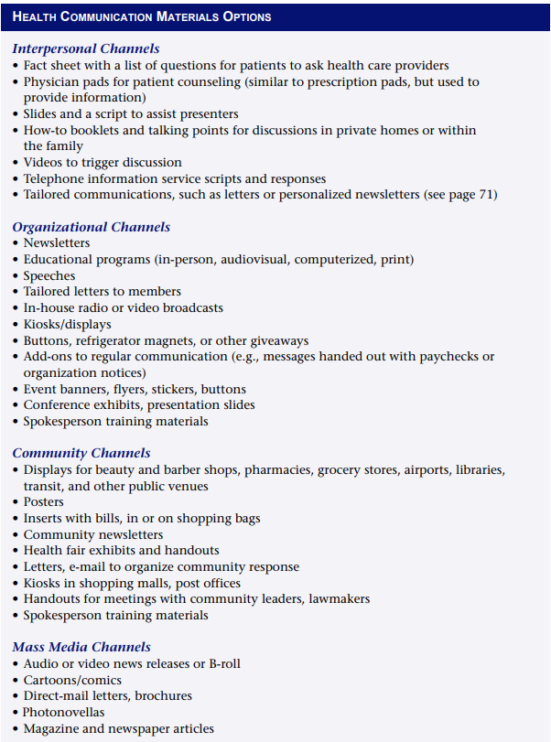
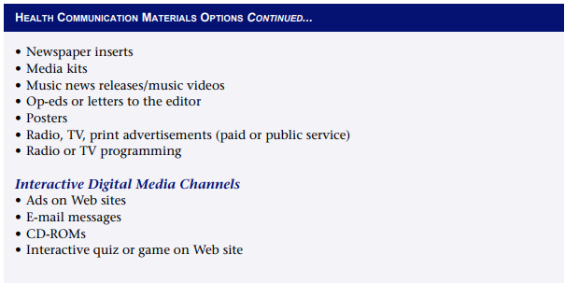
Step 3: Decide what materials to develop
Notes:
Once you have message concepts that are effective with the intended audience, determine the material formats (e.g., brochure, videotape) that will best suit your program by evaluating: • The nature of the message (e.g., its complexity, sensitivity, style) • The function of the message (e.g., to call attention to an issue or to teach a new skill)

Slide 9
Step 4: Develop Messages and Materials
The following guidelines will help your program develop materials that intended audiences understand, accept, and use:
  Ensure the message is accurate
  Be consistent
  Be clear
  Be relevant to the intended audience
  Be credible
  Be appealing
Tailored Communications
  Developing Effective Print Materials for Low-Literacy Intended Audiences
  Developing Effective Web Sites (Table Pg 76 from Textbook)

Slide 10
Step 5: Pretest Messages and Materials
Conducting Concept Tests and Materials Pretests
To plan and conduct concept tests and materials pretesting, complete the following steps:
  Determine test objectives.
  Choose methods.
  Secure vendors, facilities, and moderators or interviewers (if required).
  Identify, screen, and recruit respondents.
  Draft test instruments (discussion guides, questionnaires).
  Conduct pretesting.
  Analyze results.
  Make the best use of results.

Slide 11
Common Myths and Misconceptions About Pretesting
Myth: I don’t have the time or money.
Fact: Pretesting needs to be planned as an integral step in the materials development process from the beginning. Include time and resources for pretesting and for any changes you might need to make as a result in the project budget and timeline.
Myth: My boss won’t support pretesting.
Fact: Use the information in this module and in the Selected Readings of your textbook to convince your boss that you need to pretest.
Myth: I can tell the difference between good and bad materials, so I don’t need to pretest.
Fact: Your training and experience are essential credentials, but are you sure you can react objectively to materials you have created or are responsible for?
Myth: Our artist/producer says that pretesting can’t be used to judge creativity.
Fact: Graphics staff, artists, and creative writers may be sensitive to criticism from “nonprofessionals,” including the intended audience. Explaining the purpose of pretesting and involving them in the pretesting may help them understand and appreciate the process.

Slide 12
Questions to Ask and Answer:
What materials will fit our strategy, appeal to our intended audience, and adequately convey our message? How can we make the materials as effective as possible?
Do we need to create new materials? What types?
How do we develop culturally appropriate messages and materials?
How do we develop effective materials for low-literacy intended audiences?
How can we make sure the materials will be used?
When and how should we pretest our materials?
How can we keep pretesting costs down?
What should we do with pretest results?
How can we get the best results from creative and research professionals? From reviewers?

Slide 13
Exercise
Read the Benefits and Limitations of pretesting as described in pages 80-81 in your textbook. In groups of 4, discuss which of these apply to the context of your country. Can you adjust any of the points to make a limitation be more beneficial?

Slide 14
Stage 3: Implementing the Program
Preparing to launch and implement your program
Holding a press conference
Maintaining media relations after launch
Working with the media during a crisis
Managing implementation: monitoring and problem solving
Maintaining partnerships
Common myths and misconceptions about implementation

Slide 15
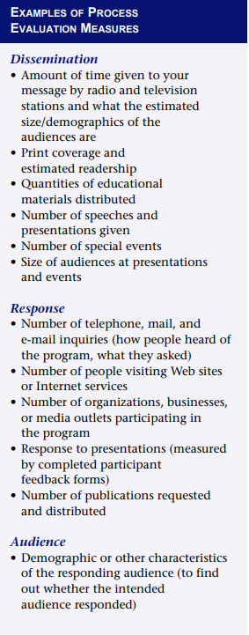
Preparing to Implement Your Program
  Program Launch
  Kick-off Event and enhancing media coverage
  of your event
  Holding a Press Conference
    Invitations
    Speakers
    Timing
    Logisitcs
    Media Kits
    Follow up
Managing Implementation
  Process Evaluation
  Measuring Audience Satisfaction
  Making Adjustments
Notes:
Preparing to Implement Your Program Before you launch the program, plan for distribution, promotion, and process evaluation. Make sure you also develop a launch plan, produce sufficient quantities of materials, and prepare your staff for the work ahead. Program Launch

Slide 16
Common Myths and Misconceptions About Implementing
Myth: People need the information we are providing, so we will have a large number of requests for our materials.
Fact: “If we print it they will come” holds true only if you are printing money. For most programs, effective promotion is critical to getting materials into the hands of those who need them. Disseminating printed products is as challenging, and as important, as developing them.
Myth: Working with the media is more trouble than it is worth. They take statements out of context, don’t bother to check facts, and care only about sensationalism.
Fact: Although is possible to have bad experiences with the media, if you pay attention to your work with them, you can help foster positive outcomes.
Myth: When the press conference is over, we can relax.
Fact: The longevity of news can be measured in days—if not minutes. Single channels or even the entire mass media are unlikely to reach all intended audiences, and one event or activity is not enough.

Slide 17
Common Myths and Misconceptions About Implementing
Myth: We have partners, so we don’t have to worry as much about implementation. They’ll do a lot of the work for us.
Fact: Partners can help with implementation, but they are unlikely to reduce your workload.
Myth: If a program is not an immediate success, it is a failure.
Fact: All change takes time. Even the best-planned health communication programs have to make mid-course corrections.
Myth: It is unseemly for a government/nonprofit health program to spend money to promote itself.
Fact: By promoting your program, you are promoting your issue and your message. The more people who know about what you have to offer, the more the community will benefit.

Slide 18
Questions to Ask and Answer:
How should we launch the program?
Should we use a kickoff event?
How should we develop and sustain media coverage? Partner involvement? Audience interest?
How should we manage a press conference?
How should we work with the media during a crisis?
How can we ensure that our program operates according to plan?
How can we use process evaluation?
How can we find out whether we are reaching the intended audience with our information?
How can we find out whether they are responding favorably to our message and materials?
Are we maintaining good relationships with our partners?

Slide 19
Stage 4: Assessing Effectiveness and Making Refinements
Why outcome evaluation is important
Revising the outcome evaluation plan you wrote during Stage 1
Conducting the assessment
Refining the health communication program
Common myths and misperceptions about evaluation
Notes:
Why Outcome Evaluation Is Important Outcome evaluation is important because it shows how well the program has met its communication objectives and what you might change or improve to make it more effective. Learning how well the program has met its communication objectives is vital for: • Justifying the program to management • Providing evidence of success or the need for additional resources • Increasing organizational understanding of and support for health communication • Encouraging ongoing cooperative ventures with other organizations

Slide 20
Conducting Outcome Evaluation
Conduct outcome evaluation by following these steps:
  Determine what information the evaluation must provide.
  Define the data to collect.
  Decide on data collection methods.
  Develop and pretest data collection instruments.
  Collect data.
  Process data.
  Analyze data to answer the evaluation questions.
  Write an evaluation report.
  Disseminate the evaluation report.

Slide 21
Step 1: Determine What Information the Evaluation Must Provide
An easy way to do this is to think about the decisions you will make based on the evaluation report. What questions do you need to answer to make those decisions?

Slide 22
Step 2: Define the Data You Need to Collect
Determine what you can and should measure to assess progress on meeting objectives. Use the following questions as a guide:
  Did knowledge of the issue increase among the intended audience (e.g., understanding how to choose foods low in fat or high in fiber, knowing reasons not to smoke)?
  Did behavioral intentions of the intended audience change (e.g., intending to use a peer pressure resistance skill, intending to buy more vegetables)?
  Did intended audience members take steps leading to the behavior change (e.g., purchasing a sunscreen, calling for health information, signing up for an exercise class)?
  Did awareness of the campaign message, name, or logo increase among intended audience members?
  Were policies initiated or other institutional actions taken (e.g., putting healthy snacks in vending machines, improving school nutrition curricula)?

Slide 23
Step 3: Decide on Data Collection Methods
There are several data collection methods.
Look at the Table on pages 112-113 of your textbook. In groups of 4, read the evaluation design and its major limitations. Discuss which evaluation designs are more appropriate for your culture/context and topic covered.

Slide 24
Step 4: Develop and Pretest Data Collection Instruments
Most outcome evaluation methods involve collecting data about participants through observation, a questionnaire, or another method. Instruments may include tally sheets for counting public inquiries, survey questionnaires, interview guides. Select a method that allows you to best answer your evaluation questions based upon your access to your intended audience and your resources. To develop your data collection instruments—or to select and adapt existing ones—ask yourself the following questions:
  Which data?
  From whom?
  How?

Slide 25
Steps 5-7
5. Collect Data
  Collect post program data. You should have collected baseline data during planning in Stage 1, before your program began, to use for comparison with post program data.
6. Process Data
  Put the data into usable form for analysis. This may mean organizing the data to give to professional evaluators or entering the data into an evaluation software package.
7. Analyze the Data to Answer the Evaluation Questions
  Use statistical techniques as appropriate to discover significant relationships. Your program might consider involving university-based evaluators, providing them with an opportunity for publication and your program with expertise.

Slide 26
Step 8: Write an Evaluation Report
A report outlining what you did and why you did it, as well as what worked and what should be altered in the future, provides a solid base from which to plan future evaluations. Your program evaluation report explains how your program was effective in achieving its communication objectives and serves as a record of what you learned from both your program’s achievements and shortcomings. Be sure to include any questionnaires or other instruments in the report so that you can find them later.
See Appendix A of your textbook for a sample evaluation report

Slide 27
Step 9: Disseminate the Evaluation Report
Ask selected stakeholders and key individuals to review the evaluation report before it is released so that they can identify concerns that might compromise its impact. When the report is ready for release, consider developing a dissemination strategy for the report, just as you did for your program products, so the intended audiences you’ve chosen will read it. Don’t go to the hard work of writing the report only to file it away.
Letting others know about the program results and continuing needs may prompt them to share similar experiences, lessons, new ideas, or potential resources that you could use to refine the program.
In fact, feedback from those who have read the evaluation report or learned about your findings through conference presentations or journal coverage can be valuable for refining the program and developing new programs. You may want to develop a formal mechanism for obtaining feedback from peer or partner audiences. If you use university-based evaluators, the mechanism may be their publication of findings. If appropriate, use the evaluation report to get recognition of the program’s accomplishments.
If appropriate, use the evaluation report to get recognition of the program’s accomplishments.

Slide 28
Refining Your Health Communication Program
Review the evaluation report and consider the following to help you identify areas of the program that should be changed, deleted, or augmented:
  Goals and objectives:
    Have your goals and objectives shifted as you’ve conducted the program? If so, revise the original goals and objectives to meet the new situation.
    Are there objectives the program is not meeting? Why? What are the barriers you’re encountering?
    Has the program met all of your objectives, or does it seem not to be working at all? Consider ending the program.
  Where additional effort may be needed:
    Is there new health information that should be incorporated into the program’s messages or design?
    Are there strategies or activities that did not succeed? Review why they didn't work and determine what can be done to correct any problems.
  Implications of success:
    Which objectives have been met, and by what successful activities?
    Should successful communication activities be continued and strengthened because they appear to work well or should they be considered successful and completed?
    Can successful communication activities be expanded to apply to other audiences or situations?
  Costs and results of different activities:
    What were the costs (including staff time) and results of different aspects of the program?
    Do some activities appear to work as well as, but cost less than, others?
  Accountability:
    Is there evidence of program effectiveness and of a continued need to persuade your organization to continue the program?
    Have you shared the results of your activities with the leadership of your organization?
    Have you shared results with partners?
    Do the assessment results show a need for new activities that would require partnerships with additional organizations?

Slide 29
Common Myths and Misconceptions About Evaluation
Myth: We can’t afford an evaluation.
Fact: Rarely does anyone have access to adequate resources for an ideal health communication program, much less an ideal evaluation. Nevertheless, including evaluation as a part of your work yields the practical benefit of telling you how well your program is working and what needs to be changed.
Myth: Evaluation is too complicated. No one here knows how to do it.
Fact: Many sources of help are available for designing an evaluation. Several pertinent texts are included in the selected readings at the end of your textbook as well.
Myth: Evaluation takes too long.
Fact: Although large, complicated outcome evaluation studies take time to design and analyze (and may require a sufficient time lapse for changes in attitudes or behavior to become clear), other types of evaluation can be conducted in a few weeks or months, or even as little as a day.

Slide 30
Common Myths and Misconceptions About Evaluation
Myth: Program evaluation is too risky. What if it shows our funding source (or boss) that we haven’t succeeded?
Fact: A greater problem is having no results at all. A well-designed evaluation will help you measure and understand the results (e.g., if an attitude or a perception did not change, why not?).
Myth: We affected only 30 percent of our intended audience. Our program is a failure.
Fact: Affecting 30 percent of the intended audience is a major accomplishment; it looks like a failure only if your program’s objectives were set unrealistically high.
Myth: If our program is working, we should see results very soon.
Fact: Results will vary depending on the program, the issue, and the intended audience. Don’t expect instant results

Slide 31
Questions to Ask and Answer:
How can we use outcome evaluation to assess the effectiveness of our program?
How do we decide what outcome evaluation methods to use?
How should we use our evaluation results?
How can we determine to what degree we have achieved our communication objectives?
How can we make our communication program more effective?

Slide 32
Thank you

