Slide 1

Course number 6
COMMUNICATION
nEUROcare -
a European initiative for capacity building to meet the challenges
of caring for people with neurodegenerative disorders in Sri Lanka
Unit number: 4a Unit name: Alternative and Augmentative Communication
Loukia Taxitari
Neapolis University Pafos

Slide 2
Learning Objectives
Acquaint the students with the use and applications of Augmentative and Alternative Communication (AAC)
Understand and utilize different types of AAC
Understand and utilize the appropriate tools of AAC in different types of NDDs

Slide 3
Communication Support 1/6
Communication support is defined broadly as anything that improves access to or participation
in communication, events, or activities.
Notes:
DOI:10.3233/NRE-151241

Slide 4
Communication Support 2/6
Includes:
  strategies, materials, or resources
  modifications in the environment around the person with impairments
  supportive attitudes that foster communication participation
  policies and practices of agencies and institutions that foster communication success
Notes:
Support includes strategies, materials, or resources that are used by people
with impairments or by others who communicate
with people with impairments. It involves modifications
in the environment around the person with impairments
or modifications to activities in which people
engage. It also includes supportive attitudes that foster
communication participation. Finally, support includes
policies and practices of agencies and institutions
that foster communication success”
DOI:10.3233/NRE-151241

Slide 5
Communication Support 3/6
Key assumptions that justify intervention with communication supports:
The ultimate goal of all treatment is to enhance participation in communicative life
Communication is a collaborative enterprise
Communication support is an ethical issue
Notes:
According to
Simmons-Mackie, there are key assumptions
that justify intervention with communication supports like: (1) The ultimate
goal of all treatment is to enhance participation
in communicative life. Regardless of the stage of the
neurodegenerative process, the patient and his communication
partners can set goals that achieve meaningful
outcomes. (2) Communication is a collaborative
enterprise. Since meaning is negotiated between and
among participants, those with communication challenges
and their partners must develop strategies and
resources to send and receive messages successfully.
(3) Communication support is an ethical issue. It is
the responsibility of the interventionist to identify and
establish any method, strategy or resource that might
help a patient communicate more successfully.
DOI:10.3233/NRE-151241

Slide 6
Communication Support 4/6
Each person has the right to:
request desired objects, actions, events and people
refuse undesired objects, actions, or events
express personal preferences and feelings
be offered choices and alternatives
reject offered choices
request and receive another person’s attention and interaction
Notes:
(National Joint Committee for the Communication
Needs of Persons with Severe Disabilities,1992).
DOI:10.3233/NRE-151241

Slide 7
Communication Support 5/6
Each person has the right to:
ask for and receive information about changes in routine and environment
receive intervention to improve communication skills
receive a response to any communication, whether or not the responder can fulfill the request
have access to AAC (augmentative and alternative communication) and other AT (assistive technology) services and devices at all times
Notes:
DOI:10.3233/NRE-151241

Slide 8
Communication Support 6/6
Each person has the right to:
have AAC and other AT devices that function properly at all times
be in environments that promote one’s communication as a full partner with other people, including peers
be spoken to with respect and courtesy
be spoken to directly and not be spoken for or talked about in the third person while present
have clear, meaningful and culturally and linguistically appropriate communications
Notes:
The National Joint Committee for the Communication
Needs of Persons with Severe Disabilities presents
a Communication Bill of Rights (Table 1) that clearly
states that all people with disabilities, including those
with severe speech and language impairment secondary
to neurodegenerative disease, have a basic right to
affect, through communication, the conditions of their
existence DOI:10.3233/NRE-151241

Slide 9
What is ‘Augmentative and Alternative Communication?’
Augmentative and alternative communication (AAC) refers to a set of tools use by people who cannot express themselves clearly using their natural speech alone.
Augment means to add to or to enhance.
Alternative means a choice or a substitute.
Communication means to send and receive messages with at least one other person.
Notes:
Rather
than working on goals to return patients to their previous
levels of functioning,AACprovidesways to remain
engaged in daily activities with alternative compensatory
approaches or durable medical equipment.
DOI:10.3233/NRE-151241
Augmentative and alternative communication (AAC) refers to a set of tools use by people who cannot express themselves clearly using their natural speech alone. (https://doi.org/10.1080/17483107.2022.2105961)
Augmentative and alternative communication is a type of communication that combines gestures, eye pointing, vocalisations and pointing to symbols as communication for people with limited speech abilities.
Augment means to add to or to enhance. For example, we can augment speech by using gestures, eye pointing and body language.
Alternative means a choice or a substitute. We can use alternative communication to speech by pointing to symbols, signing or by spelling.
Communication means to send and receive messages with at least one other person.
(https://novitatech.com.au/augmentative-and-alternative-communication-aac/)
This means augmentative and alternative communication (often shorted to AAC) is the term for all communication that is not speech, but other types used to enhance or to replace speech.
, or augmentative and alternative communication, is a set of tools and techniques used to help people with communication disorders, including those caused by neurodegenerative diseases. AAC can be particularly useful for adults with neurodegenerative diseases such as Parkinson's disease, Huntington's disease, amyotrophic lateral sclerosis (ALS), and Alzheimer's disease.

Slide 10
Applications of AAC
Compensating for speech difficulties.
Improving quality of life.
Supporting memory and cognition.
Providing caregiver support.
Facilitating end-of-life care.
Notes:
Compensating for speech difficulties: Many adults with neurodegenerative diseases have difficulty speaking due to weakness, tremors, or other motor issues. AAC can provide tools such as communication boards, speech-generating devices, and software that can help them communicate more effectively.
Improving quality of life: By improving communication, AAC can help adults with neurodegenerative diseases to maintain their independence, reduce frustration and anxiety, and improve their social interactions.
Supporting memory and cognition: AAC can also support memory and cognition in adults with neurodegenerative diseases. For example, memory aids such as visual schedules, checklists, and reminders can help individuals remember important tasks and information.
Providing caregiver support: Caregivers of adults with neurodegenerative diseases can also benefit from AAC tools and techniques. For example, using picture boards or visual schedules can help caregivers communicate with their loved ones more effectively and reduce stress.
Facilitating end-of-life care: In some cases, individuals with neurodegenerative diseases may lose the ability to communicate completely. In these cases, AAC tools such as facial expression charts or eye-tracking technology can be used to help them communicate their needs and preferences in end-of-life care.
Overall, AAC can be a valuable tool for improving communication and quality of life for adults with neurodegenerative diseases.

Slide 11
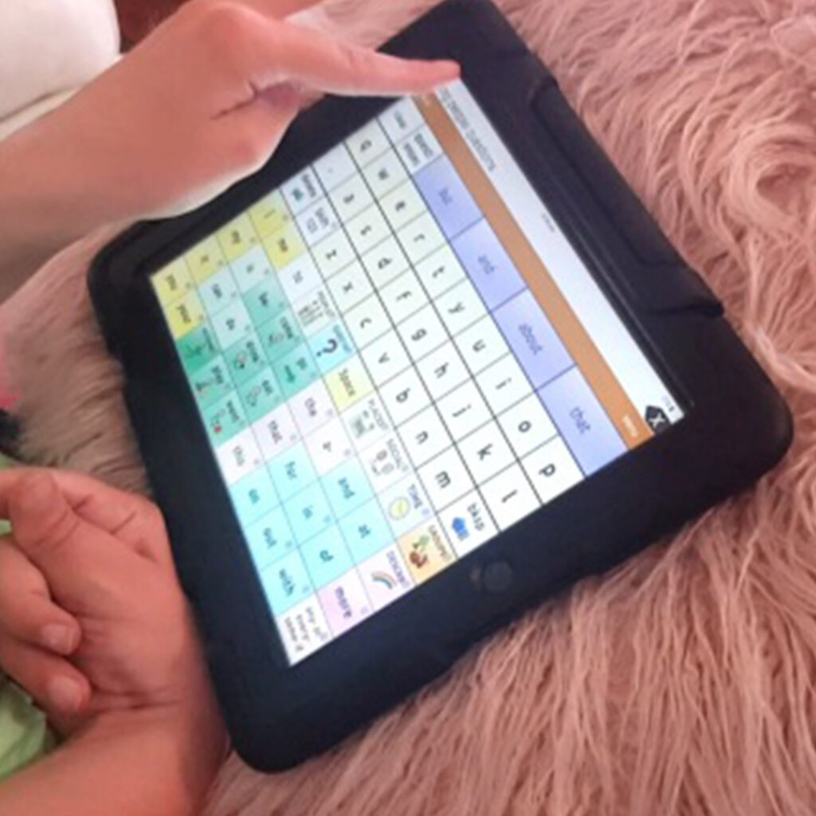
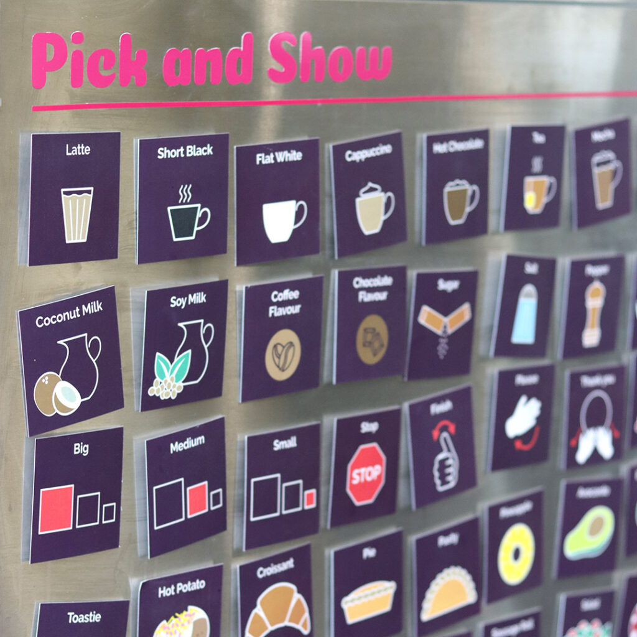

AAC applications
Learn AAC - AssistiveWare
Notes:
You can find more information in the link shown.

Slide 12
Types of AAC
The term ‘AAC’ includes four interlinked strands:
The communication medium
A means of access to the communication medium
A system of representing meaning
Strategies for interacting with a communication partner
Notes:
The term ‘AAC’ includes four interlinking strands (Royal College of Speech and Language
Therapists, 2006):
The communication medium – how the meaning of the message is being transmitted. This can be
unaided, for instance by using gestures, facial expression, signing, etc., or it can be aided, where
the person communicates using some sort of device other than their body, for instance via a
communication chart, or an electronic device with speech output.
A means of access to the communication medium – this may be via a keyboard or touch screen, or
by using a switch to scan from an array of letter, words, or pictures.
A system of representing meaning – when people speak, their meaning is represented by spoken
words which act as ‘symbols’. Where a person is unable to speak, their meaning has to be
represented by a different set of symbols. These symbols may be traditional orthography (letters
or words), or it may be a set of pictorial symbols
Strategies for interacting with a communication partner, for example being able to start up a
conversation, or to sort things out when the other person does not understand.
(https://www.researchgate.net/publication/263737513)

Slide 13
Augmentative and Alternative Communication
Augmentative and Alternative Communication
Aided
High Tech
Low Tech
Unaided
Non – Tech
Notes:
This term is used for an augmentative method of communication which does not require the use of any additional material or equipment. Unaided communication includes the whole range of expressive things we can do with our bodies, such as gestures, facial expression, eye gaze, and body postures, and might include some mime-like movements and signs. At the simplest level, gesture is intuitive for everybody, and often immediately intelligible. It may be used by people with profound difficulties. More sophisticated gestural codes can also be developed.
The biggest advantage of gestures and signing is that they are quick, immediate and practical – you can’t forget to take these systems with you; you can use them wherever you are; you don’t need any expensive or cumbersome equipment; they can’t break down. The disadvantage of gesture for transmitting information is, as Michael Williams (1994), who is himself an AAC user, says:
“Gestures can get you a cup of coffee in the morning, but they do a poor job of telling your friend about that delicious piece of cake you had the other night. Gestures can only express things in the here and now. Also, gestures are poor candidates for expressing things like truth and beauty.”
Signing is a much more sophisticated form of communication, a whole specialist area in itself, which is beyond the scope of this book. There are a number of different forms of signing – some use restricted numbers of signs as a support for speech, while at the other end of the scale others provide complex and powerful language, with enormously rich expressive capabilities. While signing is of course a primary AAC choice for people with deafness and hearing impairment, it is not always quite as useful for people with other motor and physical difficulties. The disadvantage of sign language is above all that not everyone in the communication impaired person’s environment – in fact, sometimes hardly anyone – may sign well themselves or understand sign to an advanced degree. Staff needs continual training in signing. Furthermore, many people who need augmentative communication systems have some degree of physical and/or neurological impairment, which may make the formation of recognizable signs physically difficult.

Slide 14

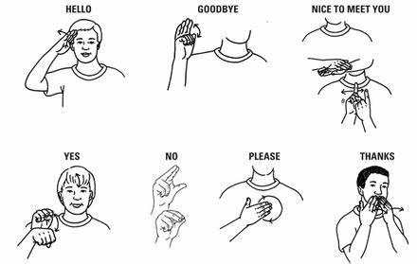
Unaided Communication
Unaided communication includes the whole range of expressive things we can do with our
bodies, such as gestures, facial expression, eye gaze, and body postures, and might include some mime-like movements and signs.
Notes:
This term is used for an augmentative method of communication which does not require the use of any additional material or equipment. Unaided communication includes the whole range of expressive things we can do with our bodies, such as gestures, facial expression, eye gaze, and body postures, and might include some mime-like movements and signs. At the simplest level, gesture is intuitive for everybody, and often immediately intelligible. It may be used by people with profound difficulties. More sophisticated gestural codes can also be developed.
The biggest advantage of gestures and signing is that they are quick, immediate and practical – you can’t forget to take these systems with you; you can use them wherever you are; you don’t need any expensive or cumbersome equipment; they can’t break down. The disadvantage of gesture for transmitting information is, as Michael Williams (1994), who is himself an AAC user, says:
“Gestures can get you a cup of coffee in the morning, but they do a poor job of telling your friend about that delicious piece of cake you had the other night. Gestures can only express things in the here and now. Also, gestures are poor candidates for expressing things like truth and beauty.”
Signing is a much more sophisticated form of communication, a whole specialist area in itself, which is beyond the scope of this book. There are a number of different forms of signing – some use restricted numbers of signs as a support for speech, while at the other end of the scale others provide complex and powerful language, with enormously rich expressive capabilities. While signing is of course a primary AAC choice for people with deafness and hearing impairment, it is not always quite as useful for people with other motor and physical difficulties. The disadvantage of sign language is above all that not everyone in the communication impaired person’s environment – in fact, sometimes hardly anyone – may sign well themselves or understand sign to an advanced degree. Staff needs continual training in signing. Furthermore, many people who need augmentative communication systems have some degree of physical and/or neurological impairment, which may make the formation of recognizable signs physically difficult.

Slide 15
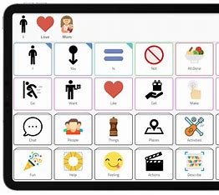
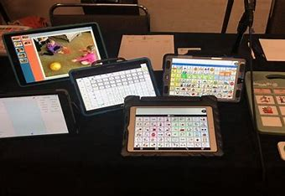
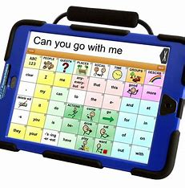
Aided Communication
An aided communication system can vary from something very simple (e.g., the alphabet written on a plain post-card) to a highly sophisticated microelectronic system specially programmed with a large vocabulary.
Notes:
This term refers to systems which involve some physical object or equipment such as symbol charts or books; it also refers to computer based systems or Voice Output Communication aids (VOCAs). An aided communication system can be something very simple (e.g., the alphabet written on a plain post-card) or it may involve a highly sophisticated microelectronic system specially programmed with a large vocabulary.
The biggest advantages of aided communication are the flexibility and the richness of communication that can be achieved by creating and customizing vocabulary sets; employing sophisticated methods of storage and retrieval; and providing users with special means of accessing them. Aided communication can be used by very young children, non-readers, and individuals with severe intellectual and sensory disabilities, as many systems are based on simple pictures and symbols. Systems based on alphabetic symbols, for those who can use them, give access to a limitless range of communication. Low tech systems can be very quick and simple to use. High tech aids can be designed for operation by very minimal movements (e.g., a single switch press), so can be accessible to individuals with severe physical disabilities. Rate enhancement techniques may be included in the design of an electronic aid, to try and help users approach a higher speed of communication. Voice output increases users’ independence. Use of high tech systems greatly increases the range of types of communication available (e.g., group discussions, phone use, use in employment, connection with other computers, email, chatting online, etc.) beyond personal face to face communication.
The biggest disadvantage of aided communication is the equipment itself. Having to remember and carry objects around with you, inevitably means something can get forgotten, left behind, lost or broken. Sometimes equipment can be bulky, or heavy. If the communication equipment is electronic, there may be a need to keep track of wheelchair mountings, battery chargers or spare batteries, on top of the basic equipment – and there is always the specter of technical failure. For this reason, it is vital to have a) a non-electronic back-up, and b) insurance. Another disadvantage, to the user, of high tech aids is that acquisition of a sophisticated piece of technology may be very expensive.

Slide 16
Low Tech Aided Communication
Tangible symbols (e.g., real objects, miniature objects or parts of objects, on an activity calendar)
Picture/photo boards or books
Symbol communication charts or books, topic boards
Letter, word or phrase boards
Communication cards (e.g., clipped on a key ring on a belt)
Eye-blink, or eye-pointing pointing codes
Fix pictures, symbols or letters, or a code to a frame in front of the user, who eye-points to the item they want to communicate
Notes:
Low tech
Low tech is anything that doesn’t involve electricity or electronics (Vanderheiden, 1984). Low tech communication systems may take many forms, and might include, for example:
Tangible symbols (e.g., real objects, miniature objects or parts of objects, on an activity calendar)
Picture/photo boards or books
Symbol communication charts or books, topic boards
Letter, word or phrase boards
Communication cards (e.g., clipped on a key ring on a belt)
Eye-blink, or eye-pointing pointing codes
Fix pictures, symbols or letters, or a code to a frame in front of the user, who eye-points to the item they want to communicate (see
Features of a low tech system to look out for are the choice of representational system, (i.e., what kind of pictures, symbols or codes suit the user best) and the method of selection of items (e.g., direct pointing, saying ‘yes’ or ‘no’ when a helper points, switch use, etc.).
https://www.researchgate.net/publication/263737513

Slide 17
High Tech Aided Communication 1/2
Pointer boards (hit a switch to stop the pointer going round, when it’s at the object, picture or symbol required.
Switches connected to battery-operated devices or simple environmental control devices such as attention-getting beepers, cassette players, single message tape-loops or other simple message players.
Switches connected to a ‘Mains Switcher’ to allow a user to control the environment and devices like a television, or a lamp.
Toys or books that speak when certain areas are pressed.
Simple, single message playback devices such as talking press switches.
Notes:
High tech
High tech is anything using electricity/electronics. This category covers a wide spectrum, starting with very low ‘high tech’ devices, for example:
Pointer boards (hit a switch to stop the pointer going round, when it’s at the object, picture or symbol required.
Switches connected to battery-operated devices or simple environmental control devices such as attention-getting beepers, cassette players, single message tape-loops or other simple message players.
Switches connected to a ‘Mains Switcher’ to allow a user to control the environment and devices like a television, or a lamp.
Toys or books that speak when certain areas are pressed.
Simple, single message playback devices such as talking press switches.
State of the art in high technology AAC is computer-based systems with text to speech software, and sophisticated access methods like eye-gazing. Terms like Voice Output Communication Aid (VOCA), Speech Generating Device (SGD), and Communicator can be used to denote such systems, but they are also sometimes used for lower tech non computer-based devices. Initially the computer-based systems were housed in desktop computers, later in notebooks, and the most successful configuration came when industrial or consumer tablet computers were used. Both industrial and consumer tablet computers have the important feature of the touch screen that can be used for direct selection, and the industrial ones have the advantage of being shock, drop, dust and moisture tolerant. In the very usual case where users can’t use a normal keyboard, these tablet computers that lack keyboard are much more compact, robust, and require limited space, which is very important when mobility is needed.
Lately the outburst of the tablet market with products from Apple Inc., like the iPad, and Samsung, like the Galaxy series, offered very convenient and portable new platforms for AAC systems. Furthermore, Android based Smartphones, and iPhones also raised the high tech systems one level higher, having hundreds of AAC apps available online.
Features to look out for in high ‘high tech’ communication systems would include:
Portability and robustness.
Range and type of possible input methods (keyboard; overlay keyboard; switch input; a range of scan options).
Type of screen display (none; static; displaying only text; dynamic; displaying symbols).
Techniques used to store and retrieve messages.
Output (transient or permanent); what type of screen, if any; digitized voice; synthetic voice; text; hard copy printout; storage on disk.
High tech communication aids vary also in the degree to which they demand of the user more or less sophisticated techniques of visual perception, memory, sequencing skills, language processing, meaning associations, grammar or encoding.

Slide 18
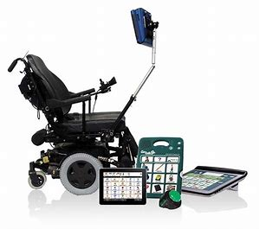
High Tech Aided Communication 2/2
State-of-the-art
Computer-based systems
Text-to-speech software
Eye-gazing
Tablets
Notes:
High tech
High tech is anything using electricity/electronics. This category covers a wide spectrum, starting with very low ‘high tech’ devices, for example:
Pointer boards (hit a switch to stop the pointer going round, when it’s at the object, picture or symbol required.
Switches connected to battery-operated devices or simple environmental control devices such as attention-getting beepers, cassette players, single message tape-loops or other simple message players.
Switches connected to a ‘Mains Switcher’ to allow a user to control the environment and devices like a television, or a lamp.
Toys or books that speak when certain areas are pressed.
Simple, single message playback devices such as talking press switches.
State of the art in high technology AAC is computer-based systems with text to speech software, and sophisticated access methods like eye-gazing. Terms like Voice Output Communication Aid (VOCA), Speech Generating Device (SGD), and Communicator can be used to denote such systems, but they are also sometimes used for lower tech non computer-based devices. Initially the computer-based systems were housed in desktop computers, later in notebooks, and the most successful configuration came when industrial or consumer tablet computers were used. Both industrial and consumer tablet computers have the important feature of the touch screen that can be used for direct selection, and the industrial ones have the advantage of being shock, drop, dust and moisture tolerant. In the very usual case where users can’t use a normal keyboard, these tablet computers that lack keyboard are much more compact, robust, and require limited space, which is very important when mobility is needed.
Lately the outburst of the tablet market with products from Apple Inc., like the iPad, and Samsung, like the Galaxy series, offered very convenient and portable new platforms for AAC systems. Furthermore, Android based Smartphones, and iPhones also raised the high tech systems one level higher, having hundreds of AAC apps available online.
Features to look out for in high ‘high tech’ communication systems would include:
Portability and robustness.
Range and type of possible input methods (keyboard; overlay keyboard; switch input; a range of scan options).
Type of screen display (none; static; displaying only text; dynamic; displaying symbols).
Techniques used to store and retrieve messages.
Output (transient or permanent); what type of screen, if any; digitized voice; synthetic voice; text; hard copy printout; storage on disk.
High tech communication aids vary also in the degree to which they demand of the user more or less sophisticated techniques of visual perception, memory, sequencing skills, language processing, meaning associations, grammar or encoding.

Slide 19
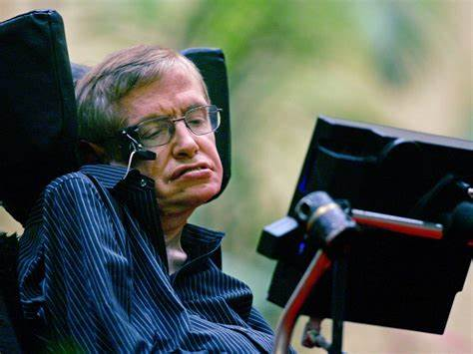
Stephen Hawking and “the stars”
Renowned physicist – Professor of Theoretical Physics in Cambridge
Suffered from a rare early-onset, slow-progressing form of ALS.
Need for AAC.
Development of state-of-the-art
high-tech communication system with
continuous upgrades by Intel.
Use of his eye-movements and
advanced statistical algorithms to predict
language + mechanical speech production

Slide 20

Stephen Hawking’s AAC Device

Slide 21
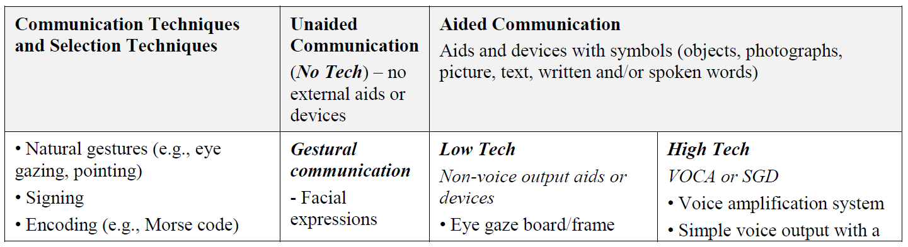
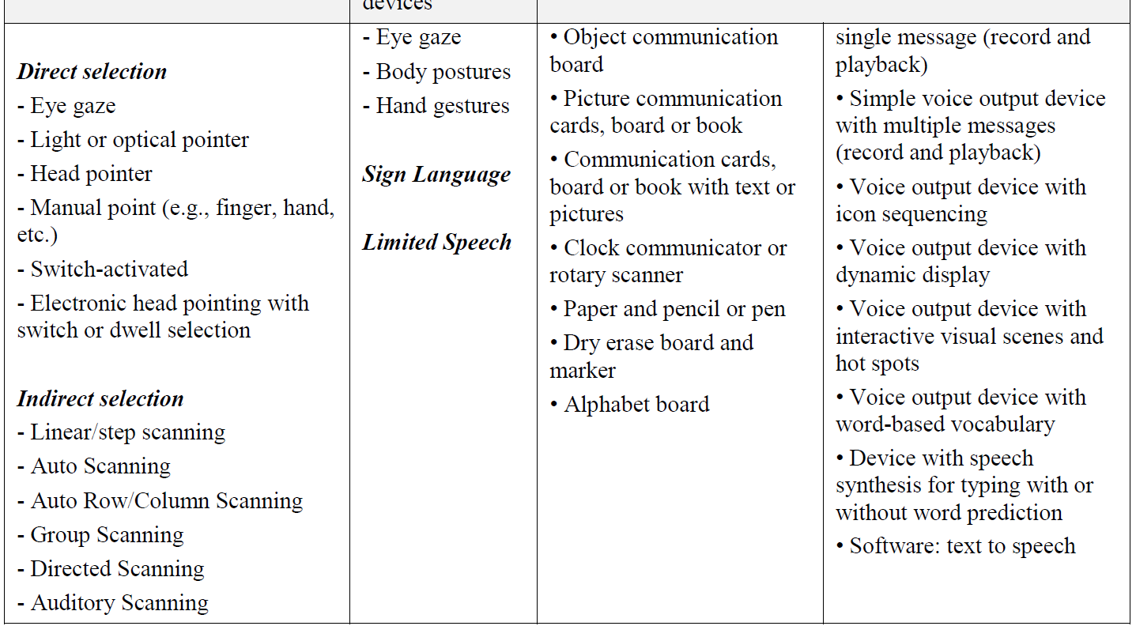
Aided Communication 4/5
Notes:
High tech
High tech is anything using electricity/electronics. This category covers a wide spectrum, starting with very low ‘high tech’ devices, for example:
Pointer boards (hit a switch to stop the pointer going round, when it’s at the object, picture or symbol required.
Switches connected to battery-operated devices or simple environmental control devices such as attention-getting beepers, cassette players, single message tape-loops or other simple message players.
Switches connected to a ‘Mains Switcher’ to allow a user to control the environment and devices like a television, or a lamp.
Toys or books that speak when certain areas are pressed.
Simple, single message playback devices such as talking press switches.
State of the art in high technology AAC is computer-based systems with text to speech software, and sophisticated access methods like eye-gazing. Terms like Voice Output Communication Aid (VOCA), Speech Generating Device (SGD), and Communicator can be used to denote such systems, but they are also sometimes used for lower tech non computer-based devices. Initially the computer-based systems were housed in desktop computers, later in notebooks, and the most successful configuration came when industrial or consumer tablet computers were used. Both industrial and consumer tablet computers have the important feature of the touch screen that can be used for direct selection, and the industrial ones have the advantage of being shock, drop, dust and moisture tolerant. In the very usual case where users can’t use a normal keyboard, these tablet computers that lack keyboard are much more compact, robust, and require limited space, which is very important when mobility is needed.
Lately the outburst of the tablet market with products from Apple Inc., like the iPad, and Samsung, like the Galaxy series, offered very convenient and portable new platforms for AAC systems. Furthermore, Android based Smartphones, and iPhones also raised the high tech systems one level higher, having hundreds of AAC apps available online.
Features to look out for in high ‘high tech’ communication systems would include:
Portability and robustness.
Range and type of possible input methods (keyboard; overlay keyboard; switch input; a range of scan options).
Type of screen display (none; static; displaying only text; dynamic; displaying symbols).
Techniques used to store and retrieve messages.
Output (transient or permanent); what type of screen, if any; digitized voice; synthetic voice; text; hard copy printout; storage on disk.
High tech communication aids vary also in the degree to which they demand of the user more or less sophisticated techniques of visual perception, memory, sequencing skills, language processing, meaning associations, grammar or encoding.
https://www.researchgate.net/publication/263737513

Slide 22
Aided Communication 5/5
Advantages
  Various patient groups
  Requiring minimal movements
  User independence
Disadvantages
  Requirements of digital equipment
  Price
Notes:
High tech
High tech is anything using electricity/electronics. This category covers a wide spectrum, starting with very low ‘high tech’ devices, for example:
Pointer boards (hit a switch to stop the pointer going round, when it’s at the object, picture or symbol required.
Switches connected to battery-operated devices or simple environmental control devices such as attention-getting beepers, cassette players, single message tape-loops or other simple message players.
Switches connected to a ‘Mains Switcher’ to allow a user to control the environment and devices like a television, or a lamp.
Toys or books that speak when certain areas are pressed.
Simple, single message playback devices such as talking press switches.
State of the art in high technology AAC is computer-based systems with text to speech software, and sophisticated access methods like eye-gazing. Terms like Voice Output Communication Aid (VOCA), Speech Generating Device (SGD), and Communicator can be used to denote such systems, but they are also sometimes used for lower tech non computer-based devices. Initially the computer-based systems were housed in desktop computers, later in notebooks, and the most successful configuration came when industrial or consumer tablet computers were used. Both industrial and consumer tablet computers have the important feature of the touch screen that can be used for direct selection, and the industrial ones have the advantage of being shock, drop, dust and moisture tolerant. In the very usual case where users can’t use a normal keyboard, these tablet computers that lack keyboard are much more compact, robust, and require limited space, which is very important when mobility is needed.
Lately the outburst of the tablet market with products from Apple Inc., like the iPad, and Samsung, like the Galaxy series, offered very convenient and portable new platforms for AAC systems. Furthermore, Android based Smartphones, and iPhones also raised the high tech systems one level higher, having hundreds of AAC apps available online.
Features to look out for in high ‘high tech’ communication systems would include:
Portability and robustness.
Range and type of possible input methods (keyboard; overlay keyboard; switch input; a range of scan options).
Type of screen display (none; static; displaying only text; dynamic; displaying symbols).
Techniques used to store and retrieve messages.
Output (transient or permanent); what type of screen, if any; digitized voice; synthetic voice; text; hard copy printout; storage on disk.
High tech communication aids vary also in the degree to which they demand of the user more or less sophisticated techniques of visual perception, memory, sequencing skills, language processing, meaning associations, grammar or encoding.
https://www.researchgate.net/publication/263737513

Slide 23
Communication Partners
Behavior and attitudes of communication partners influence the success of AAC use
Effective partners understand turn taking and engage in balanced conversations, ask questions but also share in topic shifts, and co-construct messages with a range of communication supports
It is important for people with ALS to have multiple options for communication in different situations, with different partners, and under different conditions
Notes:
Conversation partner inclusion is a key component
of all AAC interventions. Since communication is
not a solitary activity, the behavior and attitudes of
communication partners influence the success of AAC
use. Interacting with a person
who has a language, cognitive, or speech impairment
places a novel set of demands on the communication
partner, especially if the partners have been lifelong
conversants before symptoms developed (Chapey et al.,
2001). One of the standards of care in optimizing
communication for people who are losing natural
speech is finding a way to improve the communication
effectiveness of various partners (Ball & Lasker,
2013; Ball, Fager, & Fried-Oken, 2012). Effective
partners understand turn taking and engage in balanced
conversations, ask questions but also share in
topic shifts, and co-construct messages with a range
of communication supports.
NeuroRehabilitation 37 (2015) 69–87
DOI:10.3233/NRE-151241

Slide 24
11 Roles Providers Must Consider 1/2
Delineate 11 roles that providers must consider:
Establish the patient’s preference for the amount and format of presented information
Establish the patient’s preference for each person’s role in decision-making
Gather information about the patient’s concerns and expectations
Share medical information and evidence
Recognize that a decision can and must be made in the situation
Evaluate the presented information with the patient
Notes:
The provider is a communication partner who is
responsible for elements of shared decision making
during the natural course of the disease. Health care
providers are included in one of the partner circles
of the Social Network Inventory discussed earlier. Yorkston and colleagues
delineate 11 roles that providers must
consider: establish the patient’s preference for the
amount and format of presented information; establish
the patient’s preference for each person’s role in
decision-making; gather information about the patient’s
concerns and expectations; share medical information
and evidence; recognize that a decision can and must be
made in the situation; evaluate the presented information
with the patient; DOI:10.3233/NRE-151241

Slide 25
11 Roles Providers Must Consider 2/2
Delineate 11 roles that providers must consider:
Negotiate decisions and resolve conflict
Frequently check understanding of facts and perspectives
Agree on a decision and an action plan
Authorize final choices
Implement the agreed upon choice
Notes:
negotiate decisions and resolve
conflict; frequently check understanding of facts and
perspectives; agree on a decision and an action plan;
authorize final choices; and implement the agreed upon
choice. Materials are available that guide providers
toward effective communication (Communication
Matters, 2008). Clearly, in addition to understanding the
symptom trajectories of each disease and knowing the
options for communication supports and intervention,
it is critical that providers support effective, valuebased
patient-provider communication that will affect
outcomes and quality of life for patients with neurodegenerative
diseases that cause speech, language, and
cognitive impairments.
DOI:10.3233/NRE-151241

Slide 26
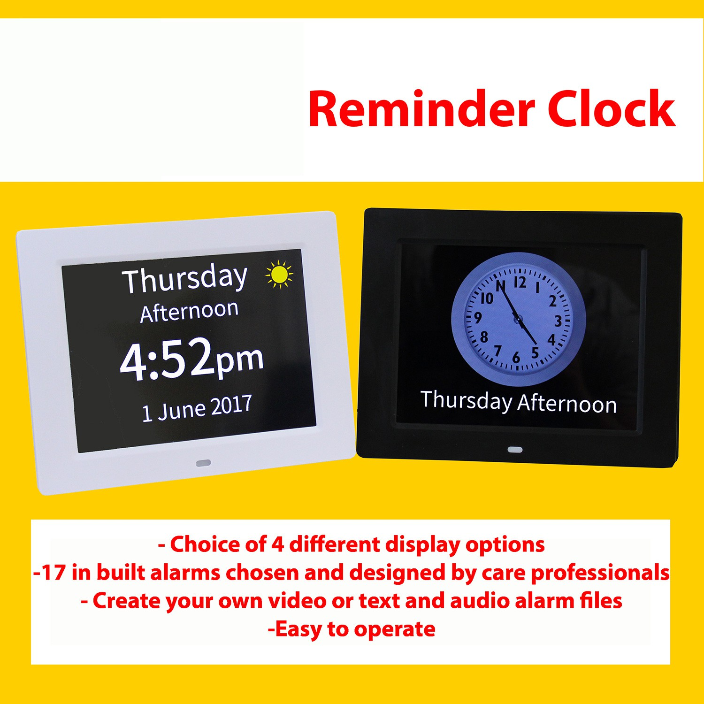
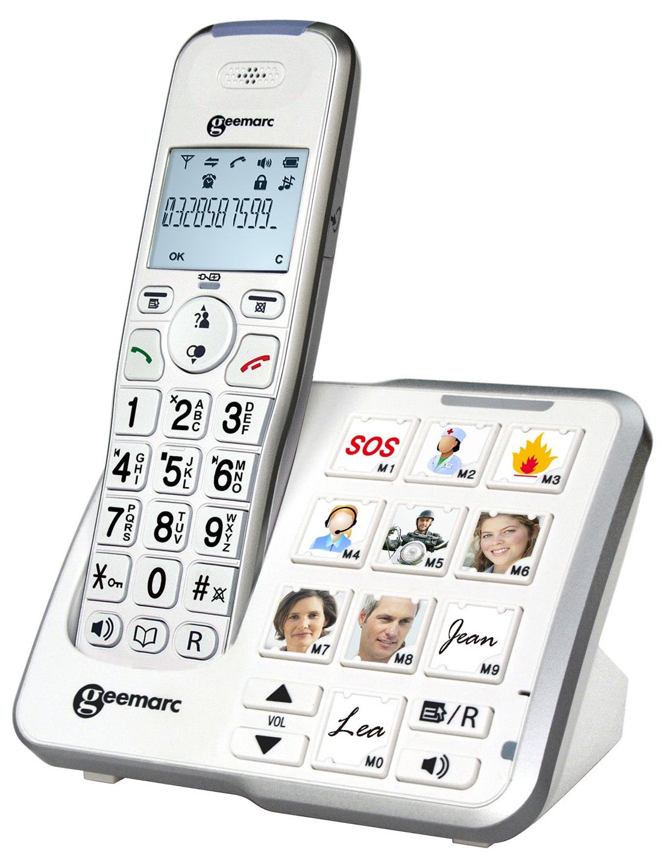
Alzheimer’s Disease – Helpful Products 1/2
Clocks and watches
Games and activities
Phones
Music and Audio
Notes:
https://shop.alzheimers.org.uk/

Slide 27
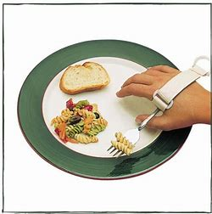
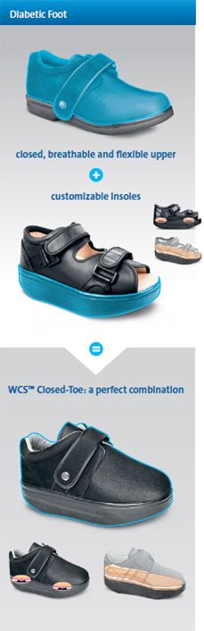
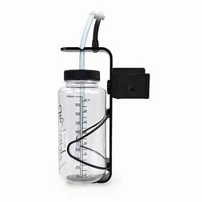


Alzheimer’s Disease – Helpful Products 2/2
Eating and drinking
Clothing and footwear
Help around the home
Notes:
https://shop.alzheimers.org.uk/

Slide 28
References & Useful Websites:
Fried-Oken, M., Mooney, A. & Petters, B. (2015). Supporting communication for patients with neurodegenerative disease, NeuroRehabilitation, 37, 69–87, doi:10.3233/NRE-151241
Weiner, W. J., Shulman, L. M., & Lang, A. E. (2013). Parkinson's disease: A complete guide for patients and families. www.jhu.edu
Websites:
Johns Hopkins Medicine (n.d.). Neurodegenerative Diseases. www.hopkinsmedicine.org [May, 2023]
Asha (n.d.). Augmentative and Alternative Communication (AAC) (asha.org) [October 2023]
Conversation (n.d.)The technology that gave Stephen Hawking a voice should be accessible to all who need it (theconversation.com) [October 2023]

Slide 29

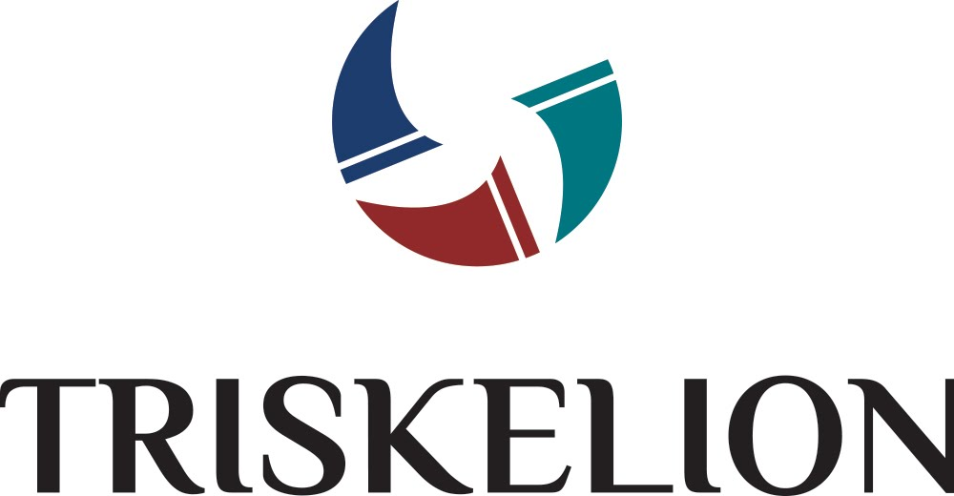

Developed by

