Slide 1

Course number 6
COMMUNICATION
nEUROcare -
a European initiative for capacity building to meet the challenges
of caring for people with neurodegenerative disorders in Sri Lanka
Unit number: 3 Unit name: Communication and NDDs
Loukia Taxitari
Neapolis University Pafos

Slide 2
Learning Objectives
Understanding of common difficulties with communication
Understanding of communication difficulties in different types of NDDs (primary motor difficulties, cognitive or language)
Understanding misconceptions in communication with NDD patients
Becoming aware of how not to communicate with NDD patients
Supporting communication in the early stage of disease
  Keeping the conversations going
  Using pictures/videos/flashcard
  Barriers/challenges to communication
  Making sense of syntactic errors
  Responding to challenging behaviour
Notes:
The learning objectives encompass an exploration of the various communication challenges presented by different types of Neurodevelopmental Disorders (NDDs), an examination of the common hurdles encountered in communication, an analysis of the prevailing misconceptions surrounding communication with NDD patients, a comprehensive understanding of the ineffective approaches to communication, and an exploration of the strategies for facilitating supportive communication in the early stages of the disease.

Slide 3
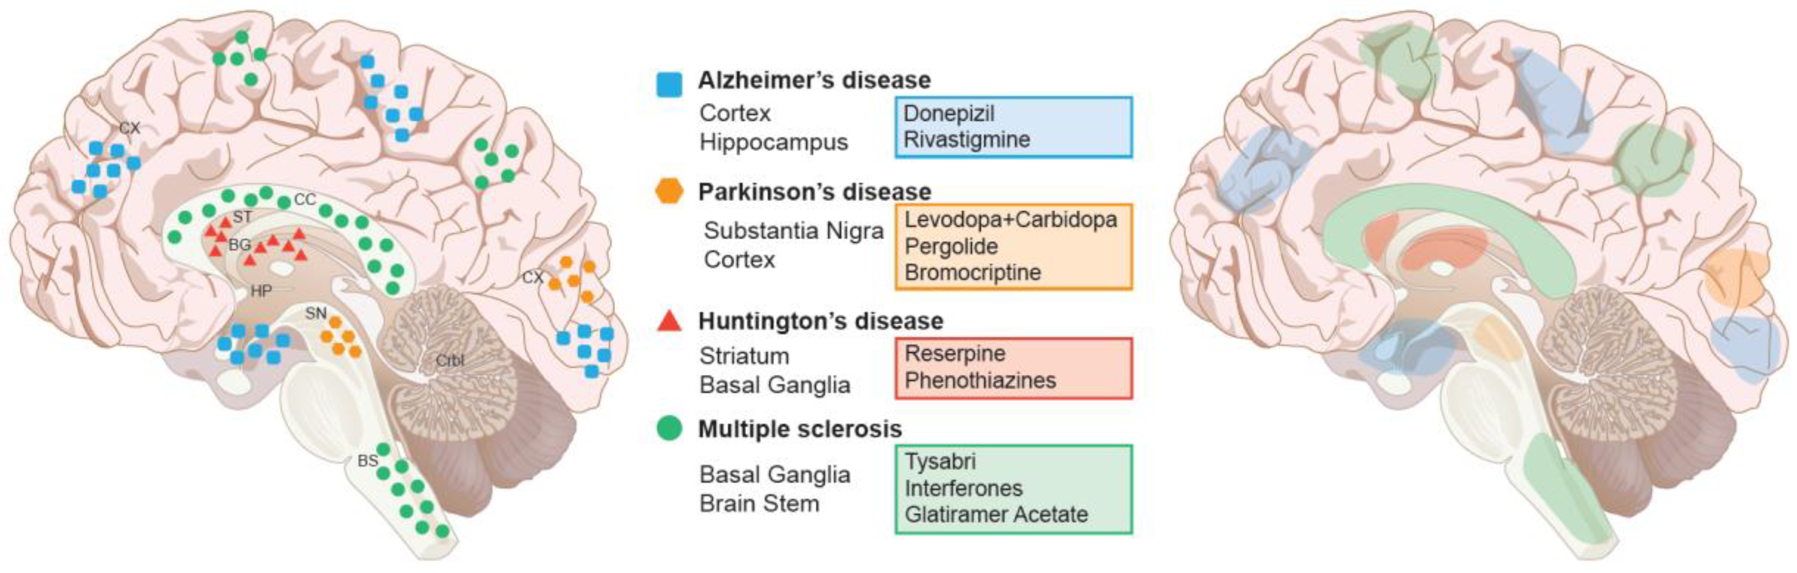
Purpose
Improve the communication for staff working with
people affected by neurodegenerative diseases
Notes:
Communication between a nurse and a care receiver is essential to build relationships, perform nursing care tasks such as bathing, toileting, and eating, and to adapt and respond to the needs of clients.

Slide 4
What is Dementia Disease?
Dementia is a general term involving impaired thinking, remembering or reasoning that can affect a person’s ability to function safely.
Notes:
Dementia is a general term impaired thinking, remembering or reasoning that can affect a person’s ability to function safely. The term has been replaced by “major neurocognitive disorder” and “mild cognitive disorder” in medical terminology.
Dementia symptoms may be confused with symptoms of depression or other mood disorders
Dementia is not a normal consequence of aging.
The condition has many causes, so patients with signs or symptoms of dementia should get a comprehensive examination to determine the underlying diagnosis.
There are not direct therapies for most types of dementia, but some conditions, such as normal pressure hydrocephalus, can be treatable. For the remainder, drugs may make symptoms more manageable.
(https://www.hopkinsmedicine.org/health/conditions-and-diseases/dementia)

Slide 5
What are the Different Types of Dementia?
Alzheimer’s Disease
Vascular Dementia
Corticobasal Degeneration
Creutzfeldt-Jakob Disease
Dementia with Lewy Bodies
Frontotemporal Dementia
HIV Dementia
Huntington’s Disease
Normal Pressure Hydrocephalus
Notes:
The following are the different types of dementia: Alzheimer’s Disease, Vascular Dementia, Corticobasal Degeneration, Creutzfeldt-Jakob Disease, Dementia with Lewy Bodies, Frontotemporal Dementia, HIV Dementia, Huntington’s Disease, Normal Pressure Hydrocephalus, Parkinson’s Disease and Multiple Sclerosis.

Slide 6
Symptoms of Dementia
Dementia may involve a range of progressive symptoms, depending on its cause:
Mood and personality changes
Difficulty with words and language
Poor judgment
Confusion regarding familiar places and time, date and season
Inability to concentrate or think clearly
Difficulties with gait or balance
Increased daytime sleepiness
Apathy
Visual hallucinations
Notes:
Dementia may involve a range of progressive symptoms, depending on its cause:
Mood and personality changes
Difficulty with words and language
Poor judgment
Confusion regarding familiar places and time, date and season
Inability to concentrate or think clearly
Difficulties with gait or balance
Increased daytime sleepiness
Apathy
Visual hallucinations

Slide 7
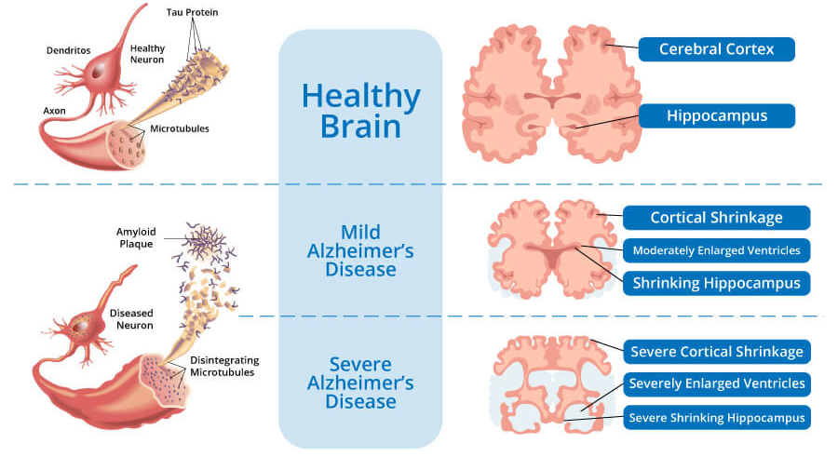
What is Alzheimer’s Disease?
Notes:
Alzheimer disease is the most common cause of dementia and thus the most common type that nurses encounter in clinical practice. Alzheimer disease is an incurable neurodegenerative disease. The hallmark pathology of Alzheimer disease includes amyloid plaques and neurofibrillary tangles in the brain. One also sees general shrinkage of the brain and a decrease in the number of functioning neurons. Currently, there is no cure for Alzheimer disease, and treatments that are available may impact the symptoms but do not slow down the disease process. Alzheimer disease affects different patients in different ways, and progresses steadily until patients are completely disabled. The disease typically progresses through three stages. Patients with Alzheimer disease live 4 to 20 years after diagnosis. The most common causes of death are from aspiration of food or fluids into the lungs and from the complications of immobility, as patients are unable to walk (Nurse to Nurse DEMENTIA CARE)

Slide 8
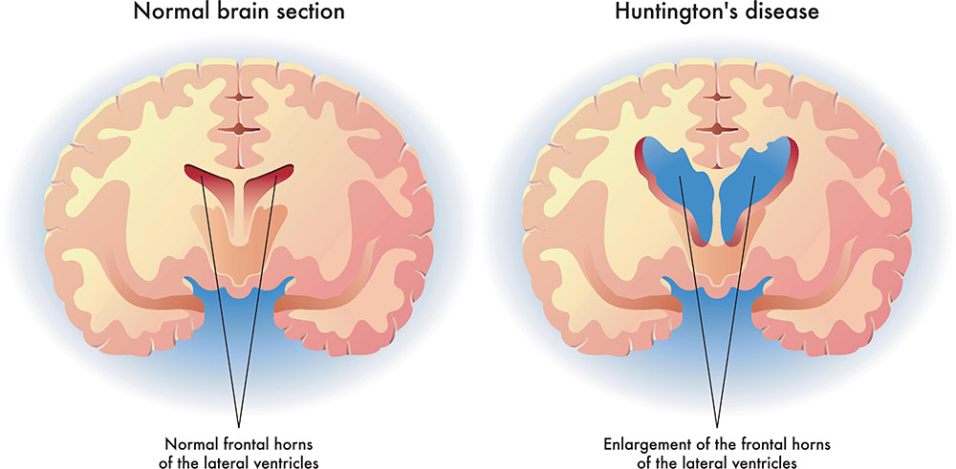
What is Huntington’s Disease?
Notes:
Huntington's disease is an inherited disorder that causes nerve cells (neurons) in parts of the brain to gradually break down and die. The disease attacks areas of the brain that help to control voluntary (intentional) movement, as well as other areas. People living with Huntington's disease develop uncontrollable dance-like movements (chorea) and abnormal body postures, as well as problems with behavior, emotion, thinking, and personality.
For example, uncontrolled movements in the person's fingers, feet, face, or torso. These movements are signs of chorea. They can get more intense when the person is nervous or distracted; as Huntington's disease progresses, the person’s movements can become more extreme and obvious.
Symptoms of Huntington's disease typically appear in middle-aged people (adult HD). They can also appear in children (juvenile HD), but this is rare. The disease gets worse over time. Early signs of Huntington's disease can vary, but often include mild clumsiness or problems with balance or movement, cognitive or psychiatric symptoms (problems with thinking or emotion), and changes in behavior. (https://www.ninds.nih.gov/health-information/disorders/huntingtons-disease#:~:text=HD%20is%20caused%20by%20a,at%20risk%20for%20the%20disease.
https://www.healthdirect.gov.au/huntingtons-disease)

Slide 9
Symptoms of Huntington’s Disease
Early symptoms | As the disease progresses, the following symptoms become more common:
Irritability Depression Mood swings Trouble driving Trouble learning new things Forgetting facts Trouble making decisions | Trouble feeding oneself Difficulty swallowing Strange and uncontrolled movements that are either slow or wild and jerking (chorea) Loss of memory and judgment Changes in speech Personality changes Disorientation and confusion Hallucinations, paranoia, and psychosis
Notes:
This neurodegenerative disorder presents with a range of early symptoms, followed by severe manifestations as it progresses. Some of the early symptoms are irritability, depression, mood swings, trouble driving and learning new things, forgetting facts and having trouble making decisions. As the disease progresses, the following symptoms become more common: trouble feeding oneself, difficulty swallowing, strange and uncontrolled movements, loss of memory and judgement, changes in speech and personality, disorientation and confusion, hallucinations, paranoia and psychosis.
(https://www.hopkinsmedicine.org/health/conditions-and-diseases/huntingtons-disease)

Slide 10
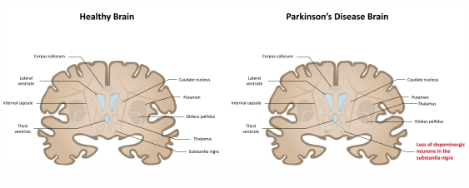
What’s Parkinson’s Disease?
Notes:
Parkinson’s disease is a degenerative neurologic disease. Degenerative means “declining in quality”—thus, the disease increases in severity over time; neurologic refers to the nervous system. One could therefore say that Parkinson’s disease is a disease of the nervous system that gets worse over time. Parkinson’s disease progresses slowly. We also describe Parkinson’s disease as a chronic, progressive neurologic disease. Chronic means “of long duration”; progressive means “proceeding in steps” or “advancing.” Parkinson’s disease does not go away, and it gradually gets worse. (Parkinson’s Disease A Complete Guide for Patients and Families William J.Weiner, M.D. Lisa M.)

Slide 11
What’s Parkinson’s Disease?
TRAP | T= tremor R= rigidity A= akinesia (“lack of movement”) P=postural instability
Notes:
The characteristic symptoms of moderate Parkinson’s disease can be remembered with the acronym TRAP: T is for tremor and R for rigidity. A is for akinesia (meaning, literally, “lack of movement”), referring to the loss of spontaneous or voluntary movement and loss of fluid motion (the slowing down, rather than complete loss, of movement is called bradykinesia). P is for postural instability, which involves difficulties with balance and the risk of falling. (Parkinson’s Disease A Complete Guide for Patients and Families William J.Weiner, M.D. Lisa M.)

Slide 12
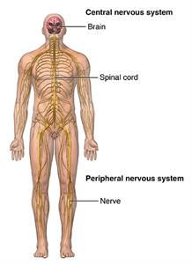
What is Multiple Sclerosis?
Notes:
Multiple sclerosis is a long-lasting (chronic) disease of the central nervous system. It is thought to be an autoimmune disorder, a condition in which the body attacks itself by mistake. Multiple sclerosis is an unpredictable disease that affects
people differently. Some people with Multiple sclerosis may have only mild symptoms. Others may lose their ability to see clearly, write, speak, or walk when communication between the brain and other parts of the body becomes disrupted.
Myelin is the fatty tissue that surrounds and protects nerve fibers. In Multiple sclerosis , the myelin is destroyed in many areas. This loss of myelin forms scar tissue called sclerosis. These areas are also called plaques or lesions. When the
nerves are damaged in this way, they can’t conduct electrical impulses to and from the brain.
(https://www.hopkinsmedicine.org/health/conditions-and-diseases/multiple-sclerosis-ms)

Slide 13
What is Multiple Sclerosis?
Primary symptoms | Secondary symptoms | Tertiary symptoms
These symptoms are a direct result of the destruction of myelin: Weakness Numbness Shaking (tremors) Loss of vision Pain Paralysis Loss of balance Bladder and bowel problems | These are complications that may occur as a result of the primary symptoms, for example: Paralysis can lead to bedsores. Bladder problems may cause repeated urinary tract infections. Inactivity can result in weakness, poor posture muscle imbalances, decreased bone density, and breathing problems. Becoming less mobile because of weakness and trouble swallowing can lead to a greater risk of pneumonia. | These are social, job-related, and psychological problems: A person who becomes unable to walk or drive may lose his or her livelihood. Strain of dealing with a chronic neurological illness may disrupt personal relationships. Depression is often seen among people with MS.
Notes:
The symptoms of Multiple sclerosis are often unpredictable. They may be mild or severe, short-term or long-lasting. They may appear in different combinations, depending on the area of the nervous system affected. The following are the most common symptoms of Multiple sclerosis . But each person may have different symptoms. The primary symptoms are a direct result of the destruction of myelin and they mainly consist of weakness, numbness, shaking, loss of vision, pain, paralysis, loss of balance and bladder and bowel problems. The secondary symptoms are complications that may occur because of the primary symptoms, such as paralysis leading to bedsores, urinary tract infections due to the bladder problems, weakness, poor posture, muscle imbalances, decreased bone density, and breathing problems, and finally due to the reduced mobility patients are at a greater risk of pneumonia. The tertiary symptoms involve social, job-related and psychological problems. The patient becomes unable to walk or drive and might lose their livelihood, also their personal relationships are being disrupted and they have a higher risk of depression.
(https://www.hopkinsmedicine.org/health/conditions-and-diseases/multiple-sclerosis-ms)

Slide 14
Dementia and Communication
Issues you can expect to see throughout the disease progression include:
        Difficulty finding the right words.
        Using familiar words repeatedly.
        Describing familiar objects rather than calling them by name.
        Easily losing a train of thought.
        Difficulty organizing words logically.
        Reverting to speaking a native language.
        Speaking less often.
        Relying on gestures more than speaking.
Notes:
1. CHANGES IN COMMUNICATION
For individuals living with Alzheimer’s, changes in communication vary and are based on the person
and how far along he or she has progressed in the disease. Issues you can expect to see throughout the disease progression include:
»» Difficulty finding the right words.
»» Using familiar words repeatedly.
»» Describing familiar objects rather than
calling them by name.
»» Easily losing a train of thought.
»» Difficulty organizing words logically.
»» Reverting to speaking a native language.
»» Speaking less often.
»» Relying on gestures more than speaking.
(COMMUNICATION
TIPS FOR SUCCESSFUL COMMUNICATION
DURING ALL STAGES OF ALZHEIMER’S DISEASE)

Slide 15
Communication in the early stage 1/2
Tips for successful communication:
Don’t make assumptions about a person’s ability to communicate because of an Alzheimer’s diagnosis. The disease affects each person differently.
Don’t exclude the person with the disease from conversations.
Speak directly to the person rather than to his or her care partner or companion.
Take time to listen to the person express his or her thoughts, feelings and needs.
Give the person time to respond. Don’t interrupt unless help is requested.
Notes:
2. COMMUNICATION IN THE EARLY STAGE
In the early stage of Alzheimer’s disease, which is sometimes referred to as mild Alzheimer’s in a medical context, an individual is still able to participate in meaningful conversation and
engage in social activities. However, he or she may repeat stories, feel overwhelmed by excessive stimulation or have difficulty finding the right word.
Tips for successful communication:
Don’t make assumptions about a person’s ability to communicate because of an Alzheimer’s diagnosis. The disease affects each person differently.
Don’t exclude the person with the disease from conversations.
Speak directly to the person rather than to his or her care partner or companion.
Take time to listen to the person express his or her thoughts, feelings and needs.
Give the person time to respond. Don’t interrupt unless help is requested.
(COMMUNICATION
TIPS FOR SUCCESSFUL COMMUNICATION
DURING ALL STAGES OF ALZHEIMER’S DISEASE)

Slide 16
Communication in the early stage 2/2
Tips for successful communication:
Ask what the person is still comfortable doing and what they might need help with.
Discuss which method of communication is most comfortable. This could include face-to-face conversation, email or phone calls.
It’s OK to laugh. Sometimes humor lightens the mood and makes communication easier.
Don’t pull away; your honesty, friendship and support are important to the person.
Notes:
Ask what the person is still comfortable doing and what he or she may need help with.
Discuss which method of communication is most comfortable. This could include face-to-face conversation, email or phone calls.
It’s OK to laugh. Sometimes humor lightens the mood and makes communication easier.
Don’t pull away; your honesty, friendship and support are important to the person.
(COMMUNICATION
TIPS FOR SUCCESSFUL COMMUNICATION
DURING ALL STAGES OF ALZHEIMER’S DISEASE)

Slide 17
Communication in the middle stage 1/2
Tips for successful communication:
Engage the person in one to one conversation in a quiet space with minimal
distractions.
Speak slowly and clearly.
Maintain eye contact. It shows you care about what they are saying.
Give the person plenty of time to respond so they can think about what to say.
Be patient and offer reassurance. It may encourage the person to explain their thoughts.
Ask one question at a time.
Ask yes or no questions. For example, “Would you like some coffee?” rather than “What would you like to drink?”
Notes:
The middle stage of Alzheimer’s, sometimes referred to as moderate Alzheimer’s, is typically
the longest and can last for many years. As the disease progresses, the person will have greater
difficulty communicating and require more direct care.
Tips for successful communication:
Engage the person in one-on-one conversation in a quiet space with minimal
distractions.
Speak slowly and clearly.
Maintain eye contact. It shows you care about what he or she is saying.
Give the person plenty of time to respond so he or she can think about what to say.
Be patient and offer reassurance. It may encourage the person to explain his or her thoughts.
Ask one question at a time.
Ask yes or no questions. For example, “Would you like some coffee?” rather than “What would you like to drink?”
(COMMUNICATION
TIPS FOR SUCCESSFUL COMMUNICATION
DURING ALL STAGES OF ALZHEIMER’S DISEASE)

Slide 18
Communication in middle stage 2/2
Tips for successful communication:
Avoid criticizing or correcting. Instead, listen and try to find the meaning in what the person says. Repeat what was said to clarify.
Avoid arguing. If the person says something you don’t agree with, let it be.
Offer clear, step-by-step instructions for tasks. Lengthy requests may be overwhelming.
Give visual cues. Demonstrate a task to encourage participation.
Written notes can be helpful when spoken words seem confusing.
Notes:
Avoid criticizing or correcting. Instead, listen and try to find the meaning in what the person says. Repeat what was said to clarify.
Avoid arguing. If the person says something you don’t agree with, let it be.
Offer clear, step-by-step instructions for tasks. Lengthy requests may be overwhelming.
Give visual cues. Demonstrate a task to encourage participation.
Written notes can be helpful when spoken words seem confusing.
(COMMUNICATION
TIPS FOR SUCCESSFUL COMMUNICATION
DURING ALL STAGES OF ALZHEIMER’S DISEASE)

Slide 19
Communication in late stage
Tips for successful communication:
Approach the person from the front and identify yourself.
Encourage nonverbal communication. If you don’t understand what the person is trying to say, ask them to point or gesture.
Use touch, sights, sounds, smells and tastes as a form of communication with the person.
Consider the feelings behind words or sounds. Sometimes the emotions being expressed are more important than what’s being said.
Treat the person with dignity and respect. Avoid talking down to the person or act as if they are not there.
It’s OK if you don’t know what to say; your presence and friendship are most important.
Notes:
The late stage of Alzheimer’s disease, sometimes referred to as severe Alzheimer’s, may last from several weeks to several years. As the disease advances, the person in the late stage may rely on nonverbal communication, such as facial
expressions or vocal sounds. Around-the-clock care is usually required in this stage.
Tips for successful communication:
Approach the person from the front and identify yourself.
Encourage nonverbal communication. If you don’t understand what the person is trying to say, ask him or her to point or gesture.
Use touch, sights, sounds, smells and tastes as a form of communication with the person.
Consider the feelings behind words or sounds. Sometimes the emotions being expressed are more important than what’s being said.
Treat the person with dignity and respect. Avoid talking down to the person or as if he or she isn’t there.
It’s OK if you don’t know what to say; your presence and friendship are most important.
(COMMUNICATION
TIPS FOR SUCCESSFUL COMMUNICATION
DURING ALL STAGES OF ALZHEIMER’S DISEASE)

Slide 20


Keys to Behavioral Management
Management of behavioral problems is an important aspect of dementia care.
There are multiple possible causes and effective responses..
Trial and error are essential strategies.
Use a common language and definition of observable behavior.
Notes:
It is important for the nurse to realize that the behavioral problems of the dementia patient can be managed.
Keep these key principles in mind:
Management of behavioral problems is an important aspect of dementia care.
There are multiple possible causes and effective responses.
Trial and error are essential strategies.
A common language and definition of observable behavioral is essential to the process of assessment and management
and must be used consistently by all staff.
(Nurse to Nurse) p. 84 (93 of 209)

Slide 21
Most common Behavioral Complaints
Common complaints are listed here: Uncooperativeness Refusing to bathe Refusing medications Resisting care Attempting to leave a safe area Getting lost Screaming “Help me! Help me!” Combativeness, hitting, scratching, grabbing, spitting, slapping, kicking Pulling out tubes, IVs Getting out of bed unsafely
Notes:
It is helpful for the nurse to understand the types of behavioral
problems that are common in patients with dementia care.
These problems are typically a result of how the brain is
affected by the disease, rather than an unwillingness of the
patient to cooperate or behave properly. Common complaints
are listed here.
• Uncooperativeness
• Refusing to bathe
• Refusing medications
• Resisting care
• Attempting to leave a safe area
• Getting lost
• Screaming “Help me! Help me!”
• Combativeness, hitting, scratching, grabbing, spitting, slapping,
kicking
• Pulling out tubes, IVs
• Getting out of bed unsafely

Slide 22
Origins & Risk Factors of Behavioral Problems
Caregiver
approach
Physical
illness
Cognitive
impairment
Environmental
impact
Psychiatric
disorders
Domains of behavioral problems
Notes:
There are five domains that are typically related to behavioral
problems. Often more than one domain is involved. Careful
and systematic review of the domains often leads to the identification
of the issue triggering the behavioral. This allows the
nurse to plan a rational approach for diminishing the frequency and severity of the problem. Origins and risk factors of behavioral
problems are most commonly found in one or more of
these five areas:
1. Cognitive impairment
2. Psychiatric problems
3. Physical illness
4. Environmental impact
5. Caregiver approach
Each of the risk factors can result in a behavioral that is problematic
to caregivers. What follows are five lists of behavioral
problems associated with cognitive impairment, psychiatric disorders and caregiver approach,

Slide 23
Origins & Risk Factors of Behavioral Problems
Domain 1: Cognitive Impairment (The 4 A’s)
Underlying Problem | Common Behaviors
Amnesia: Inability to form new memories | After eating breakfast, the patient might say, “I haven’t been fed in days!”
Aphasia: Inability to find words or understand them | Telling a patient to get dressed and they just sit there with no reaction.
Apraxia: Inability to perform learned motor movements | The patient put their clothes on inside out or button them incorrectly.
Agnosia: Inability to recognize objects and people | The patient is told to put on their shirt and can’t find it, even though the shirt is in plain view.
Notes:
More specifically, the first area affected is the cognitive impairment, incorporating the 4 A’s. The first underlying problem is amnesia, meaning the inability to form new memories. For instance, After eating breakfast, the patient may say, “I haven’t been fed in days!”. Secondly, there is aphasia, which is the inability to find words or understand them. For example, telling a patient to get dressed he or she just sits there with no reaction. Furthermore, the patient may develop apraxia (inability to performed learned motor movements), resulting in them putting their clothes inside out or incorrectly buttoned and other similar behaviors. Finally, there is the underlying problem of agnosia, which is the inability to recognize objects and people. For example, the patient is told to put on his or her shirt and can’t find it, even though the shirt is in plain view.

Slide 24
Origins & Risk Factors of Behavioral Problems
Domain 2: Psychiatric Disorders
Underlying Problem | Common Behaviors
Depression | Patient won’t get out of bed in the morning.
Delusions | Patient won’t take medication because he or she says it is poisoned.
Hallucinations | Patient points under his or her bed, stating there is an animal or creature there.
Mania | Patient makes sexual overtures to caregivers and touches them inappropriately.
Notes:
Going on, the second domain affected is the development of psychiatric disorders. In this case, the patient may develop depression (they won’t get out of bed in the morning), or delusions (they won’t take medication in fear of being poisoned). In addition, there is a possibility of hallucinating, when, for example, the patient points under his or her bed, stating there is an animal or creature there or having maniac episodes, when the patient makes sexual overtures to caregivers and touches them inappropriately.

Slide 25
Origins & Risk Factors of Behavioral Problems
Domain 3: Caregiver Approach
Underlying Problem | Common Behaviors
Untrained weekend staff | Every weekend, patient refuses to dress and eat.
Demanding, threatening staff | Patient cries during meals when the staff states that if the patient doesn’t immediately eat, they will take the food away.
Giving multistage commands | Patient completes one step of a task and then stops.
Several aides attempt to hold the patient down for a bed bath | The patient bites caregivers’ arms and spits at them.
Notes:
It is clear to see that there are many reasons why dementia patients are at high risk for behavioral problems. Their cognitive
impairment, common psychiatric disorders, physical illness, environmental impact, and the caregiver approach may result in
what caregivers define as problematic behavioral. There is, however, a systematic way of understanding the underlying triggers
of problematic behavioral. Once such triggers are identified, a rational plan of care to address them can be devised.

Slide 26
Prevention & Management of Behavioral Problems
D
Describe it.
Decode it.
Design a treatment plan.
Do it.
Determine if it works.
Notes:
The 5-D Strategy provides a systematic way to logically understand
behavioral problems and provides a framework for planning
to avoid these problems in the future. The following are
the key elements of this strategy. For each behavioral observed:
1. Describe it.
2. Decode it.
3. Design a treatment plan.
4. Do it.
5. Determine if it works.

Slide 27
Prevention & Management of Behavioral Problems
D
Describe it.
Helpful descriptions include only the facts and answer these
questions:
      What did you see and hear?
      Where did it happen?
      When did it happen?
      What happened just before the behavioral was observed?
      During what activity or circumstances?
      With whom?
      How often does the behavioral occur?
Notes:
One of the most challenging parts of behavioral management is
accurately and concisely describing the problematic behavioral.
Helpful descriptions include only the facts and answer these
questions:
What did you see and hear?
Where did it happen?
When did it happen?
What happened just before the behavioral was observed?
During what activity or circumstances?
With whom?
How often does the behavioral occur?

Slide 28
Prevention & Management of Behavioral Problems
D
Decode it
Ask these types of questions to determine the domain.
Cognition
How cognitively impaired is the patient?
Is it possible the patient could have misinterpreted someone’s actions?
The nurse must directly test the cognitive abilities of the patient and determine if there has been a sudden change in cognitive impairment.
Notes:
To decode the behavioral problem, identify all the domains that
could be contributing to the underlying problem. The domains
are cognitive impairment, psychiatric problems, physical illness,
environmental impact, and caregiver approach. Ask these
types of questions to determine the domain.
Cognition
• How cognitively impaired is the patient?
• Is it possible the patient could have misinterpreted someone’s
actions?
• The nurse must directly test the cognitive abilities of the
patient and determine if there has been a sudden change in
cognitive impairment.

Slide 29
Prevention & Management of Behavioral Problems
D
Decode it
Physical Illness
• Has the patient developed a new illness recently?
• Have new medications been prescribed?
• Are possible sources of pain leading to irritability?
Notes:
Physical Illness
Remember! A change in behavioral is often the first sign of an
emerging medical illness.
• Has the patient developed a new illness recently?
• Have new medications been prescribed?
• Are possible sources of pain leading to irritability?
You must directly examine the patient and review his or her
medications. Notice if chronic conditions are stable or if a new
medical condition has arisen. Examine the patient from head to
toe by inspection and palpation; conduct a body audit.

Slide 30
Prevention & Management of Behavioral Problems
D
Decode it
Caregiver Approach
How did the caregiver react to a behavioral problem?
Did the caregiver’s reaction make the behavioral better or worse?
Is the caregiver unfamiliar with the patient and their impairments?
Notes:
Caregiver Approach
• How did the caregiver react to a behavioral problem?
• Did the caregiver’s reaction make the behavioral better or worse?
• Is the caregiver unfamiliar with the patient and his or her
impairments?

Slide 31
Prevention & Management of Behavioral Problems
D
Design a Treatment Plan
Design a plan based on the results of decoding and the identification
of likely sources of the behavioral problem.
Notes:
Design a plan based on the results of decoding and the identification
of likely sources of the behavioral problem. A rational
approach with concrete information about the incident can lead
to a plan that will begin to deal with the problem. The clinical
team should provide a definition of success. This gives the team confidence that if the plan does not work, there will be further
attempts to solve the problem. If the problem continues to
occur, revisit and revise the plan until an effective response is
identified. Remember that trial and error are an expected part
of the process.

Slide 32
Prevention & Management of Behavioral Problems
D
Do It
Monitoring the Plan
Dealing with Irregular Shifts
Role of the Leader Nurse
Notes:
Do It
Excellent behavioral management plans often fail due to the
lack of consistent implementation. The plans must be written
in simple language and provided to and explained to the persons
who will implement them. This is most often the nursing
assistant or care technician.
Monitoring the Plan
The success or failure of the plan must be reported at shift
change between the aides in order to determine if the plan needs
to be modified. Simple monitoring of outcomes can be accomplished
by putting a sheet of graph paper in the nursing aide
report book with blocks for each hour of the shift and a “+” or
“–” indicating whether the behavioral occurred that hour or not.
Dealing with Irregular Shifts
A succinct plan is especially important for shifts that float on
other units or only work occasionally. Weekend and agency
staff must also work from the same plan.
Role of the Nurse Leader
Because the success of the plan often has to do with subtle
issues such as how to greet and approach a patient, the effective
nurse or team leader will want to demonstrate the correct
approach and allow the staff to observe. The nursing leader
who is not willing to engage the difficult patient will quickly
lose credibility with the staff and they will be less likely to
attempt the suggested plan. Since most behavioral problems
occur during bathing, the effective leader must be willing to get
wet along with the aide. Praise should be given for consistent
attempts to implement the plan even if it fails.

Slide 33
Prevention & Management of Behavioral Problems
D
Determine if it works
The best way to deal with behavioral problems is to adjust your expectations to the abilities of the patient, recognize and treat physical and psychiatric disorders, moderate the environment to the patient’s tolerance, and fine-tune the caregiver approach.
Notes:
Determine If It Works
Using the definition of success as defined by the clinical team,
determine if the plan is reducing or eliminating the problem
behavioral. Trial and error are expected. An emergency plan
should also be devised, particularly when patients are aggressive.
An example of an emergency plan is: “If the plan is implemented
and the patient hits the staff two more times, the psychiatrist
will be called and other measures considered.”
Not only does the alternative plan apply a secondary
approach to eliminating the behavioral, but it helps to prevent
staff from getting demoralized and thinking that there never
will be a solution to the problem. Demoralized staff members
are more likely to retaliate against patients and eventually will
either refuse to care for the problematic patient or quit.
In conclusion, the best way to deal with behavioral problems
is to adjust your expectations to the abilities of the patient,
recognize and treat physical and psychiatric disorders, moderate
the environment to the patient’s tolerance, and fine-tune the
caregiver approach.

Slide 34
Managing Aggressive Problems
Aggressive behavioral has been defined as:
Any behavioral that threatens or causes harm to self, others, or objects. Aggressive
behaviors include kicking, hitting, biting, grabbing, spitting, slapping and other forceful actions.
Notes:
Aggressive behavioral has been defined as:
Any behavioral that threatens or causes harm to self, others, or
objects. Aggressive behaviors include kicking, hitting, biting, grabbing,
spitting, slapping and other forceful actions.
The significance of aggressive behavioral lies in the fact that
once a patient is described as aggressive, the staff may avoid the
person. Some staff may even refuse to care for these patients.
• Aggressive behaviors most commonly occur during direct
personal care. Nursing aides and family members are greatly
impacted.
• It is a salient reason for a facility or service to discharge a
patient.
• It may certainly be linked to aides choosing to change jobs if
they feel there is no answer or way to avoid the behavioral.

Slide 35
Managing Aggressive Problems
Patient | Staff Response
Anxious, fretful | Reassure, use gentle touch.
Angry | Listen but do not touch, give space.
Hostile | Start making a plan of action, survey the environment for those at risk.
Aggressive | Allow to de-escalate (calm down) if possible. If not, use non-offensive physical control to prevent harm to the patient and those around the patient.
Notes:
At times it may be obvious that a patient is escalating toward an
aggressive episode. Indicators of escalation include:
• Tension in muscles
• Restlessness, pacing about
• Furrowed brow, angry-appearing face
• Loud voice, whether making threats or not
Remember that it is most always easier to remove those at
risk from an area where a patient is escalating rather than trying
to remove the upset patient. When everyone on the clinical
team is trained in response to aggression, they can act in a coordinated
fashion and often avoid any injury or the need to transfer
the patient.

Slide 36
Managing Aggressive Problems
Tips to Reduce Aggression
Reduce noise. Do not call out the cavalry. Reduce lighting. Eliminate anything the patient perceives as a threat, such as a loud peer. Avoid charging a patient, which can often result in an exaggerated reaction. Have only one person talk to the patient.
Notes:
Tips to Reduce Aggression
Reduce noise.
Do not call out the cavalry.
Reduce lighting.
Eliminate anything the patient perceives as a threat, such as a
loud peer.
Avoid charging a patient, which can often result in an exaggerated
reaction.
Have only one person talk to the patient.
Try to avoid the use of prn, or as needed, sedating medications.
Although these medications usually provide sedation,
they often make a patient even more confused and do not solve
the problem.
The nurse and aides may wish to attend a class to learn a
“safe hold” or “secure hold.” This is a method of holding a
patient so the individual cannot hurt others or himself or herself.
It allows the patient to be moved to a safe area.

Slide 37
Caregivers must be prepared to answer …
Definitions and Basics
What is Parkinson’s disease?
Will other members of my family develop Parkinson’s disease?
Prognosis
What is the prognosis for someone with Parkinson’s disease?
What should I expect to happen to me in the first
two to three years after I’m diagnosed with Parkinson’s disease?
How do the symptoms usually progress?
Will I be an invalid?
What is the relationship between Parkinson’s disease and Alzheimer’s disease?
Does stress make the symptoms of Parkinson’s disease worse?
Notes:
Caregivers need to be in the position to answer several questions. Firstly, concerning the definitions and the basics of each diagnosis. Some examples are: What is Parkinson’s disease?
Will other members of my family develop Parkinson’s disease?
They also need to be able to answer questions concerning the prognosis of the patients.
What is the prognosis for someone with Parkinson’s disease?
What should I expect to happen to me in the first
two to three years after I’m diagnosed with Parkinson’s disease?
How do the symptoms usually progress?
Will I be an invalid?
What is the relationship between Parkinson’s disease and Alzheimer’s disease?
Does stress make the symptoms of Parkinson’s disease worse?

Slide 38
Caregivers must be prepared to answer …
Food, Drink, and Exercise
What activities and foods should I avoid?
Can I still drink alcohol with Parkinson’s disease?
Work and Leisure Activities
How long should I continue to work?
Will I still be able to drive my car?
Will I be able to travel?
When traveling across time zones, should I adjust my medication schedule?
Notes:
Other common questions have to do with the topics of food, drink and exercise. What activities and foods should I avoid?
Can I still drink alcohol with Parkinson’s disease? And Work and Leisure Activities, such as how long should I continue to work?
Will I still be able to drive my car?
Will I be able to travel?
When traveling across time zones, should I adjust my medication schedule?

Slide 39
Caregivers must be prepared to answer …
Medications
Are there interactions between anti-Parkinson’s medication and common over-the-counter medication, such as analgesics and anti-inflammatory drugs, or prescription medication, such as antibiotics, sleeping pills, antidepressants, and anxiolytics?
What drugs should be avoided by someone with Parkinson’s disease?
When should anti-Parkinson’s medication be started?
Do levodopa and other medication cause abnormal involuntary movements?
Notes:
Moreover, it is of outmost importance for caregivers to be prepared to answer questions that have to do with medications. Some examples could be: Are there interactions between antiparkinson medications and common over-the-counter
medications such as analgesics and anti-inflammatory drugs, or prescription medications such as
antibiotics, sleeping pills, antidepressants, and anxiolytics?
What drugs should be avoided by someone with Parkinson’s disease?
When should antiparkinson medication be started?
Do levodopa and other medications cause abnormal involuntary movements?

Slide 40
Caregivers must be prepared to answer …
Disability
Will I eventually require live-in help?
Will I ever require nursing-home care?
As my disease progresses, will I be able to control my bladder and bowels?
Is there sex after Parkinson’s disease?
Will Parkinson’s disease shorten my life? Is it fatal?
What is a drug holiday?
Notes:
Finally, they need to be informed about common questions concerning disabilities.
Will I eventually require live-in help?
Will I ever require nursing-home care?
As my disease progresses, will I be able to control my bladder and bowels?
Is there sex after Parkinson’s disease?
Will Parkinson’s disease shorten my life? Is it fatal?
What is a drug holiday?

Slide 41
References and Useful Websites:
Fried-Oken, M., Mooney, A. & Petters, B. (2015). Supporting communication for patients with neurodegenerative disease, NeuroRehabilitation, 37, 69–87, doi:10.3233/NRE-151241
Weiner, W. J., Shulman, L. M., & Lang, A. E. (2013). Parkinson's disease: A complete guide for patients and families. www.jhu.edu
Websites:
Alzheimer’s association. (n.d.). Communication and alzheimer's. https://www.alz.org/ [May, 2023]
Alzheimer’s society. (alzheimers.org.uk) [May, 2023]
Huntington's Disease Association (n.d.). The symptoms of Huntington’s disease vary widely between people. Even people in the same family may be affected differently. www.hda.org.uk [May, 2023]
Johns Hopkins Medicine (n.d.). Alzheimer's disease. www.hopkinsmedicine.org [May, 2023]
Johns Hopkins Medicine (n.d.). Huntington’s disease. www.hopkinsmedicine.org [May, 2023]
Johns Hopkins Medicine (n.d.). Multiple sclerosis. www.hopkinsmedicine.org [May, 2023]
Johns Hopkins Medicine (n.d.). Parkinson's disease. www.hopkinsmedicine.org [May, 2023]

Slide 42



Developed by

