Slide 1



Course number 6 COMMUNICATION
nEUROcare - a European initiative for capacity building to meet the challenges
of caring for people with neurodegenerative disorders in Sri Lanka
Unit number: 2 Unit name: Effective Communication
Loukia Taxitari Neapolis University Pafos
Notes:
Welcome everyone! This lecture focuses on the basics of communication.

Slide 2
Learning objectives
The student will be able to:
Define effective communication in healthcare and its importance in providing quality patient care.
Describe the different models of communication in healthcare
Describe the principles of interprofessional communication and its role in promoting collaborative care.
Define the different forms of contextual communication
Explain the different methods of communication in healthcare, including oral Communication, written communication, computerized communication and special methods.
Describe the principles of interprofessional communication and its role in promoting collaborative care.
Identify strategies for communicating with colleagues, patients, and families

Slide 3

Basics of communication
According to the American Hospital Association, “Today’s healthcare environment makes good communication among patients, families, and caregivers harder and harder to achieve.
Notes:
Hospital stays are shorter, medical care is more technologically complex, resources are constrained, and there is a growing need for patients and families to have more information about, and involvement in, care decisions.”

Slide 4
Basics of communication
Importance of communication:
Over the past three decades, research studies have shown that the clinician’s ability to explain, listen, and empathize can have a profound effect on patients’ biological and functional health outcomes, as well as their experience of care and patient satisfaction.
Effective communication of healthcare information can empower patients and their family members to participate as full partners in their care, and is demonstrated to improve adherence to treatment and self-management.
Notes:
With this wealth of research supporting the correlation between effective communication and health outcomes, it is clear that a structured approach to health communication can measurably improve healthcare delivery.
However, the importance of patient-provider communication extends far beyond the inpatient setting. When patients are no longer under the care of healthcare professionals, the care team should continue to communicate with patients to ensure safe outcomes and strengthen meaningful relationships with care providers.

Slide 5
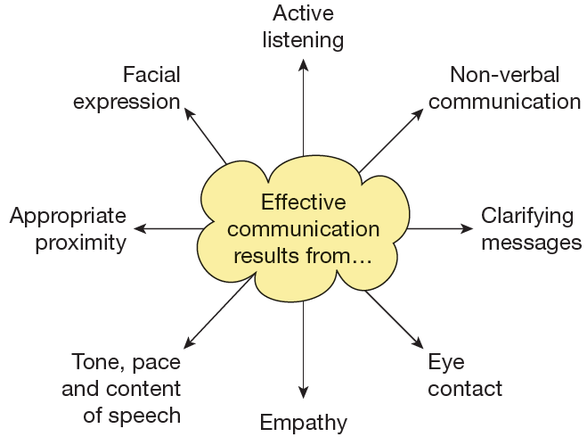
Basics of communication
Importance of communication (2):
Effective communication in care settings helps both care workers and people who use care services to form good relationships and to work
well together.
People communicate most effectively when they:
feel relaxed
are able to empathize with the other
person
experience warmth and genuineness in the relationship.
Notes:
Effective communication also requires the care worker to develop and use a range of skills, abilities and communication techniques

Slide 6
Basics of communication
Models of Communication in Healthcare:
Communication models are the formal or informal structures an organization uses for their communication needs.
Notes:
The elements of a communication model in healthcare include people, the messages they send to each other, the technologies that enable conversations between people, and the framework within which the conversations can take place.

Slide 7
Basics of communication
Models of Communication in Healthcare (2):
Communication has an essential role in any action that aims to improve health. It is difficult to imagine how a message could be delivered to promote healthy choices if we could not communicate. The communication process is a multi-dimensional transaction influenced by a variety of factors.
Notes:
In health promotion work the successful exchange of information between the practitioner and target audience is an area that has received mixed attention. Most commonly the emphasis on theory is clear, but the application of theory to practice is limited. There are a multitude of theories that can be used in the communication of health. Some of the important theoretical models that can be applied to health promotion work have been discussed below. Four important models discussed below will seek to bridge the theory-practice gap intended to enable practitioners to link theoretical models to practice.

Slide 8
Basics of communication
Models of Communication in Healthcare (3):
Models are derived from a simplified version of theory and can be used to guide the development of health promotion programmes. Theories and models are useful in planning, implementing and evaluating interventions.
Notes:
Models in health promotion usually seek to include key elements important to behaviour and decision-making processes. In health promotion and health education, models are often borrowed from areas of social psychology or health communication and applied to health contexts. Theories are valued in the field of health promotion because of their use in explaining influences on health alongside the ability to suggest ways where individual change could be achieved. Effective communication strategies should be grounded in a sound theory. They can be used to design and plan health promotion strategies and to generate decisions and solutions, ensuring that all variables are taken into consideration.

Slide 9
Basics of communication
Models of Communication in Healthcare (4):
The models that have been discussed for our understanding of health communication are:
Therapeutic Model
Health Belief Model
king’s Interaction Model
Northouse & Northouse’s Health Communication Model

Slide 10
Basics of communication
Models of Communication in Healthcare (5):
Therapeutic Model
The therapeutic model emphasises the important role that relationships play in assisting client and patients to adjust to their circumstances and to move in the direction of health and away from illness.
Notes:
When used by health professionals, therapeutic communication can be defined as skill that helps people cope with stress, confront psychological obstacles, and learn how to relate effectively. Although therapeutic communications appear to be a term the describes communication in traditional psychotherapeutic settings, it also describes communication between health professionals and clients in other health care contexts.

Slide 11
Basics of communication
Models of Communication in Healthcare (6):
Therapeutic Model
Carl Rogers (1951) believes that if the therapist communicates honest, caring understanding to the clients, it will help the client adjust in the healthy way to his or her circumstances. The Rogerian model is labelled as client centred because the focus of the interaction is on the client. In this model, the helper is encouraged to communicate with empathy, positive regards, and congruence. These three behaviours, together, compress the necessary conditions to help the client successfully (See Figure next slide).

Slide 12
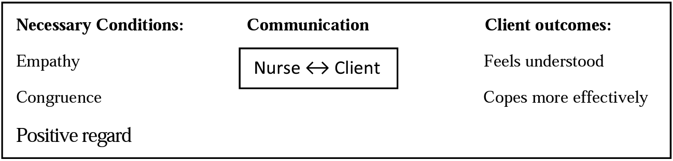
Basics of communication
Models of Communication in Healthcare (7):
Therapeutic Model
Notes:
For Rogers, empathy is the process of communicating to clients the feelings of being understood; it is standing in the shoes of the client. Positive regard is the process of communicating support to the client in a caring and non-judgmental way. It is communication that is genuine, nonthreatening and unconditional. Communicating congruence involves the honest expression of the helper’s own thoughts and feelings. Congruence requires that the helping professional will respond honestly to the client and attempt to being real in his or her relationship with the client.
In health care settings, the therapeutic model can be directly applied to professional- client communication. The Rogerian model describes ow health professional should communicate if they choose to be client centred. According to the Rogerian models, when health professionals communicate empathy, positive regard, and congruence, clients fell understood and are better able to cope with their illness.

Slide 13
Basics of communication
Models of Communication in Healthcare (8):
Health Belief Model
The HBM, formulated by Rosenstock and his colleagues (1966, 1974), is broader, more complex, and has a very different force than the therapeutic model.
The frequent use of this model in the health care settings and its heavy emphasis on the client’s perceptions are two reasons that it is being examined here.
This model was designed to explained the nature of the individuals’ preventive health actions.

Slide 14
Basics of communication
Models of Communication in Healthcare (9):
Health Belief Model
The HBM consists of three major elements:
An individual’s perceptions of susceptibility to and severity of the disease.
An individual’s perception of the benefits and barriers to taking a preventive health action to prevent disease.
The cues available to an individual that would stimulate him or her to engage in preventive health activity.

Slide 15
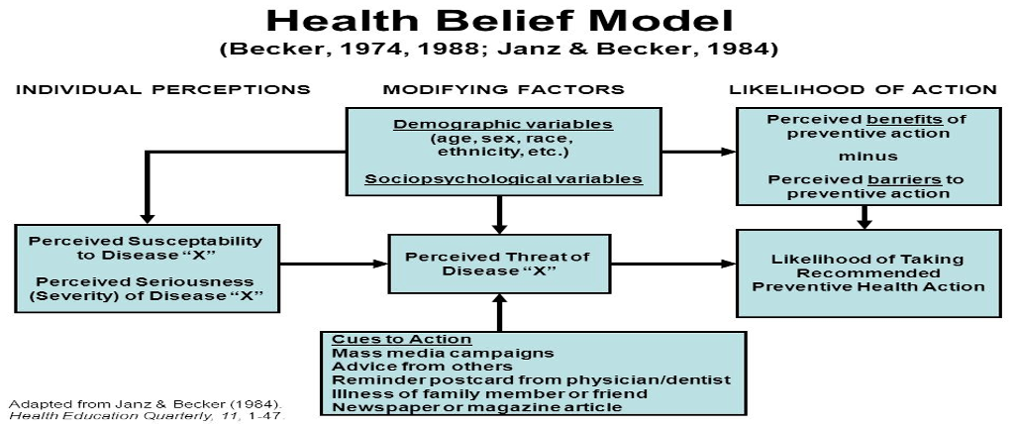
Basics of communication
Models of Communication in Healthcare (10):
Health Belief Model
Notes:
At the top of the diagram a 4 element of the model appears, containing demographic and social psychological variables. These variables called modify factory indirectly influence individual’s perception and beliefs. In essence, the health belief model is designed to predict the likelihood of an individual’s adopting a particular health behaviour as a function of perceived threat and perceived benefits.
Although many aspects of the health belief model involve communication, to aspect are distinctively communication cantered. First, the cues to action element of the model includes mass media campaigns advice from others, newspapers articles, and similar message related variables, all of which are types of communication. Communication is essentials if individuals are to received cues that have potential for motivating them to take health action.

Slide 16
Basics of communication
Models of Communication in Healthcare (11):
Health Belief Model
The health belief model are certain merits and also certain limitations:
On the positive sides, the model illustrates the importance of border mode of communication, such as the impact of mass media, on the health behaviors. The health belief model also focuses on the perceptions and beliefs of clients that can be altered to enhance certain health behaviors.
On the negative side, the health belief model has been criticized for placing too much emphasis on abstract, conceptual belief.
Notes:
Overall, this model highlights the client’s perceptions of preventive health care measures rather than the transactional pf the client- professional interaction in promoting health care.

Slide 17
Basics of communication
Models of Communication in Healthcare (12):
king’s Interaction Model
king’s model places strong emphasis on the communication process between nurses and clients and, therefore, was selected as an important model for understanding health communication.
Notes:
King uses a systems perspective to describe how health professionals (nurses) assists clients to maintain health. She provides a conceptual framework that discusses the inter relationships among personal, interpersonal and social systems. Although king describes the nature of each of these three systems, she gave particular emphasis to inter personal system in health care.

Slide 18
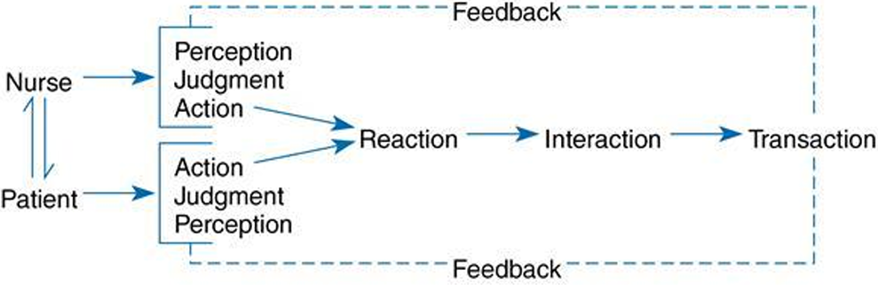
Basics of communication
Models of Communication in Healthcare (13):
king’s Interaction Model
Notes:
The paradigm king employs to discuss the role of interpersonal systems in health care is represented in the above figure.
Essentially the model suggests that in nurse- patient’s interactions both the nurse and the patients simultaneously make judgments about their circumstances and each other, based on their perceptions of the situations. Judgments, in turn lead to verbal or no verbal actions that stimulates reactions in the nurse and the patient. At this point, new perceptions are established and the process repeats itself. Interactions is the dynamics process that include reciprocal interplay between nurse’s and the client’ perceptions judgments and actions. Transactions are result of reciprocal relationships established by nurses and client as they participate to gather in determining mutual health related goals.

Slide 19
Basics of communication
Models of Communication in Healthcare (14):
king’s Interaction Model
Kings models is particularly valuable for explaining communication between a health professional and client. It represents the nurse- patient interaction process in a manner similar to the models formulated by the communication theorists.
Notes:
This model encompasses the important dimensions of relationships, process and transaction that have been identified as crucial elements in the communication process.
The feedback loop in the model also indicates the importance of shared meaning the nurse and client.
*Although king does not show in this diagram how interpersonal relations are affected by situational factors, nor how interpersonal relations are related to the patient’s health behaviour, she does explain these issues in A Theory of Nursing 1981.

Slide 20
Basics of communication
Models of Communication in Healthcare (15):
Northouse & Northouse’s Health Communication Model
The three major factors of the health communication process:
relationships,
transactions, and
contexts.

Slide 21
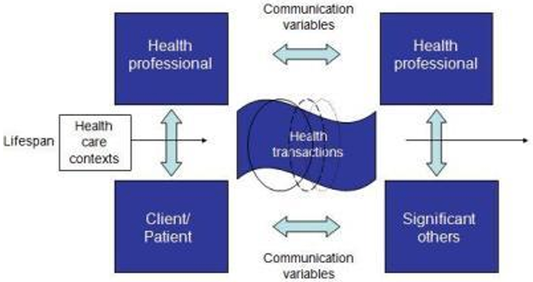
Basics of communication
Models of Communication in Healthcare (16):
Northouse & Northouse’s Health Communication Model
Notes:
Overall conclusion:
Relationships, transactions and contexts together provide a systems perspective on communication in healthcare.

Slide 22
Basics of communication
Models of Communication in Healthcare (17):
Northouse & Northouse’s Health Communication Model
Relationships:
From a system perspective, the health communication model illustrates four major type of relationships that exist in health care settings: professional-professional, professional-client, professional-significant other, and client-significant other.
The model also indicates that these interpersonal relationships can influence other types of relationships in the health care setting.
Notes:
Relationships: From a system perspective, the health communication model illustrates four major type of relationships that exist in health care settings: professional-professional, professional-client, professional-significant other, and client-significant other. As a rule, when an individual is engaged in health communication, he or she is involved in one of these four types of relationships.
The model also indicates that these interpersonal relationships can influence other types of relationships in the health care setting.
-For example, how health professionals communicate with each other can how health professionals and clients interact. Similarly, how a client reacts with member of his or her social network can influence later interactions between the client and health professionals.
In our model, the term health professional is used to identify and individual who has the education, training, and experiences to provide health services to others. Health professional includes a wide arrange of individual –nurse, health administrators, social workers, physician, health educator, occupational and physical therapist, pharmacists, chaplains, public health personnel, health psychologist, technicians, and other specialist. Each health professional brings unique characteristics, beliefs, values and perceptions to health care settings, which will affect how he or she interacts with clients and with members of the health care team. For example, the age, socio cultural background and past experience of the health professionals will affect the way which he or she responds to clients and co- workers.

Slide 23
Basics of communication
Models of Communication in Healthcare (17):
Northouse & Northouse’s Health Communication Model
Transactions:
Transactions are second major element in the health communication model. Transactions refer to the health related interactions that occur between participants in the health communication process.
Notes:
Health transactions involve any interaction between individuals about health related information. health transactions include both verbal and non-verbal communication behaviour. Both type of communication is equally important, and health transactions are most effective when verbal and non-verbal aspects of messages are compatible with each other.
Health transaction also include both the content and relationship dimensions of messages. Health transactions deal with health-related content- how a client seeks to attain and maintain health over a life span. The relationship dimension of health transactions is established within the various relationships represented by the model and this dimension influences how the content of the messages should be interpreted.
In the centre of the health communication model, health transactions are represented by a circle from which an unending spiral emerges. This illustrates the ongoing, transactional nature of health communication. Health communication is not a static event but an interactive process that occur at various points of time during the course of a person’s life. It includes continual feedback, which allows participants to adjust and readjust their communication. Health transactions are constantly moving forward and turning back to make changes and alterations in the message.

Slide 24
Basics of communication
Models of Communication in Healthcare (17):
Northouse & Northouse’s Health Communication Model
Contexts:
A third major element of the health communication process is health care contexts- the settings in which health communication takes place and the systemic properties of these settings. Health care contexts actually have a great influence on the communication among health professional, clients, family members, and others involved in the process.
Notes:
At one level, health care contexts refer to health care settings, such as hospitals, nursing homes and outpatient clinics. Health communication may be affected by the specific setting in which it occurs, such as hospital room, a physician’s office, a clinic or a waiting room, to name a few possibilities.
At another level, healthcare contexts can refer to the number of participants within a particular healthcare setting. Health communication may take place in one-to –one situation, in triads, in small groups, and among larger collections of individuals. The number of persons present within a given context also influences interactions in the context.
Overall conclusion (again):
Relationships, transactions and contexts together provide a systems perspective on communication in healthcare.

Slide 25
Basics of communication
Principles of good communication:
Effective communication is essential for the best care of hospital patients but consultants sometimes find the hospital environment hinders good communication. Since care is increasingly complex, delivered by teams of doctors and other health professionals in a range of specialties, who often work in shift patterns, communication is crucial to continuity of care.
Notes:
Effective communication in the hospital environment can be challenging, yet the Care Quality Commission’s 2012 survey(1) of hospital patients found that 80% always had confidence and trust in the doctors treating them, and 68% of in-patients said they ‘always’ received an answer to their question in a way that they could understand. However, 26% reported that this occurred only sometimes, and – perhaps more worryingly – 6% reported that they did not receive an understandable response to their questions.
Another area of concern was that 19% of patients responded that doctors spoke in front of them ‘as if they were not there’ at least some of the time, and 25% said that sometimes they received contradictory advice from different members of hospital staff. 20% of patients felt they did not receive sufficient information about their care or treatment and 10% felt they were not involved as much as they would like to be in decisions about their care.
In the MDU’s experience, many complaints by patients do not relate to the outcome of their clinical care, but rather the perceived attitude of the doctors treating them.
The extra time and effort you spend in ensuring you communicate effectively is likely to improve patients’ experience of hospital.

Slide 26
Basics of communication
Principles of good communication (2):
Communication with patients in a hospital setting can be improved by following a few basic principles.
These are as follows…

Slide 27
Basics of communication
Principles of good communication (3):
Explain yourself
Keep it open
Double check
Notes:
Explain yourself
Make sure your patient knows who you are and your role in their care. Many patients might well have seen a number of practitioners before you see them. Time spent explaining who you are and why you have come to see the patient will help your consultation. Watch and listen for some acknowledgement that the patient has understood.
Keep it open
When taking a history or seeking a patient’s view about their care, ask open questions. Try not to interrupt but regularly acknowledge what patients are saying.
Double check
To check that you understand what a patient has told you, repeat it back to them. If you are covering a sensitive topic or trying to communicate complex information, it is sometimes helpful to begin by checking the patient’s existing understanding of their illness (20% of patients felt they did not receive sufficient information about their care or treatment).
This can also be helpful if the patient appears to have a misunderstanding or worry without an obvious cause. At the end of your discussion you may also wish to check the patient has understood by asking them to summarise what you have spoken about

Slide 28
Basics of communication
Principles of good communication (4):
Look for clues
Don’t presume
Be considerate
Make notes
Notes:
Look for clues
Non-verbal cues are also important. Make eye contact. Look out for nonverbal signals. While you talk, watch for appropriate acknowledgements and/or signs of any confusion or distress.
Don’t presume
Remember, you understand medical terms that may mean nothing to many patients. Visual aids, diagrams or ‘patient pictures’ might be helpful when explaining procedures or risks. If you use these it is often helpful to record this in the notes.
Be considerate
If you wish to examine the patient, explain in advance what you intend to do during the examination. If the patient might perceive the examination is intimate, remember to offer a chaperone. Avoid over-familiarity and remain polite, even if you are extremely busy, under pressure or tired. Towards the end of all consultations, give the patient a chance to ask further questions and provide some explanation of what will happen next.
Make notes
It is important that you record what has been said to the patient and what you found on examination. Good notes that are legible, accurate and written while the facts are still clear in your mind are essential to continuity of care. Sign and date your notes clearly

Slide 29
Basics of communication
Contexts:
A formal definition of contextual communication:
Contextual communication is the bidirectional transfer of information between two parties where both parties are aware of the relational, environmental, and cultural context of the exchange.
Notes:
Simply put, it means that all entities involved know what the conversation is about.

Slide 30
Basics of communication
Contexts (2):
Communication is commonly used to give information, to obtain information and to exchange ideas. All health and social care settings will need to use effective communication in order for their system to work.
The context of communication will vary depending on the circumstance; it could be:
One to one
Group: Formal
Group:
informal
Between colleagues
Between practitioners and people who use services

Slide 31
Basics of communication
Contexts (3):
One to one communication
One to one communication are simple interactions between only two people, it can either be someone you know well or someone who you don’t particularly know. If it is someone that you don’t particularly know it is important to create a positive atmosphere before you deliver information. It is also important that the person who is receiving the information is comfortable and relaxed.
Notes:
One to one interactions usually tend to have 3 steps, first you will have a greeting to introduce yourself and make sure that the receiving person is relaxed and happy, next you exchange the information, the specific reason as to why you are talking to the person and finally, when it comes to the end of the conversation you will use the correct use of goodbye for the circumstance you are in, for example if it is an old friend you may say “see you soon” instead of “goodbye”. An example of one to one communication in a health and social care setting would be a nursery teacher contacting you to give you information about the playgroup or information about your child.

Slide 32
Basics of communication
Contexts (4):
Group communication: Formal
Another type of communication is group communication however it is spoken in a formal manner. It is often that most health and social care settings use a mix of formal and informal language to make the receiving person of the information more comfortable.
Notes:
Formal communication is understood by a wide variety of people and also shows respect towards others. This type of communication normally consists of polite language which is either spoken in a calm tone or is spoken quite slow so the person does not feel rushed or panicked. An example of where formal communication is used in a health and social care setting would be doctors having a meeting about the line of work they will be carrying out or a meeting about a patient, they won’t talk in derogatory terms or use slang words, the doctors will be polite and informative so others understand and feel as comfortable as possible about the situation. It is important that formal communication is carried out in specific circumstances because if it’s not carried out it can be seen as rude or it could have a negative outcome due to not communicating effectively. However, in certain care settings such as a care home for the elderly, if a person uses too much ‘formal language’ they can come across as pretentious, therefore care workers usually adjust the way they speak, to a mixture of formal and informal, in order to respect different ‘speech communities’ when they communicate.

Slide 33
Basics of communication
Contexts (5):
Group communication: Informal
Informal communication is often used when you know the person well and are comfortable with them, an example of when this communication is used is between friends and family. It is often that when talking to friends and family you may use terms that others may not understand or like the use of, for example ‘slang’ and ‘swearing’.
Notes:
Another type of informal communication involves local groups from specific places may have their own way of speaking, for example people in Northern England might say “Hiya mate, you alright?” and if you are from the same area or understand this group of people, you will appreciate it and see it as a friendly greeting. However, people who aren’t from this area or who are not associated with a group of people from that area will use different informal language, this can make it harder to understand the informal communication of people whom are from different social groups.
A problem that can arise if informal communication is used incorrectly or ineffectively would be offending others that don’t use that certain type of language, for example in a health and social care setting, if you were working in a school you would not talk to your surrounding friends (colleagues) in ‘slang’ or ‘swearing’ due to the setting you are in and the fact that they may not like the idea of ‘swearing’.

Slide 34
Basics of communication
Contexts (6):
Group communication: Between colleagues
Communication between colleagues often consists of verbal interactions along with others for example emails and letters. It is important that when talking to other colleagues that you are polite and respectful. If colleagues do not show respect to one another they may fail to show respect to the users of the service. When colleagues are greeted verbal interaction is normally used this means that they are asked if they are well and have a ‘warm up group talk’ in order to show that they respect and value one another.
Notes:
When interacting with colleagues it is important that you demonstrate good listening skills and that you can remember details from the conversations you have withheld with them. Colleagues also have to develop trust in each other in order to show the respect you have for the confidentiality of the conversation. Employee’s may also have social expectations about the correct way to communicate thoughts and feelings in their work setting, these social expectations differ from the way you would communicate thoughts and feelings with your friends and family. Even though communication between colleagues will often be informal, it is vital that care workers used skilled communication in order to gain trust and respect.
An example of communication between colleagues in a health and social care setting would be when a nurse is talking to a doctor, in order for the nurse to gain respect and to be able to achieve a conversation without feeling uncomfortable and delivering information, she would need to be polite and not use any derogatory terms such as ‘swearing’ and should not talk to the doctor as if he were her friend or a family member.

Slide 35
Basics of communication
Contexts (7):
Group communication: Between practitioners and people who use services
Practitioners tend to communicate with their colleagues in their own specialised language community. A language community is a social community of people that has its own special ways of using language in order to communicate between group members.
Notes:
However due to the practitioners talking in this specific jargon they are aware that the language they use needs to be translated into Exemplar Work – P1 an everyday language so they can communicate with those who use the service and people from other professions. It is important for the practitioners to change the type of language used to make sure that once they have explained it to a service user it is not misunderstood and taken in a way which can cause distress or complications, in order to avoid this the professional health and social care staff need to check their understanding of issues with the people who are communicating with them.
Not only do health and social care professionals have to communicate with people who use their services but also with colleagues who work for different organisations so it is important not to assume that people from other agencies will understand what you are talking about when specialist terms are used.
A common example of communication between a practitioner and someone who uses the service would be a teacher and a pupil, if you explain something to a pupil in terms that you would use to explain to another teacher (jargon) it is highly unlikely that the pupil will understand what you are talking about because you are probably using acronyms or certain words which the pupil hasn’t been introduced to, therefore the practitioner needs to adapt their language into terms which the service user would understand.

Slide 36
Basics of communication
Methods of Communication:
There are many different methods of communication that are usually split into 4, for example:
Oral Communication
Written Communication
Computerized Communication
Special Methods

Slide 37
Basics of communication
Methods of Communication (2):
Oral Communication
Oral communication otherwise known as oral interaction, it is the process of expressing information or ideas by word of mouth. To be able to do this it requires the development of skills and social coordination, this means;
Showing an interest
Being interesting
Having the ability to start conversations and end them
Notes:
Showing an interest
An example of communicating orally in a health and social care setting would be to obtain information for example when you want to register at the dentist you have to give over your details verbally to the receptionist for example, name, address and contact number and if you are a young child then your guardian/ carer’s name would have to be stated to ensure they are accurate.
Being interesting
Another purpose of oral communication would be to give information, an example of this would be between a teacher and a pupil’s parent to inform them of their children’s progress in school and where they can improve.
Having the ability to start conversations and end them
Another purpose of oral communication is to exchange ideas for example in a care home the clients could talk about their past and present experiences to one of the care Exemplar Work – P1 workers and based on their experiences, an idea could be made and if the client agrees potentially something could change within the service to benefit the clients.
It is important to give information as well as obtaining it because the content (what you are talking about) must be accurate, if the context given is incorrect, the person who requires the information will be misinformed, this could then later lead to serious consequences. Communicating orally requires you to make a connection with the other person, a good way of allowing this to happen is by putting the person receiving information/ giving information at ease by showing an interest in them, doing this is especially important if somebody is from a different culture because it shows that we value diversity. It is also important to be open about what we want to achieve as well as encouraging the other person/ persons to talk about what they wish to achieve when giving and obtaining information and exchanging ideas.

Slide 38
Basics of communication
Methods of Communication (3):
Written Communication
Written communication is the most common form of communication in business’, the rules for govern writing are different to the ones that follow spoken language. The accuracy of the written word is vital in all health and social care and early years’ settings.
Notes:
If the keeping of formal records is inaccurate, the user of the service may obtain incorrect information that could lead to serious complications or they could be given incorrect treatment, if this action takes places the service could later face implications such as a complaint or being taken to court.

Slide 39
Basics of communication
Methods of Communication (4):
Written Communication (2)
Inaccurate written records may result in:
Inappropriate actions
Failure to act
Complaints and litigation
When communicating through written information it needs to be:
Clear
Accurate
Legible
Notes:
Health and social care settings use written communication to record personal history for example, a doctor’s surgery may use a written record which will ask for your; name, address, emergency contact, dietary needs etc.
Written communication allows you to obtain information, give information and exchange ideas. All early years’ settings and health and social care settings are able to keep in contact with parents of children and other professionals by communicating in writing.

Slide 40
Basics of communication
Methods of Communication (5):
Computerized Communication
Computer-meditated communication (CMC) is any communication that occurs through the use of two or more electronic devices. A way in which you can communicate through computers is by email which has proved to be a significant form of communication, they can be either formal or informal depending on their purpose or the circumstance the email is being used in.
Notes:
Emails come with both disadvantages and advantages, an advantage would be that they can be produced and sent quickly as well as being received quickly where as if a letter was sent you would be waiting 3 or 4 days at least for a reply.
However, a disadvantage is that emails can be lost or you could be faced with the problem of the receiver of the email not understanding what the writer is trying to achieve or what information the writer is trying to give, this could lead to misinterpretations of the email and potentially lead to later consequences.

Slide 41
Basics of communication
Methods of Communication (6):
Special Methods
Individuals who face disabilities or learning difficulties use special methods in order for them to be able to communicate with others. All health and social care and early years’ settings need to be prepared for those who have special needs. These special needs could include:
Deafness or difficulty in hearing
Blindness or poor eye-sight
Language difficulty e.g. not speaking English or English not being your first language
Notes:
British Sign Language (BSL) is used by a large number of people in the UK, it is though that nearly 70,000 people use sign language in the UK. British sign language is an organization that was recognized by the government in March 2003. It is important to use sign language in all health and social and early years’ settings however the settings which involve children find it easier to use it due to how fascinating they find the special method, due to this it is proven that children learn sign language easier. Sign language tends to be used by those who have a hearing impairment (deafness or a difficulty in hearing).
An example of the use of sign language in one of these settings would be in a primary school, if a child has a hearing impairment the teacher may use sign language so it is easier for the child to understand and allows him/her to have the same understanding as the surrounding children just with a little more help. The use of sign language has developed over hundreds of years and allows people who experience difficulties to interact with others.

Slide 42
Basics of communication
Methods of Communication (7):
Special Methods (2)
Makaton is another special method which helps those communicate with a hearing impairment or learning difficulties. Makaton is a programme which uses signs and symbols to help people communicate with one another.
Notes:
The programme is designed to support spoken language therefore the signs and symbols are used with speech, in spoken word order. Makaton is used by people of all ages and allows these people to communicate straight away with the use of the signs and symbols.
When using Makaton people may use one of the three methods; signs, symbols or speech, or they may use all three methods to interact with others. An established set of hand movements are used with Makaton to convey meaning. Even though Makaton can be used at all ages it is usually taught to children as soon as it is realised that they need this method of communication.
An example of where Makaton can be used in an early years’ setting would be in a doctor’s surgery, the Makaton will help the client explain to the GP the problems they are facing and the GP’s can also use this method to communicate back with the client so they are aware of what is wrong with them and what they can do to help fix their problem.

Slide 43
Basics of communication
Methods of Communication (8):
Special Methods (3)
Braille is also a special method which helps people communicate, this method is used for those who have limited vision or are blind. Braille is a form of written language, in which characters are represented by patterns of raised dots, which are felt with the fingertips of the visually impaired.
Notes:
Braille was first introduced in 1829 by a blind man called Richard Braille. This special method provides those who are blind and those who have poor vision with a chance to read and write independently due to the format being based on ‘touch’. If there are correct software’s installed on computers in health and social care and early years’ settings, then everything from the computer that the client needs can have printed in Braille.

Slide 44
Basics of communication
Interpersonal communication:
Types of Interpersonal Interaction
There are two different types of interpersonal interaction:
speech or language and
non-verbal
When communicating in any interaction, to make it effective using interpersonal skills, you should be aware of the types that are listed boldly above.

Slide 45
Basics of communication
Interpersonal communication (2):
Types of Interpersonal Interaction
Speech or language:
People who are of different localities, ethnic groups, professions and work cultures have their own words, phrases and speech patterns, because of the different backgrounds and the different uses of language it is easy for clients to get confused, feel misunderstood or even feel mistreated with the way they are being spoken to because they are simply not used to it.
Notes:
Practitioners tend to use jargon, words that are used by a particular profession or group that are hard for others to understand. An example of jargon being used in a care setting would be in a hospital, a doctor could be explaining to a patient the problems they have with a part of their body, for example their knee cap and the client may not understand that due to the doctor using technical terms such as Patella instead of the simpler word ‘knee cap’ which we use every day. It is also important in all care Exemplar Work – P1 settings to understand that those who are from different geographical areas will use different words and pronounce words differently, this is often referred to as using a different dialect.
Dialect is known as, words and their pronunciation which is specific to a geographical community, for example people who live in the North West of England will use a different dialect to Londoners.
People, especially youths are more likely to use slang, informal words and phrases that are not usually found in standard dictionaries but which are used within specific social groups and communities.

Slide 46
Basics of communication
Interpersonal communication (3):
Types of Interpersonal Interaction
Speech or language:
The second type of interpersonal interaction in the speech and language section is first language. First language that a person learns to speak is often the language that they will think in. Working with clients who do not have the same first language as the practitioner can be difficult, as mental translation between languages may be required.
Notes:
For example, if there is a problem with a child in a nursery and their parents do not speak English well or don’t understand it at all it is difficult to deliver the information about the problem with the child, to help overcome this, it is more than likely that within the nursery a translator will be needed so they can help the parents understand what the problem is and allow the nursery teachers and the child’s parents come to an agreement on how to fix the problem.

Slide 47
Basics of communication
Interpersonal communication (4):
Types of Interpersonal Interaction
Non-Verbal:
The other type of interpersonal interaction is Non-Verbal.
The impersonal skills this interaction involves are:
Posture, the way you move, facing other people, gestures, facial expression, touch, silence, tone of voice, proximity and reflective listening
Notes:
As soon as you meet someone it is likely that you can guess how they are feeling, guessing how somebody feels is usually done by studying their non-verbal communication. Non- verbal means no words, so this means that this type of communication refers to the way that a person sends a message without words. These messages are sent through a number of things, ranging from the person’s posture to their body gestures they do throughout a conversation.

Slide 48
Basics of communication
Interpersonal communication (5):
Types of Interpersonal Interaction
Non-Verbal: Posture
Posture is a particular position of the body; the way a person sits or stands when communicating with someone sends a particular message.
Notes:
For example, when a person leans back and crosses their arms it can show that they are not interested and are bored however when a person leans forward it can show interest or intense involvement.
Posture in a health and social environment is crucial, for example when a doctor is informing a patient of a condition they have it is very unprofessional for them to sit back with their arms crossed because they are delivering information, it would be more professional for a doctor to sit up straight and lean slightly forward to show intense involvement so the client is aware that the doctor is there to help and that the doctor has a professional manner of delivering information.

Slide 49
Basics of communication
Interpersonal communication (6):
Types of Interpersonal Interaction
Non-Verbal: The way you move
A person’s body movement also communicates a message.
Notes:
For example, if you slouch it provides the client with the idea that the practitioner is tired and bored, where as if they stand up straight it gives the client the idea that they are refreshed, happy and prepared for the day ahead.
The way a person walks, moves their head and sits also determines their emotions. If school teachers were to sit down and cross their legs whilst slouching it would resemble the idea that they are tired, bored and cannot be bothered to be there and work, this reflects a bad example towards the children who will begin to think that it’s beneficial to slack off work and are allowed to relax in lessons.

Slide 50
Basics of communication
Interpersonal communication (7):
Types of Interpersonal Interaction
Non-Verbal: Gestures
A gesture is a movement of a part of the body, especially a hand or the head to express an idea or meaning. Some gestures within the UK carry a common meaning in most communities.
Notes:
Residential care homes that home elderly people tend to have carers that use a lot of hand gestures to explain ideas to the elderly such as they need to be cleaned or their bed needs cleaning because it is a quicker way for them to process information and they are able to understand it a lot easier.

Slide 51
Basics of communication
Interpersonal communication (8):
Types of Interpersonal Interaction
Non-Verbal: Facial expressions
A persons face often informs us as to how they are feeling, for example if they are sad they are not likely to be withholding a smile or have ‘bright eyes’, it will be more likely for a sad person to have a slight frown or pursed lips. Whereas if a person was happy they would have a big grin and have wide eyes when they make eye contact with another person.
Notes:
It is important in all social care settings to notice how a person’s facial expression changes because it can tell the practitioner as to whether they are in pain or upset and if it is something they need to look into. For example, in care homes, if a child’s face suddenly goes from being wide eyed and alert to them having pursed lips and slight tension on their faces, it is the practitioners job to look into the scenario of the child and to make sure that they are not of any harm to themselves or to others and just to make sure that they are coping well in the setting they are based.

Slide 52
Basics of communication
Interpersonal communication (9):
Types of Interpersonal Interaction
Non-Verbal: Touch
Touch is also a way of communicating without words because when a person touches someone else it can send the message of care, love and affection, however who the person is and the setting they are in will help others to understand what that specific person’s touch may mean.
Notes:
Touch can also be misinterpreted, for example, in an elderly care home a carer could touch hands with an elderly person in an attempt to comfort them because they are disorientated however they may think that the carer isn’t trying to help but is trying to dominate them. To prevent this idea from being portrayed it is better to ask the person if they would like to be comforted by being touched.

Slide 53
Basics of communication
Interpersonal communication (10):
Types of Interpersonal Interaction
Non-Verbal: Silence
Silence is the complete absence of sound. How silence makes others feel depends on the situation, sometimes silence is needed to consolidate knowledge, sometimes silence makes people feel awkward and embarrassed.
Notes:
It is important that everybody knows silence doesn’t always stop the conversation and can sometimes mean “let me think”. An example of silence being used in a health and social care setting would be in a hospital, if a patient is being told they have cancer, the doctor places silence in specific parts of the conversation to show the client that they understand and it also allows the client to obtain and consolidate the information they are being told. The silence also allows the client to think of any questions they have about what they are being told so they can then ask the doctor straight away.

Slide 54
Basics of communication
Interpersonal communication (11):
Types of Interpersonal Interaction
Non-Verbal: Tone of Voice
The tone of a person’s voice is important when speaking to other people, when a person talks quickly in a fixed tone it is potential that others will perceive that as the person being angry, but if a person’s voice is calm and slow it perceives the idea that they are friendly.
Notes:
For example, when a student is being told off by a teacher the teacher will use a stern voice to show that they are not joking and that it is a serious matter, whereas when a teacher is trying to comfort a pupil they will use a soft tone of voice so it shows that they are there to listen and are caring.

Slide 55
Basics of communication
Interpersonal communication (12):
Types of Interpersonal Interaction
Non-Verbal: Proximity
Proximity is the nearness in space, time or a relationship. The space between people can show how friendly or ‘intimate’ a conversation is. In Britain and other cultures there are expected ‘norms’ as to how close a person should be when they are talking to somebody.
Notes:
For example, if a person is stalking to a stranger it is suggested that they stand at arm’s length apart so it is a comfortable amount of space between the two. If the person is conversing with someone they are friends with or are related with then it is likely that the area between them will be more enclosed.
In all health and social care settings it is important that all clients are allowed their own personal space, if carers do not allow clients to have their own personal space it can be considered aggressive. It is also important that the practitioners who work with children understand the requirements of space due to how society can perceive people who work with children when they come to close to them, to ensure this does not happen a code of conduct is placed that all employees have to sign.

Slide 56
Basics of communication
Interpersonal communication (13):
Types of Interpersonal Interaction
Non-Verbal: Reflective listening
Reflective listening is a communication strategy which involves two key steps: seeking to understand a speaker’s idea, then offering the idea back to the speaker to confirm the idea has been understood correctly.
Notes:
An example where reflective listening is used in a health and social care setting would be in a school, a teacher will set a task and then will ask the students what they have to do and will check on them throughout the process of the activity to ensure they understand that they are doing what they are supposed to do.

Slide 57
Basics of communication
Communication Strategies for Healthcare Professionals
Communication is a vital aspect of healthcare—Communication cuts across all aspects of the industry. As a healthcare professional, you constantly communicate with colleagues, patients, and families.
In essence, implementing excellent communication strategies ensures:
Higher patient satisfaction
Higher accuracy in patient diagnosis
Patient adherence to treatment instructions.
Patients can self-manage their condition based on doctors' recommendations and ultimately
Improved patient outcome.

Slide 58
Basics of communication
Communication Strategies for Healthcare Professionals
Be Attentive
Ask Open Questions
Be Curious
Non-Verbal Communication
Summarize Throughout
Notes:
1. Be Attentive
Attention is the first step in building relationships with patients. Discussions are only meaningful when you pay attention to the patients' complaints and health needs.
Listen with an open mind, don't be judgemental, and never listen to look for the following question to ask or the next point to make.
2. Ask Open Questions
Asking open questions is an excellent way to solicit more information from your patients. Genuine questions encourage them to provide a more detailed, authentic, and lengthier response.
Remember that the more information you have about a patient, the more accurate your diagnosis is.
3. Be Curious
Always be curious about your patient. Questions are instrumental in building relationships. Asking questions borne from curiosity shows your interest in the patient. Be interested in the little details in their story and ask questions.
When you are curious enough about your patient, asking excellent and well-timed questions will become more accessible, making you an authentic communicator.
4. Non-Verbal Communication
Not all communication has to be in words. Sometimes, non-verbal communication might be all that's necessary for specific moments of your conversation.
Non-verbal communication skills include; eye contact, appropriate body language, using a specific voice tone, or simply adding a smile. Non-verbal communication can aid verbal communication and pass the message with more clarity to your patients.
5. Summarize Throughout
Not just some parts, summarize everything your patients communicate to you. Also, ask them if you have correctly understood their narrations. When you do this, you will hardly miss details. Secondly, you show willingness to understand them.

Slide 59
Basics of communication
Communication Strategies for Healthcare Professionals
Involve Friends and Family
Be Aware of Their Cultures and Religion
Be Aware of Your Patient's Situation
Inspire Trust
Show Compassion
Notes:
6. Involve Friends and Family
When patients are under stress, they tend to forget the most important details that you communicate to them. It is important to involve family members in such conversations.
Make sure that patients in more severe conditions have family or friends around them to see all sides of the story. Family or friends can remind them of the vital details that might have slipped through their minds during their visit.
7. Be Aware of Their Cultures and Religion
In communication, you need to consider that every patient is unique with different cultures or religions. You need to consider their cultural and religious beliefs while communicating or taking action with them.
8. Be Aware of Your Patient's Situation
They might be going through some non-health challenges. You must be aware of their situations as it will educate how you engage with them.
They might have lost someone close recently or even be in a financial jam. Please take note of these details so that you can relate to them better.
9. Inspire Trust
The best way to inspire trust in your patients is to always keep to your words. Never make a promise or give assurances you cannot control. Also, being compassionate and showing constant interest in your patients' welfare is another way to build trust in your patients.
When there is trust between you and your patient, they get comfortable opening up with you in in-depth details about their condition.
10. Show Compassion
You need to understand your patients. Treat them equally with respect and dignity. Many patients pass through a lot. They might feel depressed, scared, or even helpless in the hospital.
But allowing your compassion to show in your communication with them will go a long way in easing their anxiety and worries.

Slide 60
Basics of communication
Communication Strategies for Healthcare Professionals
Communicate in Different Ways
Avoid Medical Jargon and Technical Language
Be Patient
Keep Records
Avoid Interruptions
Notes:
11. Communicate in Different Ways
Communicating using different methods aids comprehension. Charts and visual aids can be a great way to achieve this. Creatively come up with ways to support your communication with analogies and tools.
12. Avoid Medical Jargon and Technical Language
Not every patient understands medical terms and language. As much as you can, refrain from using medical jargon during patient communication. Break down the terminologies into bits and pieces your patients will understand.
13. Be Patient
More often, patients want someone to listen to them. Allowing them time and space to express themselves is a great communication strategy to make them feel comfortable with you. Most patients need time to express their feelings and communicate their symptoms accurately.
Therefore patiently listening to your patients gives you the ability to make a better diagnosis.
14. Keep Records
Make proper documentation of the interactions you make with your patients. This makes information sharing across departments easy. When records are accurately curated and documented, patients will not need to repeat their stories repeatedly.
15. Avoid Interruptions
Make your environment conducive enough for effective communication. Put measures in place to avoid interruptions and unnecessary noise during consultations. Some common examples of such disruption are fans, computers, music, etc.
FINAL THOUGHTS
Effective communication is critical in the healthcare profession. These 17 strategies can help healthcare professionals to communicate effectively with their patients, co-workers, and superiors.
By being mindful of the patient's needs and using various strategies, healthcare professionals can ensure that they are providing the best possible care to their patients.

Slide 61
References:
Ellis, M., & Astell, A. (2017). Communicating with people living with dementia who are nonverbal: The creation of Adaptive Interaction. PloS one, 12(8), e0180395.
Fasold, R. W., & Connor-Linton, J. (Eds.). (2014). An introduction to language and linguistics. Cambridge university press.
Keeley, M,. P. (2017). Family communication at the end of life. MDPI AG.
Hayes, B. P. (2015). Introductory linguistics. Los Angeles.
Interpersonal communication handbook https://textbooks.whatcom.edu/cmst210/
Pearson, J. C., Nelson, P. E., Titsworth, S., & Harter, L. (2017). Human communication (p. 416). New York: McGraw-Hill Education.
Schiavo, R., (2007). Health communication. From theory to practice. John Wiley & Sons,Inc.
Skarbalienė, A., Skarbalius, E., & Gedrimė. L. (2018). Effective communication in the healthcare settings: Are the graduates ready for it? Case study. https://doi.org/10.30924/mjcmi.24.si.9
Schiavo, R., (2007). Health communication. From theory to practice. John Wiley & Sons,Inc.

Slide 62
Useful Webpages:
start [linguisticsweb.org]
All Things Linguistic
https://www.alz.org/help-support/caregiving/daily-care/communications
https://www.asccare.com/nonverbal-communication-alzheimers-disease/

Slide 63



Developed by

