Slide 1
Comprehensive care for people with Neurodegenerative disorders

Slide 2
Learning Outcomes
At the end of this session, participants will be able to:
Conceptualise comprehensive care and explain its importance
Explain how to utilise a conceptual model to structure comprehensive care
Discuss important aspects of caring a patient with NDD
Outline a comprehensive approach to caring for patients with NDD
Identify ways they could contribute towards establishing comprehensive care for patients with NDD in Sri Lanka

Slide 3
What is comprehensive care?
There is no clear universally agreed definition (Renghea et al 2022). Attempts include:
Coordinated delivery of the total health care required or requested by a patient) (Government of South Australia, 2023).
Comprehensive care must be personalised and prioritise what the person needs most, even if it is not related to the clinical reason for admission. This care must be extended to the family and society. In addition, it should focus on spiritual care, social relations and personal projection, which … improves quality of life and patient satisfaction … Comprehensive care …favours a balance between the patient's health, personal autonomy and satisfaction with his or her life in general terms. (Renghea et al 2022).
It involves integrated teams of health professionals working together with the person receiving care and family / caregivers, and communicating effectively to plan, manage and coordinate care with the patient.
It requires health service organizations to have systems and processes in place to support this, and to foster a collaborative and person-centred culture.
It addresses physical, psychological, spiritual, social, cultural, economic factors that influence the impact of health issues.

Slide 4
Why CC is important?
Delivering comprehensive care is about ensuring that health care provided
is informed by a person's clinical and personal needs and preferences
is shaped by shared decisions
is planned and delivered in partnership with the multidisciplinary team.
This is important because greater independence to make own decisions/ choices; ability to participate socially, increases sense of living a meaningful life and greater quality of life.
And because having decisions made for individuals, being denied independence diminishes self esteem and sense of purpose.
And because addressing for example, physical reasons for impaired swallowing, does not necessarily improve ability to eat. Motivation to eat (psychological), ideal surroundings (environmental), food choices/ acceptability of foods (sociocultural), ability to afford foods (politico-economic) all need to be considered if the person is to be supported to be able to eat.
This is true regarding all ALs

Slide 5
Model for comprehensive care
The Roper-Logan-Tierney (RLT) Model for Nursing is a theory of nursing based on activities of daily living. We find it can be helpfully applied in the broader context of care.
Dependence-independence continuum: the dependence and independence of the patient is reviewed throughout the care plan and evaluation. Goals are designed to support maximising independence as far as is possible/ reasonable and care interventions aim at meeting needs that cannot be independently met.

Slide 6
Contd…..
The model identifies five factors that influence the activities of living.
Biological, psychological, socio-cultural, environmental and politico-economic
The incorporation of these factors into the theory makes it a comprehensive approach
The factors are used to determine the individual patient’s relative independence in regards to the activities of living.

Slide 7
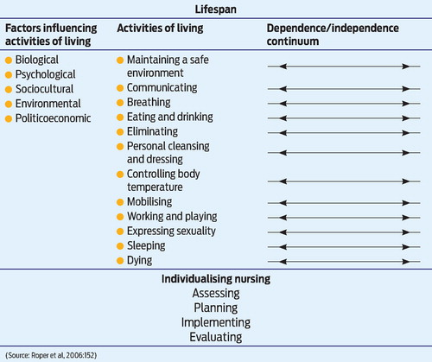
RLT Model

Slide 8
Biological/Physical factors
Physical aspects of diseases
Medication associated issues (Hypoglycaemia, prone to fainting etc)
Examples include: physical deficits causing walking difficulty, shuffling gait, falls tendency, incontinence, swallowing and breathing problems.

Slide 9
Psychological Factors
The psychological factors influencing how well or otherwise individuals may be able to carry out Als involve
Emotions
Temperament / mood
Cognition
Thinking
Perceptions
Ability to understand

Slide 10
Sociocultural Factors
The sociocultural factor gives the impact of society and culture as experienced by the individual patient.
expectations and values based on class and status
culture within the sociocultural factor relates to the beliefs, expectations
values held by the individual patient for him or herself as well as by others pertaining to independence

Slide 11
Sociocultural factors
Social (concerned with roles, relationships and interactions / engagement in society.
Cultural (concerned with values and beliefs shared among groups/ societies)
Family – nuclear, extended
Social roles - Carers of grand children, commitments to social and religious activities
Cultural perspectives on -
Aging
Retirement
Incontinence
Dementia
Incapacity
All the above influence dependence/ independence with regard to carrying out Als.
These factors influence attitudes
Positively - e.g. through fostering inclusivity, non-judgemental, supportive community approaches
Negatively – e.g. through reinforcing social stigma, blame, exclusion, isolation.

Slide 12
Contd…
Sociocultural factors then, influence for example:
Help-seeking behaviours
Use of complementary and alternative medicine
Social stigma
Caregiver burden
Social factors include infrastructure, such as public transport, access to hospitals / clinics/ family doctor.

Slide 13
Environmental Factors
Good consideration of environmental factors should make it a “green” model.
The theory takes into consideration the impact of the environment on the activities of living.
Examples of relevant issues include:
Unfamiliar surrounding - Moving to a care home
Unsafe home environment
Unguarded machinery
Noisy environment

Slide 14
Politico-economic Factors
Politico-economic factors include the impact of the government, politics, and economy on how independently or otherwise people are able to carry out activities of living.
government policies and programs
war or conflict
availability to benefits
political reforms
interest rates
availability of public and private funding

Slide 15
Politico-economic factors
Examples include:
National policy and Government Act on aging, caring and rehabilitation
Preventive health care from public health agencies
Fund allocation for aging matters (Teaching, Researching, Caring)
Specialized education programmes for aging
State, Private or NGOs focused on elderly
Pension scheme, donations
Day centres/Elderly care associations

Slide 16
Contd….
Financial implications of caring within a family (extended family)
Payments for caregivers
Part time jobs (security officers, sewing, weaving, tea plucking etc)
Low wages, poor conditions (working)
Economic crisis - Cost of medicine and goods

Slide 17
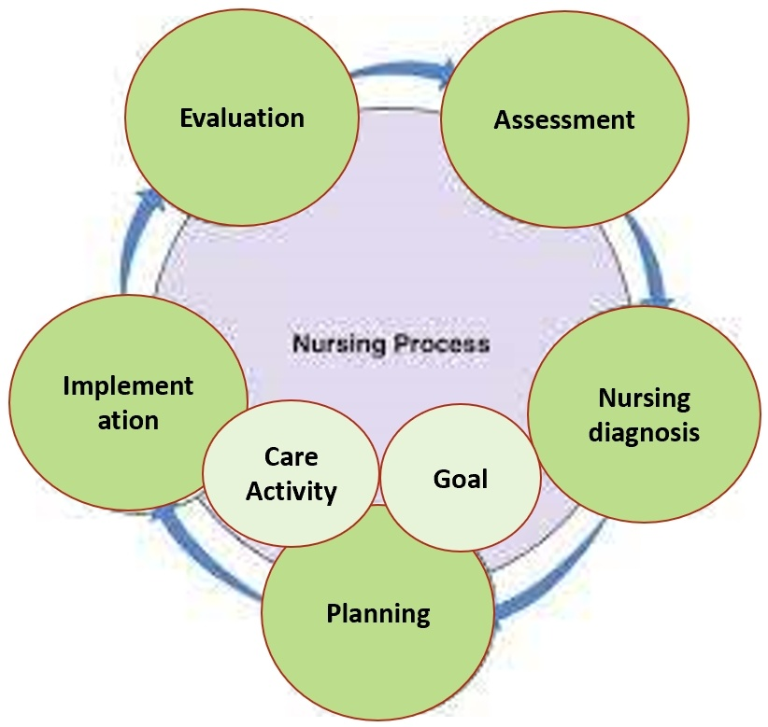
Comprehensive care planning for patients with NDD
Interdisciplinary team involvement in every step
Identifying needs
Care planning process

Slide 18
Caring for patients with NDD
Caring for patients with NDD is challenging.
The quality of caring affects the patient’s behaviors and progression.
Characteristics of a good caregiver - demonstrate kindness, empathy, mercy
Need to be abreast on treatment, overall care and other issues with knowledge and understanding.

Slide 19
Identifying needs
Help to carry out Als such as bathing, dressing, mobilizing, managing toileting, may be needed due to problems such as:
Impaired memory
Disturbed thought process
Risk for injury
Confusion/chronic confusion
Anxiety
Impaired verbal communication
Impaired physical mobility
Disturbed sleep pattern
Social isolation and loneliness
Bereavement and grief
Disturbed sensory perception
Compromised family coping
Wandering

Slide 20
Contd……
Ability to carry out Als independently and consequently the person’s quality of life may also be impacted by issues such as:
Social deprivation and stigma
Loneliness
Disability
Dependence on external care
Increased use of health services
Increased risk of chronic illnesses
Risk for suicidal attempts
Increased mortality

Slide 21
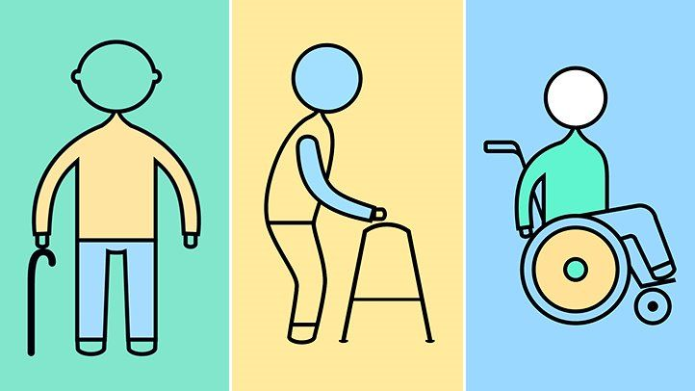

Maintaining a safe environment (Minimizing risk)
Remember- keep goals SMART – specific, measurable, achievable, realistic, time-based.
Poor example – unclear, not specific:
Problem | Goal | Intervention | Evaluation
Mr Jones keeps falling over. | Improve his balance. | Instruct him to stay in his chair until someone is ready to help him walk. | Over time check he’s improving
Better?....
Problem | Goal | Intervention | Evaluation
Mr Jones has fallen three times in the past two weeks- twice tripping over a rug, and once when he turned while walking, to see who was calling to him. | Mr Jones will have no further falls | Remove loose rugs from routes Mr Jones walks. Avoid calling to Mr Jones from behind him – get in front of him before talking to him. | Review with team including Mr Jones and his carer weekly from (date) and following any trip or near miss. Modify care plan if / as appropriate.

Slide 22
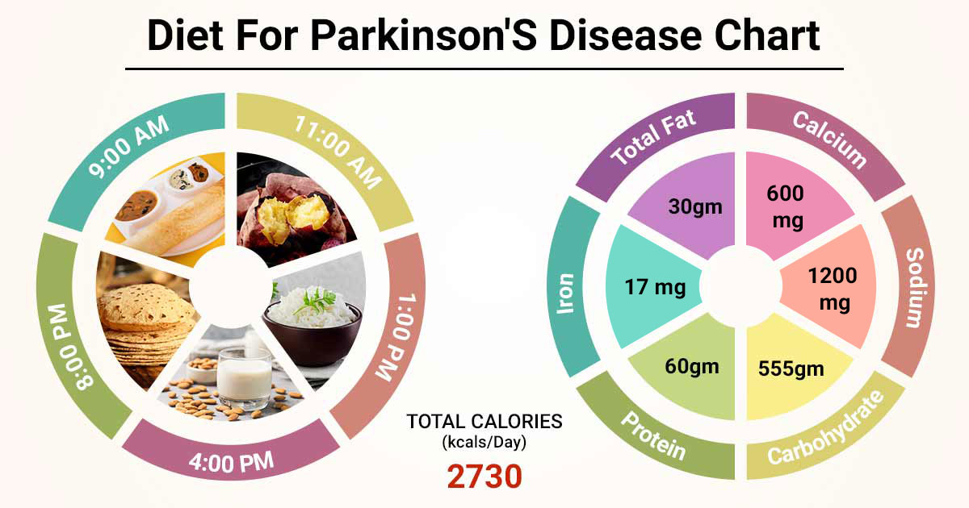
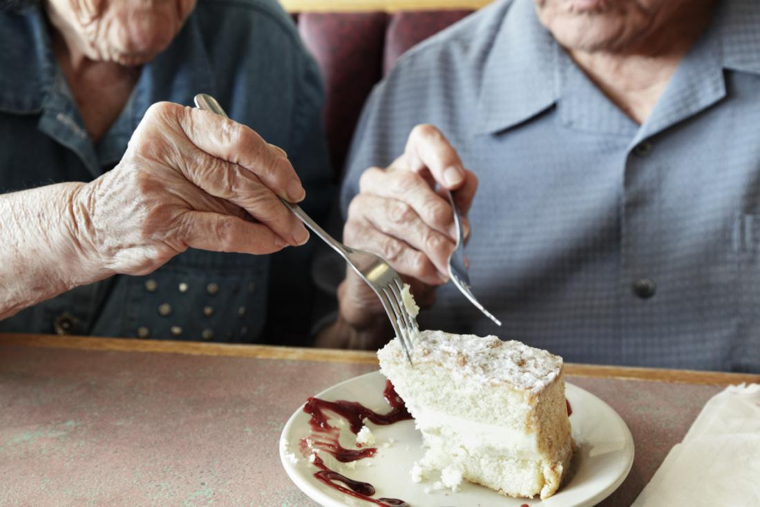
Enhancing nutrition and overall health

Slide 23
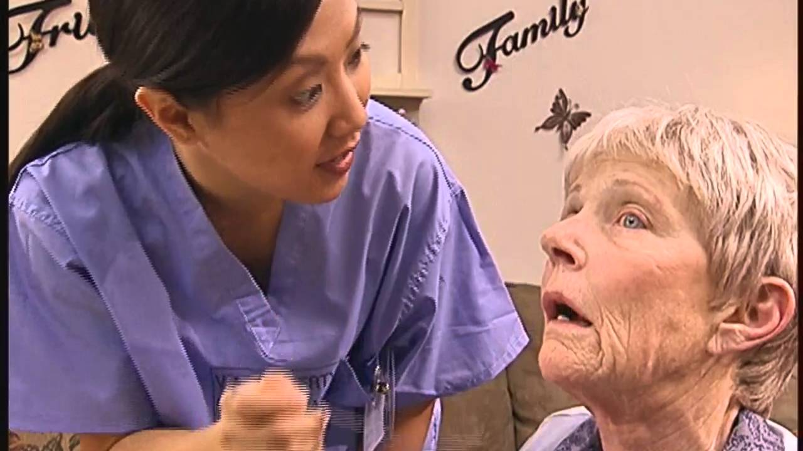


Establishing appropriate communicating

Slide 24
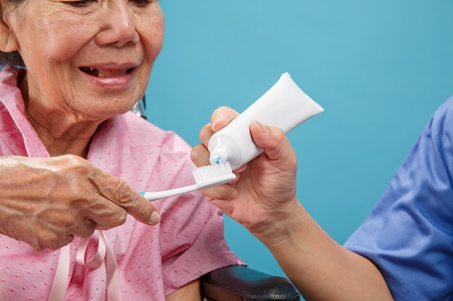
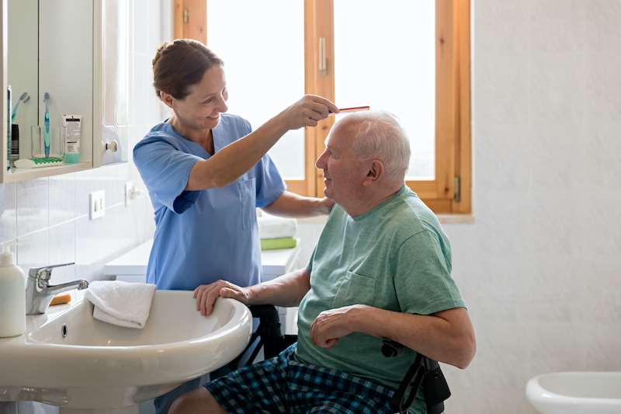
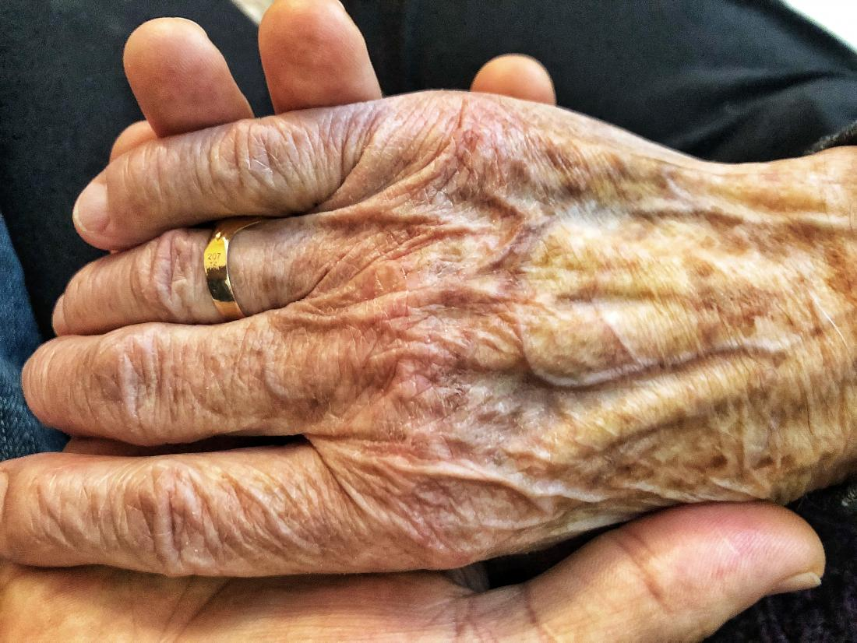
Providing hygienic needs and skin care

Slide 25


Fulfilling eliminating/toileting needs

Slide 26
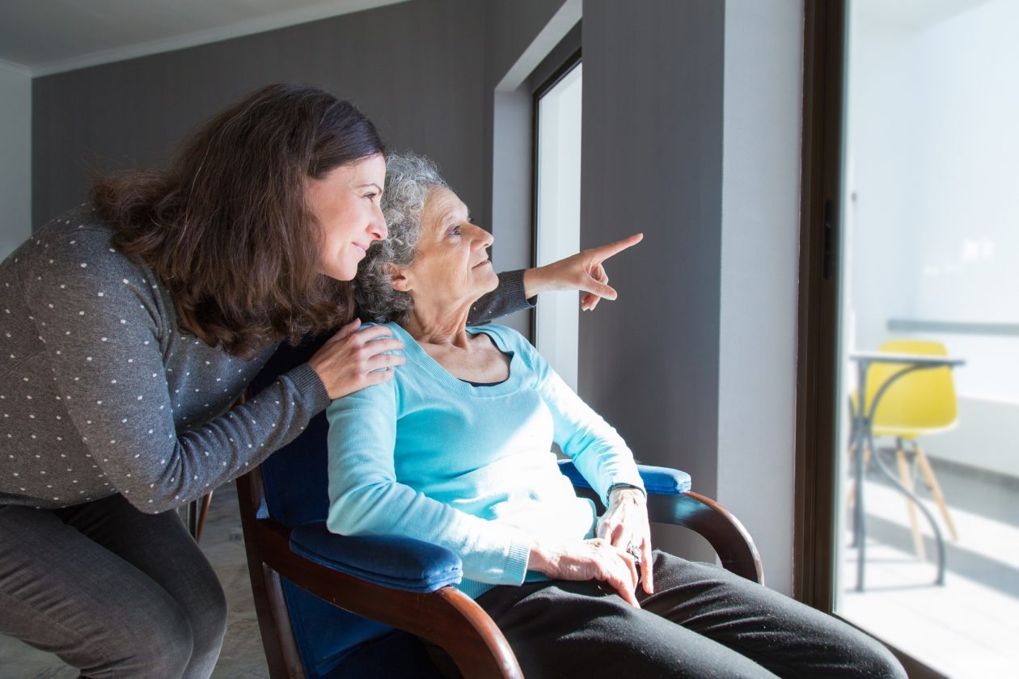
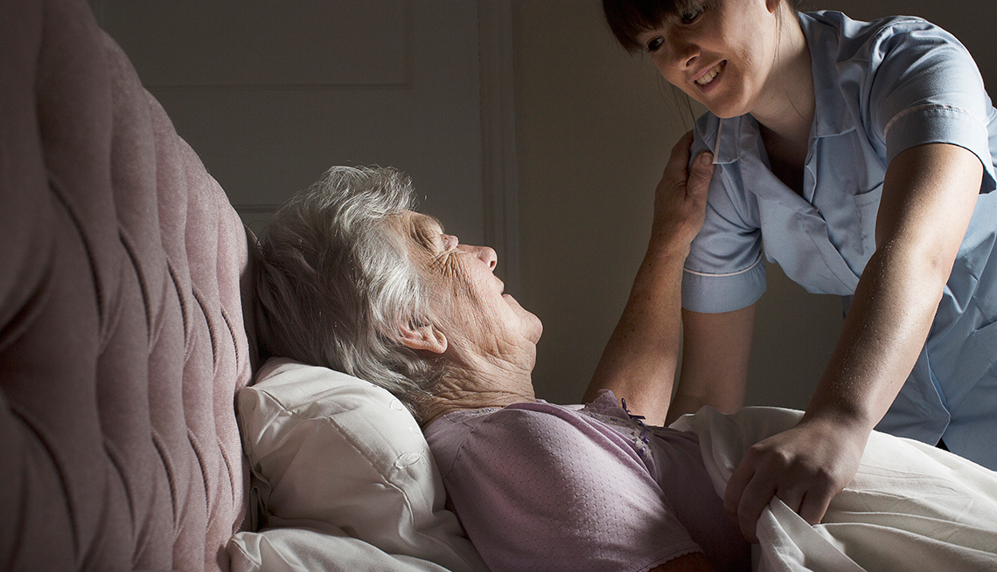

Relieving physical and mental pain and promote sleep

Slide 27

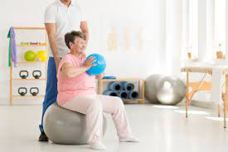

Enhancing physical and mental activity (The AL of ‘working and playing’)

Slide 28

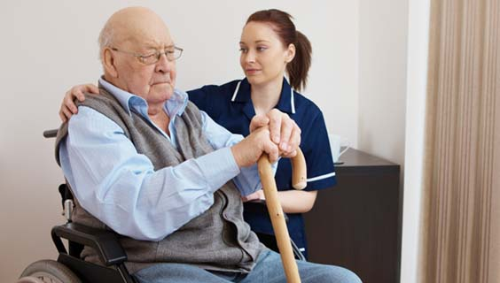
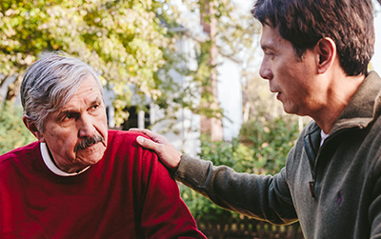
Handling wandering, aggression, agitation (Als of Mobilising and of Communicating)
Reminiscence therapy (old family members, neighbors, friends with regular sessions)
Cognitive stimulation therapy – sessions with different themes (childhood, food, current affaires, using money, word games, memory games) – These improve cognition, language comprehension, relationships, quality of life.
Cognitive rehabilitation – strategy using cognitive exercises through real life experience
Reality orientation therapy – 24 hrs orientation with manipulation of environment with sign boards, calendars, notices, clocks etc
Validation therapy/Fantasy therapy – use patients emotions to avoid stress, boredom, loneliness (take away from the reality if the reality is painful)
Creative/Expressive therapy – art therapy, drama therapy, dance therapy, music therapy (use of aesthetic for enhance the relationships and joy)

Slide 29
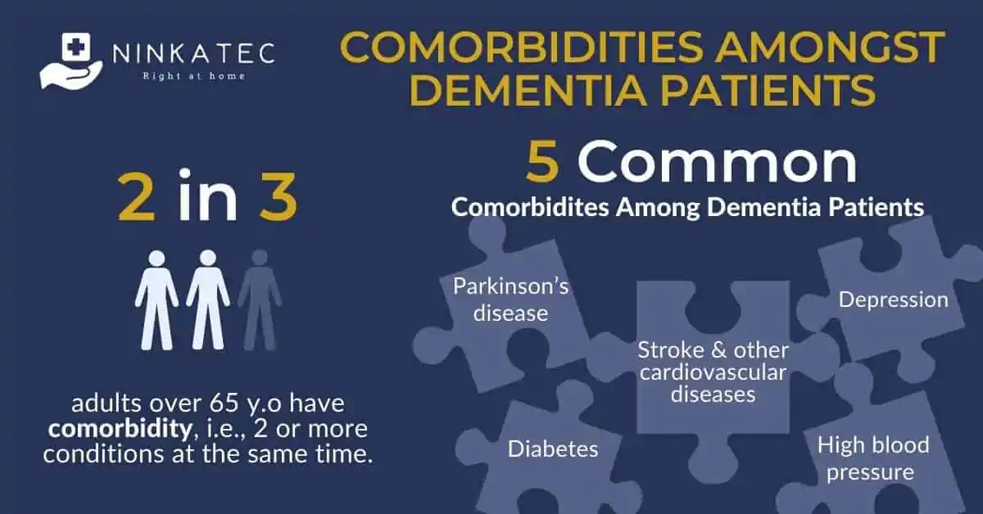
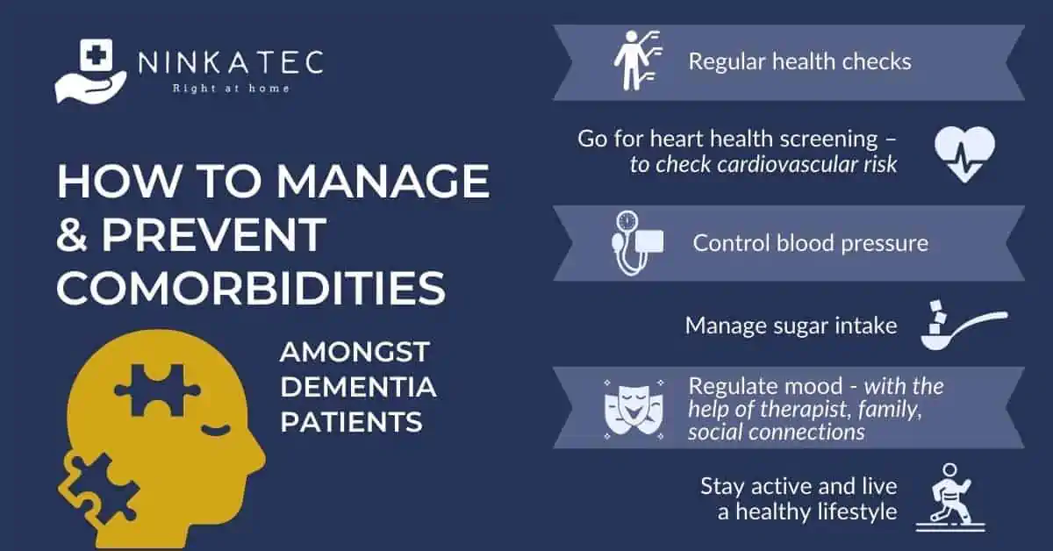

Managing and controlling associated problems of medical comorbidities and medications and psychotic problems
Hence the importance of identifying, in this case, physical factors and psychological factors to be addressed, and setting clear, agreed, specific, measurable, achievable, realistic, time-based (SMART) goals.
Without doing so, all the problems seem a confusing mix, and when we intervene, it is difficult to evaluate the effectiveness – especially if we were never really clear about what goal/s were intended to be achieved.

Slide 30

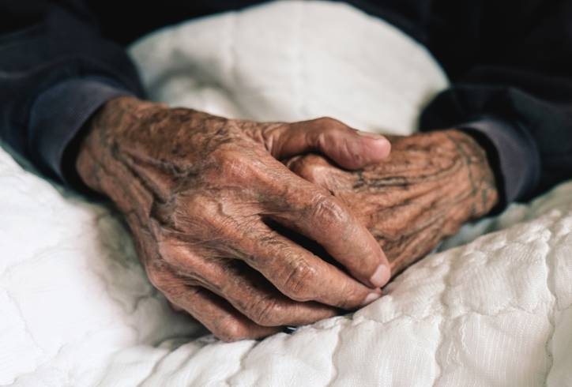
Planning end of life
Maximising independence to make choices
Involve the person and family
Respect wishes, and religious practices; Address spiritual needs; Think about:
Physical factors, e.g. pain, continence management, hydration…
Psychological factors, e.g. anxiety, fear of death, depression, worry for others…
Politicoeconomic factors, e.g. the laws concerning wills/ advanced directives; cost of funeral…
Sociocultural factors, e.g. religious beliefs around death, traditions, spiritual leader involvement…
Environmental factors, e.g. problems with privacy in hospital, practical access to wash and toilet facilities at home…

Slide 31
Involve the interdisciplinary team, e.g…
Occupational therapy – intervention support with everyday tasks to improve social participation, wellbeing, daily functioning and sense of competence, and if necessary, home modification.
Bright light therapy
Aroma therapy
Pet therapy/Animal assisted therapy
Use of assistive technologies – assist frail vulnerable members in home care (use with care as it can detract from building human relationships)

Slide 32
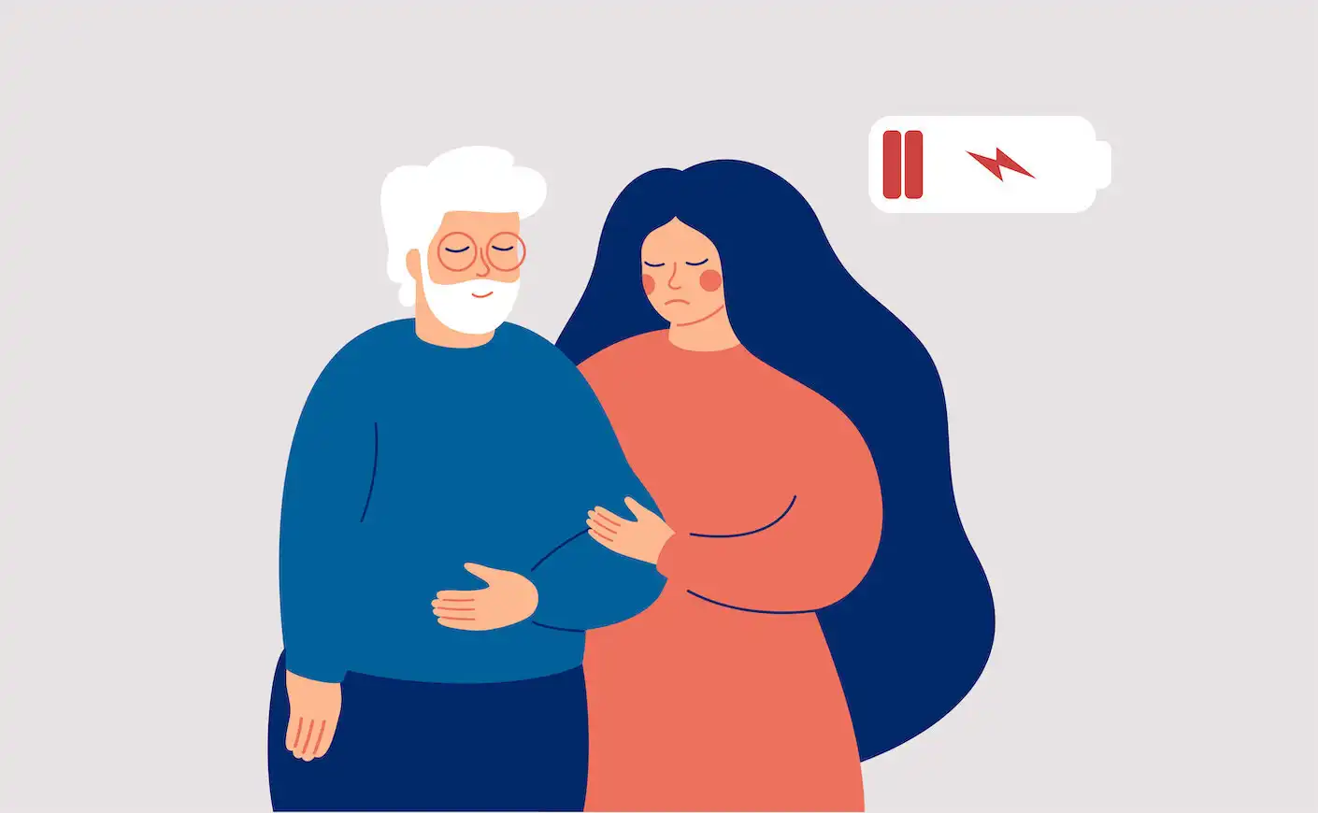
Caregiver role strain/caregiver support
Primary caregiver – most a family member
Burden to the caregiver (social, psychological, economic, physical)
Some do not understand it as a burden (due to cultural and religious boundaries); but their suffering is concealed.
They should be supported in every aspect to look after them selves, rest and relax
Direct them to information, support and to enhance manual dexterity.

Slide 33
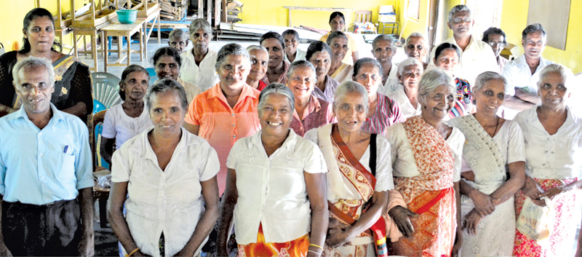
Addressing the needs of elderly patients with NDD in SL
Patients with NDD are cared by the informal caregivers in the Sri Lankan setting.
Sri Lanka has the 3rd highest rate of elderly population.
Different sociocultural, environmental, and politico-economic issues in Sri Lanka would double its impact in future.

Slide 34
Contd….
Sri Lankan healthcare professionals (HCP) should address the coordinated delivery of care for affected elderly while addressing the needs of patients and controlling factors affecting negatively on care and rehabilitation.
A comprehensive approach should be taken with an inter-disciplinary team involvement and involvement of informal caregivers or the family.

Slide 35
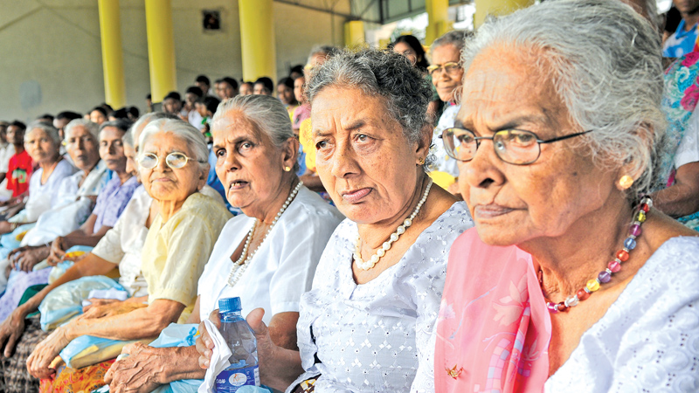
Challenges encountered
Organizational barriers
Cultural and ethical perspectives
Adherence to principles of caring
Education and training
Delivery of continuing care
Financial issues, economic crisis
Cultural acceptance
Barriers in lobbying

Slide 36
Overcome the challenges
Have greater integration between medical and social care services for patients living with NDD
Have mutual understanding and realistic expectations regarding the availability and utility of medical treatments and social services
Identify the reasons why patients living with NDD require highly accessible, specialized and flexible services
Undergo training in NDD to learn how to support function and respond to needs
Introduce programs and services that are personalized and able to accommodate a full spectrum of symptoms and needs
Provide collaborative efforts that may reduce harm for patients and their families (health authorities, social services, politics, education, research and training)

Slide 37
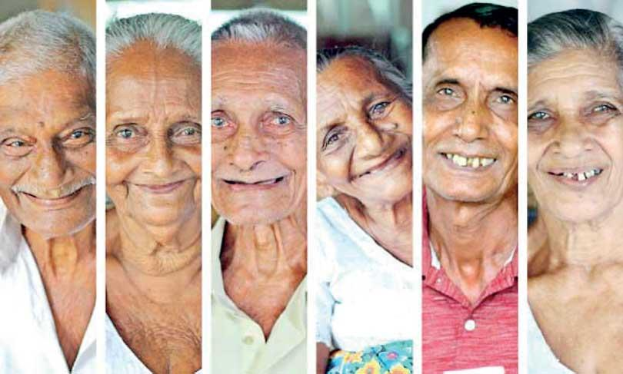
Summary
Diagnosis, management and rehabilitation of a patient with NDD is a long journey.
Comprehensive care delivers coordinated care, improve the health and reduce cost.
Current health system remains with many barriers and challenges.
All should have to accompany with the patient and the carer on the journey assisting and supporting with their expertise to enhance the QoL.

Slide 38
References
Government of South Australia (2023) Comprehensive Care, https://www.sahealth.sa.gov.au/wps/wcm/connect/public+content/sa+health+internet/clinical+resources/clinical+programs+and+practice+guidelines/safety+and+wellbeing/comprehensive+care/comprehensive+care#:~:text=Comprehensive%20care%20is%20the%20coordinated,wellbeing%2C%20and%20is%20clinically%20appropriate.
Renghea, A. ., Cuevas-Budhart, M. A. ., Yébenes-Revuelto, H., Gómez del Pulgar, M. ., & Iglesias-López, M. T. . (2022). "Comprehensive Care" Concept in Nursing: Systematic Review. Investigación Y Educación En Enfermería, 40(3). https://doi.org/10.17533/udea.iee.v40n3e05

Slide 39




Thank you

