Slide 1
Course number 6 COMMUNICATION
nEUROcare - a European initiative for capacity building to meet the challenges
of caring for people with neurodegenerative disorders in Sri Lanka
CPD COURSE- 1 hour
By: Thomas Nilsen Triskelion, Norway
2023

Slide 2
Learning objectives
Discuss the fundamental aspects and basic principles of communication
Describe suitable communication methods towards patients with common Neurodegenerative Diseases (NDD) and family/caregivers from diverse populations and cultural backgrounds.
Summarize different AAC- Augmentative and Alternative Communication tools for communication with NDD patients.
Describe how the various types of NDDs require different kinds of communication strategies and be able to choose the appropriate one in every situation.
Discuss legal and ethical issues when dealing with NDD patients
Notes:
After this CPD- course the student will be able to:
Discuss the fundamental aspects and basic principles of communication
Describe suitable communication methods towards patients with common Neurodegenerative Diseases (NDD) and family/caregivers from diverse populations and cultural backgrounds.
Summarize different AAC- Augmentative and Alternative Communication tools for communication with NDD patients.
Describe how the various types of NDDs require different kinds of communication strategies and be able to choose the appropriate one in every situation.
Discuss legal and ethical issues when dealing with NDD patients

Slide 3

Outline of the lecture
Basics about communication
Theoretical perspectives on communication
Communication models
Challenges in communicating
Person-centred communication
Parkinson’s and communication at 3 stages
Alzheimer’s / Huntington’s communication tips
Conversation validations
Non-verbal strategies
Life-story book communication
Legal and ethical issues

Slide 4
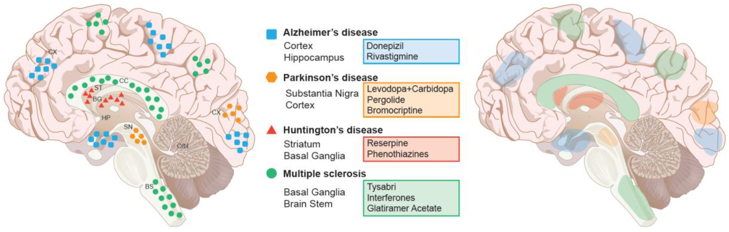
Purpose
Improve the communication for staff working with people affected by neurodegenerative diseases
Notes:
Purpose of the module:
Improve the communication for staff working with people affected by neurodegenerative diseases

Slide 5
Basics
Importance of communication:
Over the past three decades, research studies have shown that the healthcare worker’s ability to explain, listen, and empathize can have a profound effect on patients’ biological and functional health outcomes, as well as their experience of care and patient satisfaction.
Effective communication of healthcare information can empower patients and their family members to participate as full partners in their care, and is demonstrated to improve adherence to treatment and self-management.
Notes:
As communication, we can define the exchange of information, thoughts and feelings among people using speech or other means.
The therapeutic practice involves the oral communication of public health officials and nurses on the one hand and the patient or his relatives on the other. It is a two-way process.
Good communication makes residents feel valued, cared for and puts them at ease. Effective communication not only improves care services but also creates a better working environment for carers as it creates more transparency and openness related to daily tasks and requirements.

Slide 6
Basics of communication in healthcare
Be Attentive
Ask Open Questions
Be Curious
Non-Verbal Communication
Summarize Throughout
Notes:
Communication Strategies for Healthcare Professionals
1. Be Attentive
Attention is the first step in building relationships with patients. Discussions are only meaningful when you pay attention to the patients' complaints and health needs.
Listen with an open mind, don't be judgemental, and never listen to look for the following question to ask or the next point to make.
2. Ask Open Questions
Asking open questions is an excellent way to solicit more information from your patients. Genuine questions encourage them to provide a more detailed, authentic, and lengthier response.
Remember that the more information you have about a patient, the more accurate your diagnosis is.
3. Be Curious
Always be curious about your patient. Questions are instrumental in building relationships. Asking questions borne from curiosity shows your interest in the patient. Be interested in the little details in their story and ask questions.
When you are curious enough about your patient, asking excellent and well-timed questions will become more accessible, making you an authentic communicator.
4. Non-Verbal Communication
Not all communication has to be in words. Sometimes, non-verbal communication might be all that's necessary for specific moments of your conversation.
Non-verbal communication skills include; eye contact, appropriate body language, using a specific voice tone, or simply adding a smile. Non-verbal communication can aid verbal communication and pass the message with more clarity to your patients.
5. Summarize Throughout
Not just some parts, summarize everything your patients communicate to you. Also, ask them if you have correctly understood their narrations. When you do this, you will hardly miss details. Secondly, you show willingness to understand them.

Slide 7
Involve Friends and Family
Be Aware of Their Cultures and Religion
Be Aware of Your Patient's Situation
Inspire Trust
Show Compassion
Be Patient
Notes:
6. Involve Friends and Family
When patients are under stress, they tend to forget the most important details that you communicate to them. It is important to involve family members in such conversations.
Make sure that patients in more severe conditions have family or friends around them to see all sides of the story. Family or friends can remind them of the vital details that might have slipped through their minds during their visit.
7. Be Aware of Their Cultures and Religion
In communication, you need to consider that every patient is unique with different cultures or religions. You need to consider their cultural and religious beliefs while communicating or taking action with them.
8. Be Aware of Your Patient's Situation
They might be going through some non-health challenges. You must be aware of their situations as it will educate how you engage with them.
They might have lost someone close recently or even be in a financial jam. Please take note of these details so that you can relate to them better.
9. Inspire Trust
The best way to inspire trust in your patients is to always keep to your words. Never make a promise or give assurances you cannot control. Also, being compassionate and showing constant interest in your patients' welfare is another way to build trust in your patients.
When there is trust between you and your patient, they get comfortable opening up with you in in-depth details about their condition.
10. Show Compassion
You need to understand your patients. Treat them equally with respect and dignity. Many patients pass through a lot. They might feel depressed, scared, or even helpless in the hospital.
But allowing your compassion to show in your communication with them will go a long way in easing their anxiety and worries.
11. Be Patient
More often, patients want someone to listen to them. Allowing them time and space to express themselves is a great communication strategy to make them feel comfortable with you. Most patients need time to express their feelings and communicate their symptoms accurately.
Therefore patiently listening to your patients gives you the ability to make a better diagnosis.

Slide 8
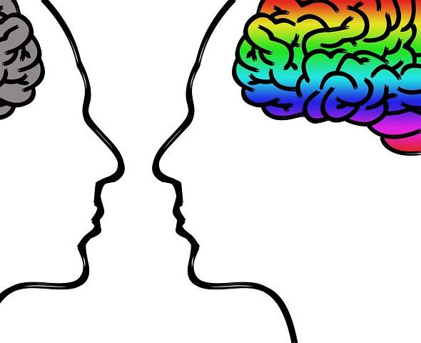

Communication and Neurodegenerative diseases (NDD)
“It is not how much you do,
but how much love you put into the doing.”
— Mother Teresa

Slide 9
Theoretical perspectives in person-centred communication - three theories:
Coupland et.al's Communication Accommodation Theory
Ryan et.al’s Communication Predicaments of Ageing Model
Ryan et al's Communication Enhancement Model
Notes:
In consideration of extant theory that have been used to study person-centred communication, three theoretical perspectives emerged.
the Communication Accommodation Theory assumes that communicators modify or adjust their speech and non-verbal behaviours to each other based on individual values, perceptions and motivations. In other words, speakers accommodate their approaches based on their belief of the other persons’ communicative capabilities (Coupland et al., 1988).
Ryan et.al’s Communication Predicaments of Ageing Model
Inspired by the Communication Accommodation Theory, this model (Ryan et al., 1986) asserted that the natural tendency for health care providers to accommodate their speech when conversing with older adults is based on distorted perspectives of dependency and incompetence.
The Communication Enhancement Model (Ryan et al., 1995) was introduced to address the communication predicaments and negative health outcomes outlined in the Communication Predicaments of Ageing Model. Embedded within an action-oriented health promotion framework, the Communication Enhancement Model aims to direct change at both the individual and system levels (Ryan et al., 1995). The model has also been positioned to provide
a theoretical basis for enhancing communication strategies between providers and people with dementia (Orange, et al., 1995). Establishing a link to person-centred dementia care and communication, the model promotes individualized assessment and knowledge of the person and their strengths.

Slide 10

1. Coupland et.al's Communication Accommodation Theory
Coupland's Communication Accommodation Theory (CAT) identifies three main communication strategies that individuals use when communicating with others:
Convergence (adapt to others)
Divergence (modifying their com. to amplify differences with others)
Maintenance (communicate to keep a relationship)
Cat also identifies three factors that influence an individual's choice of communication strategy:
Social Identity
Context
Attitudes
Notes:
The Communication Accommodation Theory (CAT) is a social psychology theory that explains how people adjust their communication styles to accommodate or adapt to others in order to create social bonds or reduce interpersonal conflict. It was first proposed by Howard Giles and colleagues in the 1970s, and expanded by Giles and Peter Coupland in the 1990s.
Coupland's Communication Accommodation Theory identifies three main communication strategies that individuals use when communicating with others:
Convergence: This is the strategy of adapting one's communication style to be more similar to that of the other person. This is often used to build rapport, reduce social distance, and enhance social harmony. Convergence can be accomplished by using similar vocabulary, adopting similar gestures, and using similar pronunciation patterns.
Divergence: This is the strategy of deliberately emphasizing the differences between oneself and the other person. This can be done to assert one's identity, maintain social distance, or highlight a power imbalance. Divergence can be accomplished by using specialized vocabulary or accent, emphasizing different gestures, or using a different tone of voice.
Maintenance: This is the strategy of maintaining one's own communication style without attempting to adapt to the other person's style. This can be done when there is a mutual respect for each other's communication style, or when there is a desire to maintain a clear distinction between groups.
Coupland's Communication Accommodation Theory also identifies three factors that influence an individual's choice of communication strategy:
Social Identity: An individual's social identity, such as their age, gender, or ethnicity, can influence their communication style and the extent to which they are willing to accommodate to others.
Context: The communication context, such as the purpose of the interaction, the setting, or the relationship between the individuals, can also influence the choice of communication strategy.
Attitudes: An individual's attitudes towards the other person, their communication style, and their relationship can also influence the choice of communication strategy.
In summary, Coupland's Communication Accommodation Theory explains how individuals use communication strategies to accommodate or adapt to others, and identifies factors that influence these strategies. It highlights the importance of social identity, context, and attitudes in shaping communication behavior.

Slide 11
2. Ryan et.al’s Communication Predicaments of Ageing Model
The PCEM model consists of four key elements, which are:
Empathy
Respect
Genuineness
Concreteness
Notes:
The Communication Predicaments of Ageing Model is a communication theory proposed by Ryan, Giles, and Bartolucci that seeks to explain the communication challenges faced by older adults in intergenerational communication. The model suggests that there are three main predicaments that older adults face in their communication with younger generations:
Structural predicaments: Structural predicaments refer to the differences in communication structures and systems that exist between generations. This includes differences in communication technology, language use, and communication norms. For example, older adults may have limited experience with digital communication technologies, leading to difficulties in communicating with younger individuals who prefer texting or social media.
Interactional predicaments: Interactional predicaments refer to the difficulties that arise from differences in conversational styles and preferences between generations. For example, younger individuals may engage in more interruptions and overlapping speech, which can be seen as rude or disrespectful by older adults who value turn-taking and politeness.
Attitudinal predicaments: Attitudinal predicaments refer to the negative stereotypes and attitudes that younger generations may hold towards older adults. These attitudes may include ageism, stereotyping, and marginalization. Negative attitudes towards older adults can lead to communication barriers and social exclusion.
The model also identifies four communication processes that can be used to address these predicaments and improve communication between generations:
Accommodation: Accommodation involves making adjustments in one's communication style to better fit the communication style of the other person. For example, younger individuals can accommodate to the communication needs of older adults by speaking more slowly and clearly.
Perspective-taking: Perspective-taking involves trying to understand the perspective and experiences of the other person. This can help to reduce negative attitudes and stereotypes towards older adults.
Negotiation: Negotiation involves finding common ground and mutually acceptable communication practices. This can help to bridge the communication gaps between generations.
Social support: Social support involves providing emotional support and assistance to older adults in their communication with younger generations. This can help to reduce the negative effects of ageism and marginalization.
In summary, Ryan et al's Communication Predicaments of Ageing Model identifies three main communication predicaments faced by older adults in their communication with younger generations, and provides four communication processes that can be used to improve intergenerational communication.

Slide 12


3. Ryan et al's Communication Enhancement Model
The model suggests that communication is influenced by three factors:
Provider factors
Patient factors
Environmental factors
Notes:
The Communication Enhancement Model is a communication theory proposed by Ryan and colleagues that seeks to explain the factors that contribute to effective communication between older adults and healthcare professionals. The model suggests that effective communication is influenced by three main factors:
Provider factors: Provider factors refer to the characteristics of the healthcare professional, such as their communication skills, empathy, and knowledge of the patient. Effective communication requires healthcare professionals to use appropriate language and terminology, demonstrate empathy, and provide clear explanations of medical conditions and treatment options.
Patient factors: Patient factors refer to the characteristics of the older adult patient, such as their health literacy, cognitive ability, and emotional state. Effective communication requires healthcare professionals to adapt their communication style to meet the patient's individual needs, such as using plain language and visual aids to improve comprehension.
Environmental factors: Environmental factors refer to the physical and social environment in which communication takes place, such as the noise level, privacy, and cultural context. Effective communication requires healthcare professionals to consider the impact of the environment on the patient's ability to communicate and adapt accordingly.
The model also identifies four communication processes that can be used to enhance communication between older adults and healthcare professionals:
Establishing rapport: Establishing rapport involves building a relationship of trust and respect between the healthcare professional and the older adult patient. This can be achieved by using active listening, demonstrating empathy, and acknowledging the patient's concerns and preferences.
Assessing patient needs: Assessing patient needs involves identifying the patient's communication needs and adapting the communication style to meet those needs. This can include using plain language, visual aids, and allowing for adequate time to ask questions and provide feedback.
Providing information: Providing information involves giving clear and accurate explanations of medical conditions, treatment options, and other relevant information. This can be accomplished by using appropriate language, visual aids, and repetition to ensure comprehension.
Facilitating shared decision-making: Facilitating shared decision-making involves involving the patient in the decision-making process and respecting their preferences and values. This can be achieved by providing information about treatment options and allowing the patient to make informed decisions based on their personal values and preferences.
In summary, Ryan et al's Communication Enhancement Model identifies three main factors that contribute to effective communication between older adults and healthcare professionals, and provides four communication processes that can be used to enhance communication in healthcare settings.

Slide 13

You can’t have a one-size-fits-all communication care plan because everybody is different … any activity needs to be bespoke to the individual.
(Interviewee in the IDEAL programme)
Notes:
Ref: from Methods and approaches for enhancing communication with people with moderate-to-severe dementia that can facilitate their inclusion in research and service evaluation: Findings from the IDEAL programme
Rachel Collins and Anna Hunt

Slide 14
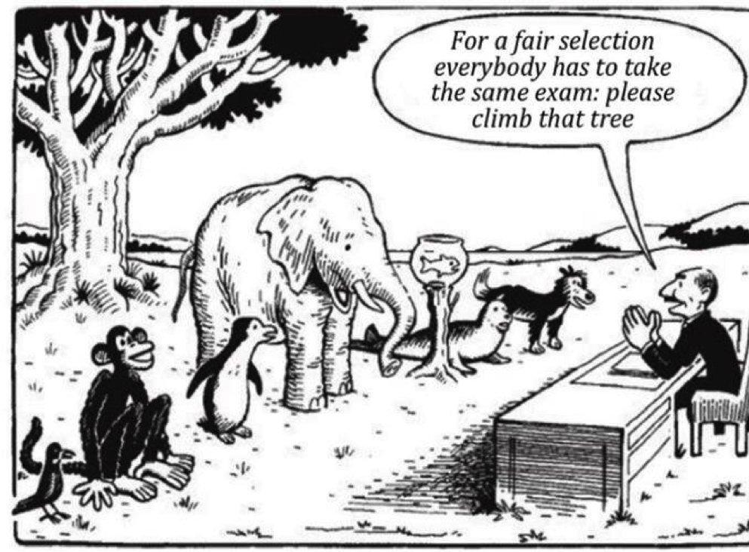
Notes:
It is a bit like this illustration shows if you have a standardised way to communicate towards everyone
For a fair selection, everybody has to take the same exam:
Please climb that tree

Slide 15

Challenges for communication in the NDD context
Morris L, Mansell W, Williamson T, Wray A, McEvoy P. (2020)
Notes:
Several factors potentially contribute to difficulties in communication between family carers and people living with NDDs, and it is these factors that need to be accommodated

Slide 16
Comprehend change:
Caregivers may find it challenging to comprehend how a person with NDDs internal environment changes. In addition to affecting memory function, degraded cognition can also affect personality and, either directly or indirectly, the content and style of communication (Pozzebon, Douglas, & Ames, 2016).
While adjusting to these changes, the NDD patient may blame other people or their environment or even themselves. In turn, this makes it more difficult for the caregiver to maintain stability in their relationship and in daily tasks.

Slide 17

Language:
According to several studies (Bayles & Tomoeda, 2014; Obler & De Santi, 2000; Watson, Aizawa, Savundranayagam, & Orange, 2012; Wray, 2016), NDDs frequently alters the production and comprehension of language. Due to their declining verbal abilities, people with NDDs may express themselves less clearly or use atypical methods to convey their message, which can be challenging for caregivers to grasp (Pozzebon et al., 2016; Wray, 2016). When communication breaks down, the person with NDDs or the caregiver may become frustrated, bored, or tired about not being able to communicate as they would like. For instance, this may happen when the caregiver needs to repeat something several times or when the person with NDDs keeps telling the same stories.

Slide 18

Theory of mind:
Research suggests that some NDD patients have trouble inferring the mental states of others based on the information that is immediately available, such as facial expression or voice tone (Bora, Eryavuz, Kayahan, Sungu, & Veznedaroglu, 2006; Bora, Walterfang, & Velakoulis, 2015; Heitz et al., 2016).
The connection with a caregiver may become strained as a result, as they could feel unheard and underappreciated.

Slide 19

Role shifts and interpersonal reliance:
According to Butcher, Holkup, and Buckwalter (2001) and Russell (2001), the dynamics of the relationship between a person with NDDs and a family caregiver frequently change as a result of increased dependence and cultural expectations. Changes in a relationship may also cause a break from previous patterns of communication and engagement. For instance, a partner or child may feel more and more like they are taking on the role of parent (Pozzebon et al., 2016). There may be a great deal of doubt regarding how to react appropriately in certain circumstances during this transition (Polk, 2005; Wray, 2014).

Slide 20

Grief:
As they observe the ongoing changes that a person with NDDs is going through and as they deal with their own emotional and social reactions to the "loss" of the person to the disease (Pozzebon et al., 2016), caregivers may also be going through a complex grief response (Butcher et al., 2001).
People's capacities for "adaptive coping" differ, which is the assimilation and acceptance of this shift that would allow "restoration of coherence to the narrative of [their] lives" (Schut & Stroebe, 1999, p. 202).

Slide 21

Practical pressure and fatigue:
For many caregivers, the sheer number of hours they are responsible for a person living with NDDs, which may extend to 24 hours a day, makes it all but impossible to get the emotional and physical distance needed for reflecting on how they are responding during interaction (Wray, 2016).
This is due to practical pressures, fatigue, and social isolation. Social interactions are frequently drastically curtailed, and it can be challenging for some carers to ask for help if they worry about being stigmatized or that others won't get the scope and severity of their struggles
(Pozzebon et al., 2016).

Slide 22
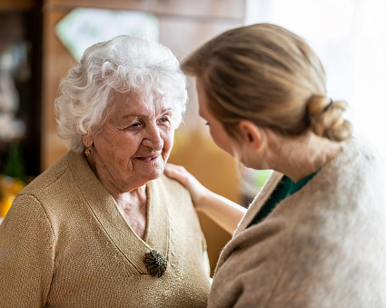
Attachment:
Close family caregivers and the people they are caring for have strong "attachment relationships». The interactions may be emotionally charged, with tensions and expectations from the long history of the connection that are frequently unacknowledged and unrecognized (Pozzebon et al., 2016). It may be harder to keep the cognitive distance required for a reasoned reaction due to these circumstances and the emotional weight of such interactions.

Slide 23
Person-centred communication
Person-centred communication is felt to be a necessary operational component of person-centred dementia care (Brooker, 2007; Downs & Collins, 2015; Kitwood, 1997)
Effective person-centred communication in NDD care consists of both linguistic (language-based) strategies and relational (person-centred) approaches (Ryan, Byrne, Spykerman, & Orange, 2005; Ryan, Meredith, MacLean, & Orange, 1995; Savundrananyagam & Moore-Nielsen, 2015)
(O’Rourke DJ, Lobchuk MM, Thompson GN, Lengyel C. Expanding the conversation: A Person-centred Communication Enhancement Model. Dementia. 2022;21(5):1596-1617. doi:10.1177/14713012221080252)
Notes:
The linguistic elements of person-centred dementia communication are defined as language-based strategies that promote communication goals of reciprocity, clarity/coherence and continuity when communicating with individuals with dementia. The relational aspects of person-centred dementia communication include approaches that extend beyond the functional aspects of communication to address personhood, inclusive of the individual’s life history, values and preferences (Savundrananyagam & Moore-Nielsen, 2015).
The person-centred theoretical work indicates that communication approaches enacted by providers offer a critical pathway to developing and maintaining meaningful person-provider relationships and supporting person-centred care (McCormack & McCance, 2006). The literature also suggests that individuals with moderate dementia can engage in meaningful communication and mutually satisfying relationships.
In many cases, they are also able to evaluate social behaviour and interpret the difference between ‘task-based’ and ‘person-centred’ behaviour (Sabat & Lee, 2011). Thus, a connection to the person-centred care theoretical literature is essential to underpin the elements of person-centred communication approaches.
Secondly, the cohesive theoretical principles of person-centred care, namely valuing and respecting the person, and perceiving them as a unique individual with specific needs and care approaches (Brooker, 2007; Kitwood, 1997) are reflected with the elements of person-centred communication. Effective language-based accommodation strategies plus these relational (personcentred) approaches are necessary to ensure respectful communication and quality interpersonal relations whilst promoting or maintaining communication competence (Savundranayagam & Moore-Nielsen, 2015)

Slide 24

Person-centred Communication Enhancement Model

Slide 25
Empathy: The model emphasizes the importance of empathetic understanding, where the communicator strives to genuinely comprehend the thoughts, feelings, and experiences of the other person.
Non-judgmental attitude: The communicator adopts a non-judgmental stance, creating a safe and accepting environment that encourages open expression and trust.
Active listening: Active listening involves fully engaging with the speaker, paying attention to both verbal and non-verbal cues, and demonstrating understanding through appropriate responses.
Reflective skills: The communicator reflects back the thoughts and emotions expressed by the other person, helping to clarify and validate their experiences.

Slide 26
Collaboration: The model emphasizes collaboration and shared decision-making, where both parties work together to develop a mutual understanding and find solutions that are satisfactory for everyone involved.
Respect for autonomy: The person's autonomy and self-determination are respected throughout the communication process, ensuring that their values, preferences, and choices are acknowledged and considered.
Emotional support: The communicator provides emotional support, acknowledging and validating the person's feelings, and offering reassurance and encouragement as needed.
These elements collectively promote a person-centred approach to communication, prioritizing the individual's unique needs, perspectives, and experiences.

Slide 27

Application of the model with Neurodegenerative diseases

Slide 28
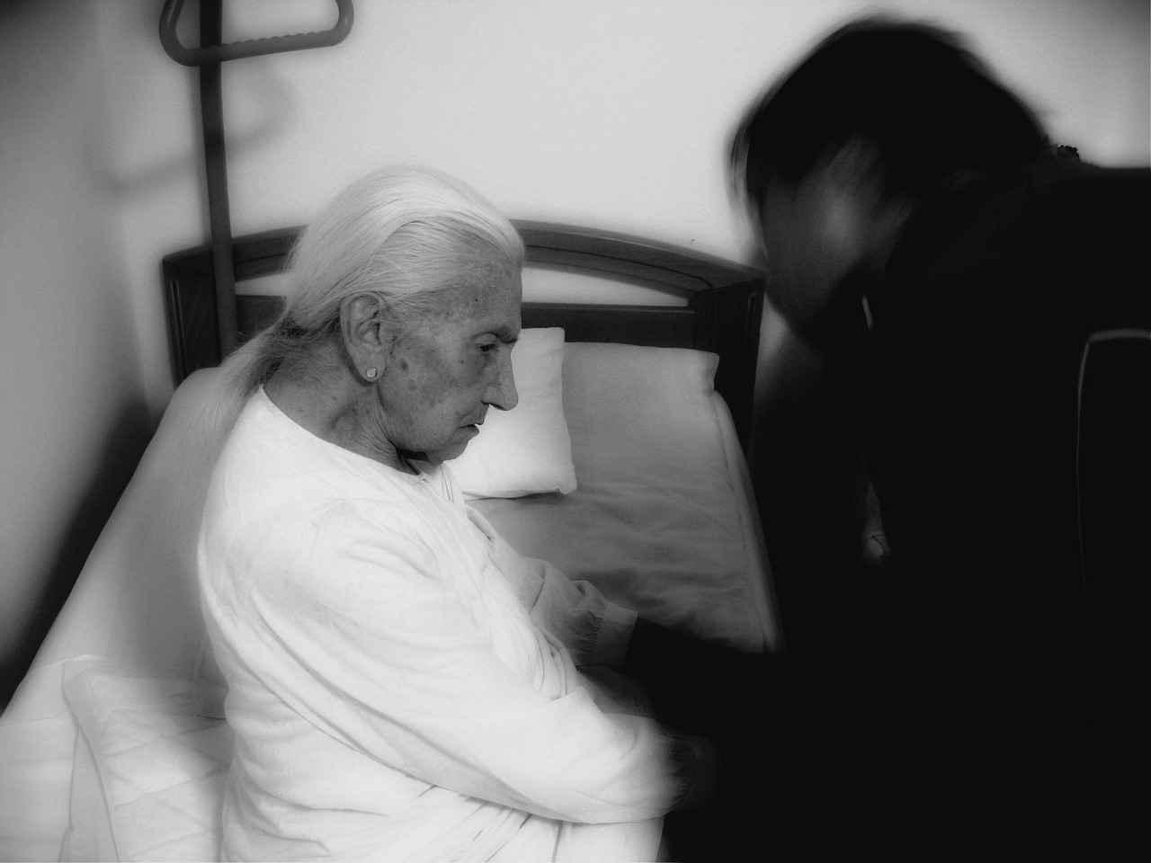
Applying the person-centred enhancement model in caring for people with neurodegenerative diseases involves adapting communication strategies and approaches to meet the specific needs and challenges of these individuals.
Remember that each person with a neurodegenerative disease is unique, and it is essential to adapt these strategies to suit their individual needs and abilities. Regularly assess and reassess the person's communication preferences and adjust your approach accordingly.
Here are some key considerations:

Slide 29
Establishing rapport: Build a trusting and supportive relationship with the person by taking the time to understand their unique needs, preferences, and abilities. This can help create a foundation of trust and enhance communication.
Adapt communication style: Neurodegenerative diseases can affect cognitive and communication abilities. Adjust your communication style by using clear and simple language, speaking slowly, and allowing extra time for the person to process information and respond.
Active listening and empathy: Practice active listening to understand the person's thoughts, concerns, and emotions. Show empathy by validating their experiences and feelings, even if their verbal expression is limited or unclear.
Non-verbal cues: Pay attention to non-verbal cues such as facial expressions, body language, and gestures. These cues can provide valuable insights into the person's emotions and needs.

Slide 30

Tailor information and choices: Provide information and choices in a manner that is easily understandable and aligned with the person's cognitive abilities. Offer manageable options to promote autonomy and participation in decision-making, considering their capabilities and limitations.
Patience and flexibility: Remain patient and flexible when communicating with individuals with neurodegenerative diseases. Be prepared to adapt your approach and repeat information as needed, while allowing the person sufficient time to process and respond.

Slide 31
Collaborative care: Involve the person, along with their family or caregivers, in care planning and decision-making. Recognize their expertise and perspectives, seeking their input and involving them in discussions about their care and well-being.
Emotional support: Offer emotional support by acknowledging and validating the person's emotions, fears, and frustrations. Provide reassurance and comfort, and be attentive to their psychological well-being throughout the care process.
Training and education: Continuously enhance your knowledge and skills through training and education specific to neurodegenerative diseases. This will enable you to better understand the condition, its impact on communication, and effective strategies for person-centered care.

Slide 32
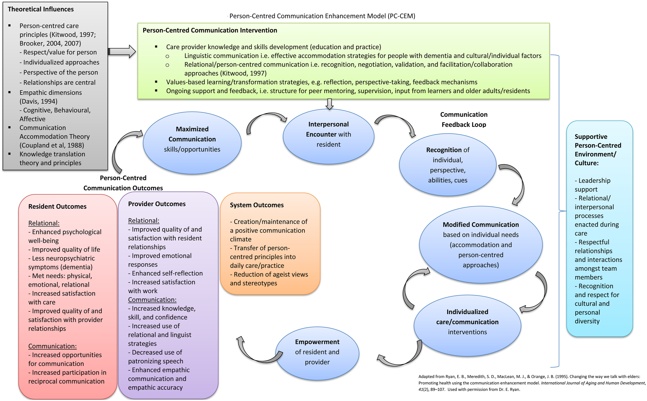
Notes:
The Person-centred Communication Enhancement Model (PCEM) is a communication framework that aims to improve communication between individuals by emphasizing the importance of understanding and valuing the unique perspectives and experiences of each person. It was developed by Richard W. Peach, a communication scholar and educator.
The PCEM model consists of four key elements, which are:
Empathy: Empathy involves understanding and sharing the feelings, thoughts, and experiences of another person. It is the foundation of the PCEM model, and it is critical to effective communication. Empathy helps individuals to better understand the perspective of the other person and to communicate in a way that is more sensitive and appropriate.
Respect: Respect involves acknowledging and valuing the other person's experiences, perspectives, and feelings. It means treating others as equal and recognizing their worth as individuals. Respect is essential to creating a positive and productive communication environment.
Genuineness: Genuineness involves being authentic and transparent in one's communication. It means expressing oneself honestly and openly, without trying to hide one's true feelings or intentions. Genuineness helps to build trust and credibility in communication.
Concreteness: Concreteness involves communicating in a clear, specific, and precise manner. It means using concrete language and avoiding vague or abstract terms. Concreteness helps to ensure that communication is clear and that both parties have a shared understanding of what is being discussed.
In summary, the PCEM model emphasizes the importance of empathy, respect, genuineness, and concreteness in communication. By focusing on these elements, individuals can create a more positive and productive communication environment and improve their ability to connect with others.

Slide 33

Alzheimer’s and communication at different stages

Slide 34

Alzheimer early stages
Tips:
Don’t make assumptions about someone’s ability to communicate when they have an Alzheimer’s diagnosis. It affects everyone differently.
Don’t exclude the person with Alzheimer’s
from conversations.
Notes:
In the early stages of Alzheimer's, communication can become more challenging as the individual may experience difficulty finding the right words, expressing themselves clearly, and following conversations. They may also repeat themselves, have trouble organizing their thoughts, and struggle with remembering recent events or conversations.
As the disease progresses, individuals may experience greater difficulty with communication, including trouble with comprehension, difficulty understanding the meaning of words, and trouble recognizing familiar faces or objects. They may also begin to rely more on nonverbal communication, such as facial expressions and body language, to convey their needs and emotions.
It's important to be patient and understanding when communicating with someone with Alzheimer's, to speak slowly and clearly, and to use simple, concrete language. It can also be helpful to provide visual cues, such as pointing to objects or using gestures, to aid in communication.

Slide 35

It’s OK to laugh. Humour can lighten the mood and make talking easier.
Speak directly to the person and not to their care partner.
Take time to listen to someone expressing their thoughts, feelings and needs.
Ask what the person is still comfortable doing and what they may need help with.
Discuss which type of communication is most comfortable.
Don’t pull away; your support, friendship and honesty are important to the person.
Give the person time to respond. Don’t interrupt unless help is requested.
Notes:
It’s OK to laugh. Humour can lighten the mood and make talking easier.
Speak directly to the person and not to their care partner.
Take time to listen to someone expressing their thoughts, feelings and needs.
Ask what the person is still comfortable doing and what they may need help with
Discuss which type of communication is most comfortable
Don’t pull away; your support, friendship and honesty are important to the person
Give the person time to respond. Don’t interrupt unless help is requested.

Slide 36

Alzheimer middle stages
Notes:
The middle stage of Alzheimer’s, sometimes referred to as moderate Alzheimer’s, is regarded the longest and can last for many years. As the disease progresses, the person will have greater difficulty communicating and require more direct care, as the individual may have difficulty understanding spoken language, following instructions, and recalling common words. They may also struggle to express themselves and rely more on nonverbal communication.
As the disease progresses, individuals may have more difficulty with conversation and may withdraw from social interaction altogether. They may also become more frustrated or agitated when they cannot communicate effectively.
It's important to continue to be patient and understanding when communicating with someone in the middle stages of Alzheimer's. Communication strategies such as using simple language, visual cues, and nonverbal communication can still be helpful. Additionally, it may be helpful to speak in a calm and reassuring tone, to give the individual time to respond, and to provide support and encouragement. Using reminiscence therapy, such as asking about past experiences or using old photos to spark memories, may also be helpful in facilitating communication.

Slide 37
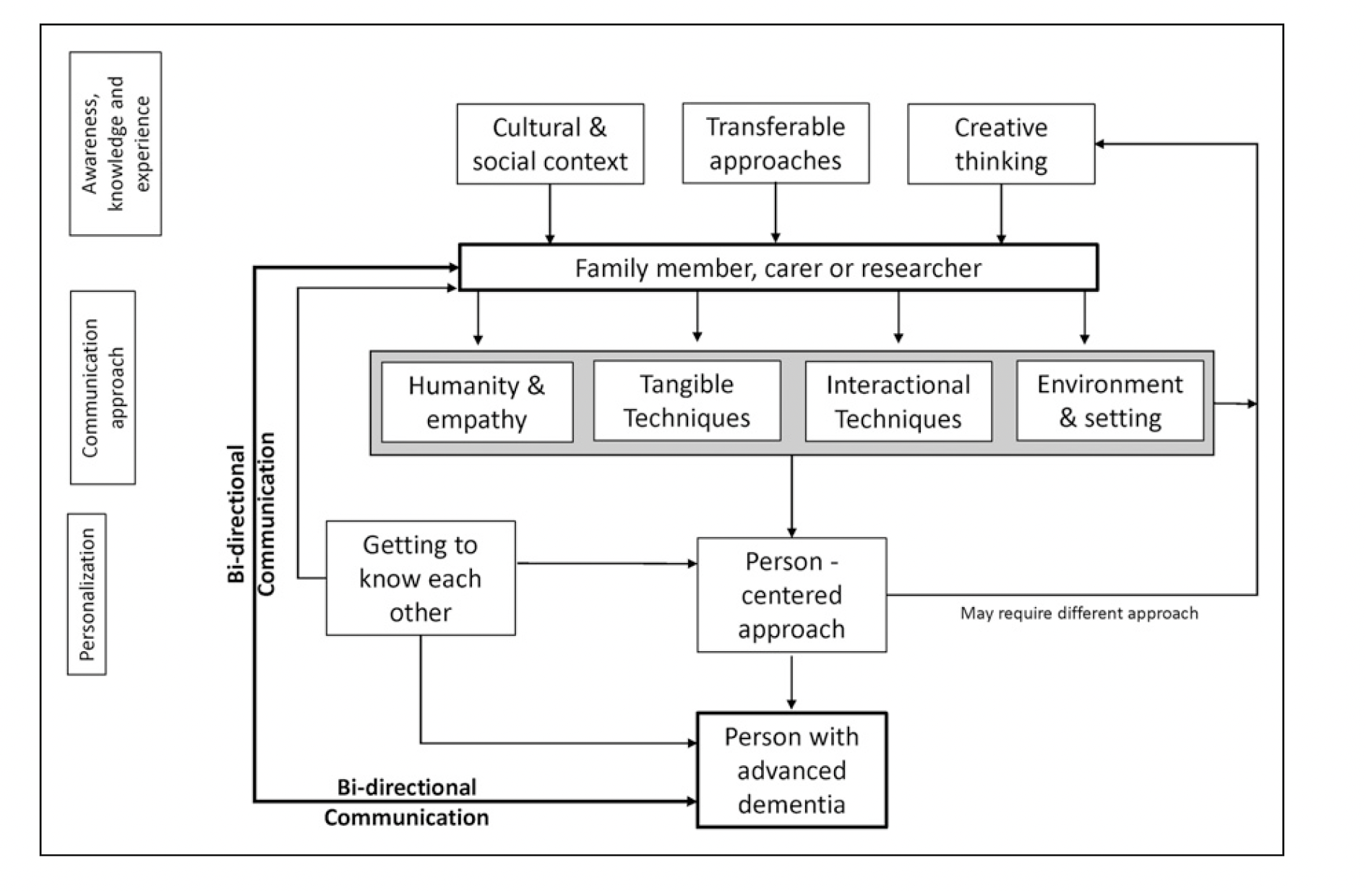
(Collins R, Hunt A, Quinn C, Martyr A, Pentecost C, Clare L. 2022 )
Notes:
Diagram to visualize the process of communicating with people with moderate-to-severe dementia. (Collins R, Hunt A, Quinn C, Martyr A, Pentecost C, Clare L. 2022 )

Slide 38
Alzheimer middle stages
Tips :
Speak very slowly and clearly.
Engage the person in one-on-one conversation in a quiet space with very few distractions.
Maintain eye contact.
Give the person plenty of time to respond so they can think about what to say.

Slide 39
Give visual cues. Demonstrate a task to encourage participation.
Ask one question at a time. Ask yes or no questions.
Be patient and offer reassurance. It may encourage expressing thoughts.
Avoid correction. Rather, listen and try to find the meaning in what the person says. Repeat to clarify.
Avoid arguing. If they say things you don’t agree with, leave it.
Give clear, step-by-step instructions for tasks.
Written notes can be helpful when spoken words seem confusing.
Notes:
When asking, use yes or no questions. For example, “Would you like some coffee?” rather than “What would you like to drink?”. Keep the instructions short. Lengthy requests may be overwhelming.

Slide 40

Alzheimers late stages
Notes:
The late stage of Alzheimer’s disease, sometimes called severe Alzheimer’s, can last from weeks to several years. As the disease advances, the person in the late stage may rely primarily on nonverbal communication, such as facial expressions or vocal sounds. Around-the-clock care is usually required in this stage. If you don’t understand what the person is trying to say, ask him or her to point or gesture.
In the late stages of Alzheimer's, communication can be extremely challenging as the individual may have difficulty speaking, recognizing others, and understanding their surroundings. They may also become nonverbal and may rely on nonverbal communication such as facial expressions, eye contact, or gestures to convey their needs and emotions.
As the disease progresses, individuals may also experience difficulty with swallowing, which can further complicate communication and lead to isolation and frustration.
In the late stages of Alzheimer's, it's important to continue to communicate with the individual using nonverbal cues and gestures. It's also important to maintain a calm and reassuring tone of voice, to maintain eye contact, and to provide physical touch and reassurance. Caregivers and family members may also consider using touch therapy, such as massage or holding hands, to provide comfort and support.
It's important to remember that even if the individual with Alzheimer's can no longer communicate in traditional ways, they can still benefit from human connection and touch. The focus should shift towards creating a calm and comforting environment that meets the individual's basic needs and allows for meaningful connections with loved ones.

Slide 41
Alzheimer’s late stages Is communication possible?
Is it possible to communicate with a person with advanced Alzheimer’s who may not be able to talk and at first appears totally unresponsive?
When you first meet someone with no language and you see that little of their personality remaining, it is easy to believe that it is not.
But there is clear evidence – through the power of music, song and touch – that people with advanced Alzheimer’s do not lose the ability to communicate.
Notes:
The late stage of Alzheimer’s disease, sometimes called severe Alzheimer’s, can last from weeks to several years. As the disease advances, the person in the late stage may rely primarily on nonverbal communication, such as facial expressions or vocal sounds. Around-the-clock care is usually required in this stage. If you don’t understand what the person is trying to say, ask him or her to point or gesture.
In the late stages of Alzheimer's, communication can be extremely challenging as the individual may have difficulty speaking, recognizing others, and understanding their surroundings. They may also become nonverbal and may rely on nonverbal communication such as facial expressions, eye contact, or gestures to convey their needs and emotions.
As the disease progresses, individuals may also experience difficulty with swallowing, which can further complicate communication and lead to isolation and frustration.
In the late stages of Alzheimer's, it's important to continue to communicate with the individual using nonverbal cues and gestures. It's also important to maintain a calm and reassuring tone of voice, to maintain eye contact, and to provide physical touch and reassurance. Caregivers and family members may also consider using touch therapy, such as massage or holding hands, to provide comfort and support.
It's important to remember that even if the individual with Alzheimer's can no longer communicate in traditional ways, they can still benefit from human connection and touch. The focus should shift towards creating a calm and comforting environment that meets the individual's basic needs and allows for meaningful connections with loved ones.

Slide 42
Alzheimers late stages
Tips :
Approach the person from the front and identify
yourself with your name.
Focus on nonverbal communication.
Use touch, sights, sounds, smells and tastes as a
Communication tool with the person.
Notes:
How we communicate with a person with advanced Neurodegenerative diseases can vary, depending on what we know about the individual – particularly things they have enjoyed during their life. It can be influenced by where they are receiving the care (in their own home, care home or hospital) and the relationship they have with the people providing care and support.
It sometimes helps to think about how we communicate with a baby or toddler just starting out on their life. We have to be very careful when making comparisons between older people and children. We do not want to be in the habit of treating adult citizens as if they were children in a way that would feel patronising.
From a conceptual point of view, however, if we see human development as being triggered by the brain maturing through infancy and childhood, what we see happening in Neurodegenerative diseases can be viewed as a reversal of this process. So we focus our communication approach accordingly.
There are some striking similarities between what babies and toddlers need from their carers or care workers and what people with advanced or end-stage Neurodegenerative diseases need from theirs. Most people who have cared for babies or toddlers find some reactions that come quite naturally.
We feel drawn to use touch, to hold, to stroke gently, to achieve eye-contact, to try to make them smile, to soothe them when they cry and to make sure they are comfortable. Over time we get to know the personality of the baby or toddler and what they are trying to communicate.
Communicating with a person with advanced Neurodegenerative diseases requires us to use these same set of skills. We need to recognise that we are caring for someone who has a long life behind them and many stored memories and experiences. If we can find a bridge into these memories we can find a way to communicate with them and nurture their spirit at this final stage of life.

Slide 43
Consider the feelings behind words or sounds.
Treat the person with dignity and respect.
It’s OK if you don’t know what to say; being there is the most important.
Notes:
Remember respect-Avoid talking down to the person or as if he or she isn’t there. Sometimes the emotions being expressed are more important than what’s being said.

Slide 44
It is usually best not contradict a person if they are confused.
If the person becomes distressed or frustrated because they can’t remember something, gently reassure them. Also consider changing the topic of conversation or activity.
It can help to introduce yourself every time you see the person.
Notes:
Communication should be there until the end. Never assume that the person cannot hear or understand you. Try reminiscing about their past, talk to them about things of interest (for example, how the family are and what the grandchildren are doing). Pick up on a hobby or interest they may have had (if they enjoyed horse racing, talk about the races that day, the form of the horses, the odds and the jockeys involved).
Non-verbal communication is vital. Touch can be used to stimulate senses and provide reassurance. Try to achieve eye contact. Be aware of the tone of your voice. Remember that the expression on your face will convey more than the content of your words.
Communicating well with a person in end-stage dementia is not written about extensively. It is something that is best seen first-hand. Some years ago, communication experts Kate Allan and John Killick undertook an in-depth piece of work in Australia called the Good Sunset Project specifically to develop ways of working with people with advanced dementia. They based this on a communication approach developed in coma work and got some very positive results.

Slide 45

Reflection task 3
Pair up and discuss the following:
Discuss the importance of non-verbal communication in interactions with Alzheimer's patients. What non-verbal cues and gestures can nurses utilize to enhance communication?
Ten minutes of discussion in pairs
Fifteen minutes of discussion in a
plenary session

Slide 46

During your encounter with these patients, always remind yourself of a very important lesson. The main focus of providing care for the elderly, especially those who have dementia, is not about your agenda (like teaching a class), or wanting a patient to sit back down in her wheelchair or somewhere. The focus is on the needs of the elderly person in front of you.

Slide 47
«When I affirm my dad’s conversation, whether I understand it or not, we are more likely to go into a meaningful conversation that I do understand.
—A SON’S ADVICE»
(from Creating Moments of Joy Along the Alzheimer's Journey, Jolene Brackey)

Slide 48

Parkinson’s- Huntington’s some tips for easier communication
Notes:
Parkinson’s- Huntington’s some tips for easier communication

Slide 49
Make sure they swallow any excess saliva before they attempt to speak. If dry mouth is a problem, keep a water bottle handy, so that you can help them to a sip before speaking.
During talks, maintain eye contact and talk at eye level. If the person with PD/HD is seated, take a seat next to them and adopt a relaxed posture to show that you are patient and prepared to listen. Allow adequate time for a comprehensive exchange of words and speak clearly and gently. Be patient; the majority of people with PD/HD who have trouble speaking do not have cognitive difficulties (i.e., their minds are intact); rather, their muscles and nerves are impeding their ability to talk as clearly as they formerly did.

Slide 50
If a person with PD/HD doesn't specifically ask for your assistance in locating a word or phrase, avoid finishing his sentences. Encourage examples of clear, effective communication. If you comprehend what he is saying, respond by nodding your head or saying "yes" or "I see." But don't pretend to comprehend when you don't. Ask for clarification or a repeat of the remaining portions of the message after repeating whatever portions you did understand. If you ask for the sentence to be said again, you can get a better pronunciation the second time.
Rephrase a phrase or sentence for the person with PD/HD using new terminology. Ask for an explanation if you don't understand what was said; if you pretend to understand to save time, misunderstandings may occur. Additionally, if the person with PD/HD feels you understand, she might not try as hard to talk correctly.

Slide 51
Ask questions that require yes/no answers. For example, instead of asking, “What would you like to eat?” ask, “Would you like a kottu roti?” Or, ask questions that will elicit one-word or short-phrased responses. Ask, “What kind of meat would you like in your kottu roti?” instead of “What do you want for lunch?”.
Before supporting someone who has PD/HD , give verbal cues. If you're going to assist someone with something, let them know what you're about to do before touching them. By doing this, you'll be less likely to startle the person. For instance, say, "Let's goes outside now," before leading the person to the door.

Slide 52
SUGGESTIONS FOR COMMUNICATION
"A good laugh and a long sleep
are the two best cures for anything."
-Irish Proverb
Notes:
Some more suggestions for communication:
Whenever you need a person with NDDs to complete a task, you will be able to communicate your message in far less time by showing patience and confidence through body language and words. As we’ve seen in the context of dining and bathing, taking time to sit with the patient to talk about simple things without expecting a response is one of the best ways to win cooperation.
Communication says that we value the patient. Also, never underestimate the power of physical communication with a person who has NDDs. Touch is a marvellous expression of nurturing and security. «Use simple language because idioms, metaphors, slang, and other speech variations are tough for a person with NDDs to interpret. If you suggest to a patient that she is “pulling my leg,” be prepared for her to do just that literally.
When you need to have a serious conversation, find a quiet place where the patient will not be overstimulated. The best place is one where you can sit at right angles with the patient, establish eye contact, and touch him to show your support, concern, and love during the conversation.
Assure the patient frequently that her/his communication is successful. They know failure all too well and need constant reassurance that he/she is still functioning.
When the patient’s words are mixed up and seem nonsensical, smile, touch her, and say, “I have a problem understanding.” This underscores that he/she is not the problem.
Humour remains the best way to communicate. Laughing at oneself is a true gift; laughing with someone else is the greatest joy. Watch comedy videotapes together, listen to humorous audio cassettes, and read aloud funny anecdotes.

Slide 53
Conversation validation for Neuro-degenerative diseases
Example Statement from Mrs Damayanti:
Most carers would say: “Mrs Damayanti, you know that your daughter lives in Weligama and was here to visit you last summer. I’m sure you’re wrong.”
The Validation of her idea will be the best response: “Well Mrs Damayanti, if your daughter has come all this way to visit you, I’m sure she remembers where you live. Let’s sit down and I would like to hear more about her.”
“I just saw my daughter and her son outside in the garden. I need to go outside and talk to them.”
Notes:
The following examples allow us to support our patients with dementia in a caring manner:
Conversation validation for NDDs
Example Statement from Mrs Damayanti:
“I just saw my daughter and her son outside in the garden. I need to go outside and talk to them.”
Most carers would say: “Mrs Damayanti, you know that your daughter lives in Weligama and was here to visit you last summer. I’m sure you’re wrong.”
The Validation of her idea will be the best response: “Well Mrs Damayanti, if your daughter has come all this way to visit you, I’m sure she remembers where you live. Let’s sit down and I would like to hear more about her.”

Slide 54
Example Statement from Mrs Damayanti:
“I just want to eat my lunch – why is everyone denying me that?”
In reality, most carers would say:
“Now Mrs Damayanti, you know you just had dinner – remember it was fish curry, garlic rice, and a cake! You will have lunch again tomorrow.”
The Validation of her idea will be the best response:
“Sounds like you are hungry – would you like me to find some fruits and a cup of tea?”

Slide 55
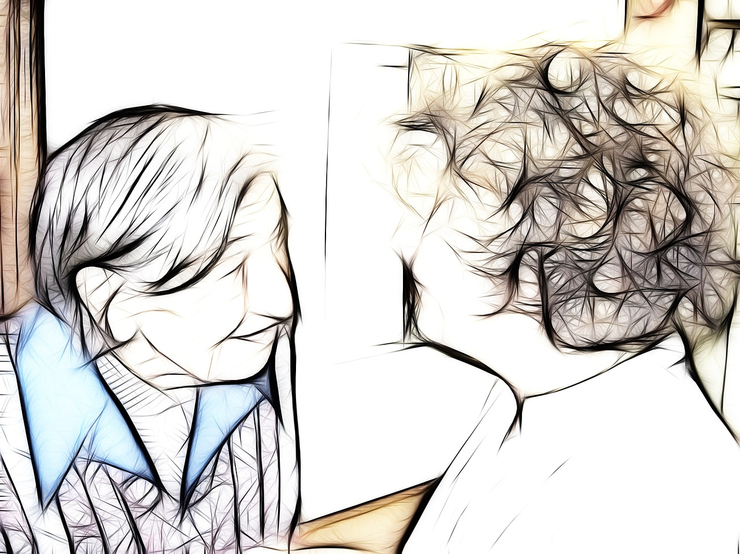
Offer a positive response
“This is so enjoyable, sitting here with you.”
“I don’t know what it is, but you always manage to make me laugh.”
“I enjoy your company very much.”
“That’s a piece of good advice – I’ll have to take that into consideration.”
“Your smile makes me happy.”
“You have so many nice memories – I really enjoy listening to you.”
Notes:
Sometimes the best thing we can do around a conversation is make the person feel special. Consider the following ‘I care’ statements:
This is so enjoyable, sitting here with you.”
“I don’t know what it is, but you always manage to make me laugh.”
“I enjoy your company very much.”
“That’s a piece of good advice – I’ll have to take that into consideration.”
“Your smile makes me happy.”
“You have so many nice memories – I really enjoy listening to you.”

Slide 56

TYPICAL APPROACH: Is that a new dress? | BETTER APPROACH: What a nice dress!
Do you know who I am? | Hi, I’m so glad to see you.
What would you like to do? | I’d like to invite you to take a walk with me.
You already told me that. | That’s interesting – thank you for sharing!
I just explained that to you. | Let me show you.
Notes:
TYPICAL APPROACH:
Is that a new dress?
BETTER APPROACH:
What a nice dress!
TYPICAL APPROACH:
Do you know who I am?
BETTER APPROACH:
Hi, I’m so glad to see you.
TYPICAL APPROACH:
What would you like to do?
BETTER APPROACH:
I’d like to invite you to take
a walk with me.
TYPICAL APPROACH:
You already told me that.
BETTER APPROACH:
That’s interesting – thank you for sharing!
TYPICAL APPROACH:
I just explained that to you.
BETTER APPROACH:
Let me show you.

Slide 57
«Reminding and scolding me does not make me better, only sadder. When someone asks me questions about where I’ve been and who I’ve seen and what I did, and I can’t retrieve that information, I feel stupid and unworthy.»
FROM THE PATIENT’S
PERSPECTIVE:
(Excerpt from Learning to Speak Alzheimer’s, Joanne Koenig Coste)
Notes:
«Reminding and scolding me does not make me better, only sadder. When someone asks me questions about where I’ve been and who I’ve seen and what I did, and I can’t retrieve that information, I feel stupid and unworthy.»
Excerpt from Learning to Speak Alzheimer’s, Joanne Koenig Coste)

Slide 58
«You can make me a part of this world only if you actively involve me and if your connection with «me remains until the end. You must constantly reach out and touch me—physically, spiritually, emotionally.»
(From Learning to Speak Alzheimer’s, Joanne Koenig Coste)
Notes:
Words are only a small part of communication. Suppose you visit an Alzheimer’s unit somewhere, and the people living there have different ethnical origins. In that case, you might frequently come across small groups or some people relating to each other as dear old friends. They appear to be reminiscing the days of their youth and are laughing together as they share stories of their past. Upon closer inspection, you might find that each person speaks a different language, perhaps the mother tongue that they grew up with. Even though they have no words in common there is emotional communication taking place.
We can only assume that Alzheimer’s patients focus on the speaker’s eyes and determine meaning through tone and gestures, much the way we can watch television without sound and still understand the plot.
Everyone uses gestures and pictures, tone and voice pitch, facial expressions and body movements to convey messages to friends, colleagues, family, and strangers. At times, body language seems more honest and reliable than words. People with Alzheimer’s, in trying to compensate for their cognitive and sensory losses, pay more attention to this nonverbal communication and become quite adept at understanding it.

Slide 59

How non-verbal communication can help when words fail
Notes:
How non-verbal communication can help when words fail
Non-verbal communication can be particularly valuable in neurodegenerative disease care when verbal communication becomes challenging. Here are some ways non-verbal communication can assist in such situations:

Slide 60
Facial expressions: Use your facial expressions to convey warmth, empathy, and reassurance. A smile can help create a positive and comforting environment, while a concerned expression can demonstrate understanding and empathy.
Eye contact: Maintain eye contact with the person to show attentiveness and interest. Eye contact can help establish a connection and promote a sense of being seen and understood.
Touch: Appropriate touch, such as holding hands or gently patting the person's shoulder, can convey comfort, support, and reassurance. However, always ensure that the person is comfortable with touch and respect their personal boundaries.
Notes:
Facial expressions: Use your facial expressions to convey warmth, empathy, and reassurance. A smile can help create a positive and comforting environment, while a concerned expression can demonstrate understanding and empathy.
Eye contact: Maintain eye contact with the person to show attentiveness and interest. Eye contact can help establish a connection and promote a sense of being seen and understood.
Touch: Appropriate touch, such as holding hands or gently patting the person's shoulder, can convey comfort, support, and reassurance. However, always ensure that the person is comfortable with touch and respect their personal boundaries.

Slide 61
Body language: Pay attention to your own body language and use it to convey openness, calmness, and respect. Avoid crossing your arms or displaying signs of impatience or frustration, as this can create barriers to effective communication.
Gentle gestures: Use gentle gestures to communicate understanding and support. For example, nodding your head to indicate agreement or understanding, or pointing to objects or pictures to aid comprehension.
Visual aids: Utilize visual aids such as photographs, objects, or written cues to enhance understanding and facilitate communication. These aids can help stimulate memories, prompt conversations, and provide context to the person's environment.
Music and sound: Engage the person with dementia through music, soothing sounds, or familiar melodies. Music can evoke emotions, memories, and a sense of comfort, even when verbal communication is limited.
Notes:
Body language: Pay attention to your own body language and use it to convey openness, calmness, and respect. Avoid crossing your arms or displaying signs of impatience or frustration, as this can create barriers to effective communication.
Gentle gestures: Use gentle gestures to communicate understanding and support. For example, nodding your head to indicate agreement or understanding, or pointing to objects or pictures to aid comprehension.
Visual aids: Utilize visual aids such as photographs, objects, or written cues to enhance understanding and facilitate communication. These aids can help stimulate memories, prompt conversations, and provide context to the person's environment.
Music and sound: Engage the person with dementia through music, soothing sounds, or familiar melodies. Music can evoke emotions, memories, and a sense of comfort, even when verbal communication is limited.

Slide 62

Body positioning: Be aware of your body positioning and maintain a calm and non-threatening posture. Approach the person from the front, at their eye level, and avoid standing too close or invading their personal space.
Observation and interpretation: Observe the person's non-verbal cues, such as changes in facial expression, body language, or agitation. Interpret these cues to understand their needs, emotions, and potential discomfort, and respond accordingly.
Patience and presence: Remain patient and present during interactions. Give the person ample time to process information, respond, and express themselves. Avoid rushing or interrupting, as it can cause further frustration or confusion.
Notes:
Body positioning: Be aware of your body positioning and maintain a calm and non-threatening posture. Approach the person from the front, at their eye level, and avoid standing too close or invading their personal space.
Observation and interpretation: Observe the person's non-verbal cues, such as changes in facial expression, body language, or agitation. Interpret these cues to understand their needs, emotions, and potential discomfort, and respond accordingly.
Patience and presence: Remain patient and present during interactions. Give the person ample time to process information, respond, and express themselves. Avoid rushing or interrupting, as it can cause further frustration or confusion.
Non-verbal communication can be a powerful tool for establishing meaningful connections and maintaining a sense of understanding and empathy in neurodegenerative disease care. By adapting and utilizing these techniques, you can enhance communication and foster a supportive and person-centered care environment.

Slide 63

Encourage communication
speak clearly and slowly, using short sentences
make eye contact with the person when they're talking or asking questions
give them time to respond, because they may feel pressured if you try to speed up their answers
encourage them to join in conversations with others, where possible
let them speak for themselves during discussions about their welfare or health issues
Notes:
Encourage communication
Try to start conversations with the person you're looking after, especially if you notice that they're starting fewer conversations themselves.
speak clearly and slowly, using short sentences
make eye contact with the person when they're talking or asking questions
give them time to respond, because they may feel pressured if you try to speed up their answers
encourage them to join in conversations with others, where possible
let them speak for themselves during discussions about their welfare or health issues

Slide 64
try not to patronise them, or ridicule what they say
acknowledge what they have said, even if they do not answer your question, or what they say seems out of context – show that you've heard them and encourage them to say more about their answer
give them simple choices – avoid creating complicated choices or options for them
use other ways to communicate – such as rephrasing questions because they cannot answer in the way they used to
Notes:
.

Slide 65
Body language and physical contact
be patient and remain calm, which can help the person communicate more easily
keep your tone of voice positive and friendly, where possible
talk to them at a respectful distance to avoid intimidating them – being at the same level or lower than they are (for example, if they are sitting) can also help
pat or hold the person's hand while talking to them to help reassure them and make you feel closer – watch their body language and listen to what they say to see whether they're comfortable with you doing this
Notes:
Communication is not just talking. Gestures, movement and facial expressions can all convey meaning or help you get a message across. Body language and physical contact become significant when speech is difficult for a person with dementia. It's important that you encourage the person to communicate what they want, however they can. Remember, we all find it frustrating when we cannot communicate effectively, or are misunderstood.
be patient and remain calm, which can help the person communicate more easily
keep your tone of voice positive and friendly, where possible
talk to them at a respectful distance to avoid intimidating them – being at the same level or lower than they are (for example, if they are sitting) can also help
pat or hold the person's hand while talking to them to help reassure them and make you feel closer – watch their body language and listen to what they say to see whether they're comfortable with you doing this

Slide 66
Listening and understanding
use eye contact to look at the person, and encourage them to look at you when either of you are talking
try not to interrupt them, even if you think you know what they're saying
stop what you're doing so you can give the person your full attention while they speak
minimise distractions that may get in the way of communication, such as the television or the radio playing too loudly, but always check if it's OK to do so
repeat what you heard back to the person and ask if it's accurate, or ask them to repeat what they said
Notes:
Communication is a two-way process. As a carer of someone with dementia, you will probably have to learn to listen more carefully.
You may need to be more aware of non-verbal messages, such as facial expressions and body language. You may have to use more physical contact, such as reassuring pats on the arm, or smile as well as speaking.
use eye contact to look at the person, and encourage them to look at you when either of you are talking
try not to interrupt them, even if you think you know what they're saying
stop what you're doing so you can give the person your full attention while they speak
minimise distractions that may get in the way of communication, such as the television or the radio playing too loudly, but always check if it's OK to do so
repeat what you heard back to the person and ask if it's accurate, or ask them to repeat what they said

Slide 67
USING LIFE-STORY BOOK FOR COMMUNICATION
.

Slide 68

A life-story book, also known as a memory book or biography, is a personalized document that captures and chronicles important aspects of a person's life.
In the context of NDD care, a life-story book serves as a valuable tool to enhance communication, understanding, and person-centered care for individuals living with dementia. It typically includes a collection of photographs, written narratives, and significant life events that reflect the person's unique experiences, memories, and identity.

Slide 69
A few systematic reviews have been published which have discussed the usage of Life Story Book among persons with dementia and evidenced the effectiveness of the Life Story Book.
Although there were no standard protocols reported in the systematic reviews in terms of the protocols of conducting this intervention, the general findings reported that Life Story Book effectively improves the quality of care in terms of cognition, depression, positive mood, communication, quality of life, autobiographical memory, and social interactions.
(Subramaniam P, Thillainathan P, Ghani NAM, Sharma S., 2022.)

Slide 70
A wide variety of materials can be used in creating Life Story Book such as photographs, memorabilia, stories, narration, own words/quotation, favourite songs and music. Make it chronological from birth to the present.
Alternatively, the Life Story Book can be arranged according to topics of interest with the person with NDD compiling it in the way they wish to narrate the story, with assistance from family members and carers
Template for this available for download here
Notes:
Templates for these life-story books can be found via a simple internet search. Templates are also downloadable
https://www.dementiauk.org/get-support/living-with-dementia/creating-a-life-story/#our-template

Slide 71
Here are some key features and benefits of life-story books in connection with NDD care:
Personalization: Life-story books are tailored to the individual, highlighting their personal history, relationships, interests, and achievements. They capture the essence of who the person is, allowing caregivers and healthcare professionals to gain a deeper understanding of their life and preferences.
Communication aid: Life-story books can facilitate communication with individuals who have difficulty expressing themselves verbally due to cognitive decline. Caregivers can use the book as a visual prompt to spark conversations, reminisce, and engage the person in meaningful interactions.

Slide 72
Memory support: The visual and written content in the life-story book can help stimulate memories and trigger recall of past experiences. This can be particularly beneficial in promoting cognitive stimulation, reducing anxiety, and fostering a sense of continuity and familiarity for individuals with dementia.
Person-centered care: Life-story books promote a person-centered approach by putting the individual at the center of their care. Caregivers can refer to the book to understand the person's preferences, routines, and life history, allowing them to tailor their care and support accordingly.

Slide 73
Emotional well-being: Life-story books can evoke positive emotions, provide comfort, and promote a sense of identity and self-worth. By reminiscing about happy moments and cherished relationships, individuals with dementia may experience a boost in mood and overall well-being.
Care continuity: Life-story books provide valuable information for different care providers, ensuring continuity of care across different settings and personnel. They serve as a resource for healthcare professionals, enabling them to deliver personalized and consistent care to the person with dementia.

Slide 74

Creating a life-story book involves collaboration between the person with NDD, their family members, and caregivers. It requires gathering information, photographs, and memorabilia that represent significant life events and milestones. It's important to approach the process sensitively, respecting the person's autonomy and privacy, and involving them as much as possible in the compilation of their life story.
Overall, life-story books can play a significant role in improving communication, person-centered care, and emotional well-being for individuals living with dementia. They serve as tangible and meaningful reminders of a person's life journey and help maintain their dignity, individuality, and connection with others.

Slide 75
Changes in communication
Using familiar words repeatedly.
Describing familiar objects rather than calling them by name.
Difficulty finding the right words.
Easily losing a train of thought.
Difficulty with logical word organizing
Speaking not so frequently.
Reverting to speaking a native language
Using gestures more than words
Notes:
The communication skills of someone living with Alzheimer’s or another NDD will gradually decline as the disease progresses. Eventually, they will have more difficulty expressing thoughts and emotions. These challenges in communication can lead to great frustration. However, by understanding what changes that will most likely occur, you can prepare, make appropriate adjustments and know how to respond and help to improve communication.
For persons living with Alzheimer’s, changes in communication vary and are based on individual factors and how far along they have progressed in the disease. Issues you can expect to observe throughout the disease’s development include:

Slide 76
Communication support- AAC
Augmentative and alternative communication (AAC) refers to strategy, technique or tool that enhances, replaces, augments or supplements an individual’s
communication capabilities.
Here we will focus on AAC and other AT (assistive technology) services and devices.
Augment means to add to or to enhance.
Alternative means a choice or a substitute.
Communication means to send and receive messages with at least one other person.
Notes:
Augmentative and alternative communication (AAC) refers to a set of tools used by people who cannot express themselves clearly using their natural speech alone.
Communication support is defined broadly as anything that improves access to or participation in communication, events, or activities.
Here we will focus on AAC and other AT (assistive technology) services and devices.
Augment means to add to or to enhance.
Alternative means a choice or a substitute.
Communication means to send and receive messages with at least one other person.
Compensating for speech difficulties: Many adults with neurodegenerative diseases have difficulty speaking due to weakness, tremors, or other motor issues. AAC can provide tools such as communication boards, speech-generating devices, and software that can help them communicate more effectively.
Improving the quality of life: By improving communication, AAC can help adults with neurodegenerative diseases to maintain their independence, reduce frustration and anxiety, and improve their social interactions.
Supporting memory and cognition: AAC can also support memory and cognition in adults with neurodegenerative diseases. For example, memory aids such as visual schedules, checklists, and reminders can help individuals remember important tasks and information.
Providing caregiver support: Caregivers of adults with neurodegenerative diseases can also benefit from AAC tools and techniques. For example, using picture boards or visual schedules can help caregivers communicate with their loved ones more effectively and reduce stress.
Facilitating end-of-life care: In some cases, individuals with neurodegenerative diseases may lose the ability to communicate completely. In these cases, AAC tools such as facial expression charts or eye-tracking technology can be used to help them communicate their needs and preferences in end-of-life care.
Overall, AAC can be a valuable tool for improving communication and quality of life for adults with neurodegenerative diseases.

Slide 77
Types
There are a lot of different types of AAC. No-tech and low-tech options include things like
gestures and facial expressions,
writing, drawing,
spelling words by pointing to letters, and
pointing to photos, pictures, or written words.
High-tech options include things like
using an app on an iPad or tablet to communicate and
using a computer with a “voice," sometimes called a speech-generating device.
Notes:
Caregivers are crucial partners for the success of AAC intervention, both for providing accurate information about a person’s past and for engineering the current environment for successful AAC implementation. Supporting someone’s communication through cueing or tools is not intuitive, however. Caregivers may require specific training to learn positive interaction styles and cueing strategies. One value of AAC for conversation between persons with dementia and their caregivers is that the tools offer visual and literal joint reference to create common meaning for social interaction.

Slide 78

Examples
Memory wallet:
Can contain 20-30 pictures and sentences about familiar persons, places, and events that the patient have difficulty remembering.
Able link compass:
Visual Assistant is a Pocket PC prompting system which uses pictures and audio prompts. It has been designed to provide visual, as well as verbal cues to assist the user in performing individualized tasks that have been set up by the caregiver.
Notes:
Ref:
http://www.aimsxml.com/Sub_Pages/Palmtop.html

Slide 79
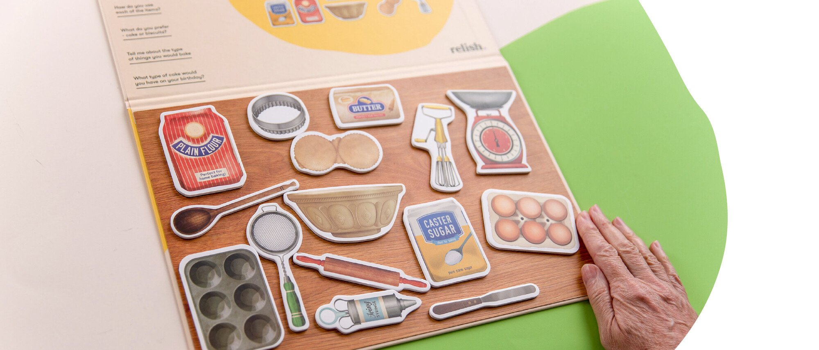

Magnetic Picture Boards for Dementia & Alzheimer's
This collection of beautifully illustrated magnetic pieces invites people with dementia to create a comforting and conversation-sparking scene from some favourite memories.
Notes:
Ref:
https://relish-life.com/dementia-reminiscence/magnetic-picture-boards

Slide 80
Bourgeois research (1991-1994)
Made individualized memory wallets or cards
Measured outcomes of conversations between trained caregivers (spouse, adult child, day staff)
Wallets: Pictures and words for 3 topics: Family names, Biographical information, Daily schedules.
Notes:
Bourgeois has shown that use of simple memory aids enhances the quality of conversation of persons with moderate Alzheimer-type dementia. Six individuals with moderate to severe dementia served as either subject or partner in dyads during 5-min conversational probes conducted three times per week in day-care and nursing-home settings. During phases when a memory aid, consisting of personally relevant picture and sentence stimuli, was available, most subjects used their own aid to improve the quality of conversations by increasing the frequency of on-topic statements, diminishing nonproductive utterances, lengthening their conversational turn, and/or increasing the frequency of turns taken

Slide 81
Findings
Increased the frequency of factual information;
Decreased the rate of ambiguous, perseverative, erroneous, or unintelligible utterances;
Increased the conversational responsibility (turn-taking) of a person with dementia;
Increased the number of on-topic statements during a conversation
Notes:
Yasuda and colleagues (2009) have reported success in reducing behavioral disturbances in persons with dementia by using personalized reminiscence photo videos (personal photos with narration and background music) and video phone technology.

Slide 82
Legal and ethical issues
The central ethical aspects are respect for patients and heir health care decisions, and maintaining the primacy of patient's need in the face of external pressure in a changing social, economic, and political climate.
Ethical issues include those relating to patient confidentiality, patient relationships, malpractice and negligence and informed consent
In Sri Lanka, as health professionals, we are bound to take informed consent from the patients before we start any work with the patients. This may be taken verbally or in writing.
When we consider care of the NDD patients they are not capable of giving their own informed consent to the staff and we need their close relative’s consent to start their investigations, treatment and other things.
Although it has no legal validity, the consent can be taken from next of kin when the patient is unsound or due to the medical condition
Notes:
In Sri Lanka, as health professionals, we are bound to take informed consent from the patients before we start any inspection and examination of the body, procedures, investigations and treatments with the patients. This may be taken verbally or in writing. At this moment we will have to explain risk and benefits of what we are going to do with the patients. When we consider care of the NDD patients, many are not capable of giving their own informed consent to the staff, and we need their close relative’s consent to start our job. If not this can end up as a serious legal issue.
Informed consent implies that they really know and have an understanding of what they are agreeing to. It is the general view of the Sri Lankan law that the patients should decide for themselves, and not have things decided for them by the healthcare staff, no matter how well the intention of this would be. Several court cases have considered elements that staff should consider;
The personality, temperament and attitude of the patient
The person’s level of understanding
To be valid such consent must be:
Competently given
Freely given
Informed and specific to the examination or procedure being performed
According to the Sri Lankan Policy on healthcare quality and safety, it is a priority To promote evidence-based, ethically accepted clinical practices to ensure the best possible outcome for the patient.

Slide 83
As long as individuals with dementia have legal capacity they should take part in decision making.
However, with disease progression, they will lose their capacity. By giving power-of-attorney before losing capacity the patient can legally authorize others to act on their behalf when they no longer have capacity.
Hence it is important to educate both patients and their families about these aspects during the early stage of the disease.
Healthcare staff should also assess and document the capacity at the time of decision-making when necessary. Living wills are not valid in Sri Lanka.
In Sri Lanka, families may have difficulty bringing patients to the clinic, so often things are too late to fix.
Notes:
Ref: Healthcare for older people with Dementia Holistic approach. Sri Lanka association of geriatric medicine, 2018
https://www.slagm.lk/wp-content/uploads/2019/04/Dementia-Final.pdf

Slide 84
Case presentation
Mr. A a 69 year old male, retired clerk living with his wife, presented with a history of gradual onset, progressive memory impairment for a year and suspiciousness for two months. He suspected that his belongings were stolen by family members. At times he became irritable and verbally aggressive towards his wife. He needed supervision to maintain self-care and other basic activities of daily living. Features did not suggest a vascular etiology or Lewy Body Dementia. He had hypertension which was under control on medications and also had visual impairment. Both the patient and his wife were dependent on his pension of 21000 rupees per month. He owned a land with a house worth 6 million rupees and had a bank account with one million rupees in savings. He did not have any ongoing legal concerns. His wife was his main caretaker and she found it difficult to care for him due to the recent disturbed behavior. She got little support from the two children who were employed and living separately.
Mental state examination showed that the mood was irritable and he had persecutory delusion. He had impaired orientation and could only recall the time of day and the name of the country, but he was orientated in person.
Initial assessment:
Although the history is suggestive of dementia in this patient, further cognitive assessment and investigations are needed to establish the diagnosis, identify the subtype if possible, grade the severity and exclude any other brain pathology which could account for the symptoms.
Comprehensive history was obtained from the patient and his wife regarding the course of the disease, risks, behavioural and psychological symptoms of dementia (BPSD), social, financial, legal aspects and physical and psychiatric co-morbidities.
Notes:
DISCUSS IN PAIRS WHAT CAN THE HEALTCARE PROFESSIONAL CONTRIBUTE WITH HERE?
Case from:
https://www.slagm.lk/wp-content/uploads/2019/04/Dementia-Final.pdf
Page 16
Ideally a detailed functional assessment and risk assessment should be carried out by the multidisciplinary team.
Neuro-imaging is recommended at least once during the assessment specially to look for reversible causes. Even though MRI scan is better, in Sri Lanka a CT scan of brain is an option as MRI scan facilities are limited.
His family must be educated about the nature of illness, the role of cognitive enhancers, importance of non-pharmacological interventions and legal aspects.
Non-pharmacological strategies
Physical exercise, socialization and regular routines were recommended as this improves quality of life and reduces boredom and behaviour problems. Tasks which are cognitively stimulating such as reading, board games and puzzle making were recommended. These activities should be tailored according to the patient’s interest and abilities. In in-patient units and day units these activities can be carried out in groups. Reminiscence therapy which includes looking at old photographs was tried with help of his family. Reality orientation with calendars and clocks was done
Care giver assessment is an important aspect of management. His wife was
assessed to see whether she was coping well and if there was any evidence
of stress or depression. She was educated regarding stress management
strategies. In Sri Lanka the family looks after patients with dementia as there
are very few residential and day facilities which take care of such patients.
Patients living around Colombo can attend the day center of the Sri Lanka
Alzheimer’s Foundation. This provides a respite for caregivers. It is important
that the whole family contributes to the management as often a single carer is
burdened with the task of looking after such patients.
A family meeting was held with his two children and they were encouraged to
provide respite for their mother during weekends.

Slide 85
Self Study
Life Story Book to Enhance Communication in People with Dementia: A Systematic Review of Reviews. Download: https://doi.org/10.21203/rs.3.rs-1557576/v1
Methods to Enhance Verbal Communication between Individuals with Alzheimer’s Disease and Their Formal and InformalCaregivers: A Systematic Review. Download: https://www.ncbi.nlm.nih.gov/pmc/articles/PMC2925413/
Expanding the conversation: A Person-centred Communication Enhancement Model Download: https://www.ncbi.nlm.nih.gov/pmc/articles/PMC9243449/
A person-centred communication approach to working with older people who have dementia Download: https://www.researchgate.net/publication/347598698_A_person-centred_communication_approach_to_working_with_older_people_who_have_dementia
Methods and approaches for enhancing communication with people with moderate-to-severe dementia that can facilitate their inclusion in research and service evaluation: Findings from the IDEAL programme. Download: https://www.ncbi.nlm.nih.gov/pmc/articles/PMC9109550/
Communication with older people with dementia. Download: https://www.researchgate.net/publication/241689739_Communicating_with_older_people_with_dementia
Supporting communication for patients with neurodegenerative disease. Download: https://www.ncbi.nlm.nih.gov/pmc/articles/PMC6380499/

Slide 86
References
American Geriatrics Society Expert Panel on Person-Centered Care (2016). Person-centered care: A definition and essential elements. Journal of the American Geriatrics Society, 64(1), 15–18. DOI: 10.1111/jgs.13866.
Andrews-Salvia M, Roy N, Cameron RM. Evaluating the effects of memory books. Journal of Medical, Speech-Language Pathology. 2003;11:51–59.
Bayles, K. A., & Tomoeda, C. K. (2014). Cognitive-communication disorders of dementia (2nd ed.). San Diego, CA: Plural Publishing.
Brooker, D. (2003). What is person-centred care in dementia? Reviews in Clinical Gerontology, 13(3), 215–222.
Brooker, D. (2007). Person-centred dementia care: Making services better. London, UK: Jessica Kingsley Publishers.
Eggenberger, E., Heimerl, K., & Bennett, M. I. (2013). Communication skills training in dementia care: A systematic review of effectiveness, training content, and didactic methods in different care settings. International Psychogeriatrics, 25(3), 345–358. DOI: 10.1017/S1041610212001664.
Eley R, Kaiser P. Life Story Work in Dementia Care - a New Road Map. Journal of Dementia Care. 2017;25:22-23.
Elfrink TR, Zuidema SU, Kunz M, Westerhof GJ. Life story books for people with dementia: a systematic review. International Psychogeriatrics. 2018;30(12):1797–811.
Moos I, Björn A. Use of the life story in the institutional care of people with dementia: a review of intervention studies. Ageing and Society. 2006;26(3):431–54.
Morris L, Mansell W, Williamson T, Wray A, McEvoy P. Communication Empowerment Framework: An integrative framework to support effective communication and interaction between carers and people living with dementia. Dementia (London). 2020 Aug;19(6):1739-1757. doi: 10.1177/1471301218805329. Epub 2018 Oct 28. PMID: 30370794; PMCID: PMC7576889.
O’Rourke DJ, Lobchuk MM, Thompson GN, Lengyel C. Expanding the conversation: A Person-centred Communication Enhancement Model. Dementia. 2022;21(5):1596-1617. doi:10.1177/14713012221080252
Savundranayagam, M. Y.,&Moore-Nielsen, K. (2015). Language-based communication strategies that support person-centered communication with persons with dementia. International Psychogeriatrics, 27(10), 1707–1718. DOI: 10.1017/S1041610215000903.
Subramaniam P, Thillainathan P, Ghani NAM, Sharma S. Life Story Book to Enhance Communication in People with Dementia: A Systematic Review of Reviews. Research Square; 2022. DOI: 10.21203/rs.3.rs-1557576/v1.

Slide 87
References
Parker G, Gridley K, Birks Y, Glanville J. Using a systematic review to uncover theory and outcomes for a complex intervention in health and social care: a worked example using life story work for people with dementia. Journal of Health Services Research & Policy. 2020;25(4):135581961989709.
Subramaniam P, Woods B, Whitaker C. Life review and life story books for people with mild to moderate dementia: a randomised controlled trial. Aging & Mental Health. 2013;18(3):363–75.
McKeown J, Clarke A, Ingleton C, Ryan T, Repper J. The use of life story work with people with dementia to enhance person-centred care. International Journal of Older People Nursing. 2010;5(2):148–58.
Thompson R. Realising the potential: Developing life story work in practice. In Sanders, K. and Shaw, T. (Eds) Foundation of Nursing Studies Dissemination Series. 2010;5(5).
Watson, B., Aizawa, L. D., Savundranayagam, M. Y., & Orange, J. (2012). Links among communication, dementia and caregiver burden. Canadian Journal of Speech-Language Pathology and Audiology, 36(4), 276–283.
Wray, A. (2013). Mislaying Compassion: Linguistic Triggers of Inadequate Caregiving. In B. H. Davis, & J. Guendouzi (Eds.), Pragmatics in dementia discourse (pp. 117–145). Newcastle-Upon- Tyne, England: Cambridge Scholars Publishing.
Wray, A. (2014). Formulaic language and threat: the problem of empathy and compassion in Alzheimer’s disease interaction. In R. T. Schrauf, & N. Mueller (Eds.), Dialogue and dementia: Cognitive and communicative resources for engagement (pp. 263–286). New York, NY: Psychology Press.
Wray, A. (2016). Mechanisms of conflict and aggression in the dementia context. Journal of Language Aggression and Conflict, 4(1), 114–140.
Guidelines on ethical conduct in Sri Lanka : https://www.mc.lk/images/publications/EthicalConduct.pdf
National policy on healthcare quality and safety in Sri Lanka, Ministry of Health 2021, https://www.quality.health.gov.lk/images/pdf/resources/policy/national_policy_quality_and_safety.pdf
Bourgeois MS. Effects of memory aids on the dyadic conversations of individuals with dementia. J Appl Behav Anal. 1993 Spring;26(1):77-87. doi: 10.1901/jaba.1993.26-77. PMID: 8473260; PMCID: PMC1297721.
All the pictures in the presentation are open resource or created by Midjourney Artificial Intelligence program

Slide 88



Developed by

