Slide 1


Course number 6 COMMUNICATION
nEUROcare - a European initiative for capacity building to meet the challenges
of caring for people with neurodegenerative disorders in Sri Lanka
Unit number: 1 Unit name: Introduction
Loukia Taxitari Neapolis University Pafos
Notes:
Hello everybody, this lecture acts as an introduction to the structure of the series of classes about the needed communication skills for the optimum care of NDD patients.

Slide 2
Unit 1- Introduction
Overview of learning objectives and breakdown of modules/hours
Syllabus, outline, expectations, learning outcomes
The relevance of communication skills for caring for patients with NDD
General overview of the module
Notes:
This presentation will provide an overview of learning objectives and breakdown of modules/hours and issues about syllabus, outline, expectations, learning outcomes. Also, it will offer insights on the relevance of communication skills for caring for patients with NDD and a general overview of the module .

Slide 3
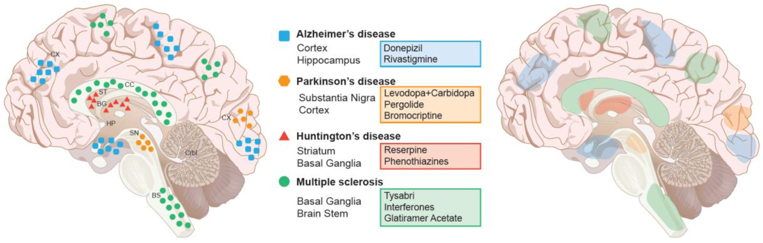
Purpose
Improve the communication for staff working with people affected by neurodegenerative diseases
Notes:
The objective is the improvement of the communication for staff working with people affected by neurodegenerative diseases

Slide 4
Learning objectives
The student will be able to:
Discuss the fundamental aspects and basic principles of communication
Describe suitable communication methods towards patients with common Neurodegenerative Diseases (NDD) and family/caregivers from diverse populations and cultural backgrounds.
Adapt to (un)expected situations by determining the ethical course of action and appropriate communicative process.
Utilize skills to manage emotions, understand families' perspectives, actively listen, creatively problem-solve, and appropriately disclose difficult information.
Apply effective communication strategies to develop, participate in, and lead multidisciplinary teams.
Demonstrate responsibility for own learning, which is essential for good communication.
Notes:
The learning objectives consist of Discussing fundamental communication aspects and principles and Describing effective communication methods for diverse Neurodegenerative Disease (NDD) patients and caregivers. Also, Adapting to ethical decision-making and appropriate communication in unexpected situations and Utilizing emotional management, active listening, and problem-solving for sensitive information disclosure. Finally, Applying communication strategies within multidisciplinary teams and Demonstrating self-directed learning for effective communication.

Slide 5
Teaching /Learning Methods:
Traditional lectures with PPT’s
Experimentation with the various techniques
Group discussions
Audio-visual Material
Case studies
Educational videos
Websites
Self study reading
Notes:
Teaching and learning methods include various techniques, such as traditional lectures with PPT’s, experimentation with the various techniques, group discussions and audio-visual material. Furthermore, the incorporation of case studies, educational videos, websites and self study reading are also common.

Slide 6
Breakdown of hours per unit
 | Lecture | Practical | Self-study
1. Introduction | 0.5 | - | 1.5
2. Basics of communication | 2 | 1 | 4
3. Communication and NDDs | 1 | 2 | 6
4. Communication strategies | 3 | 4 | 8
5. Augmentative and Alternative Communication | 1 | 1 | 4
6. Communication between health-care providers and family members/caregivers & Legal and ethical issues in communication | 2 | 3 | 6
 | 9.5 | 11 | 29.5
 | 15 hours in total (1 credit)
Notes:
Here you can see an extensive breakdown of hours per unit. Starting with the hours for the introduction, followed by the basics of communication and the communication and NDDs. Then you can see the hours for the “AAC and communication strategies” section, the one about the “communication between health-care providers and family members/caregivers” and the legal and ethical issues in communication unit. As a total, they add up to 9 hours of lecture, 16 hours of practical learning and 30 hours of self studying.

Slide 7
Course Content: (Main Units/Lessons and Sub-topics)
Unit 1: Introduction
Overview of learning objectives and breakdown of modules/hours etc.
Syllabus, outline, expectations, learning outcomes
The relevance of communication skills for caring for patients with NDD
General overview of the module
Unit 2: Basics of Communication
Basics of communication (models, importance, principles, contexts, interpersonal communication)
Types of communication (verbal, non-verbal, listening)
Effective & ineffective communication (benefits/consequences etc.)
Specific communication tools, tips and strategies
Notes:
Now we may continue to the course content.
The first unit is the introduction which offers an Overview of learning objectives and breakdown of modules/hours etc., informs of the syllabus, outline, expectations, learning outcomes, explores the relevance of communication skills for caring for patients with NDD and supplies with a general overview of the module.
The second unit is about the basics of communication, explaining models, principles etc., offering information on the types of communication and the differences between effective and ineffective communication. Finally, it provides specific communication tools, tips and strategies.

Slide 8
Course Content: (Main Units/Lessons and Sub-topics)
Unit 3: Communication and NDD’s
Communication difficulties in different types of NDDs (primary motor difficulties, cognitive or language)
Common difficulties with communication
Misconceptions in communication with NDD patients
How not to communicate with NDD patients
Supporting communication in the early stage of disease
Notes:
The third unit focuses on the communication with NDD patients. Specifically, which are the communication difficulties in different types of NDDs and the common difficulties with communication. Also, it emphasizes the misconceptions in communication with NDD patients, how to communicate with NDD patients and supporting communication in the early stage of disease.

Slide 9
Course Content: (Main Units/Lessons and Sub-topics)
Unit 4: Communication strategies
Three theoretical models of person-centered communication
How to communicate with NDD patients in early- middle and late stages of their disease
Adapt to (un)expected situations by determining the ethical course of action and appropriate person-centered communicative process.
Utilize skills to manage emotions, actively listen, creatively problem-solve, and communicate with NDD patients
Personalise your communication approach to any patient with NDD
Notes:
The fourth unit is about the communication in the middle stages of NDDs focusing on the common difficulties with communication and the support of communication in the middle stage of the disease.
The fifth unit is about the learning outcomes of AACs, involving the technological aids in communication and the augmentative and alternative communication (AAC).

Slide 10
Course Content: (Main Units/Lessons and Sub-topics)
Unit 5: Augmentative and Alternative Communication
Technological aids in communication
Augmentative and Alternative Communication (AAC): behavioral strategies, low- and high-tech aids
AAC in different types of NDDs
Notes:
The fourth unit is about the communication in the middle stages of NDDs focusing on the common difficulties with communication and the support of communication in the middle stage of the disease.
The fifth unit is about the learning outcomes of AACs, involving the technological aids in communication and the augmentative and alternative communication (AAC).

Slide 11
Course Content: (Main Units/Lessons and Sub-topics)
Unit 6: Communication between healthcare providers and family members/caregivers
Existing practices of communication among health care services and multidisciplinary teams in Sri Lanka
Communication skills for patient education
Education of families and caregivers in how to communicate effectively with healthcare and social services
Communicating bad news to the patient and family members and caregivers, as well as to apply communication strategies in different situations that are faced by the patients with NDD
Dealing with emotional reactions and conveying information with compassion
Power dynamics within the family
Notes:
The sixth unit is about the communication between healthcare providers and family members/caregivers. This involves the best practice in communication within healthcare services/multidisciplinary teams, educating families/caregivers in how to communicate effectively with healthcare and social services. Moreover, it covers the subject of communicating bad news to the patient and family members/caregivers, the subject of dealing with emotional reactions, how to convey information with compassion. And finally, how the power dynamics work within the family and the legal and ethical issues in communication.

Slide 12
Course Content: (Main Units/Lessons and Sub-topics)
Unit 6: Legal and ethical issues in communication
Explanation of legal and ethical issues in communication
Importance of using an effective communication in legal and ethical matters
Communication strategies that are used in dealing with legal and ethical issues of NDD patients
Notes:
The sixth unit is about the communication between healthcare providers and family members/caregivers. This involves the best practice in communication within healthcare services/multidisciplinary teams, educating families/caregivers in how to communicate effectively with healthcare and social services. Moreover, it covers the subject of communicating bad news to the patient and family members/caregivers, the subject of dealing with emotional reactions, how to convey information with compassion. And finally, how the power dynamics work within the family and the legal and ethical issues in communication.

Slide 13
Assessment Strategy: (Details: quizzes %, mid-term %, end course unit %, end term/year %, other % (specify); Theory (%), Practical (%), Thesis (%), Viva (%), Other (%) (number of questions, type, time allocation and % marks to be given) Marks allocated for the evaluation of continuous assessment shall be within 20-40% and end semester examinations shall be within 60%-80%.
Formative Assessment (if necessary only) | Summative Assessment
 | Continuous assessments In class 30% | End course assessment Final practical exam (70%)
Notes:
Now you can see the assessment strategy involving continuous assessments in class for 30% and the end of course assessment with a final practical exam for 70% of the points.

Slide 14

Communication:
As communication we can define the exchange of information, thoughts and feelings among people using speech or other means.
Therapeutic practice involves the oral communication of public health officials and nurses on the one hand and the patient or their relatives on the other. It is a two-way process.
Notes:
As communication we can define the exchange of information, thoughts and feelings among people using speech or other means.
Therapeutic practice involves the oral communication of public health officials and nurses on the one hand and the patient or his relatives on the other. It is a two way process.
The patient conveys their fears and concerns to their nurse and helps them make a correct nursing diagnosis. The nurse takes the information and in turn transmits other information to the patient with discretion and delicacy as to the nature of the disease and advises with treatment and a rehabilitation plan for health promotion.

Slide 15

Communication (2):
Communication plays an instrumental role in health and social care and is a core aspect of working relationships. Being able to communicate effectively is a skill that has a range of benefits, perhaps most importantly that it helps you to deliver person-centered, high-quality care.
Notes:
However, communication isn’t as straightforward as it might first appear. It’s not simply about what we say, but about relationships, understanding, and ensuring that our needs are met and our wishes are addressed. It is a two-way process involving one person expressing themselves and being understood by another.

Slide 16

Communication (3):
The role of communication in health and care is crucially important. The nature of health care environments means that you will be interacting with multiple people on a daily basis, and it’s essential that you are able to communicate effectively with them.
Notes:
It’s important to remember that communication looks different to everyone. There are many ways that people communicate, including verbal communication (speaking aloud), written communication, such as sending emails or keeping records, and non-verbal communication, such as hand gestures or facial expressions. However, there are also many additional ways that people communicate, depending on what works best for them and their needs.
For example, individuals may communicate using sign language, Makaton or Braille. It’s important that all types of communication are supported.

Slide 17
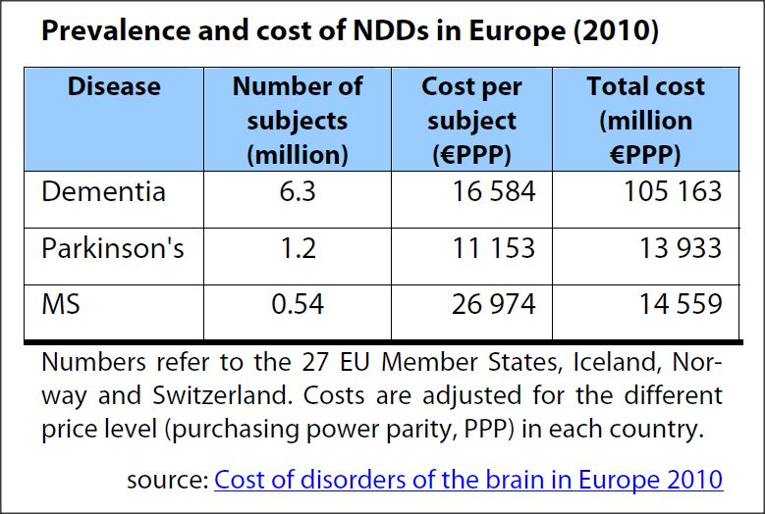
Neurodegenerative diseases (NDDs):
Neurodegenerative diseases (NDDs) are neuronal diseases that affect the central and peripheral nervous systems (CNS and PNS) of the brain’s composition and function. NDDs can lead to progressive loss of nerve structure needed for brain functions.
Notes:
Neurodegenerative disease is one of the significant causes of mortality and disability globally.

Slide 18
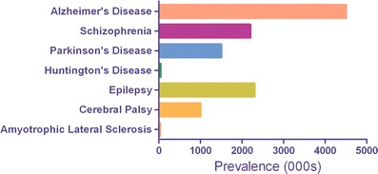
Neurodegenerative diseases (NDDs) (2):
Prevalence in the USA of several important neurological diseases characterized by progressive neurodegeneration. Numbers are expressed in thousands (000 s) of persons affected.
Notes:
Prominent NDDs include Alzheimer’s disease (AD), Parkinson’s disease (PD), Huntington’s disease (HD), amyotrophic lateral sclerosis (ALS), multiple sclerosis (MS), psychological disorders, motor neuron disorders, dementia with Lewy bodies (DLB), vascular dementia (VaD), epilepsy, cerebral ischemia, behavioral disorders and mental illness.
NDDs are associated with genetics, cell signaling impairments, neuronal apoptosis, inflammatory response, deposition of aggregated proteins, mitochondrial dysfunctions, oxidative stress, aging, gender, mutations, ethnicity, environmental exposures, and climate.

Slide 19
The relevance of communication skills for caring for patients with NDD
Research published by the BMJ makes reference to various issues related to communication in healthcare and how “referrals can be rejected simply for being on the wrong form.” This showcases the impact of bad communication channels and a structure that doesn’t create effective results for residents.
Notes:
Instead, putting communication at the top of the agenda means patients receive faster and more effective care.

Slide 20
The relevance of communication skills for caring for patients with NDD (2)
Good communication makes patients feel valued, cared for and puts them at ease. Effective communication not only improves care services but also creates a better working environment for carers as it creates more transparency and openness related to daily tasks and requirements.
Notes:
This means people feel more empowered and motivated.

Slide 21
The relevance of communication skills for caring for patients with NDD (3)
The importance of communication between patient and carer is also incredibly important. Often patients can benefit from adapting their lifestyle or taking on some responsibility for self-medication or self-management.
Notes:
This means ensuring the patient fully understands what to do is incredibly important, and something that can’t be taken lightly.

Slide 22
General overview of the module
Through the introductory course graduates are presented with the learning objectives of the syllabus, the units/chapters, the hours needed for the course, the general outline as well as the expectations and learning outcomes.
A brief description will follow, regarding communication, neurodegenerative diseases (NDDs) and the importance of someone possessing these communication skills while caring for patients with NDDs.

Slide 23
References:
Ellis, M., & Astell, A. (2017). Communicating with people living with dementia who are nonverbal: The creation of Adaptive Interaction. PloS one, 12(8), e0180395.
Fasold, R. W., & Connor-Linton, J. (Eds.). (2014). An introduction to language and linguistics. Cambridge university press.
Keeley, M,. P. (2017). Family communication at the end of life. MDPI AG.
Hayes, B. P. (2015). Introductory linguistics. Los Angeles.
Interpersonal communication handbook https://textbooks.whatcom.edu/cmst210/
Pearson, J. C., Nelson, P. E., Titsworth, S., & Harter, L. (2017). Human communication (p. 416). New York: McGraw-Hill Education.
Schiavo, R., (2007). Health communication. From theory to practice. John Wiley & Sons,Inc.
Skarbalienė, A., Skarbalius, E., & Gedrimė. L. (2018). Effective communication in the healthcare settings: Are the graduates ready for it? Case study. https://doi.org/10.30924/mjcmi.24.si.9
Schiavo, R., (2007). Health communication. From theory to practice. John Wiley & Sons,Inc.

Slide 24
Useful Webpages:
start [linguisticsweb.org]
All Things Linguistic
https://www.alz.org/help-support/caregiving/daily-care/communications
https://www.asccare.com/nonverbal-communication-alzheimers-disease/

Slide 25



Developed by

