Slide 1



Sleep disorders, diagnostics, treatment
Heisl Vaher MD

Slide 2

Lecture content
Sleep disorders
Insomnia
Sleep time breathing disorders
Sleep studies
Restless legs syndrome
Circadian rythm disorders

Slide 3
Clinically most relevant sleep disorders American Psychiatric Association.Diagnostic and Statistical Manual of Mental Disorders (DSM-5), Fifth edition. 2013.
• Insomnia
• Use of Hypnotics: risks and choices
• Cognitive behavioral therapy (CBT)
• Sleep apnea
• Narcolepsy
• PLMD (periodic limb movements)
• Circadian rhythm sleep disorders

Slide 4
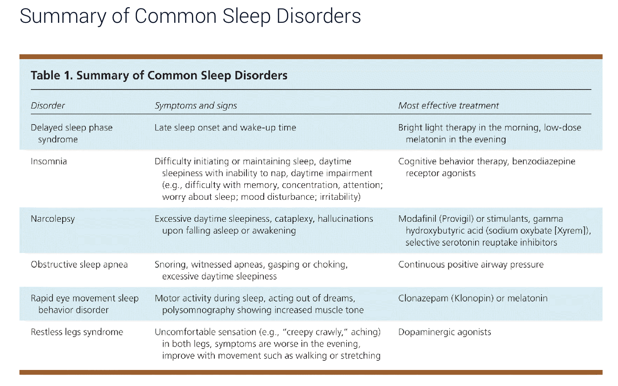

Am Fam Physician. 2013;88(4):231-238

Slide 5
Insomnia
Complaints of disturbed sleep in the presence of adequate opportunity and circumstance for sleep
(1) difficulty in initiating sleep
(2) difficulty in maintaining sleep or
(3) waking up too early
(4) Nonrestorative or poor-quality sleep
NIH conference on chronic insomnia http://consensus.nih.gov/2005/2005InsomniaSOS026html.htm

Slide 6
Insomnia Am Fam Physician. 2013;88(4):231-238
Daytime hyperarousal
Some patients with chronic insomnia have daytime hyperarousal and are not able to fall asleep in theday
They might be fatigued, but they are not sleepy
Repeated difficulty with sleep initiation (sleep latency more than 30 min)
Duration less than 7 h (normally 7-9 hours per night for adults)
Unconsolidated sleep (sleep interrupted by arousals or awakenings)
Daytime impairment (fatigue; tiredness; difficulty with memory, concentration, and attention; worry about sleep; mood disturbances; or irritability
Insomnia is usually diagnosed with a patient history that includes evaluation for contributing psychiatric or medical conditions.

Slide 7
Sleep hygiene https://www.sleepfoundation.org/sleep-hygiene
- Consistent bed time and wake time
- Do not spend extra hours in bed to make up for poor sleep
- No long daytime naps (e.g.90min)
- Can try 15-40 min naps and closely follow sleep logs to decide if naps are OK
AVOID ALERTING IN BED
If patient needs to spend time worrying, do it in a worry chair
Mystery books and watching TV should be avoided in bed
Where possible, do alerting activities outside the bedroom

Slide 8
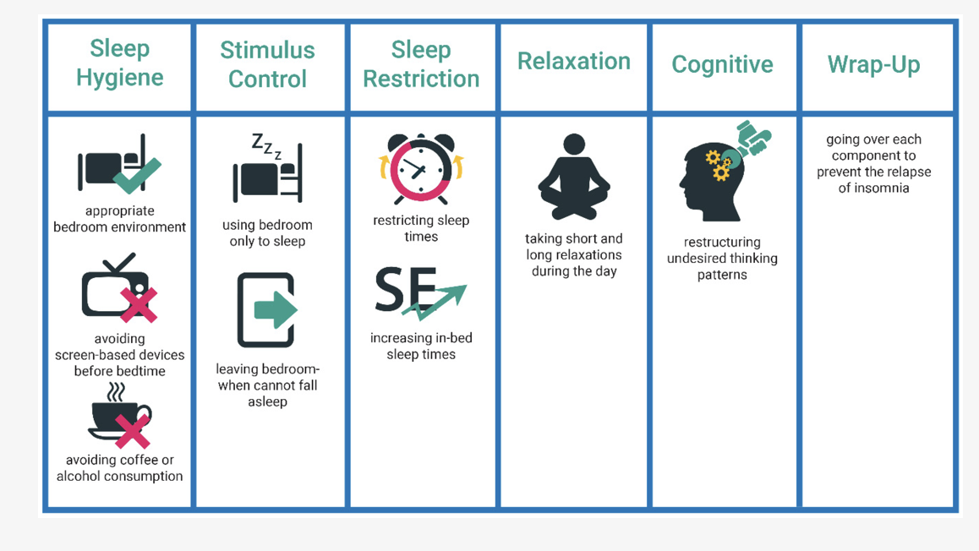
SLEEP RESTRICTION
Reducing time-in bed has powerful and lasting
benefits for insomnia
E.g.,patient who says she only
sleeps 6hours should reduce time-in-bed to 6hours
Correct negative conditioning to
bedtime experience: RELEARN that when you go to
bed you habitually go to sleep
Uyumaz et al. 2021

Slide 9
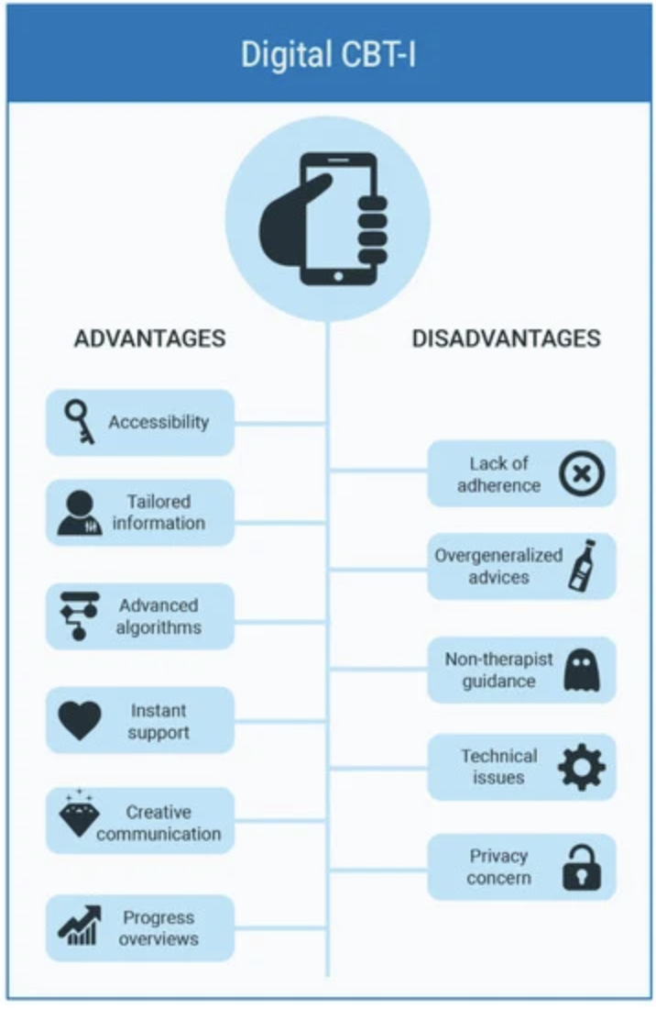
Sleep restriction (Uyumaz et al. 2021)
If patient is sleeping >85% of time in bed, may increase time in bed by 15min. Per week
If patient reports sleeping <85% of time in bed, then time in bed should bereduced
Maintain regular get-uptime

Slide 10
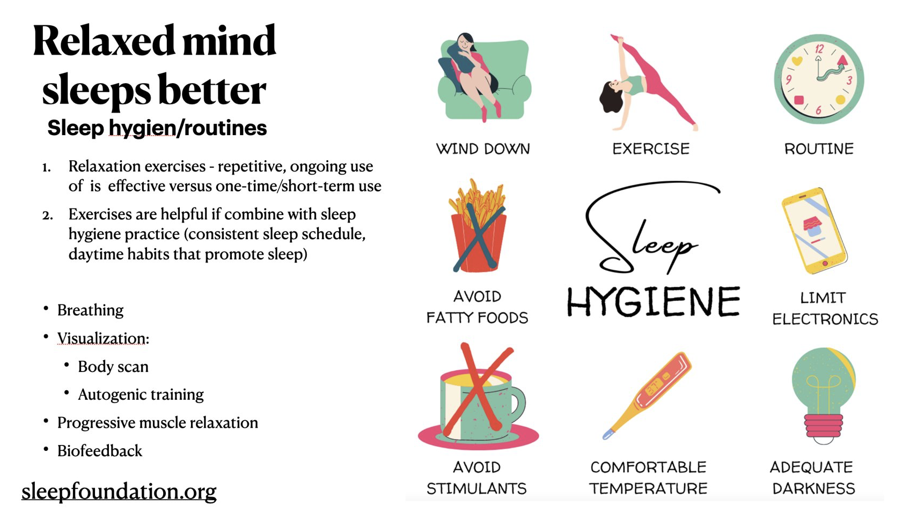

Slide 11
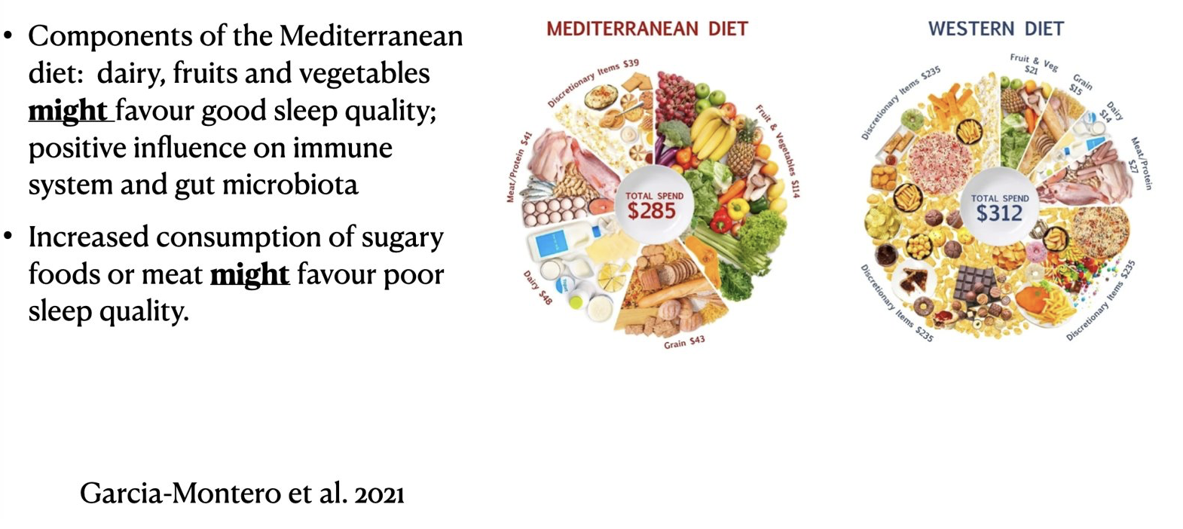
Measures that can decrease sleep latency
• Tension-release relaxation exercises: meditative, autogenic
• Decreased stimulation prior to bedtime (avoid "action" movies, arguments, etc.)
• Light bedtimes nack (perhaps milk or other
tryptophan-increasing foods, e.g., carbohydrates, dairy products)

Slide 12
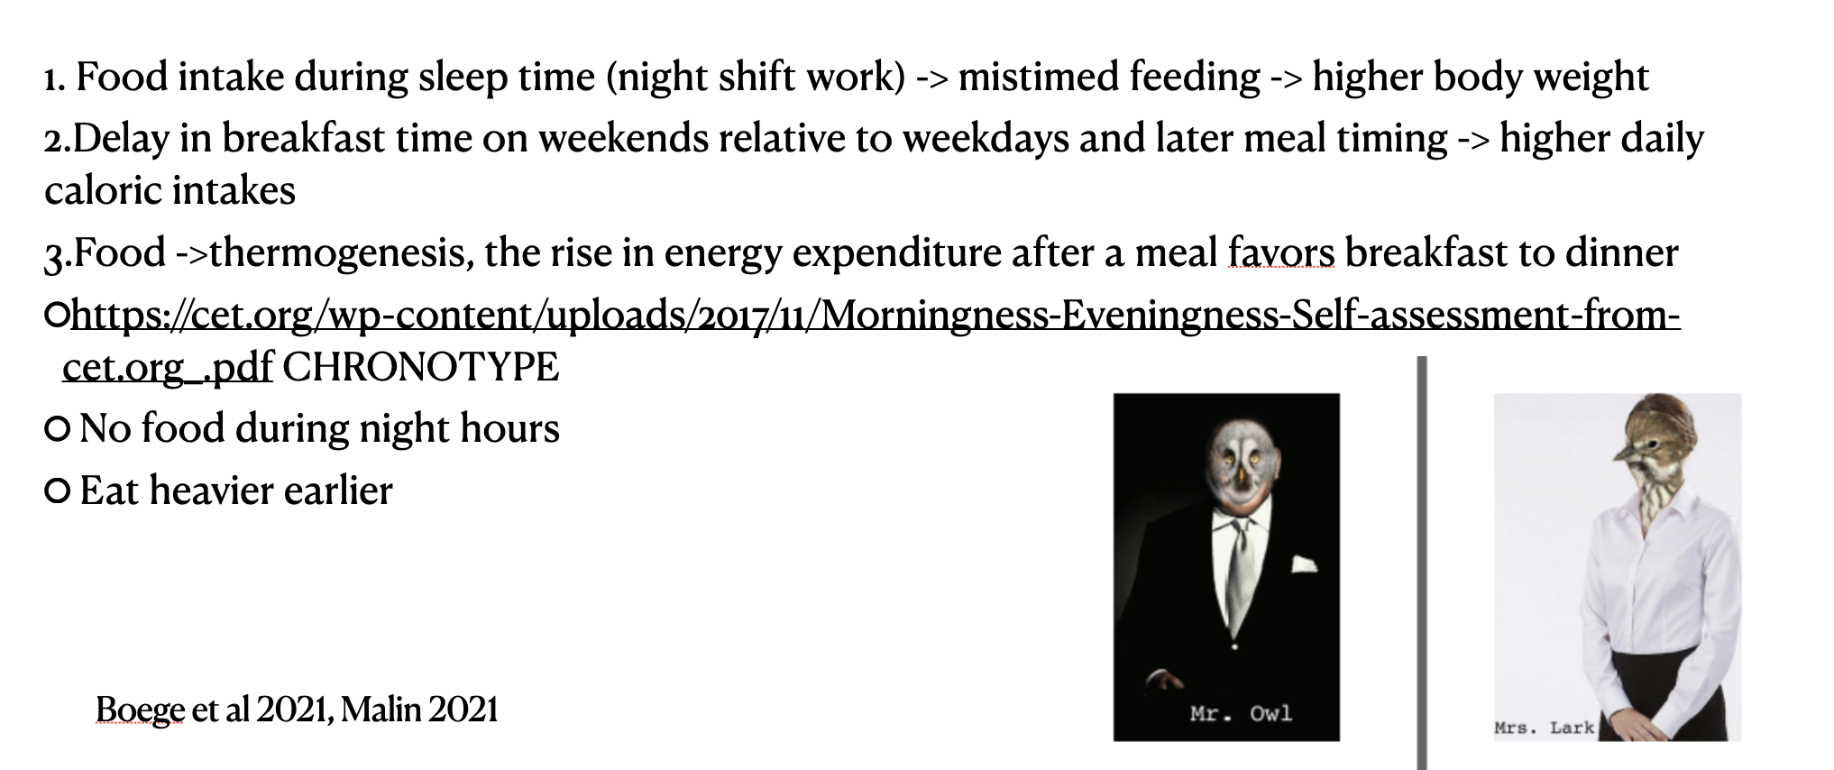

Slide 13
Treatment of insomnia (Lie et al 2015)
Regardless of the type of therapy used, the treatment of chronic insomnia has two primary objectives:
improving sleep quality and quantity, and improving daytime impairments.
Initial approaches to treatment usually include at least one behavioral intervention, such as stimulus control therapy or relaxation therapy. Biofeedback therapy is also used.
When pharmacotherapy is required, the choice of a specific drug within a class should be directed by:
1) symptom pattern;
2) treatment goals;
3) past treatment responses;
4) patient preference;
5) cost;
6) the availability of other treatments;
7) comorbid conditions;
8) contraindications;
9) concurrent medication interactions;
10) potential adverse effects.

Slide 14
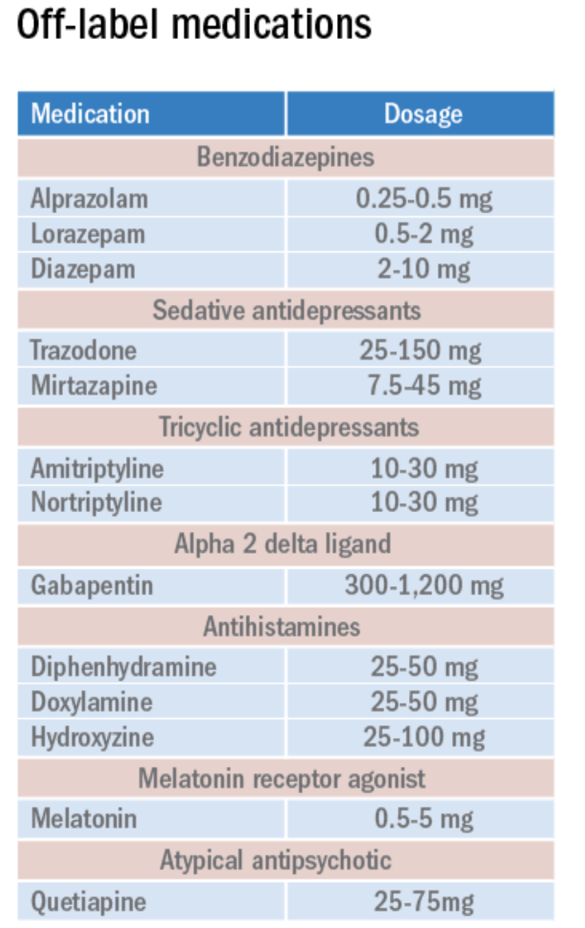
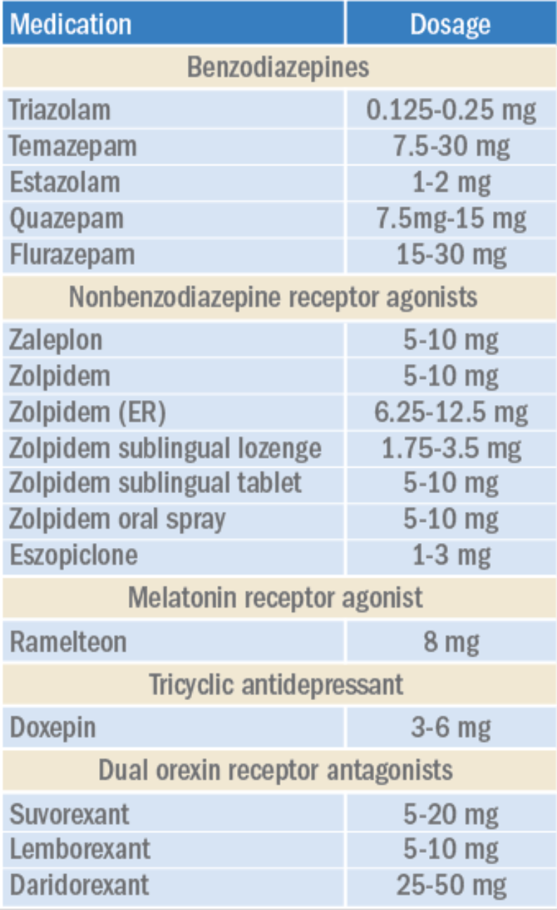
FDA approved pharmacological medications https://www.mdedge.com/chestphysician/article/254416/sleep-medicine/quest-good-nights-sleep-update-pharmacologic-therapy/page/0/1

Slide 15
Sleep time breathing disorders
The term breathing-related sleep disorder refers to a spectrum of breathing anomalies:
chronic or habitual snoring (HS)
upper airway resistance syndrome (UARS)
to frank obstructive sleep apnea (OSA)
obesity hypoventilation syndrome (OHS)
Central sleep apnea (CSA) - Central sleep apnea can result from heart failure, stroke, high altitude.
American Academy of Sleep Medicine. (2014). The International Classification of Sleep Disorders – Third Edition (ICSD-3). Darien, IL

Slide 16
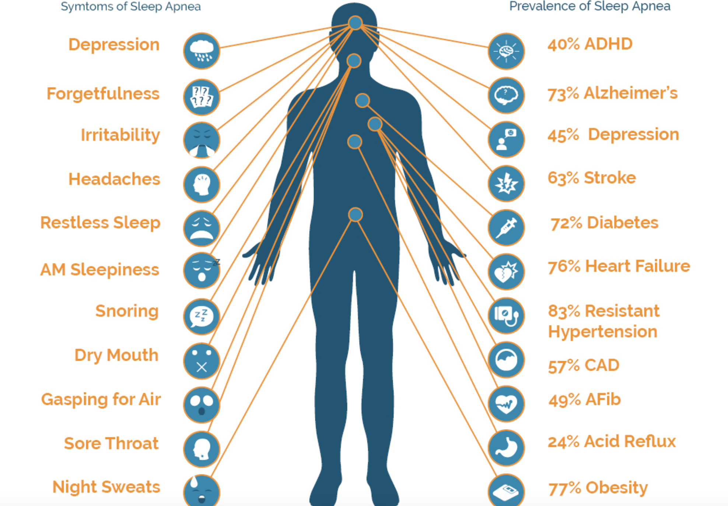
APNEA SYMPTOMS
Daytime somnolence
Snoring, often loud
Insomnia (occasionally)
Impaired intellectual functioning
Impaired concentration
Depression
Hypertension
Redline, Strohl 1998; https://www.atlantasleepapneatreatment.com/obstructive-sleep-apnea/

Slide 17
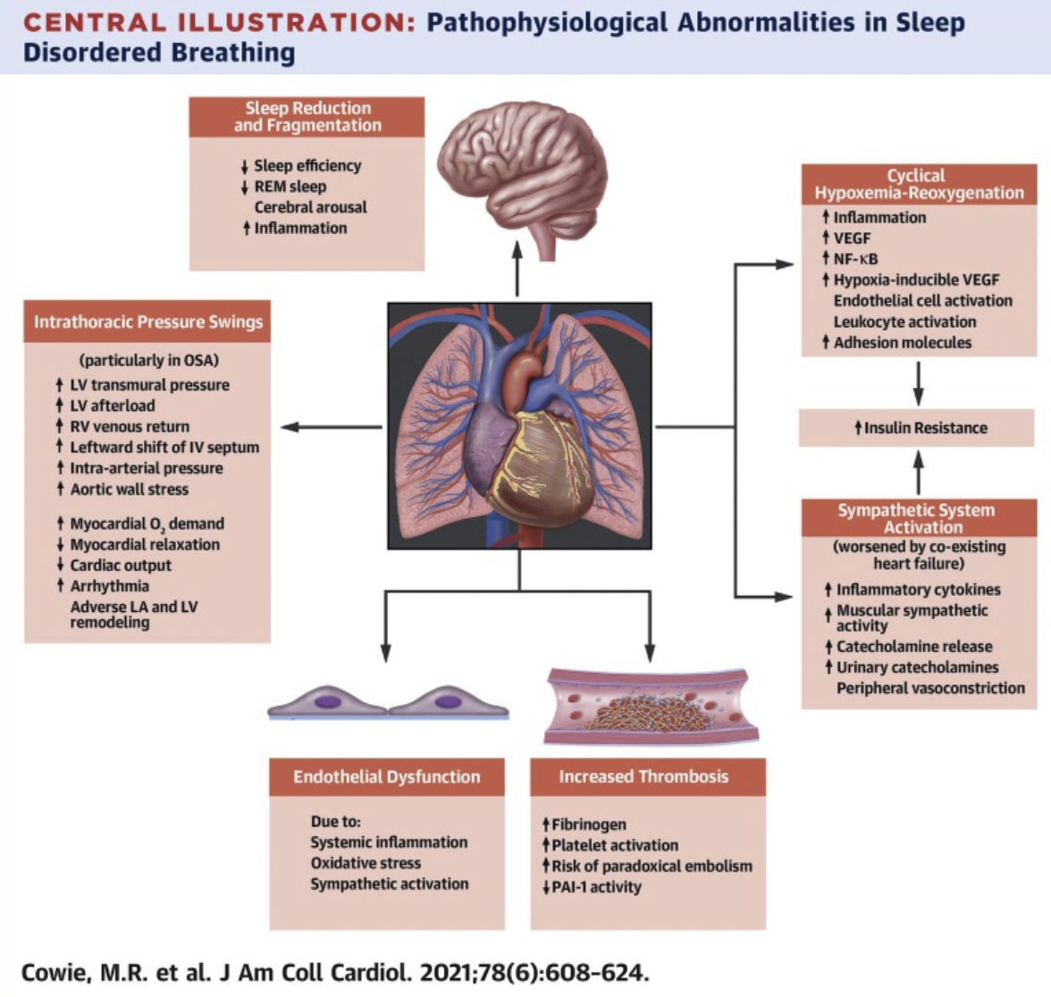

Slide 18
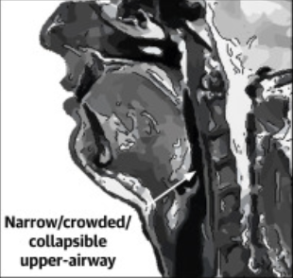
Pathophysiology of sleep apnea:
anatomic factors that reduce lumen size of upper airway (e.g., obesity, poor dental development)
impairments in central respiratory drive: malfunctioning in neurologic regulation of the muscles that dilate the upper airway during inspiration
disordered respiratory feedback loops
relaxation of phasic muscle activity (e.g, sedative-hypnotics, alcohol)
collapse of upper airway during inspiration
Eckert et al, 2013

Slide 19
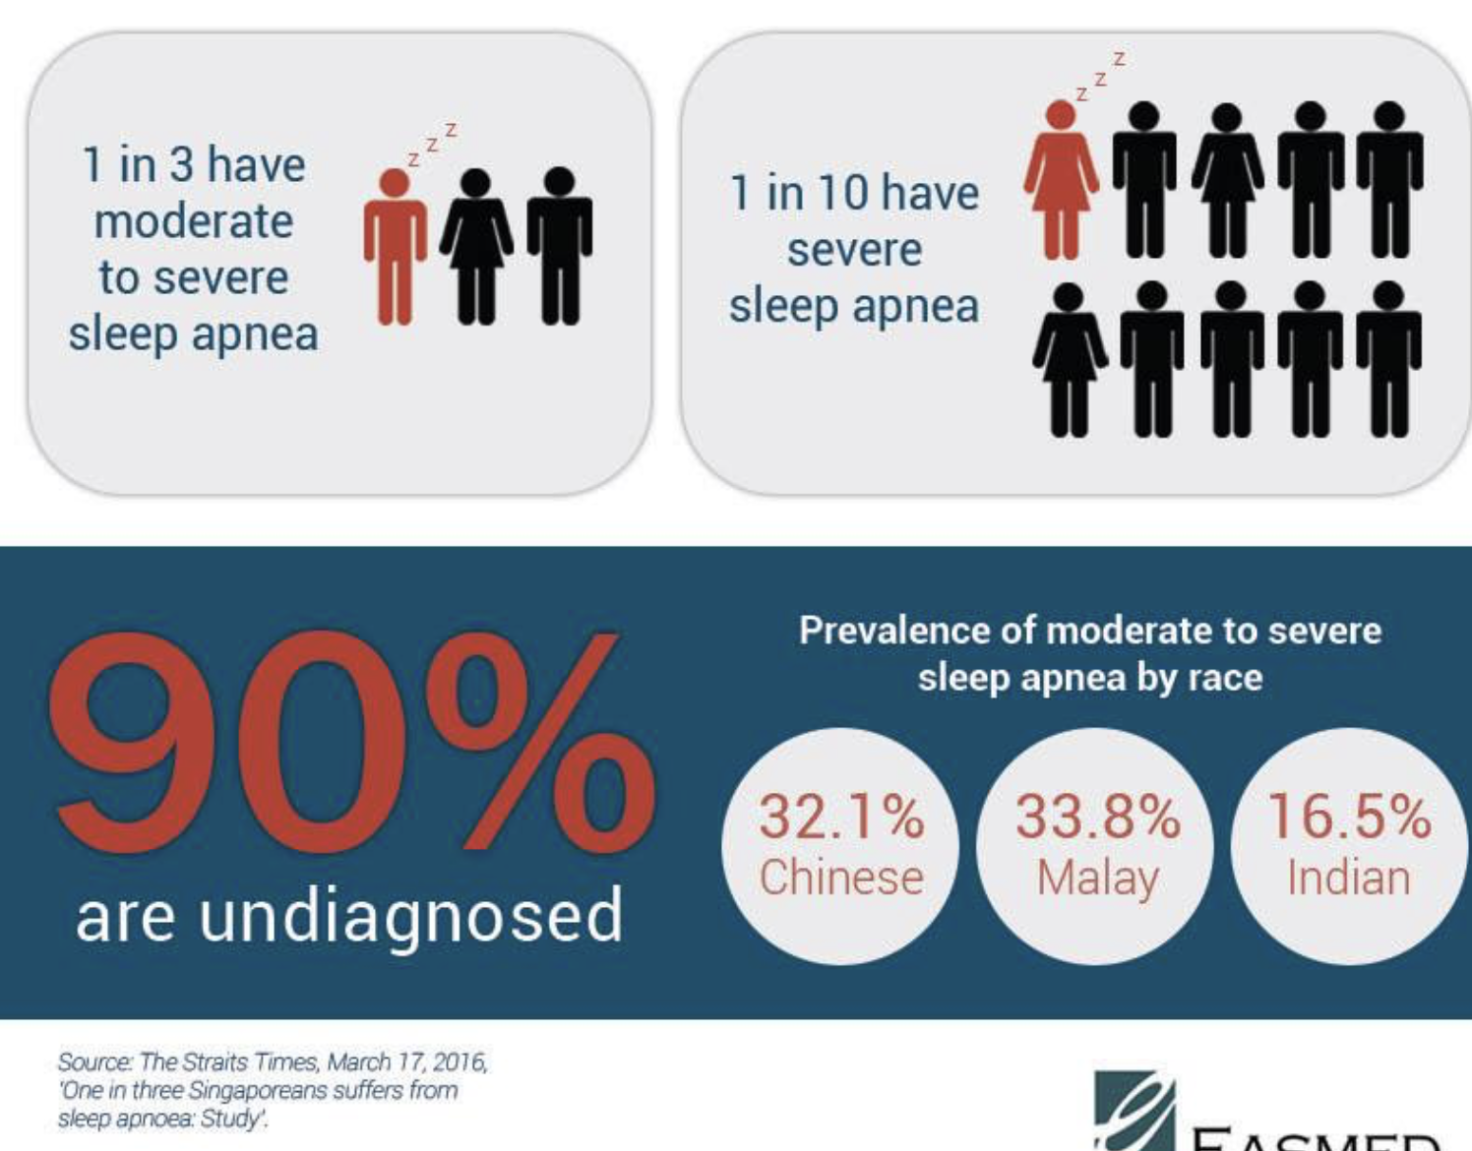
Sleep apnea epidemiology in normal populations
Workers age 30- 60years (hypersomnia with apnea) - 2-4 % in women. Median had 10 sleep breathing events per hr. No significant correlation between apneas and daytime well- being was seen in this representative sample. Kripke et al., Sleep 1997.
Over age 65y, 80% have at least some mild apneas. Ancoli-Israel e t al., Sleep 1981
iiiiiiiiiiiiiiiiiiiiiiiiiiiiiiiiiiiiiiiiiiiiiiiiiiiiiiiiiiiiiiiiiiiiiiiiiiiiiiiiiiii

Slide 20
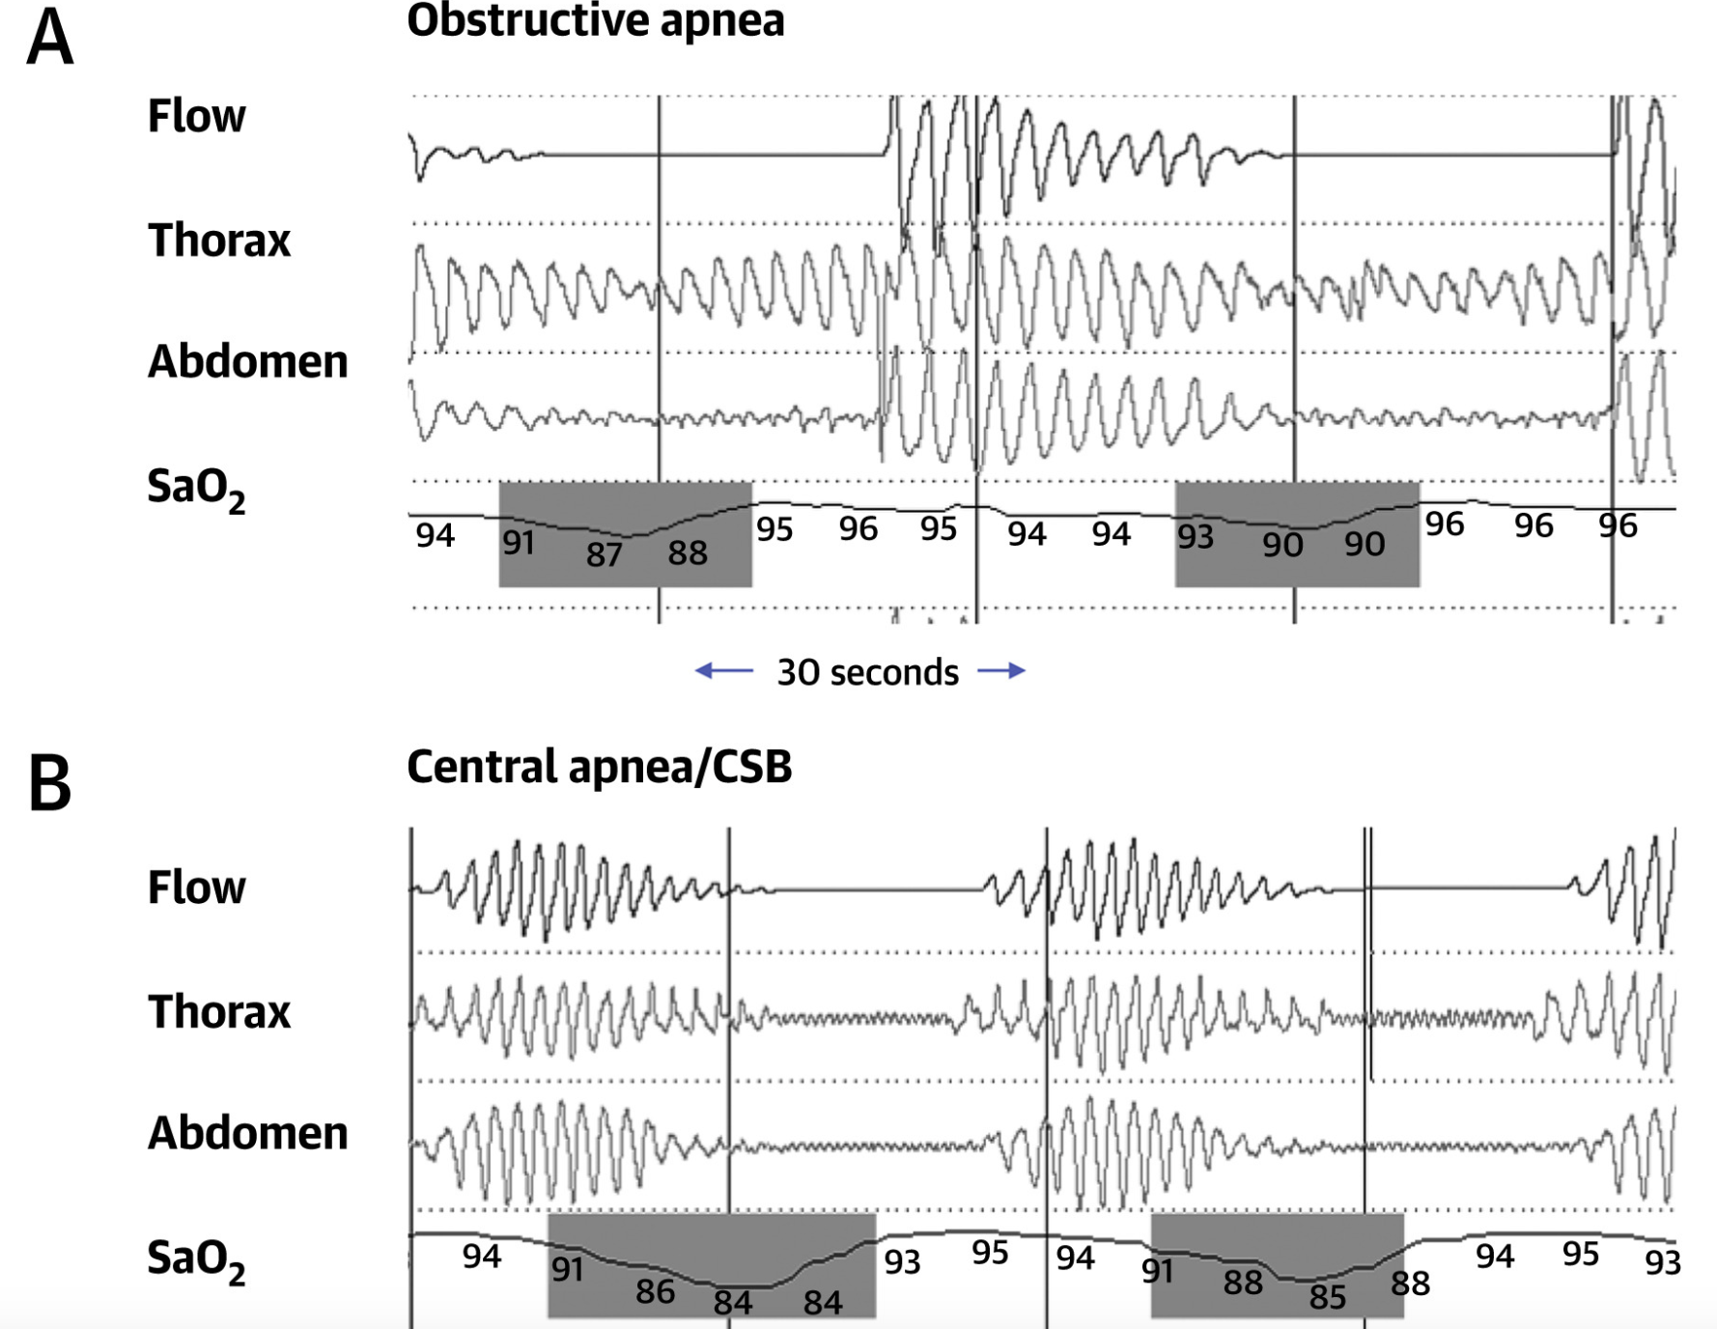
APNEA diagnosis (poly)somnography
Brain waves - EEG
Eye movements - EEG, EMG
Heart rate - EKG
Breathing pattern (thermistor)
Blood oxygen level - Spo2
Body position
Chest and abdominal movement
Limb movement - EMG
Snoring and other noises
Cowie et al, 2021)

Slide 21
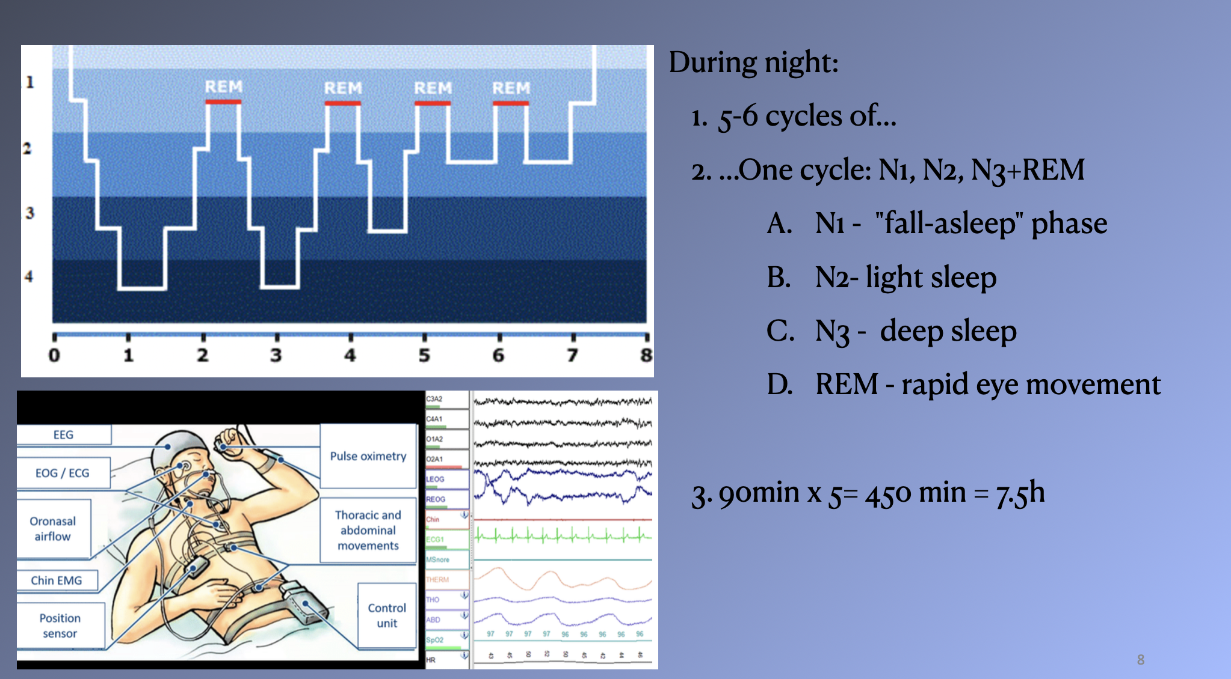

Slide 22
PSG indications
Sleep apnea or another sleep-related breathing disorder; breathing stops and starts repeatedly during sleep.
Periodic limb movement disorder; flexing and extending their legs while sleeping, sometimes linked to restless legs syndrome (uncontrollable urge to move the legs while awake, usually in the evenings or at bedtime)
Narcolepsy; overwhelming daytime drowsiness, falling asleep suddenly
REM sleep behavior disorder; acting out dreams during sleep.
Unusual behaviors during sleep; walking, moving around or rhythmic movements during sleep.
Unexplained long-lasting insomnia. People with insomnia have trouble falling asleep or staying asleep.
https://www.mayoclinic.org/tests-procedures/polysomnography/about/pac-20394877#:~:text=Polysomnography%2C%20known%20as%20a%20sleep,measures%20eye%20and%20leg%20movements.

Slide 23
TREATMENT of MILD OBSTRUCTIVE SLEEP APNEA (Cowie et al, 2021)
Lose weight. About half of people with sleep apnea are overweight; extra fat in pharyngeal area and on chest compromises airway nightly
No alcohol and sleeping pills – decrease of the muscle tone
Change sleep positions
Quitting smoking
Allergy care
MFT ((oro)myofunctional therapy) (Camacho et al. 2015)

Slide 24
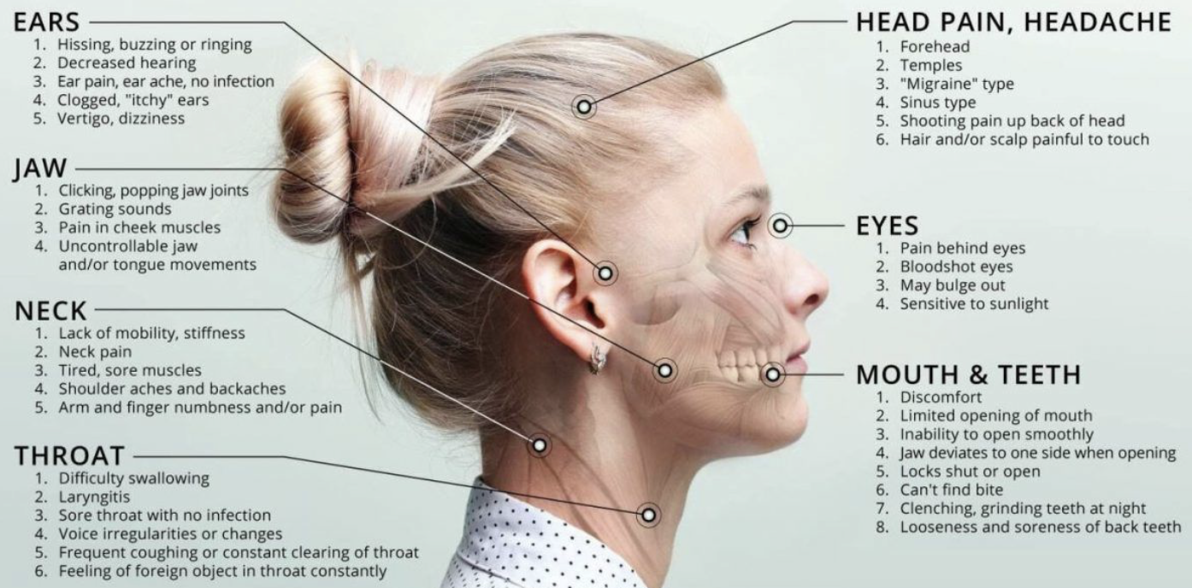
Oro-myofunctional therapy. https://tmjcentrent.com/2021/12/08/the-importance-of-myofunctional-therapy/

Slide 25
SEDATIVE HYPNOTICS and SLEEP APNEA (Lu et al. 2005)
• Can push snorer into sleep apnea
• Can worsen sleep apnea
• Can worsen COPD
• Same risks with alcohol

Slide 26
TREATMENT of MODERATE or SEVERE SLEEP APNEA (Cowie et al, 2021)
• Continuous Positive Airway Pressure (usually auto regime sometimes bi-level system)
• Mandibular and tongue advancement oral appliances
• Surgery (less proven)
- (Uvulopalatoplasties)
- Mandibular or maxillary advancement

Slide 27
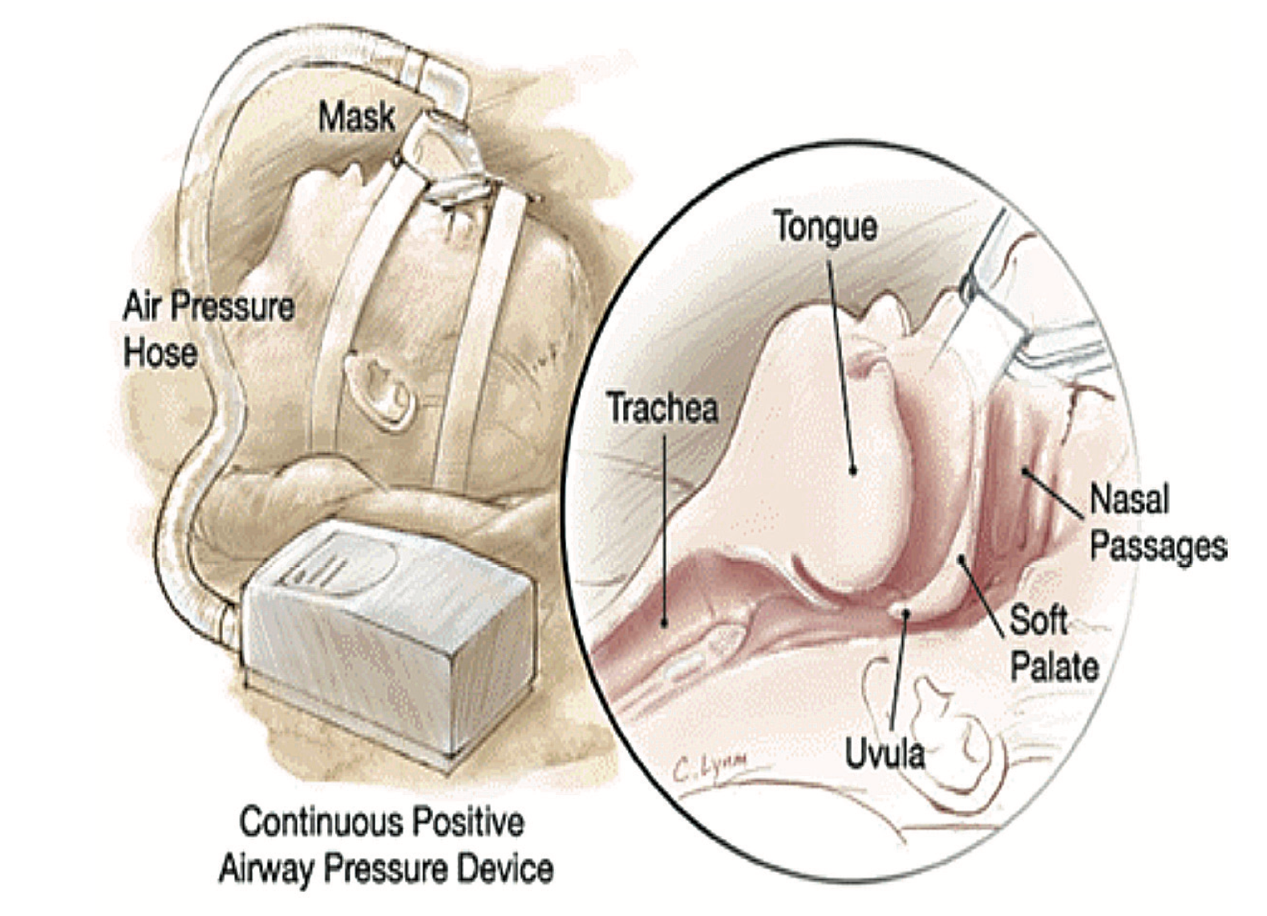
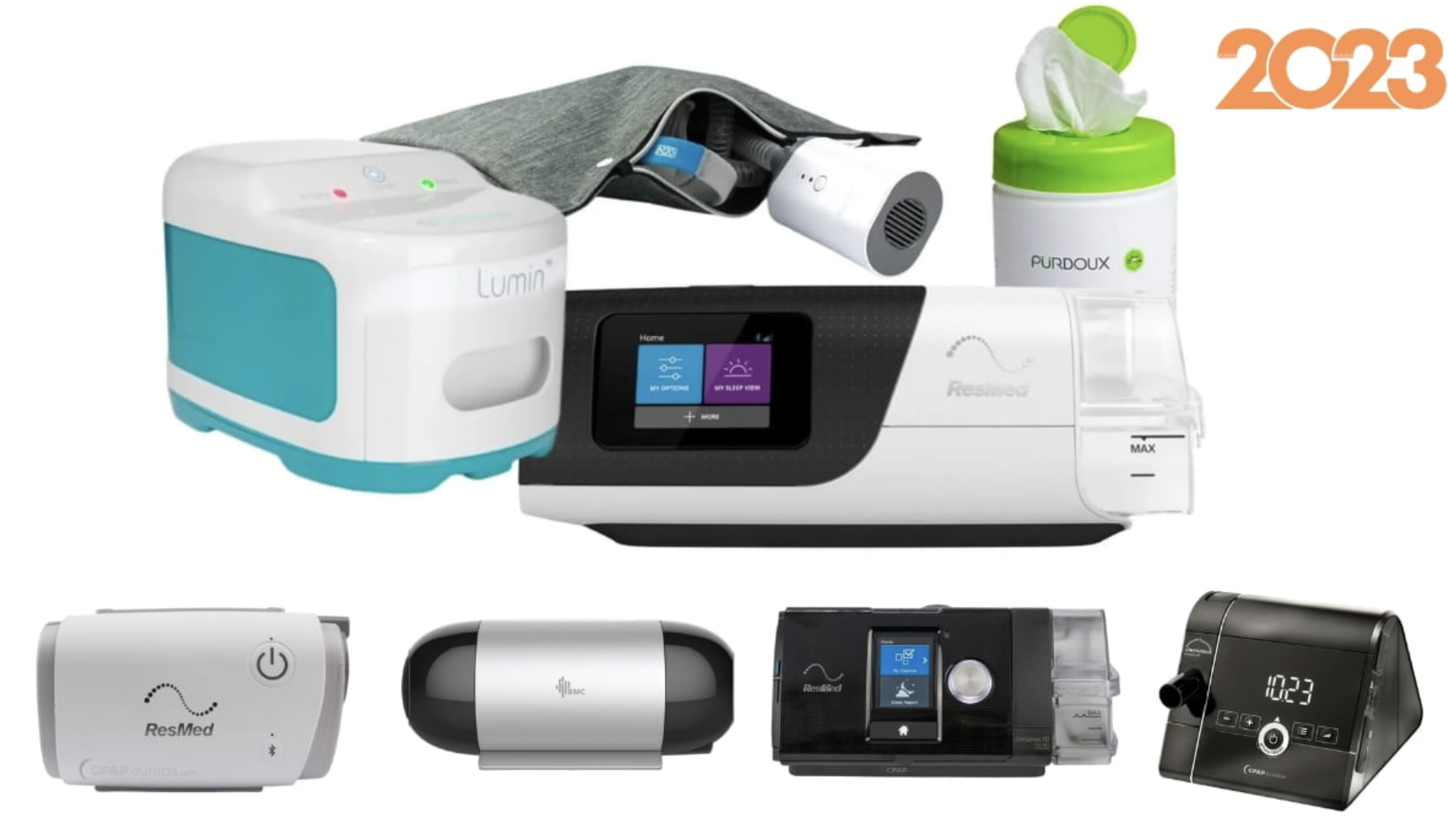
CONTINUOUS POSITIVE AIRWAY PRESSURE https://www.nxp.com/docs/en/brochure/BBCNTSPSVAIRPRSART.pdf

Slide 28
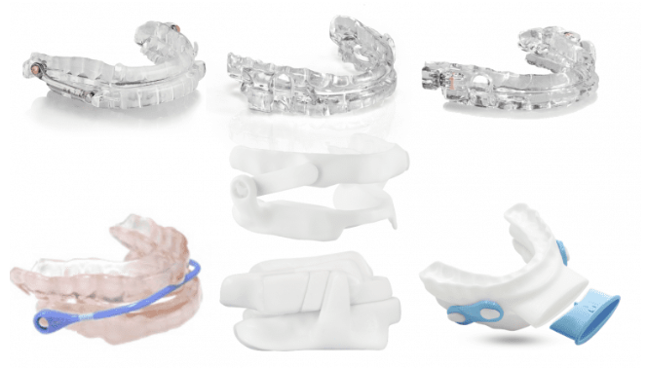
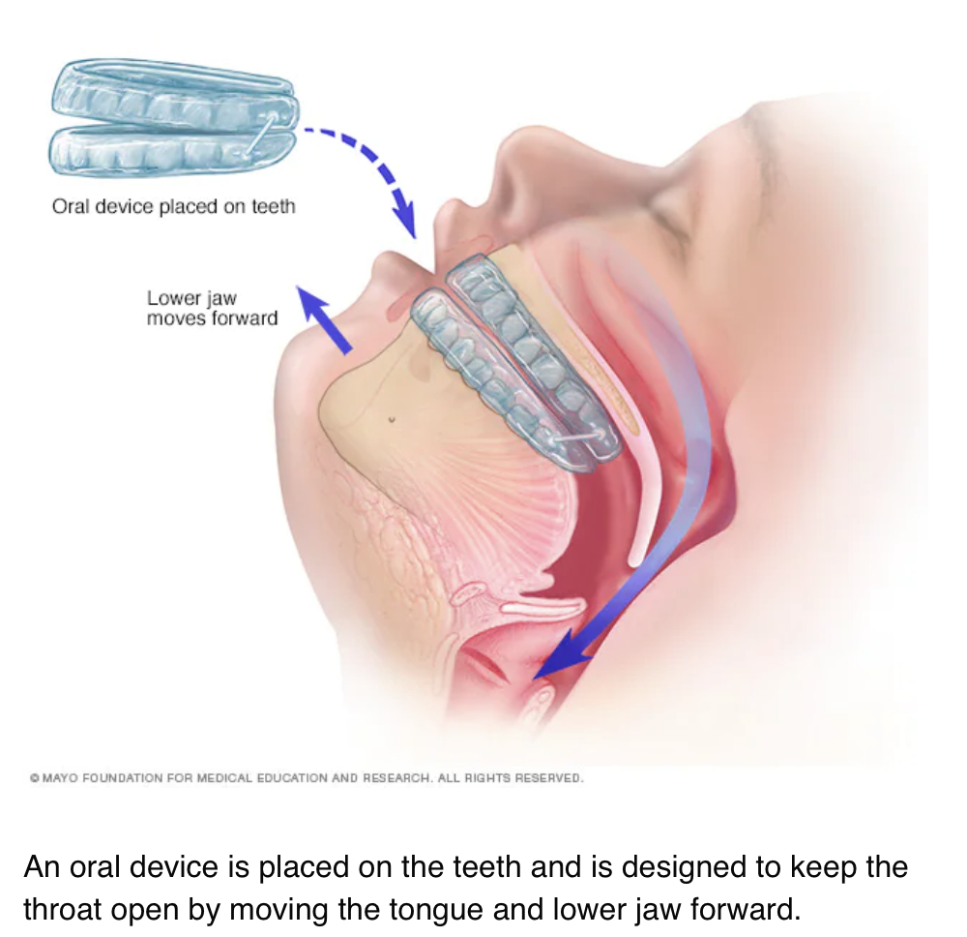
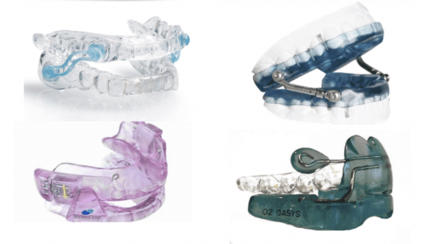
ORAL APPLIANCES

Slide 29
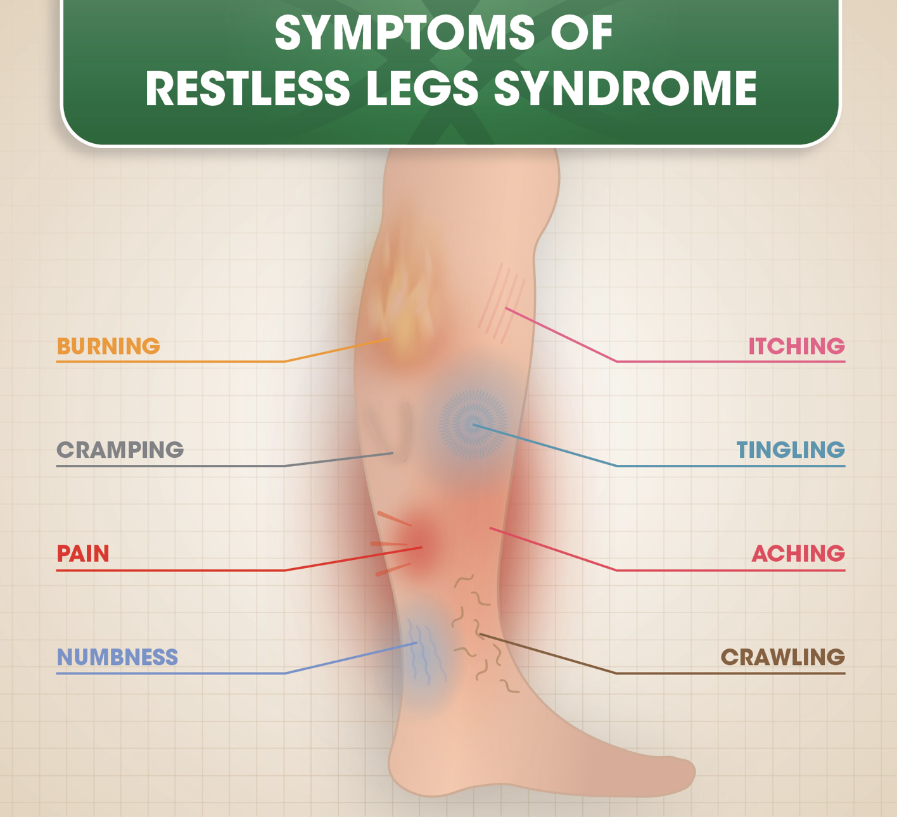
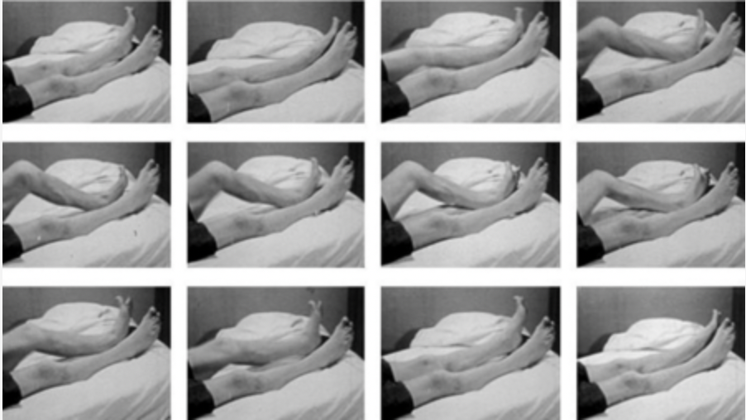
RLS, PLMS https://childneurologycenter.com/disorder/leg-movement-disorders/

Slide 30
RLS; PLMS
Restless Legs Syndrome (RLS) & Periodic Limb MovementDisorder(PLMD)
RLS: Legs squirm before sleep; not all-daylike akathisia; patient complains of onset insomnia
Patients with periodic limb movement sleep disorder may have a higher risk of cerebrovascular accidents.
PLMD: rhythmic limb movements
50-80% of patients with RLS have PLMD
Genetic factors discovered in
2007
Low iron stores a factor
(Karna et al. 2023)

Slide 31
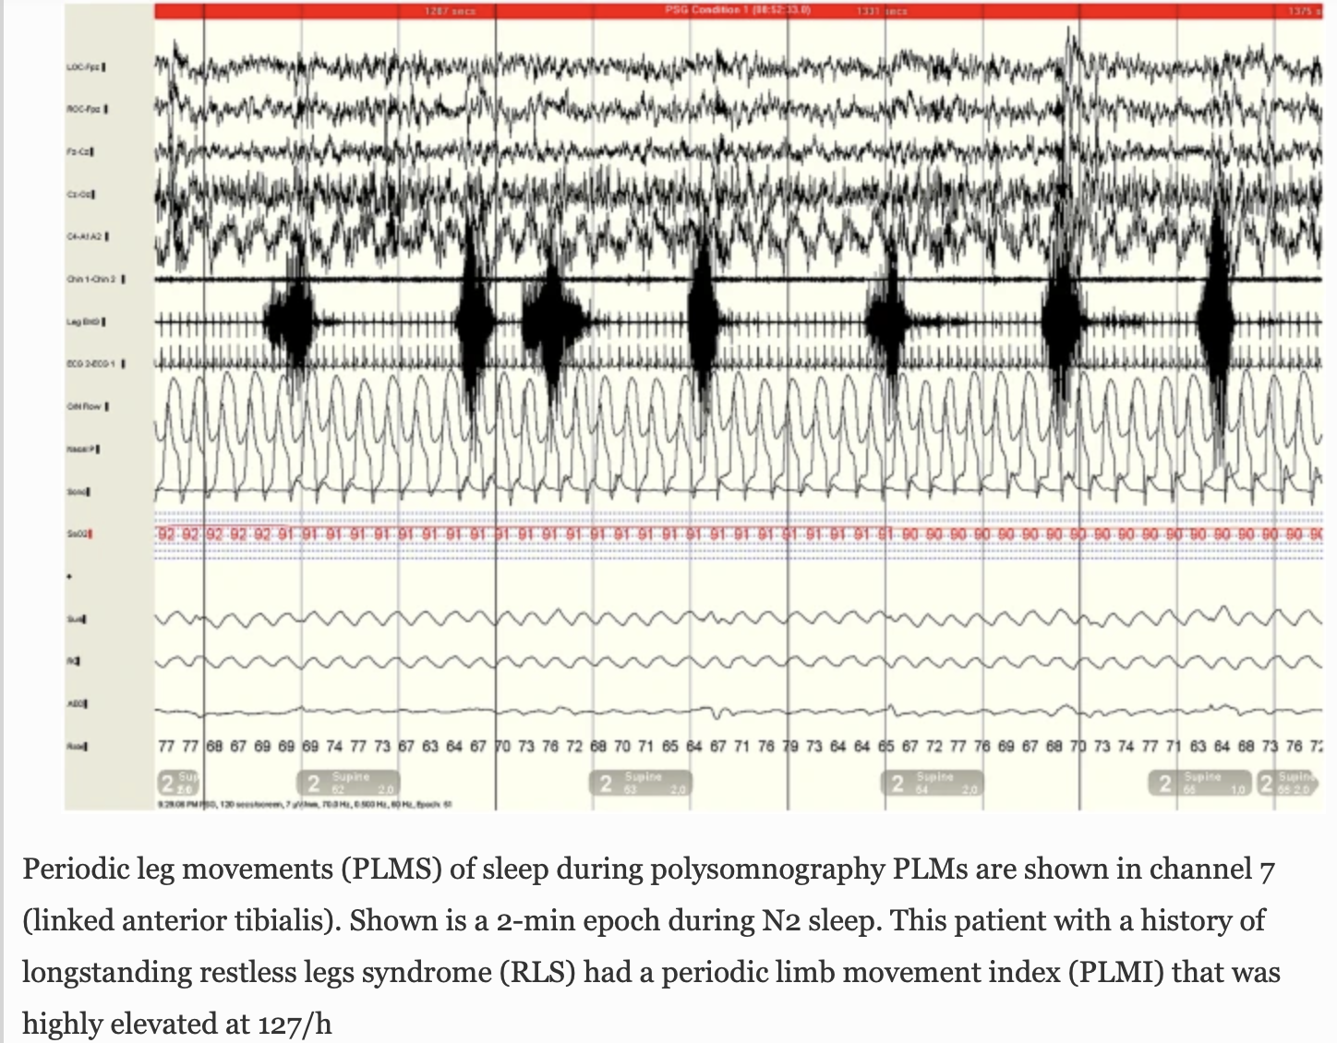
Gossard et al. 2021

Slide 32
Treatment of RLS, PLMS (Karna et al. 2023)
Periodic Limb MovementDisorder(PLMD) and Restless Legs Syndrome
Benzodiazepines or opioids
- Palliative, not curative
- Soothes RLS discomfort
- Increases sleep continuity in PLMD
Iron supplement of ion for ferritin <50

Slide 33
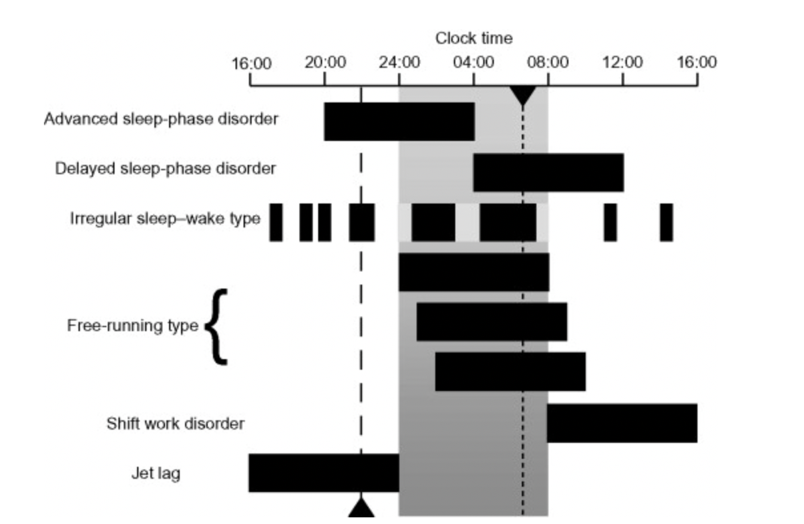
CIRCADIAN rhythm disorder PATHOPHYSIOLOGY (Reid et al. 2011)
MISALIGNMENT between sleep and biological rhythms
• due to external demands, e.g., nightshift
• due to a diminished capacity to respond to rhythm synchronizers (e.g.,blind subjects)
• genetic defects in the body clock

Slide 34
Recent data suggest that the circadian clock regulates cognitive functions such as memory and mood in a sleep-dependent and sleep-independent manner.
Some circadian clock proteins are important regulators of longevity; for example, BMAL1, NPAS2, CRY and PER.
Circadian rhythms in sleep and behaviour are significantly affected by ageing; this impairment can contribute to the cognitive decline of the ageing brain.
Circadian rhythms in sleep and behaviour are markedly disturbed in patients with Alzheimer's disease, Parkinson's disease and Huntington's disease.
Circadian clock disruption can serve as a biomarker of progression in a neurodegenerative disease.
Circadian-clock-dependent control of metabolism, oxidative stress response, DNA repair and autophagy can contribute to brain ageing and neurodegeneration.
Restoration of circadian clock function in animal models of neurodegeneration improves cognitive performance and increases the lifespan of these animals.
Restoration of circadian rhythms with combined light and melatonin therapy improves sleep quality in humans.
Kondratova, Kondratov 2012

Slide 35
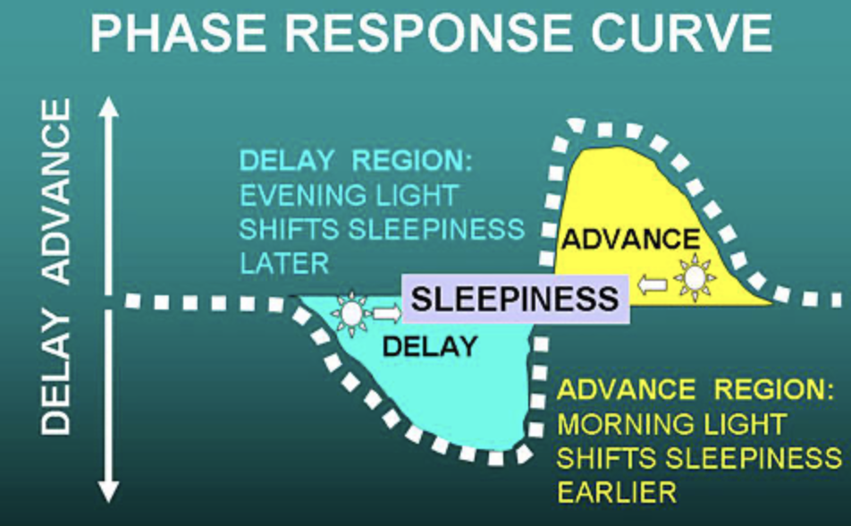
DELAYED SLEEP PHASE
• Can't get to sleep at night
• Can't get up in the morning
• Tired most of the day
• More alert in the evening
Kripke et al 2007

Slide 36
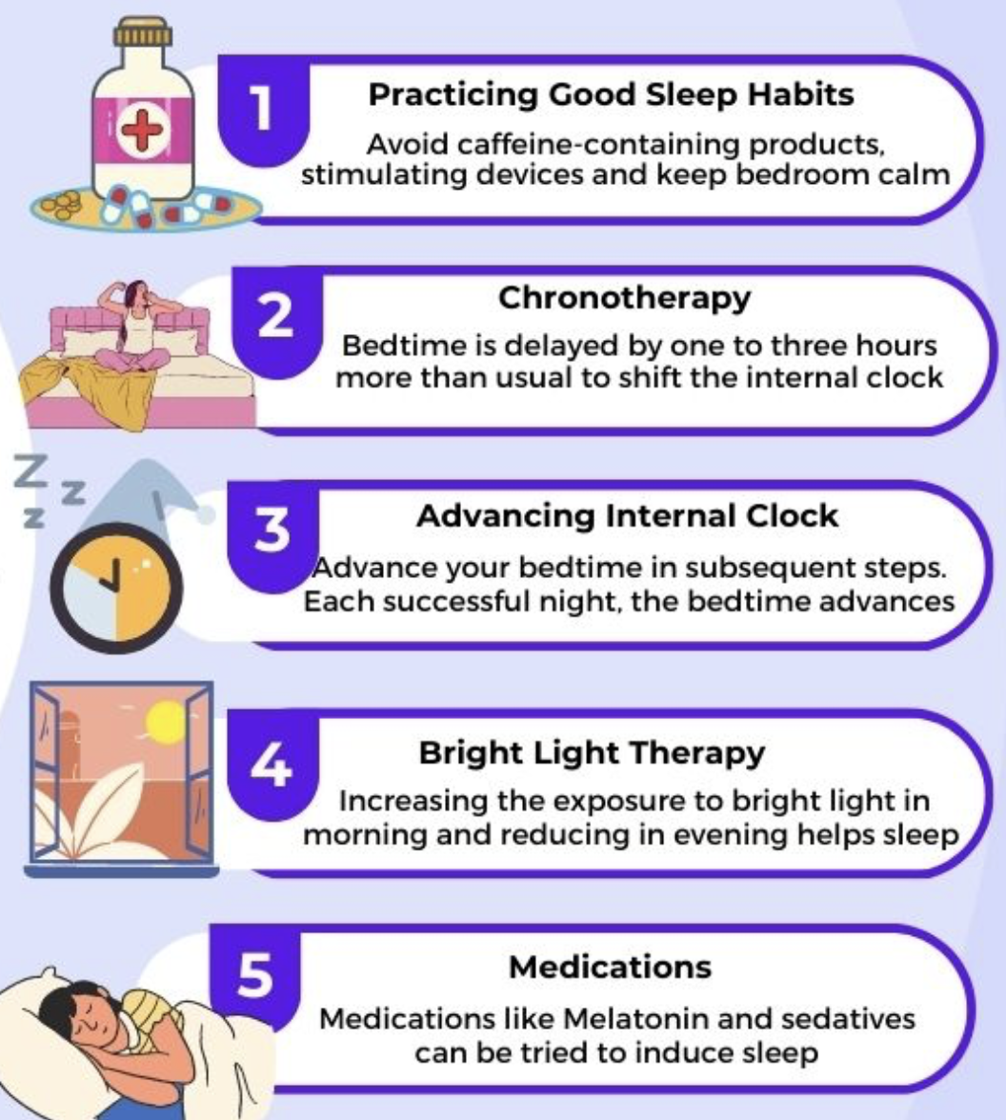
Treatments for Delayed Sleep Phase
• Bright light in the morning:
As soon after arising as possible
• Vitamiin B12: 1 - 3 mg orally daily
- Some evidence that B12 phase advances – might augment light treatment
• Melatonin 0.02-0.20mg. ~10hours after arising
https://www.icliniq.com/articles/neurological-health/delayed-sleep-phase-syndrome

Slide 37
SYMPTOMS of ADVANCED SLEEP PHASE
• Drowsy or falls asleep early in the evening
• Awakens too early in the morning
• Most energetic in the morning
Use brighter light in the evening – just before bedtime
• Sometimes 50-100 watts fluorescent is sufficient
- Usually best near the television
https://www.sleepfoundation.org/advanced-sleep-phase-disorder#:~:text=A%20person%20with%20advanced%20sleep,earlier%20than%20they%20would%20prefer

Slide 38
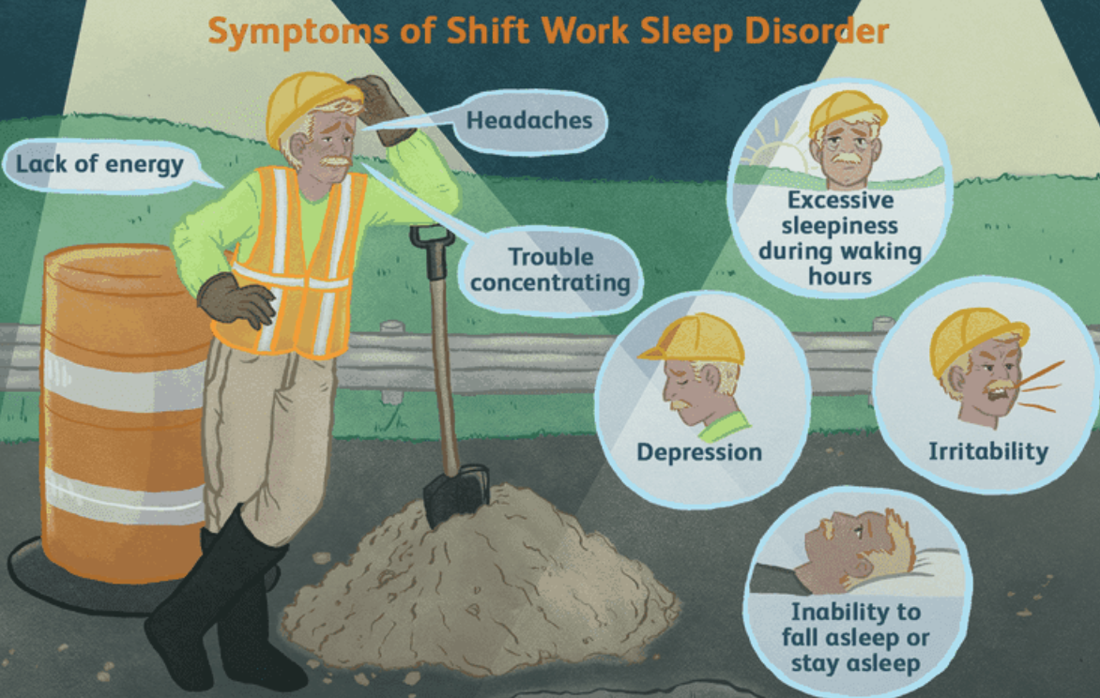
SHIFT WORK misalignement TREATMENT
An increasing percentage of the population
• Impairs sleep and night performance
• Possibly associated with depression and
shortened life
• Accidents
• Melatonin is not as effective as brightlight for treatment of nightshift work (<1week studies)
• Long-term studies not available
• Adjustment to nightshifts is helped by wearing orange (blue-block) glasses when driving home in the morning
https://www.verywellhealth.com/what-is-shift-work-sleep-disorder-4584820

Slide 39
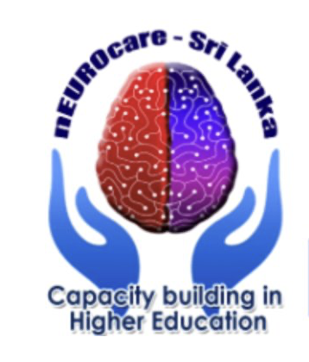
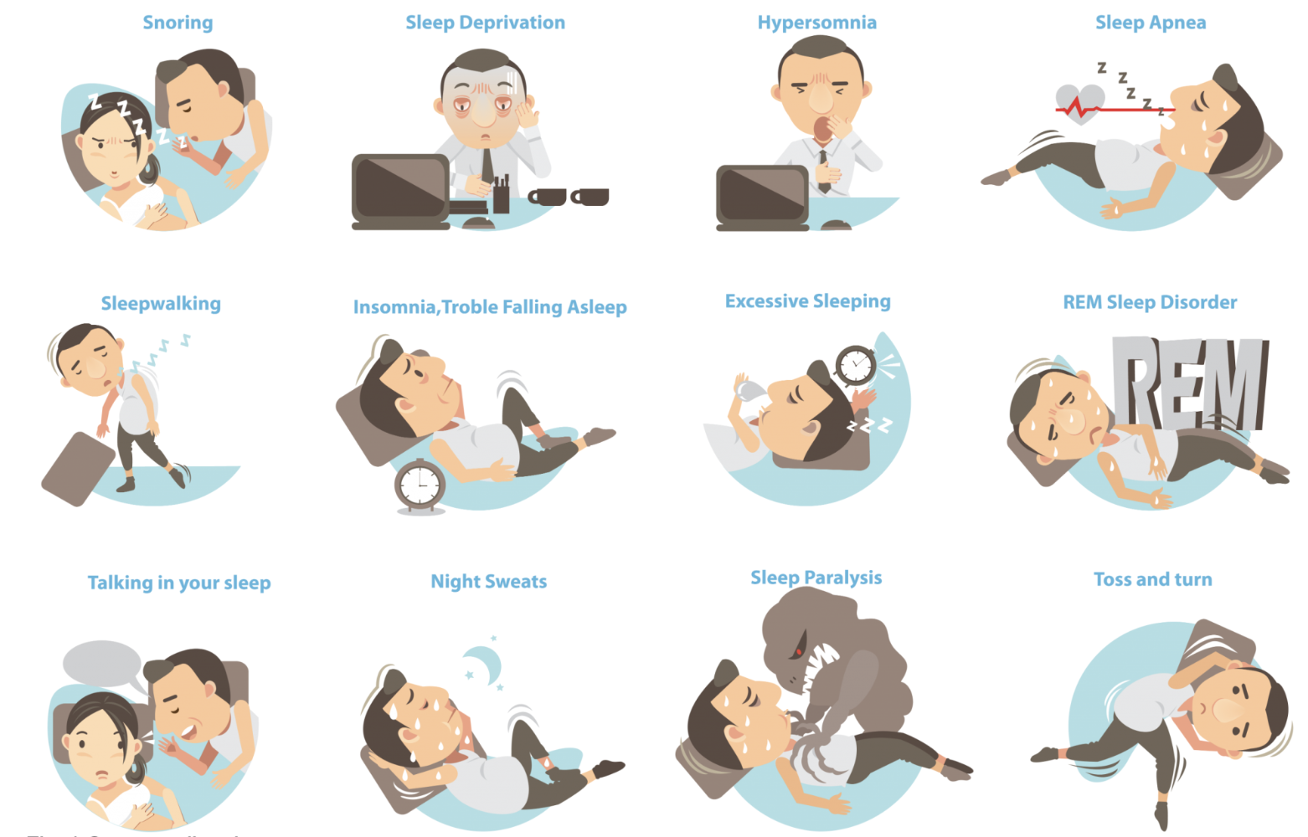
In conclusion
All sleep disorders cannot be prevented, but risk is reduced by practicing good sleeping habits
There are more than 80 different sleep disorders.
The proper management of sleep disorders requires the efforts of an interprofessional healthcare team that includes clinicians, specialists, pharmacists, nursing staff, psychological professionals (social workers, counselors, etc.). (Karna et al. 2023)
https://www.tmjsleepcentre.net.au/introduction-to-common-sleep-disorders/

Slide 40
Literature
Boege HL, Bhatti MZ, St-Onge MP. Circadian rhythms and meal timing: impact on energy balance and body weight. Curr Opin Biotechnol. 2021 Aug;70:1-6. doi: 10.1016/j.copbio.2020.08.009. Epub 2020 Sep 29. PMID: 32998085; PMCID: PMC7997809.
Cowie MR, Linz D, Redline S, Somers VK, Simonds AK. Sleep Disordered Breathing and Cardiovascular Disease: JACC State-of-the-Art Review. J Am Coll Cardiol. 2021 Aug 10;78(6):608-624. doi: 10.1016/j.jacc.2021.05.048. PMID: 34353537.
Eckert DJ, White DP, Jordan AS, Malhotra A, Wellman A. Defining phenotypic causes of obstructive sleep apnea. Identification of novel therapeutic targets. Am J Respir Crit Care Med. 2013 Oct 15;188(8):996-1004. doi: 10.1164/rccm.201303-0448OC. PMID: 23721582; PMCID: PMC3826282.
Lu B, Budhiraja R, Parthasarathy S. Sedating medications and undiagnosed obstructive sleep apnea: physician determinants and patient consequences. J Clin Sleep Med. 2005 Oct 15;1(4):367-71. PMID: 17564403.
Redline S, Strohl KP. Recognition and consequences of obstructive sleep apnea hypopnea syndrome. Clin Chest Med. 1998 Mar;19(1):1-19. doi: 10.1016/s0272-5231(05)70428-7. PMID: 9554214.
Camacho M, Certal V, Abdullatif J, Zaghi S, Ruoff CM, Capasso R, Kushida CA. Myofunctional Therapy to Treat Obstructive Sleep Apnea: A Systematic Review and Meta-analysis. Sleep. 2015 May 1;38(5):669-75. doi: 10.5665/sleep.4652. PMID: 25348130; PMCID: PMC4402674.

Slide 41
Literature
Erten Uyumaz, B.; Feijs, L.; Hu, J. A Review of Digital Cognitive Behavioral Therapy for Insomnia (CBT-I Apps): Are They Designed for Engagement? Int. J. Environ. Res. Public Health 2021, 18, 2929.
García-Montero C, Fraile-Martínez O, Gómez-Lahoz AM, Pekarek L, Castellanos AJ, Noguerales-Fraguas F, Coca S, Guijarro LG, García-Honduvilla N, Asúnsolo A, Sanchez-Trujillo L, Lahera G, Bujan J, Monserrat J, Álvarez-Mon M, Álvarez-Mon MA, Ortega MA. Nutritional Components in Western Diet Versus Mediterranean Diet at the Gut Microbiota-Immune System Interplay. Implications for Health and Disease. Nutrients. 2021 Feb 22;13(2):699. doi: 10.3390/nu13020699. PMID: 33671569; PMCID: PMC7927055.
Gossard, T.R., Trotti, L.M., Videnovic, A. et al. Restless Legs Syndrome: Contemporary Diagnosis and Treatment. Neurotherapeutics 18, 140–155 (2021). https://doi.org/10.1007/s13311-021-01019-4
Karna B, Sankari A, Tatikonda G. Sleep Disorder. 2023 Jun 11. In: StatPearls [Internet]. Treasure Island (FL): StatPearls Publishing; 2023 Jan–. PMID: 32809555.
Kondratova, A., Kondratov, R. The circadian clock and pathology of the ageing brain. Nat Rev Neurosci13, 325–335 (2012).
Kathryn J. Reid, ... Phyllis C. Zee, in Progress in Brain Research, 2011
Lie JD, Tu KN, Shen DD, Wong BM. Pharmacological Treatment of Insomnia. P T. 2015 Nov;40(11):759-71. PMID: 26609210; PMCID: PMC4634348.
Malin SK, Remchak ME, Smith AJ, Ragland TJ, Heiston EM, Cheema U. Early chronotype with metabolic syndrome favours resting and exercise fat oxidation in relation to insulin-stimulated non-oxidative glucose disposal. Exp Physiol. 2022 Nov;107(11):1255-1264. doi: 10.1113/EP090613. Epub 2022 Sep 19. PMID: 36123314; PMCID: PMC9633545.

