Slide 1
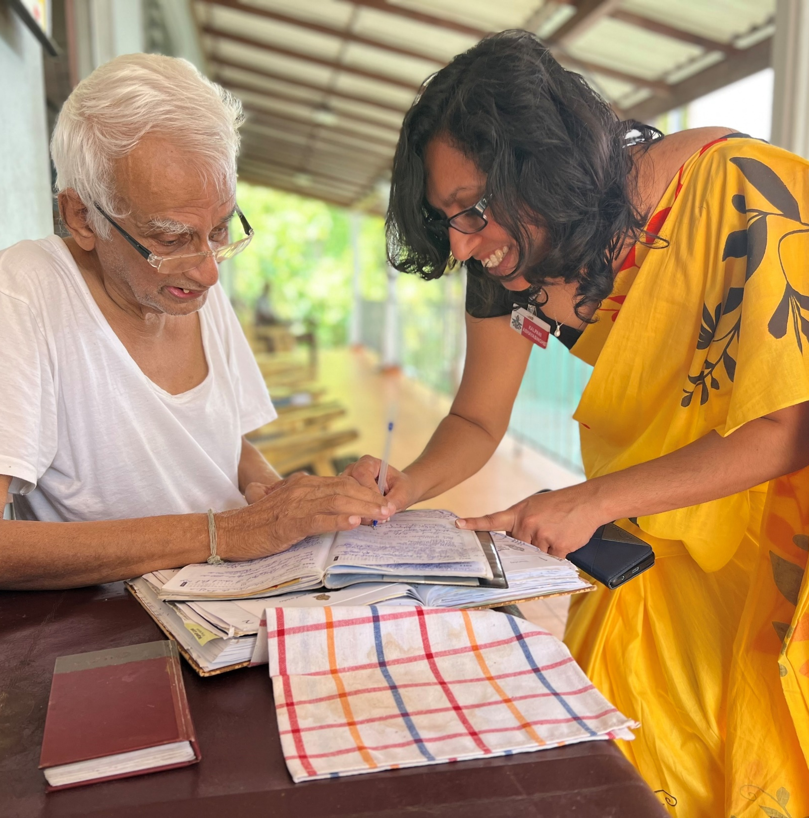
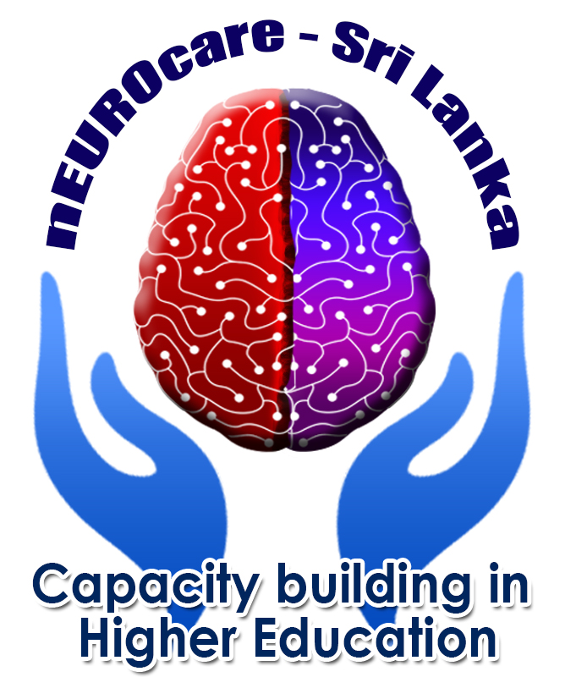

PERSON-CENTERED CARE (PCC) McCormack & McCance
Reference number: 618596-EPP-1-2020-1-SE-EPPKA2-CBHE-JP This publication [communication] reflects the views only of the authors, and the Commission cannot be held responsible for any use, which may be made of the information contained therein.
Notes:
Good morning.
In this lecture, I would like to explain the theoretical McCormack & McCance model of PCC.

Slide 2

INTENDED LEARNING OUTCOMES
At the completion of this lecture student will be able to:
explain the concepts of McCormack & McCance model of PCC;
analyze McCormack & McCance model of PCC in clinical practice;
apply McCormack & McCance model of PCC in clinical practice;
compare between the local and global perspectives of PCC.

Slide 3
PCC - Framework highlights
Complexity of person-centred nursing / caregiving
Articulation of the key constructs
Emphasis's the contextual, attitudinal and moral dimensions of humanistic caring practice
Multi-disciplinary and inter-professional team working
Notes:
The literature widely recognizes the importance of creating a PCC culture across the continuum of care, where governments and organizations play a key role in the development of clear and comprehensive policies, processes, and structures necessary for healthcare systems and healthcare providers to deliver PCC. A standard set of core values among all parties, as part of a strategic vision, is essential in providing and receiving care that includes persons, healthcare providers, communities, and organizations within and outside of traditional healthcare services. While it is agreed that a key guiding principle in implementing PCC is to incorporate the person perspective, there is a need to ensure that care is also person‐directed, whereby persons are provided with sufficient and appropriate information to make decisions about their care and level of engagement.
Person-centered care (PCC) receives a great deal of attention and has been adopted widely in healthcare organizations throughout the world. In the past two decades, many interventions have been implemented to make healthcare organizations more person-centered. Commonly implemented PCC interventions for persons entail person empowerment, physical support, and information provision; those for healthcare professionals focus mainly on education and training and improvement of the continuity and coordination of care.
With such efforts, most organizations claim to be person-centered; the reality, however, is more nuanced. In theory, PCC should be delivered using a comprehensive approach, with multiple interventions tailored specifically to the needs of the most vulnerable groups in society (e.g., patients with less education, migration backgrounds, or low health literacy) in practice, achieving this goal remains a huge struggle. This nuanced picture of PCC in practice is especially relevant for primary care delivery to persons with neurodegenerative diseases are often considered to form one of the most vulnerable groups in society.

Slide 4
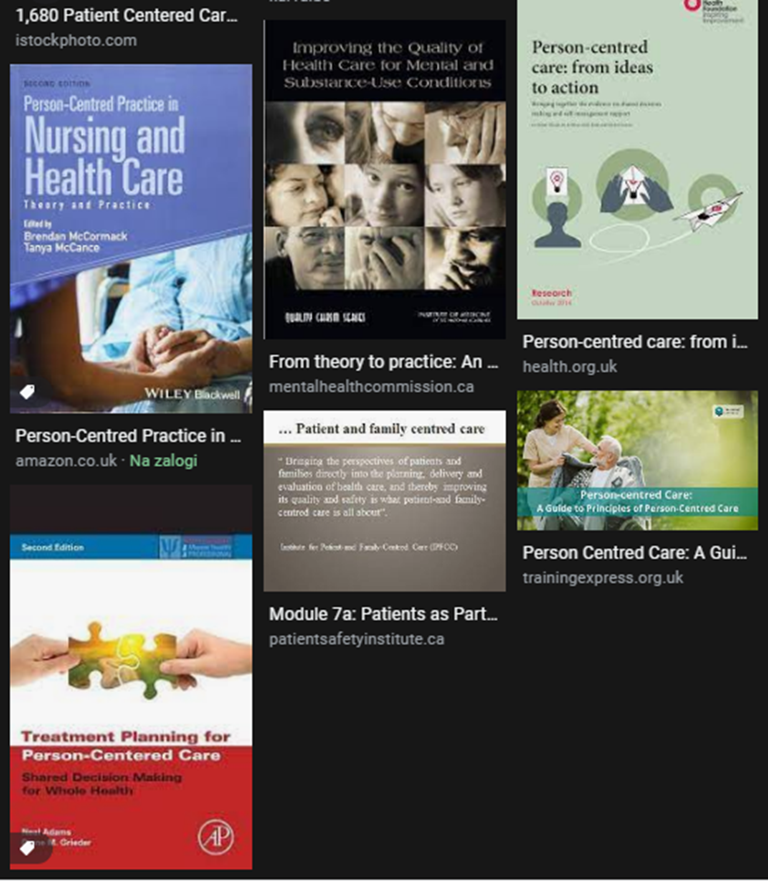
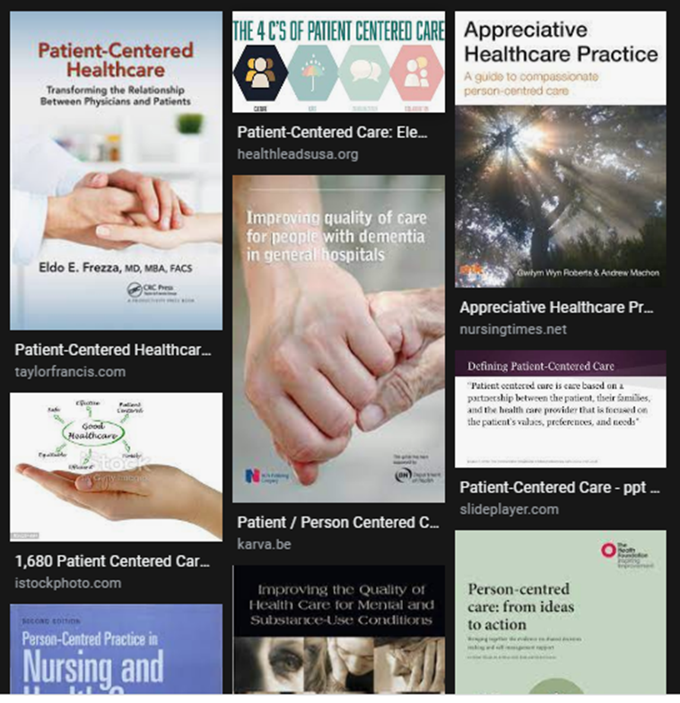
Notes:
Health and social care systems, organizations and providers are under pressure to organize care around persons’ needs with constrained resources. To implement person-centred care (PCC) successfully, barriers must be addressed. Up to now, there has been a lack of comprehensive investigations on possible determinants of PCC across various health and social care organizations.
With increased research, the concept of person-centered care is advancing, and it remains an important concept in the health sector. Despite reported evidence of significant benefits, this concept is poorly utilized by professional nurses. The principle has not been demonstrated and absorbed at primary health care levels.
However, there are many research, books, and guidelines where we can difficulties and obstacles identified and addressed them in practice.

Slide 5
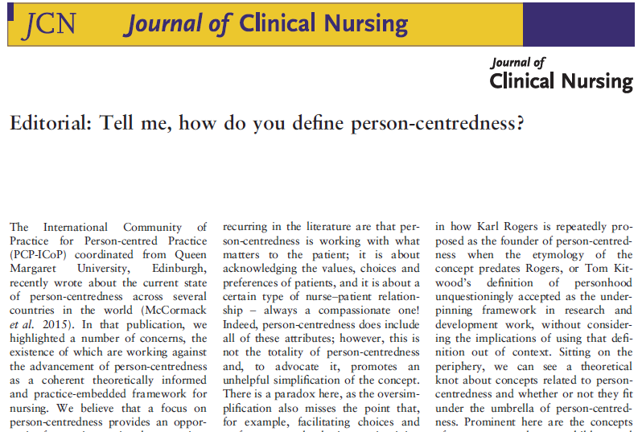
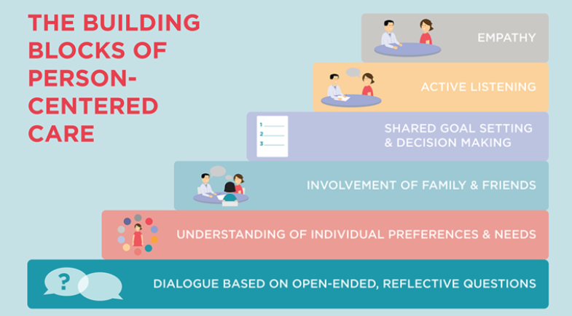
Defining PERSON–Centered care
Care is individualized and customized.
Patient and families have control over health care decisions, not clinicians.
https://www.youtube.com/watch?v=3zFvzXxlcP4
Notes:
Person-centredness is an approach to practice established through the formation and fostering of healthful relationships between all care providers, service users and others significant to them in their lives.
It is underpinned by values of respect for persons (personhood), individual right to self-determination, mutual respect, and understanding. It is enabled by cultures of empowerment that foster continuous approaches to practice development”. This are words of Jan Dewing and Brendan McCormack and you can read this as an editorial in the Journal of clinical practice with title Tell me, how do you define person-centredness?
The definition of person centredness by McCormack and McCance surfaces four attributes of persons and person-centred relationships:
Respect for all persons
Engagement and collaboration
Individual and collective right to determine their own destiny
Equity and equality.

Slide 6
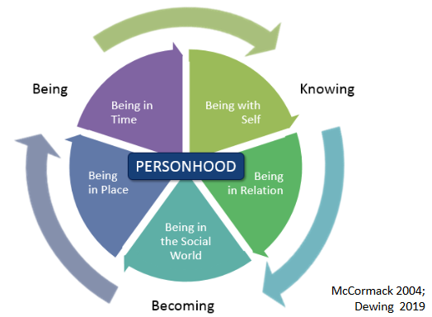
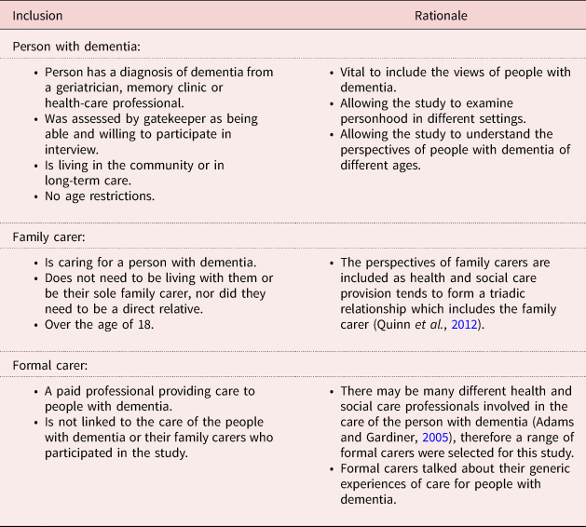
Knowing and Becoming Model
Hennelly, N., & O'Shea, E. (2022). A multiple perspective view of personhood in dementia. Ageing & Society, 42(9), 2103-2121. doi:10.1017/S0144686X20002007
PERSONHOOD
Shared decision making
Effective staff relationships
Supportive organizational strategies
Power sharing
Potential for innovation and risk taking
The physical environment
Notes:
The core concept of person-centredness, personhood, is that the person in care is placed at the centre of all efforts, so the focus of action is primarily on what matters to them
as a person, supporting a neutral understanding of personhood with different manifestations of ‘self’ (McCormack and McCance, 2017).
Person-centredness requires paying attention to our being as persons (McCormack and McCance, 2017). The fundamental principles reflect the modes of being at the core of person-centredness, as proposed by McCormack (2004):
- being in relation (having meaningful relationships),
being in a social world (participating in social life and current events),
Being in place (living in a familiar, person-in-care-friendly and home-like environment), and
being with self (maintaining identity and self-esteem, being free in decisions, and experiencing meaning in everyday life)
Being in time.
Dementia care is used here as an example of how different percpective on personhood influence the care of the older person.
The person with dementia should be seen as an embodied being, as they still experience feelings, perceptions and emotions, have the ability to form relationships, have aspects of self-identify that come to light occasionally, experience enjoyment and can still lead a satisfactory life (Dewing, 2008; Post, 2013).
In the Journal of Aging Society, you can read an article A multiple perspective views of personhood in dementia where the authors compare the inclusion and rationale of three groups of people- person with dementia, a family carer, and a formal caregiver.
Being, doing, belonging, becoming – occupational therapy filozophy (Hitch et al., 2014) is also close related to person center care
Examining Relationships between Physical Environments and Behaviors of Residents with Dementia in a Retrofit Special Care Unit https://journals.sagepub.com/doi/10.1111/joid.12094
https://www.youtube.com/watch?v=krPt8z0okoQ
https://www.cambridge.org/core/journals/ageing-and-society/article/abs/multiple-perspective-view-of-personhood-in-dementia/617B0BD0337AF500484010B738747452

Slide 7
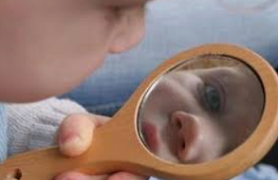

THE CONCEPT OF PERSON
Who am I?
Values that are important or I consider to be important?
My beliefs? How I express them?
My dreams, hopes, desires?
My emotional engagement in my relationships?
The life that I want to live?
Notes:
So that we can understand and put PCC into practice, first you should know yourself, I should know myself.
Who am I?
In list below you can find some questions. Answer them individually. Write down the answers on a peace of paper. Than make groups and share answers with others and make discussion.
If have still time go to the wbsite and solve the quiz: https://www.proprofs.com/quiz-school/story.php?title=pq-what-type-of-person-am-i_2d4

Slide 8
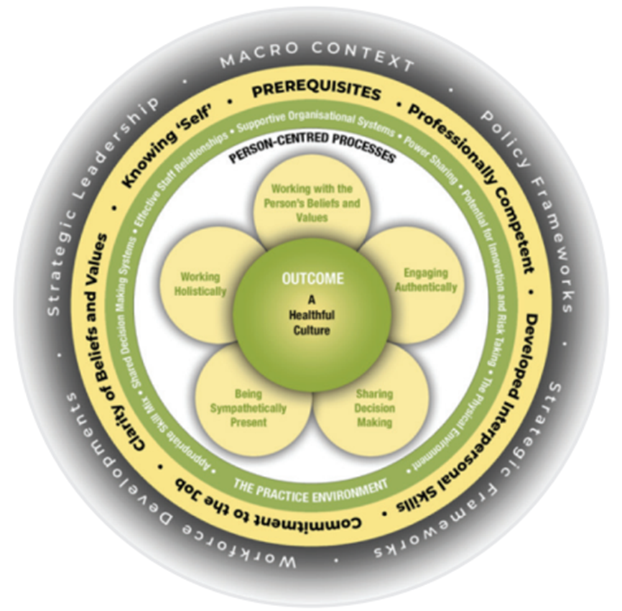
Framework MCCormack & McCance, 2006,2010,2017
Notes:
Brendan McCormack and Tanya McCance have been responsive and receptive to advances in personcentred knowledge and research over a long period of time and the framework has been refined
accordingly (2006-2019). It originated as a nursing framework – the Person-centred Nursing Framework (McCormack and McCance, 2006; 2010) – and has been used as the theoretical framework of many
research projects (for example, Buckley et al., 2013; van der Cingel et al., 2016; Lannie and Peelo-Kilroe, 2017; Lynch et al., 2018; McCormack et al., 2018). This has provided greater depth and understanding
as to how the theoretical framework can be applied to clinical practice.
The development of the Personcentred Nursing and Person-centred Practice Frameworks has spanned over 20 years of research, practice development and evaluation activities.
The original framework published in 2006, was developed for use in the intervention stage of a large quasi-experimental project that focused on measuring the effectiveness of the
implementation of person-centred nursing in a tertiary hospital setting (McCormack and McCance 2006).
The 2006 version of the Person-centred Nursing Framework (PCNF) was derived by combining the conceptual framework that McCormack had developed focusing on person-centred practice
with older people and Tanya McCance’s (2003) framework that focused on patients’ and nurses’ experience of caring in nursing.
Their first publication (McCormack and McCance 2006) – set out the processes involved in developing the framework. More significantly, the specific shared philosophical underpinnings
that enabled two conceptual frameworks to be combined into one theoretical framework were described. This shared philosophical starting point enabled us to set out the key aspects
of what it means to be a ‘person’ that were consistent with a philosophy of human science and embraced key human science principles of freedom, holism, relationality, time and
knowledge (McCance and McCormack 2017).
We can see the historical shift between the versions of the framework (McCormack and McCance, 2006, 2017). For example, in 2006 outcomes were patient focused, ‘creating a therapeutic culture’,
while in the 2017 version intended outcomes are more inclusive of staff and the ‘existence of healthful cultures’, while the language has changed from working with patients’ values to working with peoples
values to be more inclusive of others (McCormack and McCance, 2006, 2019). In the 2017 version, a fifth layer was added to acknowledge the influence of the broader macro systems on person-centred
cultures and practices. The name changed from a nursing framework to a practice framework to be more inclusive of other professions, although the Person-centred Nursing Framework is still available
for nursing work.
The framework provides guidance on how to relate to and respect the personhood of staff, patients and self.
https://www.fons.org/Resources/Documents/Journal/Vol10No2/IPDJ_1002_003.pdf

Slide 9
Person-centred practice
PCP as defined by McCormack and McCance (2017, p 3) is:
‘An approach to practice established through the formation and fostering of healthful relationships between all care providers, service users and others significant to them in their lives. It is underpinned by the values of respect for persons, individuals’ right to self-determination, mutual respect and understanding. It is enabled by cultures of empowerment that foster continuous approaches to practice development.’
Notes:
The use of the terms ‘person-centredness’ and ‘person-centred care’ has become increasingly common in health and social care services at a global level. A cynic might argue that the term is being used as
a ‘catch-all’ for anything to do with high-quality health and social care but we would contend that it is representative of something more significant than this, namely, a movement that has an explicit
focus on humanising health services and ensuring the patient/client is at the centre of care delivery. In this context, the body of evidence supporting the processes and outcomes associated with personcentredness
in health and social care is constantly growing and becoming increasingly diverse.
The Person-centred Practice Framework reflects the essence of human caring. Caring is a central concept in all health and social care practice, no matter the context or profession. Meaningful caring involves the interaction between values, beliefs and attitudes and is a far more complex activity than is often perceived, requiring intentional actions by health and social care workers. Caring requires us to know ourselves and in developing this self-knowing, care practices (such as washing, dressing, helping with food and drink, help with using the toilet etc) can be elevated from a series of tasks to opportunities for engaging with the whole person and with everything that is important to them in their lives. McCormack & McCance define person-centred practice as:
“… focusing on the formation and fostering of healthful relationships with service users and others significant to them in their lives, as well as between all care providers. It is underpinned by values of respect for persons (personhood), individual right to self-determination, mutual respect and understanding. It is enabled by cultures of empowerment that foster continuous approaches to practice development” (McCormack & McCance, 2017)

Slide 10
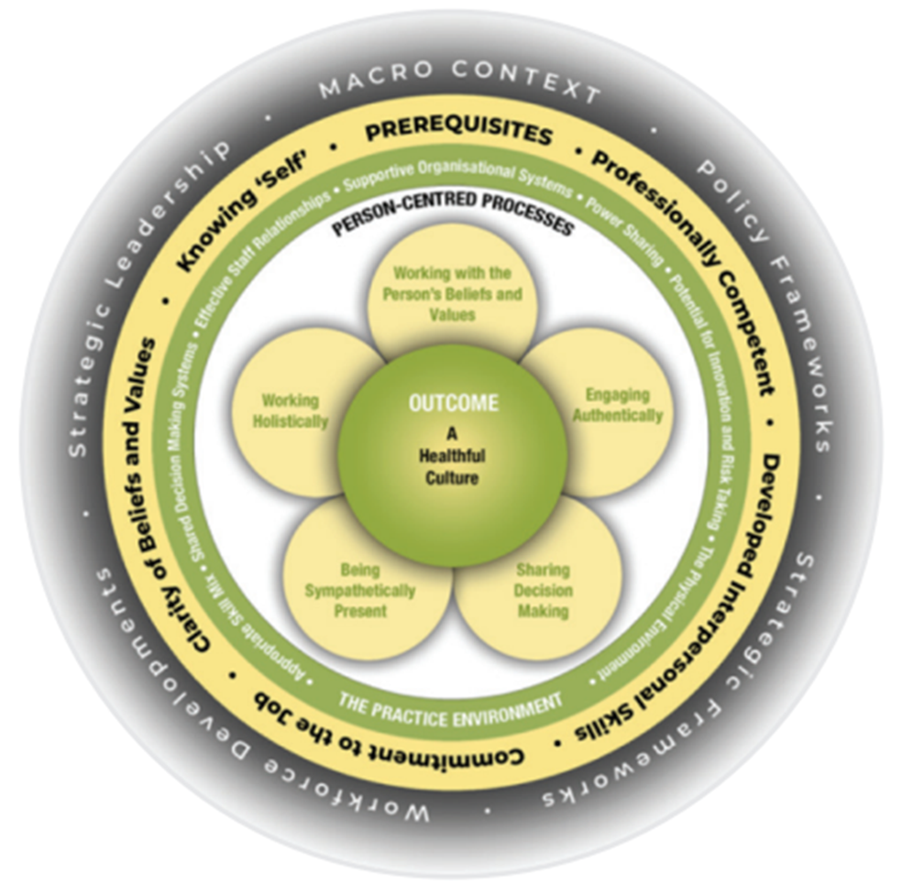
Person centred practice framework
Globally adopted
Translated info few languages
Underpinning strategy and policy frameworks
Curriculum framework
Theoretical framework in research
Instrument development
(PCPI-S, PCPI-SU, PCPI-ST)
Model development, testing
Notes:
The Person-centred Practice Framework was derived from McCormack’s conceptual framework (2001, 2003) focusing on person-centred practice with older people, and the framework of McCance et al. (2001) focusing on patients and nurses experience of caring in nursing. The Person-centred Practice Framework has been adopted globally as a way of conceptualising nursing policy, practice, education and research. It has been used to inform care-delivery models (McCormack et al 2012), curriculum frameworks (McCormack & Dewing 2019), research methodologies and research practices (McCormack et al 2017). The framework sets out what authors have determined, through more than 20 years of research and practice development, to be the key components of person-centred practice.

Slide 11
Methods and tools used to explore person-centred practice
1. Macro context (That it takes from the society to achive PCC)
2. Prerequisites, Requires (The attributes of the HCPs)
3. The care environment (Context in which care is delivered)
4. Person-centred processes (Delivering care through a range of activities)
5. Expected outcomes (Results of effective person centered health care)
Notes:
The Person-centred Practice Framework (McCormack and McCance, 2017) is described as a mid-range theory, it is ‘more concrete and narrower than grand theories; made up of a limited number of concepts and propositions that are written at a relatively concrete and specific level’ (Fawcett, 2005, p 34). This assists with reflection on, and operationalisation of person-centred practices across disciplines, with different stakeholders and at different healthcare levels.
It comprises five key interrelating elements:
the macro context;
prerequisites required by care providers;
the care environment; and
person-centred processes,
all leading to person-centred outcomes, with the important element of strategic support (macro-context) being at the outer ring of the framework (see Figure 1).
It provides a common language, a shared meaning and an understanding of the enablers and barriers to delivering a person-centred culture, unlike other models which consider only the relational elements. This framework recognizes the importance of these relationships and provides clarity of how they can be operationalised through the person-centred processes, prerequisites and the environment in which care occurs.
The influence of Kitwood and Kant can be seen within the framework. The framework provides guidance on how to relate to and respect the personhood of staff, patients and self.
Five key domains

Slide 12

1 Macro context
Health and social care policy
Strategic frameworks
Workforce development
Strategic leadership
Notes:
The macro context is the last element added to the PCC base image as the largest outer circle. Within the macro context, students are confronted with

Slide 13
1 Macro context
Social care ~ Health care
Quality strategies, safety, patient flow, regulations
Staff well being, nurses, student
Master - Servant ~ person centred
Notes:
In a macro context, students could explore what types of social and health policies already exist in Šri LankaCreate a list of network providers or institutions at the local and national levels where professionals or non-professionals can be found providing or sharing information about care.Students can research and discuss national regulations for people with neurodegenerative diseases;Research what well-being means for employees or family members, and if possible, what well-being means for older people in Sri LankaVideo
Video_ https://www.nmc.org.uk/standards/code/code-in-action/person-centred-care/

Slide 14
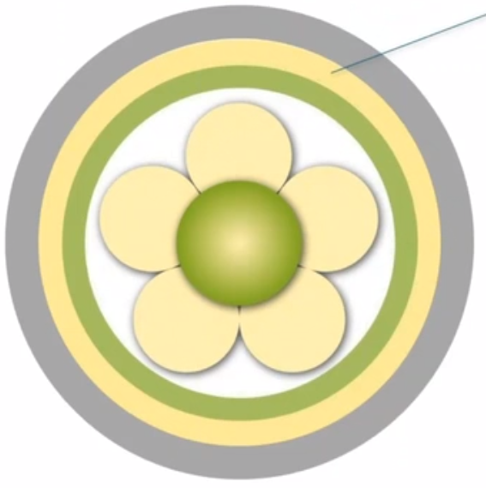
2 PREREQUISITES
Professionally competent
Developed interpersonal skills
Knowing self
Clarity of beliefs and values
Commitment to the job
Notes:
Prerequisites focus on staff attributes and are considered the key building blocks for developing health care professionals who can provide effective person-centred care. Attributes include: professional competence, strong interpersonal skills, commitment to work, clarity of beliefs and values, and self-awareness. There is no hierarchy in relation to these attributes, all are equally important, but it is the combination of attributes that reflects a person-centred professional who can deal with the challenges of an ever-changing context.
Video https://www.nmc.org.uk/standards/code/code-in-action/person-centred-care/

Slide 15
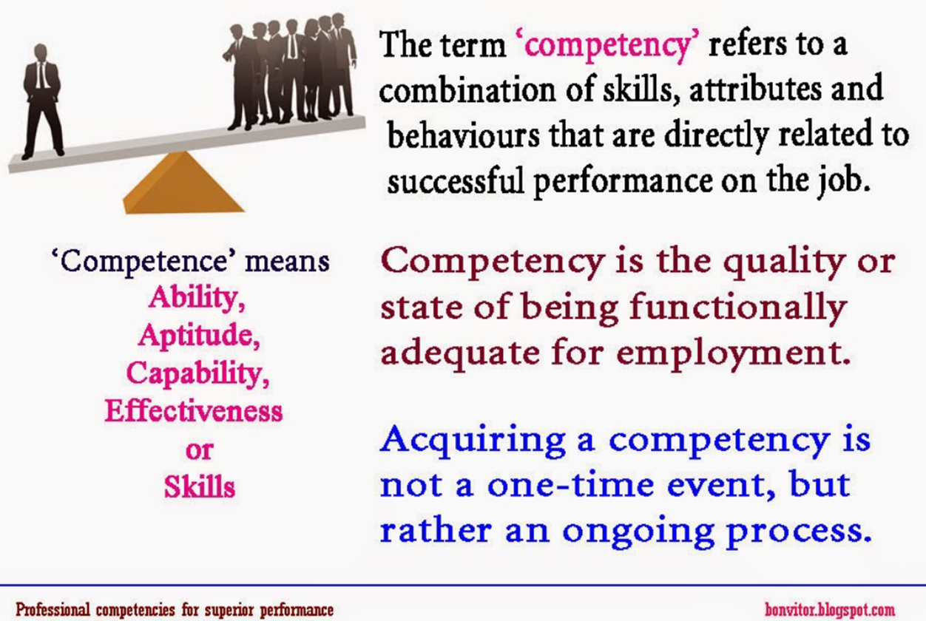
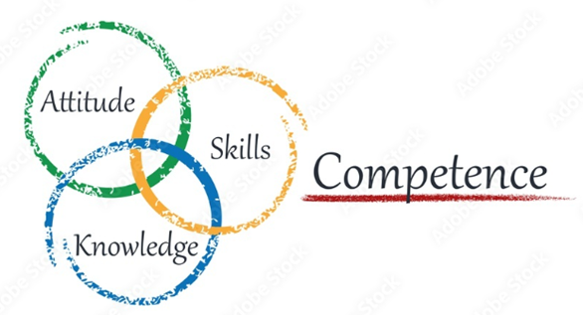
2. Prerequisites
Professionally competent
Notes:
In the context of person-centredness, competence means more than simply performing a task or demonstrating a desired behaviour, but rather reflects a holistic approach that encompasses knowledge, skills, and attitudes. In discussing the concept of competence, three main approaches are taken in the literature: a task-based or behaviourist approach, an approach that focuses on general characteristics, and the holistic approach (Hager et al. 1994). The holistic approach is consistent with the underlying values of person-centredness and emphasises bringing together individual abilities that result from a combination of characteristics and tasks to be performed in specific situations, including professional judgement .
Sundberg (2001), in discussing a holistic approach to competence development, offers a pragmatic view of competence as:
Knowledge - what one learns in education;
Experience - what one gains in one's job, workplace, and social life;
the ability to use the knowledge and experience (p. 104).
He argues that we are not able to develop another person's competence, as this is in the hands of the individual, but what we can do is 'set the framework, provide the tools, and act like catalysts' (p. 104).

Slide 16
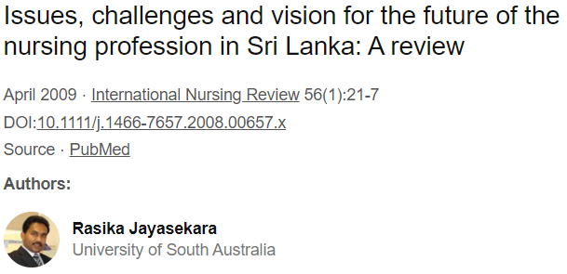
2. Prerequisites
Professionally competent
The appropriate and relevant competencies for practicioners
Minimum standards for registration
The challenge in professional educaton - poglavje 7?
Requirements to continue to learn and develop
Influence of workplace culture (values)
Notes:
The appropriate and relevant competencies for practitioners are reflected in many competency frameworks reported in the literature, the most important of which have been produced by regulators of the professions. The person-centred care framework implicitly assumes that a professional meets the minimum standards for registration. The importance of the concept of person-centeredness in competency frameworks and curricula is increasing. However, the challenge in professional education is not unlike the dilemma in practise-we use the term loosely, but it tends to reflect a principled understanding of person-centeredness without the consistency to operationalize it in practise. This problem is illustrated in Chapter 7 of this book by O'Donnell et al. In this chapter, they describe the results of a meta-synthesis of person-centeredness in nursing curricula led by O'Donnell and colleagues at the University of Ulster. They concluded that although the merits of person-centred practise are widespread in contemporary health literature, there is little evidence of approaches that explicitly promote it in the design and/or delivery of nursing curricula. However, there is progress in this area as person-centeredness has become a core concept in curricula and innovative approaches to curriculum development are becoming more evident, as the example in Chapter 7 demonstrates.
The development of person-centred professionals does not stop with registration. Even after registration, professionals must continue to learn and acquire skills that will enable them to become more skilled professionals. The challenge in developing expertise, however, is the influence of workplace culture. Culture shapes the values shared by teams in the workplace and, in turn, the skills that are considered most important within a team. An example of this is emergency care, where medical technical skills are more important than nursing skills (McConnell et al. 2015). Patient safety is also high on the agenda globally, and approaches are continually being promoted in healthcare to demonstrate improvements in clinical indicators that contribute to morbidity and mortality endpoints. However, some of the saddest and most shocking stories in healthcare are often less about technical expertise and minimising physical harm and more about the dehumanising experience of healthcare. The widely acclaimed Francis Report (Francis 2013), followed by the Berwick Inquiry (Berwick 2013), clearly demonstrated this in the United Kingdom. Moreover, the call for more compassionate care is a global message (e.g., WHO 2007; Lown et al. 2011; Dewing et al. 2014a), underscoring the need to train professionals to advocate for a holistic approach to practise that takes into account the needs of patients as people.

Slide 17
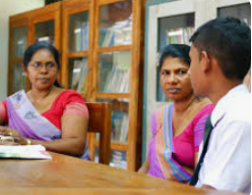
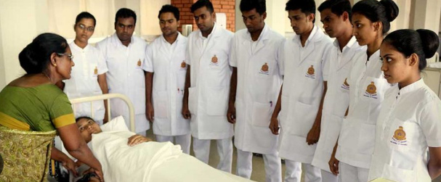
2. Prerequisites
Developed interpersonal skills
Positive relationship
Effective communication (verbal & non verbal skills)
Person-centred communication (individuals based)
(warm friendly practicioner)
(advanced communication skills)
(courageous conversation)
Emotional intelligence (knowing self & knowing others)
Notes:
Person-centredness is built on positive relationships and is dependent on a strong interpersonal skill base. Effective communication requires a combination of good verbal and non-verbal skills. Verbal communication deals with what is said (speech), and what is heard (listening), whilst non-verbal communication is concerned with body language such as posture, proximity, touch, movements, facial expressions, eye contact, gestures and other behaviours, which can add another layer of communication to verbal messages. There are many professional texts available that focus on these fundamental communication skills; however, we would argue that person-centred communication is more than the sum of its parts and that each interaction is dependent on the people involved. In essence we communicate with individuals based on what we know about them as people. This will influence what we say, how we say it, the language used and the use of specific strategies. Getting this right is really important because the impact of poor communication can be profound and often increases the vulnerability experienced by patients and their families.
At one level, a warm friendly practitioner is indicative of good interpersonal skills, and the impact of this on patients and families, and indeed other team members, should not be underestimated. The appropriate use of humour can also build rapport (Tanay et al. 2013; Tremayne 2014). There is, however, a need to move beyond simply building rapport to developing trusting partnerships that will ensure holistic needs are identified, making shared decision-making a real possibility. As professionals we can be warm and friendly, but if we don’t have the courage to step into the world space of another person and engage in the important conversations, then our impact will only ever be superficial. This requires professionals to develop advanced communication skills that enable them to engage in courageous conversations in order to get to the heart of what is important to the person. As previously argued by McCormack & McCance (2010), the development of effective interpersonal ability is linked to the notion of emotional intelligence as described by Goleman (1999). Emotional intelligence uses emotions intelligently and is a combination of knowing ‘self’ and knowing ‘others’ in the context of emotional beings; that is, how I and others that I relate to respond emotionally. It is through an understanding of ‘self’ as an emotional being that we can respond effectively to the emotional behaviours of others, and this aligns closely to the attribute of ‘knowing self’ within the Person-centred Nursing Framework.

Slide 18
2. Prerequisites
Knowing self
Our own life history and experiences
(develop relationships)
(engage at emotional level)
(personal meanings, beliefs, values)
Lifelong learning and personal growth
(self-reflection)
Being able to reflect in action and on action
Notes:
As professionals, we are also individuals with our own life stories and experiences that shape how we build relationships and how we engage on an emotional level. We develop as persons throughout our lives through engagement with the social world, and this shapes our personal meanings, beliefs, and values and determines 'who I am" In the context of the person-centred care framework, this means that how a person sees themselves and how they construct their world can influence how they work as a professional and how they interact with others. However, developing self-awareness is not a skill that can be learned; it requires lifelong learning and personal growth based on self-reflection. Facilitated self-reflection is a mechanism for improving our self-awareness and understanding of our behaviours. Schon (1983) argues that the ability to reflect on one's actions in order to engage in a continuous learning process is one of the defining characteristics of professional practise and is consistent with the concept of competence described above. The ability to reflect in action (while something is being done) and on action (after it has been done) has become an important feature of professional education programmes in many disciplines. To become a person-centred practitioner, we must also be open to giving and receiving feedback, and we must be able to work with that feedback through critical reflection. Improving personal self-awareness can be difficult, however, as it can force us to confront things we do not like about ourselves and can also bring to light painful experiences from the past that influence our actions in the present.

Slide 19
2. Prerequisites
Clarity of beliefs and values
beliefs and values are interrelated
enable practitioners to work
person-centred cultures
Values
what people think ought to be done/moral and ethical codes
Beliefs
what people think is true or not true
Notes:
Within person-centered care, clarity of beliefs and values is cited as one of the prerequisites that enable professionals to work with the care environment. According to Manley (2004), 'values define what people think should be done' (p. 55, italics in original), and these are closely related to moral and ethical codes. Beliefs, on the other hand, are 'what people believe to be true or not true' (p. 55). Beliefs and values are interrelated in that 'it is difficult to separate values from their believed implications' (p. 55). Finally, basic assumptions include beliefs, interpretations of beliefs, and values and emotions. They are understood as accepted truths that are unconsciously held and taken for granted (Brown 1998). Very often we live in a world of assumptions without being aware of it. Ideally, practitioners develop and agree on a set of professional values that are shared by all and then lived out in daily practice. However, this is the biggest challenge because often the values the team holds (i.e., the values we talk about) do not match the behaviors exhibited in practice. Developing person-centered cultures is based on the premise that everyone is committed to closing the gap between the values that are talked about and the behaviors that are observed (or not, as is often the case) in practice. The goal is an effective workplace culture in which certain values are shared in the workplace, such as person-centeredness, lifelong learning, high challenge, and high support, and implemented in practice through the development of a shared vision and mission with individual and collective accountability for meeting that standard (Manley et al. 2011). Practice development is the improvement methodology that provides a set of tools and approaches that enable teams to work toward these goals (McCormack et al. 2013; Dewing et al. 2014b).

Slide 20
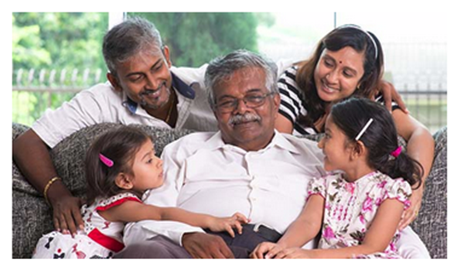
2. Prerequisites
Commitment to the job
reflect the dedication and a sense
(provide care)
(going the extra miles)
intentionalities
(be sensitive and minful)
at individual/at team/at organisational level
(transformational leadership)
Notes:
Commitment to the profession at its most basic level reflects dedication and a sense that the nurse wants to provide the best care for patients and their families. Commitment at an individual level shows that the nurse demonstrates a high level of commitment to patients and families by going the extra mile. However, commitment to the profession means more than just going the "extra mile." It is also linked to the idea of intentionality, which is defined as 'the fact of acting intentionally or purposefully' (www.oxforddictionaries.com). The concept of intentionality is discussed in the nursing literature by several nursing theorists. Watson (1985) defines caring as 'a value and attitude that must become a will, intention, or commitment that manifests itself in concrete actions' (p. 32). Furthermore, she believes that 'our intentionality informs our choices and actions, helping us to be sensitive and mindful of what matters most in our lives and work' (p. 17). Commitment to work, in this sense, is more than an act of kindness, but a mindful action based on different kinds of facts.
Commitment at the individual level, however, can be difficult to sustain if it conflicts with the philosophy of the team. In this case, the engaged physician finds that he or she is constantly swimming against the tide and becomes disillusioned and dissatisfied with the standard of care within the team. Contemporary leadership literature emphasises the importance of transformational leadership, described by Kouzes and Posner (2002) as 'empowering others to act' through approaches that foster collaboration, build trust, and provide visible support. However, individuals and teams also work within organisations, which emphasises organisational-level engagement. Furthermore, the literature suggests that organisational commitment is influenced by organisational culture and that understanding organisational culture is important because it influences how we understand organisational life and the importance we place on activities (Manley 2011; Napier et al. 2014). This underscores the relationship between commitment to work and clarity of beliefs and values not only at the individual level, but also at the team and organisational levels.

Slide 21
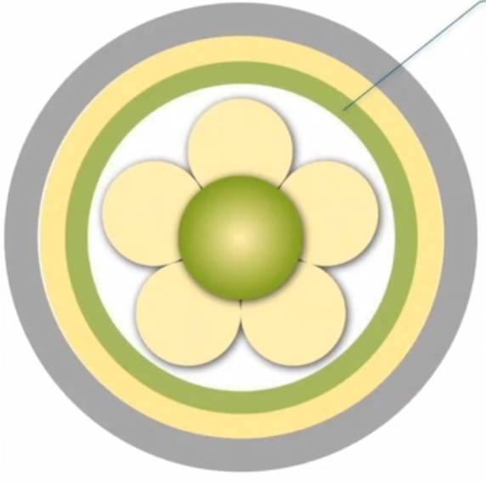
3. care environment
Appropriate skill mix
Shared decision making
Effective staff relationships
Supportive organizational strategies
Power sharing
Potential for innovation and risk taking
The physical environment
Notes:
In the previous section, staff characteristics were discussed and described as prerequisites for person-centred practise. However, we believe that regardless of staff characteristics, the true potential of teams can only be realised if the care environment is conducive to person-centred practise. This reflects a complexity within the care environment that focuses on the context in which care is delivered. There is increasing recognition that context has a significant impact on clinical and team effectiveness. There is a growing body of literature in the area of knowledge translation and knowledge utilisation that addresses the following topics: Exploring the importance of context; Identifying the key elements of context and their facilitating or hindering properties (for evidence/knowledge use); and Developing approaches to measure the impact of context on clinical and team effectiveness, including the impact on patient outcomes (Rycroft-Malone 2004; McCormack et al. 2009; Rycroft-Malone et al. 2013). It is increasingly recognised that context is a complex phenomenon, and while it may be easy to say what it is (in our case, context refers to the care environment), it is less easy to describe its characteristics and properties. To some extent, this difficulty reflects the relationship between context and culture, an area explored in more detail in Section 2 of this book. The position taken with respect to the framework is that context is synonymous with the care environment, and within the care environment are multifaceted characteristics and qualities of the environment (people, processes, and structures) that impact the effectiveness of person-centred practise.
To this end, seven characteristics of the care environment are described within the framework, including:an appropriate skill mix; systems that facilitate shared decision making; power sharing; effective relationships among staff; organisational systems that are supportive; potential for innovation and risk-taking; the physical environment.
In addition, we would argue that the constructs comprising the care environment have a significant impact on operationalizing person-centred practise and have the greatest potential to limit or enhance the facilitation of person-centred processes (McCormack et al. 2011).

Slide 22
3. The care environment
Appropriate skill mix
physicians & nurses
registered & non-registered nurses & nursing team
Policy solution? (response to shortages of staff)
(cost containment)
(facilitating the interface between organizations)
Placed the value (hierarchy/users focus)
Notes:
A central theme in the skill-mix debate is the value placed on different types of health care and nursing staff work.Nurses' work has been characterized in a variety of ways, such as technical or nontechnical, direct or indirect, skilled or unskilled, acute or nonacute, urgent or nonurgent. Most of these categorizations are morally charged terms that suggest a hierarchy of value or worth among different activities. The challenge is that tangible, observable, and objectively measurable activities are often assigned a higher value.

Slide 23
3. The care environment
Shared decision making
development of an effective team
(specific values)
(characterise practice)
(needs)
(formal systems)
learning cultures
central principle of practice development methodology
Notes:
In this context, it is critical that employees are provided with opportunities for engagement that allow them to actively participate in decisions that directly impact their work environment.Characteristics of an effective workplace culture include:
-Specific values (explicitly shared in the workplace and put into practise with individual and collective accountability)
-Adaptability (innovation and creativity shape practise)
-Appropriate change (aligns with the needs of patients/service users/communities)
-Formal systems (to enable continuous assessment of learning, performance, and shared governance).
A learning culture is one in which nurses find their work exciting and invigorating and in which they have the prospect of personal and professional growth.
The central principle of the practise development metodology is individual, team, and organisational commitment to collaborative, inclusive, and participatory ways of working.We can also speak of the principles as being consistent with notions of a relationship with others that values hearing all voices and including all in decision making.

Slide 24
3. The care environment
Effective staff relationships
relationships within the team
(interpersonal abilities)
(beliefs)
(values)
(knowing self)
Notes:
EFFECTIVE STAFF RELATIONSHIPS ARE INTERPERSONAL CONECTIONS THAT ARE PRODUCTIVE IN THE ACHIVEMENT OF HOLISTIC PERSON-CENTRE CARE.
As well as looking at how we build positive relationships with our patients and service users, we should also look at how we build our professional relationships.
It is important to recognise the link between power, violence, distorted perceptions and avtonomy with other constructs such as our interpersonal skills, clear beliefs, values and self-knowledge.

Slide 25
3. The care environment
Power sharing
power and its impact on decision-making
(stereotypical hierrarchical relationships)
(critical role of knowledge as power)
PCP, avtonomy, equality, centrality, guiding
Notes:
Closely related to developing effective employee relations is the issue of power distribution.Stereotypical hierarchical relationships still exist within organizational systems. This situation requires practitioners to challenge existing practices that cause domination so that we can move away from hierarchical domination and understand the critical role of knowledge as power.
A clear division of roles and an appreciation of the contribution of different team members to the overall nursing experience are necessary.There is no doubt that person-centered person practice requires an organization of work that allows staff to exercise power.
PC practice makes it clear that avtonomy, equality in relationships, and the centrality of beliefs and values to decision making are necessary.

Slide 26
3. The care environment
The physical environment
increase number of single rooms
(acquired infection
(improve patient satisfaction
aesthetic environment
(art)
(sensory and emotional stimulation)
Notes:
There are examples of the importance of the physical environment to care.
Most hospitals and health care facilities were designed with clinical efficiency in mind, not people.
Do you know of any examples of more single rooms? Single rooms will reduce the incidence of hospital-acquired infections and improve patient satisfaction in terms of noise, privacy, and dignity, but they do not take into account the presence of health care workers and aspects that we know are important to person-centred practise.The aesthetic environment promotes healing, nourishment, care, belonging, and sensory responses, and plays an important role in creating aesthetically pleasing spaces. .
The strategic placement of art (paintings, sculptures and illustrations) for sensory and emotional stimulation, the use of light, sounds and smells to promote relaxation and therapeutic engagement.

Slide 27
3. The care environment
Supportive organizational systems
administration
professional practice
professional development
the need for staff to be…
Notes:
While team-level support systems are essential, it is important to recognise that teams are situated in a broader organisational context that can have a significant impact on team functioning.
This success is associated with three areas that are important to multiprofessional teams:
- Administration - decentralised structures, flexible working, participative and supportive management style, adequate staffing, use of professional staff, and well-prepared and qualified leaders (nurses).
- Professional practise - models of professional practise, associated autonomy and responsibility, availability of professional guidance and emphasis on teaching
- Professional development - planned staff orientation, emphasis on in-service training, competency-based clinical leaders, and management development.

Slide 28
3. The care environment
Potential for innovation and risk taking
independence (avtonomous, dependent, provide care)
Four processes form:
1. The facilitaion of decision-making
2. The recognition of the values
3. The making explicit of intention
4. The creation of a culture of care
Notes:
In nursing, professional autonomy is considered one of the most important factors in nurses' job satisfaction and is defined as professional independence, initiative, and freedom that are either allowed or required in daily work.
It is based on the premise that people are sometimes autonomous and sometimes dependent, and sometimes care for those who are dependent.
McCormack argues that nurses must go through four processes in an interconnected relationship with patients to facilitate adaptation to decision making. These four processes include:
1. Facilitating decision making by sharing information and integrating new information into existing perspectives and care practices.
2. Recognizing the importance of individual values in decision making and knowing how individuals' values influence the decisions they make.
3. Clarifying intentions and motivations for actions and the boundaries within which nursing decisions are made.
4. Creating a culture of care that values the patient's views as a legitimate basis for decision making while recognizing that the individual need not always be the final authority in decisions.

Slide 29
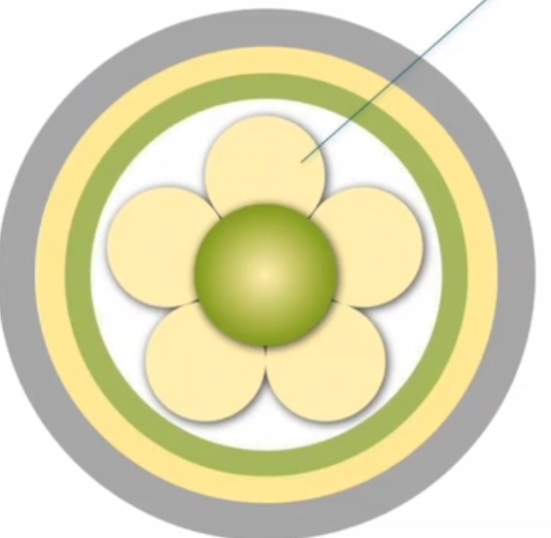
4 Person-centred processes
Providing holistic care
Working with patients values and beliefs
Engaging authentically
Shared decision making
Being sympathetically present
Notes:
Person-centred processes focus on the delivery of care through a series of activities that operationalize person-centred practise.These include: working with patient beliefs and values, authentic engagement, empathetic presence, shared decision making, and holistic care. This is the component of the framework that focuses specifically on the patient and describes person-centred practise in the context of care delivery.

Slide 30
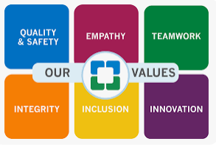
4. Person-centred processes
Working with patients values and beliefs
- clear picture (values)
(what is happening)
(a person´s life history)
- a person-centred assessment (process)
Notes:
Working with the patient's beliefs and values is one of the basic principles of person-centred care, which involves developing a clear picture of what the patient values about his or her life and how he or she frames what is happening. Knowing each other's values and beliefs requires nursing care in which it is important to understand each patient as an individual human being.
A person's life story shapes who they are today, with events influencing and guiding the choices they make and the kind of life they want to live. It is this story that gives meaning to the individual's values and provides a better understanding of what is important to the patient in order to integrate personalised information into a care plan.
Person-centred assessment is key to obtaining information that provides a picture of the patient as an individual with a unique life story. This area is also closely related to the assessment process and the thorny issue of documentation and what constitutes the patient report.

Slide 31
4. Person-centred processes
Sharing decision making
How professionals can facilitate participation in shared
decision-making?
(be there)
(offering personal support)
(offering practical experience)
(being with and doing with)
(trust/dynamic led/partnership/lear from each other)
Notes:
This element of the framework focuses on facilitating patient participation in decision making by providing information and integrating newly formed perspectives into established practises.
The role of the person-centred practitioner is to be there for the patient, providing personalised support and practical expertise while empowering them to follow their own chosen path and make their own decisions. It is about being with the patient and acting with them, actively participating to activate the potential within themselves.
Those who care and those who are cared for do not have to relate to each other as strong and weak, but both can grow from the other's ability to learn from each other on an equal footing.

Slide 32
4. Person-centred processes
Engaging authentically
(unique interaction with that person at that time)
(based on their own values and beliefs)
Different levels of engagement
(full engagement – connectedness)
(partiqal disengagement)
(complete disengagement)
Notes:
Engagement is a way of working that reflects a practitioner's attachment to his or her patient. If we accept that each care situation is viewed as a unique interaction and that the focus is on the interaction with that person at that time, based on their own values and beliefs, we can assume that the practitioner is authentically engaging with the patient.
With this in mind, McCormack presents different levels of disengagement: full engagement, partial disengagement, and full disengagement.
Full engagement occurs when the patient and caregiver are connected in the relationship and there is a partnership of care. Shared decision making occurs, and the values of the caregiver and the patient are present at a subconscious level in the care and support.
As a result, partial disengagement occurs while the nurse takes stock of the situation and formulates the problem. At this point, the interconnected work between nurse and patient is interrupted, and regardless of the cause, the nurse-patient relationship is altered and the nurse may lose the maximum understanding that was present while engaged with the patient. Such a disconnection then requires a period of contemplation, and for a period of time, a complete separation occurs. At this point, the nurse must decide on appropriate actions to restore the relationship. Support mechanisms that facilitate reflective practice can help achieve this goal.

Slide 33
4. Person-centred processes
Being sympathetically present
(to describe a way of being with the patients)
(recognise the uniqueness and value)
(reflect the quality of the relationship)
(understanding of the patient´s losses, limitations)
Notes:
It is often argued why the term empathy is not used, which is often considered more appropriate in the context of health care. The term sympathetic presence was chosen carefully to describe a way of relating to the patient that recognises the uniqueness and value of the individual and reflects the quality of the relationship between clinician and patient. When a therapist demonstrates a saympathetic understanding of the patient's losses and current limitations through acceptance of the person, a therapeutic relationship is established that aims to achieve an effective care outcome that focuses on the person's needs and life perspectives. Therefore, the ability to demonstrate an sympathetically presence depends on knowing the patient and having insight into his or her beliefs and values.
Every time a clinician approaches a patient for any reason, whether to administer medication, perform a procedure, or ask a specific question, it is an opportunity to focus on the person. There is an unresolved issue that needs to be addressed, and that can be a problem for a number of reasons. It may be because the practitioner does not feel confident or lacks the expertise to address the patient's needs, or it may be a result of the environment and other priorities that are stressing the practitioner at that time.

Slide 34
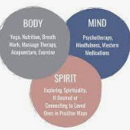
4. Person-centred processes
Providing holistic care
(reflect living a positive life)
(include the basic needs)
(access to the widest possible information)
(external environment)
What is the challenge for practicioners?
Notes:
The social model of health includes the basic needs for food, drink, shelter, warmth, etc. Access to as much information as possible and the ability and confidence to process that information, as well as the recognition that an individual is never completely isolated from other people and the external environment and cannot be understood in complete isolation from the influences of their environment. In this context, we take a more holistic, multidimensional approach to identifying patient needs, as distinct from a conceptual model.
The challenge is to ensure that therapists consider the whole person in a way that provides comprehensive therapeutic benefit.

Slide 35
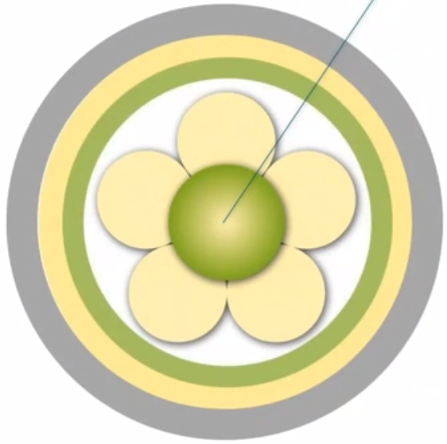
5 Outcomes
Healthful culture
Feeling of well being
Involvement in care
Good care experience
Notes:
Person centred outcomes are the central construct within the framework and represent the results expected from effective person centred practice.The outcomes include a good experience of care, involvement in care, feeling of well being and existence of a health culture (previously creating a therateutic environment).

Slide 36
5. Outcomes
Good care experience
(reflect evaluation a patient)
(satisfaction with care)
(using surveys)
(patient experience / feedback / objective, subjective)
Notes:
A good nursing experience reflects the valuation a patient or nurse places on their episode of care. At the organisational level, surveys are often conducted and lack depth.The decision to refine this outcome measure was based on research findings, as well as strategies and policies that focus on patient experience.Patient experience varies widely and is defined as feedback from patients about what actually happened during the course of care or treatment.

Slide 37

5. Outcomes
Felling of well being
(among patients and practitioners)
Notes:
McCance made the point that positive care experiences create a sense of well-being in patients and are a sign that patients feel valued. Similarly, professionals need to feel valued for their work, and this is also seen as a key aspect of outcome assessment in person-centred practise.

Slide 38

5. Outcomes
Existence of a healthful culture
(decision making is shared)
(staff relationships are collaborative)
(leadership is transformational)
(innovative practices are supported)
Notes:
A healthy culture means living a positive life that embraces all dimensions of our being.A healthy culture is one in which decision-making is shared, relationships among employees are collaborative, leadership is transformative, innovative practises are supported, and the end result is for teams to work to develop a workplace that is people-centred.
The use of the term "healthy" reflects good health performance more broadly.
It has already been proven that empowering staff to deliver person-centred care has benefits for staff and consequently increases retention and job satisfaction.

Slide 39

5. Outcomes
Measured by Person-Centred Practice Inventory (PCPI)
Observations of practice
Notes:
The Person-Centered Practice Inventory - Staff (PCPI - S) is a psychometrically valid instrument that specifically relates to a theoretical framework for person-centered practice and provides a general measure of person-centeredness. Here https://www.cpcpr.org/resources you can download the English, German, Swiss-German, Danish, Norwegian, Spanish and Malaysian versions of the PCPI-S and PCPI-C (Nursing).
On the following slides you will find the measurement instruments of the Person-Centered Practice Inventory (PCPI).

Slide 40
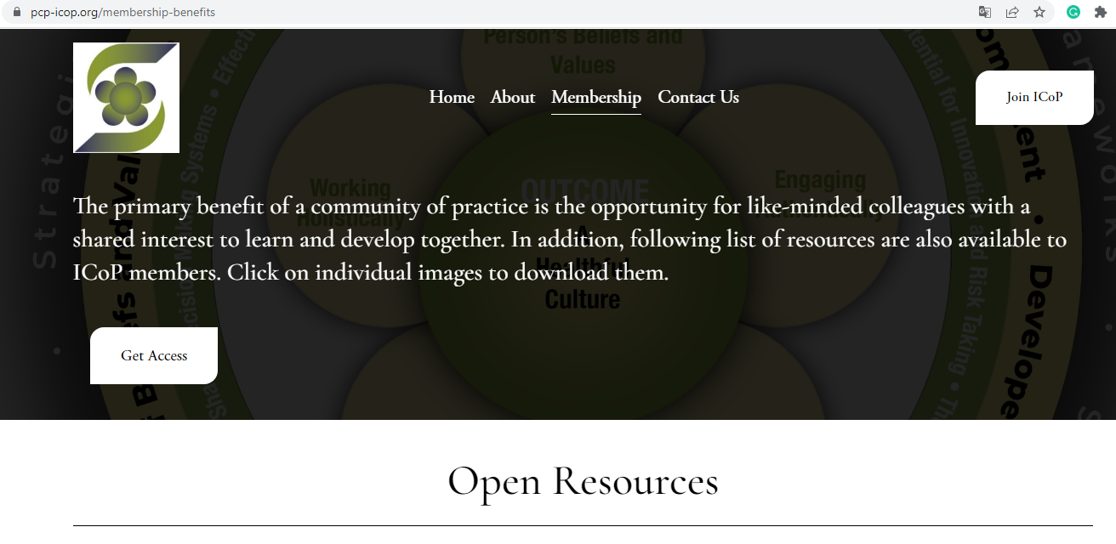
5. Outcomes
Notes:
On the following slides you will find measurement tools from the Person-Centered Practice Inventory (PCPI), assessment forms for staff, service users and a revised tool for critical analysis of workplace culture .

Slide 41
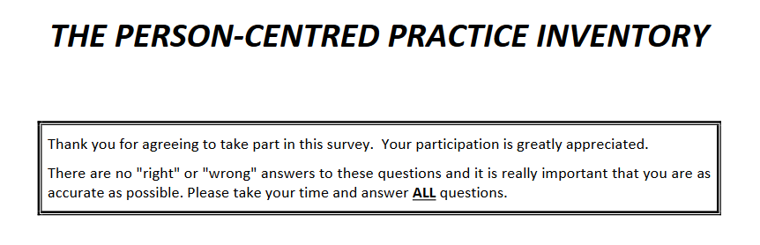
5. Outcomes
Measured by Person-Centred Practice Inventory (PCPI)
https://www.cpcpr.org/_files/ugd/26205d_a985e51cdaca4fa293aa3540631a7bb1.pdf
Notes:
https://www.cpcpr.org/_files/ugd/26205d_a985e51cdaca4fa293aa3540631a7bb1.pdf

Slide 42
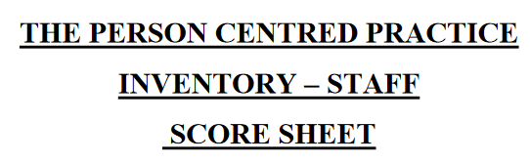
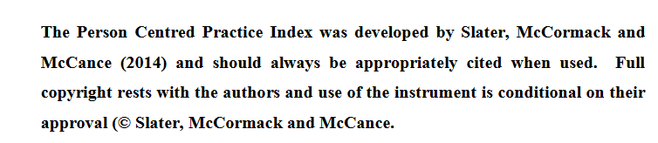
5. Outcomes
Measured by
Person-Centred
Practice Inventory (PCPI)
Notes:
https://www.cpcpr.org/_files/ugd/26205d_3b93f3201fe04acdbf1cb0544b51d575.pdf

Slide 43
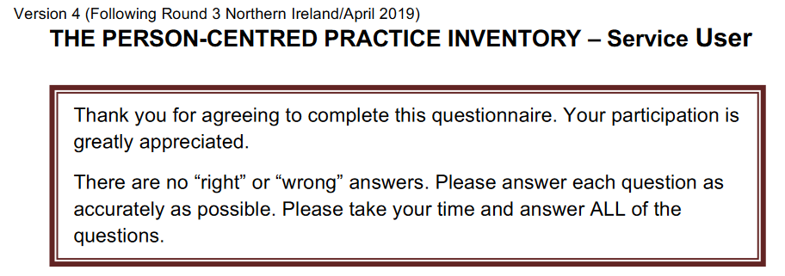
5. Outcomes
Measured by Person-Centred
Practice Inventory (PCPI)
Notes:
https://www.cpcpr.org/_files/ugd/26205d_69c91d56cfe847a8919649a43d8cd991.pdf

Slide 44

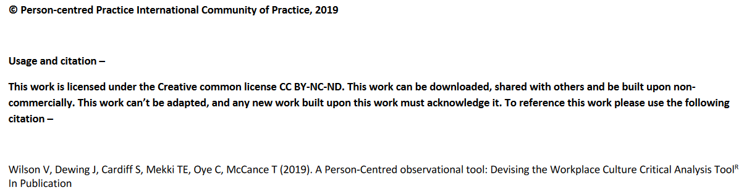
5. Outcomes
Notes:
https://www.cpcpr.org/_files/ugd/26205d_e31213a6afbc4e18b4cfa2d2c3386357.pdf

Slide 45
references
Centre for person-centred practice resarch. https://www.cpcpr.org/resources
McCance, T., McCormack, B., & Dewing, J. (2011). An exploration of person-centredness in practice. Online journal of issues in nursing, 16(2), 1. https://pubmed.ncbi.nlm.nih.gov/22088150/
McCance, T., McCormack, B. ( ). The Person-centred practice framework. Chapter 3. https://nursekey.com/the-person-centred-practice-framework/
Cardiff, S., McCormack, B., & McCance, T. (2018). Person-centred leadership: A relational approach to leadership derived through action research. Journal of clinical nursing, 27(15-16), 3056–3069. https://doi.org/10.1111/jocn.14492
Mayer,H., McCormack, B., Hildebrandt, C., Köck-Hódi, S., Zoje, E. & Wallner, M. (2020). Knowing the person of the resident – a theoretical framework for Person-centred Practice in Long-term Care (PeoPLe). International Practice Development Journal 10(2):1-16. DOI:10.19043/ipdj.102.003
Notes:
At the end you will find some notes for your further reading and an explanation of the practice of McCormack and McCance.

Slide 46
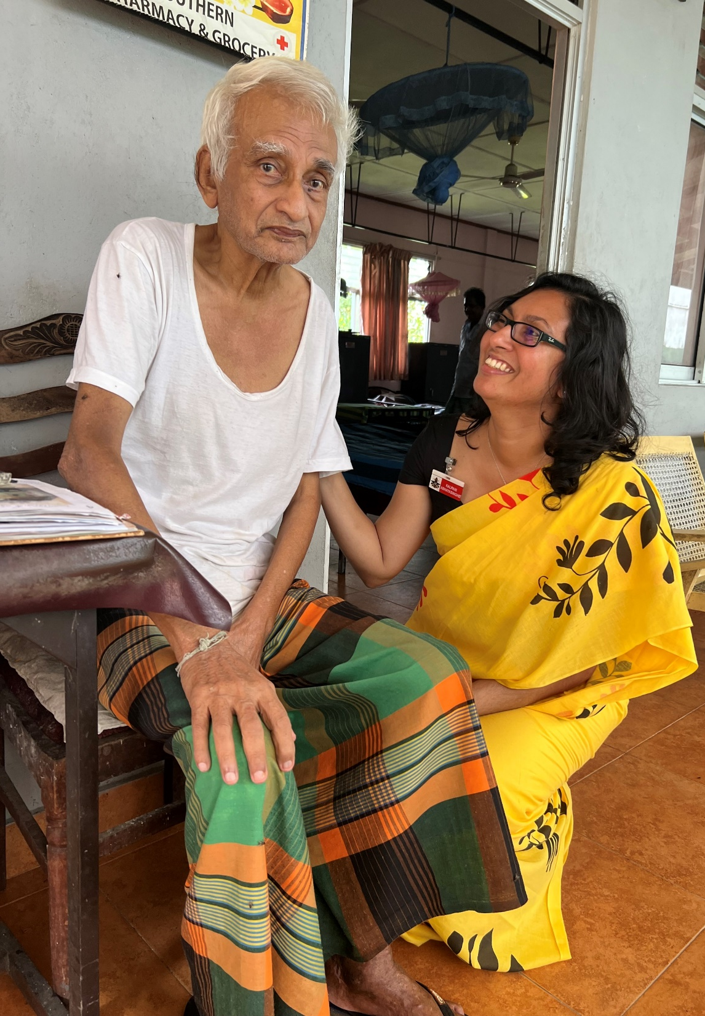
Thank you for listening!
Reference number: 618596-EPP-1-2020-1-SE-EPPKA2-CBHE-JP This publication [communication] reflects the views only of the authors, and the Commission cannot be held responsible for any use, which may be made of the information contained therein.

