Slide 1
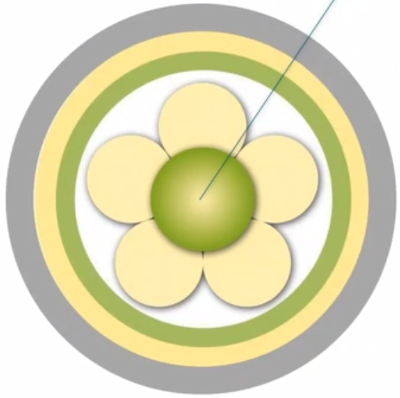

5 Outcomes
Healthful culture
Feeling of well being
Involvement in care
Good care experience
Notes:
Person centred outcomes are the central construct within the framework and represent the results expected from effective person centred practice.The outcomes include a good experience of care, involvement in care, feeling of well being and existence of a health culture (previously creating a therateutic environment).

Slide 2
5. Outcomes
Good care experience
(reflect evaluation a patient)
(satisfaction with care)
(using surveys)
(patient experience / feedback / objective, subjective)
Notes:
A good nursing experience reflects the valuation a patient or nurse places on their episode of care. At the organisational level, surveys are often conducted and lack depth.The decision to refine this outcome measure was based on research findings, as well as strategies and policies that focus on patient experience.Patient experience varies widely and is defined as feedback from patients about what actually happened during the course of care or treatment.

Slide 3

5. Outcomes
Felling of well being
(among patients and practitioners)
Notes:
McCance made the point that positive care experiences create a sense of well-being in patients and are a sign that patients feel valued. Similarly, professionals need to feel valued for their work, and this is also seen as a key aspect of outcome assessment in person-centred practise.

Slide 4

5. Outcomes
Existence of a healthful culture
(decision making is shared)
(staff relationships are collaborative)
(leadership is transformational)
(innovative practices are supported)
Notes:
A healthy culture means living a positive life that embraces all dimensions of our being.A healthy culture is one in which decision-making is shared, relationships among employees are collaborative, leadership is transformative, innovative practises are supported, and the end result is for teams to work to develop a workplace that is people-centred.
The use of the term "healthy" reflects good health performance more broadly.
It has already been proven that empowering staff to deliver person-centred care has benefits for staff and consequently increases retention and job satisfaction.

Slide 5

5. Outcomes
Measured by Person-Centred Practice Inventory (PCPI)
Observations of practice
Notes:
The Person-Centered Practice Inventory - Staff (PCPI - S) is a psychometrically valid instrument that specifically relates to a theoretical framework for person-centered practice and provides a general measure of person-centeredness. Here https://www.cpcpr.org/resources you can download the English, German, Swiss-German, Danish, Norwegian, Spanish and Malaysian versions of the PCPI-S and PCPI-C (Nursing).
On the following slides you will find the measurement instruments of the Person-Centered Practice Inventory (PCPI).

Slide 6
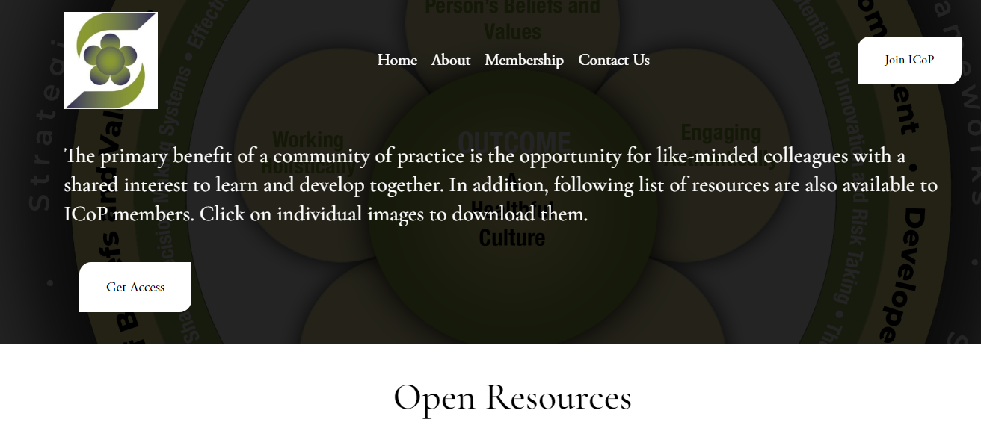
5. Outcomes
Notes:
On the following slides you will find measurement tools from the Person-Centered Practice Inventory (PCPI), assessment forms for staff, service users and a revised tool for critical analysis of workplace culture .

Slide 7
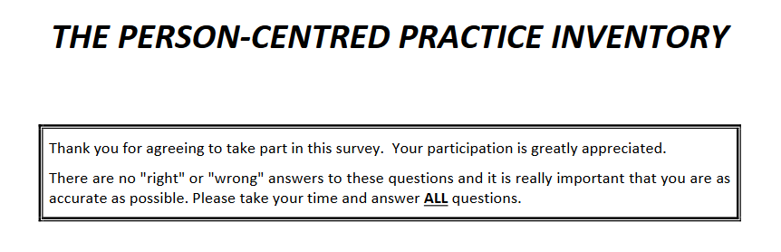
5. Outcomes
Measured by Person-Centred Practice Inventory (PCPI)
https://www.cpcpr.org/_files/ugd/26205d_a985e51cdaca4fa293aa3540631a7bb1.pdf
Notes:
https://www.cpcpr.org/_files/ugd/26205d_a985e51cdaca4fa293aa3540631a7bb1.pdf

Slide 8
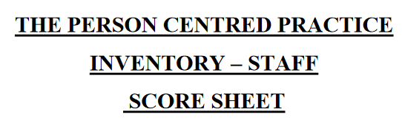
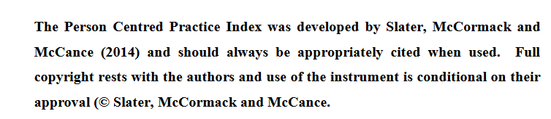
5. Outcomes
Measured by
Person-Centred
Practice Inventory (PCPI)
Notes:
https://www.cpcpr.org/_files/ugd/26205d_3b93f3201fe04acdbf1cb0544b51d575.pdf

Slide 9
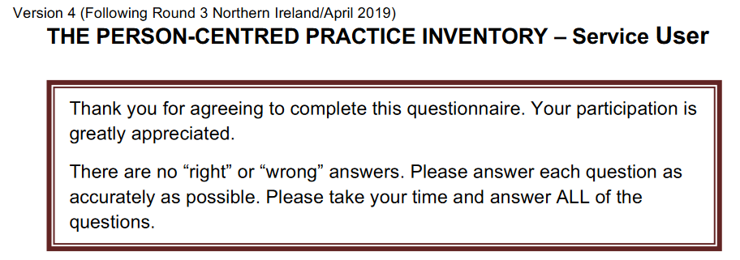
5. Outcomes
Measured by Person-Centred
Practice Inventory (PCPI)
Notes:
https://www.cpcpr.org/_files/ugd/26205d_69c91d56cfe847a8919649a43d8cd991.pdf

Slide 10

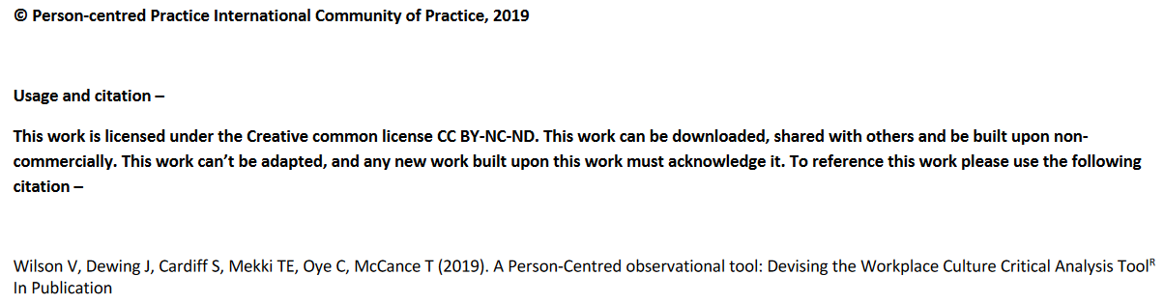
5. Outcomes
Notes:
https://www.cpcpr.org/_files/ugd/26205d_e31213a6afbc4e18b4cfa2d2c3386357.pdf

Slide 11
references
Centre for person-centred practice resarch. https://www.cpcpr.org/resources
McCance, T., McCormack, B., & Dewing, J. (2011). An exploration of person-centredness in practice. Online journal of issues in nursing, 16(2), 1. https://pubmed.ncbi.nlm.nih.gov/22088150/
McCance, T., McCormack, B. ( ). The Person-centred practice framework. Chapter 3. https://nursekey.com/the-person-centred-practice-framework/
Cardiff, S., McCormack, B., & McCance, T. (2018). Person-centred leadership: A relational approach to leadership derived through action research. Journal of clinical nursing, 27(15-16), 3056–3069. https://doi.org/10.1111/jocn.14492
Mayer,H., McCormack, B., Hildebrandt, C., Köck-Hódi, S., Zoje, E. & Wallner, M. (2020). Knowing the person of the resident – a theoretical framework for Person-centred Practice in Long-term Care (PeoPLe). International Practice Development Journal 10(2):1-16. DOI:10.19043/ipdj.102.003
Notes:
At the end you will find some notes for your further reading and an explanation of the practice of McCormack and McCance.

Slide 12
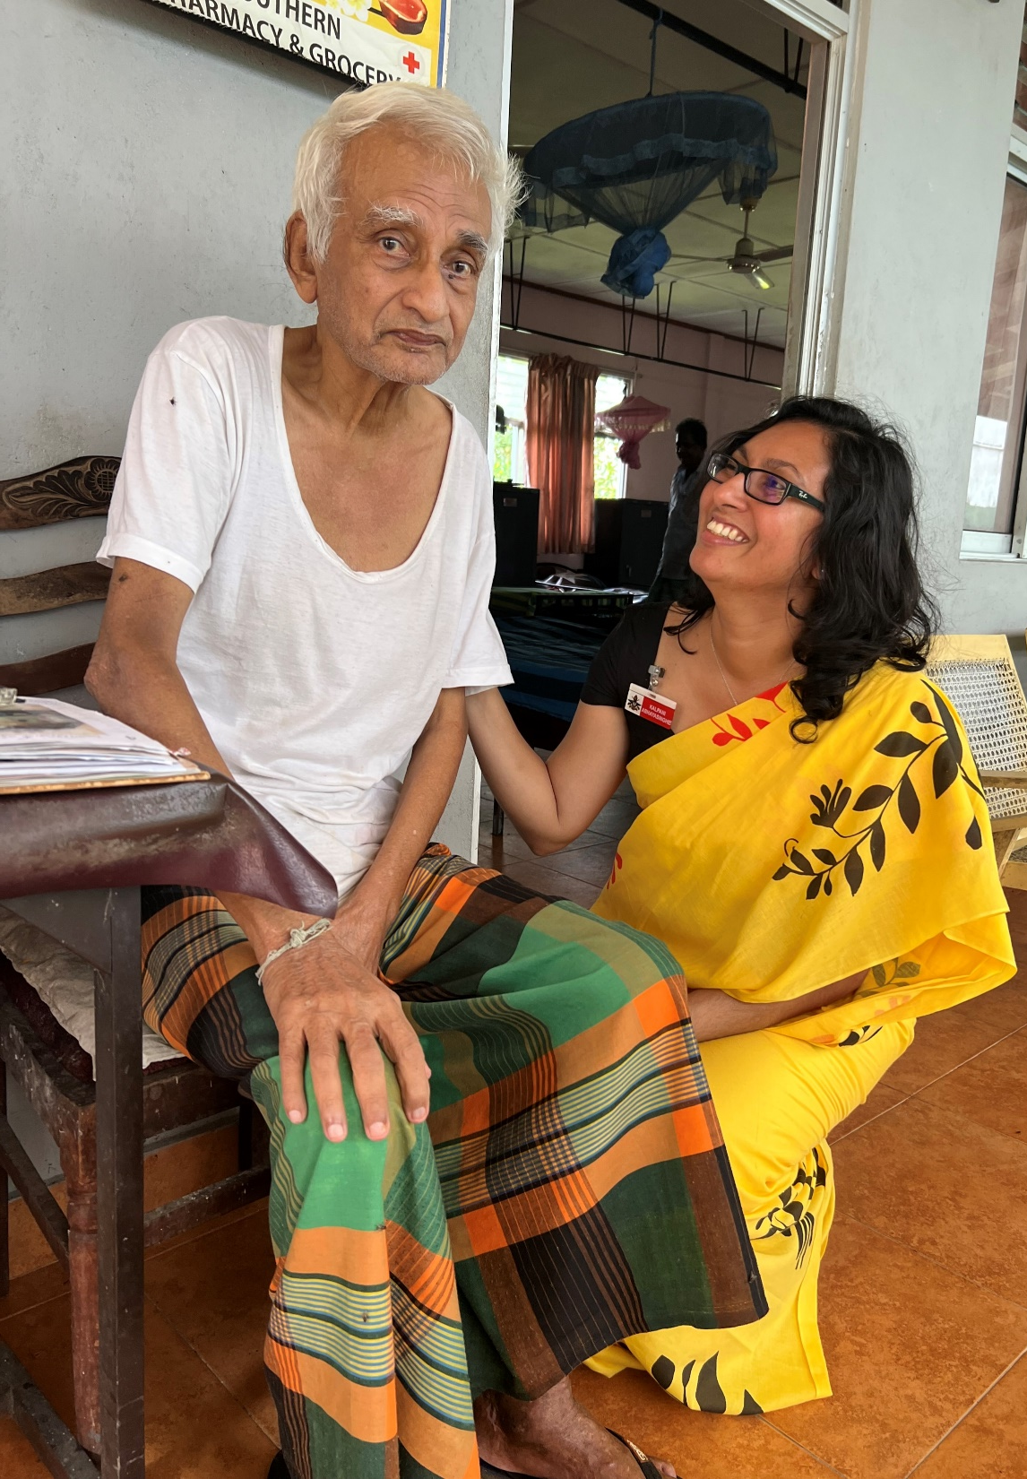


Thank you for listening!
Reference number: 618596-EPP-1-2020-1-SE-EPPKA2-CBHE-JP This publication [communication] reflects the views only of the authors, and the Commission cannot be held responsible for any use, which may be made of the information contained therein.

