Slide 1
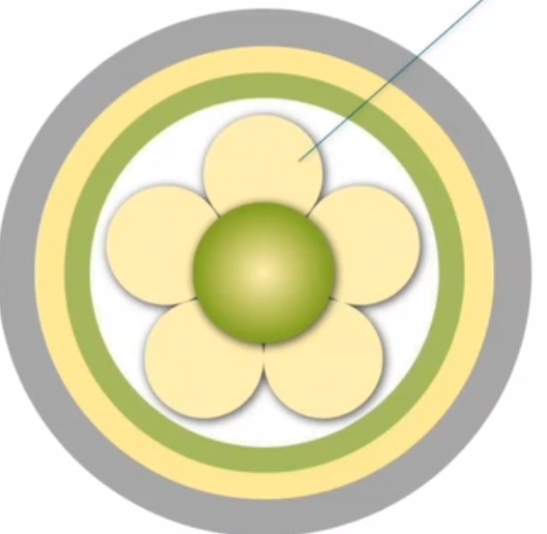

4 Person-centred processes
Providing holistic care
Working with patients values and beliefs
Engaging authentically
Shared decision making
Being sympathetically present
Notes:
Person-centred processes focus on the delivery of care through a series of activities that operationalize person-centred practise.These include: working with patient beliefs and values, authentic engagement, empathetic presence, shared decision making, and holistic care. This is the component of the framework that focuses specifically on the patient and describes person-centred practise in the context of care delivery.

Slide 2
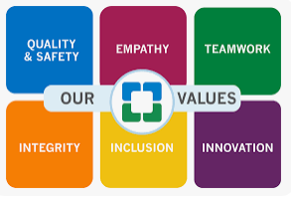
4. Person-centred processes
Working with patients values and beliefs
- clear picture (values)
(what is happening)
(a person´s life history)
- a person-centred assessment (process)
Notes:
Working with the patient's beliefs and values is one of the basic principles of person-centred care, which involves developing a clear picture of what the patient values about his or her life and how he or she frames what is happening. Knowing each other's values and beliefs requires nursing care in which it is important to understand each patient as an individual human being.
A person's life story shapes who they are today, with events influencing and guiding the choices they make and the kind of life they want to live. It is this story that gives meaning to the individual's values and provides a better understanding of what is important to the patient in order to integrate personalised information into a care plan.
Person-centred assessment is key to obtaining information that provides a picture of the patient as an individual with a unique life story. This area is also closely related to the assessment process and the thorny issue of documentation and what constitutes the patient report.

Slide 3
4. Person-centred processes
Sharing decision making
How professionals can facilitate participation in shared
decision-making?
(be there)
(offering personal support)
(offering practical experience)
(being with and doing with)
(trust/dynamic led/partnership/lear from each other)
Notes:
This element of the framework focuses on facilitating patient participation in decision making by providing information and integrating newly formed perspectives into established practises.
The role of the person-centred practitioner is to be there for the patient, providing personalised support and practical expertise while empowering them to follow their own chosen path and make their own decisions. It is about being with the patient and acting with them, actively participating to activate the potential within themselves.
Those who care and those who are cared for do not have to relate to each other as strong and weak, but both can grow from the other's ability to learn from each other on an equal footing.

Slide 4
4. Person-centred processes
Engaging authentically
(unique interaction with that person at that time)
(based on their own values and beliefs)
Different levels of engagement
(full engagement – connectedness)
(partiqal disengagement)
(complete disengagement)
Notes:
Engagement is a way of working that reflects a practitioner's attachment to his or her patient. If we accept that each care situation is viewed as a unique interaction and that the focus is on the interaction with that person at that time, based on their own values and beliefs, we can assume that the practitioner is authentically engaging with the patient.
With this in mind, McCormack presents different levels of disengagement: full engagement, partial disengagement, and full disengagement.
Full engagement occurs when the patient and caregiver are connected in the relationship and there is a partnership of care. Shared decision making occurs, and the values of the caregiver and the patient are present at a subconscious level in the care and support.
As a result, partial disengagement occurs while the nurse takes stock of the situation and formulates the problem. At this point, the interconnected work between nurse and patient is interrupted, and regardless of the cause, the nurse-patient relationship is altered and the nurse may lose the maximum understanding that was present while engaged with the patient. Such a disconnection then requires a period of contemplation, and for a period of time, a complete separation occurs. At this point, the nurse must decide on appropriate actions to restore the relationship. Support mechanisms that facilitate reflective practice can help achieve this goal.

Slide 5
4. Person-centred processes
Being sympathetically present
(to describe a way of being with the patients)
(recognise the uniqueness and value)
(reflect the quality of the relationship)
(understanding of the patient´s losses, limitations)
Notes:
It is often argued why the term empathy is not used, which is often considered more appropriate in the context of health care. The term sympathetic presence was chosen carefully to describe a way of relating to the patient that recognises the uniqueness and value of the individual and reflects the quality of the relationship between clinician and patient. When a therapist demonstrates a saympathetic understanding of the patient's losses and current limitations through acceptance of the person, a therapeutic relationship is established that aims to achieve an effective care outcome that focuses on the person's needs and life perspectives. Therefore, the ability to demonstrate an sympathetically presence depends on knowing the patient and having insight into his or her beliefs and values.
Every time a clinician approaches a patient for any reason, whether to administer medication, perform a procedure, or ask a specific question, it is an opportunity to focus on the person. There is an unresolved issue that needs to be addressed, and that can be a problem for a number of reasons. It may be because the practitioner does not feel confident or lacks the expertise to address the patient's needs, or it may be a result of the environment and other priorities that are stressing the practitioner at that time.

Slide 6
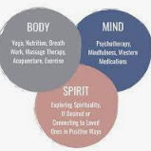
4. Person-centred processes
Providing holistic care
(reflect living a positive life)
(include the basic needs)
(access to the widest possible information)
(external environment)
What is the challenge for practicioners?
Notes:
The social model of health includes the basic needs for food, drink, shelter, warmth, etc. Access to as much information as possible and the ability and confidence to process that information, as well as the recognition that an individual is never completely isolated from other people and the external environment and cannot be understood in complete isolation from the influences of their environment. In this context, we take a more holistic, multidimensional approach to identifying patient needs, as distinct from a conceptual model.
The challenge is to ensure that therapists consider the whole person in a way that provides comprehensive therapeutic benefit.

