Slide 1
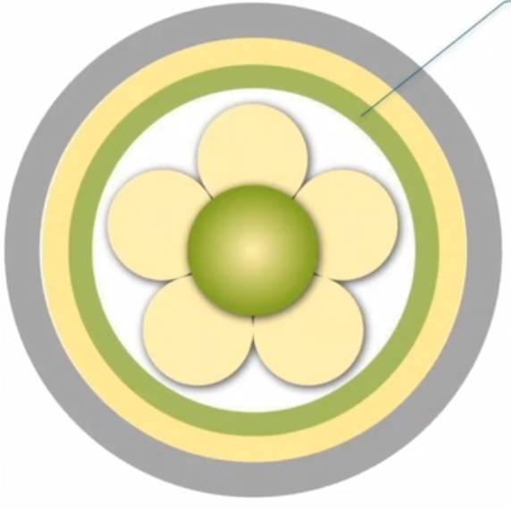

3. care environment
Appropriate skill mix
Shared decision making
Effective staff relationships
Supportive organizational strategies
Power sharing
Potential for innovation and risk taking
The physical environment
Notes:
In the previous section, staff characteristics were discussed and described as prerequisites for person-centred practise. However, we believe that regardless of staff characteristics, the true potential of teams can only be realised if the care environment is conducive to person-centred practise. This reflects a complexity within the care environment that focuses on the context in which care is delivered. There is increasing recognition that context has a significant impact on clinical and team effectiveness. There is a growing body of literature in the area of knowledge translation and knowledge utilisation that addresses the following topics: Exploring the importance of context; Identifying the key elements of context and their facilitating or hindering properties (for evidence/knowledge use); and Developing approaches to measure the impact of context on clinical and team effectiveness, including the impact on patient outcomes (Rycroft-Malone 2004; McCormack et al. 2009; Rycroft-Malone et al. 2013). It is increasingly recognised that context is a complex phenomenon, and while it may be easy to say what it is (in our case, context refers to the care environment), it is less easy to describe its characteristics and properties. To some extent, this difficulty reflects the relationship between context and culture, an area explored in more detail in Section 2 of this book. The position taken with respect to the framework is that context is synonymous with the care environment, and within the care environment are multifaceted characteristics and qualities of the environment (people, processes, and structures) that impact the effectiveness of person-centred practise.
To this end, seven characteristics of the care environment are described within the framework, including:an appropriate skill mix; systems that facilitate shared decision making; power sharing; effective relationships among staff; organisational systems that are supportive; potential for innovation and risk-taking; the physical environment.
In addition, we would argue that the constructs comprising the care environment have a significant impact on operationalizing person-centred practise and have the greatest potential to limit or enhance the facilitation of person-centred processes (McCormack et al. 2011).

Slide 2
3. The care environment
Appropriate skill mix
physicians & nurses
registered & non-registered nurses & nursing team
Policy solution? (response to shortages of staff)
(cost containment)
(facilitating the interface between organizations)
Placed the value (hierarchy/users focus)
Notes:
A central theme in the skill-mix debate is the value placed on different types of health care and nursing staff work.Nurses' work has been characterized in a variety of ways, such as technical or nontechnical, direct or indirect, skilled or unskilled, acute or nonacute, urgent or nonurgent. Most of these categorizations are morally charged terms that suggest a hierarchy of value or worth among different activities. The challenge is that tangible, observable, and objectively measurable activities are often assigned a higher value.

Slide 3
3. The care environment
Shared decision making
development of an effective team
(specific values)
(characterise practice)
(needs)
(formal systems)
learning cultures
central principle of practice development methodology
Notes:
In this context, it is critical that employees are provided with opportunities for engagement that allow them to actively participate in decisions that directly impact their work environment.Characteristics of an effective workplace culture include:
-Specific values (explicitly shared in the workplace and put into practise with individual and collective accountability)
-Adaptability (innovation and creativity shape practise)
-Appropriate change (aligns with the needs of patients/service users/communities)
-Formal systems (to enable continuous assessment of learning, performance, and shared governance).
A learning culture is one in which nurses find their work exciting and invigorating and in which they have the prospect of personal and professional growth.
The central principle of the practise development metodology is individual, team, and organisational commitment to collaborative, inclusive, and participatory ways of working.We can also speak of the principles as being consistent with notions of a relationship with others that values hearing all voices and including all in decision making.

Slide 4
3. The care environment
Effective staff relationships
relationships within the team
(interpersonal abilities)
(beliefs)
(values)
(knowing self)
Notes:
EFFECTIVE STAFF RELATIONSHIPS ARE INTERPERSONAL CONECTIONS THAT ARE PRODUCTIVE IN THE ACHIVEMENT OF HOLISTIC PERSON-CENTRE CARE.
As well as looking at how we build positive relationships with our patients and service users, we should also look at how we build our professional relationships.
It is important to recognise the link between power, violence, distorted perceptions and avtonomy with other constructs such as our interpersonal skills, clear beliefs, values and self-knowledge.

Slide 5
3. The care environment
Power sharing
power and its impact on decision-making
(stereotypical hierrarchical relationships)
(critical role of knowledge as power)
PCP, avtonomy, equality, centrality, guiding
Notes:
Closely related to developing effective employee relations is the issue of power distribution.Stereotypical hierarchical relationships still exist within organizational systems. This situation requires practitioners to challenge existing practices that cause domination so that we can move away from hierarchical domination and understand the critical role of knowledge as power.
A clear division of roles and an appreciation of the contribution of different team members to the overall nursing experience are necessary.There is no doubt that person-centered person practice requires an organization of work that allows staff to exercise power.
PC practice makes it clear that avtonomy, equality in relationships, and the centrality of beliefs and values to decision making are necessary.

Slide 6
3. The care environment
The physical environment
increase number of single rooms
(acquired infection
(improve patient satisfaction
aesthetic environment
(art)
(sensory and emotional stimulation)
Notes:
There are examples of the importance of the physical environment to care.
Most hospitals and health care facilities were designed with clinical efficiency in mind, not people.
Do you know of any examples of more single rooms? Single rooms will reduce the incidence of hospital-acquired infections and improve patient satisfaction in terms of noise, privacy, and dignity, but they do not take into account the presence of health care workers and aspects that we know are important to person-centred practise.The aesthetic environment promotes healing, nourishment, care, belonging, and sensory responses, and plays an important role in creating aesthetically pleasing spaces. .
The strategic placement of art (paintings, sculptures and illustrations) for sensory and emotional stimulation, the use of light, sounds and smells to promote relaxation and therapeutic engagement.

Slide 7
3. The care environment
Supportive organizational systems
administration
professional practice
professional development
the need for staff to be…
Notes:
While team-level support systems are essential, it is important to recognise that teams are situated in a broader organisational context that can have a significant impact on team functioning.
This success is associated with three areas that are important to multiprofessional teams:
- Administration - decentralised structures, flexible working, participative and supportive management style, adequate staffing, use of professional staff, and well-prepared and qualified leaders (nurses).
- Professional practise - models of professional practise, associated autonomy and responsibility, availability of professional guidance and emphasis on teaching
- Professional development - planned staff orientation, emphasis on in-service training, competency-based clinical leaders, and management development.

Slide 8
3. The care environment
Potential for innovation and risk taking
independence (avtonomous, dependent, provide care)
Four processes form:
1. The facilitaion of decision-making
2. The recognition of the values
3. The making explicit of intention
4. The creation of a culture of care
Notes:
In nursing, professional autonomy is considered one of the most important factors in nurses' job satisfaction and is defined as professional independence, initiative, and freedom that are either allowed or required in daily work.
It is based on the premise that people are sometimes autonomous and sometimes dependent, and sometimes care for those who are dependent.
McCormack argues that nurses must go through four processes in an interconnected relationship with patients to facilitate adaptation to decision making. These four processes include:
1. Facilitating decision making by sharing information and integrating new information into existing perspectives and care practices.
2. Recognizing the importance of individual values in decision making and knowing how individuals' values influence the decisions they make.
3. Clarifying intentions and motivations for actions and the boundaries within which nursing decisions are made.
4. Creating a culture of care that values the patient's views as a legitimate basis for decision making while recognizing that the individual need not always be the final authority in decisions.

