Slide 1


1 Macro context
Health and social care policy
Strategic frameworks
Workforce development
Strategic leadership
Notes:
The macro context is the last element added to the PCC base image as the largest outer circle. Within the macro context, students are confronted with

Slide 2
1 Macro context
Social care ~ Health care
Quality strategies, safety, patient flow, regulations
Staff well being, nurses, student
Master - Servant ~ person centred
Video:
https://www.nmc.org.uk/standards/code/code-in-action/person-centred-care/
Notes:
In a macro context, students could explore what types of social and health policies already exist in Šri LankaCreate a list of network providers or institutions at the local and national levels where professionals or non-professionals can be found providing or sharing information about care.Students can research and discuss national regulations for people with neurodegenerative diseases;Research what well-being means for employees or family members, and if possible, what well-being means for older people in Sri LankaVideo
Video_ https://www.nmc.org.uk/standards/code/code-in-action/person-centred-care/

Slide 3
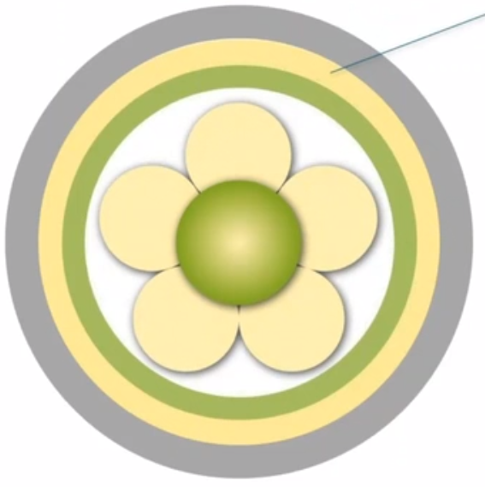
2 PREREQUISITES
Professionally competent
Developed interpersonal skills
Knowing self
Clarity of beliefs and values
Commitment to the job
Notes:
Prerequisites focus on staff attributes and are considered the key building blocks for developing health care professionals who can provide effective person-centred care. Attributes include: professional competence, strong interpersonal skills, commitment to work, clarity of beliefs and values, and self-awareness. There is no hierarchy in relation to these attributes, all are equally important, but it is the combination of attributes that reflects a person-centred professional who can deal with the challenges of an ever-changing context.
Video https://www.nmc.org.uk/standards/code/code-in-action/person-centred-care/

Slide 4
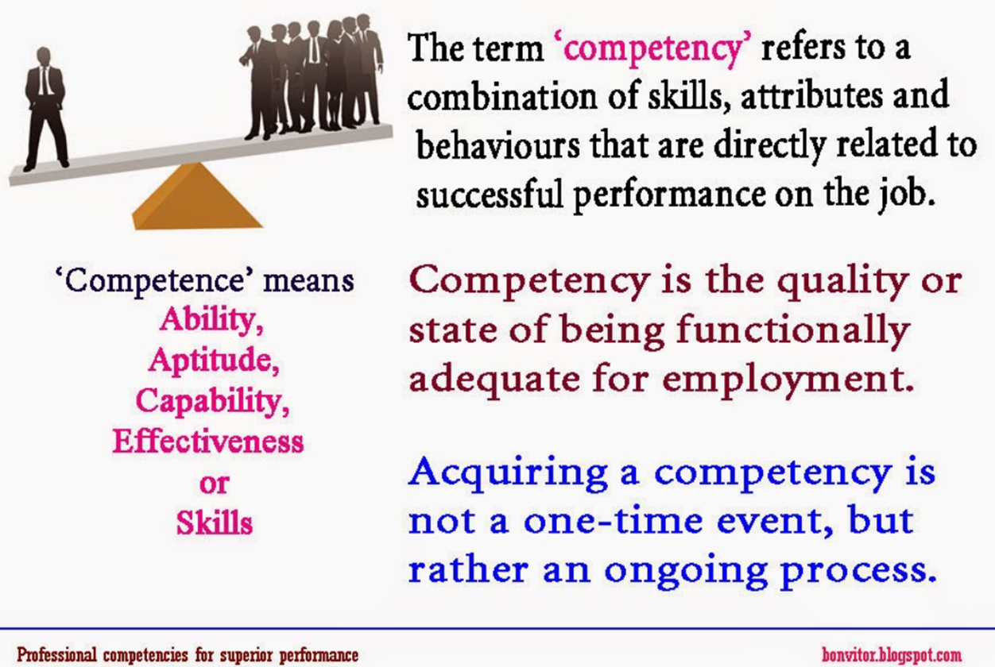
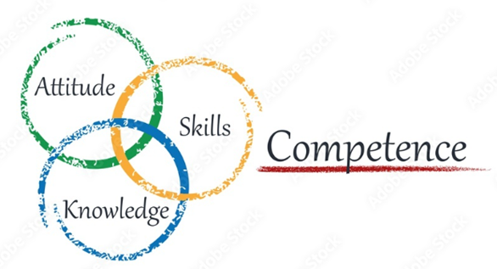
2. Prerequisites
Professionally competent
Notes:
In the context of person-centredness, competence means more than simply performing a task or demonstrating a desired behaviour, but rather reflects a holistic approach that encompasses knowledge, skills, and attitudes. In discussing the concept of competence, three main approaches are taken in the literature: a task-based or behaviourist approach, an approach that focuses on general characteristics, and the holistic approach (Hager et al. 1994). The holistic approach is consistent with the underlying values of person-centredness and emphasises bringing together individual abilities that result from a combination of characteristics and tasks to be performed in specific situations, including professional judgement .
Sundberg (2001), in discussing a holistic approach to competence development, offers a pragmatic view of competence as:
Knowledge - what one learns in education;
Experience - what one gains in one's job, workplace, and social life;
the ability to use the knowledge and experience (p. 104).
He argues that we are not able to develop another person's competence, as this is in the hands of the individual, but what we can do is 'set the framework, provide the tools, and act like catalysts' (p. 104).

Slide 5
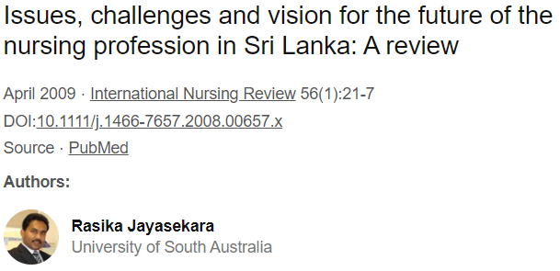
2. Prerequisites
Professionally competent
The appropriate and relevant competencies for practicioners
Minimum standards for registration
The challenge in professional educaton
Requirements to continue to learn and develop
Influence of workplace culture (values)
Notes:
The appropriate and relevant competencies for practitioners are reflected in many competency frameworks reported in the literature, the most important of which have been produced by regulators of the professions. The person-centred care framework implicitly assumes that a professional meets the minimum standards for registration. The importance of the concept of person-centeredness in competency frameworks and curricula is increasing. However, the challenge in professional education is not unlike the dilemma in practise-we use the term loosely, but it tends to reflect a principled understanding of person-centeredness without the consistency to operationalize it in practise. This problem is illustrated in Chapter 7 of this book by O'Donnell et al. In this chapter, they describe the results of a meta-synthesis of person-centeredness in nursing curricula led by O'Donnell and colleagues at the University of Ulster. They concluded that although the merits of person-centred practise are widespread in contemporary health literature, there is little evidence of approaches that explicitly promote it in the design and/or delivery of nursing curricula. However, there is progress in this area as person-centeredness has become a core concept in curricula and innovative approaches to curriculum development are becoming more evident, as the example in Chapter 7 demonstrates.
The development of person-centred professionals does not stop with registration. Even after registration, professionals must continue to learn and acquire skills that will enable them to become more skilled professionals. The challenge in developing expertise, however, is the influence of workplace culture. Culture shapes the values shared by teams in the workplace and, in turn, the skills that are considered most important within a team. An example of this is emergency care, where medical technical skills are more important than nursing skills (McConnell et al. 2015). Patient safety is also high on the agenda globally, and approaches are continually being promoted in healthcare to demonstrate improvements in clinical indicators that contribute to morbidity and mortality endpoints. However, some of the saddest and most shocking stories in healthcare are often less about technical expertise and minimising physical harm and more about the dehumanising experience of healthcare. The widely acclaimed Francis Report (Francis 2013), followed by the Berwick Inquiry (Berwick 2013), clearly demonstrated this in the United Kingdom. Moreover, the call for more compassionate care is a global message (e.g., WHO 2007; Lown et al. 2011; Dewing et al. 2014a), underscoring the need to train professionals to advocate for a holistic approach to practise that takes into account the needs of patients as people.

Slide 6
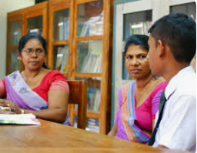
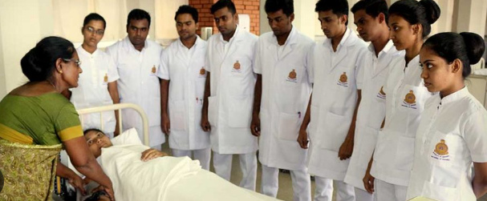
2. Prerequisites
Developed interpersonal skills
Positive relationship
Effective communication (verbal & non verbal skills)
Person-centred communication (individuals based)
(warm friendly practicioner)
(advanced communication skills)
(courageous conversation)
Emotional intelligence (knowing self & knowing others)
Notes:
Person-centredness is built on positive relationships and is dependent on a strong interpersonal skill base. Effective communication requires a combination of good verbal and non-verbal skills. Verbal communication deals with what is said (speech), and what is heard (listening), whilst non-verbal communication is concerned with body language such as posture, proximity, touch, movements, facial expressions, eye contact, gestures and other behaviours, which can add another layer of communication to verbal messages. There are many professional texts available that focus on these fundamental communication skills; however, we would argue that person-centred communication is more than the sum of its parts and that each interaction is dependent on the people involved. In essence we communicate with individuals based on what we know about them as people. This will influence what we say, how we say it, the language used and the use of specific strategies. Getting this right is really important because the impact of poor communication can be profound and often increases the vulnerability experienced by patients and their families.
At one level, a warm friendly practitioner is indicative of good interpersonal skills, and the impact of this on patients and families, and indeed other team members, should not be underestimated. The appropriate use of humour can also build rapport (Tanay et al. 2013; Tremayne 2014). There is, however, a need to move beyond simply building rapport to developing trusting partnerships that will ensure holistic needs are identified, making shared decision-making a real possibility. As professionals we can be warm and friendly, but if we don’t have the courage to step into the world space of another person and engage in the important conversations, then our impact will only ever be superficial. This requires professionals to develop advanced communication skills that enable them to engage in courageous conversations in order to get to the heart of what is important to the person. As previously argued by McCormack & McCance (2010), the development of effective interpersonal ability is linked to the notion of emotional intelligence as described by Goleman (1999). Emotional intelligence uses emotions intelligently and is a combination of knowing ‘self’ and knowing ‘others’ in the context of emotional beings; that is, how I and others that I relate to respond emotionally. It is through an understanding of ‘self’ as an emotional being that we can respond effectively to the emotional behaviours of others, and this aligns closely to the attribute of ‘knowing self’ within the Person-centred Nursing Framework.

Slide 7
2. Prerequisites
Knowing self
Our own life history and experiences
(develop relationships)
(engage at emotional level)
(personal meanings, beliefs, values)
Lifelong learning and personal growth
(self-reflection)
Being able to reflect in action and on action
Notes:
As professionals, we are also individuals with our own life stories and experiences that shape how we build relationships and how we engage on an emotional level. We develop as persons throughout our lives through engagement with the social world, and this shapes our personal meanings, beliefs, and values and determines 'who I am" In the context of the person-centred care framework, this means that how a person sees themselves and how they construct their world can influence how they work as a professional and how they interact with others. However, developing self-awareness is not a skill that can be learned; it requires lifelong learning and personal growth based on self-reflection. Facilitated self-reflection is a mechanism for improving our self-awareness and understanding of our behaviours. Schon (1983) argues that the ability to reflect on one's actions in order to engage in a continuous learning process is one of the defining characteristics of professional practise and is consistent with the concept of competence described above. The ability to reflect in action (while something is being done) and on action (after it has been done) has become an important feature of professional education programmes in many disciplines. To become a person-centred practitioner, we must also be open to giving and receiving feedback, and we must be able to work with that feedback through critical reflection. Improving personal self-awareness can be difficult, however, as it can force us to confront things we do not like about ourselves and can also bring to light painful experiences from the past that influence our actions in the present.

Slide 8
2. Prerequisites
Clarity of beliefs and values
beliefs and values are interrelated
enable practitioners to work
person-centred cultures
Values
what people think ought to be done/moral and ethical codes
Beliefs
what people think is true or not true
Notes:
Within person-centered care, clarity of beliefs and values is cited as one of the prerequisites that enable professionals to work with the care environment. According to Manley (2004), 'values define what people think should be done' (p. 55, italics in original), and these are closely related to moral and ethical codes. Beliefs, on the other hand, are 'what people believe to be true or not true' (p. 55). Beliefs and values are interrelated in that 'it is difficult to separate values from their believed implications' (p. 55). Finally, basic assumptions include beliefs, interpretations of beliefs, and values and emotions. They are understood as accepted truths that are unconsciously held and taken for granted (Brown 1998). Very often we live in a world of assumptions without being aware of it. Ideally, practitioners develop and agree on a set of professional values that are shared by all and then lived out in daily practice. However, this is the biggest challenge because often the values the team holds (i.e., the values we talk about) do not match the behaviors exhibited in practice. Developing person-centered cultures is based on the premise that everyone is committed to closing the gap between the values that are talked about and the behaviors that are observed (or not, as is often the case) in practice. The goal is an effective workplace culture in which certain values are shared in the workplace, such as person-centeredness, lifelong learning, high challenge, and high support, and implemented in practice through the development of a shared vision and mission with individual and collective accountability for meeting that standard (Manley et al. 2011). Practice development is the improvement methodology that provides a set of tools and approaches that enable teams to work toward these goals (McCormack et al. 2013; Dewing et al. 2014b).

Slide 9
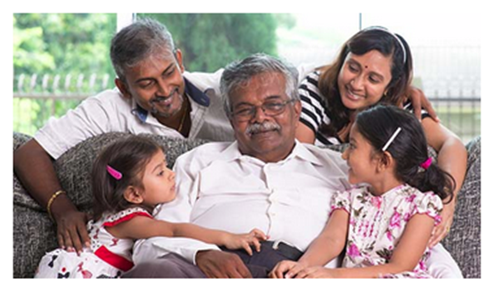
2. Prerequisites
Commitment to the job
reflect the dedication and a sense
(provide care)
(going the extra miles)
intentionalities
(be sensitive and minful)
at individual/at team/at organisational level
(transformational leadership)
Notes:
Commitment to the profession at its most basic level reflects dedication and a sense that the nurse wants to provide the best care for patients and their families. Commitment at an individual level shows that the nurse demonstrates a high level of commitment to patients and families by going the extra mile. However, commitment to the profession means more than just going the "extra mile." It is also linked to the idea of intentionality, which is defined as 'the fact of acting intentionally or purposefully' (www.oxforddictionaries.com). The concept of intentionality is discussed in the nursing literature by several nursing theorists. Watson (1985) defines caring as 'a value and attitude that must become a will, intention, or commitment that manifests itself in concrete actions' (p. 32). Furthermore, she believes that 'our intentionality informs our choices and actions, helping us to be sensitive and mindful of what matters most in our lives and work' (p. 17). Commitment to work, in this sense, is more than an act of kindness, but a mindful action based on different kinds of facts.
Commitment at the individual level, however, can be difficult to sustain if it conflicts with the philosophy of the team. In this case, the engaged physician finds that he or she is constantly swimming against the tide and becomes disillusioned and dissatisfied with the standard of care within the team. Contemporary leadership literature emphasises the importance of transformational leadership, described by Kouzes and Posner (2002) as 'empowering others to act' through approaches that foster collaboration, build trust, and provide visible support. However, individuals and teams also work within organisations, which emphasises organisational-level engagement. Furthermore, the literature suggests that organisational commitment is influenced by organisational culture and that understanding organisational culture is important because it influences how we understand organisational life and the importance we place on activities (Manley 2011; Napier et al. 2014). This underscores the relationship between commitment to work and clarity of beliefs and values not only at the individual level, but also at the team and organisational levels.

