Slide 1
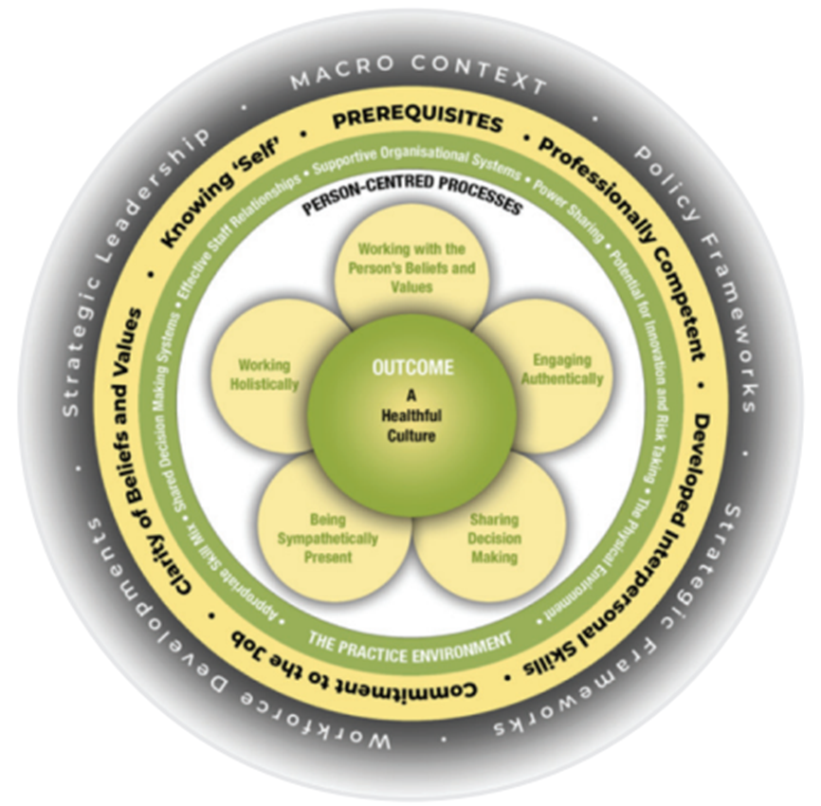

Framework
MCCormack
& McCance, 2006,2010,2017
Notes:
Brendan McCormack and Tanya McCance have been responsive and receptive to advances in personcentred knowledge and research over a long period of time and the framework has been refined
accordingly (2006-2019). It originated as a nursing framework – the Person-centred Nursing Framework (McCormack and McCance, 2006; 2010) – and has been used as the theoretical framework of many
research projects (for example, Buckley et al., 2013; van der Cingel et al., 2016; Lannie and Peelo-Kilroe, 2017; Lynch et al., 2018; McCormack et al., 2018). This has provided greater depth and understanding
as to how the theoretical framework can be applied to clinical practice.
The development of the Personcentred Nursing and Person-centred Practice Frameworks has spanned over 20 years of research, practice development and evaluation activities.
The original framework published in 2006, was developed for use in the intervention stage of a large quasi-experimental project that focused on measuring the effectiveness of the
implementation of person-centred nursing in a tertiary hospital setting (McCormack and McCance 2006).
The 2006 version of the Person-centred Nursing Framework (PCNF) was derived by combining the conceptual framework that McCormack had developed focusing on person-centred practice
with older people and Tanya McCance’s (2003) framework that focused on patients’ and nurses’ experience of caring in nursing.
Their first publication (McCormack and McCance 2006) – set out the processes involved in developing the framework. More significantly, the specific shared philosophical underpinnings
that enabled two conceptual frameworks to be combined into one theoretical framework were described. This shared philosophical starting point enabled us to set out the key aspects
of what it means to be a ‘person’ that were consistent with a philosophy of human science and embraced key human science principles of freedom, holism, relationality, time and
knowledge (McCance and McCormack 2017).
We can see the historical shift between the versions of the framework (McCormack and McCance, 2006, 2017). For example, in 2006 outcomes were patient focused, ‘creating a therapeutic culture’,
while in the 2017 version intended outcomes are more inclusive of staff and the ‘existence of healthful cultures’, while the language has changed from working with patients’ values to working with peoples
values to be more inclusive of others (McCormack and McCance, 2006, 2019). In the 2017 version, a fifth layer was added to acknowledge the influence of the broader macro systems on person-centred
cultures and practices. The name changed from a nursing framework to a practice framework to be more inclusive of other professions, although the Person-centred Nursing Framework is still available
for nursing work.
The framework provides guidance on how to relate to and respect the personhood of staff, patients and self.
https://www.fons.org/Resources/Documents/Journal/Vol10No2/IPDJ_1002_003.pdf

Slide 2
Person-centred practice
PCP as defined by McCormack and McCance (2017, p 3) is:
‘An approach to practice established through the formation and fostering of healthful relationships between all care providers, service users and others significant to them in their lives. It is underpinned by the values of respect for persons, individuals’ right to self-determination, mutual respect and understanding. It is enabled by cultures of empowerment that foster continuous approaches to practice development.’
Notes:
The use of the terms ‘person-centredness’ and ‘person-centred care’ has become increasingly common in health and social care services at a global level. A cynic might argue that the term is being used as
a ‘catch-all’ for anything to do with high-quality health and social care but we would contend that it is representative of something more significant than this, namely, a movement that has an explicit
focus on humanising health services and ensuring the patient/client is at the centre of care delivery. In this context, the body of evidence supporting the processes and outcomes associated with personcentredness
in health and social care is constantly growing and becoming increasingly diverse.
The Person-centred Practice Framework reflects the essence of human caring. Caring is a central concept in all health and social care practice, no matter the context or profession. Meaningful caring involves the interaction between values, beliefs and attitudes and is a far more complex activity than is often perceived, requiring intentional actions by health and social care workers. Caring requires us to know ourselves and in developing this self-knowing, care practices (such as washing, dressing, helping with food and drink, help with using the toilet etc) can be elevated from a series of tasks to opportunities for engaging with the whole person and with everything that is important to them in their lives. McCormack & McCance define person-centred practice as:
“… focusing on the formation and fostering of healthful relationships with service users and others significant to them in their lives, as well as between all care providers. It is underpinned by values of respect for persons (personhood), individual right to self-determination, mutual respect and understanding. It is enabled by cultures of empowerment that foster continuous approaches to practice development” (McCormack & McCance, 2017)

Slide 3
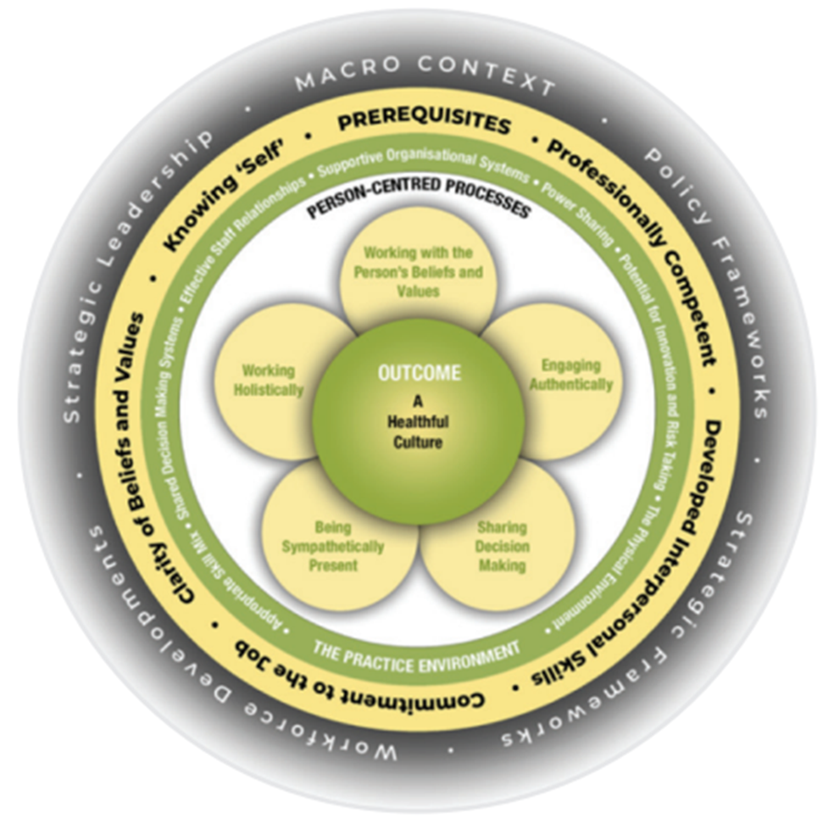
Person centred practice framework
Globally adopted
Translated info few languages
Underpinning strategy and policy frameworks
Curriculum framework
Theoretical framework in research
Instrument development
(PCPI-S, PCPI-SU, PCPI-ST)
Model development, testing
Notes:
The Person-centred Practice Framework was derived from McCormack’s conceptual framework (2001, 2003) focusing on person-centred practice with older people, and the framework of McCance et al. (2001) focusing on patients and nurses experience of caring in nursing. The Person-centred Practice Framework has been adopted globally as a way of conceptualising nursing policy, practice, education and research. It has been used to inform care-delivery models (McCormack et al 2012), curriculum frameworks (McCormack & Dewing 2019), research methodologies and research practices (McCormack et al 2017). The framework sets out what authors have determined, through more than 20 years of research and practice development, to be the key components of person-centred practice.

Slide 4
Methods and tools used to explore person-centred practice
1. Macro context (That it takes from the society to achive PCC)
2. Prerequisites, Requires (The attributes of the HCPs)
3. The care environment (Context in which care is delivered)
4. Person-centred processes (Delivering care through a range of activities)
5. Expected outcomes (Results of effective person centered health care)
Notes:
The Person-centred Practice Framework (McCormack and McCance, 2017) is described as a mid-range theory, it is ‘more concrete and narrower than grand theories; made up of a limited number of concepts and propositions that are written at a relatively concrete and specific level’ (Fawcett, 2005, p 34). This assists with reflection on, and operationalisation of person-centred practices across disciplines, with different stakeholders and at different healthcare levels.
It comprises five key interrelating elements:
the macro context;
prerequisites required by care providers;
the care environment; and
person-centred processes,
all leading to person-centred outcomes, with the important element of strategic support (macro-context) being at the outer ring of the framework (see Figure 1).
It provides a common language, a shared meaning and an understanding of the enablers and barriers to delivering a person-centred culture, unlike other models which consider only the relational elements. This framework recognizes the importance of these relationships and provides clarity of how they can be operationalised through the person-centred processes, prerequisites and the environment in which care occurs.
The influence of Kitwood and Kant can be seen within the framework. The framework provides guidance on how to relate to and respect the personhood of staff, patients and self.
Five key domains

