Slide 1
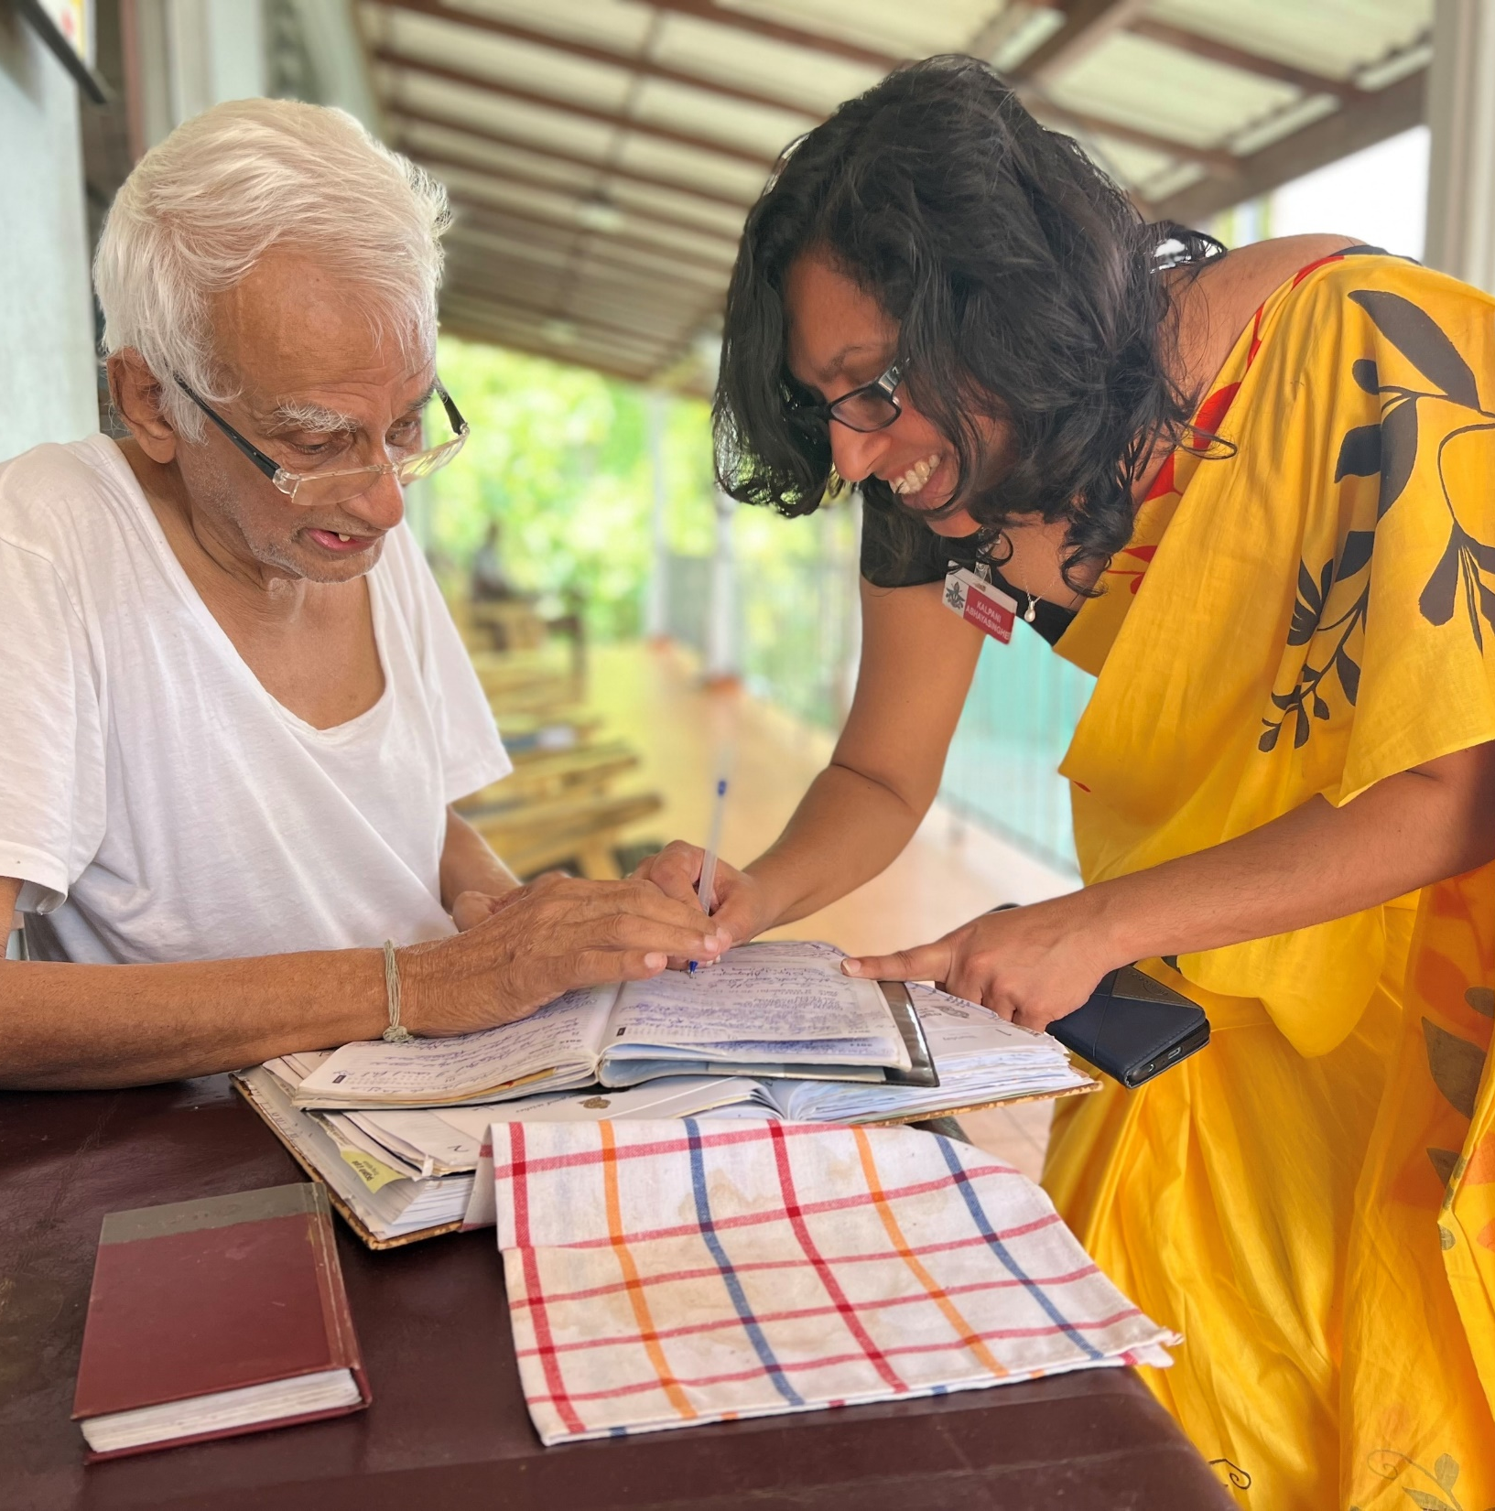
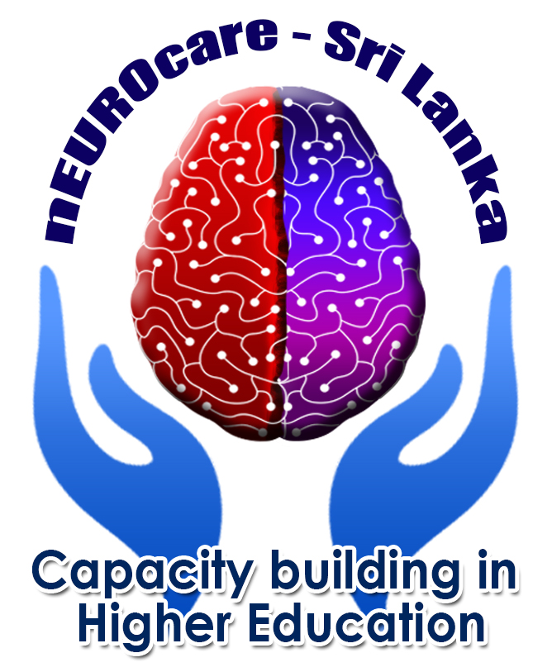


PERSON-CENTERED CARE
(PCC)
McCormack & McCance
Reference number: 618596-EPP-1-2020-1-SE-EPPKA2-CBHE-JP
This publication [communication] reflects the views only of the authors, and the Commission cannot be held responsible for any use, which may be made of the information contained therein.
Notes:
Good morning.
In this lecture, I would like to explain the theoretical McCormack & McCance model of PCC.

Slide 2

INTENDED LEARNING OUTCOMES
At the completion of this lecture student will be able to:
explain the concepts of McCormack & McCance model of PCC;
analyze McCormack & McCance model of PCC in clinical practice;
apply McCormack & McCance model of PCC in clinical practice;
compare between the local and global perspectives of PCC.

Slide 3
PCC - Framework highlights
Complexity of person-centred nursing / caregiving
Articulation of the key constructs
Emphasis's the contextual, attitudinal and moral dimensions of humanistic caring practice
Multi-disciplinary and inter-professional team working
Notes:
The literature widely recognizes the importance of creating a PCC culture across the continuum of care, where governments and organizations play a key role in the development of clear and comprehensive policies, processes, and structures necessary for healthcare systems and healthcare providers to deliver PCC. A standard set of core values among all parties, as part of a strategic vision, is essential in providing and receiving care that includes persons, healthcare providers, communities, and organizations within and outside of traditional healthcare services. While it is agreed that a key guiding principle in implementing PCC is to incorporate the person perspective, there is a need to ensure that care is also person‐directed, whereby persons are provided with sufficient and appropriate information to make decisions about their care and level of engagement.
Person-centered care (PCC) receives a great deal of attention and has been adopted widely in healthcare organizations throughout the world. In the past two decades, many interventions have been implemented to make healthcare organizations more person-centered. Commonly implemented PCC interventions for persons entail person empowerment, physical support, and information provision; those for healthcare professionals focus mainly on education and training and improvement of the continuity and coordination of care.
With such efforts, most organizations claim to be person-centered; the reality, however, is more nuanced. In theory, PCC should be delivered using a comprehensive approach, with multiple interventions tailored specifically to the needs of the most vulnerable groups in society (e.g., patients with less education, migration backgrounds, or low health literacy) in practice, achieving this goal remains a huge struggle. This nuanced picture of PCC in practice is especially relevant for primary care delivery to persons with neurodegenerative diseases are often considered to form one of the most vulnerable groups in society.

Slide 4
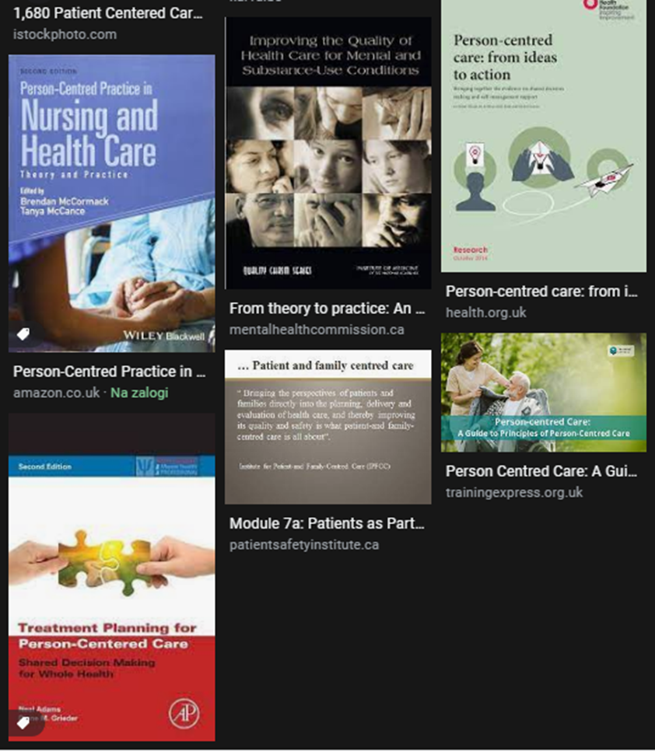
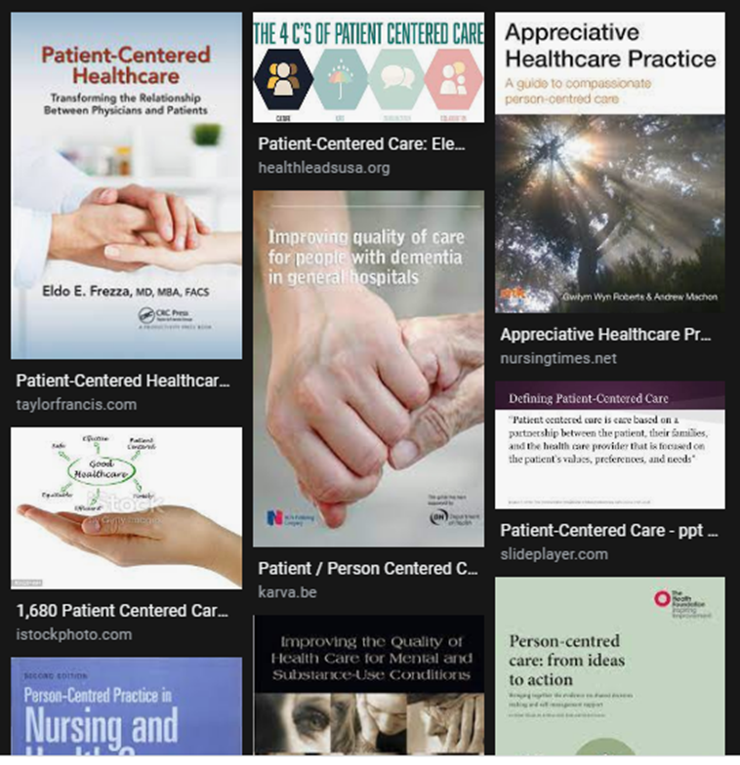
Notes:
Health and social care systems, organizations and providers are under pressure to organize care around persons’ needs with constrained resources. To implement person-centred care (PCC) successfully, barriers must be addressed. Up to now, there has been a lack of comprehensive investigations on possible determinants of PCC across various health and social care organizations.
With increased research, the concept of person-centered care is advancing, and it remains an important concept in the health sector. Despite reported evidence of significant benefits, this concept is poorly utilized by professional nurses. The principle has not been demonstrated and absorbed at primary health care levels.
However, there are many research, books, and guidelines where we can difficulties and obstacles identified and addressed them in practice.

Slide 5
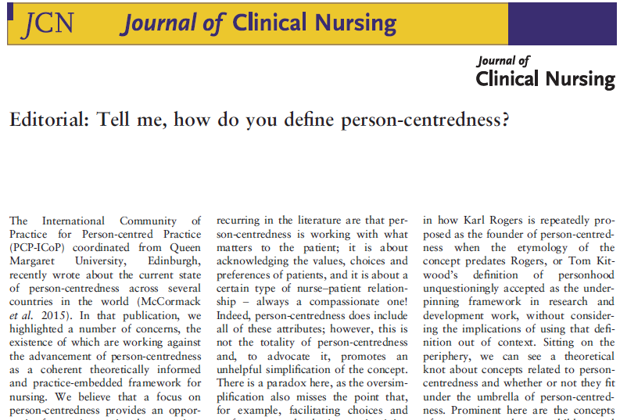
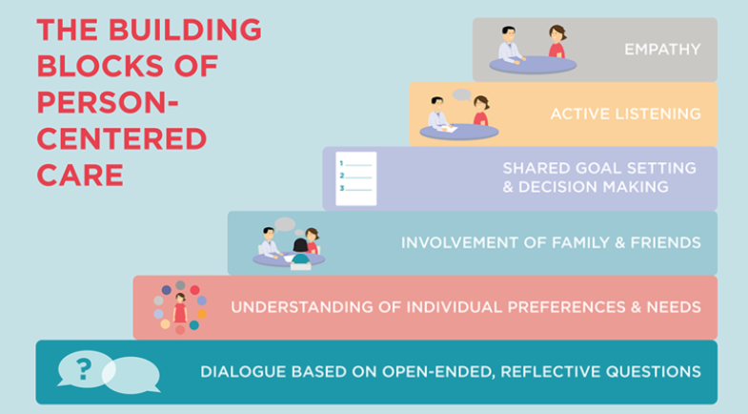
Defining PERSON–Centered care
Care is individualized and customized.
Patient and families have control over health care decisions, not clinicians.
https://www.youtube.com/watch?v=3zFvzXxlcP4
Notes:
Person-centredness is an approach to practice established through the formation and fostering of healthful relationships between all care providers, service users and others significant to them in their lives.
It is underpinned by values of respect for persons (personhood), individual right to self-determination, mutual respect, and understanding. It is enabled by cultures of empowerment that foster continuous approaches to practice development”. This are words of Jan Dewing and Brendan McCormack and you can read this as an editorial in the Journal of clinical practice with title Tell me, how do you define person-centredness?
The definition of person centredness by McCormack and McCance surfaces four attributes of persons and person-centred relationships:
Respect for all persons
Engagement and collaboration
Individual and collective right to determine their own destiny
Equity and equality.

Slide 6
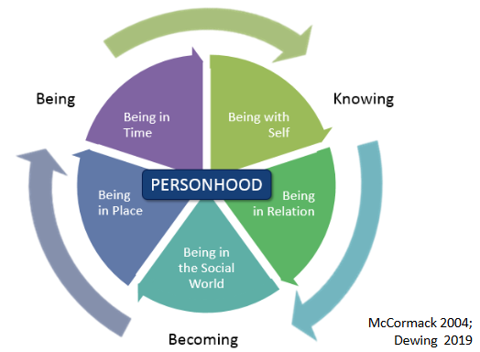
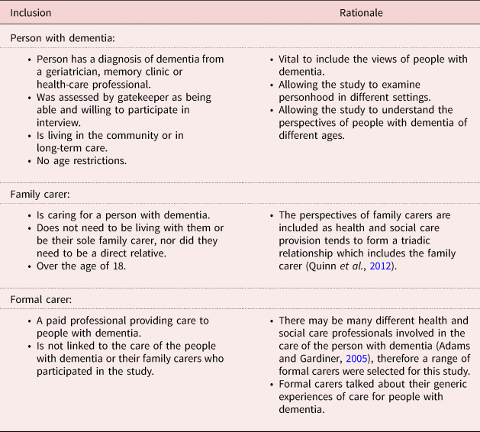
Knowing and Becoming Model
Hennelly, N., & O'Shea, E. (2022). A multiple perspective view of personhood in dementia. Ageing & Society, 42(9), 2103-2121. doi:10.1017/S0144686X20002007
PERSONHOOD
Shared decision making
Effective staff relationships
Supportive organizational strategies
Power sharing
Potential for innovation and risk taking
The physical environment
Notes:
The core concept of person-centredness, personhood, is that the person in care is placed at the centre of all efforts, so the focus of action is primarily on what matters to them
as a person, supporting a neutral understanding of personhood with different manifestations of ‘self’ (McCormack and McCance, 2017).
Person-centredness requires paying attention to our being as persons (McCormack and McCance, 2017). The fundamental principles reflect the modes of being at the core of person-centredness, as proposed by McCormack (2004):
- being in relation (having meaningful relationships),
being in a social world (participating in social life and current events),
Being in place (living in a familiar, person-in-care-friendly and home-like environment), and
being with self (maintaining identity and self-esteem, being free in decisions, and experiencing meaning in everyday life)
Being in time.
Dementia care is used here as an example of how different percpective on personhood influence the care of the older person.
The person with dementia should be seen as an embodied being, as they still experience feelings, perceptions and emotions, have the ability to form relationships, have aspects of self-identify that come to light occasionally, experience enjoyment and can still lead a satisfactory life (Dewing, 2008; Post, 2013).
In the Journal of Aging Society, you can read an article A multiple perspective views of personhood in dementia where the authors compare the inclusion and rationale of three groups of people- person with dementia, a family carer, and a formal caregiver.
Being, doing, belonging, becoming – occupational therapy filozophy (Hitch et al., 2014) is also close related to person center care
Examining Relationships between Physical Environments and Behaviors of Residents with Dementia in a Retrofit Special Care Unit https://journals.sagepub.com/doi/10.1111/joid.12094
https://www.youtube.com/watch?v=krPt8z0okoQ
https://www.cambridge.org/core/journals/ageing-and-society/article/abs/multiple-perspective-view-of-personhood-in-dementia/617B0BD0337AF500484010B738747452

Slide 7
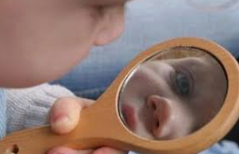

THE CONCEPT
OF PERSON
Who am I?
Values that are important or I consider to be important?
My beliefs? How I express them?
My dreams, hopes, desires?
My emotional engagement in my relationships?
The life that I want to live?
https://www.proprofs.com/quiz-school/story.php?title=pq-what-type-of-person-am-i_2d4
Notes:
So that we can understand and put PCC into practice, first you should know yourself, I should know myself.
Who am I?
In list below you can find some questions. Answer them individually. Write down the answers on a peace of paper. Than make groups and share answers with others and make discussion.
If have still time go to the wbsite and solve the quiz: https://www.proprofs.com/quiz-school/story.php?title=pq-what-type-of-person-am-i_2d4

Slide 8
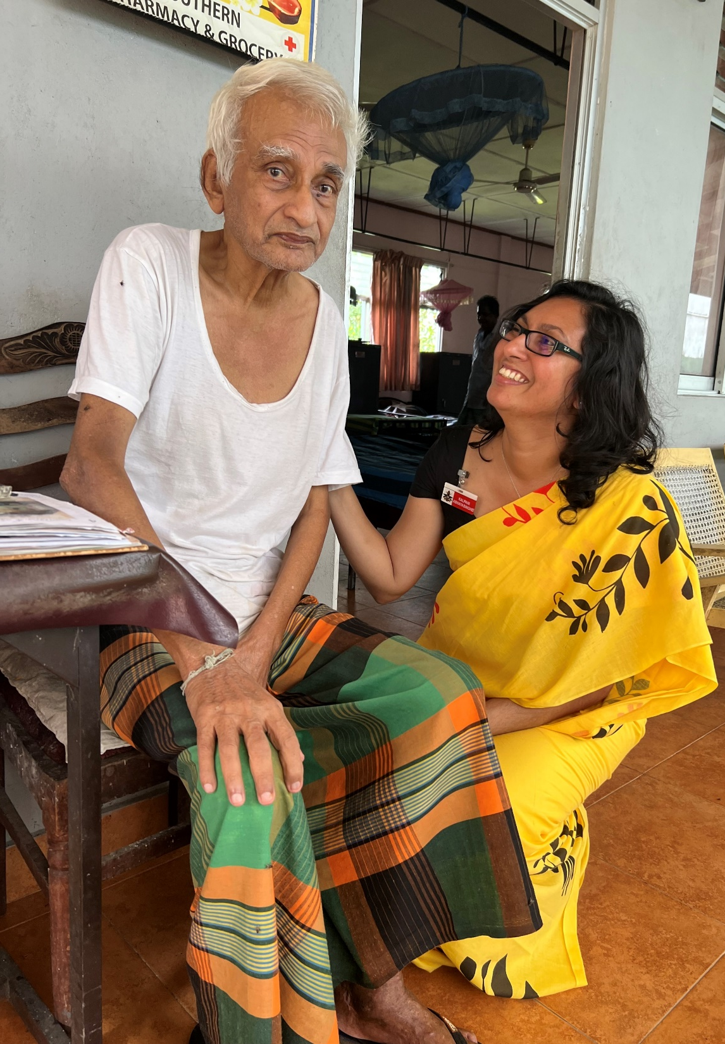
Thank you for listening!
Reference number: 618596-EPP-1-2020-1-SE-EPPKA2-CBHE-JP
This publication [communication] reflects the views only of the authors, and the Commission cannot be held responsible for any use, which may be made of the information contained therein.

