Slide 1




Sleep and neurodegeneration
Heisl Vaher MD
Otorhinolaryngologist
Somnologist Tartu University
Notes:
Hello to everyone. This short, introductory lecture gives brief insight to importance of sleep in relation to neurodegeneration diseases. My name is Heisl Vaher. I am a medical doctor daily focusing on sleep disorders and ear, nose, throat diseases.

Slide 2
Learning objectives
Sleep in maintenance of mental health and cognition
Several sleep related symptoms are predictive of neurodegeneration
Treatment of sleep disorders can maintain better life quality in case of ND
Notes:
Sleep comprises approximately one third of human life. There are remarkable changes in sleep quantity and also in its quality when looking at sleep from aging perspective. Sleep has to change as we grow older, because there is constant differentiation taking place in brain anatomy and functions, as well changes in body composition. Environment and light play major role in sleep health. In this introductory lecture the aim is to outline main reasons why we, humans, need stable sleep hours and conditions. As sleep is interrelated with the development of many diseases we will take a look how sleep problem can increase risks for mental and cognitive decline differing a lot . Patient with dementia should be provided with treatment of sleep disorders and safe and healthy sleeping environment.

Slide 3

Foreword
Benjamin Franklin’s
(American scientist and politician 1706-1790) aphorism:
“Early to bed, early to rise, makes a man healthy, wealthy, and wise.”
Not be universally true but we understand that unreliable bedtime hours will earn us poor health, financial poverty, and cognitive impairment.
There is a relationship between circadian rhythms, sleep, and neurodegenerative (ND) diseases.
Notes:
Wise men back then already knew the importance of sleep. The aphorism “Early to bed, early to rise etc…” by Benjamin Franklin gives rather good insight to healthy attitudes people of knowledge have had long time ago. The saying brings out that one of the main queues to healthy sleep in regularity of it, timing your sleep to take place approximately at same hours. We can also draw connection in between sleep timing rhythm and overall circadian rhythms in human body, which houses several hundred of those.

Slide 4
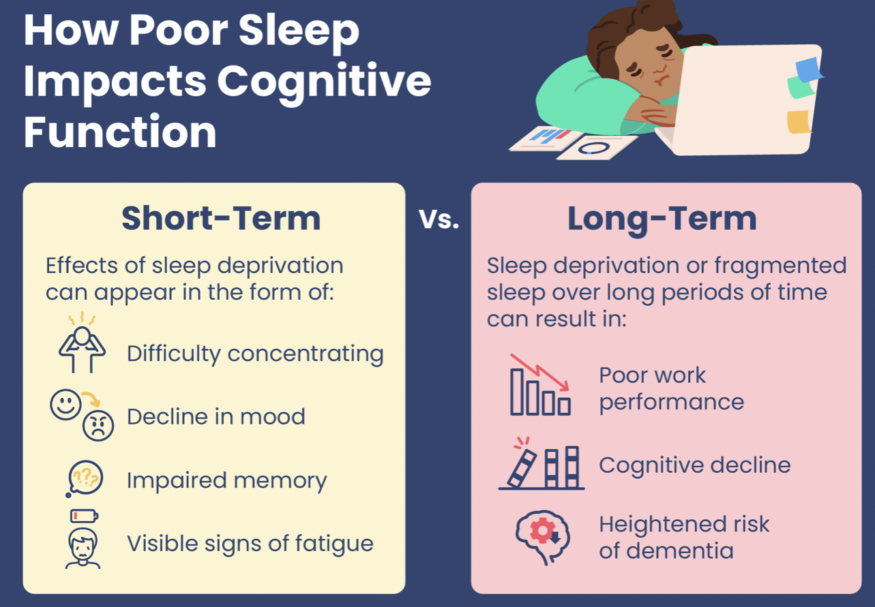

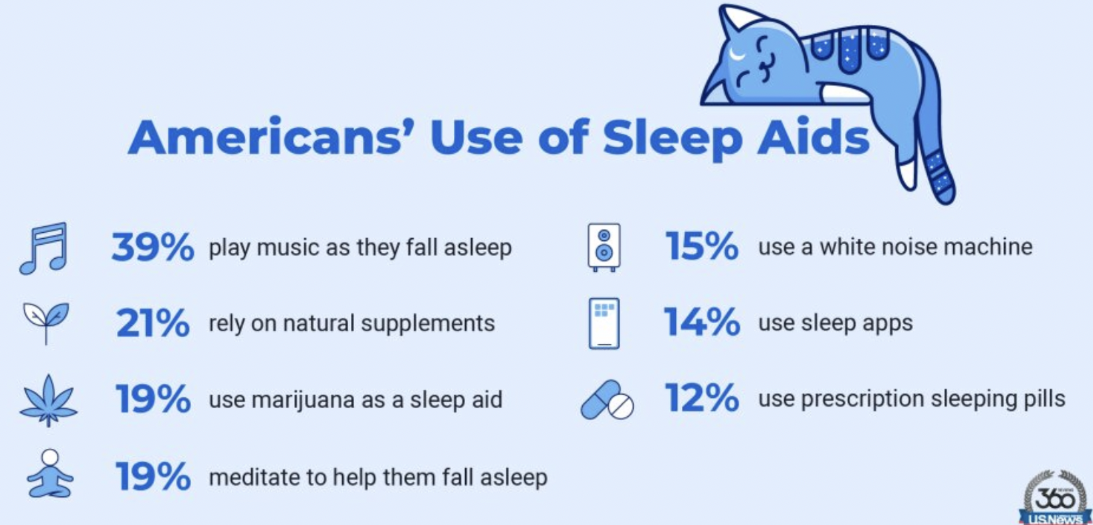
Good sleep maintains good mental health
1.Regularity
2.Amount
3.Conditioning
4.Promote sleep without medication if possible
https://www.sleepfoundation.org/sleep-deprivation/lack-of-sleep-and-cognitive-impairment
Notes:
Having same kind of repetitive pace for daily and nightly activities helps bodily functions to be organized when it comes to sleep. One needs to pay attention to sleep times regularity, amount of shut eye period, make sure that sleep environment is suitable and avoid sleep aids if possible. In the central picture you can see an example of american's managing their sleep and 31% tend to use sleep aids not recommended for long periods. In the right corner you can vies what happens in short and long run when sleep needs are not met. Heightened risk of dementia is brought out there. I advice to look at the webpage called sleep foundation - link is below the box called How poor sleep impacts cognitive function. Sleep foundation page is comprehensive and easily read page about vast sleep topics.

Slide 5
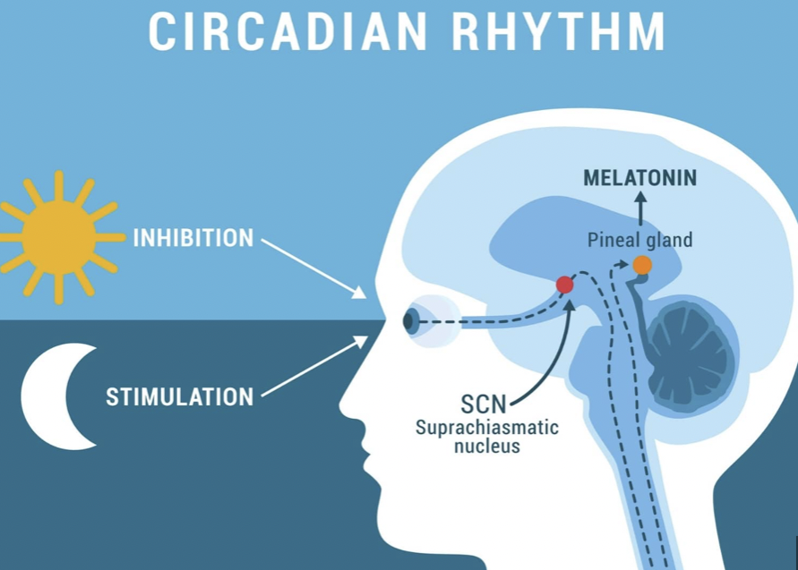
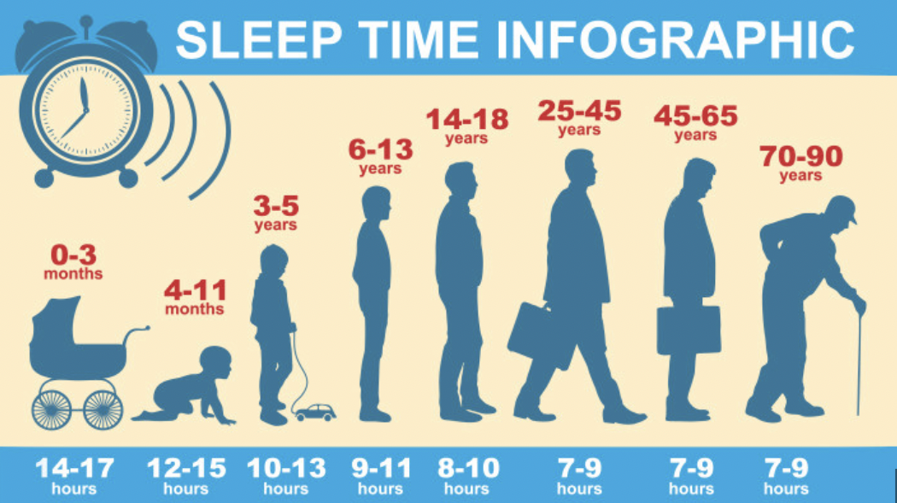
Sleep and age
5.Older adults’ circadian rhythms are less “entrained”: diurnal sleep/wake patterns are weaker (typically light–dark cycles): declining eye lens opacity and clarity, reduced exposure to bright light, and degeneration of the SCN. (Hofman et al, 2006)
7.Older adults have fragmented endogenous circadian rhythms (Yoon et al, 2003) - degeneration of the SCN (Wang et al, 2015)
8.Disrupted circadian rhythms, act on sleep, mood, and memory, linked to poorer cognition and risk of cognitive impairment (Kondratova et al, 2012)
1.Sleep and circadian rhythms are regulated: genes, neural circuits, environment (Berry et al. 2015)
2.Multiple regions regulate the sleep/wake states: age- or dementia-related changes in sleep affected by ventrolateral preoptic area (VLPO), suprachiasmatic nucleus (SCN). VLPO inhibit s arousal areas during sleep (Scherin et al, 1996)
3.VLPO ->sleep maintenance, lesions to it -> sleep fragmentation patterns similar siin in AD (Lu et al, 2000)
4.SCN - central circadian pacemaker in timing of sleep. External cues (light) act through the SCN to entrain circadian rhythms in the central nervous system and peripheral tissues. (Buijs et al, 2001)
Notes:
I recommend to take time to digest this slide. In longer sleep lectures we will go through sleep architecture and responsible structures in brain. When we age then light and external factors telling us to go to bed are less potent and partially it causes the sensation sleep being less satisfactory. It should be bared in mind that after the age of 40 sleep related activities should be focused on and steady habits formed.

Slide 6
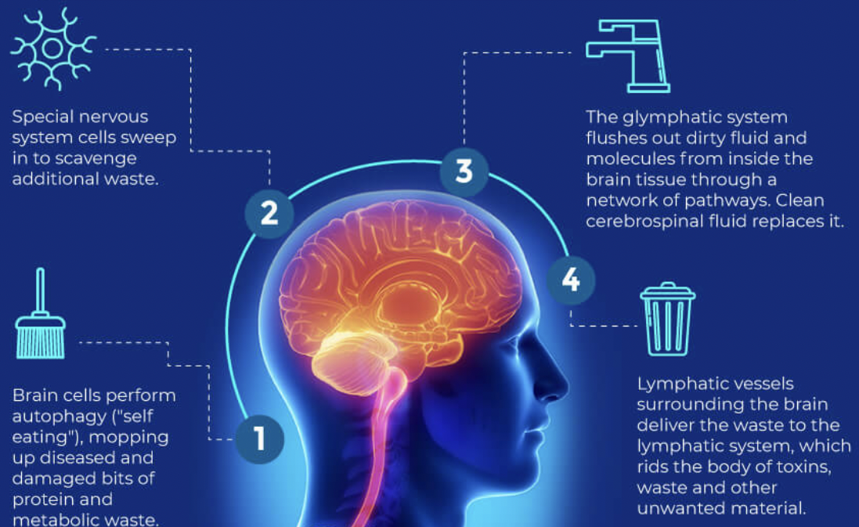
Brain waste disposal system
CNS is highly active, metabolic waste can build up quickly.
Before the discovery of this brain-based garbage disposal system, it was believed that each individual cell handled its own metabolic detritus.
If the cellular system became overloaded or slowed down as we aged, metabolic garbage would build up between the cells. This garbage includes products such as beta-amyloid — the protein associated with dementia (Xie et al. 2013)
Notes:
Why is disruption of sleep so bad? There is emerging evidence that sleep disruption is associated with beta amyloid protein accumulation and and tau neurofibrillary tangles that are characteristic of Alzheimer disease. Glymphatic system (in experimental animal models) is believed to remove in clearance of beta amyloid during sleep. In simplistic terms - we can say that glymphatic system is the housekeeping section in brain.

Slide 7
Poor sleep predicts heightened risk for dementia
Sleep plays an important role in maintaining brain health with age, and may play a key role in AD prevention (Spira et al 2014). A causal association between poor sleep and AD could be of critical importance to AD prevention because effective interventions to control the following symptoms exist to improve sleep:
difficulty falling asleep and staying asleep
poor sleep quality
short and long sleep duration
sleep breathing disorders - SDB (Bloom et al 2009).
Study of midlife sleep (mean age = 52) and cognitive impairment and dementia 18 to 26 years later in >2,300 Finnish twins:
short (<7 hours) and long (>8 hours) sleep duration
poor sleep quality
use of hypnotic medications >60 days per year - > lower cognitive composite scores
long sleep ->1.8 times the odds of developing AD (measured by receipt of an AD medication
apolipoprotein e (APOE) ε4 allele status, sex, and age ->differentially affect cognition in different populations (Virta et al. 2009).
Notes:
There are some universal symptoms to pay attention when estimating if one is sleeping well. I one study by Spira and colleagues they bring out symptoms worth paying attention to when suspecting future dementia development: difficulties initiating and stying in sleep; poor sleep quality; too short and too long sleep and as well sleep time breathing disorders. More clear in numbers is the study performed in Scandinavia where twins were followed prospectively regarding sleep habits and demetia sypmtoms. What they considered too short sleep was less than 7 h and over 8 hor sleep was said too long. Topic very importnat in dementia is the use of sleep aids. In this study usage of sleep aids more than 60 days per year predicted dementia development. Also other factors as apolipoprotein , marital status, gender and age were looked at in this study.

Slide 8
How poor sleep may lead to cognitive decline
In humans, self-reported short sleep duration and lower actigraphy-measured sleep efficiency have been associated with higher β-amyloid burden, as measured by positron emission tomography (Spira et al. 2013) or cerebrospinal fluid (CSF), in cognitively normal individuals (Ju et al. 2013).
Excessive daytime sleepiness has also been found to predict increased β-amyloid in older adults without dementia (Carvalho et al. 2018)
Studies in mice and humans found that sleep deprivation increased soluble β-amyloid and promoted the formation of β-amyloid plaques (Kang et al 2009, Ju et al 2017, Lucey et al 2018)
Poorer sleep quality over several days correlates with increased CSF tau (Ju et al 2017)
Since tau pathology is associated with the onset of cognitive deficits in Alzheimer disease, these findings add to the mounting evidence of a causal link between disrupted sleep and progression of Alzheimer disease pathology (Robbins et al 2021)
Notes:
Now we come to the topic what points or looks for association in between sleep length and accumulation of beeta amyloid and tau proteins. There is probably a cut off point where accumulation of these substances increases the level of normal aging and leads to development of dementia. Definitely the option to measure and estimate these substances in CNS is most helpful in diagnostics of dementia.

Slide 9
Types of dementia in which sleep problems have been described
Alzheimer's disease- AD - (25-50% present with sleep problems)
Progressive supranuclear palsy (PSP), Steele-Richardson-Olszewsky syndrome (15-20% have RBD and RSWA)
Parkinson disease - PD
Dementia with Lewy bodies - DLB
Vascular dementia
Huntington disease - HD
Creutzfeldt-Jakob disease - CJD
Frontotemporal dementia - FTD
Notes:
Sleep disorders have been described in many forms of dementia. Alzheimer disease has gained lots of attention in that regard. I future lectures sleep disorders in different dementia subtypes will be discussed.

Slide 10
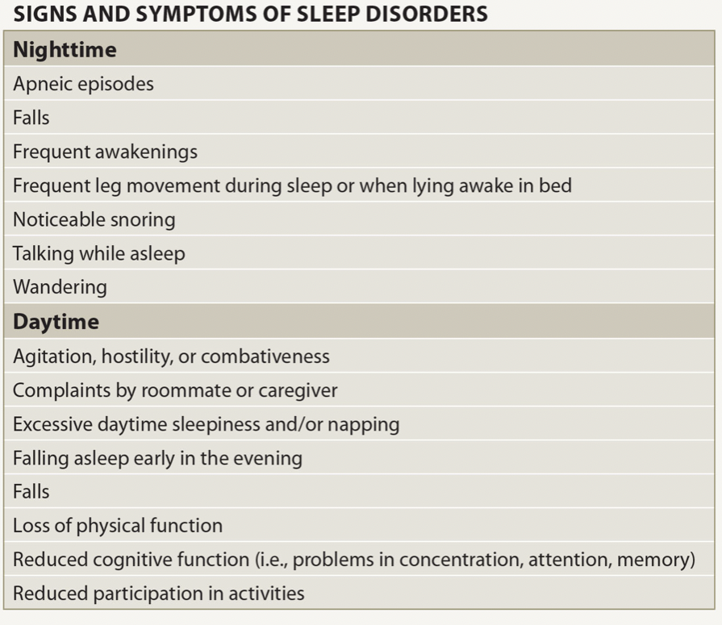
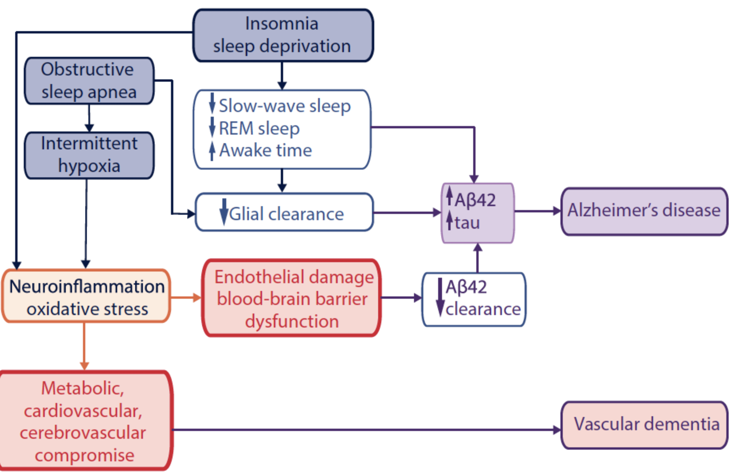
Sleep disorder symptoms pointing to DN
https://practicalneurology.com/articles/2019-june/sleep-disorders-dementia
Notes:
Perhaps the most acknowledged sleep disorders are insomnia and obstructive sleep apnea - because of their prevalence is general population. That aswell applies to DN population. But it is interesting to follow the pathophysiologic route for those two as one leading to increased night time complaints (insomnia) - has potential for vascular dementia development and sleep time breathing disorder sleep apnea is related to Alzheimers d.

Slide 11
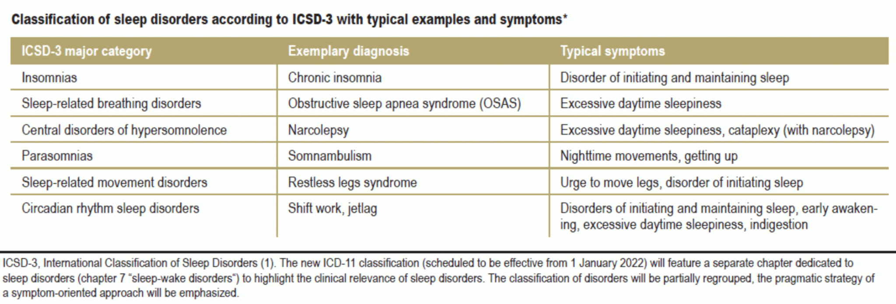
Sleep disorders to be considered in ND management
Notes:
Sleep disorders tend to develop overtime and have rather “quiet” course , often due to the fact that in advanced age people can choose or are forced to sleep alone - and sleep disorders can stay unnoticed for long. As pointed out in table excessive daytime sleepiness is one of the cardinal symptoms among others. In case of ND sleep disorders need to be analyzed in a systematic manner. Questionnaires and objective evaluation are often unavoidable. Many disorders can improve with suitable changes in sleep hygiene, whereas there are disorders to be treated with special equipment (CPAP) and medication.

Slide 12
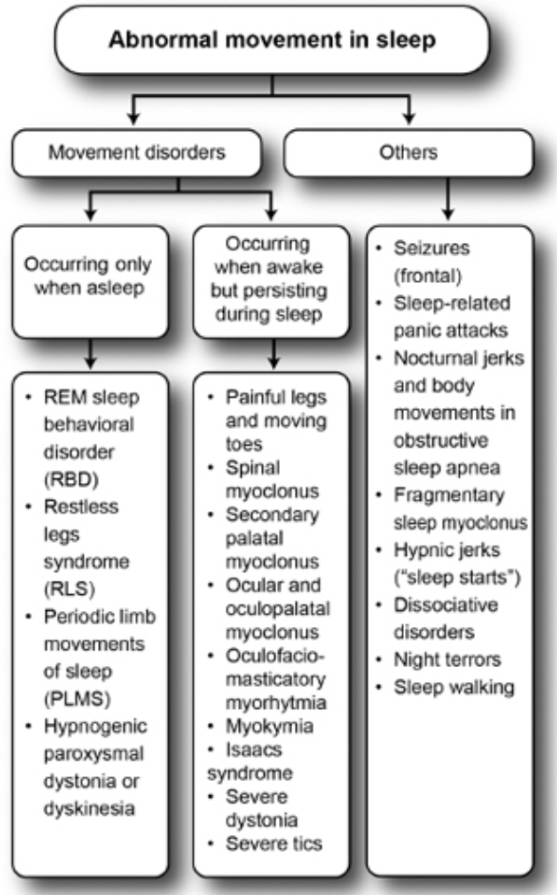
REM sleep behavior disorder (RBD) predictive of DN
RBD is generally considered to be associated with synucleinopathy
RBD may be triggered by neurodegenerative diseases or associated with antidepressant treatments, alcohol, and drug withdrawal
Also reported in other neurodegenerative diseases including AD, FTD, HD, ALS, etc, which are not characterized by α-syn pathology.
RBD may precede years before the onset of the symptoms of synucleinopathy and predict neurodegeneration and cognitive impairment.
(Zhang et al, 2020)
Notes:
Symptom what might be considered peculiar or even anecdotal is REM sleep behavior disorder. Long considered as a nightmare disorder but it is a parasomnia/movement disorder and it can be one of the hallmarks of future dementia .

Slide 13
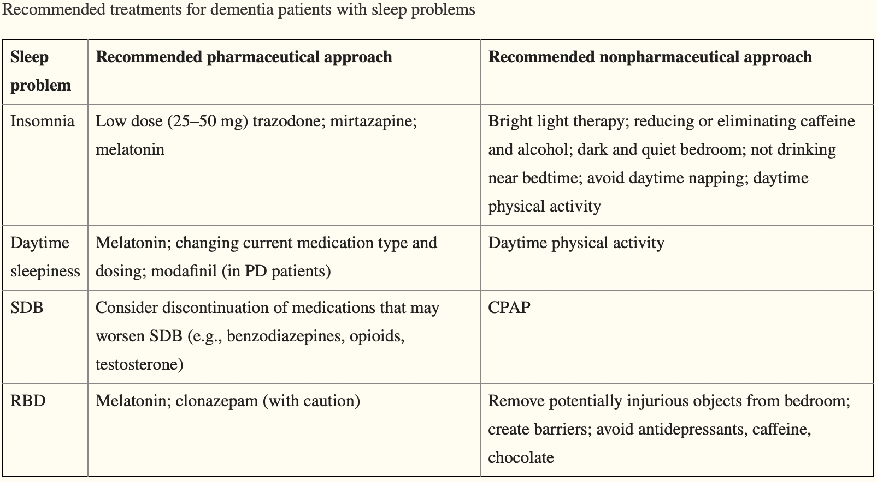
Treatment of sleep disorders in DN
Notes:
Though treatment plan for sleep disorders always starts with managing the environment (to be safe, comfortable and not triggering more sleep problems), understanding that patients with dementia are already in the state of polypharmacy and that can be challenging to understand the meds worsening sleep.

Slide 14
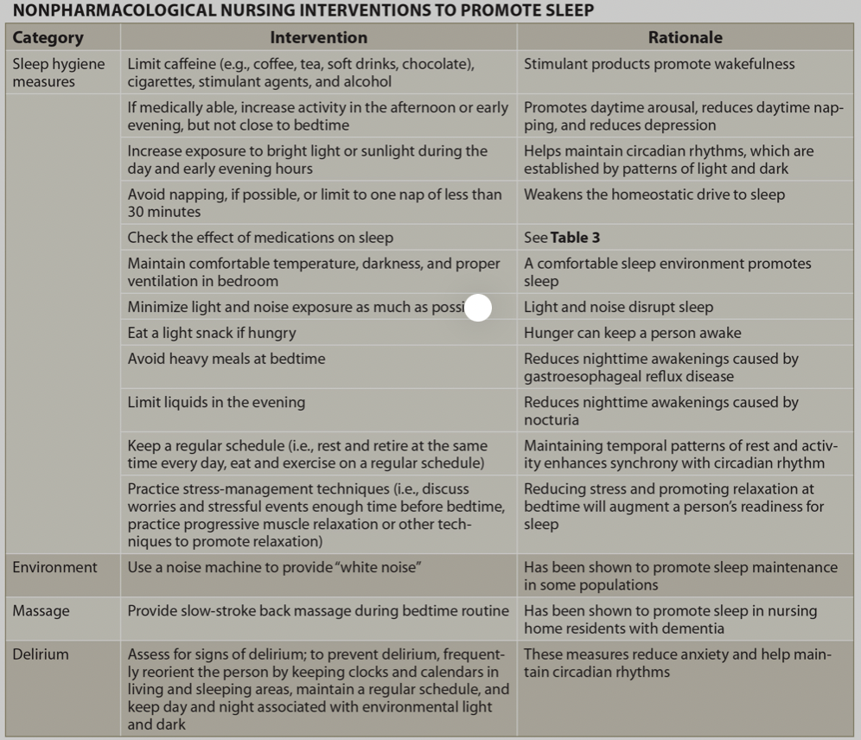
Treatment of sleep disorders in DN (Wennberg et al. 2017)
Notes:
There are numerous of aspects to focus on when improving sleep. Hygiene comprises of going through patients day activity by activity. Sleep pressure has to start building from morning, there can be habits what interfere. Propensity to sleep inhabits everyone but with advanced age and in case of dementia the connections are not that strong or do not exist anymore and need to be rebuilt.

Slide 15

Take home message
Normal sleep should be pursued in all age groups
Prevent/slow down development of dementia by making sleep hygiene and routine a habit
Recreational drugs and sleep aids can ruin sleep in long run
Sleep disorders tend to get worse if not noticed and treated
Treating sleep problems will improve life quality of a patient and caregiver
Notes:
The topic of sleep medicine with emphasize on neurodegeneration diseases is vast. Strong focus should be in prevention of dementia. Healthy sleep patterns come here very helpful. And that applies as well to ongoing degeneration.

Slide 16
Literature
Berry RB, Brooks R, Gamaldo CE, et al. The AASM Manual for the Scoring of Sleep and Associated Events. 2. Vol. 2. Darien, IL: American Academy of Sleep Medicine; 2015.
Bloom HG, Ahmed I, Alessi CA, Ancoli-Israel S, Buysse DJ, Kryger MH, et al. Evidence-based recommendations for the assessment and management of sleep disorders in older persons. J Am Geriatr Soc. 2009;57(5):761–89.
Buijs RM, Kalsbeek A. Hypothalamic integration of central and peripheral clocks. Nat Rev Neurosci. 2001;2(07):521–526.
Carvalho D.Z, Louis E.K.S, Knopman D.S, et al. Association of excessive daytime sleepiness with longitudinal β-amyloid accumulation in elderly persons without dementia. JAMA Neurol . 2018;75:672–680.
Hofman MA, Swaab DF. Living by the clock: the circadian pacemaker in older people. Ageing Res Rev. 2006;5(01):33–51.
Ju YE, McLeland JS, Toedebusch CD, Xiong C, Fagan AM, Duntley SP, Morris JC, Holtzman DM. Sleep quality and preclinical Alzheimer disease. JAMA Neurol. 2013 May;70(5):587-93. doi: 10.1001/jamaneurol.2013.2334. PMID: 23479184; PMCID: PMC3676720.
Ju Y.-E.S, Ooms S.J, Sutphen C, et al. Slow wave sleep disruption increases cerebrospinal fluid amyloid-β levels. Brain . 2017;140:2104–2111.
Kang J.-E, Lim M.M, Bateman R.J, et al. Amyloid-β dynamics are regulated by orexin and the sleep-wake cycle. Science . 2009;326:1005–1007.
Kondratova AA, Kondratov RV. The circadian clock and pathology of the ageing brain. Nat Rev Neurosci. 2012;13(05):325–335.
Lu J, Greco MA, Shiromani P, Saper CB. Effect of lesions of the ventrolateral preoptic nucleus on NREM and REM sleep. J Neurosci. 2000;20(10):3830–3842.
Lucey B.P, Hicks T.J, McLeland J.S, et al. Effect of sleep on overnight CSF amyloid-β kinetics. Ann Neurol . 2018;83:197–204.
Robbins R, Quan S.F, Weaver M.D, et al. Examining sleep deficiency and disturbance and their risk for incident dementia and all-cause mortality in older adults across 5 years in the United States. Aging (Albany NY) . 2021;13(3):3254–3268.

Slide 17
Literature
Sherin JE, Shiromani PJ, McCarley RW, Saper CB. Activation of ventrolateral preoptic neurons during sleep. Science. 1996;271(5246):216–219.
Spira A.P, Gamaldo A.A, An Y, et al. Self-reported sleep and β-amyloid deposition in community-dwelling older adults. JAMA Neurol . 2013;70:1537–1543.
Spira AP, Chen-Edinboro LP, Wu MN, Yaffe K. Impact of sleep on the risk of cognitive decline and dementia. Curr Opin Psychiatry. 2014 Nov;27(6):478-83. doi: 10.1097/YCO.0000000000000106. PMID: 25188896; PMCID: PMC4323377.
Virta JJ, Heikkila K, Perola M, Koskenvuo M, Raiha I, Rinne JO, et al. Midlife sleep characteristics associated with late life cognitive function. Sleep. 2013;36(10):1533–41. 41A
Wang JL, Lim AS, Chiang WY, et al. Suprachiasmatic neuron numbers and rest-activity circadian rhythms in older humans. Ann Neurol. 2015;78(02):317–322.
Wennberg AMV, Wu MN, Rosenberg PB, Spira AP. Sleep Disturbance, Cognitive Decline, and Dementia: A Review. Semin Neurol. 2017 Aug;37(4):395-406. doi: 10.1055/s-0037-1604351. Epub 2017 Aug 24. PMID: 28837986; PMCID: PMC5910033.
Xie L, Kang H, Xu Q, et al. Sleep drives metabolite clearance from the adult brain. Science . 2013;342:373–377.
Yoon IY, Kripke DF, Elliott JA, Youngstedt SD, Rex KM, Hauger RL. Age-related changes of circadian rhythms and sleep-wake cycles. J Am Geriatr Soc. 2003;51(08):1085–1091.
Zhang F, Niu L, Liu X, Liu Y, Li S, Yu H, Le W. Rapid Eye Movement Sleep Behavior Disorder and Neurodegenerative Diseases: An Update. Aging Dis. 2020 Mar 9;11(2):315-326. doi: 10.14336/AD.2019.0324. PMID: 32257544; PMCID: PMC7069464.

