Slide 1
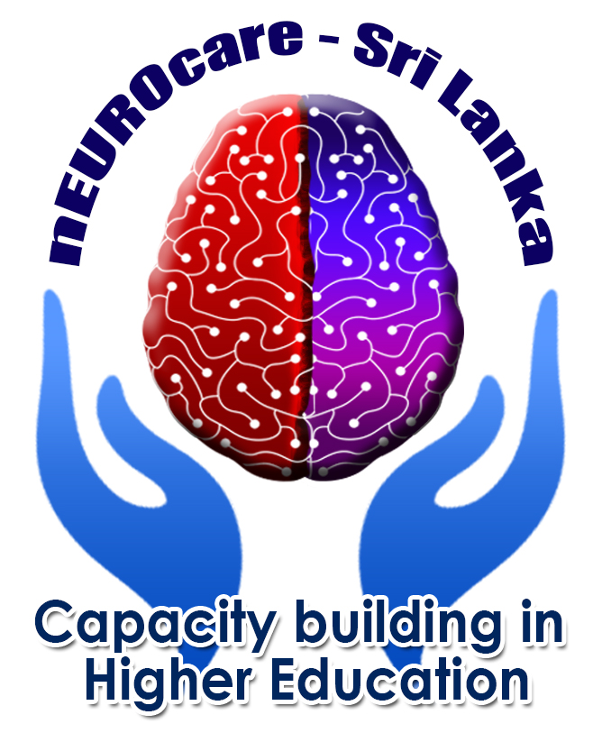

Clinical Assessment and Outcome measurements
Amyotrophic lateral sclerosis (ALS)

Slide 2
Definition
a neurodegenerative disease that causes degeneration of the lower and upper motor neurons and is the most prevalent motor neuron disease
formerly known as Lou Gehrig's disease
Link for a video 1
https://www.youtube.com/watch?v=aDpN-6EAd3k

Slide 3
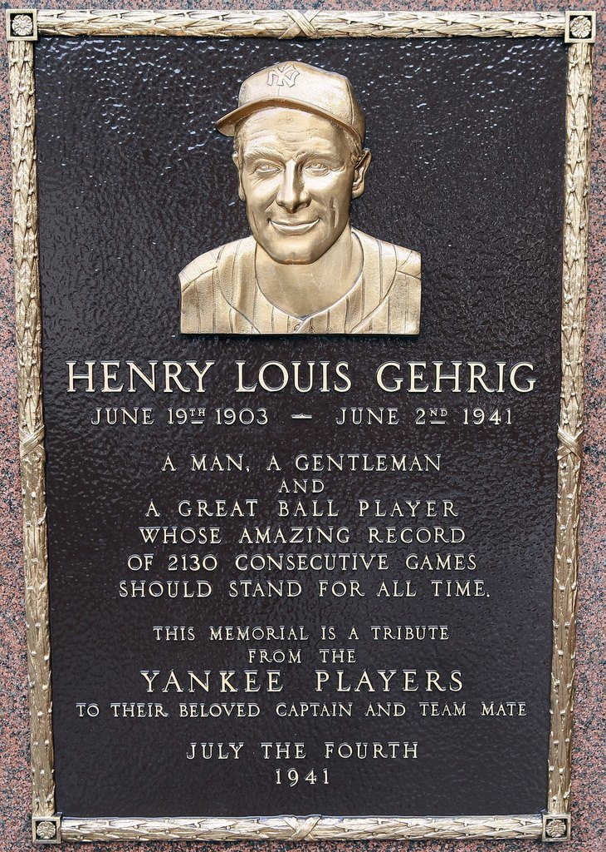

Slide 4
For 71 years, Lou Gehrig has been the face of Amyotrophic Lateral Sclerosis, or ALS, now most commonly known as "Lou Gehrig’s disease."
After getting the diagnosis of a disease that would quickly rob him of his muscle strength and control, Gehrig retired from baseball. At a ceremony honoring him at Yankee Stadium on July 4, 1939, his voice full of emotion, he said, "Today I consider myself the luckiest man on the face of the Earth. That I might have been given a bad break, but I’ve got an awful lot to live for. Thank you." He died just two years later of the disease that now bears his name.

Slide 5
Mechanism of Disease: ALS
Link for a video 2
https://www.youtube.com/watch?v=oNsP67M57tM

Slide 6
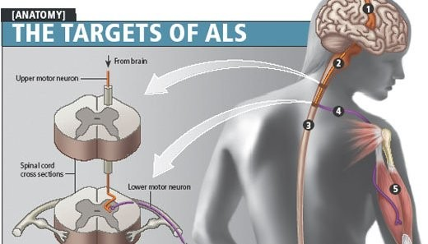

Slide 7
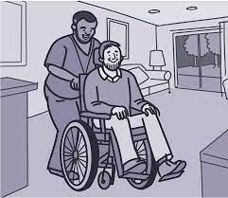
Causes of ALS
Link for a video 3
https://www.youtube.com/watch?v=YjaKcA0hNNw

Slide 8
Signs and Symptoms of ALS
Signs and Symptoms of ALS
Progressive bulbar palsy,
Progressive spinal muscular atrophy,
Primary lateral sclerosis
Focal weakness beginning in arm, leg, and bulbar muscles
The individual may trip or drop things, may have slurred speech, abnormal fatigue, and uncontrollable periods of laughing or crying
As the disease progresses there is noted muscle atrophy, weight loss, spasticity, muscle cramping, and fasciculations (twitching of the muscle fascicles at rest).

Slide 9
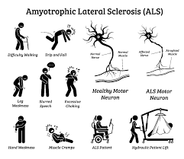

Slide 10
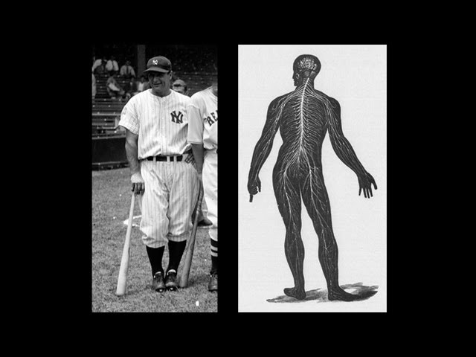
Link for a video 4
https://www.youtube.com/watch?v=d9PxRqGUMd0&list=PPSV

Slide 11
Diagnosis of ALS
The diagnosis of amyotrophic lateral sclerosis (ALS) is primarily clinical.
When the disease has progressed far in its course and involves many parts of the body, the patient’s appearance and the findings on the neurologic examination may provide sufficient evidence for the diagnosis
Link for a video 5
https://www.youtube.com/watch?v=Zqh2i_0HFR4&list=PPSV

Slide 12
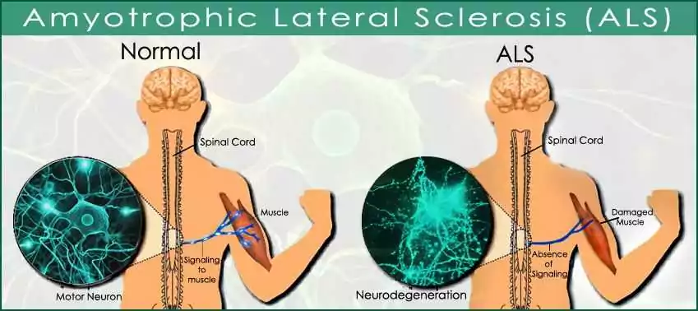

Slide 13
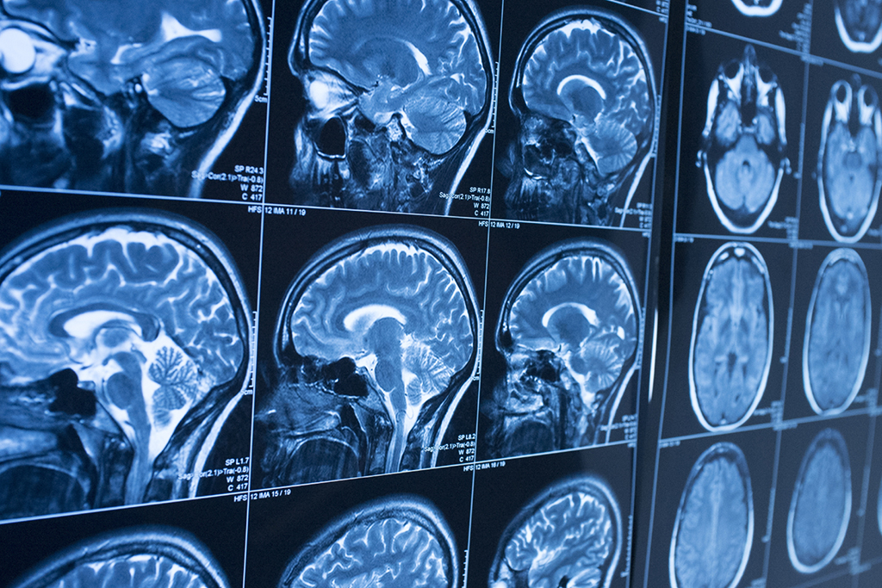
Diagnosis of ALS
Electromyography (EMG)—evaluates how well nerves and muscles are functioning. This test can include:
  A nerve conduction study (NCS) — measures the electrical activity of nerves and muscles by assessing the nerve's ability to send a signal along the nerve or to the muscle.
  A needle exam — a recording technique that detects electrical activity in muscle fibers using a needle electrode
Magnetic resonance imaging (MRI) — uses a magnetic field and radio waves to produce detailed images of the brain and spinal cord

Slide 14
Summary
Link for a video 6
https://www.youtube.com/watch?v=oBmIlm94iRY

Slide 15



