Slide 1




Sleep function concepts to maintain good mental and physical health
Heisl Vaher MD
Somnologist
ENT specialist

Slide 2

Pre-lecture preparation
Sleep hygien https://www.sleepfoundation.org/sleep-hygiene
How to Design the Ideal Bedroom for Sleep https://www.sleepfoundation.org/bedroom-environment/how-to-design-the-ideal-bedroom-for-sleep

Slide 3
Lecture content
Introduction to healthy sleep
How does sleep affect different organ systems
Bidirectional effect of sleep and mental health
Basic rules of physical activity to gain and remain normal sleep
Following sleep. How to know if there is a sleep disorder?
Estimating bedroom environment at
hospital ward and at home (resp what is applicable).
Simple techniques to apply for sleep
improvement based on light, noise,
air quality
and temperature, bedding

Slide 4

Introduction to healthy sleep

Slide 5
Introduction to healthy sleep
Sleep is repetitive function
Routine plays major role in maintaining good health/preventing disease progression
Learning about ones own sleep
Building suitable daily rhythm
Managing healthy bedroom environment

Slide 6
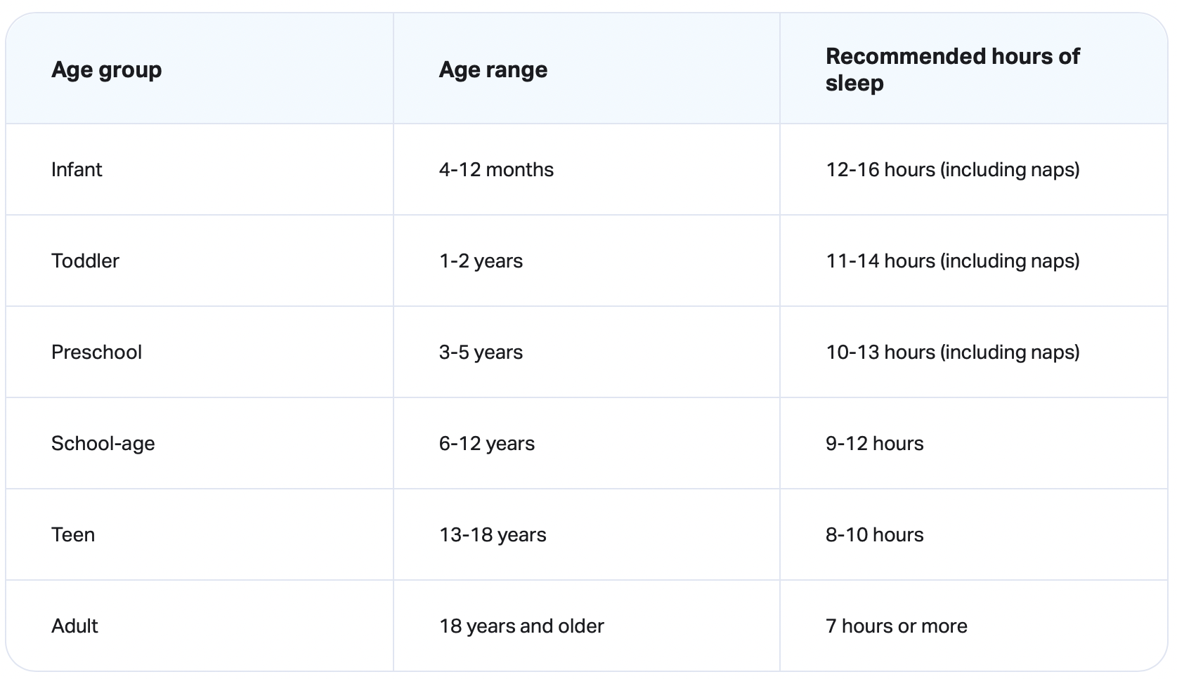
Introduction to healthy sleep – sleep need https://www.sleepfoundation.org/how-sleep-works/how-much-sleep-do-we-really-need

Slide 7
Introduction to healthy sleep
Sticking to the same sleep schedule every day and on weekends
To fall asleep quickly practice pre-bedtime routine
Napping should not be regular untill elderly years (except power nap)
  Caffeine+ timed sleep
Mattress, pillows, bedding
Dark, quiet, cool environment
Screens interfere with sleep
Intake of stimulants/substances - caffeine, alcohol, nicotine

Slide 8
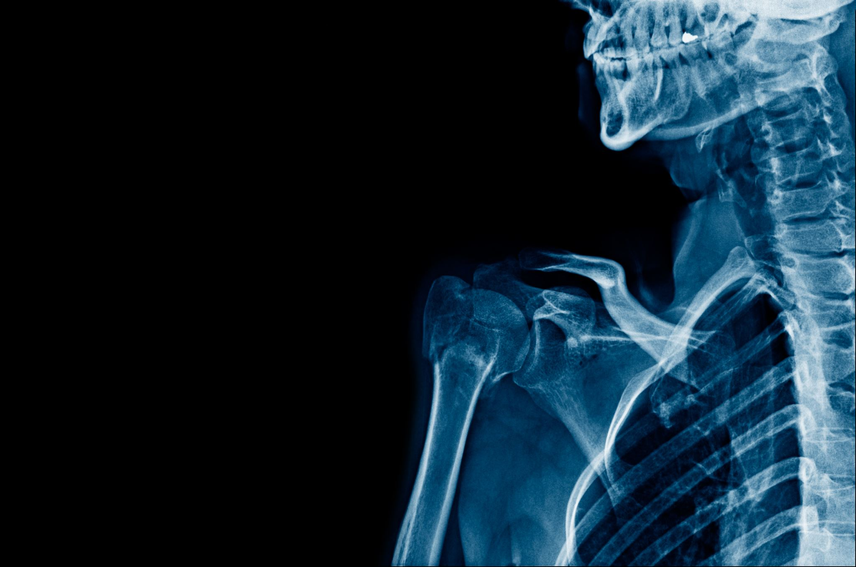
How does sleep affectdifferent organ systems

Slide 9
  Hormones of growth
  Immune system
  Cognition and memory
  Metabolism; appetite
  Cardiovascular health

Slide 10
How does sleep affect different organ systems
Lack of sleep increases the risk for
  Frequent infections of upper respiratory tract
  Mental health problems (mood changes, depression; insomnia)
    Traffic accidents
  Obesity
  Heart disease
  Immune system - >cancer

Slide 11

Bidirectional effect of sleep and mental well being

Slide 12
Bidirectional effect of sleep and mental well being
Even a light mental health disorder can lead to sleep disorder (Crystal 2012)
Anxiety can cause racing or repetitive thoughts, and worries that keep you awake.
One may also have panic attacks while you're trying to fall asleep.
Depression and seasonal affective disorder (SAD) can make you sleep more,
including staying in bed for longer or sleeping more often.
Depression can also cause insomnia. (https://www.mind.org.uk/information-support/types-of-mental-health-problems/sleep-problems/)

Slide 13
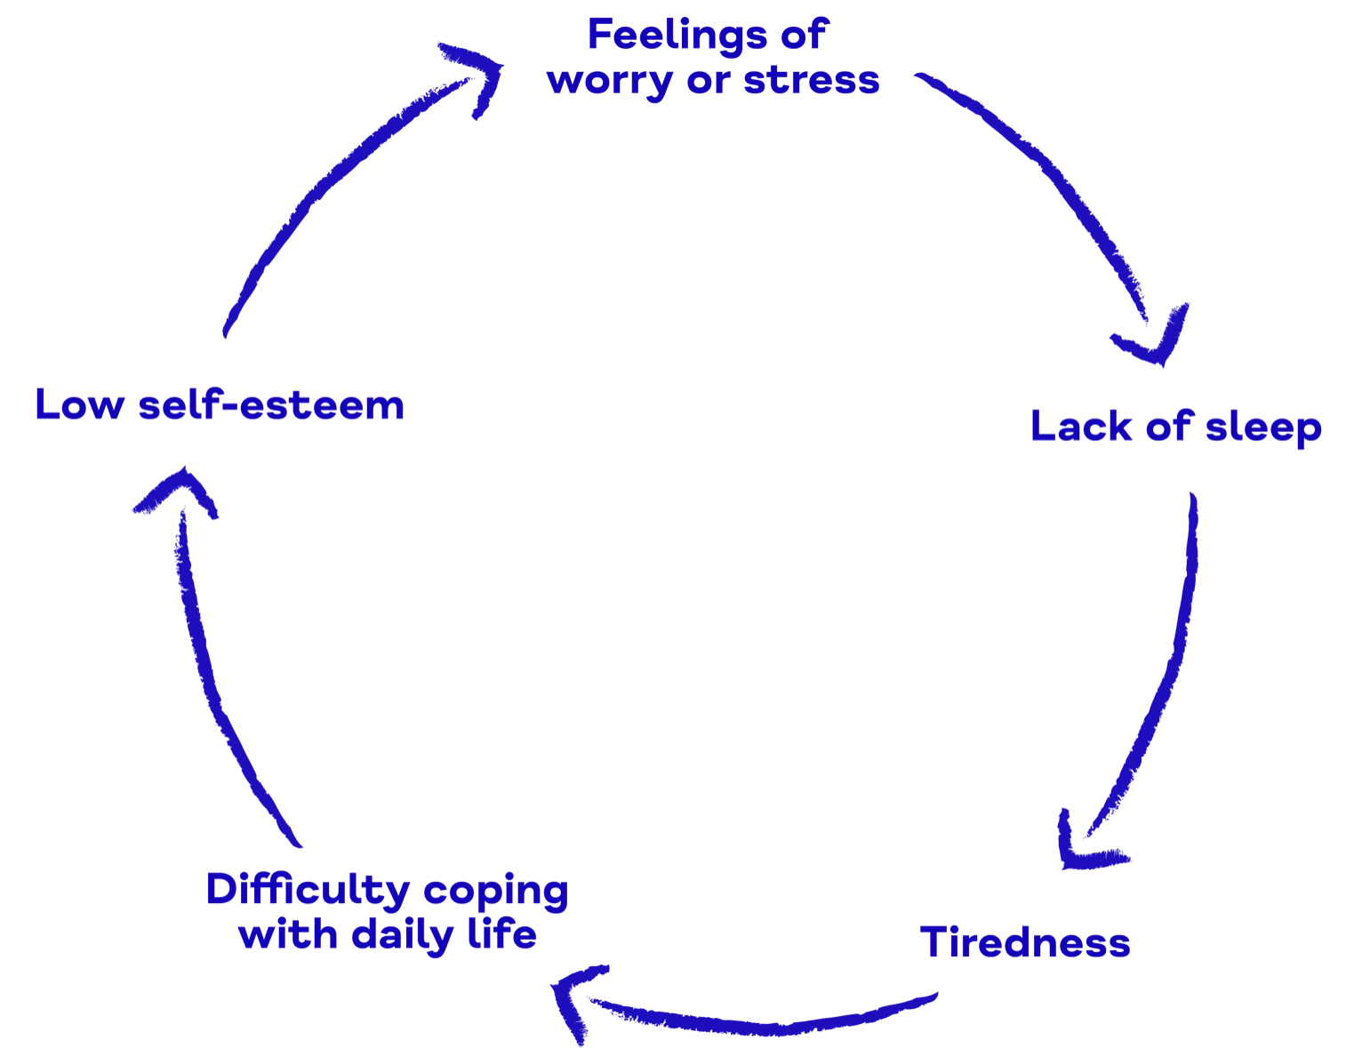

Bidirectional effect of sleep and mental well being https://www.mind.org.uk/information-support/types-of-mental-health-problems/sleep-problems/about-sleep-and-mental-health/

Slide 14
Bidirectional effect of sleep and mental well being
Insomnia can be a symptom anxiety and depression (<-social jet lag, insomnia->)
2. Insomnia among other sleep problems can also contribute to the onset and worsening of different mental health problems, including depression, anxiety, and even suicidal ideation. (https://www.columbiapsychiatry.org/news/)

Slide 15
Bidirectional effect of sleep and mental well being
Sleep helps maintain cognitive skills:
  attention, learning, and memory
Poor sleep can make it much more difficult to cope with even relatively minor stressors and can even impact our ability to perceive the world accurately
https://www.columbiapsychiatry.org/news/

Slide 16
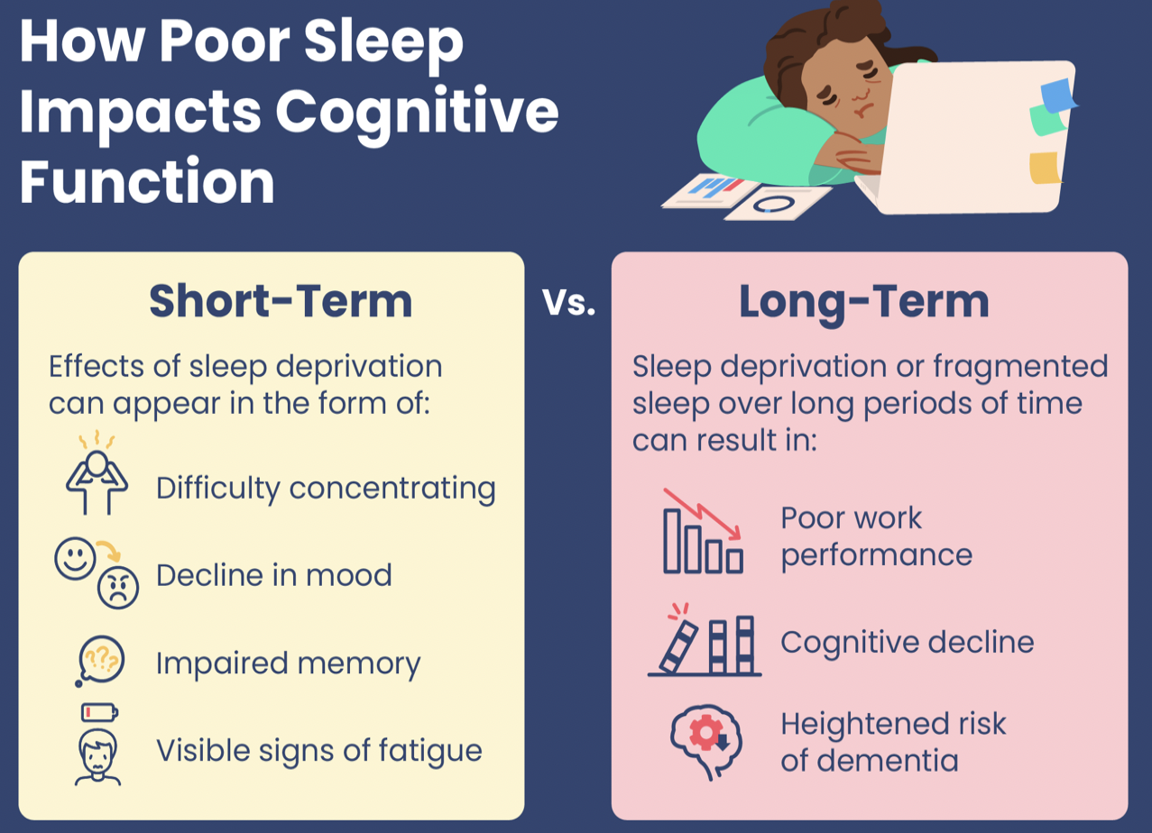

Bidirectional effect of sleep and mental well being https://www.sleepfoundation.org/sleep-deprivation/lack-of-sleep-and-cognitive-impairment

Slide 17

Basic rules of physical activity to gain and remain normal sleep

Slide 18
Basic rules for physical activity to gain and remain normal sleep https://health.gov/sites/default/files/2019-09/
How to approach your patients regarding physical activity suggestion:
Improves brain health, cognition, anxiety, depression, quality of life, and sleep
Helps to keep a healthy weight
Reduces risk of : heart disease, type II diabetes, some cancers
Makes bones and muscles strong: helps manage arthritis
Prevents falls
Helps to manage chronic diseases
Elevation in core body
temperature signals the body clock that it's time to be awake
After about 30 to 90 minutes, the core body temperature
starts to fall.
The decline helps to facilitate sleepiness.
(https://www.hopkinsmedicine.org/health/wellness-and-prevention/exercising-for-better-sleep)

Slide 19
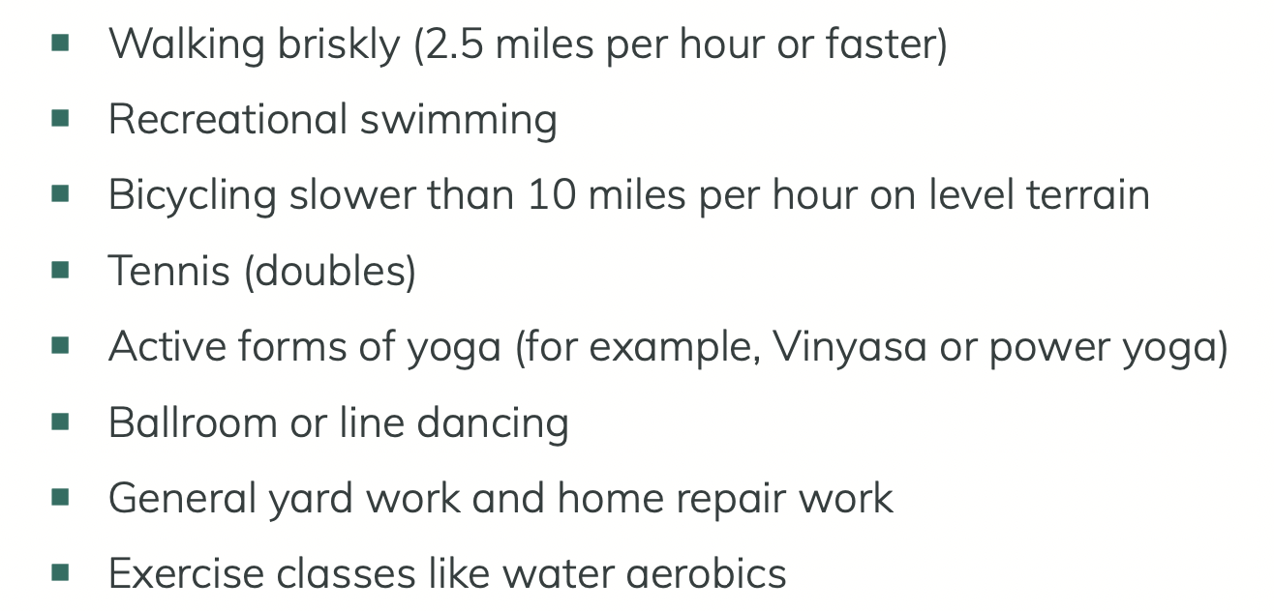
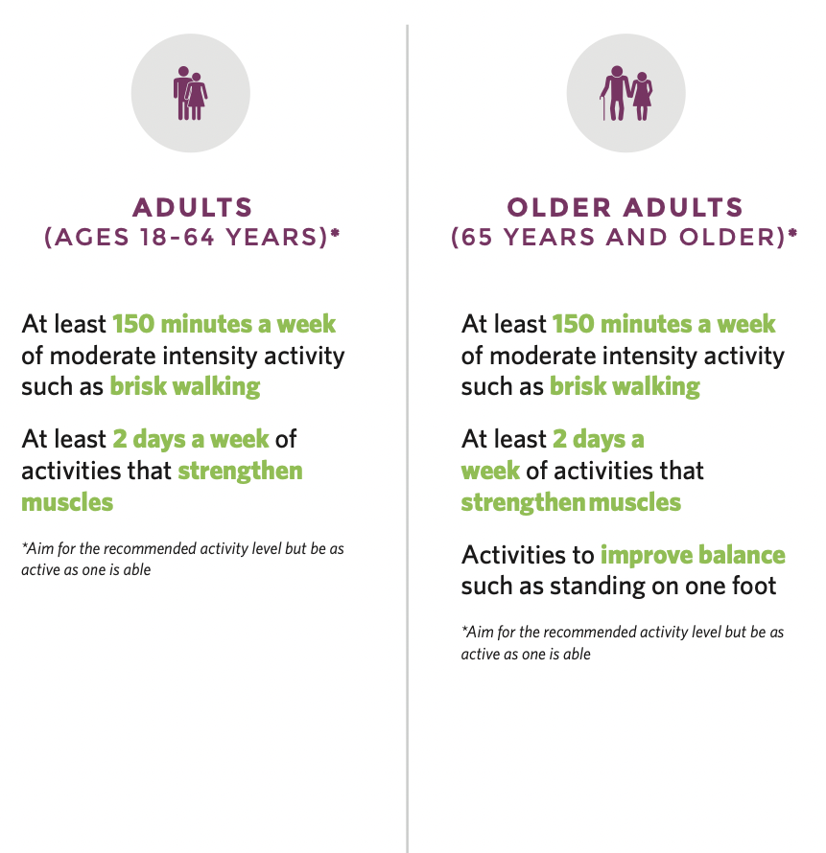
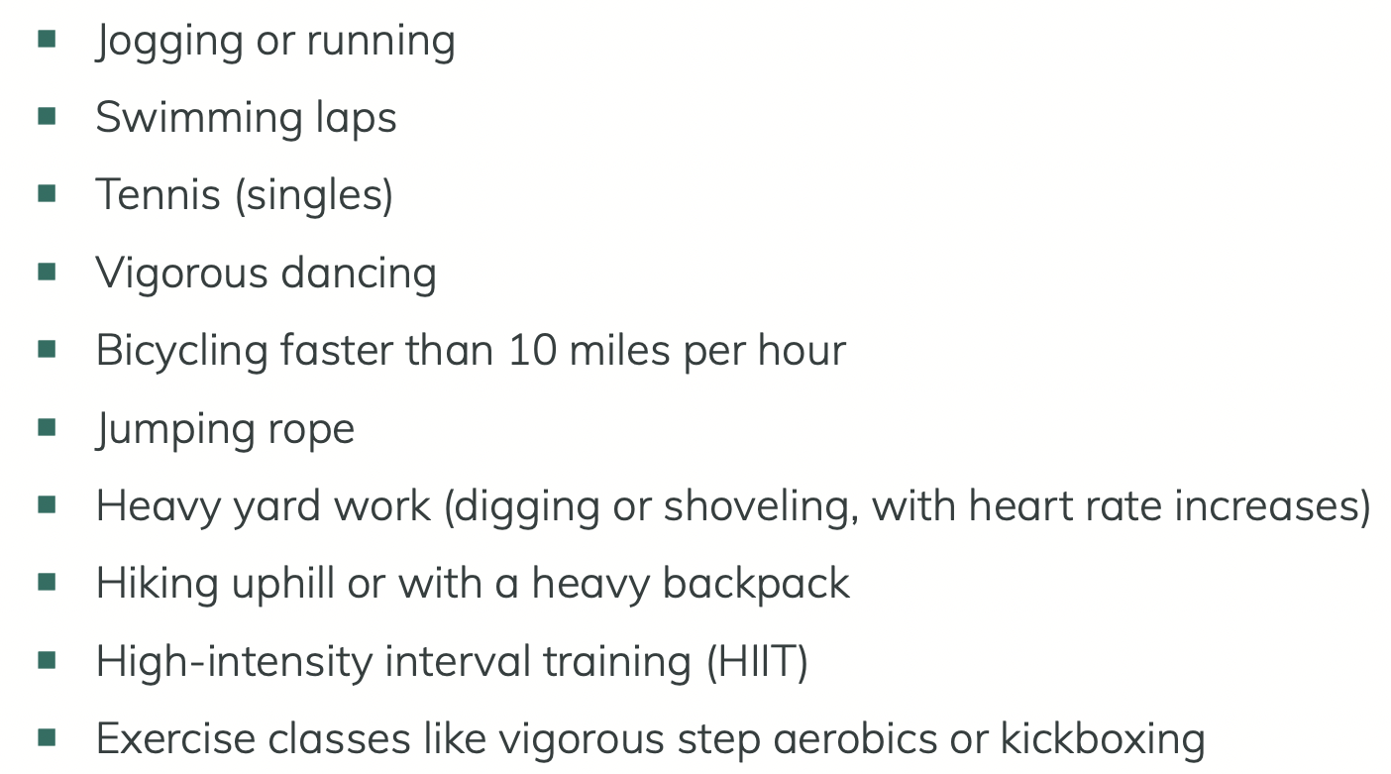
Basic rules of physical activity to gain and remain normal sleep https://health.gov/sites/default/files/2019-09/

Slide 20
Basic rules of physical activity to gain and remain normal sleep
Expect changes when aging (Sterniczuk et al 2017):
  Sleep patterns tend to change as person ages.
  Most people find that aging causes them to have a harder time falling asleep.
  Waking up more often during the night and earlier in the morning.
  Total sleep time stays the same or is slightly decreased (6.5 to 7 hours per night).

Slide 21
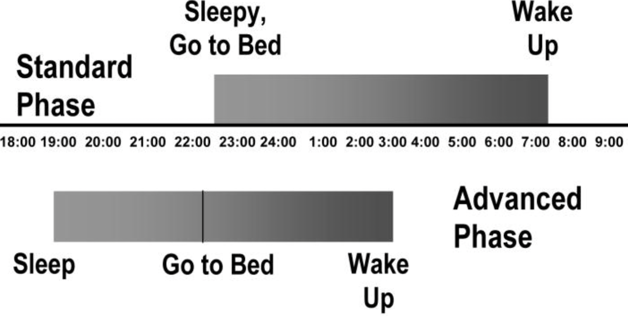
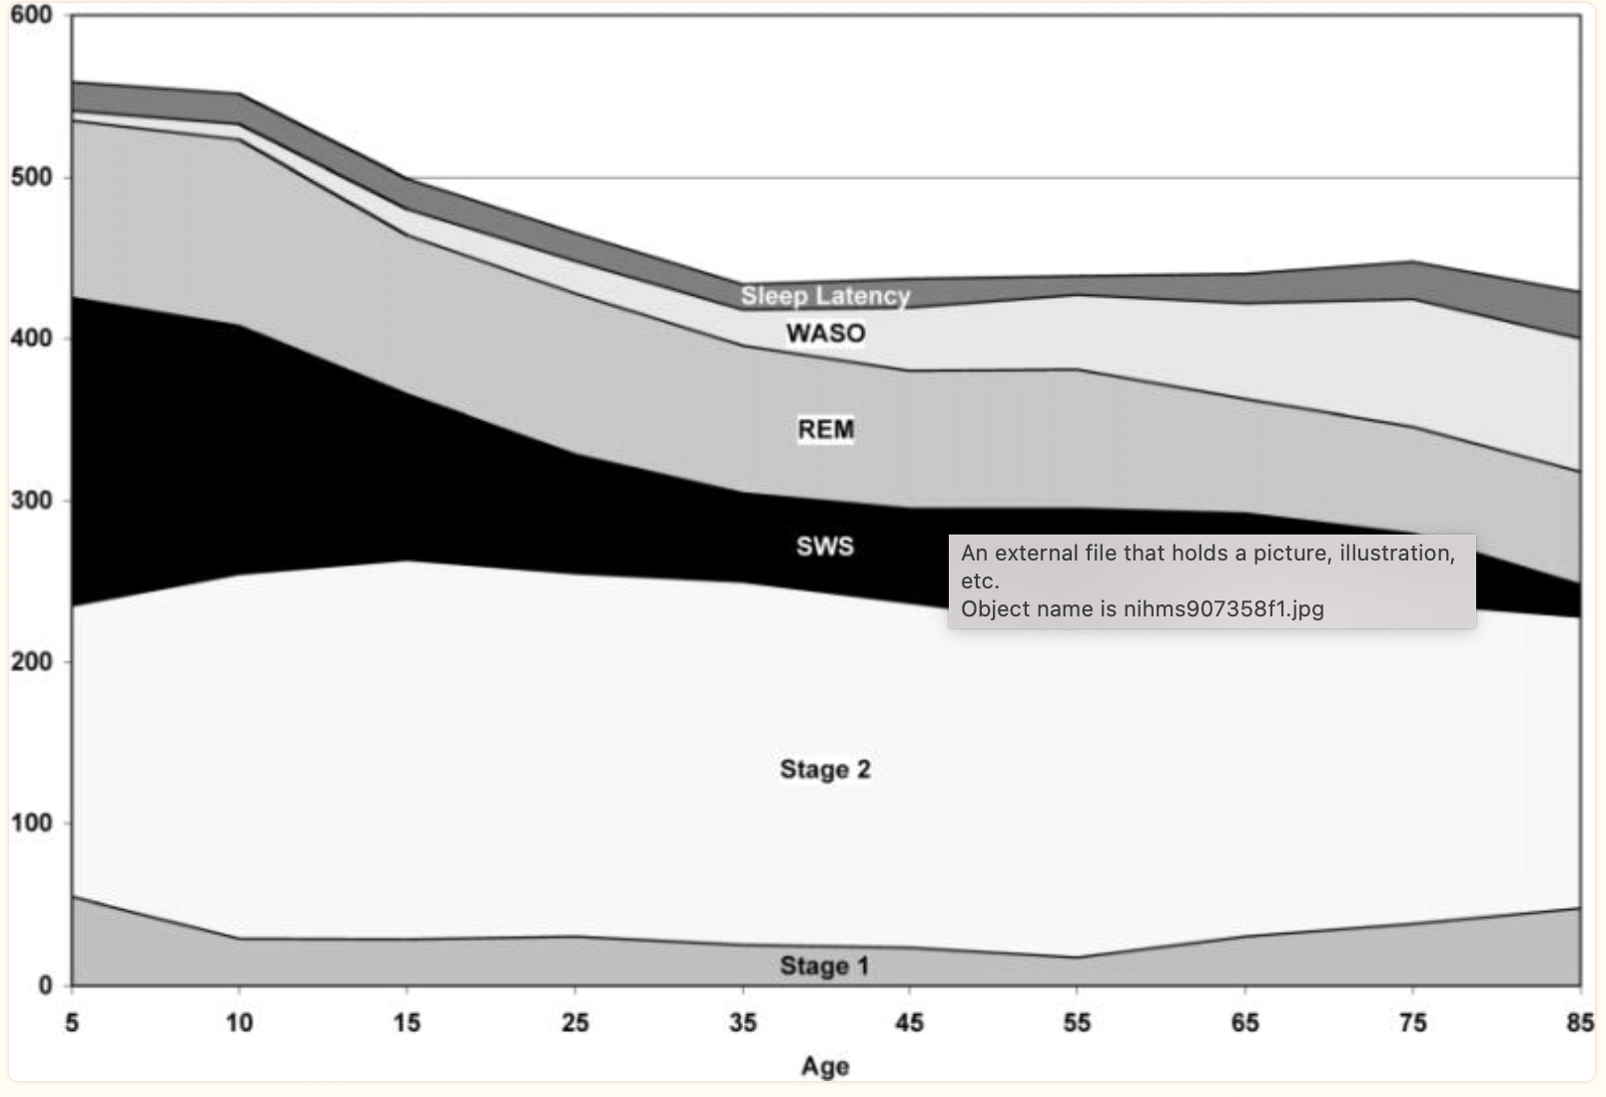
Basic rules of physical activity to gain and remain normal sleep (Ohayon et al 2004; Cooke, Ancoli-Israel, 2011)

Slide 22

Following sleep. How to know if there is a sleep disorder?
Excessive daytime sleepiness. Sleep diary

Slide 23
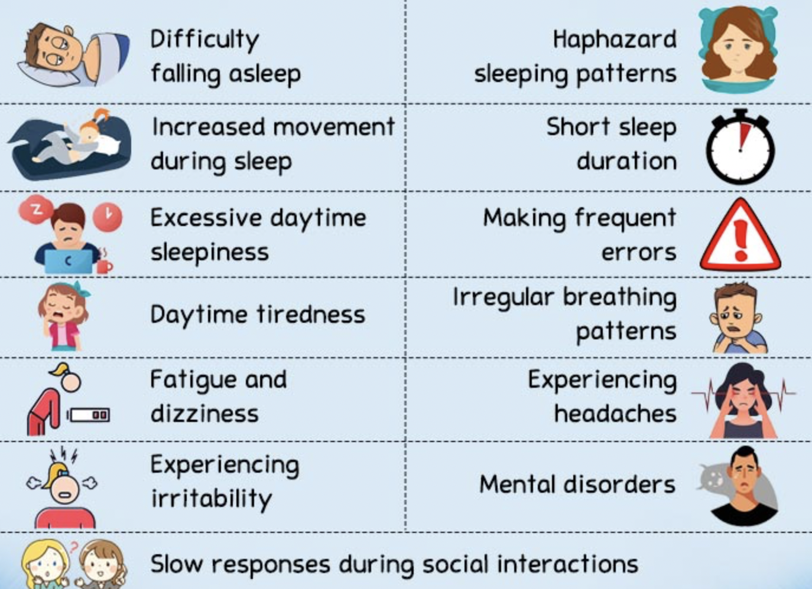
Following sleep. How to know if there is a sleep disorder? https://mind.help/topic/sleep/sleep-disorders/
Patient presents with:

Slide 24
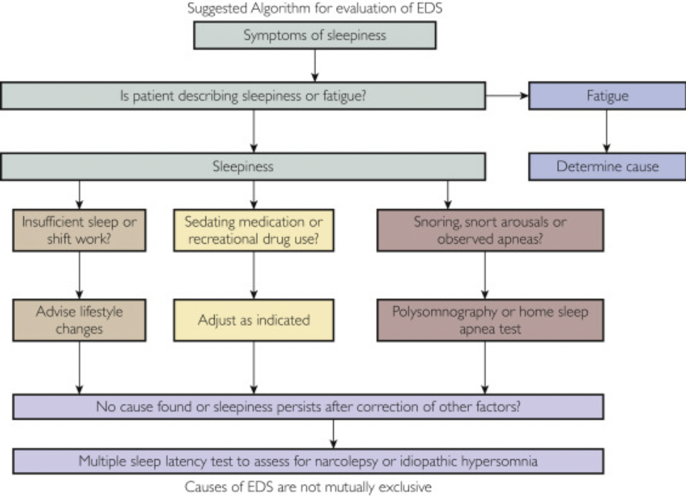
Excessive daytime sleepiness (https://www.mayoclinicproceedings.org/article/S0025-6196%2820%2930984-8/fulltext)

Slide 25
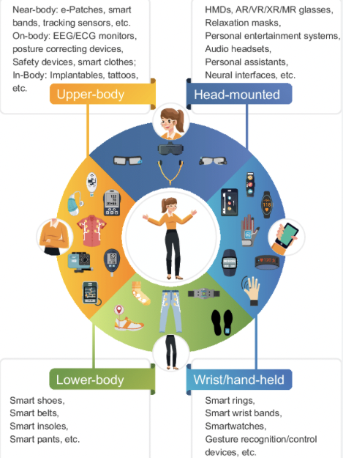
Following/ recording sleep (Ometov et al 2021)

Slide 26
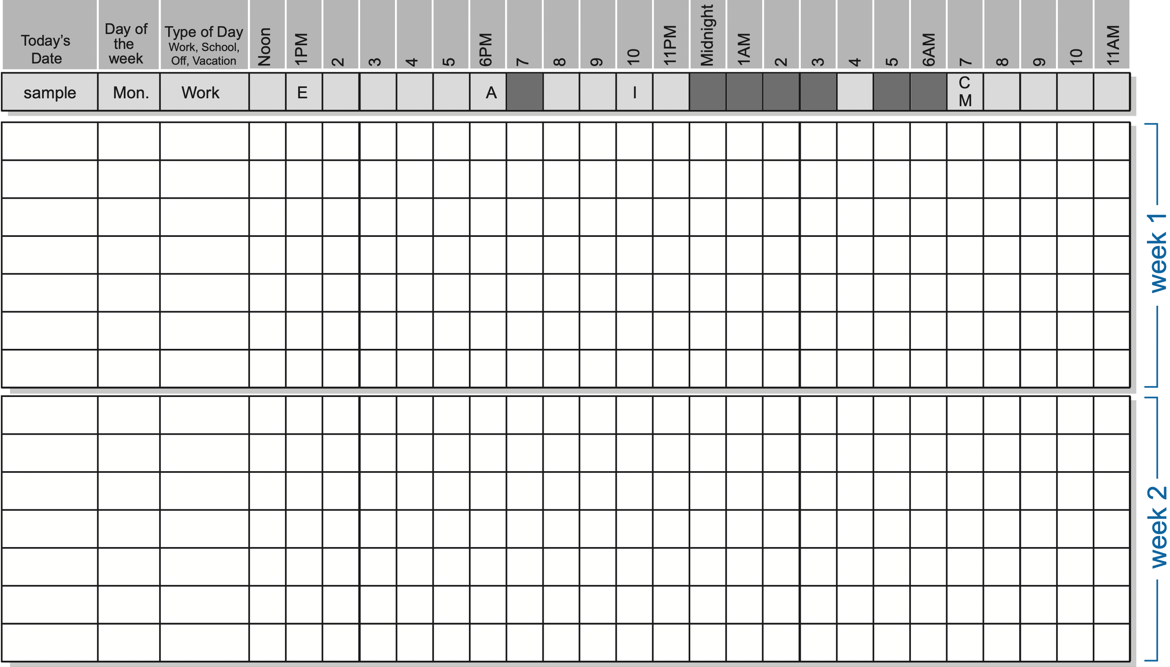
Following sleep. Sleep diary (https://www.uclahealth.org/sites/default/files/documents/sleepdiary.pdf)

Slide 27
Estimating bedroom environment at hospital ward and at home

Slide 28
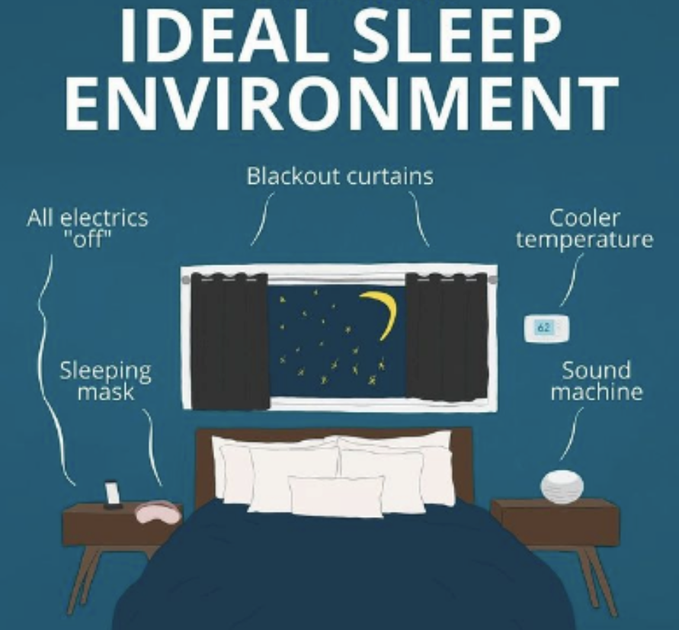
Estimating bedroom environment at hospital ward and at home https://www.hopkinsmedicine.org/health/wellness-and-prevention/sleep
Light
Noise
Temperature
Cleaness/tidiness
Cosiness
Comfortability
Personal needs and preferations met

Slide 29
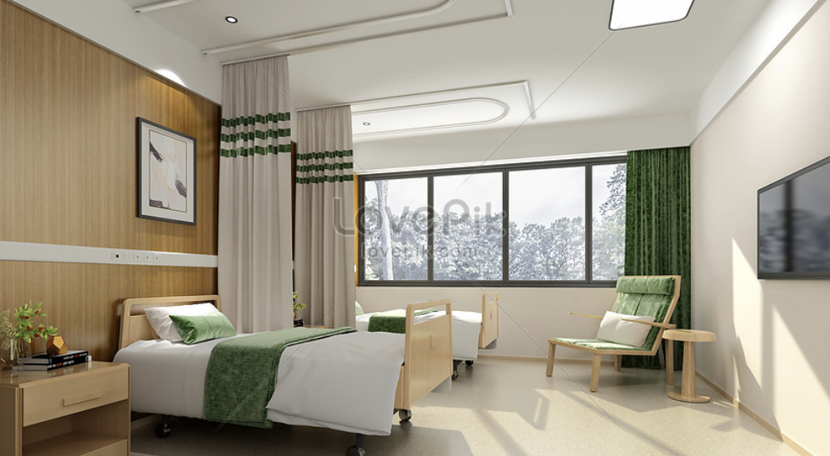

Estimating bedroom environment at hospital ward and at home
Allow and urge to move around as much as possible during the day
Learn about patients usual routine and bedtime, to follow your usual pattern if there is one
Diminish times of waking the patient during the night
Group well- sleepers together
Comforting items should be allowed
Earplugs, eye mask; reduced noise and light.
Relaxing music for evening, invigoarating sound during morning
Avoiding screens for an hour before sleep. Their blue light reduces natural sleepiness and keeps us awake
Sleep is hard to come by if the patient is hungry
Decaffeinated drinks

Slide 30
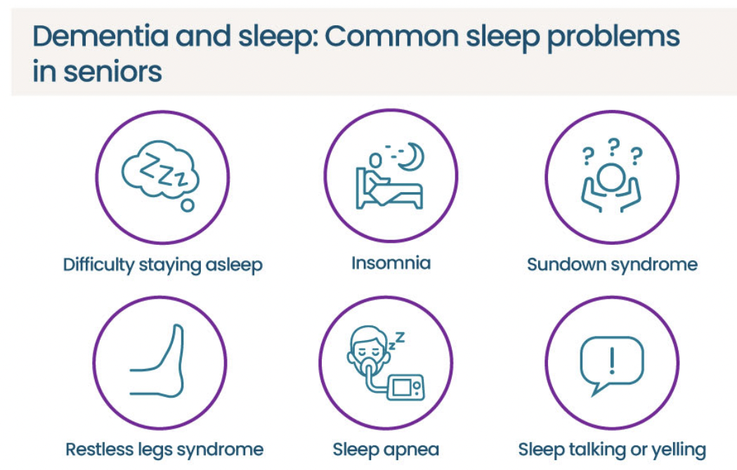
Estimating bedroom environment at hospital ward and at home https://sleepopolis.com/education/the-ultimate-guide-to-sleeping-in-a-nursing-home; https://www.aplaceformom.com/caregiver-resources/articles/manage-dementia-sleep-problems
Dementia goes hand in hand with sleep problems
Nursing homes work on strict schedules
Insufficient sleep at night
Sedating medications
Damage to brain cells caused by dementia
Changes in sleep patterns caused by dementia
Mental health conditions, such as depression
Other sleep disorders, such as sleep apnea - excessive daytime sleepiness - napping daily

Slide 31
In lecture group discussions:
Signs of unhealthy sleep?
Topics: Sleepiness,
fatigue, pain, anxiety.
How to know the complaint is referring to a sleep
Disorder?
- how to fill the diary?
  Group discussion of bedroom environment in home
  bedroom/hospital of four wards

Slide 32
Literature
https://www.sleepfoundation.org/how-sleep-works/how-much-sleep-do-we-really-need
Krystal AD. Psychiatric disorders and sleep. Neurol Clin. 2012 Nov;30(4):1389-413. doi: 10.1016/j.ncl.2012.08.018. PMID: 23099143; PMCID: PMC3493205.
(https://www.columbiapsychiatry.org/news/)
https://www.mind.org.uk/information-support/types-of-mental-health-problems/sleep-problems/)
https://www.sleepfoundation.org/sleep-deprivation/lack-of-sleep-and-cognitive-impairment
https://vesselhealth.com/blogs/ultimate-guides/restorative-sleep
https://health.gov/sites/default/files/2019-09/Physical_Activity_Guidelines_2nd_edition.pdf#page=56
Sterniczuk R, Rusak B. Sleep in relation to aging, frailty, and cognition. In: Fillit HM, Rockwood K, Young J, eds. Brocklehurst's Textbook of Geriatric Medicine and Gerontology.8th ed. Philadelphia, PA: Elsevier; 2017:chap 108.

Slide 33
Ohayon MM, Carskadon MA, Guilleminault C, Vitiello MV. Meta-analysis of quantitative sleep parameters from childhood to old age in healthy individuals: developing normative sleep values across the human lifespan. Sleep. 2004;27(7) :1255–1273.
https://www.hopkinsmedicine.org/health/wellness-and-prevention/exercising-for-better-sleep#:~:text=Exercise%20also%20raises%20your%20core%20body%20temperature.&text=Elevation%20in%20core%20body%20temperature,decline%20helps%20to%20facilitate%20sleepiness.
Ometov, A., Shubina, V., Klus, L., Skibińska, J., Saafi, S., Pascacio, P., Flueratoru, L., Gaibor, D. Q., Chukhno, N., Chukhno, O., Ali, A., Channa, A., Svertoka, E., Qaim, W. B., Casanova-Marqués, R., Holcer, S., Torres-Sospedra, J., Casteleyn, S., Ruggeri, G., ... Lohan, E. S. (2021). A Survey on Wearable Technology: History, State-of-the-Art and Current Challenges. Computer Networks, 193, Article 108074. https://doi.org/10.1016/j.comnet.2021.108074
https://mind.help/topic/sleep/sleep-disorders/
https://www.mayoclinicproceedings.org/article/S0025-6196%2820%2930984-8/fulltext
Cooke JR, Ancoli-Israel S. Normal and abnormal sleep in the elderly. Handb Clin Neurol. 2011;98:653-65. doi: 10.1016/B978-0-444-52006-7.00041-1. PMID: 21056216; PMCID: PMC3142094.
https://sleepopolis.com/education/the-ultimate-guide-to-sleeping-in-a-nursing-home/#sleeping-in-a-nursing-home
https://www.aplaceformom.com/caregiver-resources/articles/manage-dementia-sleep-problems

