Slide 1
4.9 ASSESING AND MEASURING IN PD / 2
GP2 - Clinical assessment and outcome measurement
Zvezdan Pirtošek University of Ljubljana

Slide 2
LEARNING OBJECTIVES
1. Understand the key scales used to assess Parkinson’s Disease (PD).
2. Evaluate and understand when and how to apply motor and non-motor scales.
3. Explore their applicability to various stages of PD.
4. Use case studies to illustrate practical applications of these scales.

Slide 3
ASSESSING IN PD
Motor function
Non-motor function
Cognition
Mood & psychiatric impairment
Autonomic impairment
Sleep
GI symptoms
…
Complications of treatment
Motor fluctuations
Dyskinesia
Psychiatric
Quality of life
Carer burden
Overall parkinsonian severity

Slide 4
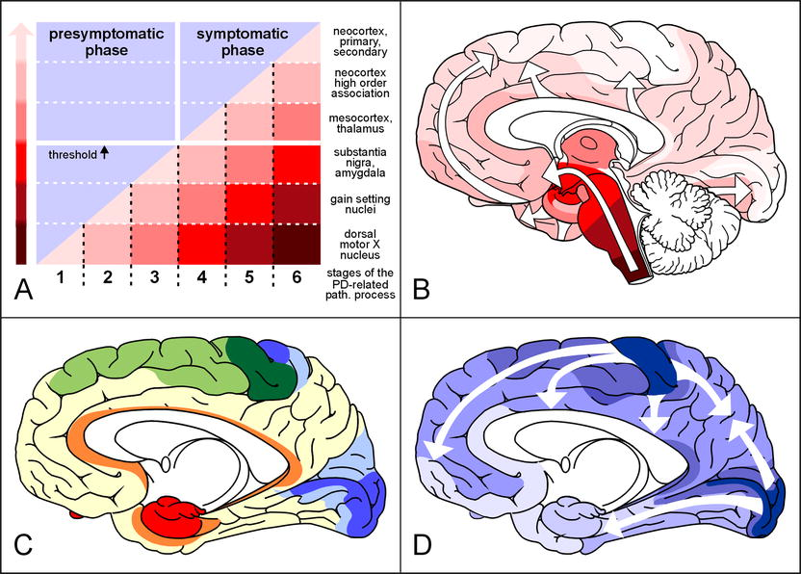
BRAAK STAGING OF PD

Slide 5
PD: MOTOR SYMPTOMS AND SIGNS
Main
Also
Tremor
Bradykinesia
Hypokinesia
Rigidity
Postural instability
Reduced facial expression (hypomimia):
Micrographia
Freezing of gait
Dyskinesia
Akinesia

Slide 6
TREMOR: CLINICAL ASSESSMENT
Neurological Examination:
Observation of tremor at rest, during activity, and with postural maintenance.
Focus on tremor frequency, amplitude, and distribution.
Patient History:
Detailed history of tremor onset, progression, and impact on daily activities.
Family history of tremor or other neurological disorders.
Video Recording:
Utilized for detailed analysis and documentation.
Allows for comparison over time and peer review.

Slide 7
TREMOR: QUANTITATIVE MEASUREMENT TOOLS
Accelerometry:
Uses sensors to measure tremor frequency, amplitude, and acceleration.
Provides quantitative data for detailed analysis.
Electromyography (EMG):
Records electrical activity of muscles.
Useful for differentiating between tremor types and underlying muscle activity patterns.
Digitizing Tablets and Smart Devices:
Capture handwriting and drawing tasks.
Analyze tremor characteristics through digitized data.

Slide 8
TREMOR: STANDARDIZED RATING SCALES
Unified Parkinson's Disease Rating Scale (UPDRS):
Comprehensive tool covering motor and non-motor symptoms.
Part III focuses on motor examination, including tremor at rest, action, and postural tremor.
Fahn-Tolosa-Marin Tremor Rating Scale (FTMTRS):
Specific for tremor assessment.
Evaluates tremor severity, functional impact, and anatomical distribution.
Essential Tremor Rating Assessment Scale (TETRAS):
Though designed for essential tremor, useful for PD tremor.
Assesses tremor during various tasks and postures

Slide 9
BRADYKINESIA: CLINICAL ASSESSMENT
Unified Parkinson's Disease Rating Scale (UPDRS)
Sections Relevant to Bradykinesia:
Motor Examination (Part III): Includes tasks like finger tapping, hand movements, pronation-supination of hands, toe tapping, and leg agility.
Scoring: Each task is rated on a scale from 0 (normal) to 4 (severe impairment).
MDS-UPDRS (Movement Disorder Society-sponsored revision of UPDRS)
Sections Relevant to Bradykinesia:
Items 3.4 to 3.8: Focus specifically on the evaluation of bradykinesia through similar tasks as the original UPDRS.

Slide 10
BRADYKINESIA: QUANTITATIVE MEASUREMENT TOOLS
Timed Tests
Examples: Timed Up and Go (TUG) test, and finger tapping speed test.
Procedure:
TUG Test: Measures the time taken to stand up from a chair, walk 3 meters, turn, walk back, and sit down.
Finger Tapping Test: Measures the number of taps in a specific duration (usually 10 seconds).
Electronic Devices and Sensors
Accelerometers and Gyroscopes
Usage: Worn on the body to capture movement data.
Benefits: Provide precise, objective measurements of movement amplitude and speed.
Smartphone Applications
Functionality: Utilize built-in sensors to assess motor symptoms, including bradykinesia, through guided tasks and exercises.

Slide 11
BRADYKINESIA: ADVANCED IMAGING & SENSORS
Dopamine Transporter (DAT) Imaging
Uses Single Photon Emission Computed Tomography (SPECT) or Positron Emission Tomography (PET) to visualize dopamine transporter levels in the brain.
Correlates with the severity of bradykinesia and other motor symptoms by showing dopamine deficiency.
Kinematic Analysis
Involves capturing detailed motion data using motion capture systems or wearable sensors.
Parameters Assessed: Speed, amplitude, and coordination of movements during specific tasks.
Applications: Used in research settings to quantify bradykinesia and evaluate the effectiveness of treatments.

Slide 12
RIGIDITY: CLINICAL EXAM
Clinical Examination:
Performed by a neurologist or trained healthcare professional.
Passive movement of limbs: The examiner moves the patient's limbs and assesses resistance.
Observation of cogwheel rigidity: A ratchety resistance felt during passive movement, common in Parkinson’s disease.

Slide 13
RIGIDITY: SCALES
Unified Parkinson's Disease Rating Scale (UPDRS):
Widely used comprehensive scale.
Rigidity assessed in different body parts (neck, arms, legs).
Scores range from 0 (no rigidity) to 4 (severe rigidity).
Modified Ashworth Scale (MAS):
Originally designed for spasticity but used for rigidity.
Measures resistance during passive soft-tissue stretching.
Scores range from 0 (no increase in muscle tone) to 4 (affected parts rigid in flexion or extension).
Hoehn and Yahr Scale:
Stages the severity of Parkinson’s disease.
Indirectly measures rigidity as part of overall disease staging.
Stages range from 1 (unilateral symptoms) to 5 (wheelchair-bound or bedridden unless aided).

Slide 14
RIGIDITY: QUANTITATIVE ASSESSMENTS
Electromyography (EMG):
Measures electrical activity of muscles at rest and during movement.
Can quantify the degree of muscle activation and rigidity.
Biomechanical Assessment:
Use of sensors and motion analysis systems to measure resistance and movement patterns.
Provides objective data on the mechanical properties of rigidity.

Slide 15
ASSESSING FREEZING OF GAIT
Freezing of Gait Questionnaire (FOG-Q):
A self-administered questionnaire to evaluate the severity and impact of FOG.
Includes items on the frequency, duration, and impact of FOG episodes.
New Freezing of Gait Questionnaire (NFOG-Q):
An updated version of FOG-Q with improved reliability and validity.
Consists of a structured interview and video-based assessments.
Timed Up and Go Test (TUG):
Description: Measures the time taken to stand up from a chair, walk three meters, turn around, walk back, and sit down.
Relevance: Prolonged TUG times can indicate the presence of FOG
Video Analysis:
Recording and analyzing a patient's gait to identify and quantify FOG episodes.
Provides visual confirmation and detailed assessment of gait patterns.

Slide 16
ASSESSING FREEZING OF GAIT
Wearable Technology:
Use of accelerometers and gyroscopes to detect FOG episodes in real-time.
Benefits: Provides continuous monitoring and objective data on gait patterns.
Artificial Intelligence (AI) and Machine Learning:
Application of AI algorithms to analyze gait data and predict FOG episodes.
Advantages: Enhances early detection and personalized intervention strategies

Slide 17
POSTURAL INSTABILITY
Clinical Observation and Patient History:
Clinician assesses balance during routine examination
Pull Test: a sudden pull on the patient's shoulders to assess their ability to recover balance.
Part of the UPDRS and other Parkinson’s disease assessments.
Patient-reported experiences of balance difficulties and falls.
Functional Reach Test (FRT):
Measures the maximum distance a person can reach forward while standing in a fixed position.
Simple, quick, and effective for screening balance issues.
Timed Up and Go (TUG) Test:
Measures the time it takes for a person to stand up from a chair, walk 3 meters, turn, walk back, and sit down.
Provides insights into functional mobility and balance.

Slide 18
POSTURAL INSTABILITY
Berg Balance Scale (BBS):
14-item scale assessing balance through tasks like standing up, reaching, turning, and standing on one leg.
Widely used in clinical and research settings.

Slide 19
SCALES TO MEASURE DYSKINESIA
Unified Dyskinesia Rating Scale (UDysRS)
Patient-based historical information.
Clinician-based objective examination.
Scoring: Assesses impact on daily living, time spent with dyskinesia, and severity.
Pros: Comprehensive; widely used in research and clinical settings.
Abnormal Involuntary Movement Scale (AIMS)
Clinician rates the severity of dyskinesia in various body parts.
Assesses global severity and impact on function.
Scoring: Rates dyskinesia on a 5-point scale (0-4).
Pros: Simple; quick to administer.
Rush Dyskinesia Rating Scale (RDRS)
Observational tool for rating dyskinesia severity.
Includes head, trunk, and limbs assessment.
Scoring: Each region rated separately; total score reflects overall severity.
Pros: Focused on specific regions; useful in detailed assessments.

Slide 20

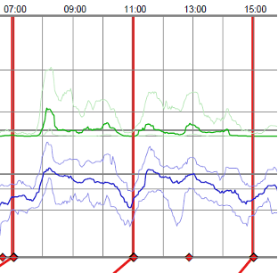
PARKINSON'S KINETIGRAPH (PKG)

Slide 21
NON-MOTOR SYMPTOMS
Mood and Psychiatric Symptoms
Cognitive Symptoms
Sleep Disturbances
Autonomic Dysfunction
Sensory Symptoms
Gastrointestinal Symptoms
Fatigue
Speech and Voice Changes
Visual Symptoms
Dermatological Symptoms
Weight Change

Slide 22
NON-MOTOR SYMPTOMS
Non-Motor Symptoms Scale (NMSS)
Non-Motor Symptoms Scale for Parkinson's Disease (NMSS-PD)
Parkinson's Disease Questionnaire (PDQ-39)
Non-Motor Symptoms Questionnaire (NMSQuest)
Scales for Outcomes in Parkinson's Disease–Autonomic (SCOPA-AUT)
Montreal Cognitive Assessment (MoCA)
Beck Depression Inventory (BDI) or Geriatric Depression Scale (GDS)
Hospital Anxiety and Depression Scale (HADS):
REM Sleep Behavior Disorder Screening Questionnaire (RBDSQ)
Epworth Sleepiness Scale (ESS)
Rapid Eye Movement Sleep Behavior Disorder Questionnaire-Hong Kong (RBDQ-HK):

Slide 23
PD NMS: Patient Questionnaire Pilot Study (UK, USA, Germany, Spain)
Parkinson’s Disease
N = 123
Age: 68.1 ± 10.3 yrs (41-87)
59.3% Male
51% mixed, 28% AD, , 20% TD
PD Duration: 6.4 ± 4.3 y (0.5-22 yrs)
84% levodopa, 60% DA
Controls
N = 89
Age: 62.7 ± 12.8 yrs (27-81)
42.7% Male
Chaudhuri R, et al. The NMSQuest study (p NA) Mov Disord 2006:21(7):916-923.

Slide 24
PD NMS Patient Questionnaire Study GU/GI Tract Symptoms
p = 0.01
p = 0.001
p = 0.0000
p = 0.000
p = 0.0001
p = 0.2
p = 0.0007
p = 0.3
p = 0.2
Vomiting, fecal incontinence, incomplete bowel
emptying not significantly different from controls

Slide 25
PD NMS Patient Questionnaire Study Cognition/Neuropsychiatric Features
Cognition + Neuropsychiatry
p = 0.06
p = 0.01
p = 0.0000
p = 0.004
p = 0.9
p = 0.01
p = 0.001
p = 0.0001
p = 0.006
Pain and memory problems were not
significantly different from controls

Slide 26
PD NMS Patient Questionnaire Study Autonomic Features
Autonomic
p = 0.0007
p = 0.1
p = 0.0000
p = 0.25
p = 0.05
p = 0.003
p = 0.0000
Ankle swelling and sex drive not significantly different from controls

Slide 27
PD NMS Patient Questionnaire Study Sleep Disturbances
Sleep + Somnolence
p = 0.2
p = 0.04
p = 0.0005
p = 0.001
p = 0.003
Insomnia not significantly different from controls

Slide 28
MOOD AND PSYCHIATRIC IMPAIRMENT

Slide 29
MOOD AND PSYCHIATRIC IMPAIRMENT
Geriatric Depression Scale (GDS)
Beck Depression Inventory (BDI)
Hospital Anxiety and Depression Scale (HADS)
Hamilton Depression Rating Scale (HAM-D)
Montgomery-Asberg Depression Rating Scale (MADRS)
State-Trait Anxiety Inventory (STAI)
Apathy Evaluation Scale (AES)
Generalized Anxiety Disorder 7 (GAD-7)
Zung Self-Rating Anxiety Scale (SAS)
Unified Parkinson's Disease Rating Scale (MDS-UPDRS) Part I:
Neuropsychiatric Inventory (NPI):

Slide 30
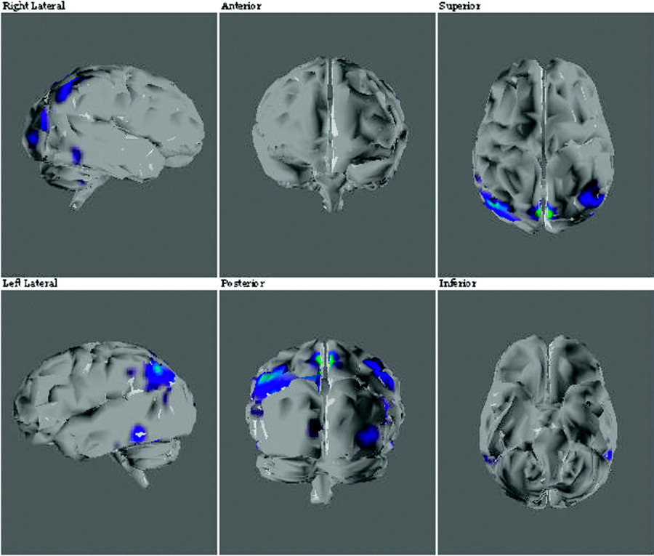
PET Imaging of PD Hallucination

Slide 31
DIFFERENCE BETWEEN BDI AND GDS
Beck Depression Inventory (BDI):
Geriatric Depression Scale (GDS):
Age Group: The BDI is not specific to any particular age group and can be used to assess depression in adults of various ages, including younger and middle-aged individuals.
Number of Questions: The BDI typically consists of 21 multiple-choice questions or items.
Question Types: The BDI assesses a wide range of depressive symptoms, including cognitive, emotional, and physical symptoms.
Scoring: Each item is scored on a scale from 0 to 3, with a higher total score indicating more severe depressive symptoms.
Age Group: The GDS is specifically designed for older adults and is often used with individuals aged 65 and older.
Number of Questions: There are two versions of the GDS. The GDS-15 consists of 15 yes/no questions, while the GDS-30 has 30 yes/no questions.
Question Types: The GDS focuses on mood-related and affective symptoms of depression, and it does not include physical symptoms that may overlap with medical conditions common in older adults.
Scoring: The scoring varies depending on the version of the GDS used. It typically involves counting the number of "yes" responses, with a higher score indicating more severe depressive symptoms.

Slide 32
COGNITION

Slide 33
COGNITION
Non-Motor Symptoms Scale (NMSS)
Non-Motor Symptoms Questionnaire (NMSQuest)
Montreal Cognitive Assessment (MoCA)
Parkinson's Disease-Cognitive Rating Scale (PD-CRS)
Addenbrooke's Cognitive Examination (ACE)
Frontal Assessment Battery (FAB)
Trail Making Test
Stroop Test
Repeatable Battery for Assessment of Neuropsychological Status (RBANS)
Clock Drawing Test
Mattis Dementia Rating Scale (DRS)

Slide 34
Montreal Cognitive Assessment (MoCA)

Slide 35

Montreal Cognitive Assessment (MoCA)

Slide 36
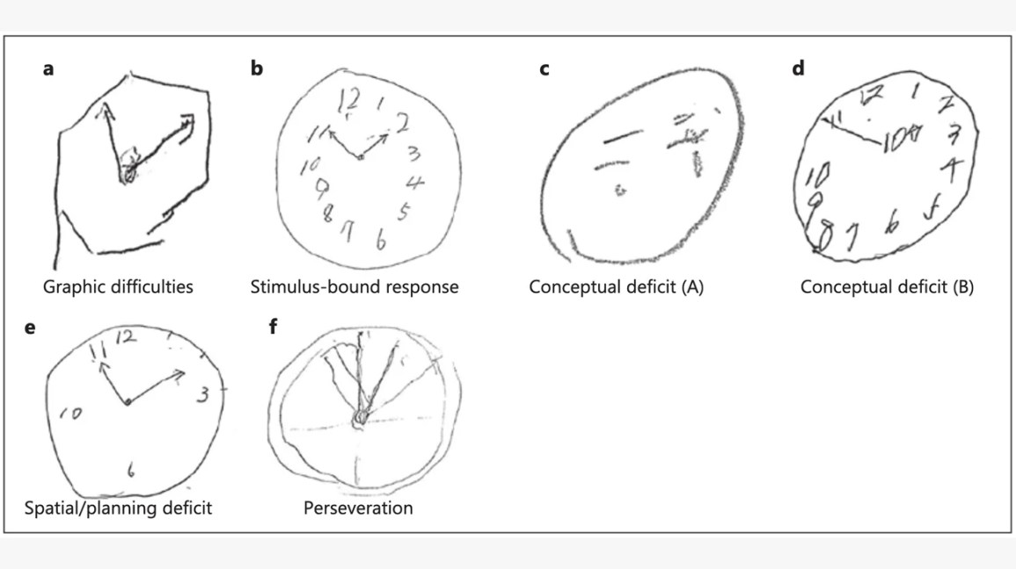
CLOCK DRAWING TEST

Slide 37
COGNITION: Clinical Symptoms of PDD vs AD
Parkinson’s Disease Dementia (N=34)
Alzheimer’s Disease (N=92)
Major Depression
Fluctuation
Falls
Visual Hallucinations
Parkinsonism
Ballard C, et al. Am J Psych. 1999;156:1039-1045.
Ballard C, et al. J Clin Psych. 2001;62:46-49.

Slide 38
SLEEP
Parkinson's Disease Sleep Scale (PDSS)
The Unified Parkinson's Disease Rating Scale (UPDRS)
Epworth Sleepiness Scale (ESS)
Non-Motor Symptoms Scale (NMSS)
Rapid Eye Movement Sleep Behavior Disorder Screening Questionnaire (RBDSQ)
Pittsburgh Sleep Quality Index (PSQI)
Insomnia Severity Index (ISI)
Berlin Questionnaire

Slide 39
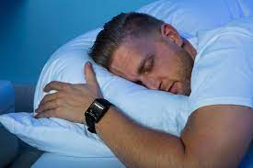
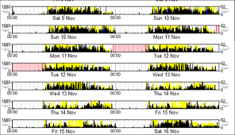
ACTIGRAPHY

Slide 40
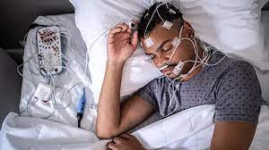
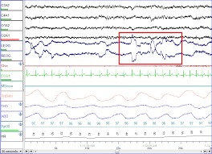
POLYSOMNOGRAPHY
1. Electroencephalography (EEG)
2. Electrooculography (EOG).
3. Electromyography (EMG)
4. Electrocardiography (ECG)
5. Respiratory Monitoring
6. Additional Sensors

Slide 41
AUTONOMIC DYSFUNCTION

Slide 42
AUTONOMIC DYSFUNCTION
The Unified Parkinson's Disease Rating Scale (UPDRS)
The Non-Motor Symptom Scale (NMSS)
Orthostatic Hypotension Questionnaire
Cardiovascular Autonomic Function Tests
Gastrointestinal Symptom Rating Scale (GSRS)
Urodynamic Studies
Sweat Testing
Questionnaires and Interviews:
Ambulatory Blood Pressure Monitoring (ABPM)
Skin Biopsy
Scales for Outcomes in Parkinson's Disease–Autonomic (SCOPA-Auton)

Slide 43
TREATMENT-RELATED COMPLICATIONS
Motor fluctuations
Dyskinesia
Psychiatric symptoms
Impulse control disorder

Slide 44
MOTOR FLUCTUATIONS
Motor fluctuations are periods of fluctuating motor control in Parkinson’s Disease (PD), characterized by 'ON' (good mobility) and 'OFF' (reduced mobility) states.
Importance of Assessment:
- Optimizes treatment strategies.
- Enhances patient quality of life by minimizing fluctuations.

Slide 45
ASSESSMENTS
Patient Diaries:
Patients log ON/OFF states and dyskinesia over a few days.
Provides real-world data on fluctuation patterns.
Clinical Observation:
Neurologist evaluates patient’s motor performance during clinic visits.
Often combined with patient-reported symptoms.
Wearable Technology:
Devices with accelerometers and gyroscopes monitor movement patterns.
Provides objective and continuous fluctuation data.

Slide 46
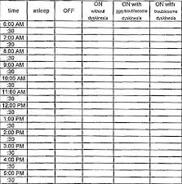

Slide 47
SCALES ASSESSING MOTOR FLUCTUATIONS
Unified Parkinson’s Disease Rating Scale (UPDRS) Part IV
Assesses duration and severity of OFF states.
Movement Disorder Society-Unified Parkinson's Disease Rating Scale (MDS-UPDRS) Part IV
Expanded version of UPDRS with enhanced focus on motor complications.
Includes detailed self-reported items on OFF and ON states.
Tracks therapy-induced fluctuations over time.
SCOPA-Motor Fluctuations Scale
Part of the Scales for Outcomes in Parkinson’s Disease (SCOPA), focusing specifically on motor fluctuations.
Quantifies frequency and severity of ON/OFF states.
Assesses impact of fluctuations on activities of daily living.
Visual Analogue Scales (VAS) for Motor Fluctuations
Simple tool for patients to rate their symptom severity throughout the day.
Patients mark their perceived motor state on a scale from 0 (OFF) to 10 (ON).
Tracks fluctuations across different times.
Quick and intuitive for patients; useful for outpatient settings.

Slide 48
DYSKINESIA
Dyskinesia refers to involuntary, erratic, and excessive movements, often observed in Parkinson’s Disease (PD) patients during dopaminergic treatment.
Types:
Peak-dose dyskinesia: Occurs when levodopa concentrations peak.
Diphasic dyskinesia: Appears during the onset or wearing-off of levodopa.
Off-dystonia: Seen when medication levels are low.
Pathophysiology:
Altered basal ganglia circuits due to chronic dopaminergic stimulation & increased sensitivity of dopamine receptors and aberrant signaling.
Importance of Assessment:
- Optimizes treatment strategies.
- Enhances patient quality of life by minimizing fluctuations.

Slide 49
ASSESSMENT OF DYSKINESIA
Unified Dyskinesia Rating Scale (UDysRS)
Abnormal Involuntary Movement Scale (AIMS)
SCOPA Motor Fluctuations Scale (SCOPA-Motorfluct)
Rush Dyskinesia Rating Scale (RDRS)
Lang-Fahn Activities of Daily Living Dyskinesia Scale (LF-ADLDS)
Patient Dyskinesia Questionnaire (PDQ)
Clinical Global Impression of Change in Dyskinesia (CGIC-Dyskinesia)

Slide 50
DYSKINESIA
Objective assesment
Subjective assesment
Accelerometry: Uses wearable sensors to measure movement patterns quantitatively.
Pros: Provides continuous data; high sensitivity.
Cons: Requires technical expertise; data interpretation can be complex.
Electromyography (EMG): Measures muscle electrical activity to detect involuntary movements.
Pros: Detailed muscle activity data.
Cons: Invasive; requires specialized equipment and skills.
Clinical Observation: Neurologist observes and rates dyskinesia severity during clinical visits.
Pros: Non-invasive; standard part of clinical evaluation.
Cons: Subjective; limited to observation period.
Patient Diaries: Patients record their dyskinesia episodes and severity over time.
Pros: Provides insight into daily variations; empowers patients.
Cons: Relies on patient compliance and accuracy

Slide 51
IMPULSE CONTROL DISORDER
Questionnaire for Impulsive-Compulsive Disorders in Parkinson's Disease-Rating Scale (QUIP-RS)
Minnesota Impulse Disorders Interview (MIDI)
Questionnaire for Impulsive-Compulsive Disorders in Parkinson's Disease-Short Version (QUIP-S)
Parkinson's Disease Questionnaire (PDQ-8 or PDQ-39)
UPDRS (Unified Parkinson's Disease Rating Scale) Part I

Slide 52
DEFINITION OF QUALITY OF LIFE
The World Health Organization (WHO) defined QOL as “an individual's perception of their position in life in the context of the culture and value systems in which they live and in relation to their goals, expectations, standards, and concerns”.
WHO. The World Health Organization quality of life assessment (WHOQOL): position paper from the World Health Organization. Soc Sci Med. 1995;41(10):1403–1409.

Slide 53
QoL IN PD ENCOMPASSES SEVERAL ASPECTS
physical,
psychological,
autonomy,
cognitive,
social relations,
environmental
generic
PD-specific

Slide 54
MAJOR CORRELATES OF QOL IN PD
comorbid depressive symptoms,
PD severity
PD subtypes
Soh S-E, Morris ME, McGinley JL. Determinants of health-related quality of life in Parkinson's disease: a systematic review. Parkinsonism Relat Disord. 2011;17(1):1–9.

Slide 55
CONTRIBUTING FACTORS TO POOR QoL
gait impairments,
adverse effects of medications,
psychosocial dysfunction
Soh S-E, Morris ME, McGinley JL. Determinants of health-related quality of life in Parkinson's disease: a systematic review. Parkinsonism Relat Disord. 2011;17(1):1–9.

Slide 56
QUALITY OF LIFE
Parkinson's Disease Questionnaire-39 (PDQ-39)
Parkinson's Disease Quality of Life Questionnaire (PDQL)
The Parkinson's Disease Quality of Life Scale (PDQ-8)
The EuroQol-5D (EQ-5D)
The Visual Analog Scale (VAS)
The 12-Item Short Form Health Survey (SF-12) or 36-Item Short Form Health Survey (SF-36)
The World Health Organization Quality of Life-BREF (WHOQOL-BREF)
The Montgomery-Åsberg Depression Rating Scale (MADRS)

Slide 57
CAREGIVER’S BURDEN
Caregiver burden refers to the physical, emotional, social, and financial stress experienced by individuals providing care for PD patients.
Relevance in PD:
Progressive nature of PD increases dependence.
Non-motor symptoms (e.g., cognitive decline, behavioral issues) add to caregiver strain.
Impacts caregivers’ physical health, mental well-being, and quality of life.
Importance of Assessment: Early identification and management of caregiver burden can:
Improve outcomes for both caregivers and patients.
Reduce burnout and promote long-term care sustainability.

Slide 58
COMMONLY USED SCALES TO MEASURE CAREGIVER BURDEN
Zarit Burden Interview (ZBI):
22-item scale measuring emotional, social, and financial burden.
Scores range from 0 (no burden) to 88 (severe burden).
Example items: "Do you feel stressed between caring for your relative and trying to meet other responsibilities?"
Caregiver Strain Index (CSI):
13-item questionnaire focusing on physical and emotional strain.
Quick and easy to administer; suitable for clinical settings.
Parkinson’s Disease Caregiver Questionnaire (PDCQ):
PD-specific tool addressing motor and non-motor care challenges.
Evaluates how PD symptoms impact caregiver responsibilities.

Slide 59
CAREGIVER BURDEN ASSESSMENT: A CASE EXAMPLE
A 65-year-old wife caring for her husband, a 72-year-old PD patient in the advanced stage.
The patient exhibits severe motor fluctuations, cognitive decline, and hallucinations.
Assessment Tools Used:
Zarit Burden Interview (ZBI): Caregiver scored 65/88, indicating high burden.
PDCQ: Identified significant stress due to patient’s hallucinations and nighttime disruptions.
Interventions:
Referral to a support group for caregivers.
Inclusion of respite care services.
Adjustment of patient’s treatment plan to address nighttime disturbances and hallucinations.

Slide 60
OVERALL PD: SCOPA
SCOPA Motor Scale (SCOPA-Motor):
SCOPA Autonomic Dysfunction Scale (SCOPA-Aut):
SCOPA Sleep Scale (SCOPA-Sleep):
SCOPA Cognition Scale (SCOPA-Cog
SCOPA Psychosocial Scale (SCOPA-PS
SCOPA Disability Scale (SCOPA-Dis
SCOPA Motor Fluctuations Scale (SCOPA-Motorfluct)
SCOPA-GI Scale (SCOPA-GI)

Slide 61
FUTURE DIRECTIONS IN ASSESSMENT
Wearable Technology: Continuous monitoring of symptoms.
Artificial Intelligence: Predictive models for diagnosis and progression.
Personalized Medicine: Tailoring assessments and treatments to individual genetic profiles.

Slide 62
CONCLUSION AND LESSONS LEARNED
Selecting stage-appropriate scales is critical for effective assessment and management.
Combining motor, non-motor, and quality-of-life scales provides a comprehensive patient evaluation.
Case studies highlight the practical utility of these scales in diverse clinical scenarios.
Future advancements in technology and integrated tools promise enhanced PD care.

Slide 63
References
Goetz CG, Tilley BC, Shaftman SR, et al. Movement Disorder Society-sponsored revision of the Unified Parkinson’s Disease Rating Scale (MDS-UPDRS): scale presentation and clinimetric testing results. Movement Disorders. 2008;23(15):2129-2170.
Fahn S, Elton RL, UPDRS Development Committee. Unified Parkinson's Disease Rating Scale. Recent Developments in Parkinson's Disease. 1987;2:153-163.
Hoehn MM, Yahr MD. Parkinsonism: onset, progression, and mortality. Neurology. 1967;17(5):427-442.
Visser M, Marinus J, Stiggelbout AM, Van Hilten JJ. Assessment of autonomic dysfunction in Parkinson’s disease: the SCOPA-AUT. Movement Disorders. 2004;19(11):1306-1312.
Schwab RS, England AC. Projection technique for evaluating surgery in Parkinson’s disease. Third Symposium on Parkinson’s Disease. Edinburgh, UK: E&S Livingstone; 1969:152-157.
Chaudhuri KR, Pal S, DiMarco A, et al. The non-motor symptoms complex of Parkinson’s disease: a comprehensive assessment scale. Movement Disorders. 2007;22(5):580-586.
Giladi N, Shabtai H, Simon ES, et al. Construction of freezing of gait questionnaire for patients with Parkinsonism. Parkinsonism & Related Disorders. 2000;6(3):165-170.
Jenkinson C, Fitzpatrick R, Peto V, et al. The Parkinson's Disease Questionnaire (PDQ-39): development and validation of a Parkinson’s disease summary index score. Age and Ageing. 1997;26(5):353-357.
de Boer AG, Wijker W, Speelman JD, et al. Quality of life in Parkinson’s disease: development of a questionnaire. Journal of Neurology, Neurosurgery & Psychiatry. 1996;61(1):70-74.
Stiasny-Kolster K, Mayer G, Schäfer S, et al. The REM Sleep Behavior Disorder Screening Questionnaire—a new diagnostic instrument. Movement Disorders. 2007;22(16):2386-2393.
Goetz CG, Nutt JG, Stebbins GT. The Unified Dyskinesia Rating Scale: presentation and clinimetric profile. Movement Disorders. 2008;23(16):2398-2403.
Beck AT, Steer RA, Carbin MG. Psychometric properties of the Beck Depression Inventory: twenty-five years of evaluation. Clinical Psychology Review. 1988;8(1):77-100.
Yesavage JA, Brink TL, Rose TL, et al. Development and validation of a geriatric depression screening scale: a preliminary report. Journal of Psychiatric Research. 1982;17(1):37-49.

