Slide 1
ASSESSING AND MEASURING IN ALS, part 1
GP2 - Clinical assessment and outcome measurement
Zvezdan Pirtošek University of Ljubljana

Slide 2
Amyotrophic lateral sclerosis
ALS is a rapidly progressive neurodegenerative disorder that affects motor neurons in the brain and spinal cord, leading to severe muscle weakness, paralysis, and ultimately, respiratory failure.
Global Impact: With an incidence rate of approximately 1-2 per 100,000 people per year, ALS presents a significant healthcare challenge due to its debilitating nature and lack of a cure.
Need for Accurate Assessment: Early and precise assessment of ALS is crucial for diagnosing the disease, determining its severity, and implementing effective treatment strategies that can prolong life and improve the quality of life.

Slide 3
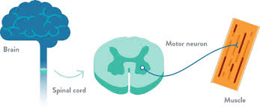

Amyotrophic lateral sclerosis –

Slide 4
Objectives
After completing this lecture, the student should be able to:
Identify the key clinical and laboratory tools used in the assessment and measurement of ALS.
Apply these tools effectively to assess the presence and measure the severity of ALS in clinical settings.
Differentiate ALS from other neurological disorders using appropriate diagnostic methods, focusing on accurate assessment and measurement of symptoms.
Understand the critical role of early and accurate assessment in managing ALS and improving patient outcomes.
Evaluate the current challenges and emerging research aimed at enhancing the accuracy of ALS diagnosis and the measurement of disease severity.

Slide 5
Structure of the Talk
Introduction: Overview of ALS and the importance of assessment and measurement.
Key Assessments:
History Taking
Clinical Examination
EMG and NCS
Neuroimaging and CSF Analysis
Biochemical Markers and Genetic Testing
Differential Diagnosis: Distinguishing ALS from other neurological disorders.
Case Studies: Real-world application of diagnostic tools.
Challenges and Future Directions: Addressing diagnostic hurdles and exploring new research.

Slide 6
Importance of History Taking in ALS
A comprehensive medical history is the first step in diagnosing ALS. It helps to identify early symptoms, understand the pattern of disease progression, and rule out other conditions.
Focus Areas: Detailed documentation of symptom onset, rate of progression, and family history is critical in forming a differential diagnosis and understanding the potential severity of ALS.

Slide 7
Detailed History Taking - Onset of Symptoms
Subtle Signs: Early symptoms of ALS, such as muscle weakness, twitching (fasciculations), or cramping, can be subtle and are often overlooked. Identifying when these symptoms first appeared is crucial for diagnosis.
Documentation: Accurately recording the timeline of symptom onset helps to differentiate ALS from other neurological conditions with similar presentations, such as multifocal motor neuropathy or cervical myelopathy.

Slide 8
Family History and Genetic Factors
Familial ALS: About 10% of ALS cases are familial, often following an autosomal dominant inheritance pattern. Identifying a family history of ALS or other neurodegenerative disorders is critical in understanding the genetic risks.
Common Mutations: Genetic mutations, particularly in the C9orf72, SOD1, TARDBP, and FUS genes, are commonly associated with familial ALS. The presence of these mutations can provide information about the likely progression and severity of the disease.
Severity Correlation: Certain genetic mutations, like the C9orf72 expansion, are associated with a more aggressive disease course, which can help clinicians predict and measure the severity of ALS in affected individuals.

Slide 9
Detailed History Taking - Progression of Symptoms
Tracking Symptom Spread: In ALS, muscle weakness typically starts in one region (e.g., a hand or foot) and progressively spreads to other parts of the body. Documenting this spread is vital for confirming ALS and measuring its severity.
Bulbar Symptoms: The onset of bulbar symptoms, such as dysarthria (slurred speech) or dysphagia (difficulty swallowing), is particularly concerning as it often indicates a more aggressive form of the disease.
Severity Assessment: A rapid progression of symptoms, especially with early bulbar involvement, suggests a more severe disease course and influences treatment planning.

Slide 10
Clinical Examination in ALS
Upper and Lower Motor Neuron Signs: ALS is characterized by a combination of upper motor neuron signs (e.g., spasticity, hyperreflexia) and lower motor neuron signs (e.g., muscle atrophy, fasciculations). Assessing these signs is crucial for diagnosing ALS and measuring its severity.
Functional Examination: Evaluating muscle strength, tone, and reflexes provides quantitative data on the extent of motor neuron damage and helps to track disease progression over time.
Severity Assessment: Clinical examination findings, such as the degree of muscle weakness and the presence of pathological reflexes (e.g., Babinski sign), are key indicators of ALS severity.

Slide 11
Detailed Motor Examination
Muscle Strength Testing: Using the Medical Research Council (MRC) scale, clinicians can grade muscle strength on a scale from 0 (no movement) to 5 (normal strength). This helps in quantifying the degree of weakness and tracking disease progression.
Reflex Testing: Hyperreflexia (exaggerated reflexes) in the presence of muscle weakness and atrophy is indicative of upper motor neuron involvement. Testing reflexes, including the Babinski sign, helps in differentiating ALS from other motor neuron diseases.
Measurement of Severity: The severity of ALS can be gauged by the extent of muscle weakness, the presence of spasticity, and the progression of these signs over time.

Slide 12
Bulbar Function Testing
Speech and Swallowing: Dysarthria (slurred speech) and dysphagia (difficulty swallowing) are common in ALS, particularly in bulbar-onset cases. These symptoms are assessed through speech evaluations and swallowing studies.
Tongue Examination: The presence of tongue atrophy, fasciculations, and decreased strength are indicative of lower motor neuron involvement in the bulbar region. This examination is essential for assessing the impact of ALS on communication and nutrition.
Severity Measurement: Bulbar symptoms often signify a more severe form of ALS, and their progression can be used to measure the disease's impact on quality of life and overall prognosis.

Slide 13
Electromyography (EMG) in ALS
Role of EMG: EMG is a critical diagnostic tool for ALS, providing objective evidence of denervation and reinnervation, which are hallmarks of motor neuron disease.
Key Findings: In ALS, EMG typically reveals fibrillations, fasciculations, and large, polyphasic motor unit potentials. These findings confirm lower motor neuron degeneration and help assess the severity of the disease.
Severity Measurement: The extent and distribution of abnormal EMG findings correlate with the severity of motor neuron involvement and can help monitor disease progression.

Slide 14
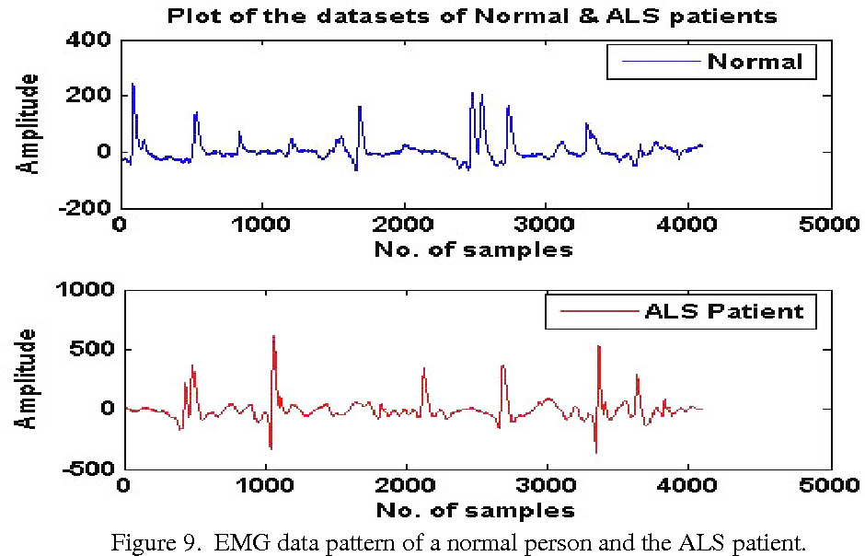
Electromyographic assessment in ALS
Differential Diagnosis: EMG is used to distinguish ALS from other neurological conditions
Identification of Denervation: in the form of fasciculations, fibrillation potentials, and positive sharp waves. These findings are characteristic for diagnosis of ALS.
Quantification Muscles:
Assessing the Functioof Muscle Weakness:
Monitoring Disease Progression:
Localization of Affected nality of Remaining Motor Neurons
Differentiating Upper Motor Neuron and Lower Motor Neuron Involvement
Notes:
Electromyography (EMG) plays a crucial role in the diagnosis and management of Amyotrophic Lateral Sclerosis (ALS). ALS is a progressive neurodegenerative disease that primarily affects the motor neurons in the brain and spinal cord. EMG is an essential diagnostic tool for several reasons:
Differential Diagnosis: EMG is used to distinguish ALS from other neurological conditions that may present with similar symptoms, such as muscle weakness and fasciculations (muscle twitches). By assessing the electrical activity of the muscles and the pattern of motor neuron involvement, EMG can help rule out other potential causes of the symptoms.
Identification of Denervation: ALS leads to the loss of motor neurons, resulting in denervation of muscles. EMG can detect denervation by identifying spontaneous electrical activity in the form of fasciculations, fibrillation potentials, and positive sharp waves. These findings are characteristic of motor neuron degeneration and support the diagnosis of ALS.
Quantification of Muscle Weakness: EMG can assess the extent and severity of muscle weakness by measuring the amplitude and duration of motor unit action potentials (MUAPs). In ALS, there is often a reduction in MUAP amplitude due to the loss of motor neurons, contributing to muscle weakness.
Monitoring Disease Progression: EMG can be used to monitor disease progression over time. By periodically assessing the electrical activity of muscles, healthcare providers can observe changes in denervation and muscle function, helping to track the course of the disease.
Localization of Affected Muscles: EMG can help identify which muscles are affected by ALS, aiding in the selection of appropriate muscles for biopsy or other diagnostic procedures. This information can be valuable for research purposes and to guide interventions.
Assessing the Functionality of Remaining Motor Neurons: In ALS, some motor neurons may remain functional while others degenerate. EMG can help evaluate the function of remaining motor neurons by recording the response of muscles to nerve stimulation. This information can be relevant for prognosis and management decisions.
Differentiating Upper Motor Neuron and Lower Motor Neuron Involvement: ALS can affect both upper motor neurons (UMNs) and lower motor neurons (LMNs). EMG findings can help distinguish between UMN and LMN involvement, which is essential for understanding the specific presentation of ALS and guiding treatment strategies.
It's important to note that the diagnosis of ALS is typically based on a combination of clinical assessments, EMG findings, and other diagnostic tests. While EMG is a valuable tool, it is not used in isolation to confirm an ALS diagnosis. A comprehensive evaluation by a neurologist, often including clinical history, physical examination, and other tests, is necessary for a definitive diagnosis of ALS.

Slide 15
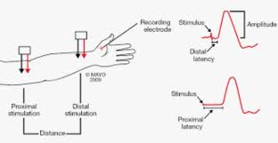
Nerve Conduction Studies (NCS)
Purpose: NCS is used in conjunction with EMG to differentiate ALS from other neuromuscular disorders, such as multifocal motor neuropathy or myasthenia gravis. In ALS, sensory nerve conduction is usually normal, while motor conduction may show reduced amplitude without conduction block.
Findings: NCS findings typical of ALS include preserved sensory conduction with evidence of motor axon loss. The absence of conduction block helps differentiate ALS from conditions like MMN.
Severity Assessment: While NCS primarily aids in differential diagnosis, the degree of motor axon loss can provide additional information on the severity of ALS.

Slide 16
Neuroimaging in ALS
MRI: MRI is essential for ruling out other conditions that can mimic ALS, such as brain tumors, multiple sclerosis, or cervical myelopathy. Although MRI findings specific to ALS are limited, certain patterns can support the diagnosis.
Typical Findings: In ALS, MRI may show cortical atrophy, particularly in the motor cortex, and hyperintensity along the corticospinal tracts. These findings correlate with upper motor neuron involvement.
Measurement of Severity: While not definitive for ALS, MRI can reflect the extent of upper motor neuron degeneration and help measure the severity of the disease.

Slide 17
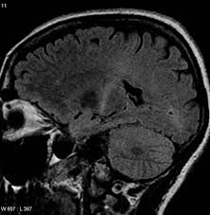
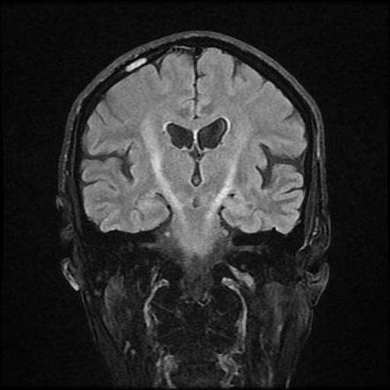
MR in ALS
Cortical atrophy
Hyperintensity along the corticospinal tracts

Slide 18
Advanced Imaging Techniques
Diffusion Tensor Imaging (DTI): DTI is used to assess white matter integrity in- ALS: DTI provides detailed images of white matter tracts. In ALS, DTI typically shows reduced fractional anisotropy in the corticospinal tracts, indicating degeneration of motor pathways.
Magnetic Resonance Spectroscopy (MRS): MRS can detect metabolic changes in the brain, such as reduced N-acetylaspartate (NAA) levels in the motor cortex. This reduction is associated with neuronal loss and correlates with disease severity.

Slide 19
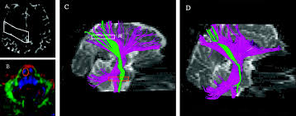
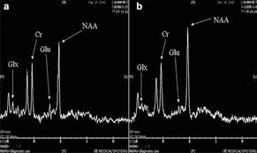
Advanced Imaging Techniques
DTI
MRS

Slide 20
Cerebrospinal Fluid (CSF) Analysis
Role in ALS: CSF analysis is primarily used to exclude other conditions, such as infections or multiple sclerosis, that can present with similar symptoms to ALS. However, emerging biomarkers are being studied for their potential role in diagnosing ALS and assessing disease severity.
Common Findings: In ALS, CSF analysis may show slightly elevated protein levels. More importantly, elevated levels of neurofilament light chain (NFL) and phosphorylated neurofilament heavy chain (pNF-H) are increasingly recognized as biomarkers for ALS, reflecting axonal damage.
Measurement of Severity: Higher levels of NFL in CSF are associated with more severe axonal damage, providing a quantifiable measure of ALS severity that can be monitored over time.

Slide 21
CSF Biomarkers in ALS
Neurofilament Light Chain (NFL): NFL is a protein released into the CSF and blood when nerve cells are damaged. Elevated levels of NFL are strongly associated with ALS and correlate with the extent of motor neuron damage, making it a valuable biomarker for assessing disease severity.
Phosphorylated Neurofilament Heavy Chain (pNF-H): Similar to NFL, pNF-H is another biomarker that reflects axonal damage. Elevated levels of pNF-H in CSF are linked to more severe ALS and faster disease progression.
Research Advances: Ongoing research aims to validate these biomarkers for use in clinical practice, potentially allowing for earlier diagnosis and more accurate measurement of disease severity.

Slide 22
Biochemical Markers in ALS
Key Biomarkers: In addition to NFL and pNF-H, other biochemical markers such as superoxide dismutase 1 (SOD1) and TAR DNA-binding protein 43 (TDP-43) are important in understanding the pathogenesis and progression of ALS.
Oxidative Stress Markers: Markers such as 8-hydroxy-2'-deoxyguanosine (8-OHdG) in urine and malondialdehyde (MDA) in plasma indicate oxidative damage in ALS patients, which is linked to motor neuron death and disease severity.
Measurement of Severity: Monitoring these biochemical markers over time provides valuable information on the progression of ALS and the effectiveness of therapeutic interventions.

Slide 23
Role of Metabolic Markers
Lipid Metabolism: Dysregulation of lipid metabolism, including altered cholesterol and fatty acid profiles, has been observed in ALS patients. These changes may reflect metabolic stress and inflammation in motor neurons.
Energy Metabolism: ALS patients often exhibit hypermetabolism, which correlates with faster disease progression. Monitoring markers of energy metabolism can provide insights into the severity of ALS and help tailor nutritional and metabolic interventions.
Severity Assessment: Metabolic changes, particularly in lipid and energy metabolism, can be used as indirect measures of disease severity and may guide personalized treatment approache

Slide 24
Genetic Testing in ALS
Overview: Approximately 10% of ALS cases are familial, often due to mutations in specific genes such as C9orf72, SOD1, TARDBP, and FUS. Genetic testing is crucial for identifying these mutations and understanding the genetic basis of ALS.
Common Mutations: The C9orf72 hexanucleotide repeat expansion is the most common genetic cause of ALS, particularly in familial cases. SOD1 mutations are also significant, particularly in patients with a family history of ALS.
Severity Prediction: Certain genetic mutations are associated with a more rapid disease course. For example, patients with C9orf72 mutations often experience faster disease progression, making genetic testing an important tool for predicting disease severity.

Slide 25
Genetic Counseling in ALS
Importance: Genetic counseling is essential for patients with familial ALS and their families. It provides information on the inheritance patterns, risks to family members, and implications of genetic testing results.
Testing Recommendations: Genetic testing is recommended for all patients with a family history of ALS, as well as for sporadic cases with early onset or atypical features. Identifying the specific genetic mutation can help predict the disease course and guide management decisions.
Measurement of Risk: Genetic testing not only helps diagnose ALS but also assesses the risk of the disease in family members, providing valuable information for family planning and early intervention strategies.

Slide 26
Differential Diagnosis in ALS
Importance: ALS shares symptoms with several other neurological disorders, making differential diagnosis a critical component in ensuring accurate diagnosis and treatment. Misdiagnosis can lead to inappropriate treatments and delay in care.
Key Conditions: Conditions such as multifocal motor neuropathy (MMN), myasthenia gravis (MG), and cervical myelopathy must be considered and ruled out during the diagnostic process.
Severity Measurement: Utilizing diagnostic tools like EMG, nerve conduction studies (NCS), and imaging helps differentiate ALS from other conditions and accurately assess the severity of motor neuron involvement.

Slide 27
Differential Diagnosis - Complex Case
Case Presentation: A 52-year-old male presents with progressive weakness in the arms and legs, along with muscle cramps and occasional double vision. These symptoms are atypical for ALS, necessitating a thorough differential diagnosis.
Diagnostic Process: The patient undergoes EMG, NCS, MRI, and laboratory testing to rule out other conditions such as multifocal motor neuropathy (MMN) and myasthenia gravis (MG). The presence of conduction block on NCS and positive anti-GM1 antibodies confirms the diagnosis of MMN.
Severity Assessment: Although the patient’s symptoms initially suggested ALS, the differential diagnosis process revealed MMN, a treatable condition. The diagnostic tools used helped accurately assess the severity of the patient’s condition and guide appropriate treatment.

Slide 28
Clinical Case Study - Early Bulbar ALS
Patient Presentation: A 60-year-old female presents with a six-month history of slurred speech (dysarthria) and difficulty swallowing (dysphagia). These bulbar symptoms are concerning for ALS, particularly in the absence of limb weakness.
Diagnostic Approach: EMG of the tongue and limb muscles reveals widespread denervation and reinnervation, consistent with ALS. MRI rules out structural causes of bulbar symptoms, and CSF analysis shows elevated NFL levels, supporting the diagnosis.
Severity Measurement: The early involvement of bulbar muscles, combined with EMG and CSF findings, suggests a more severe form of ALS with a potentially rapid progression. Early diagnosis allows for the implementation of palliative measures and participation in clinical trials.

Slide 29
Clinical Case Study - Limb-Onset ALS
Patient Presentation: A 55-year-old male presents with progressive weakness in his right hand, which has gradually spread to his arm and shoulder over the past year. He reports muscle twitches and cramps but no sensory changes.
Diagnostic Findings: EMG reveals widespread denervation in the affected limb, with evidence of reinnervation. Genetic testing identifies a C9orf72 mutation, confirming the diagnosis of familial ALS.
Severity Assessment: The presence of a genetic mutation and the rate of symptom progression suggest a moderate to severe form of ALS. The patient’s symptoms are carefully monitored, and interventions are planned to manage his condition as it progresses.

Slide 30
Case Study - Advanced ALS
Patient Presentation: A 65-year-old male with advanced ALS presents with severe muscle weakness, respiratory insufficiency, and bulbar symptoms.
Diagnostic Tools Used: Comprehensive evaluation using EMG, advanced imaging (DTI, MRS), and CSF biomarkers (NFL, pNF-H) to assess the extent of disease progression.
Management Strategies: The patient is receiving palliative care, including respiratory support (e.g., non-invasive ventilation), nutritional support via gastrostomy, and communication aids for speech.
Severity Measurement: The use of advanced diagnostic tools has provided a detailed assessment of the severity of ALS in this patient, guiding palliative care and end-of-life decisions.

Slide 31
Challenges in ALS Diagnosis
Variability in Presentation: ALS can present with a wide range of symptoms, from limb weakness to bulbar dysfunction, making it challenging to diagnose in the early stages. This variability can lead to misdiagnosis or delayed diagnosis, impacting the patient’s prognosis.
Diagnostic Delays: Common causes of diagnostic delays include the initial presentation of symptoms that mimic other conditions, such as multifocal motor neuropathy or myasthenia gravis. Delays in diagnosis can prevent timely interventions and access to clinical trials.
Measurement of Severity: Accurate and early diagnosis is essential for assessing the severity of ALS and guiding treatment decisions. Delays in diagnosis can result in underestimation of disease severity and missed opportunities for therapeutic interventions.

Slide 32
Diagnostic Tools Overview
Combining Tools: The diagnosis and assessment of ALS severity require a combination of history taking, clinical examination, EMG, imaging, and biomarkers. Each tool provides unique information that, when combined, offers a comprehensive picture of the patient’s condition.
Assessment of Severity: The integration of these diagnostic tools allows clinicians to accurately measure the extent of motor neuron involvement, track disease progression, and tailor treatment plans to the patient’s needs.

Slide 33
Clinical Case Scenario for ALS Assessment and Measurement
Patient Profile: A 58-year-old male presents to the neurology clinic with a 9-month history of progressive weakness in his left hand and arm, which has now started to affect his right hand. He reports difficulty with fine motor tasks, such as buttoning his shirt and using a pen. Over the last three months, he has also noticed occasional muscle twitching (fasciculations) in his arms and legs. He denies any sensory disturbances, such as numbness or tingling, and there is no significant family history of neurological diseases.
Medical History: The patient has no history of trauma, significant illness, or surgeries. He is a non-smoker, with no history of alcohol or drug abuse.
Neurological Exam: Reveals muscle atrophy in the small muscles of the left hand, decreased grip strength bilaterally, and hyperreflexia in both arms and legs, with a positive Babinski sign on the right. No sensory deficits are noted.
Speech: Mild dysarthria is observed, but the patient denies difficulty swallowing.

Slide 34
Questions for the Student
History Taking:
What specific questions would you ask the patient to further clarify the timeline and progression of symptoms?
How would you assess the impact of the symptoms on the patient’s daily life and activities?
Clinical Examination:
How would you differentiate between upper and lower motor neuron signs in this patient?
What additional physical examination techniques would you use to assess the presence and severity of ALS?
Electromyography (EMG) and Nerve Conduction Studies (NCS):
What patterns would you expect to find in EMG and NCS for a patient with suspected ALS?
How would these findings help confirm the diagnosis and measure the severity of the disease?
Neuroimaging:
What is the role of MRI in the diagnosis of ALS?
How could advanced imaging techniques such as Diffusion Tensor Imaging (DTI) or Magnetic Resonance Spectroscopy (MRS) contribute to the assessment of this patient?

Slide 35
Questions for the Student:
Cerebrospinal Fluid (CSF) Analysis:
What specific CSF biomarkers would be relevant for confirming ALS in this patient?
How would the levels of neurofilament light chain (NFL) in the CSF correlate with the severity of the disease?
Biochemical Markers:
What role do oxidative stress markers play in ALS, and how could they be measured in this patient?
Discuss the importance of measuring metabolic changes, such as lipid metabolism, in ALS and how it might apply to this patient’s case.
Genetic Testing:
Given the patient's history and presentation, would you recommend genetic testing? If so, which mutations would you test for?
How could genetic testing inform the management and prognosis of this patient?
Differential Diagnosis:
What other conditions would you consider in the differential diagnosis of this patient, and how would you rule them out?
How would you use the findings from EMG, NCS, neuroimaging, and CSF analysis to differentiate ALS from other motor neuron diseases?

Slide 36
References
Behler, A., Müller, H. P., Ludolph, A. C., & Kassubek, J. (2023). Diffusion Tensor Imaging in Amyotrophic Lateral Sclerosis: Machine Learning for Biomarker Development. International Journal of Molecular Sciences, 24(3), 1911. https://doi.org/10.3390/ijms24031911
Roggenbuck, J., Eubank, B., Wright, J., Kolb, J. S., & Harms, B. M. (2022). Development of Evidence-Based Consensus Guidelines for ALS Genetic Counseling and Testing. Presented at the 2022 Annual NEALS Meeting.
Bhattarai, A., Egan, G. F., Talman, P., & Chua, P. (2022). Magnetic Resonance Iron Imaging in Amyotrophic Lateral Sclerosis. Journal of Magnetic Resonance Imaging, 55(4), 1283–1300. https://doi.org/10.1002/jmri.27530
Braak, H., Brettschneider, J., Ludolph, A. C., Lee, V. M., Trojanowski, J. Q., & Tredici, K. D. (2013). Amyotrophic Lateral Sclerosis—A Model of Corticofugal Axonal Spread. Nature Reviews Neurology, 9(12), 708–714. https://doi.org/10.1038/nrneurol.2013.221
Hecht, M. J., et al. (2023). The Present and the Future of Neuroimaging in Amyotrophic Lateral Sclerosis. American Journal of Neuroradiology, 44(2), 223-234. https://doi.org/10.3174/ajnr.A7387

