Slide 1
Learning of selected scales in HD, part 2
GP2 - Clinical assessment and outcome measurement
Zvezdan Pirtošek
University of Ljubljana

Slide 2
Objectives
After completing this lecture, the student will be able to:
Explain the structure and purpose of the Neuropsychiatric Inventory.
Accurately assess neuropsychiatric symptoms using the NPI.
Apply the NPI in clinical case scenarios.

Slide 3
Introduction to NPI
The NPI is a structured interview tool used to assess neuropsychiatric symptoms across various neurological and psychiatric disorders.
Applications: Widely used in clinical practice and research, particularly in neurodegenerative diseases like Alzheimer’s Disease, Huntington's Disease, and Parkinson's Disease.

Slide 4
History and Development
Origins: Developed by Dr. Jeffrey L. Cummings in the 1990s to provide a standardized method for evaluating neuropsychiatric symptoms.
Key Features: Focuses on 12 behavioral domains, each assessed for frequency and severity.
Key Contributors: Initially designed for Alzheimer's Disease, the NPI has been adapted for use in various other conditions, making it a versatile tool in both clinical and research settings.

Slide 5
NPI Domains Overview
Delusions: False beliefs that are not grounded in reality.
Hallucinations: Perceptual experiences occurring without external stimuli.
Agitation/Aggression: Physical or verbal outbursts.
Depression/Dysphoria: Persistent feelings of sadness or hopelessness.
Anxiety: Excessive worry or fear.
Euphoria/Elated Mood: Inappropriately elevated mood.
Apathy/Indifference: Lack of interest or emotional response.
Disinhibition: Impulsivity and lack of restraint.
Irritability/Lability: Mood swings and irritability.
Aberrant Motor Behavior: Unusual movements or behaviors.
Nighttime Behavioral Disturbances: Sleep-related issues.
Appetite/Eating Disorders: Changes in eating habits.

Slide 6
NPI Scoring System
Frequency (1-4): How often the behavior occurs (1 = Occasionally, 4 = Very frequently).
Severity (1-3): The impact of the behavior (1 = Mild, 3 = Severe).
Total Domain Score: Calculated as the product of frequency and severity (Range: 1-12 per domain).
Interpretation: Higher scores indicate more severe neuropsychiatric symptoms. Scores can be used to track changes over time and to guide treatment.

Slide 7
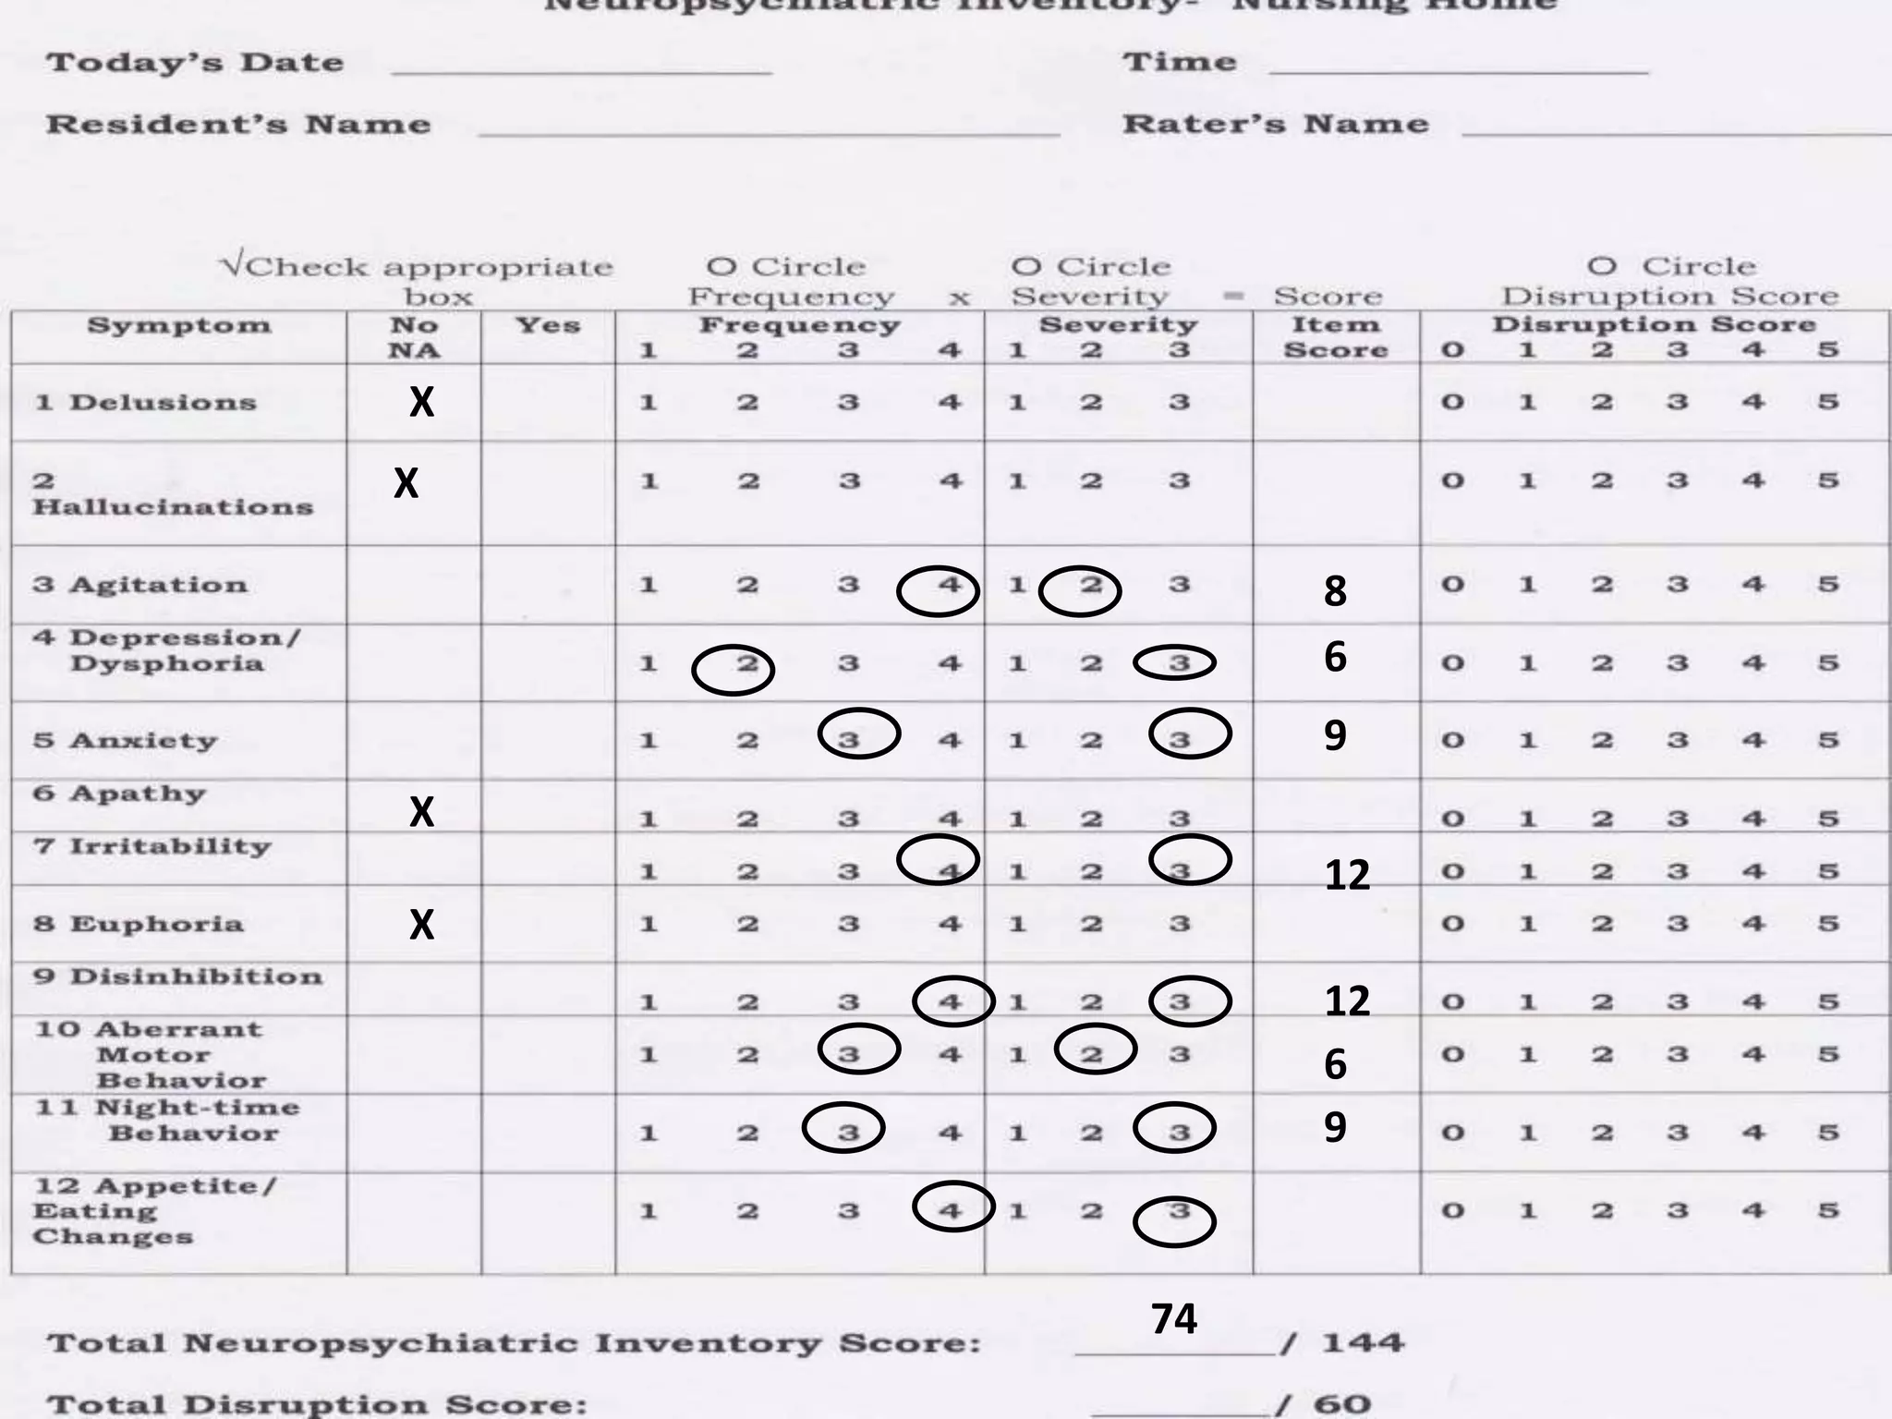

Slide 8
Administration of the NPI
Who Administers: Typically administered by a trained clinician or researcher.
Setting: Can be conducted in various settings, including outpatient clinics, hospitals, and long-term care facilities.
Duration: The interview generally takes about 20-30 minutes to complete, depending on the complexity of the patient’s symptoms.
.

Slide 9
Assessment Process in NPI Administration
Initial Setup:
  Patient and Caregiver Introduction: Begin by explaining the purpose of the NPI and the process to both the patient and the caregiver.
  Establishing Context: Ensure that the caregiver understands the importance of accurate reporting, emphasizing that there are no right or wrong answers.
Conducting the Interview:
  Domain by Domain: Guide the caregiver through each domain of the NPI, providing examples and clarifications as needed.
  Probing for Details: Ask follow-up questions to clarify the frequency and severity of symptoms. For example, if the caregiver mentions irritability, inquire about specific triggers, duration, and the typical response.
  Recording Scores: Use a standardized scoring sheet to document the frequency and severity for each domain immediately after discussing it with the caregiver.

Slide 10
1. Delusions
Definition: False beliefs held despite evidence to the contrary.
Examples:
  Persecutory Delusions: Believing that neighbors are plotting against them.
  Grandiose Delusions: Thinking they have a special mission or are famous.
  Somatic Delusions: Insisting they have a serious, undiagnosed illness despite medical evidence.

Slide 11
2. Hallucinations
Hallucinations
Content:
Definition: Sensory experiences without an external stimulus.
Examples:
  Auditory Hallucinations: Hearing voices that comment on their actions or converse with them.
  Visual Hallucinations: Seeing people or animals that aren't present, like a dog in the room.
  Tactile Hallucinations: Feeling bugs crawling on the skin when nothing is there.

Slide 12
3. Agitation/Aggression
Definition: Physical or verbal outbursts, restlessness.
Examples:
  Physical Aggression: Pushing, hitting, or throwing objects during a confrontation.
  Verbal Agitation: Yelling, using abusive language, or making repeated demands.
  Restlessness: Pacing around the room, unable to stay seated, or repeatedly getting up during the night.

Slide 13
4. Depression/Dysphoria
Definition: Persistent feelings of sadness, hopelessness, or loss of interest.
Examples:
  Withdrawal: Refusing to engage in previously enjoyed activities, like gardening or playing cards.
  Persistent Sadness: Expressing feelings of worthlessness or crying frequently without specific reasons.
  Changes in Sleep or Appetite: Sleeping much more or less than usual, or significant weight changes due to lack of interest in eating.

Slide 14
5. Anxiety
Definition: Excessive worry, fear, or unease.
Examples:
  Health Anxiety: Constantly seeking reassurance about minor physical symptoms, fearing serious illness.
  Social Anxiety: Avoiding gatherings or events due to fear of embarrassment or being judged.
  Generalized Anxiety: Persistent worry about various everyday issues, such as finances, safety, or the future.

Slide 15
6. Euphoria/Elated Mood
Definition: Inappropriately elevated mood, often not matching the situation.
Examples:
  Inappropriate Laughter: Laughing loudly in serious situations, like during a solemn conversation or in response to sad news.
  Excessive Optimism: Overestimating their abilities or making grand plans that are unrealistic, like planning a big event despite significant health issues.
  Over-friendliness: Being overly familiar with strangers, offering hugs or personal stories.

Slide 16
7. Apathy/Indifference
Definition: Lack of interest, enthusiasm, or concern.
Examples:
  Disengagement: No longer initiating conversations or activities, like sitting passively for long periods.
  Neglect of Personal Care: Ignoring basic hygiene routines, such as not bathing or changing clothes.
  Lack of Response to Stimuli: Showing little reaction to family visits or not participating in events they previously enjoyed.

Slide 17
8. Disinhibition
Definition: Impulsivity and lack of social restraint.
Examples:
  Inappropriate Comments: Making sexual or rude remarks in public or during family gatherings.
  Impulsive Actions: Sudden decisions to spend large amounts of money or engage in risky activities without consideration of consequences.
  Excessive Eating or Drinking: Consuming large quantities of food or alcohol without apparent awareness or concern.

Slide 18
9. Irritability/Lability
Definition: Frequent mood swings, irritability, or emotional instability.
Examples:
  Sudden Anger: Becoming quickly angry or frustrated over minor issues, such as a misplaced item or a change in routine.
  Rapid Mood Changes: Shifting from happiness to sadness or anger without a clear trigger.
  Crying Spells: Bursting into tears unpredictably during conversations or activities.

Slide 19
10. Aberrant Motor Behavior
Definition: Unusual or repetitive movements that are not goal-directed.
Examples:
  Pacing: Walking back and forth continuously, often in the same area, without an apparent purpose.
  Repetitive Hand Movements: Twisting fingers, rubbing hands together, or tapping repeatedly on surfaces.
  Fidgeting: Constantly shifting in their seat, adjusting clothing, or playing with objects without a clear reason.

Slide 20
11. Nighttime Behavioral Disturbances
Definition: Problems with sleep that occur during the night.
Examples:
  Restlessness: Frequent tossing and turning, unable to stay asleep for long periods.
  Night Wandering: Getting up repeatedly during the night and wandering around the house, often disoriented.
  Sleep Talking or Yelling: Engaging in conversations, shouting, or making noises while still asleep, often disturbing others.

Slide 21
12. Appetite/Eating Disorders
Definition: Significant changes in eating habits or appetite.
Examples:
  Overeating: Consuming large amounts of food, especially sweets or snacks, often without realizing it.
  Loss of Appetite: Refusing to eat meals or showing little interest in food, leading to noticeable weight loss.
  Pica: Eating non-food items like paper, dirt, or fabric, which can be dangerous if not addressed.

Slide 22
Clinical Decision-Making Based on NPI Scores
Interpreting Results:
  Identifying Priorities: Focus on domains with the highest scores, as these often indicate the most pressing issues that need to be addressed.
  Contextual Considerations: Consider the patient's overall health, other comorbid conditions, and current treatment regimen when interpreting the scores.
Developing an Intervention Plan:
  Multidisciplinary Approach: Collaborate with other healthcare professionals, including psychiatrists, neurologists, and social workers, to develop a comprehensive care plan.
  Tailoring Treatments: Adjust medications, introduce behavioral interventions, or provide caregiver education based on the specific symptoms identified in the NPI.

Slide 23
NPI Case Example 1: Ms. A
Patient Profile: Mrs. A, a 72-year-old woman with a 5-year history of dementia. She lives with her daughter, who is her primary caregiver. Mrs. A has become increasingly agitated, especially during the late afternoon and evening. She has also started wandering at night, causing significant stress for her daughter.
Medical History: She has a history of hypertension, managed with lisinopril, and osteoarthritis, for which she takes ibuprofen as needed. There is no history of psychiatric disorders before the onset of dementia.
Social History: Mrs. A is a retired schoolteacher who was active in her community, particularly in church and local volunteer activities. Since her diagnosis, she has gradually withdrawn from these activities. She now spends most of her time at home, where her daughter takes care of her.
Current Concerns: Over the past three months, Mrs. A has become increasingly agitated in the afternoons, displaying restlessness, pacing, and verbal aggression. Her daughter reports that these behaviors are particularly challenging during the evening ("sundowning"). At night, Mrs. A frequently wakes up disoriented, tries to leave the house, and becomes agitated when redirected.

Slide 24
NPI Case Example 1: Ms. A
Cognitive Examination: Mrs. A shows significant cognitive decline, consistent with moderate to severe dementia. She has difficulty with short-term memory, orientation, and executive functions. She is unable to recall recent events or follow complex instructions.
Behavioral Observations: During the assessment, Mrs. A appeared restless and fidgety, frequently looking towards the door. She expressed confusion about the time of day and seemed unaware of her surroundings. Her speech was tangential, and she occasionally became irritable when questioned about her behavior.

Slide 25
NPI Case Example 1: Ms. A
Student Task:
Question 1: Based on Mrs. A’s history and examination, which NPI domains would you consider assessing? List the domains that seem most relevant to her case.
Question 2: How would you score Mrs. A on these domains? Consider the frequency and severity of her behaviors as described.

Slide 26
Correct Answers for Case Example 1
Relevant NPI Domains:
  Agitation/Aggression: Frequent restlessness and verbal aggression during the late afternoon and evening.
  Nighttime Behavioral Disturbances: Frequent nighttime wandering and disorientation.
Correct Scoring:
  Agitation/Aggression: Frequency 4 (Very frequently), Severity 2 (Moderate) – Total score: 8.
  Nighttime Behavioral Disturbances: Frequency 4 (Very frequently), Severity 3 (Severe) – Total score: 12.

Slide 27
Interactive Case Example 2: Mr. B
Patient Profile: Mr. B, a 65-year-old man with an 8-year history of PD. His wife reports that Mr. B has started experiencing visual hallucinations and has developed delusions that she is plotting against him. These symptoms have become more frequent and distressing over the past month.
Medical History: Mr. B was diagnosed with PD 8 y ago. His current medications include levodopa/carbidopa for motor symptoms and sertraline for a history of depression. He has no prior history of psychiatric disorders. His PD symptoms include tremors, rigidity, and bradykinesia, which are managed reasonably well with medication.
Social History: Mr. B is a retired accountant who enjoyed intellectual activities, such as playing chess and reading. However, due to his motor symptoms and cognitive decline, he has become less active socially and physically. His wife has noticed a gradual decline in his cognitive abilities, including occasional forgetfulness and difficulty with complex tasks.
Current Concerns: In the past month, Mr. B has begun seeing people in the house who aren’t there, particularly in the late afternoon and evening. These hallucinations are vivid and detailed, causing him to believe that strangers are in his home. He has also developed delusions that his wife is hiding things from him and conspiring against him, leading to frequent arguments and a breakdown in trust.

Slide 28
Interactive Case Example 2: Mr. B
Cognitive Examination: Mr. B demonstrates mild cognitive impairment, with difficulties in memory recall, visuospatial tasks, and executive functioning. His motor symptoms are evident, with noticeable tremors and bradykinesia.
Behavioral Observations: During the interview, Mr. B frequently glanced around the room as if seeing things that weren’t there. He expressed frustration and suspicion towards his wife, questioning her actions and intentions. His speech was coherent, but he displayed a marked distrust of those around him

Slide 29
Interactive Case Example 2: Mr. B
Student Task:
Question 1: Which NPI domains should be assessed for Mr. B? Identify the domains that are most relevant to his symptoms.
Question 2: How would you score these domains based on the information provided? Consider the frequency and severity of his hallucinations and delusions.

Slide 30
Correct Answers for Case Example 2
Relevant NPI Domains:
  Hallucinations: Frequent, vivid visual hallucinations where Mr. B sees people who aren’t there.
  Delusions: Frequent delusions involving his wife, where he believes she is plotting against him.
Correct Scoring:
  Hallucinations: Frequency 3 (Frequently), Severity 2 (Moderate) – Total score: 6.
  Delusions: Frequency 3 (Frequently), Severity 3 (Severe) – Total score: 9.

Slide 31
Interactive Case Example 3: Mrs. C
Patient Profile: Mrs. C, a 78-year-old woman with dementia, diagnosed 3y ago. She has become increasingly withdrawn and depressed, no longer participating in social activities, and is frequently found sitting alone, often crying.
History:
Medical History: Mrs. C has a history of stroke, hypertension, and hyperlipidemia, all of which are managed with medication. She was diagnosed with dementia three years ago and has since experienced a gradual decline in cognitive function. Her cognitive deficits are primarily in the areas of attention, executive function, and memory.
Social History: Mrs. C was once very active in her community, particularly in church and social clubs. Since her diagnosis, she has gradually withdrawn from these activities. She resides in a long-term care facility, where she has become increasingly isolated.
Current Concerns: The nursing staff reports that Mrs. C has become more withdrawn over the past few months. She no longer participates in group activities, prefers to stay in her room, and is often seen crying. When approached, she expresses feelings of loneliness and hopelessness, and her interactions with others are minimal.

Slide 32
Interactive Case Example 3: Mrs. C
Cognitive Examination: Mrs. C displays significant cognitive deficits, particularly in executive function and memory. She has difficulty organizing her thoughts and following through with tasks.
Behavioral Observations: Mrs. C was observed sitting alone in her room, appearing tearful and despondent. She was unresponsive to attempts at engagement and showed little interest in conversation or activities. When asked about her feelings, she expressed a sense of abandonment and hopelessness.

Slide 33
Interactive Case Example 3: Mrs. C
Student Task:
Question 1: Which NPI domains are likely relevant for assessing Mrs. C’s condition? Choose the domains that best reflect her symptoms.
Question 2: How would you score these domains, taking into account the frequency and severity of her depression and withdrawal?

Slide 34
Correct Answers for Case Example 3
Relevant NPI Domains:
  Depression/Dysphoria: Frequent expressions of sadness, hopelessness, and frequent tearfulness.
  Apathy/Indifference: Frequent withdrawal from activities and social interactions, with a lack of motivation to engage.
Correct Scoring:
  Depression/Dysphoria: Frequency 3 (Frequently), Severity 3 (Severe) – Total score: 9.
  Apathy/Indifference: Frequency 4 (Very frequently), Severity 2 (Moderate) – Total score: 8.

Slide 35
Interactive Case Example 4: Mr. D
Patient Profile: Mr. D, a 70-year-old man with Lewy body dementia, diagnosed 2y ago. His wife has noticed that Mr. D is excessively cheerful, often laughing inappropriately, and making impulsive, socially inappropriate comments.
Medical History: Mr. D has a history of type 2 diabetes and mild hypertension. His LBD symptoms include fluctuating cognition, REM sleep behavior disorder, occasional visual hallucinations. He has no history of psychiatric illness.
Social History: Mr. D was a retired engineer who enjoyed problem-solving activities, such as puzzles and playing bridge. His cognitive abilities have declined, particularly in terms of attention and visuospatial skills, but he remains socially active. However, his recent behavior has caused concern among his family.
Current Concerns: Over the past several months, Mr. D has begun to exhibit excessive cheerfulness, laughing inappropriately at serious moments. He also makes impulsive remarks that are often socially inappropriate, leading to discomfort during family gatherings and social interactions. His wife reports that these behaviors are unpredictable and have become a source of embarrassment and concern.

Slide 36
Interactive Case Example 4: Mr. D
Cognitive Examination: Mr. D shows fluctuating cognitive performance, with particular difficulties in attention and executive function. He also has episodes of confusion, particularly in the evenings.
Behavioral Observations: During the interview, Mr. D frequently laughed at inappropriate moments and made impulsive comments that were unrelated to the conversation. He seemed unaware of the inappropriateness of his behavior and did not respond to cues to stop.

Slide 37
Interactive Case Example 4: Mr. D
Student Task:
Question 1: What NPI domains should you focus on for Mr. D? Identify the domains that align with his reported behaviors.
Question 2: How would you score these behaviors on the NPI? Consider the frequency and severity of his inappropriate laughter and impulsive remarks.

Slide 38
Correct Answers for Case Example 4
Relevant NPI Domains:
  Euphoria/Elated Mood: Frequent excessive cheerfulness and inappropriate laughter, unrelated to the situation.
  Disinhibition: Frequent impulsive and socially inappropriate comments during interactions.
Correct Scoring:
  Euphoria/Elated Mood: Frequency 3 (Frequently), Severity 2 (Moderate) – Total score: 6.
  Disinhibition: Frequency 3 (Frequently), Severity 3 (Severe) – Total score: 9.

Slide 39
REFERENCES
Cummings, J. L., Mega, M., Gray, K., Rosenberg-Thompson, S., Carusi, D. A., & Gornbein, J. (1994). The Neuropsychiatric Inventory: Comprehensive assessment of psychopathology in dementia. Neurology, 44(12), 2308-2314.
Cummings, J. L. (1997). The Neuropsychiatric Inventory: Assessing psychopathology in dementia patients. Neurology, 48(5 Suppl 6), S10-S16.
Ismail, Z., Herrmann, N., & Lanctôt, K. L. (2014). The Neuropsychiatric Inventory: A systematic review. Journal of Alzheimer's Disease, 42(4), 1223-1240.
de Medeiros, K., & Robert, P. (2011). The Neuropsychiatric Inventory: Assessing behavioral symptoms in dementia. Dementia and Geriatric Cognitive Disorders, 11(3), 299-313.
Geda, Y. E., & Schneider, L. S. (2013). Neuropsychiatric symptoms in Alzheimer's disease and other dementias: A clinical perspective. International Psychogeriatrics, 25(11), 1795-1805.
Ritchie, K., & Lovestone, S. (2022). Psychometric Properties of the Neuropsychiatric Inventory: A Review. Journal of Alzheimer's Disease, 86(4), 1341-1353.
Practical Neurology (2023). Neuropsychiatric Symptoms in Dementia: Advances in Management. Practical Neurology. Available at: Practical Neurology
O'Brien, J. et al. (2023). The Association Between Motor Activity and Total Neuropsychiatric Inventory Scores in Dementia. Innovations in Aging, 7(Supplement_1), 677.

