Slide 1
4.10. Learning of selected scales in PD, part 1
GP2 - Clinical assessment and outcome measurement
Zvezdan Pirtošek
University of Ljubljana

Slide 2
Objectives
Understand the role of UPDRS in evaluating Parkinson's Disease (PD)
Learn main components and sections of UPDRS
Analyze theoretical clinical case studies to apply UPDRS
Highlight the importance of standardized scales in clinical practice and research

Slide 3
Learning the UPDRS Scale for Parkinson's Disease
The Unified Parkinson's Disease Rating Scale (UPDRS) is a comprehensive tool used to measure the severity and progression of Parkinson's disease (PD).
Purpose: To evaluate both motor and non-motor symptoms of PD and their impact on daily life.
Importance: Standardized method for assessing PD, used in both clinical practice and research.

Slide 4
History of UPDRS
Development: Introduced in the 1980s by Dr. Stanley Fahn and colleagues to provide a standardized method for assessing PD symptoms and signs.
Evolution: Revised over time to improve accuracy and reliability, leading to the current MDS-UPDRS.
Key Contributors: Developed by leading neurologists and researchers in the field of movement disorders.

Slide 5
UPDRS structure
Sections:
  Section I: Mentation, Behavior, and Mood
  Section II: Activities of Daily Living (ADL)
  Section III: Motor Examination
  Section IV: Complications of Therapy
Focus: Each section addresses different aspects of PD, providing a comprehensive assessment.

Slide 6
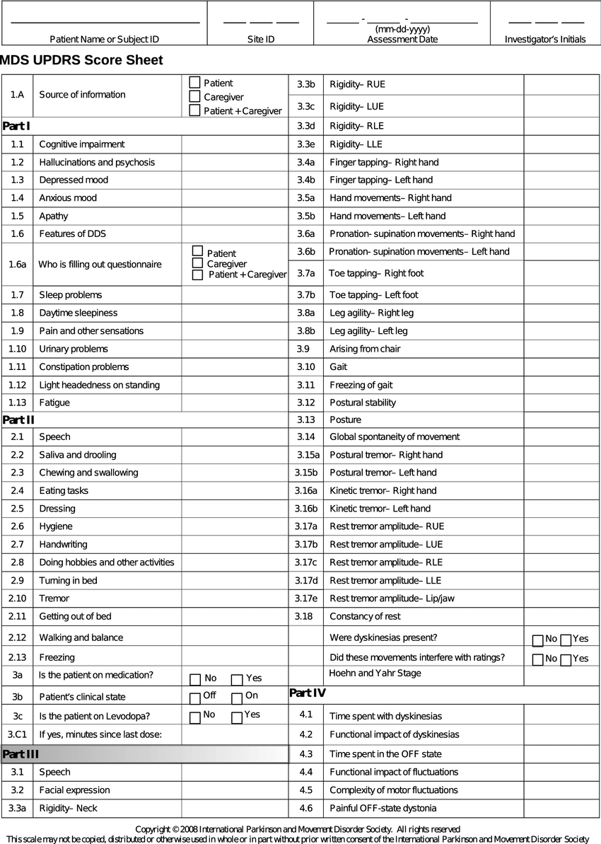

Slide 7
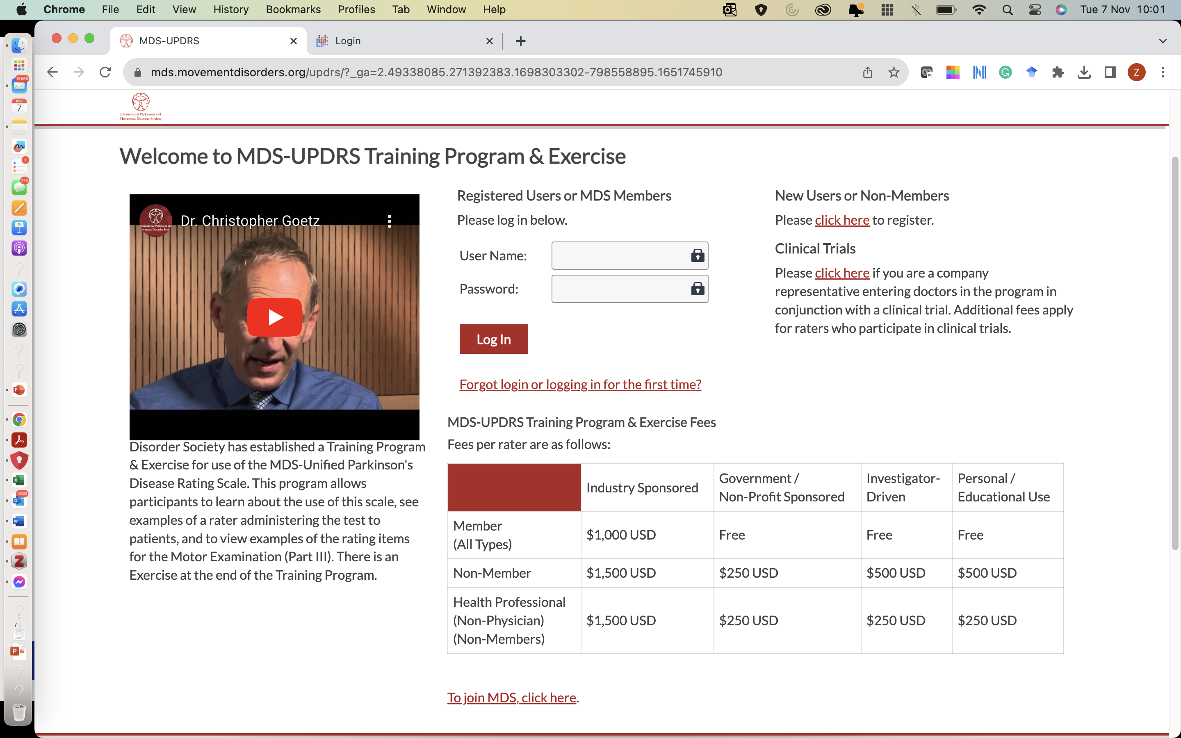
MDS-UPDRS
https://mds.movementdisorders.org/updrs/?_ga=2.49338085.271392383.1698303302-798558895.1651745910

Slide 8
Section I - Mentation, Behavior and Mood
Components: Intellectual impairment, thought disorder, depression, motivation/initiative.
Significance: Assesses the cognitive and emotional aspects of PD, crucial for a holistic understanding of the patient's condition

Slide 9
Section Ii - Activities of Daily Living (ADL)
Components: Speech, salivation, swallowing, handwriting, cutting food, dressing, hygiene, turning in bed, walking, tremor.
Significance: Evaluates the impact of PD on daily activities and independence, essential for planning interventions.

Slide 10
Section Iii - Motor Examination
Components: Speech, facial expression, tremor at rest, action/postural tremor, rigidity, finger taps, hand movements, rapid alternating movements of hands, leg agility, arising from chair, posture, gait.
Significance: Assesses motor symptoms and physical abilities, which are critical for diagnosing and tracking the progression of PD.

Slide 11
Section IV - Complications of Therapy
Components: Dyskinesias, clinical fluctuations, other complications, sleep disturbances.
Significance: Evaluates side effects and complications related to PD treatments, important for optimizing therapy.

Slide 12
SECTION I

Slide 13
Intellectual Impairment
Description: Assesses cognitive decline and its impact on daily life.
Scoring:
  0: None.
  1: Mild, consistent forgetfulness with partial recollection of events; no impairment in work or social function.
  2: Moderate memory loss, more marked for recent events; moderate impairment in work or social function.
  3: Severe memory loss, only highly learned material retained; severe impairment in work or social function.
  4: Severe memory loss, only fragments remain.

Slide 14
Thought Disorder
Description: Evaluates the presence of hallucinations, delusions, and confusion.
Scoring:
  0: None.
  1: Vivid dreams.
  2: Illusions (occasional, usually benign).
  3: Hallucinations (somewhat disturbing).
  4: Persistent hallucinations or delusions causing behavioral problems.

Slide 15
Depression
Depression Description: Assesses the severity of depressive symptoms.
Scoring:
  0: Not present.
  1: Periods of sadness or guilt greater than normal, but less than 50% of the day.
  2: Persistent sadness or guilt greater than 50% of the day.
  3: Persistent sadness or guilt with somatic symptoms.
  4: Persistent sadness or guilt with vegetative symptoms.

Slide 16
Motivation/Initiative
Description: Evaluates the patient's motivation and initiative in daily activities.
Scoring:
  0: Normal.
  1: Less motivation, but activities are started without prompting.
  2: Motivation decreased; needs to be reminded to initiate activities.
  3: Rarely initiates activities without prompting.
  4: Never initiates activities.

Slide 17
SECTION II

Slide 18
Speech
Description: Assesses clarity and volume of speech.
Scoring:
  0: Normal.
  1: Slight loss of expression, diction, and/or volume.
  2: Monotone, slurred but understandable; moderately impaired.
  3: Marked impairment, difficult to understand.
  4: Unintelligible.

Slide 19
Salivation
Description: Evaluates drooling and salivation control.
Scoring:
  0: Normal.
  1: Slight but definite excess of saliva in mouth; may have nighttime drooling.
  2: Moderately excessive saliva; may have minimal drooling.
  3: Marked excess of saliva with some drooling.
  4: Marked drooling, requires constant tissue or handkerchief.

Slide 20
Swallowing
Swallowing Description: Assesses difficulty in swallowing.
Scoring:
  0: Normal.
  1: Rare choking.
  2: Occasional choking.
  3: Requires soft food.
  4: Requires NG tube or gastrostomy feeding

Slide 21
Handwriting
Description: Evaluates changes in handwriting, such as micrographia.
Scoring:
  0: Normal.
  1: Slightly slow or small.
  2: Moderately slow or small; all words are legible.
  3: Severely affected; not all words are legible.
  4: The majority of words are not legible.

Slide 22
Cutting Food and Handling Utensils
Description: Assesses the ability to use utensils and cut food.
Scoring:
  0: Normal.
  1: Somewhat slow and clumsy but no help needed.
  2: Can cut most foods, although clumsy and slow; some help needed.
  3: Food must be cut by someone, but can still feed self.
  4: Needs to be fed.

Slide 23
Dressing
Description: Evaluates the ability to dress independently.
Scoring:
  0: Normal.
  1: Somewhat slow, but no help needed.
  2: Occasional assistance with buttons, etc.
  3: Considerable help required, but can do some things alone.
  4: Helpless.

Slide 24
Hygiene
Description: Assesses personal hygiene maintenance.
Scoring:
  0: Normal.
  1: Somewhat slow, but no help needed.
  2: Needs help to shower or bathe; independently washes face and hands.
  3: Requires assistance for washing, brushing teeth, combing hair, going to the bathroom.
  4: Fully dependent.

Slide 25
Turning in Bed
Description: Evaluates the ease of turning in bed.
Scoring:
  0: Normal.
  1: Somewhat slow and clumsy, but no help needed.
  2: Can turn alone or adjust sheets, but with great difficulty.
  3: Can initiate, but not turn or adjust sheets alone.
  4: Helpless.

Slide 26
Walking
Walking Description: Assesses walking ability.
Scoring:
  0: Normal.
  1: Mild difficulty; may notice slight change in stride length or speed.
  2: Moderate difficulty; often required to slow down and adjust stride.
  3: Severe difficulty; shuffles, significant festination or freezing.
  4: Cannot walk without assistance.

Slide 27
Tremor
Description: Assesses tremor that affects daily activities.
Scoring:
  0: Absent.
  1: Slight; not bothersome to patient.
  2: Moderate; interferes with some activities.
  3: Severe; interferes with many activities.
  4: Marked; interferes with most activities.

Slide 28
Section III

Slide 29
Speech
Speech Description: Evaluates clarity and volume of speech.
Scoring:
  0: Normal.
  1: Slight loss of expression, diction, and/or volume.
  2: Monotone, slurred but understandable; moderately impaired.
  3: Marked impairment, difficult to understand.
  4: Unintelligible.

Slide 30
Facial Expression
Description: Assesses facial mobility and expressiveness.
Scoring:
  0: Normal.
  1: Slightly hypomimic, less expressive than usual.
  2: Moderately hypomimic; less expression.
  3: Mask-like, but occasional blinking or other expression.
  4: Mask-like, no expression.

Slide 31
Tremor at Rest
Description: Measures tremor in different body parts at rest.
Scoring:
  0: Absent.
  1: Slight and infrequently present.
  2: Mild in amplitude and persistent; or moderate in amplitude, but only intermittently present.
  3: Moderate in amplitude and present most of the time.
  4: Marked in amplitude and present most of the time.

Slide 32
Action or Postural Tremor of Hands
Description: Assesses tremor during movement or maintaining posture.
Scoring:
  0: Absent.
  1: Slight; present with action.
  2: Moderate in amplitude, present with action.
  3: Moderate in amplitude, present with posture holding as well as action.
  4: Marked in amplitude, interferes with feeding.

Slide 33
Rigidity
Rigidity Description: Evaluates muscle stiffness.
Scoring:
  0: Absent.
  1: Slight or detectable only when activated by mirror or other movements.
  2: Mild to moderate.
  3: Marked, but full range of motion easily achieved.
  4: Severe, range of motion achieved with difficulty.

Slide 34
Finger Taps
Description: Assesses speed and amplitude of finger tapping.
Scoring:
  0: Normal.
  1: Mild slowing and/or reduction in amplitude.
  2: Moderately impaired. Definite and early fatiguing. May have occasional arrests in movement.
  3: Severely impaired. Frequent hesitation in initiating movements or arrests in ongoing movements.
  4: Can barely perform the task.

Slide 35
Hand Movements
  Description: Evaluates the ability to perform rapid hand movements.
  Scoring:
    0: Normal.
    1: Mild slowing and/or reduction in amplitude.
    2: Moderately impaired. Definite and early fatiguing. May have occasional arrests in movement.
    3: Severely impaired. Frequent hesitation in initiating movements or arrests in ongoing movements.
    4: Can barely perform the task.

Slide 36
Rapid Alternating Movements of Hands
Description: Assesses ability to perform rapid alternating hand movements.
Scoring:
  0: Normal.
  1: Mild slowing and/or reduction in amplitude.
  2: Moderately impaired. Definite and early fatiguing. May have occasional arrests in movement.
  3: Severely impaired. Frequent hesitation in initiating movements or arrests in ongoing movements.
  4: Can barely perform the task.

Slide 37
Leg Agility
  Description: Evaluates speed and amplitude of leg movements.
  Scoring:
    0: Normal.
    1: Mild slowing and/or reduction in amplitude.
    2: Moderately impaired. Definite and early fatiguing. May have occasional arrests in movement.
    3: Severely impaired. Frequent hesitation in initiating movements or arrests in ongoing movements.
    4: Can barely perform the task.

Slide 38
Arising from Chair
  Description: Assesses ease of standing up from a seated position.
  Scoring:
    0: Normal.
    1: Slow; may need more than one attempt.
    2: Pushes self up from arms of seat.
    3: Tends to fall back and may have to try more than one time, but can get up without help.
    4: Unable to arise without help.

Slide 39
Posture
Description: Evaluates upright posture and posture abnormalities.
Scoring:
  0: Normal erect.
  1: Not quite erect, slightly stooped (could be normal for older person).
  2: Moderately stooped, definitely abnormal; can be slightly leaning to one side.
  3: Severely stooped with kyphosis; can be moderately leaning to one side.
  4: Markedly forward flexed with extreme abnormality of posture.

Slide 40
Gait
Description: Assesses walking ability and abnormalities.
Scoring:
  0: Normal.
  1: Walks slowly, may shuffle with short steps, but no festination or propulsion.
  2: Walks with difficulty, requires little or no assistance; may have some festination, short steps, or propulsion.
  3: Severe disturbance of gait, requiring assistance.
  4: Cannot walk at all, even with assistance.

Slide 41
Postural Stability
Description: Assesses balance and response to a pull test.
Scoring:
  0: Normal.
  1: Recovers unaided.
  2: Would fall if not caught.
  3: Falls spontaneously.
  4: Unable to stand without assistance.

Slide 42
Body Bradykinesia and Hypokinesia
  Description: Evaluates general slowness of movement and reduction in amplitude.
  Scoring:
    0: None.
    1: Minimal slowness, giving movement a deliberate character; could be normal for some persons. Possibly reduced amplitude.
    2: Mild degree of slowness and poverty of movement which is definitely abnormal. Alternatively, some reduced amplitude.
    3: Moderate slowness, poverty or small amplitude of movement.
    4: Marked slowness, poverty or small amplitude of movement.

Slide 43
Section IV

Slide 44
Dyskinesias
Description: Assesses presence and severity of involuntary movements.
Scoring:
  0: None.
  1: Mild.
  2: Moderate.
  3: Marked.
  4: Severe.

Slide 45
Clinical Fluctuations
Clinical Fluctuations Description: Evaluates on-off phenomena and other fluctuations.
Scoring:
  0: None.
  1: Mild.
  2: Moderate.
  3: Marked.
  4: Severe.

Slide 46
Other Complications
  Description: Assesses complications such as freezing episodes.
  Scoring:
    0: None.
    1: Mild.
    2: Moderate.
    3: Marked.
    4: Severe.

Slide 47
Sleep Disturbances
  Description: Evaluates sleep problems related to PD.
  Scoring:
    0: None.
    1: Mild.
    2: Moderate.
    3: Marked.
    4: Severe.

Slide 48
Scoring Methodology
Scoring Methodology
How to Score: Each item is scored on a scale of 0 to 4.
  0: Normal or no symptoms
  1: Mild symptoms
  2: Moderate symptoms
  3: Severe symptoms
  4: Very severe symptoms
  Total Score: Sum of individual item scores. Higher scores indicate greater severity of symptoms.

Slide 49
Interpretation of Scores
UPDRS Original (1987)
MDS-UPDRS (2008)
The updated Movement Disorder Society (MDS)-UPDRS is more comprehensive and split into four parts:
Part I: Non-Motor Experiences of Daily Living
  13 items (6 clinician-assessed, 7 self-reported), scored 0–4 each
  Total: 0–52 points
Part II: Motor Experiences of Daily Living
  13 items, scored 0–4 each
  Total: 0–52 points
Part III: Motor Examination
  33 items, some with sub-items, scored 0–4 each
  Total: 0–132 points
Part IV: Motor Complications
  6 items, scored 0–4 each
  Total: 0–24 points
Grand Total for MDS-UPDRS: 0–260 points.
Part I: Mentation, Behavior, and Mood
  4 items, scored 0–4 each
  Total: 0–16 points
Part II: Activities of Daily Living (ADL)
  13 items, scored 0–4 each
  Total: 0–52 points
Part III: Motor Examination
  14 items, some with sub-items, scored 0–4 each
  Total: 0–108 points
Part IV: Complications of Therapy
  11 items, scored 0–4 each
  Total: 0–44 points
Grand Total for UPDRS (Original): 0–220 points.

Slide 50
Interpretation of Scores
Lower scores: Indicate minimal or no impairment.
Higher scores: Indicate greater severity of symptoms or disability.
The MDS-UPDRS is now the standard as it is better validated and more sensitive to changes, making it the preferred tool in research and clinical practice.

Slide 51
Administering the UPDRS
Best Practices:
  Ensure a quiet and comfortable environment.
  Conduct assessments at the same time of day for consistency.
  Combine clinical observations with patient self-reports.
  Example: Conducting assessments in the morning before medication to capture baseline symptoms.

Slide 52
Example Patient Assessment
  Patient: 65-year-old male, diagnosed with PD 5 years ago.
  Symptoms: Tremor, rigidity, bradykinesia, and mild cognitive decline.
  UPDRS Score:
    Section I: 6
    Section II: 12
    Section III: 24
    Section IV: 8
  Total Score: 50 (Moderate PD)
  Summary: Patient exhibits moderate motor and non-motor symptoms, requiring optimized medication and physical therapy.

Slide 53
Common Challenges
Difficulties:
  Variability in patient responses.
  Differences in clinician scoring.
  Subjectivity in assessment.
  Example: A patient may have fluctuating symptoms, making consistent scoring challenging.

Slide 54
Limitations of UPDRS
Areas of Concern:
  May not capture all symptoms accurately.
  Limited in assessing non-motor symptoms.
  Requires regular training and standardization.
  Example: Cognitive and mood symptoms may be underrepresented in the total score.

Slide 55
Updates and Modifications
Introduction: The Movement Disorder Society-UPDRS (MDS-UPDRS) is an updated version of the UPDRS.
Key Differences:
  Enhanced focus on non-motor symptoms.
  Improved scoring consistency.
  Increased sensitivity to changes over time.
  Example: The MDS-UPDRS includes a detailed section on non-motor experiences of daily living.

Slide 56
Future Directions
Potential Updates:
  Integration of technology for better accuracy (e.g., wearable sensors).
  Enhanced patient-reported outcomes.
  Ongoing research and refinement.
  Example: Developing mobile apps to assist with continuous symptom monitoring.

Slide 57
Training Resources
Available Courses:
  Online training modules (e.g., MDS-UPDRS training on the Movement Disorder Society website).
  Certification programs for healthcare professionals.
  Workshops and seminars.

Slide 58
CLINICAL CASES
Let us start working on clinical cases.
Slide 1: Clinical description with detailed observations using descriptive terminology only will be given. Please, translate clinical observations into UPDRS scores.
Slide 2: Clinical observations will be shown as UPDRS scores. Please give total UPDRS score and suggest the stage of the disease, with concluding comments.
Slide 3: Total UPDRS score will be revealed, the stage of the disease,suggested with concluding comments.
However, there may be an occasional mistake. Identify it.

Slide 59
Case 1: Clinical Description
- 58-year-old male, diagnosed with Parkinson’s Disease 3 years ago
- Primary complaints: Mild tremor in the right hand, difficulty in handwriting, occasional stiffness in the neck, and slow movements.
- Reports mild constipation and slight sleep disturbances.
Clinical Observations:
- Patient appears slightly anxious and has mild difficulty falling asleep.
- Demonstrates noticeable tremor in the right hand at rest.
- Difficulty with rapid alternating movements in the right hand.
- Rigidity noted in the neck and upper right extremity.
- Gait is normal, but bradykinesia is evident during finger tapping.

Slide 60
Case 1: UPDRS Scoring
UPDRS Scoring (translated from clinical description):
- Part I: Anxiety (1), mild sleep disturbances (1)
- Part II: Difficulty in handwriting (1), reduced fine motor control (1)
- Part III: Resting tremor in right hand (2), rigidity in neck and upper limb (2), bradykinesia during finger tapping (1)
- Part IV: No motor complications reported (0)

Slide 61
Case 1: Conclusion
Conclusion:
Total UPDRS Score: 9
Stage: Early-stage Parkinson's Disease
Comments:
- Symptoms are predominantly motor with mild non-motor involvement.
- Early intervention and monitoring are essential for progression control.

Slide 62
Case 2: Clinical Description
Patient Profile:
- 65-year-old female, diagnosed with Parkinson’s Disease 8 years ago
- Primary complaints: Worsening balance, frequent falls, difficulty dressing.
- Reports significant non-motor symptoms including constipation, vivid dreams, and mood swings.
Clinical Observations:
- Moderate hallucinations and frequent vivid dreams.
- Significant difficulty rising from a chair and dressing independently.
- Pronounced rigidity in all limbs, significant bradykinesia, and postural instability leading to falls.
- Motor fluctuations and dyskinesias observed during peak-dose periods.

Slide 63
Case 2: UPDRS Scoring
UPDRS Scoring (translated from clinical description):
- Part I: Hallucinations (2), vivid dreams (2), mood swings (2)
- Part II: Difficulty dressing (3), rising from a chair (3), freezing (2)
- Part III: Rigidity (3), bradykinesia (3), postural instability (4)
- Part IV: Motor fluctuations (2), dyskinesias (2)

Slide 64
Case 2: Conclusion
Conclusion:
Total UPDRS Score: 28
Stage: Advanced-stage Parkinson's Disease
Comments:
- Severe motor symptoms with significant non-motor impact.
- Safety interventions are critical to prevent falls and ensure quality of life.

Slide 65
Case 3: Clinical Description
Patient Profile:
- 72-year-old male, diagnosed with Parkinson’s Disease 12 years ago
- Primary complaints: Severe motor fluctuations and tremors, requiring assistance for daily activities.
- Reports mood disturbances and urinary urgency.
Clinical Observations:
- Severe tremor in all limbs, interfering with daily activities.
- Moderate rigidity and freezing episodes during ambulation.
- Motor fluctuations with peak-dose dyskinesias.
- Frequent urination and mild depressive symptoms.

Slide 66
Case 3: UPDRS Scoring
UPDRS Scoring (translated from clinical description):
- Part I: Mood disturbance (1), urinary urgency (1)
- Part II: Assistance required for daily activities (3), freezing (2)
- Part III: Severe tremor (4), rigidity (2), freezing (2)
- Part IV: Motor fluctuations (2), dyskinesias (2)

Slide 67
Case 3: Conclusion
Conclusion:
Total UPDRS Score: 19
Stage: Advanced-stage Parkinson's Disease
Comments:
- Severe impairment in motor function requires caregiver support.
- Adjustments in treatment are needed to manage motor complications.

Slide 68
Case 4: Clinical Description
Patient Profile:
- 60-year-old male, diagnosed with Parkinson’s Disease 6 years ago
- Primary complaints: Difficulty walking, frequent freezing, and occasional tremor in the left hand.
- Reports mild depression and daytime sleepiness.
Clinical Observations:
- Patient appears mildly depressed and struggles to stay awake during the consultation.
- Exhibits resting tremor in the left hand, rigidity in the neck and upper limbs.
- Freezing episodes observed when initiating gait.
- Postural instability with difficulty performing the pull test.

Slide 69
Case 4: UPDRS Scoring
UPDRS Scoring (translated from clinical description):
- Part I: Depression (1), daytime sleepiness (1)
- Part II: Freezing episodes (2), difficulty walking (2)
- Part III: Tremor in left hand (2), rigidity in neck and upper limbs (2), postural instability (3)
- Part IV: No motor complications reported (0)

Slide 70
Case 4: Conclusion
Conclusion:
Total UPDRS Score: 13
Stage: Moderate-stage Parkinson's Disease
Comments:
- Gait and balance issues are predominant.
- Early intervention with physiotherapy and regular monitoring advised.

Slide 71
Case 5: Clinical Description
Patient Profile:
- 70-year-old female, diagnosed with Parkinson’s Disease 10 years ago
- Primary complaints: Severe rigidity, slow movements, and impaired speech.
- Reports hallucinations and significant difficulty performing daily activities.
Clinical Observations:
- Severe bradykinesia and rigidity in all limbs.
- Hypophonia observed during conversation.
- Frequent hallucinations described as seeing figures in the room.
- Requires assistance with dressing and eating.

Slide 72
Case 5: UPDRS Scoring
UPDRS Scoring (translated from clinical description):
- Part I: Hallucinations (2)
- Part II: Difficulty dressing and eating (3 each), impaired speech (2)
- Part III: Severe bradykinesia (3), rigidity in all limbs (3)
- Part IV: No motor fluctuations or dyskinesias reported (0)

Slide 73
Case 5: Conclusion
Conclusion:
Total UPDRS Score: 16
Stage: Moderate to advanced-stage Parkinson's Disease
Comments:
- Severe motor and non-motor symptoms require a multidisciplinary approach.
- Regular neurological assessments and caregiver support are essential.

Slide 74
Case 6: Clinical Description
Patient Profile:
- 68-year-old male, diagnosed with Parkinson’s Disease 9 years ago.
- Primary complaints: Severe tremor in the right arm and slowness in performing daily activities.
- Reports mild memory issues and difficulty concentrating.
Clinical Observations:
- Mild cognitive impairment with difficulty in multitasking.
- Severe tremor in the right arm, moderate bradykinesia, and rigidity in both upper limbs.
- Difficulty rising from a chair and mild postural instability.

Slide 75
Case 6: UPDRS Scoring
UPDRS Scoring (translated from clinical description):
- Part I: Mild cognitive impairment (1)
- Part II: Slowness in daily activities (2), difficulty rising from a chair (2)
- Part III: Severe tremor (3), bradykinesia (2), rigidity in upper limbs (2), postural instability (2)
- Part IV: No motor complications reported (0)

Slide 76
Case 6: Conclusion
Conclusion:
Total UPDRS Score: 14
Stage: Moderate-stage Parkinson’s Disease
Comments:
- Motor symptoms dominate, with mild cognitive involvement.
- Routine monitoring and support for activities of daily living are recommended.

Slide 77
Case 7: Clinical Description
Patient Profile:
- 74-year-old female, diagnosed with Parkinson’s Disease 12 years ago.
- Primary complaints: Frequent falls, severe rigidity, and difficulty speaking.
- Reports occasional hallucinations and vivid dreams.
Clinical Observations:
- Severe rigidity in all limbs, hypophonia, and freezing episodes.
- Postural instability leading to frequent falls.
- Hallucinations and vivid dreams noted during consultation.

Slide 78
Case 7: UPDRS Scoring
UPDRS Scoring (translated from clinical description):
- Part I: Hallucinations (2), vivid dreams (1)
- Part II: Difficulty speaking (2), freezing episodes (2)
- Part III: Severe rigidity (3), postural instability (4)
- Part IV: No motor complications reported (0)

Slide 79
Case 7: Conclusion
Conclusion:
Total UPDRS Score: 14
Stage: Advanced-stage Parkinson’s Disease
Comments:
- Significant motor and non-motor symptoms impacting quality of life.
- Fall prevention strategies and multidisciplinary care are essential.

Slide 80
Case 8: Clinical Description
Patient Profile:
- 62-year-old male, diagnosed with Parkinson’s Disease 5 years ago.
- Primary complaints: Mild tremor in the left hand, occasional stiffness, and mild depression.
- Reports sleep disturbances and fatigue.
Clinical Observations:
- Mild resting tremor in the left hand.
- Slight rigidity in the neck and upper limbs.
- Mild depression and occasional difficulty staying asleep.

Slide 81
Case 8: UPDRS Scoring
UPDRS Scoring (translated from clinical description):
- Part I: Mild depression (1), sleep disturbances (1)
- Part II: Fatigue affecting daily activities (2)
- Part III: Mild tremor (2), rigidity in neck and upper limbs (1)
- Part IV: No motor complications reported (0)

Slide 82
Case 8: Conclusion
Conclusion:
Total UPDRS Score: 7
Stage: Early-stage Parkinson’s Disease
Comments:
- Early-stage symptoms with non-motor involvement.
- Focus on non-pharmacological interventions and regular monitoring.

Slide 83
Case 9: Clinical Description
Patient Profile:
- 66-year-old female, diagnosed with Parkinson’s Disease 7 years ago.
- Primary complaints: Increasing tremor in the left hand, rigidity in both legs, and difficulty turning in bed.
- Reports mild depression and occasional vivid dreams.
Clinical Observations:
- Noticeable resting tremor in the left hand, rigidity in the lower limbs.
- Moderate difficulty with bed mobility.
- Mild depressive symptoms and vivid dreams reported.

Slide 84
Case 9: UPDRS Scoring
UPDRS Scoring (translated from clinical description):
- Part I: Mild depression (1) — Patient shows signs of low mood and mild anhedonia; vivid dreams (1).
- Part II: Difficulty turning in bed (2) — Patient requires assistance to reposition comfortably.
- Part III: Resting tremor in left hand (2), rigidity in lower limbs (2).
- Part IV: No motor complications reported (0).

Slide 85
Case 9: Conclusion
Conclusion:
Total UPDRS Score: 8
Stage: Moderate-stage Parkinson’s Disease
Comments:
- Symptoms are balanced between motor and non-motor domains.
- Emphasis on managing tremor and improving mobility in daily life.

Slide 86
Case 10: Clinical Description
Patient Profile:
- 75-year-old male, diagnosed with Parkinson’s Disease 15 years ago.
- Primary complaints: Severe bradykinesia, rigidity, and difficulty speaking clearly.
- Reports frequent hallucinations and significant freezing episodes.
Clinical Observations:
- Hypophonia observed during conversation; severe bradykinesia noted in limb movements.
- Severe rigidity in all limbs with frequent freezing episodes.
- Frequent hallucinations involving visual imagery of people in the room.

Slide 87
Case 10: UPDRS Scoring
UPDRS Scoring (translated from clinical description):
- Part I: Frequent hallucinations (2) — Patient experiences visual hallucinations daily.
- Part II: Difficulty speaking (2) — Patient demonstrates low speech volume; frequent freezing episodes (3).
- Part III: Severe bradykinesia (3), rigidity in all limbs (3).
- Part IV: No motor complications reported (0).

Slide 88
Case 10: Conclusion
Conclusion:
Total UPDRS Score: 16
Stage: Advanced-stage Parkinson’s Disease
Comments:
- Significant motor impairment with notable non-motor symptoms.
- Interventions should address hallucinations and optimize speech therapy.

Slide 89
Conclusions & Lessons taken
UPDRS is a comprehensive tool to assess Parkinson’s Disease progression and symptoms.
Standardized application enhances diagnostic accuracy and monitoring.
Incorporating UPDRS in clinical practice aids in tailored treatment approaches.
Continuous education and case discussions ensure optimal use in multidisciplinary teams

Slide 90
References
Fahn S, Marsden CD, Calne DB, Goldstein M. Recent Developments in Parkinson's Disease, Vol 2. Florham Park, NJ. Macmillan Health Care Information 1987, pp 15 3-163, 293-304
Martinez-Martin P, Gil-Nagel A, Gracia LM, et al. Unified Parkinson’s disease Rating Scale characteristics and structure. The Cooperative Multicentric Group. Mov Disord 1994;9:76 – 83
Louis ED, Lynch T, Marder K, et al. Reliability of patient completion of the historical section of the Unified Parkinson’s disease Rating Scale. Mov Disord 1996;11:185–192
Rabey JM, Bass H, Bonuccelli U, Brooks D, et al. Evaluation of the short Parkinson’s evaluation scale: a new friendly scale for the evaluation of Parkinson’s disease in clinical drug trials. Clin Neuropharm 1997;20:322–337
Siderowf A, McDermott M, Kieburtz K, et al. Test-retest reliability of the UPDRS in patients with early Parkinson’s disease: results of a multicenter clinical trial. Mov Disord 2002;17:758 –763
Stebbins GT, Goetz CG. Factor structure of the Unified Parkinson’s disease Rating Scale: Motor Examination section. Mov Disord 1998;13:633– 636
Stebbins GT, Goetz CG, Lang AE, et al. Factor analysis of the motor section of the Unified Parkinson’s disease Rating Scale during the off-state. Mov Disord 1999;14:585589
Camicioli R, Grossmann SJ, Spencer PS, et al. Discriminating mild parkinsonism: methods for epidemiological research. Mov Disord. 2001;16:33– 40
Goetz C, Poewe W, Rascol O, Sampaio C, Stebbin G. State of the Art Review: The Unified Parkinson’s Disease Rating Scale (UPDRS):Status and Recommendations. Movt. Disorders. 2013;18:7;738:750.
Hauser RA, Lyons KE, Pahwa R. The UPDRS-8: a brief clinical assessment scale for Parkinson's disease. Int J Neurosci. 2012 Jul;122(7):333-7. doi: 10.3109/00207454.2012.657381

