Slide 1
Understanding neurodegenerative disorders from a psychological perspective
Psychology
Neapolis University Pafos, Cyprus
Notes:
Welcome to understanding neurodegenerative disorders from a psychological perspective, the first lecture from the psychopathology unit. Understanding neurodegenerative disorders (NDDs) from a psychological perspective is crucial for comprehending psychopathology in individuals with NDDs because it allows us to identify and address the psychological symptoms and challenges that frequently accompany these disorders.

Slide 2
Learning Objectives
Describe the psychological aspects of neurodegenerative disorders, such as changes in attention, language, perception, and praxis, and discuss their implications for daily life.
Describe the importance of adopting a psychological perspective in caring for individuals with neurodegenerative disorders.
Explain the relationship between neurodegenerative disorders and the development of psychopathological symptoms.
Evaluate the potential factors contributing to the development of psychopathology in individuals with neurodegenerative disorders.
Notes:
Upon completion of this lecture, you should be able to:
Describe the importance of understanding psychopathology in caring for individuals with NDDs.
Define the key elements in the current conceptualisation of abnormality or psychological disorder.
Explain the relationship between neurodegenerative disorders and the development of psychopathological symptoms. Discuss the potential impact of psychopathology on the overall disease progression and quality of life in individuals with neurodegenerative disorders.
Evaluate the potential factors contributing to the development of psychopathology in individuals with specific neurodegenerative disorders.

Slide 3

The importance of understanding psychopathology in caring for individuals with NDDs
Activity
Imagine you are stuck in a chair and can’t move but you are not sure why. Then someone you don’t know is approaching you, is invading your personal space and you are not able to work out what their intentions are.
How do you think you would feel?
What would you do?
Someone living with an NDD may not be able to reason through this scenario and their response will likely be to behave in a way that minimises danger or keeps them safe.
Notes:
Before we begin, we will carry out an empathy exercise that's designed to help us better understand and empathize with the experiences of individuals living with Neurodegenerative Disorders. NDD’s often bring about cognitive and physical challenges that can make everyday situations confusing and even frightening for those affected. The purpose of this activity is to put ourselves in their shoes, so to speak, and gain insight into how they might perceive and react to unfamiliar or potentially distressing situations.
Begin by sitting comfortably and closing your eyes to fully immerse yourself in this exercise.
Imagine you are seated in a chair, and you suddenly realize that you cannot move. It's as though you're stuck, and you're uncertain about why this has happened.
Now, envision an unfamiliar person approaching you. This person is getting very close, invading your personal space, and you're unable to discern their intentions. You don't know this person, and their actions are unclear.
Take a moment to consider how you would feel in this situation. Try to put yourself in that scenario and think about your emotions.
Next, consider how you would react. What actions would you take in response to this unfamiliar individual encroaching on your personal space when you can't move or understand their intentions?
Now, think about the fact that someone living with a neurodegenerative disorder may not have the ability to reason through this scenario as you can. Their response is likely to be instinctual, aimed at minimizing perceived danger and ensuring their safety.

Slide 4

Neurodegenerative disorders and psychological distress
Neurodegenerative
disorders
Psychological
distress
Notes:
Being diagnosed with a Neurodevelopmental Disorder can significantly affect one’s psychological and mental health. NDDs encompass a group of conditions that affect the development of the brain and nervous system, and that can lead to significant changes in cognition, behavior, and emotions. NDDs therefore bring a unique set of challenges that significantly impact an individual's psychological well-being.
Recognizing the link between NDDs and mental health is crucial for providing comprehensive care. It underscores the importance of early intervention, therapy, and holistic support for individuals with NDDs and their families. By addressing both the core challenges of NDDs and the co-occurring mental health conditions, we can help improve the overall well-being of individuals with NDDs, support their families and caregivers, and work towards a more inclusive and understanding society.

Slide 5
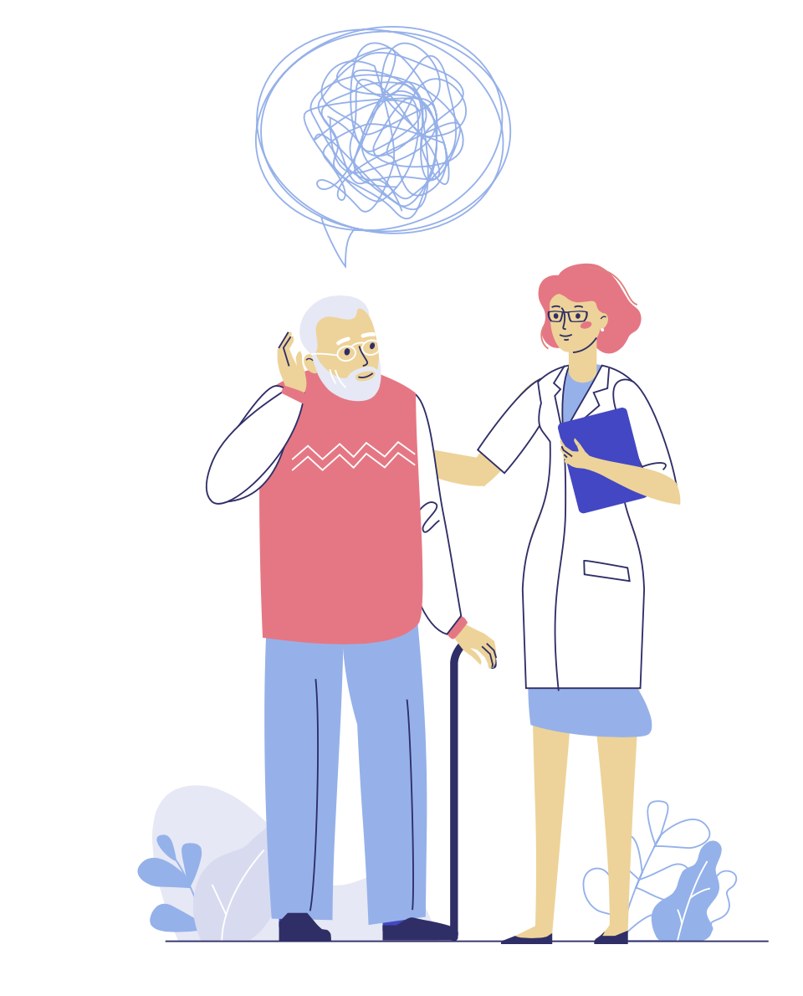
Psychological impact of diagnosis
Receiving a diagnosis
Someone recently diagnosed with a NDD is likely to experience a range of emotions.
These may include grief, loss, anger, shock, fear, disbelief and even relief. Sometimes people experience positive reactions when they receive a diagnosis of a NDD.
They can feel relieved to know what is wrong or be glad to be able to plan ahead.
Notes:
Someone recently diagnosed with a NDD is likely to experience a range of emotions. These may include grief, loss, anger, shock, fear, disbelief and even relief. Sometimes people experience positive reactions when they receive a diagnosis of a NDD. They can feel relieved to know what is wrong or be glad to be able to plan ahead. Some people may struggle to deal with these emotions. They may feel afraid about the future, scared about moments of confusion and forgetfulness, and upset about the impact dementia has on those around them.

Slide 6
Psychological impact of neurodegenerative disorders
NDD’s can significantly impair one’s cognitive capacity
(i.e., how efficiently they are able to use their brain)
They can cause impairments in the following areas:
Memory
Attention
Language
Praxis/
Psychomotor skills
Perception
Executive functioning
Notes:
As a neurodegenerative disorder advances, individuals face increasingly significant challenges to their cognitive capacity, which is vital for their psychological well-being. This deterioration occurs because neurodegenerative disorders lead to the progressive breakdown of neurons, which are essential for communication within the brain and central nervous system. Unlike many other cells in the body, neurons cannot regenerate, which makes their loss particularly devastating. Moreover, these disorders hinder the production of neurotransmitters, critical for brain cell communication. Consequently, individuals with neurodegenerative disorders may experience deficits in various cognitive abilities including memory, attention, language, perception, psychomotor skills, executive functioning and personality. In the following sections, we will delve into each of these aspects from a psychological perspective.

Slide 7
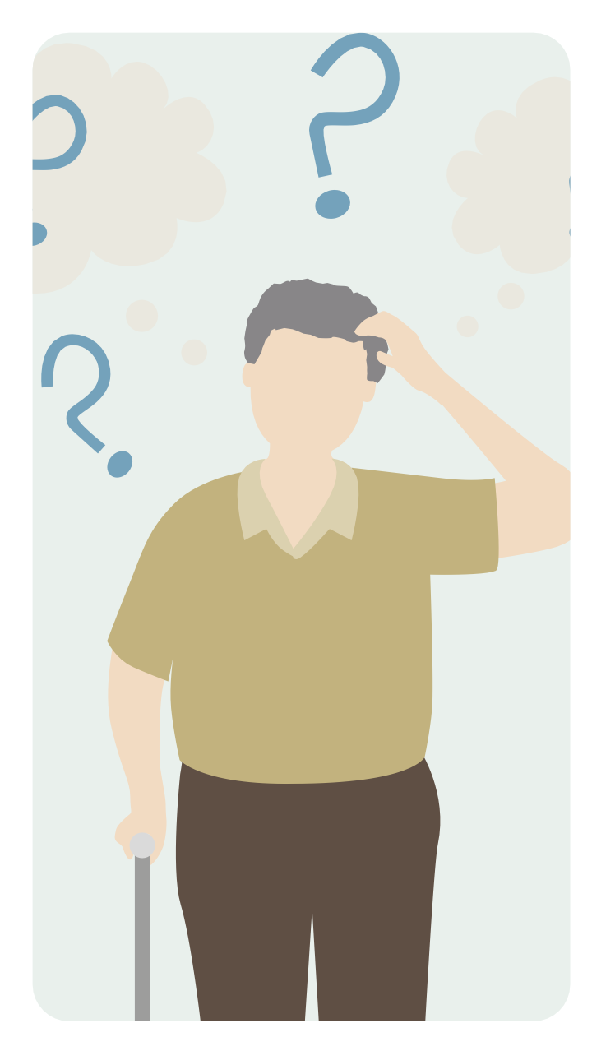
Memory
Memory refers to our capacity to learn, integrate and remember information when required, sometimes many years later. This includes memory for facts and experiences, as well as how to perform tasks and motor actions.
Memory is a multifaceted cognitive function.
Different forms of memory rely on various brain regions.
Memory processes include encoding, storage, and retrieval of information.
NDDs can lead to selective memory deficits based on affected brain areas.
Dysfunction in any part of the memory process can impair memory function.
Changes in memory are a very common symptom of NDDs.
Notes:
Memory refers to our capacity to learn, integrate and remember information when required, sometimes many years later. This includes memory for facts and experiences, as well as how to perform tasks and motor actions.
There are various forms of memory that are dependent upon different areas of the brain, though these systems work in conjunction with each other. This means it is possible for a person with an NDD to have deficits in some aspects of memory but not in others, depending on what parts of their brain are affected by the disease. The process of remembering newly learnt information includes the encoding, storage and retrieval of the information. A breakdown at any point of this process of learning new information can impact on memory function. Changes in memory tend to be the most common symptom and the first sign that may be indicative of NDDs; although this is not the case for all types of NDDs.

Slide 8
Activity – Memory
Close your eyes and take a few minutes to think back to this morning, or yesterday evening. Try and remember what you did over a set period of time, for example, from the time you arrived home until you went to bed.
Now consider what it is like for someone with a NDD. They will be able to do very little of this, perhaps none, even from events over the last hour. They might have impressions or vague memories of episodes and how things sounded, looked or felt. They will probably not know when they occurred, such as whether it was an hour ago or last year, nor in what order. Imagine what it would be like not to have access to what has recently happened, access to the day to day progression of life and things you must learn to keep safe.
How do you think it feels for someone with a NDD who can't remember recent events or their sequence, and what impact does this have on their daily life and sense of safety?
Notes:
Now lets try an activity that will help us to understand how someone's memory might be affected when living with an NDD.
Close your eyes and take a few minutes to think back to this morning, or yesterday evening. Try and remember what you did over a set period of time, for example, from the time you arrived home until you went to bed. You will usually be able to remember not only a number of things you did, but also a large amount of detail such as what your emotions were, what events looked like or sounded like. Once you are engaged in the exercise, one memory will cue another. In addition, you will usually be able to remember the order in which things occurred. Now consider what it is like for someone with moderate dementia. They will be able to do very little of this, perhaps none, even from events over the last hour. They might have impressions or vague memories of episodes and how things sounded, looked or felt. They will probably not know when they occurred, such as whether it was an hour ago or last year, nor in what order. Imagine what it would be like not to have access to what has recently happened, access to the day to day progression of life and things you must learn to keep safe.
How do you think it feels for someone with moderate dementia who can't remember recent events or their sequence, and what impact does this have on their daily life and sense of safety?

Slide 9
Memory (cont.)
Anura and Tamil New Year Celebration
Anura used to be the primary organizer of the New Year event. This year, he struggles to remember all the details that made the celebration special. He forgets key parts of the traditional customs and may not even recall the order in which they are supposed to occur. Anura's family members, who usually relied on him to guide them through the customs and rituals, notice that he keeps repeating the same questions and stories as if he's stuck in a loop. He forgets that he already discussed certain aspects of the event just moments before. Anura might not recognize all the family members who attend the celebration. He becomes anxious and confused when trying to identify his own close relatives, which is a stark departure from his previous familiarity with everyone. Anura's once-keen culinary skills are affected as well. He forgets ingredients for traditional dishes, leaving out key elements and changing the taste of dishes that were always prepared just right. His frustration and confusion in the kitchen are evident. Anura's memory deficits during this cherished family gathering feel like a loss of identity and connection to his cultural heritage. He becomes frustrated and upset, unable to fully engage in a tradition that has always been a source of pride and joy for him.
Notes:
let's consider a specific situation involving a character named Anura, a Sri Lankan man who is experiencing memory deficits due to a neurodegenerative disorder. Anura's experience will help us understand what memory deficits might feel like in a relatable, everyday context.
Anura's family had always been a source of pride and joy for him. Every year, he would meticulously organize a big family gathering at his home to celebrate the Sinhala and Tamil New Year, a cherished cultural tradition. This event was a symbol of unity, filled with laughter, food, and cultural rituals.
However, as Anura's neurodegenerative disorder progresses, his memory deficits are becoming increasingly apparent:
The Situation: Sinhala and Tamil New Year Celebration
Memory Deficit 1: Anura used to be the primary organizer of the New Year event. This year, he struggles to remember all the details that made the celebration special. He forgets key parts of the traditional customs and may not even recall the order in which they are supposed to occur.
Memory Deficit 2: Anura's family members, who usually relied on him to guide them through the customs and rituals, notice that he keeps repeating the same questions and stories as if he's stuck in a loop. He forgets that he already discussed certain aspects of the event just moments before.
Memory Deficit 3: Anura might not recognize all the family members who attend the celebration. He becomes anxious and confused when trying to identify his own close relatives, which is a stark departure from his previous familiarity with everyone.
Memory Deficit 4: Anura's once-keen culinary skills are affected as well. He forgets ingredients for traditional dishes, leaving out key elements and changing the taste of dishes that were always prepared just right. His frustration and confusion in the kitchen are evident.
Emotional Impact: Anura's memory deficits during this cherished family gathering feel like a loss of identity and connection to his cultural heritage. He becomes frustrated and upset, unable to fully engage in a tradition that has always been a source of pride and joy for him.
For Anura, this situation and similar ones like it emphasize the emotional toll of memory deficits. The loss of cherished traditions, a sense of disconnection from family, and a feeling of helplessness are deeply challenging. Coping with memory deficits in the context of a neurodegenerative disorder requires patience, understanding, and support from his family as they adapt to the changes and strive to preserve their cultural traditions and his quality of life.

Slide 10
Attention
Attention refers to our ability to concentrate, at any one instant, on what is important and selectively shut out the other information which is constantly being provided by our senses and thoughts.
Think about holding a conversation in a bustling environment or reading a book for an extended period. These tasks require sustained attention, the ability to focus on one thing and ignore distractions. For many individuals with neurodegenerative disorders, controlling attention becomes increasingly challenging. Their ability to filter out distractions and maintain focus diminishes over time.
Examples of behaviours linked to impaired attention:
Wandering and Disorientation: Many individuals with neurodegenerative diseases, such as Alzheimer's disease, may exhibit wandering behaviour. They might become disoriented and lose track of their location, even in familiar places. This behaviour is often linked to impaired attention and the inability to maintain a clear sense of direction and purpose.
Repetitive Questioning: Repetitive questioning is a common behaviour seen in individuals with impaired attention, particularly in Alzheimer's disease. They may repeatedly ask the same question, forgetting that they've already received an answer. This behaviour can be frustrating for both the affected individual and their caregivers, as it reflects their difficulty in sustaining attention and memory recall.

Slide 11
Attention (cont.)
Attention deficits in individuals with neurodegenerative disorders can have cultural and personal variations, but they are generally challenging and frustrating. Imagine Priya, who is facing attention deficits due to a neurodegenerative disorder. Before the onset of her neurodegenerative disorder, Priya was known for her attention to detail and her ability to juggle multiple tasks efficiently. She managed her household, including preparing traditional Sri Lankan meals, with precision. However, as the neurodegenerative disorder progresses, attention deficits become a significant part of her daily life:
Difficulty in Preparing Meals: Priya, who once effortlessly prepared intricate Sri Lankan dishes, now finds it challenging to focus on the cooking process. She may forget important steps in a recipe or leave ingredients out of a dish, resulting in a change in the taste and quality of the traditional meals she once excelled at making.
Memory and Recipe Forgetting: Priya starts forgetting family recipes that have been passed down through generations. She might forget the key ingredients or the sequence of cooking techniques required for a particular dish. This is not only frustrating but can also affect the cultural heritage she valued.
Social Awkwardness: In social gatherings and family events, Priya's attention deficits become evident. She might struggle to participate in conversations, often losing track of what is being discussed. This can lead to social isolation and feeling disconnected from her cultural community.
Difficulty Managing Household Finances: Handling finances and budgeting, which were once well within her capabilities, become overwhelming. She might forget to pay bills or misplace important financial documents, leading to stress and uncertainty.
Language and Communication Challenges: Priya may experience difficulties in comprehending and responding to communication in her native Sinhala or Tamil languages. Conversations that were once fluid become fragmented and confusing, affecting her ability to connect with her family and community.
Loss of Cultural Engagement: Priya's attention deficits can result in a diminished engagement with Sri Lankan cultural activities and traditions. She might find it challenging to participate in religious ceremonies, festivals, and other cultural events that were once integral to her life.
Notes:
Attention deficits in individuals with neurodegenerative disorders can have cultural and personal variations, but they are generally challenging and frustrating. Let's consider a relatable example involving a character named Priya, who is facing attention deficits due to a neurodegenerative disorder. Priya's experience will help us understand what it feels like for a Sri Lankan individual with attention deficits in their everyday life.
Before the onset of her neurodegenerative disorder, Priya was known for her attention to detail and her ability to juggle multiple tasks efficiently. She managed her household, including preparing traditional Sri Lankan meals, with precision. However, as the neurodegenerative disorder progresses, attention deficits become a significant part of her daily life:
Difficulty in Preparing Meals: Priya, who once effortlessly prepared intricate Sri Lankan dishes, now finds it challenging to focus on the cooking process. She may forget important steps in a recipe or leave ingredients out of a dish, resulting in a change in the taste and quality of the traditional meals she once excelled at making.
Memory and Recipe Forgetting: Priya starts forgetting family recipes that have been passed down through generations. She might forget the key ingredients or the sequence of cooking techniques required for a particular dish. This is not only frustrating but can also affect the cultural heritage she valued.
Social Awkwardness: In social gatherings and family events, Priya's attention deficits become evident. She might struggle to participate in conversations, often losing track of what is being discussed. This can lead to social isolation and feeling disconnected from her cultural community.
Difficulty Managing Household Finances: Handling finances and budgeting, which were once well within her capabilities, become overwhelming. She might forget to pay bills or misplace important financial documents, leading to stress and uncertainty.
Language and Communication Challenges: Priya may experience difficulties in comprehending and responding to communication in her native Sinhala or Tamil languages. Conversations that were once fluid become fragmented and confusing, affecting her ability to connect with her family and community.
Loss of Cultural Engagement: Priya's attention deficits can result in a diminished engagement with Sri Lankan cultural activities and traditions. She might find it challenging to participate in religious ceremonies, festivals, and other cultural events that were once integral to her life.
For Priya, these attention deficits feel like a loss of identity, cultural connection, and the ability to manage daily life as she once did. It can lead to feelings of frustration, anxiety, and a sense of disconnection from her cultural heritage. Coping with these challenges in the context of a neurodegenerative disorder requires not only medical support but also a strong network of family and community support to help preserve her cultural identity and quality of life.

Slide 12

Language
Language functions include the ability to understand written or spoken language, i.e. reading and listening to a conversation, and to express language by speaking and writing.
Language also includes knowledge of word meanings, objects, people and facts about the world, i.e. knowing that a dog has four legs, is furry and barks; this is referred to as semantic memory. People with semantic memory difficulties tend to present with language problems, for example, word finding difficulties, often referred to as a ‘tip of the tongue’ phenomenon.
Effective communication also requires the ability to understand ‘non-verbal’ communication such as understanding humour and sarcasm; recognising emotions in faces and speech; and understanding conversation rules (e.g. turn-taking).

Slide 13
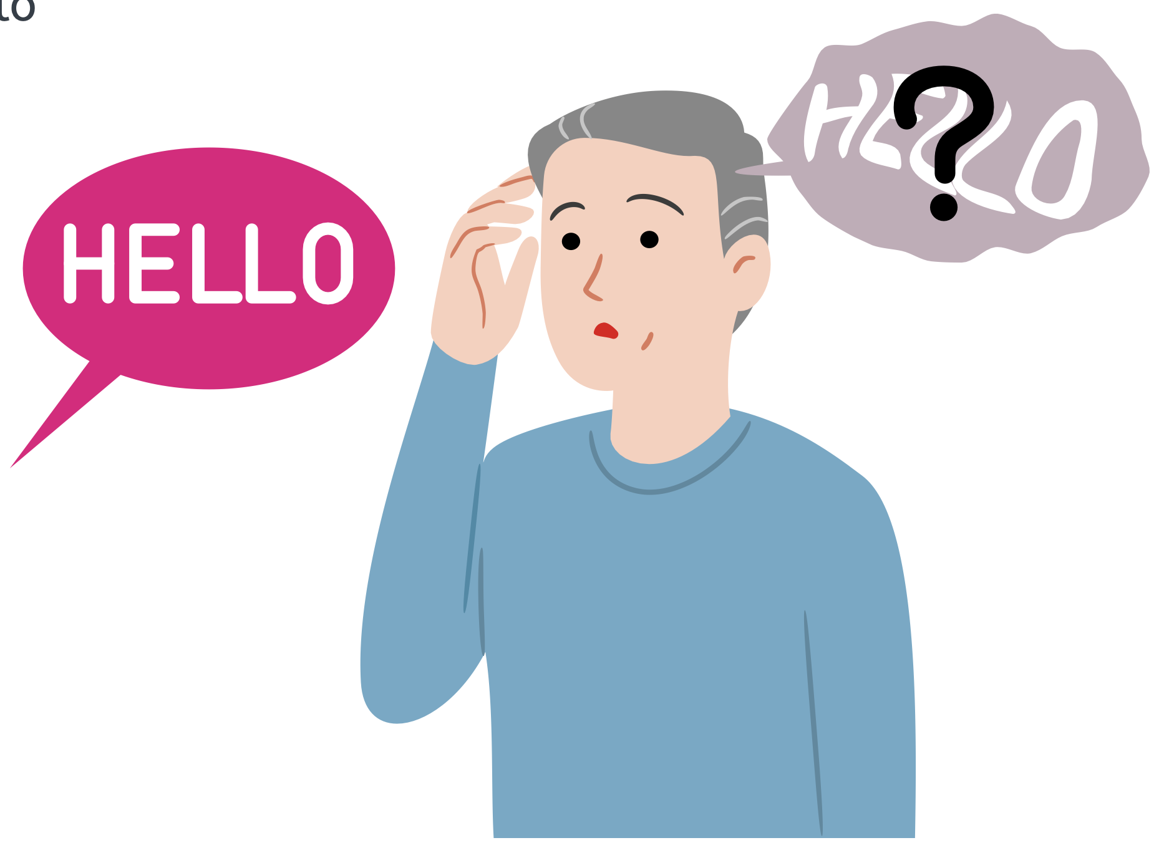
Language (cont.)
Neurodegenerative disorders can impair language in various ways.
Difficulty with Word Finding: People may struggle to find and articulate words, experiencing "tip-of-the-tongue" moments.
Incoherent Speech: Speech can become fragmented and incoherent, with difficulty forming sentences and organizing thoughts.
Agrammatism: Difficulty using proper grammar and syntax can lead to disjointed speech.
Loss of Vocabulary: Patients may forget words and their meanings, leading to a reduced vocabulary.
Impaired Comprehension: Understanding spoken or written language can become challenging, resulting in confusion and miscommunication.
Inappropriate Speech: Patients may exhibit socially inappropriate or offensive language due to disinhibition.
Difficulty Reading and Writing: Neurodegenerative disorders can affect reading and writing skills, making it hard to communicate through text.

Slide 14
Language (cont.)
Impaired language for an individual with an NDD can be likened to attempting a conversation in a foreign language they once spoke fluently but are slowly losing. Imagine an individual with Primary Progressive Aphasia, a type of NDD that primarily affects language abilities. This person used to be articulate, express their thoughts clearly, and engage in meaningful conversations. However, as their condition progresses, they experience impaired language.
Frustration and Isolation: They sit down with a group of friends for a casual conversation. They once relished these interactions, but now they experience a growing sense of frustration. As their friends discuss recent events, they struggle to find words or form coherent sentences. It's like trying to assemble a puzzle with missing pieces.
Searching for Words: In the middle of a sentence, they may pause, searching for a word that's slipped from their grasp. It feels like trying to recall a name on the tip of their tongue, but this sensation occurs regularly, making conversation a constant challenge.
Miscommunication: They might unintentionally choose the wrong words or use words incorrectly. A simple question like, "How was your weekend?" might elicit a response about a completely unrelated topic. They watch the confusion on their friends' faces, knowing they've failed to convey their thoughts.
Withdrawal: As impaired language becomes more prominent, they may begin to withdraw from social interactions. The effort and anxiety of not being able to communicate effectively take a toll. They avoid conversations, preferring isolation to the frustration of trying to express themselves.
Emotional Turmoil: The individual experiences a mix of emotions: frustration, embarrassment, sadness, and anger. They recognize the people around them are attempting to be patient and understanding, but this only intensifies the emotional turmoil. They feel like they're slowly losing a part of themselves.
Loss of Identity: The person once known for their eloquence and wit now struggles to maintain their identity. It's as if they're watching their verbal prowess slip away, and they long for the days when language was effortless.
Notes:
Impaired language for an individual with a Neurodegenerative Disorder (NDD) can be likened to attempting a conversation in a foreign language they once spoke fluently but are slowly losing. Let's consider an example:
Imagine an individual with Primary Progressive Aphasia, a type of NDD that primarily affects language abilities. This person used to be articulate, express their thoughts clearly, and engage in meaningful conversations. However, as their condition progresses, they experience impaired language.
Frustration and Isolation: They sit down with a group of friends for a casual conversation. They once relished these interactions, but now they experience a growing sense of frustration. As their friends discuss recent events, they struggle to find words or form coherent sentences. It's like trying to assemble a puzzle with missing pieces.
Searching for Words: In the middle of a sentence, they may pause, searching for a word that's slipped from their grasp. It feels like trying to recall a name on the tip of their tongue, but this sensation occurs regularly, making conversation a constant challenge.
Miscommunication: They might unintentionally choose the wrong words or use words incorrectly. A simple question like, "How was your weekend?" might elicit a response about a completely unrelated topic. They watch the confusion on their friends' faces, knowing they've failed to convey their thoughts.
Withdrawal: As impaired language becomes more prominent, they may begin to withdraw from social interactions. The effort and anxiety of not being able to communicate effectively take a toll. They avoid conversations, preferring isolation to the frustration of trying to express themselves.
Emotional Turmoil: The individual experiences a mix of emotions: frustration, embarrassment, sadness, and anger. They recognize the people around them are attempting to be patient and understanding, but this only intensifies the emotional turmoil. They feel like they're slowly losing a part of themselves.
Loss of Identity: The person once known for their eloquence and wit now struggles to maintain their identity. It's as if they're watching their verbal prowess slip away, and they long for the days when language was effortless.
In this example, impaired language feels like attempting to communicate in a language they once mastered, only to discover that the words are fading away. It's not merely a challenge of vocabulary or grammar; it's a profound loss of the ability to convey thoughts, emotions, and maintain connections with others. This experience can be incredibly distressing for the individual and emotionally challenging for their loved ones who witness the gradual loss of their communicative abilities.

Slide 15






Perception
Perception is primarily the capacity we have to interpret or make sense of the information provided by our vision, hearing, touch, smell and taste. It can also refer to making sense of information coming from within us – both bodily sensations and thoughts.
visual perception allows us to see, recognise and understand objects, people, and places;
spatial perception enables us to know where we are in relation to objects in the world and to act in relation to objects in space;
auditory perception enables us to hear and understand what we are hearing;
somatosensory perception enables us to experience the sensations of touch, temperature and body position (proprioception), which in turn allow us to understand the physical environment;
olfactory perception enables us to experience and interpret different smells; and
gustatory perception enables us to taste and interpret different tastes.

Slide 16
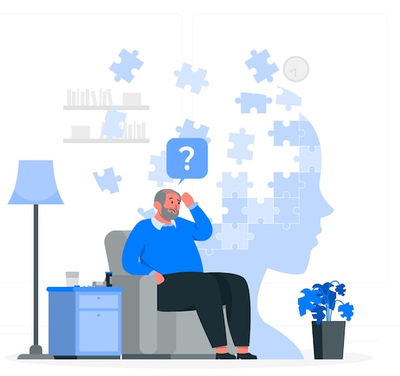
Perception (cont.)
Neurodegenerative disorders can impair one's perception
Altered Sensory Processing: These disorders can disrupt how the brain processes sensory information, leading to distortions or misinterpretations of sensory input.
Impaired Spatial Awareness: Individuals may have difficulty perceiving distances, spatial relationships, and objects in their environment, which can lead to issues with balance and navigation.
Changes in Time Perception: Perception of time can become distorted, with individuals struggling to estimate time intervals accurately.
Visual and Auditory Hallucinations: Some neurodegenerative disorders can cause hallucinations, where individuals perceive things that are not actually present, either visually or auditorily.
Reduced Sensory Awareness: Individuals may become less aware of sensations like pain or temperature changes, leading to potential safety concerns.

Slide 17
Perception (cont.)
Impaired perception for an individual with an NDD can be likened to a confusing and ever-shifting puzzle where pieces are missing or jumbled. Imagine an individual with Alzheimer's disease who has impaired perception. This person is sitting in their own living room, a space that should be familiar and comforting. However, due to their condition, their perception of this room is drastically altered.
Familiar Room, Unfamiliar Territory: They glance around and see furniture, family photos, and cherished belongings, but they struggle to recognize any of it. What was once their cosy, welcoming living room now feels like an unfamiliar space, as if they've walked into someone else's home.
Lost in Time: The wall clock, once a reliable source of time, appears cryptic. It might show the correct hour, but the concept of time itself feels elusive. The room might as well be a timeless void.
Mystery Objects: Everyday objects may seem perplexing. They see a coffee cup on the table, but they can't grasp its purpose or how it relates to them. They might even question why it's there or what it signifies.
Faces Without Identity: Family photos adorn the walls, but the faces in the pictures no longer carry meaning. Even photos of their own children and spouse evoke no sense of connection or recognition. These once-beloved people appear as strangers.
Anxiety and Unease: This altered perception can trigger anxiety and unease. The person's own living room, intended to be a place of comfort, becomes a source of stress and confusion. They might even fear that they've somehow ended up in a stranger's house.
Notes:
Impaired perception for an individual with a Neurodegenerative Disorder (NDD) can be likened to a confusing and ever-shifting puzzle where pieces are missing or jumbled. Let's consider an example:
Imagine an individual with Alzheimer's disease who has impaired perception. This person is sitting in their own living room, a space that should be familiar and comforting. However, due to their condition, their perception of this room is drastically altered.
Familiar Room, Unfamiliar Territory: They glance around and see furniture, family photos, and cherished belongings, but they struggle to recognize any of it. What was once their cozy, welcoming living room now feels like an unfamiliar space, as if they've walked into someone else's home.
Lost in Time: The wall clock, once a reliable source of time, appears cryptic. It might show the correct hour, but the concept of time itself feels elusive. The room might as well be a timeless void.
Mystery Objects: Everyday objects may seem perplexing. They see a coffee cup on the table, but they can't grasp its purpose or how it relates to them. They might even question why it's there or what it signifies.
Faces Without Identity: Family photos adorn the walls, but the faces in the pictures no longer carry meaning. Even photos of their own children and spouse evoke no sense of connection or recognition. These once-beloved people appear as strangers.
Anxiety and Unease: This altered perception can trigger anxiety and unease. The person's own living room, intended to be a place of comfort, becomes a source of stress and confusion. They might even fear that they've somehow ended up in a stranger's house.
Struggling to Communicate: When a family member enters the room and starts a conversation, the individual may find it challenging to understand or respond. Their perception of spoken words is muddled, and they might respond with unrelated or nonsensical statements.
In this example, impaired perception is like a fog that obscures the individual's ability to connect with their environment and loved ones. The living room, which should be a place of familiarity and safety, becomes a bewildering landscape. This altered perception profoundly impacts their sense of identity and the connections that are fundamental to their well-being. It's a disorienting and disheartening experience, not only for the individual but also for their caregivers and loved ones who witness these struggles.

Slide 18

Praxis/Psychomotor skills
Praxis is best described as putting thoughts or knowledge into action – the link between thinking and doing.
It has links to procedural memory which is the memory of how to do certain things in a certain way or to carry out tasks.
For psychological purposes, praxis or psychomotor capacity refers to the ability to perform tasks involving fine motor skills, i.e. buttoning a shirt and hand-eye coordination, i.e. eating food with a knife and fork.

Slide 19
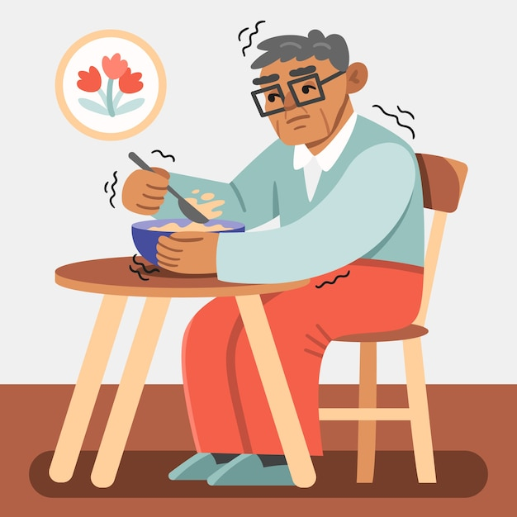
Praxis/Psychomotor skills (cont.)
Neurodegenerative disorders can impair praxis/psychomotor skills by causing:
Loss of Coordination: Individuals may experience a decline in fine and gross motor skills, leading to difficulties in tasks like buttoning a shirt or walking.
Reduced Dexterity: Fine motor skills, such as writing or using utensils, can become challenging due to muscle weakness and lack of precision.
Slowed Movement: Movements may become slower and less coordinated, affecting daily activities like getting dressed or preparing a meal.
Difficulty Planning and Executing Movements: Patients may struggle with motor planning, making it hard to perform complex tasks that require a sequence of actions.
Tremors and Muscle Stiffness: Some neurodegenerative disorders can cause tremors or muscle rigidity, further impairing motor skills.

Slide 20
Praxis/Psychomotor skills (cont.)
Impaired praxis and psychomotor skills for an individual with an NDD can be compared to trying to play a musical instrument when your fingers no longer respond as they should. Imagine an individual with Parkinson's disease, a condition that can affect fine motor skills and coordination. Playing the piano used to be a cherished hobby, but as their condition progresses, they experience impaired praxis and psychomotor skills.
The Attempt: They sit down at the piano, a beloved instrument they once played beautifully. They place their fingers on the keys and look at the sheet music for a familiar tune. However, as they begin to play, they notice that their fingers don't move as gracefully or accurately as they used to.
Frustration and Struggle: The simple act of pressing the keys becomes a struggle. Their fingers feel sluggish and unresponsive, as if the connection between their brain and hands has frayed. The melody they once effortlessly created now sounds disjointed and out of tune.
Loss of Fluidity: Playing a musical piece used to be a form of self-expression, but now it feels mechanical and disjointed. Their fingers stumble on the keys, and the fluidity that defined their music is missing.
Emotional Dissonance: Frustration sets in as they confront the dissonance between what they want to play and what their hands can manage. It's like trying to convey a beautiful idea through music but being thwarted by their own body.
Withdrawal: The individual might avoid the piano altogether. The instrument that once brought them joy has become a source of frustration and disappointment. They may not want to showcase their diminished abilities to others.
Loss of Identity: The piano used to be an integral part of their identity, a source of pride and creativity. Now, the loss of their musical skill affects their sense of self. It's as if they're slowly saying goodbye to a cherished aspect of who they were.
Notes:
Impaired praxis and psychomotor skills for an individual with a Neurodegenerative Disorder (NDD) can be compared to trying to play a musical instrument when your fingers no longer respond as they should. Let's delve into this analogy:
The Out-of-Tune Piano:
Imagine an individual with Parkinson's disease, a condition that can affect fine motor skills and coordination. Playing the piano used to be a cherished hobby, but as their condition progresses, they experience impaired praxis and psychomotor skills.
The Attempt: They sit down at the piano, a beloved instrument they once played beautifully. They place their fingers on the keys and look at the sheet music for a familiar tune. However, as they begin to play, they notice that their fingers don't move as gracefully or accurately as they used to.
Frustration and Struggle: The simple act of pressing the keys becomes a struggle. Their fingers feel sluggish and unresponsive, as if the connection between their brain and hands has frayed. The melody they once effortlessly created now sounds disjointed and out of tune.
Loss of Fluidity: Playing a musical piece used to be a form of self-expression, but now it feels mechanical and disjointed. Their fingers stumble on the keys, and the fluidity that defined their music is missing.
Emotional Dissonance: Frustration sets in as they confront the dissonance between what they want to play and what their hands can manage. It's like trying to convey a beautiful idea through music but being thwarted by their own body.
Withdrawal: The individual might avoid the piano altogether. The instrument that once brought them joy has become a source of frustration and disappointment. They may not want to showcase their diminished abilities to others.
Loss of Identity: The piano used to be an integral part of their identity, a source of pride and creativity. Now, the loss of their musical skill affects their sense of self. It's as if they're slowly saying goodbye to a cherished aspect of who they were.
In this example, impaired praxis and psychomotor skills feel like attempting to play an instrument with fingers that no longer respond as they should. What was once a form of creative self-expression has transformed into a frustrating and isolating experience. This scenario highlights the challenges individuals with NDDs face as their motor skills and coordination decline, affecting not only their ability to engage in hobbies but also their sense of self and identity.
Regenerate

Slide 21

Executive functioning
Executive functions are the cognitive skills needed to solve problems, make plans/decisions, and regulate behaviour in order to achieve goals.
Driven from the pre-frontal cortex in the frontal lobes
Different frontal lobe regions linked to various aspects of executive functioning
Examples include planning, problem-solving, initiation of action, behaviour regulation, and remembering to do things in the future
Personality, insight, and awareness are part of executive functions
Considered higher-level activities
Analogous to a chief executive managing and overseeing a large organization, involving planning, organizing, and delegating tasks for efficiency and effectiveness
Notes:
Executive functions are the cognitive skills needed to solve problems, make plans/decisions, and regulate behaviour in order to achieve goals.
They appear to be largely driven from the very front area of the brain (pre-frontal cortex within the frontal lobes) and are therefore sometimes called frontal functions but, unlike all other cortical areas, there are extensive links into and networks with, all parts of the brain. Different regions of the frontal lobes are considered to be important for different aspects of executive functioning (though there is not complete agreement on this issue). For example, one region is important for planning and problem solving, one is important for initiation of action, one for regulation, controlling and monitoring of behaviour and finally another is important for the ability to remember to do things in the future. Personality is also seen as being part of executive functions, as is insight and awareness. These functions tend to be thought of as higher level activities. It can be helpful to think of executive functions like a chief executive of a big organisation: planning, organising, delegating tasks to their staff to complete effectively and efficiently.

Slide 22
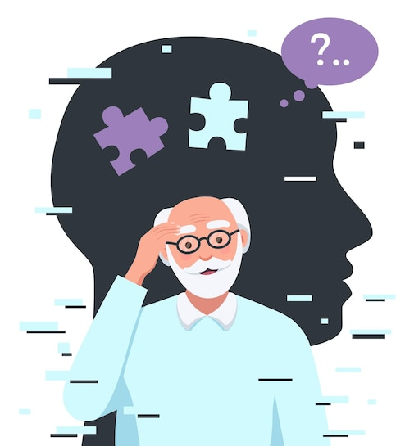
Executive functioning (cont.)
Neurodegenerative disorders can impair executive functioning by causing:
Difficulty in planning, problem-solving, and decision-making.
Impaired initiation of actions and task completion.
Reduced ability to regulate, control, and monitor behaviour.
Challenges in remembering to do tasks in the future.
Altered personality traits and decreased insight and awareness.
Disruption of higher-level cognitive activities resembling a malfunctioning chief executive in a large organization.
Notes:
Executive functions are the cognitive skills needed to solve problems, make plans/decisions, and regulate behaviour in order to achieve goals.
They appear to be largely driven from the very front area of the brain (pre-frontal cortex within the frontal lobes) and are therefore sometimes called frontal functions but, unlike all other cortical areas, there are extensive links into and networks with, all parts of the brain. Different regions of the frontal lobes are considered to be important for different aspects of executive functioning (though there is not complete agreement on this issue). For example, one region is important for planning and problem solving, one is important for initiation of action, one for regulation, controlling and monitoring of behaviour and finally another is important for the ability to remember to do things in the future. Personality is also seen as being part of executive functions, as is insight and awareness. These functions tend to be thought of as higher level activities. It can be helpful to think of executive functions like a chief executive of a big organisation: planning, organising, delegating tasks to their staff to complete effectively and efficiently.

Slide 23
Executive functioning (cont.)
Impaired executive functioning for an individual with an NDD can be likened to trying to manage daily finances when you've lost the ability to plan, organize, and make decisions effectively. Imagine someone with Alzheimer's disease, a condition that often leads to impaired executive functioning. This person, who was once known for their financial acumen, is now tasked with managing their household budget.
The Financial Responsibility: They've always been the family's financial planner, ensuring bills are paid on time and budgets are maintained. However, as their condition progresses, their ability to manage finances deteriorates.
Disorganized Finances: They sit down to review bills and financial statements, but they struggle to make sense of the numbers. It's like trying to assemble a puzzle with missing pieces. The once-organized ledger is now a chaotic collection of numbers.
Difficulty in Decision-Making: Making financial decisions, such as determining which bills to prioritize or whether to invest savings, has become increasingly challenging. They find themselves second-guessing their choices and feeling uncertain.
Missed Payments and Late Fees: Bills start to pile up, some unpaid and others overdue. They miss payments, incurring late fees and, in some cases, affecting their credit score. It's like trying to juggle too many balls but dropping them one by one.
Emotional Stress: The once-confident financial planner now feels overwhelmed and stressed. Their sense of financial control has slipped away, and they're anxious about the consequences of missed payments and growing debts.
Withdrawal from Financial Responsibilities: The financial planner may choose to withdraw from managing finances altogether, handing the responsibilities to a family member or a professional. What used to be a source of pride has become a source of anxiety.
Loss of Identity: Financial acumen was a key part of their identity, but now it's fading. This loss of an important skill affects their self-esteem and sense of self. They feel like they're saying goodbye to a fundamental aspect of who they once were.
Notes:
Impaired executive functioning for an individual with a Neurodegenerative Disorder (NDD) can be likened to trying to manage daily finances when you've lost the ability to plan, organize, and make decisions effectively. Let's explore this everyday scenario:
The Overwhelmed Financial Planner:
Imagine someone with Alzheimer's disease, a condition that often leads to impaired executive functioning. This person, who was once known for their financial acumen, is now tasked with managing their household budget.
The Financial Responsibility: They've always been the family's financial planner, ensuring bills are paid on time and budgets are maintained. However, as their condition progresses, their ability to manage finances deteriorates.
Disorganized Finances: They sit down to review bills and financial statements, but they struggle to make sense of the numbers. It's like trying to assemble a puzzle with missing pieces. The once-organized ledger is now a chaotic collection of numbers.
Difficulty in Decision-Making: Making financial decisions, such as determining which bills to prioritize or whether to invest savings, has become increasingly challenging. They find themselves second-guessing their choices and feeling uncertain.
Missed Payments and Late Fees: Bills start to pile up, some unpaid and others overdue. They miss payments, incurring late fees and, in some cases, affecting their credit score. It's like trying to juggle too many balls but dropping them one by one.
Emotional Stress: The once-confident financial planner now feels overwhelmed and stressed. Their sense of financial control has slipped away, and they're anxious about the consequences of missed payments and growing debts.
Withdrawal from Financial Responsibilities: The financial planner may choose to withdraw from managing finances altogether, handing the responsibilities to a family member or a professional. What used to be a source of pride has become a source of anxiety.
Loss of Identity: Financial acumen was a key part of their identity, but now it's fading. This loss of an important skill affects their self-esteem and sense of self. They feel like they're saying goodbye to a fundamental aspect of who they once were.
In this relatable example, impaired executive functioning feels like attempting to manage finances, a once-familiar task, but facing confusion, indecision, and disorganization at every turn. The practical responsibilities they once handled with ease now seem insurmountable. This scenario reflects the real-life challenges that individuals with NDDs encounter as their ability to plan, organize, and make decisions diminishes, affecting not only their financial well-being but their overall sense of self and identity.

Slide 24
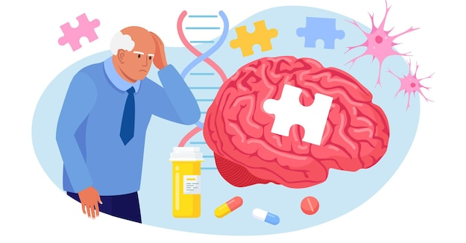
Multiple cognitive deficits
Notes:
Deficits in attention, memory, language, perception, psychomotor skills, and executive memory, collectively referred to as multiple cognitive deficits, can significantly contribute to psychological distress for individuals confronting neurodegenerative disorders. These challenges intertwine to create a profound sense of frustration, isolation, and helplessness. The inability to engage in once-familiar tasks, communicate effectively, or even navigate the world with confidence erodes an individual's self-esteem and sense of independence. This psychological distress not only affects the affected individual but also places emotional burdens on their families and caregivers, underscoring the importance of comprehensive support systems and strategies to alleviate the psychological toll of these cognitive deficits.

Slide 25
Activity – Arjun’s day at the market
Read the following information about Arjun very carefully:
Arjun, an individual facing a neurodegenerative disorder, sets out for his trip to the bustling local market, a place he once navigated with ease. As he strolls through the market's vibrant stalls, he finds himself distracted, unable to maintain focus on the task at hand. The shopping list he prepared earlier, meant to ensure he picks up all the ingredients for a special family dinner, seems like an intricate puzzle. He frequently forgets the items he's already collected, and an air of confusion shrouds him. Amid the hustle and bustle of the market, Arjun attempts to interact with vendors and fellow shoppers. His attempts at communication reveal a growing difficulty in finding the right words. He relies more on gestures, a stark contrast to his once-confident conversational skills. This struggle to express himself leaves him feeling increasingly self-conscious and isolated. Arjun's quest to select fresh produce is plagued by uncertainty. He's unsure about the quality of items, often making mistakes in his purchases. It's as though his perception of the world around him is altered, and this uncertainty compounds his growing sense of frustration. Simple tasks, like handling money, counting change, and bagging his purchases, now pose unforeseen challenges. He observes the curious glances of other market-goers, adding to his self-doubt and frustration. Throughout the day, Arjun's ability to plan his trip, stick to a budget, and make informed decisions is noticeably impaired. He forgets to bring his reusable bags, struggles to adhere to his budget, and second-guesses his choices. The familiar feeling of independence he once experienced during his market visits is slipping away.
Notes:
Let's consider a character named Arjun, a Sri Lankan individual who is battling a neurodegenerative disorder. Arjun's journey will help illustrate the interplay of deficits in attention, memory, language, perception, psychomotor skills, and executive functioning in his everyday life and how these challenges contribute to psychological distress.

Slide 26
Activity – Arjun’s day at the market (cont.)
2. Working in groups try to identify the specific cognitive challenges that Arjun is facing. Write these down.
3. How might this experience affect Arjun psychologically?

Slide 27
Activity – Arjun’s day at the market (cont.)
Answers
Attention Deficits: Arjun has always been a frequent visitor to the bustling local market. However, his attention deficits make it challenging for him to focus on the task at hand. As he navigates the market's vibrant stalls, he finds himself easily distracted. His ability to concentrate on his shopping list is compromised, causing frustration and disorientation.
Memory Deficits: Arjun's shopping list includes a variety of items needed for a special family dinner. However, his memory deficits make it difficult for him to remember the specific ingredients he needs. He frequently forgets the items he's already picked up, leading to confusion and the fear of forgetting something crucial for the meal.
Language and Communication Challenges: While interacting with the market vendors and fellow shoppers, Arjun's language deficits become evident. He struggles to find the right words to communicate his needs and often resorts to gestures. This inability to express himself as he used to leaves him feeling self-conscious and isolated.
Perception Difficulties: Arjun's perception deficits make it challenging to gauge the freshness of the produce. He may struggle to recognize spoiled fruits or vegetables, leading to errors in his purchases. These difficulties further add to his psychological distress, as he feels incapable of making wise choices.
Psychomotor Skill Impairments: As he goes through the market, Arjun's psychomotor skills are notably impaired. He finds it challenging to handle money, count change, and even bag his purchases effectively. These difficulties lead to frustration and embarrassment, as he senses the growing scrutiny of those around him.
Executive Functioning Challenges: Arjun's ability to plan his shopping trip effectively is hampered by his executive functioning deficits. He forgets to bring his reusable bags, struggles to stick to a budget, and cannot make well-informed decisions about product choices. The feeling of helplessness and the inability to perform these once-familiar tasks weigh heavily on his emotional state.

Slide 28
Activity – Arjun’s day at the market (cont.)
Answers
Psychological Distress: The cumulative impact of these deficits during a simple market visit takes a toll on Arjun's mental well-being. He experiences frustration, embarrassment, self-doubt, and a sense of isolation. His inability to engage in routine activities that were once effortless becomes a source of deep distress, affecting his overall quality of life.
Arjun's experience at the market serves as a poignant example of how the convergence of multiple cognitive deficits can contribute to significant psychological distress for individuals battling neurodegenerative disorders. It underscores the importance of empathy, support, and adapted strategies to help individuals maintain their independence and emotional well-being in the face of these challenges.

Slide 29
Neurodegenerative disorders and psychological distress
Psychological
distress
Social impairment
Communication difficulties
Sensory sensitivities
Stigmatization and social biases
Notes:
The core features of NDDs can directly influence one’s psychological well-being. Difficulties in social interaction, communication, and sensory sensitivities are common in many NDDs. These challenges can lead to feelings of frustration, isolation, and anxiety. Communication difficulties can result in emotional distress and difficulties in forming and maintaining relationships. Sensory sensitivities, which are often heightened in individuals with NDDs, can make everyday sensory inputs overwhelming, triggering anxiety and emotional dysregulation. Stigmatization and societal biases against individuals with NDDs can further worsen their psychological well-being. Misunderstanding and discrimination can lead to social isolation, low self-esteem, and heightened levels of anxiety and depression.

Slide 30
Neurodegenerative disorders and psychological distress
Cognitive Impairment can lead to:
Emotional & Behavioural Disturbances
For example:
Mental Disorders
For example:
Apathy
Anxiety
Aggression
Disinhibition
Anxiety Disorders
Mood Disorders
Delirium
Psychosis

Slide 31
Neurodegenerative disorders and psychological distress
Individuals with NDDs are at a higher risk of experiencing mental disorders including:
Depression
Anxiety
Apathy
Psychosis
Sleep disorders
Leung et al., (2021); Zhao et al., (2016)
Notes:
Research indicates that individuals with NDDs are at a higher risk of developing psychological disorders. These psychological disorders include mood disorders such as depression, anxiety disorders, apathy, psychotic symptoms including delusions and hallucinations, as well as sleep disorders. Psychiatric symptoms can significantly impact the quality of life for individuals with neurodegenerative disorders and their caregivers.
The problem is that psychopathological symptoms in neurodegenerative disorders can sometimes be misinterpreted or overlooked, leading to inadequate care or inappropriate management. A comprehensive understanding of psychopathology allows caregivers to differentiate between symptoms related to the neurodegenerative disorder and those that require specific psychiatric interventions.

Slide 32
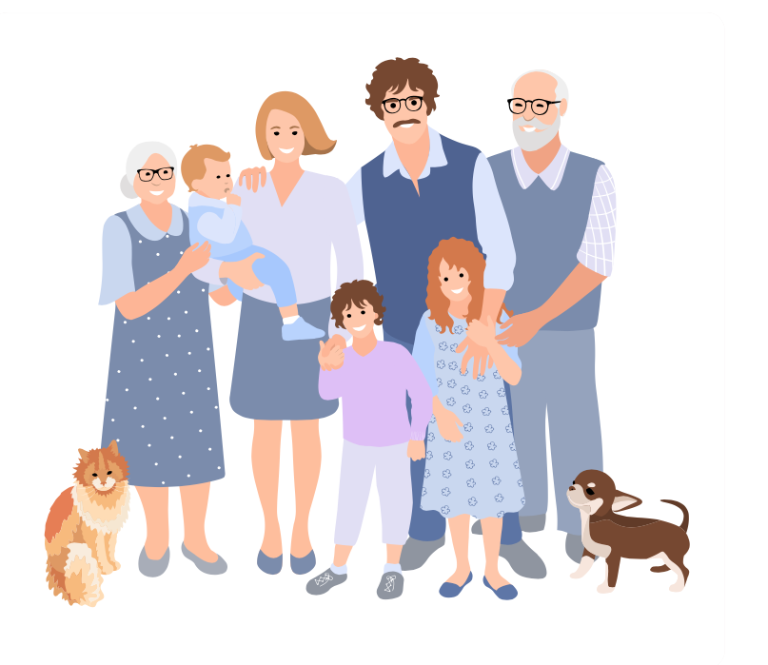
Effects on family and caregivers
Strain on relationships
Mental health impact
Reduced quality of life
Lack of understanding
Emotional stress
Increased care burden
Financial Strain
Altered roles and lifestyle
Notes:
The psychological wellbeing of an individual with a Neurodegenerative Disorder can have significant impacts on their families and caregivers. Families and caregivers may face:
Emotional Stress:
Families and caregivers often witness the deterioration of their loved one's cognitive and physical abilities, leading to feelings of grief, sadness, and helplessness.
Behavioral and psychological symptoms associated with NDDs, like aggression, agitation, or depression, can be emotionally taxing, causing frustration and anxiety for family members and caregivers.
Increased Care Burden:
As NDDs progress, patients may become increasingly dependent on their caregivers. This can lead to physical and emotional exhaustion for caregivers who must provide extensive assistance with daily tasks, such as bathing, dressing, and feeding.
Managing challenging behaviors and ensuring patient safety can be overwhelming, especially if caregivers lack proper support or resources.
Financial Strain:
The cost of caring for individuals with NDDs, including medical expenses, home modifications, and professional caregivers, can be substantial. This financial burden can lead to stress and hardship for families.
Altered Roles and Lifestyle:
Caregivers may need to adjust their own lives significantly. They may need to reduce their working hours or quit their jobs, which can impact their financial stability.
The role of the caregiver may become all-consuming, leading to a loss of personal time and social isolation.
Strained Relationships:
The stress and emotional toll of caregiving can strain relationships between caregivers and other family members. Sibling conflicts, marital strain, and resentment can develop.
Mental Health Impact:
The constant stress of caregiving and witnessing the psychopathological symptoms of NDDs can lead to depression, anxiety, or other mental health issues in caregivers.
Reduced Quality of Life:
Caregivers often report a lower quality of life, experiencing feelings of being trapped in their caregiving role and limited opportunities for personal growth or leisure.
Lack of Understanding:
Families and caregivers may not fully comprehend the nature of psychopathological symptoms in NDD patients, leading to frustration and confusion.
It's crucial for healthcare providers to recognize the challenges that families and caregivers face and offer them support, education, and respite care. Providing psychological and emotional assistance to both the patient and their caregivers can improve the overall well-being of the entire family and enhance the quality of care provided to individuals with NDDs. Additionally, community resources, support groups, and respite care services can help alleviate some of the burdens caregivers face.

Slide 33
Everybody is unique
Each individual will experience their disease in their own unique way
Their experience will be influenced by their genetic makeup, personality & life history
Notes:
It is important to remember that the person living with a neurodegenerative disorder is first and foremost an individual and many problems in care for people with neurodegenerative disorders arise because of a failure to treat the individual in a person-centred way. Every single person who has a diagnosis of a neurodegenerative disorder will experience their diagnosis in their own unique way. Their experience will be influenced by their genetic make up, personality and their life history, to name but a few, along with the interaction of these factors with their illness and the new experiences the diagnosis brings.

Slide 34
Who is this person?
People with NDDs are often defined by the disease or by their behaviour.
However, it is essential to consider the whole person if we are to provide good person-centred care.
You will need to gather information:
from the person themselves directly if they can still communicate or from observation
from family and friends
from medical and social history if available
from your colleagues – who may have different insights.
Notes:
People with NDDs are often defined by the disease or by their behaviour.
However, it is essential to consider the whole person if we are to provide good person-centred care. Knowing the person well provides a context to understand the person’s behaviour and lends itself to increased quality of life for the person living with dementia and reduced stress for caregivers.
You can never know everything but to at least partially answer the question, “Who is this person?” you will need to gather information:
from the person themselves directly if they can still communicate or from observation
from family and friends
from medical and social history if available
from your colleagues – who may have different insights.

Slide 35
Who is this person?
Some people may have a ‘getting to know me’ document (Alzheimer Scotland) or similar: https://www.alzscot.org/our-work/dementia-support/information-sheets/getting-to-know-me
This will be a helpful document to use when beginning the process of gathering important information about the person with the disorder.
However, it is important to ensure that families are included in this process, it is kept up to date and that all those involved with caring for the person are aware of the information and incorporate it into their practice.

Slide 36
Psychological models
There are various psychological models that can help to capture the client’s unique psychological experience. These include:
Biopsychosocial model
Iceberg model
Psychological needs model

Slide 37
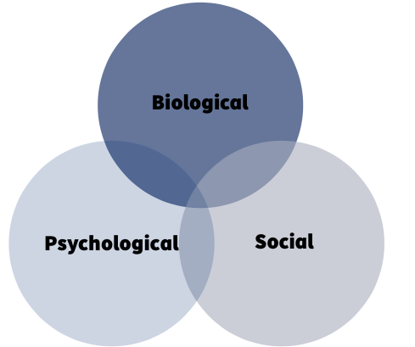



Biopsychosocial model
Biological/Physical: most common reason for distress in people with NDDs. Examples: pain, constipation, dehydration, side-effects from medications.
Psychological: missing family or pets, feeling lonely, or be worried about relatives because they can’t remember where their family member is. This can cause feelings of low mood and anxiety. The person may feel threatened or confused, and be more likely to be nervous or scared and seek safety or the comfort of others.
Social or Environmental factors: not having a lot of stimulation or company can lead to feelings of apathy and sadness. Too much stimulation can cause sensory overload.
Notes:
The biopsychosocial model is a comprehensive framework for understanding and assessing the health of individuals that takes into account biological, psychological, and social factors. When applied to individuals with neurodegenerative disorders, it can provide a more holistic understanding of their psychological well-being.
Let’s consider this model for an individual with a neurodegenerative disorder.
Biological factors are the most common reason for distress in individuals with NDDs. This is because neurodegenerative disorders are primarily characterized by underlying biological changes in the nervous system. The model considers the biological aspects, such as the specific brain regions affected, the progression of the disease, and the impact on neurotransmitters, hormones, and other physiological factors. Understanding the biological component helps clinicians diagnose and track the progression of the disorder and may guide medical interventions, such as medication or surgical treatments.
The psychological component of the model focuses on the emotional and cognitive aspects of the individual's experience. People with neurodegenerative disorders often face significant psychological challenges, including depression, anxiety, and cognitive decline. Evaluating these psychological factors allows for the assessment of mental health and the development of interventions like psychotherapy, cognitive rehabilitation, and support groups to address emotional well-being and maintain cognitive functioning.
The social aspect considers the individual's social support, relationships, and their interaction with the environment. Neurodegenerative disorders can have a profound impact on a person's social life, leading to isolation and changing social roles. Evaluating the social aspects helps healthcare professionals identify areas where social support and interventions may be needed. Support groups, caregiver assistance, and community resources can be valuable components of the treatment plan.

Slide 38
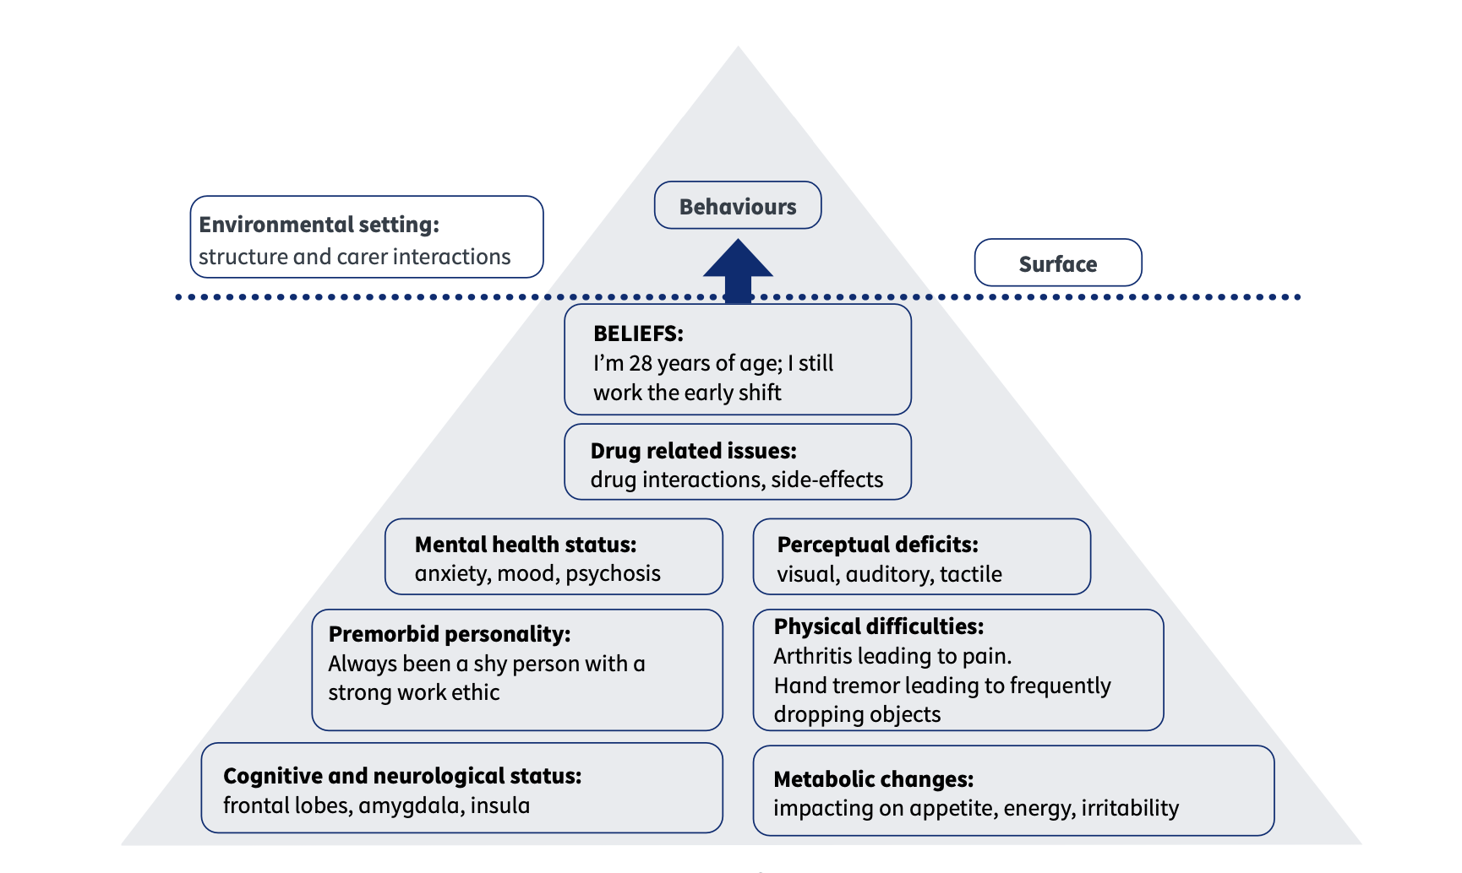
Iceberg model
James (2011)
Notes:
When we think about someone’s experience of distress we need to think about the underlying causes as well as the outward signs. A helpful model to enable us to get a better appreciation and understanding of underlying causes of distressed behaviour is the Iceberg Model
This model is designed to illustrate that the visible behaviors and symptoms of individuals with NDDs represent only a small portion of the overall picture, much like the tip of an iceberg, while the underlying factors and needs are hidden beneath the surface. Here's a brief description of the iceberg model in relation to dementia care:
Tip of the Iceberg (Visible Symptoms): This top portion of the iceberg represents the observable behaviors, symptoms, and challenges exhibited by individuals with NDDs. These can include memory loss, confusion, agitation, aggression, wandering, and difficulty with daily activities. These visible symptoms are what caregivers, healthcare professionals, and family members often first notice and try to address.
Below the Surface (Underlying Factors): Beneath the waterline of the iceberg lies a vast and less visible portion, representing the underlying factors influencing the visible symptoms. These factors can include unmet physical and emotional needs, sensory impairments, communication difficulties, past experiences, pain, frustration, or unexpressed emotions. Understanding and addressing these underlying factors is crucial for providing effective and person-centered care for individuals with NDDs.
The iceberg model highlights the importance of looking beyond the surface-level symptoms and behaviors in NDD care. Caregivers and healthcare professionals should aim to explore and address the root causes, needs, and individual experiences of people living with dementia. By doing so, they can provide more empathetic and tailored care that enhances the quality of life for individuals with NDDs and supports their overall well-being.

Slide 39
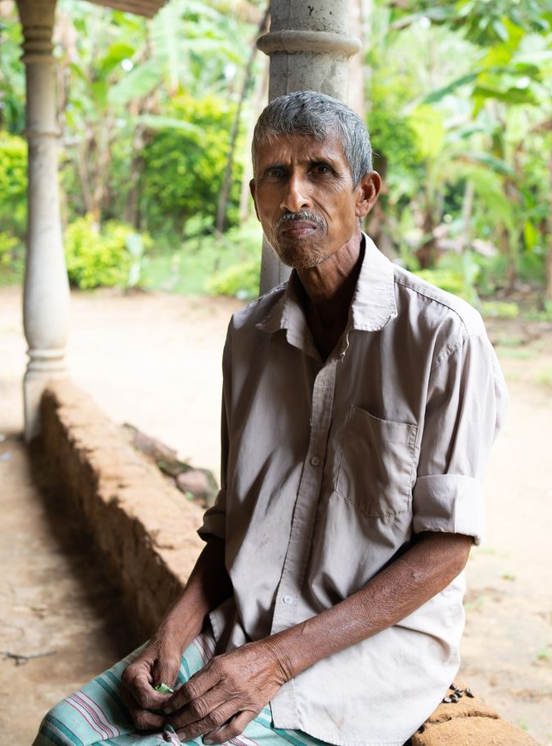
Activity – Applying the Iceberg Model
Read the following information about Sanjay carefully:
Meet Sanjay, a 65-year-old man who thinks he's 30. He gets up really early every day to work at a tea plantation close to his home. Sanjay is always worried about being late; it's a big concern for him. Now, there's something else going on in his life. The medicines he's taking have side effects, and his eyesight isn't as good as it used to be. Sometimes, he forgets to wear his glasses. Sanjay sees himself as a really hardworking and dedicated person. But there's a change in how he acts. He might forget where he is, and sometimes he does things without really thinking about them. Working for so many years in the fields has taken a toll on his body. His joints hurt, and he's not as patient when things get confusing. When he's really anxious, he can get a bit grumpy.
Notes:
The Iceberg Model is a powerful tool for understanding the various factors that influence a person's behavior and emotions. In this activity, we'll apply the Iceberg Model to the life of Sanjay, a Sri Lankan individual, and try to uncover what lies beneath the surface of his thoughts and actions. By doing this, you'll gain a deeper understanding of how complex human experiences can be.
Begin by reading the information about Sanjay carefully.

Slide 40
Activity – Applying the Iceberg Model (cont.)
Surface Level (Above the Water): As a group, discuss what you observe on the surface. These are the visible behaviours and beliefs of Sanjay. Write down your observations.
Beneath the Surface (Below the Water): Now, consider what might be happening below the surface, just like the hidden part of an iceberg. Try to identify the deeper factors that could be influencing Sanjay's behaviour. These may be related to his thoughts, feelings, or physical condition. Discuss and list these factors.
The Iceberg Model: Using the information you've gathered, create an Iceberg Model diagram on a piece of paper or a whiteboard. Label the top part "Surface" and the lower part "Below the Surface." List the surface-level observations and the deeper factors accordingly.
Analysis and Discussion: After creating the model, discuss how the factors below the surface may affect Sanjay's anxiety, forgetfulness, and self-perception. Consider the interplay between these factors.
Conclusion: Reflect on how understanding the Iceberg Model can help us approach individuals with empathy and consideration. What proactive strategies might be effective in helping Sanjay? How can we apply this model to better understand people in our everyday lives?
Notes:
Surface Level (Above the Water): As a group, discuss what you observe on the surface. These are the visible behaviors and beliefs of Sanjay. Write down your observations.
Beneath the Surface (Below the Water): Now, consider what might be happening below the surface, just like the hidden part of an iceberg. Try to identify the deeper factors that could be influencing Sanjay's behavior. These may be related to his thoughts, feelings, or physical condition. Discuss and list these factors.
The Iceberg Model: Using the information you've gathered, create an Iceberg Model diagram on a piece of paper or a whiteboard. Label the top part "Surface" and the lower part "Below the Surface." List the surface-level observations and the deeper factors accordingly.
Analysis and Discussion: After creating the model, discuss how the factors below the surface may affect Sanjay's anxiety, forgetfulness, and self-perception. Consider the interplay between these factors.
Conclusion: Reflect on how understanding the Iceberg Model can help us approach individuals with empathy and consideration. What proactive strategies might be effective in helping Sanjay? How can we apply this model to better understand people in our everyday lives?

Slide 41
Activity – Applying the Iceberg Model (cont.)
Answers
Surface Level (Above the Water):
Sanjay believes he is 30 years old and works an early shift at a local tea plantation.
He is anxious about being late for work.
Sanjay considers himself hardworking and dedicated.
He sometimes forgets to wear his glasses.
He may experience side effects from medications.
Beneath the Surface (Below the Water):
Sanjay's anxiety about being late for work might be influenced by his financial situation, job security, or the pressure to support his family.
Sanjay's forgetfulness to wear glasses could be related to his eyesight issues, which might be causing him discomfort or embarrassment.
The side effects from medications could be impacting his cognitive functions and emotions, making him anxious and forgetful.
The joint pain and discomfort from his physically demanding job might affect his tolerance levels and make him more prone to negative responses to stress and anxiety.
Notes:
Surface Level (Above the Water):
Sanjay believes he is 30 years old and works an early shift at a local tea plantation.
He is anxious about being late for work.
Sanjay considers himself hardworking and dedicated.
He sometimes forgets to wear his glasses.
He may experience side effects from medications.
Beneath the Surface (Below the Water):
Sanjay's anxiety about being late for work might be influenced by his financial situation, job security, or the pressure to support his family.
Sanjay's forgetfulness to wear glasses could be related to his eyesight issues, which might be causing him discomfort or embarrassment.
The side effects from medications could be impacting his cognitive functions and emotions, making him anxious and forgetful.
The joint pain and discomfort from his physically demanding job might affect his tolerance levels and make him more prone to negative responses to stress and anxiety.
The factors below the surface influence Sanjay's anxiety and forgetfulness. For instance, his financial concerns and job security might be causing stress, which can result in anxiety. His eyesight issues and medication side effects may contribute to forgetfulness, affecting his work and daily life.
Understanding these deeper factors helps us empathize with Sanjay's situation and suggests that proactive strategies should address both the surface-level behaviors and the underlying issues. For instance, providing support for his vision problems, considering alternative medications, or offering financial assistance could be part of a holistic approach.
Conclusion:
This activity illustrates how the Iceberg Model can help us recognize the complexities of human behavior and emotions. It reminds us to look beyond the surface and consider the deeper factors that shape an individual's experiences and actions, enabling us to approach people with more empathy and effective strategies.

Slide 42
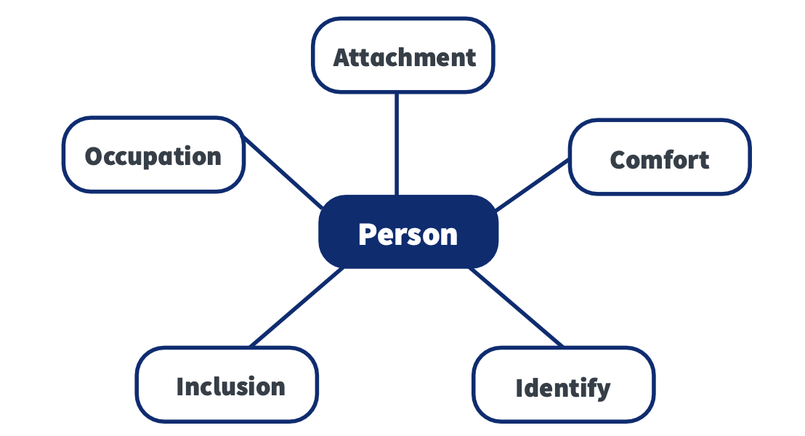
Psychological needs model
Kitwood (1997)
Notes:
The Psychological Needs Model, developed by Tom Kitwood in 1997, is a framework that can be applied to understand and address the psychological distress experienced by individuals with neurodegenerative disorders, such as Alzheimer's disease or Parkinson's disease. This model places an emphasis on person-centered care and the importance of meeting the psychological and emotional needs of these individuals. When applied to understanding psychological distress, the model helps identify the sources of distress and offers guidance for mitigating it. Here's how the model relates to understanding and addressing distress in individuals with neurodegenerative disorders:
Comfort: Psychological distress can often result from physical discomfort or pain. Individuals with neurodegenerative disorders may experience a range of physical symptoms, such as pain, discomfort, or side effects from medication. Addressing these physical needs is crucial to alleviate distress.
Attachment: Loss of social connections and companionship can lead to feelings of isolation and loneliness, contributing to distress. Caregivers and loved ones should provide emotional support and opportunities for social interaction to reduce this distress.
Identity: The erosion of a person's sense of self and identity due to cognitive decline can be distressing. Understanding and respecting the individual's life history and identity is essential in preserving their sense of self-worth and reducing distress.
Inclusion: Exclusion from decision-making or social activities can lead to feelings of powerlessness and distress. Involving individuals in decisions and activities to the best of their abilities can help restore a sense of inclusion and reduce distress.
Occupation: Boredom and lack of engagement in meaningful activities can contribute to distress. Providing activities that align with the individual's interests and abilities can combat boredom and enhance their well-being.
In the context of neurodegenerative disorders, understanding that psychological distress may stem from unmet psychological needs, and applying the principles of the Psychological Needs Model, can guide caregivers, healthcare professionals, and loved ones in providing more effective support and care. By addressing these needs, it's possible to reduce distress, enhance the quality of life, and maintain the individual's dignity and well-being, despite the challenges posed by their condition.

Slide 43
Activity – Psychological Needs Model
Reflection
Reflect on the concept that people living with NDDs find it harder to get their psychological needs met by the nature of living with their disorder, i.e. poor memory, lack of contact with family and friends, change in ability to speak/hold a conversation.
• What do you usually do to communicate your needs?
• How do you think this might differ if you had a diagnosis of a neurodegenerative disorder?
• How would you feel if your psychological needs continued to go unmet?
• What would you do?
Notes:
This activity encourages us to contemplate the difficulties individuals with Neurodegenerative Disorders (NDs) face in meeting their psychological needs. Conditions like Alzheimer's disease, Parkinson's disease, and Huntington's disease often lead to challenges related to memory, social isolation, and communication difficulties. The questions provided invite us to consider these challenges from a personal perspective and think about the emotional and practical aspects of addressing such difficulties.
Reflect on the concept that people living with NDDs find it harder to get their psychological needs met by the nature of living with their disorder, i.e. poor memory, lack of contact with family and friends, change in ability to speak/hold a conversation.
• What do you usually do to communicate your needs?
• How do you think this might differ if you had a diagnosis of a neurodegenerative disorder?
• How would you feel if your psychological needs continued to go unmet?
• What would you do?

Slide 44
Activity – Psychological Needs Model (cont.)
Answers
1. What do you usually do to communicate your needs?
This question prompts reflection on our own communication strategies. In daily life, people often use clear and direct language to express their needs. Non-verbal communication, such as gestures, body language, or facial expressions, may also play a significant role. If we encounter a barrier to communication, we usually find an alternative way to express ourselves or seek assistance.
2. How do you think this might differ if you had a diagnosis of a neurodegenerative disorder?
If we were diagnosed with a neurodegenerative disorder, our ability to communicate needs could significantly change. The progressive nature of these disorders often leads to a decline in memory and cognitive function, making it more challenging to articulate needs. Moreover, decreased awareness of the condition might affect our ability to understand and express those needs effectively. In this scenario, we might rely more heavily on support from caregivers, technology, or other assistive devices to convey our needs.
Notes:
What do you usually do to communicate your needs? This question prompts reflection on our own communication strategies. In daily life, people often use clear and direct language to express their needs. Non-verbal communication, such as gestures, body language, or facial expressions, may also play a significant role. If we encounter a barrier to communication, we usually find an alternative way to express ourselves or seek assistance.
How do you think this might differ if you had a diagnosis of a neurodegenerative disorder? If we were diagnosed with a neurodegenerative disorder, our ability to communicate needs could significantly change. The progressive nature of these disorders often leads to a decline in memory and cognitive function, making it more challenging to articulate needs. Moreover, decreased awareness of the condition might affect our ability to understand and express those needs effectively. In this scenario, we might rely more heavily on support from caregivers, technology, or other assistive devices to convey our needs.

Slide 45
Activity – Psychological Needs Model (cont.)
Answers
3. How would you feel if your psychological needs continued to go unmet?
If our psychological needs continued to go unmet due to the challenges presented by a neurodegenerative disorder, we might experience a range of emotions:
Frustration: We would likely feel frustrated and helpless due to our inability to effectively communicate and have our needs met.
Loneliness: Isolation and loneliness could set in if we were unable to maintain contact with loved ones.
Anxiety and Depression: The prolonged unmet needs could lead to increased anxiety and depression, negatively impacting our overall well-being.
4. What would you do?
If our psychological needs remained unmet due to a neurodegenerative disorder, we might:
Seek help: Reach out to caregivers, healthcare professionals, or support networks to address our needs.
Engage in self-soothing activities: Participate in calming activities or routines to manage anxiety and frustration.
Display challenging behaviours: In some cases, individuals might exhibit challenging behaviors as a form of communication when they are unable to express their needs verbally.
Notes:
3. How would you feel if your psychological needs continued to go unmet?
If our psychological needs continued to go unmet due to the challenges presented by a neurodegenerative disorder, we might experience a range of emotions:
Frustration: We would likely feel frustrated and helpless due to our inability to effectively communicate and have our needs met.
Loneliness: Isolation and loneliness could set in if we were unable to maintain contact with loved ones.
Anxiety and Depression: The prolonged unmet needs could lead to increased anxiety and depression, negatively impacting our overall well-being.
4. What would you do?
If our psychological needs remained unmet due to a neurodegenerative disorder, we might:
Seek help: Reach out to caregivers, healthcare professionals, or support networks to address our needs.
Engage in self-soothing activities: Participate in calming activities or routines to manage anxiety and frustration.
Display challenging behaviors: In some cases, individuals might exhibit challenging behaviors as a form of communication when they are unable to express their needs verbally.
In conclusion, recognizing the unique challenges that individuals with neurodegenerative disorders face is essential for providing appropriate care and support. Empathy, patience, tailored communication, and personalized interventions are crucial for helping individuals with neurodegenerative disorders have their psychological needs met, thereby improving their overall quality of life and well-being. This activity fosters a deeper understanding of the challenges associated with these disorders and encourages a more empathetic perspective.

Slide 46
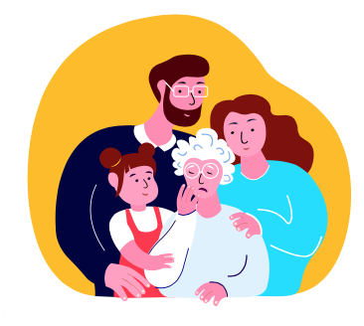
Understanding NDDs from a psychological perspective is crucial
Enhanced Patient Care
Improved Diagnosis and Treatment
Symptom Management
Person-Centred Care
Improved Communication
Family and Caregiver Support
Ethical Considerations
Identification of Coexisting Conditions
Reducing Stigma
Research and Development
Notes:
Healthcare providers need to understand neurodegenerative disorders from a psychological perspective for several critical reasons:
Enhanced Patient Care: Individuals with neurodegenerative disorders often experience a wide range of psychological and emotional challenges, including anxiety, depression, confusion, and agitation. By understanding the psychological aspects of these disorders, healthcare providers can offer more comprehensive care that addresses not only the physical symptoms but also the emotional and mental well-being of their patients.
Improved Diagnosis and Treatment: A psychological perspective can aid in early diagnosis and more accurate assessment of neurodegenerative disorders. Many of these conditions present with cognitive and behavioral changes that may be subtle initially. Understanding these changes can lead to more timely interventions and treatment planning.
Symptom Management: Neurodegenerative disorders can manifest with behavioral and psychological symptoms, such as aggression, agitation, and hallucinations. Healthcare providers who are well-versed in the psychological aspects of these disorders can develop more effective strategies for managing these symptoms, improving the patient's overall quality of life.
Person-Centered Care: Recognizing the psychological and emotional needs of patients allows healthcare providers to offer person-centered care that takes into account the individual's unique experiences, preferences, and values. This approach fosters a more respectful and compassionate therapeutic relationship.
Improved Communication: Many neurodegenerative disorders affect an individual's ability to communicate effectively. Healthcare providers who understand the psychological aspects of these disorders can adapt their communication strategies to facilitate better interactions and ensure patients are actively involved in their care decisions.
Family and Caregiver Support: Neurodegenerative disorders have a profound impact on not only the affected individuals but also their families and caregivers. Healthcare providers who consider the psychological aspects can offer support and resources to these caregivers, reducing their stress and improving the overall care provided to the patient.
Ethical Considerations: A psychological perspective is essential for addressing ethical concerns related to consent, autonomy, and end-of-life decisions in individuals with neurodegenerative disorders. Understanding the patient's emotional state and values is crucial for making ethical decisions about their care.
Identification of Coexisting Conditions: Neurodegenerative disorders often coexist with other mental health conditions, such as depression and anxiety. Recognizing and addressing these comorbidities is essential for providing comprehensive care and improving the patient's overall well-being.
Reducing Stigma: A deeper understanding of the psychological aspects of neurodegenerative disorders can help reduce stigma and stereotypes associated with these conditions. Healthcare providers can play a role in promoting greater empathy and understanding in society.
Research and Development: Research efforts to develop new treatments and interventions for neurodegenerative disorders benefit from a psychological perspective. It helps identify potential targets for therapy and prevention and informs the development of interventions aimed at improving the patient's psychological and emotional state.

Slide 47
Self Study Material
Achieving person-centred dementia care through a bio-psychosocial model https://cdn.ps.emap.com/wp-content/uploads/sites/3/2020/12/201209-Achieving-person-centred-dementia-care-through-a-bio-psychosocial-model1.pdf

