Slide 1
Evidence-based psychosocial interventions for individuals with neurodegenerative disorders
Psychology
Neapolis University Pafos, Cyprus

Slide 2
Learning Objectives
Understand the core principles and methods of evidence-based psychosocial interventions for neurodegenerative disorders
Develop proficiency in individualized treatment planning for individuals with neurodegenerative disorders, incorporating psychosocial strategies to address their unique cognitive, emotional, and social needs.
Explain how to apply evidence-based psychosocial interventions in practice, evaluate their effectiveness, and adapt interventions to accommodate the changing needs and progression of neurodegenerative disorders.

Slide 3
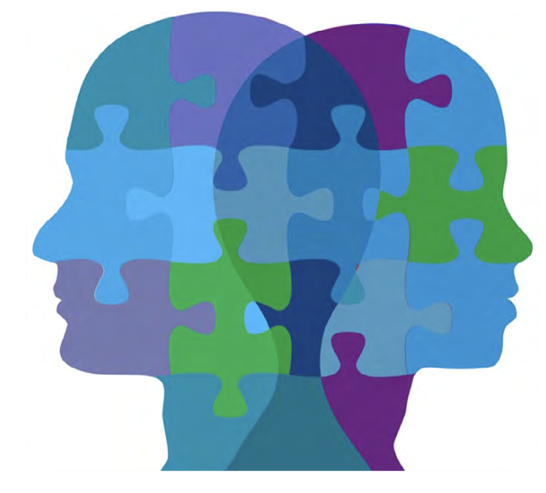
What is a psychosocial intervention?
A psychosocial intervention encompasses various evidence-based strategies to aid individuals in tackling obstacles and preserving their mental well-being.
Not reliant on medication.
Offered to individuals diagnosed with NDDs and their families.
Aimed at enhancing the quality of life after diagnosis.
Notes:
A ‘psychosocial intervention’ is a broad term used to describe different ways to support people to overcome challenges and maintain good mental health. Psychosocial interventions do not involve the use of medication. Psychosocial interventions are available to people who have received a diagnosis of dementia and their families. They are intended to help people to live well following diagnosis.
Deciding on the right psychosocial interventions depends on a patients needs and preferences.
This presentation outlines a list of different needs that individuals with NDDs may experience, and the psychosocial interventions that may be helpful in addressing these needs.

Slide 4
Psychosocial interventions
Psychosocial interventions can help with:
coming to terms with an NDD diagnosis
maintaining one’s social life and relationships after receiving a diagnosis
reducing stress and improving mood, for example, if feeling worried, anxious, or depressed
thinking and memory (cognitive function)
living independently
quality of life – maintaining health and happiness, and control over one’s life
support for families

Slide 5
Planning psychosocial care
What does good psychological care involve?
Listening to what people with NDDs want and making sure that their voices are heard.
Ensuring through clinical leadership that the diagnostic pathway is based on good psychological care; for example, ensuring that pre-diagnostic assessment counselling is offered to everyone seeking a formal diagnosis.
Contributing a detailed neuropsychological assessment to inform differential diagnosis.
Ensuring that the expertise, input and involvement of family carers and other advocates is encouraged where the person with the NDD needs additional support in exercising choice and control.
Notes:
Each individual’s experience of dementia is unique. Dementia affects people from all groups within society, and it is vital to ensure that all groups have equal access to high- quality services and care in a timely manner throughout the course of dementia. The experience of dementia is influenced both by the types of changes that characterise the person’s dementia and by the person’s life experience, personality, resources, and family and social context. Dementia is a progressive condition, and the nature of the experience, along with the resulting needs, will change over time. The trajectory and rate of change varies considerably and can be influenced for example by other physical health conditions. The care needs of people experiencing young-onset dementia, who may have young families, who are often physically fit and mobile, and who enjoy the kinds of interests and activities shared by people in their own age-group, can differ considerably from those of people who develop dementia in later life.
What does good psychological care involve?
Listening to what people with NDDs want and making sure that their voices are heard.
Ensuring through clinical leadership that the diagnostic pathway is based on good psychological care; for example, ensuring that pre-diagnostic assessment counselling is offered to everyone seeking a formal diagnosis.
Contributing a detailed neuropsychological assessment to inform differential diagnosis.
Ensuring that the expertise, input and involvement of family carers and other advocates is encouraged where the person with dementia needs additional support in exercising choice and control.

Slide 6
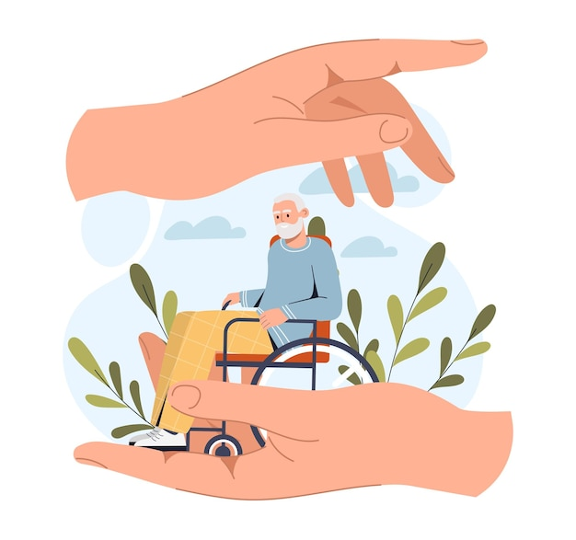
Planning psychosocial care
Improving people’s experience of NDDs means ensuring that their care and treatment is individually tailored to their needs throughout their journey.
People with NDDs should be supported in making their own decisions as far as possible. When this is not possible, their wishes, feelings, values and beliefs should be taken into account, in consultation with carers, to the greatest extent possible in making decisions in their best interests.
Notes:
Maintaining a sense of control, identity, and connection is a key focus as NDDs progress. When it becomes harder to remember and communicate important information or to access familiar and personally-meaningful experiences, there is a risk that the person will experience a sense of isolation and dislocation at a time when the emotional resources to protect against this threat are lacking. It is vital that healthcare staff, together with family and friends and all those in regular contact with a person affected by NDDs, work to support and maintain links with key aspects of the person's individual, social, and cultural identity, including personal preferences, wishes, memories, and experiences, and that this kind of support is integral within different contexts of care. This support helps to engender trust, establish a sense of security and comfort, and provide a sense of social connection, thus maintaining well-being and self-esteem.

Slide 7
Psychosocial interventions
Adjustment to diagnosis
Post-Diagnostic Counselling
Maintaining independence
Assistive technology
Dementia advisors
Maintaining quality of life
Creative art therapies
Psychological distress
Cognitive functioning
Families and caregivers
Relationships & communication
Counselling and Psychotherapy
Post-Diagnostic Groups
Cognitive Behavioural Therapies
Life Review Therapy
Stress/Anxiety Management
Reminiscence
Animal-assisted Therapy
Family/systemic Therapy
Assistive technology
Cognitive rehabilitation
Cognitive stimulation
Cognitive training
Occupational therapy
Reminiscence
Specialist information
Assistive technology
Cognitive Behavioural Therapies
Counselling & Psychotherapy
Memory Cafes
Family/systemic therapy
Peer support groups
Occupational therapy
Post-diagnostic groups
Memory Cafes
Family/Systemic therapy
Peer support groups
Post-diagnostic groups
Occupational therapy
Involvement groups
Cognitive rehabilitation
Life story work
Music therapy
Animal-assisted therapy
Reminiscence
Involvement groups
Notes:
When planninc a psychosocial intervention it is important to begin by considering the challenges/needs of the patient. These might include.
A variety of evidence-based psychosocial interventions are available. This slide lists many of these in relation to the needs/challenges that they address. We will now discuss many of these in the upcoming slides.

Slide 8
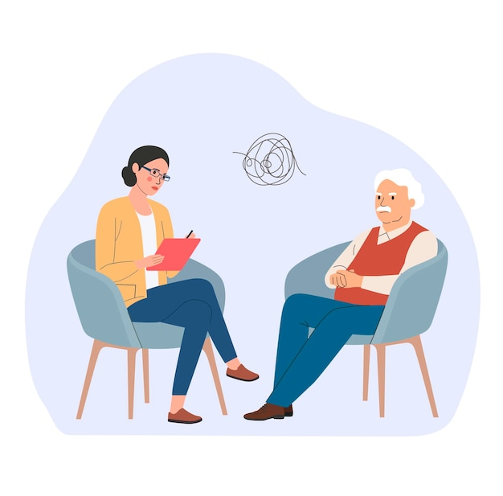
Post Diagnostic Counselling
Post-diagnostic counselling involves providing support for individuals who have recently been diagnosed with an NDD.
It assists in coming to terms with the diagnosis and helps individuals consider their specific needs and the next steps in their treatment.
These counselling sessions are conducted on an individual basis.
Typically, post-diagnostic counselling is offered shortly after the diagnosis, aiming to discuss the diagnosis, answer questions, and provide information on further advice and support.
Notes:
Post-diagnostic counseling is a supportive process that helps individuals come to terms with their recent diagnosis of an NDD. It assists in understanding their needs and planning the next steps in their treatment journey. Typically, this counseling is offered in one-on-one sessions and is provided after the diagnosis to discuss the diagnosis, address questions, and provide information about further guidance and support.

Slide 9
Post Diagnostic Counselling (cont.)
Any individual who has recently received a diagnosis of a NDD should have access to post-diagnostic counselling if they desire it and when they feel ready..
This form of support may encompass:
Information about the NDD diagnosis.
Opportunities for open discussions regarding the diagnosis.
Planning for future support and care.
Emotional counselling to help individuals cope with the emotional impact of their diagnosis.
Notes:
Any individual who has recently received a diagnosis of NDDs should have access to post-diagnostic counseling if they desire it and when they feel ready to engage in such discussions.
Upon receiving a diagnosis of NDD, healthcare professionals will offer personalized information, advice, and support. Additionally, they can extend support to the family during this challenging period.
This form of support may encompass:

Slide 10
Post Diagnostic Counselling (cont.)
Advantages:
Enhanced understanding of how the NDD diagnosis may affect the individual and their family.
Access to essential information and support at a crucial time.
An opportunity to discuss concerns, fears, and make plans for future coping and support.
Who can provide post-diagnostic counselling?
Psychiatrists, clinical psychologists, counselling psychologists, occupational therapists, mental health nurses, or general practitioners (GPs).
Notes:
Participating in post-diagnostic counseling can bring about several advantages, including:
Enhanced understanding of how the NDD diagnosis may affect the individual and their family.
Access to essential information and support at a crucial time.
An opportunity to discuss concerns, fears, and make plans for future coping and support.
Post-diagnostic counseling is generally offered by psychiatrists, and in some instances, it can also be provided by clinical psychologists, occupational therapists, mental health nurses, or general practitioners (GPs). The availability of post-diagnostic counseling sessions may vary depending on the individual's local area in Sri Lanka.

Slide 11
Post Diagnostic Counselling (cont.)
Example of post-diagnostic counselling:
https://www.youtube.com/watch?v=5Kxj-5Ezlzw
Notes:
Participating in post-diagnostic counseling can bring about several advantages, including:
Enhanced understanding of how the NDD diagnosis may affect the individual and their family.
Access to essential information and support at a crucial time.
An opportunity to discuss concerns, fears, and make plans for future coping and support.
Post-diagnostic counseling is generally offered by psychiatrists, and in some instances, it can also be provided by clinical psychologists, occupational therapists, mental health nurses, or general practitioners (GPs). The availability of post-diagnostic counseling sessions may vary depending on the individual's local area in Sri Lanka.

Slide 12

Post diagnostic groups/courses
Post-diagnostic groups consist of a series of sessions, each focusing on various topics or themes related to memory and cognitive health.
They assist in coming to terms with the diagnosis and helps individuals consider their specific needs and the next steps in their treatment.
Post-diagnostic groups are open to anyone who has received a recent diagnosis of NDDs, as well as their family members.
Notes:
A post-diagnostic group or course is designed for individuals who have recently received a diagnosis of an NDD, sometimes including their family members. These groups consist of a series of sessions, each focusing on various topics or themes related to memory and cognitive health.
Post-diagnostic groups are open to anyone who has received a recent NDD diagnosis, as well as their family members.

Slide 13
Post diagnostic groups/courses (cont.)
During a post-diagnostic group or course, participants have the opportunity to learn and discuss a range of memory-related topics, including:
Understanding memory problems and NDDs.
Learning memory enhancement techniques and strategies.
Coping with everyday situations affected by memory issues.
Communicating with family, friends, and others about memory problems and NDDs.
Adjusting to life with an NDD diagnosis.
Enhancing the quality of life while living with an NDD.
Notes:
During a post-diagnostic group or course, participants have the opportunity to learn and discuss a range of NDD-related topics, including:
Understanding memory problems and NDDs.
Learning memory enhancement techniques and strategies.
Coping with everyday situations affected by memory issues.
Communicating with family, friends, and others about memory problems and NDDs.
Adjusting to life with an NDD diagnosis.
Enhancing the quality of life while living with NDDs.
Some groups also address practical matters, providing information about available services, legal considerations, and potential entitlements to benefits.

Slide 14
Post diagnostic groups/courses (cont.)
Advantages:
Gaining knowledge about memory and NDDs.
Exploring strategies to manage NDD symptoms.
Boosting confidence and overall well-being.
Feeling a sense of belonging and purpose.
Developing better coping mechanisms after an NDD diagnosis.
Meeting others who are facing similar situations.
Who can provide post-diagnostic groups/courses?
Professionals with expertise in working with individuals living with NDDs. Facilitators may include dementia advisors, occupational therapists, nurses, psychologists, and support workers. Can be provided at Memory Cafés (see slides on Memory Cafés).
Notes:
Participating in post-diagnostic groups can offer several advantages, such as:
Gaining knowledge about memory and NDDs.
Exploring strategies to manage NDD symptoms.
Boosting confidence and overall well-being.
Feeling a sense of belonging and purpose.
Developing better coping mechanisms after an NDD diagnosis.
Meeting others who are facing similar situations.
However, it is important to consider that Post-diagnostic groups and courses may not fully address the specific needs of individuals, particularly if they have a rarer form of NDD or are in the early stages of diagnosis. In such cases, specialized information or post-diagnostic counseling may be more appropriate.
These groups and courses are typically facilitated by professionals with expertise in working with individuals living with NDDs. Facilitators may include dementia advisors, occupational therapists, nurses, psychologists, and support workers. These professionals often come from your local memory service.

Slide 15

Advance care planning
Advance care planning is the process of discussing and recording a patients their future wishes and preferences for care and treatment.
This record comes into effect if the patient loses mental capacity to make important decisions about their current or future care. It can include statements on how the patient wishes to be treated at the end of their life.

Slide 16
Advance care planning (cont.)
Advance care planning involves discussing and recording one's wishes and preferences, and making these known to nurses, doctors, and other family members. It includes anything that is important to the individual, no matter how trivial it seems. Advance care planning may include:
Discussion and Decision-Making
Identification of Healthcare Preferences:
Designation of a Healthcare Proxy
Living Will
Advance Statement of Wishes and Preferences
Legal Documentation
Regular Review and Updates
Communication
Notes:
Advance care planning involves a series of actions and decisions made by an individual to outline their preferences and wishes for future medical care, especially in situations where they may become unable to communicate their choices. It typically includes the following components:
Discussion and Decision-Making: Advance care planning begins with discussions between the individual and their healthcare providers, family members, and other loved ones. These conversations often cover the individual's values, beliefs, and healthcare goals, as well as the various treatment options available.
Identification of Healthcare Preferences: During these discussions, the individual identifies their healthcare preferences, which may encompass the type of medical treatments they wish to receive or decline in different situations. This can include decisions about resuscitation, life-sustaining treatments, surgery, and more.
Designation of a Healthcare Proxy: The individual may designate a healthcare proxy, also known as a surrogate decision-maker or durable power of attorney for healthcare. This person is authorized to make medical decisions on the individual's behalf if they are unable to do so.
Living Will: A living will is a legal document that specifies the individual's healthcare preferences in writing, often related to end-of-life care. It provides guidance to healthcare providers and family members regarding the individual's desires for medical interventions.
Advance Statement of Wishes and Preferences: An advance statement is a document summarizing how the individual would like to be cared for in the future. It may cover aspects of care such as pain management, hospice, and palliative care.
Legal Documentation: Depending on the jurisdiction, individuals may create legal documents to formalize their preferences and give them legal weight. These documents may include advance healthcare directives, do-not-resuscitate (DNR) orders, and durable powers of attorney for healthcare.
Regular Review and Updates: Advance care plans should be regularly reviewed and updated as the individual's health and preferences change over time. It's crucial to ensure that the plan remains current and reflects the person's most recent wishes.
Communication: Sharing the advance care plan with healthcare providers, family members, and the healthcare proxy is essential to ensure that everyone is aware of the individual's preferences and can follow them when necessary.
The goal of advance care planning is to empower individuals to have control over their medical care, even if they cannot communicate their wishes due to illness or incapacity. It provides guidance to healthcare teams and loved ones, helping to ensure that care aligns with the person's values and preferences. Advance care planning is especially relevant for situations where individuals face serious illnesses, end-of-life care, or chronic conditions that may affect their decision-making capacity.

Slide 17
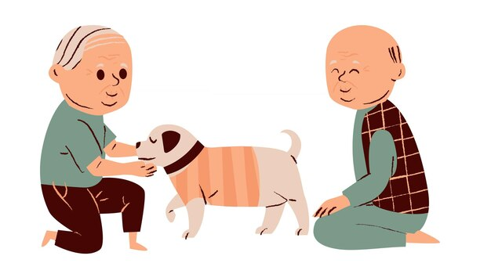
Animal-assisted therapy
Animal-assisted therapy is a form of therapy that involves organized interactions with animals to enhance well-being and overall quality of life.
This therapy includes structured encounters with various animals like dogs, cats, fish, as well as artificial animals like toy animals and robot animals.
Notes:
Animal-assisted therapy is a form of therapy that involves organized interactions with animals to enhance well-being and overall quality of life.
This therapy includes structured encounters with various animals like dogs, cats, fish, as well as artificial animals like toy animals and robot animals. It's important to note that animal-assisted therapy has distinct objectives and outcomes and differs from simply having a pet or being around animals, which can also bring about positive emotions.

Slide 18
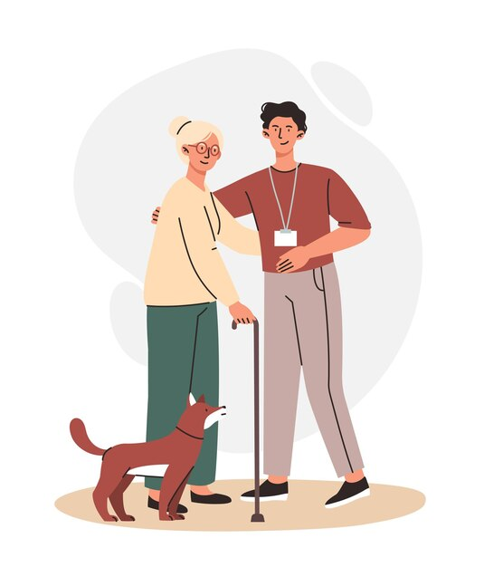
Animal-assisted therapy (cont.)
How does it work?
Trained handlers facilitate interactions.
Goals: exercise, communication, confidence.
Enhances well-being and independence.
Notes:
There are various approaches to animal-assisted therapy that offer therapeutic benefits. Some forms of animal-assisted therapy entail interacting with an animal under the guidance of a trained handler. The therapist will oversee your interaction with the animal, aiming to achieve specific goals, such as encouraging physical activity, improving communication skills, or boosting self-confidence. In other cases, animals are used to enhance your well-being through companionship and bonding or to help you maintain your independence.

Slide 19
Animal-assisted therapy (cont.)
Meet Robert, an 80-year-old man with Alzheimer's disease. Robert is experiencing memory loss, agitation, and a decline in cognitive function. His family and healthcare team decide to incorporate animal-assisted therapy into his care plan to improve his emotional well-being and cognitive abilities.
1. Introduction and Assessment:
A certified therapist, Jane, brings a trained therapy dog, Lucy, to the long-term care facility where Robert resides. Jane assesses Robert's cognitive and emotional state to tailor the session accordingly.
2. Social Interaction:
Jane introduces Lucy to Robert, allowing him to pet and interact with the dog. The presence of the dog often elicits smiles and positive reactions from Robert, even when his memory lapses.
3. Memory Stimulation:
Jane uses picture cards with images of animals and encourages Robert to name or describe the animals. Lucy is present, providing comfort and support during the exercise. To further stimulate Robert's memory, Jane incorporates discussions about pets he may have had in the past, encouraging reminiscence and storytelling.
4. Reducing Agitation:
When Robert becomes agitated or anxious, Jane uses Lucy as a calming presence. The gentle touch and companionship of the dog have a soothing effect on Robert, helping to reduce his agitation and anxiety.
5. Physical Activity:
Jane engages Robert in gentle physical activities like throwing a ball for Lucy to retrieve. This physical engagement helps improve Robert's motor skills, coordination, and overall mobility.
6. Emotional Connection:
Over time, Robert forms a strong emotional connection with Lucy. The presence of the dog brings comfort and a sense of companionship, reducing feelings of loneliness and isolation often experienced by individuals with Alzheimer's.
Notes:
Now lets consider an example to help us understand what an animal-assisted therapy session may look like for an individual with a NDD, and what benefits this may have.

Slide 20
Animal-assisted therapy (cont.)
After several AAT sessions, Robert and his family notice several evident benefits:
Improved mood and reduced anxiety: Robert's interactions with Lucy help improve his overall mood, reduce anxiety, and provide moments of joy and comfort, even when he struggles with memory loss.
Enhanced cognitive function: The memory-stimulation exercises and discussions about past pets help maintain some cognitive abilities, promoting mental engagement.
Increased social interaction: Robert becomes more engaged with others during and after AAT sessions, as he is more likely to initiate conversations about Lucy and his past pets.
Improved physical well-being: The physical activities with Lucy help maintain Robert's physical abilities and promote a sense of accomplishment.
Enhanced quality of life: Robert's emotional connection with Lucy and the overall AAT experience contribute to a higher quality of life by alleviating feelings of loneliness and isolation.
Notes:
Meet Robert, an 80-year-old man with Alzheimer's disease. Robert is experiencing memory loss, agitation, and a decline in cognitive function. His family and healthcare team decide to incorporate animal-assisted therapy into his care plan to improve his emotional well-being and cognitive abilities.
AAT Session:
1. Introduction and Assessment:
A certified therapist, Jane, brings a trained therapy dog, Lucy, to the long-term care facility where Robert resides. Jane assesses Robert's cognitive and emotional state to tailor the session accordingly.
2. Social Interaction:
Jane introduces Lucy to Robert, allowing him to pet and interact with the dog. The presence of the dog often elicits smiles and positive reactions from Robert, even when his memory lapses.
3. Memory Stimulation:
Jane uses picture cards with images of animals and encourages Robert to name or describe the animals. Lucy is present, providing comfort and support during the exercise.
To further stimulate Robert's memory, Jane incorporates discussions about pets he may have had in the past, encouraging reminiscence and storytelling.
4. Reducing Agitation:
When Robert becomes agitated or anxious, Jane uses Lucy as a calming presence. The gentle touch and companionship of the dog have a soothing effect on Robert, helping to reduce his agitation and anxiety.
5. Physical Activity:
Jane engages Robert in gentle physical activities like throwing a ball for Lucy to retrieve. This physical engagement helps improve Robert's motor skills, coordination, and overall mobility.
6. Emotional Connection:
Over time, Robert forms a strong emotional connection with Lucy. The presence of the dog brings comfort and a sense of companionship, reducing feelings of loneliness and isolation often experienced by individuals with Alzheimer's.

Slide 21

Assistive technology
Assistive technology refers to a wide range of tools, devices, and technologies designed to help individuals who are affected by neurodegenerative conditions and to maintain or regain their independence and improve their quality of life.

Slide 22

Assistive technology (cont.)
Examples:
Communication aids
Mobility and accessibility devices
Memory and cognitive support
Environmental control systems
Adaptive computer technology
Wearable devices
Home automation
Assistive devices for daily living
Neurorehabilitation technologies
Notes:
Assistive technology for neurodegenerative disorders can encompass various types of aids and solutions to address specific challenges associated with these conditions. Some examples include:
Communication aids: People with neurodegenerative disorders, such as ALS or advanced stages of Parkinson's disease, may experience difficulty with speech. Augmentative and alternative communication (AAC) devices, speech-generating devices, or communication apps on tablets can help individuals express themselves and interact with others.
Mobility and accessibility devices: People with conditions like multiple sclerosis or advanced Parkinson's disease may have difficulty with mobility. Mobility aids like wheelchairs, scooters, and walkers, as well as home modifications like ramps and grab bars, can improve accessibility and mobility.
Memory and cognitive support: Assistive technology can include reminder apps, digital calendars, and other memory aids to help individuals with conditions like Alzheimer's disease or dementia manage their daily routines and tasks.
Environmental control systems: These systems allow individuals to control various aspects of their home environment, such as lights, thermostats, and appliances, using voice commands or other accessible interfaces.
Adaptive computer technology: Specialized software and hardware can assist people with neurodegenerative disorders in using computers and digital devices. This includes screen readers, voice recognition software, and customized input devices.
Wearable devices: Devices like smartwatches can help monitor health metrics, track movement, and provide emergency assistance for individuals with neurodegenerative disorders.
Home automation: Smart home technology can be integrated to enhance safety and convenience, such as voice-controlled lights, door locks, and security systems.
Assistive devices for daily living: These may include adaptive utensils, reachers, dressing aids, and other tools designed to make everyday tasks easier for individuals with limited mobility or dexterity.
Neurorehabilitation technologies: Virtual reality, robotics, and other advanced technologies can be used in rehabilitation and therapy for individuals with conditions like stroke or Parkinson's disease to improve motor skills and cognitive functions.
The goal of assistive technology in the context of neurodegenerative disorders is to empower individuals, enhance their independence, and improve their overall quality of life by addressing the specific challenges they face due to their condition. These technologies can be customized to suit the individual's needs and may evolve over time as the condition progresses. It's essential for individuals with neurodegenerative disorders, their caregivers, and healthcare professionals to work together to identify the most appropriate assistive technologies to meet their unique requirements.

Slide 23
Cognitive stimulation therapy
Cognitive stimulation is a structured and individualized approach that involves engaging individuals in a variety of cognitive exercises and activities to enhance their cognitive functions.
This therapy aims to slow the progression of cognitive decline and improve mental acuity in individuals with conditions like Alzheimer's disease or dementia.
Cognitive stimulation activities can include memory games, puzzles, discussions, and problem-solving tasks, all tailored to the individual's abilities and interests.
The goal is to stimulate and maintain cognitive skills, promote mental engagement, and improve the individual's quality of life as they navigate the challenges of their neurodegenerative disorder.

Slide 24

Counselling and psychotherapy
Counselling and psychotherapy are both forms of talk therapy that involve conversations between a trained mental health professional and an individual or a group of individuals.
They aim to help people address emotional, psychological, and behavioural issues, improve their well-being, and develop coping strategies to deal with life's challenges.

Slide 25
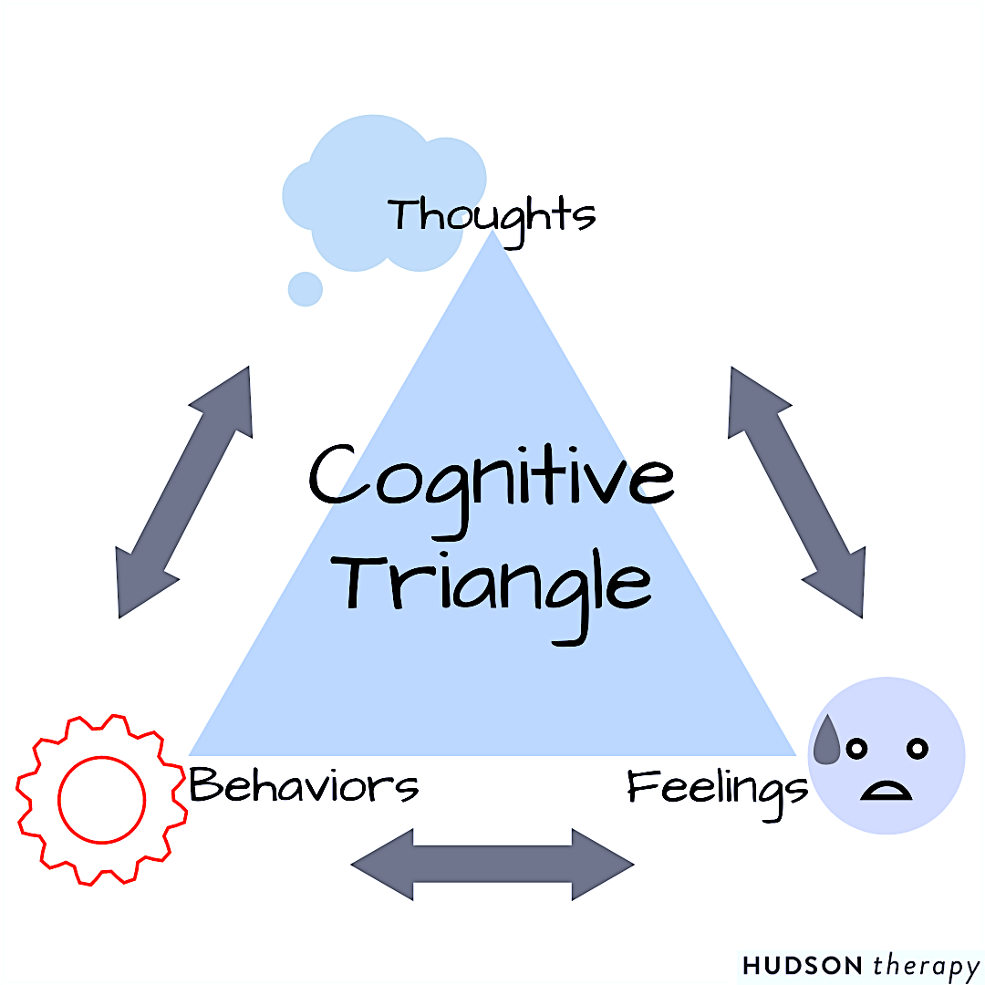
Counselling and psychotherapy (cont.)
Cognitive Behavioral Therapy (ACT)
CBT is a structured, goal-oriented form of psychotherapy that focuses on identifying and changing negative thought patterns and behaviours.
It can be useful for individuals with NDDs, who may experience anxiety, depression, or other emotional distress. CBT helps them develop coping strategies and adapt to the cognitive and functional changes that occur.

Slide 26
Counselling and psychotherapy (cont.)
Acceptance and Commitment Therapy (ACT)
ACT is a mindfulness-based therapy that encourages individuals to accept their thoughts and feelings rather than trying to change or suppress them.
This approach is helpful for people with neurodegenerative disorders who are dealing with grief, loss, and the emotional impact of their condition. ACT helps individuals find meaning and purpose in their lives and commit to values-based actions despite their challenges.

Slide 27
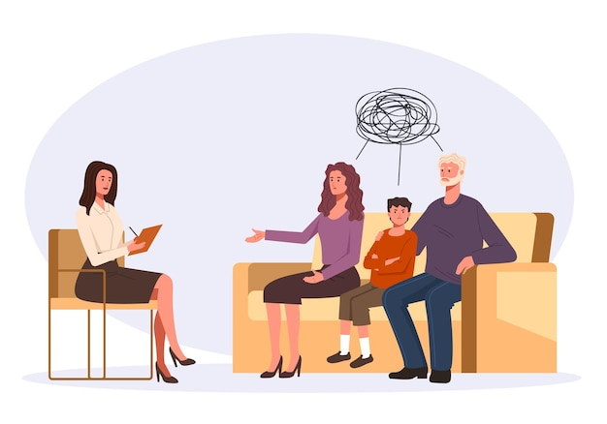
Counselling and psychotherapy (cont.)
Family and Systemic Therapy
Neurodegenerative disorders don't just affect the individual; they have a profound impact on family dynamics. Family therapy involves working with both the person with the disorder and their family members to improve communication, address conflicts, and provide mutual support. It can help family members better understand the condition, its progression, and their roles in caregiving.

Slide 28
Counselling and psychotherapy (cont.)
Group Therapy
Group therapy sessions provide individuals with neurodegenerative disorders the opportunity to connect with others facing similar challenges.
These groups offer a supportive and empathetic environment where participants can share experiences, strategies, and coping mechanisms.
Group therapy can help reduce feelings of isolation and foster a sense of community.

Slide 29
Creative arts therapies
Creative arts therapies in the context of neurodegenerative disorders involve the use of artistic and creative activities to address emotional, cognitive, and psychosocial needs in individuals affected by NDDs.
These therapies harness the expressive and therapeutic power of the arts to enhance well-being and maintain a sense of self.
They can enhance cognitive function, reduce anxiety and depression, foster a sense of accomplishment, and improve the overall quality of life for individuals with neurodegenerative disorders.
Notes:
Creative arts therapies in the context of neurodegenerative disorders involve the use of artistic and creative activities to address emotional, cognitive, and psychosocial needs in individuals affected by conditions like Alzheimer's disease, Parkinson's disease, or dementia. These therapies harness the expressive and therapeutic power of the arts to enhance well-being and maintain a sense of self.
Creative arts therapies are often conducted by trained and certified therapists who tailor the activities to the specific needs and abilities of the individual. These therapies can enhance cognitive function, reduce anxiety and depression, foster a sense of accomplishment, and improve the overall quality of life for individuals with neurodegenerative disorders. They provide a non-verbal means of expression, which can be especially valuable when verbal communication is compromised.

Slide 30

Creative arts therapies (cont.)
Creative arts therapies:
Art Therapy
Music Therapy
Dance/Movement Therapy
Drama Therapy
Poetry and Writing Therapy
Notes:
There are several forms of creative arts therapies, including:
Art Therapy: In art therapy, individuals use visual art mediums such as painting, drawing, and sculpture to express themselves and work through emotional and psychological challenges. Art therapy can help individuals with neurodegenerative disorders communicate, manage emotions, and preserve their identity.
Music Therapy: Music therapy involves the use of music to engage individuals and stimulate cognitive and emotional functions. Music can trigger memories, improve mood, and promote social interaction. This therapy may include singing, playing instruments, or listening to music tailored to the individual's preferences.
Dance/Movement Therapy: Dance and movement therapy uses physical expression and rhythmic movements to enhance physical mobility and emotional well-being. It can be particularly beneficial for individuals with Parkinson's disease to improve balance, coordination, and overall quality of life.
Drama Therapy: Drama therapy uses role-playing, storytelling, and dramatic activities to help individuals explore emotions, memories, and communication. It can improve interpersonal skills and provide a creative outlet for self-expression.
Poetry and Writing Therapy: Poetry and writing therapy involve writing or creating poetry to express thoughts and emotions. It can stimulate cognitive processes, encourage self-reflection, and serve as a means of communication for individuals with language difficulties.

Slide 31
Life review or Reminiscence therapy
Life review therapy or reminiscence therapy is a structured and therapeutic process that involves individuals with conditions such as Alzheimer's disease or dementia reflecting on and discussing their life experiences, memories, and personal narratives.
Key components:
Reminiscence
Storytelling
Therapeutic Dialogue
Integration and Coping
Notes:
Life review therapy or reminiscence therapy is a structured and therapeutic process that involves individuals with conditions such as Alzheimer's disease or dementia reflecting on and discussing their life experiences, memories, and personal narratives.
This approach allows individuals to revisit and explore their life history, achievements, and significant events, often with the guidance of a trained therapist.
Key components:
Reminiscence: Life review therapy encourages individuals to recall and share memories, both positive and challenging, from different stages of their life. These memories may be organized chronologically or thematically.
Storytelling: Participants are encouraged to tell their life stories, sharing anecdotes, experiences, and personal insights. This storytelling process can be a powerful means of self-expression and emotional release.
Therapeutic Dialogue: Life review therapy typically involves structured discussions with a therapist, family members, or support groups. These dialogues provide a safe and supportive environment for individuals to reflect on their past and gain new perspectives on their life journey.
Integration and Coping: The process of reviewing one's life allows individuals to make sense of their experiences and develop coping strategies for dealing with the challenges of their neurodegenerative disorder. It can foster a sense of closure and acceptance.
Overall, life review therapy offers a valuable means of promoting psychological well-being and enhancing the sense of self for individuals with neurodegenerative disorders, helping them to maintain their dignity and connection to their life journey.

Slide 32
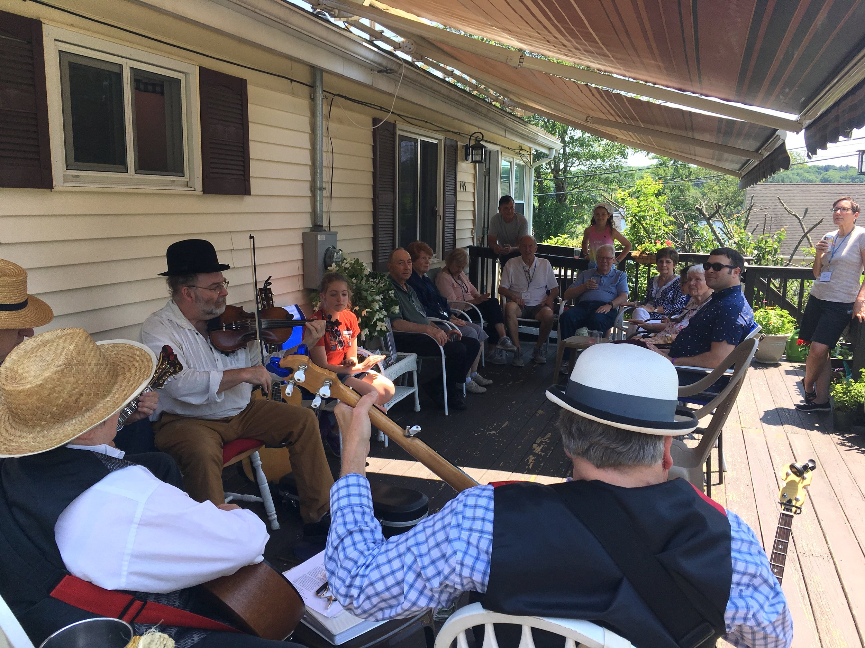
Memory cafés
What is a Memory Café?
A Memory Café is a community gathering for individuals with NDDs.
It provides a supportive and welcoming atmosphere.
Attendees include individuals with memory issues, caregivers, and family members.
Notes:
A memory café is a social gathering or community event designed to provide a supportive and welcoming environment for individuals living with memory-related conditions, such as Alzheimer's disease or other forms of dementia, as well as their caregivers and family members. These cafes offer a relaxed setting where attendees can come together, share experiences, and engage in conversations about memory-related issues. They often include activities, refreshments, and sometimes educational discussions or guest speakers, all with the aim of fostering a sense of community, reducing isolation, and providing support for those affected by memory-related conditions. Memory cafes are typically open to anyone interested in memory-related issues and are held in various community settings.

Slide 33
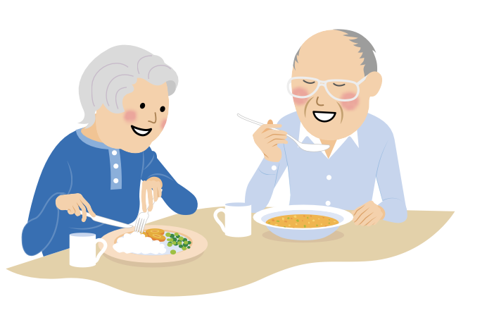
Memory cafés (cont.)
Activities
Reminiscence Sessions: Sharing and discussing personal memories and stories.
Arts and Crafts: Creative activities like painting and crafting.
Music Programs: Live music, sing-alongs, or musical instrument sessions.
Themed Events: Special occasions or seasonal celebrations.
Guest Speakers: Educational talks by experts in memory-related conditions.
Mindfulness Exercises: Relaxation and stress reduction techniques.
Games and Puzzles: Board games, word games, and memory activities.
Outdoor Outings: Trips to parks, gardens, or outdoor locations.
Therapy Animals: Visits from dogs or cats for emotional support.
Cooking or Baking: Preparing simple recipes or baking together.
Notes:
Memory cafes offer a variety of activities to engage and support individuals with memory-related conditions and their caregivers. Here are some examples of activities that often take place in memory cafes:
Reminiscence Sessions: Sharing and discussing personal memories and stories.
Arts and Crafts: Creative activities like painting and crafting.
Music Programs: Live music, sing-alongs, or musical instrument sessions.
Themed Events: Special occasions or seasonal celebrations.
Guest Speakers: Educational talks by experts in memory-related conditions.
Mindfulness Exercises: Relaxation and stress reduction techniques.
Games and Puzzles: Board games, word games, and memory activities.
Outdoor Outings: Trips to parks, gardens, or outdoor locations.
Therapy Animals: Visits from dogs or cats for emotional support.
Cooking or Baking: Preparing simple recipes or baking together.
The specific activities can vary depending on the memory cafe's location, resources, and the preferences of attendees. The primary goal is to provide a supportive and enjoyable environment for all participants while catering to their individual needs and abilities.

Slide 34
Memory cafés
Benefits:
Social connection and reducing isolation.
Finding a supportive community and understanding.
Enhancing emotional well-being and reducing stress.
Engaging in cognitive stimulation.
Providing relief for caregivers.
Offering education and learning opportunities.
Promoting empowerment and confidence.
Providing diverse activities to cater to various interests.
Enhancing overall well-being.
Improving communication and self-expression.
Reducing stigma and fostering acceptance.
Contributing to physical and emotional health.
Delaying the need for institutional care.
Notes:
Memory cafes offer several advantages for individuals with memory-related conditions and their caregivers. Here are some of the key benefits:
Social Connection: Memory cafes help individuals connect with others, preventing feelings of loneliness and isolation.
Supportive Community: They provide a caring and understanding community where people share similar experiences and challenges.
Emotional Well-being: Engaging in activities and conversations at memory cafes can boost mood and reduce stress and anxiety.
Cognitive Stimulation: Memory cafe activities stimulate the brain, helping to keep the mind active and engaged.
Caregiver Respite: Memory cafes offer caregivers a break while their loved ones enjoy meaningful activities.
Education and Information: These gatherings often feature experts who provide valuable information about memory-related conditions and available resources.
Empowerment: Participants often feel a sense of accomplishment and gain confidence through shared experiences.
Diverse Activities: Memory cafes offer various activities to suit different interests and abilities.
Improved Quality of Life: Engaging in memory cafe activities can lead to a higher overall quality of life.
Enhanced Communication: Participants can express themselves more effectively and communicate with others.
Reduced Stigma: Memory cafes help reduce the negative perceptions associated with memory-related conditions by promoting understanding and acceptance.
Overall Well-being: Activities such as mindfulness exercises, music therapy, and outdoor outings contribute to better physical and emotional health.
Residential Stability: Participation in memory cafes can help individuals remain in their homes and communities longer, delaying the need for institutional care.

Slide 35
Memory cafés
Who provides Memory Cafés?
Alzheimer’s/Dementia Associations: Local chapters or organizations dedicated to NDD care often organize memory cafes.
Community Centers: Community centers may host memory cafes as part of their senior or wellness programs.
Healthcare Facilities: Hospitals, clinics, and memory care facilities may offer memory cafe programs for patients and their families.
Nonprofit Organizations: Various nonprofits focused on dementia support and caregiving may provide memory cafe services.
Local Support Groups: Independent support groups for individuals with memory conditions and their caregivers sometimes organize memory cafes.
Volunteer Groups: Volunteer organizations or community volunteers may establish and run memory cafes.
Religious Institutions: Some churches and religious organizations offer memory cafes as part of their community outreach programs.
Notes:
Memory cafes are typically provided by a range of organizations and community groups, often in collaboration with healthcare professionals and volunteers. Some common providers of memory cafes include:
Alzheimer’s/Dementia Associations: Local chapters or organizations dedicated to NDD care often organize memory cafes.
Community Centers: Community centers may host memory cafes as part of their senior or wellness programs.
Healthcare Facilities: Hospitals, clinics, and memory care facilities may offer memory cafe programs for patients and their families.
Nonprofit Organizations: Various nonprofits focused on dementia support and caregiving may provide memory cafe services.
Local Support Groups: Independent support groups for individuals with memory conditions and their caregivers sometimes organize memory cafes.
Volunteer Groups: Volunteer organizations or community volunteers may establish and run memory cafes.
Religious Institutions: Some churches and religious organizations offer memory cafes as part of their community outreach programs.
The availability and structure of memory cafes can vary from one region to another, so it's a good idea to check with local healthcare providers, Alzheimer’s and Dementia associations, and community centers to find out more about memory cafes in your area. If not, you can always organize a Memory Café.

Slide 36

Memory cafés
How to set up a Memory Café:
https://youtu.be/hoZFkcNea4M?si=3hlZVzt09mQHfI3z
Notes:
Participating in post-diagnostic groups can offer several advantages, such as:
Gaining knowledge about memory and NDDs.
Exploring strategies to manage NDD symptoms.
Boosting confidence and overall well-being.
Feeling a sense of belonging and purpose.
Developing better coping mechanisms after an NDD diagnosis.
Meeting others who are facing similar situations.
However, it is important to consider that Post-diagnostic groups and courses may not fully address the specific needs of individuals, particularly if they have a rarer form of NDD or are in the early stages of diagnosis. In such cases, specialized information or post-diagnostic counseling may be more appropriate.
These groups and courses are typically facilitated by professionals with expertise in working with individuals living with NDDs. Facilitators may include dementia advisors, occupational therapists, nurses, psychologists, and support workers. These professionals often come from your local memory service.

Slide 37

Activity - Memory cafés
In this activity, you will work in small groups to plan and create your own Memory Cafe. This hands-on experience will help you see how to apply your skills in a real-world scenario. Here's what you'll be doing:
Form small groups: Divide yourselves into small groups of 4-5 students.
Select a location for your Memory Cafe.
Identify the target audience you want to support.
Plan engaging activities that cater to their specific needs.
Create a schedule for your Memory Cafe sessions.
Estimate a budget for your project.
Think about how to promote and market your Memory Cafe within the community.
Ensure safety and accessibility for participants.
Consider methods for gathering feedback to improve your Memory Cafe.
Each group will present their memory cafe plan to the class. After all presentations, engage in a class discussion to share feedback and insights. Talk about the challenges and benefits of setting up a memory cafe and how it relates to providing psychological support for individuals with neurodegenerative disorders.
Notes:
In this activity, you will work in small groups to plan and create your own Memory Cafe. This hands-on experience will help you see how to apply your skills in a real-world scenario. Here's what you'll be doing:
Form small groups: Divide yourselves into small groups of 4-5 students.
Choose a location: Within your groups, pick a location that you think would be suitable for a memory cafe. Think about places in the community that could work well.
Define your target audience: Discuss and decide on the specific group of people you want to support through your memory cafe. Consider their age, the types of neurodegenerative disorders they may have, and whether you want to include caregivers or family members.
Plan the activities: Brainstorm and come up with a list of activities you believe would benefit the chosen audience. These activities should focus on cognitive and emotional support. Be creative and think about what would engage and help them.
Develop a schedule: Create a rough schedule for your memory cafe, outlining when you'd like to hold it and what activities will take place during each session. You can keep it simple for now and adjust later.
Set a budget: Estimate the budget required for your memory cafe. Think about the costs involved in organizing the activities and providing refreshments. Consider creative ways to manage costs.
Marketing and outreach: Discuss how you might spread the word about your memory cafe to your target audience and their caregivers. What methods can you use to promote it within the community?
Safety and accessibility: Think about how you can ensure the safety and accessibility of your memory cafe for individuals with neurodegenerative disorders. Consider their needs and comfort.
Evaluation and feedback: Plan how you'll collect feedback from participants and caregivers to improve your memory cafe continually.
Each group will present their memory cafe plan to the class. After all presentations, engage in a class discussion to share feedback and insights. Talk about the challenges and benefits of setting up a memory cafe and how it relates to providing psychological support for individuals with neurodegenerative disorders.

Slide 38
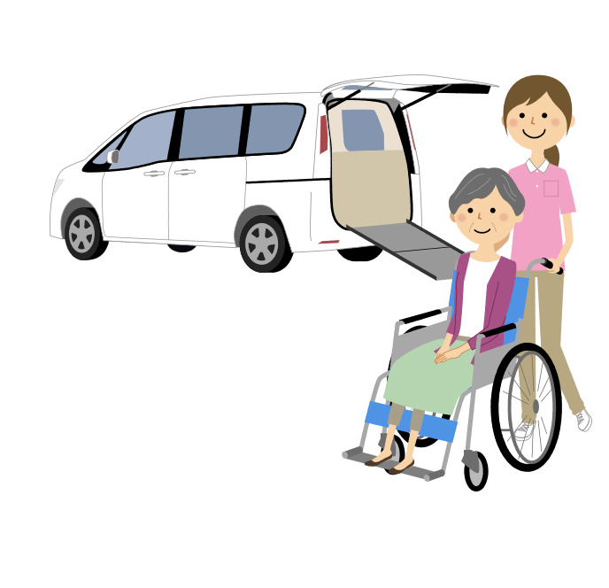
Occupational therapy
Occupational therapy in the context of neurodegenerative disorders is a client-centred healthcare profession that focuses on helping individuals with conditions like Alzheimer's disease, Parkinson's disease, or Huntington's disease maintain their independence and improve their ability to engage in daily activities and routines.
Occupational therapists (OTs) work with individuals to address physical, cognitive, emotional, and environmental challenges, with the goal of enhancing their overall quality of life.

Slide 39

Occupational therapy (cont.)
Occupational Therapy
Assessment
Individualised treatment plans
Cognitive stimulation
Functional skills training
Mobility and physical rehabilitation
Environmental modifications
Assistive devices
Sensory integration
Family and caregiver education
Notes:
Key aspects of occupational therapy in this context include:
Assessment: Occupational therapists begin by conducting a comprehensive evaluation of the individual's physical and cognitive abilities, as well as their daily living environment. This assessment helps identify specific challenges and goals.
Individualized Treatment Plans: Based on the assessment, occupational therapists develop individualized treatment plans that are tailored to the person's unique needs and objectives. These plans focus on improving function and enhancing the individual's capacity to perform daily activities.
Cognitive Stimulation: For individuals with cognitive deficits, occupational therapists may use cognitive stimulation exercises and activities to promote memory, problem-solving, and attention skills. These interventions are aimed at slowing cognitive decline and improving mental acuity.
Functional Skills Training: Occupational therapists work with individuals to regain or maintain practical skills required for daily living, such as dressing, bathing, cooking, and managing finances. They may provide adaptive techniques or devices to make these tasks more manageable.
Mobility and Physical Rehabilitation: When applicable, occupational therapists address physical limitations and mobility challenges. This may involve exercises, assistive devices, or techniques to improve strength, balance, and coordination.
Environmental Modifications: Occupational therapists assess the individual's living environment and recommend adaptations to enhance safety and accessibility. This can include removing hazards, installing handrails, and providing memory aids.
Assistive Devices: Occupational therapists may recommend and teach individuals how to use assistive devices such as adaptive tools, communication aids, or mobility devices to support independence and quality of life.
Sensory Integration: In some cases, individuals with neurodegenerative disorders may experience sensory challenges. Occupational therapists can address sensory processing difficulties through sensory integration techniques.
Family and Caregiver Education: Occupational therapists often provide education and training to family members and caregivers to help them understand the individual's needs and how to provide support at home. This can include techniques for effective communication and care.
Occupational therapy aims to empower individuals with neurodegenerative disorders to maintain their dignity and independence for as long as possible. It plays a crucial role in enhancing the individual's overall well-being and helping them adapt to the evolving challenges of their condition, while promoting their ability to engage in meaningful daily activities.

Slide 40
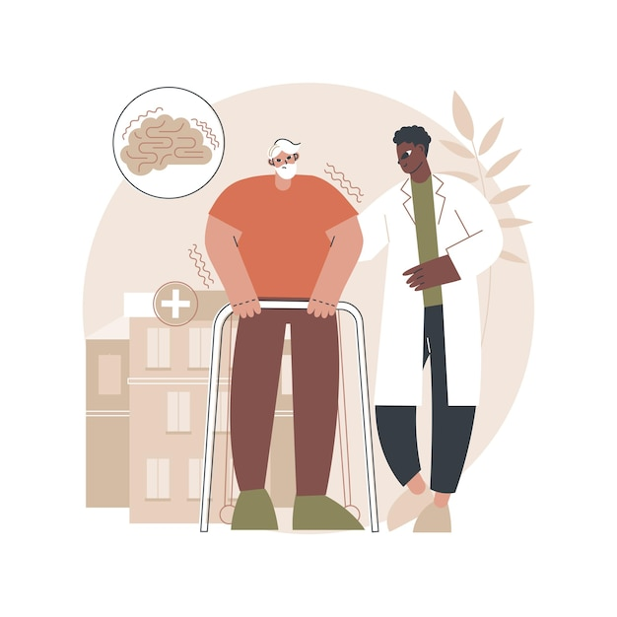
Cognitive rehabilitation
Cognitive rehabilitation refers to a structured and individualized program of interventions and therapies designed to address cognitive deficits and functional impairments
Cognitive rehabilitation aims to help individuals with neurodegenerative disorders maintain or improve their cognitive and functional abilities, enhance their quality of life, and promote independence for as long as possible.
It is not a cure for these disorders but rather a supportive approach to managing the cognitive and behavioural challenges that arise as the diseases progress.

Slide 41
Cognitive rehabilitation (cont.)
Cognitive rehabilitation
Cognitive training
Functional skills training
Psychoeducation
Environmental modifications
Behavioural strategies
Occupational therapy
Speech and language therapy
Notes:
Key components of cognitive rehabilitation in the context of neurodegenerative disorders may include:
Cognitive Training: This involves structured exercises and activities that target specific cognitive functions, such as memory, attention, problem-solving, and language skills. These exercises are tailored to the individual's needs and abilities.
Functional Skills Training: Individuals are trained to develop or relearn practical skills necessary for daily living, such as cooking, dressing, and managing finances. This can help them maintain independence for as long as possible.
Psychoeducation: Providing individuals and their caregivers with information about the nature of the neurodegenerative disorder, its progression, and strategies for coping with cognitive and emotional challenges.
Environmental Modifications: Making adjustments to the individual's living environment to make it more supportive and easier to navigate. This may include simplifying tasks, using memory aids, and ensuring safety.
Behavioral Strategies: Teaching coping strategies and techniques to manage behavioral symptoms that can occur in neurodegenerative disorders, such as agitation, aggression, or wandering.
Occupational Therapy: Occupational therapists may work with individuals to help them regain or maintain their ability to perform daily activities and tasks.
Speech and Language Therapy: For individuals with language and communication difficulties, speech therapists can provide interventions to enhance communication and maintain or regain language skills.
It's important to note that the effectiveness of cognitive rehabilitation can vary depending on the stage and severity of the neurodegenerative disorder. While it may not reverse the underlying neurodegeneration, it can help slow the progression of cognitive decline and improve the individual's quality of life.
Cognitive rehabilitation programs are typically developed and implemented by multidisciplinary teams, including neuropsychologists, occupational therapists, speech therapists, and other healthcare professionals, working in collaboration with family caregivers. The specific interventions used will be tailored to the individual's unique needs and goals.

Slide 42
Cognitive rehabilitation: Case study
Patient Profile:
Name: Mrs. Devika Silva
Age: 72
Gender: Female
Ethnicity: Sri Lankan
Diagnosis: Alzheimer's Disease (Mild to Moderate stage)
Background:
Mrs. Devika Silva, a 72-year-old Sri Lankan woman, had always been the heart of her close-knit, multigenerational household in a suburban area of Colombo, Sri Lanka. Devika was known for her love of traditional Sri Lankan customs and the warmth she brought to her family. She lived with her loving husband, Mr. Silva, who was her primary caregiver, and their two adult children, Rohan and Sujatha, who resided in the same household.
Devika's Alzheimer's diagnosis hit her family hard. They noticed her struggles with everyday tasks and communication, leading to increasing frustration and confusion. Devika's memory lapses meant she often forgot important family events and cherished cultural traditions, leaving her feeling disconnected from her Sri Lankan heritage. The burden on Mr. Silva and her children grew as they tried to support her while maintaining their own livelihoods.

Slide 43
Cognitive rehabilitation: Case study (cont.)
Needs and Challenges:
Cultural Identity and Emotional Needs: Devika's inability to participate in cultural customs and celebrations caused her immense distress. Her memory lapses prevented her from preparing traditional Sri Lankan dishes and participating in religious ceremonies, activities that were deeply meaningful to her.
Family Caregiver Stress: Mr. Silva, who had always relied on Devika's support in managing the household, faced significant stress as he juggled caregiving, daily responsibilities, and the emotional toll of seeing his wife's condition deteriorate.
Communication and Emotional Expression: Devika's difficulty in expressing her needs and emotions led to frustration and isolation. She struggled to convey her love, sadness, or frustration, which was particularly distressing for her family.

Slide 44
Cognitive rehabilitation: Case study (cont.)
Cognitive Rehabilitation Program:
Cognitive Training: The program incorporated cultural aspects into cognitive training exercises, focusing on improving memory and attention. Memory games involving traditional Sri Lankan customs and holidays helped Devika reconnect with her heritage while enhancing her cognitive abilities.
Functional Skills Training: Occupational therapy sessions tailored tasks to her cultural interests, such as simplified cooking of her favourite Sri Lankan dishes. By providing her with the skills to participate in these activities, her cultural identity was preserved.
Psychoeducation: The program included sessions specifically addressing the emotional and cultural needs of Sri Lankan families. This helped the Silvas understand that Devika's condition was beyond her control and taught them strategies to cope and support each other.

Slide 45
Cognitive rehabilitation: Case study (cont.)
Speech and Language Therapy: Speech therapy included the use of culturally relevant picture cards to facilitate communication, enabling Devika to express her feelings and needs more effectively, easing her frustration and isolation.
Environmental Modifications: Cultural elements were incorporated into her living environment, such as decorating the house with traditional artwork, and using cultural symbols to aid her memory.
Social and Cultural Engagement: Caregivers were encouraged to engage Devika in traditional activities, such as celebrating festivals and crafting traditional items. This not only stimulated her cognitively but also helped her maintain her cultural identity and sense of belonging.

Slide 46
Cognitive rehabilitation: Case study (cont.)
Progress and Outcomes:
The cognitive rehabilitation program not only addressed Devika's cognitive deficits but also catered to her cultural and emotional needs. The enriched program led to the following outcomes:
Devika's connection to her cultural heritage was rekindled, allowing her to actively participate in family customs and celebrations.
The burden on Mr. Silva and the children was alleviated as they gained a better understanding of her condition and learned to provide better support.
Improved communication and emotional expression reduced Devika's frustration and isolation, leading to a closer and more harmonious family dynamic.
While Alzheimer's disease remained a challenging condition, the cognitive rehabilitation program, deeply rooted in Sri Lankan culture, allowed the Silva family to maintain their traditions and quality of life while navigating the complexities of the disease. Regular follow-up and adjustments ensured ongoing support and care.

Slide 47
Conclusion
Assessment
Setting goals
Develop a care plan
Implement interventions
Regular evaluation, monitoring and adaptation
Notes:
Assessment: Begin by conducting a thorough assessment of the individual's needs, preferences, and current psychosocial challenges. Gather information about their medical history, cognitive and emotional status, social support, and daily routines.
Setting Goals: Collaborate with the individual and their family to establish clear, achievable psychosocial goals. These goals should align with their values and priorities and address areas such as emotional well-being, social engagement, and maintaining a sense of identity.
Develop a Care Plan: Based on the assessment and established goals, create a personalized care plan. This plan should outline specific interventions and strategies to address the individual's psychosocial needs. Consider incorporating cognitive stimulation activities, emotional support, and social interaction opportunities.
Implement Interventions: Put the care plan into action, ensuring that the individual receives the necessary psychosocial support and services. Provide cognitive stimulation exercises, emotional counseling, and opportunities for socialization based on their needs and preferences.
Regular Evaluation: Continuously assess the effectiveness of the interventions and the individual's progress toward their goals. Make adjustments to the care plan as needed to better meet their evolving psychosocial needs.
Communication and Support: Maintain open and effective communication with the individual and their family. Offer emotional support, answer questions, and provide guidance on coping strategies and available resources.
Social Engagement: Encourage the individual to participate in social activities and connect with support groups or therapy services. Foster social interaction and maintain a sense of community and belonging.
Monitoring and Adaptation: Keep a watchful eye on the individual's emotional and cognitive status. Be prepared to adapt the psychosocial care plan to address changing needs and challenges associated with the neurodegenerative disorder.
Education and Empowerment: Provide education to the individual and their caregivers about the nature of the neurodegenerative disorder and the available psychosocial resources. Empower them with the knowledge and skills to effectively manage the condition.
Documentation: Maintain clear and accurate records of the care provided, progress made, and any notable changes in the individual's psychosocial well-being. This documentation helps in tracking outcomes and adjusting the care plan as necessary.
Remember that psychosocial care for individuals with neurodegenerative disorders is a dynamic and individualized process. Regular communication, flexibility, and a person-centered approach are essential in ensuring the best possible support for the individual's emotional and social needs.

Slide 48
Self-Study
Patel, B., Perera, M., Pendleton, J., Richman, A., & Majumdar, B. (2014). Psychosocial interventions for dementia: From evidence to practice. Advances in Psychiatric Treatment,20(5), 340-349. doi:10.1192/apt.bp.113.011957
Post-diagnostic support for people with dementia and their family carers: a literature review: https://www.understandtogether.ie/training-resources/helpful-resources/publications/reviews-and-evaluations/dementia-post-diagnostic-support-literature-review-2019-.pdf
Dementia: The NICE-SCIE guideline on supporting people with dementia and their carers in health and social care:
https://www.scie.org.uk/publications/misc/dementia/dementia-fullguideline.pdf?res=true
Psychological dimensions of dementia: Putting the person at the centre of care https://business.senedd.wales/documents/s60602/DEM%2005%20The%20British%20Psychological%20Society.pdf
Psychosocial Interventions and Dementia
https://www.fondation-mederic-alzheimer.org/wp-content/uploads/2023/03/2021-guide-interventions-non-medicamenteuses-en.pdf
Brodaty, H., & Burns, K. (2012). Nonpharmacological management of apathy in dementia: a systematic review. The American Journal of Geriatric Psychiatry, 20(7), 549-564. https://doi.org/10.1097/JGP.0b013e31822be242

