Slide 1
Psychopathology in individuals with neurodegenerative disorders
Psychology
Neapolis University Pafos, Cyprus
Notes:
Welcome to Psychopathology in individuals with neurodegenerative disorders. This is the second lecture in the Psychopathology unit. Understanding psychopathology in individuals with neurodegenerative disorders is important for healthcare providers because it enables the accurate diagnosis, appropriate treatment, and improved quality of life for patients, as neuropsychiatric symptoms significantly impact their well-being and care.

Slide 2
Learning Objectives
Identify the common neuropsychiatric symptoms and behaviours associated with various neurodegenerative disorders (NDDs).
Explain the difference between emotional and behavioural disturbances and psychiatric disorders.
Evaluate the diagnostic criteria and tools used to assess psychopathology in individuals with NDDs, and differentiate these symptoms from the core cognitive deficits of the disorders.
Define the key elements in the current conceptualisation of abnormality or psychiatric disorder.
Discuss the potential impact of psychopathology on the overall disease progression and quality of life in individuals with NDDs.
Notes:
Upon completion of this lecture, you should be able to:
Describe the importance of understanding psychopathology in caring for individuals with NDDs.
Define the key elements in the current conceptualisation of abnormality or psychological disorder.
Explain the relationship between neurodegenerative disorders and the development of psychopathological symptoms. Discuss the potential impact of psychopathology on the overall disease progression and quality of life in individuals with neurodegenerative disorders.
Evaluate the potential factors contributing to the development of psychopathology in individuals with specific neurodegenerative disorders.

Slide 3
Psychopathology in individuals with NDDs
Psychological distress
Emotional & behavioural disturbances
Psychiatric disorders
Notes:
In this lecture, we will distinguish psychological distress by categorizing it into two interrelated yet distinct components: emotional and behavioral disturbances, and psychiatric conditions. It is crucial to differentiate between emotional and behavioral disturbances and psychiatric conditions in the context of caring for individuals with neurodegenerative disorders because this distinction allows healthcare providers to tailor their assessment, treatment, and support strategies effectively, as the origins, management approaches, and prognoses of these two components can vary significantly. This differentiation enables a more comprehensive and individualized care plan, ultimately improving the overall well-being and quality of life for those affected by neurodegenerative disorders.

Slide 4
Psychopathology in individuals with NDDs
 | Emotional and Behavioral Disturbances | Psychiatric Disorders
Origin | Result from the neurodegenerative disorder itself | Independent psychiatric conditions
Causative Factors | Direct consequence of brain changes in neurodegenerative disorders | Not directly caused by neurodegenerative processes
Examples of Conditions | Common in Alzheimer's, frontotemporal dementia, Parkinson's disease, etc. | Depression, anxiety disorders, psychosis, and other recognized psychiatric disorders
Symptoms | Mood swings, agitation, irritability, apathy, social withdrawal, impulse control problems, and more | Symptoms specific to the particular mental disorder (e.g., low mood in depression)
Classification | Considered as symptoms of the neurodegenerative disorder | Standalone psychiatric diagnoses
Treatment | Addressed as part of the overall management of the neurodegenerative disorder | Treated as separate psychiatric conditions with specific therapeutic approaches
Notes:
Emotional and behavioral disturbances and psychiatric disorders in the context of neurodegenerative disorders are related but distinct concepts. Here's an overview of the differences between the two:
Emotional and Behavioral Disturbances:
Emotional and behavioral disturbances refer to changes in a person's emotions, moods, and behaviors that can occur as a result of neurodegenerative disorders.
These disturbances are often a direct consequence of the underlying neurodegenerative process affecting the brain. For example, conditions like Alzheimer's disease, frontotemporal dementia, and Parkinson's disease can lead to emotional and behavioral changes.
Common emotional and behavioral disturbances in neurodegenerative disorders can include mood swings, agitation, irritability, apathy, social withdrawal, and impulse control problems.
These disturbances are typically considered symptoms of the neurodegenerative disorder and are not classified as standalone mental disorders.
Psychiatric Disorders:
Psychiatric disorders, such as depression, anxiety disorders, and psychosis, are recognized psychiatric conditions that can occur independently of neurodegenerative disorders.
In the context of neurodegenerative disorders, individuals may be at an increased risk of developing mental disorders due to the impact of the brain changes associated with their neurodegenerative condition.
For example, someone with Alzheimer's disease may also experience depression or anxiety as separate mental disorders, in addition to the emotional and behavioral disturbances related to the neurodegenerative process.
In summary, the key difference lies in the origin and classification of symptoms. Emotional and behavioral disturbances are symptoms of neurodegenerative disorders and are a direct result of the brain changes caused by these conditions. Psychiatirc disorders are independent psychiatric conditions that can co-occur with neurodegenerative disorders, but they are separate diagnoses and not directly caused by the neurodegenerative process. It's important for healthcare professionals to differentiate between the two when assessing and treating individuals with neurodegenerative disorders to provide appropriate care and support.

Slide 5
Emotional and Behavioral Disturbances
Notes:
Treating psychopathological symptoms in individuals with neurodegenerative disorders can enhance their overall functioning, independence, and social engagement. By addressing these symptoms, caregivers can contribute to improving the individual's overall quality of life.

Slide 6
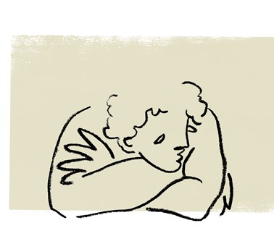
Apathy
A lack of motivation, interest, or emotional response.
The term “apathy” is derived from the Greek “pathos” meaning passion - apathy means “lack of passion”.
Apathy is commonly observed in individuals with neurodegenerative disorders
Notes:
However, some patients only present with loss of interest and do not have a depressed mood. This condition should be regarded as apathy.

Slide 7
Types of Apathy
Types of apathy:
Emotional apathy, characterized by a lack of both positive and negative emotions
Behavioural apathy, characterized by a lack of self-initiated behaviors
General apathy, characterized by less motivation, poor emotional responses, and lack of social engagement

Slide 8
Symptoms of Apathy
Difficulty completing everyday tasks
Feelings of indifference
Lack of emotion
Lack of interest in activities
Lack of motivation to accomplish goals
Low energy levels
Reduced participation in activities
Unemotional in response to both positive and negative events
Notes:
However, some patients who are treated for dysthymia only present with loss of interest and do not have a depressed mood. This condition should be regarded as apathy.

Slide 9
Symptoms of Apathy
Imagine a patient named Sarah, who has been diagnosed with Alzheimer's disease, a common neurodegenerative disorder. Apathy in this case may manifest as follows:
Lack of Initiative: Sarah, who used to be an avid gardener, no longer shows any interest in tending to her garden. She used to spend hours caring for her plants, but now, she rarely steps outside to check on them. Her garden, once full of vibrant flowers and vegetables, is now overgrown and neglected.
Social Withdrawal: Sarah used to enjoy weekly gatherings with friends and family, but now she consistently declines invitations and prefers to stay at home. She no longer initiates phone calls or interactions, even with her closest loved ones. This isolation is often due to the emotional numbness associated with apathy.
Neglect of Personal Care: Sarah used to take pride in her appearance and grooming. However, as apathy sets in, she begins to neglect basic self-care tasks. She might wear the same clothes for several days, forget to shower, or skip meals, which can have adverse effects on her physical health.
Loss of Interest in Hobbies: Sarah used to be an enthusiastic reader and an active member of a local book club. However, she has stopped reading, and her book club participation has dwindled to nothing. She no longer seeks out new books, and her once extensive collection gathers dust.
Difficulty Adhering to Medical Regimens: Apathy can affect an individual's willingness to follow prescribed treatments and medications. Sarah may forget to take her medication regularly or resist medical appointments, making it challenging for healthcare providers to manage her condition effectively.
Emotional Blunting: Sarah no longer expresses joy, sadness, or frustration with the same intensity as before. She may react minimally to emotional stimuli, even in situations that used to elicit strong emotions. This emotional numbing can make it difficult for healthcare providers to gauge her emotional well-being accurately.
Lack of Engagement in Cognitive Rehabilitation: For individuals with neurodegenerative disorders like Alzheimer's, cognitive rehabilitation and mental stimulation are essential. Apathy can lead to a decreased willingness to engage in memory exercises or cognitive activities, hindering rehabilitation efforts.
Notes:
Apathy in the context of healthcare for an individual with a neurodegenerative disorder can be observed in various ways, affecting their motivation, engagement, and overall quality of life. To illustrate this, let's consider a real-life, everyday example:
Imagine a healthcare provider working with a patient named Sarah, who has been diagnosed with Alzheimer's disease, a common neurodegenerative disorder. Apathy in this case may manifest as follows:
Lack of Initiative: Sarah, who used to be an avid gardener, no longer shows any interest in tending to her garden. She used to spend hours caring for her plants, but now, she rarely steps outside to check on them. Her garden, once full of vibrant flowers and vegetables, is now overgrown and neglected.
Social Withdrawal: Sarah used to enjoy weekly gatherings with friends and family, but now she consistently declines invitations and prefers to stay at home. She no longer initiates phone calls or interactions, even with her closest loved ones. This isolation is often due to the emotional numbness associated with apathy.
Neglect of Personal Care: Sarah used to take pride in her appearance and grooming. However, as apathy sets in, she begins to neglect basic self-care tasks. She might wear the same clothes for several days, forget to shower, or skip meals, which can have adverse effects on her physical health.
Loss of Interest in Hobbies: Sarah used to be an enthusiastic reader and an active member of a local book club. However, she has stopped reading, and her book club participation has dwindled to nothing. She no longer seeks out new books, and her once extensive collection gathers dust.
Difficulty Adhering to Medical Regimens: Apathy can affect an individual's willingness to follow prescribed treatments and medications. Sarah may forget to take her medication regularly or resist medical appointments, making it challenging for healthcare providers to manage her condition effectively.
Emotional Blunting: Sarah no longer expresses joy, sadness, or frustration with the same intensity as before. She may react minimally to emotional stimuli, even in situations that used to elicit strong emotions. This emotional numbing can make it difficult for healthcare providers to gauge her emotional well-being accurately.
Lack of Engagement in Cognitive Rehabilitation: For individuals with neurodegenerative disorders like Alzheimer's, cognitive rehabilitation and mental stimulation are essential. Apathy can lead to a decreased willingness to engage in memory exercises or cognitive activities, hindering rehabilitation efforts.
From a healthcare provider's perspective, addressing apathy in patients with neurodegenerative disorders is crucial. It can have a profound impact on their overall well-being, and strategies such as behavioral interventions, medication adjustments, and tailored therapies may be employed to mitigate the effects of apathy and enhance the patient's quality of life.

Slide 10
Apathy and NDDs
Apathy is highly prevalent in various neurodegenerative disorders, including Alzheimer's disease, Parkinson's disease, Huntington's disease, and frontotemporal dementia. It is considered one of the most frequent neuropsychiatric symptoms in these conditions.
Apathy can occur at different stages of neurodegenerative disorders. In some cases, it may be present early in the disease process and persist throughout its course. In other instances, apathy may emerge or worsen as the condition progresses.
The exact neurobiological mechanisms underlying apathy in neurodegenerative disorders are not fully understood. However, structural and functional changes in specific brain regions, neurotransmitter imbalances (e.g., dopamine), and disruption of neural circuits involved in motivation and reward processing have been implicated.

Slide 11
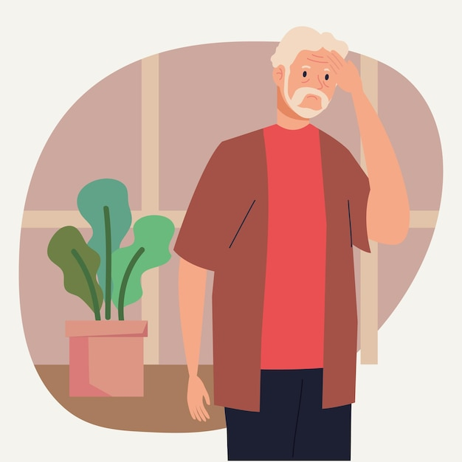
Anxiety
Anxiety is a natural and common human emotion characterized by feelings of unease, worry, or fear in response to perceived threats or stressors.
It is a normal part of the human experience and can be adaptive, as it helps individuals stay alert and respond to potentially dangerous situations.
However, when anxiety becomes excessive, chronic, or interferes with daily life, it may be classified as an anxiety disorder.
Notes:
Anxiety is a natural and common human emotion characterized by feelings of unease, worry, or fear in response to perceived threats or stressors.
It is a normal part of the human experience and can be adaptive, as it helps individuals stay alert and respond to potentially dangerous situations.
However, when anxiety becomes excessive, chronic, or interferes with daily life, it may be classified as an anxiety disorder.

Slide 12
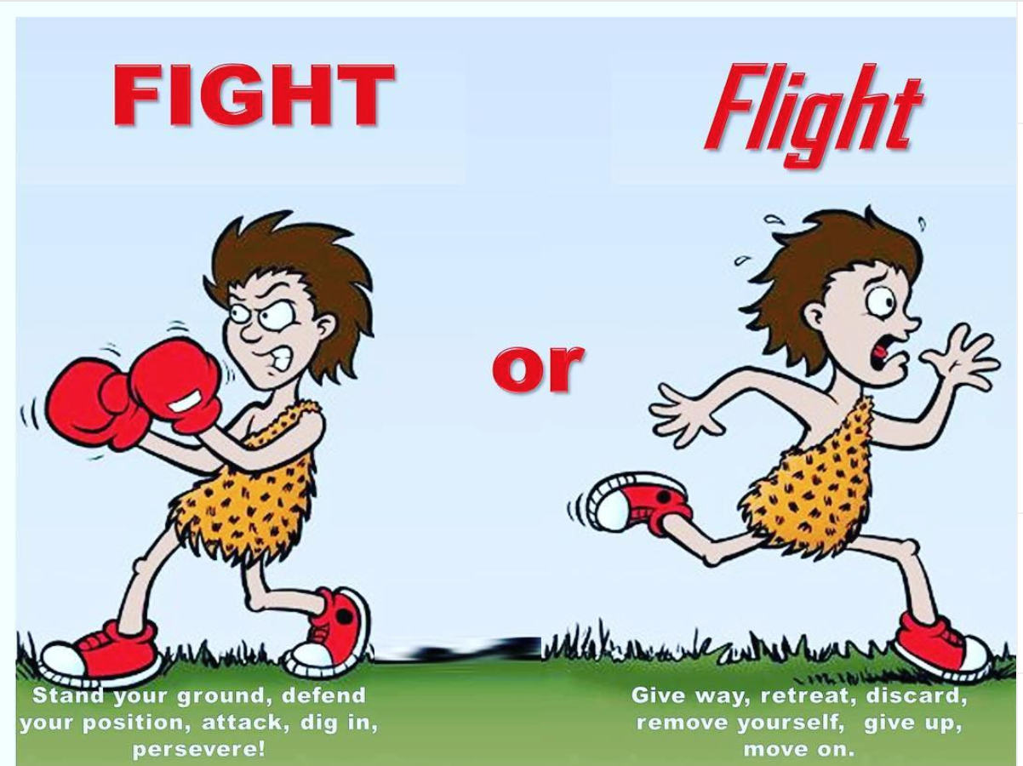
Fight-or-flight response
The fight-or-flight response has three stages:
1. Alarm: During this stage, the central nervous system is ramped up, preparing the body to fight or flee.
2. Resistance: This is the stage in which the body attempts to normalize and recover from the initial elevated fight-or-flight response.
3. Exhaustion: If the first two stages occur repeatedly over time, such as when under chronic stress, this can cause the body to feel exhausted and begin to break down.
Notes:
The fight or flight response is key to understanding anxiety. It is an an automatic physiological reaction to an event that is perceived as stressful or frightening. The perception of threat activates the sympathetic nervous system and triggers an acute stress response that prepares the body to fight or flee.
The fight-or-flight response, also known as the acute stress response, refers to the physiological reaction that occurs when in the presence of something mentally or physically terrifying. This response is triggered by the release of hormones that prepare your body to either stay and deal with a threat or to run away to safety.
The physiological responses associated with fight or flight can play a critical role in surviving truly threatening situations. However, many patients suffering from anxiety disorders or other conditions may have threat systems which have become over-active, or which are insufficiently counterbalanced by activity in the parasympathetic nervous system.

Slide 13
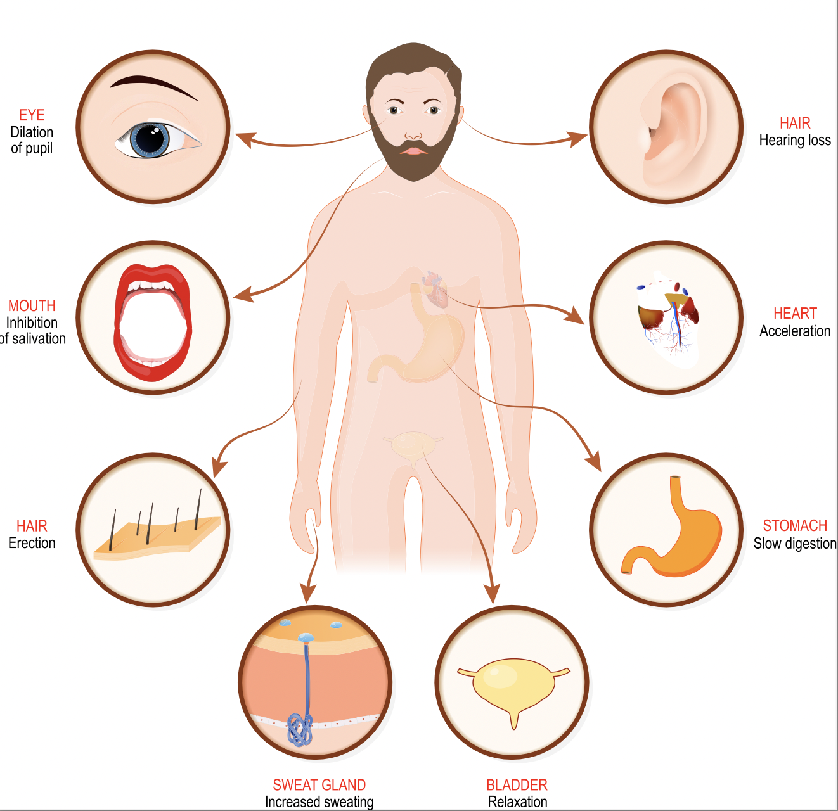
Anxiety – Physiological response
Heart: Increased heart rate; Dilation of coronary blood vessels; Increase in blood flow Increased availability of oxygen and energy to the heart.
Circulation: Dilation of blood vessels serving muscles; Constriction of blood vessels serving digestion; Increased availability of oxygen to skeletal muscles; Blood shunted to skeletal muscles and brain.
Lungs: Dilation of bronchi; Increased respiration rate; Increased availability of oxygen in blood.
Liver: Increased conversion of glycogen to glucose; Increased availability of glucose in skeletal muscle and brain cells.
Skin: Skin becomes pale or flushed as blood flow is reduced; Increased blood flow to muscles and away from non-essential parts of the body such as the periphery.
Eyes: Dilation of the pupils; Allows in more light so that visual acuity is improved to scan nearby surroundings.
Notes:
The fight or flight reaction is associated with activation of the sympathetic nervous system. The chain reaction brought about by the fight or flight response can result in the following physical effects:

Slide 14
Anxiety – Psychological response
Automatic reactions:
Quickening of thought
Attentional focus on salient targets (e.g., source of threat and potential avenues for escape)
Secondary reactions:
Appraisals about the meaning of physiological reactions e.g., “I’m having a heart attack”, or “I’m going crazy”)
Notes:
In addition to physiological reactions there is also a psychological component to fight or flight response. Automatic reactions include a quickening of thought and an attentional focus on salient targets such as the source of the threat and potential avenues for escape. Secondary psychological responses can include appraisals about the meaning of the body reactions. For example, patients with panic disorder often misinterpret fight or flight responses as signs of impending catastrophe (“I’m having a heart attack”, “I’m going crazy”).

Slide 15

Activity - Anxiety
Consider the following examples of situations that could trigger a fight-or-flight response:
Encountering a growling dog while walking in the park
Preparing to give a big presentation at work
Someone who is terrified of heights going to the top floor of a skyscraper for a meeting
Make a list of three physical threats and three psychological threats which may trigger a fight-or-flight response for an individual with a NDD.
Notes:
The fight-or-flight response can happen in the face of imminent physical danger, such as when encountering a growling dog during a walk in the park. It can also be the result of a psychological threat, such as preparing to give a big presentation at school or work. Another example of the flight-or-fight response is if a person who is terrified of heights has to go to the top floor of a skyscraper to attend a meeting.
We're going to make a list of things that could trigger a strong fight-or-flight response in someone with an NDD. We'll make two lists: one for physical threats and one for psychological threats.
First, think about physical threats. These are situations that can physically scare someone with an NDD. For example:
A very noisy and crowded place.
Someone acting aggressively or threatening.
Going to a place that's completely unfamiliar.
Now, let's consider psychological threats. These are situations that are mentally or emotionally challenging but not necessarily physically dangerous. Think about what might be really tough for someone with an NDD, like:
Having to concentrate on a difficult task for a long time.
Dealing with lots of distractions and interruptions.
Being in a situation that makes them very anxious.
Your goal is to create a list of three physical threats and three psychological threats that you think might trigger a fight-or-flight response in someone with an NDD.

Slide 16
Activity - Anxiety
Physical threats:
A very noisy and crowded place.
Someone acting aggressively or threatening.
Going to a place that's completely unfamiliar.
Psychological threats:
These are situations that are mentally or emotionally challenging but not necessarily physically dangerous. Think about what might be really tough for someone with an NDD, like:
Having to concentrate on a difficult task for a long time.
Dealing with lots of distractions and interruptions.
Being in a situation that makes them very anxious.
Notes:
First, think about physical threats. These are situations that can physically scare someone with an NDD. For example:
A very noisy and crowded place.
Someone acting aggressively or threatening.
Going to a place that's completely unfamiliar.
Now, let's consider psychological threats. These are situations that are mentally or emotionally challenging but not necessarily physically dangerous. Think about what might be really tough for someone with an NDD, like:
Having to concentrate on a difficult task for a long time.
Dealing with lots of distractions and interruptions.
Being in a situation that makes them very anxious.
Your goal is to create a list of three physical threats and three psychological threats that you think might trigger a fight-or-flight response in someone with an NDD.

Slide 17
Disinhibition
Loss of self-control over actions, emotions, and impulses that often results in socially inappropriate or impulsive behaviours.
Neurodegenerative disorders and disinhibition:
  Conditions like frontotemporal dementia (FTD) and some Alzheimer's forms can cause disinhibition.
  Affected brain regions, especially the frontal lobes, govern executive functions, decision-making, impulse control, and social behaviour.
Notes:
Disinhibition, in the context of neurodegenerative disorders, refers to a pattern of behavior characterized by a loss of restraint or self-control over one's actions, emotions, or impulses. It often manifests as a reduced ability to inhibit socially inappropriate or impulsive behaviors.
Neurodegenerative disorders, such as frontotemporal dementia (FTD) or some forms of Alzheimer's disease, can lead to disinhibition as a neuropsychiatric symptom. The brain regions that are affected in these disorders, particularly the frontal lobes, are responsible for executive functions, decision-making, impulse control, and regulating social behavior.

Slide 18

Disinhibition
Common behaviours and characteristics associated with disinhibition in the context of neurodegenerative disorders may include:
  Impulsivity
  Inappropriate social behaviour
  Lack of filter
  Inappropriate sexual behaviour
  Difficulty adhering to social norms
  Risk-taking behaviours
  Poor judgment
Notes:
Common behaviors and characteristics associated with disinhibition in the context of neurodegenerative disorders may include:
Impulsivity: Patients may act on their impulses without considering the consequences, leading to impulsive spending, eating, or other behaviors.
Inappropriate social behavior: Individuals may make socially inappropriate comments, gestures, or engage in socially unacceptable actions without recognizing or understanding the inappropriateness.
Lack of filter: Disinhibition often involves saying things that are typically filtered or censored in social interactions, which can lead to offensive or hurtful remarks.
Inappropriate sexual behavior: Patients may display inappropriate sexual behaviors or comments, sometimes making others uncomfortable.
Difficulty adhering to social norms: This can include disruptions in personal boundaries, such as invading personal space or touching others without permission.
Risk-taking behaviors: Individuals may engage in risky activities without regard for safety, such as reckless driving.
Poor judgment: Patients may make poor decisions in various aspects of their lives, including financial, medical, or legal matters.

Slide 19
Disinhibition
Imagine working with a patient named Raj, who has been diagnosed with Frontotemporal Dementia (FTD), a neurodegenerative disorder known for causing disinhibition. In this scenario, disinhibition might manifest as follows:
Inappropriate Social Behavior: Raj, who was once known for his polite and reserved demeanor, now exhibits a lack of social filters. He may make blunt or tactless comments without considering the impact on others. For example, at a family gathering, he might openly criticize someone's appearance or ask intrusive personal questions.
Overeating and Impulsivity: Disinhibition can lead to impulsive behaviors, including overeating or consuming unhealthy foods. Raj, who used to maintain a healthy diet, now shows little restraint when it comes to eating sweets and fatty foods. He may impulsively buy excessive amounts of food, leading to concerns about his physical health.
Hypersexuality: Raj may become excessively flirtatious or exhibit inappropriate sexual behavior, even in public settings. This can lead to discomfort and social awkwardness for his family and caregivers, as they try to manage these situations.
Disregard for Safety: Disinhibition can result in a lack of concern for safety precautions. Raj might engage in risky behaviors, such as crossing busy streets without checking for traffic, or attempting activities that are physically dangerous, like climbing ladders without supervision.
Financial Impulsivity: Raj may demonstrate poor financial judgment, making impulsive and unwise purchases. This could lead to financial strain for his family and caregivers, who must oversee his finances to prevent excessive spending or financial exploitation.
Notes:
Disinhibition in the context of healthcare for a Sri Lankan individual with a neurodegenerative disorder can be challenging to manage and may lead to various social and behavioral issues. Let's explore this phenomenon through a real-life, everyday example from a healthcare provider's perspective:
Imagine working with a patient named Raj, who has been diagnosed with Frontotemporal Dementia (FTD), a neurodegenerative disorder known for causing disinhibition. In this scenario, disinhibition might manifest as follows:
Inappropriate Social Behavior: Raj, who was once known for his polite and reserved demeanor, now exhibits a lack of social filters. He may make blunt or tactless comments without considering the impact on others. For example, at a family gathering, he might openly criticize someone's appearance or ask intrusive personal questions.
Overeating and Impulsivity: Disinhibition can lead to impulsive behaviors, including overeating or consuming unhealthy foods. Raj, who used to maintain a healthy diet, now shows little restraint when it comes to eating sweets and fatty foods. He may impulsively buy excessive amounts of food, leading to concerns about his physical health.
Hypersexuality: Raj may become excessively flirtatious or exhibit inappropriate sexual behavior, even in public settings. This can lead to discomfort and social awkwardness for his family and caregivers, as they try to manage these situations.
Disregard for Safety: Disinhibition can result in a lack of concern for safety precautions. Raj might engage in risky behaviors, such as crossing busy streets without checking for traffic, or attempting activities that are physically dangerous, like climbing ladders without supervision.
Financial Impulsivity: Raj may demonstrate poor financial judgment, making impulsive and unwise purchases. This could lead to financial strain for his family and caregivers, who must oversee his finances to prevent excessive spending or financial exploitation.
From a healthcare provider's perspective, addressing disinhibition in patients with neurodegenerative disorders like FTD is crucial. Strategies may include behavior management techniques, caregiver education, and, in some cases, medication to help regulate disinhibited behaviors. Caregivers often play a vital role in providing a safe and supportive environment for individuals like Raj while also seeking professional guidance to navigate the challenges associated with disinhibition. It's essential to maintain empathy and understanding for both the affected individual and their caregivers during this difficult journey.

Slide 20
Disinhibition
Impact on Daily Functioning: Disinhibition can significantly impact an individual's daily life and relationships. It can strain personal and professional relationships, lead to legal issues, financial problems, and even pose risks to one's safety.
Challenges for Caregivers: Caregivers, whether family members or healthcare professionals, often face considerable challenges in managing and supporting individuals with disinhibition. It can be emotionally and physically draining, requiring a deep understanding of the condition and effective coping strategies.
Progression: It's important to note that disinhibition in NDDs can worsen as the disease progresses. As the brain damage accumulates, the symptoms may become more severe.
Notes:
Impact on Daily Functioning: Disinhibition can significantly impact an individual's daily life and relationships. It can strain personal and professional relationships, lead to legal issues, financial problems, and even pose risks to one's safety.
Challenges for Caregivers: Caregivers, whether family members or healthcare professionals, often face considerable challenges in managing and supporting individuals with disinhibition. It can be emotionally and physically draining, requiring a deep understanding of the condition and effective coping strategies.
Progression: It's important to note that disinhibition in NDDs can worsen as the disease progresses. As the brain damage accumulates, the symptoms may become more severe.

Slide 21
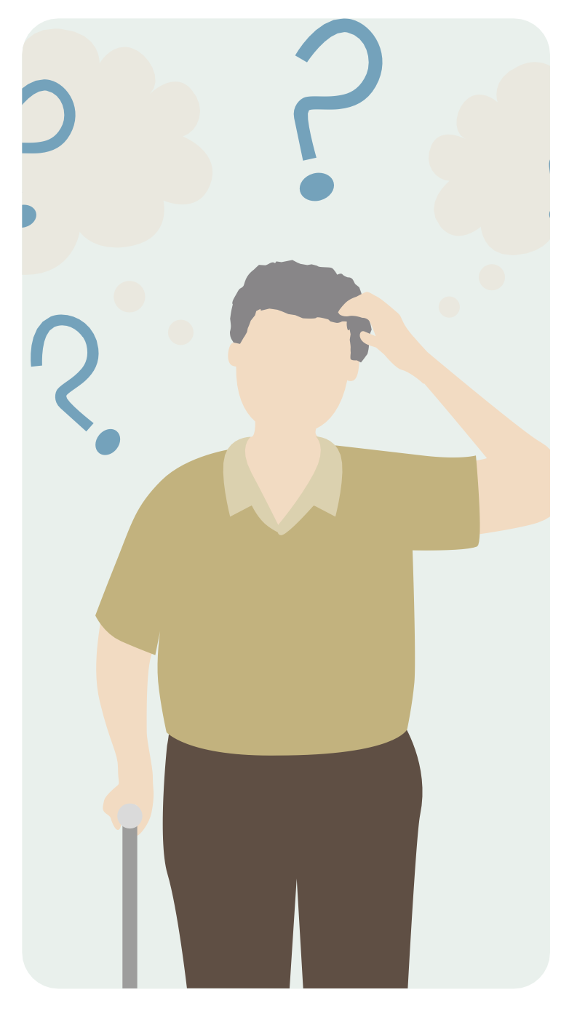
Loss of insight (Anosognosia)
Being unaware or partially aware of one’s cognitive or behavioural deficits.
Involves a lack of insight into one's own condition, often resulting in a failure to recognize the severity of their impairments.
Notes:
Anosognosia is the medical term for a condition in which an individual with a neurodegenerative disorder is unaware or partially aware of their cognitive or behavioral deficits. It involves a lack of insight into one's own condition, often resulting in a failure to recognize the severity of their impairments.

Slide 22
Loss of insight (Anosognosia)
Prevalence: Anosognosia is relatively common in NDDs, especially in diseases like Alzheimer's disease and some variants of frontotemporal dementia.
Causes: The exact cause of anosognosia is not fully understood, but it is thought to be related to the brain changes that occur in NDDs, particularly in regions responsible for self-awareness and self-monitoring.
Impact: Anosognosia can pose challenges for individuals with NDDs, their caregivers, and healthcare providers. Patients may resist treatment or interventions due to a lack of awareness of their condition, which can hinder their care and safety.
Progression: Anosognosia often worsens as the NDD progresses, making it important to continually assess and address changes in awareness.
Notes:
Prevalence: Anosognosia is relatively common in NDDs, especially in diseases like Alzheimer's disease and some variants of frontotemporal dementia.
Causes: The exact cause of anosognosia is not fully understood, but it is thought to be related to the brain changes that occur in NDDs, particularly in regions responsible for self-awareness and self-monitoring.
Impact: Anosognosia can pose challenges for individuals with NDDs, their caregivers, and healthcare providers. Patients may resist treatment or interventions due to a lack of awareness of their condition, which can hinder their care and safety.
Progression: Anosognosia often worsens as the NDD progresses, making it important to continually assess and address changes in awareness.

Slide 23

Self-referential behaviour
Self-referential behaviour, also known as egocentricity or self-centeredness, is a common symptom in some individuals with NDDs.
It involves a heightened focus on one's own needs, desires, and experiences, often at the expense of others' needs.
Notes:
Impact on Daily Functioning: Disinhibition can significantly impact an individual's daily life and relationships. It can strain personal and professional relationships, lead to legal issues, financial problems, and even pose risks to one's safety.
Challenges for Caregivers: Caregivers, whether family members or healthcare professionals, often face considerable challenges in managing and supporting individuals with disinhibition. It can be emotionally and physically draining, requiring a deep understanding of the condition and effective coping strategies.
Progression: It's important to note that disinhibition in NDDs can worsen as the disease progresses. As the brain damage accumulates, the symptoms may become more severe.
disinhibition in the context of NDDs is a complex and challenging symptom that arises from the impact of these diseases on the brain's frontal regions. Recognizing and managing disinhibition is essential for providing effective care, improving the individual's quality of life, and offering support to caregivers and loved ones.

Slide 24
Self-referential behaviour
Prevalence: Self-referential behaviour can be observed in various NDDs but is especially prominent in frontotemporal dementia. It is linked to changes in the brain regions that control social and emotional behaviour.
Behaviours: Individuals exhibiting self-referential behaviour may act as if they are the centre of attention, show a lack of empathy for others, and may not consider the feelings or needs of those around them.
Impact: This behaviour can strain relationships with family members, friends, and caregivers, as individuals with NDDs may become less responsive to the needs of others.
Notes:
Prevalence: Self-referential behavior can be observed in various NDDs but is especially prominent in frontotemporal dementia. It is linked to changes in the brain regions that control social and emotional behavior.
Behaviors: Individuals exhibiting self-referential behavior may act as if they are the center of attention, show a lack of empathy for others, and may not consider the feelings or needs of those around them.
Impact: This behavior can strain relationships with family members, friends, and caregivers, as individuals with NDDs may become less responsive to the needs of others.
In both cases, loss of insight and self-referential behavior are challenging aspects of NDDs that require a multifaceted approach to care and support. Healthcare providers and caregivers should work to create an environment that promotes understanding, patience, and effective communication while also addressing the specific needs and behaviors of individuals with NDDs.

Slide 25
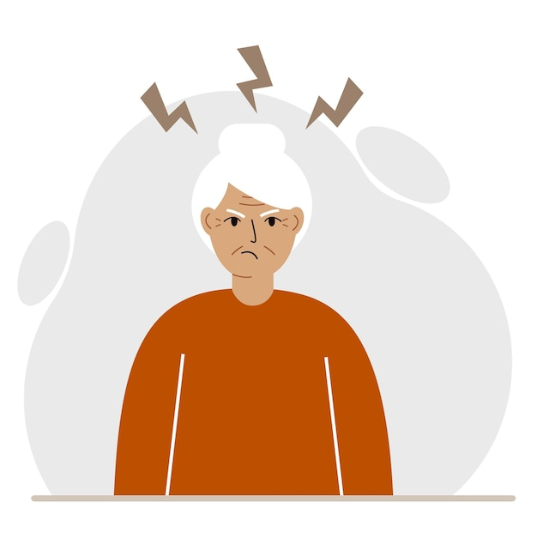
Irritability and aggression
Heightened reactivity, easily triggered frustration or anger
Common in various NDDs (e.g., Alzheimer's, frontotemporal dementia, vascular dementia).
Prevalence often rises with disease progression and cognitive changes.
Notes:
Irritability in the context of neurodegenerative disorders (NDDs) refers to a heightened state of reactivity and easily triggered frustration or anger. This symptom can manifest in individuals with NDDs, causing emotional distress for both the affected individuals and their caregivers. Irritability is a common neuropsychiatric symptom in various NDDs, including Alzheimer's disease, frontotemporal dementia, and vascular dementia. Its prevalence tends to increase as the NDD progresses and as individuals experience more significant cognitive and behavioral changes.

Slide 26
Irritability and aggression
Causes:
  Neurological changes
  Communication difficulties
  Environmental factors
Characteristics:
  Outbursts of anger or frustration.
  Impatience and intolerance for minor inconveniences.
  Heightened sensitivity to sensory stimuli, like noise or touch.
  Agitation and restlessness.
Notes:
The causes of irritability and aggression in NDDs are multifaceted and can include a combination of factors, such as:
Neurological changes: Brain regions responsible for mood regulation and emotional control may be affected by the disease process.
Communication difficulties: Individuals with NDDs may experience frustration due to their challenges in expressing themselves and understanding others.
Environmental factors: Changes in the living environment or daily routines can also trigger irritability.
Irritability and aggression can manifest in various ways, such as:
Outbursts of anger or frustration.
Impatience and intolerance for minor inconveniences.
Heightened sensitivity to sensory stimuli, like noise or touch.
Agitation and restlessness.

Slide 27

Irritability and aggression
Consequences:
  Caregiver distress
  Strained relationships
  Reduced quality of life
Notes:
Irritability can have several significant consequences:
Caregiver distress: Caregivers may experience emotional and physical strain when dealing with irritable behavior.
Strained relationships: Irritability can lead to conflicts and strained relationships with family members and healthcare providers.
Reduced quality of life: For individuals with NDDs, irritability can negatively impact their overall well-being and increase emotional distress.

Slide 28
Repetitive behaviours
Consistent, recurring actions or activities
Result from cognitive and neurological changes
Prevalence and Causes:
Common in NDDs (e.g., Alzheimer's, frontotemporal dementia, Parkinson’s).
Linked to specific brain changes and deficits, e.g., memory and adaptability in Alzheimer's.
Notes:
Repetitive behaviors in the context of neurodegenerative disorders (NDDs) refer to the consistent, recurring actions or activities that individuals with these conditions may engage in. These behaviors are often a result of cognitive and neurological changes and can have various forms and causes.
Repetitive behaviors are relatively common in NDDs, including Alzheimer's disease, frontotemporal dementia, and Parkinson's disease. The underlying causes of these behaviors are often related to specific brain changes associated with these disorders. For example, in Alzheimer's disease, they may result from memory deficits and difficulties in adapting to changing circumstances.

Slide 29
Repetitive behaviours
Repetitive behaviours:
  Motor behaviours
  Verbal behaviours
  Routines and rituals
  Obsessions and compulsions
Function and Purpose:
  Coping mechanism
  Comfort and familiarity
  Communication
Notes:
Repetitive behaviors can take various forms, including:
Motor behaviors: This includes actions like pacing, tapping, hand-wringing, or constantly rearranging objects.
Verbal behaviors: Individuals may repeat words, phrases, or questions, often without a clear purpose.
Routines and rituals: Establishing rigid daily routines and rituals can be a way to cope with anxiety and uncertainty.
Obsessions and compulsions: Some individuals may exhibit obsessive thoughts or engage in compulsive behaviors that they feel compelled to repeat.
Repetitive behaviors may serve different functions, such as:
Coping mechanism: These behaviors can help individuals with NDDs manage anxiety, stress, or cognitive challenges.
Comfort and familiarity: Repetition can provide a sense of comfort and familiarity in an otherwise confusing or disorienting world.
Communication: In some cases, these behaviors may be a way for individuals to express their needs, discomfort, or distress when verbal communication is compromised.

Slide 30
Repetitive behaviours
Imagine working with a patient named Kala, who has been diagnosed with Alzheimer's disease. Repetitive behaviors in Kala might look like the following:
Constant Pacing: Kala frequently paces back and forth in her living space, hallway, or a specific room, often without any apparent reason. This repetitive walking can continue for extended periods and may interfere with her daily routine.
Continuous Verbal Repetition: Kala repeatedly asks the same questions or makes the same statements, even after receiving answers. For instance, she might ask, "What time is it?" multiple times within a few minutes, regardless of the response.
Sorting and Rearranging Objects: Kala may repetitively sort and rearrange objects around her. She could spend hours rearranging the contents of her purse or organizing items on her kitchen table without a clear purpose.
Compulsive Handwashing: Repetitive handwashing can be a common behavior. Kala may wash her hands multiple times in a short span, potentially causing skin irritation or discomfort.
Checking Doors and Locks: She may check doors and locks repeatedly, even immediately after verifying their security. This behavior can lead to anxiety and frustration, as she believes the doors are constantly unlocked.
Frequent Request for Confirmation: Kala may seek reassurance or confirmation for routine tasks, like whether she's taken her medication or locked her front door. She may repeatedly call family members or caregivers to verify these actions.
Endless Folding and Unfolding of Clothing: Repetitive folding and unfolding of clothes, such as a stack of towels or a piece of fabric, can be another manifestation. Kala may engage in this activity for extended periods.
Notes:
Repetitive behavior in the context of healthcare for a Sri Lankan individual with a neurodegenerative disorder, such as Alzheimer's disease, can manifest as the persistent and recurring performance of specific actions, often without a clear purpose or goal. Let's explore this behavior through a real-life, everyday example from a healthcare provider's perspective:
Imagine working with a patient named Kala, who has been diagnosed with Alzheimer's disease. Repetitive behaviors in Kala might look like the following:
Constant Pacing: Kala frequently paces back and forth in her living space, hallway, or a specific room, often without any apparent reason. This repetitive walking can continue for extended periods and may interfere with her daily routine.
Continuous Verbal Repetition: Kala repeatedly asks the same questions or makes the same statements, even after receiving answers. For instance, she might ask, "What time is it?" multiple times within a few minutes, regardless of the response.
Sorting and Rearranging Objects: Kala may repetitively sort and rearrange objects around her. She could spend hours rearranging the contents of her purse or organizing items on her kitchen table without a clear purpose.
Compulsive Handwashing: Repetitive handwashing can be a common behavior. Kala may wash her hands multiple times in a short span, potentially causing skin irritation or discomfort.
Checking Doors and Locks: She may check doors and locks repeatedly, even immediately after verifying their security. This behavior can lead to anxiety and frustration, as she believes the doors are constantly unlocked.
Frequent Request for Confirmation: Kala may seek reassurance or confirmation for routine tasks, like whether she's taken her medication or locked her front door. She may repeatedly call family members or caregivers to verify these actions.
Endless Folding and Unfolding of Clothing: Repetitive folding and unfolding of clothes, such as a stack of towels or a piece of fabric, can be another manifestation. Kala may engage in this activity for extended periods.
From a healthcare provider's perspective, addressing repetitive behaviors in individuals with neurodegenerative disorders is important for their well-being. Strategies may include redirection, engagement in purposeful activities, and creating a structured daily routine to minimize stress and anxiety. Caregivers and family members often play a vital role in helping manage and provide support for individuals like Kala while ensuring their safety and comfort. It's crucial to provide a compassionate and patient-centered approach to care for individuals exhibiting repetitive behaviors.

Slide 31
Changes in eating behaviour
Changes in eating behaviours are relatively common in NDDs, particularly in conditions like Alzheimer's disease, frontotemporal dementia, and Parkinson's disease.
Individuals with NDDs may exhibit:
  Loss of appetite
  Overeating or binge eating
  Changes in food preferences
  Food rituals
Notes:
Individuals with NDDs may exhibit a range of changes in eating behaviors, including:
Loss of appetite: A reduced desire to eat, leading to unintended weight loss.
Overeating or binge eating: Some individuals may consume excessive amounts of food, potentially leading to weight gain.
Changes in food preferences: Altered taste perception or heightened sensitivity to certain flavors, leading to dietary changes.
Food rituals: The development of rigid routines or rituals surrounding meals.
Changes in eating behaviors can have significant consequences:
Nutritional deficiencies: Poor dietary intake can result in nutrient imbalances and deficiencies.
Weight changes: Unintended weight loss or weight gain can affect overall health.
Emotional distress: Individuals with NDDs may experience frustration, anxiety, or depression related to their eating behaviors.
It's important to approach these changes in eating behaviors with sensitivity and flexibility, recognizing that they are often a result of the neurological changes caused by NDDs.

Slide 32
Psychiatric Disorders
Notes:
Treating psychopathological symptoms in individuals with neurodegenerative disorders can enhance their overall functioning, independence, and social engagement. By addressing these symptoms, caregivers can contribute to improving the individual's overall quality of life.

Slide 33

Psychiatric disorders
According to the American Psychiatric Association (APA), a psychiatric disorder, or a mental disorder refers to a noticeable disturbance in a person’s emotions, behaviours, or thinking patterns that impacts their quality of life.

Slide 34
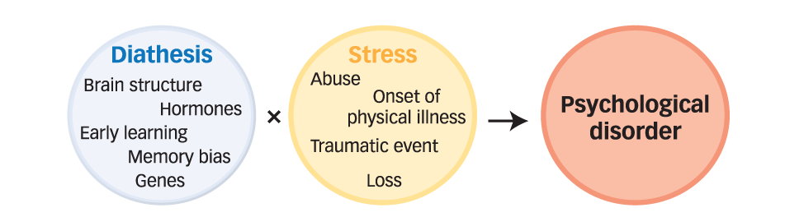
Diathesis-stress model
Notes:
The diathesis-stress model is a psychological framework used to understand the development of psychopathology, which refers to the study of mental disorders. This model suggests that psychopathology results from the interaction of two factors: diathesis and stress.
Diathesis:
Diathesis refers to an individual's predisposition or vulnerability to developing a mental disorder. This vulnerability can be influenced by genetic, biological, psychological, or environmental factors. Some people may have a higher diathesis, which means they are more predisposed to mental health problems due to their genetic makeup or life experiences. Diathesis factors can include things like a family history of mental illness, a specific genetic predisposition, or a personality trait that increases vulnerability.
Stress:
Stress, in the context of the diathesis-stress model, represents life events or environmental factors that put pressure on an individual. These stressors can be acute, chronic, or related to major life changes. Examples of stressors include traumatic experiences, relationship conflicts, financial difficulties, academic or occupational pressures, and more. The impact of stress can vary from person to person.
According to the diathesis-stress model, the development of a mental disorder occurs when an individual's diathesis (vulnerability) interacts with the level of stress they experience.

Slide 35
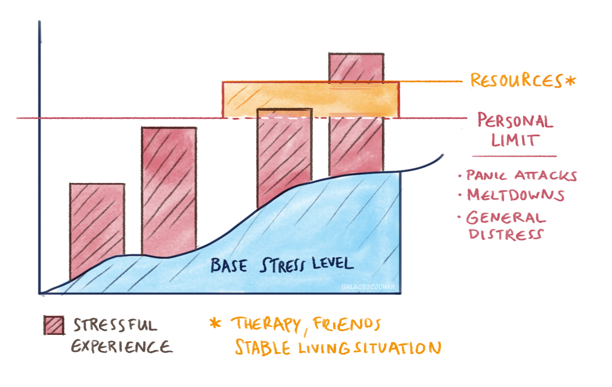
Diathesis-stress model
Notes:
Imagine a seesaw. On one side, there's something about you that makes you sensitive to stress, like sensory sensitivities in autism. This is your "vulnerability."
On the other side, there are stressors like school problems, loud noises, or social situations. This is your "stress."
Your baseline stress level is like where the seesaw starts. Some people start high because of their NDD traits; others start lower.
Your personal limit is how much stress you can handle before feeling overwhelmed. It's different for everyone.
If your baseline stress level is high, or if you face a lot of stressors, and it goes beyond your personal limit, you might experience mental health difficulties.
Resources, like therapy, friends, and coping strategies, can help you manage stress and keep it under your personal limit, so you don't have mental health problems.

Slide 36
Classifying disorders
The classification of psychiatric disorders is crucial for organizing, diagnosing, and treating psychological conditions.
There are two primary classification systems:
The Diagnostic and Statistical Manual of Mental Disorders (DSM), published by the American Psychiatric Association - widely used in the United States and many other countries.
The International Statistical Classification of Diseases and Related Health Problems (ICD) by the World Health Organization - used globally for clinical diagnoses, epidemiology, and health management purposes.
Both classification systems provide a common language and set of criteria for diagnosing mental disorders, promoting consistency and facilitating communication among clinicians and researchers.
The current editions are DSM-5-TR and ICD-11, with the DSM-5-TR being more widely used in clinical practice.
Notes:
The classification of mental disorders is crucial for organizing, diagnosing, and treating psychological conditions.
The two primary classification systems used worldwide are the Diagnostic and Statistical Manual of Mental Disorders (DSM) and the International Classification of Diseases (ICD).
The DSM, published by the American Psychiatric Association, is widely used in the United States and many other countries.
The ICD, developed by the World Health Organization (WHO), is used globally for clinical diagnoses, epidemiology, and health management purposes.
Both classification systems provide a common language and set of criteria for diagnosing mental disorders, promoting consistency and facilitating communication among clinicians and researchers.
The current editions are DSM-5 and ICD-11, with the DSM-5 being more widely used in clinical practice.

Slide 37
Who can make a diagnosis?
Psychiatrists: These medical doctors specialize in psychiatry and have the authority to diagnose mental health disorders. They undergo extensive training and are licensed to practice medicine and provide psychiatric care.
Clinical Psychologists: Trained in psychological testing and assessment, clinical psychologists can diagnose various mental health conditions. They use standardized measures, interviews, and observations to gather comprehensive information for an accurate diagnosis.
Psychiatric Nurses: Psychiatric nurses may be involved in the assessment and diagnosis of mental health disorders, particularly in the context of psychiatric settings. They work under the supervision of psychiatrists and contribute to the diagnostic process.
Mental Health Professionals: Other qualified mental health professionals, such as psychiatric social workers and mental health counsellors, may have the competence to provide provisional diagnoses within their scope of practice. They may work collaboratively with psychiatrists and psychologists to ensure accurate diagnoses and appropriate treatment plans.
Notes:
Psychiatrists: These medical doctors specialize in psychiatry and have the authority to diagnose mental health disorders. They undergo extensive training and are licensed to practice medicine and provide psychiatric care.
Clinical Psychologists: Trained in psychological testing and assessment, clinical psychologists can diagnose various mental health conditions. They use standardized measures, interviews, and observations to gather comprehensive information for an accurate diagnosis.
Psychiatric Nurses: Psychiatric nurses may be involved in the assessment and diagnosis of mental health disorders, particularly in the context of psychiatric settings. They work under the supervision of psychiatrists and contribute to the diagnostic process.
Mental Health Professionals: Other qualified mental health professionals, such as psychiatric social workers and mental health counsellors, may have the competence to provide provisional diagnoses within their scope of practice. They may work collaboratively with psychiatrists and psychologists to ensure accurate diagnoses and appropriate treatment plans.

Slide 38

Who can make a diagnosis?
It is important to note that the specific regulations and practices regarding psychiatric diagnosis may vary within different regions and healthcare settings across countries. It is advisable to consult local authorities or healthcare institutions for the most accurate and up-to-date information.
https://nimh.health.gov.lk/en/

Slide 39
Psychiatric Disorders
Here, we will cover some of the most common psychiatric conditions and disorders in individuals with NDDs:
  Anxiety Disorders
  Mood Disorders
  Delirium
  Psychosis

Slide 40
Anxiety Disorders
Anxiety disorders are common mental health conditions characterized by excessive and persistent feelings of worry, fear, and apprehension
Anxiety disorders can impact individuals of all ages, genders, and backgrounds
We all feel anxious at times, but with an anxiety disorder, the anxiety tends to be fairly constant and has a very negative and intrusive impact on daily functioning and quality of life

Slide 41
Types of Anxiety Disorders
Generalized Anxiety Disorder (GAD): Chronic and excessive worry about various aspects of life
Panic Disorder: Recurrent and unexpected panic attacks accompanied by intense physical and psychological symptoms
Social Anxiety Disorder: Intense fear of social situations and significant distress during social interactions
Specific Phobias: Excessive fear of specific objects or situations (e.g., spiders, heights, flying)
Obsessive-Compulsive Disorder (OCD): Intrusive thoughts (obsessions) and repetitive behaviors (compulsions)
Post-Traumatic Stress Disorder (PTSD): Develops after experiencing or witnessing a traumatic event

Slide 42
Symptoms of Anxiety Disorders
Psychological symptoms
  Excessive worrying: Persistent and uncontrollable worries that are disproportionate to the situation. These worries may relate to various aspects of life, such as work, relationships, health, or finances.
  Restlessness and irritability: Anxiety can lead to a constant feeling of restlessness, making it difficult to relax or stay still. Irritability and a low tolerance for frustration are also common, causing individuals to become easily agitated or annoyed.
  Difficulty concentrating: Anxiety can impair concentration and focus. Individuals may find it challenging to pay attention to tasks, follow conversations, or remember information. This can interfere with academic or professional performance.
  Sleep disturbances: Anxiety often disrupts sleep patterns. Individuals may have trouble falling asleep, experience frequent awakenings throughout the night, or have restless, unsatisfying sleep. Consequently, they may wake up feeling tired and fatigued.

Slide 43
Anxiety vs Anxiety Disorders
Aspect | Normal Anxiety | Anxiety Disorder
Intensity | Proportional to situation | Excessive, overwhelming
Duration | Temporary | Chronic, lasting at least 6 months or longer
Triggers | Specific stressors | May lack specific triggers or have non-specific triggers
Impact on Daily Life | Does not significantly interfere | Significant interference with daily tasks, relationships, and overall functioning
Physical Symptoms | Mild and short-lived | Severe and chronic physical symptoms
Seeking Professional Help | Often managed with support | Often requires professional help for effective management
Notes:
Differentiating normal anxiety from an anxiety disorder involves considering the intensity, duration, and impact of the anxiety on an individual's life. Here are some key distinctions to help you differentiate between the two:
Intensity:
Normal Anxiety: Normal anxiety is a natural response to stress or threats and is typically proportional to the situation. It may feel uncomfortable, but it is manageable and does not overwhelm daily functioning.
Anxiety Disorder: Anxiety disorders involve excessive and intense anxiety that is often out of proportion to the trigger or is present without any apparent cause. The anxiety in a disorder can be so severe that it interferes with a person's ability to function effectively.
Duration:
Normal Anxiety: Normal anxiety is temporary and usually subsides once the stressor or threat is resolved. It is a fleeting response to specific situations.
Anxiety Disorder: Anxiety disorders are characterized by chronic, persistent anxiety that lasts for at least six months or longer. The anxiety often persists, even when there is no immediate threat or stressor.
Triggers:
Normal Anxiety: Normal anxiety is often triggered by identifiable stressors, such as a work deadline, a public speaking event, or a personal relationship issue.
Anxiety Disorder: Anxiety disorders may not have specific triggers or can be triggered by minor or non-specific situations, making the anxiety more pervasive and less predictable.
Impact on Daily Life:
Normal Anxiety: Normal anxiety does not significantly interfere with a person's daily life, relationships, or overall functioning. It may even be motivating and help with problem-solving.
Anxiety Disorder: Anxiety disorders have a substantial negative impact on a person's ability to carry out daily tasks, maintain relationships, and participate in activities they once enjoyed. These disorders often lead to significant distress and impairment in various areas of life.
Physical Symptoms:
Normal Anxiety: Physical symptoms, such as muscle tension or a mild increase in heart rate, are common in response to normal anxiety but are not severe or persistent.
Anxiety Disorder: Anxiety disorders can lead to severe physical symptoms like panic attacks, constant muscle tension, or gastrointestinal problems that are chronic and disruptive.
Seeking Professional Help:
Normal Anxiety: Most people can manage normal anxiety on their own or with support from friends and family.
Anxiety Disorder: Individuals with anxiety disorders often require professional help, such as therapy or medication, to manage their symptoms effectively.
If you or someone you know is experiencing anxiety that is chronic, intense, and significantly affecting daily life, it's important to seek help from a healthcare provider or mental health professional for an accurate diagnosis and appropriate treatment. Anxiety disorders are treatable, and early intervention can lead to improved quality of life.

Slide 44

Mood Disorders
Mood disorders are a category of mental health conditions characterized by significant and persistent disturbances in mood, emotions, and overall emotional well-being.
They can significantly impact a person's daily functioning, relationships, and overall quality of life.
Moods may range from extremely low (depressed), to extremely high or irritable (manic).

Slide 45
Types of Mood Disorders
Mood disorders encompass a range of conditions, including major depressive disorder, bipolar disorder, and persistent depressive disorder.
Major Depressive Disorder (MDD): Marked by persistent feelings of sadness, loss of interest or pleasure, changes in appetite and sleep, fatigue, difficulty concentrating, and thoughts of death or suicide.
Bipolar Disorder: Involves extreme mood swings, including manic episodes of elevated mood, energy, and risky behavior, as well as depressive episodes with symptoms similar to major depressive disorder.
Persistent Depressive Disorder (PDD): A chronic form of depression lasting for at least two years, characterized by milder symptoms than MDD but lasting longer.

Slide 46
Symptoms of Mood Disorders
Depressive Symptoms: Persistent sadness, loss of interest, changes in appetite and sleep, fatigue, difficulty concentrating, feelings of worthlessness or guilt, and thoughts of death or suicide.
Manic Symptoms (Bipolar Disorder): Elevated mood, extreme energy, decreased need for sleep, increased self-esteem, racing thoughts, impulsivity, and engaging in risky behaviors.
Chronic Low Mood (PDD): Persistent feelings of sadness or emptiness, lack of interest in activities, low self-esteem, poor concentration, and a general sense of hopelessness.
It's important to note that the specific symptoms and their severity may vary among individuals and different types of mood disorders. Diagnosis and appropriate treatment by a healthcare professional are essential for accurate management of mood disorders.

Slide 47
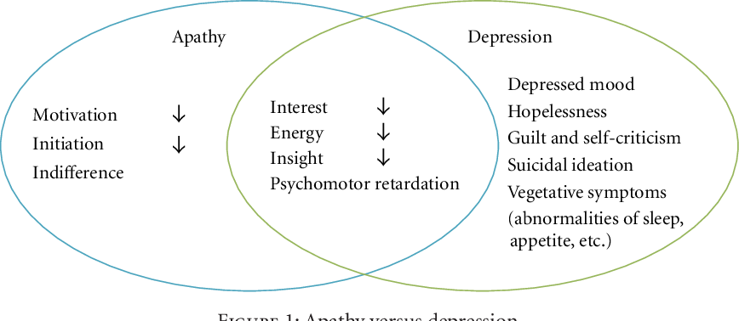
Apathy vs Depression

Slide 48

Delirium
Delirium is an acute and fluctuating mental state characterized by disturbances in attention, awareness, and cognitive functioning.
It is a temporary state of confusion and cognitive impairment that develops rapidly, typically within hours or days
It is not a primary psychiatric disorder but a secondary condition caused by an underlying medical or physiological problem.

Slide 49
Symptoms of Delirium
Disturbances in attention: Individuals with delirium often have difficulty focusing, sustaining, or shifting attention. They may appear easily distracted and have trouble following conversations or completing tasks.
Altered level of consciousness: Delirium can cause fluctuations in a person's level of awareness and consciousness. They may experience periods of hyperalertness, followed by drowsiness or even periods of stupor.
Disorganized thinking: Delirium can lead to disorientation, confusion about time, place, and personal identity. Individuals may have difficulty recalling recent events or recognizing familiar people or surroundings.
Fluctuating course: Delirium symptoms can vary throughout the day, with periods of relative clarity and periods of increased confusion or agitation. These fluctuations are characteristic of delirium and distinguish it from other cognitive disorders.

Slide 50
Delirium
Mrs. De Silva is a Sri-Lankan woman in her late 70s who has Alzheimer's disease. She is typically calm and resides in a memory care facility. However, she experiences an episode of delirium due to a urinary tract infection (UTI), which is a common trigger for delirium in older adults.
Profound Confusion: Mrs. De Silva, usually cheerful and coherent, suddenly appears profoundly confused. She doesn't recognize her caregivers or fellow residents. When asked about her family in Sri Lanka, she responds with fragmented and nonsensical sentences, as if lost in a labyrinth of her own thoughts.
Agitation and Restlessness: Mrs. De Silva's calm demeanor gives way to restlessness and agitation. She attempts to leave her room repeatedly, believing she needs to catch a flight to Sri Lanka. She paces back and forth, wringing her hands in visible distress.
Incoherent Speech: Her speech becomes incoherent and disjointed. She speaks rapidly in her native Sinhala language, often switching between languages and dialects, creating further confusion for caregivers who cannot understand her.
Hallucinations and Fear: Mrs. De Silva experiences vivid hallucinations. She believes she sees her long-deceased husband and relatives in the room, and she expresses fear and distress, often reaching out to touch these apparitions.
Refusal of Food and Medication: She refuses to eat or take her prescribed medication. It's as if she believes that the food and pills offered to her are part of a foreign and unfamiliar world, causing her to push them away.
Increased Aggression: Mrs. De Silva, who is usually gentle, exhibits moments of aggression. She may scratch or push away caregivers, and she vocalizes frustration loudly, making it challenging for the staff to provide care.
Notes:
let's illustrate what delirium may look like from the perspective of a healthcare provider caring for a Sri-Lankan individual with a neurodegenerative disorder, such as Alzheimer's disease, through a real-life, everyday scenario:
Scenario: Mrs. De Silva's Episode of Delirium
Background: Mrs. De Silva is a Sri-Lankan woman in her late 70s who has Alzheimer's disease. She is typically calm and resides in a memory care facility. However, she experiences an episode of delirium due to a urinary tract infection (UTI), which is a common trigger for delirium in older adults.
1. Profound Confusion: Mrs. De Silva, usually cheerful and coherent, suddenly appears profoundly confused. She doesn't recognize her caregivers or fellow residents. When asked about her family in Sri Lanka, she responds with fragmented and nonsensical sentences, as if lost in a labyrinth of her own thoughts.
2. Agitation and Restlessness: Mrs. De Silva's calm demeanor gives way to restlessness and agitation. She attempts to leave her room repeatedly, believing she needs to catch a flight to Sri Lanka. She paces back and forth, wringing her hands in visible distress.
3. Incoherent Speech: Her speech becomes incoherent and disjointed. She speaks rapidly in her native Sinhala language, often switching between languages and dialects, creating further confusion for caregivers who cannot understand her.
4. Hallucinations and Fear: Mrs. De Silva experiences vivid hallucinations. She believes she sees her long-deceased husband and relatives in the room, and she expresses fear and distress, often reaching out to touch these apparitions.
5. Refusal of Food and Medication: She refuses to eat or take her prescribed medication. It's as if she believes that the food and pills offered to her are part of a foreign and unfamiliar world, causing her to push them away.
6. Increased Aggression: Mrs. De Silva, who is usually gentle, exhibits moments of aggression. She may scratch or push away caregivers, and she vocalizes frustration loudly, making it challenging for the staff to provide care.
From the healthcare provider's perspective, this episode of delirium in Mrs. De Silva is akin to a sudden, turbulent storm disrupting her otherwise calm and familiar world. The provider's role is to address the underlying cause of the delirium (in this case, the UTI), closely monitor her, and provide a supportive and reassuring environment. Delirium is often reversible when the underlying cause is treated, and Mrs. De Silva's caregivers aim to guide her safely through the cognitive tempest and back to her usual state of well-being.

Slide 51

Psychosis
Psychosis refers to a mental health condition characterized by a loss of touch with reality, leading to a range of cognitive, emotional, and behavioral disturbances.
It is a symptom rather than a standalone disorder.
People experiencing psychosis may have difficulty distinguishing between what is real and what is not.

Slide 52
Psychosis
Psychosis can occur as a feature of various psychiatric disorders, most notably schizophrenia, but it can also be associated with other conditions such as bipolar disorder, major depressive disorder with psychotic features, or substance-induced psychosis.
Schizophrenia: A chronic mental disorder characterized by hallucinations, delusions, disorganized thinking, and behavioural changes.
  Bipolar Disorder: A mood disorder involving episodes of mania and depression, with psychotic symptoms sometimes occurring during manic or depressive episodes.
Drug-Induced Psychosis: Psychosis triggered by substance abuse, such as hallucinogens, stimulants, or excessive alcohol consumption.
Brief Psychotic Disorder: A short-term episode of psychosis triggered by severe stress, trauma, or other external factors.

Slide 53
Symptoms of Psychosis
Hallucinations: Sensory experiences (seeing, hearing, or feeling things) that are not present in reality.
Delusions: Firmly held beliefs or ideas that are not based on evidence or rational thinking.
Disorganized Thinking: Difficulty organizing thoughts, expressing ideas coherently, or maintaining logical connections.
Disorganized Behavior: Impaired ability to carry out daily activities, erratic movements, or unpredictable behaviors.
Negative Symptoms: Reduced motivation, emotional expressiveness, or social engagement.

Slide 54
Psychosis and NDDs
Psychosis can occur in various neurodegenerative disorders, but the frequency and severity may vary. For example, psychosis is relatively common in Dementia with Lewy Bodies (DLB), occurring in up to 80% of cases, while it is less prevalent in Alzheimer's disease or Parkinson's disease.
Psychosis often emerges in the later stages of neurodegenerative disorders, as the underlying brain pathology progresses. However, in some cases, particularly in Dementia with Lewy Bodies, psychosis can be an early and prominent symptom.
Psychosis in neurodegenerative disorders can manifest as hallucinations (perceiving things that are not there) or delusions (firmly held false beliefs). Visual hallucinations are particularly common, but auditory and other sensory hallucinations can also occur. Delusions may involve paranoid beliefs or grandiose ideas.
Psychosis can significantly impact the well-being and quality of life of individuals with neurodegenerative disorders. It can lead to distress, confusion, and impaired functioning, making it more challenging for patients to perform daily activities and communicate effectively.

Slide 55
Psychopathology and Disease Progression
Notes:
Treating psychopathological symptoms in individuals with neurodegenerative disorders can enhance their overall functioning, independence, and social engagement. By addressing these symptoms, caregivers can contribute to improving the individual's overall quality of life.

Slide 56
Psychopathology and disease progression
NDD symptoms
Psychopathology
Notes:
The connection between neurodegenerative disorders (NDDs) and psychopathological conditions is intricate and involves a two-way interaction. On one hand, having an NDD increases the likelihood of experiencing psychological issues. Conversely, these psychological issues can make the symptoms of NDDs worse. In simpler terms, NDDs can lead to mental health problems, and mental health problems, in turn, can make NDD symptoms more severe.

Slide 57
Reduced quality of life
Emotional distress
Social isolation
Loss of independence
Cognitive impairment
Negative impact on carers
Less enjoyable activities
Physical health complications
Higher healthcare costs
Risk of self-harm
Lower overall wellbeing
Notes:
Psychopathology can significantly reduce the quality of life for individuals with neurodegenerative disorders (NDDs) in several ways:
Emotional Distress: Psychopathological conditions like depression and anxiety can cause intense emotional distress in NDD patients. The constant feelings of sadness, worry, or fear can make everyday life challenging and less enjoyable, leading to a diminished quality of life.
Social Isolation: Many individuals with NDDs experience cognitive decline and behavioral changes, which can make social interactions more difficult. Psychopathological symptoms can exacerbate this, causing patients to withdraw from social activities, leading to isolation and loneliness.
Loss of Independence: NDD patients often value their independence, but psychopathological symptoms can compromise their ability to perform daily tasks. For example, individuals with Parkinson's disease who experience depression may find it difficult to complete routine activities, like dressing or preparing meals, without assistance.
Cognitive Impairment: Psychopathological conditions can worsen cognitive deficits in NDDs. For instance, anxiety can lead to difficulty concentrating and memory problems, which can further reduce a person's ability to engage in meaningful activities or conversations.
Negative Impact on Caregivers: The burden of caring for NDD patients with psychopathological symptoms falls on their caregivers. This can lead to increased stress, exhaustion, and a reduced quality of life for the caregivers themselves.
Reduced Participation in Enjoyable Activities: Psychopathological conditions can sap motivation and interest in hobbies and activities that once brought joy. This can leave NDD patients feeling unfulfilled and unhappy.
Physical Health Complications: The stress and anxiety associated with psychopathological symptoms can have physical health implications. Stress, for instance, can exacerbate the physical symptoms of NDDs, making movement or self-care even more challenging.
Lower Overall Well-Being: The combination of cognitive decline, emotional distress, and social isolation can result in a lower overall sense of well-being. NDD patients may struggle to find meaning and satisfaction in their lives due to the compounding effects of both conditions.
Higher Healthcare Costs: The presence of psychopathological symptoms may lead to increased healthcare costs due to the need for additional psychiatric care, medications, and hospitalization. This can add financial stress, further reducing the quality of life for NDD patients and their families.
Risk of Self-Harm: In some cases, psychopathological symptoms may lead to self-harming thoughts or actions. The despair and hopelessness associated with both conditions can increase the risk of self-harm, adding an additional layer of distress and danger.

Slide 58

Psychopathology and disease progression
Disease progression
Stress-related neuroinflammation
Cognitive impairment
Neurotransmitter imbalances
Physical health consequences
Hormonal changes
Behavioural changes
Reduced medication adherence
Impaired coping mechanisms
Impact on family and caregivers
Notes:
Psychopathology can exacerbate the disease progression of Neurodegenerative Disorders (NDDs) in several ways. NDDs, such as Alzheimer's disease, Parkinson's disease, and Huntington's disease, are characterized by the progressive degeneration of the nervous system. When individuals with NDDs also experience psychopathological conditions, the interaction between the two can accelerate the decline in cognitive and physical function. Here's how psychopathology can exacerbate NDDs' disease progression:
Stress-Related Neuroinflammation: Psychopathological conditions, particularly chronic stress and anxiety, can trigger a neuroinflammatory response. This neuroinflammation may exacerbate the underlying neuroinflammatory processes associated with many NDDs, such as Alzheimer's disease. The combination of these inflammatory processes can accelerate neuronal damage and cognitive decline.
Cognitive Impairment: Psychopathological symptoms like depression and anxiety can impair cognitive functioning. In NDDs where cognitive decline is a primary feature, such as Alzheimer's disease, this comorbidity can intensify the cognitive impairment, leading to faster progression of cognitive deficits.
Neurotransmitter Imbalances: Many psychopathological conditions involve disturbances in neurotransmitter systems, and NDDs also often involve disruptions in these systems. When both sets of conditions are present, there can be additive or synergistic effects on neurotransmitter imbalances, which can further impact cognitive and motor functions. For example, dopamine imbalances in Parkinson's disease can be exacerbated by comorbid depression.
Physical Health Consequences: Psychopathology can lead to negative health behaviors and consequences. For instance, individuals with NDDs who experience psychopathological conditions may be less likely to engage in physical exercise, maintain a healthy diet, or adhere to medication regimens. This can worsen physical symptoms and contribute to disease progression in NDDs.
Hormonal Changes: Stress associated with psychopathology can lead to changes in hormonal systems. In some NDDs, like Alzheimer's, changes in the stress hormone cortisol have been linked to disease progression. Psychopathology-induced hormonal changes can thus exacerbate the neurodegenerative processes.
Behavioral Changes: Psychopathological symptoms, such as agitation, aggression, and social withdrawal, can lead to behavioral changes that negatively affect the individual's ability to engage in therapeutic activities and interact with caregivers and support systems. These changes can impact the quality of life and exacerbate the progression of NDDs.
Medication Adherence: Individuals with both NDDs and psychopathology may struggle with medication adherence due to cognitive deficits or apathy. Non-adherence to NDD medications can result in suboptimal symptom management and disease progression.
Impaired Coping Mechanisms: Psychopathological conditions can interfere with the individual's ability to cope with the challenges of NDDs. This may result in increased distress, worsening of symptoms, and further progression of the neurodegenerative disorder.
Impact on Caregivers: The presence of psychopathological symptoms in individuals with NDDs can increase the burden on caregivers. Caregivers may experience high levels of stress, anxiety, and depression themselves, affecting their ability to provide care and support. This can indirectly contribute to the worsening of the individual's condition.

Slide 59

Benefits of treating psychopathology
Slower disease progression
Enhanced medication adherence
Improved quality of life
Reduced caregiver burden
Enhanced coping mechanisms
Reduction in behavioral disturbances
Improved social functioning
Financial benefits
Notes:
Treating psychopathological symptoms in individuals with Neurodegenerative Disorders (NDDs) offers several significant benefits in terms of disease progression and overall well-being:
Slower Disease Progression: Addressing psychopathological symptoms can lead to better disease management. Research suggests that individuals with NDDs who receive treatment for coexisting psychopathology may experience a slower rate of cognitive and physical decline. For example, treating depression in Alzheimer's disease can help preserve cognitive function for a longer duration.
Enhanced Medication Adherence: Psychopathology, such as apathy or forgetfulness, can lead to non-adherence to medications prescribed for the NDD. Treating psychopathological symptoms can improve medication adherence, ensuring that the individual receives the full therapeutic benefits of NDD-specific treatments.
Improved Quality of Life: Addressing psychopathological symptoms can significantly enhance the overall quality of life for individuals with NDDs. By reducing mood disturbances, anxiety, and behavioral challenges, individuals can enjoy a better sense of well-being and engagement in daily activities.
Reduced Caregiver Burden: Treating psychopathological symptoms helps alleviate the burden on caregivers. This, in turn, enables caregivers to provide better care, reducing stress and burnout. When caregivers are better equipped to support their loved ones, it benefits both the patient and the caregiver's well-being.
Enhanced Coping Mechanisms: Psychological interventions can equip individuals with NDDs with better coping mechanisms, enabling them to navigate the challenges of their condition more effectively. This can lead to increased resilience and adaptability, which can slow the progression of both NDDs and psychopathology.
Reduction in Behavioral Disturbances: Managing psychopathological symptoms often reduces challenging behaviors that may exacerbate NDD symptoms. For instance, individuals with frontotemporal dementia who receive treatment for mood disturbances are less likely to exhibit aggressive or impulsive behaviors, creating a more stable environment for themselves and their caregivers.
Improved Social Functioning: Addressing psychopathological symptoms can lead to improved social interactions. Reducing social withdrawal and enhancing emotional regulation can help individuals with NDDs maintain social relationships, further enhancing their overall well-being.
Financial Benefits: Effective treatment of psychopathological symptoms may lead to cost savings in terms of healthcare utilization. Reduced hospitalization and medical interventions may lower the financial burden on both individuals and healthcare systems.
In summary, addressing psychopathological symptoms in individuals with NDDs not only enhances their emotional and psychological well-being but also has a direct and positive impact on disease progression. By providing comprehensive care that considers both NDD-specific and psychopathological symptoms, we can improve the overall trajectory of the individuals affected by these challenging conditions.

Slide 60
References
Ballard, C., Neill, D., O’Brien, J., McKeith, I. G., Ince, P., & Perry, R. (2000). Anxiety, depression and psychosis in vascular dementia: Prevalence and associations. Journal of Affective Disorders, 59(2), 97–106. https://doi.org/10.1016/S0165-0327(99)00057-9
Leung, D. K., Chan, W. C., Spector, A., & Wong, G. H. (2021). Prevalence of depression, anxiety, and apathy symptoms across dementia stages: A systematic review and meta‐analysis. International Journal of Geriatric Psychiatry, 36(9), 1330-1344. https://doi.org/10.1002/gps.5556
Wolitzky-Taylor, K. B., Castriotta, N., Lenze, E. J., Stanley, M. A., & Craske, M. G. (2010). Anxiety disorders in older adults: A comprehensive review. Depression and Anxiety, 27(2), 190–211. https://doi.org/10.1002/da.20653
Zhao, Q. F., Tan, L., Wang, H. F., Jiang, T., Tan, M. S., Tan, L., ... & Yu, J. T. (2016). The prevalence of neuropsychiatric symptoms in Alzheimer's disease: systematic review and meta-analysis. Journal of affective disorders, 190, 264-271. https://doi.org/10.1016/j.jad.2015.09.069

Slide 61
Self Study
Mendez, M. F., Lauterbach, E. C., & Sampson, S. M. (2008). An evidence-based review of the psychopathology of frontotemporal dementia: a report of the ANPA Committee on Research. The Journal of neuropsychiatry and clinical neurosciences, 20(2), 130-149. https://neuro.psychiatryonline.org/doi/full/10.1176/jnp.2008.20.2.130
Badrakalimuthu, V. R., & Tarbuck, A. F. (2012). Anxiety: A hidden element in dementia. Advances in Psychiatric Treatment, 18(2), 119–128. https://doi.org/10.1192/apt.bp.110.008458
Calleo, J. S., Kunik, M. E., Reid, D., Kraus-Schuman, C., Paukert, A., Regev, T., Wilson, N., Petersen, N. J., Snow, A. L., & Stanley, M. (2011). Characteristics of Generalized Anxiety Disorder in Patients With Dementia. American Journal of Alzheimer’s Disease & Other Dementiasr, 26(6), 492–497. https://doi.org/10.1177/1533317511426867
Esch, T., Stefano, G. B., Fricchione, G. L., & Benson, H. (2002). The role of stress in neurodegenerative diseases and mental disorders. Neuroendocrinology letters, 23(3), 199-208. https://www.nel.edu/userfiles/articlesnew/NEL230302R02.pdf
Kwak, Y. T., Yang, Y., & Koo, M.-S. (2017). Anxiety in Dementia. Dementia and Neurocognitive Disorders, 16(2), 33. https://doi.org/10.12779/dnd.2017.16.2.33

Slide 62
Self-Study
Ishizaki, J., & Mimura, M. (2011). Dysthymia and Apathy: Diagnosis and Treatment. Depression Research and Treatment, 2011, 893905. https://doi.org/10.1155/2011/893905
Understanding stress and distress in dementia: the importance of a person-centred preventative approach https://www.understandtogether.ie/training-resources/helpful-resources/publications/reviews-and-evaluations/dementia-post-diagnostic-support-literature-review-2019-.pdf

