Slide 1
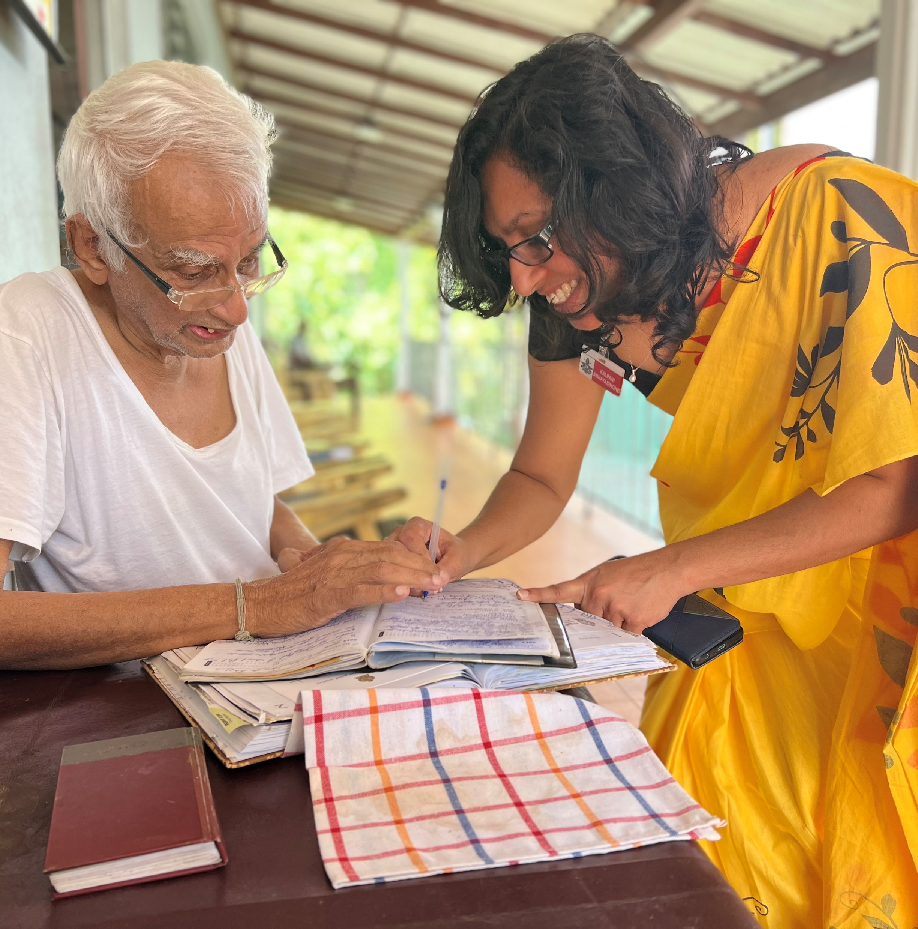


PERSON-CENTERED CARE kitwood
ANAMARIJA KEJŽAR
Reference number: 618596-EPP-1-2020-1-SE-EPPKA2-CBHE-JP
This publication [communication] reflects the views only of the authors, and the Commission cannot be held responsible for any use, which may be made of the information contained therein.
Notes:
Personcentered care = size 36 Fat (capital letters)
What the presentation is about= size 28 (capital letters) for example= KITWOOD, ETHICAL PRINCIPLES
Name of person presenting it= size 18 (capital letters)

Slide 2

INTENDED LEARNING OUTCOMES
explain the concept of Kitwood;
describe principles and Kitwood model
At the completion of this lecture student will be able to:

Slide 3
CONTENT
The experience of dementia
Agenda for care practice
The transformation of the culture of care (caring organizations, eduacitng and taking care for staff)

Slide 4
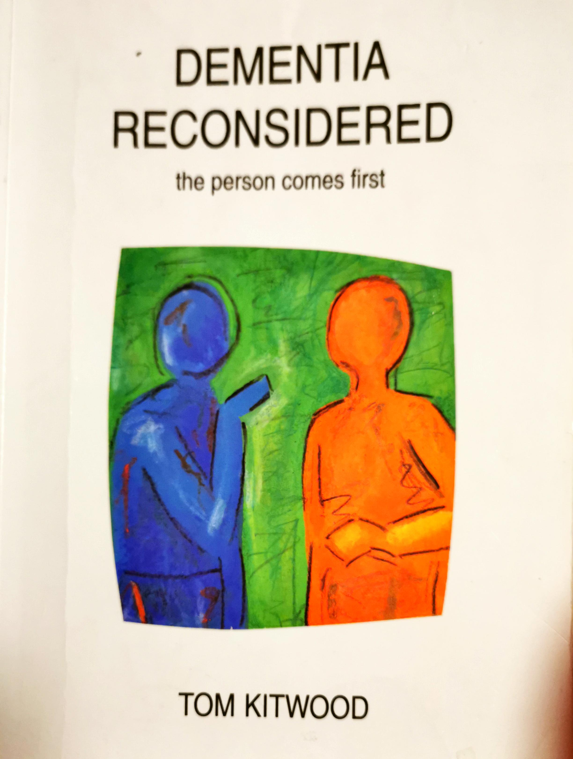

Slide 5
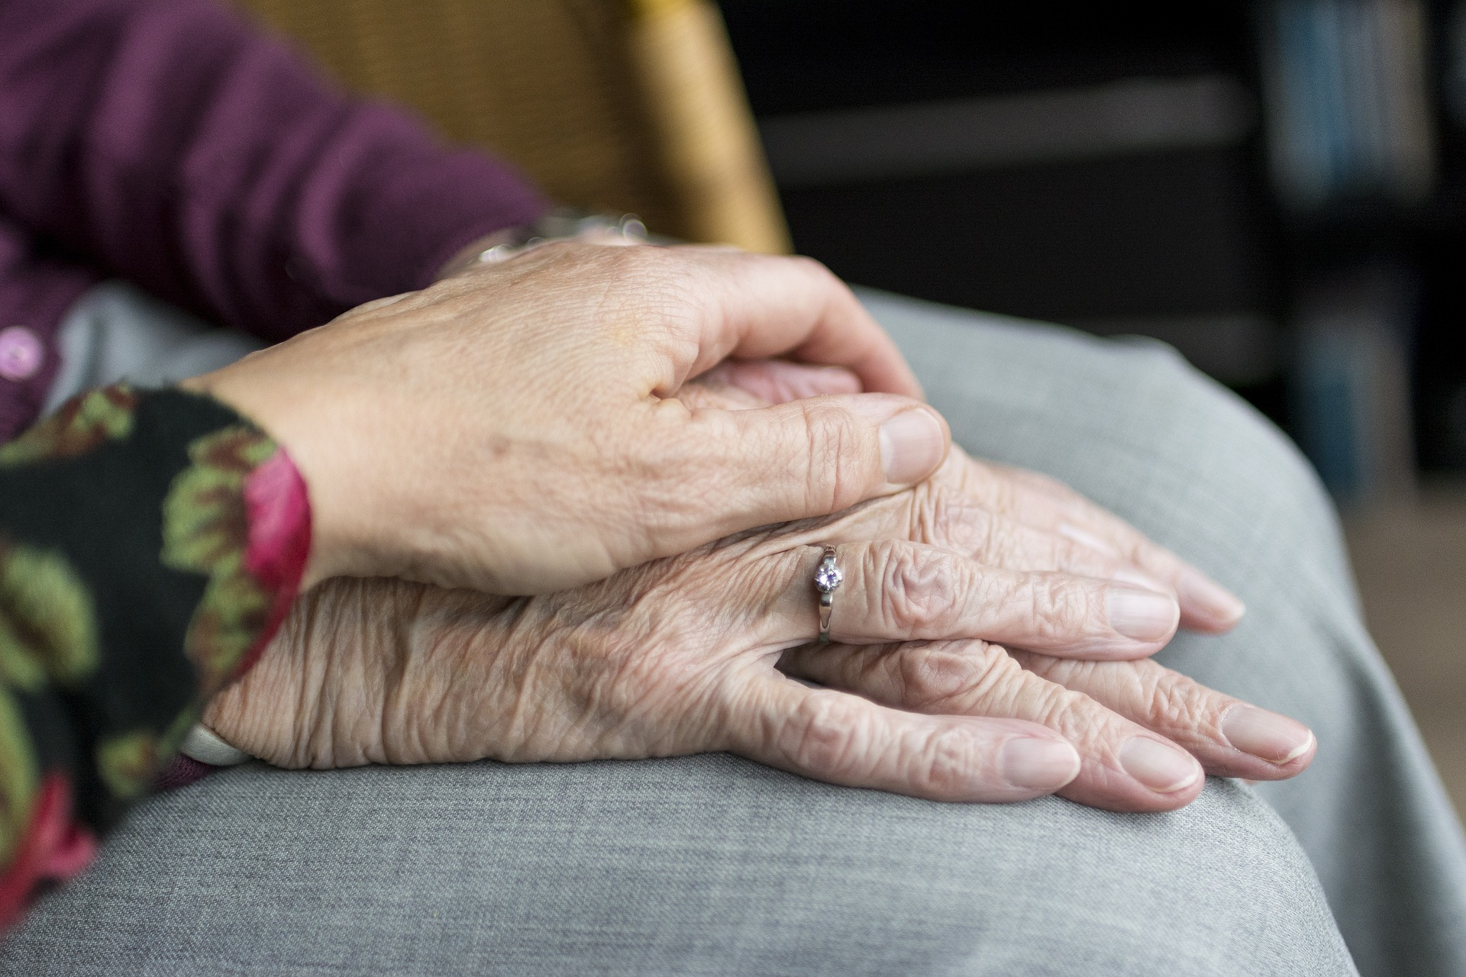
BEING A PERSON
Diagnosing dementia
Destigmatising dementia and
other NDD
The issue of inclusion
Personhood and relationship

Slide 6
Treating dementia
Treating person
Does personality change?
Psychotic complications
How personhood is undermined through stages of dementia?
Different types of dementia

Slide 7
MALIGNANT SOCIAL PSYCHOLOGY (BY KITWOOD)
Treachery
Disempowerment
Infantilization
Intimidation
Labelling
Stigmatization
Outpacing
Invalidation
Objectification

Slide 8
LATER KITWOOD ALSO ADDED:
Ignoring
Imposition
Witholding
Accusation
Disruption
Mockery
Disparagement
See: https://www.youtube.com/watch?v=4Zo_JQZo3Y0

Slide 9
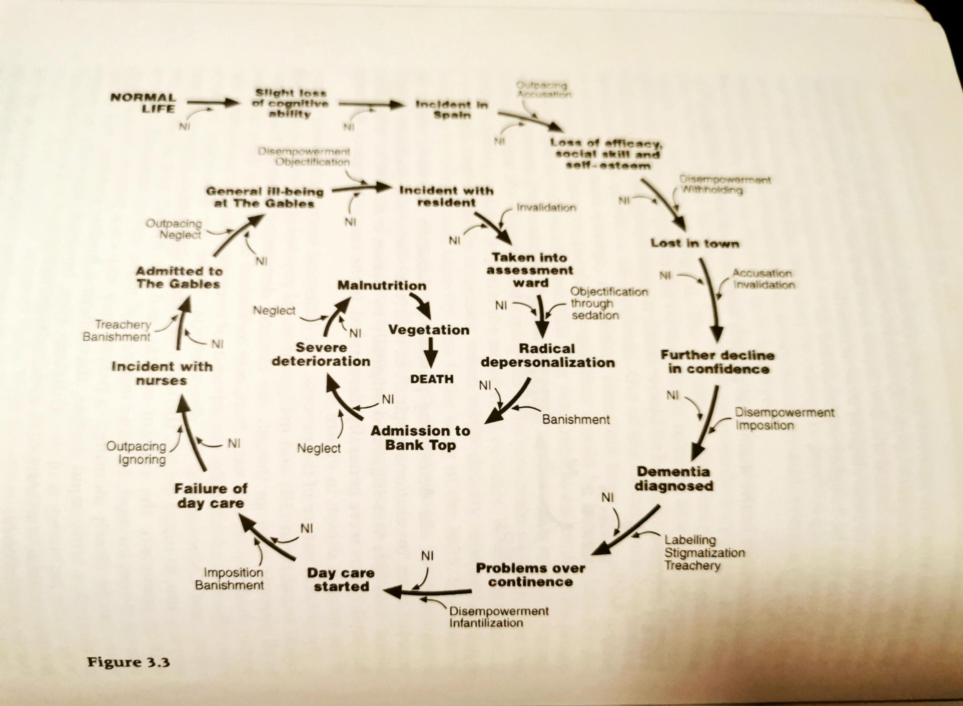
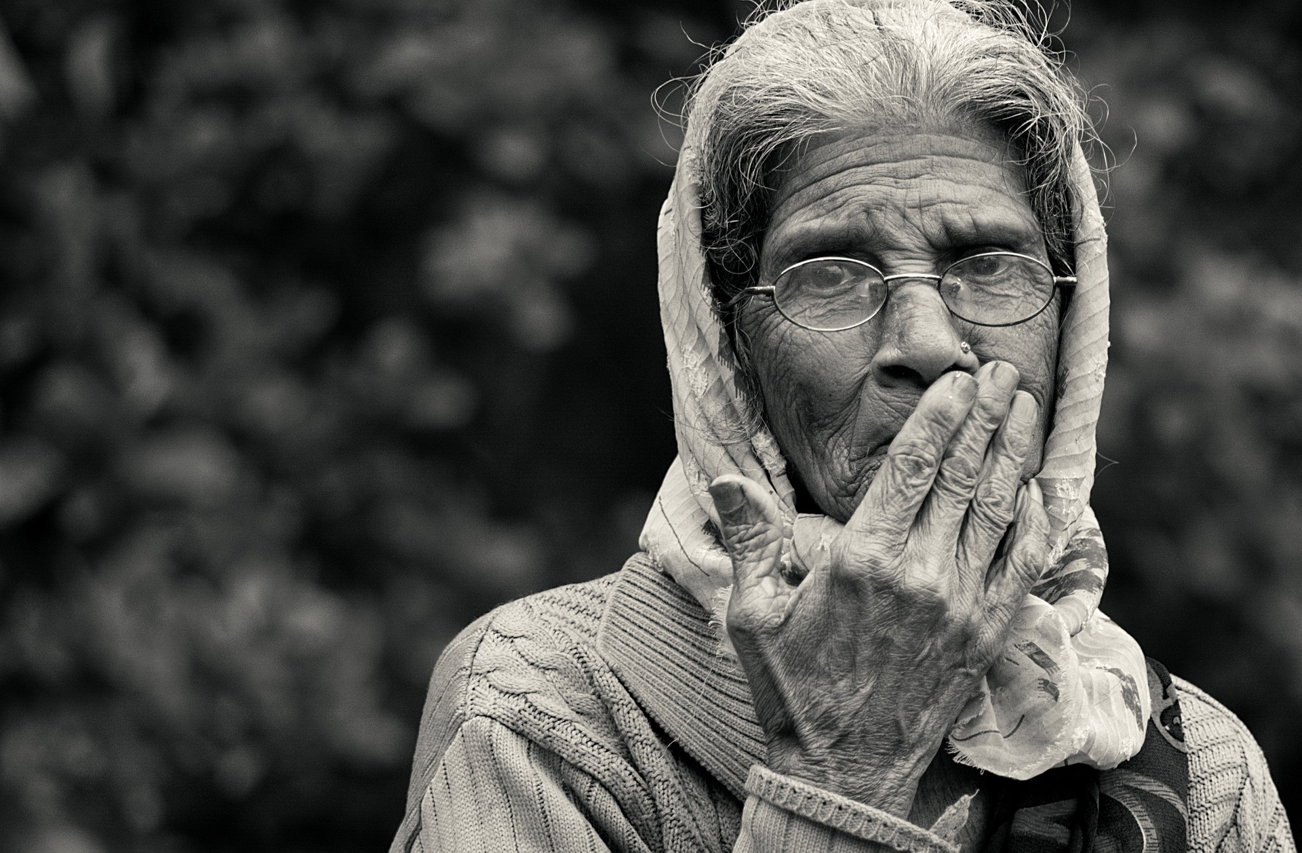
LIVING WITH DEMENTIA

Slide 10

MAINTAINING PERSONHOOD
The central task of dementia care is maintaing personhood, when physical needs have been met
It enables:
  Exercise of choice
  The use of abilities
  The expression of feelings and
  Living in the context of relationship
  …Developing congruent care

Slide 11

THE EXPERIENCE OF DEMENTIA
Each person‘s experience is unique
Feelings
Global states
„Burnt-out“ states

Slide 12
What do people with dementia need?
What do carers need?
See: https://www.youtube.com/watch?v=7E49cK17qs0&t=7s

Slide 13
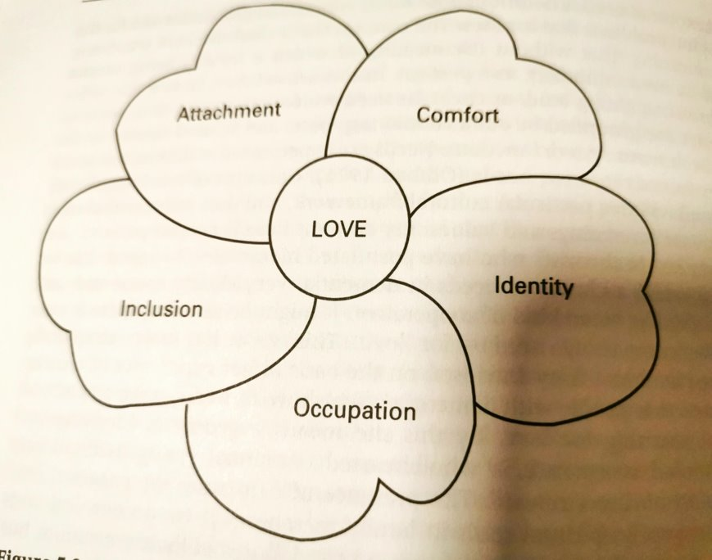
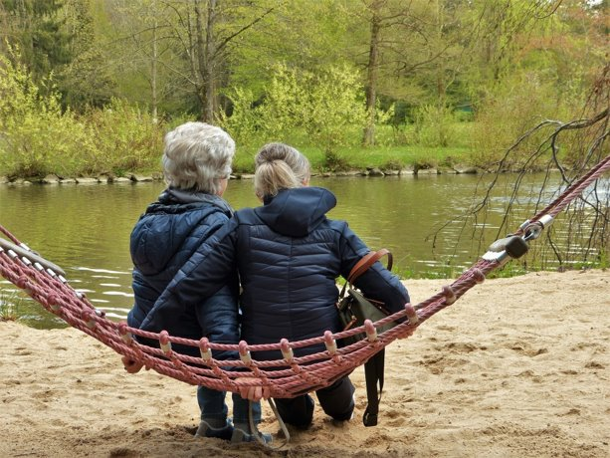

Slide 14

IMPROVING CARE
Caring organizaton:
  Values
  Mission
  Personalisation of care
  Education of staff
  Stimulating activities
  Personal planning
  Palliative care
  Help for relatives

Slide 15
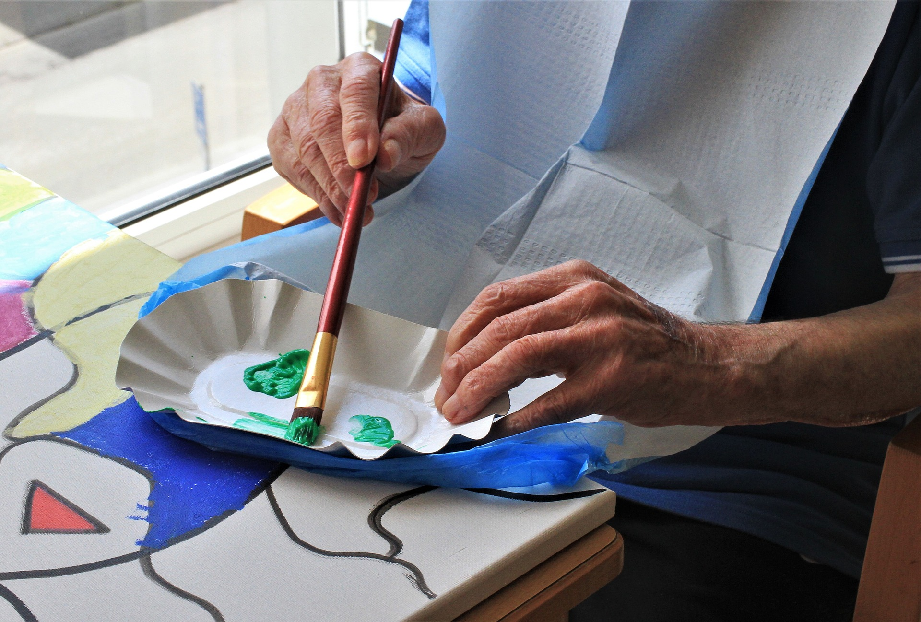
To reamin personhood
To develop trust and relationship
To destigmatize
To prevent burn out/depression
From to cure – to care
See: https://www.youtube.com/watch?v=nmfad3dmXSE

Slide 16
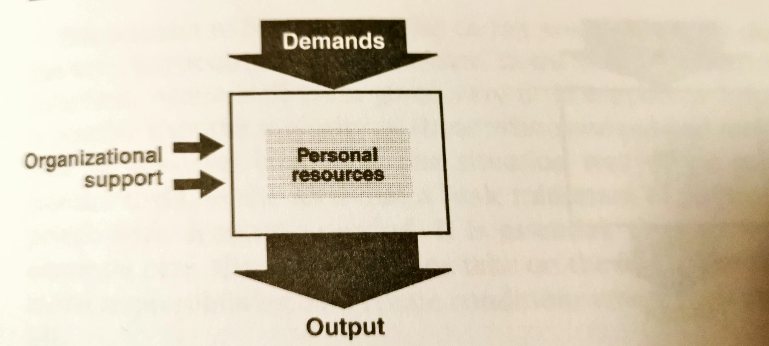
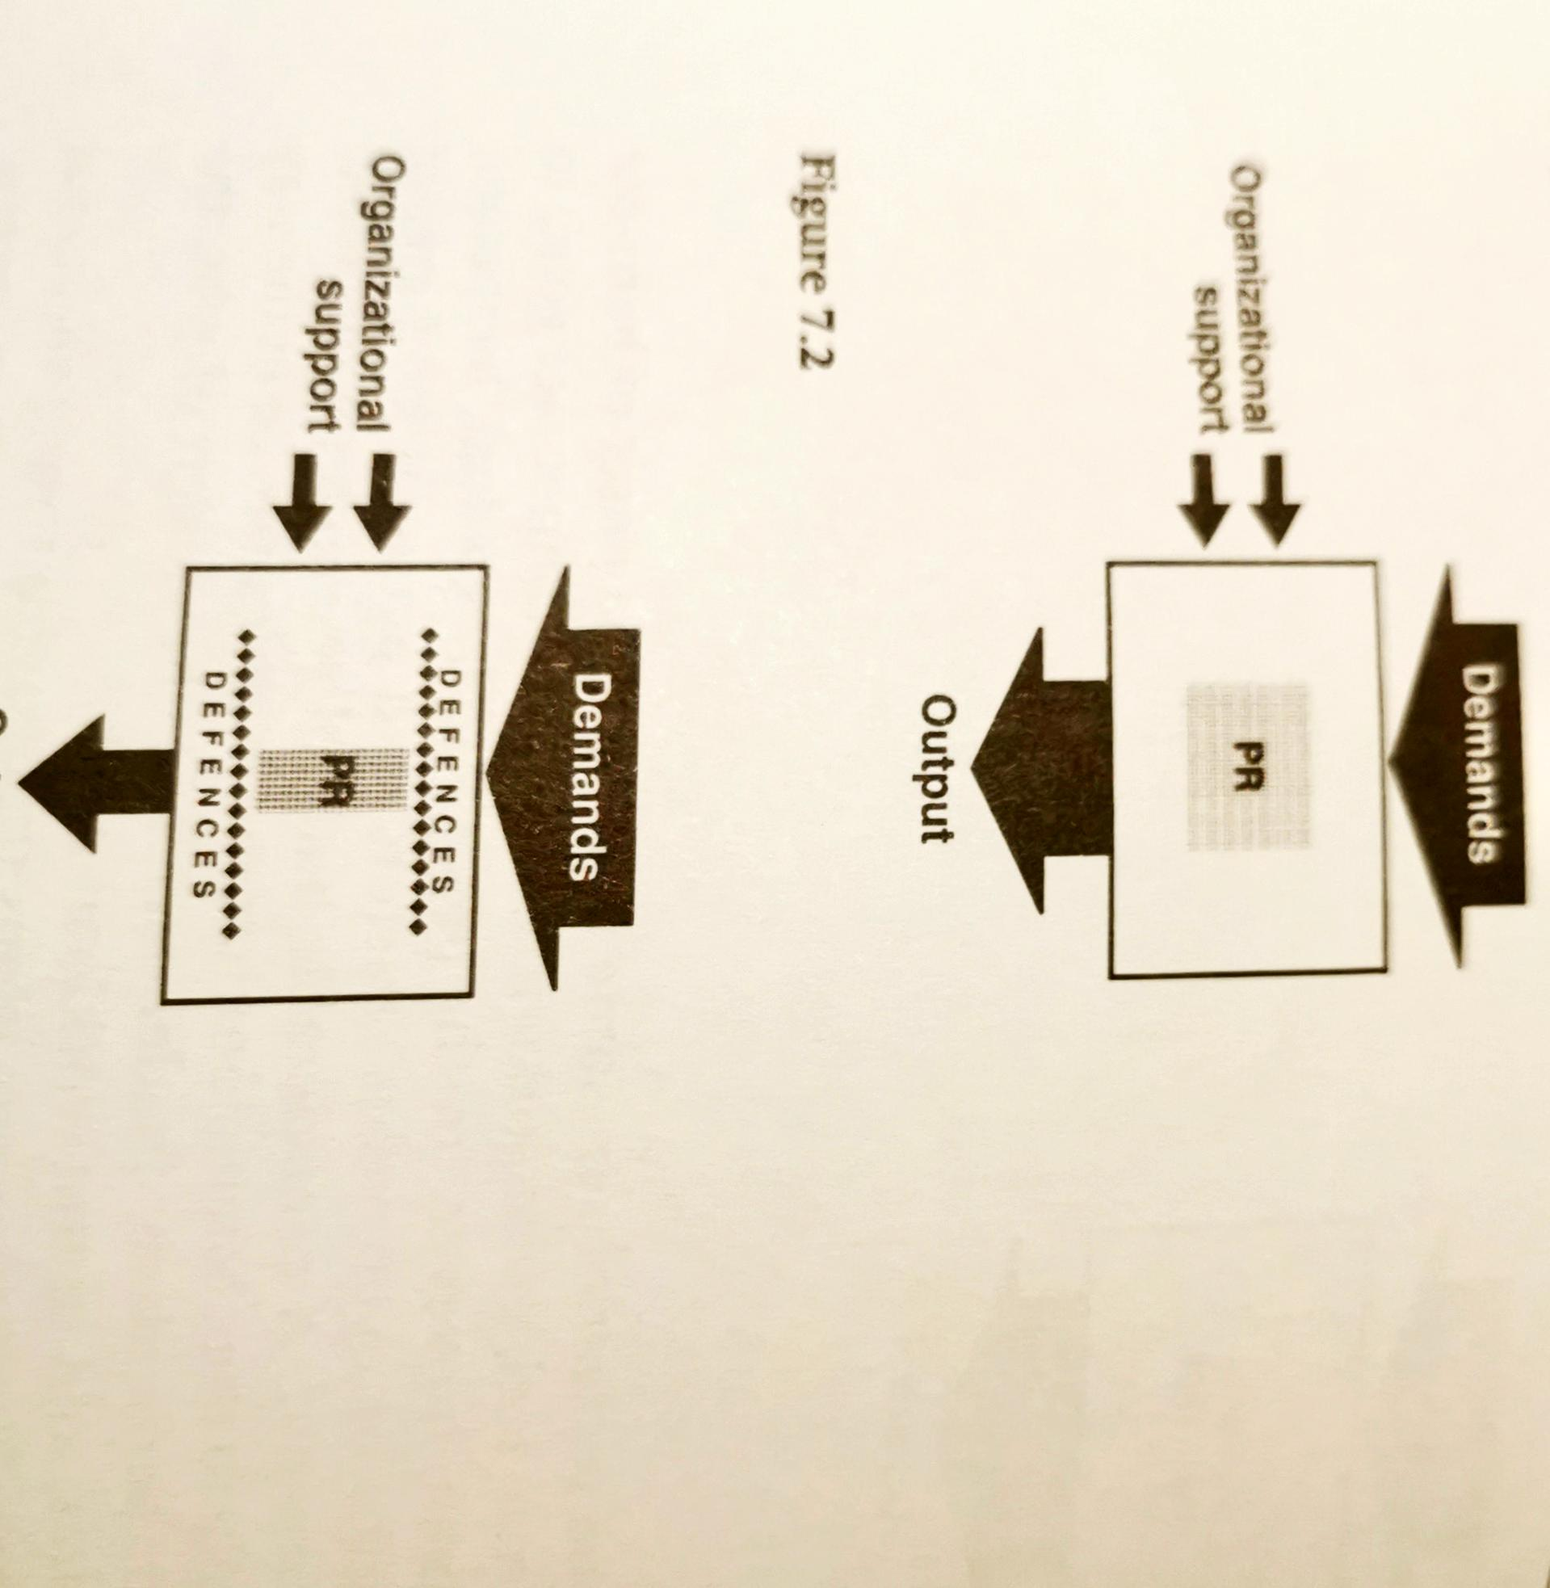
ORGANIZATIONAL STYLE AND STRUCTURE

Slide 17
ROLE OF THE MANAGEMENT
Taking care of the staff
Supervision
In-service training
Individual staff development
Effective quality assurance
Community care
To communicate. To listen.

Slide 18
SELF LEARNING QUESTIONS FOR STUDENTS:
What defines Kitwood model of PCC?
How to destigmatize dementia?
How to communicate with person with dementia, how and when to include relatives?
What kind of caring organization is neede to deliver PCC?
What would have to change to have PCC in care homes?
How to help relatives who take care for person with dementia? – post-diagnostic support.

Slide 19
REFERENCES
Kitwood, T. Dementia reconsidered; the person comes first.1997, Open University Press
Personalisation in care homes; PIRU report, 2021.
May, H., Edwards, P., & Brooker, D. (2009). Enriched care planning for people with Dementia: A good practice guide to delivering person-centred care. Jessica Kingsley Publishers.

Slide 20
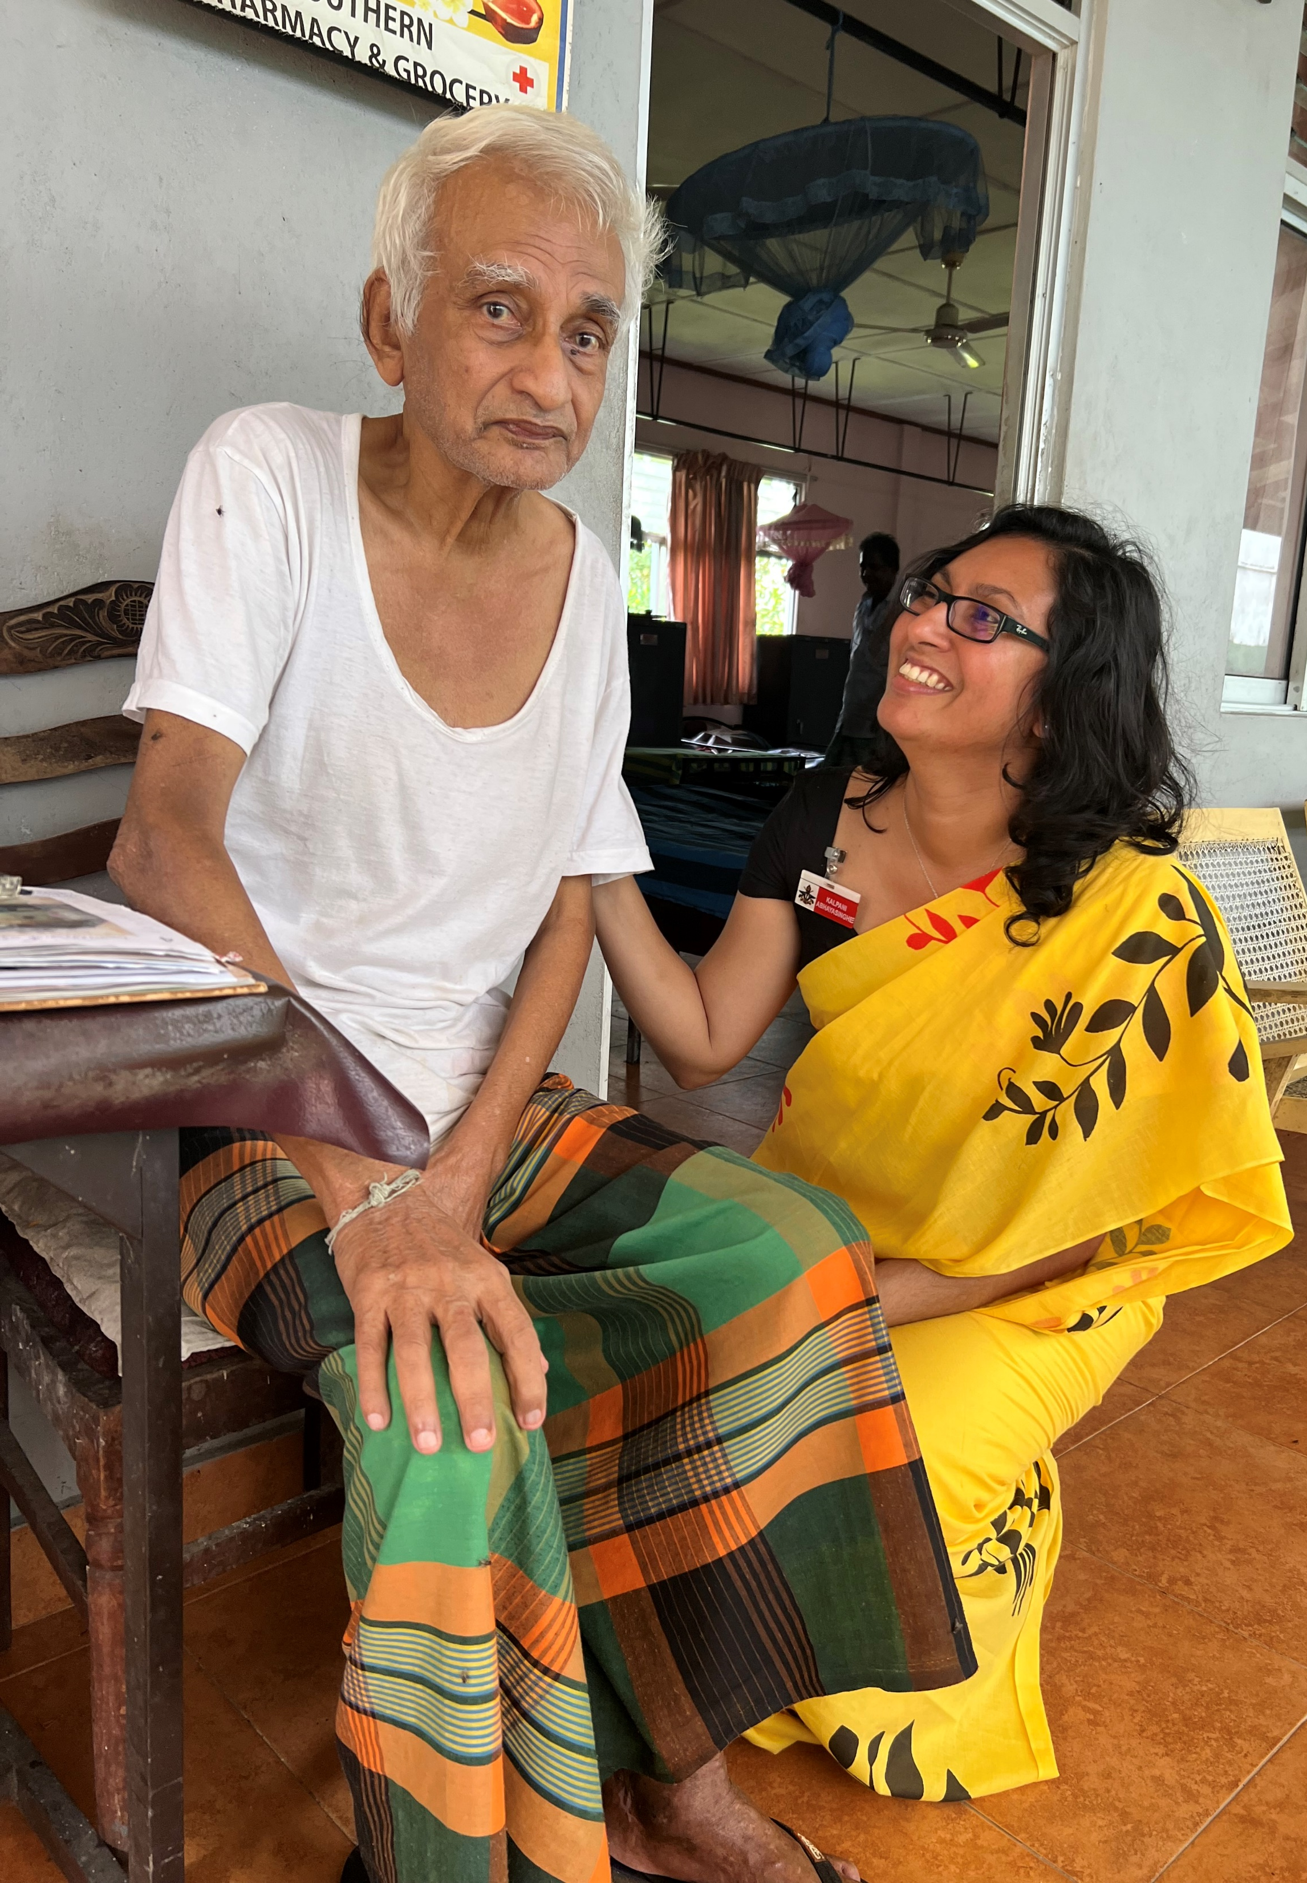
Thank you for listening!
Reference number: 618596-EPP-1-2020-1-SE-EPPKA2-CBHE-JP
This publication [communication] reflects the views only of the authors, and the Commission cannot be held responsible for any use, which may be made of the information contained therein.

