Slide 1
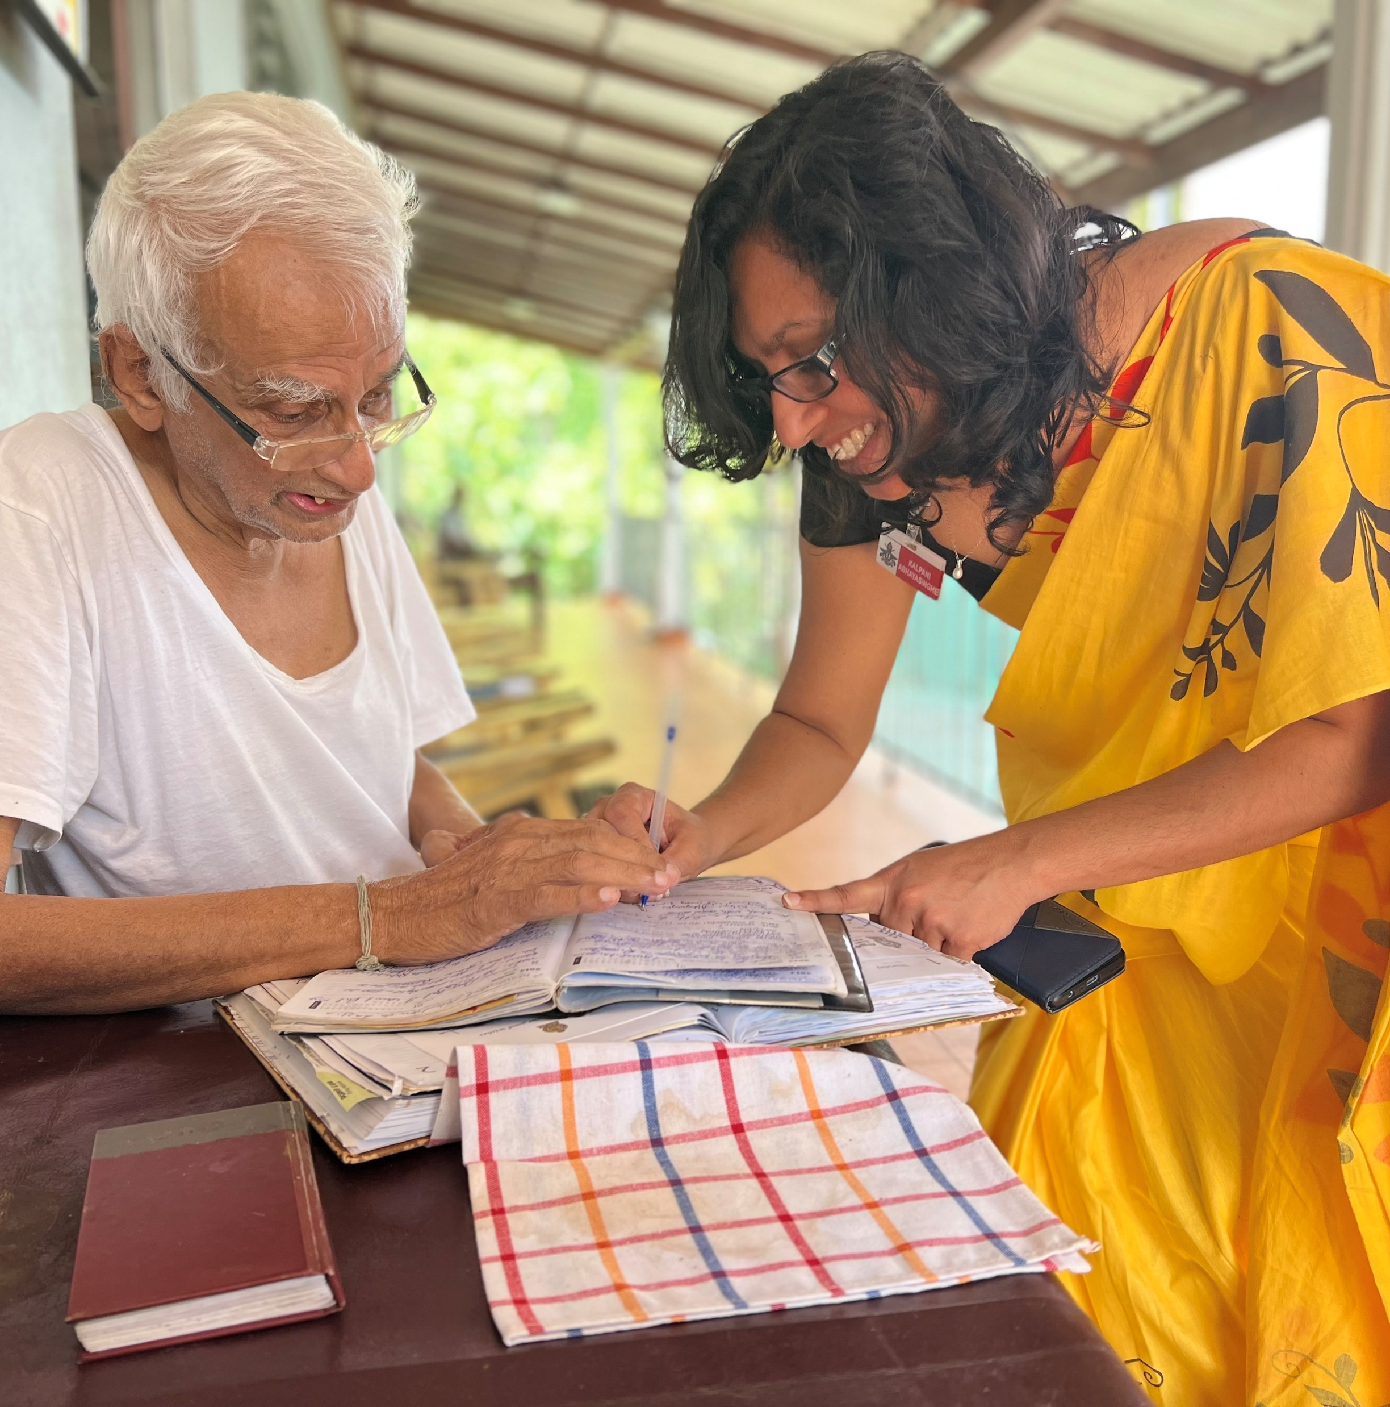
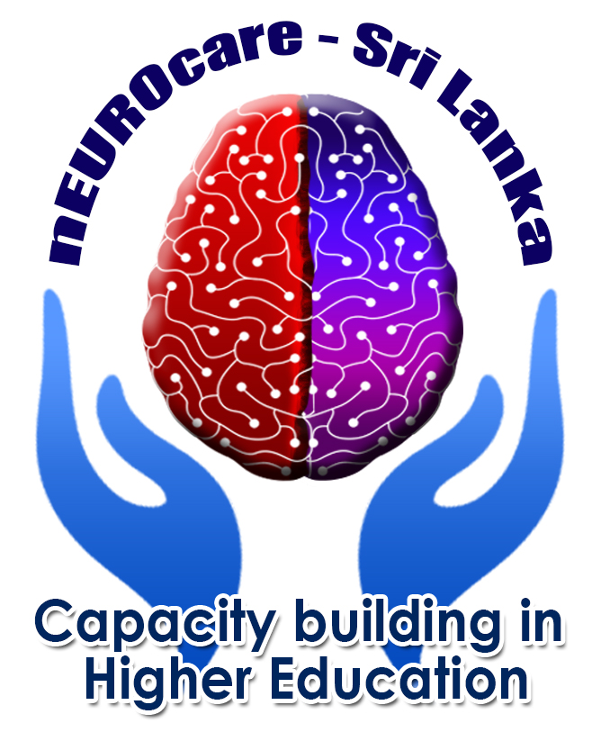

PERSON-CENTERED CARE
INDRODUCTION
Reference number: 618596-EPP-1-2020-1-SE-EPPKA2-CBHE-JP
This publication [communication] reflects the views only of the authors, and the Commission cannot be held responsible for any use, which may be made of the information contained therein.
EMMA EDBERG MATEI
Notes:
Hi and welcome to this lecture about Personcentered care! My name is Emma Edberg Matei and I am a nurse specialised in psychiatric care. Im a lecturer in Kristianstad University Sweden . In this lecture I am going to give a brief introduction to the topic PCC.

Slide 2

INTENDED LEARNING OUTCOMES
have knowledge about what person-centerad care is
explain why it is important to have an person-centered approach when caring
At the completion of this lecture you will be able to:

Slide 3
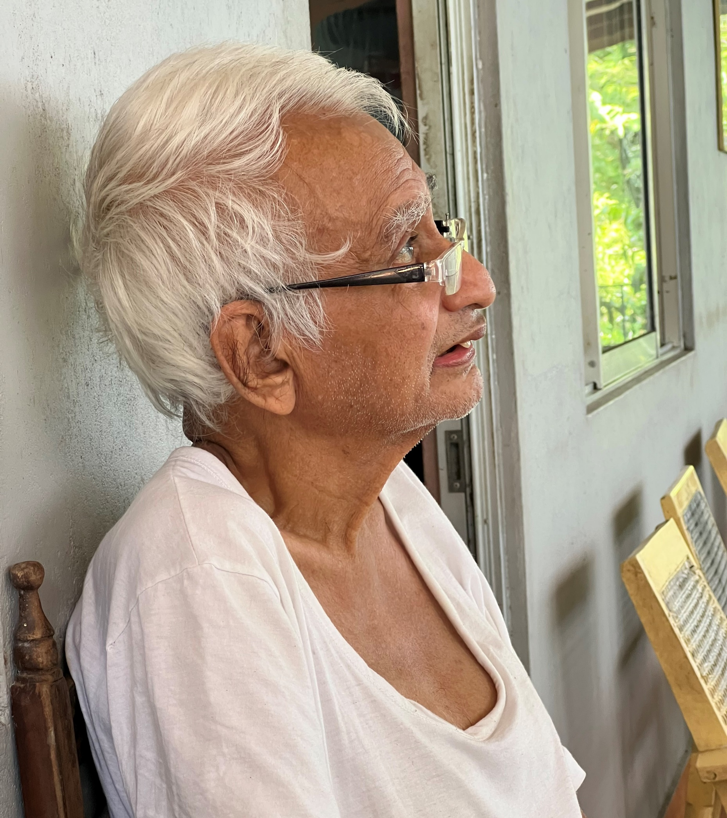
WHAT DEFINES A PERSON?
Notes:
So first of all, To know what PPC is you need to know what a person is.

Slide 4

PERSON-CENTERED CARE & WHAT IS A PERSON?
The concept of a person can be defined using four ethical principles:
Autonomy – a person has the right to choose his own path in life
Dignity – a person has value by virtue of being human
Integrity – a person is respected as a whole in a life context and with a life history
Vulnerability – a person is vulnerable, and vulnerability is a human condition of life, something that all people are.
Notes:
The concept of what defines a person is complex and multifaceted, and it has been explored by philosophers, psychologists, and thinkers throughout history. The understanding of what defines a person can vary across cultures, philosophies, and disciplines. Ultimately, the definition of a person is a deeply philosophical and existential question, and different perspectives may provide different answers. While different perspectives may exist, a person in a health care context could be explained by defined by our four ethical principes. The four ethical principles —autonomy, dignity, integrity, and vulnerability—are fundamental concepts in bioethics and guide ethical decision-making in various contexts. Here's an explanation of each principle:
Autonomy: Autonomy refers to a person's right to make independent decisions about their own life, free from influence or coercion. It emphasizes individual freedom and self-determination. Respecting autonomy involves acknowledging and respecting a person's right to make choices based on their own values, beliefs, and preferences. In healthcare, this principle highlights the importance of informed consent, respecting patients' decisions regarding their treatment options, and ensuring their participation in decision-making processes.
Dignity: Dignity recognizes the inherent worth and value of every individual. It encompasses the idea that all individuals should be treated with respect, fairness, and empathy. Respecting dignity means recognizing and upholding the rights of individuals to be free from discrimination, exploitation, and degrading treatment. In healthcare, dignity requires providing compassionate care, maintaining privacy and confidentiality, and preserving a person's sense of self-worth and identity even in challenging circumstances.
Integrity: Integrity relates to moral and professional honesty, consistency, and adherence to ethical principles. It involves acting in accordance with one's values, being truthful, and demonstrating a high level of ethical conduct. Respecting integrity entails fostering trust, transparency, and accountability in relationships and systems. In healthcare, integrity is vital for maintaining professional standards, ensuring truthful communication, and avoiding conflicts of interest.
Vulnerability: Vulnerability recognizes that individuals may be in a position of diminished capacity, dependence, or susceptibility to harm. It emphasizes the need for special protection, support, and advocacy for those who are vulnerable. Respecting vulnerability means taking into account the unique needs and challenges faced by certain individuals or groups and promoting their well-being. In healthcare, this principle underscores the importance of providing extra care and attention to vulnerable populations such as children, the elderly, those with disabilities, and those facing socioeconomic disadvantages.
These four ethical principles provide a framework for ethical decision-making and guide professionals, policymakers, and individuals in ensuring that actions and policies are respectful, just, and promote the well-being of all individuals involved. It is important to consider and balance these principles in various contexts to navigate complex ethical dilemmas effectively.

Slide 5

WHAT is health?
Notes:
So, besides knowing what a person is in a health care setting you also need to understand what health is to understans whay PCC is important.

Slide 6
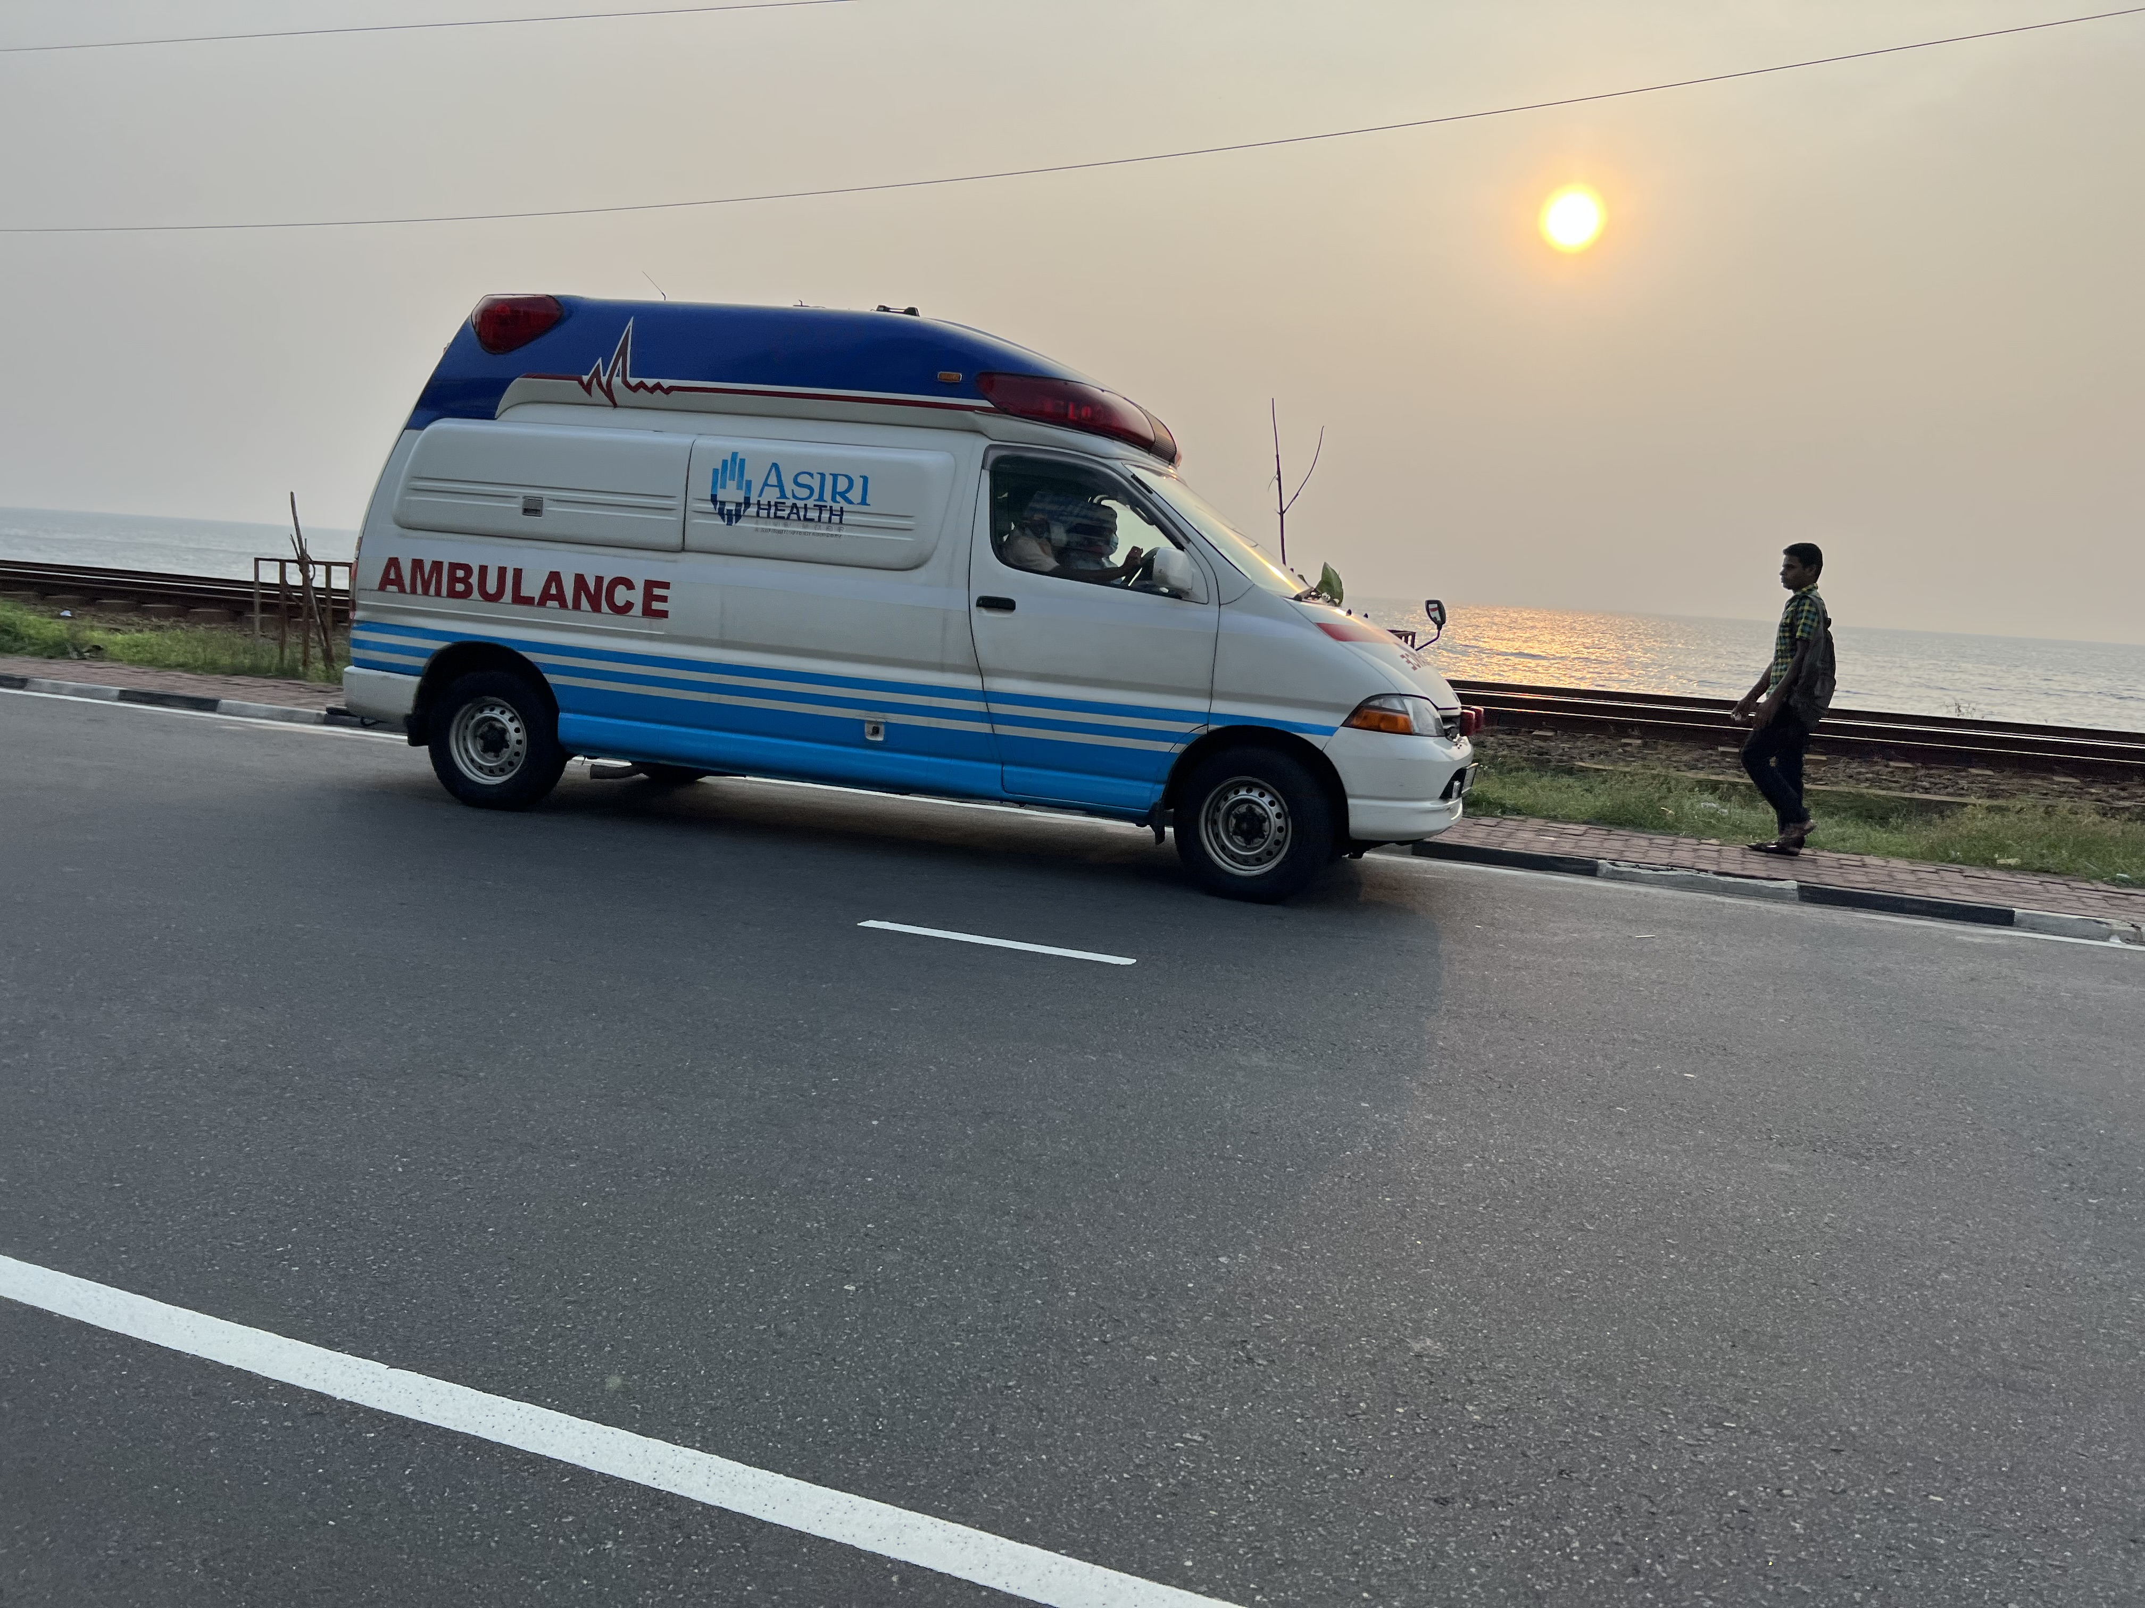
WHAT IS HEALTH AND HOW DO WE DEFINE IT?
“Health is a state of complete physical, mental and social well-being and not merely the absence of disease or infirmity”
(WHO, 1948)
Notes:
So what is healt and how do we define it? Well, it is one of the fundamental rights of every human being to reach the highest attainable standard of health, without distinction of race, religion, political belief, economic or social condition.
Health can be understood as a state of overall well-being, encompassing physical, mental, and social dimensions. It goes beyond the absence of disease or infirmity and involves a holistic perspective on an individual's condition.
Physical Health: Physical health refers to the functioning and well-being of the body. It involves aspects such as body systems, organs, fitness levels, and the absence of illness or disease. Maintaining physical health involves adopting healthy lifestyle choices, including regular exercise, balanced nutrition, adequate sleep, and avoiding harmful habits such as smoking or excessive alcohol consumption.
Mental Health: Mental health relates to a person's emotional, psychological, and cognitive well-being. It involves factors like emotional resilience, coping skills, self-esteem, and the ability to manage stress. Good mental health allows individuals to think clearly, handle life's challenges, and maintain healthy relationships. It also involves seeking support and treatment when experiencing mental health concerns or disorders.
Social Health: Social health focuses on the quality of an individual's interactions and relationships with others. It involves having satisfying and supportive relationships, effective communication skills, and a sense of belonging within a community. Social health recognizes the importance of social connections, social support systems, and the ability to engage in meaningful social activities.
Spiritual Health: Spiritual health refers to an individual's sense of purpose, values, and connection with something greater than themselves. It is not necessarily linked to religious beliefs but encompasses a broader understanding of meaning, values, and existential well-being. Spiritual health can involve practices such as meditation, reflection, self-discovery, and finding a sense of inner peace.
Environmental Health: Environmental health recognizes the impact of the physical environment on an individual's well-being. It involves aspects such as access to clean air, water, and safe living conditions. Environmental health also encompasses sustainable practices, responsible resource management, and minimizing exposure to harmful substances or pollutants.
Achieving and maintaining health involves a balance and integration of these different dimensions. It is an ongoing process that requires active participation, self-care, and seeking appropriate medical care when needed. The definition and understanding of health may vary across cultures and individuals, but the aim is to promote and optimize well-being in all its aspects.
According to the WHO “Health is a state of complete physical, mental and social well-being and not merely the absence of disease or infirmity”

Slide 7
The concept of person-centered care was developed by professor Tom Kitwood
”The person always comes first”
A person-centered approach to care involves placing the person living (with dementia) at the centre of planning and decision-making; being respectful of individual beliefs and values; not making assumptions about a person before understanding thier life context and what is important to them.
Notes:
Now we have talked about what a person is and what health is and now we can dig in to the topic PCC. The fundamentals of person-centred care were originally developed by Tom Kitwood for persons with dementia during the 1990ies in UK, and has thereafter been expanded to involve all health care contexts.
To focus on the person instead of the diagnosis/disease the person has. The person always comes first, the diagnosis is always secondary. By concentrating on the person instead of the diagnosis, it also becomes clearer to us that the care we give are to support the remaining functions, rather than to see the disease and what it does to us.

Slide 8

“A future in which all people have access to health services that are provided in a way that responds to their life course needs and preferences, are coordinated across the continuum of care and are safe, effective, timely and of acceptable quality.”
WHO (2015) Global strategy on integrated people-centered health services 2016-2026
Notes:
In recent decades, care provision has developed from being system-oriented towards person-centred. Person-centred care is nowadays mentioned as a basis of care provision in international policies and steering documents, for example from WHO. WHO´s mission for the coming years is:
“A future in which all people have access to health services that are provided in a way that responds to their life course needs and preferences, are coordinated across the continuum of care and are safe, effective, timely and of acceptable quality.”

Slide 9
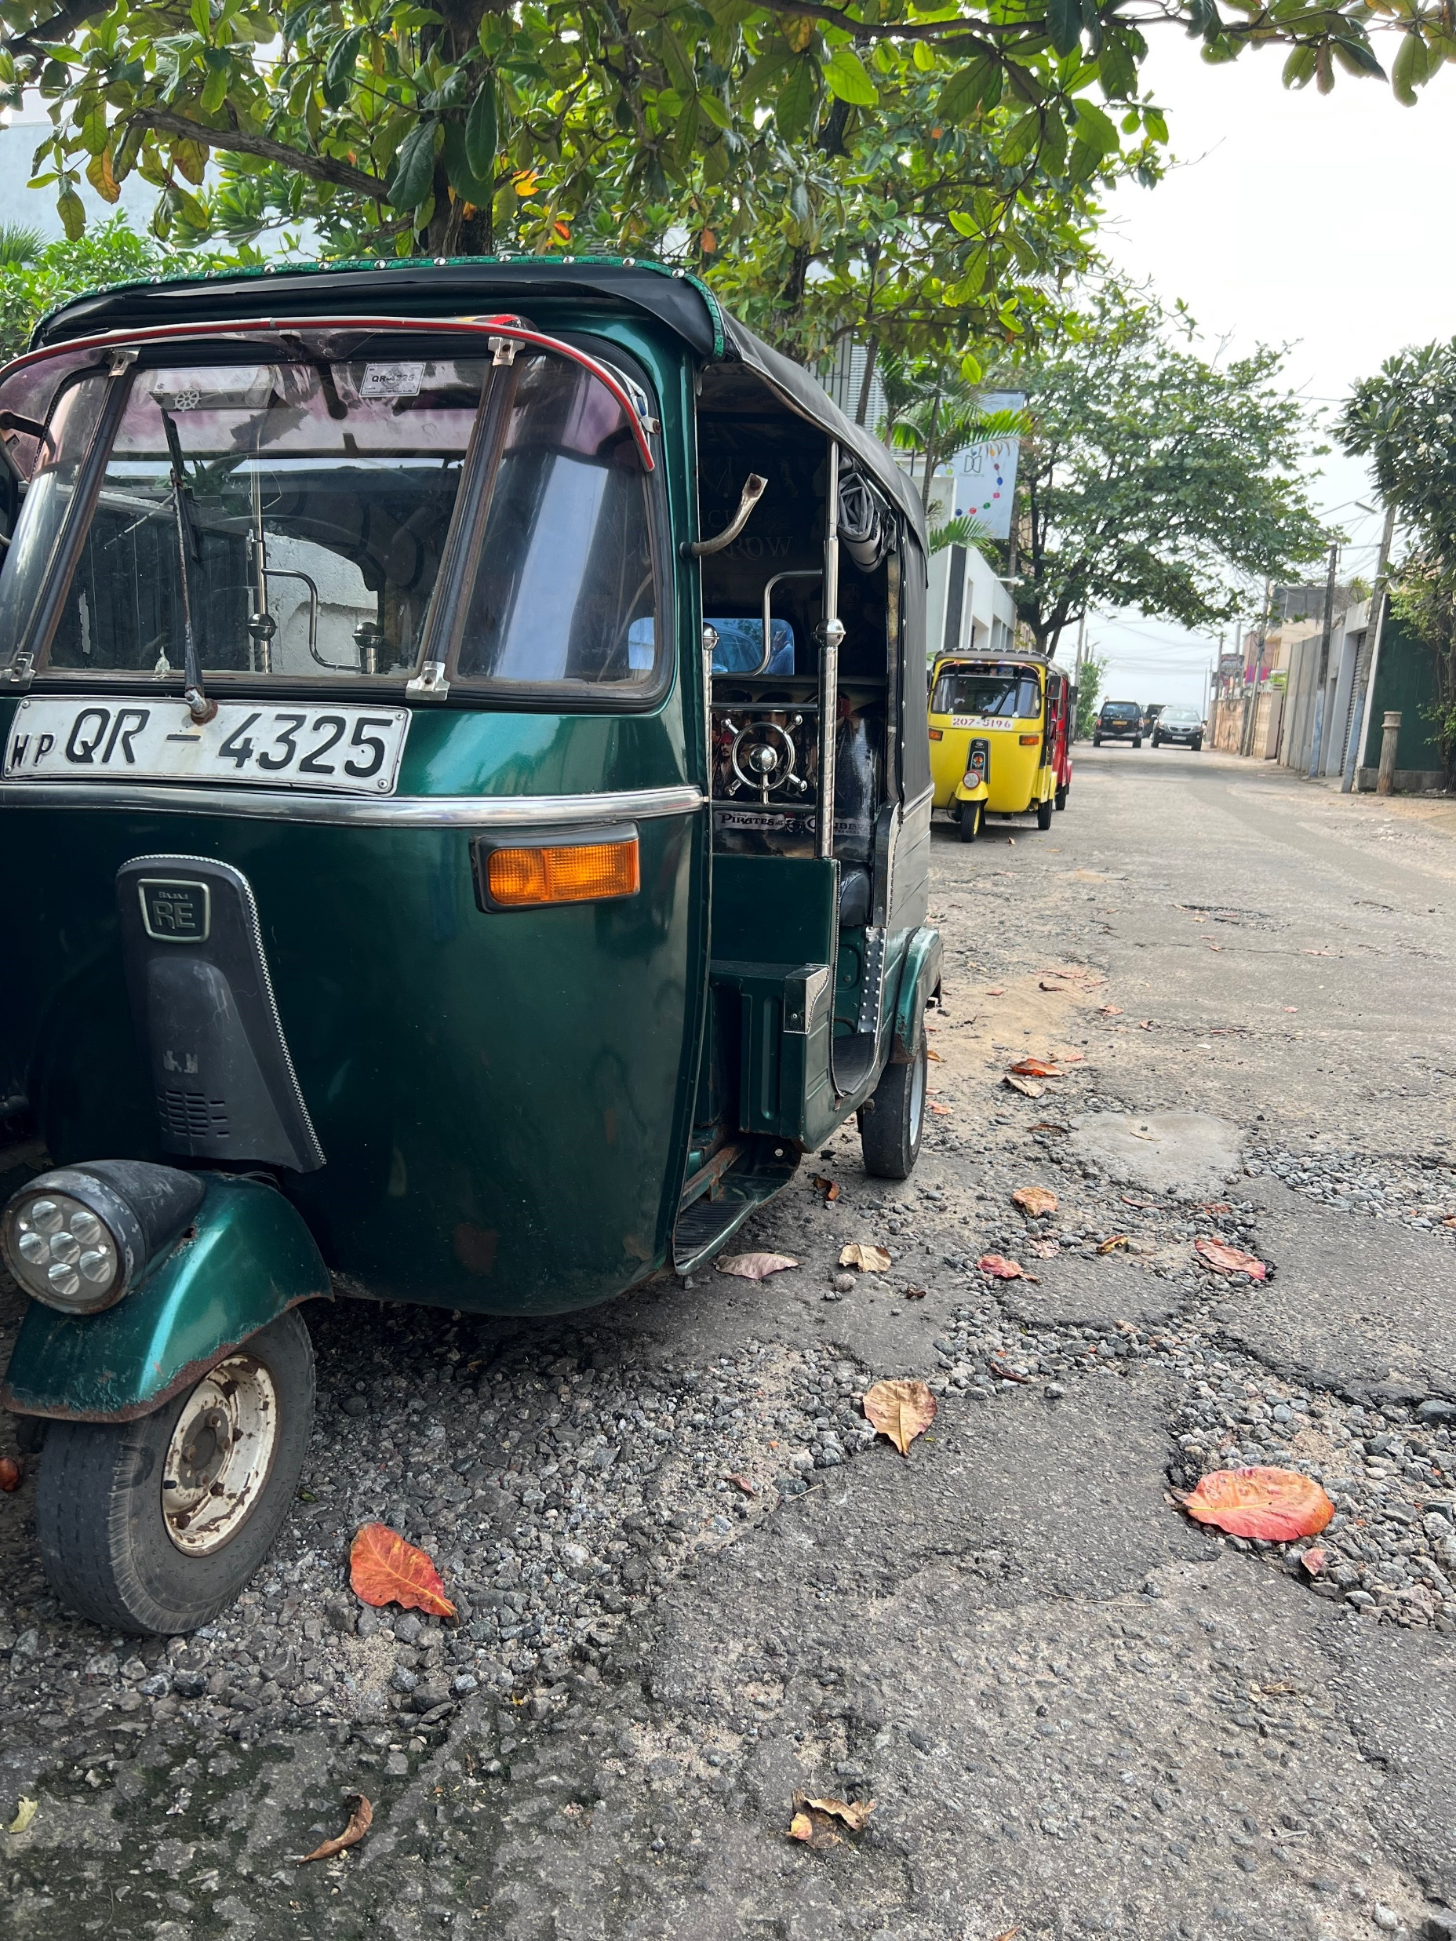
(1) Value that asserts the absolute value of human lives regardless of age or cognitive ability.
(2) An Individualized approach, recognizing uniqueness.
(3) Understanding the world from the Perspective of the service user.
(4) Providing a Social environment that supports psychological needs.
THE CONCEPTS OF
V I P S
Notes:
As I said before, the fundamentals of person-centred care were originally developed by Tom Kitwood for persons with dementia during the 1990ies in UK, and has thereafter been expanded to involve all health care contexts.
One concept that builds on the thoughts by Kitwood is VIPS, defining the core concepts of person centredness. The concept of VIPS is:
A Value that asserts the absolute value of human lives regardless of age or cognitive ability.
An Individualized approach, recognising uniqueness.
Understanding the world from the Perspective of the service user.
Providing a Social environment that supports psychological needs.
My presentation will build on the VIPS concept and give practical examples of how care can be developed and provided accordingly.

Slide 10
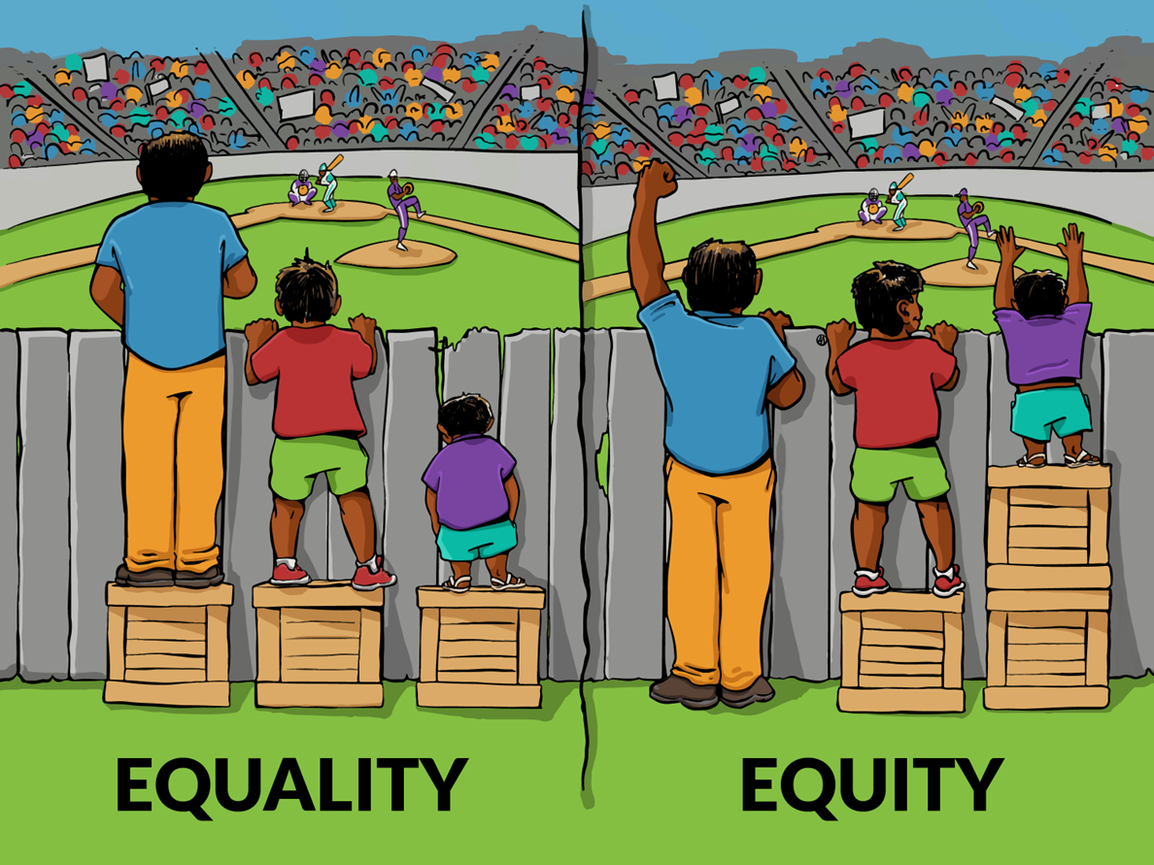
A VALUE THAT ASSERTS THE ABSOLUTE VALUE OF HUMAN LIVES REGARDLESS OF AGE OR COGNITIVE ABILITY
Notes:
The first aspect is A value that asserts the absolute value of human lives regardless of age or cognitive ability.
We all have the same right to live in a society that promotes good health. We also have the right to experience health even though we have a disease. Equal care is often on the agenda, that is the right to the same care for everyone, but it might be the time to highlight equity instead? That is, to ensure that everyone gets the care they need as individuals as we all are different. As you can see in the picture the support provided, must be adjusted to the persons individual needs, that is to be person-centred. Same treatment/adjustment, all of them will not se the baseball game, but if we se them as individuals we will adjust our way of helping them.
A value that asserts the absolute value of human lives regardless of age or cognitive ability also means valuing health care professionals as Dawn Brooker says: If the staff group feel valued, then they in turn are more likely to value those they care for.” It is therefore an important mission as leader for health care facility to strive for a leadership where coworkers work is highly valued. And it is also important to work with a vision that everyone including patients, healthcare professionals and relatives will feel valued and important.

Slide 11
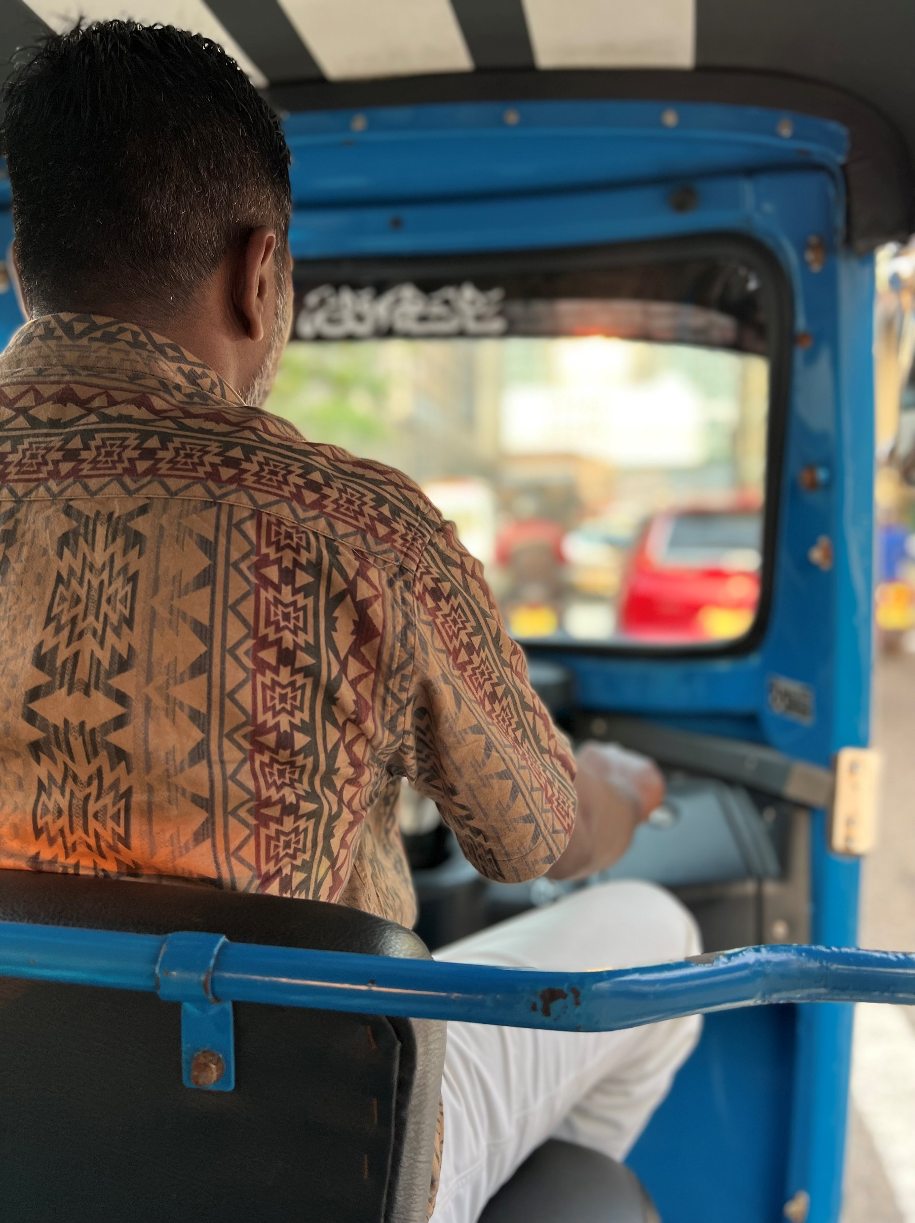
“As a leader, I think it is really important to see the person behind the professional and adapt my leadership based on the personnel’s needs. It has to do with creating the best teams, where everyone can contribute based on their individual strengths and complement each other. It also has to do with having knowledge about their family situation and to take that into account when I plan their schedules. It is crucial that the staff are seen and feel acknowledged, and it is important that they feel that they are important and have an important mission. I really try to see them as unique persons and tell them that they are irreplaceable”.
Woman, 42 years, manager at a residential care facility for older people.
Notes:
One manager at a residential care facility for older people expressed the following:
“As a leader, I think it is really important to see the person behind the professional and adapt my leadership based on the personnel’s needs. It has to do with creating the best teams, where everyone can contribute based on their individual strengths and complement each other. It also has to do with having knowledge about their family situation and to take that into account when I plan their schedules. It is crucial that the staff are seen and feel acknowledged, and it is important that they feel that they are important and have an important mission. I really try to see them as unique persons and tell them that they are irreplaceable”. Woman, 42 years, manager at a residential care facility for older people.

Slide 12
AN INDIVIDUALIZED APPROACH,
RECOGNISING UNIQUENESS
Notes:
The second aspect is An Individualized approach, recognising uniqueness.
We are all unique! And because we are unique, we have different pre-requisites and different needs. We need to focus on this uniqueness when we as healthcare professionals meet our patients. We need to see the whole person and not just the diagnosis or disease. This means that we should not just focus on the medical or physical needs, but also social, psychological and existential needs. Person-centered care also means to take the person's own resources and wishes into account and adapt the care accordingly.
How we deal with illness is a result of who we are. We all have a unique history and a unique personality, physical and mental health, social and financial resources. All of this affects us and also our way of dealing with an illness. A prerequisite for being able to have a person-centered approach is thus to have knowledge about the individual. Examples of areas that are important to have knowledge about are:
the individual's physical, psychological, social, cultural, spiritual and existential needs
personality
own resources and ways of cope with challenges
diseases and complaints
medication, effects and side effects
interests
what brings joy in everyday life
the significance of past life events
As health care professionals, these aspects should be a part of the anamnesis and also something to consider when working person-centered. Person-centered care however challenges our way of working and organizing, the health care hierarchies and structures. The approach needs to permeate the organization and be supported by leaders of health care if it should be affective. One nurse assistant described how they changed their way of working:

Slide 13

“When we were told to leave our fixed schedules and structured way to work, I remember that we were all quite resistant. At that time everyone got help with their morning care first thing in the morning to be ready for breakfast at about 8 o´clock. When I look back at that time it was quite stressful for both the residents and for us. Many residents did not want to get out of bed, and it was quite a rush. But when we started to adjust our work to the individuals, someone wanted to sleep longer in the morning and someone else wanted to get up already at 6. Suddenly the pace slowed down. And who says that everyone needs to have breakfast at 8? It was really a change of mindset for us.”
Woman, 62 years, nurse assistant at a residential care facility for people with dementia.
Notes:
As health care professionals, these aspects should be a part of the anamnesis and also something to consider when working person-centered. Person-centered care however challenges our way of working and organizing, the health care hierarchies and structures. The approach needs to permeate the organization and be supported by leaders of health care if it should be affective. One nurse assistant described how they changed their way of working:

Slide 14
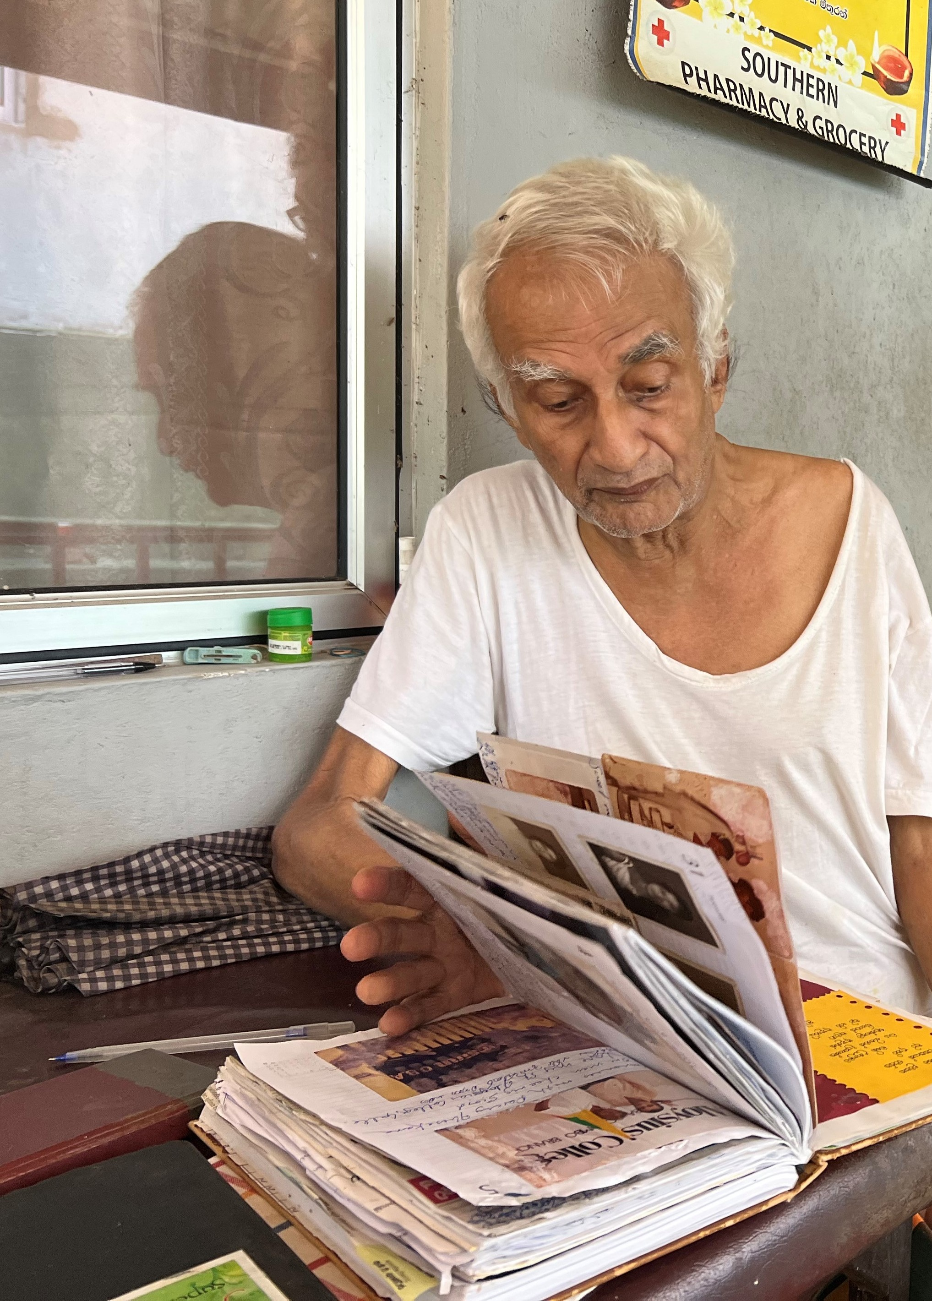
Understanding the world from the Perspective of the service user
Notes:
The third aspect is Understanding the world from the Perspective of the service user
Personhood is the way we feel about our self. It is influenced by how other see us and how we respond to that. If someone see us as an object or a disease, it will affect the way we look at ourselves and in turn our personhood.
In particular, people who have an illness that affects the way they express themselves, for example a dementia disease or Parkinsons disease, are at risk of being objectified, which in turn affect their sense of self. They are often double exposed to discrimination, ageism and being patronized as a result of a reduced cognitive ability. It may be that decisions are made over their heads or that they are not given the information they need to be able to make their own decisions. It can also be a discrimination in the physical and social environment that is not adapted to their needs. They are thus at risk for violation of their human rights.
So, imagine if you are in an environment where you are being very well supported and have meaning and purpose in your life, you will probably feel that you are a part in a community and a group. You will have that social connection, and you can feel that you are being responded to as a human being. But if your situation is the opposite and you are constantly being patronized or if other people highlight all your shortcomings, you will feel socially isolated and stigmatized, that in turn will affect your personhood.
So, for example, when we see people with dementia that withdraw, who are not functioning very well, who may be struggling both emotionally and physically it may not be a result of the disease but rather a result of a malignant environment that are not supporting the actual ability of the person.
Today, there is no cure for dementia but there are several ways to support the ability and function for those affected. If we truly believe in supporting the personhood and if we truly believe that we can create the right environment and approach in a person-centered way, the lived experience of dementia can be very different. This can give people with dementia strength and hope, but also strengthen health care professionals in their mission.

Slide 15

It is a lot of things that takes my energy these days. I often feel clumsy and awkward, walking against furniture, getting caught in doorknobs and walking into doorframes. It may seem like small everyday trifles that happens to most of us, but it happens all the time for me and it is incredibly tiring in the long run. I know that it comes with the disease and that the brain no longer has control over distance judgments and how close things are. But even though I know why, I get frustrated, it messes up my everyday life and takes all my energy.
But there is also a lot of things that gives energy. It is about taking care of your resources and enjoying them. For me, music is my lifeline. I used to play in a full orchestra in my days… It is actually quite strange how the brain works. Even though one moment I can hardly remember how to pick up my purse or read the newspaper, it is completely different as soon as there is music in the picture…
Notes:
Elizabeth, who has Alzheimers disease says:
It is a lot of things that takes my energy these days. I often feel clumsy and awkward, walking against furniture, getting caught in doorknobs and walking into doorframes. It may seem like small everyday trifles that happens to most of us, but it happens all the time for me and it is incredibly tiring in the long run. I know that it comes with the disease and that the brain no longer has control over distance judgments and how close things are. But even though I know why, I get frustrated, it messes up my everyday life and takes all my energy. But there is also a lot of things that gives energy. It is about taking care of your resources and enjoying them. For me, music is my lifeline. I used to play in a full orchestra in my days… It is actually quite strange how the brain works. Even though one moment I can hardly remember how to pick up my purse or read the newspaper, it is completely different as soon as there is music in the picture.

Slide 16

… Yesterday I was at my daughter’s house who had one of her music students visiting. It was wonderful to sit in the armchair and listen to his violin practice. And then he says; Elizabeth can't you accompany me on the grand piano? And you know what; Right then, I both wanted and was able to. The fingers ran over the keys as before without me having to look for them or take support from the notes. And at that moment I could forget all the craziness and obstacles in everyday life that the disease brings and just enjoy being a capable human being.
Elizabeth, 92 years, living with Alzheimer’s disease.
Notes:
Yesterday I was at my daughter’s house who had one of her music students visiting. It was wonderful to sit in the armchair and listen to his violin practice. And then he says; Elizabeth cant you accompany me on the grand piano? And you know what; Right then, I both wanted and was able to. The fingers ran over the keys as before without me having to look for them or take support from the notes. And at that moment I could forget all the craziness and obstacles in everyday life that the disease brings and just enjoy being a capable human being. Elizabeth, 92 years, living with Alzheimer’s disease.

Slide 17
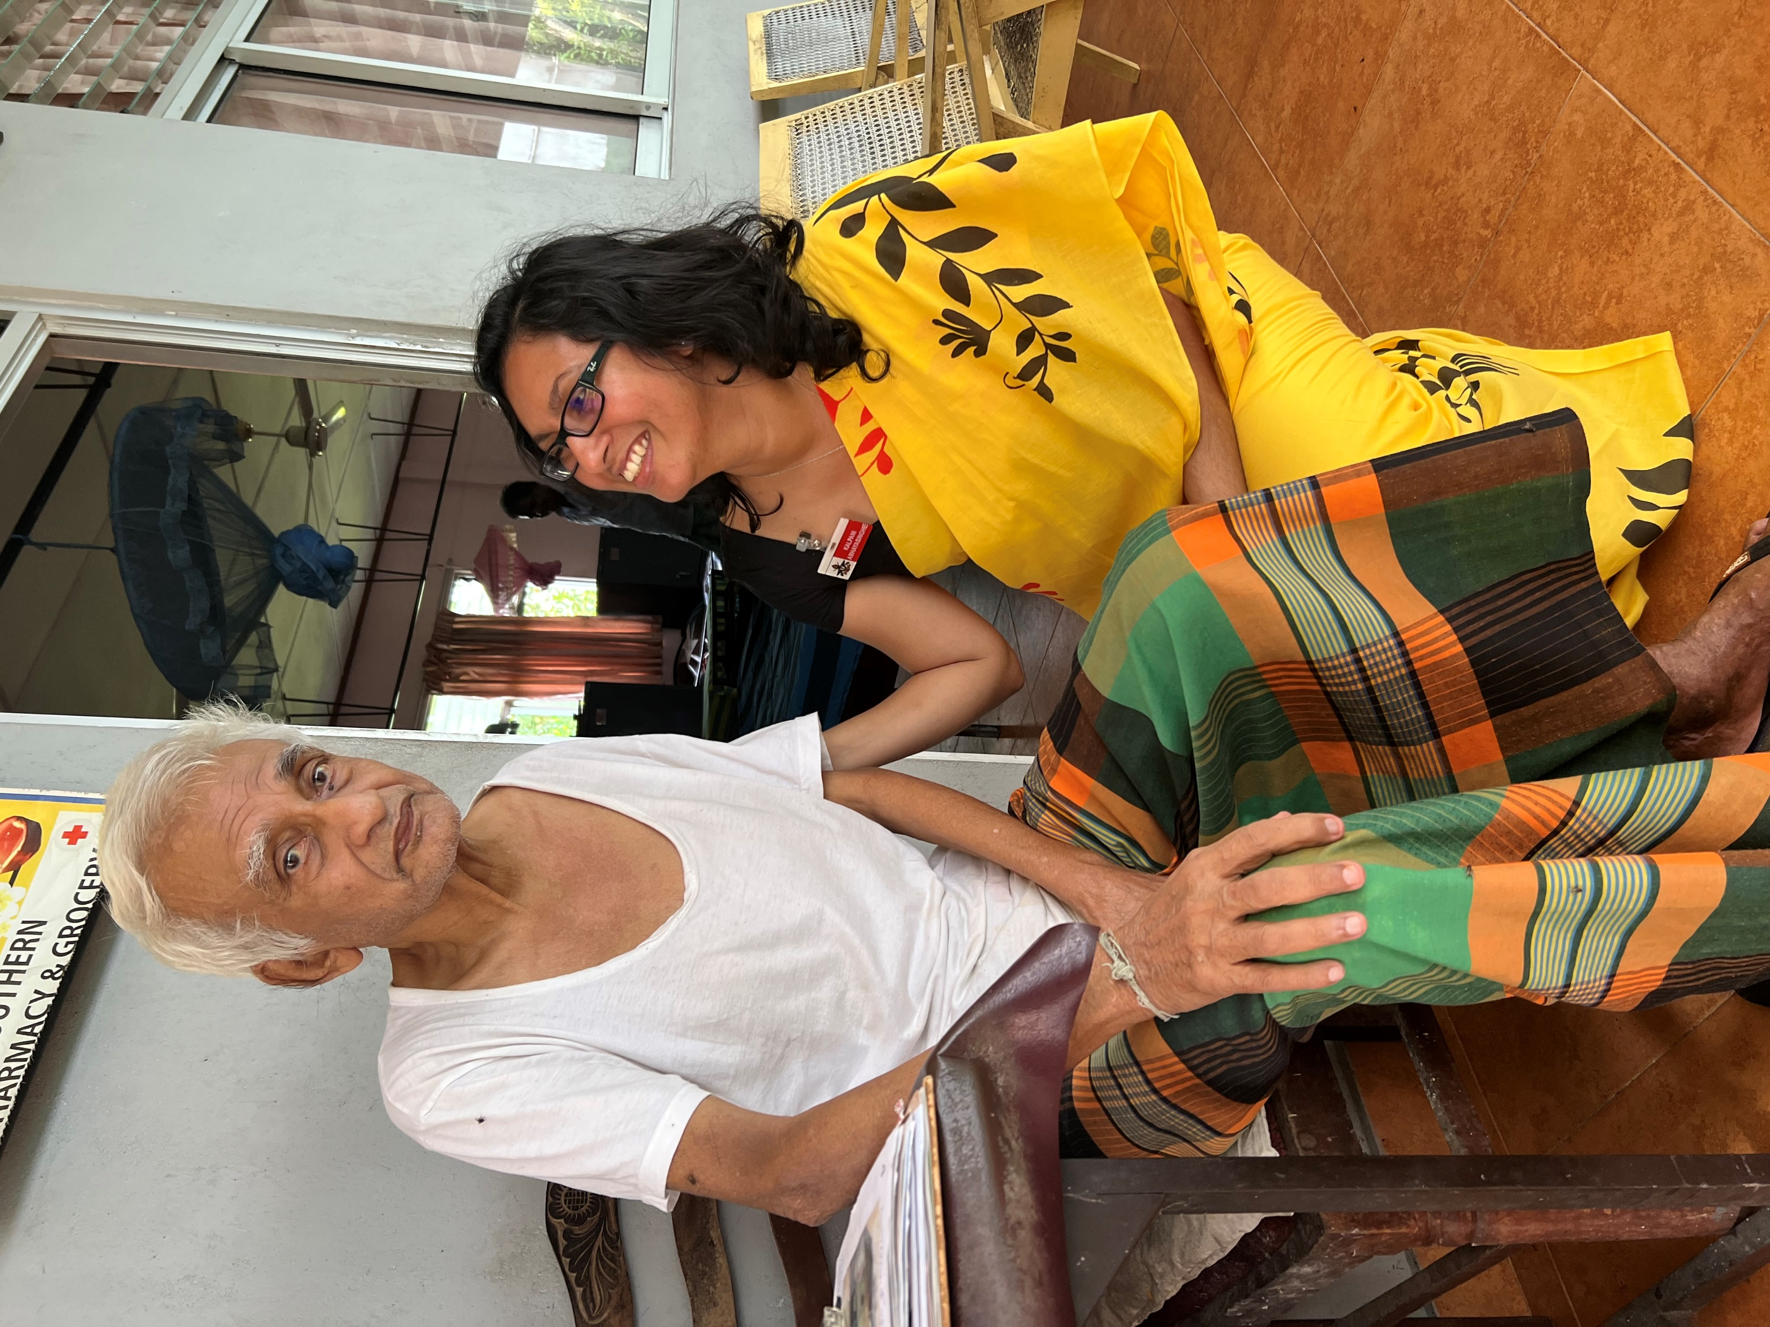
Providing a Social environment that supports psychological needs
Notes:
The fourth and last aspect is Providing a Social environment that supports psychological needs
Creating a social climate that supports psychological needs means recognizing that all human life is based on relationships and that people with dementia need an enriched social environment that both compensates for their loss and provides opportunities for personal maturity and growth. When one's sense of 'self' weakens, it becomes increasingly important to maintain it through relationships. However, relationships are not only about verbal ability, but also about body language and eye contact, at a non-verbal level.

Slide 18

“You see, it is far more than simply memory loss. We are confused, we have problems with our sight, with our balance, with numbers and with direction. It is a real disease, not a normal part of ageing. We have no sense of time passing, so we live in the present reality, with no past and no future. We put all our energy into now, not then or later. Sometimes this causes a lot of anxiety because we worry about the past or the future because we cannot ‘feel’ that it exists. But this fact that we live in the present, with a depth of spirit and some tangled emotions, rather than cognition, means you can connect with us at a deep level through touch, eye contact and smiles”.
Christine Bryden, age 56, living with frontal lobe dementia.
Notes:
Christine Bryden who got frontal lobe dementia in her 50ies describes the following.
“You see, it is far more than simply memory loss. We are confused, we have problems with our sight, with our balance, with numbers and with direction. It is a real disease, not a normal part of ageing. We have no sense of time passing, so we live in the present reality, with no past and no future. We put all our energy into now, not then or later. Sometimes this causes a lot of anxiety because we worry about the past or the future because we cannot ‘feel’ that it exists. But this fact that we live in the present, with a depth of spirit and some tangled emotions, rather than cognition, means you can connect with us at a deep level through touch, eye contact and smiles”.

Slide 19
WHY IS PERSON-CENTERED CARE IMPORTANT?
Research has found that person-centered care can have a big impact on the quality of care. It can:
Improve the experience and help people feel more satisfied
Encourage people to have a healthier lifestyle
Encourage people to be more involved in decisions about their care
Positive impact of people's health outcomes, such as their blood pressure
Reduce how often people use health services
Improve confident and satisfaction among health care professionals about the care provided
Notes:
People who have an illness are no less entitled to human rights than others. For example, people who have a dementia disease are both older and have a disease that affects their cognitive ability, which can be doubly discriminatory. It may be that decisions are made over their heads or that they are not given the information they need to be able to make a decision. It can also be about environments that are not adapted to their needs.
There is research that suggests that if the staff group feel valuated, then they in return are more likely to value those they care for.

Slide 20

Notes:
So, in summary
Respect for the individual's value is central to person-centered care. It requires that we develop a clear picture of what the person’s values are and in what way we create a context that supports this. It is the person's individual experiences of their situation that should guide the care we provide. It requires that there is an organization and structure that supports the relationship between health care professionals and the person in their care. It also requires knowledge and the opportunity to continuously reflection over the care we provide. I hope that this presentation have provided some insights to person-centered care and how we can change the care provision to support those in our care.

Slide 21
Thank you for listening!
Reference number: 618596-EPP-1-2020-1-SE-EPPKA2-CBHE-JP
This publication [communication] reflects the views only of the authors, and the Commission cannot be held responsible for any use, which may be made of the information contained therein.

