Slide 1


Clinical Assessment and Outcome measurements
Parkinson's disease (PD)
Seminar: Part II-Physical Assessment

Slide 2
Overview: The seminar (part II)
Introduction: Physical Assessment
Conducting an interview and assessment for a patient with Parkinson's disease
Understanding Parkinson disease: An evolving case study

Slide 3
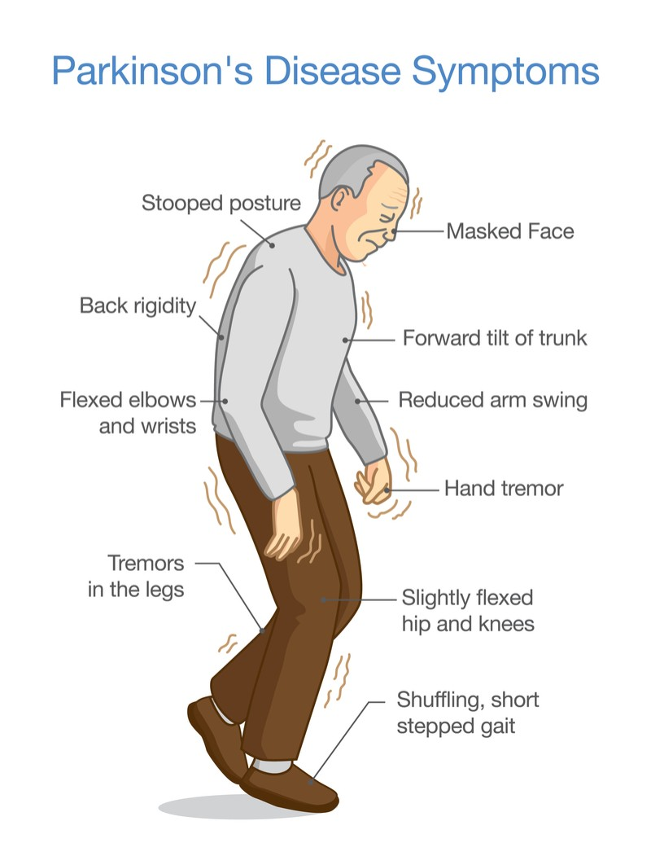
Physical Assessment: Introduction
Assessment should be an ongoing process, as Parkinson's disease is progressive, and symptoms may change over time.
Regular follow-up visits with healthcare providers are crucial to monitor the patient's condition

Slide 4
Introduction
It's essential for individuals with Parkinson's disease to work closely with healthcare professionals to tailor treatment plans to their specific needs and to engage in a multidisciplinary approach for comprehensive care.
The assessment of a Parkinson's patient involves a comprehensive evaluation of both motor and non-motor symptoms to determine the severity of the disease and develop an appropriate treatment plan

Slide 5
Main Areas for Assessing
Clinical History:
  Gathering information about the patient's medical history, including the onset and progression of symptoms.
  Noting any family history of Parkinson's disease or related disorders
Physical Examination:
  Neurological Examination: Assessing motor symptoms, including tremors, rigidity, bradykinesia, and postural instability.
  Gait and Balance Assessment: Evaluating the patient's ability to walk and maintain balance.

Slide 6
Main Areas for Assessing
Diagnostic Tests:
  Imaging Studies: While there is no definitive imaging test for Parkinson's disease, neuroimaging studies such as MRI or DaTscan may be used to rule out other conditions.
  Blood Tests: To rule out other potential causes of similar symptoms.
Motor Function Assessment:
  Utilizing standardized rating scales, such as the Unified Parkinson's Disease Rating Scale (UPDRS), to quantify the severity of motor symptoms

Slide 7
Main Areas for Assessing
Non-Motor Symptoms Assessment:
  Cognitive Function: Assessing memory, executive function, and other cognitive abilities.
  Mood and Mental Health: Evaluating for symptoms of depression, anxiety, or other mood disorders.
  Autonomic Function: Examining issues related to blood pressure, digestion, and other autonomic functions.
  Sleep Patterns: Inquiring about sleep disturbances and their impact on daily life.

Slide 8
Main Areas for Assessing
Quality of Life Assessment:
  Evaluating the impact of Parkinson's disease on the patient's daily activities, social interactions, and overall well-being.
Response to Medications:
  Monitoring the patient's response to prescribed medications, including adjustments to dosage and assessing for side effects.
Functional Assessment:
  Assessing the patient's ability to perform activities of daily living (ADLs), such as dressing, eating, and personal hygiene.
Patient and Caregiver Input:
  Incorporating information provided by the patient and their caregivers regarding the impact of symptoms on daily life
Multidisciplinary Collaboration:
  Involving various healthcare professionals, including neurologists, physical therapists, occupational therapists, and mental health professionals, to address different aspects of the disease

Slide 9
Conducting an interview and assessment for a patient with Parkinson's disease
1. Introduction and Establishing Rapport:
  Begin by introducing yourself and explaining the purpose of the interview.
  Establish a comfortable and empathetic environment to encourage open communication.
2. Patient Information:
  Confirm patient demographics (name, age, address, etc.).
  Verify primary and secondary contact information
3. Medical History:
  Gather information about the patient's overall health history.
  Inquire about any pre-existing medical conditions, surgeries, or hospitalizations.

Slide 10
4. Parkinson's Disease History:
  Ask about the onset of Parkinson's symptoms and the progression of these symptoms over time.
  Explore the patient's experiences with diagnosis and any previous treatments.
5. Current Symptoms:
  Conduct a detailed assessment of motor symptoms:
    Tremors: Type, frequency, and impact on daily activities.
    Bradykinesia: Changes in movement speed and dexterity.
    Rigidity: Assess stiffness in different muscle groups.
    Postural Instability: Inquire about balance issues and falls.
6. Non-Motor Symptoms:
  Explore non-motor symptoms and their impact:
    Cognitive Function: Memory, attention, and executive function.
    Mood and Mental Health: Depression, anxiety, or other emotional concerns.
    Autonomic Function: Issues with blood pressure, digestion, and sweating.
    Sleep Patterns: Quality of sleep, disturbances, and impact on daily life.

Slide 11
7. Medication History:
  Document the current medications, dosages, and frequency.
  Inquire about any changes in medication or effectiveness.
8. Activities of Daily Living (ADLs):
  Assess the patient's ability to independently perform daily tasks.
  Identify any challenges or adaptations made in response to Parkinson's symptoms.
9. Quality of Life:
  Explore the patient's perspective on their overall well-being and quality of life.
  Inquire about social interactions, hobbies, and recreational activities
10. Support System:
  Identify the patient's support network, including family, friends, and caregivers.
  Discuss the level of assistance the patient receives with daily activities

Slide 12
Video presentations:
https://www.youtube.com/watch?v=cxHpFWKIfGw&t=756s
https://www.youtube.com/watch?v=sJqKvajUC3k&t=15s

Slide 13
Activity
See the case Scinarrio and write physical assessment report for the patient in given scinarrio
Understanding Parkinson disease An evolving case study Vernon, Gwyn M. MSN, CRNP; Carty, Anne E. S. DNSc, RN; Salemno, Christin M. BSN, RN; Siskind, Michele M. MS, RN; Thomas, Cathi A. MS, RN, CNRN; Nurse Practitioner 39(10):p 1-10, October 15, 2014. | DOI: 10.1097/01.NPR.0000453646.44157.83

Slide 14


