Slide 1
Module 4
Martin Persson, PhD, MPH, MSc Professor of Health Science Faculty of Health Sciences Kristianstad University Sweden

Slide 2

Learning objectives
What is Utilisation–Focused Outcomes Framework
Explain what “SMARTER” goals are
Explain logic framework model
Explain why evaluation is important
Give examples of different evaluation models

Slide 3
Plan for change

Slide 4
Impact

Slide 5

Measuring change

Slide 6
YOU CANNOT MANAGE SOMETHING YOU CANNOT CONTROL.
YOU CANNOT CONTROL SOMETHING YOU CANNOT MEASURE.

Slide 7
Utilisation–Focused Outcomes Framework
It is a method used to evaluate the effectiveness of a program or intervention.
It focuses on the extent to which the program or intervention is being used or adopted by the target population, as well as the impact it is having on the intended outcomes.
This approach emphasizes the importance of understanding how and why a program or intervention is being used (or not used) in order to improve its effectiveness.
The framework typically includes several stages, such as implementation, adoption, implementation, penetration, and maintenance, and it also focuses on end-user satisfaction and how the program or intervention is contributing to the achievement of desired outcomes.
It is used to evaluate the effectiveness of various types of programs, including health care, social services, and education.
Patton, M. Q. (2008). Utilization-focused evaluation (4th ed.). Thousand Oaks: Sage Publications.

Slide 8
Utilisation–Focused Outcomes Framework
A specific participant or client target group
The desired outcome(s) for that target group
One or more indicators for each desired outcome
Performance targets
Details of data collection
How will the results be used
Patton, M. Q. (2008). Utilization-focused evaluation (4th ed.). Thousand Oaks: Sage Publications. Page 243

Slide 9
Indicators
Indicators are specific, measurable characteristics or variables that provide information about the program or initiative being evaluated.
Indicators are used to assess the program's progress and effectiveness and to determine whether it is achieving its goals.
Examples of indicators include program participation rates, changes in participants' knowledge or skills, and improvements in program outcomes such as employment or educational attainment.
Indicators are selected based on the program's goals, objectives, and target population, and are chosen with input from stakeholders to ensure that they are relevant and useful.

Slide 10
Generating indicators
Identify the program's goals and objectives: Start by clearly defining the program's goals and objectives. This will help ensure that the chosen indicator is directly related to the program's purpose.
Involve stakeholders in the process: Consult with stakeholders such as program participants, program staff, and program funders to gather their input on what they believe are important characteristics or variables of the program. This will help to ensure that the indicator chosen is relevant and useful to those who will be using the evaluation results.

Slide 11
Indicators
Select a measurable characteristic or variable: Choose a characteristic or variable that can be quantitatively measured. This could be something like program participation rates, changes in participants' knowledge or skills, or improvements in program outcomes such as employment or educational attainment.

Slide 12
Indicators
Define the indicator: Clearly define the indicator chosen in terms of what it measures and how it will be measured. For example, the "program participation rate” indicator would be defined as "the percentage of eligible individuals who participated in the program.”
Establish a baseline: Establish a baseline for the indicator chosen. This is the starting point from which progress will be measured.

Slide 13
Indicators
Set a target: Establish a target for the indicator. This is the desired level of progress or achievement for the indicator.
Monitor progress: Continuously monitor progress towards the target and make adjustments as needed to ensure the program is achieving its goals.

Slide 14
Specifying desired outcomes
Type of change | Illustration
Change in circumstances | Children safely reunited with their families of origin from foster care
Change in status | Unemployed to employed
Change in behaviour | Truants will regularly attend school
Change in functioning | Increased self-care; getting to work on time
Change in attitude | Greater self-respect
Change in knowledge | Understand the needs and capabilities of children at different ages
Change in skills | Increased reading levels; able to parent appropriately
Maintenance | Continue to live safely at home (e.g., the elderly)
Prevention | Teenagers will not use drugs
Patton, M. Q. (2008). Utilization-focused evaluation (4th ed.). Thousand Oaks: Sage Publications. Page 245

Slide 15
Implementation of psychosocial care
In pairs answer the following questions - 15 minutes
A specific participant or client target group
The desired outcome(s) for that target group
One or more indicators for each desired outcome
Performance targets
Details of data collection
How will the results be used
Patton, M. Q. (2008). Utilization-focused evaluation (4th ed.). Thousand Oaks: Sage Publications. Page 243

Slide 16


Slide 17

SMARTER GOALS
Specific
Measurable
Achievable
Relevant
Time bound
Evaluate
Re –evaluate
https://en.wikipedia.org/wiki/SMART_criteria
“no copyright infringement is intended”

Slide 18
Specific
The goal is clear, you know what you are aiming to achieve.
A specific goal will usually answer the five 'W' questions:
What: What do I want to accomplish?
Why: Specific reasons, purpose or benefits of accomplishing the goal.
Who: Who is involved?
Where: Identify a location.
Which: Identify requirements and constraints.

Slide 19
Specific – Psychosocial care
What: Implement psychosocial care
Why: Improve our psychosocial provision of care for our clients/patients
Who: Healthcare professionals at our centre/department/clinic
Where: Our centre/department/clinic
Which: Acquire a specific skill set and allocate time to use the skill set

Slide 20
Measurable
Need to be measurable in order to track success.
The goal should be quantifiable and have a way of measuring progress.
Different levels – different outcomes
Individual
As a team
The patients/families perception

Slide 21
Measurable
A measurable goal will usually answer questions such as:
How much?
How many?
How will I know when it is accomplished?
Indicators should be quantifiable

Slide 22

Achievable
The goals should be realistic and also attainable.
This is crucial!
“no copyright infringement is intended”

Slide 23
Achievable
How can the goal be accomplished?
Requires planning and good team communication
The solution has to be adapted to your specific circumstances
How realistic is the goal in the context of other constraints?
Resources
Other events going on

Slide 24
Relevant
Is it relevant to implement psychosocial provision of care at our centre/department/clinic.
A relevant goal can answer yes to these questions:
Does this seem worthwhile?
Is this the right time?
Does this match our other efforts/needs?
Is it applicable in the current environment?

Slide 25
Time-bound
Establish the implementation of psychosocial provision of care within a time-frame.
A time-bound goal will usually answer the question
When?
What can I do today?
What can I do six weeks from now?
What can I do six months from now?

Slide 26

Reminder
Plans are based upon people’s needs and are anchored with the right people!
Who is in charge (accountable)?

Slide 27
LOGIC FRAMEWORK MODEL
A VERY USEFUL TOOL

Slide 28

Background
WK Kellogg Foundation. Using logic models to bring together planning, evaluation and action: logic model development guide. 2004.
A logic framework model is a tool used in program planning and evaluation to identify the logical relationships between a program's objectives, activities, outputs, and outcomes.
It is typically presented in a visual format, such as a flowchart, and includes a clear statement of the program's overall goal, as well as specific objectives that contribute to that goal.
The model also identifies the inputs (e.g., resources, funding) required to carry out the activities and the expected outputs (e.g., products, services) and outcomes (e.g., changes in knowledge, behaviour, or conditions) that will result from those activities.
The logic framework model is used to guide program planning, implementation, and monitoring and evaluation.

Slide 29
Background
A logic model is defined as a graphical/textual representation of how a program is intended to work and links outcomes with processes and the theoretical assumptions of the program.
WK Kellogg Foundation. Using logic models to bring together planning, evaluation and action: logic model development guide. 2004.

Slide 30
Background
“It is a depiction of a program or project showing what the program or project will do and what it is to accomplish. It is a series of “if then” relationships that, if implemented as intended, lead to the desired outcomes. Stated another way, it is a framework for describing the relationships between resources, activities and results as they related to a specific program or project goal. The logic model also helps to make underlying assumptions about the program or project explicit. It provides a common approach to integrating planning, implementation and evaluation.” Hayes H, Parchman ML, Howard R. (2011) A logic model framework for evaluation and planning in a primary care practice-based research network (PBRN). Journal of the American Board of Family Medicine 24: 576–82.

Slide 31
If then…
Resources
Activities
Outputs
Outcomes
Impact
Then
Then
Then
Then

Slide 32
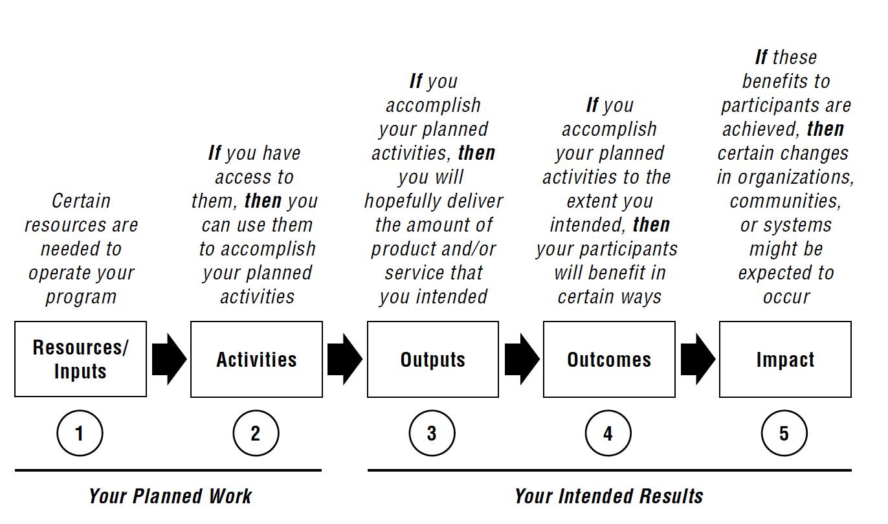
Logic Framework Model
W.K. Kellogg Foundation Logic Model Development Guide
https://www.wkkf.org/resource-directory#pp=10&p=1&q=logic%20model

Slide 33
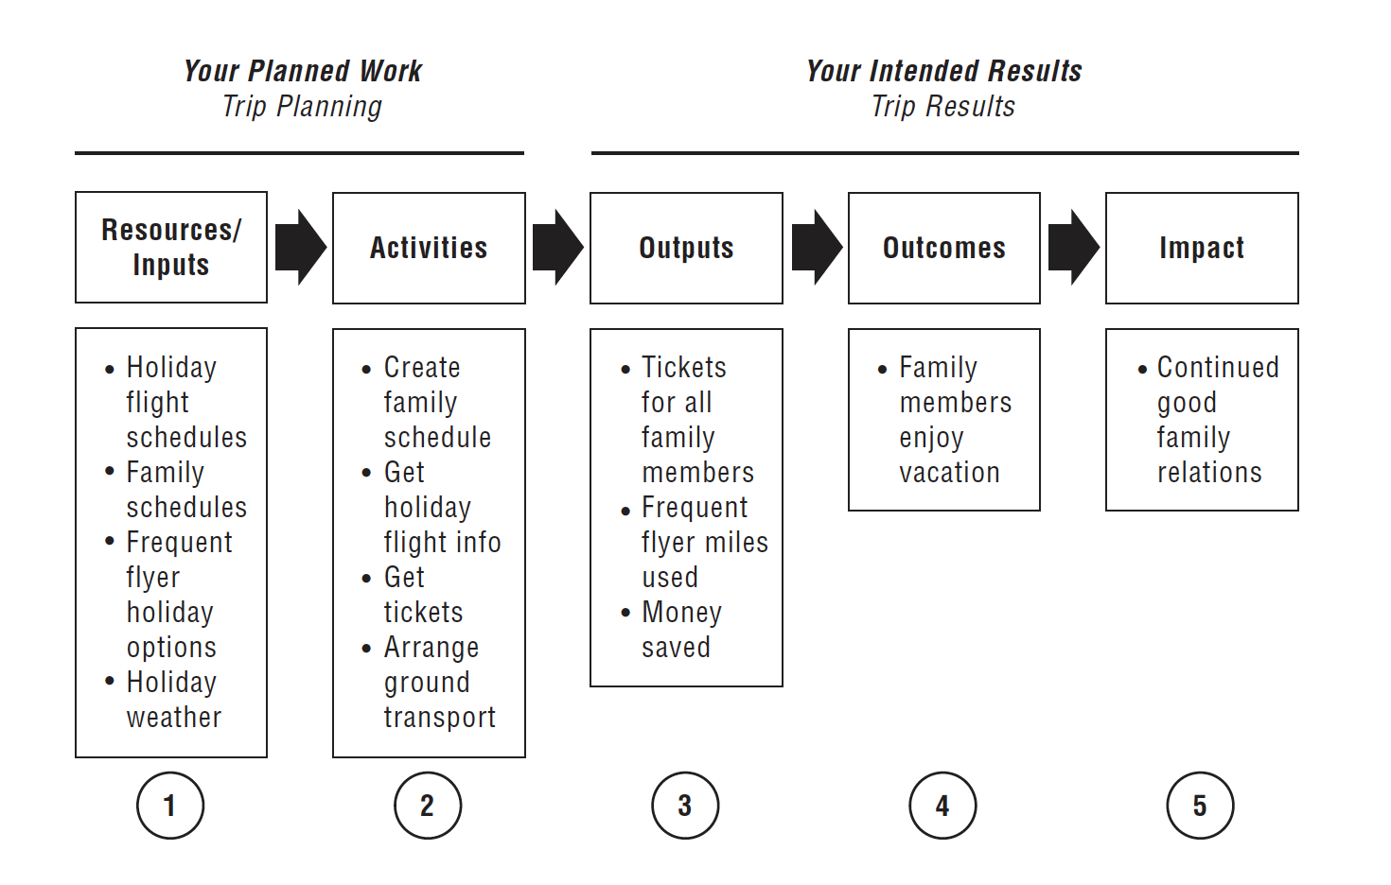
Logic Framework Model
W.K. Kellogg Foundation Logic Model Development Guide
https://www.wkkf.org/resource-directory#pp=10&p=1&q=logic%20model

Slide 34
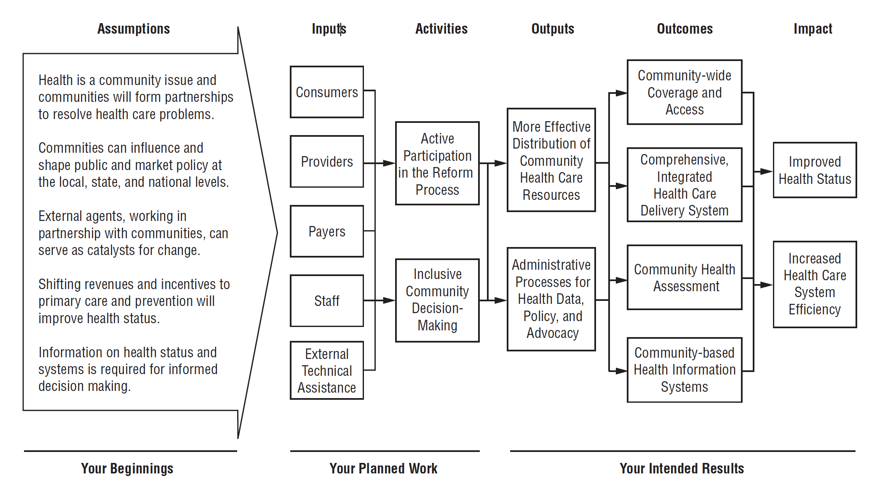
Logic Framework Model
W.K. Kellogg Foundation Logic Model Development Guide
https://www.wkkf.org/resource-directory#pp=10&p=1&q=logic%20model

Slide 35
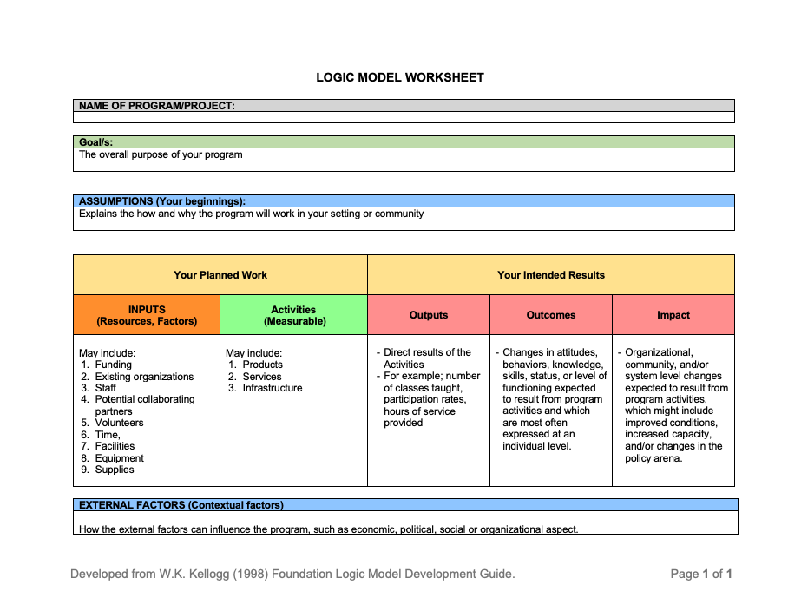

Slide 36

Step by Step
Problem Statement
What is the problem we want to solve?
Improve the psychosocial care for our patients
????

Slide 37
Step by Step
Goal/objective
What is the goal of the program/training?
Should include the intended result/s
The target population
Formulate a goal for
Psychosocial
????
Important to remember that all logic model components should be related to your goal
Phrase the goal in the term of the change you want to achieve

Slide 38
Step by Step
Assumptions
The conditions necessary for success
They already exist
You have generated awareness and interest about the program you want to implement
Explains the how and why the program will work in your setting or community
You believe them are true

Slide 39
Step by Step
Factors are resources or barriers
Protective factors or resources could include funding, existing organizations, potential collaborating partners, interpersonal networks, staff and volunteers, time, facilities, equipment, and supplies.
Risk factors or barriers might include such things as attitudes, lack of resources, policies, laws, regulations, and geography.
W.K. Kellogg Foundation Logic Model Development Guide, page 8
https://www.wkkf.org/resource-directory#pp=10&p=1&q=logic%20model

Slide 40
Step by Step
Activities are the processes, techniques, tools, events, technology, and actions of the planned program.
Products –promotional materials and educational curricula;
Services – education and training, counselling, or health screening;
Infrastructure – structure, relationships, and capacity used to bring about the desired results.
W.K. Kellogg Foundation Logic Model Development Guide, page 8
https://www.wkkf.org/resource-directory#pp=10&p=1&q=logic%20model

Slide 41
Step by Step
Outputs are the direct results of program activities. They are usually described in terms of the size and/or scope of the services and products delivered or produced by the program. They indicate if a program was delivered to the intended audiences at the intended “dose.”
A program output, for example,
might be the number of classes taught, meetings held, or materials produced and distributed;
program participation rates and demography;
or hours of each type of service provided.
W.K. Kellogg Foundation Logic Model Development Guide, page 8
https://www.wkkf.org/resource-directory#pp=10&p=1&q=logic%20model

Slide 42
Step by Step
Outcomes are specific changes in attitudes, behaviours, knowledge, skills, status, or level of functioning expected to result from program activities and which are most often expressed at an individual level.
W.K. Kellogg Foundation Logic Model Development Guide, page 8
https://www.wkkf.org/resource-directory#pp=10&p=1&q=logic%20model

Slide 43
Step by Step
Impacts are organizational, community, and/or system level changes expected to result from program activities, which might include improved conditions, increased capacity, and/or changes in the policy arena.
Relates back to your goal!
W.K. Kellogg Foundation Logic Model Development Guide, page 8
https://www.wkkf.org/resource-directory#pp=10&p=1&q=logic%20model

Slide 44
Logic model
An inventory of what you have and what you need to operate your program;
A strong case for how and why your program will produce your desired results;
A method for program management and assessment.
W.K. Kellogg Foundation Logic Model Development Guide, page 8
https://www.wkkf.org/resource-directory#pp=10&p=1&q=logic%20model

Slide 45
Exercise – in pairs 15 minutes
Use the Basic Logic Model Development Template
Develop a model for either,
Psychosocial concept
????
Remember that Outcomes and Impacts should be SMART:
Specific
Measurable
Action-oriented
Realistic
Time bound

Slide 46
Your Planned Work |  | Your Intended Results
INPUTS (Resources, Factors) | Activities (Measurable) | Outputs | Outcomes | Impact
In order to accomplish our set of activities we will need the following: | In order to address our problem or asset we will conduct the following activities: | We expect that once completed or under way these activities will produce the following evidence of service delivery: | We expect that if completed or ongoing these activities will lead to the following changes in 1–2 years: | We expect that if completed these activities will lead to the following changes in 2 -5 years:

Slide 48
Implementation

Slide 49

“no copyright infringement is intended”

Slide 50
Evaluation

Slide 51

Evaluate
It is crucial to evaluate the implementation in order to know if it is successful or what needs to be changed in order to make it successful.

Slide 52

Evaluate
Feedback to the team
What is good
What could be changed (if needed)
This means you might have to review your SMARTER process.

Slide 53
Re-evaluate
Evaluation has to be a continuous process.
In order to:
Feedback
Ensure everything goes according to plan
Change is the only constant aspect; hence the evaluation ensures that the delivery of psychosocial provision of care is consistent over time.

Slide 54
So what kind of evaluation should be done?

Slide 55
Formative Evaluation
Formative evaluation is a method of evaluating a project or program while it is still in progress. The goal of formative evaluation is to identify areas where improvement is needed, and to make adjustments to the project or program as it is being implemented.
This type of evaluation is used to inform and improve the learning process.

Slide 56
Formative Evaluation
Formative evaluation typically involves collecting data from a variety of sources, such as surveys, interviews, observations, and focus groups. This data is then analysed and used to identify strengths and weaknesses in the project or program, as well as areas where improvement is needed.
Different stakeholders, such as the project team, participants and external evaluators can do the evaluation process.

Slide 57
Formative Evaluation
Based on the findings, recommendations for improvement can be made and implemented. This allows for ongoing adjustments and improvements to be made to the project or program, with the ultimate goal of increasing its effectiveness and achieving its intended outcomes.

Slide 58
Formative Evaluation
In summary, Formative evaluation is a process of continuous improvement and learning that aims to identify areas where adjustments are necessary and make them while the project is still in progress. The data collection, analysis and adjustment to the project is done by different stakeholders, with the ultimate goal of increasing the effectiveness of the project and achieving the intended outcomes.

Slide 59
Two types of formative evalaution
Developmental evaluation
Monitoring evaluation

Slide 60
Developmental evaluation
Developmental evaluation is a type of formative evaluation that is used to assess the progress and effectiveness of a program or initiative as it is being implemented. It is a flexible and iterative process involving ongoing data collection and analysis and is used to make adjustments and improvements to the program as it is implemented.

Slide 61
Developmental evaluation
The main objective of developmental evaluation is to help program designers, implementers, and funders to understand the program, its implementation and its outcomes, in order to make adjustments and adaptations as needed. The focus of developmental evaluation is on the program's design, implementation, and early results, rather than on long-term outcomes or final results.

Slide 62
Developmental evaluation
Developmental evaluation involves a close collaboration between the evaluator, the program staff, and the stakeholders; it focuses on understanding the program's design and process, identifying and addressing potential problems, as well as opportunities for improvement.
This type of evaluation is particularly useful for complex and adaptive programs, where goals and objectives are often uncertain or evolving.

Slide 63
Developmental evaluation
It can be done by conducting focus groups, interviews, observation, and other data collection methods to gain insights into how the program is being implemented, what is working well and what is not, and what adjustments are needed to improve the program.

Slide 64
Monitoring evaluation
Monitoring evaluation is a type of formative evaluation that is used to track the progress and performance of a program over time. It is a continuous process that involves the regular collection and analysis of data on program inputs, activities, outputs, and outcomes.
The main objective of monitoring evaluation is to provide program staff and stakeholders with information on program performance so that they can make adjustments and improvements as needed.

Slide 65
Monitoring evaluation
Monitoring evaluation is different from summative evaluation, which assesses the overall effectiveness of a program at the end of a specific period of time, and from developmental evaluation, which assesses the progress and effectiveness of a program as it is being implemented.

Slide 66
Monitoring evaluation
In monitoring evaluation, data is collected on a regular basis, typically on a monthly or quarterly basis, and is used to track progress and performance against established goals and objectives.
The data collected can include information on program inputs, such as budget and staff resources; program activities, such as the number of participants served or services provided, program outputs, such as the number of brochures printed or training sessions conducted, and program outcomes, such as changes in participant knowledge or behaviour.

Slide 67
Monitoring evaluation
Monitoring evaluation can be done by using quantitative data, such as program output and outcome measures, as well as qualitative data, such as participant satisfaction surveys or interviews with program staff.
The data collected is analysed and used to make judgments about the program's performance, identify areas for improvement, and make adjustments to the program as needed.

Slide 68
Summative evaluation
Summative evaluation is a method of assessing the overall effectiveness of a program or system at the end of a specific period of time. It typically involves collecting data and using it to make judgments about the program, such as its effectiveness, efficiency, and impact.
Summative evaluations are often used to make decisions about the continuation or modification of a program.
This approach is different from formative evaluation, which assesses the progress of a program during its implementation and is used to make adjustments and improvements as the program is ongoing.

Slide 69
Accountability evaluation
Accountability evaluation is a type of summative evaluation that is used to determine whether a program or organization is meeting its goals and fulfilling its responsibilities to stakeholders.
This type of evaluation is typically conducted by external entities, such as government agencies or independent evaluators, and is used to provide information about program performance to funders, policymakers, and other stakeholders.

Slide 70
Accountability evaluation
The purpose of accountability evaluation is to ensure that programs are using resources effectively, achieving desired outcomes, and being accountable to the public.
Accountability evaluations often involve the collection of quantitative data, such as program output and outcome measures, as well as qualitative data, such as participant satisfaction surveys or interviews with program staff.

Slide 71
Accountability evaluation
This information is used to make judgments about the program's effectiveness and identify improvement areas.
It is important to note that accountability evaluations differ from compliance evaluations, which assess whether an organisation is adhering to regulations and policies rather than its effectiveness in achieving its goals.

Slide 72
Compliance evaluations
Compliance evaluations are assessments of an organization's adherence to laws, regulations, standards, and policies. Internal or external auditors, government agencies, or industry groups can conduct these evaluations.
The goal of a compliance evaluation is to identify any non-compliance issues and to recommend corrective actions to bring the organization into compliance. Compliance evaluations typically include a review of policies, procedures, and documentation, as well as on-site inspections and interviews with staff.
Depending on the industry and regulations, compliance evaluations may be required on a regular basis, such as annually, or specific events or incidents may trigger them.

Slide 73
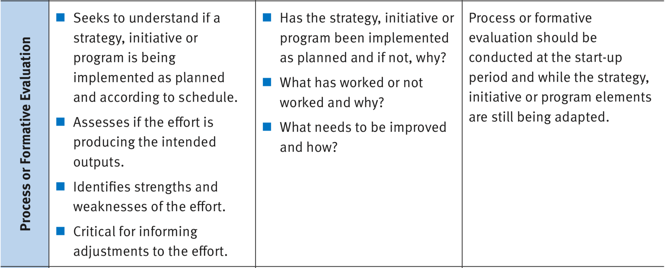
W K KELLOGG FOUNDATION 2017. The Step-by-Step Guide to Evaluation: How to Become Savvy Evaluation Consumers. Page 27

Slide 74
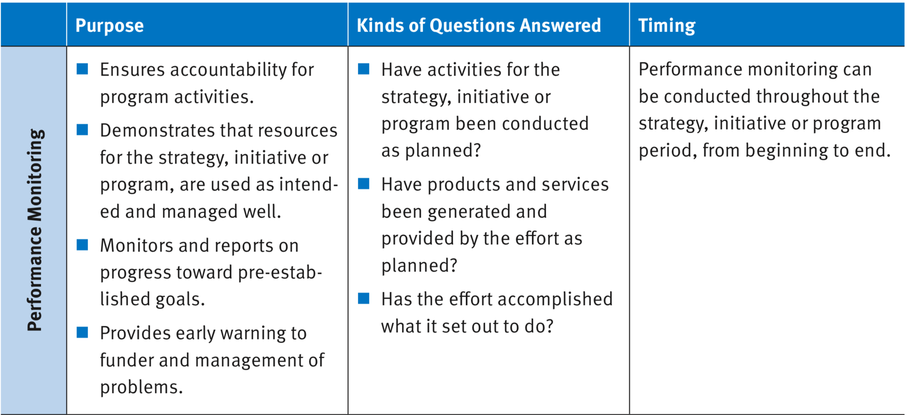
W K KELLOGG FOUNDATION 2017. The Step-by-Step Guide to Evaluation: How to Become Savvy Evaluation Consumers. Page 27

Slide 75
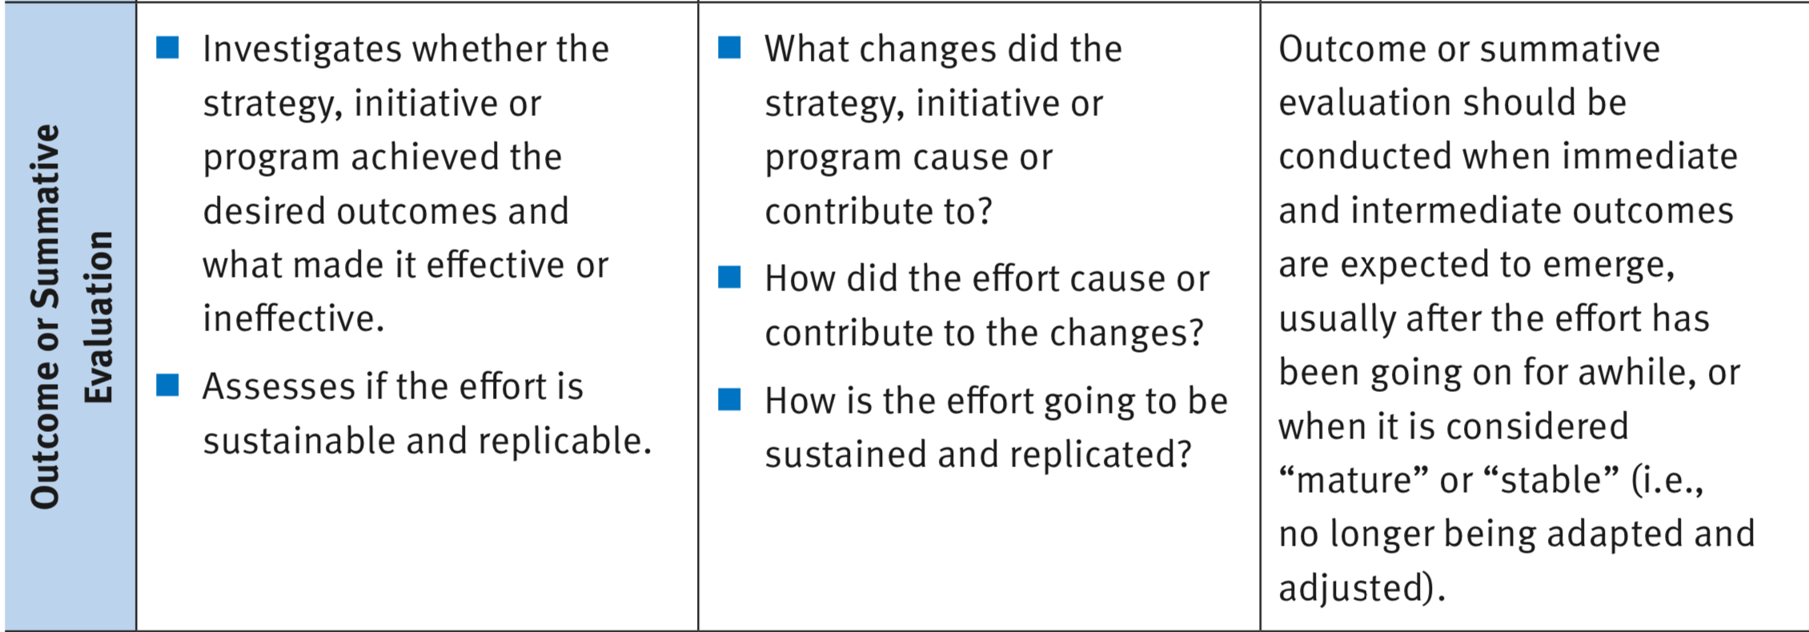
W K KELLOGG FOUNDATION 2017. The Step-by-Step Guide to Evaluation: How to Become Savvy Evaluation Consumers. Page 27

Slide 76
Exercise
In pairs look at the handout with the time line and the handout with different evaluation methods.
What types of evaluations would you conduct to assess the implementation of the psychosocial care and at which timepoints.
You need to explain your answers to the group
15 minutes for this exercise.

Slide 78
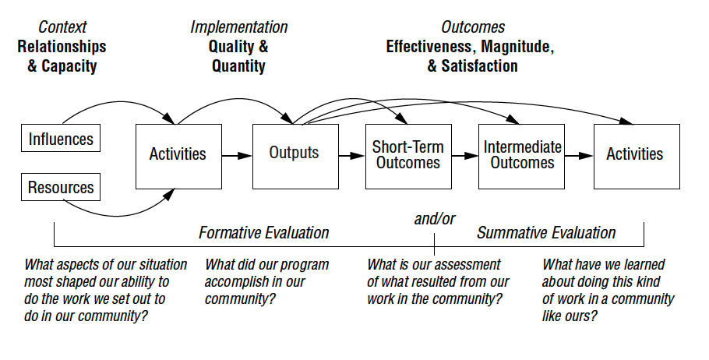
W.K. Kellogg Foundation Logic Model Development Guide (2004), page 36

Slide 79
Evaluation purpose | Key values | Guiding principles | Political Implications
1) Overall Summative Judgement | Future of the program; | Independence and credibility Rigor of design Significance Time-bound | Intended for funders, decision-makers, policymakers; Very high stakes
2) Formative Improvement and Learning | Focus on improving the program/intervention/ model | Trust Learning environment Relevance | Intended for those involved in the program (staff, admin, participants); Moderate Stakes
3) Accountability | Efficiency in use of resources Program management Outcome and Results | Transparency Validity Integrity & credibility Consistency Fairness | Intended for those involved in the funding, running and management of the program; High stakes
4) Monitoring | Program management | Timeliness, regularity, relevance and consistency in reporting | Intended for program managers; Low stakes (high stakes when external accountability)
5) Developmental | Adaptation and change based on emerging conditions | Openness Adaptive capacity Critical | Intended for Social innovators; Low stakes on short term but high stakes on long term
6) Knowledge generating | Enhance understanding Improve practice | Quality and comparability Triangulation | Intended for planners, theorists, researchers, policymakers; Moderate to low stakes
Patton, M. Q. (2008). Utilization-focused evaluation (4th ed.). Thousand Oaks: Sage Publications. Page 139

Slide 80
W.K. Kellogg Foundation Logic Model Development Guide (2004), page 36

Slide 81
W.K. Kellogg Foundation Logic Model Development Guide (2004), page 36

Slide 82

Participatory
“no copyright infringement is intended”

Slide 83
Participatory evaluation
Participatory evaluation is a type of evaluation that involves active participation from the stakeholders of a program or project. The goal of participatory evaluation is to involve those who are affected by the program in the evaluation process in order to ensure that their perspectives and needs are taken into account.

Slide 84
Participatory evaluation
Participatory evaluation typically involves a collaborative process where stakeholders are actively involved in the design, implementation, and interpretation of the evaluation. This can include things like involving stakeholders in setting evaluation goals and objectives, selecting evaluation methods and indicators, collecting and analyzing data, and using evaluation results to inform decision-making.

Slide 85
Participatory evaluation
Participatory evaluations are often used in community development, education, health and social programs, as it allows to identify the potential problems, the needs of the people, and the impact of the program on the community. This approach can also increase the stakeholders' ownership, accountability and commitment to the program, resulting in more effective and sustainable outcomes.

Slide 86

Participatory evaluation
How would you implement the participatory approach in a formative and summative evaluation?

Slide 87
WE ARE WHAT WE REPEATEDLY DO, EXCELLENCE THEN, IS NOT AN ACT, BUT A HABIT.

Slide 88
Sustain change

Slide 89
4 phases of implementation
The first phase involve identifying the need for change of working routine
The second phase is about implementing the new method.
In the third phase the new method is applied in clinical practice.
In the fourth and last phase is considered implemented if the method is used of more than 50% of the staff and after 1-2 years the new method is the routine
Damschroder, L. J., Aron, D. C., Keith, R. E., Kirsh, S. R., Alexander, J. A., & Lowery, J. C. (2009). Fostering implementation of health services research findings into practice: a consolidated framework for advancing implementation science. Implementation science, 4, doi:10.1186/1748-5908-4-50.

Slide 90
SUMMARY

Slide 91
Learning objectives
What is Utilisation–Focused Outcomes Framework
Explain what “SMARTER” goals are
Explain the logic framework model
Explain why evaluation is important
Give examples of different evaluation models

