Slide 1
Module 3
Martin Persson, PhD, MPH, MSc Professor of Health Science Faculty of Health Sciences Kristianstad University Sweden

Slide 2

Learning objectives
Understand how barriers influence implementation
How to identify barriers
Give example on “factors to consider”
Give example of leadership skills

Slide 3

Barriers

Slide 4

Obstacles

Slide 5
Barriers
There is an agreement by several researchers of the importance to address barriers and facilitators of implementation
Damschroder, L. J., Aron, D. C., Keith, R. E., Kirsh, S. R., Alexander, J. A., & Lowery, J. C. (2009). Fostering implementation of health services research findings into practice: a consolidated framework for advancing implementation science. Implementation science, 4, doi:10.1186/1748-5908-4-50.
Durlak, J. A. & DuPre, E. P. (2008). Implementation matters: a review of research on the influence of implementation on program outcomes and the factors affecting implementation. Am J Community Psychol 41, 327–350.
Greenhalgh, T., Robert, G., Macfarlane, F., Bate, P. & Kyriakidou, O. (2004). Diffusion of innovations in service organisations. Systematic review and recommendations. The Milbank Quarterly, 82, 581–629.
Nilsen, P. (2015). Making sense of implementation theories, models and frameworks. Implementation Science, 10, 53 https://doi.org/10.1186/s13012-015-0242-0

Slide 6
Barriers
It is during the third phase (Damschroder et al, 2009), when the new method is implemented, most projects fail because the professionals feels uncomfortable and uncertain. There is an evident risk that the professional rather than using the method as intended changes and adjust it. Thus, an integrated and ongoing supervision of the new method, in the ordinary activities, could prevent this from happening.
Damschroder, L. J., Aron, D. C., Keith, R. E., Kirsh, S. R., Alexander, J. A., & Lowery, J. C. (2009). Fostering implementation of health services research findings into practice: a consolidated framework for advancing implementation science. Implementation science, 4, doi:10.1186/1748-5908-4-50.

Slide 7
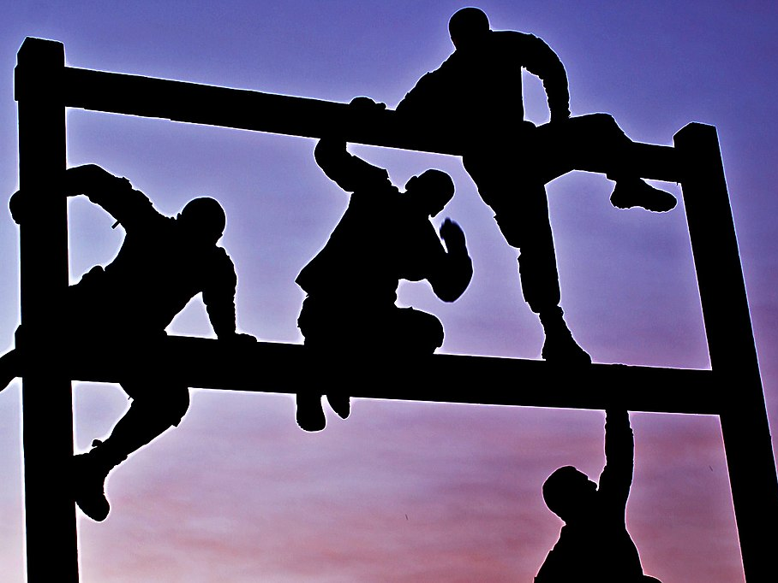
What are the potential barriers?
This Photo by Unknown Author is licensed under CC BY-SA

Slide 8
Awareness and knowledge
What needs to change?
We have no or limited psychosocial provision of care.
Why does it need to change?
This needs to change so we can provide better care for our patients

Slide 9
Awareness and knowledge
Everyone in the team needs to know the answers to these 2 questions
If not, implementation of the new concept is less likely to work.

Slide 10
Barriers – talk in pairs (10 minutes)
What are the barriers/obstacles you have encountered based on your experience?
What barriers do you think are the most challenging?

Slide 11

Barriers/obstacles
Group discussion 10 minutes

Slide 12

The Benefit versus Cost ratio
Influences how an individual will behave in relation to implementing the change.
The perception that implementing is more beneficial than the cost (effort) is crucial.
This Photo by Unknown Author is licensed under CC BY-NC

Slide 13
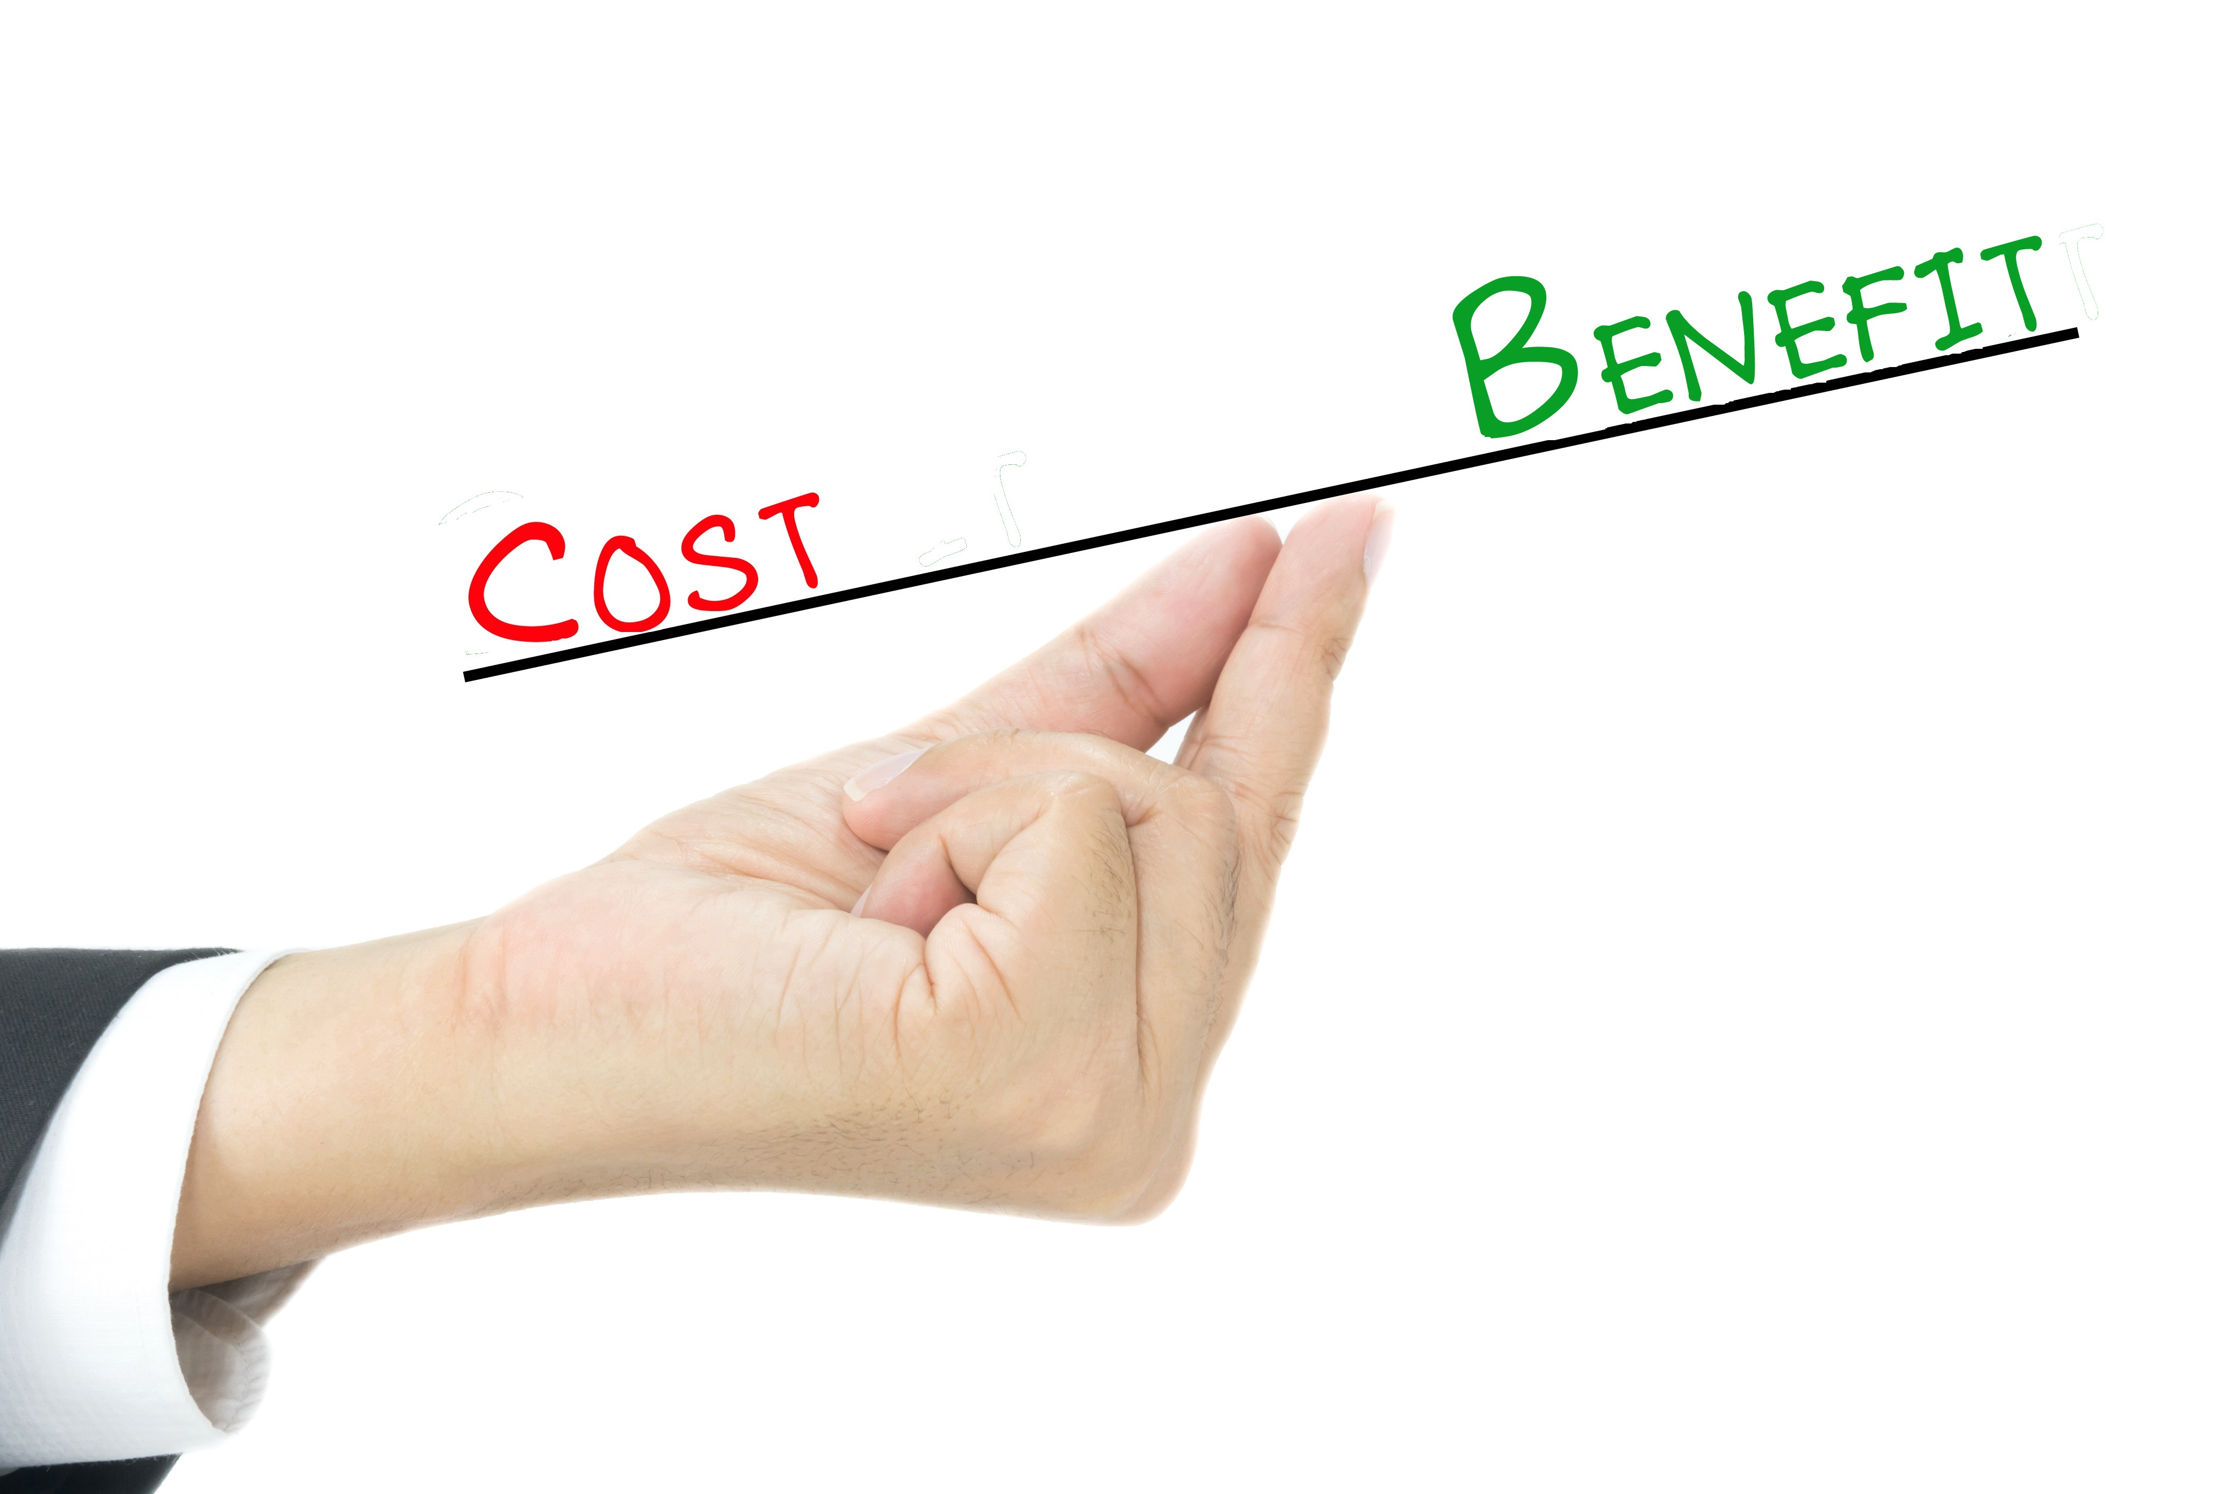
Benefit versus Cost ratio
In relation to the implementation of psychosocial care, what are the:
Benefits
Costs
“no copyright infringement is intended”

Slide 14

Skills
To implement change, people need to feel that they are skilled enough
So when implementing a new concept (such as psychosocial care), it is crucial that everyone that works in the clinic/department has received some training/information.

Slide 15
Practicalities
Resources
Physical
A suitable environment (e.g. secluded room) to talk about psychosocial aspects
Staff
Have all staff been trained/gained the necessary skill set?
Time
Allocation of time to conduct the additional task
Time for the patient
Tine to record/administration

Slide 16

Barriers outside your control

Slide 17
Barriers outside your control
This may include external factors that can influence the implementation/provision of psychosocial care, for example:
Staff leaving
Financial aspects
Physical environment
Financial crisis

Slide 18
Barriers outside your control
It is important to think about how you can address these aspects in your setting.
By having a viable plan in place about how to address the potential external risks factors, staff feel more comfortable allocating their resources and effort for implement the necessary changes.

Slide 19

Grol, R., & Wensing, M. (2004). What drives change? Barriers to and incentives for achieving evidence-based practice. Med J Aust, 180(6 Suppl), S57-60.
This Photo by Unknown Author is licensed under CC BY-SA

Slide 20
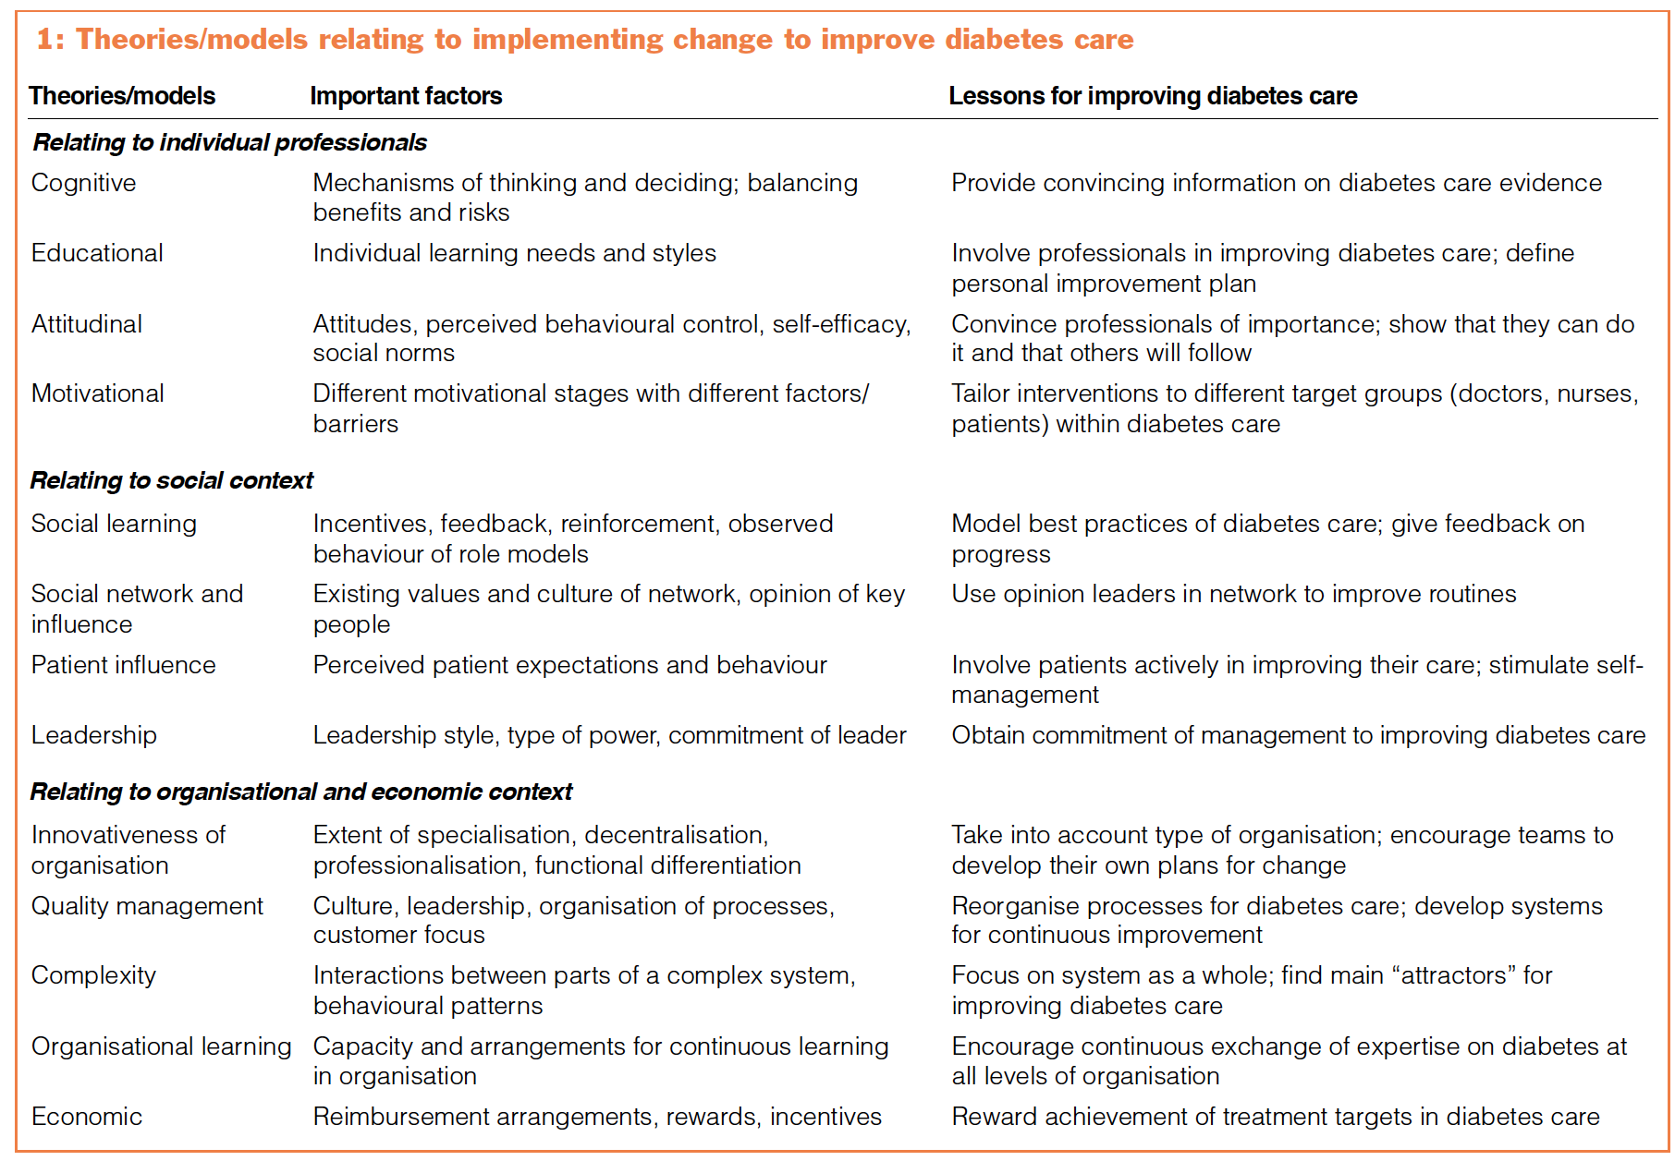
Factors to consider
Grol, R., & Wensing, M. (2004). What drives change? Barriers to and incentives for achieving evidence-based practice. Med J Aust, 180(6 Suppl), S57-60.

Slide 21
Factors to consider
Grol, R., & Wensing, M. (2004). What drives change? Barriers to and incentives for achieving evidence-based practice. Med J Aust, 180(6 Suppl), S57-60.

Slide 22
Factors to consider
Grol, R., & Wensing, M. (2004). What drives change? Barriers to and incentives for achieving evidence-based practice. Med J Aust, 180(6 Suppl), S57-60.

Slide 23
Summary
The authors argue that a variety of barriers, such as lack of knowledge, lack of resources, and resistance to change, can prevent healthcare professionals from adopting evidence-based practices. On the other hand, incentives such as improved patient outcomes, professional recognition, and financial rewards can encourage the adoption of evidence-based practices.
A multifaceted approach is needed to overcome barriers and provide incentives for the implementation of evidence-based practice in healthcare.
Grol, R., & Wensing, M. (2004). What drives change? Barriers to and incentives for achieving evidence-based practice. Med J Aust, 180(6 Suppl), S57-60.

Slide 24
Questions to answer
Do I have a clear view of how this change will affect me?
Write down how you think the implementation/change will affect your work
Positive aspects
Negative aspects
Work burden

Slide 25
Questions to answer
How will this change affect my co-workers?
Write down how you think the implementation/change will affect their work
Positive aspects
Negative aspects
Work burden
Think of the personas you generated earlier!

Slide 26
Confirm value of change
Together with the co-workers identify the positive effect of the change
Cooperation and reactions of patients and significant others
Was there any the side-effects?
If so, what kind?

Slide 27

Prepare for change
We have now identified how to address the potential barriers that can prevent a successful implementation.

Slide 28

Leadership
Who will lead the implementation process?
Specific person/persons
Someone must be in charge of the process
Accountability

Slide 29

What makes a bad leader?

Slide 30
Leadership
Skills
Be committed to the change
Have time to support the rest of the staff
Have a good knowledge of the clinic/work/business setting
Be a team player
Some change management experience would be an asset

Slide 31
SUMMARY

Slide 32
Learning objectives
Understand how barriers/obstacles influence implementation
How to identify barriers
Give an example on “factors to consider”
Give an example of leadership skills

