Slide 1
Module 2
Martin Persson, PhD, MPH, MSc Professor of Health Science Faculty of Health Sciences Kristianstad University Sweden

Slide 2
Learning objectives
Understand the process of transition
Understand the difference between extrinsic motivation and intrinsic motivation
Explain the four step model
Understand the theory of change model

Slide 3

Implementation
“no copyright infringement is intended”

Slide 4
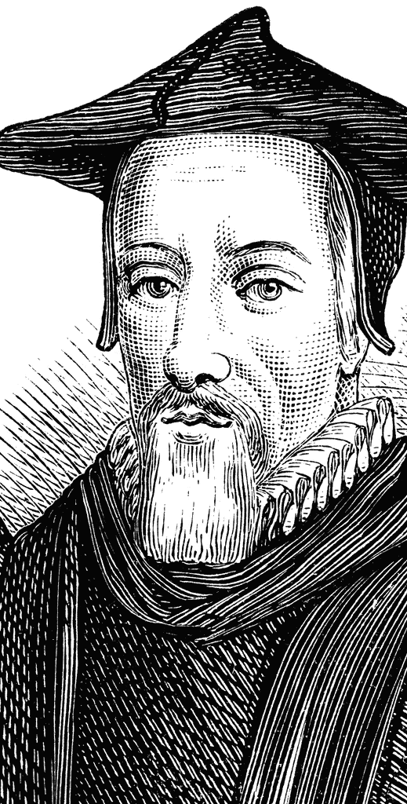
‘Change is not made without inconvenience, even from worse to better.’ Richard Hooker, 1554–1600
“no copyright infringement is intended”

Slide 5

Scenario
You are the team leader in an organisation of your choice
You are tasked to implement a change
Your team consists of 15 individuals
Limited resource allocation
It will add to the work burden for your team initially.
Learning new knowledge
Change of routine

Slide 6

What is the hardest thing with change from your perception?
In a small groups or pairs discuss this question for five to 10 minutes

Slide 7
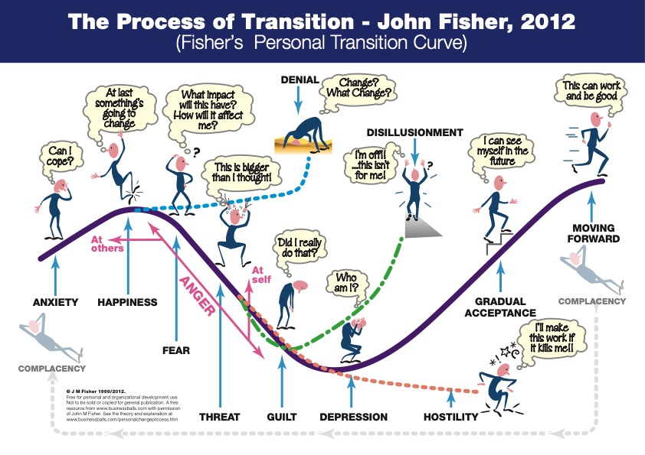

Slide 8
“To help people move through the transition effectively we need to understand their perception of the past, present and future. What is their past experience of change and how has it impacted on them?, how did they cope? Also what will they be losing as part of the change and what will they be gaining?
Therefore the goal of the 'manager'/change agent is to help make the transition as effective and painless as possible. By providing education, information, support, etc. we can help people transition through the curve and emerge on the other side.”
https://www.businessballs.com/change-management/personal-change-stages-john-fisher/

Slide 9
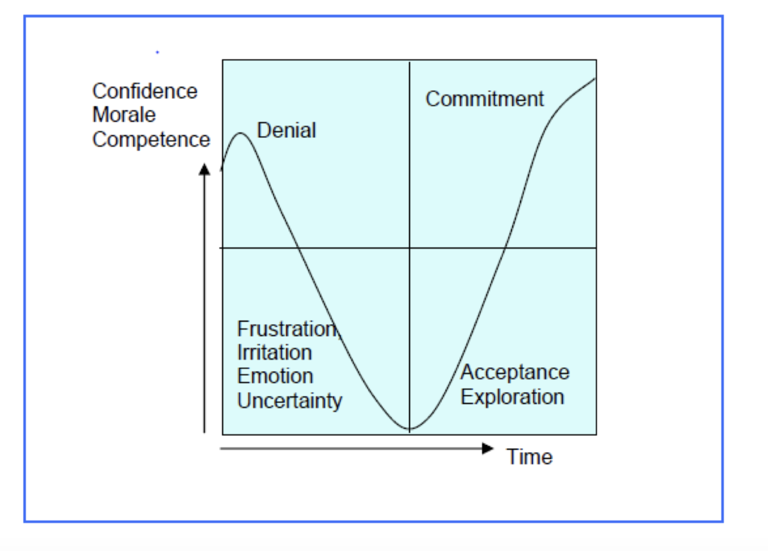
Individual
“no copyright infringement is intended”

Slide 10
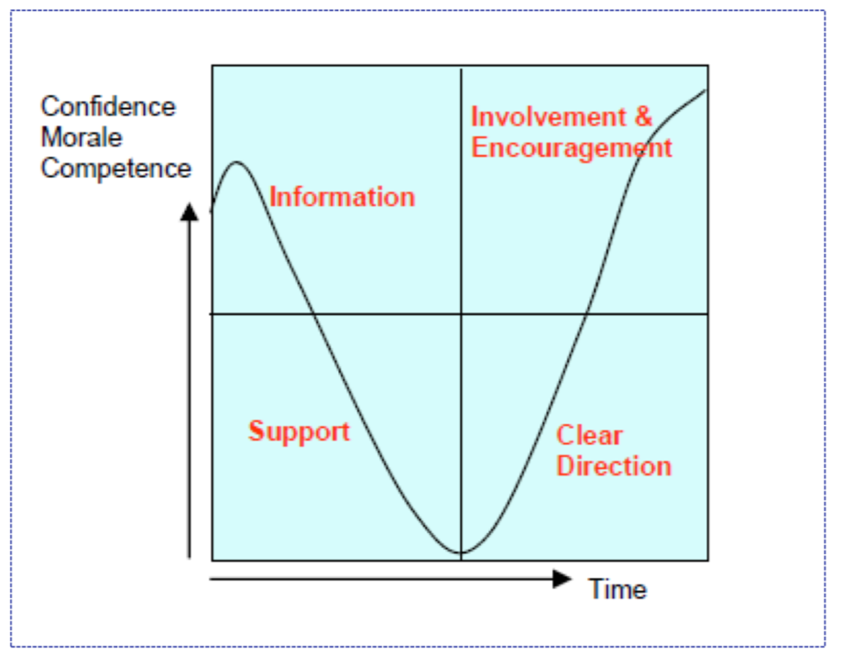
Individual
“no copyright infringement is intended”

Slide 11
Exercise
You will receive two handouts; please complete them by yourself – 5 to 7 minutes
Talk to the person next to you and share your answers: 10 minutes
Are they the same or different?

Slide 12

Motivation
What motivates you?
How would you motivate your team members?

Slide 13
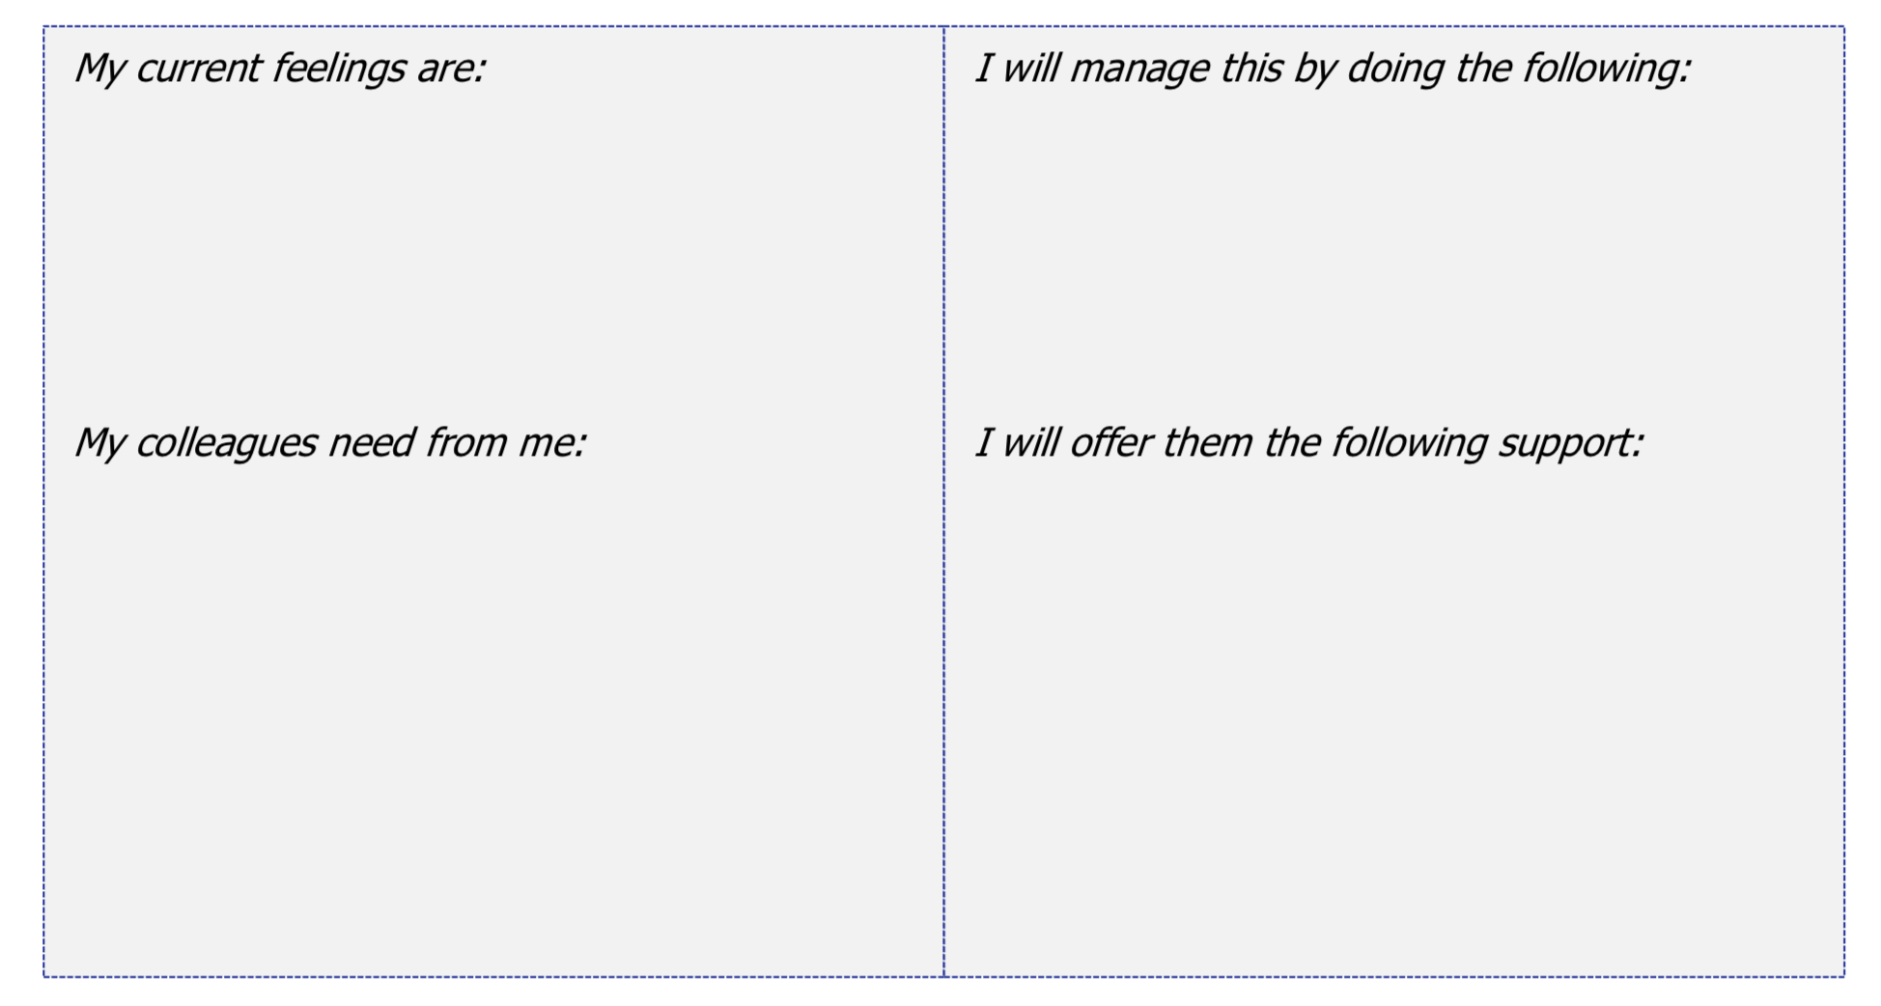
How do you feel about change?
“no copyright infringement is intended”

Slide 14

Motivation – the drive for change!
You won’t get motivated until you feel motivated
This relates to awareness and knowledge.
“no copyright infringement is intended”

Slide 15

Motivation – the drive for change!
So what does motivate us then?
There are different types of motivation.
Extrinsic (External) motivation
Intrinsic (Internal) motivation

Slide 16
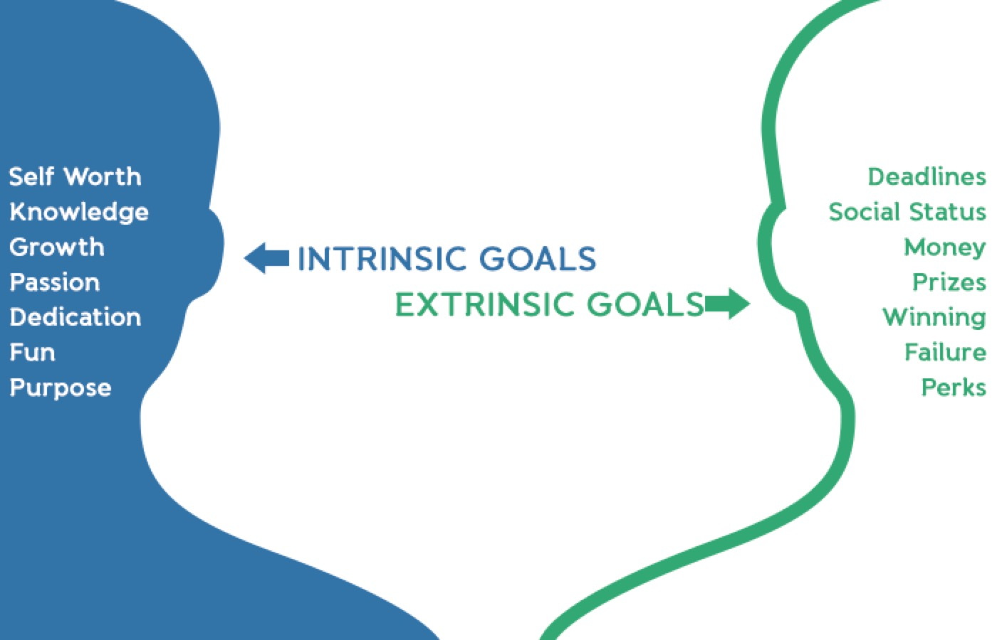
“no copyright infringement is intended”

Slide 17
Extrinsic (External) motivation
Drives us to do things for tangible rewards or the result of pressures
We are implementing the psychosocial care so we can meet the criteria for cleft center status
If I am trained in psychosocial care, I will receive a higher status and/or more pay

Slide 18
Intrinsic (Internal) motivation
Drives us to do things just for the fun/interest of it, or because we believe it is a good or right thing to do
We are implementing the psychosocial care so we can help our patients better
If I am trained in psychosocial care, I feel that I can provide better care for my patients

Slide 19

Motivation – the drive for change!
By understanding what motivates yourself and/or your colleagues, you generate the drive for change.

Slide 20
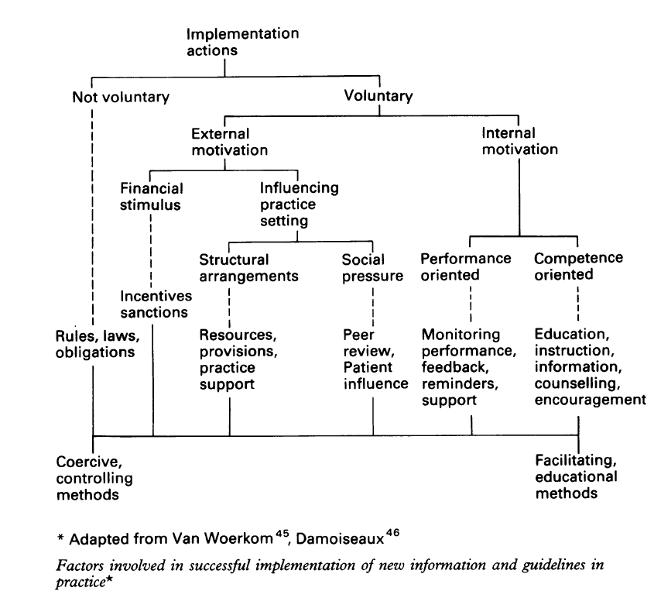
Grol, R. (1992).
Implementing guidelines in general practice care
Quality in Health Care, 1, 184-191.

Slide 21
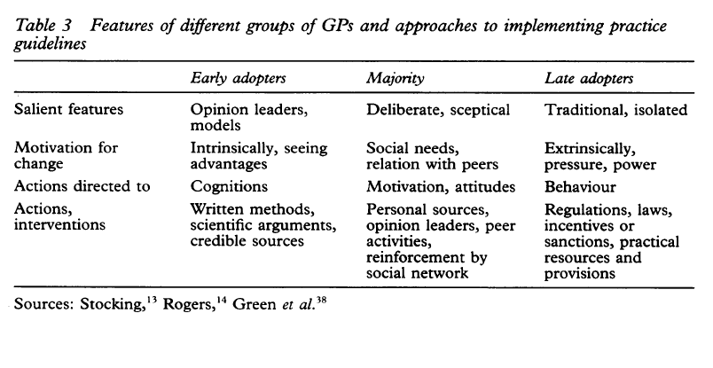
Grol, R. (1992).
Implementing guidelines in general practice care
Quality in Health Care, 1, 184-191.

Slide 22

the Four step model of change

Slide 23




The Four Step Model of Change
NO COMMITMENT COMMITMENT
ADOPTION
How do we ensure staff will use it on a daily basis?
TRIAL
INTEREST
How do we get them involved in the implementation?
How do we get staff interested?
AWARENESS
HOW DO WE ACHIEVE ADOPTION?
How do we raise awareness?

Slide 24
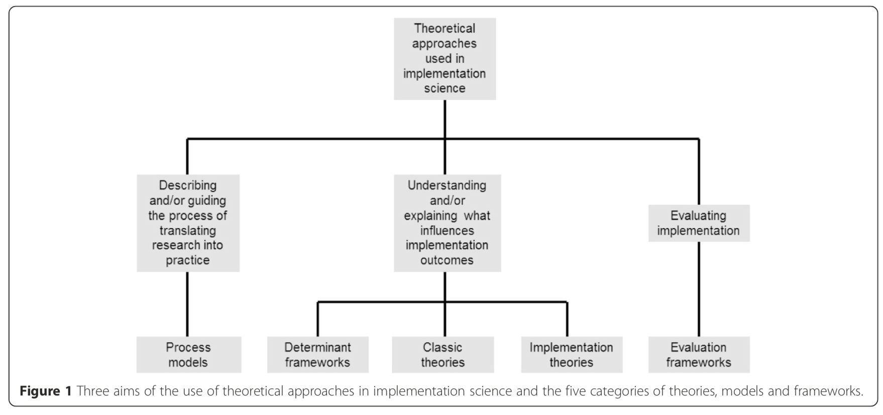
Nilsen P. Making sense of implementation theories, models and frameworks. Implement Sci. 2015;10:53.

Slide 25
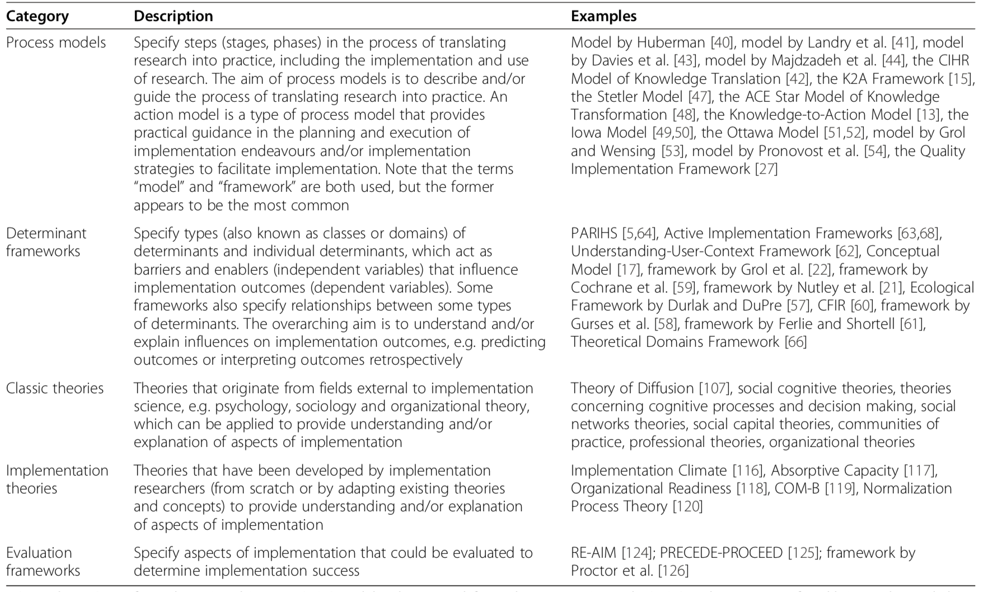
Nilsen P. Making sense of implementation theories, models and frameworks. Implement Sci. 2015;10:53.

Slide 26
4 phases of implementation
The first phase involve identifying the need for change of working routine
The second phase is about implementing the new method.
In the third phase the new method is applied in clinical practice.
In the fourth and last phase is considered implemented if the method is used of more than 50% of the staff and after 1-2 years the new method is the routine
Damschroder, L. J., Aron, D. C., Keith, R. E., Kirsh, S. R., Alexander, J. A., & Lowery, J. C. (2009). Fostering implementation of health services research findings into practice: a consolidated framework for advancing implementation science. Implementation science, 4, doi:10.1186/1748-5908-4-50.

Slide 27
Prepare for change
Plan for change
Implementation
Sustain change
Evaluate
If necessary adjust

Slide 28
Prepare for change

Slide 29

Theory of change

Slide 30

Theory of change
A theory of change is a narrative that explains the links between program strategies or activities and outcomes, and how and why the desired change is expected to come about.
W K Kellogg Foundation. The Step-by-Step Guide to Evaluation: How to Become Savvy Evaluation Consumers. 2017.

Slide 31
Theory of change
Exercise

Slide 32
Change challenge
How would you implement psychosocial provision of care in your organisation
Use the following handouts to help you to solve this challenge
Work in a group of 2 – 3 people
Each group present their outcomes
Time allocation:
20 minutes to complete the handouts
10 to 15 minutes for discussion

Slide 33
STRATEGIES
ASSUMPTIONS
5
6
INFLUENCIAL FACTORS
PROBLEM OR ISSUE
DESIRED RESULTS
(OUTPUTS, OUTCOMES, IMPACT)
1
4
3
NEEDS/ASSETS
2
Adapted from W K Kellogg Foundation. (2004). W.K. Kellogg Foundation Logic Model Development Guide. Page 31

Slide 34
Problem or Issue
Describe what it is your program/intervention trying to solve
Patient Needs
Specify the needs of your target group
Desired results
Identify your desired results
Outputs (immediate results)
Outcomes (intermediate results)
Impact (long-term results)
Influential factors
Protective factors or resources could include funding, potential collaborating partners, staff and volunteers, time, facilities, equipment, and supplies.
Risk factors or barriers might include such things as attitudes, lack of resources, policies, laws, regulations, and geography.
Strategies
Identify “best practises” and/or research that supports why this will succeed
Assumptions
State the assumption behind how and why the identified change strategies will work in your setting (e.g. principles, ideas, beliefs).
1
2
3
4
5
6
Adapted from W K Kellogg Foundation. (2004). W.K. Kellogg Foundation Logic Model Development Guide. Page 31

Slide 35
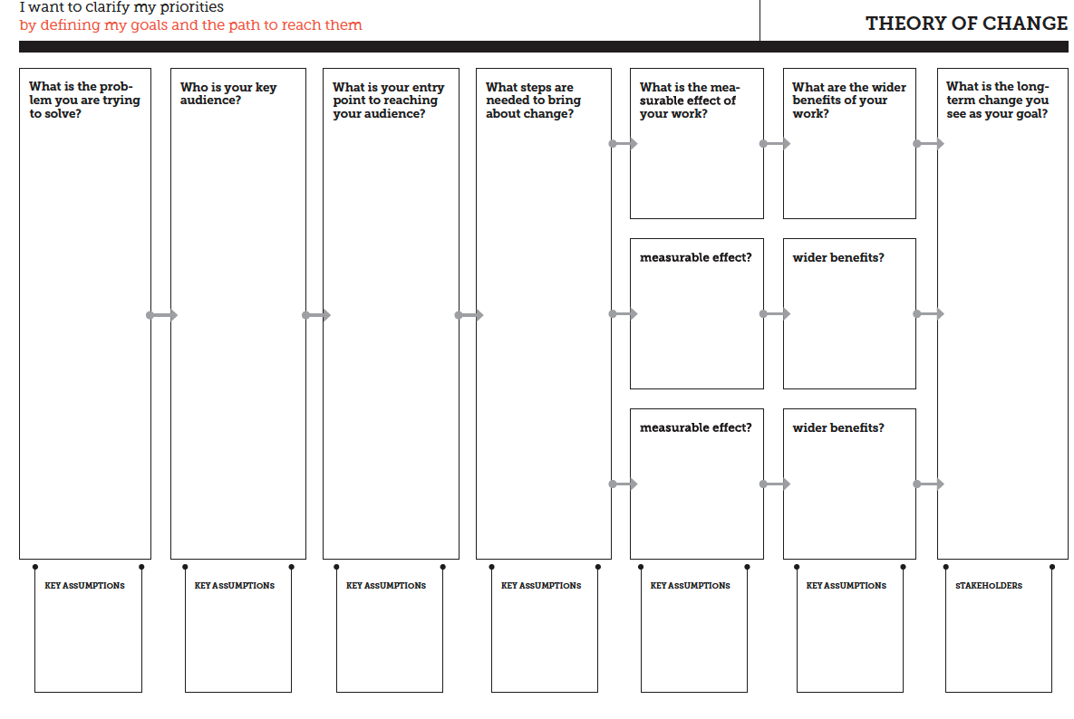
https://diytoolkit.org/media/DIY-Toolkit-Full-Download-A4-Size.pdf

Slide 36
Understanding
Do we share a common vision and view of the implementation?
Explain the vision in your own words
Do we understand the impact the change has on the team?

Slide 37
SUMMARY

Slide 38

Learning objectives
Understand the process of transition
Understand the difference between extrinsic motivation and Intrinsic motivation
Explain the four step model
Understand the theory of change model

