Slide 1
Exercises

Slide 2

Patient Persona 1: [name]
Diagnosis, main / (secondary if applicable)
Medical condition
Age:
Sex:
Family situation, ethnicity, language, relevant social factors
Education, occupation, financial situation, living condition
Demographic
Demographic
Notes:
Use a persona to bucket valuable information and observations about an actor into a recognizable character.
Miscommunication and misunderstanding is a risk when a team are unknowingly talking about different types of patients, nurses or relatives
Also, recognizing that we have our frames and assumptions of people, this is a way to get those up into the light
You can make a number of personas, focus on the most important groups and remember to validate your assumptions. You don’t want to be solving problems for people that don’t exist.
User persona should always be created based on information you have about your target audience. That’s why always start with user research. Having solid information about your users will prevent you from making false assumptions.

Slide 3
What does he/she
THINK AND FEEL?
What does he/she
HEAR?
What does he/she
SEE?
What does he/she
SAY AND DO?
PAIN | GAIN

Slide 4
Empathy Map
Think and feel: the patterns of thoughts, ideas and feelings that the patient experiences around a topic.
Say and do: their words and actions which illustrate their motivations and behaviour.
Hear: what they’ve read, what they hear through media and from healthcare professionals, friends and family, government information campaigns etc.
See: where people were, the objects that surrounded them and what was going on around them.
Pain/Challenges: the pain points they experienced, the parts of the process that blocked or slowed them achieving their goal, what hindered rather than helped.
Gain/Opportunity: benefits that they, and others, would experience if our service redesign removed those pains and barriers
https://www.albertahealthservices.ca/assets/info/hp/cdm/if-hp-cdm-empathy-mapping-summary.pdf

Slide 5
Persona 1
Persona 2
Persona 3
Persona 4
Motivation
Motivation
Motivation
Motivation
Psychographics
Psychographics
Psychographics
Psychographics
Opportunity
Opportunity
Opportunity
Opportunity
Pain point
Pain point
Pain point
Pain point

Slide 6
What is the hardest thing with change from your perception?

Slide 7
Motivation
What motivates you?
How would you motivate your team members?

Slide 8
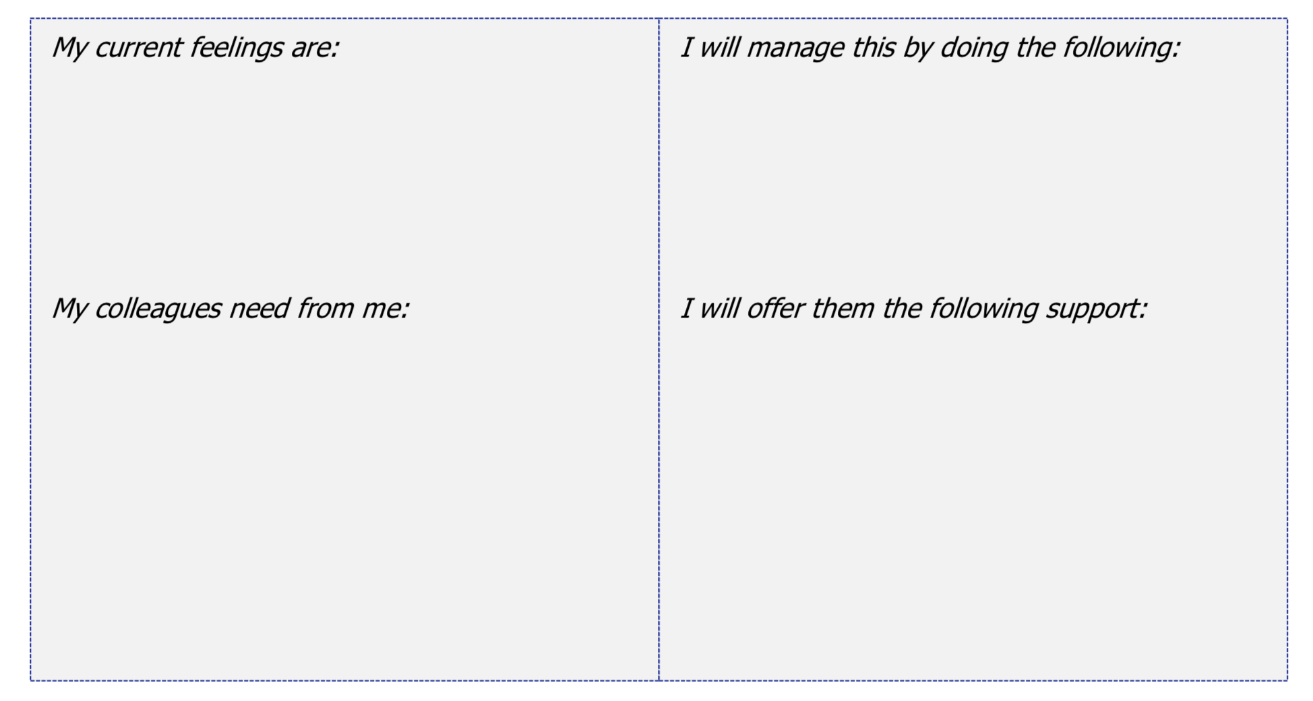
“no copyright infringement is intended”

Slide 9
STRATEGIES
ASSUMPTIONS
5
6
INFLUENCIAL FACTORS
PROBLEM OR ISSUE
DESIRED RESULTS
(OUTPUTS, OUTCOMES, IMPACT)
1
4
3
NEEDS/ASSETS
2
Adapted from W K Kellogg Foundation. (2004). W.K. Kellogg Foundation Logic Model Development Guide. Page 31

Slide 10
Problem or Issue
Describe what it is your program/intervention trying to solve
Patient Needs
Specify the needs of your target group
Desired results
Identify your desired results
Outputs (immediate results)
Outcomes (intermediate results)
Impact (long-term results)
Influential factors
Protective factors or resources could include funding, potential collaborating partners,, staff and volunteers, time, facilities, equipment, and supplies.
Risk factors or barriers might include such things as attitudes, lack of resources, policies, laws, regulations, and geography.
Strategies
Identify “best practises” and/or research that supports why this will succeed
Assumptions
State the assumption behind how and why the identified change strategies will work ion your setting (e.g. principles, ideas, beliefs).
1
2
3
4
5
6
Adapted from W K Kellogg Foundation. (2004). W.K. Kellogg Foundation Logic Model Development Guide. Page 31

Slide 11
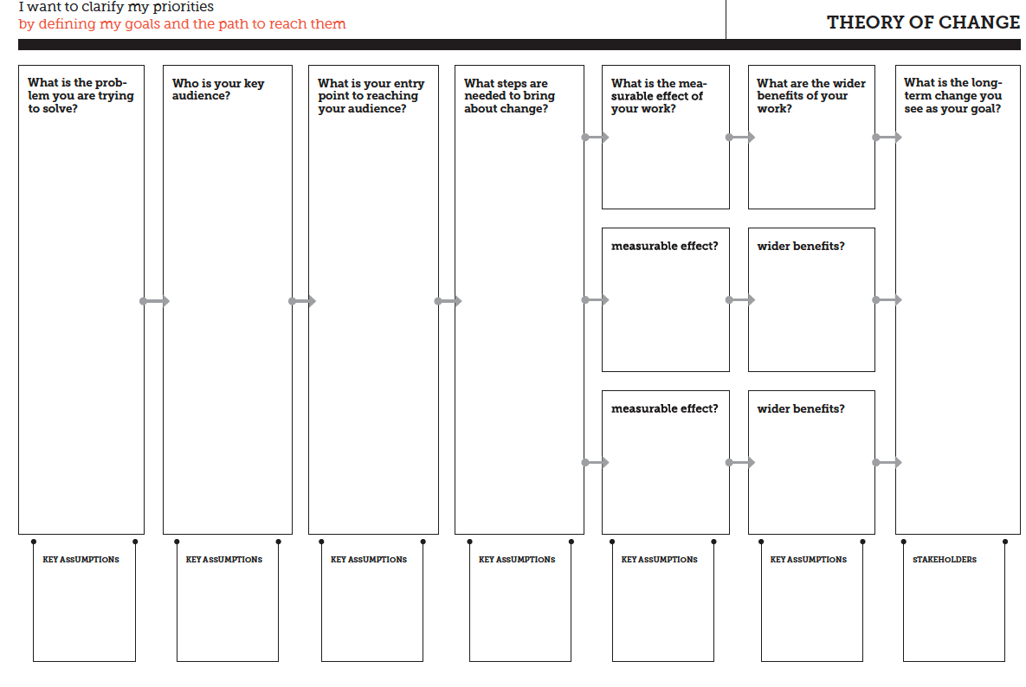
https://diytoolkit.org/media/DIY-Toolkit-Full-Download-A4-Size.pdf

Slide 12
Barriers – talk in pairs
What are the barriers you have encountered based upon your experience?
What barriers do you think is the most challenging?

Slide 13
You
Your co-workers
Positive aspects
Negative aspects
Work burden
Positive aspects
Negative aspects
Work burden

Slide 14
A specific participant or client target group
The desired outcome(s) for that target group
One or more indicators for each desired outcome
Details of data collection
How will the results be used
Performance targets
Patton, M. Q. (2008). Utilization-focused evaluation (4th ed.). Thousand Oaks: Sage Publications. Page 243

Slide 15
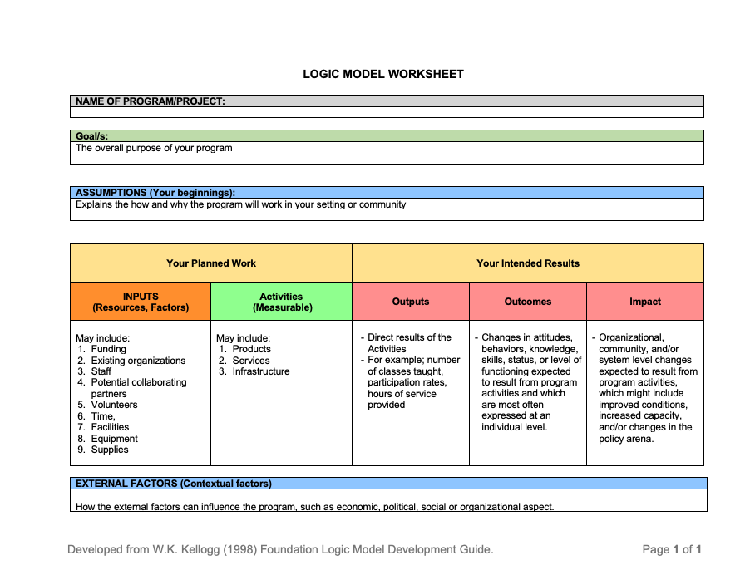

Slide 16
Your Planned Work |  | Your Intended Results
INPUTS (Resources, Factors) | Activities (Measurable) | Outputs | Outcomes | Impact
In order to accomplish our set of activities we will need the following: | In order to address our problem or asset we will conduct the following activities: | We expect that once completed or under way these activities will produce the following evidence of service delivery: | We expect that if completed or ongoing these activities will lead to the following changes in 1–2 years: | We expect that if completed these activities will lead to the following changes in 2 -5 years:

Slide 17
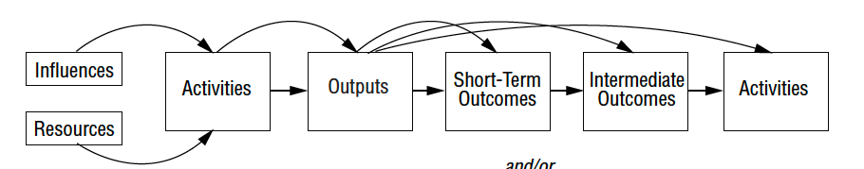
W.K. Kellogg Foundation Logic Model Development Guide (2004), page 36

Slide 18
Evaluation purpose | Key values | Guiding principles | Political Implications
1) Overall Summative Judgement | Future of the program; | Independence and credibility Rigor of design Significance Time-bound | Intended for funders, decision-makers, policymakers; Very high stakes
2) Formative Improvement and Learning | Focus on improving the program/intervention/ model | Trust Learning environment Relevance | Intended for those involved in the program (staff, admin, participants); Moderate Stakes
3) Accountability | Efficiency in use of resources Program management Outcome and Results | Transparency Validity Integrity & credibility Consistency Fairness | Intended for those involved in the funding, running and management of the program; High stakes
4) Monitoring | Program management | Timeliness, regularity, relevance and consistency in reporting | Intended for program managers; Low stakes (high stakes when external accountability)
5) Developmental | Adaptation and change based on emerging conditions | Openness Adaptive capacity Critical | Intended for Social innovators; Low stakes on short term but high stakes on long term
6) Knowledge generating | Enhance understanding Improve practice | Quality and comparability Triangulation | Intended for planners, theorists, researchers, policymakers; Moderate to low stakes
Patton, M. Q. (2008). Utilization-focused evaluation (4th ed.). Thousand Oaks: Sage Publications. Page 139

