Slide 1
Comprehensive Care
Lecture Nine
Breathing

Slide 2
Aims
To understand care for people with NDDs experiencing problems with the activity of breathing.
To be able to apply principles learned earlier in this course, particularly in the Neurology and Communication Modules.

Slide 3
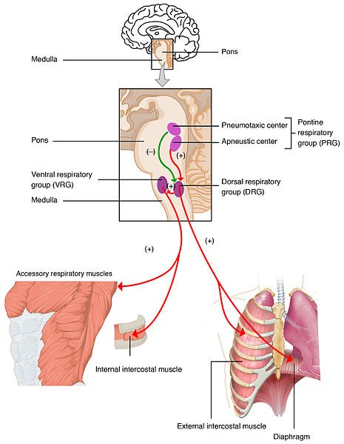
Why will NDDs impact on breathing?
Primarily due to physical factors: impaired muscular control; reduced energy; impact of impaired swallowing- aspiration, loss of cough reflex.
Psychological factors- e.g. fear, anxiety cause changes in breathing patterns. Fear of the future; of other care home residents; of ‘sharp’ ‘unfriendly’ healthcare professionals/ family caregivers; of a frightening world due to changes in perception (e.g. visuo-spatial; hallucination; misunderstandings in conversations..).
Environmental, Sociocultural and Politicoeconomic factors – overcrowded living conditions; asbestos; smoking; norms about care for elderly and / or people with ill-health- lost opportunities to exercise…

Slide 4
Dilemmas in care
Would you insist on ceasing smoking? Recommend it?
What if it becomes a reason to go outside and walk around?
What if it is one of the few remaining enjoyments in life?
How can you support the need for a healthier home environment?
Activity 1 – 5 mins. Discuss attitudes to protecting respiration versus freedom of choice. How actively would students pursue what they believe is ‘best for the person’?
Tutor-led class discussion- 5 minutes.

Slide 5
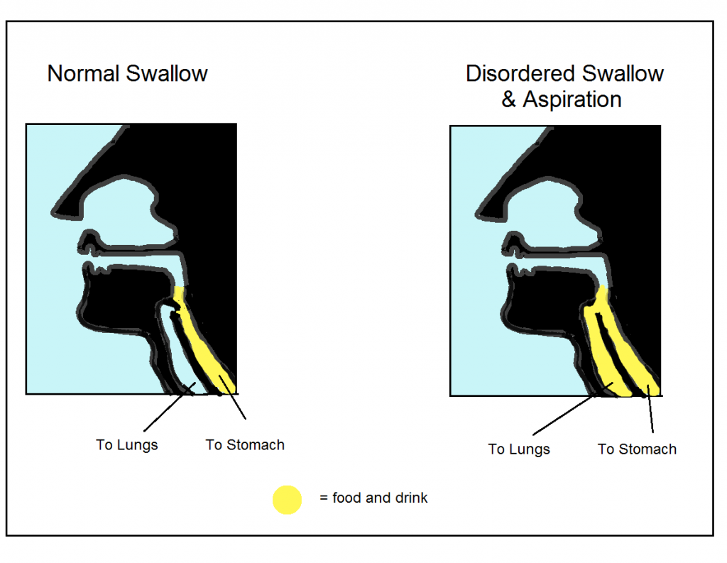
Avoiding Choking (see also in ‘Eating and Drinking’)
Recognise warning signs: drooling; failing to clear food from mouth / throat; ‘pouching’ gurgling voice; coughing when eating; difficulty/ pain on swallowing; difficulty swallowing medication.
Leading over time to: insufficient eating & drinking; malnutrition/ dehydration; unable to manage certain foods (even if preferred); reflux; inhalation of food/ aspiration of fluids>>>> chest infection>>>>pneumonia; asphyxiation.
See interventions to support eating and drinking in that lecture.
Ist aid principles- training.
https://www.hey.nhs.uk/patient-leaflet/swallowing-difficulties-in-dementia/

Slide 6
Breathing impairment- impact on other Als
…and Implications for Nursing
Think about our response-
Speaking –
Mobilising-
Eliminating / continence management-
Personal cleansing and dressing-
Controlling body temperature
Working and playing
Expressing sexuality
Sleeping
Dying
Activity 2 – 10 minutes – thought showering..
10 minutes- Tutor-led class discussion.

Slide 7
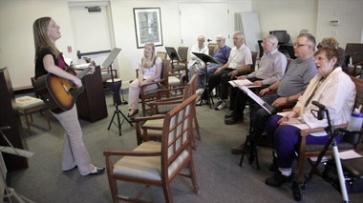
Supporting speaking
SALT, PT and OT assessments are important
Help the person relax, sit or stand comfortably before speaking, - ensure a posture that optimises breathing. Encourage to take a good breath- reassure you’re not in a rush.
Many people with PD don’t realise they’re speaking quietly. Ask to speak as if addressing someone at the back of a crowded room.
Encourage to keep sentences short if breathing is problematic.
Singing, and voice exercises can help.
Encourage to stay sociable – this keeps up speech practice.
https://www.oregonlive.com/living/2012/05/portland_parkinsons_choir_give.html

Slide 8

Supporting mobilising
Often people avoid physical activity when it makes them short of breath – help them / carers understand this will reduce lung function further.
Seek a suitable, individualised exercise programme through a PT.
Walking- start with small goals, a few minutes daily- build up.
Stretching – keep muscles supple.
Gentle exercises with small weights e.g. dumbells may be appropriate / helpful – (for all exercises seek PT advice).
Tai Chi can help – breathing techniques, increase posture and balance through slow controlled movement.
Better Health (2023) https://www.betterhealth.vic.gov.au/health/healthyliving/breathing-problems-and-exercise
https://blogs.scientificamerican.com/observations/reclaiming-control-in-the-face-of-parkinsons/

Slide 9

Supporting Eliminating / continence management
People with COPD and Asthma have a higher risk of NDDs including Alzheimer’s disease and Parkinson’s disease. Wang et al (2019)
And AD & PD increase the risk of neurogenic bladder.
CNS pathology in PD is associated with bladder dysfunction (urgency and frequency). Anticholinergic drugs e.g. Oxybutinin may help. Bethanechol is a synthetic muscarinic (cholinergic) stimulant that can act on cholinergic receptors in the detrusor muscle. But before these are prescribed a doctor must rule out other causes e.g. enlarged prostate. For some, problems are worsened by these drugs so individual expert assessment is necessary. Mousa et al 2022.
30-40% pwpd - urinary dysfunction, yet just 15% have urinary incontinence. E.G. many visit the w.c. multiple times nightly (overactive bladder).
Non-pharmacological approaches such as pelvic floor training and cautious fluid management may help but evidence is low (Kholer et al 2021).
Impaired bladder emptying is less frequent but troublesome in PD. https://www.parkinson.org/library/fact-sheets/urinary-problems
https://nafc.org/product/continence-care-for-people-with-parkinsons-disease/

Slide 10
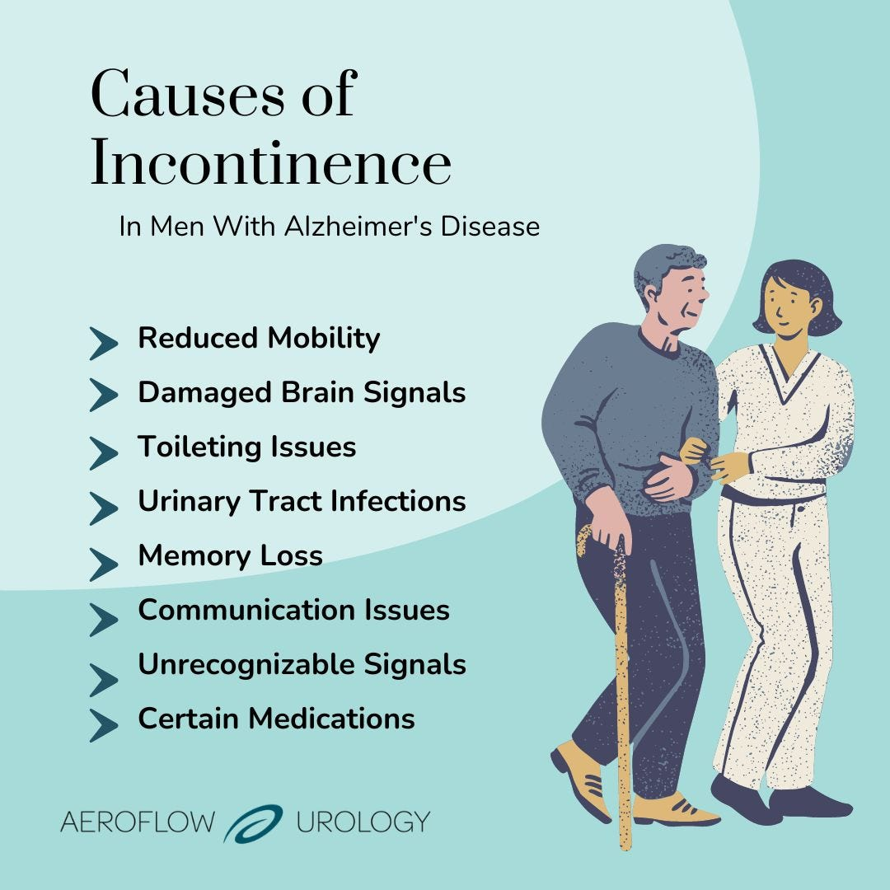
Supporting Eliminating / continence management
Focus on impact of impaired breathing
Continence issues in NDDs:
Slow reaction to / misinterpretation of stimulus to use W.C.
Poor mobility- can’t get there on time
Communicating - can’t tell someone ‘I need the W.C.’
Can’t find or recognise the W.C. (e.g. may use a waste bin)
Difficulty using W.C., sorting clothing
Embarrassment at past accidents/ annoyance of carer/ staff
Depression/ lost motivation- no interest in attending to own needs such as eliminating
Arguably- if these possibilities are understood we are halfway to solving the problems
Alzheimer’s Society (2023)
https://aeroflowurology.com/blog/alzheimers-disease-incontinence-in-men

Slide 11
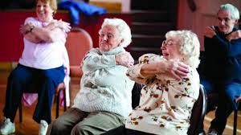
Impact of breathing problems in NDDs on:
Cleansing & Dressing- ensure there’s no rush- plan ahead. Wait till calm (not angry, frustrated). Sit to wash, shower, dress; OT assessment.
Controlling body temperature- ensure changes to temperature are gradual – e.g., if going out to colder air, a sweater, scarf, cover mouth. Hot weather- check pollen count, avoid extremes, use a fan, keep out of direct sun..
Working and playing – Gentle activities, build in rests.
Expressing sexuality- COPD/ other breathing problems associated with NDDs can be an early reason for an end to a couple’s sexual relationship. Facilitate discussion, reassure, reduce embarrassment. Address concerns, including body image, jealousy, suspicion. If more energy in daytime, don’t wait till night. Intimacy doesn’t need to involve intercourse.
https://www.parkinsons.org.uk/information-and-support/your-magazine/experts/exercise-lungs

Slide 12
Impact of breathing problems in NDDs on:
Sleeping – Sleeping on left side helps keep airways open. Symptoms of sleep apnoea include loud snoring, choking noises while asleep and excessive daytime sleepiness. Sleep apnoea is associated with impaired cognitive functioning in adults including memory and attention. Discuss with partner to aid assessment, and refer to doctor/ sleep specialist. Improved sleeping through improved breathing can enhance QoL. Krysta et al (2017).
Dying- inhalers and nebulisers, and oxygen if prescribed can help breathlessness. A fan the person can hold – moving air on the face can give the feeling of easier breathing. Reassurance to reduce anxiety/ panic attacks help, as does posture. If breathlessness despite these measures is very distressing, low-dose sedatives e.g. diazepam, lorazepam; or morphine might be prescribed in late stages, to reduce the sensation of breathlessness. Marie Curie (2023) https://www.mariecurie.org.uk/professionals/palliative-care-knowledge-zone/condition-specific-short-guides/respiratory-diseases
Comfort, reassurance, reduced anxiety, and good mouthcare are key at this point.

Slide 13
Summary 1
NDDs can affect breathing in various ways, e.g. in PD respiratory muscle weakness and rigidity can cause shortness of breath, decreased lung function and difficulty coughing and clearing airways.
In HD respiratory dysfunction can reduce lung capacity, breathing becomes difficult, impacting on sleep.
In dementias respiratory dysfunction can result from brain changes that control breathing and from decreasing mobility and muscle weakness, reducing lung function, increasing shortness of breath and increasing the risk of respiratory infections.
Loss of swallow control, pouching and ineffective chewing in these conditions can lead to choking

Slide 14
Summary 2
Impaired breathing in NDDs can significantly impair ability of individuals to carry out activities of living.
Shortness of breath can limit physical activity, making it difficult to perform tasks such as walking, climbing stairs, or wash, bath and dress independently.
Breathing difficulties can also interfere with sleep, cause fatigue, reduce cognitive function.
All of this is detrimental to quality of life.
Respiratory infections can further compromise breathing leading to hospitalisation. Pneumonia (including aspiration pneumonia are often the eventual cause of death for people with NDDs.

Slide 15
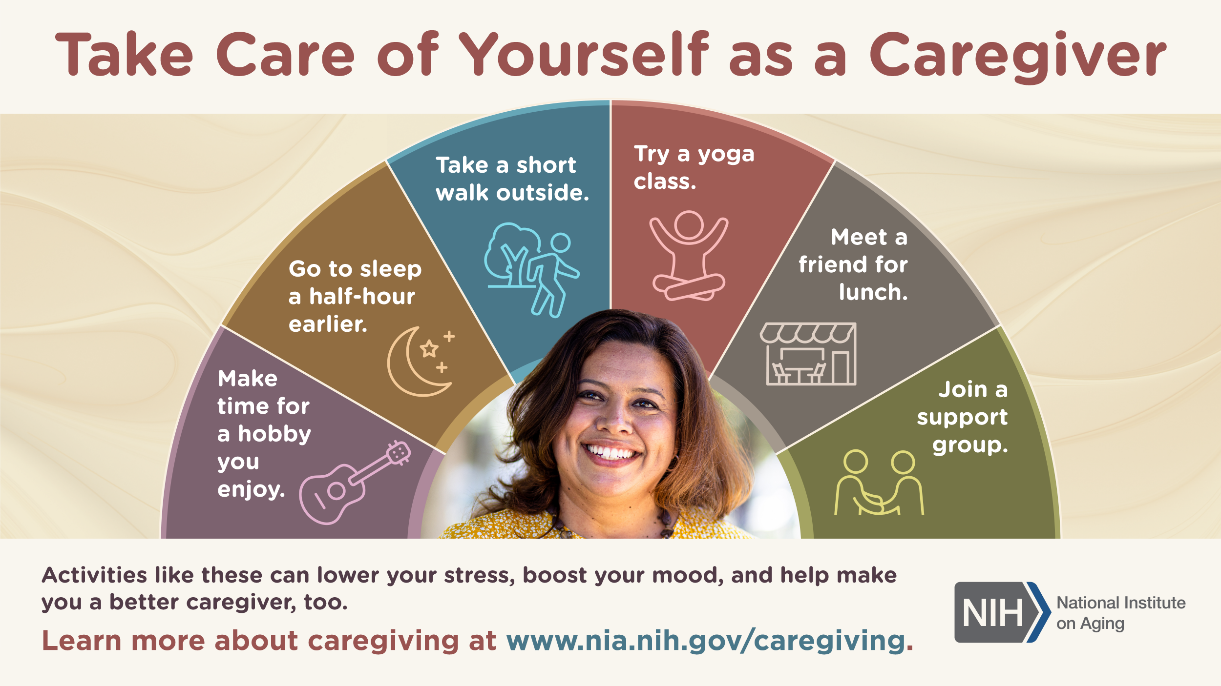
Summary 3 – who cares for the carers?
The impact of breathing problems associated with NDDs can be immense not only for the individual directly affected but also for caregivers, who increasingly may need to assist with respiratory symptom management as well as supporting Als such as bathing, dressing and mobilising.
They may need to monitor for signs of respiratory infection and manage medications. Signs to observe for and report to professionals include coughing, fever/ high temperature, sweating, (may feel cold even though hot) and difficulty breathing/ use of accessory muscles.
Tips for caregivers include: work closely with healthcare professionals to optimize breathing- may involve O2 therapy, medications and respiratory devices (inhalers/ nebulizers).
Encourage physical activity as appropriate – agree level of safety with health professionals.
Ensure a comfortable sleeping environment and adhere to a consistent bedtime routine.
Work to reduce stress and promote self care, encouraging independence as far as is reasonably practical – seek support from other caregivers (emotional as well as practical)
Take care of yourself – be open and discuss your predicament, what you can manage and what you can’t go on doing, with healthcare professionals.
https://www.nia.nih.gov/health/infographics/take-care-yourself-caregiver

Slide 16
Scenario
Miss Morningside lives alone at her home with no family nearby. She has recently been diagnosed with Alzheimer’s disease after reporting to her doctor trouble with recalling names and recent events, and being lost in the village she has always lived in. She insists on remaining in her own home, and the doctor agrees for now, so long as she is considered safe. A community nurse named Anna visits twice weekly – to assess safety. Anna notices Miss Morningside is breathless going upstairs, and suggests using a downstairs room as her bedroom, and using the downstairs shower room with W.C to wash in as opposed to the upstairs bathroom. On a walk to the grocer shop, Anna finds that Miss Morningside is short of breath on her way back, needing to stop several times. Miss Morningside is keen to remain independent and do her own shopping. The doctor’s report does mention breathlessness on exertion but suggests this is purely due to general physical decline and not any other cause.
See if you can come up with a care plan focussed on the issue around Miss Morningside’s breathlessness.
Problem | Goal | Intervention | Evaluation

Slide 17
Scenario - my attempt- you may do better…
Problem | Goal | Intervention (and rationale) | Evaluation
Miss Morningside is coming to terms with a recent Alzheimer’s disease diagnosis. She has breathlessness on exertion and struggles to manage stairs and shopping safely. She is resistant to suggestions such as moving to a downstairs bedroom and shower room and having help with shopping. | Improve Miss Morningside’s safety and independence while managing her breathlessness. | Educate and support. Show understanding regarding resistance to change in the home and offers of help. The diagnosis is new and taking time to adjust is natural. Educate re AD and management strategies. Teach techniques to conserve energy in daily activities. Assuring Miss Morningside of her own active role in managing the condition will help empower her and understand risks that can be reduced with accepting some necessary changes. Seek to agree a trial of using downstairs bedroom and shower room. This promotes safety, and by avoiding potential accidents will enable staying at home and independent longer. Regular assessments. Anna to continue twice weekly visits. This allows for monitoring and timely modification of plan as necessary. Evaluate cause of breathlessness. Seek referral to specialist for exploration of possible underlying causes. Also, whether some confusion may be related to breathlessness rather than directly caused by AD. It is crucial to identify the specific cause to ensure appropriate management and minimize potential risks associated with her condition. Collaborate with Miss Morningside’s doctor. Share observations regarding breathlessness on exertion. Discuss possible further investigations or adjustments to plan if necessary, based on reports from specialist referral. This collaboration helps ensure Miss Morningside’s needs are met comprehensively, regarding breathlessness, and wider effects of AD, taking account of physical, psychological, environmental, sociocultural and politicoeconomic factors. Pursue with Miss Morningside the issue of assistance with shopping. Discuss utilising delivery services, or accessing voluntary support. Discuss whether fetching some of the lighter items will be manageable, and so help maintain an achievable level of independence and social engagement associated with her shopping trips. | Twice weekly Anna will review the result of the interventions and discuss possible modifications with MDT asindicated by Miss Morningside’s condition.

Slide 18
References
Alzheimer’s Society (2023) Toilet problems, continence and dementia, https://www.alzheimers.org.uk/get-support/daily-living/toilet-problems-continence
Better Health (2023) https://www.betterhealth.vic.gov.au/health/healthyliving/breathing-problems-and-exercise
Kholer M, Schwarz J, Saxer S (2021) Promoting urinary continence with nonpharmacological interventions in Parkinson’s disease, Pflege 35(1) https://econtent.hogrefe.com/doi/epdf/10.1024/1012-5302/a000845
Krysta K, Bratek A, Zawada K, Stepańczak R. Cognitive deficits in adults with obstructive sleep apnea compared to children and adolescents. J Neural Transm (Vienna). 2017 Feb;124(Suppl 1):187-201. doi: 10.1007/s00702-015-1501-6. Epub 2016 Jan 4. PMID: 26729362; PMCID: PMC5281652.
Marie Curie (2023) Caring for someone with a long-term lung condition, https://www.mariecurie.org.uk/professionals/palliative-care-knowledge-zone/condition-specific-short-guides/respiratory-diseases
Parkinson’s UK (2023) Speech and communication problems, https://www.parkinsons.org.uk/information-and-support/speech-and-communication-problems
Parkinson’s Disease Foundation (2023) Urinary problems in Parkinson’s disease, https://www.parkinson.org/library/fact-sheets/urinary-problems
Wang Y et al (2019) Association between Chronic Obstructive Pulmonary Disease and Dementia: Systematic Review and Meta-Analysis of Cohort Studies. Dement Geriatr Cogn Dis Extra. 11;9(2):250-259. doi: 10.1159/000496475. PMID: 31543892; PMCID: PMC6738277.
Moussa, M., Abou Chakra, M., Papatsoris, A. G., Dellis, A., Dabboucy, B., Peyromaure, M. ., Barry Delongchamps, N. ., Bailly, H., & Duquesne, I. (2022). Perspectives on the urological care in Parkinson’s disease patients. Archivio Italiano Di Urologia E Andrologia, 94(1), 107–117. https://doi.org/10.4081/aiua.2022.1.107

Slide 19

Any questions?

Slide 20

Thank you

Slide 21
Duration – 2 hours, 30 minutes
Recorded Lecture time- 1 hour 30 minutes
Activity 1 (slide 4) Attitudes to health promotion (e.g. smoking cessation) in context of NDDs 5 minutes
Tutor-led class discussion re activity 1 5 minutes
Activity 2 (slide 6) Impact of impaired breathing on Als 10 minutes
Tutor-led discussion on activity 2 10 minutes
Activity 3 (slides 16/17) case scenario/ care plan 15 minutes
Tutor-led discussion on activity 3 15 minutes
Total duration: 2 hours, 30 minutes.

