Slide 1
Comprehensive Care
Lecture Eight
Communicating

Slide 2
Aims
To understand care for people with NDDs experiencing problems with the activity of communicating.
To be able to apply principles learned earlier in this course, particularly in the Neurology and Communication Modules.

Slide 3
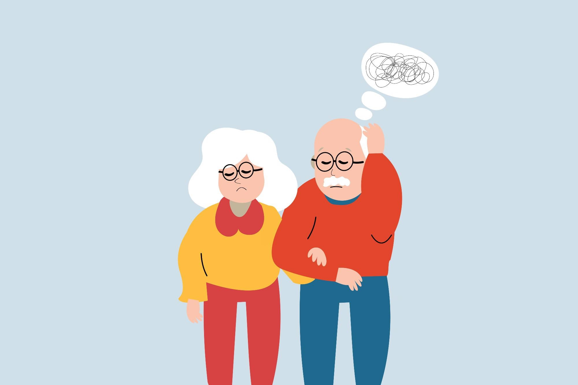
Problems with communicating associated with NDDs
Speech – impact on muscles & nerves involved in speech production = difficulty speaking clearly and intelligibly. This can manifest as slurred speech, slow speech or difficulty forming words.
Language difficulties – Some NDDs impact on ability to understand or use language- verbal or written or both – so difficult to express wishes and needs, or form / maintain relationships, and to understand others.
https://www.news-medical.net/health/Mythbusting-Misconceptions-in-Dementia.aspx

Slide 4
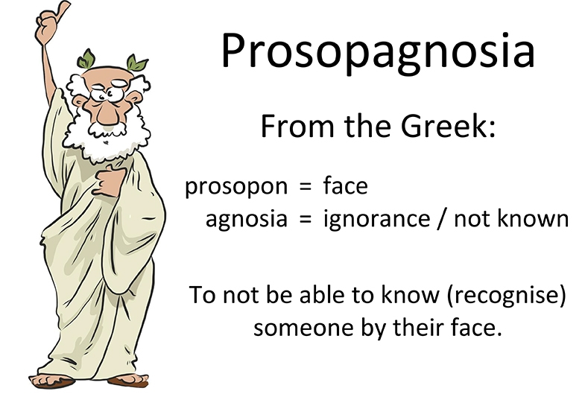
Further Problems with communicating associated with NDDs
Cognitive impact - on memory, attention, and executive function.
Dysphagia / difficulty swallowing – impacts on speaking / communicating effectively.
Emotional and social difficulties.
Non-verbal communication difficulties – e.g. facial expression, ‘strange’ body movements, eye contact, failure to interpret cues, impaired facial recognition, e.g. classic difference between AD and HD.
https://cviscotland.org/lessons.php?id=58

Slide 5
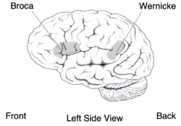
https://en.wikipedia.org/wiki/Wernicke%27s_area

Slide 6
Aphasia in NDDs
A different problem to Aphasia from injury, infarct or tumour confined to specific issues such as give different forms of a verb (conjugate) (e.g. give ‘walked’ as the past tense of a verb).
Gradual onset and deterioration rather than acute.
Care implication – recognise that difficult verbal communication doesn’t necessarily mean the patient is depressed or tired, or lacking intelligence. Communicate in simple sentences but avoid patronising / treating as a child.
In NDDs if executive function deteriorates (e.g. in dementia, or PD), in principle might still have the function to conjugate verbs but might not do so, through inability ‘to view the sentence as a whole’ University of Groningen. "Parkinson’s disease undermines language processing." ScienceDaily. ScienceDaily, 9 February 2011. <www.sciencedaily.com/releases/2011/02/110209082642.htm>.

Slide 7
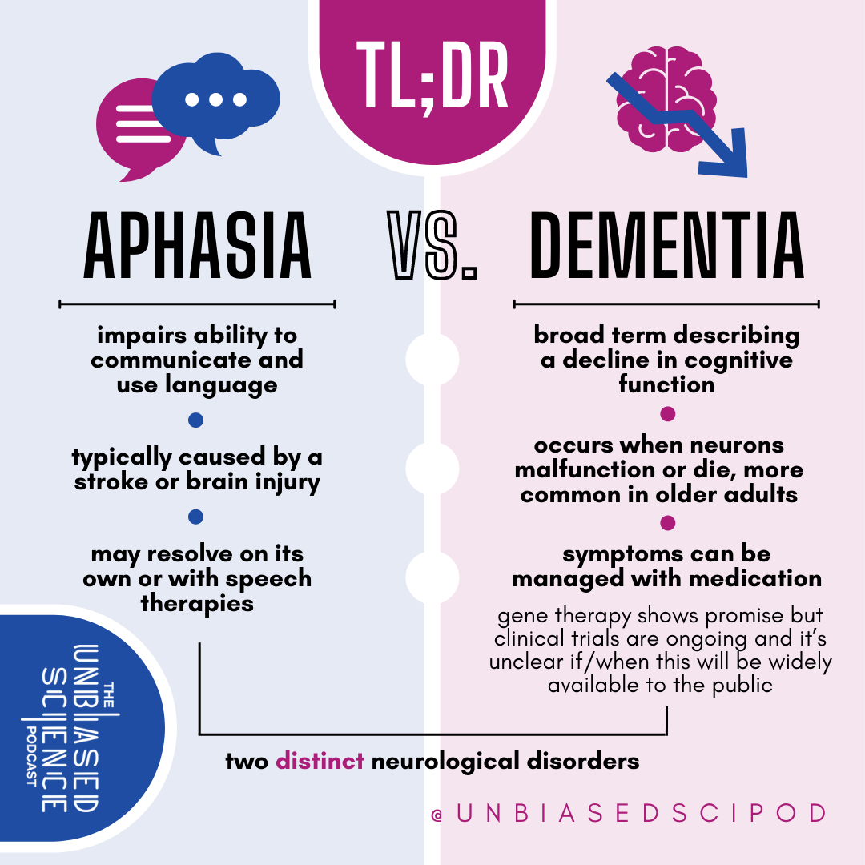
What’s the difference?
Broca’s aphasia- ‘non-fluent aphasia’ – short or incomplete sentences
Wernike’s aphasia- ‘fluent aphasia’ – long sentences that fail to communicate information.
Aphasia may resolve itself or SALT may help strengthen languages and give strategies for the person and family/ friends/ colleagues.
PPA- primary progressive aphasia = tissue loss in language areas of brain, caused by genetic inheritance or NDDs
https://theunbiasedscipod.substack.com/p/dementia-and-aphasia
[Yes, distinct but can be related]

Slide 8
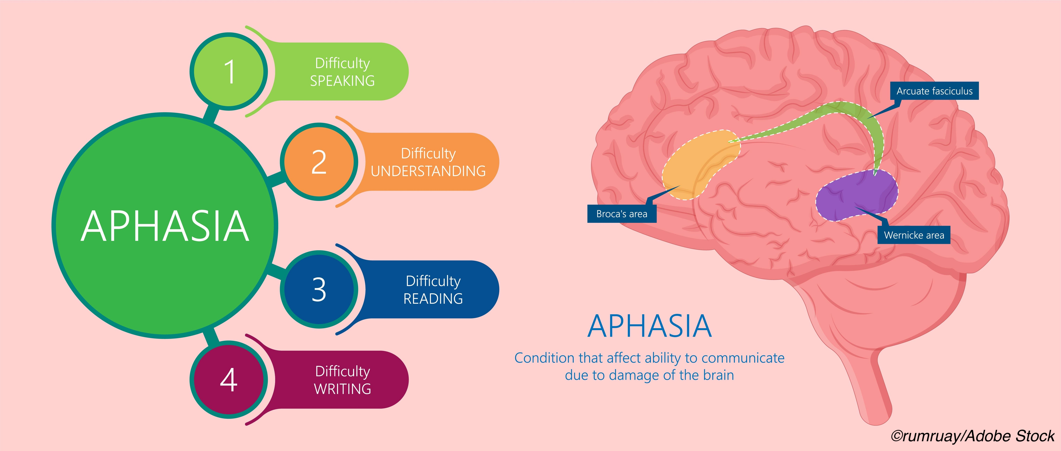
Primary Progressive aphasia
Implications for care are relevant to aphasia in any NDD.
A type of frontotemporal dementia, rare, - causes trouble expressing thoughts, finding and understanding words.
Can lose ability to speak, write and understand language. – slow progression.
Semantic variant – trouble understanding spoken or written language, particularly single words, and with naming objects.
Logopenic variant – trouble retrieving words, frequent pauses in speech, difficulty in repeating words/ phrases.
Non-fluent Agrammatic variant – poor grammar- written & spoken, errors in speech sounds (apraxia of speech).
https://www.mayoclinic.org/diseases-conditions/primary-progressive-aphasia/diagnosis-treatment/drc-20350504 visited 23 03 2023
https://www.physiciansweekly.com/memory-preserved-in-primary-progressive-aphasia-with-alzheimers-disease/

Slide 9
PPA and AD
Memory resilience in people with primary progressive aphasia (PPA) and Alzheimer’s disease (AD) was related to neurodegeneration, APOE genotype, (apolipoprotein E (APOE) genotype is a genetic risk factor for dementia, Alzheimer's disease, and cardiovascular disease) and concomitant pathology, a small longitudinal cohort study found.
In people who had primary progressive aphasia with Alzheimer’s disease (PPA-AD), episodic memory was preserved at initial testing and showed no decline at a mean 2.35 years later, even though significant language function decline was seen.
In contrast, people with amnestic dementia and Alzheimer’s disease (DAT-AD) showed declines in both memory and language in evaluations that were a mean 1.7 years apart.
Mesulam M et al (2021), Memory Resilience in Alzheimer Disease With Primary Progressive Aphasia, Neurology, 96 (6) e916 e925; DOI: 10.1212/WNL.0000000000011397 https://n.neurology.org/content/96/6/e916

Slide 10
Primary Progressive aphasia - continued
Causes- frontal, temporal, parietal lobe atrophy especially left side., associated with abnormal protein presence- reduced brain function / activity in these areas.
Learning disabilities with developmental dyslexia, and family history are risk factors.
Complications involving impairment of other mental skills such as memory, movement control and social and behavioural problems, poor judgement, blunt emotions sometimes develop.
Diagnosis - Neurological examination, blood tests, MRI.
Treatment – No cure Unless underlying cause can be resolved e.g. tumour). S.A.L.T. helps maintain language skills longer.
Support – Carrying a card that explains the problem may help early on e.g. in shops & other community settings.
Give plenty time to talk- avoid finishing sentences/ answering for the person.
Speak slowly in simple (adult) sentences.
Listen carefully.
Care for the carers- this is extremely frustrating on all sides.
Relate this to speech difficulties in all NDDs - Expressive and Receptive aphasia

Slide 11
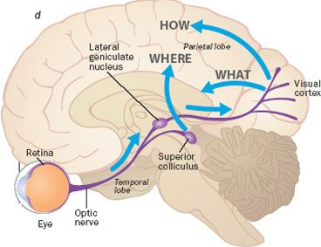
Changes in perception – all senses affect communicating
Helpful to understand, and communicate to families/ caregivers
why a person might know what an object is called, but not what it is for--- or vice-versa.
Or why they may struggle with spatial awareness.
Why afraid when being assisted to sit backwards into a chair…
Why the environment – even home- may seem unfamiliar, unpredictable, unsafe…
Why might a person seem aggressive if spatial awareness is impaired? How will they be treated- versus how SHOULD they be treated?

Slide 12

Managing Behaviour change in NDDS
Personality and behaviour change are often the most distressing aspects of NDDs for caregivers.
Irritability, anxiety and depression are often early problems.
Depression may present as apathy, loss of interest in activities, social withdrawal, isolation, poor concentration. Seek diagnosis and treatment.
‘Behaviour’ is a form of communicating. Some individuals with cognitive impairment may exhibit ‘aggressive’ or ‘disruptive’ behaviours that require specialist, experienced management.
Family caregivers may suffer as a result, hence the need for all perspectives in assessments of care needs.
Professionals may ask ‘do you sleep well?’; do you manage bathing ok?’ etc, and the ‘patient’ may lack insight, and the caregiver may feel it’s unsafe to explain problems in the company of the ‘patient’.
https://www.verywellhealth.com/anger-and-aggression-in-dementia-4134488

Slide 13
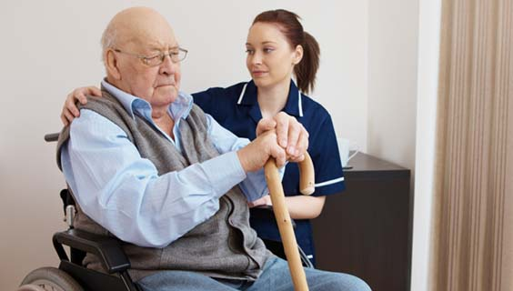
Aggression
Two brain areas working in harmony control our aggression: prefrontal cortex & amygdala
Pfc inhibits aggression and makes moral judgements. Think- Picks disease, frontotemporal dementia, - and can be affected in any NDD.
Stimulation of the amygdala can induce or inhibit aggressive behaviour.
Principle: These people are on a short fuse – don’t light it!!
Tips- Triggers can include – pain, depression, sleep/ rest problems, constipation, wet/ soiled diaper, sudden changes of environment/ routine, people around, noise, being made to do something/ not allowed to do something, loneliness, unwanted medicine effects/ interaction of medicines.
https://www.nia.nih.gov/health/coping-agitation-and-aggression-alzheimers-disease

Slide 14

Tips- managing aggression
Look for early signs- think with team- what has changed- any possible triggers? And address it.
Ensure everyone’s safety
Reassure, speak calmly (reassure caregivers- it’s not their fault)
Encourage caregivers to be open with professionals
Allow as much control over life as possible / safe.
Stick to routines – keep to the plan. OR --- give lots of warning and preparation.
Distraction – e.g. snacks. Choice of something to do.
Familiar photos, ornaments around
Limit caffeine/ alcohol.
Reduce noise.
Avoid hugging / over-fussing
https://salmonhealth.com/blog/dementia-behavior-management/

Slide 15
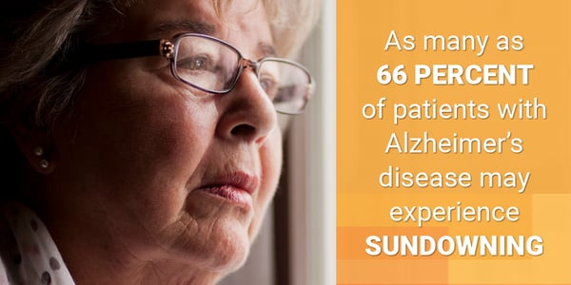
Sundowning
Increased agitation, confusion, anxiety late in the day
Encourage daytime activities
Consider a commode near the bed – reduce confusion finding bathroom at night
Wind down towards evening
Avoid caffeine, & high carbohydrate foods
Nightlights may reduce fear of the dark.
https://training.mmlearn.org/sundowning-a-guide-to-difficult-behavior-at-the-end-of-the-day#background

Slide 16

Wandering
Stress can exacerbate confusion and lead to wandering
Reduce noise and activity buzz near the person
Activity programmes help – e.g. dance, or other movement exercises
As soon as you see pacing, or distress signs, reassure we’re in a safe place
Discuss possible pain with physician- may wander to escape discomfort
Keep keys, wallet, coats out of sight- items that suggest going out
Technology- bed / chair pressure alarms?
Think about the ‘have you seen my mother?’ conundrum:
  Rights and wrongs of collusion, distraction, ‘reality orientation’ ‘reminiscence therapeutic approach’
https://www.rti.org/insights/dementia-wandering

Slide 17
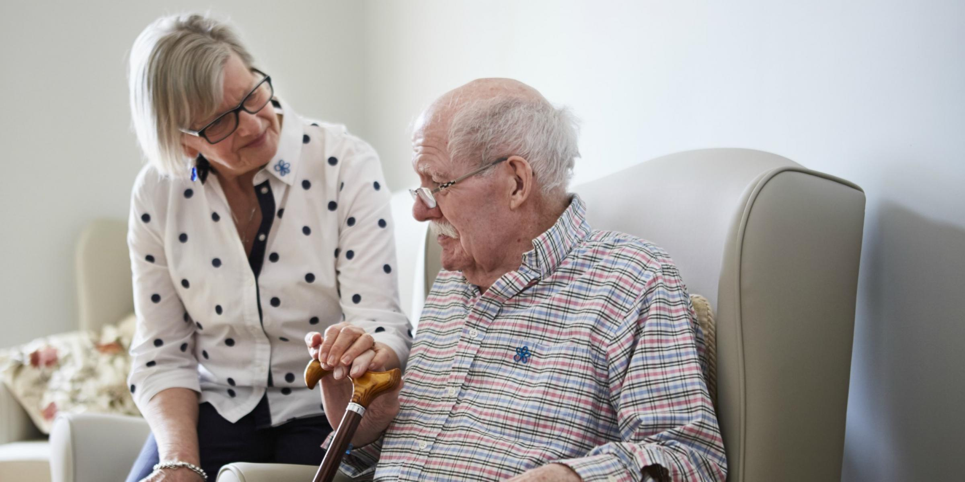
Perseverance - repetition
Not easily reduced – hugely taxing on caregiver patience
Rotate caregiving / ensure frequent respite
Encourage openness about whether caregiver is coping – avoid predictable tensions between caregiver and patient
Avoid confrontation – e.g. ‘I want to go home/ this IS your home’ type conversations
See ‘wandering’- ‘have you seen my mother’ …
Remove triggers- frequent checks on safety, met needs & so on = probably better than reliance on call buzzer
https://www.alzheimers.org.uk/blog/i-want-go-home-what-to-say-to-someone-in-dementia-care

Slide 18
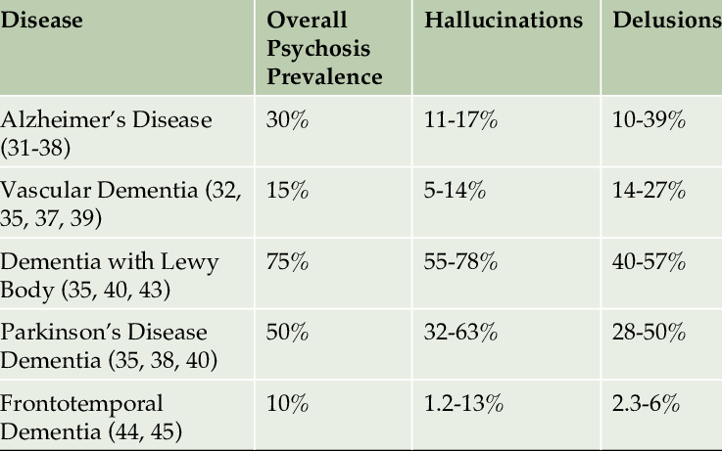
Hallucinations
Any senses may be affected
Contact physician – consider effect of medicines. (but may be dementia induced)
Soft lights, comfortable ambient temperature, quiet
Remove trip hazards/ obstacles
Distract- favourite song, memory, places, what we did today/ will do tomorrow
Cummings J et al (2018) Pimavanserin: potential treatment for dementia-related psychosis, Journal of Prevention of Alzheimer’s Disease, 5(4) https://www.researchgate.net/publication/332215135_Pimavanserin_Potential_Treatment_For_Dementia-Related_Psychosis

Slide 19
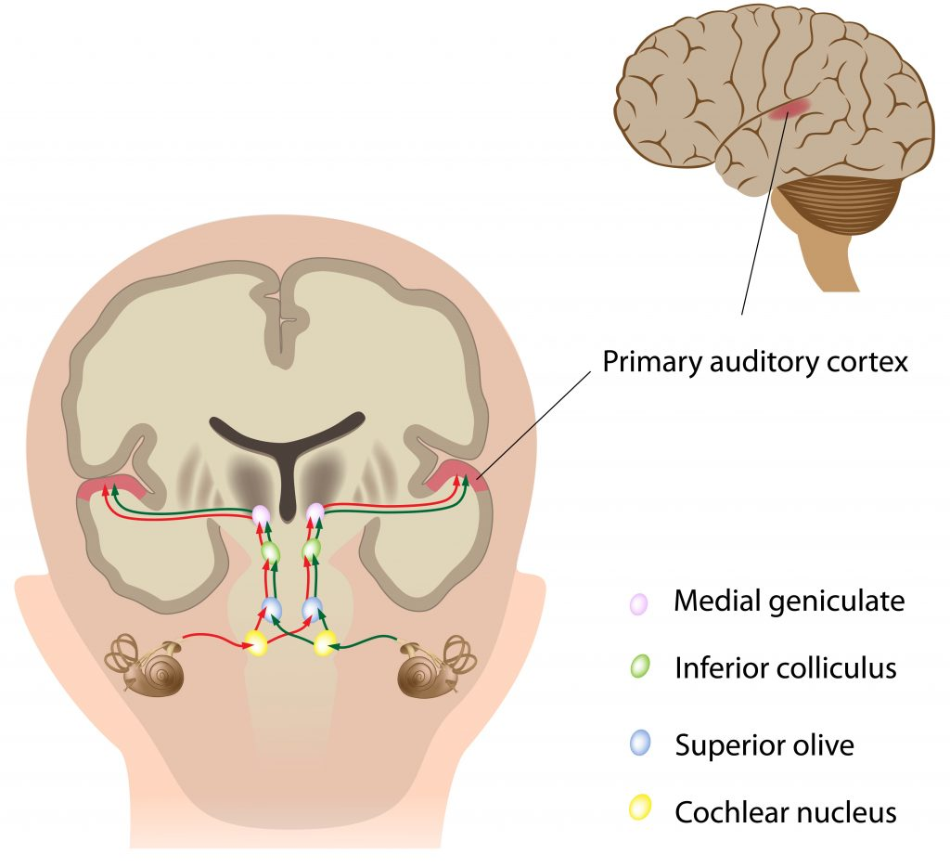
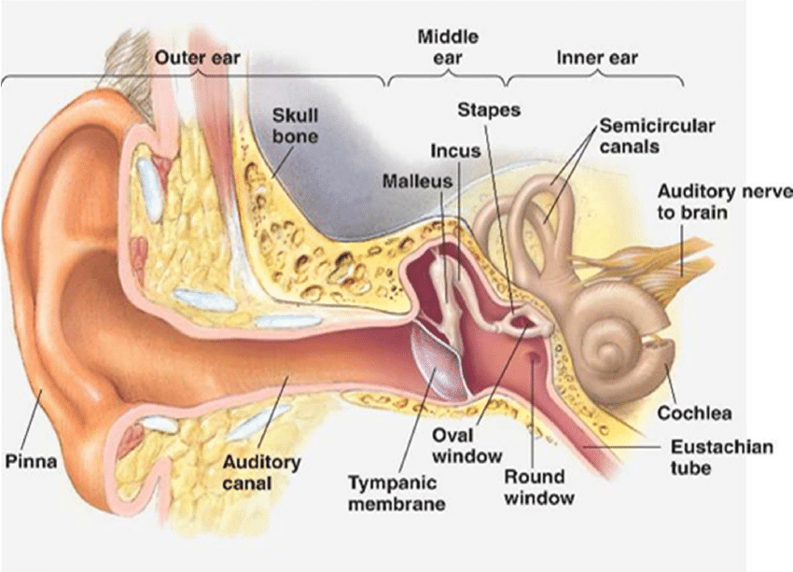
Revision- Neurology Module: Hearing
https://teachmeanatomy.info/neuroanatomy/pathways/auditory-pathway/ Visited 24 10 2022
https://www.researchgate.net/figure/The-anatomy-of-the-auditory-system-of-human-ear_fig1_344278403 Visited 233 10 22
Mild hearing loss= 2x as likely to develop dementia; moderate= 3x
Lin, F, Metter, E, O’Brien, R., Resnick, S., Zonderman, A, Ferrucci, L. (2011) Hearing loss and incident dementia, Archives of Neurology, 68(2) 214-220.
‘Challenging behaviour’ may be due to impaired communicating– through hearing loss.
Think about how frustrated you might be, if you couldn’t understand what people are saying. Can you see a potential for becoming angry- treated medically for aggression, when the problem is impaired hearing?

Slide 20
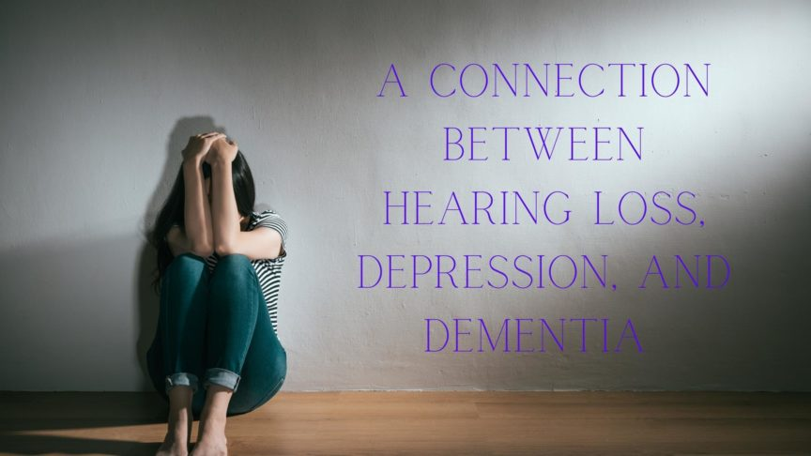
Signs of hearing loss in people with NDDs
Difficulty understanding speech – asking speaker to repeat
Appearing puzzled, or e.g., nodding yes, then not following up the conversation with appropriate action (e.g.- nodding to indicate ‘yes, I’ll go for a bath now’, and instead going somewhere else).
Social isolation, withdrawal from social situations/ discussions.
Turning TV and radio up loud.
https://www.pacifichearingcare.com/blog/a-connection-between-hearing-loss-depression-and-dementia/

Slide 21
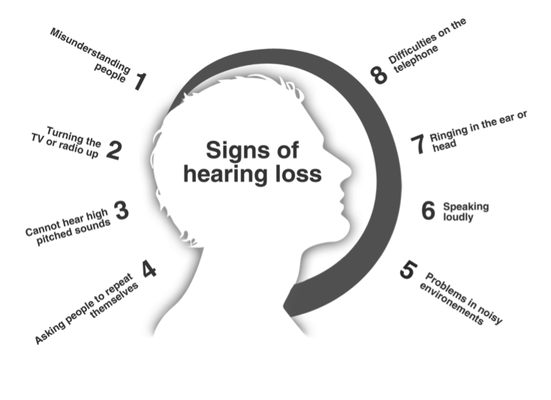
Hearing Impairment and safety
Leroi I, Wolski L, Pavlina Charalambous A, Constantinidou F, Renaud D, Dawes P, Hann M, Himmelsbach I, Miah J, Payne M, Simkin Z, Thodi C, Kent Yeung W & Mengitsu Yohannes A (2022) Support care needs of people with hearing and vision impairment in dementia: a European cross-national perspective, Disability and Rehabilitation, 44:18, 5069-5081, DOI: 10.1080/09638288.2021.1923071
Many people with age-related hearing, vision, and cognitive impairment had unmet social care needs.
Carer / partner needs include addressing the risk of loneliness and social isolation.
Individually designed interventions to compensate for and / or reduce the impact of hearing, vision, and cognitive impairment should incorporate physical and psychological support, as well as education.
Think about safety issues specifically related to hearing impairment. What advice could you give family caregivers?
https://www.bwclinic.com/blog/2018/7/19/hearing-loss-and-dementia

Slide 22
Hearing impairment and safety- 2
RNID (2020) https://rnid.org.uk/about-us/research-and-policy/social-research-reports/hearing-matters/ :-
Hearing loss doubles the risk of developing depression • increases the risk of anxiety and other mental health issues • increases the risk of developing dementia • is linked to cardiovascular disease, stroke and obesity • may be linked to sight loss and more frequent falls.
Think --- not hearing fire/ smoke alarms; safety announcements; approaching vehicles…

Slide 23
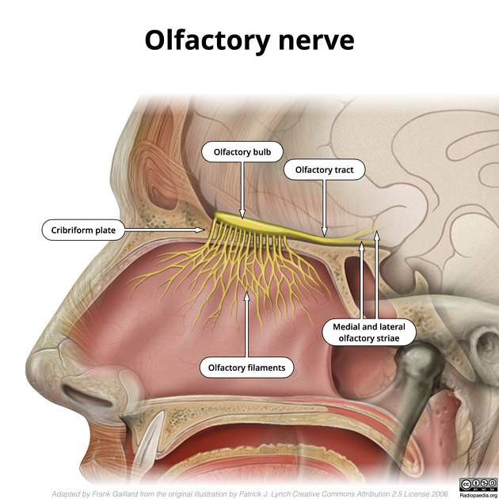
Sense of smell and communicating
Fear- high levels of perspiration de Groot JHB, Kirk PA, Gottfried JA. 2020Encoding fear intensity in human sweat. Phil. Trans. R. Soc. B 375, 20190271. (doi:10.1098/rstb.2019.0271)
Aggression-high testosterone levels- detected odours in ‘senders’ (playing computer games) and ‘receivers’ (eeg - increased activation in the dorsomedial prefrontal cortex was observed, an area that appears from previous work to be involved in social cognition, especially evaluation of others and response to threat. - Pause BM, Storch D, Lübke KT. 2020Chemosensory communication of aggression: women's fine-tuned neural processing of male aggression signals. Phil. Trans. R. Soc. B 375, 20190270
Smell sense is closely associated with emotional memory. Smell sense is directly conveyed from odour receptors in the nose to the olfactory bulb and to neighbouring areas including the limbic system, the hipocampus and the temporal lobe associated with memory. Khamsi R, (2022) Unpicking the link between smell and memories, NATURE, https://www.nature.com/articles/d41586-022-01626-x#:~:text=Smell%2Dsensing%20neurons%20in%20the,memories%20can%20be%20so%20precise. Visited 03 11 2022.
https://radiopaedia.org/articles/olfactory-nerve?lang=gb Visited 29 10 22
Robers S, Havlicek J, Schaal B (2020) Human olfactory communication: current challenges and future prospects, Phil. Trans. R. Soc. B3752019025820190258

Slide 24
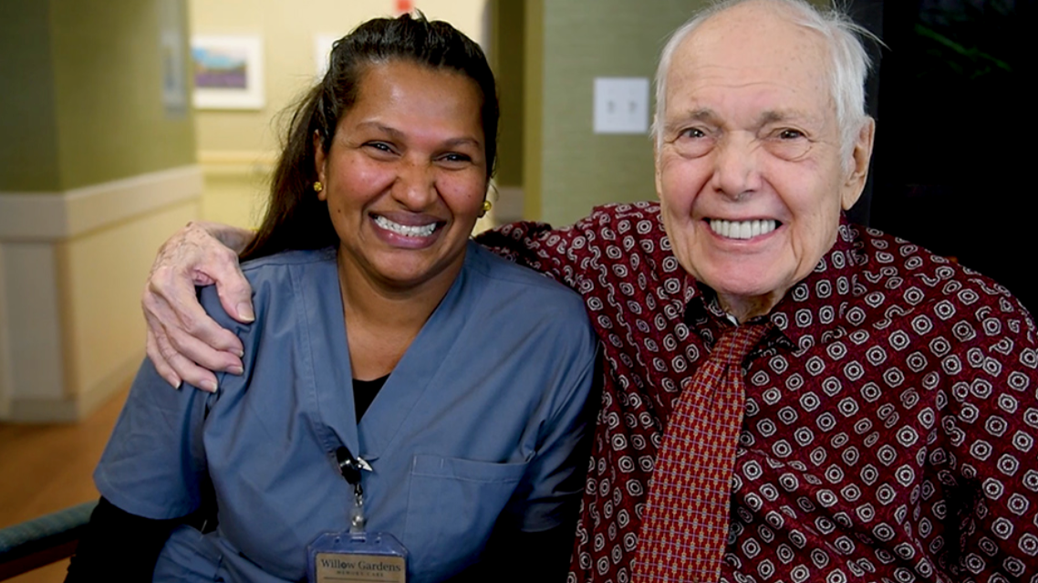
Touch and Communicating
Raisamo R, Salminem K, Rantala J, Farooq A, Ziat M (2022) Interpersonal Haptic Communication: Review and Direcitons for the future, Int. Jn. Human – Computer studies, 166 (2022) 102881.
In childhood, touch is said to underpin all forms of human communicating
Frequency of touch decreases but remains important through adulthood.
“Risk averse ‘task only touch’ care environments…sorely lacking in informed proactive approaches to touch through insufficient knowledge, fear and lack of confidence” Danuta Lipinska, in Tanner, L (2017) Embracing touch in dementia care: a person-centred approach to care and relationships, Kingsley, London.
Touch heals- stimulates oxytocin release (increasing feelings of safety, closeness and trust) and decreases cortisol levels (stress response) Brandon P (2018) The healing power of touch: why are we depriving our elders? Age-u-cate Training Institute, https://www.ageucate.com/blog/?p=1608
https://westchestermagazine.com/partner-content/willow-gardens-united-hebrew-july-2020/

Slide 25
Touch and Communicating
Raisamo R, Salminem K, Rantala J, Farooq A, Ziat M (2022) Interpersonal Haptic Communication: Review and Direcitons for the future, Int. Jn. Human – Computer studies, 166 (2022) 102881.
“Making eye contact, connecting with residents, hugging, holding their hand, or simply placing a hand on an arm or shoulder when speaking with them are all simple ways to integrate touch into everyday activities or care. …touch can also be added through hand massages and manicures, gentle massages when having their hair washed, or holding arms or hands while assisting them with their mobility or getting around the community”. https://blog.pacificaseniorliving.com/blog/touch-memory-care-the-power-of-touch-therapy-for-dementia-residents
But what of risks of abuse / imposing on personal space – are the fears of staff justified? How do we get the balance right? [See lecture on ‘Expressing Sexuality’]
https://westchestermagazine.com/partner-content/willow-gardens-united-hebrew-july-2020/

Slide 26

Touch in Caring
What is acceptable in the relationship between professional caregiver and vulnerable patient/ client/ service-user?
England, much of United States- touching forearm is acceptable- though not in the Midwest USA.
Jones and Yarbrough (1985) – touch = most intimate communication form. Yarbrough distinguished ‘non-vulnerable body parts’ (hand, arm, shoulder, upper back) from vulnerable body parts- all other regions.
Is hand-shaking acceptable? Depends who initiates? What if someone with dementia wants a hug?
https://www.carebysarah.co.uk/dementia-care/
Jones & Yarbrough (1985), A naturalistic study of the meanings of touch. Communication Monographs, 52., 19-56.
Haptic Communication- https://psychology.fandom.com/wiki/Haptic_communication

Slide 27
Touch in Caring
So--- adopting the right approach requires understanding and correct interpretation of the person you’re communicating with regarding:
Their personality; cultural background; current mood (may change from moment to moment).
Context of the moment- social and environmental.
Accurate, honest, humble, insightful assessment of your own impact/ effect/ impression you make.
It tends to be much easier to spot when someone adopts a wrong approach than a right one.
All of this requires skilful subjective judgement.
Care teams need to work at being comfortable with critical analysis of how colleagues communicate bringing some objectivity to the subjective skill. --- Discussions must be supportive, encouraging, blameless, avoiding causing anyone to feel the need to be defensive.
Aim- all feel safe to be open and learn from each other’s successes and approaches that didn’t work well. True of all communicating; and mentioned here especially because of the particularly sensitive nature of touch.
Jones & Yarbrough (1985), A naturalistic study of the meanings of touch. Communication Monographs, 52., 19-56.
Haptic Communication- https://psychology.fandom.com/wiki/Haptic_communication

Slide 28

Humour in caring
The role of humour and laughter therapy in decreasing caregiver burden among carers of a person living with dementia- A case study Sachin Desai, (2021) 8,(2): 60-63, https://doi.org/10.18231/j.agems.2021.014
Desai S (2021) reports that everyone enjoys laughter, and that humour can alleviate caregiver burden and stress, but highlights that misplaced humour can be negatively perceived and potentially offensive.
Based on a case study the author proposes benefits of training caregivers in the use of laughter therapy / humour.
What are your thoughts on a formal approach to humour and laughter in caregiving?
  How would you argue for this?
  How would you argue against it?
https://www.aspreyhealthcare.co.uk/why-sherwood

Slide 29

Tip: Don’t re-set the clock
Pollard J (2008) Hurry up and wait, https://www.amazon.com/Hurry-Up-Wait-James-Pollard/dp/B06XYTYKZ3?pldnSite=1
Case scenario:
Dan, near the care home doorway.

Slide 30

The yes and No Game

Slide 31

The yes and No Game
Unhappy to hear
No
I’m too busy
You’ll have to wait
Happy to hear:
Yes
No problem
Great idea

Slide 32
The yes and No Game
Unhappy to hear
You can’t have a coffee now, I’m too busy, you’ll have to wait till I’ve finished helping Mrs. Chalmers.
Happy to hear:
Yes, let’s both have a coffee as soon as I’ve finished helping Mrs. Calmers. Thanks for that, it’s a great idea!

Slide 33
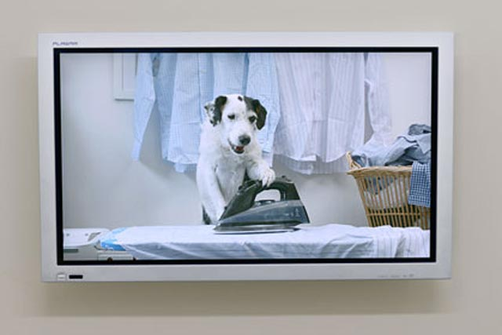
The dog on TV
Scenario – Mr. Abram’s dog.
https://www.campaignlive.co.uk/article/thinkbox-prepares-harvey-dog-tv-ad-christmas/1047304

Slide 34
NHS England Tips https://www.nhs.uk/conditions/dementia/communication-and-dementia/#:~:text=pat%20or%20hold%20the%20person's,comfortable%20with%20you%20doing%20this
If you notice the person you care for is starting fewer conversations:
Ensure you make good eye contact when theytalk/ ask questions.
Allow time to respond – don’t answer for them; don’t hurry them or seem to be in a hurry.
Make a point of engaging them in discussions with others
Encourage them to speak, especially about their health issues / wellbeing
Acknowledge/ validate what they do say
Give simple choices; avoid complicated choices
Re-phrase questions if necessary.

Slide 35
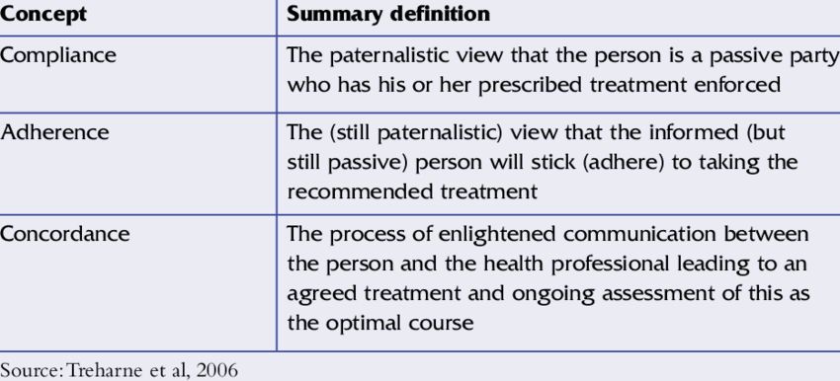

Adherence, Compliance, concordance
https://www.prescribingpractice.com/content/professional/concordance-and-non-compliance-a-psychological-perspective/
https://www.researchgate.net/figure/Key-concepts-in-medicines-management_tbl1_232966477

Slide 36
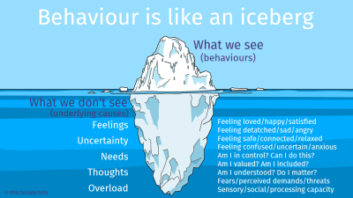
‘Behaviour’: a suitable word in nursing?
Certainly a suitable word in psychology.
But what does it mean to a patient, to discuss his / her ‘behaviour’?
What is better language?
What about terms like:
Aggression / aggressive?
Challenging behaviour?
Inappropriate?
Disinhibited?
Would you allow these words on a prescription?
https://www.pdasociety.org.uk/life-with-pda-menu/family-life-intro/understanding-behaviours/
If we are to use the word in some circumstances, think:
Did we elicit it?
Did any other factor provoke it?
Did someone or something light the fuse?

Slide 37
NHS Tips- Body language/ contact https://www.nhs.uk/conditions/dementia/communication-and-dementia/#:~:text=pat%20or%20hold%20the%20person's,comfortable%20with%20you%20doing%20this
When speech is difficult-
Be patient and calm – this calms the person and so aids confidence and ability to communicate.
Keep tone upbeat, positive, friendly.
Be at a respectful distance, and be at eye level.
Patting/ touching hand may be appropriate and reassuring- see earlier slides on touch. Observe their body language to check if this is welcomed.
Use your facila expressions to emphasise that you are actively listening and fully engaged.

Slide 38
Active Listening
Good posture and eye contact at respectful level and distance
Avoid interrupting
Avoid doing anything other than showing you are listening
Minimise distractions as far as possible
Repeat, and check that you have understood correctly.
It doesn’t matter how many times, avoid seeming impatient / frustrated- this is infectious.

Slide 39
Reading communicating – bear in mind
People with Parkinson’s disease may eventually sound monotone- doesn’t mean the content is unemotional.
Facial rigidity doesn’t mean they don’t understand the joke.
In stroke particularly, but in all NDDs, observe for difference between expressive/ receptive dysphasia
In Huntington’s disease, an intended friendly push, or gentle refusal of your care intervention may hurt you if you’re unaware of inability to control velocity and direction of limb movements. Position yourself sensibly. Avoid persisting with unwanted ‘help’.

Slide 40
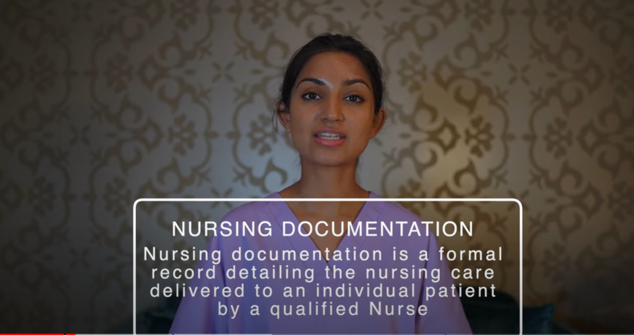
Record keeping
Accurate, clear and detailed record-keeping is essential to ensure quality care.
They should contain: medical history, current condition, reason for admission, any changes in symptoms, medication regime and other interventions tried previously or ongoing.
Regularly review and update records- ensure they continue to reflect current situation and any changes in care plan.
Store securely and keep confidential, in line with data protection regs/ laws.
Involve patient and family in the record keeping process- ensure all are aware of the plan on a needs-to-know basis.
How to DOCUMENT your nursing notes | Clinical Skills Series – Nurse Zara - https://www.youtube.com/watch?v=FRlpQhy2BC4 It’s a fabulous series on nursing skills on Youtube!!

Slide 41
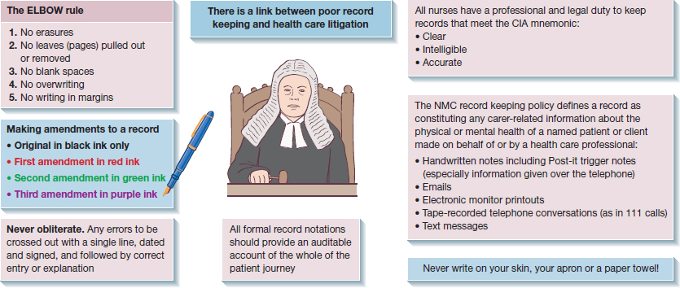
https://nursekey.com/record-keeping/

Slide 42

Record keeping
Communication between healthcare professionals involved in the patient’s care should be documented to ensure that everyone (needs-to-know basis) is aware of any changes in the patient’s condition or care plan.
Ensure records are accessible to all members of the care team who require them, while maintaining patient confidentiality
https://experience.care/blog/nursing-documentation-examples-tips/

Slide 43
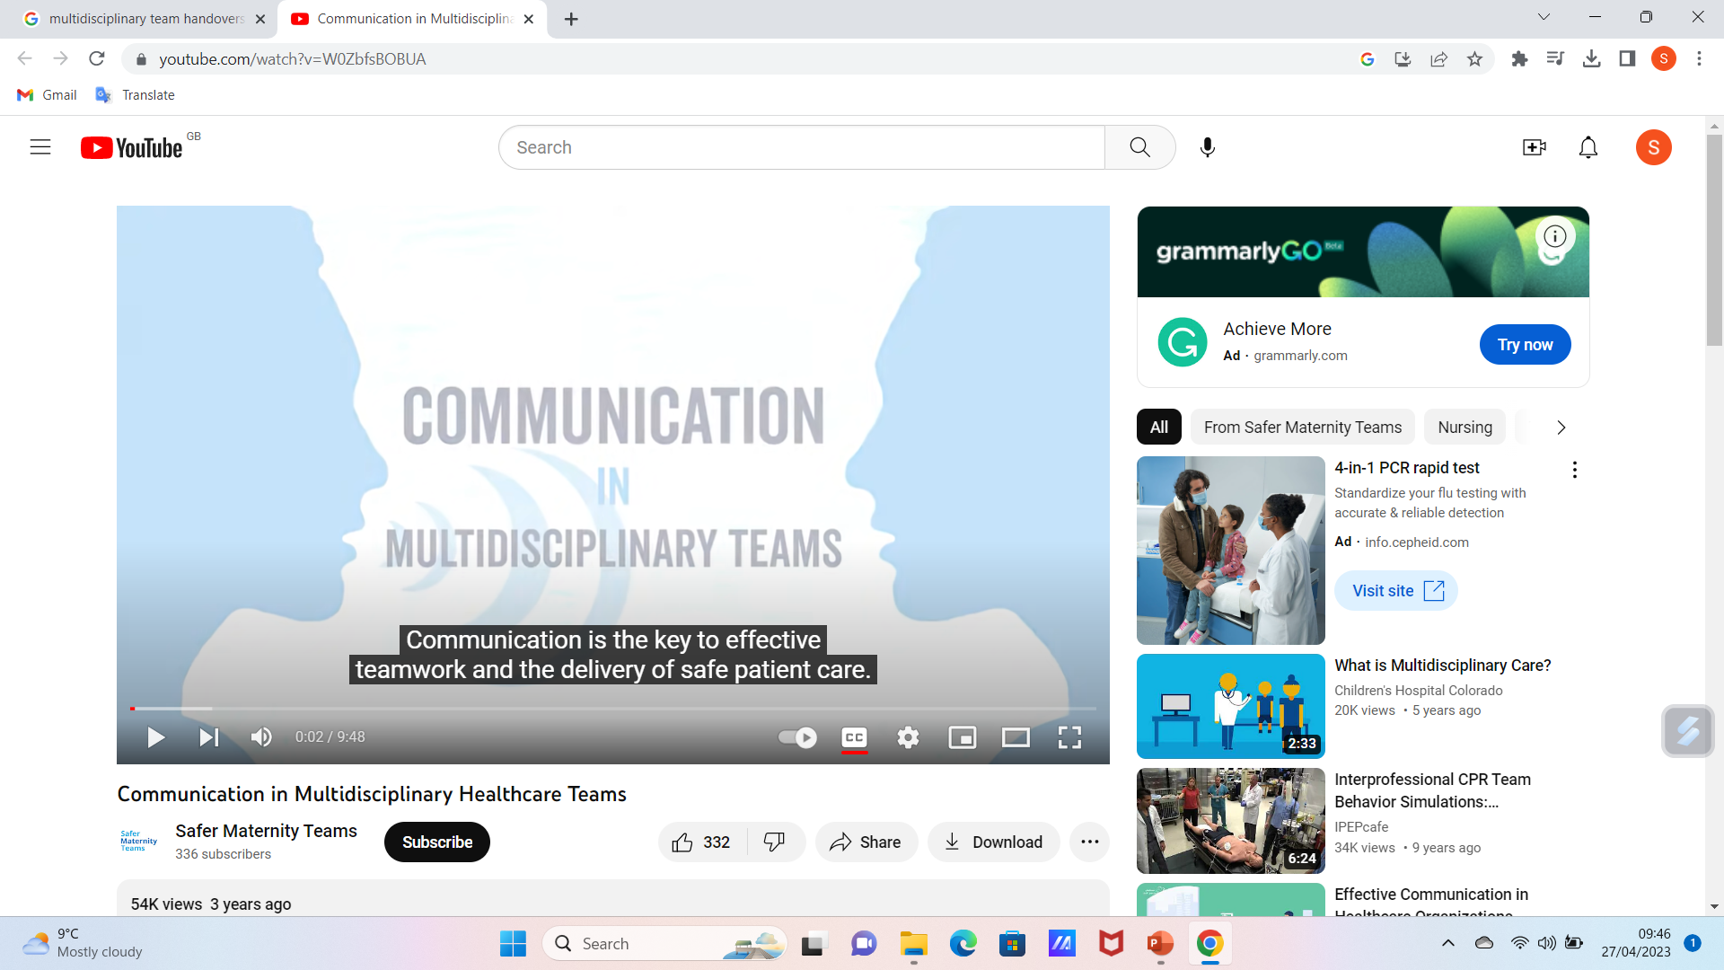
Handovers
Staff handovers are a critical time for communicating key information about patient’s care, condition and any changes.
Choose a quiet uninterrupted environment, ensure all relevant information is communicated clearly, and people have a chance to ask questions- no question is stupid; these are opportunities for teaching and learning.
All members of the mdt should be present.
Adopt a structured format, a clear agenda and a nominated lead.
Cover key topics such as- medical history, current condition, changes to the plan, updates from previous shift.
Document the handover- what was passed on.
Regular training on handover for all team.
https://www.youtube.com/watch?v=W0ZbfsBOBUA

Slide 44
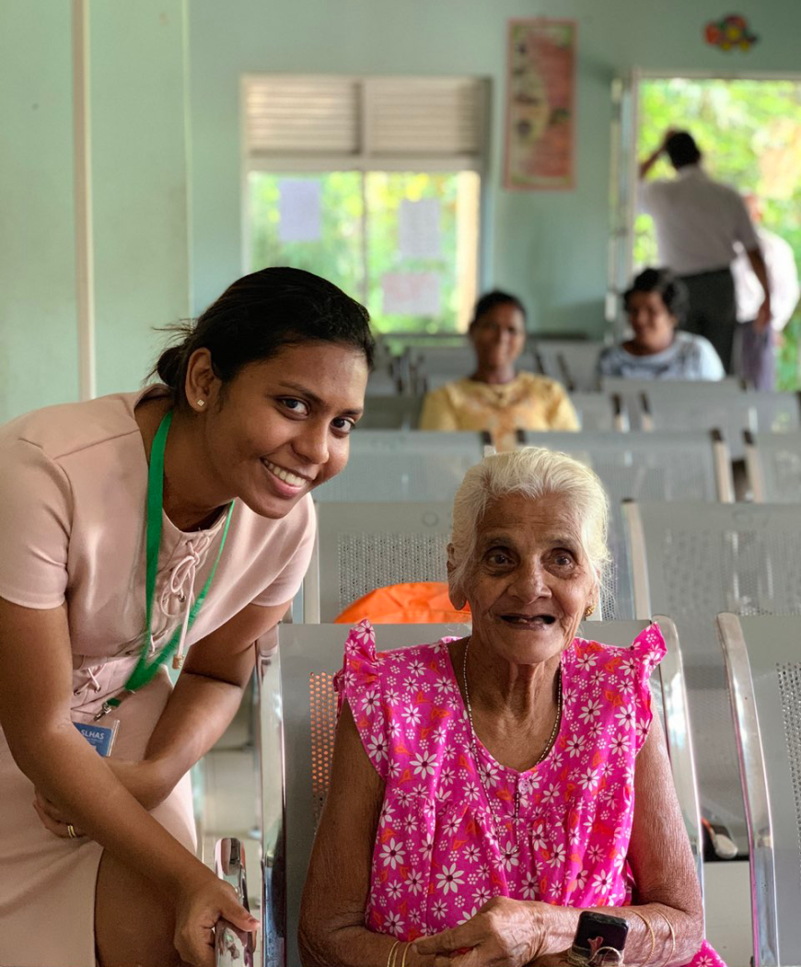
Navigating services
Start by identifying available health and social services locally – speak to local healthcare providers, community organisations or charities to check how to access these.
Discuss and identify any barriers to accessing services, such as language or cultural differences.
Engage with advocacy groups for people with NDDs, or caregiver support, find out how others have navigated the system, what worked, what didn’t.
Make sure you have a clear understanding of the patient’s medical condition, and specific problems you need addressed- have any relevant documentation with you.
https://r4d-ncd.org/2020/06/10/sri-lanka-health-and-ageing-survey/

Slide 45
Navigating services
Have a good understanding of local customs where you are working, and etiquette when interacting with medical and social care professionals.
Update yourself about latest developments in relevant research and treatments for NDDs and seek opportunities to know about opportunities to participate in research trials or studies.
Prioritise self-care and support for caregivers – engage with local counselling/ support groups.
https://r4d-ncd.org/2020/06/10/sri-lanka-health-and-ageing-survey/

Slide 46
References
Allen L (2021) Concordance and non-compliance: a psychological perspective, Prescribing Practice 3(1) https://www.prescribingpractice.com/content/professional/concordance-and-non-compliance-a-psychological-perspective/
Cummings J et al (2018) Pimavanserin: potential treatment for dementia-related psychosis, Journal of Prevention of Alzheimer’s Disease, 5(4) https://www.researchgate.net/publication/332215135_Pimavanserin_Potential_Treatment_For_Dementia-Related_Psychosis
Danuta Lipinska, in Tanner, L (2017) Embracing touch in dementia care: a person-centred approach to care and relationships, Kingsley, London.
Desai S (2021) The role of humour and laughter therapy in decreasing caregiver burden among carers of a person living with dementia- A case study, Ann Geriatr Educ Med Sci 8,(2): 60-63, https://doi.org/10.18231/j.agems.2021.014
Jones & Yarbrough (1985), A naturalistic study of the meanings of touch. Communication Monographs, 52., 19-56. Haptic Communication- https://psychology.fandom.com/wiki/Haptic_communication
Leroi I, Wolski L, Pavlina Charalambous A, Constantinidou F, Renaud D, Dawes P, Hann M, Himmelsbach I, Miah J, Payne M, Simkin Z, Thodi C, Kent Yeung W & Mengitsu Yohannes A (2022) Support care needs of people with hearing and vision impairment in dementia: a European cross-national perspective, Disability and Rehabilitation, 44:18, 5069-5081, DOI: 10.1080/09638288.2021.1923071
Mesulam M et al (2021), Memory Resilience in Alzheimer Disease With Primary Progressive Aphasia, Neurology, 96 (6) e916 e925; DOI: 10.1212/WNL.0000000000011397 https://n.neurology.org/content/96/6/e916
NHS England (2023) https://www.nhs.uk/conditions/dementia/communication-and-dementia/#:~:text=pat%20or%20hold%20the%20person's,comfortable%20with%20you%20doing%20this
Nurse Key (2018) Record Keeping, https://nursekey.com/record-keeping/

Slide 47
References
Salmon Health (2018) Dementia behaviour management: 6 caregiver challenges and suggestions, https://salmonhealth.com/blog/dementia-behavior-management/
G. J. Treharne, A. C. Lyons, E. D. Hale, K. M. J. Douglas, G. D. Kitas, ‘Compliance’ is futile but is ‘concordance’ between rheumatology patients and health professionals attainable?, Rheumatology, Volume 45, Issue 1, January 2006, Pages 1–5, https://doi.org/10.1093/rheumatology/kei223
University of Groningen. "Parkinson’s disease undermines language processing." ScienceDaily. ScienceDaily, 9 February 2011. <www.sciencedaily.com/releases/2011/02/110209082642.htm>.

Slide 48
Summary
Communicating challenges for people with NDDs include difficulty speaking, understanding speech & writing, and with non-verbal interaction.
Be patient and understanding, allow plenty of time to process information- avoid answering for them where avoidable.
Simplify language, use visual aids where appropriate. Know the family, know preferences and what the person probably wants to say in predictable situations.
Use alternatives where it may help, e.g. writing, picture boards, technology..
Watch facial/ body cues, but be aware of how this may be impacted by the NDD.
With dementia/ cognitive impairment, help to focus on the present when that is the issue. Avoid unnecessary confusion with potentially distressing past experiences (though find times to enjoy reminiscence).
Involve the family and patient in the communicating process.

Slide 49
Scenario
Mrs Shaw has advanced PD and her voice has become increasingly monotone, soft and slurred, and nurses struggle to understand her.
Try creating a clear concise care plan.
Clearly identify what the problem is, then the goal- what are you trying to achieve, the intervention and how you will evaluate- i.e. establish whether the intervention helped achieve the goal, or needs to be changed or modified.
Problem | Goal | Intervention | Evaluation

Slide 50
Scenario - my attempt- you may do better…
Problem | Goal | Intervention (and rationale) | Evaluation
Nurses are having difficulty understanding Mrs. Shaw due to her speech becoming slurred, soft and monotone related to Parkinson’s disease. This potentially leads to misunderstandings regarding Mrs Shaw’s needs and to compromised care. | To improve effective communicating between nurses and Mrs Shaw, and minimise the potential for compromised care associated with potential misunderstandings | Education & Training – provide E&T to all caring for Mrs Shaw on the effects of PD on communicating – enhancing nursing /caregiver knowledge & understanding of PD will help recognise and adapt to associated challenges. Active listening – encourage this among staff, as this involves giving full attention to the patient, clarifying information and showing empathy. Helps better understand patient needs and establish a therapeutic relationship. Visual cues – Utilise pictorial or written instructions to support verbal communicating. This can compensate for difficulty articulating. Patience & time – Allocate sufficient time to allow Mrs Shaw to synchronise breathing and speech, and to process thoughts and organise phrasing. Being rushed causes frustration and can lead patients to giving up trying to be understood. Collaborate with SALT – to gain help to establish effective speech techniques. Assistive communicating devices – e.g. text to speech apps/ communication boards. MDT collaboration – e.g. OTs, Soc workers and others to ensure a comprehensive care approach. | Set dates to evaluate effectiveness or otherwise of each intervention and modify as necessary to ensure goals are met.

Slide 51

Any questions?

Slide 52

Thank you

Slide 53
Duration – 5 hours, 20 minutes
Recorded lecture: 3hrs
Activity 1 (slide 16) (have you seen my mother?) 10mins
Tutor led discussion on activity 1 10 mins
Activity 2 (slide 26) (appropriate use of touch) 10 mins
Tutor-led discussion on activity 2 10 mins
Activity 3 (slide 28) (Use of humour in care) 10 mins
Tutor-led discussion on activity 3 10 mins
Activity 4 – Scenario and care plan 30 mins
Tutor-led discussion on activity 4 30 mins
Questions / discussion 20mins.
Total duration – communicating lecture: 5 hours, 20 minutes.

