Slide 1
Comprehensive Care
Lecture SIX
Maintaining a Safe Environment – People with NDD.

Slide 2
Aim
To understand how to care for people with NDDs with regard to the AL of maintaining a safe environment.

Slide 3
Maintaining a safe environment
As people age and become frailer, risks increase, impacting on ability to live safely at home.
Particularly those with NDDs.
Think of ways our neurological system works to maintain our safety.
Examples: Major senses- Sight-Perception; Hearing; Smell; Touch, Taste
  Balance; Coordination; Hot Cold sensation; pain; Mood;

Slide 4
Health and safety- what is the difference
Caring for a person with NDDs, working to maximise their independence starts with carefully looking for two types of hazards- health hazards and safety hazards.
Health- more associated with longer term good physical and mental functioning.
Safety- to do with being protected from accidents and harmful incidents- generally safety hazards have potential to cause more immediate harm.
Think of some potential health hazards in a home.
Then think of some safety hazards
Activity 1 – 5 minutes, tutor-led class discussion – 5 minutes = 10 minutes.

Slide 5
You might have thought of
Heath Hazards
Bacteria, Viruses, parasites.
Lead in paint
Tobacco smoke, other toxins
Noise
Radiation
Isolated, dark enc=vironment (psychological health)
Safety hazards
More immediately poisonous toxins, e.g carbon monoxide
Fire hazards- e.g. loose wiring,, faulty smoke alarms
Trip hazards
Wet floors

Slide 6
What are risks?
The Likelihood that a hazard with cause harm
Multiplied by
The seriousness of the injury/ health problems if they occur

Slide 7
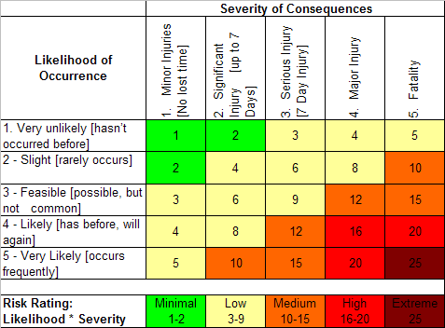
Scoring a risk
Why measure a risk?
Prioritising
Example simple risk scoring system:

Slide 8
Vision Impairment and Safety
Some general tips
Try various lighting- especially around stairways, recesses, and trip-hazards
Remove rugs/ any floor covering that curls or is raised.
Encourage removal of unnecessary clutter.
Avoid patterned carpets.
Tidy cables.
Fluorescent stickers on furniture corners
Telephone with large digits.
Put emergency numbers (Large print) prominently near phone
Habit--- keep internal doors completely open or closed.
https://www.betterhealth.vic.gov.au/health/conditionsandtreatments/vision-loss-safety-around-the-home- visited 23 10 22

Slide 9
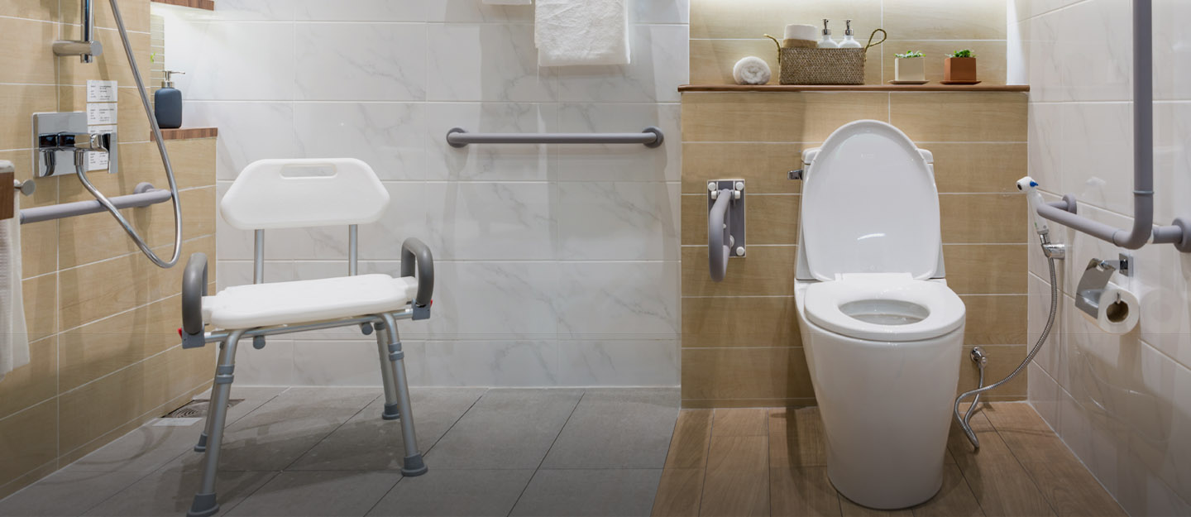
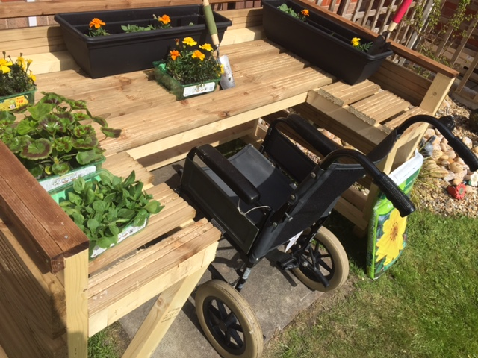
Vision Impairment and Safety
Washroom/ Bathroom tips
Contrast wall colour with towels (e.g. light walls, dark towels)
Grab rails for shower, bath and toilet..
Soap on rope; plug chained to bath.
Garden Tips
Cut low branches
Bright colours- path edges
Pad the head of rakes
Stairs
Bright coloured step edges; Rail both sides
https://www.zameen.com/blog/design-safe-bathroom-senior-citizens.html
http://www.keyhealthcare.co.uk/news/accessible-garden-for-wheelchair-users-at-elizabeth-court-care-centre

Slide 10
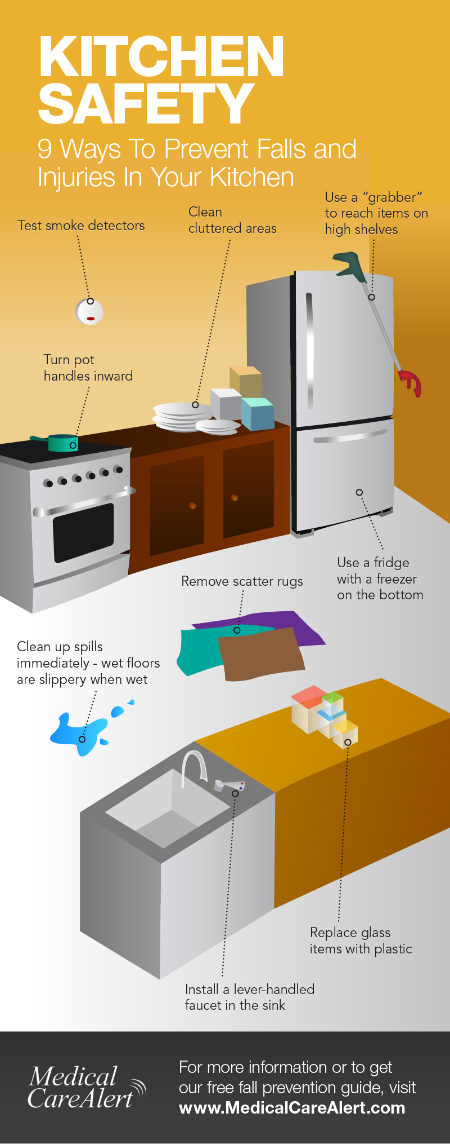
Vision Impairment and Safety
https://www.medicalcarealert.com/kitchen-safety-for-seniors-infographic/
Kitchen
Habit- turn saucepan handles away from where they can be knocked
Fire retardant oven gloves and brightly marked up fire blanket and extinguisher
Aids to cut cheese, slice eggs, lettuce etc.
A further general point:
Tour the home, imagine your sight is impaired. . Note and address: what would you bump into? (Think- in a hurry to get to toilet/ answer doorbell/ phone). Think about making a hot drink, cooking, washing, dressing.
Find hazards. Assess and reduce risks.

Slide 11
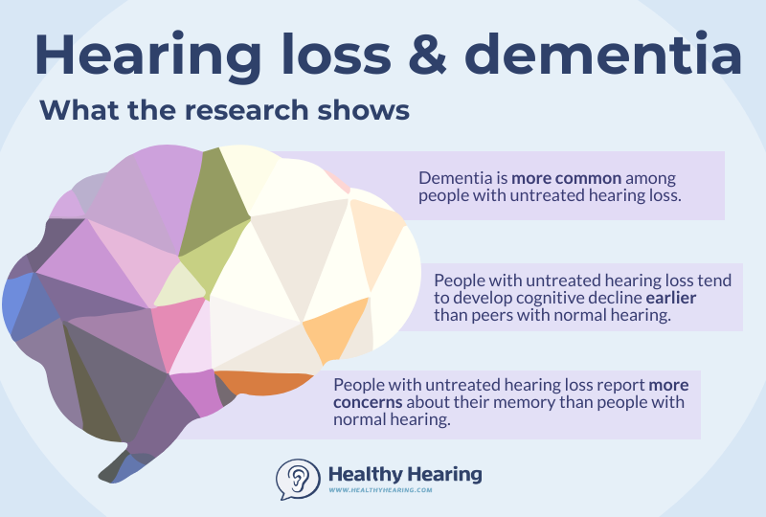
Hearing impairment and NDDs
Dementia- not only may brain degeneration affect aural pathways, people with dementia may struggle with interpreting sounds.
Also- mild hearing loss doubles the risk of developing dementia; moderate - 3 times; severe – 5 times*.
‘Cognitive decline and dysfunction are common in PD. Untreated hearing loss necessitates greater effort for auditory perceptual processing = reduced resources for cognitive processes e.g. working memory. Reduced cognitive reserves, social isolation, sensory deafferentation, or a combination of these mechanisms may explain the hearing loss/ dementia link. Hence untreated hearing loss is likely to exacerbate cognitive dysfunction that is experienced by many PD patients’.
(precis, Folmer RL, Vachhani JJ, Theodoroff SM, Ellinger R, Riggins A. Auditory Processing Abilities of Parkinson's Disease Patients. Biomed Res Int. 2017;2017:2618587. doi: 10.1155/2017/2618587. Epub 2017 May 4. PMID: 28546963; PMCID: PMC5435898) – Visited 24 10 2022. .
* https://rnid.org.uk/hearing-research/hearing-loss-and-dementia-how-are-they-linked/ Visited 24 10 2022
https://www.healthyhearing.com/report/52904-The-connection-between-hearing-loss-and-cognitive-decline

Slide 12
Some key risk areas to assess
Falls
Medication management
Malnutrition and dehydration
Social isolation
Cognitive impairment
Fire risk / burns/ scalds
Financial exploitation
Vulnerability to physical or emotional abuse or neglect
Caregiver fatigue

Slide 13
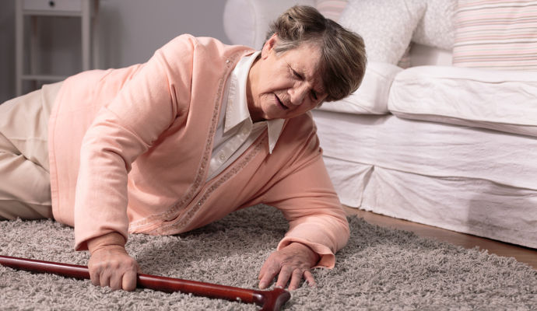
Falls
A common safety risk, and can instantly change level of dependence
Risk factors include- poor balance, weakness, vision and/ or hearing impairment, and medication side effects.
Steps to avoid falls include home modifications, especially installing grab bars and removing trip hazards, physiotherapy and reviewing medication.
https://care24seven.com/what-should-you-do-if-an-elderly-person-falls/

Slide 14
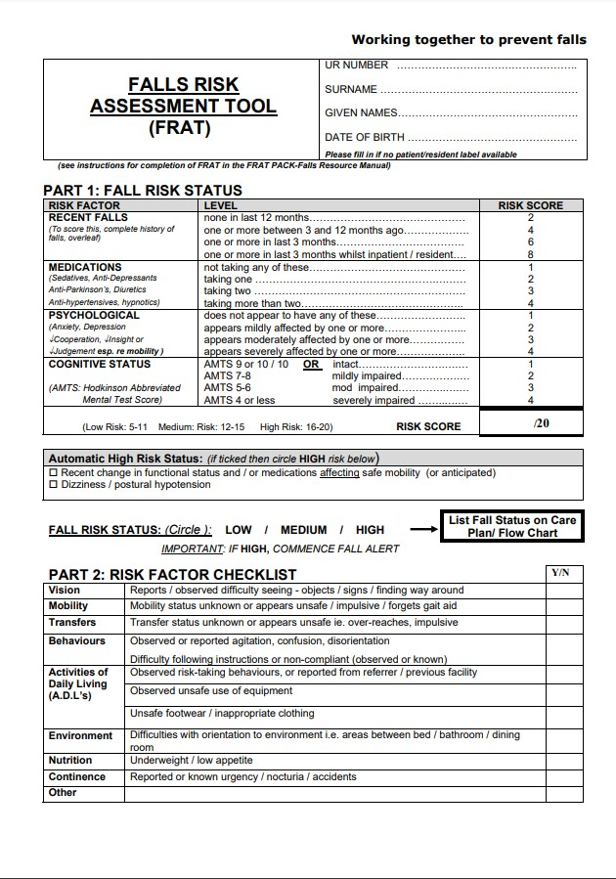
Example- falls risk assessment tool
https://www.physio-pedia.com/Falls_Risk_Assessment_Tool_(FRAT)

Slide 15

Medication management
People with NDDs may be taking multiple medications, and neither carer or patient may be sure what they are for.
Frequent reviews essential. Most healthcare systems are designed well for starting medications, not for stopping them.
Polypharmacy increases risk of adverse medicine effects such as falls, cognitive impairment, harmful drug interactions, adds to carer and patient confusion resulting in drugs taken at wrong times, not knowing what they are for and when they are helping or worsening problems.
https://www.rightathome.net/blog/polypharmacy-in-the-elderly

Slide 16
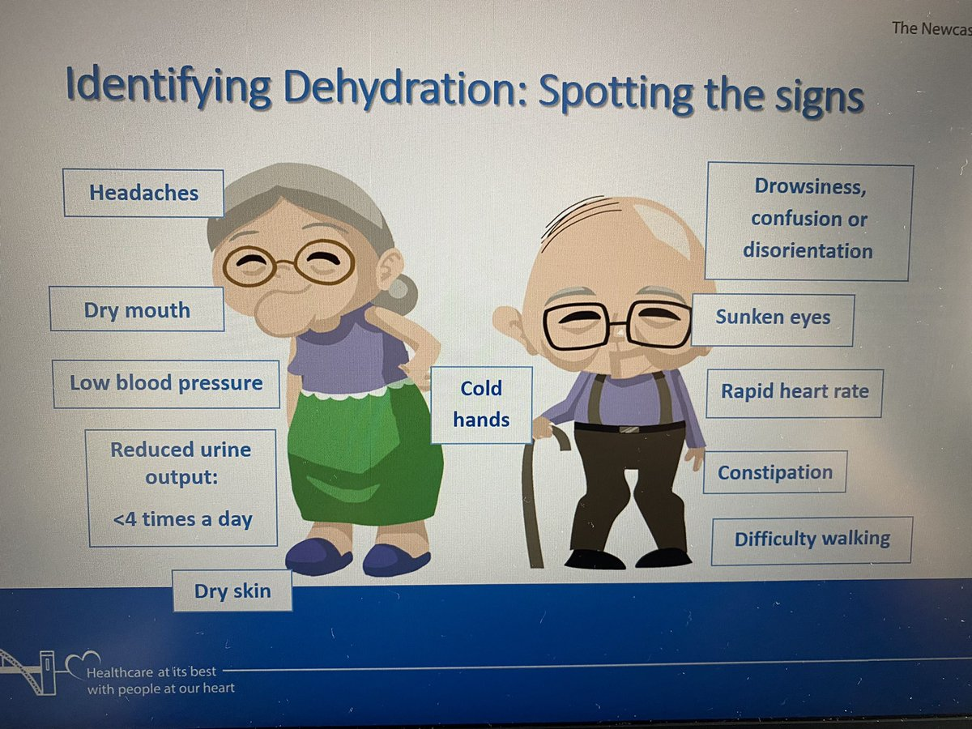
Malnutrition & Dehydration
People with NDDs may be at risk of malnutrition and dehydration due to difficulty with:
Shopping
Preparing food
Remembering to eat and drink
In hospitals quiet patients can be overlooked.
“Hospital malnutrition is a predictor of increased length of stay, impaired wound healing, increased risk of infections and complications, and increased morbidity and mortality. Thus, malnourished patients have more substantial care needs with a greater reliance on hospital resources resulting in higher healthcare costs” Cass et al (2022).
https://twitter.com/RobynCDietitian/status/1404366435728736256

Slide 17
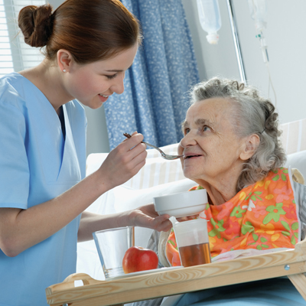
Bunn, Hooper & Welch 2018, UK
Conclusions include: Malnutrition, dehydration and low rates of vitamin D supplementation remain prevalent in older care home residents, and are associated with poor quality of life, comorbidities, increased hospital admissions and mortality.
The authors are working with organisations to develop & implement guidelines.
“Care home residents’ eating and drinking experiences are crucial aspects of nutritional and hydration care and should be fully acknowledged when addressing malnutrition and dehydration. Key aspects include:
Residents’ eating and drinking skills.
Available eating and drinking assistance.
Oral health.
Swallowing abilities.
Sensory abilities.
Appetite and anorexia of aging.
Exercise.
Individual, cultural and/or religious preferences.
Dietary needs.
Food presentation.
Social and physical environment.
Institutional systems and organisation.
Support from health professionals, including dietitians, and speech and language therapists”.
https://www.qcs.co.uk/bapen-care-home-reports-malnutrition/

Slide 18
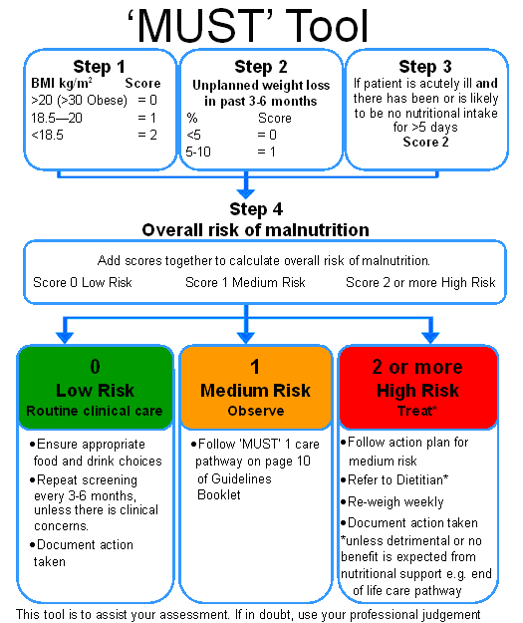
https://www.elmmb.nhs.uk/policies-and-guidelines/sip-feed-guidelines-food-first-resources/food-first-assessment/

Slide 19
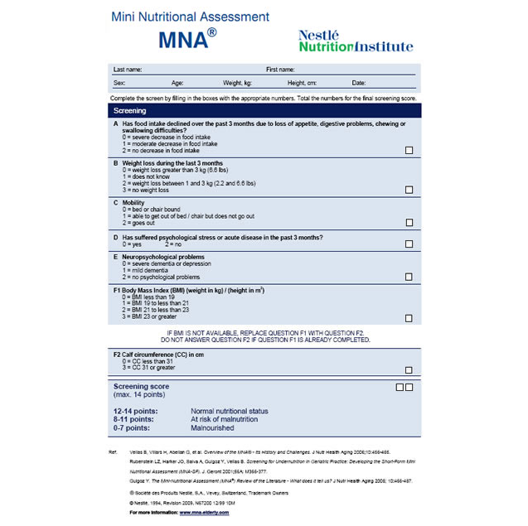
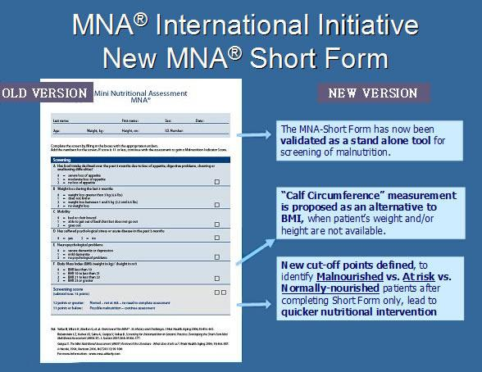

Slide 20
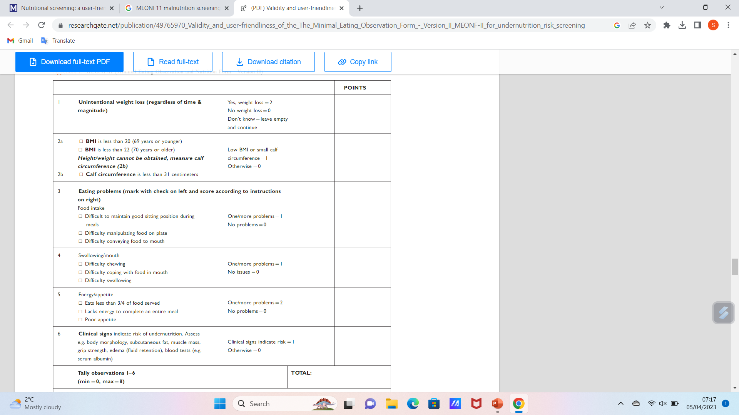
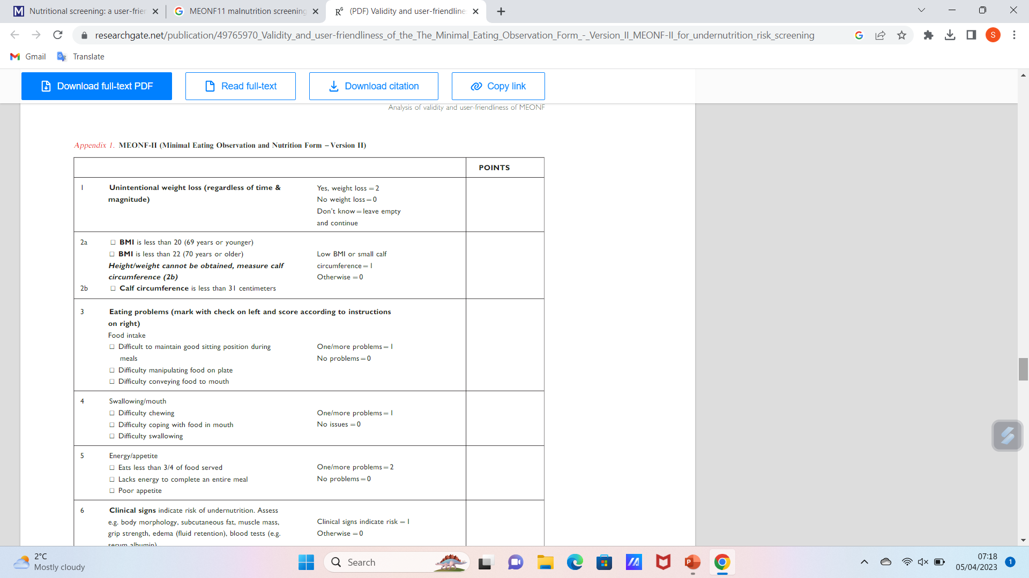
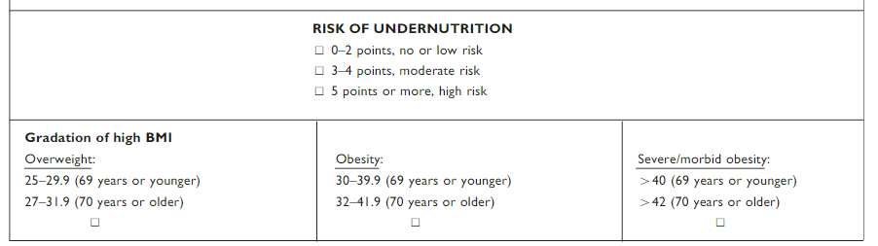
Smith S, Westergren A, Saunders J, Hagell P (2016) Nutritional screening: a user-friendly tool adapted from Sweden, BJN 25(4) https://doi.org/10.12968/bjon.2016.25.4.208

Slide 21
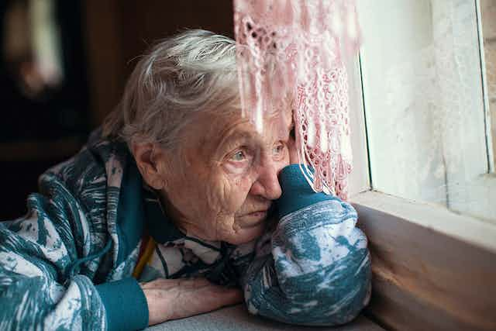
Social Isolation
This can impact negatively on mental and physical health, and QoL – reasons for living.
Higher risks of hypertension, heart disease, obesity, weakened immune system, anxiety, depression, cognitive decline, AD are linked to social isolation and loneliness.
That said, social isolation and loneliness are independent factors – they can be related but many lonely people are surrounded by family and friends, many isolated people are not lonely (National Institute on Aging (2019) Social isolation, loneliness in older people pose health risks, https://www.nia.nih.gov/news/social-isolation-loneliness-older-people-pose-health-risks).
Primary findings-“interventions to increase older adults’ social integration should address not only their behaviours, but their overall surroundings. - the influence of social policies, institutions, and ideologies in the everyday experience of isolated older adults,”
Ensuring meaningful days with social engagement is essential.
https://theconversation.com/loneliness-is-a-health-issue-and-needs-targeted-solutions-96262

Slide 22
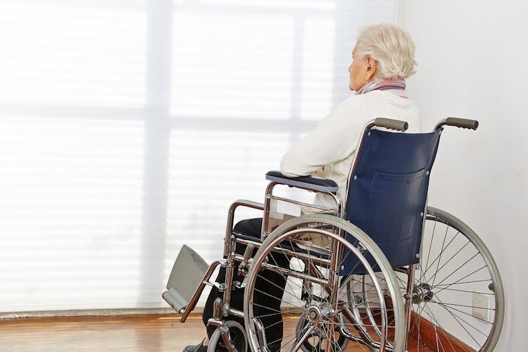
Social isolation
It’s not about just ensuring they meet lots of people and join in activities.
It’s about ensuring meaningful connections- with the right kind of people for the individual.
It necessitates knowing the person well.
Also, addressing negative beliefs about other people and the world around the person, which do seem to be at the root of loneliness. Lim, M (2018) Loneliness is a health issue and needs targeted solutions, Conversations, https://theconversation.com/loneliness-is-a-health-issue-and-needs-targeted-solutions-96262
This topic can be developed in a future lecture on the AL of ‘Working & Playing’.
“Many social initiatives send in a rotating cast of volunteers meaning quality relationships are hard to forge”.

Slide 23

Cognitive impairment
Safety risks associated with cognitive impairment include those discussed above and also…
Wandering, being lost, vulnerable & unprotected from attack and exploitation, and road hazards.
Memory loss and confusion leading to fire risk for example.
Assessing cognitive function and implementing strategies to manage decline are essential to reduce risks.
https://www.healio.com/news/psychiatry/20201014/cigarette-smoking-may-increase-risk-for-alzheimers-disease

Slide 24
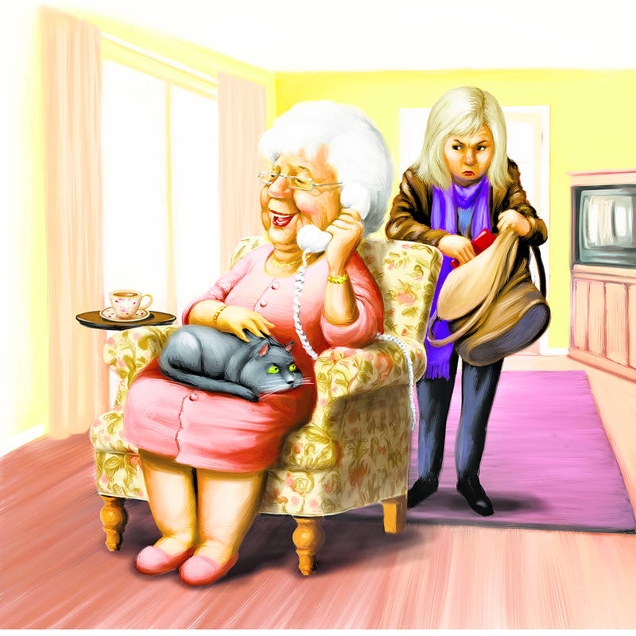
Financial exploitation- and other forms of elder abuse
Elderly people, and especially those with NDDs / cognitive impairment are easy targets for scams such as fraud and theft.
It is very important to assess the person’s financial situation, vulnerability and suggestibility and implement protective measures.
Case – Doris – gifts to staff at Christmas and other occasions…. The importance of clear staff policies.
Concept of ‘undue influence’.
Family concerns- e.g. new romance
https://www.barrons.com/articles/financial-abuse-the-silent-epidemic-1478931165

Slide 25
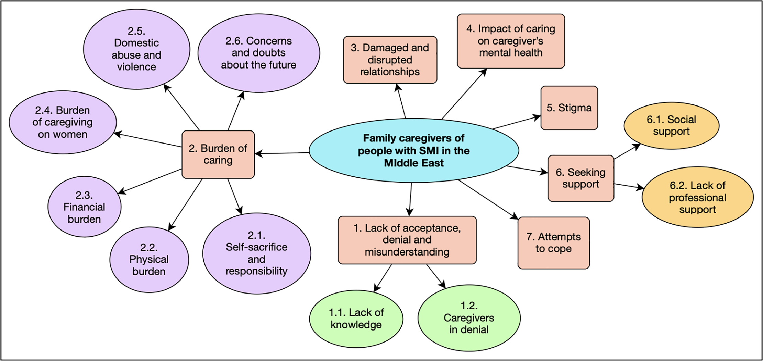
Abuse by and of family caregivers
Alyafei AH, Alqunaibet T, Mansour H, Ali A, Billings J (2021) The experiences of family caregivers of people with severe mental illness in the Middle East: A systematic review and meta-synthesis of qualitative data. PLoS ONE 16(7): e0254351. https://doi.org/10.1371/journal.pone.0254351

Slide 26
Summary
Assessing safety risks for people with NDDs and any elderly frail person requires a comprehensive evaluation of their physical and mental health as well as their living environment and social circumstances. It’s important to develop a personal plan to address these risks and promote the person’s (and family caregiver’s) personal safety, wellbeing and independence.

Slide 27
Scenario
Mr Lucas has HD and an unsteady gait. He prefers to use the stairs than the lift in his care home. Nurses ask him to wait until one of the staff can accompany him, but he forgets and impulsively sets out on his own. This has led to several falls.
See if you can suggest a care plan that respects his autonomy while staff responsibly exercise a duty of care.
Problem | Goal | Intervention | Evaluation

Slide 28
Scenario – my attempt- you may do better…
Problem | Goal | Intervention (with rationale) | Evaluation
Mr Lucas has an unsteady gait related to HD. He prefers using stairs to the lift. He agreed to wait for nurses to accompany him but forgets and impulsively sets out alone, resulting in falls. | Ensure Mr Lucas’ safety and reduce the risk of falls while respecting his autonomy and independence | Assess Mr Lucas’ cognitive and physical abilities, balance, strength, extent of memory impairment and understanding of risks associated with his unsteady gait, to help tailor intervention accordingly. Educate Mr Lucas re risks and consequences, use visual aids to help retain the information. This reinforces the importance of safety and helps make informed choices. Engage in open honest discussions about his preference. Respect his autonomy by encouraging active involvement in decision-making, taking account of his desires, values, priorities and any concerns about the lift. This fosters collaborative decision-making. Implement safety measures – handrails, non-slip surfaces, good lighting. Consider assistive devices e.g. walking aid or personal alarm system, to enhance safety. Document Mr Lucas’ agreement to safety measures, including waiting for staff to assist. This can help reinforce the agreements and help Mr Lucas feel ownership. Make frequent observations to assess adherence / concordance to the plan. This ensures the plan remains relevant and effective. | Evaluate observations weekly and if any untoward event or near miss occurs, for 3 months (date), and modify the plan accordingly.

Slide 29
References
Alyafei AH, Alqunaibet T, Mansour H, Ali A, Billings J (2021) The experiences of family caregivers of people with severe mental illness in the Middle East: A systematic review and meta-synthesis of qualitative data. PLoS ONE 16(7): e0254351. https://doi.org/10.1371/journal.pone.0254351
Bunn D, Hooper L, Welch A. Dehydration and Malnutrition in Residential Care: Recommendations for Strategies for Improving Practice Derived from a Scoping Review of Existing Policies and Guidelines. Geriatrics (Basel). 2018 Nov 12;3(4):77. doi: 10.3390/geriatrics3040077. PMID: 31011112; PMCID: PMC6371146. https://www.ncbi.nlm.nih.gov/pmc/articles/PMC6371146/
Cass AR, Charlton KE. Prevalence of hospital-acquired malnutrition and modifiable determinants of nutritional deterioration during inpatient admissions: A systematic review of the evidence. J Hum Nutr Diet. 2022 Dec;35(6):1043-1058. doi: 10.1111/jhn.13009. Epub 2022 Apr 26. PMID: 35377487; PMCID: PMC9790482.
Lim, M (2018) Loneliness is a health issue and needs targeted solutions, Conversations, https://theconversation.com/loneliness-is-a-health-issue-and-needs-targeted-solutions-96262
(National Institute on Aging (2019) Social isolation, loneliness in older people pose health risks, https://www.nia.nih.gov/news/social-isolation-loneliness-older-people-pose-health-risks).
National Institute of Health (NIH) (2021), The Dangers Of Polypharmacy And The Case For Deprescribing In Older Adults, https://www.nia.nih.gov/news/dangers-polypharmacy-and-case-deprescribing-older-adults
Nursing Home Guide: -- https://www.nursinghomeabuseguide.org/elder-abuse/caregiver-abuse/
Orfila F, Coma-Solé M, Cabanas M, Cegri-Lombardo F, Moleras-Serra A, Pujol-Ribera E. Family caregiver mistreatment of the elderly: prevalence of risk and associated factors. BMC Public Health. 2018 Jan 22;18(1):167. doi: 10.1186/s12889-018-5067-8. PMID: 29357866; PMCID: PMC5778739.
Smith S, Westergren A, Saunders J, Hagell P (2016) Nutritional screening: a user-friendly tool adapted from Sweden, BJN 25(4) https://doi.org/10.12968/bjon.2016.25.4.208

Slide 30

Any questions?

Slide 31

Thank you

Slide 32
Duration – 3 hours, 35 minutes
Recorded Lecture time: 2 hours, 10 minutes
Activity 1 slide 7, risk assessment: – 5 minutes, tutor-led class discussion – 5 minutes (total 10 minutes)
Activity 2 – care planning for case scenario: 30 minutes
Tutor-led class discussion of activity 2- 30 minutes
Questions/ discussion – 15 minutes.
Total duration- 3 hours, 35 minutes.

