Slide 1
Comprehensive Care
Lecture 6
Environmental Factors Influencing Living with NDDs

Slide 2
Learning Outcomes
To identify and address environmental factors influencing living with a NDD
To organize and document assessment, planning, implementation and evaluation (and re-assessment)

Slide 3
Environmental factors
The environmental factor should make it a “green” model.
The theory takes into consideration the impact of the environment on the activities of living, and also could facilitate consideration of the impact of people carrying out activities of living on the environment.

Slide 4
Environmental factors to consider in care can include:
Home environment – temperature, insulation, materials – e.g. brick, concrete, wood, glass – asbestos!
Adaptations to enable hazard-free access to toilet and other facilities within the house, entry and exit.
Transportation e.g. to access facilities such as primary health care facility
Moving to care institution, extended family home- coping with changes in environment.
Unguarded machinery e.g. in a workplace, shed- hobby area…
Noise levels
Rural / urban
Crowded / lonely (maybe both?).
Many more- exercise 1 – 5 minutes- think of more environmental factors influencing living with NDDs. Follow up- 10 minute tutor-led class discussion.

Slide 5
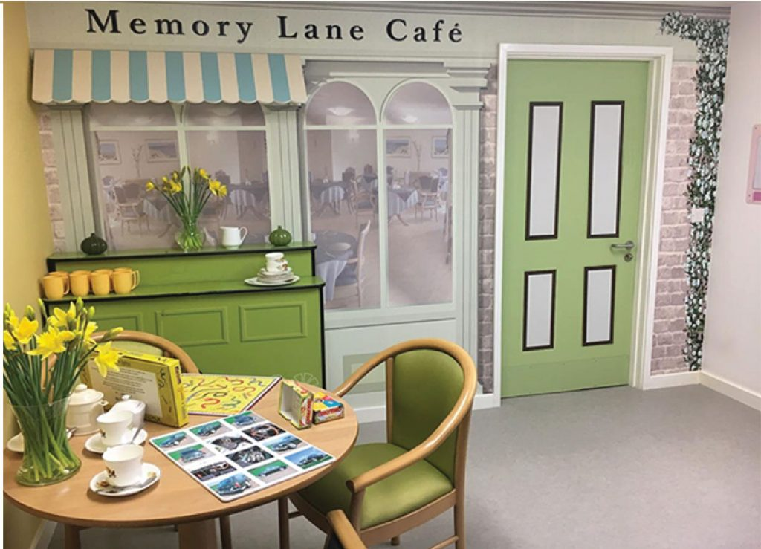
Environmental factors and NDDs
Though genetic factors influence whether we develop NDDs and their progression and impact, environmental factors play a significant role. These include:
Lifestyle- The environment we grow up in affects our lifestyle choices, including diet, exercise habits, sleep patterns and stress management- these all impact on brain health. E.g. diet rich in fruits, omega-3 = lower risk of AD; lack of exercise and poor sleep exacerbate symptoms of PD.
Toxin exposure- pesticides, heavy metals, pollutants, can increase the risk of NDDs, e.g., exposure to lead = higher risk of developing PD.
Social and emotional environment – living in areas or situations where the risk of social isolation is high – rural v urban environments have different issues – a strong social support system will improve QoL for PwNDDs.
Healthcare access – good access will impact on the management of symptoms and overall QoL.
https://findmemorycare.co.uk/did-you-know-that-your-care-environment-could-affect-the-well-being-of-your-residents/

Slide 6
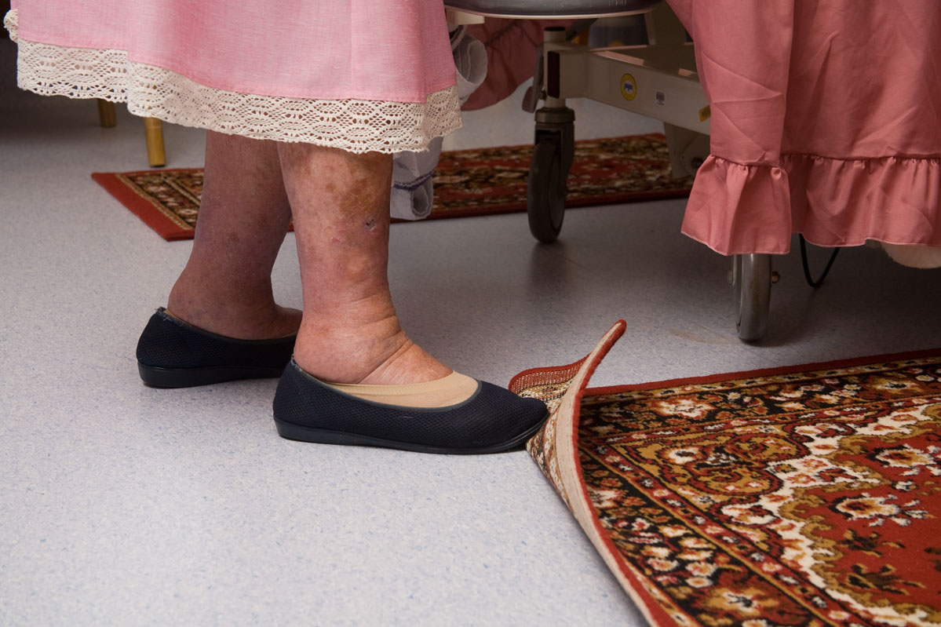
Home / care home Physical environment
Cluttered / disorganised living space can increase trips, slips and falls risk.
Poor lighting also adds to this and makes safe navigation difficult… adds to continence problems.
Lack of handrails may limit mobility and increase dependence.
Ensuring a clear well-lit pathways and installing grab bars can increase safety, confidence and independence.
Noise and overstimulation in the environment can cause anxiety and confusion.
Caregivers should seek to establish a calm and quiet environment.
Case- Mr Scott – withdrawal to room… reason established= too noisy in communal rooms.
https://www.acornstairlifts.co.uk/blog/post/2520/Tips-and-Advice/A-room-by-room-guide-to-safety-in-your-home

Slide 7
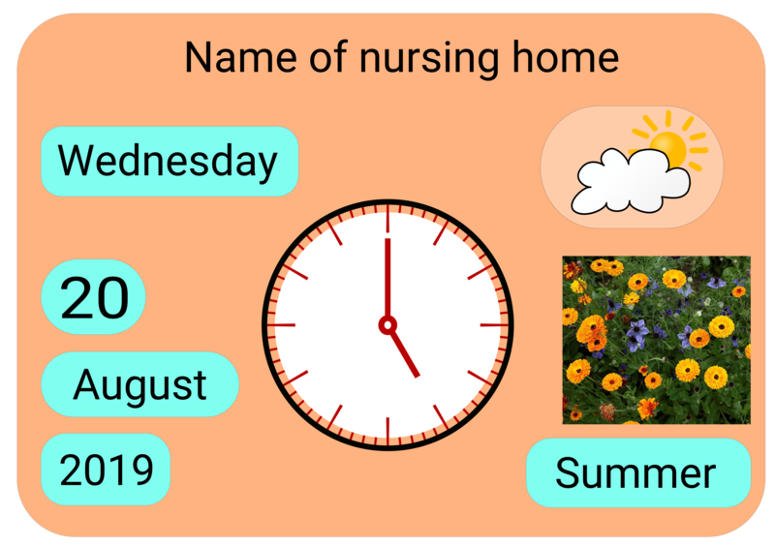
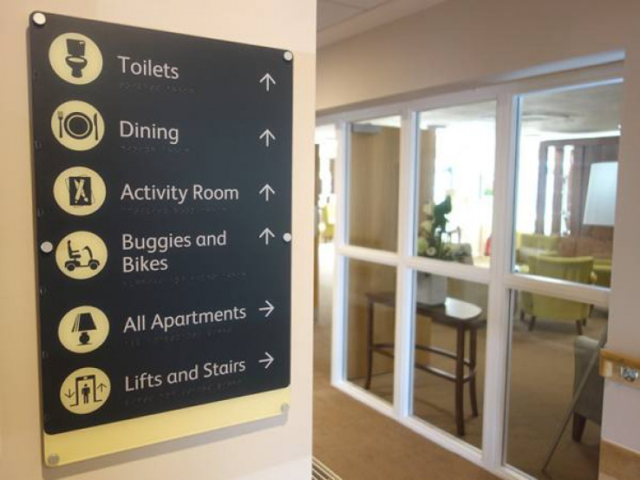
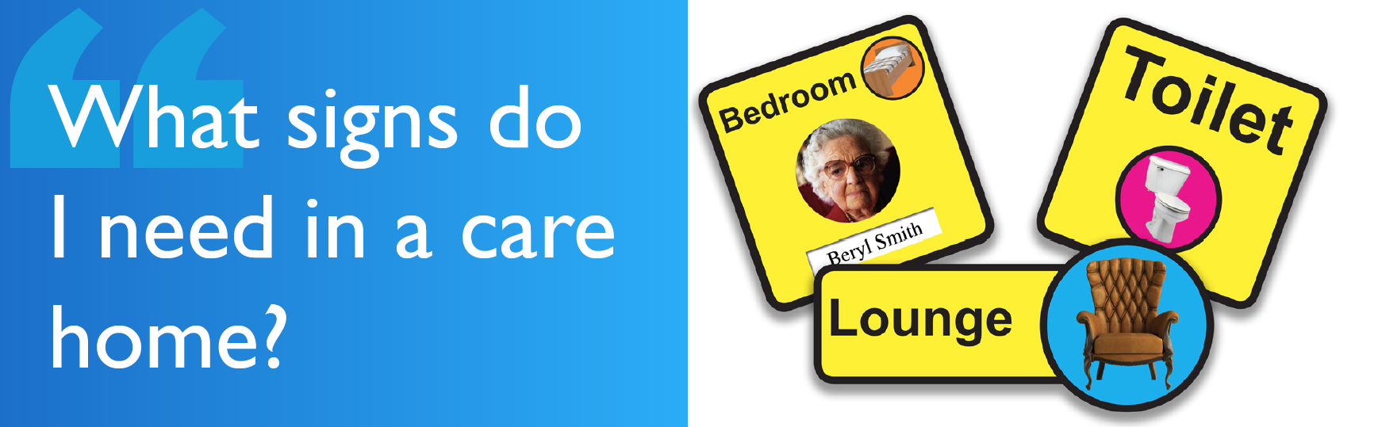
Social environment
https://commons.wikimedia.org/wiki/File:Reality_Orientation_Board.png
Loneliness, isolation and depression can be associated with care home admission or long periods in the person’s own home.
An environment where interaction with others is optimised (with opportunities to choose time alone when preferred), and with organised group activities and outings can help to mitigate loneliness, anxiety and depression.
A comfortable, familiar environment with good cues for reality orientation can reduce anxiety and agitation.
https://www.new-vision.co.uk/health/products/care-home-signage
https://www.dementiacareproducts.co.uk/a-guide-to-care-home-signage

Slide 8

Emotional environment
Be aware of triggers for anger and frustration.
Look around the environment for what compromises privacy, and uninterrupted conversation with staff and visitors.
Being around other angry people is infectious.
Reassuring staff, soothing ambience – colours, sounds.
Staff rotation with challenging individuals helps reduce staff burnout.
Activities – communal and individual are important, physically & cognitively stimulating, and emotionally reassuring, e.g. reminiscence therapy…. Environments have to be conducive to all of this.
https://www.careflex.co.uk/info-centre/blogs/specialist-seating-and-the-care-home-environment/

Slide 9
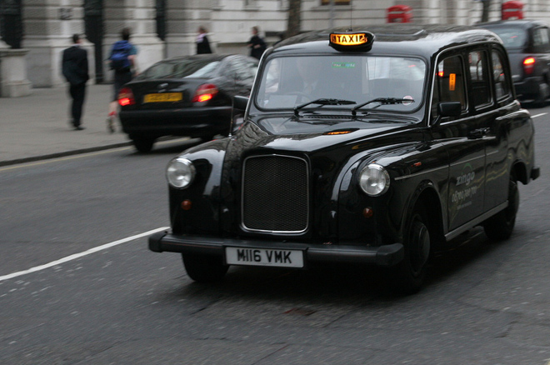
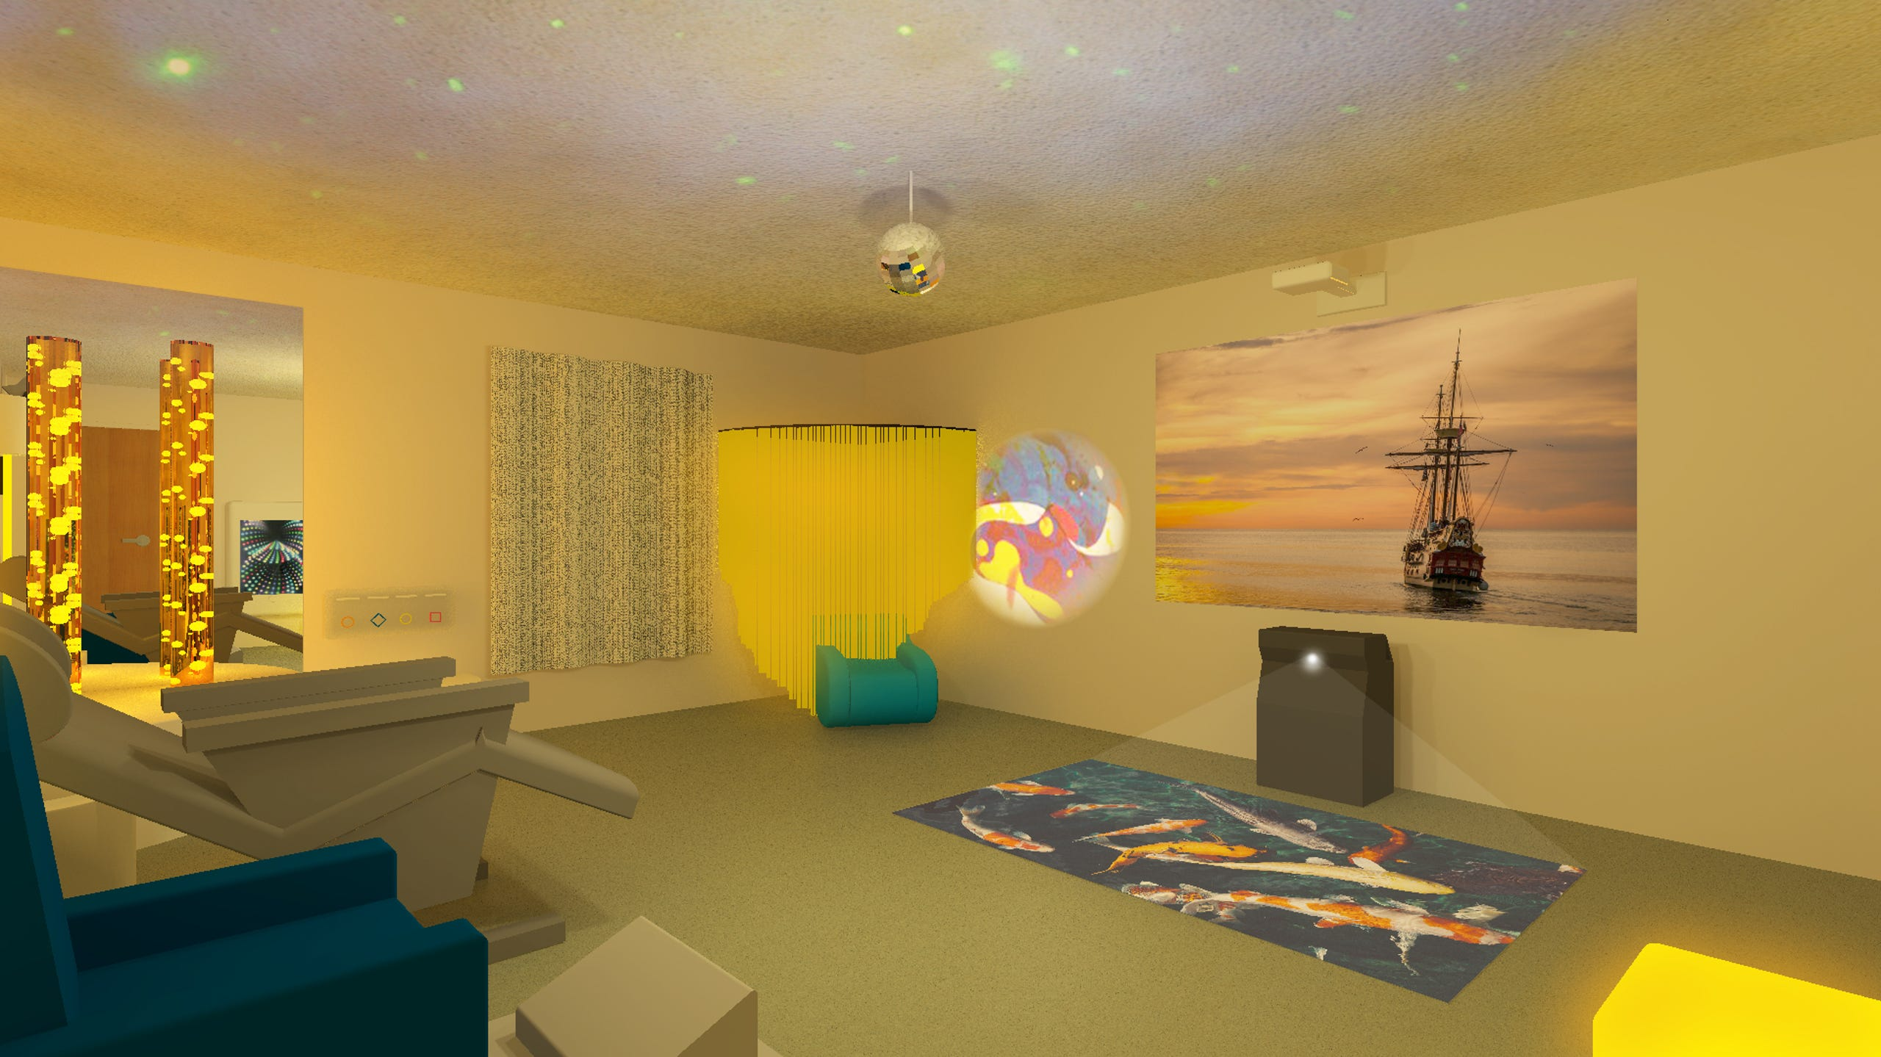
Does environment really make any difference?
https://www.wired.com/2011/12/london-taxi-driver-memory/
Maguire E, Gadian D, Johnsrude I (2000) Naviagation-related structural change in the hippocampi of taxi drivers, PNAS 97(8), https://www.pnas.org/doi/10.1073/pnas.070039597
Liew A, Teo C, Soga T (2022) The Molecular Effects of Environmental Enrichment on Alzheimer’s Disease. Mol Neurobiol 59, 7095–7118. https://doi.org/10.1007/s12035-022-03016-w
https://eu.floridatoday.com/story/life/wellness/2019/01/22/dementia-patients-responding-sensory-therapy-rooms/2613338002/

Slide 10
Scenario
Can you suggest a concise care plan, clearly stating the problem, goals and interventions with rationale that the community nurse could implement to address the issue presented in the scenario below?
Scenario: Max has frontotemporal dementia and lives at home with his sister, Agnes who is his primary caregiver. Agnes tells the community nurse that it is becoming increasingly difficult to protect Max from slipping and tripping when washing and dressing in their rather small bathroom.
Problem | Goal | Intervention | Evaluation

Slide 11
Scenario – my attempt- you may do better….
Problem | Goals | Intervention (with rationale) | Evaluation
Increased risk of slips and trips during washing and dressing for Max who has FTD, due to limited space in the bathroom | Reduce the risk of trips and slips during washing and dressing Improve safety and promote independence for Max during personal care activities Provide support and education to Agnes on managing Max’s bathing and dressing needs. | Consider, with Max and Agnes, installing sturdy grab bars near the toilet, shower and bathing areas to provide Max with support and stability in transfers and movements. (this will reduce falls risk and give added stability). Work with Max and Agnes to agree removal of any unnecessary items from the bathroom, ensuring clear pathways. (A clutter-free environment minimizes trip hazards). Discuss use of a stable shower chair for Max when bathing / washing / dressing (enhances comfort, stability and support, preventing falls and promoting independence). Suggest a non-slip bathmat. (Increses grip and minimises likelihood of slips). Train Agnes on proper transfer techniques making use of grab bars/ assistive devices. (Helps improve caregiver confidence and reduces fall risk, and risk of injury to caregiver). Educate Agnes on specific challenges associated with FTD, such as behavioural changes and impaired judgement. (enhanced knowledge empowers caregiver to respond appropriately to challenges and to know when to call for help). | Conduct weekly home safety assessments, and monthly MDT case reviews, and modify care plan according to changing needs identified through collaboration with Max and Agnes. Document all interventions, care plan modifications and outcomes.

Slide 12
Summary
Environmental factors can have a significant impact on onset and progression of NDDs.
Also on the experience of people in advancing stages of NDDs
Caregivers need to assess potential risks and modify the environment to promote safety and wellbeing.
An environment conducive to social and emotional support is essential.
Caregivers need to prioritise also their own self-care, be open about what is challenging and seek support.
Care leaders should work to ensure care environments are calm and soothing, and that teams are friendly, open, and supportive.

Slide 13
References / Bibliography
A good room – by room guide to a physically safe environment is available at: https://www.acornstairlifts.co.uk/blog/post/2520/Tips-and-Advice/A-room-by-room-guide-to-safety-in-your-home
Calkins, MP, Kaup, ML, Abushousheh, AM. Evaluation of environmental assessment tools for settings for individuals living with dementia. Alzheimer's Dement. 2022; 8:e12353. https://doi.org/10.1002/trc2.12353
Daniel R Y Gan, PhD, Habib Chaudhury, PhD, FGSA, Jim Mann, LLD, Andrew V Wister, PhD, FGSA, Dementia-Friendly Neighborhood and the Built Environment: A Scoping Review, The Gerontologist, Volume 62, Issue 6, August 2022, Pages e340–e356, https://doi.org/10.1093/geront/gnab019
Tournoy J et al () An empowering dementia environment, chapter 9, p167, in Vandenbulcke M, Dröes R, Schokkaert E (2022) Dementia and Society, an interdisciplinary approach, Cambridge University press. https://books.google.co.uk/books?hl=en&lr=&id=VhlyEAAAQBAJ&oi=fnd&pg=PA167&dq=Enriched+environment+dementia&ots=392-osvig_&sig=08bpF6RysoGzp4M_ZjeoLm0ufho#v=onepage&q=Enriched%20environment%20dementia&f=false
Maguire E, Gadian D, Johnsrude I (2000) Naviagation-related structural change in the hippocampi of taxi drivers, PNAS 97(8), https://www.pnas.org/doi/10.1073/pnas.070039597

Slide 14

Any questions?

Slide 15

Thank you

Slide 16
Duration – 2 hours, 20 minutes.
Recorded lecture – 1 hour, 30 minutes.
Activity 1(described in the recording) -5 minutes
Tutor-led class discussion of activity 2 – 5 minutes
Activity 2 – Care plan – (explained in the recording) 15 minutes
Tutor-led class discussion of activity 2 – 15 minutes
Questions and tutor responses – 10 minutes
Total time for lecture – 2 hours, 20 minutes.

