Slide 1
Comprehensive Care
Lecture 5 Politiocoeconomic factors influencing living with a NDD

Slide 2
Aims
Attending this lecture will enhance your understanding regarding:
The way in which politico-economic factors influence health and illness
How to identify and begin to address politico-economic factors influencing living with a degenerative neurological disorder

Slide 3
Politicoeconomic factors influencing living with a NDD
Politicoeconomic factors impact on aspects of living that are concerned with legality.
Political decisions and activity are very often reflected in legislation.
These factors influence our level of dependence or independence. One person’s freedom to make choices can restrict another’s.
Think-
  freedom of speech versus freedom from being offended.
  Exercising free will versus duty of care (people with neurological disorders).
Legislation should ensure fairness.
Think about how our safety depends on legislation.
Think about roles involved in setting, challenging, upholding and enforcing legislation.
  Police, army, judges, politicians, solicitors, lawyers.

Slide 4
State, law and economy
The state has the power to enforce the law. To what extent can we make our own choices? Is the law there to restrict individual choice-making, or to protect social norms?
To what extent are our activities of living governed by laws?
But don’t all social groups hold and protect norms? Think:
  Families; Friends; Schools; Hospitals; Public parks, busses & trains.
  Local community; church; religion; town; city; country; world?
Can you eat whatever you want? Think about regulation of food additives & quality control
Can you walk anywhere you like? Think about restrictions in public parks/ railway tracks and fast roads.
But the law can’t protect fairness, safety and social norms if the economy is failing.

Slide 5
State, law and economy
So- the state is powerful, but in a democratic society citizens can exercise rights to challenge the state.
  Think about how that can be achieved through:
    Mainstream media- news stories/ editorials, opinions/ fiction/
    Social media
    Voting
    Campaigning, protests,, strikes - riots (law-breaking).
Citizens in democracies have rights to:
  Safety, education, food and water; to earn a living; housing/ shelter; free speech; healthcare
  Citizens have the rights- and responsibilities !

Slide 6
Economic Crisis in Sri Lanka
Sri Lanka was reportedly on course to eliminate extreme poverty before Covid-19
From 2006-2016 2 million fewer lived on less than $2.15 daily- a measure of extreme poverty*
80% of those defined as in poverty by the World Bank criteria live in rural areas but poverty in urban areas is now increasing.
*https://blogs.worldbank.org/endpovertyinsouthasia/resilience-sri-lankas-strength-navigate-uncertain-future viewed 19 10 2022.

Slide 7
Economic Crisis in Sri Lanka- Impact on healthcare
The Covid-19 pandemic ceased tourism in 2020.
Some saw tax cuts as government mismanagement steering difficulties towards crisis.
In May 2022 Sri Lanka failed to make foreign debt payments.
Riots followed and politicians hid.
Borrowing became difficult, the currency devalued. Inflation reached 30%.
No cash reserves to import food, fuel, medicines.
Sarkar, S, The devastating health consequences of Sri Lanka’s economic collapse, BMJ 2022;377:o1543
Distribution queues lead to women near to labour struggling to obtain sufficient fuel to get to hospital.
United Nations News (2022) Sri Lanka’s economic crisis pushes health system to brink of collapse, https://news.un.org/en/story/2022/08/1124842

Slide 8
Political response
Agreements with International Monetary Fund
Medical aid from Overseas governments and charitable organisations
Sri Lanka Government pledge ‘Don’t Leave anyone Behind theme’ to target the most needy- Elderly, people with disabilities, and kidney patients and ‘destitute families’
People with neurological disorder are not specifically mentioned, but may often be included within those categories.
So, we cannot ignore that politicoeconomic factors influence health and wellbeing for all- and is important in assessing and addressing needs of people with NDDs we care for.

Slide 9
Health professionals and politicoeconomic factors
Why should health professionals consider politicoeconomic factors?
Shouldn’t we remain neutral? Impartial?
Health professionals are widely thought of as the people responsible for health
We receive recognition for fighting illness, treating and curing ailments.
We deserve some of this recognition
But think about the main determinants of health* ..see next 2 slides….
The economic state of a country is key.
1880s UK- life expectance for males= 41yrs; females= 45yrs.
Continued industrialization led to hastily built housing without adequate infrastructure.
Impact on Activities of Living?
Unsafe water (Eating and Drinking)
Poor sanitation (Eliminating)
Low wages, poor conditions (working)
Unguarded machinery, Maintaining a safe environment
Noisy environment (Communicating)
lifting heavy loads (Mobilising)
Can you think of more examples?

Slide 10
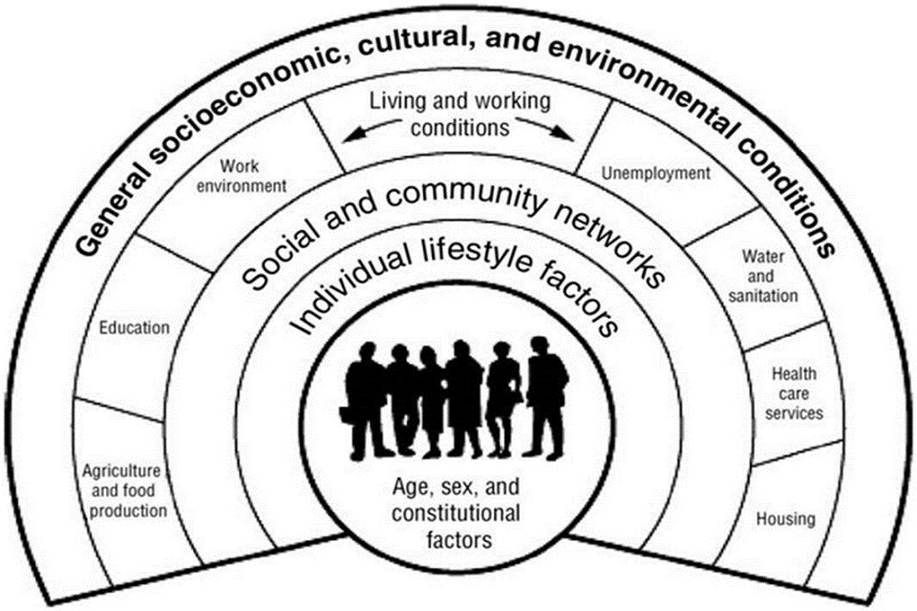
https://www.gov.uk/government/publications/health-profile-for-england/chapter-6-social-determinants-of-health
Visited 24 10 2022
(Health Profile for England, 2017, Chapter 6, Social Determinants of Health. Public Health England.
Source: Dahlgren and Whitehead (1991) (in ‘Health Profile for England’ 2017, see ref on right)

Slide 11
12 modifiable risks for dementia
Low level of education
Hypertension
Impaired hearing
Smoking
Obesity
Depression
Physical inactivity
Diabetes
Low level of social contact
Excessive alcohol consumption
Traumatic brain injury
Air pollution
Think about how politicoeconomic factors could influence the risk of dementia in a society.
Livingston G, Huntleey J, Sommerlad A et al (2020) Dementia prevention, intervention and care: 2020 report of The Lancet Commission, The Lancet , 396 (10248) 413-446.

Slide 12
Reform
Things had to get very bad before there was sufficient movement towards reform
1875- UK- Public Health Act
Similar reform activity, starting around sanitation in most industrialized countries.
Political activity pressed for better working, living and health conditions
Infectious disease declined, as did accidents, and respiratory effects of poor working conditions
UK example: free milk for children (eating and drinking)

Slide 13
Case 1 - Kamala
Re- read the case scenario, this time unpicking politicoeconomic factors.
Note actual and potential psychological problems / issues.

Slide 14
Page 1
An 84 year old woman (Kamala) was diagnosed to have cerebrovascular disease, had vascular surgery and clot removal with good recovery. Also diagnosed with Parkinson disease, and diabetes mellitus, Ischemic heart disease, and Hypertension. Medications prescribed are: Insulin, Losarten, Aspirin, Benxzeol, Levodopa.
Four months ago Kamala fell, resulting in a fractured (left) neck of the femur. She had a hip
replacement surgery, followed by rehabilitation involving walking training. She still has difficulty in
walking with shuffling gait and a tendency to fall.
One year ago she had visited her grand children in Colombo and went back home by bus against the advice of the son. She took insulin to start the trip and fell asleep in the bus and forgot to take breakfast. On the way, 150 km away from Colombo, she fell inside the bus with sweating and was admitted to a rural hospital nearby. This rural hospital found her capillary blood sugar to be LOW.
She is not able to control bladder and bowel and wears diapers on a routine basis. She needs help for personal hygiene and cleanliness.

Slide 15
Page 2
Her home is a two-story house and she lives on the ground floor. The toilet is attached but the
entrance is from outside the house.
She eats on her own taking about 45 minutes per meal and is reportedly ‘very messy’.
She has frequent fainting attacks associated with low blood sugar. She had been admitted to
Koslanda hospital several times for this. Her eating habits had been irregular prior to admission.
Kamala is a retired teacher who was very active in social work, being chairperson of the local mediation board for conflicts, being the chief “dayakaya” (servant) of the village temple, visiting the temple almost on a daily basis. The temple is on a down the hill road from home. This requires her participation in regular religious activities of the temple.
She likes to meet villagers who frequently seek her advice on almost anything in their lives, as she has been guiding them for a time. She is liked by all the villagers and neighbours, who her care whenever it is needed.

Slide 16
Page 3
Kamala lives in Koslanda 240 km away from Colombo. The Nearest hospital is at Koslanda 3 km from
home. This hospital has two medical officers and no specialist care is provided.
Her five children are living in Colombo and all are employed. They visit her on the weekend
in rotation. The children want her to stay in Colombo with her eldest daughter who is a medical
officer who could willingly take care of her.
Kamala’s husband died 10 years ago, aged 78 in Colombo while staying in his son’s home.
Kamala could not visit her husband when he was hospitalized and then passed
away. She was very upset by the incident and maintained when the times comes, she wishes to die at home.
A paid carer stays with her in the day and only occasionally at night.

Slide 17
Politicoeconomic factors influencing Kamala’s care.
You may have considered:
Costs and provision of vascular surgery and hip replacement - costs of travel
Extent of provision for an 84 year old
Costs and provision of care management and medications for hypertension, IHD and PD
Availability and costs of insulin
Provision of home assessment, - funding for potential needs- e.g. stairlift, adaptations to enable hazard-free entry to toilet withing the house.
You may have considered more ways in which politicoeconomic factors influence the care that can be provided.
The extent of care depends on the extent to which society is willing / able to provide these services, equipment and medicines.

Slide 18
Duty of care versus freedom of choice
What if your assessment is that Kamala needs daily care for her safety and wellbeing
You manage to secure provision for these needs
Kamala refuses- she wants to remain independent
What is the legal situation? Can you insist she accepts?
Coax? Persuade?
Or respect her choice.
This is a dilemma often faced in care provision- duty of care versus freedom of choice
We will re-visit this later in the course, in various contexts.
So- let’s re-visit the question – to what extent should care professionals be political? In what sense and context is a neutral stance more appropriate.

Slide 19
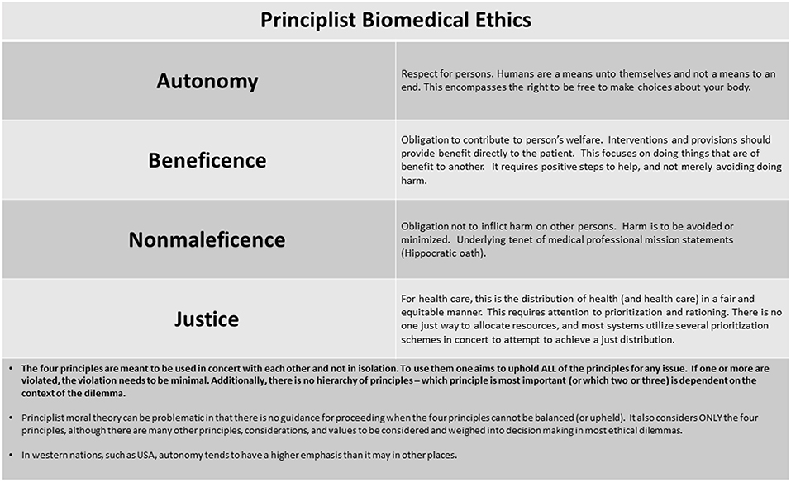

Ethical decision-making- re-visiting those duty of care v freedom of choice questions
https://www.frontiersin.org/files/Articles/476390/fped-07-00312-HTML/image_m/fped-07-00312-g001.jpg

Slide 20
Economic crisis in Sri Lanka- Impact on health and healthcare
As the Covid-19 pandemic came under control- economic crisis in Sri Lanka took hold
Health threats posed by economic crisis are multiple:
Stress, and lack of healthcare can increase cardiovascular disease.
Lack of nutrition impacts particularly on the very young, the elderly and on people with long term health conditions including NDDs.
Infectious diseases spread through increase amenity costs and impact on control measures.
Mental health is negatively impacted by political uncertainty, riots public disorder and personal debt.
Mathias A T, Jayasinghe S (2022) Worsening economic crisis in Sri Lanks: impact on health, https://www.thelancet.com/pdfs/journals/langlo/PIIS2214-109X(22)00234-0.pdf

Slide 21
Out of pocket burden of chronic disease
Logically, reduced care provision by state = greater reliance on out-of-pocket expense for personal health needs.
A European study of the out-of-pocket burden of chronic diseases (in Belgian, Czech Republic and German older adults) found that specific diseases increase the overall out-of-pocket burden, noting heart attack, hypertension, cancer, emotional disorders, rheumatoid arthritis, osteoarthritis. There are country differences: in Belgium Parkinson’s disease with the cost of medication carries a particularly high burden, whereas heart attack and chronic kidney disease feature as high in the Czech republic, and outpatient care for cancer and chronic lung disease in Germany.
The conclusion is that the out of pocket burden is not evenly distributed among older adults with chronic disease, and identifying of diseases with a high burden can help to protect vulnerable patient groups.
What is the out of pocket burden for people with NDDs in Sri Lanka? – a PhD project?
Kočiš Krůtilová V, Bahnsen L, De Graeve D. The out-of-pocket burden of chronic diseases: the cases of Belgian, Czech and German older adults. BMC Health Serv Res. 2021 Mar 17;21(1):239. doi: 10.1186/s12913-021-06259-w. PMID: 33731090; PMCID: PMC7967967.

Slide 22
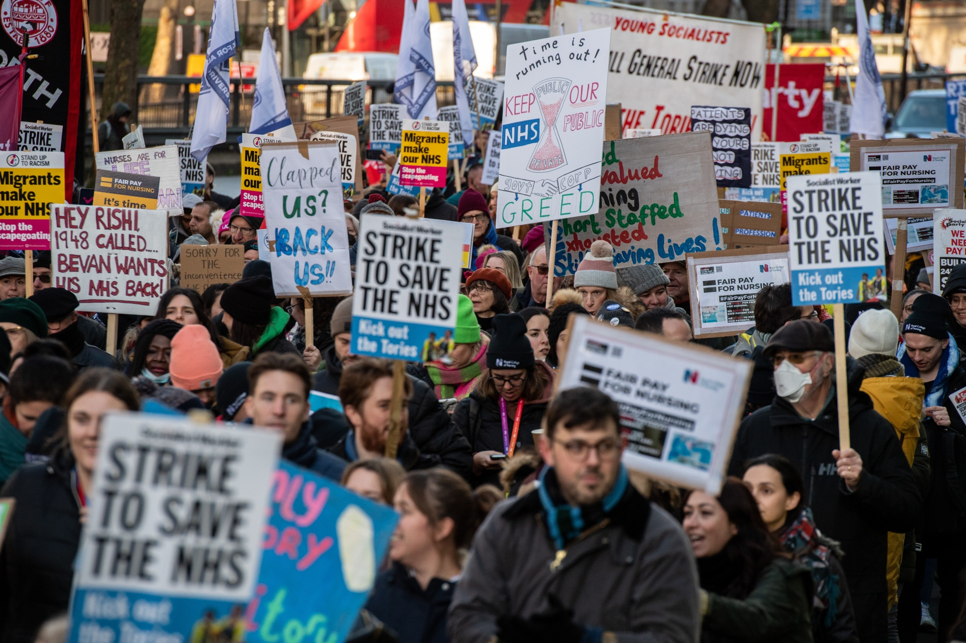
UK –Nursing and Junior Doctor strikes
Points against strikes:
  Duty to patients – Healthcare professionals have a duty of care to patients, strikes disrupt this duty, endangering wellbeing & lives of patients.
  Non-maleficence- strikes interrupt vital services delaying treatments and worsening patient outcomes.
  Professional obligations – responsibility to find alternative solutions to address concerns- e.g. dialogue, negotiations.
Points supporting strikes:
  Fairness & Justice- necessary to address unfairness in pay and working conditions, compensation for efforts and recognition of their professional value.
  Patient care / advocacy for vulnerable - understaffing compromises patient safety and care quality. Strikes draw attention to the issues urging levels that protect patients.
https://www.bloomberg.com/news/articles/2023-02-20/junior-doctors-to-strike-as-uk-health-protest-swells-to-400-000?leadSource=uverify%20wall

Slide 23
Summary
Political factors greatly influence the impact of health on individuals and the whole of society – decisions on provision and expenditure, on training of professionals, housing, education; laws on food production, smoking, reactions to pandemic; and actions of activists/ protests… etc
Politics greatly influences experiences of people with NDDs.
Economic factors do also- individual wealth, global trends, national strength of economy, tourism, manufacturing…
Ethical principles and how they are applied are closely related to law.
Professionals involved in care face difficult ethical dilemmas – e.g. to be politically neutral or to take a stand.
We do have to be politically aware.
We are concerned to maximise health and wellbeing, and independence of every patient in our care- in that sense we are apolitical.

Slide 24
References
Faris Hadad-Zervos (2022), Resilience: Sri Lanka’s strength to navigate an uncertain future, https://blogs.worldbank.org/endpovertyinsouthasia/resilience-sri-lankas-strength-navigate-uncertain-future
Visited 02 04 2023wed
United Nations News (2022) Sri Lanka’s economic crisis pushes health system to brink of collapse, https://news.un.org/en/story/2022/08/1124842
UK Government (2017) Social determinants of health, https://www.gov.uk/government/publications/health-profile-for-england/chapter-6-social-determinants-of-health
Livingston G, Huntleey J, Sommerlad A et al (2020) Dementia prevention, intervention and care: 2020 report of The Lancet Commission, The Lancet , 396 (10248) 413-446.
Mathias A T, Jayasinghe S (2022) Worsening economic crisis in Sri Lanks: impact on health, https://www.thelancet.com/pdfs/journals/langlo/PIIS2214-109X(22)00234-0.pdf
Kočiš Krůtilová V, Bahnsen L, De Graeve D. The out-of-pocket burden of chronic diseases: the cases of Belgian, Czech and German older adults. BMC Health Serv Res. 2021 Mar 17;21(1):239. doi: 10.1186/s12913-021-06259-w. PMID: 33731090; PMCID: PMC7967967.
Beauchamp, T. L., & Childress, J. F. (2001). Principles of biomedical ethics (5th ed.)
10 2022.

Slide 25

Any questions?

Slide 26

Thank you

Slide 27
Duration – 2 hours, 15 minutes
Recorded lecture time- 1 hour, 33 minutes
Activity 1 slide 9 – 5 minutes – students identifying determinants of health
Activity 2 slide 16 – students identifying politicoeconomic factors affecting Kamala’s activites of living. 15 minutes
Class discussion re Activity 2. 15 minutes
Total time for lecture: aprox 2 hours, 15 minutes.

