Slide 1
Sociocultural factors influence on people with Neurodegenerative disorders
nEUROcare
Comprehensive Care
Lecture 4

Slide 2
Learning Outcomes
To identify and consider sociocultural factors influencing living with a NDD
To organize and document assessment, planning, implementation and evaluation (and re-assessment)

Slide 3
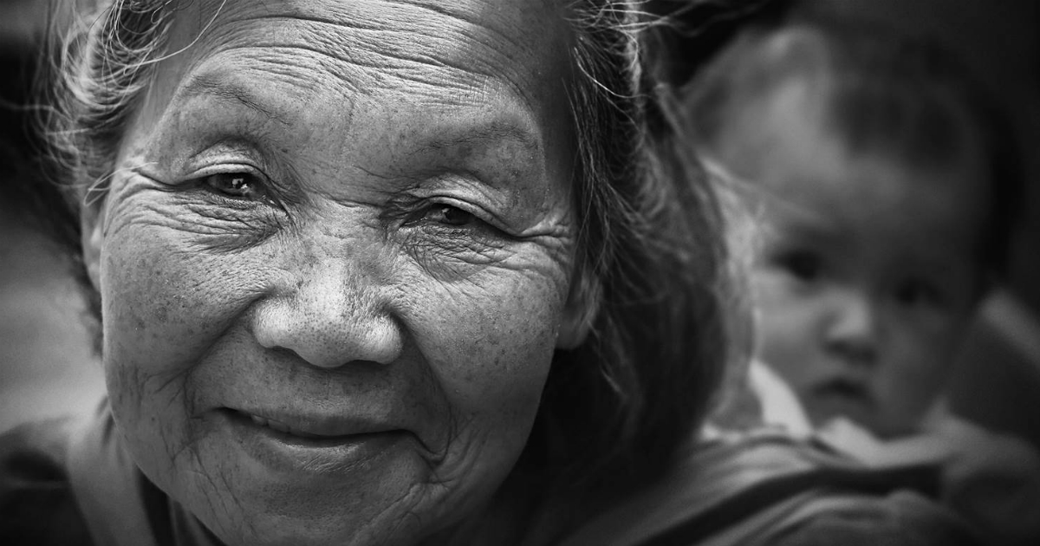
Sociocultural factors
The impact of society and culture as experienced by the individual patient.
Social expectations may be influenced by class and status
Culture relates to the beliefs and values
Expectations of individuals are altered by changes in ability to carry out activities of living
How we are viewed will be affected by e.g. beliefs about illness, and values about ageing and family roles, and our compliance or otherwise.
https://www.who.int/news-room/fact-sheets/detail/ageing-and-health

Slide 4
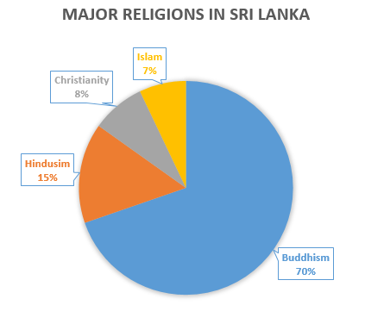
Sociocultural factors
Family – nuclear, extended
Social roles -
Cultural perspectives on -
Aging – and social / cultural attitudes to this
Carer / role model for children / Grandchildren
Retirement
Religious engagement / commitments
Community engagement / commitments
Continence
Dementia
Incapacity / Disability
Sri Lanka is regarded by the Supreme Court as a secular state -https://www.lawnet.gov.lk/wp-content/uploads/2016/11/018-SLLR-SLLR-2007-V-1-ASHIK-v.-BANDULA-AND-OTHERSNoise-Pollution-Case.pdf
https://gb-sri-lanka-buddhism.weebly.com/history.html

Slide 5
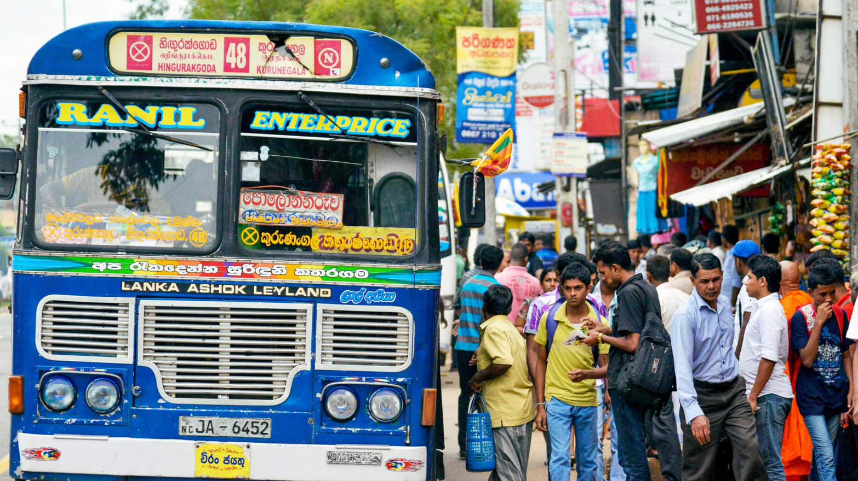
Contd…
Transport equity / Poverty restricting access to transport.
Help-seeking : weak social network; poor understanding of warning signs by families; negative attitudes to old-age culture; crisis of personal perspectives in help-seeking.
Social stigma
Caregiver burden
https://www.thedailybeast.com/my-crazy-death-defying-sri-lankan-bus-journey

Slide 6
Sociocultural perspectives
Varuni Tennakoon, Janine Wiles, Roshini Peiris-John, Rajitha Wickremasinghe, Bridget Kool, Shanthi Ameratunga, Transport equity in Sri Lanka: Experiences linked to disability and older age, (2020) Journal of Transport & Health, 18, 100913,ISSN 2214-1405, https://doi.org/10.1016/j.jth.2020.100913. https://www.sciencedirect.com/science/article/pii/S2214140520301171)
Transport- a well-known determinant of health
Salient to wellbeing and health outcomes among older people and people with disabilities.
Focus groups identified barriers as poor road systems and public vehicles, lack of representation in road development programmes, reduced opportunities for meaningful participation in society, negative public attitudes re ageing and disability, poverty restricting access to transport.

Slide 7
Attitudes to aging
Abuse against older adults in Sri Lanka is identified as a pressing problem. Maduwage S. Situational Overview of Elder Abuse in Sri Lanka. International Handbook of Elder Abuse and Mistreatment. Singapore: Springer; 2020. pp. 427–437.
Understanding suicide in elderly people in Sri Lanka may shed light:
Warning indicators of suicide in elders: angry outbursts, sleep disturbance, isolation, thoughts of meaningless life. Talking about death or suicide is a very rare indicator. Families usually unaware of signs.
Help-seeking is limited by: weak social network; poor understanding of warning signs by families; negative attitudes to old-age culture; crisis of personal perspectives in help-seeking.
Promoting mental health services and help-seeking, would reduce suicide in older people.
Rasanayake S, Navratil P (2023- in progress) Warning signs of elderly suicide and factors affecting professional help-seeking: case of Sri Lanka, Jn Population and Social Studies, 31, https://so03.tci-thaijo.org/index.php/jpss/article/view/255910

Slide 8
Caregivers
Positive perceptions of caregivers can be better cultivated when caring is lauded as a virtuous act that aids in reducing the care deficit.
A 2021 global study (20 countries) found that while perceptions of caregivers in Bangladesh was most positive, those of Sri Lanka were most negative.
This highlights the importance of culture as an influencing factor rather than geographic region (Ghana is second most positive and Tanzania is second most negative).

Slide 9
In Bangladesh families provide most, nurses provide very little hands-on care. Culture & religious norms dissuade nurses (mostly female) in Bangladesh from intimate patient contact, especially with men.
Despite a ‘strong intergenerational care system’ in Sri Lanka, emotional or verbal abuse and neglect are reported as common. Multiple reports of discrimination against caregivers for people with mental illness are said to be linked to ‘courtesy stigma’, where prejudice against people with mental illness is extended to their caregivers.
Maduwage S. Situational Overview of Elder Abuse in Sri Lanka. International Handbook of Elder Abuse and Mistreatment. Singapore: Springer; 2020. pp. 427–437. https://doi.org/10.1007/978-981-13-8610-7_24
Ng R, Indran N (2021) Societal perceptions of caregivers linked to culture across 20 countries: Evidence from a 10-billion-word database. PLoS ONE 16(7): e0251161. https://doi.org/10.1371/journal.pone.0251161
Watt MH, Perera B, Østbye T, Ranabahu S, Rajapakse H, Maselko J. Caregiving expectations and challenges among elders and their adult children in Southern Sri Lanka. Ageing Soc. 2014;34: 838–858. pmid:25152553
Fernando SM, Deane FP, McLeod HJ, Davis EL. A carer burden and stigma in schizophrenia and affective disorders: Experiences from Sri Lanka. Asian J Psychiatry. 2017;26: 77–81. pmid:28483097

Slide 10
Case Scenario
Read the case scenario again unpicking the sociocultural factors.
Note actual and potential sociocultural problems / issues.

Slide 11
An 84 year old woman (Kamala) was diagnosed with cerebrovascular disease, had vascular surgery and clot removal with good recovery.
She was also diagnosed with Parkinson disease, Diabetes Mellitus, Ischemic Heart Disease, and Hypertension.
She was on multiple medications including Insulin, Losarten, Aspirin, Benxzeol, Levodopa.
Four months back she has had a fall with fracture neck of the femur on left side. She had a hip
replacement surgery, rehabilitation and walking training following surgery. She still has difficulty in walking with shuffling gait and a tendency to fall.

Slide 12
One year back she had visited her grand children in Colombo and went back home by bus against the advice of the son. She took insulin to start the trip and fell asleep in the bus and forgot to take the breakfast. On the way, 150 km away from Colombo, she fell inside the bus with sweating and was admitted to a rural hospital nearby. This rural hospital found her capillary blood sugar to be LOW on the glucometer.
She is not able to control bladder and bowel and wears diapers on a routine basis. She needs help for personal hygiene and cleanliness.
The house is a two story house and she lived on the ground floor. The toilet is attached but the entrance is from outside the house.
She could eat on her own taking a long time about 45 minutes per meal and is very messy at meals.
She has regular fainting attacks with low blood sugar time to time. She had been admitted to Koslanda hospital several times for this. Her eating habits had been irregular.

Slide 13
Kamala is a retired teacher who was very active in social work, being chairperson of the local mediation board for conflicts, being the chief “dayakaya” (servant) of the village temple, visiting temple almost on a daily basis. The temple is on a down the hill road from home. This also requires her participation in regular religious activities of the temple.
She likes to meet villagers who frequently seeks her advice on almost anything in their lives, as she is a retired teacher who had been guiding them for a long period of time. She is liked by all the villagers and neighbours, who would support her care whenever it is needed.
She lives in Koslanda 240 km away from Colombo. Nearest hospital is at Koslanda 3 km away from home. This hospital has two medical officers and no specialist care is provided.

Slide 14
Her five children are living in Colombo and all are employed. They visit her on the weekend in rotation. They all want her to stay in Colombo with her eldest daughter who is a medical officer who could willingly take care of her.
Her husband died 10 years back at the age of 78 years in Colombo while staying in his son’s place.
She could not visit her husband when he was hospitalized during a brief serious illness and passed away. She did not like that incident and maintained that when her time comes, she wants to die at home.
There is a paid carer living /staying with her on a monthly salary, who generally stays on weekdays, but occasionally visits her home leaving the Kamala alone at the night.

Slide 15
Potential sociocultural issues for Kamala
She is 84 – potentially not expected to enjoy independence?
Difficulty walking, past hip # and PD gait – seen as unsafe to be out alone?
Multiple diagnoses and a history of failing to manage e.g. diabetes – seen as unable to make safe and reasonable choices?
Cannot eat unaided.
Doubly incontinent, poor hygiene – stigma? Seen by herself as burdensome?
House seen as unsafe and too far from family – must move to Columbo?
No longer can teach, nor care for or be a role model for children –
No part to play in community, religious community - what is her social value?

Slide 16
Is there another way to phrase the issues?
Difficulty walking, past hip # and PD gait – Support and company will help to continue maximising independence
Multiple diagnoses and managing e.g. diabetes unaided can sometimes be difficult – support to continue self-management will also foster a safe level of independence.
With support, manages eating, washing, dressing and continence.
She is 84 – many years of experience to share and be valued. Family and community need this involvement.

Slide 17
Summary
Social expectations and beliefs and values will affect how we view the standing of someone who is ageing and losing ability to carry out Als.
Professionals should work with the person and family to help emphasise what s/he can do, over lost abilities, and how support can help to maximise independence.
Language influences how people and situations are viewed – always look for a positive view on negative statements.
This can change negative attitudes and behaviours prevalent in society and culture.

Slide 18
Scenario
Priya, community nurse, visits Mr. Silva, and elderly man with PD, and his family, Mrs. Silva and son, Ramesh, in their rural village home. Priya begins discussing a care plan she has prepared. This includes exercises and use of mobility aids. However, she notices Mrs. Silva seems hesitant and Ramesh seems reluctant to discuss the suggestions. Priya politely asks if there is a specific concern or issue they would like to share. Mrs. Silva hesitates but eventually explains that the family hold strong cultural beliefs regarding the elderly and traditional healing practices. They have sought the advice of local traditional healers and are concerned about the potential conflicts between modern medical approaches and traditional medicine. Priya listens actively and expresses understanding of their concerns. She emphasises her wish to respect the family’s cultural beliefs and values in providing effective care. She explains that she is open to integrating traditional remedies and practices into Mr Silva’s care plan to align with their preferences, so long as it doesn’t compromise his safety or wellbeing. Mrs. Silva and Ramesh express relief and gratitude and tell Priya they are willing to collaborate with such a plan.
Could you summarise Priya’s modified plan regarding this sociocultural issue, concisely stating the problem, goal and interventions with rationale?
Problem | Goal | Intervention | Evaluation

Slide 19
Scenario – my attempt- you may do better!...
Problem | Goal | Intervention (rationale) | Evaluation
The family of Mr Silva expressed unease with a proposed care plan due to fears their strong cultural beliefs and preference for traditional healing practices may conflict with a modern medicine approach to care. | To develop a modified care plan that integrates traditional remedies and practices with modern medicine interventions to provide holistic care for Mr Silva, respecting family’s cultural beliefs while addressing Mr Silva’s health needs. | Involve a local traditional healer in the care team to coordinate with Priya. (this will help foster trust, and acknowledge family beliefs). Incorporate traditional remedies alongside evidence-based nursing (and medical) interventions. (This will help accommodate family preferences, respecting cultural practices). Maintain regular communicating and collaboration. Keep an open dialogue between Priya, the traditional healer, Mr Silva and his family. (This should help ensure a shared understanding and cooperation among all the team members, allowing for adjustments and modifications to the care plan as needed. | Priya will discuss the plan with the family and local traditional healer and agree and document how frequently they will meet to review the plan and implement modifications as jointly agreed.

Slide 20
References
Maduwage S. Situational Overview of Elder Abuse in Sri Lanka. International Handbook of Elder Abuse and
Mistreatment. Singapore: Springer; 2020. pp. 427–437. https://doi.org/10.1007/978-981-13-8610-7_24
Ng R, Indran N (2021) Societal perceptions of caregivers linked to culture across 20 countries: Evidence from a 10-billion-word database. PLoS ONE 16(7): e0251161. https://doi.org/10.1371/journal.pone.0251161
Watt MH, Perera B, Østbye T, Ranabahu S, Rajapakse H, Maselko J. Caregiving expectations and challenges among elders and their adult children in Southern Sri Lanka. Ageing Soc. 2014;34: 838–858. pmid:25152553
Fernando SM, Deane FP, McLeod HJ, Davis EL. A carer burden and stigma in schizophrenia and affective disorders: Experiences from Sri Lanka. Asian J Psychiatry. 2017;26: 77–81. pmid:28483097
Varuni Tennakoon, Janine Wiles, Roshini Peiris-John, Rajitha Wickremasinghe, Bridget Kool, Shanthi Ameratunga, Transport equity in Sri Lanka: Experiences linked to disability and older age, (2020) Journal of Transport & Health, 18, 100913,ISSN 2214-1405, https://doi.org/10.1016/j.jth.2020.100913. https://www.sciencedirect.com/science/article/pii/S2214140520301171)
Ashil V Bandula and others (2007) https://www.lawnet.gov.lk/wp-content/uploads/2016/11/018-SLLR-SLLR-2007-V-1-ASHIK-v.-BANDULA-AND-OTHERSNoise-Pollution-Case.pdf

Slide 21

Any questions?

Slide 22

Thank you

Slide 23
Duration – 2 hours
Lecture – 1hour
Activity 1 as outlined in slide 4- 5 mins, plus 5 mins class discussion = 10 mins.
Activity 2 as outlined in slide 18- 20 mins, plus 20 mins discussion = 40 mins
Questions and final class discussion – 10 mins.
Total= 2 hours

