Slide 1
Comprehensive Care
Lecture 22
Leading and managing a neurocare team, and change in NDD Care

Slide 2
Aims
To understand how to lead and manage change regarding care for people with NDDs
Content:
Reflective practice
Models of reflection
Barriers to change
Models of change
Making things happen
Retaining the team – generally and specifically for neurocare

Slide 3

Reviewing the experience of your course
As you near completion of your course, it’s time to reflect
It is pointless completing a specialist nEUROcare course, if your practice doesn’t change, and if that of your colleagues doesn’t change; and if QoL for people with NDDs in your care doesn’t improve.
That raises lots difficult questions such as –
What was the experience?
What did you learn?
What should stay the same?
What should change?
How can you influence, initiate, and manage change?
https://www.effectivepractitioner.nes.scot.nhs.uk/evidence,-research-and-development/reviewing-and-assessing-practice.aspx

Slide 4

Why review?
It would be terrible to make things change without a good reflection on such things as:
What was my reason for doing the course?
Was it me or someone else who felt I needed to learn more about care for people with NDDs? For what reason?
Was there something wrong or inadequate about current care provision for people with NDDs? What needed to be addressed?
Was it addressed? Do I now know how to implement what needs to happen?
Do I have the skills and resources to make it happen?
What would help me to improve care for people with NDDs?
What barriers would make change difficult?
How would I overcome those barriers?
https://www.wolterskluwer.com/en/solutions/lippincott-solutions/lippincott-blended-learning

Slide 5
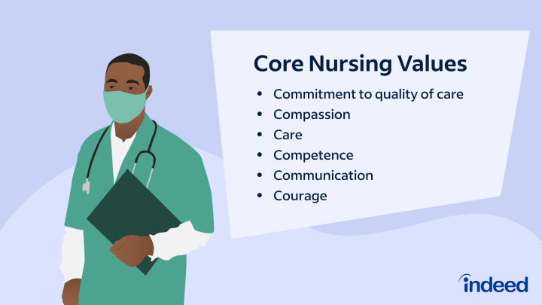
What should stay the same? Activity 1 – 10 minutes
In small groups or pairs, agree a list of what in your current practice areas exists and must be maintained… i.e., things that should not change.
Examples might (or might not) include:-
No doubt where you work there is excellent practice
Professionalism
Safety
Committed care for all patients including people with NDDs
Care for families
Good working relationships between professions
Sharing of knowledge, skills and understanding of values
https://www.indeed.com/career-advice/career-development/nursing-values

Slide 6

What should change? Activity 2 – 10 minutes (followed by 20 minutes tutor-led discussion on activities 1&2)
In small groups or pairs, agree a list of what in your current practice areas does not currently exist and must be introduced; or what needs to be improved or changed, in the light of what you have learned on this course.
Examples might (or might not) include:-
More integrated team-working
More patient / family involvement in clinical decision-making
Greater regard for patient choice.
A more structured approach to risk management
https://nursing-informatics.com/changemant.html

Slide 7
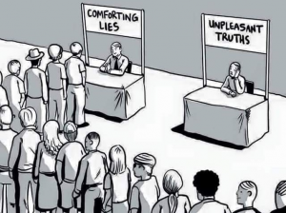
Reflective practice
Reflection on and in practice is an integral part of nursing (Mahon & O’Neil, 2020) [and relates to all healthcare professionals]
Unconscious biases limit our ability to learn from reflection – that is more reason to critically engage with the process.
None of us know what we don’t know; the unconsciously incompetent don’t know what they don’t know, plus they don’t have insight to realise it.
Hence they tend to overrate their performance while those who perform well assume others do too, and underrate theirs (Kruger & Dunning 1999).
So, those most likely to benefit from reflection in practice are least likely to be able to do so effectively (Pennycook et al 2017).
https://spielverlagerung.com/2018/03/07/what-is-reflective-practice/

Slide 8
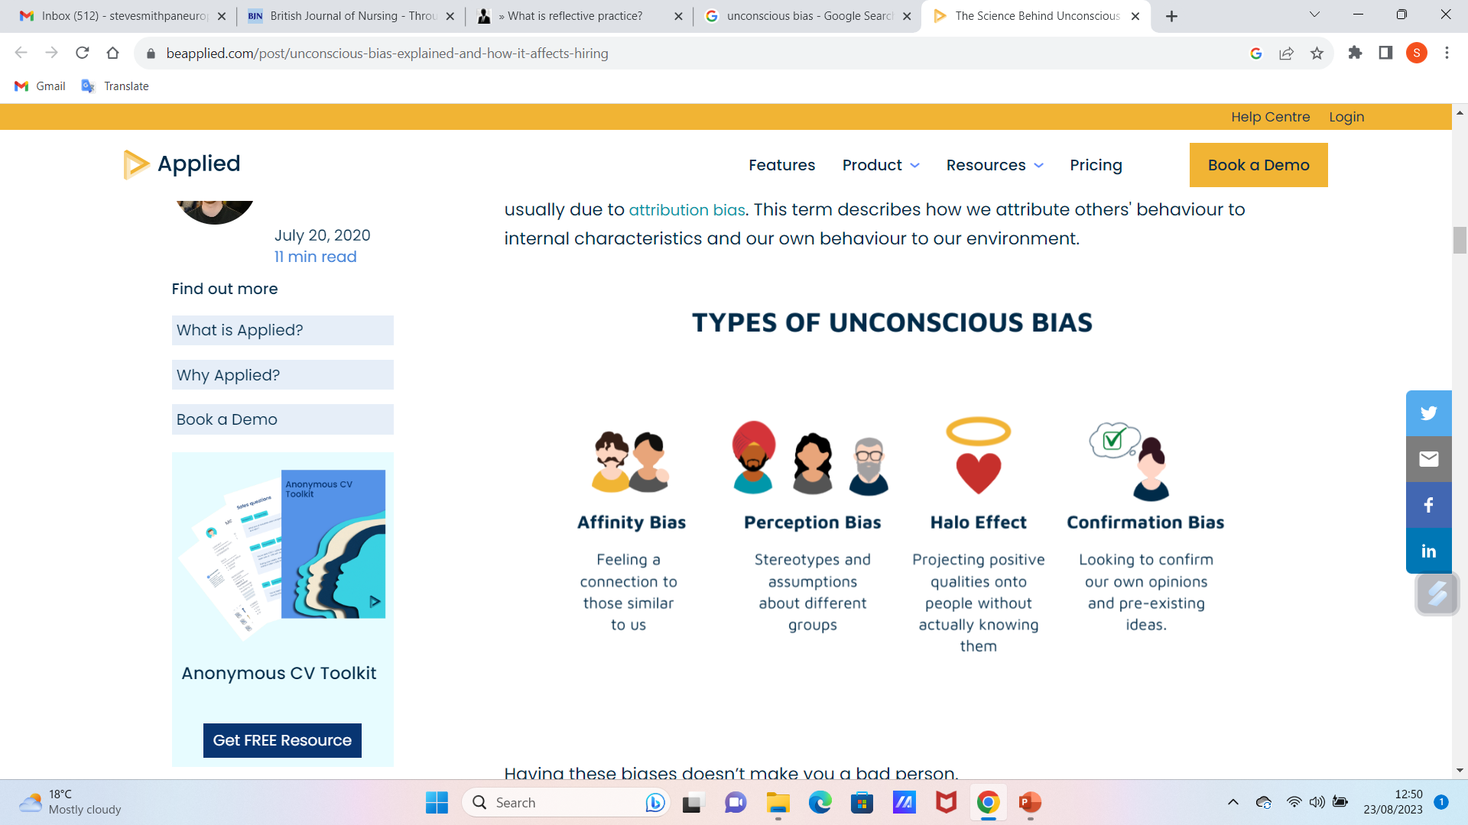
Reflective Practice
So- when reflecting, we must bear in mind:
Human minds have weaknesses- memories of past events fail us; interpretations are clouded; we have biases.
Cognitive biases we are unaware of are our unconscious biases. These limit ability to think and reflect objectively.
If our biases begin to become evident we can be hampered by defensiveness and scepticism (Shultz & Baker 2017) due to a need to harmonise between our attitudes and behaviour (cognitive consistency) and to avoid disharmony (cognitive dissonance) (Festinger 1957).
https://www.beapplied.com/post/unconscious-bias-explained-and-how-it-affects-hiring

Slide 9
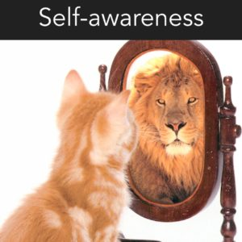
Reflective Practice
Caution then, is necessary. Reflective practice can lose its way, and become an academic chore – models restricting rather than enriching thinking (Coward 2011).
Between the ‘comforting lies we tell ourselves', and the ‘unpleasant truths we may prefer to ignore’, we will find the liminal space of accurate, but balanced, self-assessment… …where we are neither overconfident nor driven to despair…it offers self-insight and growth potential…a safe space …to balance our biases, rather than berating ourselves for having them (Karpen, 2018), … where we can foster fresh approaches to learning in, and from, practice.
https://emergingrnleader.com/self-awareness-in-leadership/

Slide 10
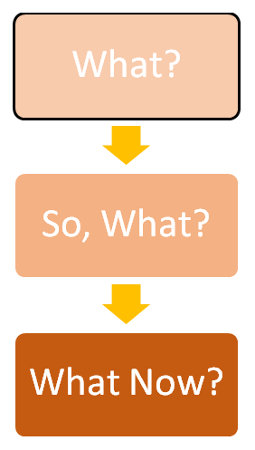
Models of Reflective Practice Jones G (2023)What is reflective practice? https://spielverlagerung.com/2018/03/07/what-is-reflective-practice/
Driscoll (2000)
What?
Describe what has happened?
What are the facts of the situation?
So, What?
Why is this an important issue to reflect upon?
What does it suggest?
What Now?
What would you do differently?
How will this affect your future practice?
My personal comment:
Good for a specific issue
Not so good for broader consideration of general approaches

Slide 11
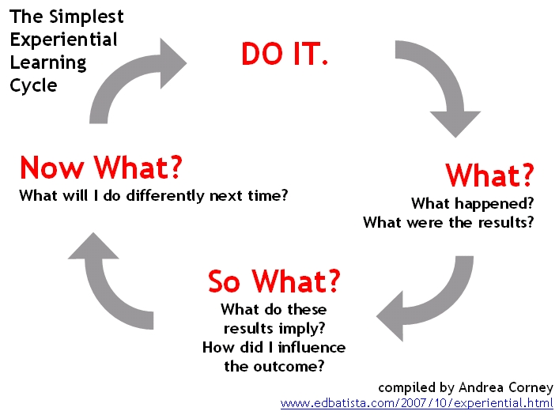
Models of Reflective Practice Jones G (2023)What is reflective practice? https://spielverlagerung.com/2018/03/07/what-is-reflective-practice/
Kolb (1984)
Kolb believed that there were four stages to effective learning and these are as follows:
Concrete Experience: Where a new experience or situation is encountered, or an existing experience is reinterpreted.
Reflective Observation of the new experience: The understanding of the importance of any inconsistencies between the experience and prior understanding.
Abstract Conceptualising: The reflection then gives way to new idea, or a new understanding of a previously abstract idea.
Active Experimentation: The learner applies them to the world around them to see what results occur.
It’s important to note that Kolb sees all four stages as an integrative process where each stage mutually supports the next one.
My comment:
A structured approach to learning through acquiring concepts, that can be applied then to new situations.
We need to reflect on long-standing situations.

Slide 12
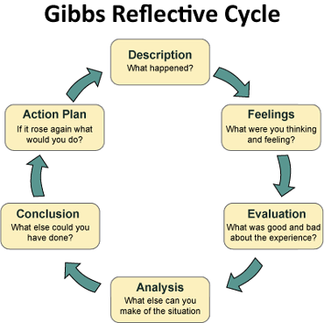
Models of Reflective Practice Jones G (2023)What is reflective practice? https://spielverlagerung.com/2018/03/07/what-is-reflective-practice/
Gibbs (1988)
What went well during the experience?
What went badly during the experience?
How did the experience end, and was it a complete (resolution) or incomplete experience?
What should or could I have done differently?
What stopped me from doing this?
What did I learn about myself from this experience?
What did I learn about my current knowledge and understanding?
Did the experience meet my learning goals?
My Comment:
More space for critical analysis; could lead to a clear action plan; will accommodate reflection on long-standing circumstances.
Great to separate feelings from what happened- the objective and the subjective.
Not so helpful for a quick – in the moment – change of approach (reflection IN action as opposed to ON action – Schon 1991)

Slide 13
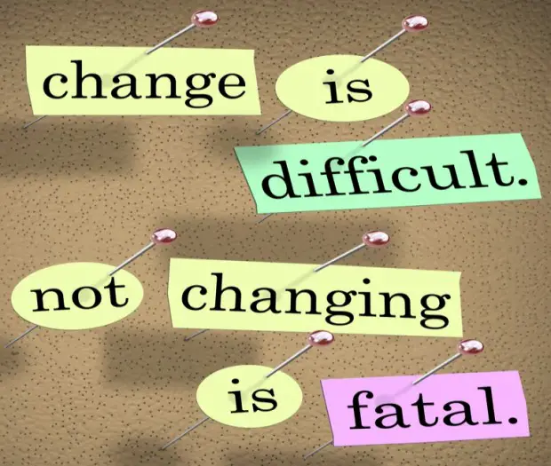
Making change happen
If, following reflection, you see a need for change, before trying to implement the change you need to consider:
Implementing change can be difficult. Not everyone sees the need you have seen. You should expect to encounter barriers – anticipate and consider how you will overcome them.
There are organisational barriers – structures may not easily allow for change; lack of management buy-in; hierarchy; committees…
There are personal barriers – resistance generally to change; lip service; ideas and expectations / traditions about who is accepted as a change instigator; people are too busy
Problems with presenting the need for change and the plan. Lack of clarity; poor communicating strategy; too many projects at once…
https://smallbiztrends.com/2013/09/implementing-change-programs.html#google_vignette

Slide 14
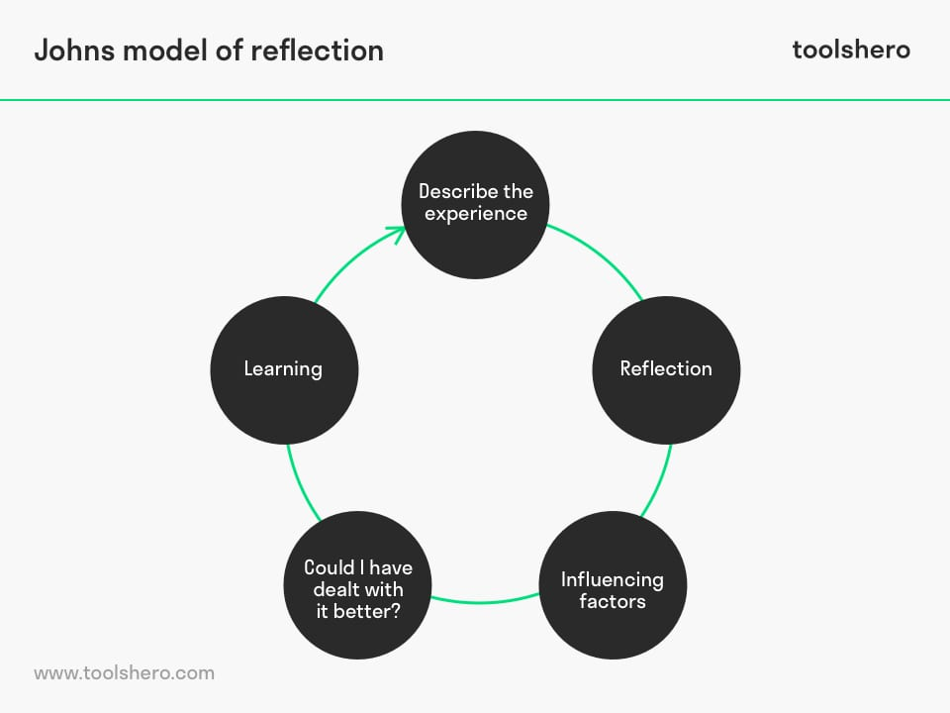
Models of Reflective Practice Johns (2000)
Phase 1: describe the experience- Phenomenon -Describe the experience you’re feeling and living right now.
Causal - What essential factors contributed to this experience?
Context- What significant background factors belong to this experience?
Explain- What are the key processes for reflection during this experience?
Phase 2: reflection
The second phase is about the reflection itself.
What am I trying to achieve? Why did I approach this the way I did?
What were the consequences of my actions for me?
What were the consequences of my actions for the patient/ family?
What were the consequences of my actions for the people I work with?
How did I feel during this experience? How did others feel?
How do I know how others felt during this experience?

Slide 15
Models of Reflective Practice Johns (2000)
Phase 5: learning
The fifth phase is about learning from areas for improvement as identified in the previous phase.
What will change because of this experience?
How do I feel about my experience now?
Does this situation have to do with past situations?
What would have been a better approach?
What are the consequences of alternatives choices I’ve made for patients? For others and me?
How approachable and available am I to better help my patients and colleagues?
How has this experience changed my knowledge?
Phase 3: influencing factors
The third phase revolves around the factors that influenced the situation as it occurred.
What internal factors influenced my decision making?
What external factors influenced my decision making ?
What sources of knowledge were available?
What sources could I have consulted?
What sources and information would have impacted my choice?
Phase 4: what could I have done better
The fourth phase concerns identifying improvement areas for the situation as it occurred. What other options did I have?
What consequences are involved in the other options?
Have I considered all options? Have I selected the best option?
My comment-
Greater space for considering both internal and external factors.

Slide 16
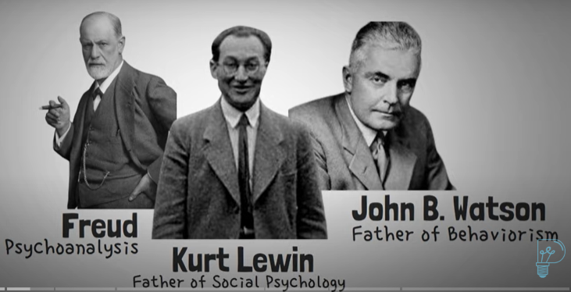
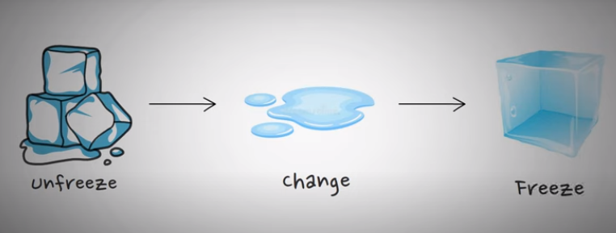
Models of change Lewin, K. (1951) Field Theory in Social Science: Selected Theoretical Papers (ed. Cartwright, D.). Harper & Row, New York.
Lewin’s Change model is probably the most influential in healthcare.
3 stages: Unfreezing, Changing, Refreezing
Individuals and organisations are influenced by forces that maintain the status quo, and those that drive change.
Stage 1 aim- create awareness of need for change and willingness to embrace it. Challenge set beliefs and practices, gain acknowledgement of problem/s. Involves education, illuminating barriers, answering rebuffs (‘that’s been tried’ ‘our hands are tied’ and so on.
Born 1890, Died 1947-heart failure.
Most cited Psychologist.
German- American.

Slide 17
Models of change Lewin, K. (1951) Field Theory in Social Science: Selected Theoretical Papers (ed. Cartwright, D.). Harper & Row, New York.
Stage 2 - Thought-showering; everybody on board; explore alternatives and likely outcomes; gain buy-in to the change- document opportunities provided to object, only with everyone’s approval –(not only on the change but how it will be introduced, what will happen when obstacles are met)- implement change.
Stage 3 – Reinforce the change as the new normal; provide training; incorporate a system of evaluation and refining; celebrate successes; events to promote/ present the way of working.

Slide 18
Change implementation – Activity 3 – 20 minutes
Allow 20 minutes for this activity in pairs or small groups:
Nipuni is a ward nurse who finds that discharge planning tends to be directed by physicians. Even when patients and a family caregiver are invited to a multi-disciplinary meeting to agree the plan, they find it difficult to speak up about their needs. Nipuni wants the team to recognise this as a problem, and then agree a change that will make it easier for patient and family perspectives to be heard and considered. But currently she feels the professionals involved are happy with the status quo.
How, drawing on Lewin’s model of change, could Nipuni effectively set about achieving agreement among the team about implementing change?

Slide 19
Tutor-led discussion – further 20 minutes
Each pair / group feed back to the class, and tutor leads discussion of the change plans emerging from activity 3.
Then move on to consider my attempt (on the following slides) – discuss whether I have thought of points the group had not considered, and whether the group came up with useful suggestions I had not come up with.

Slide 20
Change plan – my attempt 1
1. Unfreeze Stage: Nipuni needs to create awareness and motivation for change by highlighting the current issues with the discharge planning process and its impact on patient and family engagement. To do this:
Gather Data: Nipuni needs to collect data that supports the need for change. This could include patient feedback, case studies, and research showing the benefits of involving patients and families in discharge planning.
Create a Sense of Urgency: Present the data to the team and emphasize the importance of patient-centred care. Illustrate how involving patients and families in the planning process can lead to better outcomes and increased satisfaction.
Address Concerns: Acknowledge and address any resistance from team members who are content with the status quo. Engage in open discussions to understand their perspectives and concerns.

Slide 21
Change plan – my attempt 2
Transition Stage: In this stage, Nipuni will introduce the change and facilitate its adoption among the team members. Here's how she can proceed:
Engage the Team: Organize meetings or workshops where team members can share their experiences and thoughts on the current discharge planning process. Encourage open dialogue and active participation.
Share Success Stories: Present real-life examples of situations where involving patients and families in the planning process led to better outcomes. Highlight the positive impact on patient satisfaction, adherence to treatment plans, and reduced readmissions.
Involve Key Stakeholders: Identify influential team members who can support the change. Their buy-in and endorsement will help influence their peers.

Slide 22
Change plan – my attempt 3
Refreeze Stage:
Once the team is open to the idea of change, Nipuni needs to solidify the new approach as the norm. This involves:
Develop a Shared Vision: Work with the team to co-create a vision for the new discharge planning process that includes active patient and family involvement. Ensure that the vision aligns with the team's values and goals.
Define Roles and Responsibilities: Clarify the roles and responsibilities of each team member in implementing the change. Ensure that everyone understands their part in making patient and family perspectives heard.
Pilot and Feedback: Implement the new approach on a small scale initially. Gather feedback from patients, families, and team members about their experiences and any challenges faced during the process. Use this feedback to refine the approach.
Celebrate Progress: Recognize and celebrate achievements along the way. Highlight instances where patients and families were successfully engaged and their perspectives were considered.

Slide 23
Change plan – my attempt 4
Throughout the entire process, Nipuni should maintain open lines of communication, be receptive to feedback, and address any concerns that arise. Remember that change takes time, and it's important to continuously monitor progress, adapt the approach if needed, and sustain the momentum for the new way of working. By following these steps, Nipuni can effectively guide her team toward agreeing on and implementing the change to improve patient and family engagement in discharge planning.

Slide 24
Reflection Activity 4 - 20 minutes
Now- Let's imagine Nipuni implements this and generally it works well, but she finds that a couple of strong personalities in the team are not quite convinced and seem to pay lip-service to this change at times. She wants to avoid being confrontational but wants to win them around so that they become happy to implement the change, and wants to avoid them negatively influencing other team members. Using Gibbs reflective model, could you in pairs or small groups come up with a reflection Nipuni might write in this case?

Slide 25
Tutor-led discussion – further 20 minutes
Each pair / group feed back to the class, and tutor leads discussion of the reflections emerging from activity 4.
Then move on to consider my attempt (on the following slides) – discuss whether I have thought of points the group had not considered, and whether the group came up with useful suggestions I had not come up with.

Slide 26
My attempt 1
Gibbs Reflective Model: Reflection on Influencing Team Members
Description: During the implementation of the new patient and family engagement approach in discharge planning, I observed that a couple of strong personalities on the team were not entirely convinced about the change. Despite the overall positive outcomes and progress, these team members seemed to only partially embrace the change and sometimes displayed a lack of enthusiasm. This situation led me to reflect on my approach to engaging them more effectively.
Feelings: I initially felt a bit frustrated and concerned that these team members' lack of complete buy-in might impact the success of the change initiative. I was also worried that their reservations could potentially influence other team members and undermine the progress we've made so far.

Slide 27
My attempt 2
Evaluation: Upon reviewing the situation, I realized that my approach to engaging these team members might need adjustment. While the majority of the team has embraced the change and its benefits, it's crucial to address any lingering doubts to ensure the entire team is on board. I recognized the importance of finding a way to win over these strong personalities without being confrontational.
Analysis: Considering their reluctance, I realized that they might have concerns or questions that haven't been fully addressed. It's possible that they need more personalized attention to understand the benefits of the change for both patient outcomes and their own work experiences. Moreover, their skepticism might stem from their previous experiences or deeply ingrained habits.
Conclusion: To ensure the success of the change initiative and maintain a harmonious team environment, I need to find a way to engage these team members more effectively. I must approach them with empathy and open-mindedness to understand their perspectives and concerns. By addressing their doubts and actively involving them in the decision-making process, I can foster a sense of ownership and encourage their commitment to the change.

Slide 28
My attempt 3
Action Plan:
Individual Discussions: Arrange one-on-one conversations with each of these team members. Provide a safe space for them to express their reservations and concerns openly.
Customized Information: Tailor the information and examples to address their specific concerns and highlight how the change aligns with their values and goals.
Collaborative Problem-Solving: Collaborate with them to find solutions to any challenges they foresee in implementing the change. This will empower them and demonstrate that their input is valued.
Regular Check-ins: Maintain regular communication with them to track their progress, address any ongoing concerns, and celebrate their successes.
Positive Reinforcement: Recognize and celebrate their efforts and contributions to the change initiative, which can boost their motivation and confidence.
By following this action plan, I aim to effectively engage these team members, overcome their reservations, and ultimately create a unified team that embraces the change and its positive impacts on patient care and outcomes.

Slide 29
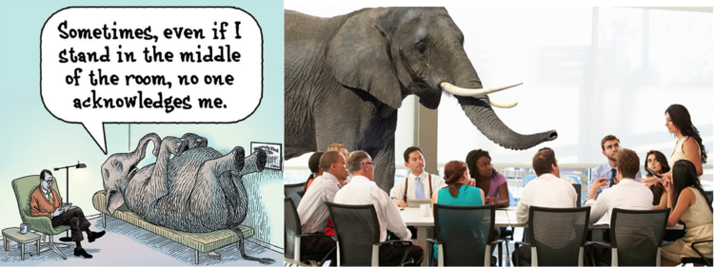
Elephant in the room – Retention
Some principles for addressing an elephant in the room:
Assume ability / willingness to change. Many suffer in silence because they don’t believe they’ll be listened to or that people or institutions may be willing to change. Raise the issue and give them a chance to change…
Get clear about what you really want. Check what you’re about to say is rational and not defensive – it often happens when emotions run high.
Set your argument in context: Avoid what you’re about to say being perceived as an ambush. Start with what’s good about how things are, and clarify in positive terms what you’re trying to achieve- acknowledge that everyone is working to be efficient, effective etc, and that you are aiming to support their good efforts.
Be objective, not subjective – stick to what happened, not your interpretation of it. (That said, you can then if appropriate, explain how this felt to you, acknowledging this is subjective). E.g. – instead of opening with ‘management regard me as incompetent’ how about – I was instructed by management not to discuss end of life issues with patients and families, but to refer such matters to a senior clinician in future. This made me feel as if management believe me to lack the competence to do this. There may be another explanation that I’d be grateful to understand.
Agree an action plan – if you managed to speak up and this was well-received, things will quickly slip back to the same situation unless you agree an action plan clarifying things that will happen next to ensure change is achieved and adhered to.
Robb G (2022) https://www.gra.uk.com/blog/5-crucial-tips-for-addressing-the-elephant-in-the-room
https://www.lbcoaching.co.za/surfacing-the-elephant-in-the-room/
Let’s talk about retention but while on the subject – how do we make it ok to discuss the elephant in the room?
A few potential examples:
An overbearing team member, maybe senior, maybe not – what they say no one dares disagree, point out their error or ask for explanation.
In discussions with families – end of life planning.
Staff burnout
Gender bias / other prejudices, bullying

Slide 30
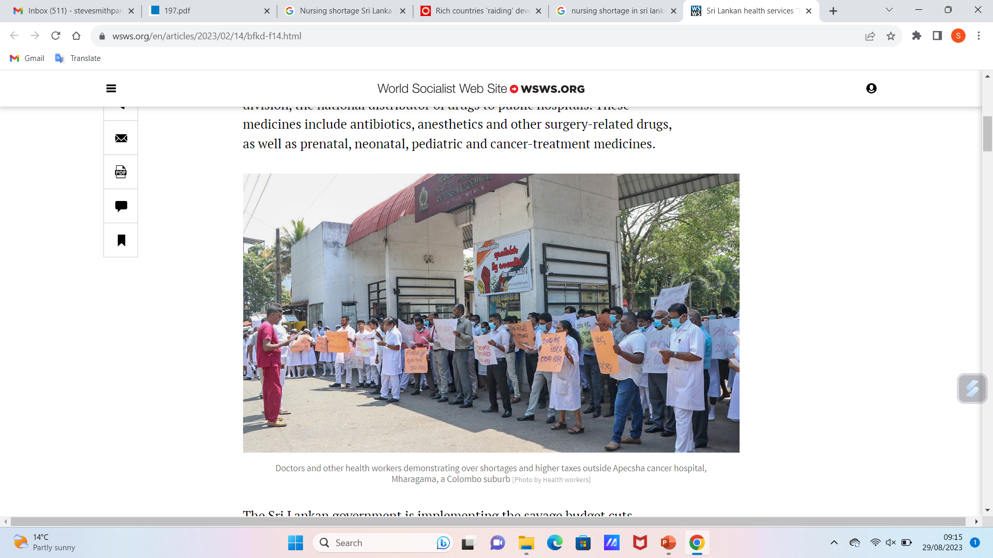
Retaining nEUROcare professionals
Nursing shortages are common worldwide. They make up the greatest proportion of healthcare professionals, and give most direct patient care Kumari Shammika Senani Mudihanselage Hellerawa, De Alwis Chamaru Adambarage (2015).
An exploratory study (self-administered questionnaire, randomly recruited nursing officers (N=93 returned of 100 selected) at Polonnaruwa District Hospital (North Central Province of Sri Lanka) found a positive relationship between nursing shortage and workload, also between workload and quality of patient care.
Ability of nurses to manage emotions of self and others mitigates stress among nurses. i.e. nurse’s emotional intelligence is a partly modifying variable for job outcome for nurses.
Doctors and other health workers demonstrating over shortages and higher taxes outside Apecsha cancer hospital, Mharagama, a Colombo suburb [Photo by Health workers]
World Socialist Website, https://www.wsws.org/en/articles/2023/02/14/bfkd-f14.html

Slide 31
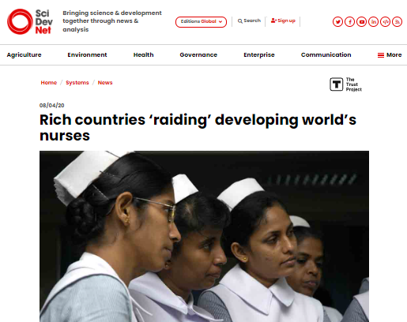
Broom (2020) - “Rich countries are ‘raiding’ nurses from their lower-income neighbours, a global nursing organisation says, leaving parts of the global South with less than 900 nurses for every one million people.
The first-ever State of the World’s Nursing report, (WHO 2020) timed to coincide with World Health Day, paints a stark picture of the disparities between rich and poor countries’ health systems.
Global imbalances of critical nursing staff are being exacerbated by the failure of developed countries to educate and train their own nurses, say the report’s authors.
“Retention is as important as recruitment. And retention means that we have to take much more seriously improving working conditions.”
Howard Catton, chief executive, International Council of Nurses
Europe and the Americas average about 81 nurses per 10,000 people. In the Western Pacific the ratio is 36 nurses to every 10,000 people.
But in Africa there are just 8.7 nurses for every 10,000 people, and in South-East Asia and the Eastern Mediterranean about 16 per 10,000”.
https://www.scidev.net/global/news/rich-countries-raiding-developing-world-s-nurses/

Slide 32
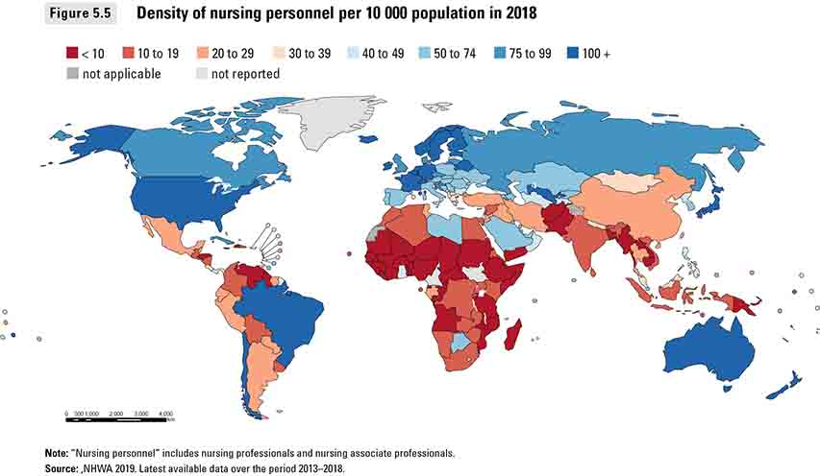
Broom (2020): “Eighty per cent of the world’s nurses only currently serve 50 per cent of the world’s population,” says Mary Watkins, alternate chair at Nursing Now, which co-produced the report with the International Council of Nurses (ICN) and the World Health Organization.
These under-staffed regions will be short of 5.7 million nurses by 2030, the report estimates.
“That’s over a 20 per cent shortage, but we know that it’s even higher in certain areas because of the maldistribution that we have,” says ICN chief executive Howard Catton.
https://www.scidev.net/global/news/rich-countries-raiding-developing-world-s-nurses/

Slide 33
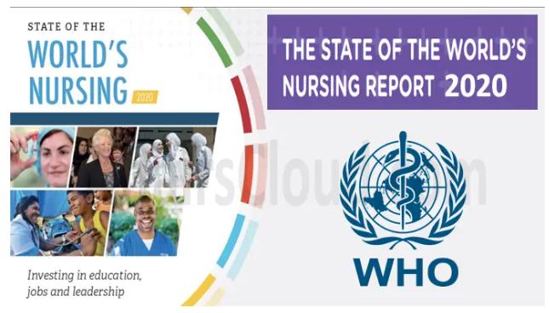
Broom (2020): Data from the OECD (the Organisation for Economic Co-operation and Development) shows the number of foreign nurses in wealthy states increased more than 20 per cent between 2006 and 2016. “We have an over-reliance in high income countries on migration,” Catton says.
We know migration has been a problem for a while, and it looks like it could be set to be worse, also because of the ageing populations in the EU and America.
“If they raid low- and middle-income countries it will exacerbate shortages and maldistribution."
The WHO (2020) report provides evidence needed for investment in the health workforce and nursing, and can help inform where the money should go to have the biggest population health impact, says the WHO’s Carey McCarthy.
https://affairscloud.com/who-released-first-state-of-the-worlds-nursing-report-2020-stating-a-global-shortfall-of-5-9-mn-nurses/

Slide 34
Reasons people stay and leave
Ford (2023)
Reasons nurses & other health professionals leave
Stress, burnout, unable to deliver the quality of care they want, negative workplace culture, feeling underpaid.
Lack of career progression opportunities, no time to undertake courses/ training.
Insufficient staffing.
Loft & Jensen (2020)
Reasons for staying
Being an experienced nurse
The importance of specialty
Good management
Professional challenges
Good colleagues
Balancing family & work
Change in organisations

Slide 35
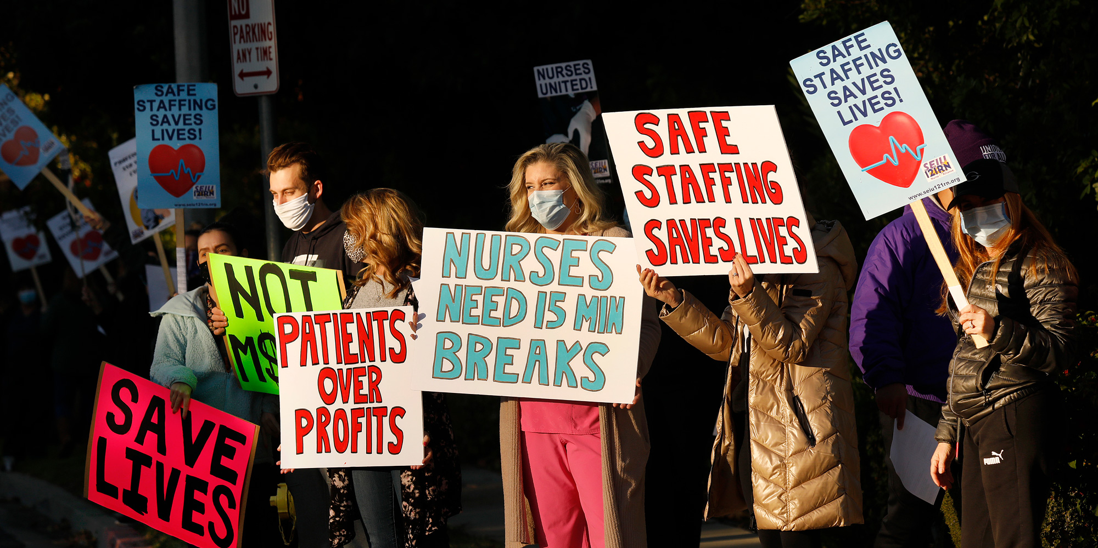
The Nursing and Midwifery Council, UK, 2022 survey reasons nurses leave (6,458 respondents, of 21,035, 30.7%).
Reasons people left the register
Respondents could select up to three options from a pre-defined list of 21 options.
1 Retirement (42.9 percent),
2 Personal circumstances (21.7 percent),
3 Too much pressure (18.3 percent).
4 Workplace culture was fourth most frequently cited reason (13 percent).
5 Leaving the UK (12 percent),
6 Covid-19 pandemic (11.8 percent).
https://theintercept.com/2020/12/20/covid-hospital-ceos-nurses/

Slide 36

Why do student nurses leave their course?
Based on discussions in the UK through 2022 with students, nurses in practice placements and university lecturers
Health & wellbeing – especially mental health
Family issues/ change in personal circumstances
Financial issues – especially cost of accommodation and travel to placements
Key issue highlighted – not feeling valued at placement.
Lack of support at placement and / or at university.
Academic fail
https://rcni.com/nursing-standard/newsroom/news/nurse-exodus-nmc-register-sees-number-of-leavers-shoot-184976

Slide 37

Keeping your team
Health and wellbeing
Requires a good early warning system
One that monitors attendance and missed deadlines.
Refers to support – encouragement to see physician; discussion of more manageable hours / lighter workload; wellbeing focus / support groups.
Reasonable adjustment discussions; for students, openness between University and placement, assurance of full support.
Encouragement to attend wellbeing events
https://www.healthcareconferencesuk.co.uk/conferences-masterclasses/nurses-in-difficulty

Slide 38
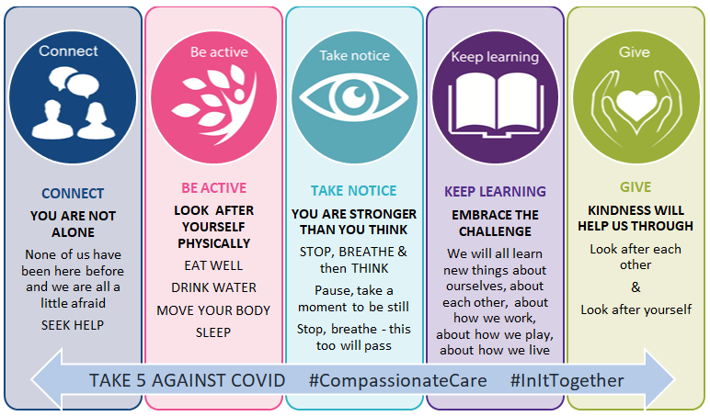
Keeping your team
Health and wellbeing (N.I. example)
Public Health Agency, Northern Ireland, message to healthcare staff during covid pandemic.
https://www.publichealth.hscni.net/covid-19-coronavirus/guidance-hsc-staff-healthcare-workers-and-care-providers/staff-health-and

Slide 39
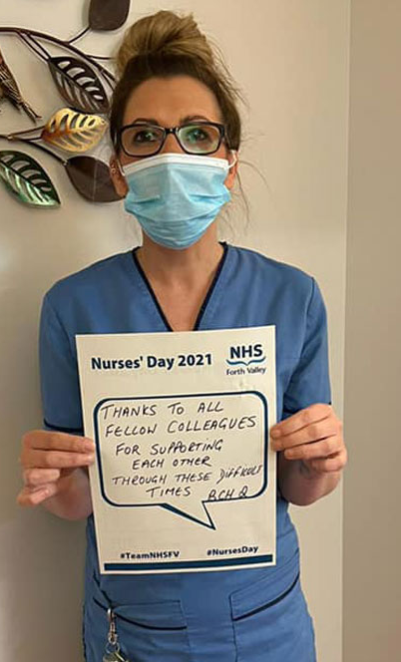
Keeping your team
Family and personal issues / changes in circumstances
Flexible hours discussions
Counselling provision
Supportive mentors
Supportive personal academic advisors
For students – intercalation options
Ensuring good peer support – friendly culture
Staff News, NHS Forth Valley, https://staffnews.nhsforthvalley.com/book-of-reflections-launched-for-international-nurses-day/

Slide 40

Keeping your team
Financial Hardship
Car share schemes
Accommodation assistance
Food banks
Hardship funds
Loans
Efficient reimbursement schemes
For students – ensuring placements are as near home as possible
https://metro.co.uk/2022/05/22/hospitals-set-up-food-banks-for-nhs-staff-who-cant-pay-for-food-16687488/

Slide 41
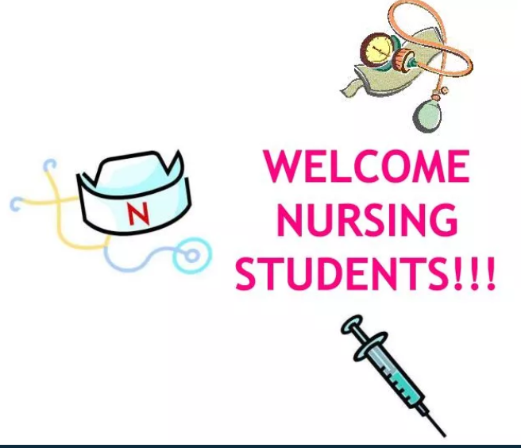

Keeping your team
https://rcni.com/nursing-standard/students/clinical-placements/management-placement-whats-involved-and-how-to-get-most-out-of-it-178701
Feeling valued – fostering belonging
Welcome new staff / students on placement
Call them by name – their preferred name
Thank them for specific things they have done, and for being on the shift – tell them the difference they have made.
Include them in all teamwork – MDTs, team discussions, ask their opinions.
Stand up for them against prejudice, unfairness.
Encourage questions- reassure- there is no stupid question.
https://rcni.com/nursing-standard/students/clinical-placements/management-placement-whats-involved-and-how-to-get-most-out-of-it-178701

Slide 42
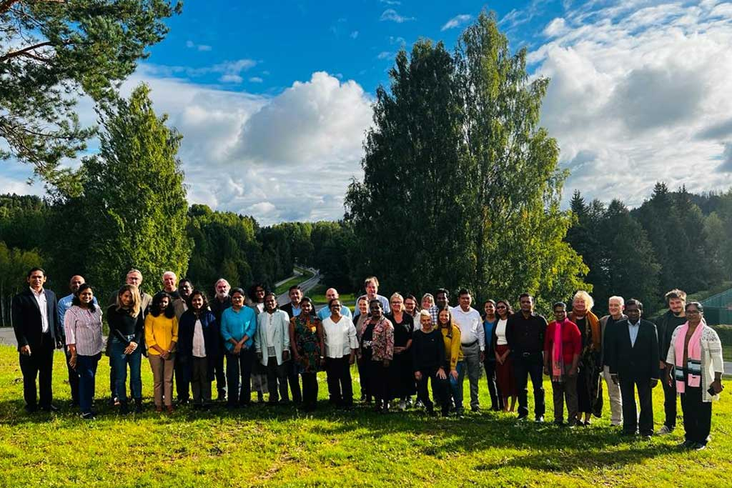
Keeping your neurocare team
Share your passion – teach about the brain, in health and the impact of changes through trauma and deterioration – to all levels of staff at fitting pitches.
Fast-track career progression for students showing an interest in neurocare.
Continuing Professional Development – CPD – support staff to attend study days and undertake short courses as well as longer programmes.
Regular appraisals and career discussions – assign all staff to an experienced coach in the neurocare field.
Teach the RLT model to show that goals of maximising independence can be achieved despite progression of disorder, and physical and mental decline.
Recognise, reward and celebrate achievements, establish a team aim to achieve acknowledged excellence in neurocare.
Sharing a passion - Partners in the nEUROcare project representing the University of Colombo, the University of Peradeniya, the University of Ruhuna, and the General Sir John Kotelawala Defence University, Kristianstad University Sweden, Triskelion in Norway, the University of Ljubljana in Slovenia, the University of Tartu in Estonia, and Neapolis University Pafos in Cyprus.

Slide 43
Summary
In this lecture we aimed to help students understand how to lead and manage change regarding care for people with NDDs
To achieve this we first considered what is meant by reflective practice, and emphasised its importance towards ensuring we learn from and improve care after our engagements with fellow professionals, patients and caregivers.
We introduced and discussed and then practiced using models of reflection and models of change.
We discussed how to make good changes happen taking account of potential barriers to change.
We discussed how to address an elephant in the room – e.g. harassment, burnout, end of life discussions, gender equality and other areas of potential prejudice.
And how to support staff retention. – generally in healthcare professions and specifically in neurocare – mainly through your own passion.

Slide 44
References
Broom F (2020) Riche countries ‘raiding’ developing world’s nurses, Sci Dev Net, https://www.scidev.net/global/news/rich-countries-raiding-developing-world-s-nurses/
Coward M. Does the use of reflective models restrict critical thinking and therefore learning in nurse education? What have we done?. Nurse Educ Today.. 2011; 31:(8)883-886 https://doi.org/10.1016/j.nedt.2011.01.012
Driscoll, J. (2007) Practising clinical supervision: a reflective approach for healthcare professionals. 2nd edn. Edinburgh: Bailliere Tindall Elsevier.
Ford M (2023) Early departure of thousands of nurses ‘deeply worrying’, Nursing Times, https://www.nursingtimes.net/news/workforce/early-departure-of-thousands-of-nurses-deeply-worrying-13-02-2023/#:~:text=%E2%80%9CRetirement%20or%20a%20change%20in,on%20retention%20not%20just%20recruitment.%E2%80%9D
Johns C. Becoming a reflective practitioner: a reflective and holistic approach to clinical nursing practice, development and clinical supervision. Oxford: Blackwell Science, 2000.
Karpen SC. The social psychology of biased self-assessment. Am J Pharm Educ.. 2018; 82:(5)
Kolb, D. A. (1984). Experiential learning: Experience as the source of learning and development (Vol. 1). Englewood Cliffs, NJ: Prentice-Hall.
Kruger J, Dunning D. Unskilled and unaware of it: how difficulties in recognizing one's own incompetence lead to inflated self-assessments. J Pers Soc Psychol.. 1999; 77:(6)1121-1134 https://doi.org/10.1037/0022-3514.77.6.1121

Slide 45
References
Kumari Shammika Senani Mudihanselage Hellerawa, De Alwis Chamaru Adambarage (2015) The nursing shortage impact on job outcome (The case in Sri Lanka) Journal of Competitiveness, 7 (3) 75-94, https://www.cjournal.cz/files/197.pdf
Loft MI, Jensen CS. What makes experienced nurses stay in their position? A qualitative interview study. J Nurs Manag. 2020 Sep;28(6):1305-1316. doi: 10.1111/jonm.13082. Epub 2020 Jul 28. PMID: 32589776.
Mahon P, O’Neil M (2020) Through the looking glass: the rabbit hole of reflective practice, British Journal of Nursing, 29(13) https://www.britishjournalofnursing.com/content/professional/through-the-looking-glass-the-rabbit-hole-of-reflective-practice/
Pennycook G, Ross RM, Koehler DJ, Fugelsang JA. Dunning–Kruger effects in reasoning: theoretical implications of the failure to recognize incompetence. Psychon Bull Rev.. 2017; 24:(6)1774-1784 https://doi.org/10.3758/s13423-017-1242-7
Robb G (2022) 5 crucial tips for addressing the elephant in the room, https://www.gra.uk.com/blog/5-crucial-tips-for-addressing-the-elephant-in-the-room
Schon, D. A. (1991). The reflective practitioner. Ashgate Publishing.
Schultz PL, Baker J. Teaching strategies to increase nursing student acceptance and management of unconscious bias. J Nurs Educ.. 2017; 56:(11)692-696 https://doi.org/10.3928/01484834-20171020-11
WHO (2020) State of the world’s nursing: investing in education, jobs and leadership, https://www.who.int/publications/i/item/9789240003279

Slide 46

Any questions?

Slide 47

Thank you

Slide 48
Duration
Recorded lecture time – 2 hours, 30 minutes
Activity 1 – 10 minutes Activity 2- 10 minutes, Tutor-led discussion of activities 1&2 -20 minutes = 40 minutes total.
Activity 3- 20 minutes; tutor-led discussion- 20 mins= 40 mins total
Activity 4- 20 minutes; tutor-led discussion- 20 mins= 40 mins total
Questions – 10 minutes.
Total 4 hours, 40 minutes.

