Slide 1
Comprehensive Care
Lecture 21
Perception issues in NDDs
Drawing on Visuospatial Awareness as a main example

Slide 2
Aims
To understand how to care for people with NDDs who may be affected by problems with visuospatial awareness

Slide 3
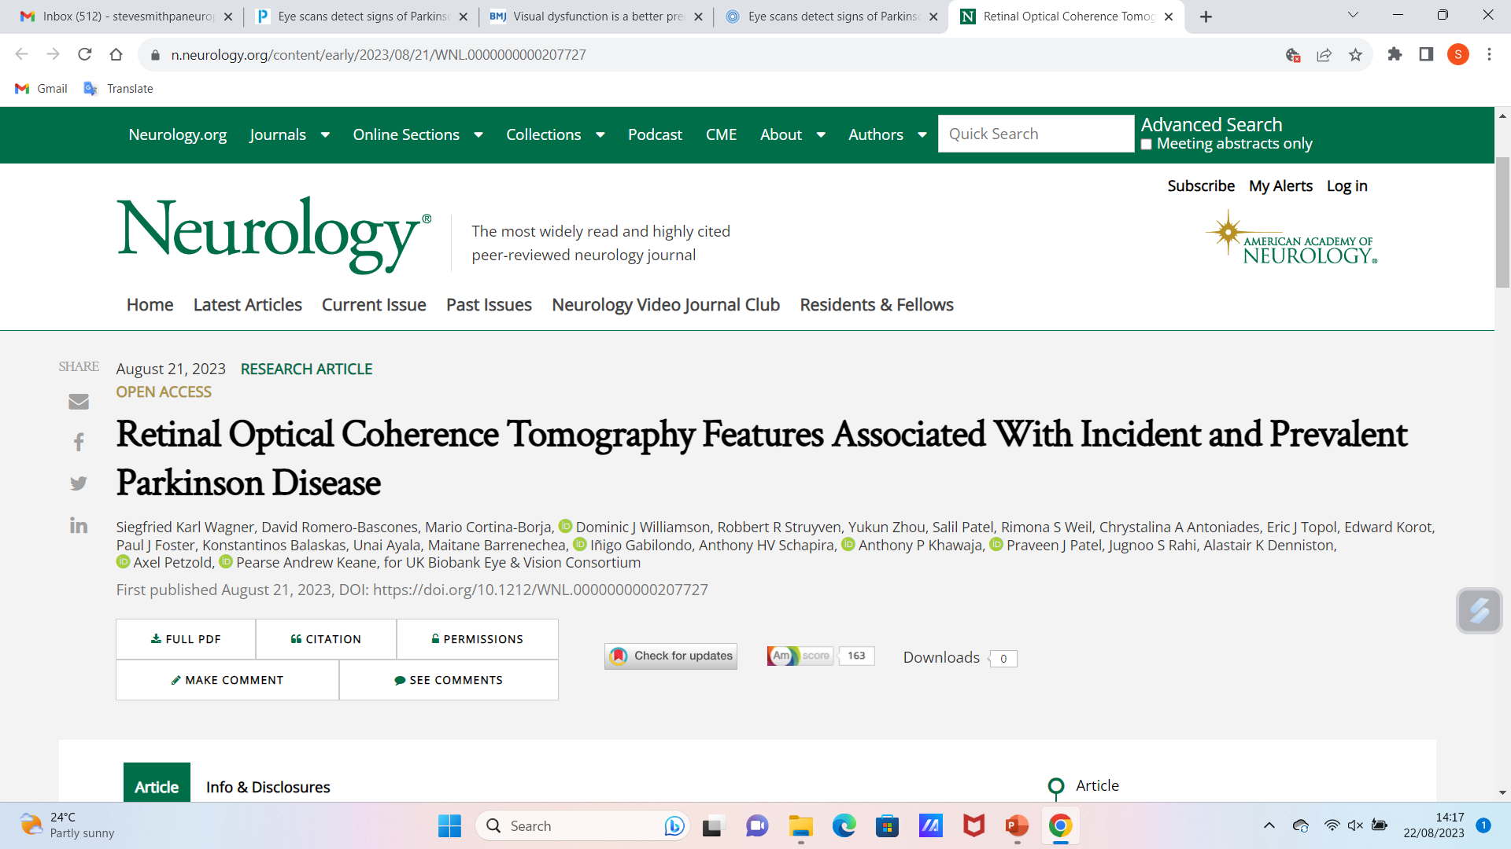
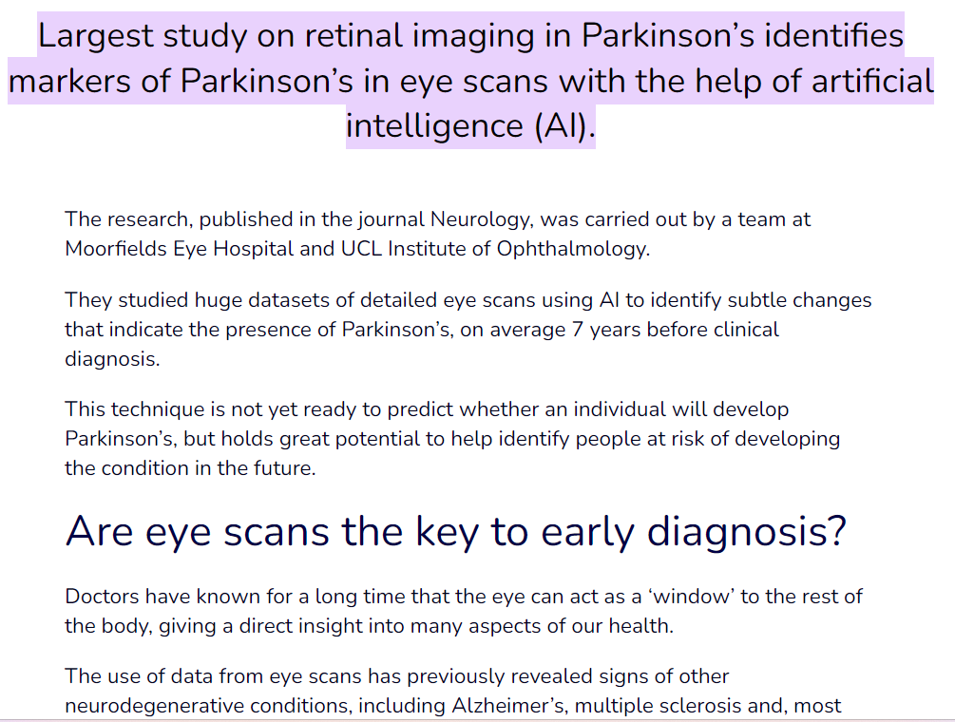
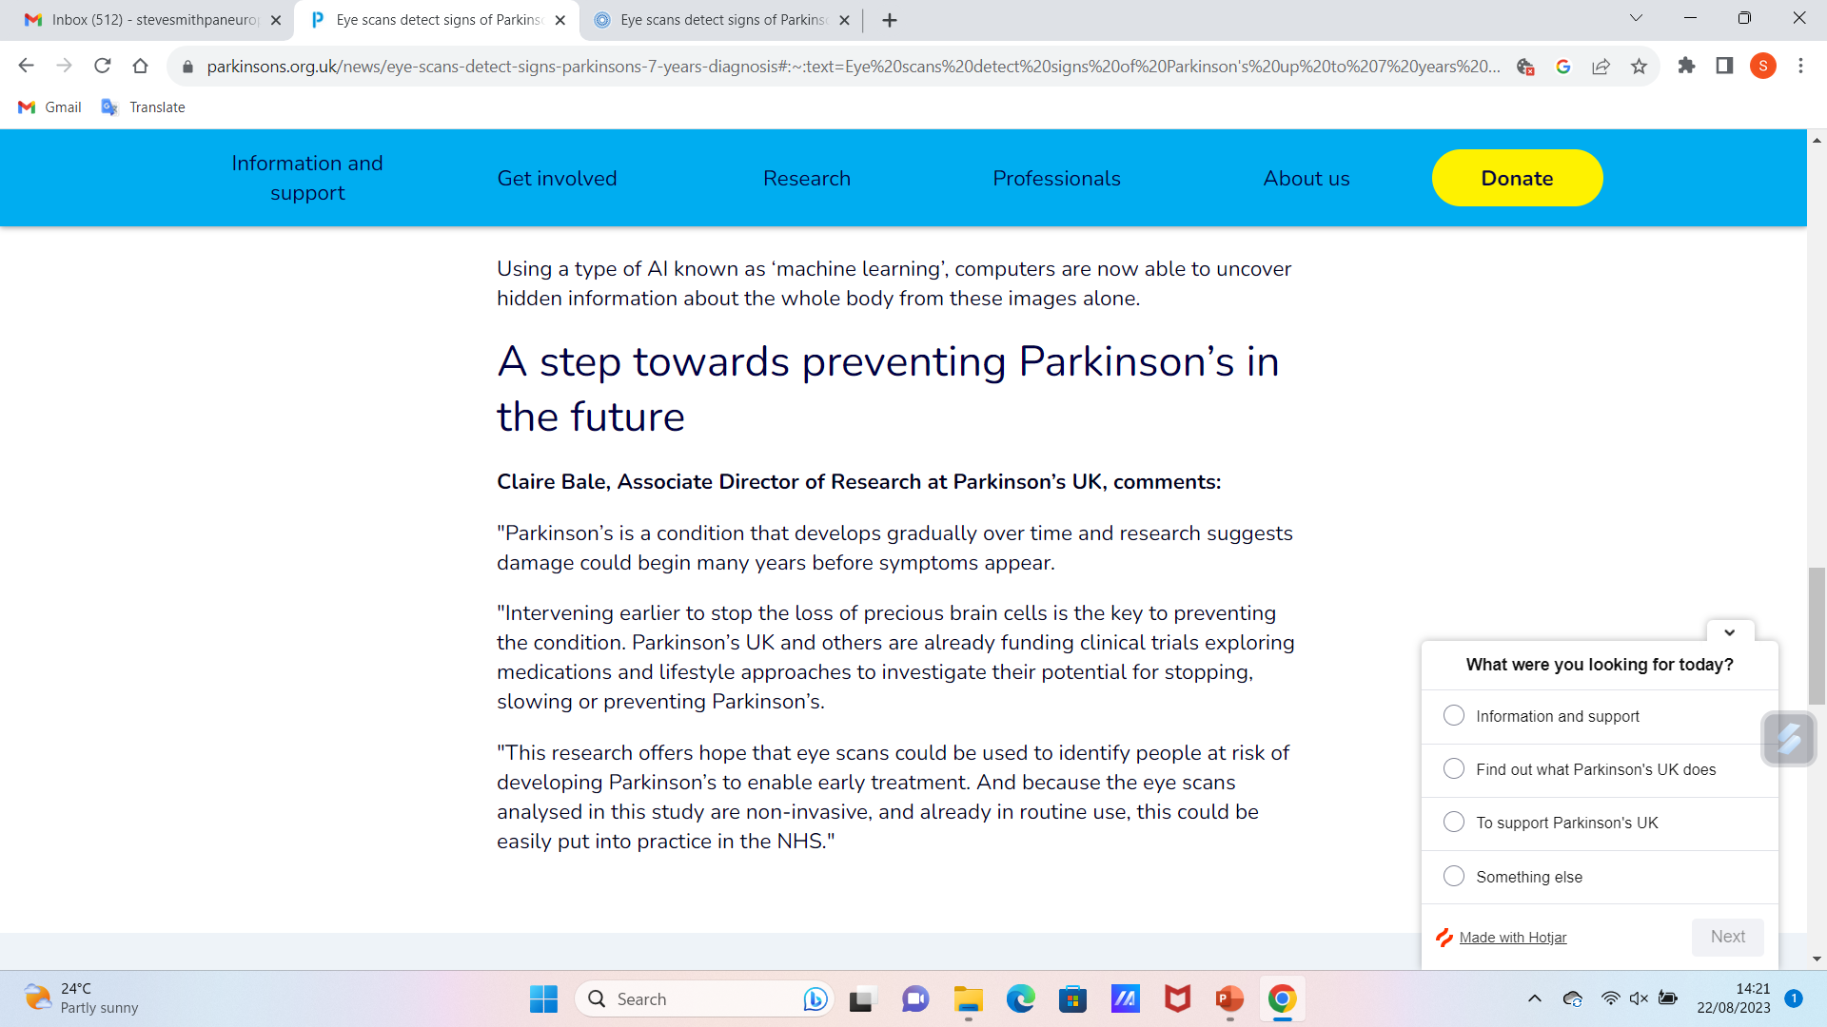
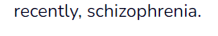
Incidentally – speaking of vision... Hope continues
Parkinson’s UK (2023), https://www.parkinsons.org.uk/news/eye-scans-detect-signs-parkinsons-7-years-diagnosis#:~:text=Eye%20scans%20detect%20signs%20of%20Parkinson's%20up%20to%207%20years%20before%20diagnosis,-22%20August%202023&text=Largest%20study%20on%20retinal%20imaging,of%20artificial%20intelligence%20(AI).

Slide 4
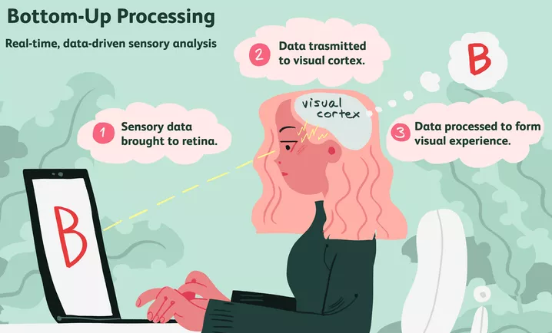
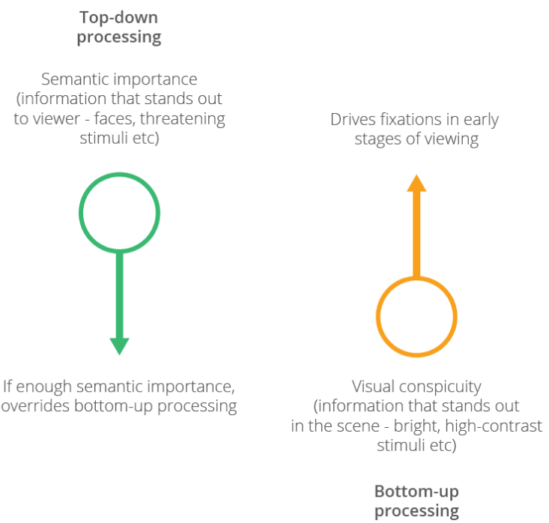
Visual processing
To understand the issues with visuospatial awareness associated with NDDs, and the implications for care, it will help to distinguish “bottom-up” and “top-down” visual processing.
Bottom-up: the stimulus influences what we perceive. Analysis of features e.g. edges, colours, shapes, textures, combined to make more complex representations of objects and scenes.
Top-down: our perception is influenced by higher level cognitive factors, e.g. expectations, memories, context and prior knowledge.
https://www.verywellmind.com/bottom-up-processing-and-perception-4584296
https://imotions.com/blog/learning/best-practice/eye-movements/

Slide 5
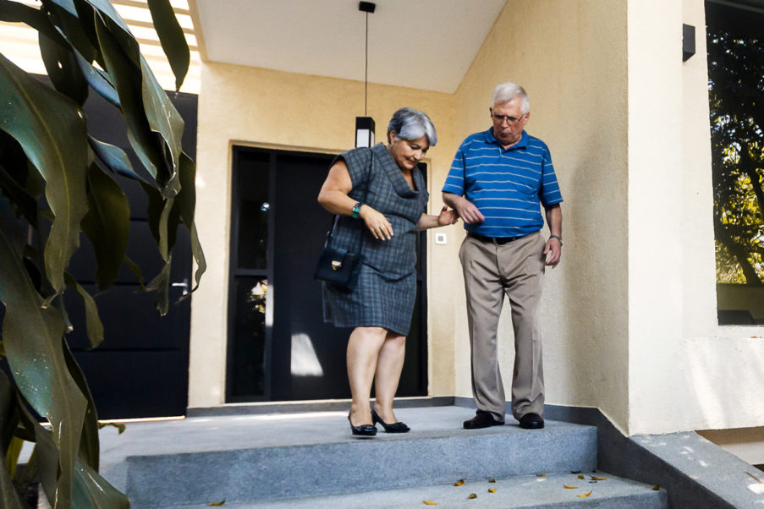
Visual processing
Main Source: Possin (2010)
We discussed issues around vision in an earlier lecture. This lecture delves further into processing.
Understanding what we see and touch and how we navigate the environment and remember where we’ve been and make sense of where we are in relation to space around us seems simple, but it involves highly complex cognitive processes.
We have to accurately focus on what is relevant to our ever-changing needs, and supress what’s not significant.
Visuospatial impairment is often the earliest indicator of cognitive decline in NDDs. We can all experience feeling unsafe when driving, difficulty with new routes forgetting where we parked, or where we put the keys but increasing frequency, and intensity of the issues suggests a problem.
https://www.ideafit.com/personal-training/spatial-awareness-and-proprioception-for-older-adults/

Slide 6
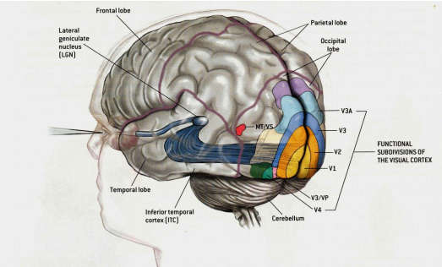
Processing - Bottom up:
Visual information reaches the occipital cortex via the retina and optic nerves and optic tracts, the lateral geniculate body of the thalamus from where it travels to the primary visual cortex.
The primary visual cortex in the occipital lobe is also known as Brodman’s area 17, or/ and as V1. V1 transmits processed visual information relating to the location and spatial data, e.g. orientation (dorsal stream – where?) and colour, and motion shape edges (temporal stream – what?).
V2 (secondary visual cortex) continues the processing of those basic features initiated in V1 and identifies more complex aspects of shapes, textures, contours; and aids ‘binocular’ vision- integrating information from both eyes to provide impressions of depth perception.
V3 – not so well defined as 1&2, thought to contribute to motion and spatial orientation perception.
V4 Associated with colour processing and object recognition. Has a role in perceiving colour differences and identifying objects based on colour information.
V5- (aka MT – middle Temporal area) – specializes in motion – very sensitive to direction and speed of stimuli.
V6 – implicated in processing visual motion and spatial integration--- spatial relationships.
Gilmore O, (2020) https://psu-psychology.github.io/psych-260-2020-fall/lectures/260-2020-09-10-anatomy-III.html#1

Slide 7
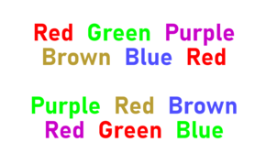

Processing – Top Down:
Perceptions begin with a general picture and work towards determining specific definition. These perceptions are influenced by prior knowledge, memories, context, motivation and expectations.
Without top-down visual processing we would be overwhelmed with constantly trying to identify the stimuli for all visual input received. The process would be so, so comparatively slow.
We have to perceive aided by guesses/ hunches/ intuition. Top-down can help ignore much unnecessary detail and make sense of the rapidly changing environment speedily.
We are helped to recognise patterns and predict, but this does hinder our ability to perceive in novel/ new ways; and can make us prone to seeing what we expect to see or want to see, instead of what is there.
Top-Down processing is highlighted by the Stroop effect; and by typos we don’t see when proof-reading our own typing – (we tend to see it after pressing send).
https://en.wikipedia.org/wiki/Stroop_effect
https://twitter.com/iabcyeg/status/1236076604817895425

Slide 8
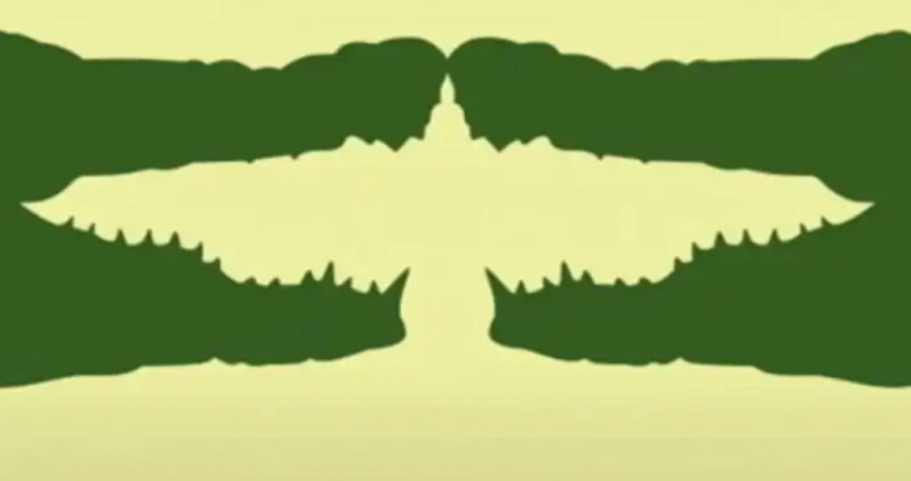
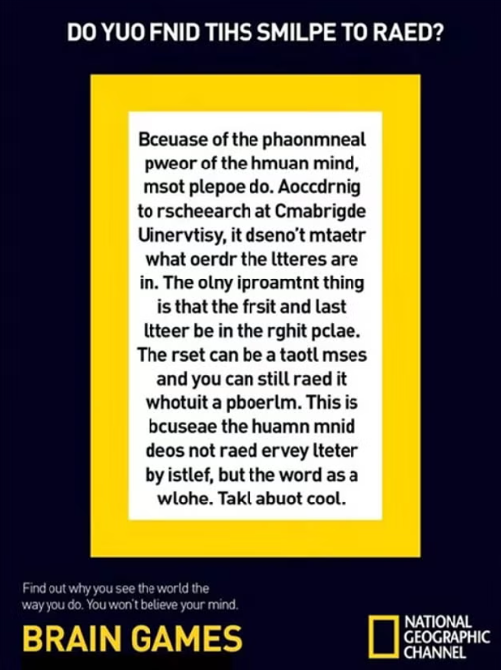
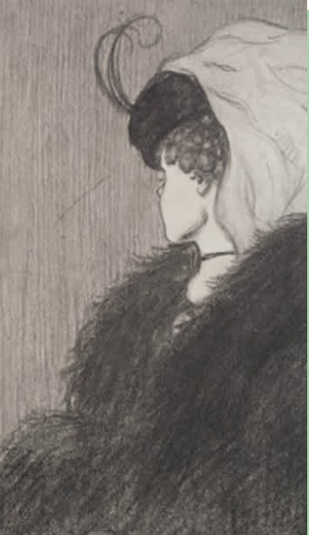
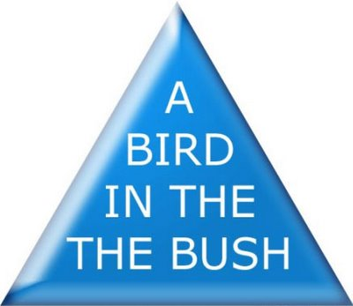
https://www.thesun.co.uk/fabulous/23126203/animal-optical-illusion-personality-test/
https://littlethings.com/lifestyle/old-young-woman-illusion
https://www.independent.co.uk/news/science/jumbled-words-letters-puzzle-cambridge-a6889811.html
https://www.moillusions.com/eye-to-brain-coordination/

Slide 9
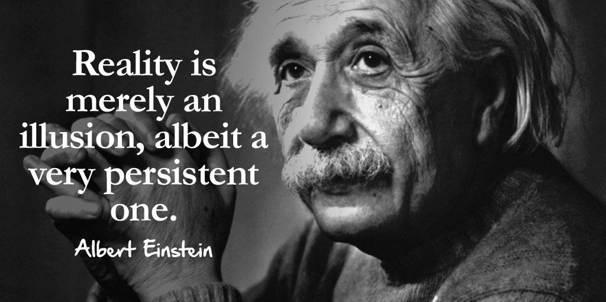
Visual perception problems in ageing, and in NDDs (1)
Misperceiving and misidentifying: Relying on bottom up processing for all visual information coming in via the optic nerves would be slow and insufficiently effective to enable us to respond adequately to the rapidly changing environment around us. So we get used to making guesses based on key features of faces, objects and so on, and if the identity is uncertain, memory of something similar, or something anticipated influences what we “see”.
So a mobile phone could be mistaken for a TV remote control; my mother, in the early days of her dementia would mistake me for my Father, who by then had been dead many years. We don’t think we’re guessing so much of what we “see”, the picture we perceive, presented by the occipital cortex is so convincing- we believe it.
As we age and the cortex and sharpness of vision too deteriorate, we have fewer clues to base our guesses on – we are bound to “see” the “wrong” image more frequently. We may be as convinced as ever, that our guesses are right.
In advancing NDDs, people are not only fooled by the kinds of optical illusions shown on the previous slide – the whole surrounding environment may become a backdrop entirely consisting of visual illusions
….Then again, isn’t that the issue for all of us?
https://www.quora.com/What-is-the-difference-between-reality-and-illusion

Slide 10
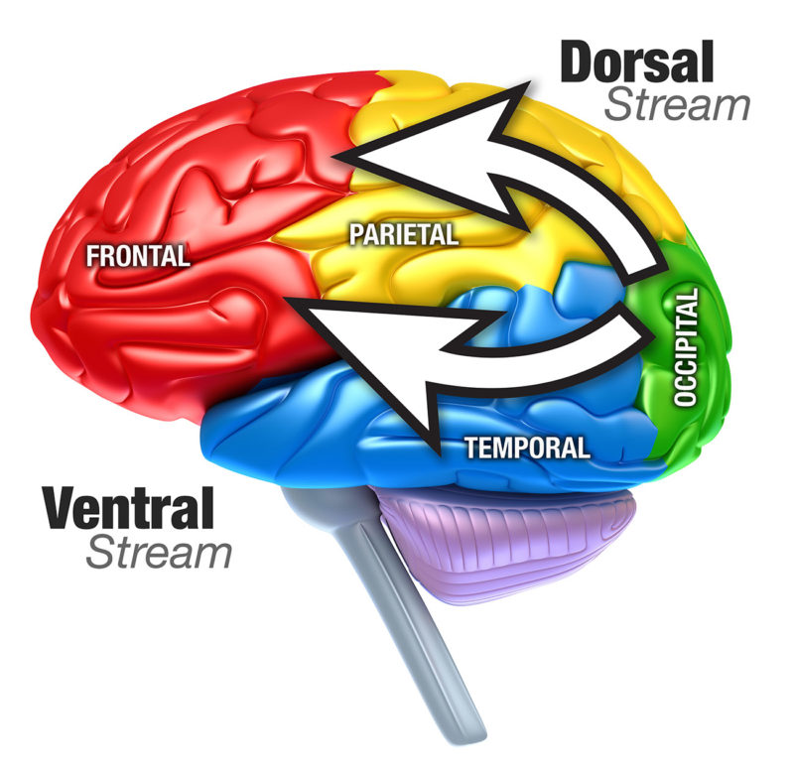
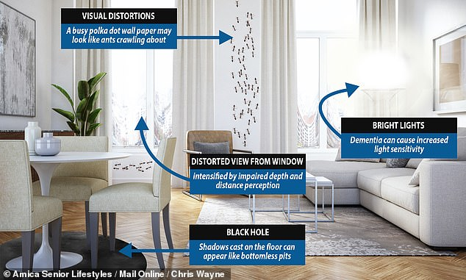
Visual perception problems in ageing, and in NDDs (2)
So – we make wrong guesses – (BTW this not only happens with visual stimuli, but also with hearing and other senses, and memory).
BUT --- what if the cortex deteriorates so far that we can no longer make guesses? We have to rely literally on bottom-up processing (which may also be impaired).
How long will it take to identify not only objects & faces etc, but 3D information needed to navigate distance to door handles; depth of stairs ; speed of oncoming traffic?
What about parts of the room we can’t see – room corners; behind us.
In the previous slide we considered a deteriorating occipital cortex – what about the dorsal and temporal paths to the parietal and temporal streams; what about the hippocampi?
https://pcvis.vision/medical-professionals/
Randall, I (2023) https://www.dailymail.co.uk/sciencetech/article-9401263/Dementia-degenerative-condition-change-way-sufferers-perceive-homes.html

Slide 11
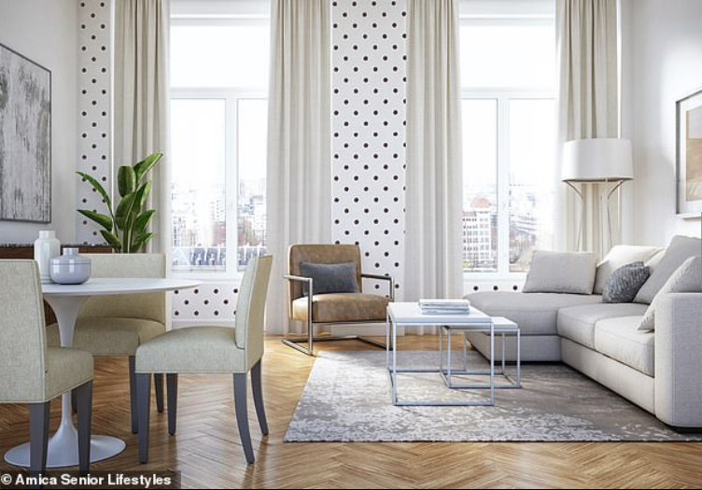
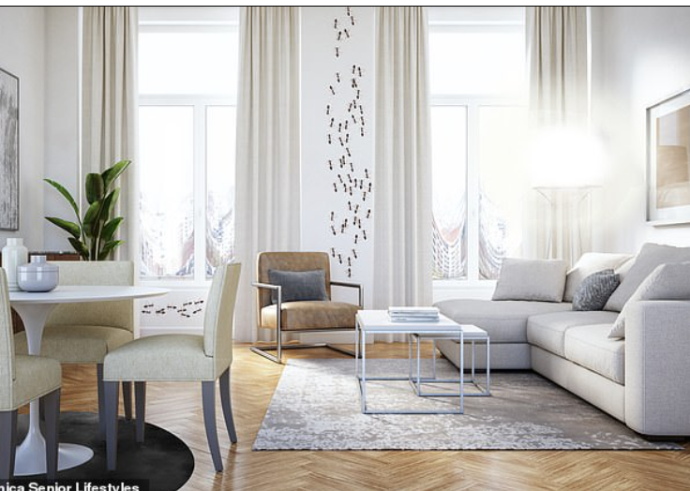


Slide 12
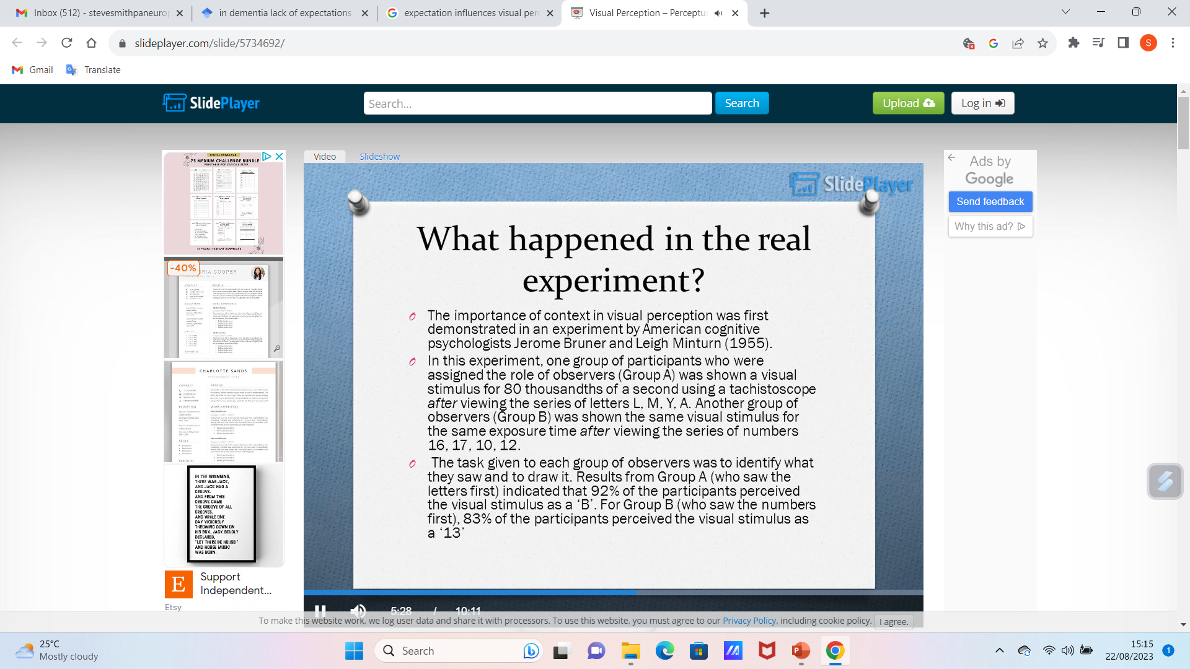
Context influences expectations

Slide 13
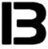
Context influences expectations
J Grivas. L Carter, ‘Psychology for the VCE Student Units 1 and 2’ 5th Edition, 2010, Queensland In Fowler, H https://slideplayer.com/slide/5734692/, accessed 22 08 2023.

Slide 14
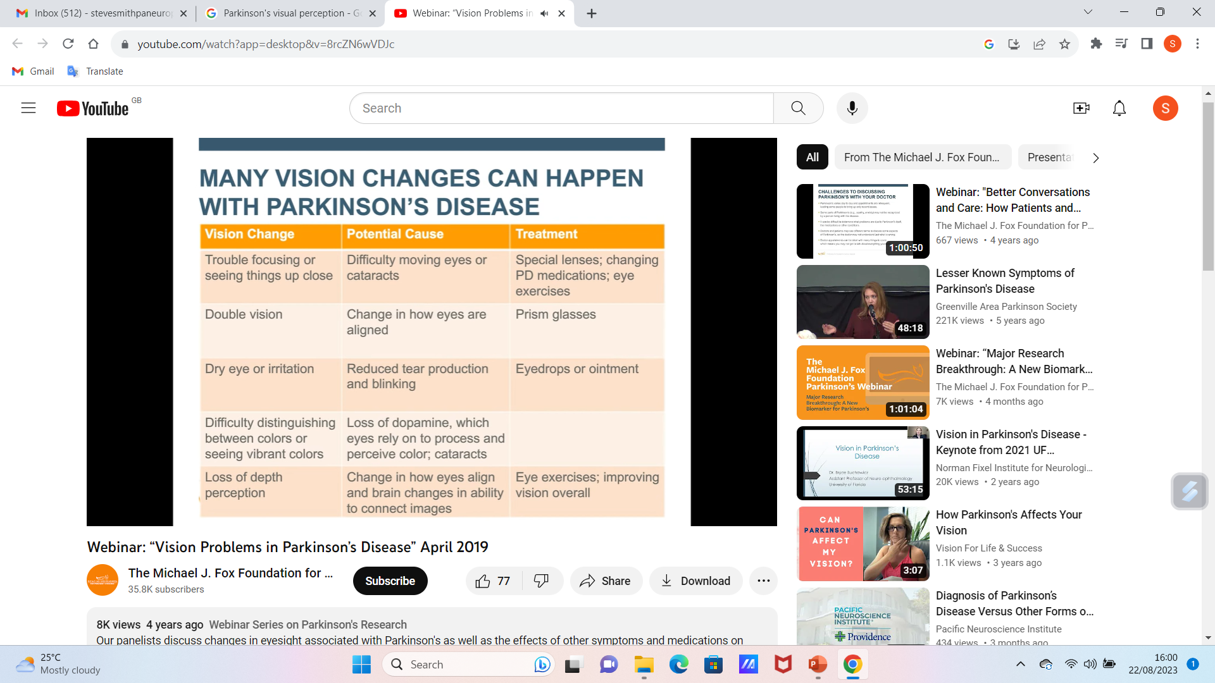
What does all this mean for caregivers?
It is valuable to teach caregivers that:
Impaired memory in NDDs can delay visual perception as memory is important in processing visual information
Compromised memory causes the brain to struggle and make sense of what is seen = slower perception of the visual world
Expectations are necessary for visual processing – preconceived notions need to be drawn on, considered for relevance, and ruled in or out as possibilities quickly. Cortical cell depletion, impaired flexible thinking impact on ability to utilise expectations, and so these problems also delay perception.
Areas involved in semantic memory also play a role in visualising imagined scenarios and picturing future events. Picture a wedding you attended in the past. Now picture the wedding of someone you know who is young and as yet has no partner they might marry. The same brain areas are needed for both those tasks.
So impaired memory means also impaired prediction / expectation, in turn = visual perception
Webinar: Michael J Fox Foundation (2019) “Vision Problems in Parkinson’s Disease” https://www.youtube.com/watch?app=desktop&v=8rcZN6wVDJc

Slide 15
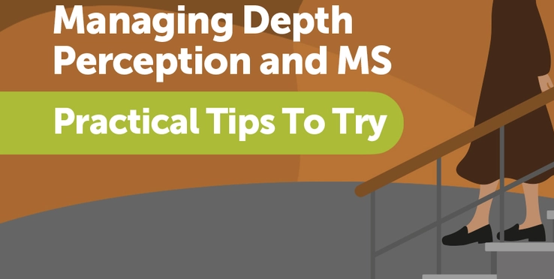
What does all this mean for caregivers?
MS Resource:
Knowing and reflecting on this, caregivers can tailor approaches to accommodate individuals with impaired memory, e.g. using visual aids or repetition to aid recognition. (we have focussed on visual perception as an example, to help caregivers understand that all perception affected this way).
Recognising the impact of expectations on perception can help caregivers communicate more effectively, and create a supportive environment.
Visual aids such as pictures/ symbols or written instructions can supplement verbal communicating, helping people with impaired memory to better understand and remember information
Repetition & consistency: repeat information or instructions consistently- reinforces memory and helps retain key details.
Structured routine: Structured schedule, and predictable routine – familiarity helps anticipate activities, reduces anxiety and confusing.
Simplify information: break down complex tasks into smaller manageable steps – easier to process and follow instructions.
Use Assistive Devices
Depth-perception issues can increase a person’s risk of experiencing falls. …
Assistive devices, like canes and walking sticks, can provide much-needed support [Some may…] need two sticks to walk because they have “no depth perception.”
Ask for Help When Needed
…On “bad” days, you may find it easier to ask a loved one or caregiver to help with certain tasks that rely on depth perception. You might also ask them to retrieve items that require going up or down stairs.
Menard V, Berman E (2022)
https://www.mymsteam.com/resources/practical-tips-for-managing-depth-perception-in-ms

Slide 16
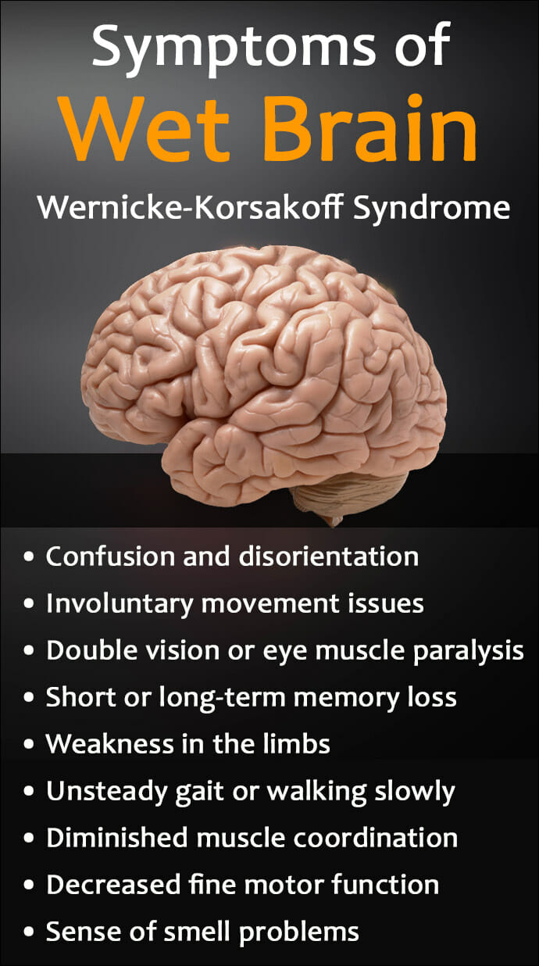
What does all this mean for caregivers?
Clear communicating: Speak slowly & clearly using simple language, avoid use of jargon and complex terms.
Visual reminders: Calendars, sticky notes, or alarms can help prompt about upcoming events or tasks.
Minimise distractions: Create a quiet and organised, tidy environment to avoid visual and auditory overwhelming distractions
Active participation: Involve the person in decision-making and problem-solving to engage their cognitive abilities, to help empower and boost confidence.
Provide time: Allow extra time for processing information and instructions, and for completing tasks.
Positive reinforcement: Offer praise for completing tasks correctly – positive feedback motivates and boosts a sense of accomplishment
https://summitmalibu.com/blog/wet-brain-causes-symptoms-wernicke-korsakoff-syndrome/
See next slide…

Slide 17
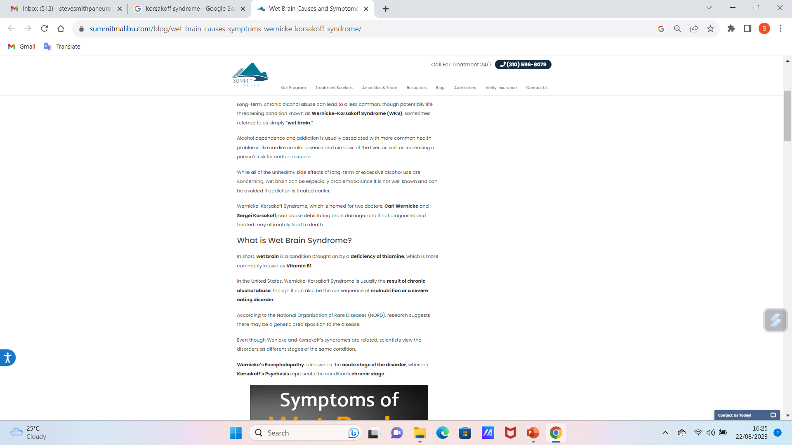
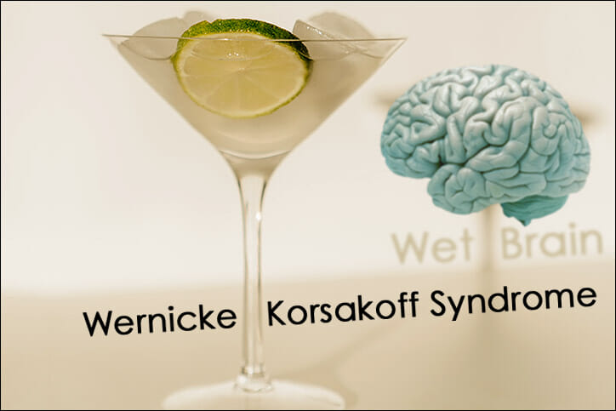
Discussion from a blog:
https://summitmalibu.com/blog/wet-brain-causes-symptoms-wernicke-korsakoff-syndrome/

Slide 18
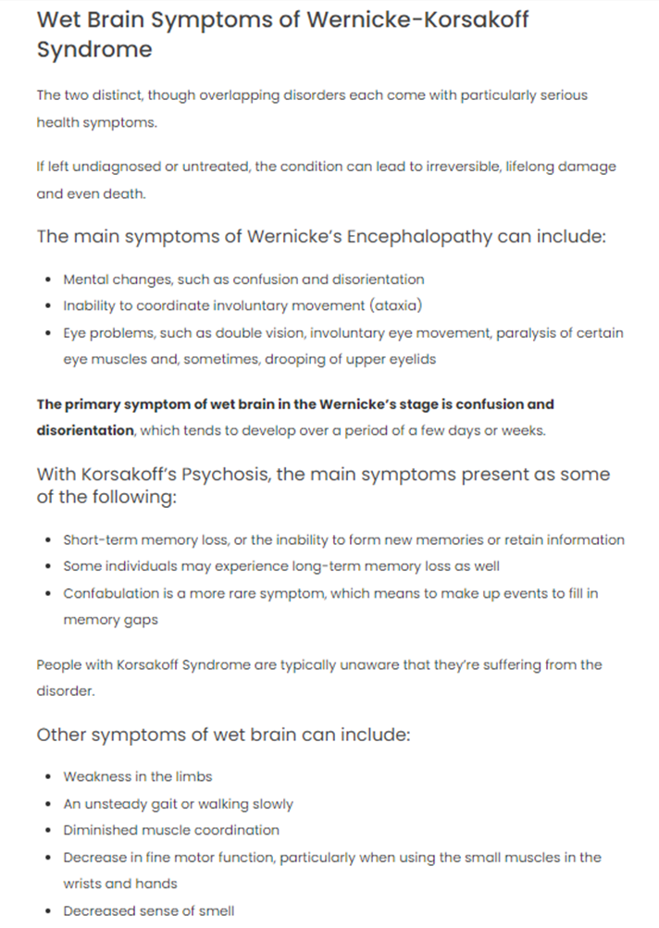

https://summitmalibu.com/blog/wet-brain-causes-symptoms-wernicke-korsakoff-syndrome/

Slide 19
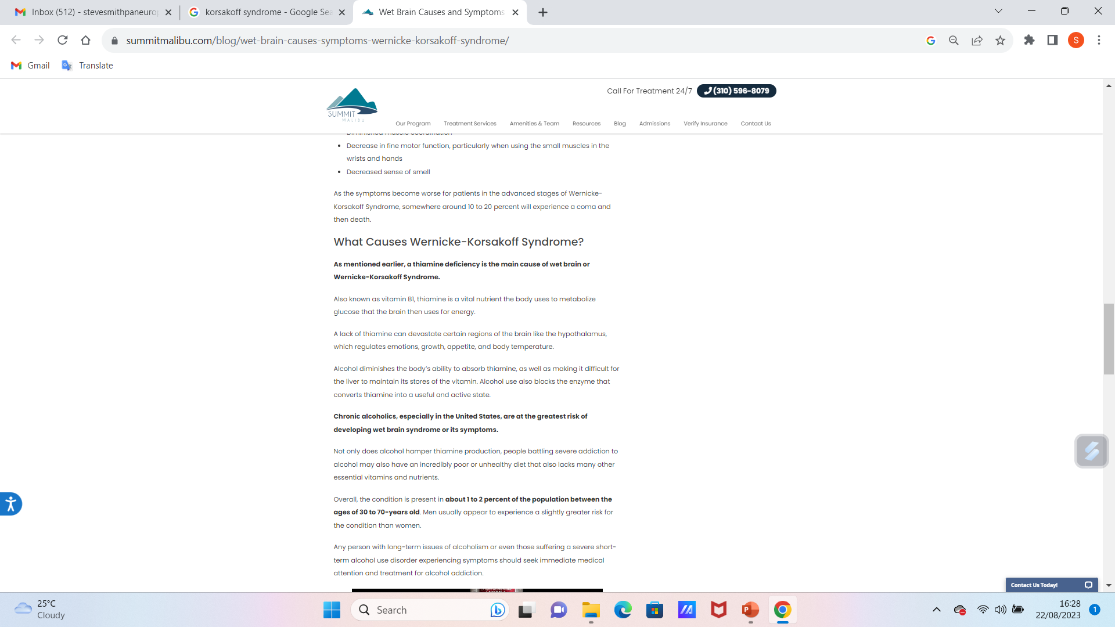
https://summitmalibu.com/blog/wet-brain-causes-symptoms-wernicke-korsakoff-syndrome/

Slide 20
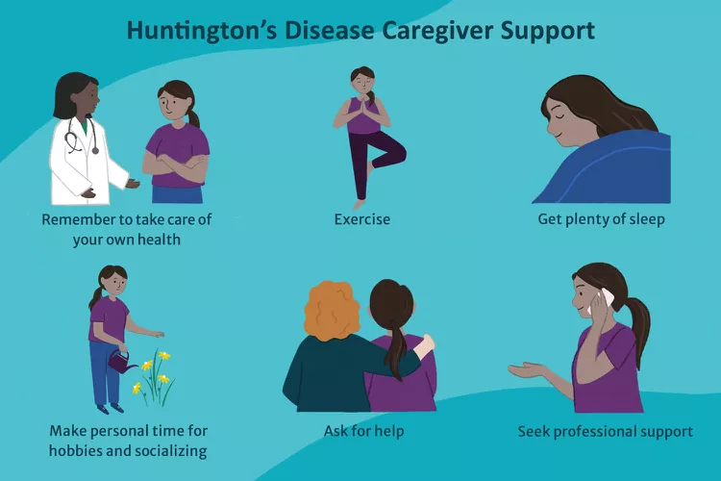
What does all this mean for caregivers?
Engage senses: utilize touch and smell sensory experiences to enhance memory and perception. Associating information with multiple senses can aid retention.
Encourage social interaction: Engaging in conversations and activities with others including peers can stimulate cognitive function and improve overall wellbeing.
Maintain a familiar environment: Changes to environment can unsettle and can be confusing to people with impaired perception
Patience and empathy: This is key to all of it – in a word- kindness!
https://www.verywellhealth.com/caring-for-a-loved-one-with-huntingtons-disease-5095920

Slide 21
References
Gilmore O, (2020) Psych 260, Neuroanatomy 3, https://psu-psychology.github.io/psych-260-2020-fall/lectures/260-2020-09-10-anatomy-III.html#1
J Grivas. L Carter, ‘Psychology for the VCE Student Units 1 and 2’ 5th Edition, 2010, Queensland In Fowler, H https://slideplayer.com/slide/5734692/, accessed 22 08 2023.
Parkinson’s UK (2023), https://www.parkinsons.org.uk/news/eye-scans-detect-signs-parkinsons-7-years-diagnosis#:~:text=Eye%20scans%20detect%20signs%20of%20Parkinson's%20up%20to%207%20years%20before%20diagnosis,-22%20August%202023&text=Largest%20study%20on%20retinal%20imaging,of%20artificial%20intelligence%20(AI).
Moawad H (2023) Caring for someone with Huntington’s disease, Verywell Health, https://www.verywellhealth.com/caring-for-a-loved-one-with-huntingtons-disease-509592
Possin KL. Visual spatial cognition in neurodegenerative disease. Neurocase. 2010 Dec;16(6):466-87. doi: 10.1080/13554791003730600. Epub 2010 Jun 2. PMID: 20526954; PMCID: PMC3028935.
Randall I (2023) What the world looks like to someone living with dementia: Photos reveal how the degenerative condition can drastically change the way sufferers perceive their own homes, Mail Online, https://www.dailymail.co.uk/sciencetech/article-9401263/Dementia-degenerative-condition-change-way-sufferers-perceive-homes.html
Wagner S, Romero-Bascones D, Cortina-Borja M et al (2023), Retinal Optical Coherence Tomography Features Associated With Incident and Prevalent Parkinson Disease, Neurology 10.1212/WNL.0000000000207727; DOI: 10.1212/WNL.0000000000207727

Slide 22

Any questions?

Slide 23

Thank you

Slide 24
Duration
Recorded lecture time – 1 hour, 20 minutes
Questions – 10 minutes.
Total time – 1 hour, 30 minutes.

