Slide 1
Comprehensive Care
Lecture 19
Focus on special problems
Vision Loss

Slide 2
Aims
To build on the earlier lectures in this module, to increase understanding of problems relating to vision loss associated with NDDs and implications for care.

Slide 3
Importance of modifiable factors in NDDs
…and the relevance of impaired vision
The Lancet commission on dementia prevention, intervention and care (Livingston et al 2020) listed modifiable risk factors for dementia including hearing loss, hypertension, obesity, lack of exercise, diabetes, brain injury, excessive alcohol consumption, and exposure to air pollution.
Many studies emphasise the association between sleep deprivation and dementia risk, e.g. Balan et al (2023). They say ‘There are multiple mechanisms describing brain damage, such as brain hypoxia, oxidative stress, or blood-brain barrier (BBB) impairment, induced by chronic sleep restriction (CSR) and the potential correlation with future cognitive decline and dementia’.
In 2022 a study by Ehrlich et al concluded that 1.8% of U.S. dementia cases were associated with vision impairment, and that as 90% visual problems were treatable, 100,000 prevalent U.S. cases at the time of the study were preventable.
They projected 250,000 preventable dementia cases in the US by 2050 if sight problems were addressed, given 90% vision impairment is treatable.

Slide 4
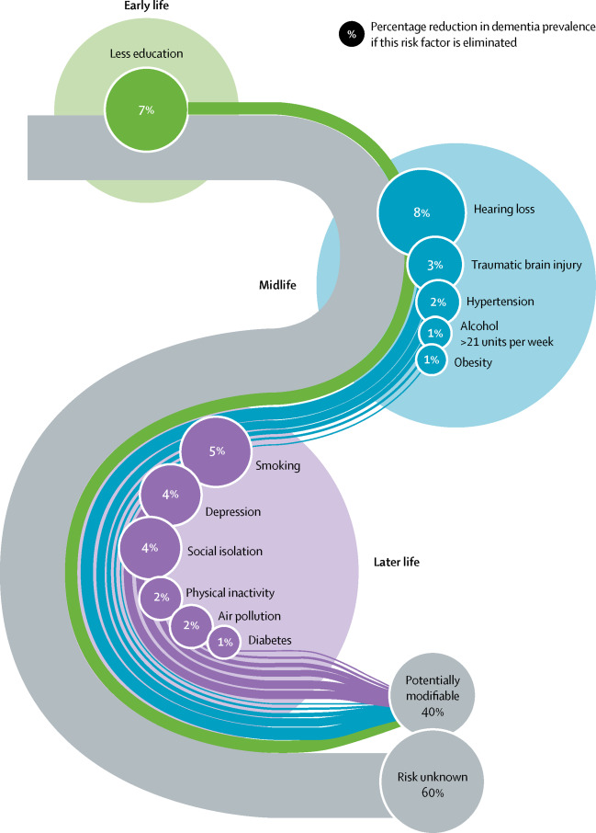
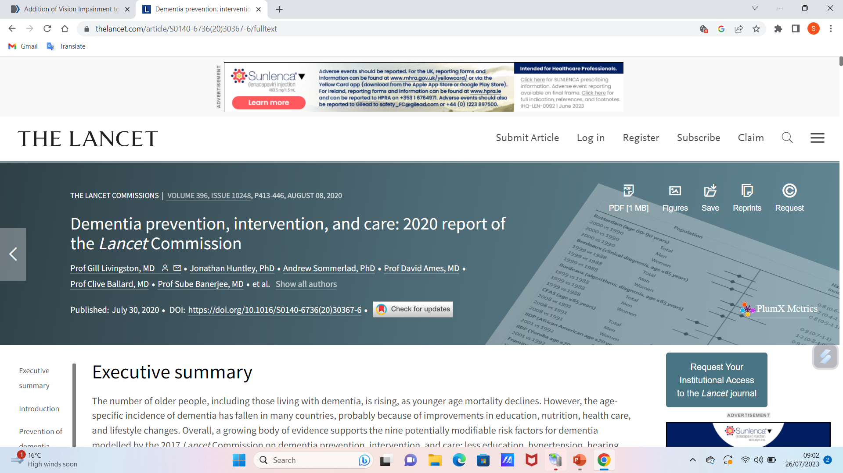
Setting sight loss significance into context

Slide 5
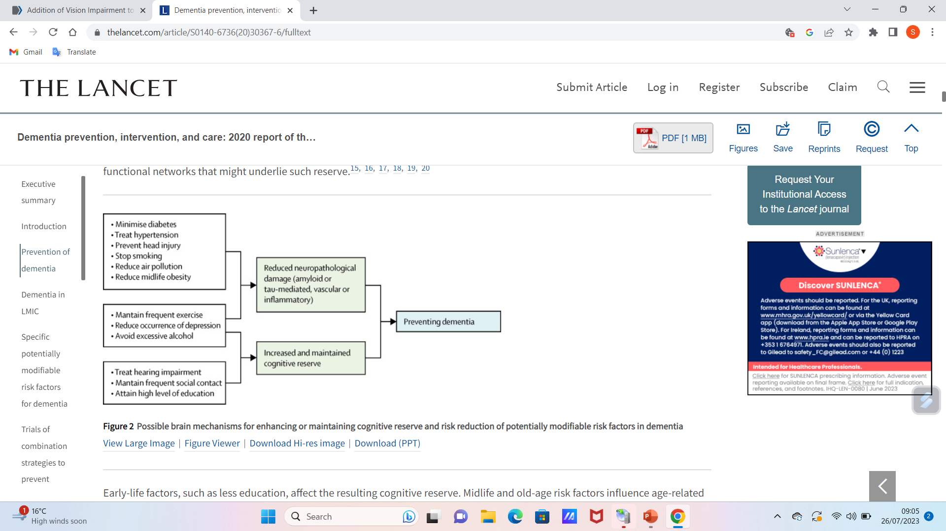
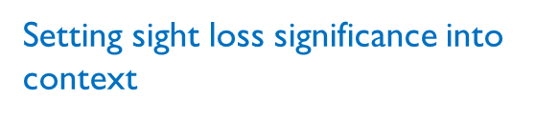
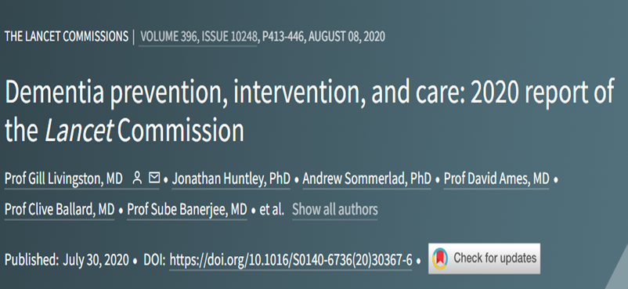
potentially modifiable risk factors for dementia.

Slide 6
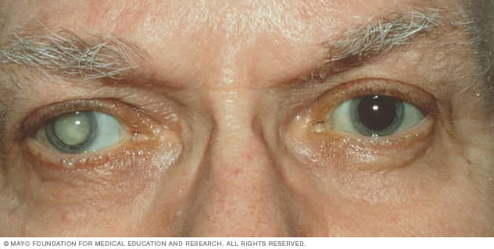
Cataracts and macular degeneration
Of 60 million pop in UK, at least 100,000 have both dementia and cataracts (Vision 2020 UK).
What are cataracts? – with age our eye lens becomes less clear. Once ‘misty’ ‘cloudy’ – described as a cataract.
Effects: more difficult to see; reading is difficult; colours seem washed out; negotiating stairs is problematic; bright lights and glare are a problem, driving – initially at night (dazzling headlights) – gradually daytime too – becomes unsafe.
Cataract surgery is one of the most common UK operations – the cloudy lens is removed and replaced with an artificial lens implant. Sight becomes clear again.
https://www.mayoclinic.org/diseases-conditions/cataracts/symptoms-causes/syc-20353790

Slide 7
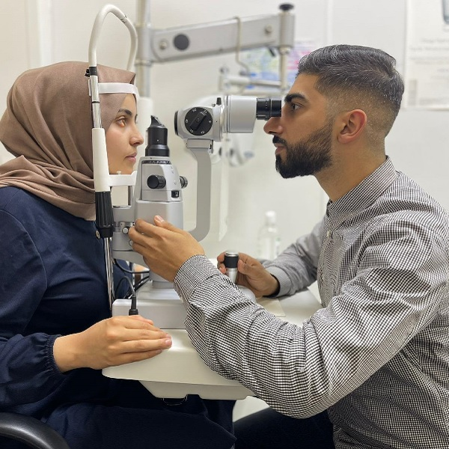
Identifying cataracts in people with NDDs
Everyone should have sight tested by an optician every two years and if over 70, and / or have a NDD, yearly. Sooner if sight problems increase between appointments.
This establishes if glasses are needed, or if already worn, if different strength lenses are required. Also, vascular issues can be detected, and cataracts can be identified.
Accompany the person with an NDD you care for to optician, or have the optician come to their home – support them to explain the problems their condition causes, so the optician can modify the examination accordingly.
Cataracts can be removed at any stage- no need to wait till ‘ripe’ and in dementia earlier may be beneficial.
https://westlondonoptician.co.uk/

Slide 8
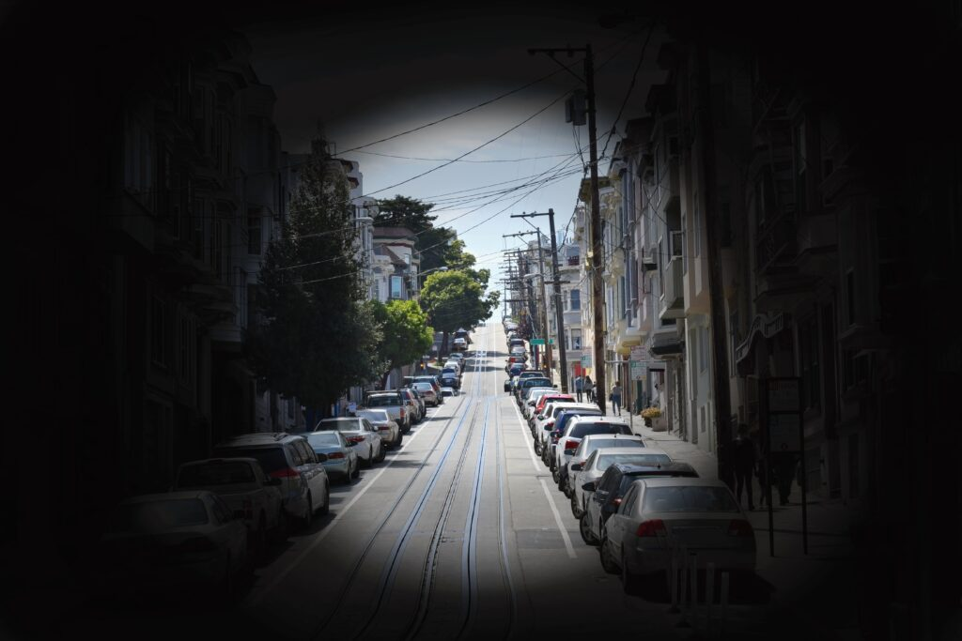
Identifying Visual problems in people with NDDs
If at a stage of NDD where the person has difficulty with speech or explaining, look out for these signs of problems with vision:
Difficulty recognising familiar faces (often assumed to be cognitive deterioration) (diagnostic overshadowing).
Difficulty recognising responding to facial expressions.
Shying away from light, or keeping bright lights on or both
Difficulty finding things
Giving up reading, or other hobbies needing sight acuity
Struggling to navigate unfamiliar environments
Struggling to manage / find food on the plate
Seeming frustrated with current glasses.
https://alzfdn.org/dont-overlook-alzheimers-affect-on-eyesight/

Slide 9
About cataract surgery for people with NDDs
If the optician detects a cataract in the person with an NDD a referral to an ophthalmologist at the hospital should be made.
Surgery is usually as a day case under local anaesthetic. Surgery is the only treatment for cataracts.
Surgery only takes about 20 minutes but due to preparation, recovery and admin time, set the day aside.
At home, a caregiver will need to help with eye care – hygiene to avoid infection and eye drops
Usually cataracts develop in both eyes but surgery is carried out on one eye at a time with 6-12 weeks between procedures. Even with surgery on one eye there is usually great benefit, and in some cases, discussion with ophthalmologist may lead to choosing to avoid a second procedure. Clearly having good vision in both eyes is optimal when tolerated.
Usually there is no physical reason why cataract surgery should cause any more difficulties for PwNDDs, but assessment re ability to cooperate / tolerability of the procedure and aftercare is essential.
Risk assessment will weigh anticipated benefits against potential distress, eye infection or other complications resulting from failed aftercare.
Bear in mind the extent to which Pw advanced NDDs benefit from visual activities – TV, drawing etc, and how isolation can be alleviated through ability to see other people clearly.

Slide 10
General anaesthesia for cataracts in advanced NDDs
In advanced NDDs where tolerability/ ability to cooperate are impaired, general surgery may be considered.
Some professionals express concern that a general anaesthetic can worsen neurological conditions such as dementia long term. However for cataract surgery the procedure is short and a low level of anaesthesia is required. The risk has to be the opthalmologists decision following MDT discussion involving patient and caregiver. Informed consent is of course necessary.
All of this information is from Ursell P, Vision 2020 (see references) – there is much more information within the document at this link.

Slide 11

Tips for reducing impact of sight loss for PwNDDs
Regular optician assessment; good eye and glasses care, keeping glasses clean.
Environment – contrasting colours, good lighting- maximising natural light.
Checking for trip hazards, clearing clutter, familiarity.
Fluorescent strips on corners and edges – on furniture, steps, doorways…
Getting person’s attention before giving information, introducing / clarifying who you are; explaining what’s about to happen e.g., ‘The doctor is about to join us’; ‘I’m leaving the room now’…
Technology can help – automatic lighting, and audio labels.
Involve occupational therapist / visual rehabilitation specialists.
Ref: Alzheimer’s Society (2023)
https://www.hsucares.com/5-things-cause-visual-problems-seniors-dementia/

Slide 12
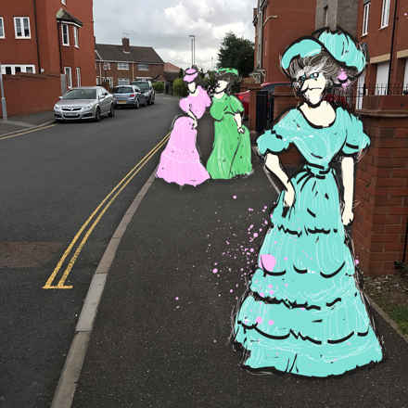
Charles Bonnet Syndrome
Important syndrome to be aware of due to potential diagnostic overshadowing.
Characterised by complex visual hallucinations in otherwise psychologically normal people.
Associated with significant sight loss.
Hallucinations may involve faces, people, places, animals, insects; sometimes whole scenes e.g. waterfalls, fields of flowers. Single person or animal or large groups.
Commonly, very small or grotesque people, or people dressed in costumes, e.g. Edwardian, Roman soldiers or children in bonnets.
Sometimes they fit with surroundings e.g. people working in your garden but sometimes very odd, e.g. a bus or train in your kitchen.
Fantasy figures may appear- dragons, unicorns…
Distinct from hallucinations associated with psychosis – people with CBS know they are hallucinating – don’t think the images are really there.
https://www.macularsociety.org/about/media/news/2021/november/charles-bonnet-syndrome-id-end-up-sitting-in-the-corner-crying-through-fear/

Slide 13

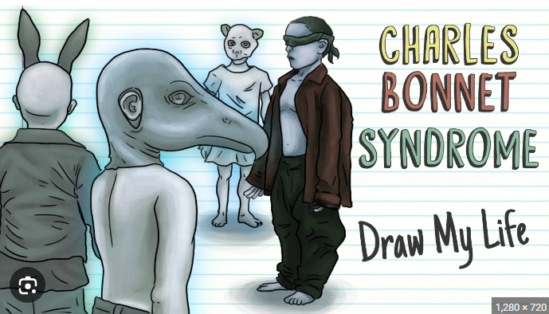

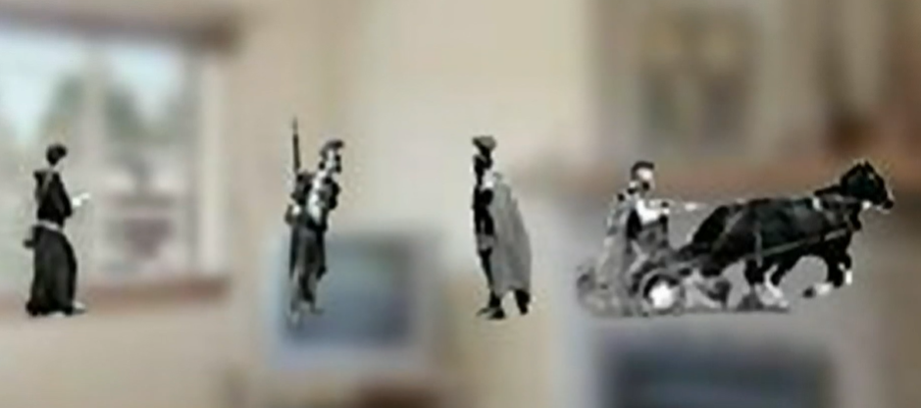
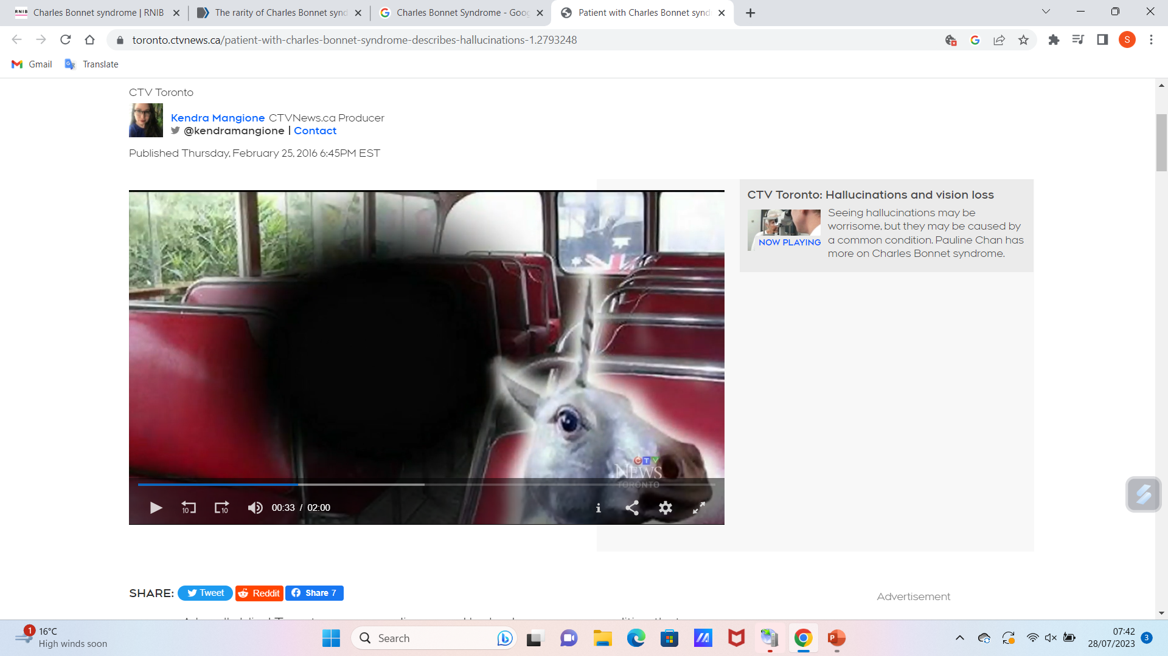
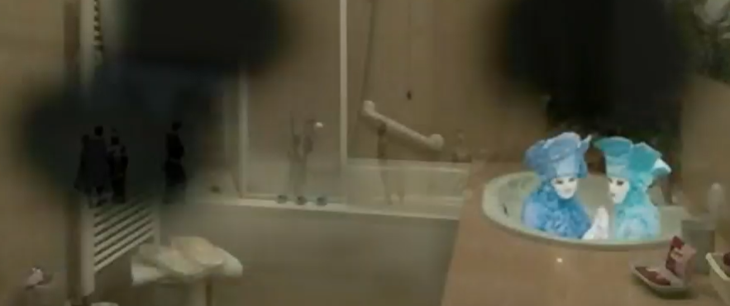
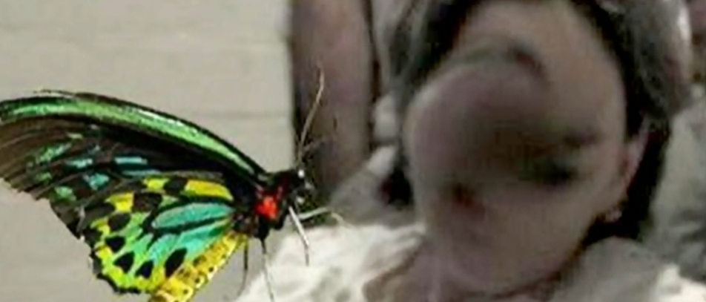
Charles Bonnet Syndrome
https://www.visionexpress.com/eye-health/charles-bonnet-syndrome
https://www.youtube.com/watch?app=desktop&v=zuEqNGzGcy8
https://www.thesenior.com.au/story/5411096/looking-for-change/
https://toronto.ctvnews.ca/patient-with-charles-bonnet-syndrome-describes-hallucinations-1.2793248

Slide 14
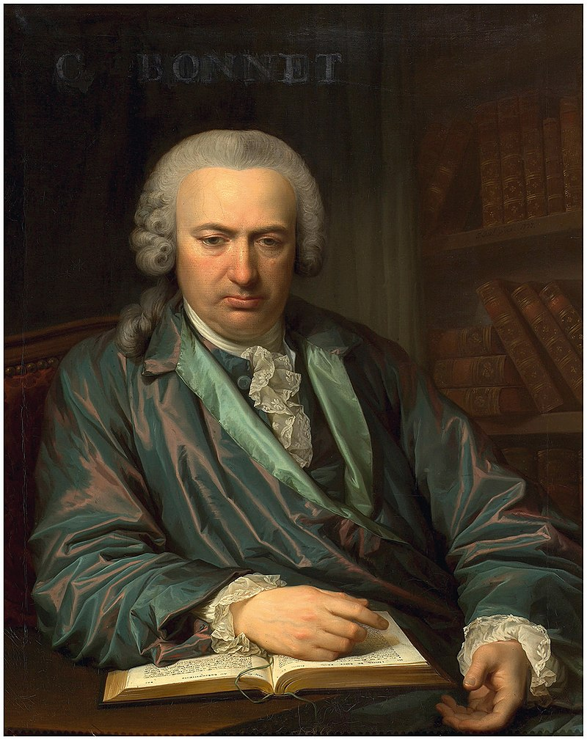
Charles Bonnet
Genevan (Swiss) naturalist and philosophical writer 1720-1793.
Among first to use the term ‘evolution’ in a biological context.
Deaf aged 7, and failing eyesight.
Numerous discoveries including that respiration of caterpillars and butterflies is through pores ‘spiracles’
Fellow of The Royal Society, Member of Swedish Academy of Sciences, Danish Academy of Sciences
In 1760 described what is now called Charles Bonnet Syndrome
He documented it in his 87-year-old grandfather, who was nearly blind from cataracts in both eyes but perceived men, women, birds, carriages, buildings, tapestries and scaffolding patterns.
(From Wikipedia – see link)
https://en.wikipedia.org/wiki/Charles_Bonnet

Slide 15
Prevalence of CBS
Estimates vary. Dhooge and Klevering (2022) say approx. 1/5 people with low vision.
Shirashi et al (2004) cite estimates ranging from 1% to 10%. They consecutively screened 1,000 ophthalmology and optician patients at a university hospital. Prevalence was 5/1000. 0.8% within a low vision group.
Some suggest the condition is more prevalent than documented due to anxiety around being perceived as mentally ill. --- see next slide….

Slide 16
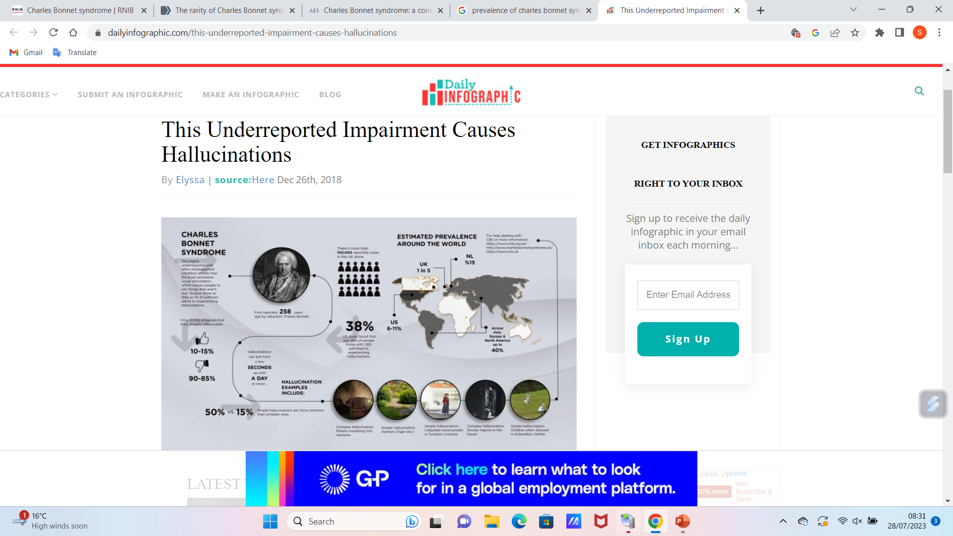
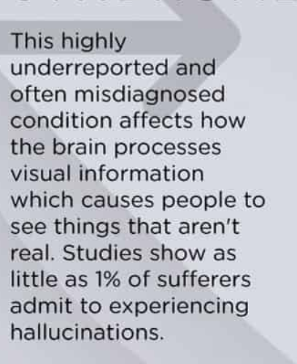
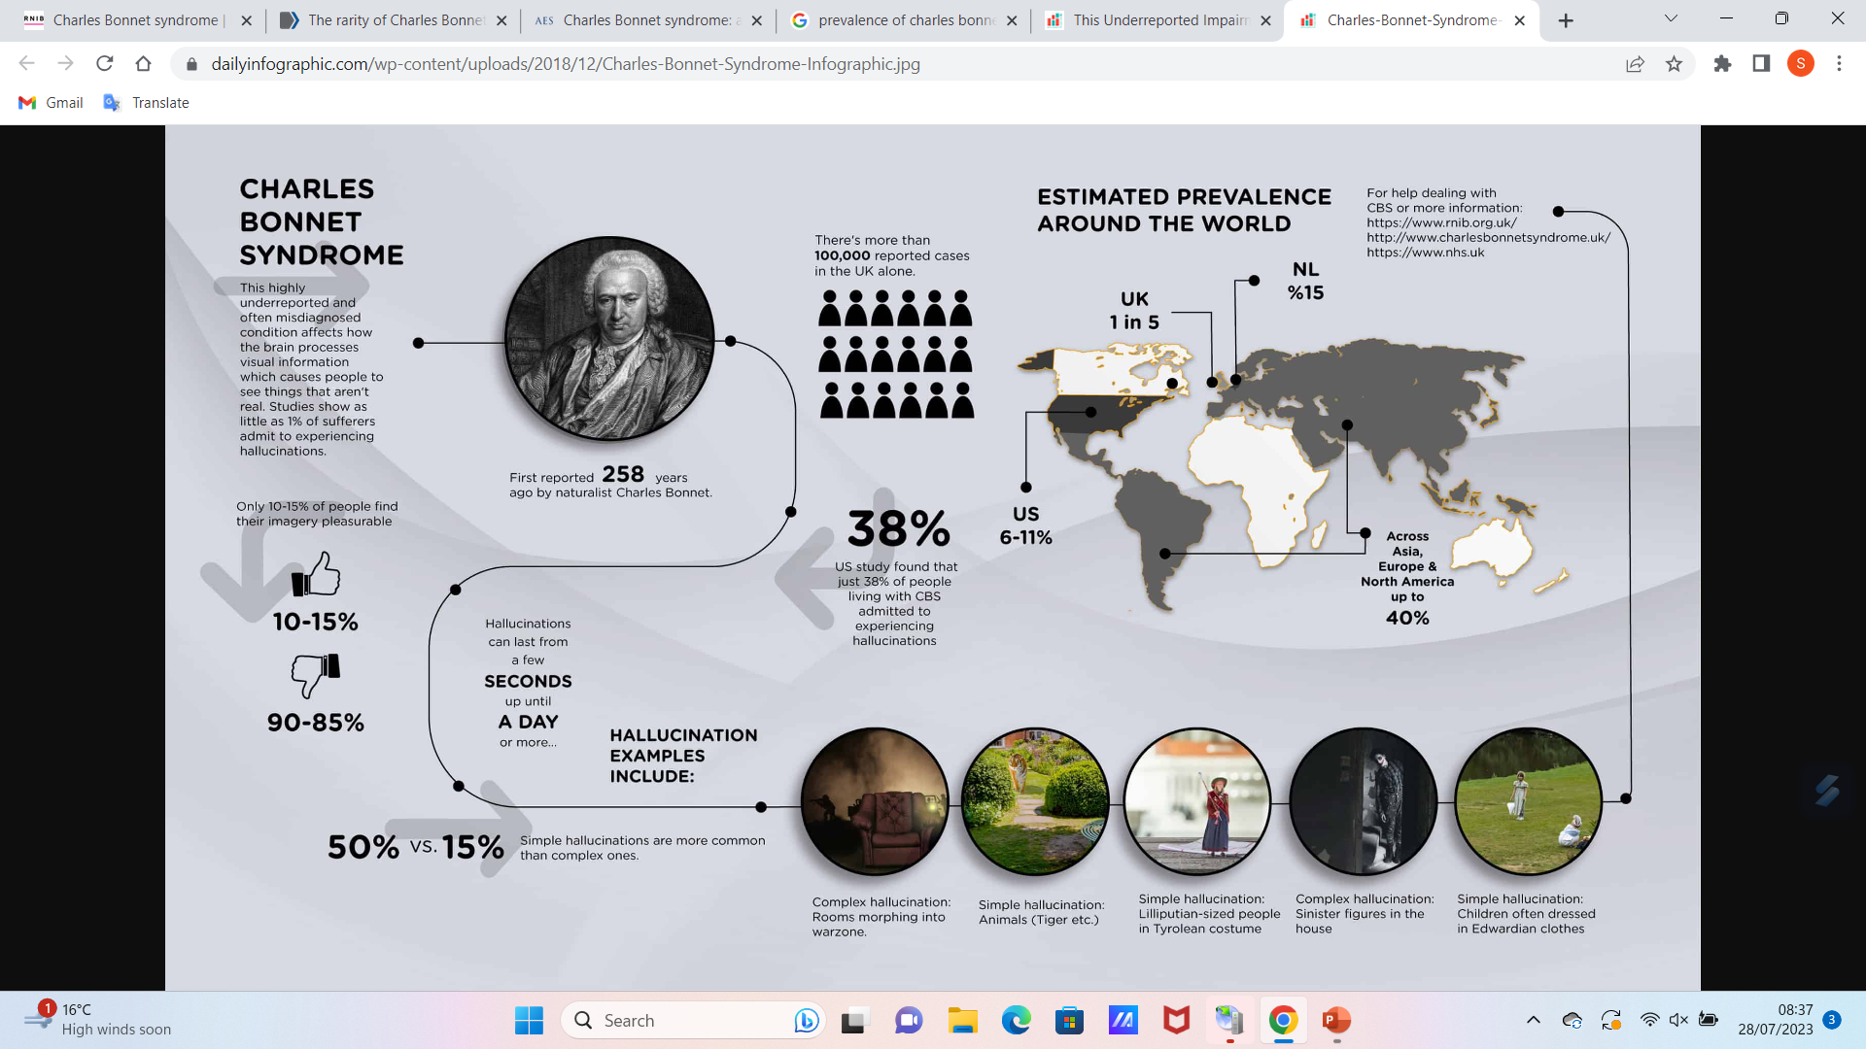

https://www.dailyinfographic.com/this-underreported-impairment-causes-hallucinations

Slide 18
Some key points concerning CBS
The risk of CBS correlates with extent of vision loss rather than underlying ophthalmic diagnosis.
Recent visual acuity loss is a risk factor and diseases associated with CBS include cataracts, age-related macular degeneration and glaucoma. Also neurological conditions affecting vision e.g. optic neuropathies, optic neuritis, giant cell (temporal) arteritis, chiasm disorders.
Ophthalmologists are urged to actively identify patients with hallucinations among all with moderate to severe visual impairment, regardless of whether underlying diagnosis is neurologic or ophthalmic.
The association of CBS with ageing is due to link to cataracts, but CBS occurs in young, even children.
Clear CBS definition is missing in many studies. The majority of CBS cases are reported in psychiatric and neurologic rather than ophthalmic literature.
WHO in the 2018 revision of ICDs allocated a specific CBS diagnostic code- 9D56: complex visual hallucinations, partial or complete vision loss, absence of mental or behavioural disorders.
Ophthalmologists are urged to ask patients with visual loss this question: have you ever seen things or images that you know were not actually present at that moment?
Se ref- Dhooge & Klevering (2022).

Slide 19
Some More key points concerning CBS
Some people with PD, AD, other NDDs and strokes may experience visual hallucinations due to visual impairment, which may be misunderstood. It is suggested that having CBS and one of these conditions may make hallucinations more frequent.
Hallucinations usually become less frequent over time. It was thought that after 12-18 months they tend to stop but now known can occur over many years, quite frequently still present after 5 years.
What helps? No treatment but reassurance that it’s not a mental health issue can help. Also knowing it usually goes away after time. Review medications- some may aggravate CBS e.g. anticholinergics. Innovations to improve sight- better lighting, magnifying glass for reading, using colour to maximise what vision the person does have, may all help reduce hallucinations.
Many find hallucinations are worse when sitting quietly, unstimulated. T.V. or other visual stimulation can help. If they happen a lot in say the lounge, and not so much in the kitchen or garden - factor this in to where most time is spent. It could be that the kitchen and garden are brighter, so try more light in lounge. However, if they happen when there’s lots of light, try switching lights dimmer.

Slide 20
Some More key points concerning CBS
Some find staring directly at images or reaching to touch them causes them to fade.
Blinking can help. Try looking from left to right about once per second for 15-30 seconds. As a guide to how far to move the eyes- suggest imagining two points about a metre apart on a wall a metre and a half in front of the person. Keep eyes open during the movements. Rest for a few moments between attempts. If ineffective after 4 attempts it’s unlikely to work, but may be worth trying again with a different hallucination.
Relaxation may help – some find stress increases hallucinations.
See RNIB reference.

Slide 21
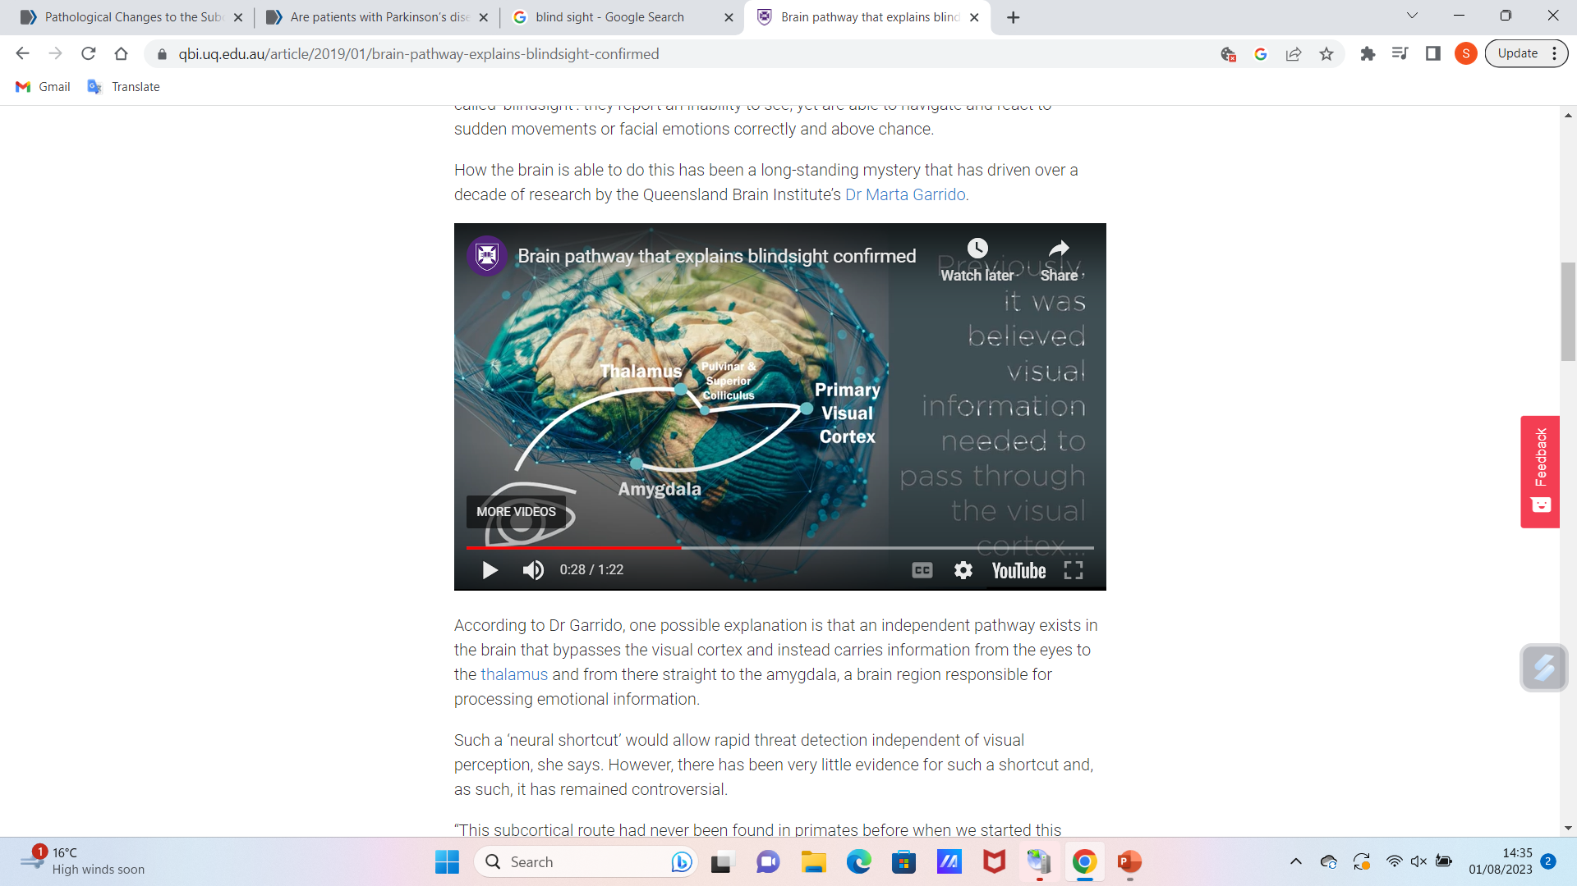
Blind sight
Weiskrantz (1986) coined this term- ‘people who are perceptually blind in an area of visual field demonstrate intact responses to stimuli in that visual field suggesting a residual network of functions..’ Diederich et al (2014).
Patients who perceive themselves blind - cannot consciously see - can guess location and sometimes identity of objects in the blind field, and may respond / react accordingly. Tammietto et al (2010) found Pw blindsight react appropriately to facial expressions especially those indicating fear or danger.
We all have blindsight in health, and do not have to rely solely on conscious sight to react to visual stimuli.
Diederich et al (2014) found PwPD were ‘blind to blindsight’. This means PwPD are less able to react rapidly to stimuli and have to rely on longer, slower, goal-directed actions informed by the neocortical visual pathway, without rapid blindsight-mediated functions.
This phenomenon is similar to the impact on movement in PD, of degeneration of the basal nuclei – longer, goal-directed pathways are relied on to initiate movement.
University of Queensland Brain Institute, https://qbi.uq.edu.au/article/2019/01/brain-pathway-explains-blindsight-confirmed
‘One possible explanation that an independent pathway exists in the brain that bypasses the visual cortex and instead carries information from the eyes to the thalamus and …straight to the amygdala, was tested by looking at the MRI scans of 622 people with functioning visual cortices …’
“Amazingly, we were able to reconstruct this pathway in every person.”

Slide 22
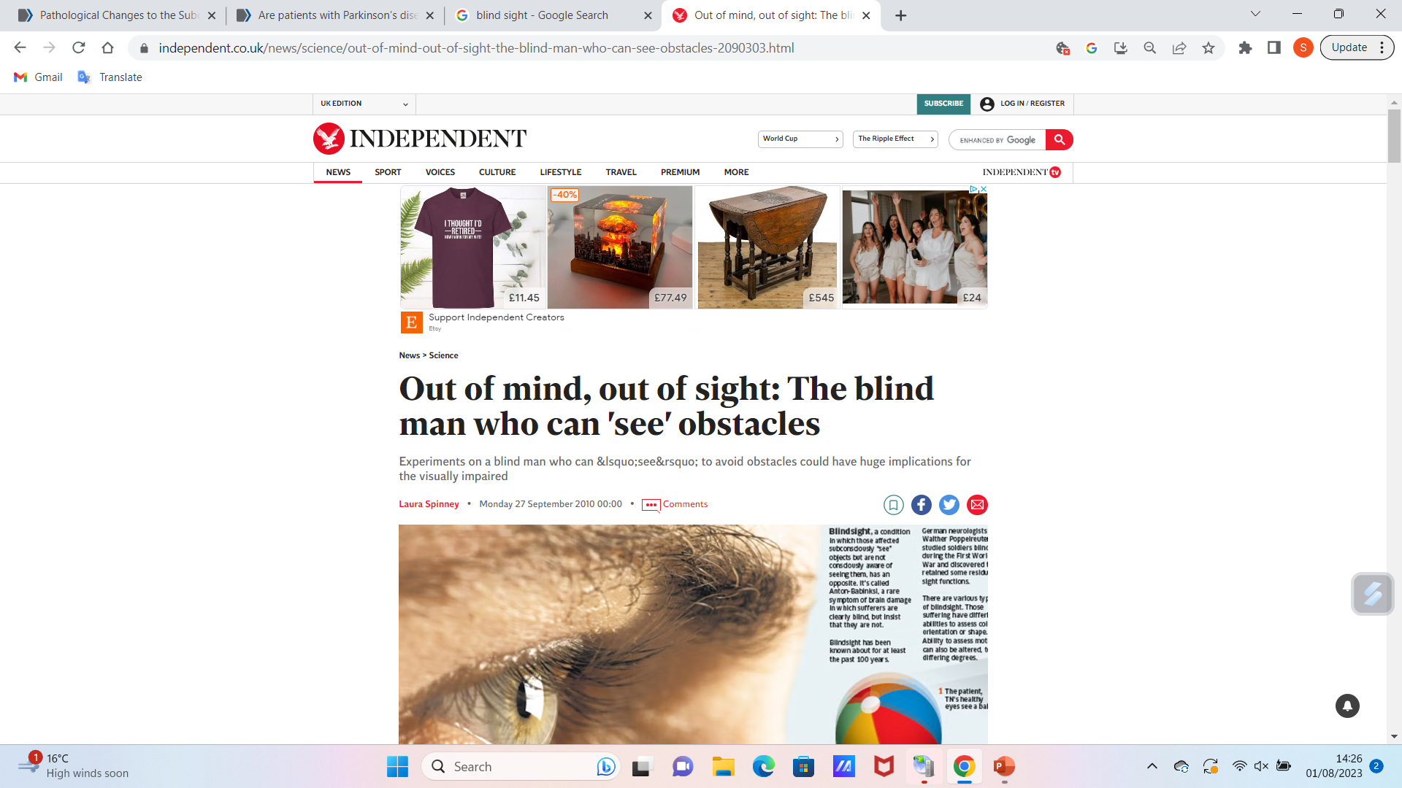
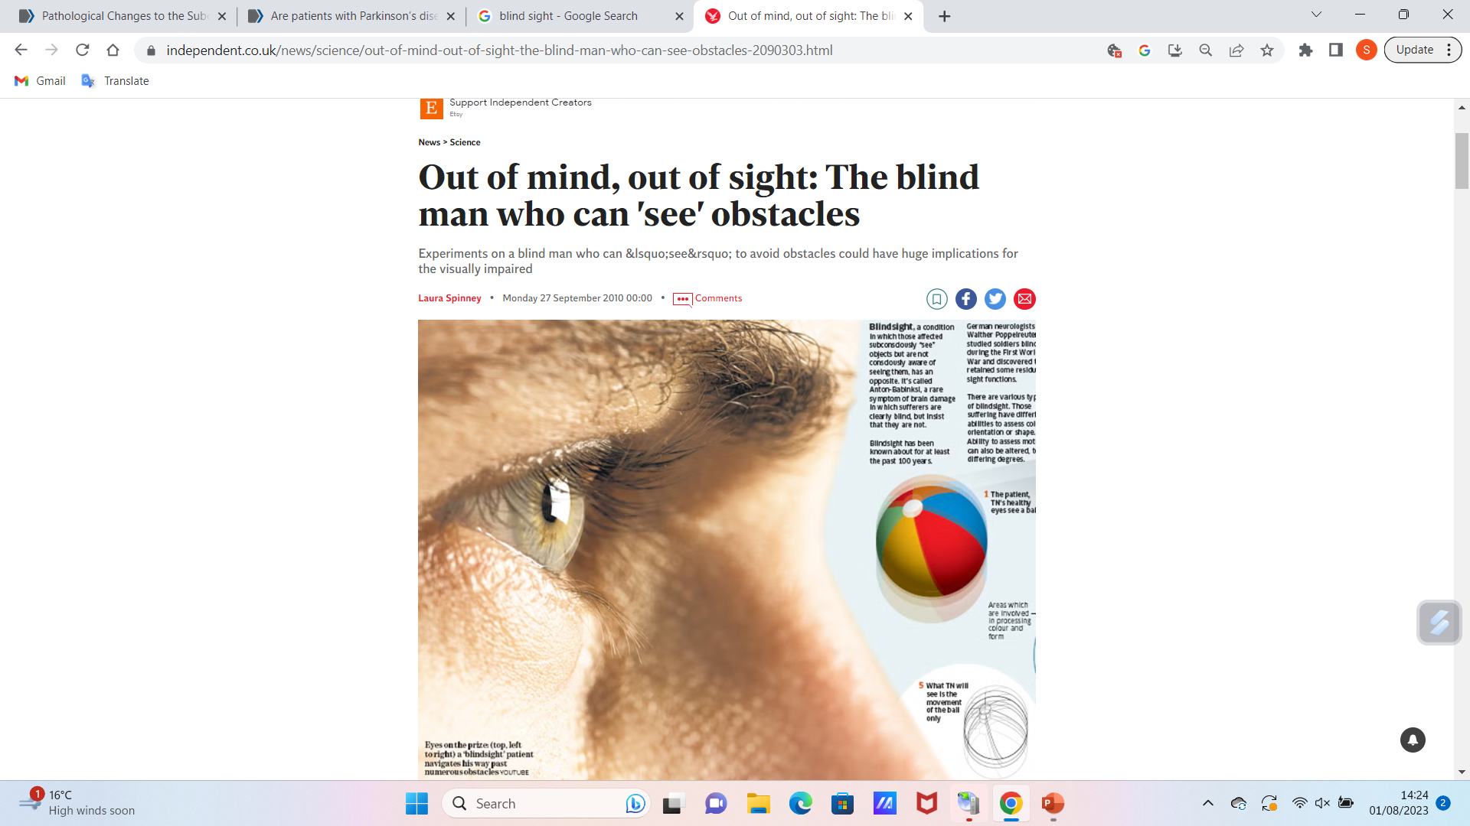
TN, …suffered a stroke in 2003 which destroyed … the primary visual cortex. The stroke affected only one hemisphere of his brain. … about a month later … a second stroke … wiped out the primary visual cortex on the other side of his brain. Suddenly, though his eyes were healthy, he became blind.
… he can still see in some situations, although he is unaware that he does so – a phenomenon known as blindsight. The most striking demonstration of this came [in 2008], when de Gelder, a neuropsychologist at Tilburg University in the Netherlands and Harvard Medical School in the US, and neuropsychologist Alan Pegna of Geneva University and others, asked him to walk down a corridor which they had arranged like an obstacle course, having littered it with tripods, filing trays and boxes. He navigated his way successfully through the obstacles, though he said he saw none of them.

Slide 23
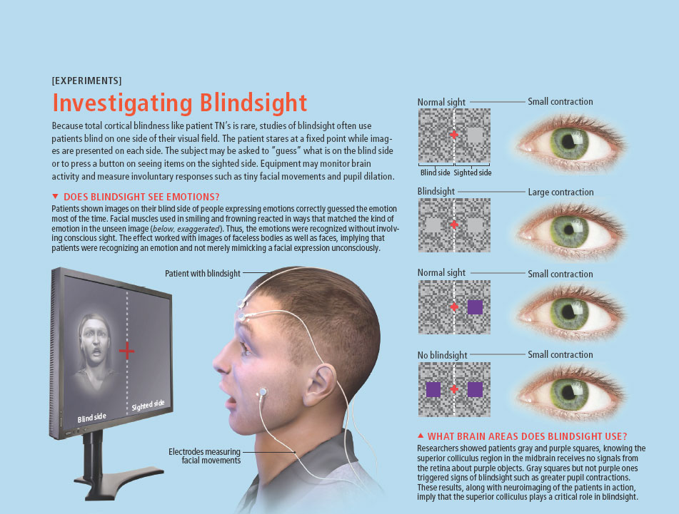

Slide 24
Blind to blind sight – effects in PD
Diedrich et al (2014)
The loss or reduction of facial expressions in PD (hypomimia) may not only be due to bradykinesia of facial muscles but also deficient emotional reactivity mediate by “real-time cell analysis” (RTCA).
“Theory of mind” (ability to consider other’s emotional states, ‘read’ their reactions, explain or predict their behaviour – vital in social interaction- is impaired.
Reduced motion detection impacts negatively on reaction times necessary for safe driving.
Implications for other NDDs?

Slide 25
Summary points
Impaired sight is significantly associated with NDDs. It is a modifiable risk factor – and should be viewed along with hypertension, smoking, excessive alcohol intake, inactivity, obesity, depression, isolation, living with pollution, hearing loss, traumatic brain injury, diabetes as a factor to manage and treat, to reduce NDD risk.
Sight problems increase the impact of NDDs – and must be actively diagnosed. Cataract removal for example can significantly increase function and QoL in PwNDDs and greatly reduce caregiver burden.
Simple tips we have discussed for improving the environment to maximise sight / reduce the impact of vision loss can be put in place and taught to patients and caregivers.
Unusual phenomena discussed such as blind sight (and blind to blind sight) and Charles Bonnet Syndrome highlight the importance of actively and frequently checking with patients and family caregivers for THEIR perspective on issues around sight.
Regular optician visits are essential, as is maintaining good care of visual aids.
We stressed the importance of avoiding diagnostic overshadowing.

Slide 26
Activity 1 – allow 20 minutes, and a further 20 minutes for a tutor led class discussion of your responses.
Make some notes on your thoughts on the following questions:
What is the relevance of understanding Charles Bonnet Syndrome when caring for a person with an advanced NDD?
What is the potential impact of being ‘blind to blindsight’ for a person with advancing Parkinson’s disease?
What reasons can you give to emphasise the importance of regular optician assessment for:
1 Elderly people generally
2 People with NDDs?

Slide 27
References
Alzheimer’s Society (2023) Sight and hearing loss with dementia, https://www.alzheimers.org.uk/about-dementia/symptoms-and-diagnosis/sight-hearing-loss#:~:text=However%2C%20people%20with%20dementia%20can,problems%2C%20but%20have%20healthy%20eyes. (Visited 28-07-2023)
Balan, I., Bilger, N., Saparov, D., Hryb, I., & Abdyraimov, A. (2023). Sleep Deprivation in Middle Age May Increase Dementia Risk: A Review. Cureus, 15(4).
Dhooge P, Klerverling B (2022), Charles Bonnet Syndrome: a condition of the visually impaired, Anneals of Eye Science, Vol 7, https://aes.amegroups.org/article/view/6863/html#:~:text=in%20this%20edition%20of%20AES,of%20vision'%20(1).
Diederich NJ, Stebbins G, Schiltz C, Goetz CG. Are patients with Parkinson's disease blind to blindsight? Brain. 2014 Jun;137(Pt 6):1838-49. doi: 10.1093/brain/awu094. Epub 2014 Apr 24. PMID: 24764573; PMCID: PMC4032103.
Ehrlich JR, Goldstein J, Swenor BK, Whitson H, Langa KM, Veliz P. Addition of Vision Impairment to a Life-Course Model of Potentially Modifiable Dementia Risk Factors in the US. JAMA Neurol. 2022 Jun 1;79(6):623-626. doi: 10.1001/jamaneurol.2022.0723.
Livingston G, Huntley J, Sommerlad A, Ames D, Ballard C, Banerjee S et al (2020) Dementia prevention, intervention and care: 2020 report of The Lancet Commission, Vol 396, issue 10248 (413-446).

Slide 28
References
Royal National Insitute of Blind People (RNIB) Charles Bonnet Syndrome, https://www.rnib.org.uk/your-eyes/eye-conditions-az/charles-bonnet-syndrome/ Visited 01 08 2023.
Tamietto M, de Gelder B. Neural bases of the non-conscious perception of emotional signals. Nature Rev Neurosci. 2010;11:697–709
Ursell P, Vision 2020 The Right To Sight UK; Dementia and Sight Loss Interest Group, https://media.rnib.org.uk/documents/Cataracts_and_dementia_factsheet.pdf
Weiskrantz L. Blindsight: a case study and implications. Oxford: Oxford University Press; 1986.

Slide 29

Any questions?

Slide 30

Thank you

Slide 31
Duration
Recorded lecture time – 1 hour 10 minutes
Activity 1 – 40 minutes (20 minutes plus 20 minutes tutor led class discussion of student responses)
Questions – 10 minutes.
Total – 2 hours.

