Slide 1
Comprehensive Care
Lecture 18
Dying

Slide 2
Aims
To understand how to care for people with NDDs with regard to the AL of dying.

Slide 3

Dying
Your care plan, as you’ve continued to evaluate interventions and reset goals should have been in a constant state of change. That’s what it takes to individualise the plan and ensure it is always responsive to evaluation and reassessment of problems you work with the client to overcome.
Dying for all us us is inevitable of course but for people with NDDs and their families it never seems so abstract, but a long process faced in reality, daily.
https://www.traditionshealth.com/blog/what-to-expect-during-end-stages-of-als/

Slide 4

Your part in the process
You are needed in that process. You give time, and you listen to fears; to practical matters and spiritual concerns.
You work with the client to tie up loose ends where possible.
S/he may want to share beliefs/ express doubts.
You may need to help communicating between the individual and family.
You have been / are doing much of this, helping in the process of dying without even realising. You will have helped ensure the maximum possible comfort.
If you at times became exasperated, even infuriated by seemingly irrational behaviour and the overwhelming general difficulty of it all, it’s because you got very involved and because you care so much - don’t allow yourself to feel guilt. It’s all to be expected.
Feel good about yourself, congratulate yourself, and take time to congratulate and reassure your colleagues too. They and you are doing great work.
https://www.compassus.com/for-caregivers/how-a-doctor-chose-his-own-path-to-hospice-care/hospice-for-advanced-huntington-s-disease/

Slide 5
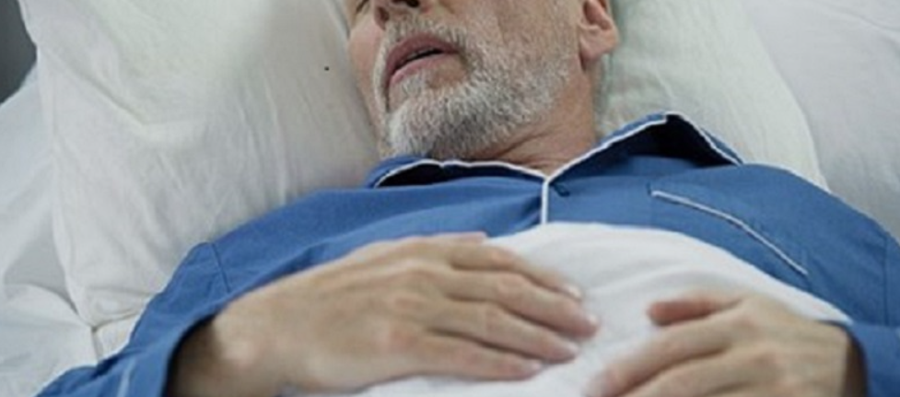
The value of teamwork
It’s important to work as a team, and to ensure everyone involved in this person’s care feels a sense of belonging to the team. Include family, nurses, care assistants, therapists, physicians of all relevant specialities….
We all need to support each other – if there is one weak connection in a chain, the whole chain is weak. It will be hard when the person we have all been involved with a long time, dies. Support each other.
No doubt as a team you did your best to establish his or her wishes, and liaise with loved ones or an advocate.
https://www.pavilionhealthtoday.com/condition/neurology/management-of-parkinson-s-disease-symptoms-in-the-last-days-of-life-a-review-and-guide/

Slide 6
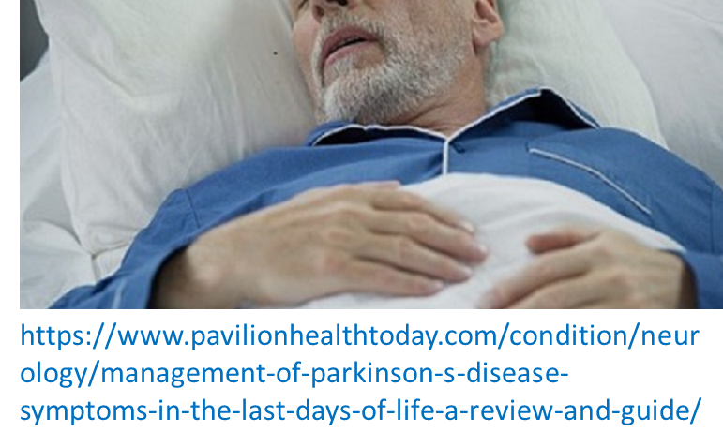
EoL care- PD
Higginson et al (2012): of 50 patients – c/o Pain 86%, fatigue 84%, difficulty communicating 58%, insomnia 58%, SoB 54%,swallowing problems 40%.
Hudson et al (2006): mention caregiver distress at choking risk.
NICE (2015): most common anticipated EoL symptoms in adults are pain, dyspnoea, nausea & vomiting, agitation, anxiety, delirium & noisy respiratory secretions. Anticholinergics and antidopaminergics may help for respiratory secretions and N&V (also? Cyclizine, domperidone, ondansetron may help in PD N&V).
For pain, simple analgesia e.g. paracetamol, NSAIDs; caution re opiates- constipation risk.
Review medications with expert – e.g., apomorphine may exacerbate N&V.

Slide 7

Also when approaching final NDD stages
Choreic movements tend to settle down whereas rigidity can increase. Gentle exercise directed by a physiotherapist can be helpful.
A therapeutic masseuse or aromatherapist can instil a sense of calm and peace through gentle hand massage.
Good mouthcare is essential as is general hygiene to avoid complications e.g. pressure sore development, changing position and good use of pressure relieving seating and mattress.
https://www.essenceofthyme.com/blog/aromatherapy-hand-massage-in-a-care-home-setting

Slide 8

‘Active dying’
Anne Robson Trust (2018): pre-active dying lasts about 3 weeks, active dying lasts about 3 days.
Signs of active dying- long pauses, irregular breathing
Coma or semi-coma, can’t be woken
Double incontinence and/ or decreased urine output; possible Discoloured urine.
Hypotension
Skin colour changes, extremities cold to touch
Hallucinations, delirium, agitation
Fluid build-up in lungs, gurgling sounds (‘death rattle’)
https://annerobsontrust.org.uk/actively-dying-what-does-it-mean/

Slide 9
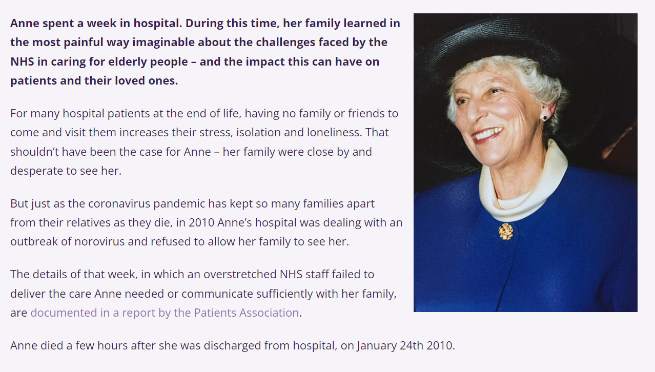

Slide 10
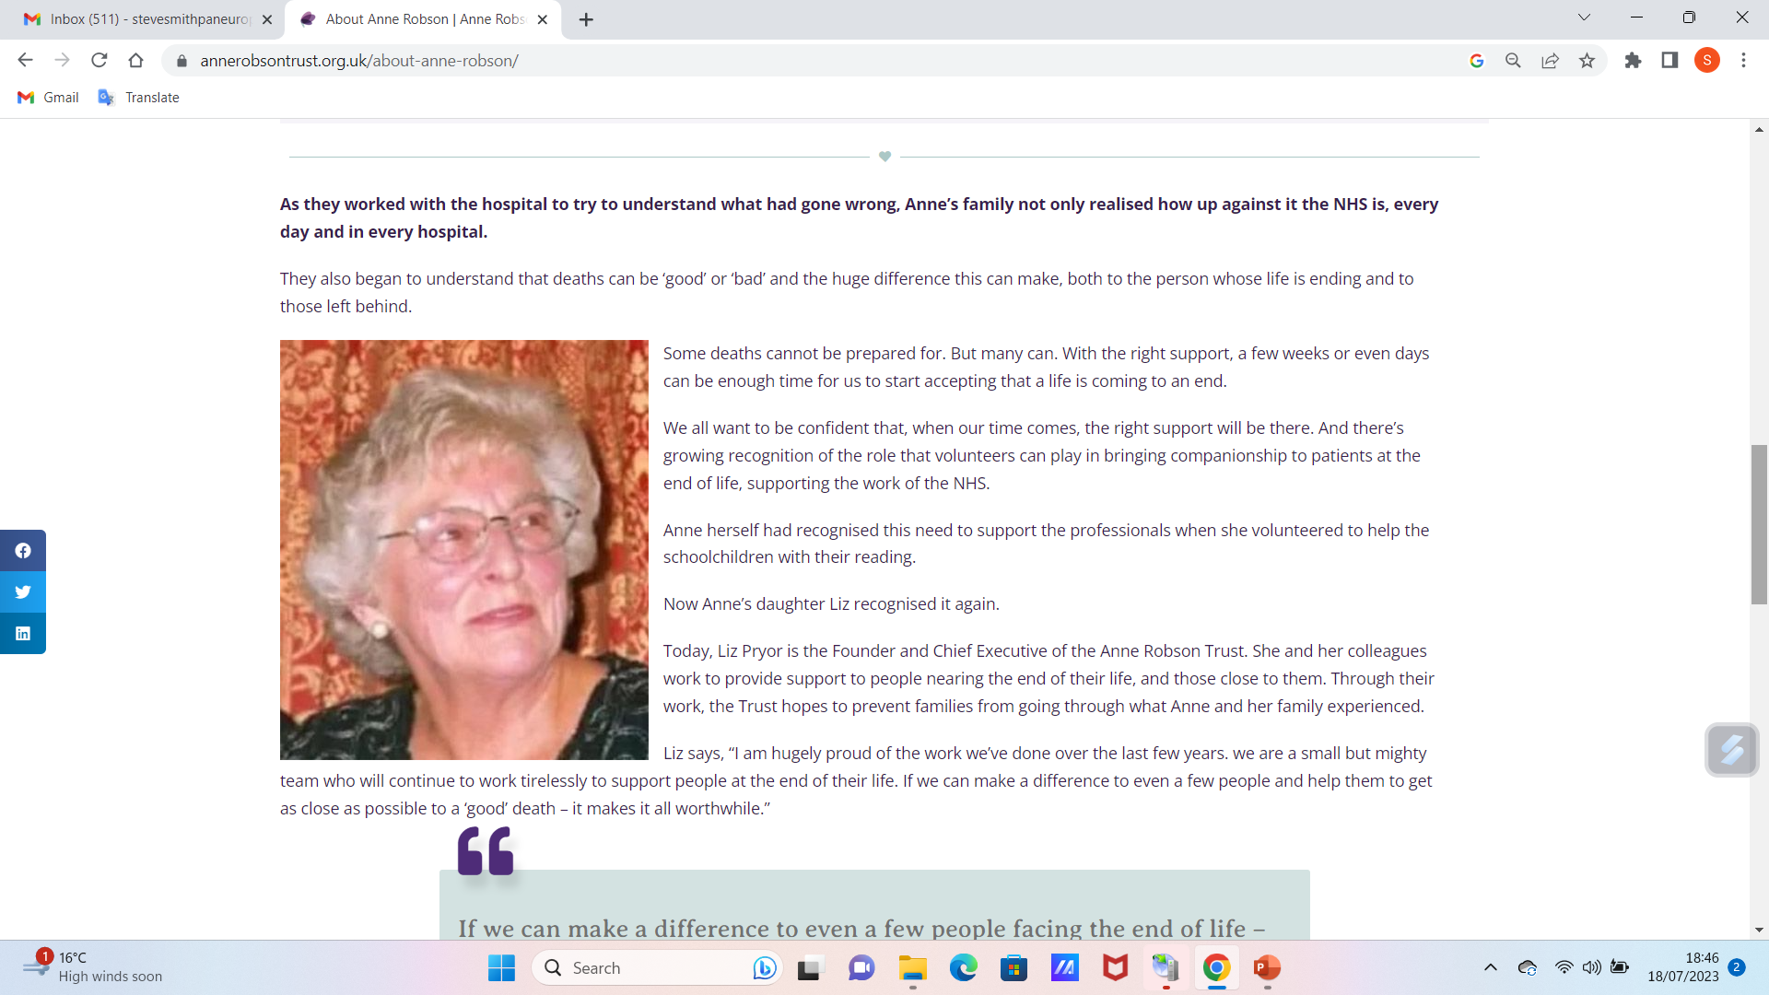

Slide 11
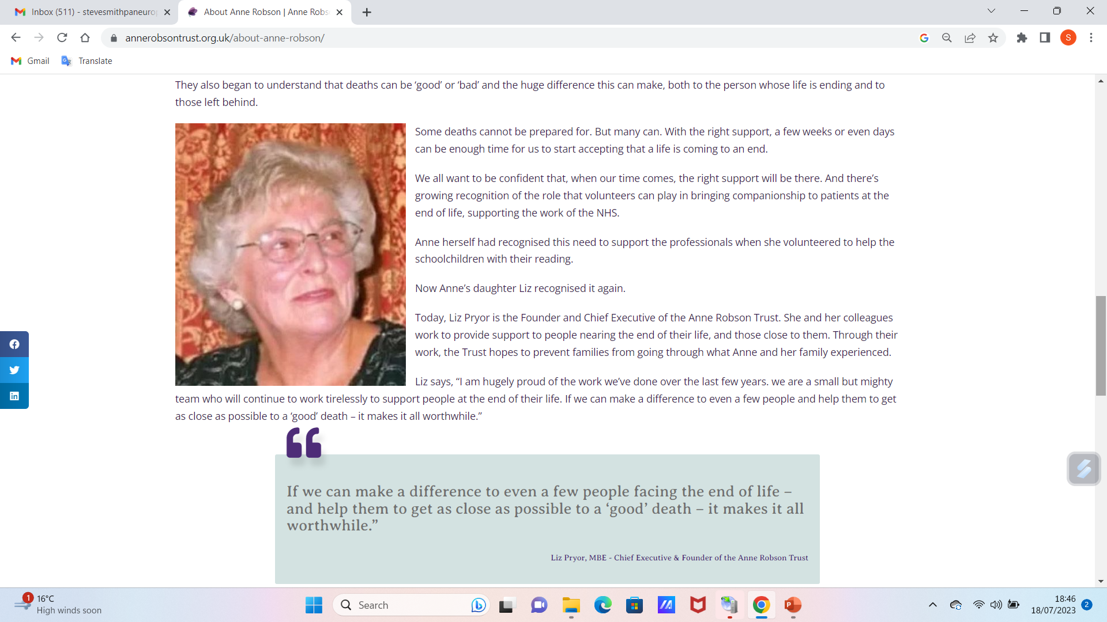

Slide 12

End of life choices
Nutrition and hydration are important factors in EoL care- but how aggressively should we pursue this? How to respond if swallowing/ chewing / oral intake / aspiration deteriorate. (recall the Eating and Drinking lecture, section on decisions around tube feeding).
Donating brain tissue for research. Think about sociocultural factors – a gift of hope for future generations, a way of living on, or an unthinkable action?
How to deal with wishes that can’t be achieved, e.g. a brain donation can’t go ahead- no current study / no funds for the research.
Keeping up to date with current local practicalities, and communicating with family.
https://www.pewtrusts.org/en/research-and-analysis/articles/2016/03/22/end-of-life-decision-making

Slide 13
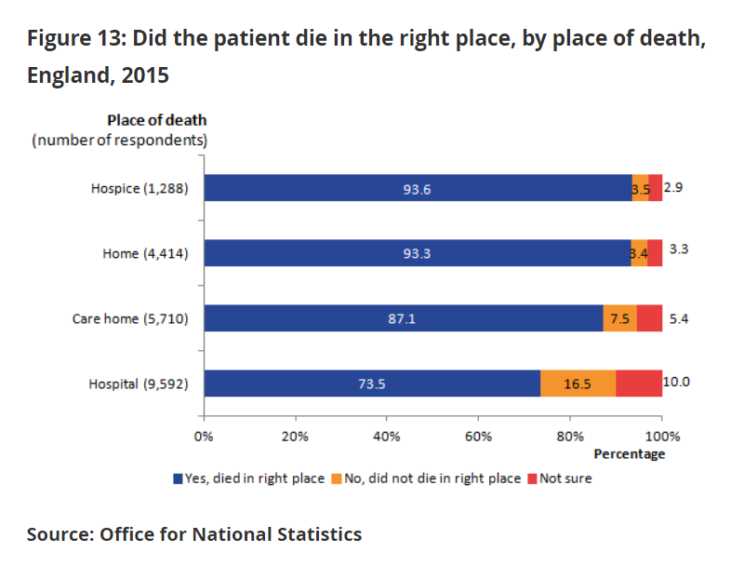
Dying at home versus dying in an institution /hospital.
But- Hoare et al (2019) found that while hospital admissions at end of life are negatively perceived, family caregivers and healthcare staff find enormous challenges in providing care at home. Hoare et al refer to a gulf between nursing and care needs at home and capacity of caregivers and nurses to respond (issues mainly around staff unavailable to respond when / as needed, and provision of equipment when, as needed).
We emphasise choice ---- it MUST be an informed choice!
21,004 bereaved respondents
Colvin H (2015)

Slide 14

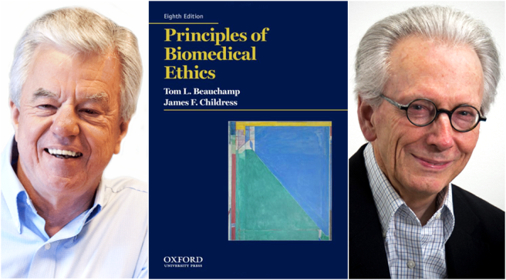
Living wills
In the UK a living will is a form that enables people to refuse medical treatments in the future. It will only be used in the absence of mental capacity. Fairly similar advanced directives exist in many countries including many in Western European, Canada, America, And Australia.
In Sri Lanka advanced directives aren’t legalised. Chang et al (2021) found that many Sri Lankan doctors lacked knowledge of A.D.s and would administer a life saving blood transfusion even in the presence of an advanced written refusal – prioritising beneficence over autonomy.
Clearly there are cultural differences. Is beneficence about acting in the person’s best interests? Physical, psychological, sociocultural interests? There are politicoeconomic concerns- you must work within the law. And we are bound to act ethically. Can ethics and law collide?
These are professional conundrums to consider in the context of the country you are working in.
https://chilternwills.com/living-will-or-advance-decision/

Slide 15
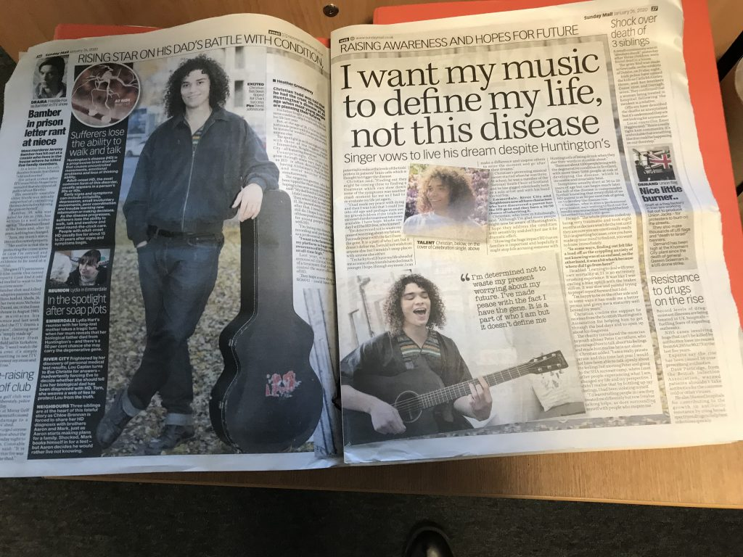
Giving hope
Historically NDDs were greatly misunderstood. Many treated as criminals, or punished by God.
Your care planning is possible because of progress and enlightenment.
Openness is increasingly common, leading to support groups for dementia, PD, HD etc. and caregiver support groups.
Drug advances
Surgical advances
Technological advances
Spiritual support
https://hdscotland.org/christian-i-hope-to-be-a-positive-role-model-for-young-people/

Slide 16
Suicide risk
Wong et al (2022): risk of suicide in dementia and dementia caregivers increases after diagnosis and after deterioration, but estimates of risk vary.
There is similar evidence for elsewhere in the world, and tragic supporting anecdotes e.g. Schmutte et al (2021); Portacolone et al (2022).
Parkinson’s disease- increased suicide risk that can’t be explained by co-morbid mental health conditions (Chen et al 2020).
Fang et al (2008): cohort study, 6,642 ALS patients (Sweden) 1965-2004. 3.6 suicides predicted based on population- 21 actual ALS suicides. – 6-fold relative risk.
HD- markedly elevated suicide risk (Alothman et al 2022).

Slide 17
Safeguarding tips re suicide in HD
HDSA https://hdsa.org/find-help/clinical-care-services/suicide-prevention/
Things to look for include:
Depressed mood
Expressed feelings of hopelessness
Expressed desire to be alone
Withdrawal from activities, friends, family, or society
Talk about “ending it all,” “not dealing with it anymore,” or generally about death
Active planning, for example specifically stating what he or she would do
Stated desire to put their life in order by saying goodbye to people or giving away possessions
Changes in behaviour such as increased agitation or sleeping much more (or much less)
A sudden change in mood from depressed to happy.

Slide 18
Response to suicidal ideation in NDDs
In emergency - know appropriate number/s to contact for urgent psychiatric intervention.
Generally- involve psychologist, therapist, counsellor, social worker, with NDD expertise.
Access support group/s.
Support a self-care plan – as much as possible, foster relaxing activities (helps with sleep), engage in exercise, have time outside, boost engagement with others, satisfying pastimes/ interests/ meeting others- meaningful friendships, family, frequent phone calls/ visits.

Slide 19
Treatment advances PD
Gene therapy: Glial cell line-derived neurotrophic factor- GDNF is a protein naturally produced in the brain. Parkinson’s UK’s research on whether it could slow, stop or reverse the progression of Parkinson’s proved inconclusive. They’re investing in planning a possible new trial. There is reason to believe this line of inquiry may offer future hope. https://www.parkinsons.org.uk/research/gdnf-glial-cell-derived-neurotrophic-factor
DBS – a well established treatment in PD, becoming more refined targeting and adjusting stimulation settings in response to symptoms, to optimise therapy and improve outcomes.
https://www.uclahealth.org/news/advances-in-deep-brain-stimulation-for-parkinsons-disease#:~:text=Deep%20brain%20stimulation%20involves%20surgically,some%20control%20within%20certain%20parameters.
Non-invasive brain stimulation: transcranial magnetic stimulation (TMS) and transcranial direct current stimulation (tDCS) – further research needed but showing promise regarding improvement to motor function and reducing levodopa-induced dyskinesias
Montemurro N, Aliaga N, Graff P, Escribano A, Lizana J. New Targets and New Technologies in the Treatment of Parkinson’s Disease: A Narrative Review. International Journal of Environmental Research and Public Health. 2022; 19(14):8799. https://doi.org/10.3390/ijerph19148799

Slide 20
More Treatment advances NDDs
HD: Antisense oligonucleotids (ASO) therapy: short DNA or RNA sequences that can specifically bind to the mRNA produced by the faulty gene. This can reduce the production of the toxic huntingtin protein. Promising recent trials suggest ability to reduce huntingtin levels in patient CSF. https://www.mdpi.com/1660-4601/19/14/8799
HD: A summary – various approaches Palaiogeorgou, et al (2023) Recent approaches on Huntington's disease (R eview). https://www.spandidos-publications.com/10.3892/br.2022.1587
LBD: Mechanisms remain unclear, highlighting importance of accurate differential diagnosis re AD, delirium, PD. https://www.sciencedirect.com/science/article/pii/S0011502922001250
AD: Halting progression seems a way off but many strategies improve QoL: Pardo-Mareno T et al (2023) https://www.mdpi.com/1999-4923/14/6/1117.
ALS: Improvements in diagnosis and prognosis help families improve EoL planning- Goutman S et al (2022)https://www.sciencedirect.com/science/article/abs/pii/S1474442221004658

Slide 21

Spiritual care for people with NDDs
De Diego-Cordero R et al (2022) Spiritual Dimension in Neurological and Neurodegenerative Diseases: A Systematic Mapping Review- Conclusions:
Spirituality in patients with a neurological disorder seems to be closely related to a higher quality of life and emotional well-being.
The spiritual dimension is an important aspect in adaptation and coping with neurological diseases, considering religious faith as a resource that can help these patients accept and cope with their condition.
There is a lower incidence of some neurological disorders in patients with strong religious beliefs and practices compared to the general population, with the lifestyles recommended by certain religions being a protective factor against the development of certain diseases and health problems.
In addition, spiritual practices such as yoga have been shown to have positive effects and to be an effective aid in the treatment of some neurological disorders. However, it is necessary to take the appropriate measures to avoid possible adverse effects when performing advanced yoga practices.
https://blog.encompasshealth.com/2019/10/05/spiritual-care-and-dementia/

Slide 22
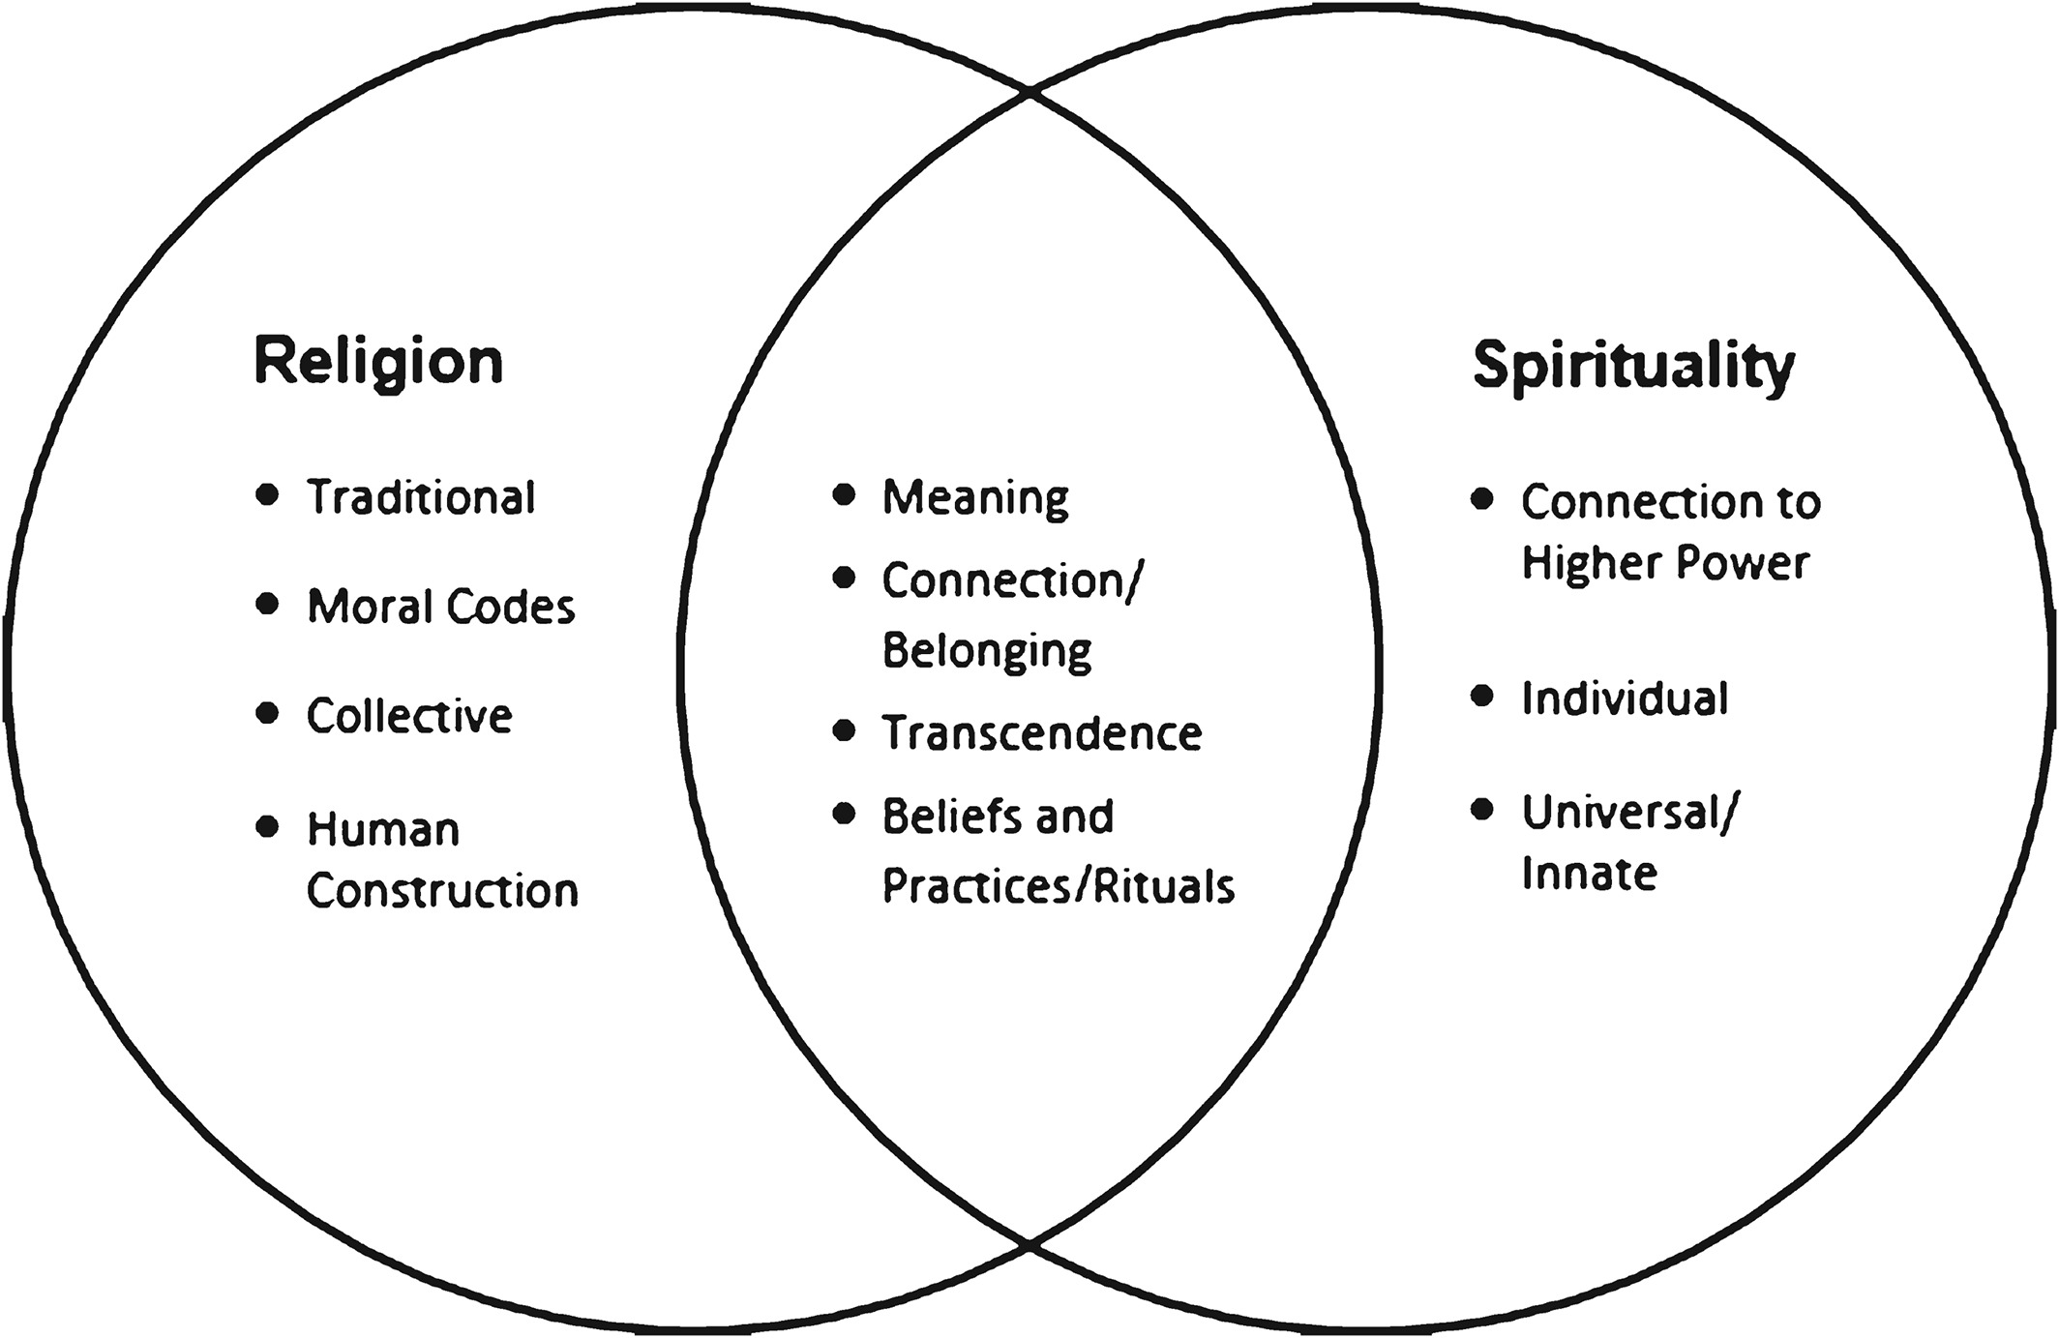
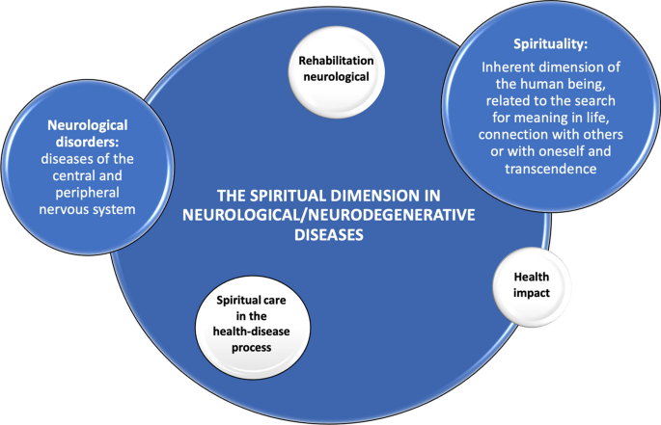
Spiritual care for people with NDDs De Diego-Cordero R et al (2022) Spiritual Dimension in Neurological and Neurodegenerative Diseases: A Systematic Mapping Review- Conclusions:
http://www.haridasa.org/religion-and-spirituality-the-uniqueness-and-divergence-between-the-two-2/

Slide 23
Care for people with NDDs with regard to the AL of dying – Summary 1
Physical care- Nurses/ caregivers should consider pain management, providing comfort, maintaining personal hygiene including good mouthcare, assisting with mobilising and ensuring adequate nutrition and hydration. Monitoring and adapting to changes in physical ability is key to promoting comfort and dignity.
Psychological and emotional support- supportive and empathetic presence, active listening to concerns and fears, facilitating open communicating, addressing distress, anxiety, depression, and seeking expert intervention as needed.

Slide 24
Care for people with NDDs with regard to the AL of dying – Summary 2
Social and spiritual needs- recognising and respecting spiritual and social needs is essential. Maintain social connections, facilitate meaningful interactions with loved ones, ensure opportunities for spiritual expression according to beliefs and preferences, encourage engagement with activities with personal significance such as reminiscence or spiritual rituals, encouraging a sense of fulfilment.
Advance Care Planning – support end of life decision-making, including preferences for medical interventions, resuscitation and life-sustaining interventions. Ensure wishes are clearly documented and known to those who need to know.

Slide 25
Care for people with NDDs with regard to the AL of dying – Summary 3
Family & caregiver support – provide emotional support, respite care, and practical assistance to help ease / reduce caregiver burden and promote wellbeing. Education on disease progression, symptom management and EoL care, to empower them to anticipate, better understand and prepare for challenges they may face.
Interdisciplinary collaboration – aimed at empowering the individual and loved ones.

Slide 26
Scenario
Regarding the scenario below, could you come up with a care plan that could be put in place, concisely identifying the key problem and the goal and interventions with rationale?
John is aged 52 and is in the final stages of ALS. He is experiencing widespread neuropathic pain – burning, tingling, shotting and electrical sensations, probably aggravated by muscle spasms due to increased tone; contractures and joint pain due to muscle weakness and atrophy; and positional pain and pain on pressure areas due to prolonged immobility. The nursing team also recognise psychological and emotional pain involving anxiety, depression and existential pain (pain without clear connection to physical pain, related to thoughts around life and death). The team have worked together to provide a good holistic care plan, but there is some disagreement around the administration of pain medication and its potential impact on John’s QoL and level of consciousness.
One nurse advocates an aggressive approach, emphasising the need to administer high doses to adequately enhance comfort and wellbeing in John’s final days.
Another expresses concerns about the potential adverse effects of pain medication such as sedation and reduced cognitive function. This view is that preserving John’s level of consciousness is crucial to his continued ability to interact with loved ones, making meaningful connections and retain a sense of dignity in these last stages.
Can you suggest a care plan that concisely identifies the problem, goal and interventions for this team, to help address this dilemma?
Problem | Goal | Intervention | Evaluation

Slide 27
Scenario – my attempt – you may do better!
Problem | Goal | Intervention | Evaluation
Various viewpoints on appropriately balancing pain management and consciousness for John have been expressed within the team. | To provide effective pain management while respecting the patient’s desire for consciousness and maintaining a sense of dignity during the end-of-life phase | Utilise pain assessment tools to evaluate the intensity and nature of John’s pain. Incorporate subjective reports, non-verbal cues and physical indicators and the impact on QoL and wellbeing. Collaborate with John, his family and healthcare team to establish an individualised plan. Consider his preferences, values and goals regarding pain relief and consciousness levels. Combine pharmacological and non-pharmacological interventions to optimise control. Analgaesics including opiates and non-opioid medicines administered orally, transdermally or other routes to be considered with possible physiotherapy, massage therapy, relaxation techniques heat or cold therapy and guided imagery. Encourage John to communicate pain levels using a rating scale and also unwanted effects to aid monitoring. Foster ongoing open communicating with John, his family and healthcare team regarding pain management goals, expectations and concerns. Address any misconceptions or fears about pain management and promote shared understanding and informed, collaborative decision-making. Assess and address John’s emotional and psychological wellbeing and provide appropriate support and counselling. Collaborate with Social Workers, counsellors and palliative care specialists to address psychological distress anxiety and existential pain. Offer John opportunities to express emotions, fears and concerns in a safe, supportive environment. | Maintain accurate, detailed documentation of pain assessments, interventions, patient responses and modifications to the care plan. Continue collaboration with the MDT to review and modify the pan as appropriate on an ongoing basis.

Slide 28
References
Alothman, D., Marshall, C.R., Tyrrell, E. et al. Risk of mortality from suicide in patients with Huntington’s disease is increased compared to the general population in England. J Neurol 269, 4436–4439 (2022). https://doi.org/10.1007/s00415-022-11085-z
Anne Robinson Trust (2018) Actively dying: what does it mean? https://annerobsontrust.org.uk/actively-dying-what-does-it-mean/
Chang, T., Darshani, S., Manikavasagam, P. et al. Knowledge and attitudes about end-of-life decisions, good death and principles of medical ethics among doctors in tertiary care hospitals in Sri Lanka: a cross-sectional study. BMC Med Ethics 22, 66 (2021). https://doi.org/10.1186/s12910-021-00631-5
Chen Y, Yu S, Hu Y, et al. Risk of Suicide Among Patients With Parkinson Disease. JAMA Psychiatry. 2021;78(3):293–301. doi:10.1001/jamapsychiatry.2020.4001
Colvin H (2015) National survey of bereaved people (Voices) England 2015, https://www.ons.gov.uk/peoplepopulationandcommunity/healthandsocialcare/healthcaresystem/bulletins/nationalsurveyofbereavedpeoplevoices/england2015#preferences-and-choice-at-the-end-of-life
de Diego-Cordero R, Martos-Lorite I, Vega-Escaño J. Spiritual Dimension in Neurological and Neurodegenerative Diseases: A Systematic Mapping Review. J Relig Health. 2022 Oct 15:1–19. doi: 10.1007/s10943-022-01683-6. Epub ahead of print. PMID: 36243837; PMCID: PMC9569166.
Fang F, Valdimarsdóttir U, Fürst C, Hultman C, Fall K, Sparén P, Ye W, (2008) Suicide among patients with amyotrophic lateral sclerosis, Brain, 131, (10), 2729-2733, https://doi.org/10.1093/brain/awn161 https://academic.oup.com/brain/article/131/10/2729/264308
Goutman S et al (2022) Recent advances in the diagnosis and prognosis of amyotrophic lateral sclerosis, The Lancet, 21(5) 480-493, https://www.sciencedirect.com/science/article/abs/pii/S1474442221004658
Higginson I, Gao W, Saleem T, Chaudhuri K, Burman R, McCrone P, Leigh P. (2012) Symptoms and quality of life in late stage Parkinson syndromes: a longitudinal community study of predictive factors. PLoS One;7(11):e46327. doi: 10.1371; https://pubmed.ncbi.nlm.nih.gov/23144781/

Slide 29
References 2
Hoare S, Kelly M, Barclay S (2019) Home care and end-of-life hospital admissions: a retrospective interview study. BJGP; 18 June 2019; DOI: 10.3399/bjgp19X704561
Hudson P, Toye C, Kristjanson L. (2006) Would people with Parkinson's disease benefit from palliative care? Palliat Med. 20(2):87-94. doi: 10.1191/0269216306pm1108oa. PMID: 16613404. https://pubmed.ncbi.nlm.nih.gov/16613404/#:~:text=These%20data%20revealed%20that%20people,with%20PD%20and%20their%20families.
NICE (2015) Guideline (NG31) Care od adults in the last days of life, https://www.nice.org.uk/guidance/ng31
Kong JW, Park JY. Understanding Suicide Risk in People with Dementia and Family Caregivers in South Korea: A Systematic Review. Behavioral Sciences. 2022; 12(4):97. https://doi.org/10.3390/bs12040097 https://www.mdpi.com/2076-328X/12/4/97
Montemurro N, Aliaga N, Graff P, Escribano A, Lizana J. New Targets and New Technologies in the Treatment of Parkinson’s Disease: A Narrative Review. International Journal of Environmental Research and Public Health. 2022; 19(14):8799. https://doi.org/10.3390/ijerph19148799
Parkinson’s UK (2023) GDNF (Glian cell-derived neurotrophic factor) https://www.parkinsons.org.uk/research/gdnf-glial-cell-derived-neurotrophic-factor
Pardo-Moreno T, González-Acedo A, Rivas-Domínguez A, García-Morales V, García-Cozar FJ, Ramos-Rodríguez JJ, Melguizo-Rodríguez L. Therapeutic Approach to Alzheimer’s Disease: Current Treatments and New Perspectives. Pharmaceutics. 2022; 14(6):1117. https://doi.org/10.3390/pharmaceutics14061117, https://www.mdpi.com/1999-4923/14/6/1117
Palaiogeorgou, A.M., Papakonstantinou, E., Golfinopoulou, R., Sigala, M., Mitsis, T., Papageorgiou, L. ... Vlachakis, D. (2023). Recent approaches on Huntington's disease (Review). Biomedical Reports, 18, 5. https://doi.org/10.3892/br.2022.1587
Portacolone E, Byers A, Halpern J, Barnes D (2022) Addressing Suicide Risk in Patients Living With Dementia During the COVID-19 Pandemic and Beyond, The Gerontologist, Volume 62, Issue 7, September 2022, Pages 956–963, https://doi.org/10.1093/geront/gnac042

Slide 30
References 3
Prasad S (2023) Recenet advances in Lewy body dementia: a comprehensive review, Disease-a-month 69(5) 101441, https://www.sciencedirect.com/science/article/pii/S0011502922001250
Rook ME, Southwell AL. Antisense Oligonucleotide Therapy: From Design to the Huntington Disease Clinic. BioDrugs. 2022 Mar;36(2):105-119. doi: 10.1007/s40259-022-00519-9. Epub 2022 Mar 7. PMID: 35254632; PMCID: PMC8899000. https://www.mdpi.com/1660-4601/19/14/8799
Schmutte T, Olfson M, Maust D, Xie M, Marcus S (2021) Suicide risk in first year after dementia diagnosis in adults, Alzheimer’s and Dementia, 18 (2) 262-271, https://alz-journals.onlinelibrary.wiley.com/doi/epdf/10.1002/alz.12390
UCLA (2020) Advances in deep brain stimulation for Parkinson’s disease, https://www.uclahealth.org/news/advances-in-deep-brain-stimulation-for-parkinsons-disease#:~:text=Deep%20brain%20stimulation%20involves%20surgically,some%20control%20within%20certain%20parameters.

Slide 31

Any questions?

Slide 32

Thank you

Slide 33
Duration – 2hours 45 minutes
Recorded lecture time: 1 hr, 45 minutes
Activity 1- care plan / scenario: 20 minutes
Tutor-led discussion on activity 1: 20 minutes
Questions / tutor-led discussion: 20 minutes
Total duration: 2 hours, 45 minutes

