Slide 1
Comprehensive Care
Lecture 17
Sleeping

Slide 2
Aims
To understand how to care for people with NDDs with regard to the AL of sleeping.

Slide 3
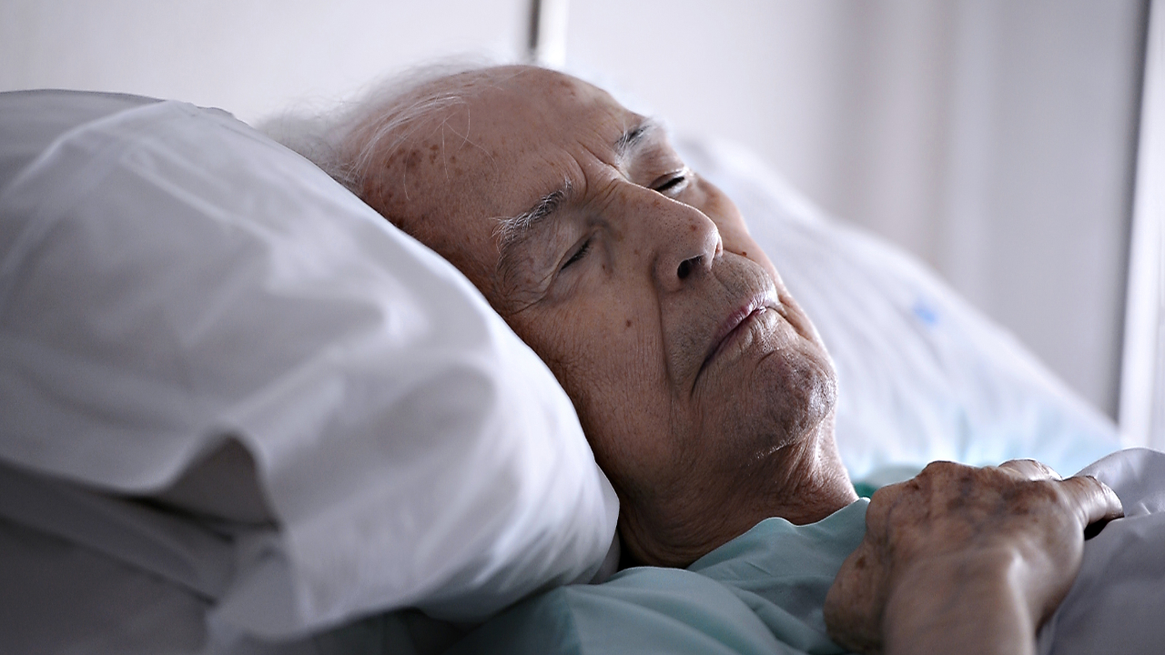
Sleeping
Movement disorders can leave people exhausted. Depleted. Fatigued.
Chorea demands constant effort to keep upright, balance, eat and drink while avoiding choking.
Bradykinesia, stiffness, rigidity require enormous work to be able to initiate and continue movement to carry out all the Als.
Whether it’s due to the high calorific demand of chorea, or the difficulties in chewing and swallowing in other conditions, people with NDDs often go to bed hungry, making sleep difficult.
If the person with an NDD is overtired and cannot settle to sleep they may get up and wander- they are at huge risk of injury and so need supervision, and saving from falls; redirecting to bed…again and again.
Coss K (2019) More than movement: treating sleep problems in Parkinson’s, Inquiry, University of Minnesota, https://research.umn.edu/inquiry/post/more-movement-treating-sleep-problems-parkinsons
Coss & team are investigating adaptation of DBS in PD to help sleep problems

Slide 4

Care for the carer
The trouble is, caregivers- family members/ partners, neighbours perhaps, or qualified carers / nurses are exhausted too.
In a home for multiple residents, I found it rare to get a moment during the night when ALL the residents were asleep. Many chores needed doing overnight – difficult to achieve when on constant guard duty.
https://alsnewstoday.com/forums/forums/topic/sleep-and-als/

Slide 5
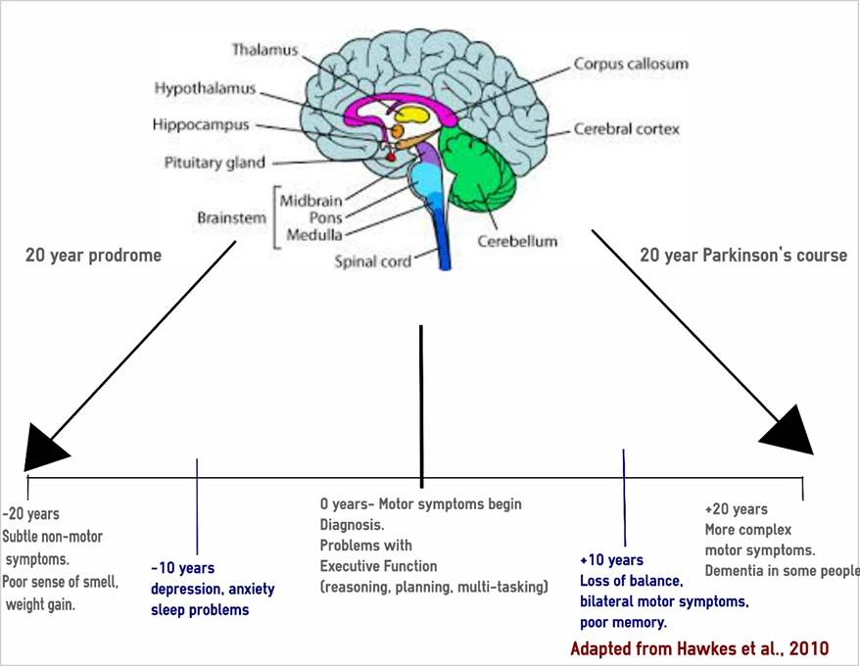
Incidentally – typical PD trajectory
Picture from: Pushpanathan M (2019) Parkinson’s disease: when you sleep better, you feel better, Research Impact, University of Western Australia, https://researchimpact.uwa.edu.au/research-impact-stories/parkinsons-and-sleep/

Slide 6
Sleep and cognition in PD
Sleep measures used in large-scale studies were not demonstrating clear relationships between sleep symptoms and the types of cognitive problems experienced.
Patients with sleep problems had poorer memory and thinking skills; particularly planning, problem-solving and mental flexibility.
Sufficient, good quality sleep at night had a significant positive impact on a person’s overall cognitive functioning.
There were also effects of poor sleep on a range of cognitive functions specifically in the areas of:
long term verbal memory, and
executive function (thinking skills), such as ability to shift attention, update working memory, generativity (mental flexibility) and fluid reasoning (solving unfamiliar problems).
Pushpanathan M et al (2016) The relationship between sleep and cognition in Parkinson’s disease: a meta analysis, Sleep Medicine Reviews, 26, 21-32, https://www.sciencedirect.com/science/article/abs/pii/S1087079215000696

Slide 7

Sleep problems in ALS
Sleep disturbances are extremely common in ALS and substantially add to the burden of disease for both patients and caregivers. Disruption of sleep can be caused by physical symptoms, such as muscle cramps, pain, reduced mobility, spasticity, mucus retention, and restless legs syndrome. In addition, depression and anxiety may lead to significant insomnia.
Since no curative treatment can be offered to affected patients, sleep complaints should be thoroughly investigated in order to identify any treatable causes and improve QoL as much as possible. Hypnotic use should be confined to palliation during the terminal phase and refractory (i.e. treatment-resistant) insomnia in earlier stages of the disease, taking into account that most compounds potentially aggravate SDB (Sleep-disordered breathing).
https://alsnewstoday.com/news/poor-sleep-common-newly-diagnosed-als-patients/
Boentert M. Sleep disturbances in patients with amyotrophic lateral sclerosis: current perspectives. Nat Sci Sleep. 2019 Aug 9;11:97-111. doi: 10.2147/NSS.S183504. PMID: 31496852; PMCID: PMC6701267.

Slide 8

Sleep problems in HD
The most common sleep problems reported by HD patients include insomnia, difficulties in falling asleep, frequent nocturnal awakenings, and excessive daytime sleepiness.
Sleep disorders in HD have diverse and complex determinants…Sleep and circadian rhythm disorders in HD might be associated with …depression, mania, and anxiety…involuntary movements and increased motor activity during sleep. Moreover, the pattern of sleep disorders in HD is often altered by the many drugs used to alleviate the core symptoms of the disease, a substantial number of which may adversely affect sleep.
Disorders of sleep and the circadian rhythm in patients with HD can contribute to exacerbation of symptoms such as irritability and anxiety, as well as cognitive disorders that can interfere with daily functioning more than the motor symptoms. The effective treatment of sleep disorders in HD patients may play an important role in improving the quality of their life, helping them cope with everyday problems, and relieving the cognitive and emotional symptoms. It should also have a great impact on the quality of sleep of caregivers and thus create the opportunity to delay patients’ institutionalization.
Morton J (Wild E, Editor) (2013) https://en.hdbuzz.net/115
Herzog-Krzywoszanska R, Krzywoszanski L. Sleep Disorders in Huntington's Disease. Front Psychiatry. 2019 Apr 12;10:221. doi: 10.3389/fpsyt.2019.00221. PMID: 31031659; PMCID: PMC6474183.

Slide 9

Sleep problems and dementia
Insomnia- think pain, discomfort, breathing problems, heartburn, UTI, incontinence, anxious, depression, medicines. (to improve dementia symptoms e.g. donepezil, rivastigmine, or galantamine. These drugs can also lead to very vivid dreams or nightmares. If this happens, they may find taking their medication in the morning rather than at bedtime helps).
There are drugs that can help a person get to sleep more easily. However, most have unpleasant or potentially dangerous side effects, such as dizziness and an increased risk of falls. This makes them less safe for a person with dementia to take. They tend to only be prescribed for very short-term use when the person has severe sleep problems.
https://www.alzaids.com/insomnia-and-dementia/

Slide 10
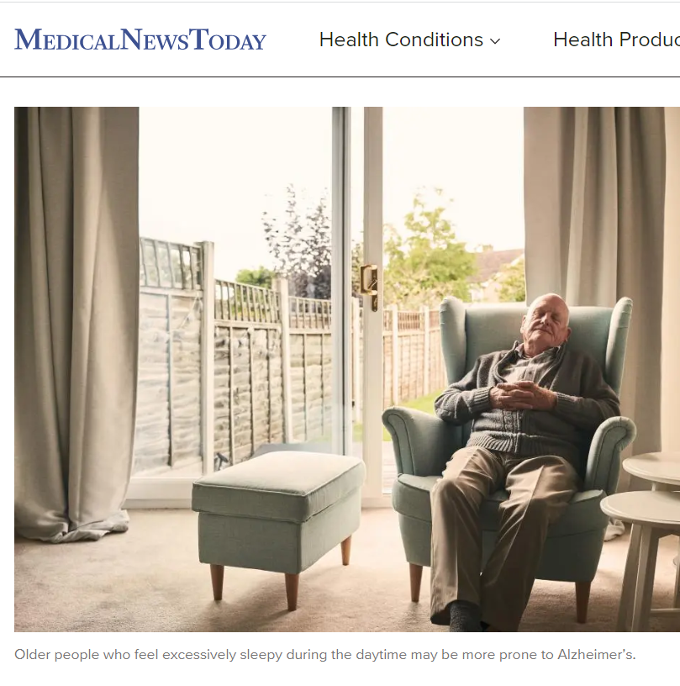
Sleep problems and dementia
Excessive daytime sleepiness – disruption of body clock, multiple daytime naps impacts on sleep at night. Most common in DLB, PD dementia and advanced AD.
It increases chances of hallucinations and delusions.
Healthy sleep routine helps: encourage sleepiness an hour before bed, regular activities in day, including a walk, good natural daylight exposure, puzzles, fun, meals at predictable times.
Avoid alcohol & caffeine.
Avoid hunger, thirst, being too full.
If daytime naps are needed, ensure they last no more than 30-60 mins.
https://www.medicalnewstoday.com/articles/321186

Slide 11
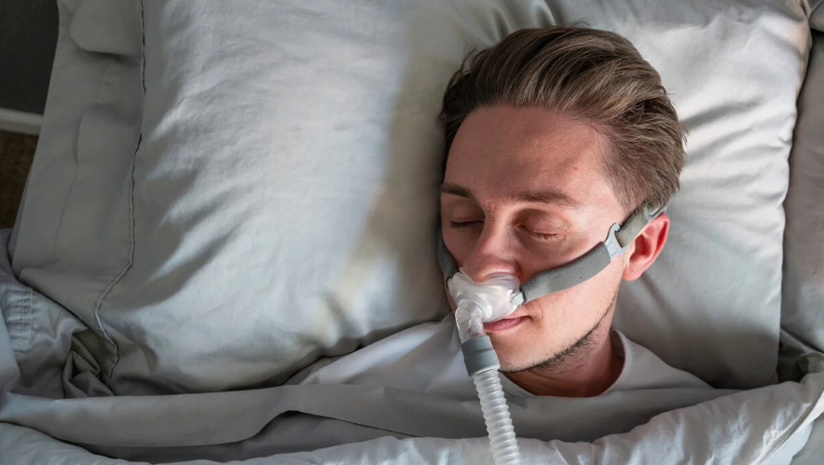
Sleep problems and dementia
Sleep-disordered breathing- The most common is sleep apnoea.
can cause drowsiness, low mood and headaches when the person is awake. It can also contribute to dementia symptoms becoming worse over time.
Can be serious. See GP. CPAP could be recommended.
Some simple adjustments to their sleeping behaviour can help. These include: sleeping on one side of the body (usually left); not smoking or drinking alcohol before going to sleep; not taking sleeping pills (unless prescribed by the doctor) as these can make the condition worse.
https://www.healthline.com/health-news/sleep-apnea-may-increase-your-risk-of-cognitive-decline-dementia

Slide 12
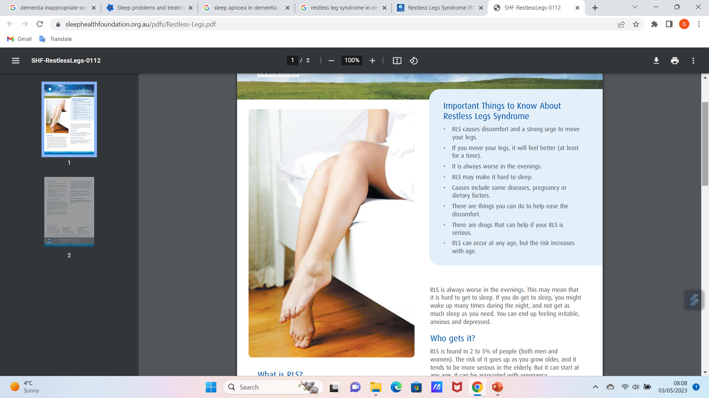
Sleep problems and dementia
Restless leg syndrome- strong urge to move limbs while awake and at rest. Cannot relax properly, impacts on sleep at night.
Unpleasant symptoms e.g. aching, tingling, only relieved by moving, may need to get up and walk around. With aphasia may rub legs to indicate to you.
Cause not understood well. More common in DLB /PD dementia, (and in pregnancy) also arthritis, diabetes, thyroid and kidney disorders, iron deficiency, and if taking medication for depression & anxiety.
Treatments include daytime physical exercise, massage, acupuncture, inflatable compression device on legs [contraindicated if may have arterial disease, or confused, prone to falls] , but a lack of evidence for any of these – maybe worth trying. Iron supplements may help. Medicines for RLS include pramipexole, ropinirole, rotigotine, but may exacerbate hallucinations, delusions if had psychosis previously especially in DLB/ PD dementia.
https://www.sleephealthfoundation.org.au/pdfs/Restless-Legs.pdf

Slide 13

Sleep problems and dementia
Periodic limb movement disorder- unconsciously move limbs, mostly legs and feet in sleep. Causes waking and lack of deep sleep.
More common in DLB / PD dementia.
Antidepressants, allergy medicines, anti-emetics, anti-psychotics may cause PLD (Periodic Limb Disorder).
So- important to review medicines, consider alternatives.
GPs tend to avoid treating with medication but if necessary may try those used for RLS.
http://www.sleepdisordersresource.com/sleep-movement-disorders/periodic-limb/periodic-limb-movement-disorder/

Slide 14
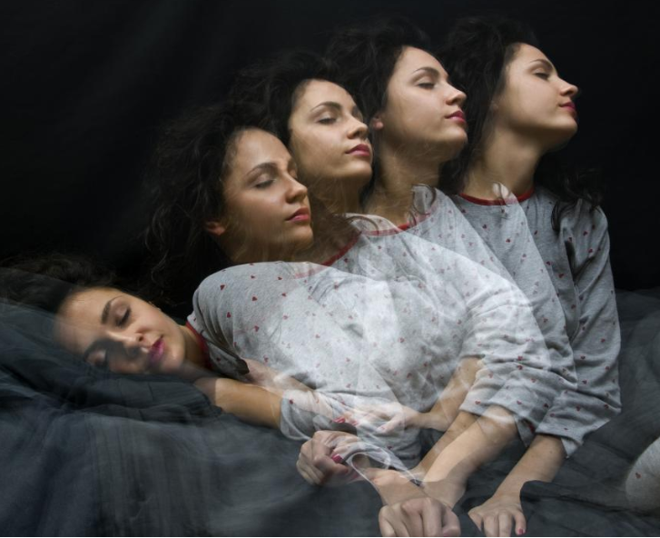
Sleep problems and dementia
REM behavioural sleep disorder (RBD) – physically acting out dreams. May involve violent limb / body movement, may injure self or partner, may fall from bed on waking.
Sleeping separately and having cushions/ mattress beside bed may be necessary. Sleeping in a sleeping bag may help, and/ or sleeping on a mattress on the floor.
Often won’t remember the dream/ flailing limbs around, but exhausted in daytime.
More common in DLB / PD dementia, and in men more than women. Often develops years before dementia.
Drugs used to treat RBD are melatonin and clonazepam, though melatonin usually with dementia as clonazepam can exacerbate dementia symptoms, cause daytime drowsiness, and increases falls and sleep apnoea risks.
https://www.medicalnewstoday.com/articles/247730#what-is-rem-sleep-behavior-disorder

Slide 15
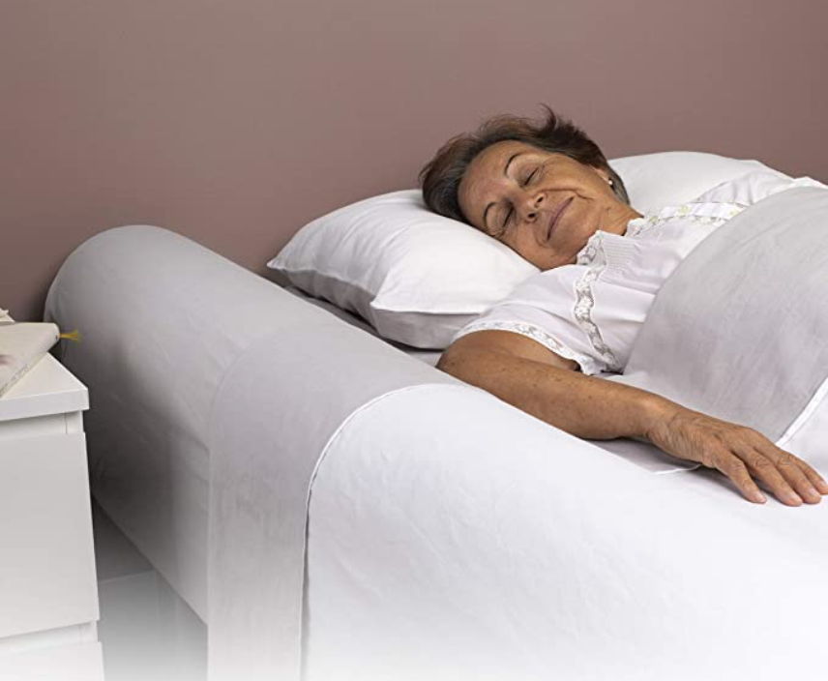
Typical staff debates related to the AL of sleeping
Does it matter if someone turns night into day?
Is it better to explain why the person can’t have a meal at 03.00am or to give the food?
Bedside rails v sleeping on a mattress on the floor… manual handling implications.
Hammocks in HD
Perseverance- better to remove the call bell? –case scenario, Adam
Case scenario - Bill
https://www.amazon.co.uk/BANBALOO-Anti-Fall-Portable-Non-Slip-Articulated/dp/B07XJLDBFH

Slide 16

What interferes with sleep in hospitals?
Staff talking
Staff noisy shoes, hard floors
Unnecessary ‘vital’ observations
Buzzers / call belles.
Beeps and other machinery noises.
Routine checks for incontinence or monitoring vital signs.
Anxiety. Unfamiliar surroundings. ‘White coat’ syndrome. Security fears.
Smoke alarms. (toast? Harvest flies?)
https://www.futurity.org/calcium-c-diff-infection-1487842/older-man-sleeping-hospital_1600/

Slide 17
Tips learned
Cover wooden floors. Ideally- choose soft flooring.
Avoid shoes that squeak or clunk on hard flooring. Use flat, quiet shoes.
Check activity engagement in the day is suitable tiring, meaningful and satisfying.
Check ‘patients’ ‘residents’ ‘clients’ have enjoyed fresh air in the day.
Sufficient snacks in the day?
Warm milky drink late evening?
Have snacks ready in case people wake hungry- avoid discussions at that point about whether eating at night is appropriate, whether the kitchen is closed. Quick snacks, no fuss = soon back to bed.
Time taken to explain the risk of turning night into day = night WILL turn into day for that individual

Slide 18
Summary
Sleep problems for people with NDDs can include insomnia, rapid eye movement behavioural sleep disorder (RBD), Excessive daytime sleepiness, Restless leg syndrome and sleep apnoea.
Nurses / caregivers can help by working to maintain a consistent sleep routine- encourage bed and waking at consistent times, even at weekends.
Create sleep-inducing environment. Dark, quiet, comfortable temperature.
Avoid stimulating activities before bed, e.g. TV, screens, caffeine.
Promote regular physical activity in daytime.
Consult GP or neurologist if sleep apnoea, and/ or if sleep problems persist. Sleep medication usually avoided with cognitive impairment but if needed, requires careful monitoring and expert prescribing and review.
Be aware re caregiver sleep disturbance.

Slide 19
Scenario
Regarding the scenario below, could you come up with a care plan that Achila could put in place, concisely identifying the key problem and the goal and interventions with rationale?
Indika has Parkinson’s disease and lives at home with his wife, Amaya. A community nurse, Achila, visits to check how the couple are managing. Indika needs help from Amaya with most activities of living. They seem to be coping well, except that Amaya looks tired. They explain that while Indika does sleep well, Amaya is disturbed through the night due to Indika moving a lot, particularly his legs, and his noisy breathing.
Problem | Goal | Intervention | Evaluation

Slide 20
Scenario – my effort- you may do better…
Problem | Goal | Intervention (with rationale) | Evaluation
Amaya, Indika’s wife and main caregiver experiences sleep disturbance due to Indika’s movement and noisy breathing at night. | Improve sleep quality for Amaya by reducing disturbance caused by Indika’s movement and breathing. | Consult with Indika’s healthcare provider to review his current medications and consider adjustment that may help reduce movement and noisy breathing during sleep. Explore the possibility of prescribing medications specifically targeting restless leg syndrome or other sleep-related symptoms. (Medications can help alleviate movement disturbances and respiratory issues associated with PD). Sleep environment optimization – Ensure bedroom is quiet, dark and at a comfortable temperature conducive to sleep. Use ear-plugs or a white noise machine for Amaya to minimize the impact of Indika’s noisy breathing. Consider using a separate bed, or mattress with minimal motion transfer to minimize disruption caused by Indika’s movement. (A sleep-conducive environment can enhance the quality of sleep for Amaya by reducing external disturbances and increasing comfort). Recommend Indika to consider using assistive devices such as leg supports or pillows to minimize leg movements during sleep. Encourage Indika to try different sleeping positions that can help reduce noisy breathing, such as sleeping on his side. (These measures can help decrease disturbance for Amaya). Provide the couple with education on maintaining good sleep hygiene practices including consistent sleep and waking times, avoiding stimulants close to bedtime and establishing a relaxing bedtime routine. (Good sleep hygiene practices promote better sleep quality, improving wellbeing). Discuss the option of respite care with the couple, allowing Amaya regular breaks and opportunities for uninterrupted sleep. (This would enable Amaya to rest and recover, reducing caregiver burden and improving her wellbeing). | 1 Achila to implement any changes based on medical review by (date). 2 Achila to visit weekly initially to review effectiveness of the interventions with the couple and make modifications as appropriate.

Slide 21
References
Boentert M. Sleep disturbances in patients with amyotrophic lateral sclerosis: current perspectives. Nat Sci Sleep. 2019 Aug 9;11:97-111. doi: 10.2147/NSS.S183504. PMID: 31496852; PMCID: PMC6701267.
Coss K (2019) More than movement: treating sleep problems in Parkinson’s, Inquiry, University of Minnesota, https://research.umn.edu/inquiry/post/more-movement-treating-sleep-problems-parkinsons
Herzog-Krzywoszanska R, Krzywoszanski L. Sleep Disorders in Huntington's Disease. Front Psychiatry. 2019 Apr 12;10:221. doi: 10.3389/fpsyt.2019.00221. PMID: 31031659; PMCID: PMC6474183.
Morton J (Wild E, Editor) (2013) HD Buzz special feature: Huntington’s disease and sleep, https://en.hdbuzz.net/115
Pushpanathan M et al (2016) The relationship between sleep and cognition in Parkinson’s disease: a meta analysis, Sleep Medicine Reviews, 26, 21-32, https://www.sciencedirect.com/science/article/abs/pii/S1087079215000696
Pushpanathan M et al (2019) Parkinson’s disease: when you sleep better, you feel better, Research Impact, University of Western Australia, https://researchimpact.uwa.edu.au/research-impact-stories/parkinsons-and-sleep/

Slide 22

Any questions?

Slide 23

Thank you

Slide 24
Duration - 2 hours, 20 minutes
Recorded lecture time- 1 hour, 30 mins
Activity 1 – Care Planning – 20 minutes
Tutor-led discussion on activity 1 – 20 minutes
Questions- tutor – led discussion – 10 minutes
Total lecture duration - 2 hours, 20 minutes.

