Slide 1
Comprehensive Care
Lecture 16
Expressing Sexuality

Slide 2
Aims
To understand how to care for people with NDDs with regard to the AL of expressing sexuality.

Slide 3

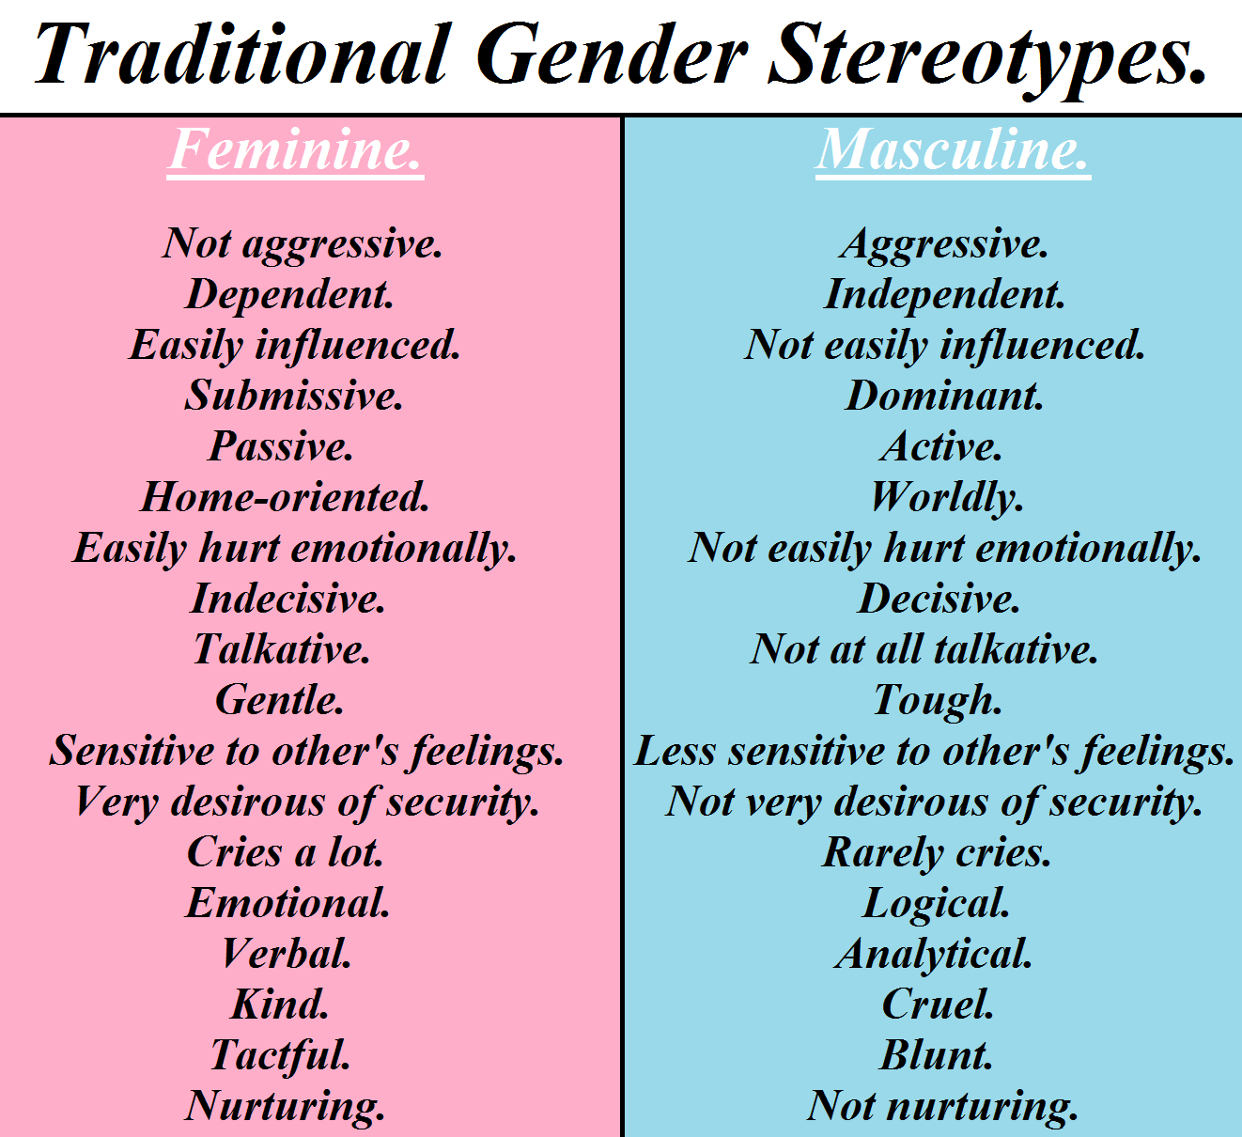

We constantly express our sexuality
How? Think about the ways we all carry out this activity of living.
https://goop.com/wellness/spirituality/how-to-cultivate-divine-feminine-energy/
https://soundgirls.org/the-sound-of-cinematic-femininity/
[Note: Some insightful, thought-provoking posts on sound in cinema, see Kirch N (2022) The sound of cinematic femininity]
https://en.wikipedia.org/wiki/Man

Slide 4

Did you think of….
Clothing we wear, what we choose and how we wear it|?
Hair styles?
Posture, voice, tone?
Friends we make, subjects we choose to discuss?
Facial expressions? Scents we wear? Occupations we choose? Hobbies?
How do we send out signals about our gender? How do signals we receive in return reaffirm our sense of self, and our gender and sexuality?
Incidentally – do you think gender, and sexuality are determined at conception, or do you think these aspects of our lives are social constructions? I suggest reading ‘We are our brains’ by Dick Swaab,(2014) Penguin. I think it is worth contemplating your own stance on this before feeling ready to support someone whose NDD is impacting on this AL.

Slide 5
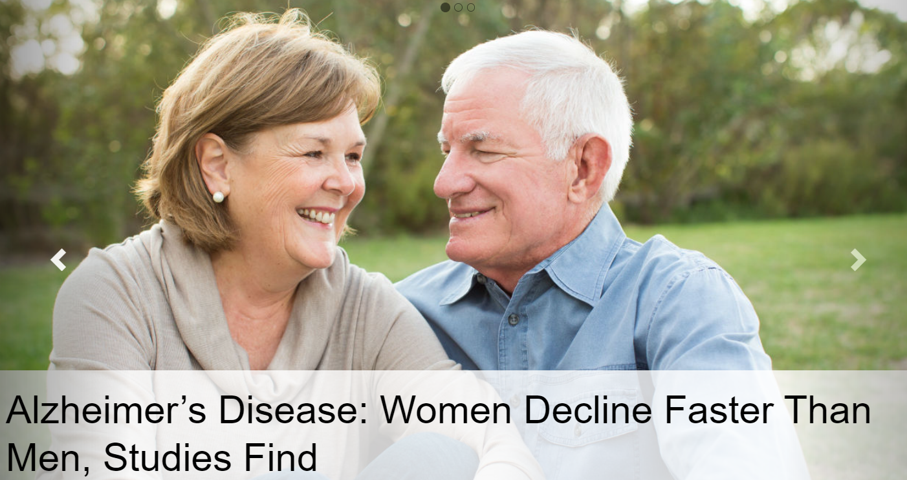
Sex and gender differences- nature or nurture?
A thought-provoking review: Ristori J, Cocchetti C, Romani A, Mazzoli F, Vignozzi L, Maggi M, Fisher AD. Brain Sex Differences Related to Gender Identity Development: Genes or Hormones? International Journal of Molecular Sciences. 2020; 21(6):2123. https://doi.org/10.3390/ijms21062123 https://www.mdpi.com/1422-0067/21/6/2123
‘Trying to assign the relative contributions of “nature” versus “nurture” [to sex and gender differences] is tough at best. … affected by numerous factors …including socialization by parents, siblings, and teachers…education, lifestyle, environmental factors…Research on sex differences cannot be complete without consideration of both genetic/hormonal and social influences that fuel development via complex nature-nurture interactions’.
Snyder H et al (2016) Sex biology contributions to vulnerability to Alzheimer's disease: A think tank convened by the Women's Alzheimer's Research Initiative, Alzheimer’s and Dementia, 12(11) 1186-1196, https://www.sciencedirect.com/science/article/abs/pii/S1552526016328746

Slide 6
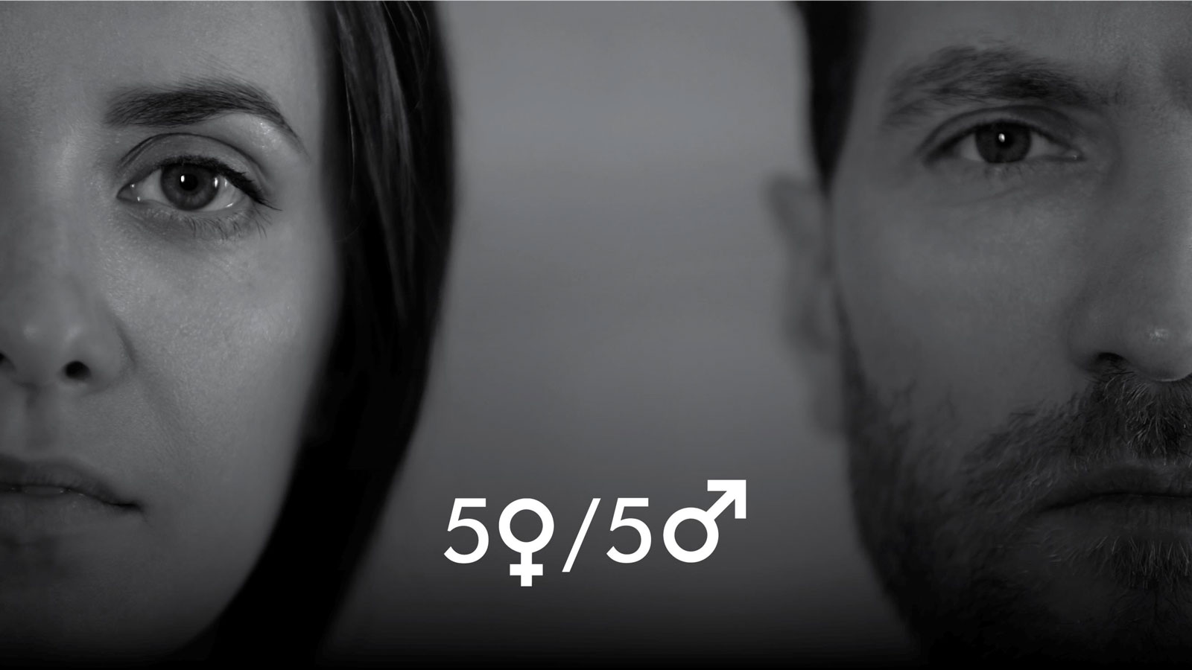
Other sex or gender differences
Women are less likely to develop Parkinson’s disease and, when they do develop it, have a later onset than men. Hayes, M.T. (2019). Gender Differences in Parkinson’s Disease. In: O’Neal, M. (eds) Neurology and Psychiatry of Women. Springer, Cham. https://doi.org/10.1007/978-3-030-04245-5_24
Earlier onset in Huntington’s disease associated with inheritance from affected males. Hasnain, N., Arif, T.B., Shafaut, R. et al. Association between sex and Huntington’s disease: an updated review on symptomatology and prognosis of neurodegenerative disorders. Wien Med Wochenschr (2022). https://doi.org/10.1007/s10354-022-00941-2 https://link.springer.com/article/10.1007/s10354-022-00941-2#citeas
ALS is 20% more common in men than women. However, with increasing age, the incidence of ALS is more equal between men and women. About 90% of ALS cases occur without any known family history or genetic cause. The remaining 10% of ALS cases are inherited through a mutated gene with a known connection to the disease. For unknown reasons, military veterans are more likely to be diagnosed with the disease than the general public. ALS Association (2023) Who gets ALS? https://www.als.org/understanding-als/who-gets-als#:~:text=ALS%20is%2020%25%20more%20common,known%20connection%20to%20the%20disease.
https://huntingtonstasmania.org.au/the-disease/

Slide 7
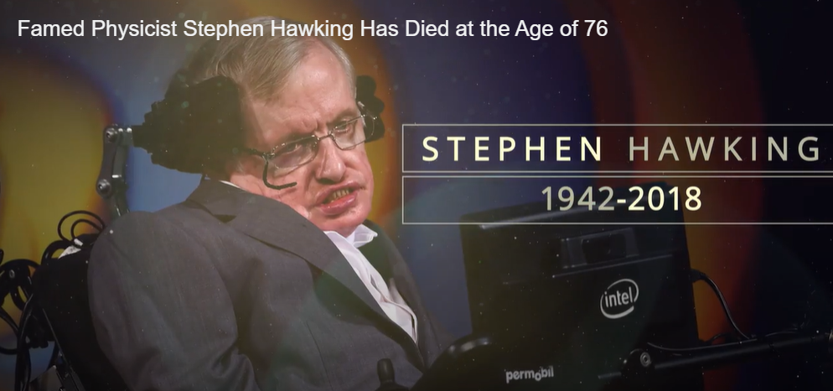
The Impact of NDDs on expressing sexuality
Symptoms of NDDs strike at every aspect of a sense of self, and sexuality.
Uncontrolled body movements, impaired speech, body language, facial expression, incontinence, spilling food, falls, ‘clumsiness’, involuntary noises, breathing difficulty, weakness, all impact negatively on self-esteem.
So can dependence on another, having to give up a home/ job, changed or lost family role, being away from loved ones. I’m sure you can come up with many examples I haven’t thought of.
We can’t get rid of symptoms but we can often reduce them, and reduce the impact on a person’s quality of life, their sense of self, and their sexuality.
We can certainly break the negative feedback loop by sending back positive signals. Not by pretending to understand how it feels but by responding to the person, for who s/he is and what s/he may be trying to communicate to us – showing s/he is valued.
https://time.com/5199001/stephen-hawking-als/

Slide 8

The veil
Jim Pollard ‘Caregiver’s handbook for advanced-stage Huntington’s disease, (2003) Huntington’s Disease Association’, talks about a number of ‘veils’ covering up the person beneath who has HD (but this is true of any NDD).
The ‘veils’ he discusses include movement disorder, impulsivity, impaired speech and so on. I’m sure you can think of many more. Think of loss of facial expression in PD. Lost memory in dementia. Disinhibition in some conditions affecting the frontal lobe.
Our task is to adjust our sights so we can see past each ‘veil’ and view the person.
We need to help others do the same. It will be easier if we can enable the person to express sexuality appropriately, in a way they are comfortable with so signals received back affirm the person’s identity and value.

Slide 9
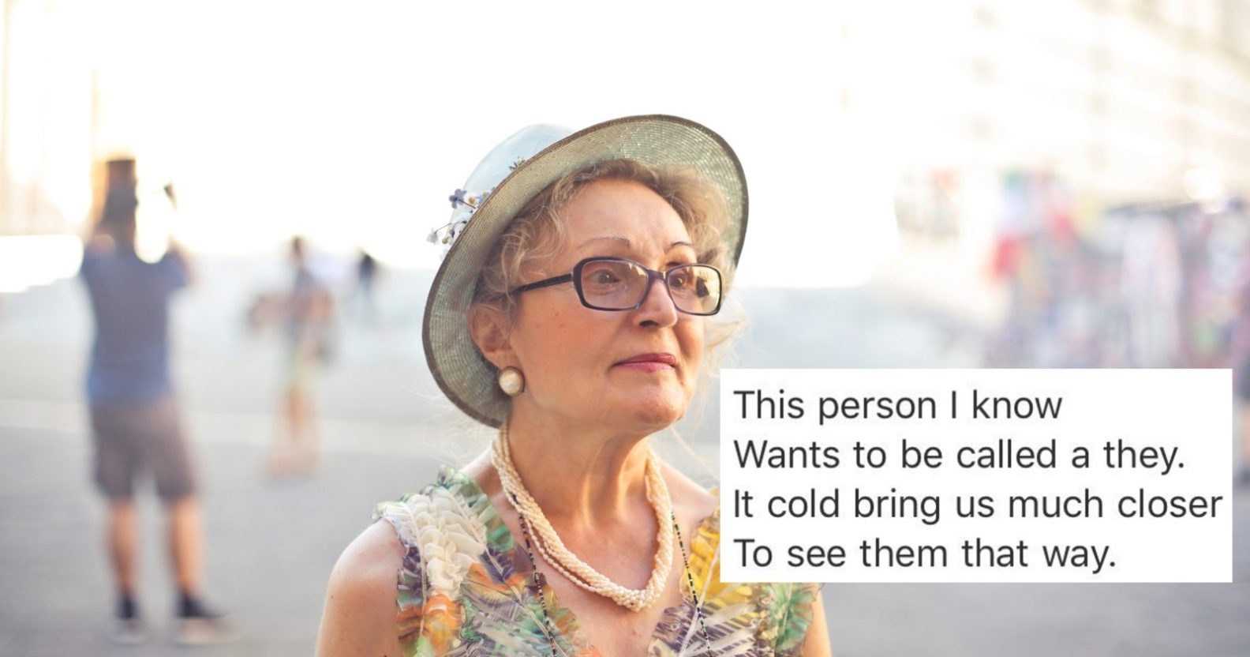
Supporting / restoring gender image
In the lecture on ‘Working & Playing’ we emphasised the importance of ensuring active, meaningful days.
Activities involving hair styling, make up and so on can enhance individuality and dignity - if we get it right – in keeping with choice, and paying attention to what reinforces attributes the person would wish to portray.
Trips should suit personalities and interests. There is a potential trade-off between trying to avoid making assumptions based on stereotypes, and supporting or restoring gender image when this is vulnerable.
A woman who perceives herself as very feminine might tend to prefer a romantic movie than a trip to the speedway. Not necessarily, and individual choice is paramount, but it’s a point to bear in mind if expressing femininity is under threat.
Jackman J (2018) https://www.thepinknews.com/2018/05/24/elderly-aunt-goes-viral-with-wonderful-poem-about-gender-neutral-pronouns/

Slide 10
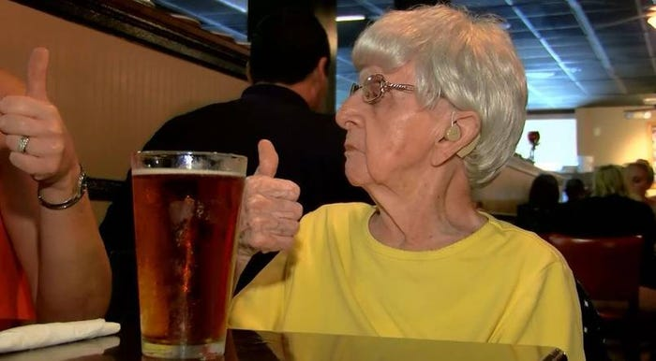
Example
I like a pint of beer- typically a man’s drink in my society. But if you brought me wine in a dainty glass I’m ok with it- I quite like wine. There are enough cues I believe, around my behaviours, about my masculinity to compensate for me having wine- typically a woman’s drink in my social networks. But if my ability to express my gender attributes were perceived to be impaired – I might need to boost cues about being male… having that beer instead might become more important.
You don’t need to agree with me about that, but you do need to think about these points, and develop your view.
Exercise:- Think about- What cues could reinforce social stigma related to assumptions that:
Elderly people with dementia are like children – it’s a second childhood?
A group of people on a charity bus are dependent on the generosity of others?
People who don’t make facial expressions / can’t speak need decisions made for them?
People in wheelchairs are simple minded?
How could we help to challenge those assumptions?
https://www.businessinsider.com/102-year-old-woman-credits-her-long-life-to-drinking-beer-every-day-2016-8?r=US&IR=T

Slide 11
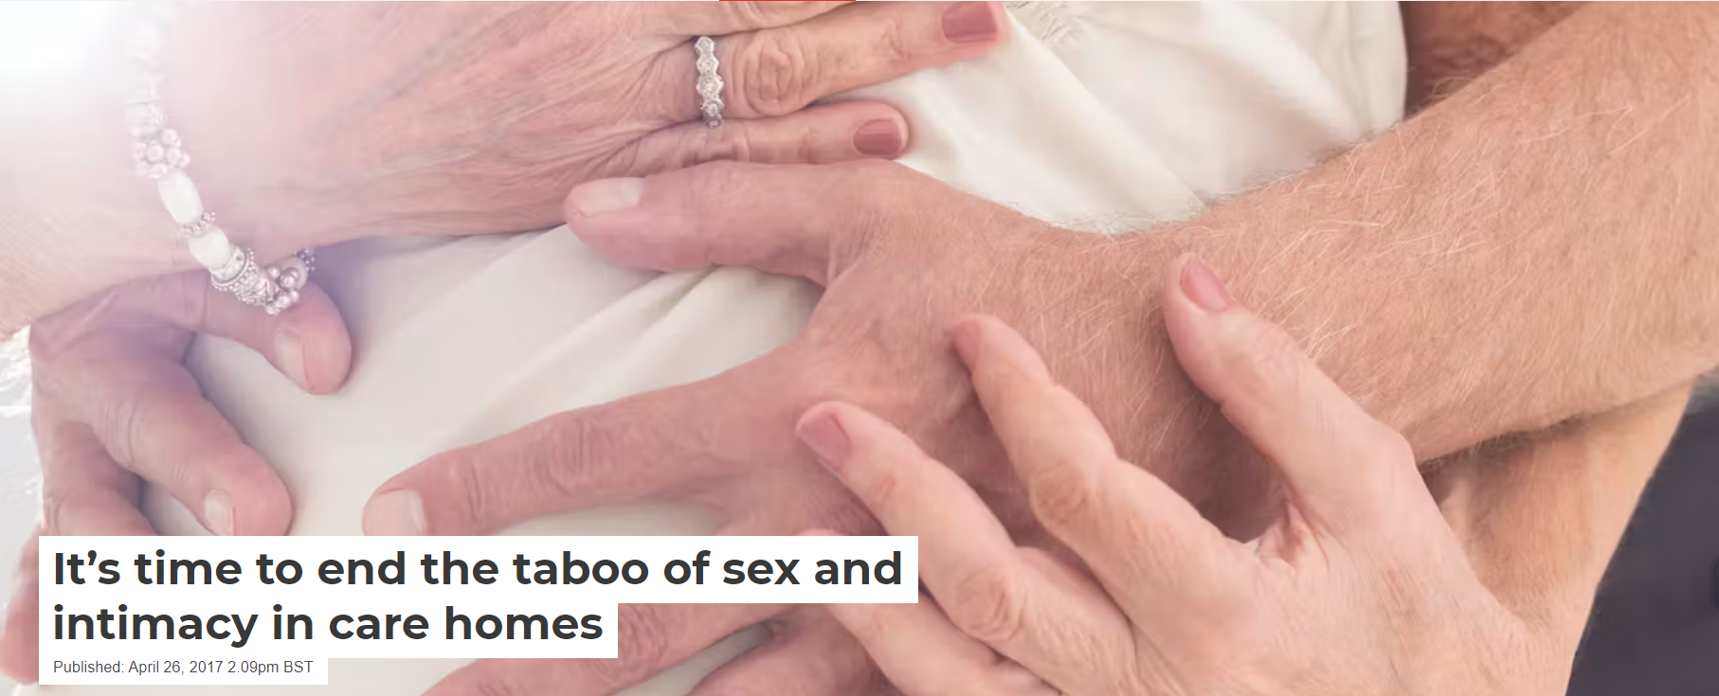
Appropriate sexual expression
Good tips at: https://alzheimer.ca/en/help-support/im-caring-person-living-dementia/understanding-symptoms/sexual-behaviour
And at: https://theconversation.com/its-time-to-end-the-taboo-of-sex-and-intimacy-in-care-homes-75740

Slide 12
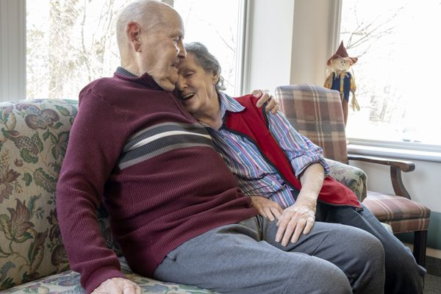
Simpson’s study:
Residents spoke of a prevalent idea that they had passed a life that ‘features or deserves sex and intimacy’. A 79 yr old male said ‘nobody talks about [sex]’. An 80 yr old female said some women ‘might want to continue sexual activity with the right person’.
For spouses cuddling and affection are a basic need and can eclipse the need for sex. Touch / holding hands remind a partner- still loved and valued- vital in sustaining a relationship where one has dementia.
Care staff called for training. Grey areas of consent when one partner is losing capacity, posing legal & ethical dilemmas.
Some problems are inbuilt in care homes- e.g. no locked door policy (safety/ fire etc), single rooms/ few opportunities for intimacy.
Sex and intimacy- a basic human right – shouldn’t be brushed under the carpet, people shouldn’t be left ashamed/ afraid/ frustrated/ abused, and to feel the subject is taboo.
https://www.theglobeandmail.com/canada/article-grey-area-the-fragile-frontier-of-dementia-intimacy-and-sexual/

Slide 13
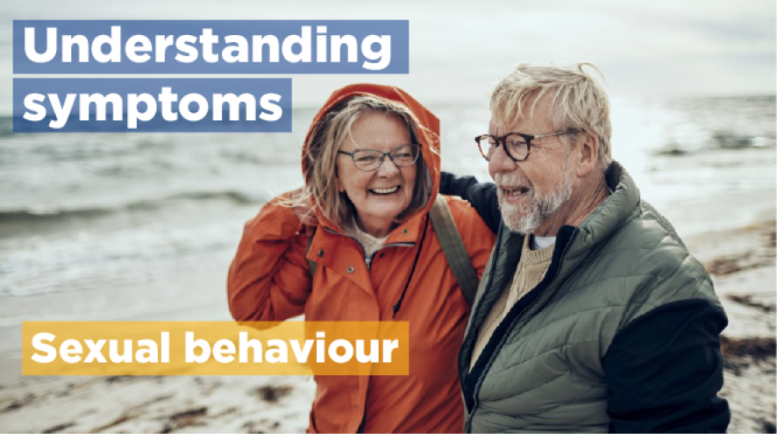
Inappropriate sexual expression
First- in my experience, although care staff tend to be particularly concerned about inappropriate sexual expression associated with NDDs, I’ve more commonly encountered people dealing with a loss of interest in sexual activity, associated with many factors including loss of self esteem, lethargy, depression, and effects of medication. Because this is less problematic for staff to manage the risk is that it is never addressed- no one facilitates the matter being discussed.
How do we enable discussion and help people affected in this way?
But- inappropriate sexual expression can be an issue.
Case scenarios – extracts from ‘Huntington’s Disease: A Nursing Guide’ Steve Smith 2005, Fern Publishing.
We don’t have ‘right answers’ to the questions these scenarios raise, but they are important to discuss with your team, and consider the points in the context of your own political, legal and ethical, sociocultural context.
https://alzheimer.ca/en/help-support/im-caring-person-living-dementia/understanding-symptoms/sexual-behaviour

Slide 14
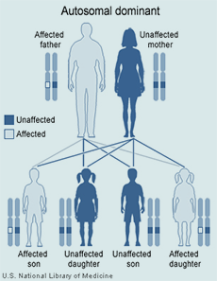
Genes and Genetic Testing
As we’re discussing HD, let’s continue, as it makes a good model for considering issues around genetics. It is different to other NDDs as there is only one way to have HD – through a single gene fault, whereas for example there are many potential routes to PD – genetic factors may play a part as may a history of head injury, and / or environmental factors.
It is through expressing sexuality of course, we reproduce. HD does not (other NDDs do not) prevent the next generation in the way some diseases do (a severely disabling genetic condition affecting children for example is unlikely to be inherited).
Offspring of someone with HD are at 50% risk of inheriting the condition.
https://health.ucdavis.edu/huntingtons/genetics.html

Slide 15
Summary 1
Mental capacity: nurses & caregivers need to ensure a patient is still capable of informed consent before engaging in sexual activity. Document any discussion/ decision-making process.
Privacy: Patients should have access to private spaces to allow for sexual activity. Nurses/ caregivers should be sensitive to privacy needs and ensure patients are not exposed to inappropriate situations or intrusions.
Safety: Caregivers/ nurses should ensure patients & partners are safebduring sexual activity. This could involve e.g. discussion around contraception, physical safety in engaging in sexual ac tivity and any risks relating to medical condition.

Slide 16
Summary 2
Communicating: It is essential to have open and honest communicating between the patient, partner and, where appropriate, person with duty of care (e.g. nurse/ caregiver) about their sexual needs & preferences. Caregivers & nurses should be aware of cultural & religious beliefs that may affect sexual expression and work to accommodate them wherever possible.
Dignity & respect: Patients (& partners) should be treated with dignity & respect in all aspects of care including expressing sexuality. Caregivers & nurses should avoid making assumptions or judgements about the person’s sexual activity and should always prioritise the patient’s wishes, needs & preferences while ensuring neither they or their partner is under any pressure to act against their own wishes.
Support: Caregivers & nurses should be able / trained to provide Emotional & psychological support in addressing issues, and aware of available resources & support networks that can help with this.

Slide 17
Scenario
Regarding the scenario below, could you come up with a care plan that Aruna should put in place, concisely identifying the key problem and the goal and interventions with rationale?
Gayan is 48 years old, has advanced HD and lives at home with his wife Nadeeka. A community nurse, Aruna, visits Gayan gives assurance that the couple are managing well at home and have no need for any nursing input. At the end of the visit Nadeeka offers to carry Aruna’s bag to her car. As Aruna bids goodbye, she notices that Nadeeka seems about to cry and asks what the matter is. Nadeeka says she never gets a chance to tell a professional that she is not coping, but can’t say that in front of Gayan as he’d be heart-broken. Nadeeka says ‘I feel sick when I have to clean him up when he’s doubly incontinent, he’s awake through most nights and I’m so tired having to follow him around the house to prevent him falling. But most difficult of all is that he continues to want to have sex. I am repulsed by his involuntary movement, and he is so rough that it feels like being raped. But I can never tell him as this is all he has left to enjoy, and he thinks we are still in a happy relationship, he thinks I enjoy sex with him and it would be too cruel to tell him otherwise. You mustn’t tell him, please, but I can’t go on like this’. Aruna apologises that the professional team have just assumed all is well in the home, listening only to Gayan’s account and then says ‘We have to address this, but it’s a very tricky dilemma. You cannot be left to suffer in this way, let me think about how best to handle it and I’ll come back very soon’.
Problem | Goal | Intervention | Evaluation

Slide 18
Scenario- my attempt, you may do better…
Problem | Goal | Intervention (and rationale). | Evaluation
Nadeeka is experiencing emotional distress and physical exhaustion due to the challenges of caring for Gayan. Above all she feels she is being sexually abused but because this is unintentional on Gayan’s part, fears raising the issue as doing so will break Gayan’s heart. | To improve Nadeeka’s emotional wellbeing, provide her with the necessary support and address the difficulties she faces in caring for Gayan. | Provide Nadeeka with a safe and non-judgemental environment to express her feelings and concerns. Offer empathetic listening and validation of her emotions. Encourage joining support groups and / or counselling services specifically for caregivers for individuals with HD. (Emotional support and validation are crucial for Nadeeka to cope with her distress and maintain her mental wellbeing). Arrange respite care services where a trained professional can provide temporary care for Gayan, allowing Nadeeka breaks and rest. Liaise with local care providers or community organisations to identify suitable respite options. (The breaks will alleviate physical exhaustion allowing Nadeeka to recharge, and in the first instance removes her from the situation of experiencing unintended sexual abuse while professionals have the chance to think through a solution with the couple). Ascertain what Nadeeka understands about HD, it’s symptoms and progression, and provide any information needed, to help her understand the reasons behind Gayan’s behaviours and challenges. Offer training on techniques for managing Gayan’s incontinence, falls risk and other symptoms to reduce her caregiver burden and enhance her caregiving skills. (Education and training are aimed at empowering Nadeeka with knowledge and skills to manage Gayan’s symptoms effectively, reducing her symptoms effectively, reducing her stress and anxiety. Coordinate a meeting with Gayan’s multidisciplinary healthcare team to discuss all Nadeeka’s concerns and develop a comprehensive care plan. (this provides an opportunity to advocate for Nadeeka’s perspective, and help Gayan to see that problems need addressing). Collaborate with a sexual health specialist or counsellor experienced in working with people with HD to address the complex issue of sexuality and intimacy, working with the couple to find a solution where Gayan’s sexual needs are met while Nadeeka is able to feel respected, dignified, safe, and in control regarding her own choices about sexual activity. | Aruna to visit the couple weekly and allow each opportunities to openly express any concerns and to feedback to the healthcare team who will support modification of the care plan if and as appropriate.

Slide 19
References
Alzheimer Society (2022) Sexual Behaviour, https://alzheimer.ca/en/help-support/im-caring-person-living-dementia/understanding-symptoms/sexual-behaviour
ALS Association (2023) Who gets ALS? https://www.als.org/understanding-als/who-gets-als#:~:text=ALS%20is%2020%25%20more%20common,known%20connection%20to%20the%20disease.
Bielski Z (2018) Grey area: the fragile frontier of dementia, intimacy and sexual consent, The Globe and Mail, https://www.theglobeandmail.com/canada/article-grey-area-the-fragile-frontier-of-dementia-intimacy-and-sexual/
Hasnain, N., Arif, T.B., Shafaut, R. et al. Association between sex and Huntington’s disease: an updated review on symptomatology and prognosis of neurodegenerative disorders. Wien Med Wochenschr (2022). https://doi.org/10.1007/s10354-022-00941-2 https://link.springer.com/article/10.1007/s10354-022-00941-2#citeas
Hayes, M.T. (2019). Gender Differences in Parkinson’s Disease. In: O’Neal, M. (eds) Neurology and Psychiatry of Women. Springer, Cham. https://doi.org/10.1007/978-3-030-04245-5_24
Jackman J (2018) https://www.thepinknews.com/2018/05/24/elderly-aunt-goes-viral-with-wonderful-poem-about-gender-neutral-pronouns/
Kirch N (2022) The sound of cinematic femininity, https://soundgirls.org/the-sound-of-cinematic-femininity/
Ristori J, Cocchetti C, Romani A, Mazzoli F, Vignozzi L, Maggi M, Fisher AD. Brain Sex Differences Related to Gender Identity Development: Genes or Hormones? International Journal of Molecular Sciences. 2020; 21(6):2123. https://doi.org/10.3390/ijms21062123 https://www.mdpi.com/1422-0067/21/6/2123
Simpson P (2017) It’s time to end the taboo of sex and intimacy in care homes, The Converastion, https://theconversation.com/its-time-to-end-the-taboo-of-sex-and-intimacy-in-care-homes-75740
Snyder H et al (2016) Sex biology contributions to vulnerability to Alzheimer's disease: A think tank convened by the Women's Alzheimer's Research Initiative, Alzheimer’s and Dementia, 12(11) 1186-1196, https://www.sciencedirect.com/science/article/abs/pii/S1552526016328746
Swaab D (2010) We are our brains, Penguin.

Slide 20

Any questions?

Slide 21

Thank you

Slide 22
Duration- 2 hours, 25 minutes
Recorded Lecture – 1 hour 25 minutes
Activity 1 (slide 3) Ways we express our sexuality – 5 mins
Tutor-led discussion on activity 1- 5 minutes
Activity 2- (slide 10) Cues that reinforce assumptions and how to challenge these – 10 minutes
Tutor-led discussion on activity 2- 10 minutes
Activity 3- (slide 17) Care plan – 20 minutes
Questions- 10 minutes
Total duration of lecture: 2 hours 25 minutes.

