Slide 1
Comprehensive Care
Lecture 14
The Impact of NDDs on Mobilising

Slide 2
Aims
To understand how to care for people with NDDs with regard to the AL of mobilising.

Slide 3
Movement disorders
Many NDDs are associated with movement disorders- some profoundly so.
Eg- Parkinson’s disease – bradykinesia, tremor, stiffness, rigidity, postural instability, shuffling gait
Huntington’s disease – chorea, (juvenile HD- movement akin to PD).
Other NDDs may be associated with features including: Ataxia, Dystonia, spasticity, impaired balance, various gait abnormalities.
Movement disorders are often the most notable feature of a NDD, and may be the feature professionals are keenest to ‘fix’ but it may not be a priority for the patient or family.

Slide 4
movement disorder: a priority for people with NDDs?
It’s obviously important- but don’t let it overshadow everything else.
HD- example- Smith S, D'Cruz G, Gray R, Flaherty H, Ivanecka A, Deane KH. A Concept Map of What Helps People with HD Live with their Condition. J Huntingtons Dis. 2015;4(3):261-70. doi: 10.3233/JHD-150161. PMID: 26444023.
39 PwHD, 48 Family caregivers, 39 Health Professionals, at 8 centres across England prioritised ‘what helps pwHD to live with the condition:
  Having expert assessment and treatment for co-morbid mental health problems occurring with HD was the top priority overall – the 3 groups combined.
  Highest priority for PwHD- being trusted to take part in decision-making for their own care.
  Highest priority for professionals - planning care for advanced stages.
  Highest priority for family caregivers – long term planning.
  For all groups- addressing chorea was a relatively low priority- but never-the-less very important.

Slide 5
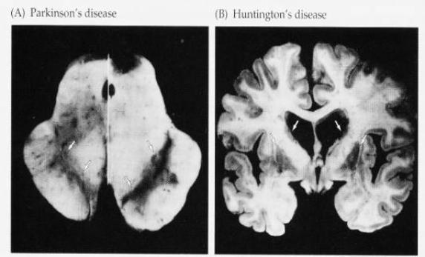
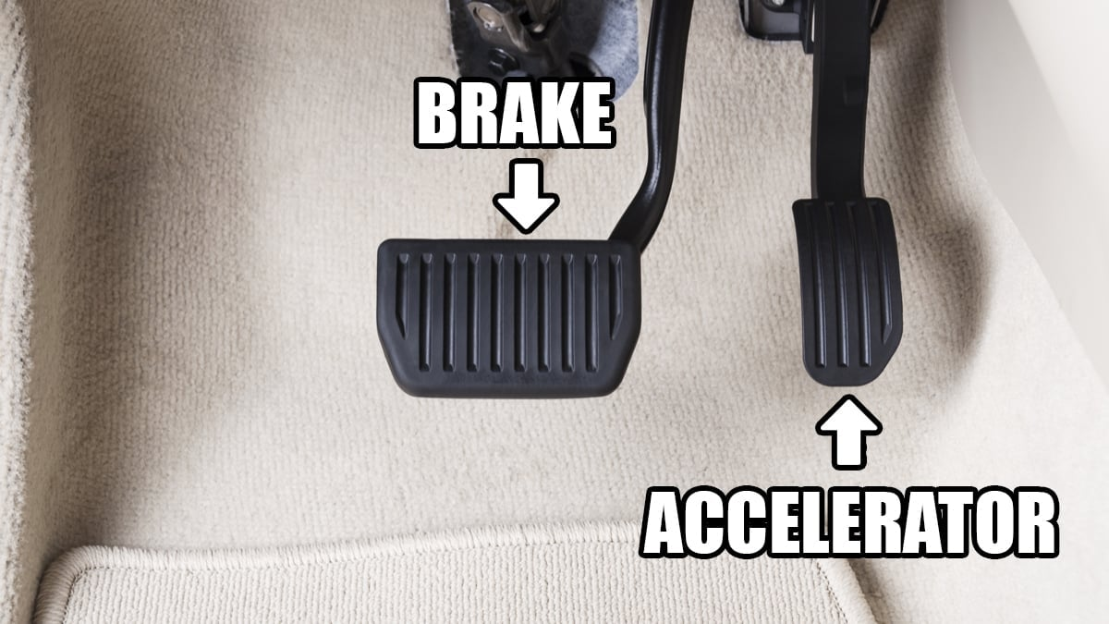
Comparison – HD / PD
Exact involvement of neurotransmitter mechanisms aren’t fully understood but change to levels of neurotransmitters including dopamine, GABA, adenosine, acetycholine are key- Jamwal S, Kumar P. Insight Into the Emerging Role of Striatal Neurotransmitters in the Pathophysiology of Parkinson's Disease and Huntington's Disease: A Review. Curr Neuropharmacol. 2019;17(2):165-175. doi: 10.2174/1570159X16666180302115032. PMID: 29512464; PMCID: PMC6343208. Visted 11 02 2023.
For simplicity, think- brake/ accelerator analogy:
In diagram (A), an example of a brain with Parkinson’s disease is on the left and a normal brain is on the right. In the brain on the left you can see how the substantia nigra is absent. In diagram (B), the caudate nucleus is greatly reduced in the Huntington’s brain. https://webs.wofford.edu/pittmandw/psy330/2002www/basalgang/index.html Visited 11 02 2023.

Slide 6
Reaching for a cup of coffee
Parkinson’s disease
Huntington’s disease
Alzheimer’s disease
What’s the difference?
What are the care implications-
For dressing?
For eating & drinking?
For washing / showering?
For manging to walk on stairs?
For sleeping
Remember to think of
Physical factors
Psychological factors
Sociocultural factors
Environmental factors
Politicoeconomical factors

Slide 7

Motor dysfunction in MCI and AD
Individuals with MCI had impaired motor function relative to those without cognitive impairment and superior motor function vs those with dementia. Among those with MCI, baseline levels of lower extremity motor performance, parkinsonian gait, and bradykinesia were inversely related to risk of AD, even after controlling for clinical stroke. Thus, a person with impaired lower limb performance or parkinsonian gait …was 2 to 3 times more likely to develop AD than a person with good lower limb function...
Conclusions: Persons with MCI also have impaired motor function, and the degree of impairment in lower extremity function is related to the risk of AD.
Aggarwal NT, Wilson RS, Beck TL, Bienias JL, Bennett DA. Motor dysfunction in mild cognitive impairment and the risk of incident Alzheimer disease. Arch Neurol. 2006 Dec;63(12):1763-9. doi: 10.1001/archneur.63.12.1763. PMID: 17172617. Visited 11 02 2023.
https://www.seasons.com/frequent-falls-can-be-early-signs-of-dementia/2491911/
The point?- movement disorder is relevant to all people with NDDs

Slide 8
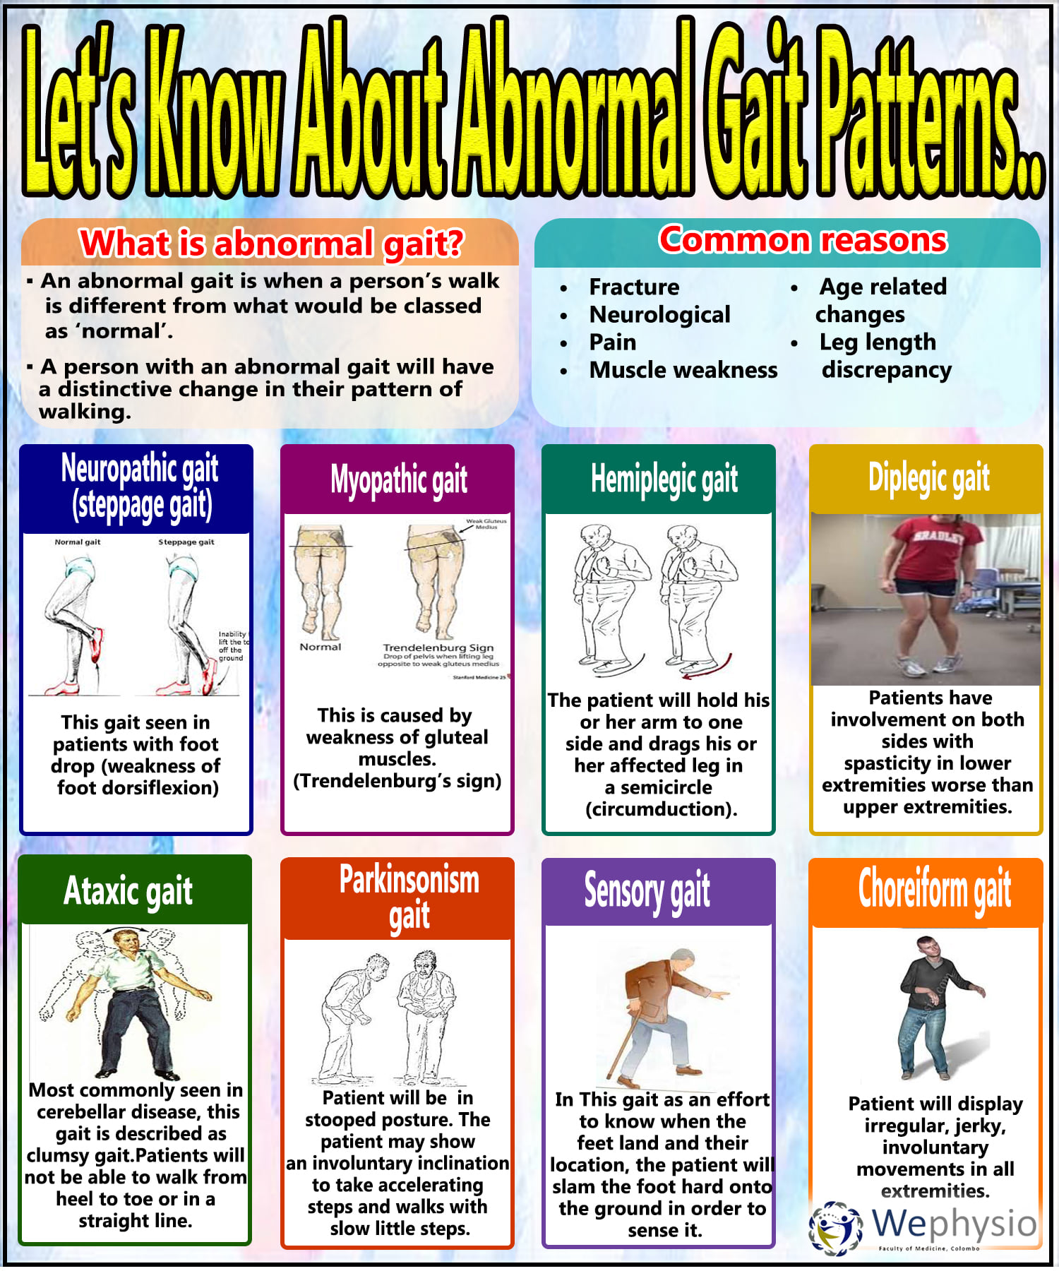
Involuntary movement Problems May include-
VOLUNTARY MOVEMENT PROBLEMS MAY INCLUDE
Chorea
Rigidity and spasticity (in PD and later stages of HD, and Juvenile HD) – note- more associated with falls than chorea- Rosenblatt A, Ranen N et al, (1999) A Physician’s Guide to the Management of Huntington’s Disease, HDA, London.
Myoclonus
Tics
Dystonia
Impaired eye movement, e.g. nystagmus, strabismus
Gait abnormalities
Speech impairment
Swallowing difficulty
https://www.facebook.com/102251898109461/photos/a.103657777968873/242557340745582/?type=3 Visited 11 02 2023

Slide 9
https://www.facebook.com/102251898109461/photos/a.103657777968873/242557340745582/?type=3 Visited 11 02 2023

Slide 10
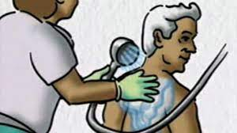
Impaired voluntary movement tends to cause more disability
But involuntary movement can cause embarrassment and stigma – socially disabling
Chorea scenario- ‘he hit me when I assisted him to wash – was it intentional?’
Medicate chorea, or learn to avoid getting hit?
Tetrabenazine- can be helpful - easier to assist to dress – reduced social embarrassment
But - reduced voluntary movement? Drowsy, lethargic? Stiffer gait? Falls? Postural hypotension- unsteadiness? Dry mouth, constipated?
Weighing up benefits / costs needs careful individual assessment over time.

Slide 11
Medication and movement disorders (PD) benefits, unwanted effects, Care Implications
Common PD medications | Commonly used for | Unwanted effects | Care implications
Levodopa (& Carbidopa – Sinemet). | Bradykinesia, stiffness | Nausea, vomiting, abnormal heart rhythms; long-term = risk of involuntary movements; restlessness, confusion. | Inhalable powder (Inbrija) and a tablet (istradefylline) can help re OFF periods. Reduce dosage for N&V.
Dopamine agonists e.g. Pramipexol, (Mirapex), Rotigotine (Neuprol), Ropinerol (Requip)… Amantadine | (While levodopa is converted to dopamine in the brain- aided by carbidopa, D. agonists mimic dopamine – don’t have to be converted). For bradykinesia, stiffness. Can help with mild PD. Used with Sinemet to reduce OFF periods. Can reduce involuntary movements caused by levodopa. | Lower risk of long term side effects but short term includes N&V, dizziness/ light headedness, confusion, hallucinations. Confusion / memory problems. | On own or with Sinemet. Observe & record all effects; organise reviews
Anticholinergics e.g. benztropine (Cogentin), trihexphenidyl (Artane). | Restore balance between dopamine & acetylcholine. Ease tremors/ muscle stiffness. | May harm thinking & memory- not often prescribed these days. | General points- all PD medications- don’t crush/ split tablets; Physical activity to help digest absorb meds; 6- 10 glasses water daily;
MAO-B Inhibitors e.g. Selegiline, (Eldepryl, Madopar); & Rasageline. Safinamide | Block enzymes that break down dopamine. Selegiline may slow PD progression- some evidence suggests. Can be and adjunct with levodopa to reduce breakthrough PD symptoms. | Nausea, dizziness, fainting, stomach pain. Rasageline also associated with headache, joint pain, indigestion, depression. Trouble falling/ staying asleep, nausea, falls, involuntary movements. | Check for changes in mood and all these potential unwanted effects.
COMT Inhibitors (Catechol-O-methyl transferase ) e.g. entacapone (Comtan), Opicapone (Ongentis), Tolcapone (Tasmar). | COMT negatively impacts on effect of levodopa. They prevent peripheral degradation of levodopa, allowing a higher concentration to cross the blood-brain barrier. | dyskinesia, nausea, vomiting, orthostatic hypotension, sleep disorders and hallucinations. Possible discoloured- red/brown urine.

Slide 12
Medication and movement disorders (HD) benefits, unwanted effects, Care Implications
Common HD medications | Commonly used for | Unwanted effects | Care implications
Xenazine (Tetrabenazine) | Reducing involuntary movements (chorea) | Voluntary movement may be inhibited. Associated with depression
Antipsychotic medicines, e.g. Risperdal (risperidone), Haldol (haloperidol) or Thorazine (Chlorpromazine) | May be used ‘off label’ [not approved for this use, but legal though pharmaceutical companies must not market for this purpose]. | Drowsiness, dry mouth, constipation, rigidity, stiffness in movement.
Benzodiazapines, e.g. Klonopin (clonazepam), Valium (diazepam). | Can help reduce chorea. | May worsen cognitive aspects of HD; risk of dependence.
  From: https://www.ninds.nih.gov/health-information/disorders/amyotrophic-lateral-sclerosis-als#:~:text=Riluzole%20(Rilutek)%20is%20an%20oral,survival%20by%20a%20few%20months.
  For ALS:-
Riluzole (Rilutek) is an oral medication believed to reduce damage to motor neurons by decreasing levels of glutamate, which transports messages between nerve cells and motor neurons. Clinical trials in people with ALS showed that riluzole prolongs survival by a few months. The thickened liquid form (Tiglutik) or the tablet (Exservan) that dissolves on the tongue may be preferred if you have swallowing difficulties.
Edaravone (Radicava) is given intravenously and has been shown to slow the decline in clinical assessment of daily functioning in people with ALS.
Other medications may be prescribed to help you manage symptoms including muscle cramps, stiffness, excess saliva and phlegm, and the unwanted episodes of crying and/or laughing, or other emotional displays. Medications may also help you with any pain, depression, sleep disturbances, and constipation.

Slide 13
Environmental factors
The importance of space for chorea. – hallways/ toilets…
Wet rooms
Rounded furniture edges
Good flooring and lighting
Flat paths
Accessible gardens

Slide 14
Psychological and Sociocultural impact of movement disorders
Reducing the impact of:
Changes to body image. Shame about movement disorder can be socially disabling, and feeds depression, and depression feeds embarrassment…
Tips- encourage telling self what they would tell someone they love; share thoughts and feelings about embarrassment with trusted friends / family / caregivers– go out and about in their company; join a support group.
Attitudes of others – staring / comments / impatience – the importance of education.
Careful caregiver assessment is essential – can they really cope?

Slide 15
Politicoeconomic factors
Good assessment and presentation of costs of providing equipment at home compared to the need for institutional care can help secure funds for aids such as – handrails; hoists; wet-room conversion; suitable car and so on.
Seek out friendly, and suitably equipped cab companies.
Argue for needs of family caregivers as well as the patient.

Slide 16
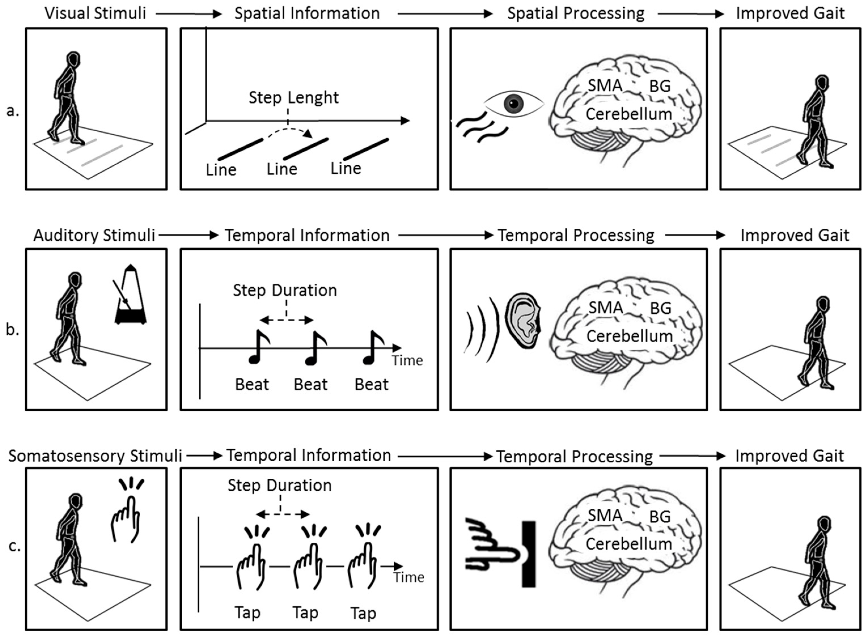
‘Freezing’ in PD
Relevance to Care Regarding all issues for all people with NDDs
4 cardinal PD symptoms: bradykinesia, tremor, rigidity, postural instability.
Freezing of gait (F.o.G.) = among most debilitating PD symptoms.
Contributes to falls and hospitalisation /nursing home admission.
When medication / surgery fail to manage this, non-pharmacological approaches are key.
3 F.o.G. types identified: purely akinesia form, tremble in place form, shuffling form – the first is rarest.
Sweeney D, Quinlan LR, Browne P, Richardson M, Meskell P, ÓLaighin G. A Technological Review of Wearable Cueing Devices Addressing Freezing of Gait in Parkinson’s Disease. Sensors. 2019; 19(6):1277. https://doi.org/10.3390/s19061277

Slide 17
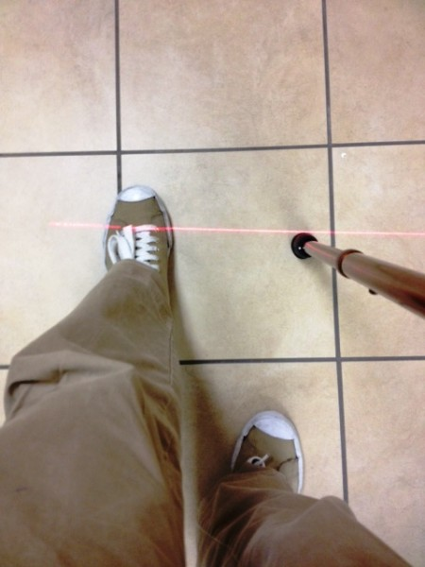
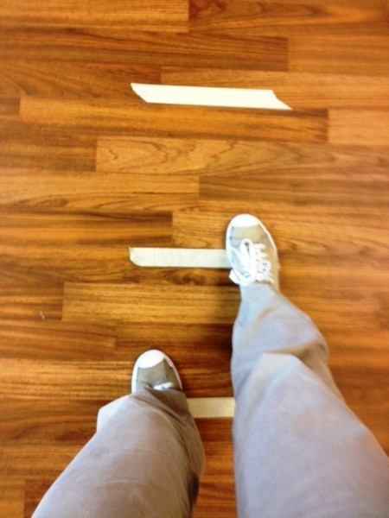
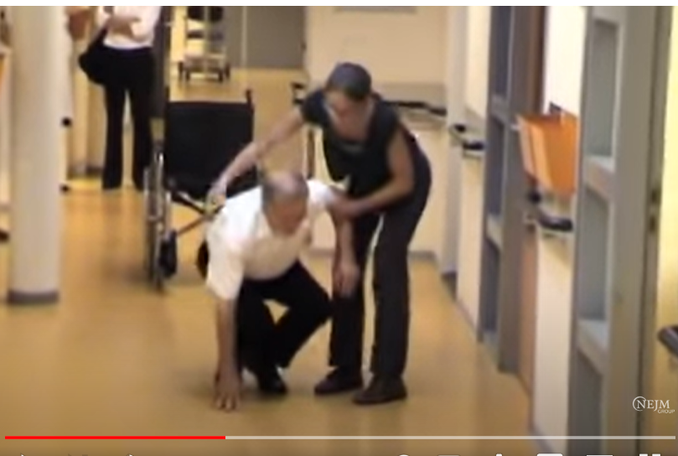
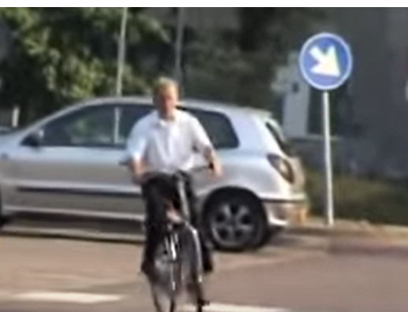
https://movementdisorders.ufhealth.org/2011/11/23/physical-therapy-tips-for-freezing-of-gait/
https://youtu.be/aaY3gz5tJSk

Slide 18
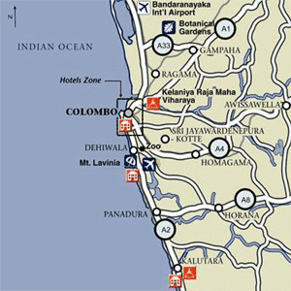

So… what is the Relevance of approaches to care regarding freezing in PD to Care Regarding all issues for all people with NDDs?
https://colombogazette.com/2022/01/03/heavy-traffic-in-and-around-colombo-as-all-public-servants-return-to-work/
http://www.worldexecutive.com/locations/asia_pacific/sri_lanka/colombo/maps.html

Slide 19
Wandering and dementia
Considerations- safety
Engage in meaningful, accompanied activities through the day. Activities and exercise help reduce anxiety, restlessness, agitation.
Meet fundamental needs- toileting, adequate food and drink, maybe reduce (not eliminate) drinks within a couple of hours prior to bedtime to avoid unnecessary toilet needs during the night.
Monitor for time of day / night most likely the individual will wander, for example- ‘sundowning’- target activities for that time.
In earlier stages- avoid overwhelming crowds, e.g. shopping malls; address driving safety if relevant; set times to check in with care staff / relatives; assess understanding of layout of new locations if relevant- where possible, adhere to familiar surroundings
Lighting/ inc. night lights around home; camouflage doors/ door handles (cover/ drape same colour as surrounding walls); try black tape on floor in front of door- may act as a visual barrier;
Higher tech?- pressure mattresses/ door mats/ alarm on door/ --- ??? Cameras???- think of ethics/ privacy.
Time to listen and talk, understand reason for wandering. Remember from ‘Communicating’- dilemma of how to address ‘I’m looking for my mother’ – (reality orientation, confrontation versus playing along, distraction, reminiscence therapy approach.

Slide 20
Cases to consider
Jason, has chorea and history of falls, needs money from the bank. Can do it, but at risk of falls/ being hit by traffic, does not wish to be accompanied.
Mary, would rather take the stairs than the lift - falls risk.
Desmond – severe memory loss and impaired spatial awareness – wants to go for walks for the day.
Try the care planning activity on the next slide- alone or as a group activity. Justify how you would reach a decision, weighing up duty of care, potential for negligence charge, against person-centred approach, respecting individual choice. Consider- mental capacity assessment.

Slide 21
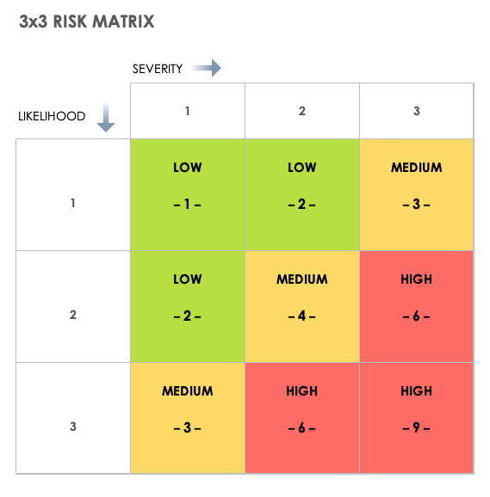
Case | Problems / Issues, and risk level* | Goal/s | Intervention | Rationale | Evaluation
Jason, has chorea and history of falls, needs money from the bank. Can do it, but at risk of falls/ being hit by traffic, does not wish to be accompanied.
Mary, would rather take the stairs than the lift - falls risk.
Desmond – severe memory loss and impaired spatial awareness – wants to go for walks for the day.
Example risk matrix, from: https://www.smartsheet.com/all-risk-assessment-matrix-templates-you-need Visited 22 02 2023

Slide 22
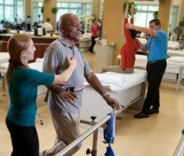
Does Physiotherapy improve mobility?
Quinn et al (2020) (see reference slide) :
Conclusions There is strong evidence to support physical therapy interventions to improve fitness, motor function, and gait in persons with HD.
https://hdsa.org/wp-content/uploads/2015/02/HDSA_PPT-for-Physical-Therapy.pdf

Slide 23
Summary
Problems with mobilising for people with NDDs can include balance & coordination difficulties, muscle stiffness, tremors, and difficulty initiating, controlling, maintaining and ending movements. Tips for caregiving include:
Falls. Ensure the environment is free from clutter, & trip hazards e.g loose rugs. Encourage use of walking aids where safe, and provide physical support where necessary. Keep floors dry.
Walking difficulty: encourage regular exercise as able/ safe (seek PT advice re exercise to improve strength, balance and flexibility). Wheelchairs may help.
Tremors: relaxation techniques and medication management may help.
Chorea: wider walkways- remove dressers in hallways etc. Avoid talking to / calling the person from behind.
Stiffness: Encourage regular stretching and other motion exercises- plus as for chorea.
Cognitive impairment: Reminiscence therapy, helping independence with the other Als can help avoid agitation and wandering especially at night.

Slide 24
Scenario
With regard to the scenario below, could you come up with a care plan the community nurse could put in place, that clearly and concisely identifies the problem, the goal, and the interventions with rationale?
Scenario: Mrs. Perera has MND and lives in a care home. She is unable to safely transfer from a chair to the w.c. or to her bed. Care staff have been lifting her manually and this has come to the manager’s attention. The manager reminds the care staff and Mrs. Perera of the home’s ‘no lift’ policy in line with health and safety rules. A hoist must be used at all times. Mrs. Perera refuses to accept using a hoist as she finds it undignified and emphasises her disability. Also, the process takes so long, she fears she will be incontinent due to urgency. The staff say they are happy to risk their own safety to allow Mrs. Perera to make her own choices about how she is transferred. The manager says this is not acceptable as they all have a duty of care to themselves as well as to Mrs. Perera.
Problem | Goal | Intervention | Evaluation

Slide 25
Scenario – my attempt – you may do better!! ….
Problem | Goal | Intervention (with rationale) | Evaluation
Mrs. Perera is unable to safely transfer from a chair to the w.c. or her bed. She refuses to use a hoist, finding it undignified and fears incontinence due to the time it takes. The care staff are willing to lift her but this violates the ‘no lift’ policy and risks staff and Mrs. Perera’s safety. | To ensure safe and dignified transfers for Mrs. Perera while addressing her concerns about time, continence and dignity. | Assess Mrs. Perera’s physical disabilities and limitations, her strength, balance and range of motion. (This aids understanding of her specific physical condition, needs and limitations, enabling tailored interventions to ensure safety an minimise fall risk during transfers). Explain to Mrs. Perera the benefits of using a hoist - with emphasis on safety for her and the care staff, reduced risk of injury and preservation of dignity. (This will increase likelihood that she will understand and be willing to cooperate. Addressing her concerns can help alleviate resistance). Involve Mrs. Perera in the selection of an appropriate hoist that suits her preferences and needs. Provide information on different types of hoist available. Consider factors such as ease of use, comfort and functionality. Allow her to trial different options and choose the one she’s most comfortable with. (freedom to make choices is empowering). Implement a timed schedule for hoist transfers. Provide staff training to be competent to use the hoist promptly, safely and efficiently. These measures will help address concerns about urgency-related incontinence. Offer emotional support and reassurance and empathetic communicating to help her feel understood and valued. Offer ongoing compassionate encouragement and praise for her cooperation during hoist transfers. (This will help build trust, a postivie rapport and willingness to engage with the plan). Emphasise to care staff the importance of consistency in implementing the plan. (This helps avoid complications likely to arise if some staff adhere to the plan and others don’t). | Staff to document results of hoisting Mrs. Perera and note any problems/ issues arising, and the team to review and modify the care plan accordingly until good safe, comfortable hoisting, satisfactory to Mrs. Perera is established.

Slide 26
References
Aggarwal NT, Wilson RS, Beck TL, Bienias JL, Bennett DA. Motor dysfunction in mild cognitive impairment and the risk of incident Alzheimer disease. Arch Neurol. 2006 Dec;63(12):1763-9. doi: 10.1001/archneur.63.12.1763. PMID: 17172617. Visited 11 02 2023.
Health and Safety Executive (2023) Managing risks and risk assessment at work, https://www.hse.gov.uk/simple-health-safety/risk/risk-assessment-template-and-examples.htm
Jamwal S, Kumar P. Insight Into the Emerging Role of Striatal Neurotransmitters in the Pathophysiology of Parkinson's Disease and Huntington's Disease: A Review. Curr Neuropharmacol. 2019;17(2):165-175. doi: 10.2174/1570159X16666180302115032. PMID: 29512464; PMCID: PMC6343208. Visted 11 02 2023.
National Institute of Neurological Disorders and Stroke(2023) Amyotrophic Lateral Sclerosis, ( https://www.ninds.nih.gov/health-information/disorders/amyotrophic-lateral-sclerosis-als#:~:text=Riluzole%20(Rilutek)%20is%20an%20oral,survival%20by%20a%20few%20months ).
Quinn L, et al (2020) recommendations to guide physical therapy practice for Huntington disease, Neurology 94 (5) 217-228; DOI: 10.1212/WNL.0000000000008887; https://n.neurology.org/content/94/5/217.abstract
Smith S, D'Cruz G, Gray R, Flaherty H, Ivanecka A, Deane KH. A Concept Map of What Helps People with HD Live with their Condition. J Huntingtons Dis. 2015;4(3):261-70. doi: 10.3233/JHD-150161. PMID: 26444023. https://pubmed.ncbi.nlm.nih.gov/26444023/
Sweeney D, Quinlan LR, Browne P, Richardson M, Meskell P, ÓLaighin G. A Technological Review of Wearable Cueing Devices Addressing Freezing of Gait in Parkinson’s Disease. Sensors. 2019; 19(6):1277. https://doi.org/10.3390/s19061277

Slide 27

Any questions?

Slide 28

Thank you

Slide 29
Duration – Mobilising lecture – 3 hours, 20 mins
Recorded lecture time- 1 hour, 40 minutes
Activity 1, slide 6 – 10 minutes
Tutor-led discussion of activity 1 – 10 minutes
Activity 2- Slide 21 – risk assessment – 20 minutes
Tutor-led discussion of activity 2 – 20 minutes
Activity 3 – slide 24 – care plan – 15 minutes
Tutor-led discussion of activity 3 – 15 minutes
Questions- tutor-led discussion – 10 minutes
Total duration – 3 hours, 20 minutes

