Slide 1
Comprehensive Care
Lecture 13
Impact of NDDs on Controlling Body Temperature

Slide 2
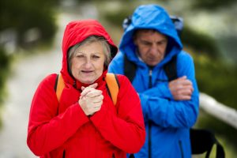
Regulating temperature
The body regulates temperature through a complex finely-balanced negative feedback system, controlled by the temperature regulating system (TRC) in the anterior hypothalamus, near the base of the brain.
Normal temp- 36-37.5 degrees C. The TRC responds to input from specialised receptors in the skin.
If cold- increase metabolism, through shivering and voluntarily through exercise. Also stimulation to add clothing, turn up ambient heat. Heat constriction through peripheral vasoconstriction, and erector muscle contraction, trapping air among body hairs.
If too warm, hairs flatten, pores open, sweat glands secrete and peripheral vessels dilate.
So, degeneration in the central nervous system can impair these intricate mechanisms.
Also, as people with NDDs become more emaciated the skin is less supple and responsive to stimuli, peripheral vessels are less able to constrict and dilate.
https://applewoodourhouse.com/the-risk-of-cold-temperatures-on-alzheimers-patients/

Slide 3
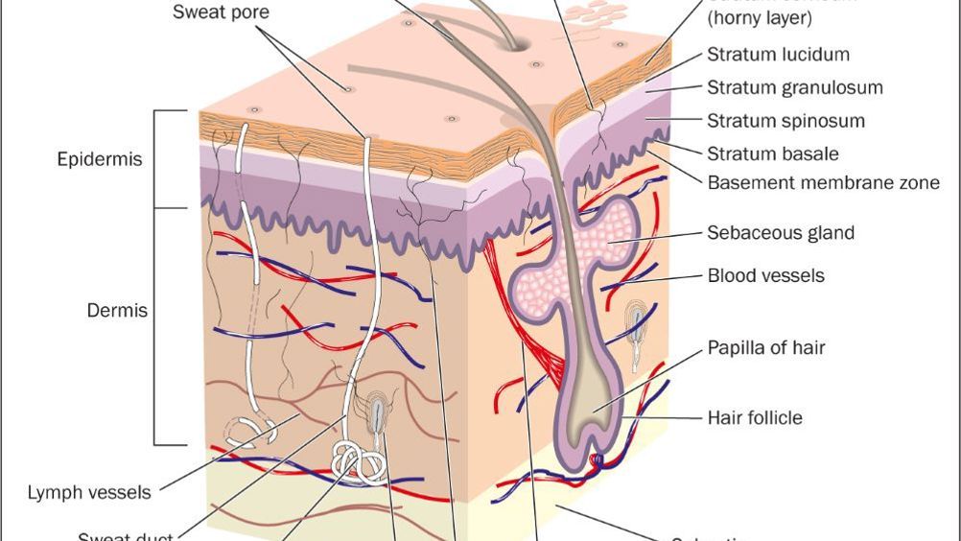
Skin temperature – relationship to ulceration
“…there is strong evidence indicating that elevated skin temperature immediately effects skin resilience. There is also important evidence showing a relationship between increased risk of ulceration and increased skin temperature in patients with impaired thermoregulation”. Mifsud T, et al (2022).
Mitchell A (2022) BJN.

Slide 4


Effects of ageing on skin integrity
Bonifant H, Holloway S. A review of the effects of ageing on skin integrity and wound healing. Br J Community Nurs. 2019 Mar 1;24(Sup3):S28-S33. doi: 10.12968/bjcn.2019.24.Sup3.S28. PMID: 30817191.

Slide 5
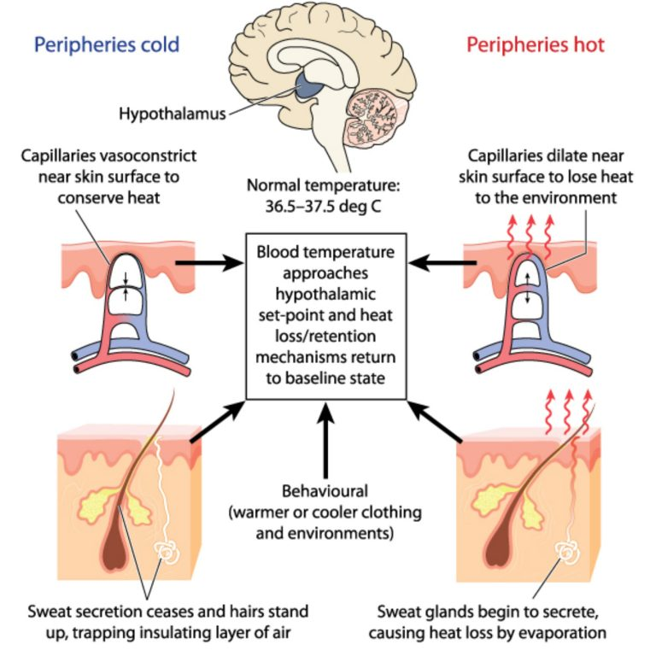
https://www.biologyonline.com/tutorials/temperature-regulation-in-animals Visited 22 02 2023

Slide 6
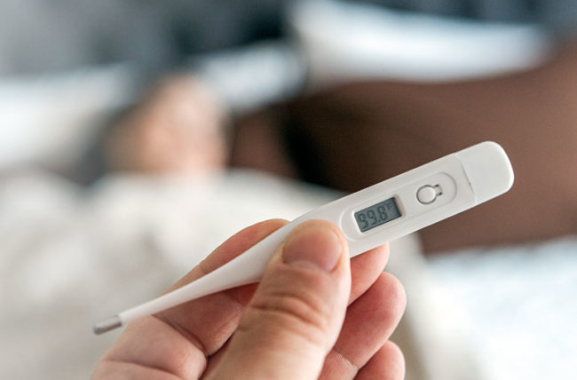
Regulating temperature
Restricted mobility, and compromised nutrition increase the risk of hypothermia.
Reduced defence against infection may lead to impaired TRC function- temperature may ‘set’ at a higher level, and body heat may accumulate.
Sensation of heat and cold by receptors in the skin may be impaired – vulnerability to burns and scalds, overheating or freezing is increased.
So- caregivers must be particularly vigilant at all times – ensuring clothing suited to ambient temperature, hats and sun protection on outings, warm enough if cold weather.
Remember some psychiatric medications increase vulnerability to sunburn.
Checking bath & shower water temperature carefully, observing skin for changes in colour, blistering, rashes.

Slide 7
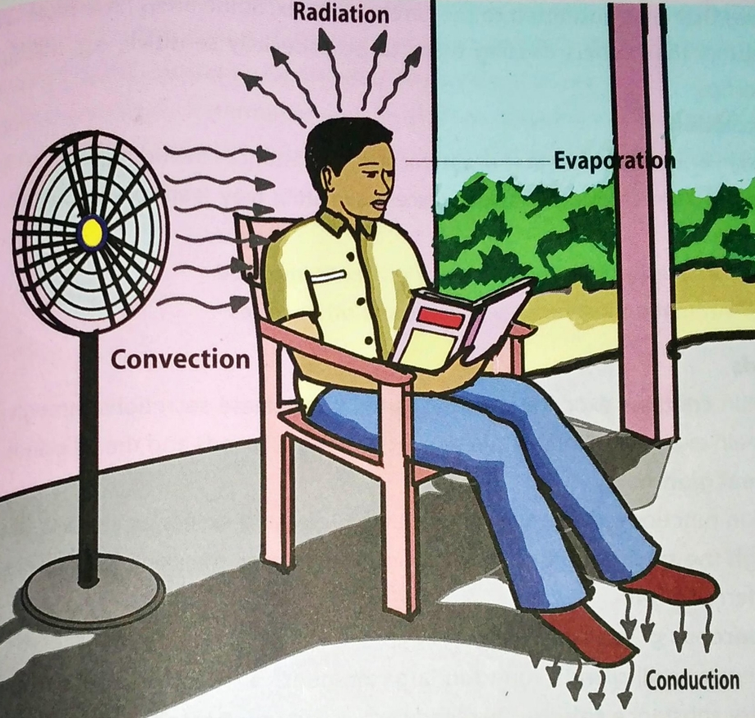
How we lose body temperature
Conduction – transfer of heat from the body to a cooler surface, e.g., lying on a pavement or stone bench.
Convection- air or water drawing off heat – e.g. wind chill or water.
Radiation – e.g. body heat radiates into the cooler ambient temperature from exposed skin.
Evaporation – sweat or water/fluid on skin evaporates taking body heat with it.
https://www.bartleby.com/questions-and-answers/1-explain-how-body-temperature-regulation-takes-place.-2-describe-the-mechanisms-of-heat-loss-and-he/0c0d915c-e495-4fa0-be4f-4629e664aa27

Slide 8
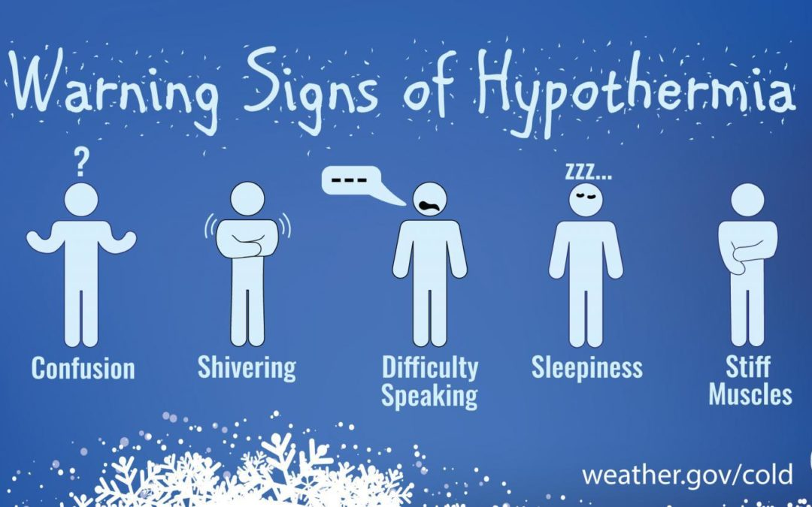
Signs of hypothermia
Mild (35-32C) pale, cool to touch, numbness in extremities, drowsiness, sluggish responses, shivering, increased heart rate & breathing.
Moderate (32-28C) decreased consciousness, urine incontinence (kidney filtration rate higher as blood is shunted to major organs), ceases shivering, heart & breathing rates decrease, BP lower.
Severe- (<28C) unconscious, slow and possibly irregular heart rate, (pulse & breathing may be present but difficult to detect) no pupil response to light, rigid muscles.
https://richlandhealth.org/blog/2020/12/22/know-hypothermia-dangers/

Slide 9
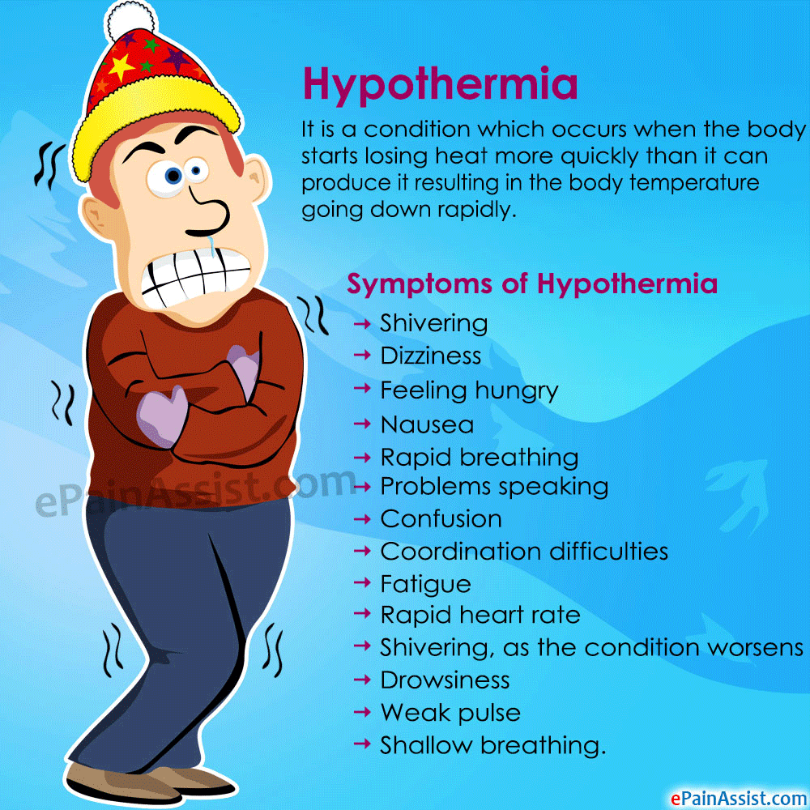
Risks of hypothermia
Impaired judgement: unaware of time of day, whereabouts, and what s/he is doing. May be wearing a T shirt of a chilly day.
Some medicines, e.g. beta-blockers and neuroleptics (antipsychotics that block dopamine, and sometimes serotonin receptors) can lower body temperature.
Wandering, hence particularly careful monitoring in cold weather. (And hot for that matter!).
https://www.westendhappenings.com/post/hypothermia

Slide 10
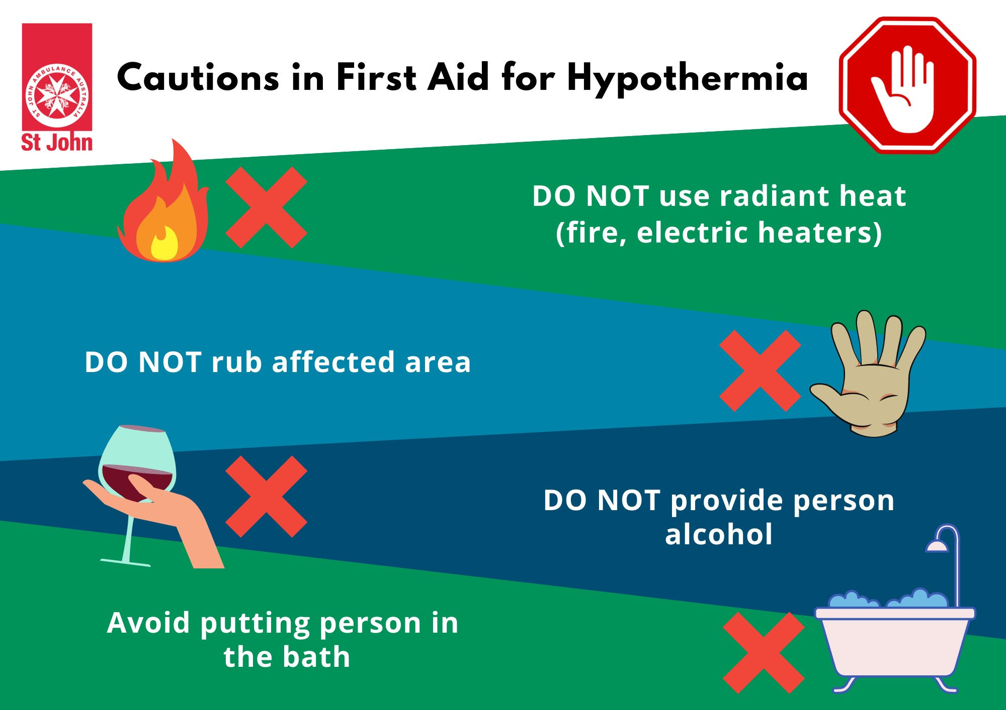
First aid for hypothermia
Don’t massage or rub the person, don’t let them help you – below 32C particularly, risk of cardiac arrest.
Move them out of the cold, but very gently… in some cases rolling a person over who is below 32C has triggered arrest.
Remove wet, replace with dry clothing. Slowly warm the person with whatever is available including your own body heat.
No alcohol – if alert and able to swallow, warm drink, ---NO fluids if vomiting.
Stay with the person, phone for help, monitor breathing, prepare for CPR if necessary. Don’t assume dead- breathing / pulse may be hard to detect.
https://www.betterhealth.vic.gov.au/health/healthyliving/hypothermia#risk-factors-for-hypothermia
https://www.stjohnvic.com.au/news/first-aid-hypothermia-treatment/

Slide 11
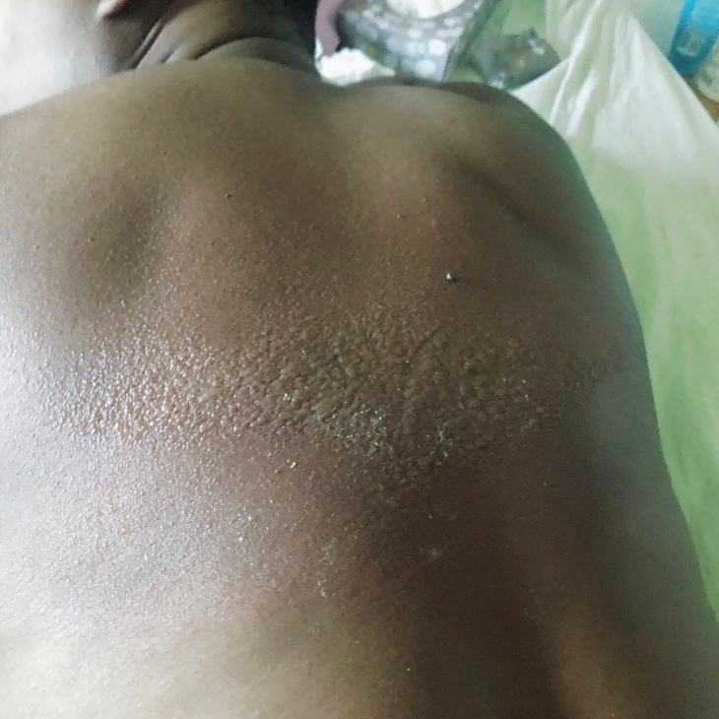
Keeping cool in hot weather
Monitor clothing- light-coloured, loose-fitting clothes can be comfortable, advise a hat/ head covering.
In the day, close curtains/ blinds, in the evening open windows, let warm air out and cool air in. Have fans indoors.
Stay in shade in hottest part of the day.
Ensure there are neighbours/ relatives who will make regular checks.
Remember- some medications increase risk of sunburn.
https://fabmommablog.com/2019/09/23/sunburn-on-dark-skin-myth-or-truth/

Slide 12

Case
A lady with advanced progressive MS lowered into a bath on hoist- water temp just 40C, @ 105F, felt cool to caregiver – but quickly noticed reddening of skin on legs, quickly raised lady out of bath, wrapped upper body in warm towel, immersed legs 20 mins in cold water. Transferred to hospital - later blistered and treated for burns. This lady was white- would be more difficult to notice on darker skin, hence careful vigilance crucial.
https://www.clinicaladvisor.com/home/topics/geriatrics-information-center/climate-change-ups-heat-deaths-especially-among-elderly/ Visited 25 02 2023

Slide 13
Case
A lady with mixed Alzheimer type and vascular dementia given a warm drink- it wasn’t very hot according to the healthcare assistant, but it spilled and caused burns to the chest. This was unfortunate- the lady had been complaining that drinks made for her are always too cold. She felt carers were over-protective. She was also tired of being given cups with lids and spouts - ‘I’m not a baby’ she had said.
The staff were right to be concerned to allow for the dignity of individual choice, even thought there is a risk, but an in-house review (important to carry out and record if there are incidents or near misses) found that the drink was in fact too hot, and too full and the lady had needed assistance and close supervision, and so the incident was a safety failure.
The real problem was insufficient thought through and documented risk assessment. Take risks by all means, if they are carefully measured, controlled and minimised, involving all the team including patient and relatives.

Slide 14
2 more Cases
A gentleman was keen to sit in the sun with caregivers and other patients. People didn’t notice how burnt he was becoming, even though they had ensured he was applied high factor suncream. Prescribed chlorpromazine, he was particularly vulnerable to sunburn.
A lady was warm enough one winter day to ask for the heater to be turned off. At night the temperature got colder, and it was several hours before anyone checked on the lady. Her bedcovers had fallen off, and due to her compromised temperature regulation affected by her advanced dementia, she was not shivering even though cold. She was fortunately discovered in time to avoid hypothermia.

Slide 15
Parkinson’s disease and sweating
PD affects involuntary control of the autonomic system e.g digestion, blood pressure, temperature and perspiration.
PwPD can experience minor or serious problems with thermoregulation. Hyperhydrosis (excessive sweating) can occur and can be an early indicator of PD. (Hypohydrosis can also occur).
Excessive sweating may aggravate skin conditions associated with PD. It can also be psychologically distressing, uncomfortable, interfere with sleep and add to social stigma, changes in body image.
Tips:- try to avoid food that triggers sweating (e.g. for some- alcohol, caffeine, very spicy food).
Use an anti perspirant frequently (deodorant only reduces odour).
Avoid tight-fitting clothing, loose track suits may be preferred; avoid synthetic clothing e.g. nylon; Wear clothes that don’t show sweat marks.
Armpit sweat shields may help- ask pharmacist or check online.
Wear leather shoes, take them off when indoors.
Avoid situations such as crowded rooms, or stressful situations that can trigger sweating.
If these measures don’t help, consult physician – Botox injections can be considered.

Slide 16
Summary
NDDs can affect the body’s ability to regulate temperature. Issue to be aware of include:
Higher risk of hypothermia or overheating and sunburn. Keep the person in a comfortable environment, when cold, ensure they dress in layers, use fans or air conditioning if available, as appropriate.
Reduced mobility. Sedentary lifestyle reduces ability to regulate temperature. Encourage regular physical activity such as gentle exercise.
Medication for NDDs – unwanted effects. These medicines can interfere with temperature regulation. Consult with prescriber if concerns arise.
Cognitive impairment. May be difficult for person to recognise or communicate being too hot or cold. Caregivers must be vigilant for signs of discomfort such as sweating or shivering and adjust the environment accordingly.
Dehydration. May have reduced thirst sensation and / or swallowing difficulties. Offer fluids regularly and monitor intake.

Slide 17
Scenario
With regard to the scenario below, could you come up with a care plan the community nurse could put in place, that clearly and concisely identifies the problem, the goal, and the interventions with rationale?
Scenario: Mrs Bandara has Alzheimer’s disease and lives with her son, Kasun and daughter-in-law Liyoni and their two teenage children. In recent months Mrs Bandara has become hypersensitive, and clothing irritates her, so she just wears a light loose cotton outfit. In the evenings she is cold and insists on turning up the heating, whereas the family are too warm and want the heat turned down. A community nurse, Mandari, visits weekly and asks how the family are managing. Kasun suggests there are no problems but Liyoni raises the issue around the temperature in the house, particularly in the evenings. Kasun says the family should bear with the heat as his mother’s comfort is a priority. Liyoni says this is unfair on the children and also the heating costs are unsustainable, Mrs Bandara must wear more clothing if she’s too cold. Kasun says this is unfair to his mother, she cannot bear wearing more clothing.
Problem | Goal | Intervention | Evaluation

Slide 18
Scenario – My attempt- you may do better…
Problem | Goal | Intervention (with rationale) | Evaluation
Mrs Bandara has temperature control and sensitivity issues that are causing conflicts within the family. | To establish a balance between Mr.s Bandara’s comfort and the family’s need for a suitable temperature, while considering practical and financial factors. | Mandari will conduct a thorough assessment of Mrs. Bandari’s sensitivity and clothing preferences. Engage in open and empathetic communication with the entire family to understand their concerns and perspectives. (Helps clarify root cause of conflict and develop a suitable plan). Provide education to the family about the impact of AD on sensory perceptions, particularly clothing sensitivity and the need for temperature regulation. Explain the potential risks associated with extreme temperatures for Mrs. Banara’s wellbeing and cognitive function (physical discomfort, hypothermia, further deterioration in body temperature regulation, confusion, accidents due to impact of cold on dexterity and mobility). (Education fosters empathy and enables informed decision-making). Offer emotional support to the family acknowledging their different viewpoints and challenges in managing this difficult situation. Encourage open dialogue and explore with the family potential compromises such as setting different temperature zones within the house. Suggest Mrs. Bandara has a comfortable personal space with controllable heating options. Recommend trying Mrs. Bandura with appropriate layers of clothing, taking account of her sensitivity, and ensure she is adequately dressed with unrestrictive clothing, that doesn’t compromise comfort. | Weekly follow-up to assess the effectiveness of agreed solutions and emerging concerns and modify the care plan accordingly based on feedback from all family members.

Slide 19
References
Better Health (2023) Hypothermia, https://www.betterhealth.vic.gov.au/health/healthyliving/hypothermia#risk-factors-for-hypothermia
Bonifant H, Holloway S. A review of the effects of ageing on skin integrity and wound healing. Br J Community Nurs. 2019 Mar 1;24(Sup3):S28-S33. doi: 10.12968/bjcn.2019.24.Sup3.S28. PMID: 30817191.
Cone Health (2018) Managing the heat with a neurological condition, https://www.conehealth.com/services/neurosciences/managing-the-heat-with-a-neuro-condition/
Duong H, Patel G. Hypothermia. In: StatPearls. StatPearls Publishing, Treasure Island (FL); 2022. PMID: 31424823. https://europepmc.org/article/nbk/nbk545239
Jucevičiūtė N et al (2019) Preclinical signs of Parkinson's disease: A possible association of Parkinson's disease with skin and hair features, Medical Hypotheses, (127) 100-104, https://www.sciencedirect.com/science/article/abs/pii/S0306987719301707 [Note- included for interest re asserted greater risk of sunburn in PD]
Mifsud T, Modestini C, Mizzi A, Falzon O, Cassar K, Mizzi S. The Effects of Skin Temperature Changes on the Integrity of Skin Tissue: A Systematic Review. Adv Skin Wound Care. 2022 Oct 1;35(10):555-565. doi: 10.1097/01.ASW.0000833612.84272.da. Epub 2022 Jul 4. PMID: 35819955; PMCID: PMC9508978.
Mitchell A (2022) Skin assessment in adults, BJN 31(5) https://www.britishjournalofnursing.com/content/clinical/skin-assessment-in-adults/
NHS (2023) Hypothermia, https://www.nhs.uk/conditions/hypothermia/
Stemedix (2017) How to Manage the Cold Weather for Those with Neurological Conditions, https://stemedix.com/manage-cold-weather-neurological-conditions/

Slide 20

Any questions?

Slide 21

Thank you

Slide 22
Duration - 2 hours
Recorded lecture time: 1 hour, 10 minutes.
Activity 1 – slide 17 – Care planning - 20 minutes
Tutor-led discussion on activity 1 – 20 minutes
Tutor-led discussion of questions/ points raised by students – 10 minutes
Total duration of lecture on the impact of living with NDDs on the activity of living of controlling body temperature: approx. 2 hours.

