Slide 1
Comprehensive Care
Lecture Twelve
Personal Cleansing & Dressing

Slide 2
Aims
Understand the impact of NDDs on Personal Cleansing & Dressing
Understand the impact of problems with cleansing and dressing on quality of life
Consider impact of problems with cleansing and dressing on caregivers
Explore ways to address problems with cleansing & dressing, maximizing independence.

Slide 3
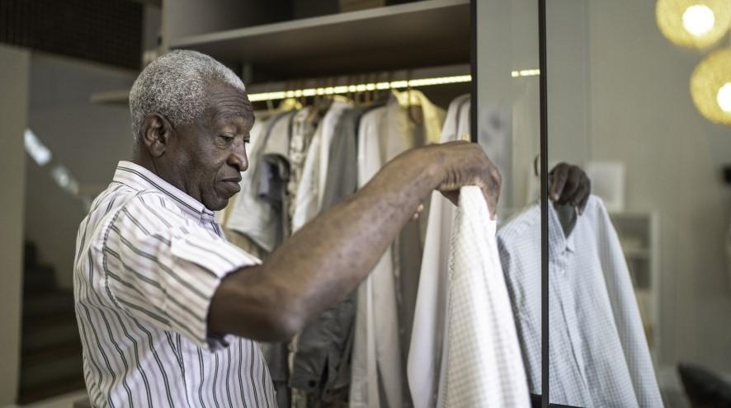
Some tips from ‘Eastleigh Care Homes’ UK https://eastleighcarehomes.co.uk/blog/what-is-the-most-suitable-clothing-for-your-relative-in-a-nursing-home/
Needs will vary from person to person. However, there are some common issues:
Help with dressing: … clothes with easy fastenings, and complete opening are appropriate. Buttoned shirts and blouses, and button front dresses are good examples.
Delicate skin: …elasticated socks, for example, are too constricting and can cause damage.
Help with toileting: Clothing should be as easy to undo as possible to allow for speed, but also serve to ensure dignity as much as possible. Fiddly fastenings, such as buckles, can cause distress and unnecessary accidents.
Incontinence: If incontinence is an issue then you will need to ensure…plenty of sets of underwear and nightwear to allow for changes as needed.
A word on shoes: Steer clear of lace-up shoes which at best pose a trip hazard, and instead choose slip-ons, elasticated shoes, or Velcro fastenings.
https://alzheimer.ca/en/help-support/im-caring-person-living-dementia/providing-day-day-care/personal-care/dressing

Slide 4
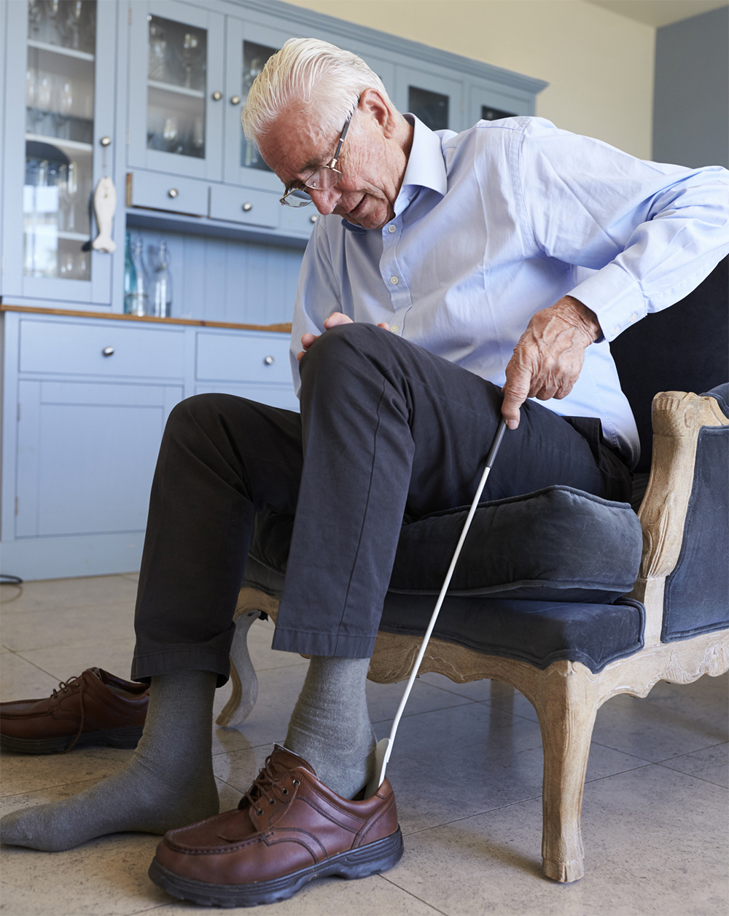
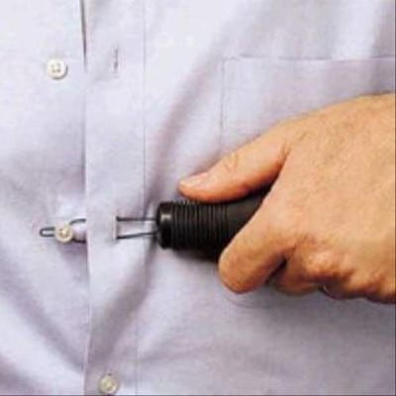
Personal choice versus safety, hygiene and practicality
Maintaining safety is crucial to care – but so is maximising independence and enabling choice.
Good care always involves wrestling with competing considerations.
Always involve the person you are caring for, family caregivers and a team of experts.
Examples of questions that typically cause concern:
Is a shower better than a bath? Is morning, afternoon or evening a better time to take a shower or bath?
How often does the person need a bath or shower?
Is it better to be independent even if the outcome is not quite so tidy and hygienic, or do we need to take over?
Is it important to be dressed or is sitting around in the daytime in pyjamas/ a nightdress OK?
These are just examples- you will encounter many, many more dilemmas relating to cleansing and dressing.
https://anitasangels.com/independent-living-tools-seniors/
https://dailycaring.com/10-simple-dressing-aids-help-seniors-stay-independent/

Slide 5
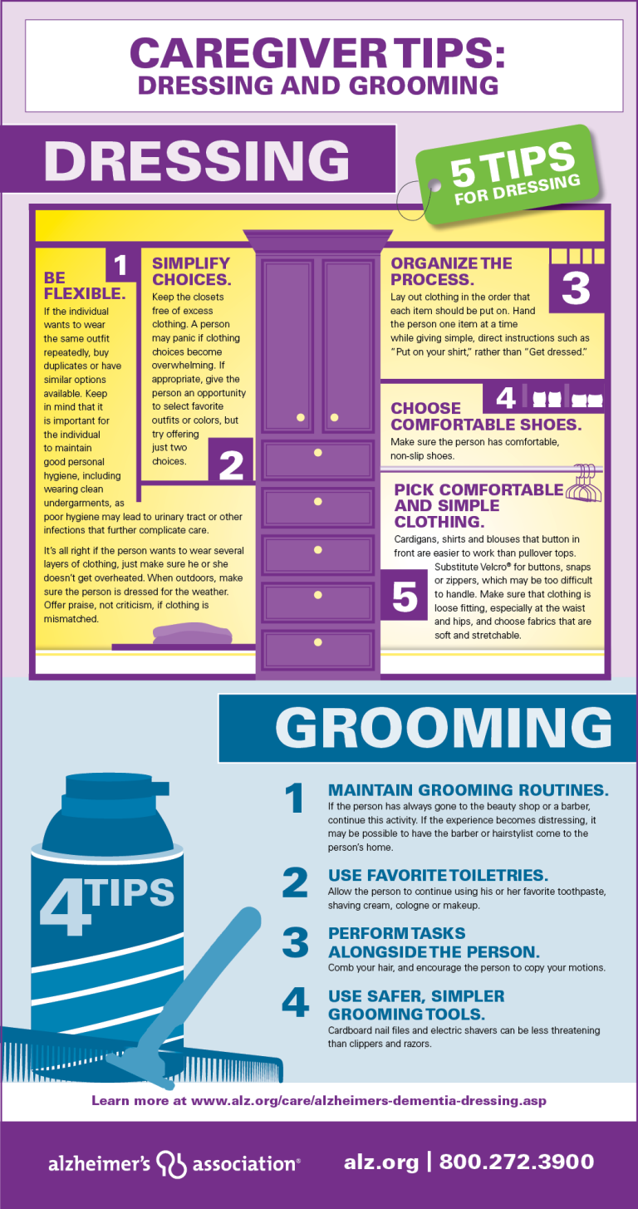
Choice versus safety and practicality
As an example of how to weigh up choices against ensuring safety and practicality let’s consider the issue of having a bath versus a shower.
Biological factor- shower may be cleaner- in a bath you’re surrounded by dirt washed off the body.
Environmental / politiocoeconomic- baths use more water
Psychological- a bath might be a choice- more relaxing?
Practicality- might be easier for a caregiver to help someone into a shower
Safety – for anyone unsteady (chorea maybe) a chair hoist into a bath may be safer. (Fall risk plus risk of carer being hit by uncontrolled limb movement- greater in shower)
Is a wash in a chair or a bed bath a safer option?
Maintaining a sense of humour helps! Good for de-fusing!
https://www.thememorycenter.com/dressing-and-bathing-someone-with-alzheimers/

Slide 6

Principles
Work with the individual to find most agreeable decision – be flexible and avoid confrontation
The right of an individual to make a choice have to be weighed against rights of others to be safe
When weighing risks of, say a fall--- balance against risk of losing independence / choice
Key – is the choice informed? We have the right to make even foolish choices even if risky to ourselves
https://www.dementia.org/how-caregivers-can-assist-with-dressing

Slide 7
Case Scenario
Maureen lived in a UK care home. Staff reprimanded by inspectors because at 4pm Maureen was in her night clothes. The inspector decided this indicated staff were getting residents ready for bed early so staff could more easily have everyone tucked in bed after clearing away the evening meal and before the night staff arrive - institutionalisation. (Recall discussion in the ‘Psychological factors’ lecture).
The team were offended- in a nursing plan, had identified Maureen’s choice- to have a shower late afternoon, and spend the evening from then in night clothes--- loose, and less restrictive given her chorea.
The inspector became satisfied the night clothes were a choice, but suggested track suits were more appropriate- and still loose. But wasn’t convinced about independent choice re a shower so early. The choice was ill-informed, the inspector said, and was made because Maureen had become institutionalised!
The staff argued the benefits of routine for people with NDDs.
What are your thoughts on this scenario- who is right? What would you weigh up here? What would you do?

Slide 8
Maximising independence in cleansing and dressing
It can be difficult to decide how much individuals with advancing NDDs can do for themselves
Individual assessment requires physiotherapist involvement- range of movement
Occupational Therapist- environment adapted suitably; appropriate equipment used to maximise independence
Spacious bathroom is essential; non-slip floor; rounded edges of bath etc; good light, few shadows
Loose clothing if preferred; removable shirt/ trouser fronts (Velcro / zips easier for most than buttons)
Slip on shoes easier than laces
Where we must intervene, e.g. shaving- allow the person to do the finishing touches where able

Slide 9

Mouth and skin care
Mouthcare- essential. Reguar (at least 4 monthly) dental visits. Checking dentures fit well
Good skin care. Impaired communication = person can’t tell us- chaffed skin, clothes rubbing, rash, tight shoes
Regular turning in advanced disease.
Appropriate cushions based on pressure sore risk assessment
Check bony prominences for redness, sore development
Careful continence assessment and appropriate measures to address- always keeping the goal with all these endeavours- maximising independence.
https://mouthcarematters.hee.nhs.uk/links-resources/mouth-care-matters-resources-2/index.html

Slide 10
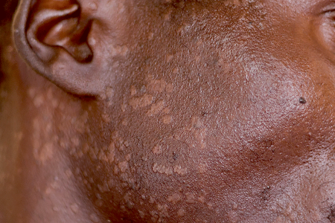
Skin problems in NDDs
Oily skin- Sebaceous glands may produce more sebum than normal- known as seborrhoea.
Use mild soap, or a gentle cleanser and water, or oil-free soap substitute. Avoid cosmetic products containing alcohol, or irritate the skin.
Seborrhoeic dermatitis- many sebaceous glands become red, sore, itchy; skin peels and flakes, thick crusts and scales may form. Particularly vulnerable areas = scalp, face (eyes- blepharitis), ears (can block inner canal), chest, bends and folds in skin e.g behind joints, under breasts, groin. Cause unknown, but seems associated with yeast on skin- important to note- not to do with poor hygiene. Anyone can be affected but often seen in PD.
Loosen crusts on scalp by rubbing olive or mineral oil hours before washing hair. Use medicated shampoo or ask doctor to prescribe shampoo containing ketoconazole and selenium sulphide. A steroid-based cream short term may help. Tea tree oil in shampoos may help. Mild steroid cream, antifungal agent may help with skin elsewhere. For blepharitis clean eyelids daily with cotton buds moistened with baby shampoo.
Seek medical help if problems persist- dermatology referral may be needed.
Useful source: https://www.parkinsons.org.uk/information-and-support/skin-and-sweating-problems
White or pink spots like these on dark skin tend to disappear with treatment- see a GP or dermatologist
https://www.aad.org/public/diseases/a-z/seborrheic-dermatitis-treatment

Slide 11
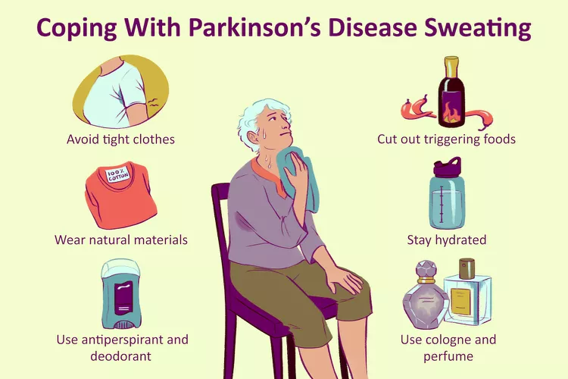
Skin problems in NDDs
Excessive sweating (hyperhidrosis) is often problematic in PD and advanced HD. Can happen in any NDD.
Most happens in PD when PD drugs ‘wear off’.
Can happen in the ‘on’ state, when drugs work their best- associated with dyskinesia (uncontrollable movement or spasms). Hence seen in HD.
Reduced sense of smell may mean unaware of body odour.
Hypohidrosis- too little sweating- can be a side effect of anticholinergics.
May result in overheating.
Caregivers / nurses can often fail to identify and address these problems- ensure your care plan considers- physical, psychological, sociocultural, politicoeconomic, and environmental influences on the AL of Personal Cleansing and Dressing.
NOTE--- More about sweating in the ‘Controlling Body Temperature lecture.
https://www.verywellhealth.com/thermoregulation-and-parkinsons-disease-5209374

Slide 12
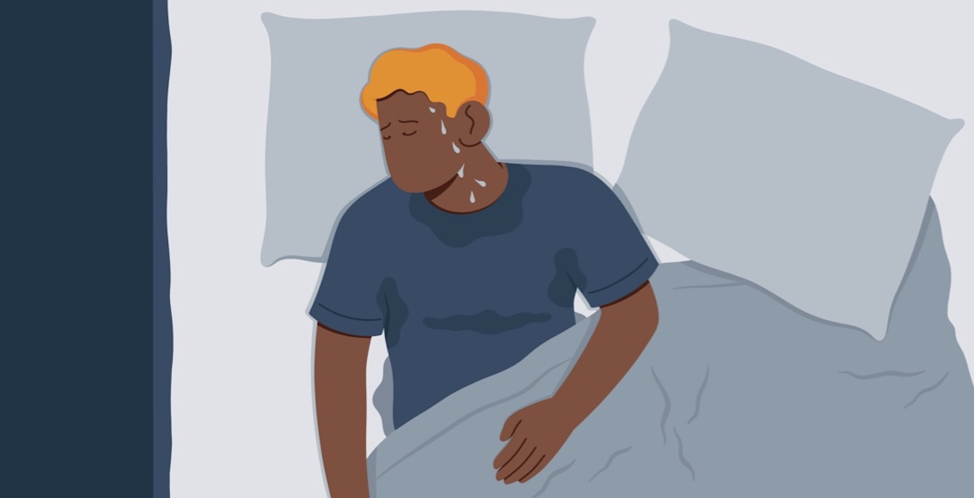
Case - Max
Unable to sleep - addressing night sweating helped.
Not uncommon in NDDs
Could indicate infection
Drink fluid, avoid strenuous exercise especially in warm weather
Address possible stress / anxiety
Check for sleep apnoea – raise with GP – to consider lifestyle changes, BiPAP / CPAP
Review medicines- antidepressants, blood pressure medicines (and cancer medications) can cause night sweats.
Loose, light cotton clothing

Slide 13
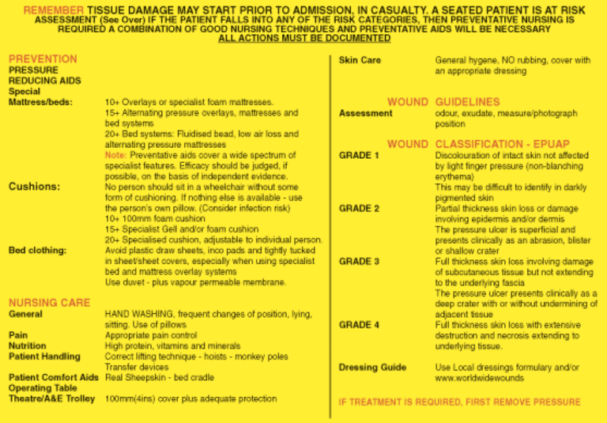
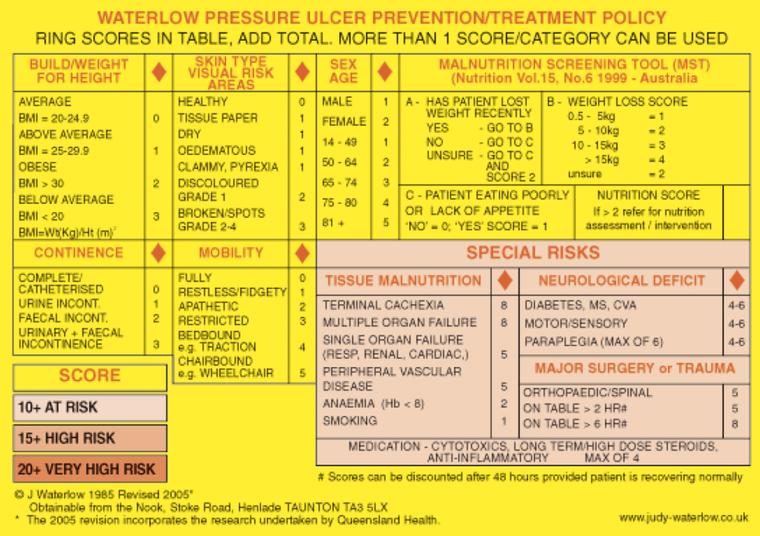
Pressure care assessment
UK- NICE Guidance: 9 quality statements – see https://www.nice.org.uk/guidance/qs89/chapter/Quality-statement-1-Pressure-ulcer-risk-assessment-in-hospitals-and-care-homes-with-nursing
Q statement 1- Hospital or care home admission- p.care assessment within 6 hours.
Q statement 2- Community referrals- must assess p care on first visit.

Slide 14
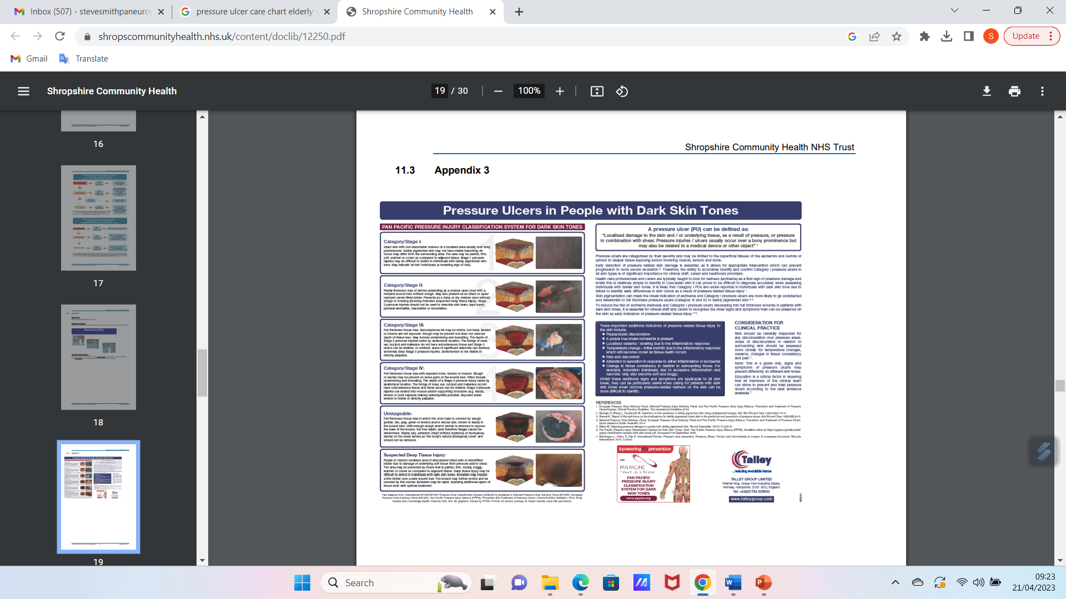
https://www.shropscommunityhealth.nhs.uk/content/doclib/12250.pdf

Slide 15
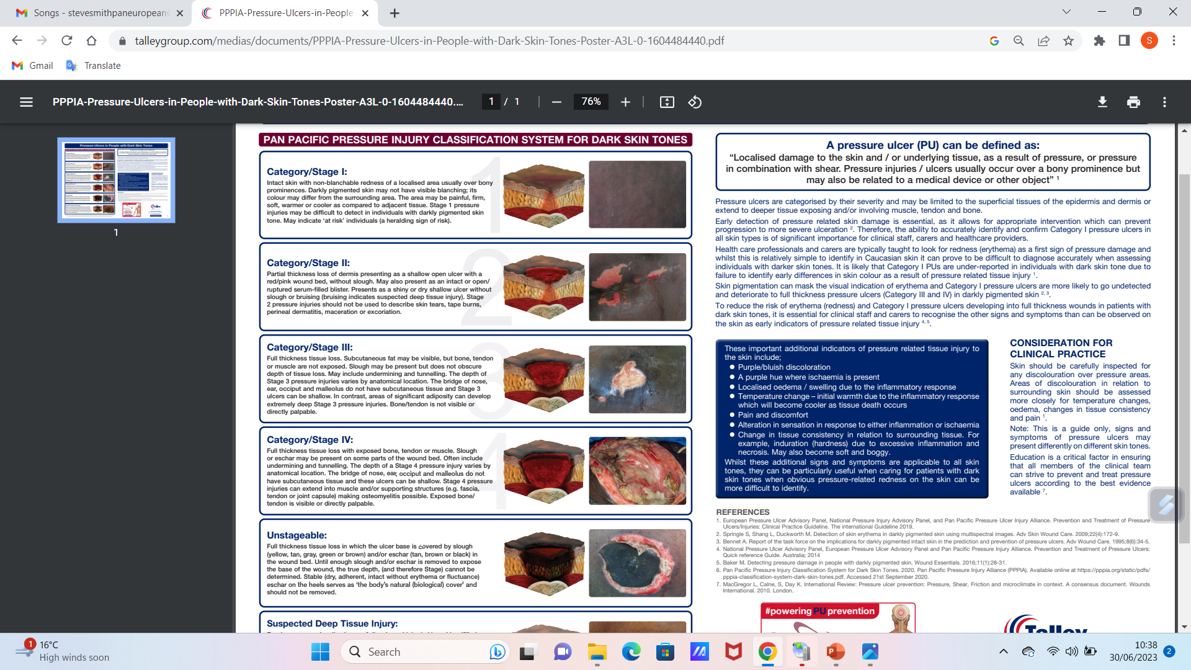

Slide 16
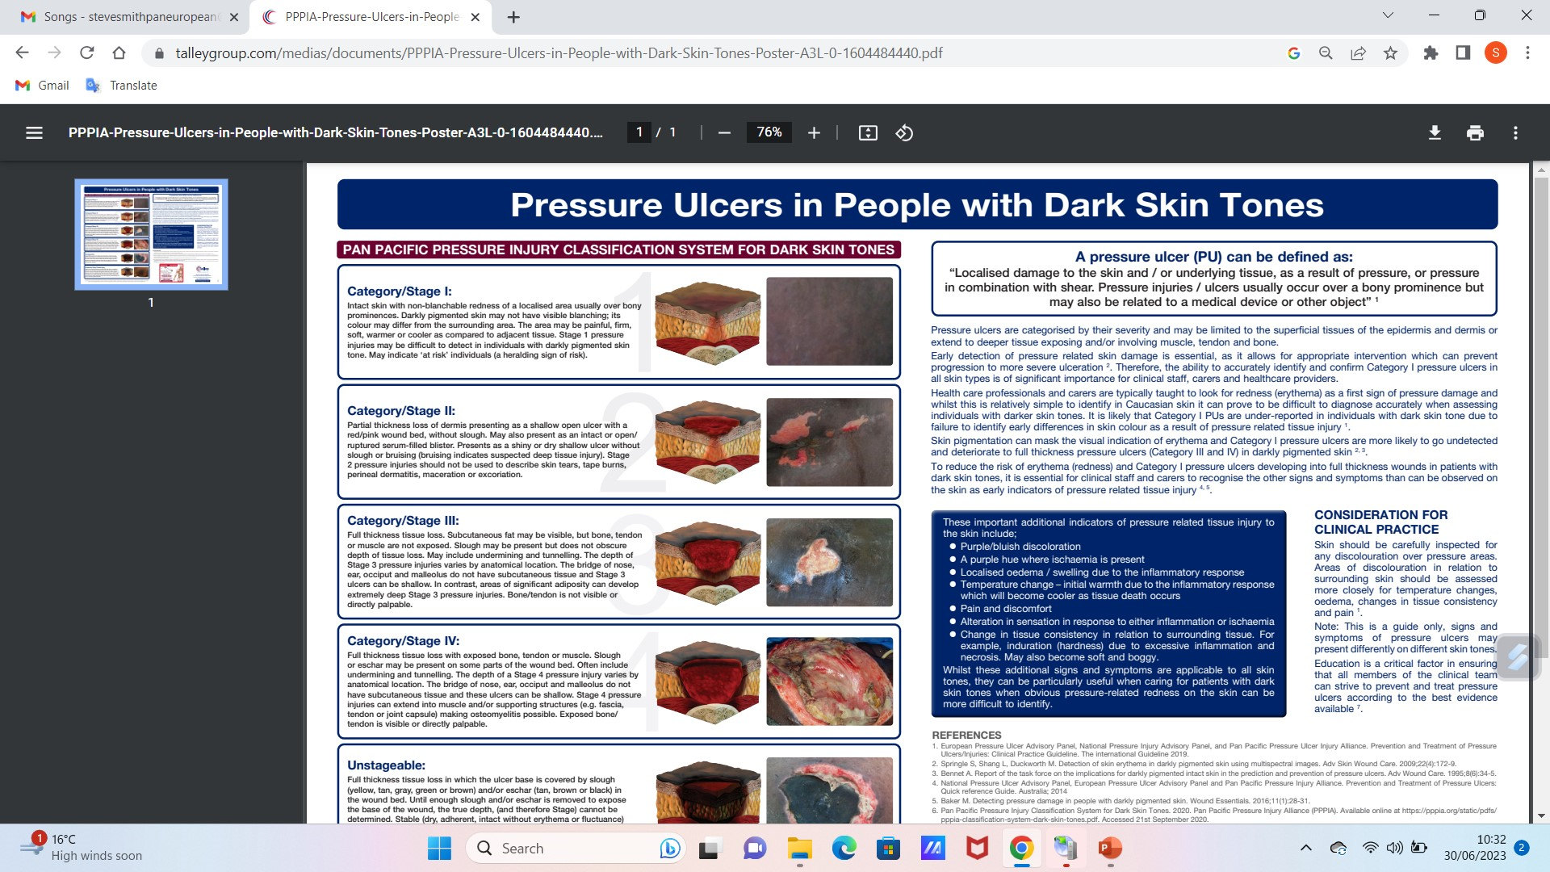

Slide 17
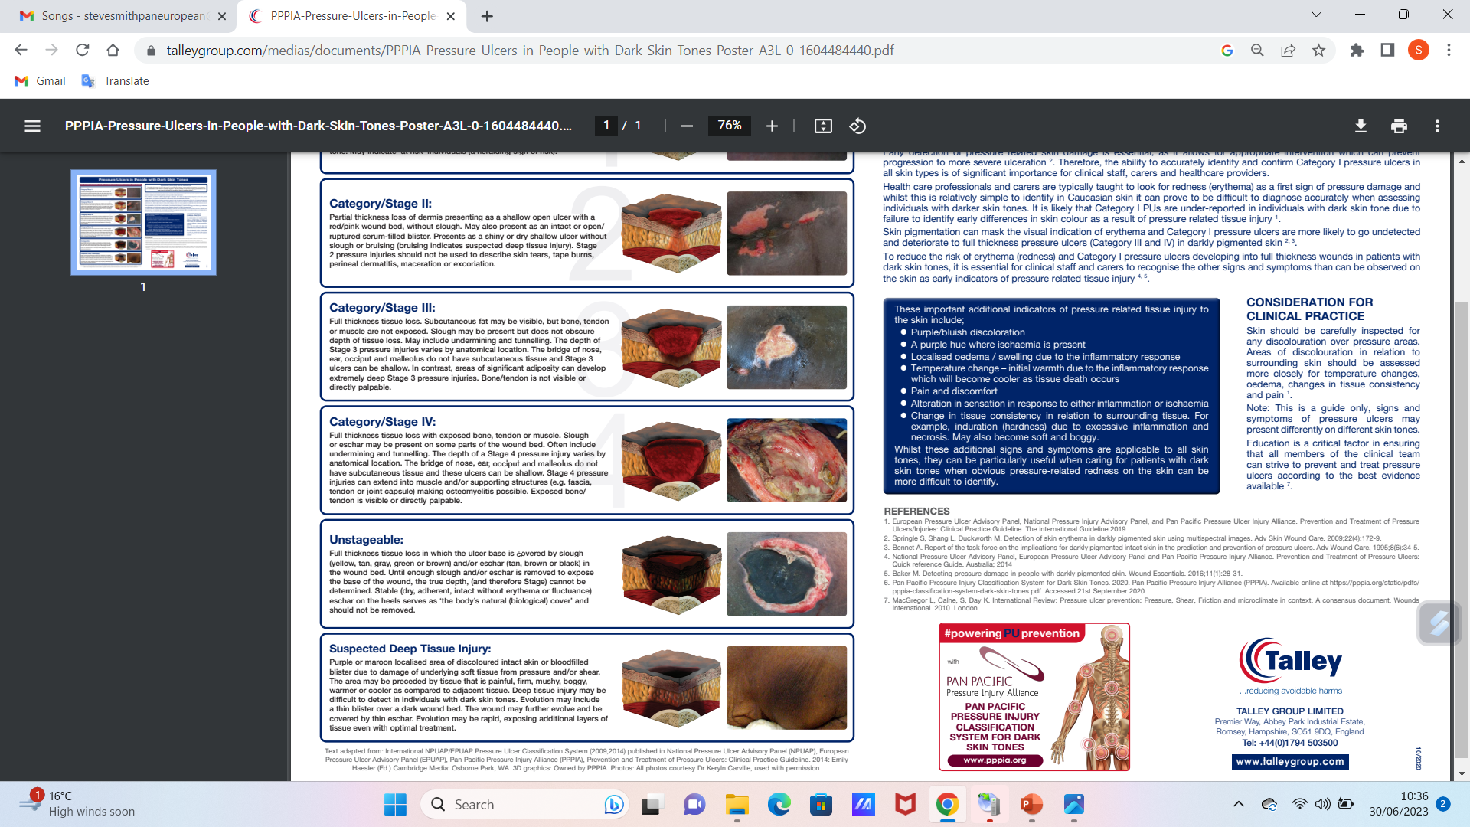

Slide 18
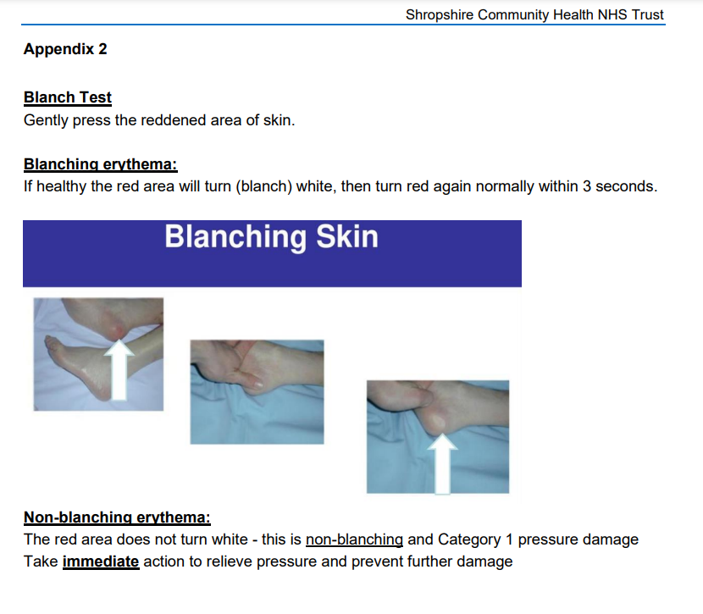
Shropshire Community Health NHS Trust, Policies, Procedures, Guidelines and Protocols (2021) https://www.shropscommunityhealth.nhs.uk/content/doclib/12250.pdf
There are numerous guides- this is good and accessible – mostly white skin orientated though, as most unfortunately are, but does attempt to address dark skin.

Slide 19
Summary 1
NDDs can cause a range of difficulties with personal hygiene and dressing:
Reduced mobility and flexibility: reduced ability to move limbs effectively.
Loss of coordination and fine motor skills- difficulty with buttons, zips etc.
Incontinence: bladder and bowel incontinence challenges management of personal hygiene.
Cognitive and behavioural changes. Challenges such as refusing to bath or change clothes- ethical issues around supporting independent choice versus duty of care.

Slide 20
Summary 2
To help address these problems caregivers can:
Agree and create a daily routine- this helps people with NDDs maintain independence and feel more in control.
Adapt clothing: e.g. elastic waistbands, Velcro fastenings, large buttons.
Assistive devices: e.g. grab bars, shower seats, handrails.
Gentle encouragement: emphasise independence, e.g. allow the person to finish (example shaving)…
Seek professional help: e.g. from Ots, PTs, SALTs…

Slide 21
Scenario
Mr Johnson has advanced AD. He tells nurses to leave him alone when they suggest helping him wash and dress.
Nurse A emphasises the importance of maintaining and respecting his independence and autonomy. Assist only as necessary – a last resort if at risk. Being in a bit of a mess is better than others taking over his life.
Nurse B emphasises efficiency and safety. A strict routine – consistency will help minimize confusion and agitation.
Nurse C emphasises person-centred care- building trust- spending time to establish a bond, always presenting options he can choose from.
Nurse D has a behaviour management background, and suggests positive reinforcement with reward systems.
Nurse E emphasises a holistic approach. Incorporate sensory stimulation techniques into the routine- soothing music/ aromatherapy, ensuring the whole washing & dressing procedure is enjoyable and calming.
The team engage in open dialogue and active listening.
How should the care plan look?

Slide 22
Scenario
Problem | Goal | Intervention | Evaluation

Slide 23
Scenario
Problem | Goal | Intervention | Evaluation
Mr Johnson tends to refuse assistance for personal hygiene despite being unable to adequately maintain cleanliness and grooming. | To ensure Mr Johnson maintains optimal personal hygiene while respecting his autonomy and dignity. | Establish trust & communicating- engage in regular conversations to build rapport & trust. Listen carefully to concerns and preferences regarding personal hygiene. Individualised approach- Assess Mr Johnson’s capabilities & limitations related to personal hygiene. Identify specific tasks he can safely and independently perform. Education – provide clear, simple instructions and explanations about the importance of personal hygiene. Educate Mr Johnson about potential health risks and discomfort associated with inadequate hygiene. Respectful assistance- Offer assistance while respecting autonomy, allow him to participate as far as possible, with support as needed. Positive reinforcement – Implement a rewards system for cooperation for personal hygiene tasks. Offer praise and encouragement when he accepts assistance and engages in hygiene practices. Sensory stimulation – Create a soothing and comfortable environment during personal hygiene routines. Incorporate sensory techniques such as calming music or aromatherapy to reduce anxiety and promote relaxation. | Each intervention will be evaluated weekly over three months until (date), and modified according to Mr Johnson’s responses and evolving needs.

Slide 24
References
Eastleigh Care Homes (2023) What is the most suitable clothing for your relative in a nursing home? https://eastleighcarehomes.co.uk/blog/what-is-the-most-suitable-clothing-for-your-relative-in-a-nursing-home/
Judy-waterlow.co.uk (2023) Pressure Ulcer Risk Assessment and Prevention, http://www.judy-waterlow.co.uk/index.htm
Shropshire Community Health NHS Trust, Policies, Procedures, Guidelines and Protocols (2021) https://www.shropscommunityhealth.nhs.uk/content/doclib/12250.pdf
The Memory Center (2016) Dressing and Bathing Someone with Alzheimer’s, https://www.thememorycenter.com/dressing-and-bathing-someone-with-alzheimers/

Slide 25

Any questions?

Slide 26

Thank you

Slide 27
Duration – 2 hours 30 minutes
Recorded lecture time- 1 hour, 30 minutes
Activity 1 – slide 7 – case scenario discussion 5 minutes
Tutor-led discussion of activity 1 5 minutes
Activity 2 – slide 22 – care plan 20 minutes
Tutor-led discussion of activity 2 20 minutes
Questions / tutor-led discussion 10 minutes
Total duration - 2hrs, 30 minutes

