Slide 1
Comprehensive Care
Lecture ten
Eliminating

Slide 2
Aims
Understand the impact of NDDs on Eliminating
Understand the impact of impaired eliminating on quality of life
Consider impact of problems with eliminating on caregivers
Explore ways to address problems with eliminating, maximizing independence.

Slide 3
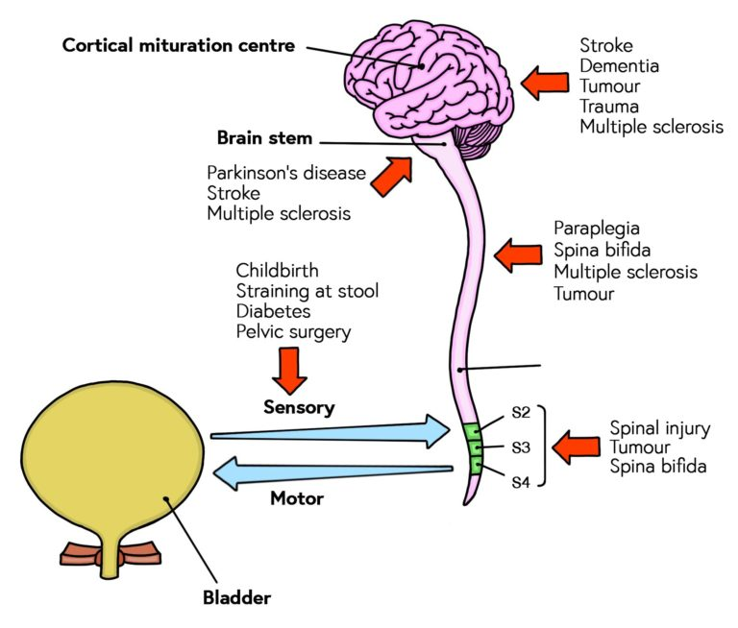
Why and how will NDDs impact on eliminating?
Many people with NDDs maintain continence to later stages.
Some don’t. This may be associated with:
Loss of or impaired sensory stimulation from bladder, rectum. Urgency or no warning at all.
Mobility problems- taking too long to get to W.C. Delayed clothing adjustment, getting onto W.C.
Disinhibition.
Inability to think ahead- focus on immediate needs.
https://www.futurelearn.com/info/courses/understanding-continence-promotion/0/steps/46094
https://twitter.com/slpinsights/status/917544732397465602/photo/1 visited 22 11 2022

Slide 4
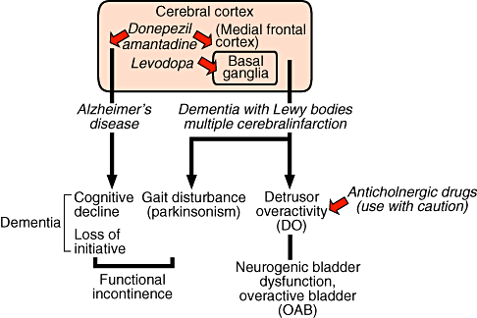
Neurological influence on problems with eliminating
Frontal lobe deterioration- difficulty in planning ahead, considering alternatives, controlling impulses, taking account of social cues
Loss of motor control. – mobilising and sphincter control, peristalsis.
https://onlinelibrary.wiley.com/doi/full/10.1111/j.1442-2042.2008.02109.x

Slide 5
Incontinence- Impact
Psychological factors: Sensing rejection; Dependence, Loss of control, autonomy; feeling a nuisance, a burden, body image.
Politicoeconomic factors: Costs- incontinence pads; staffing; laundry- sheets, bedding.
Sociocultural factors: Family re-organisation to provide care; social isolation; meaning of self/ family role; intolerance by tired caregivers. ‘You’re doing this to be awkward!’
Physical factors: Skin integrity; infection; poor nutrition and hydration- refusing to eat and drink in order to try and avoid bed-wetting/
Environmental factors: Access to facilities; Limitation on journeys/ outings;

Slide 6
What is Quality of Life?
“Quality of life (QoL) is a concept which aims to capture the well-being, whether of a population or individual, regarding both positive and negative elements within the entirety of their existence at a specific point in time. For example, common facets of QoL include personal health (physical, mental, and spiritual), relationships, education status, work environment, social status, wealth, a sense of security and safety, freedom, autonomy in decision-making, social-belonging and their physical surroundings.
The World Health Organization explains QoL as a subjective evaluation of one's perception of their reality relative to their goals as observed through the lens of their culture and value system”.
Teoli D, Bhardwaj A. Quality Of Life. [Updated 2023 Mar 27]. In: StatPearls [Internet]. Treasure Island (FL): StatPearls Publishing; 2023 Jan-. Available from: https://www.ncbi.nlm.nih.gov/books/NBK536962/

Slide 7
Approaches to measuring QoL
Generic, e.g. EQ5D – domains- mobility, self care, usual activities, pain, discomfort, anxiety, depression. https://euroqol.org/eq-5d-instruments/
Disease-specific, e.g. SF 36 - https://clinmedjournals.org/articles/jmdt/jmdt-2-023-figure-1.pdf
Proxy / self-reported.
Other approaches, e.g Time trade off (TTO) Perez DJ, McGee R, Campbell AV, Christensen EA, Williams S. A comparison of time trade-off and quality of life measures in patients with advanced cancer. Qual Life Res. 1997 Mar;6(2):133-8. doi: 10.1023/a:1026438100283. PMID: 9161113. Standard Gamble (SG) Salomon J (2014) Techniques for valuing health states, Encyclopedia of Health Economics, 454-458. https://www.sciencedirect.com/science/article/abs/pii/B9780123756787005022

Slide 8
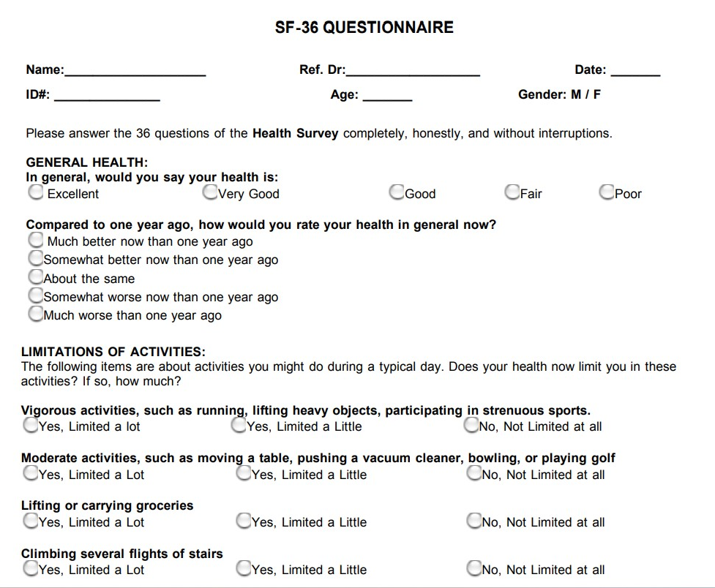


Slide 9
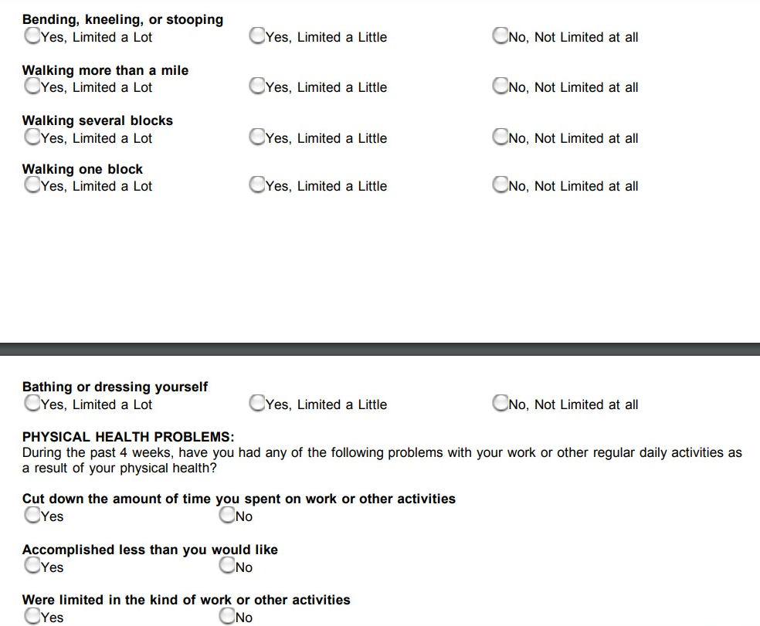

Slide 10
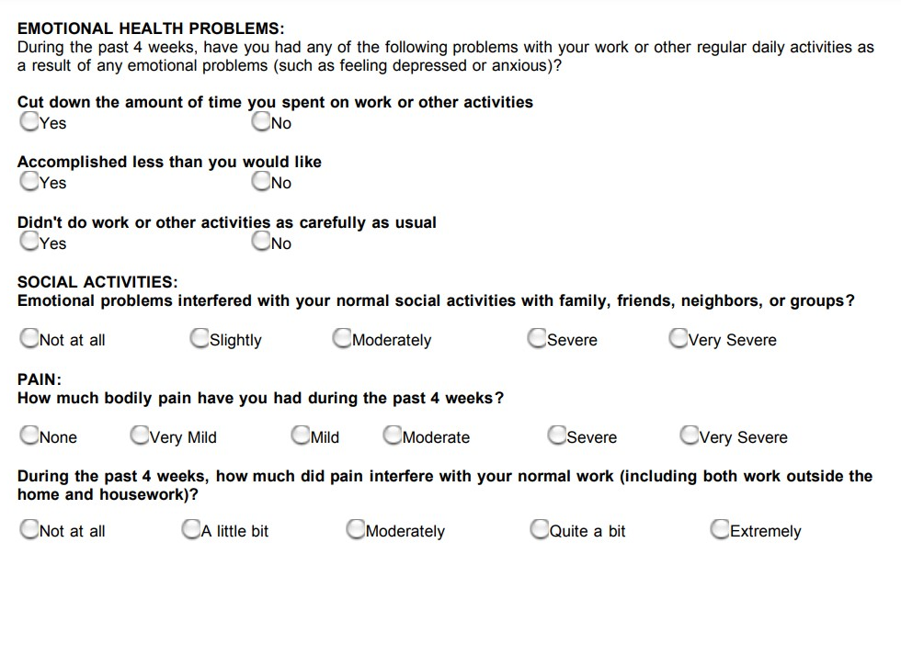

Slide 11
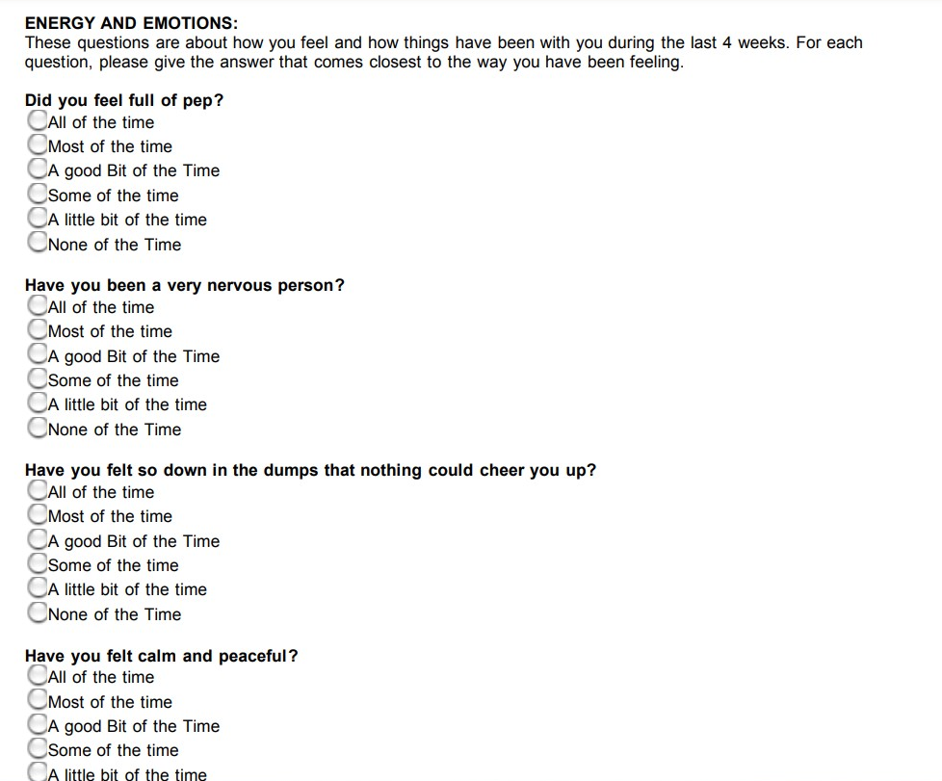

Slide 12
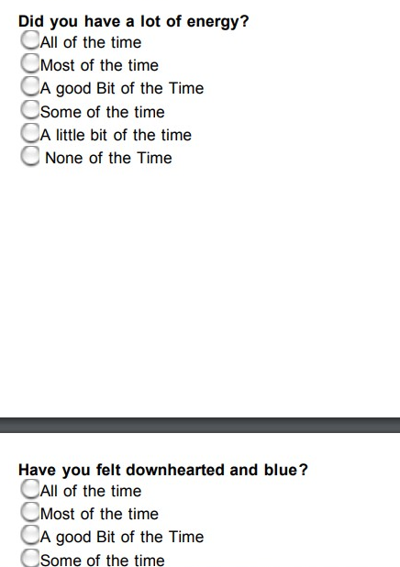
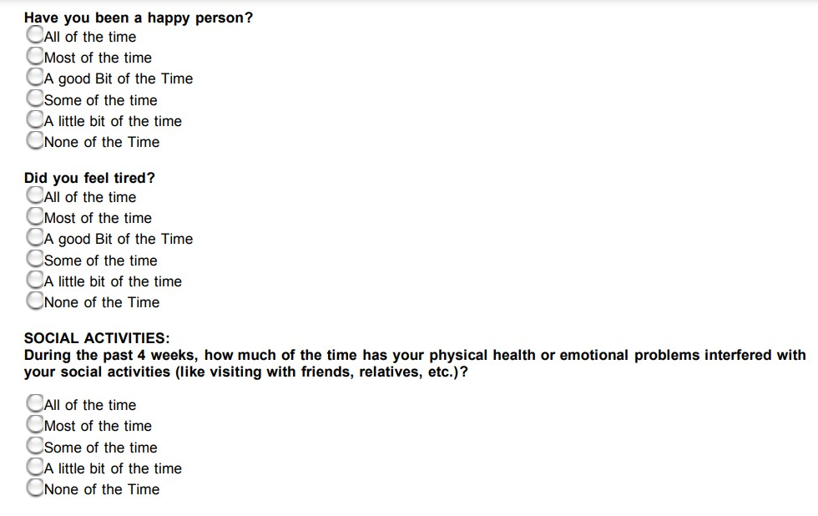

Slide 13
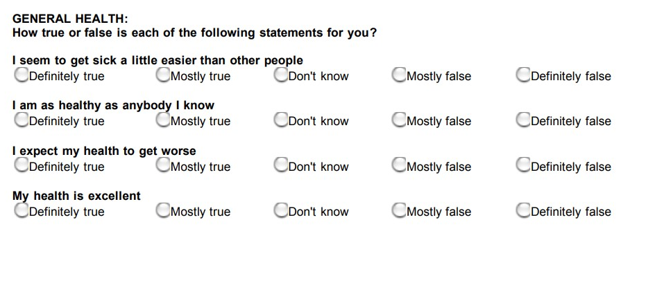
Ware JE Jr, Sherbourne CD. The MOS 36-item short-form health survey (SF-36). I. Conceptual framework and item selection. Med Care. 1992 Jun;30(6):473-83. PMID: 1593914. https://pubmed.ncbi.nlm.nih.gov/1593914/
https://clinmedjournals.org/articles/jmdt/jmdt-2-023-figure-1.pdf

Slide 14
PDQ-39
There are 39 questions in the long form Parkinson’s Disease Questionnaire, with 8 discrete scales:
mobility (10 items)
activities of daily living (6 items)
emotional well-being (6 items)
stigma (4 items)
social support (3 items)
cognitions (4 items)
communication (3 items)
bodily discomfort (3 items)
Patients are asked to think about their health and general well-being and to consider how often in the last month they have experienced certain events (e.g. difficulty walking 100 yards). Patients are asked to indicate the frequency of each event by selecting one of 5 options (likert Scale): never/occasionally/sometimes/often/always or cannot do at all.
Health Outcomes: https://innovation.ox.ac.uk/outcome-measures/parkinsons-disease-questionnaire-pdq-39-pdq-8/

Slide 15
Worth reflecting on 2 slides from the ‘Breathing’ lecture:

Slide 16

Supporting Eliminating / continence management
People with COPD and Asthma have a higher risk of NDDs including Alzheimer’s disease and Parkinson’s disease. Wang et al (2019)
And AD & PD increase the risk of neurogenic bladder.
CNS pathology in PD is associated with bladder dysfunction (urgency and frequency). Anticholinergic drugs e.g. Oxybutinin may help. Bethanechol is a synthetic muscarinic (cholinergic) stimulant that can act on cholinergic receptors in the detrusor muscle. But before these are prescribed a doctor must rule out other causes e.g. enlarged prostate. For some, problems are worsened by these drugs so individual expert assessment is necessary. Mousa et al 2022.
30-40% pwpd - urinary dysfunction, yet just 15% have urinary incontinence. E.G. many visit the w.c. multiple times nightly (overactive bladder).
Non-pharmacological approaches such as pelvic floor training and cautious fluid management may help but evidence is low (Kholer et al 2021).
Impaired bladder emptying is less frequent but troublesome in PD. https://www.parkinson.org/library/fact-sheets/urinary-problems
https://nafc.org/product/continence-care-for-people-with-parkinsons-disease/

Slide 17
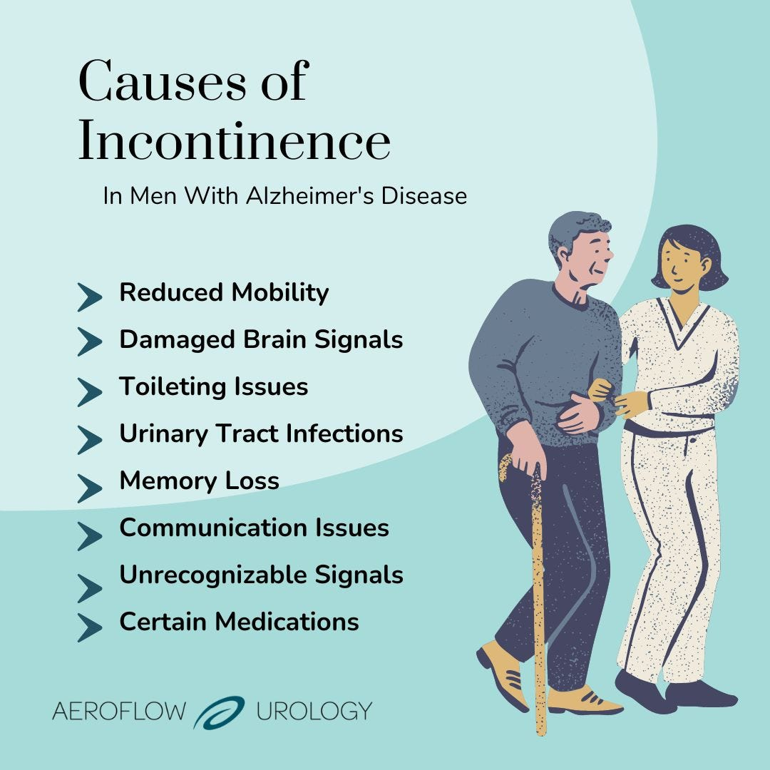
Supporting Eliminating / continence management
Focus on impact of impaired breathing
Continence issues in NDDs:
Slow reaction to / misinterpretation of stimulus to use W.C.
Poor mobility- can’t get there on time
Communicating - can’t tell someone ‘I need the W.C.’
Can’t find or recognise the W.C. (e.g. may use a waste bin)
Difficulty using W.C., sorting clothing
Embarrassment at past accidents/ annoyance of carer/ staff
Depression/ lost motivation- no interest in attending to own needs such as eliminating
Arguably- if these possibilities are understood we are halfway to solving the problems
Alzheimer’s Society (2023)
https://aeroflowurology.com/blog/alzheimers-disease-incontinence-in-men

Slide 18
Misinterpretation of ‘behaviour’
Case- woman pulling pads to pieces, crying “E-O”
Case- Man wiping excrement on walls – perceived as ritualistic behaviour.
Importance of understanding--- neurodegenerative disease does not ‘add’ – people don’t gain added behaviours. It is about losses- loss of impulse control, loss of ability to communicate needs, loss of recognition of cues…
Work as a team to understand causes, meanings- avoid writing off behaviour as ‘bizarre’.

Slide 19
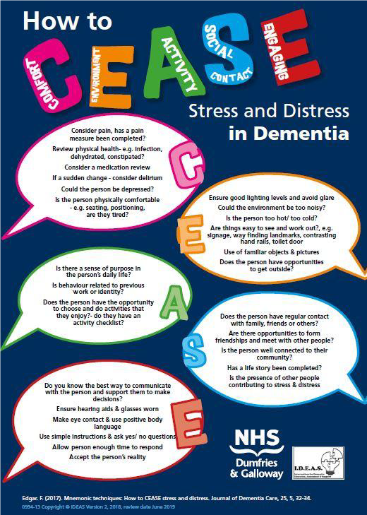
Think: Psychological factors-
Alzheimer Scotland – Action for Dementia (2019) https://letstalkaboutdementia.wordpress.com/2019/03/28/national-ahp-dementia-webex-series-top-tips-for-working-with-stress-distress/

Slide 20
Continence management approach
Don’t just accept incontinence – seek out the cause and seek to resolve it
Is there a urinary tract infection?
A neurogenic bladder?
Retention?
Is sleepiness or lethargy preventing getting to the W.C. on time?
Review anti-depressant or other medications

Slide 21
Risks associated with urgency incontinence
Falls - due to:
Hurrying to get there on time
Turning on the spot to sit (think- Parkinson’s; Huntington’s). (Also being distracted by someone calling out from behind).
Managing manoeuvres while trying to undress quickly.
Think- chorea; poor balance; rigidity; spasticity;
Inability to concentrate, stay focussed, especially with demands on more than one thing at a time.
Impaired visuo-spatial awareness.

Slide 22
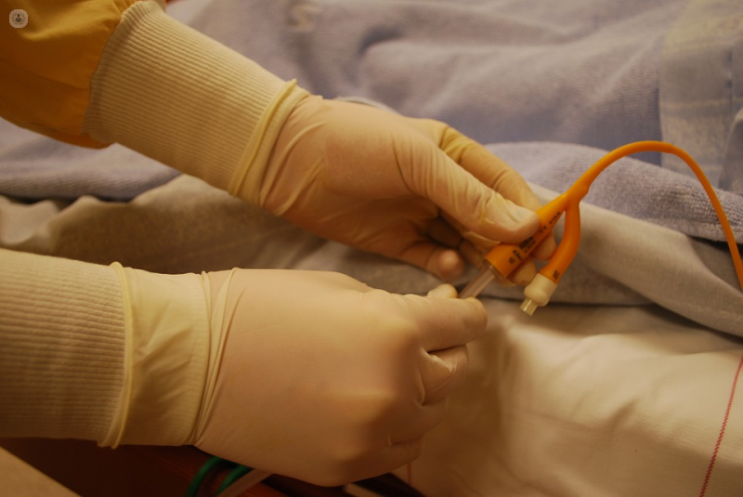
Catheter care
Be aware- ease of management should not be prioritised over risk / clinical need for patient – Oswald K (2013).
Clean your own hands and with separate water and cloth wash the skin around the catheter site, rinse off soap, do not use creams or powders.
Clean the catheter itself twice daily
Keep the catheter below waist height, avoid disconnecting the bag more than necessary, don’t let the bag overfill, check for kinks in tubing, encourage good fluid intake.
These are some key principles – but check for fuller guidance – e.g. Grayer et al (2020) Royal Marsden Manual, or Delves-Yates et al (2022)
https://www.topdoctors.co.uk/medical-dictionary/catheter#

Slide 23

Constipation management approach
Observe for signs, seek cause and seek solution.
Suspect medication
Poor diet
Insufficient fruit, drinks, exercise.
Bulking agents may help.
Regarding unresolved elimination problems- bring in continence adviser expertise.
https://patch.com/new-jersey/ramsey-nj/causes-prevention-risk-factors-chronic-constipation

Slide 24
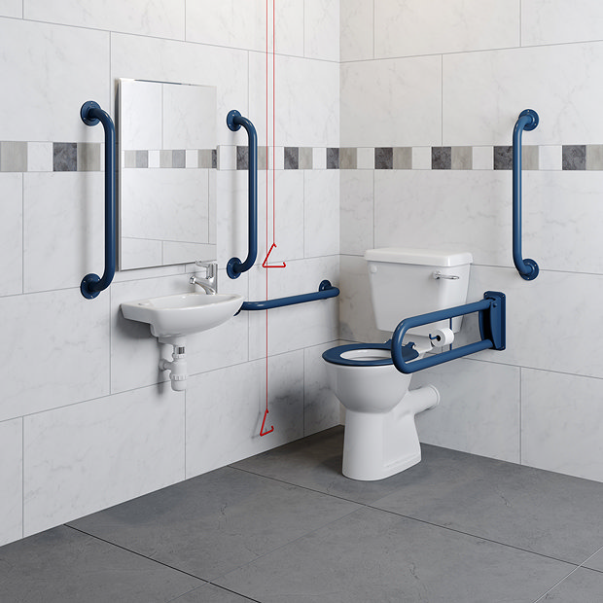
Politicoeconomic and environmental approaches
Be very clear about what the problems are. Is it around the space needed to turn and sit at the W.C. and adjust clothing?
Is it an issue grab rails or other accessibility aids could resolve?
Special clothing to ease getting to toilet on time?
Is there a need for new non-slip flooring? Rounded edges on baths/ sinks / furniture to avoid injury?
Does lighting need improving?
Clearly identifying what is needed, costing the solution, and costing failure to address the issues, financially and humanely is the first step to successfully securing financial support.
Cost potential consequences of neglect accusations for health and social care management – financial and reputation.
https://www.victorianplumbing.co.uk/premier-doc-m-pack-disabled-bathroom-toilet-basin-and-grab-rails-blue?campaign=googlebase&gclid=Cj0KCQjwxYOiBhC9ARIsANiEIfZjgyr0BXwZ8NJLdZQVO5l3q9gPtaGsU-KqFN_VaOTyVqiCDAe4qaEaAkUrEALw_wcB&gclsrc=aw.ds

Slide 25
Summary 1
NDDs can cause a range of issues related to continence management.
Urinary incontinence is common in this group, particularly in later stages, due to muscle weakness, reduced bladder capacity, impaired sensory function and cognitive decline.
Bowel incontinence due to reduced muscle tone in the rectum and anal sphincter, decreased sensation in the rectum and constipation.
Urinary retention caused by muscle weakness, bladder obstruction or nerve damage.
Constipation (especially in PD) due to reduced peristalsis, decreased rectal sensation and reduced mobility.

Slide 26
Summary 2
A multi disciplinary (preferably interdisciplinary) approach is needed- including nurses, doctors, PTs, Ots, the patient and caregivers.
Treatment may involve medications, (eg. Anticholinergics to treat an overactive bladder, bulking agents to treat constipation); behavioural techniques (e.g. bladder training, double-voiding, scheduled toilet trips, fluid and diet management).
Catheterization can be necessary. Appropriate reasons include acute urinary retention or bladder outlet obstruction; need for accurate measurements in critically ill patients; perioperative use for some surgical procedures; to assist healing of open sacral or perineal wounds in incontinent patients; when immobilisation is necessary due to unstable spine or pelvis (e.g. in trauma); to improve comfort at end of life.
But catheterisation must not be used as a substitute for nursing care for incontinence.

Slide 27
Scenario
Brian has Huntington’s disease and his chorea is so severe that he has broken many chairs he has sat on due to his jerking involuntary movements. Whenever he stands to use a urinal, urine saturates the room, causing a health hazard and has caused him to slip on the wet floor. Whenever he sits on the toilet to pass urine or faeces in recent months the seat has been broken and the toilet has become detached from the floor. A specialist company provided a very robust toilet, but the seat broke and it detached from the floor the first time Brian sat on it.
Brian refuses medication to reduce chorea because it also reduces his voluntary movement and he loses independence, for example, requiring him to be fed by others instead of managing by himself. The nurses reached agreement with Brian that he would wear incontinence pads (diapers) and change them after soiling, and this worked for some weeks. But now Brian has expressed distress that this makes him feel he’s being treated like a baby and is not prepared to wear these pads any more. The nurses are unsure what to suggest.
Can you suggest a concise care plan that briefly summarises the problem, the goal and interventions with rationale, to help the nursing team reach agreement with Brian on managing safe and dignified continence?
Problem | Goal | Intervention | Evaluation

Slide 28
Scenario - You might do better….
Problem | Goal | Intervention | Evaluation
Brian has difficulty managing continence due to severe choreic involuntary movements leading to broken chairs & toilets posing a safety hazard. The use of continence pads distresses Brian, as he feels it diminishes his independence and treats him like a baby. Medication to reduce chorea also reduces voluntary movement leading to loss of independence | To ensure safe and dignified continence management for Brian while respecting his autonomy and addressing his concerns. | Assess Brian’s continence needs including frequency of urination and bowel movements, patterns and any associated discomfort or pain. Involve Brian in setting goals relating to continence ensuring preferences, values and autonomy are respected. Discuss with Brian the importance of maintaining a safe environment for himself and others, emphasising risks associated with broken seats, detached toilets and wet floors. Explore alternative seating options such as chairs with sturdy frames or specialised seating equipment designed for people with movement disorders. Consider installing handrails or other stability aids in the bathroom to prevent slips and falls. Consult with specialist OTs to identify assistive devices that can support Brian’s continence management such as adaptive toileting equipment or ergonomic urinals. Modify the bathroom environment to minimise potential hazards caused by urinal spills. This may include slip-resistant flooring, placing absorbent mats around toilet area, and waterproof wall coverings. Engage the specialist company again, for help to install a sutable robust toilet seat that can withstand Brian’s movements ensuring it is securely attached to the floor, to find a solution that appropriately meets Brian’s needs, and engage with the International Huntington’s Association to get help to find a company willing to meet the challenge. Provide education and training for Brian including techniques to clean up spills promptly and safely, or call for help to do so, to reduce accident risks and maintain a clean, healthy environment. | Continually monitor / assess Brian’s continence management and hold weekly team meetings to address concenrs or challenges and adjust the care plan accordingly.

Slide 29
References
Alzheimer’s Society (2023) Toilet problems, continence and dementia, https://www.alzheimers.org.uk/get-support/daily-living/toilet-problems-continence
Droberg P, Zani J, ALS Association (2017) Managing symptoms of ALS, Living with ALS resource guide (6), 6-11, https://www.als.org/sites/default/files/2020-04/lwals_06_2017.pdf
Delves-Yates et al (2022) The nurses clinical skills pocket book, Sage.
Grayer, J., Baxter, J., Blackburn, L., Cooper, J., Curtis, E., Dvorjez, L., Finn, L., Gaynor, D., Henderson, B., Jagger, C., Keating, L., Leigh-Doyle, J., Lister, S., Mathiah, R., & Mohanmmed, A. (2020). Communication, psychological wellbeing and safeguarding. In S. E. Lister, J. Hofland & H. Grafton (Eds.), The Royal Marsden manual of clinical nursing procedures (10th ed.) Wiley-Blackwell.
Kholer M, Schwarz J, Saxer S (2021) Promoting urinary continence with nonpharmacological interventions in Parkinson’s disease, Pflege 35(1) https://econtent.hogrefe.com/doi/epdf/10.1024/1012-5302/a000845
Oswald K (2013) Dementia catheterisation rate a cause for concern, https://www.news-medical.net/documents/final/3-292658-202004021401-Dementia-catheterization-rate-a-cause-for-concern.pdf
Parkinson’s Foundation (2023) Urinary Incontinence, https://www.parkinson.org/understanding-parkinsons/non-movement-symptoms/incontinence#:~:text=People%20with%20Parkinson's%20disease%20(PD,infection%20or%20other%20medical%20issue.
Parkinson’s Disease Foundation (2023) Urinary problems in Parkinson’s disease, https://www.parkinson.org/library/fact-sheets/urinary-problems

Slide 30
References
Sakakibara, R., Uchiyama, T., Yamanishi, T. and Kishi, M. (2008), Dementia and lower urinary dysfunction: With a reference to anticholinergic use in elderly population. International Journal of Urology, 15: 778-788. https://doi.org/10.1111/j.1442-2042.2008.02109.x
Teoli D, Bhardwaj A. Quality Of Life. [Updated 2023 Mar 27]. In: StatPearls [Internet]. Treasure Island (FL): StatPearls Publishing; 2023 Jan-. Available from: https://www.ncbi.nlm.nih.gov/books/NBK536962/
Moussa, M., Abou Chakra, M., Papatsoris, A. G., Dellis, A., Dabboucy, B., Peyromaure, M. ., Barry Delongchamps, N. ., Bailly, H., & Duquesne, I. (2022). Perspectives on the urological care in Parkinson’s disease patients. Archivio Italiano Di Urologia E Andrologia, 94(1), 107–117. https://doi.org/10.4081/aiua.2022.1.107

Slide 31

Any questions?

Slide 32

Thank you

Slide 33
Duration- 2 hours, 35 minutes
Recorded lecture time - 1 hour, 25 minutes
Activity 1- care plan documentation – 30 minutes
Tutor-led discussion of activity 1 – 30 minutes
Questions / final discussion – 10 minutes

