Slide 1
Comprehensive Care
Lecture ONE
Introducing Roper, Logan and Tierney
A Model of Nursing, Based on a Model of Living

Slide 2
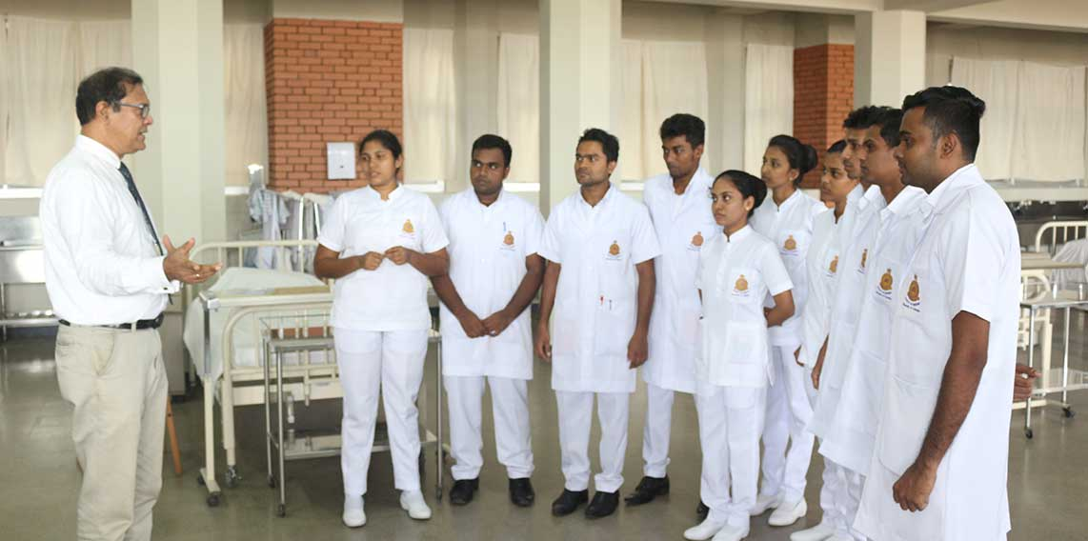
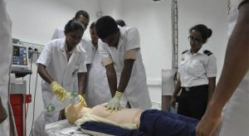

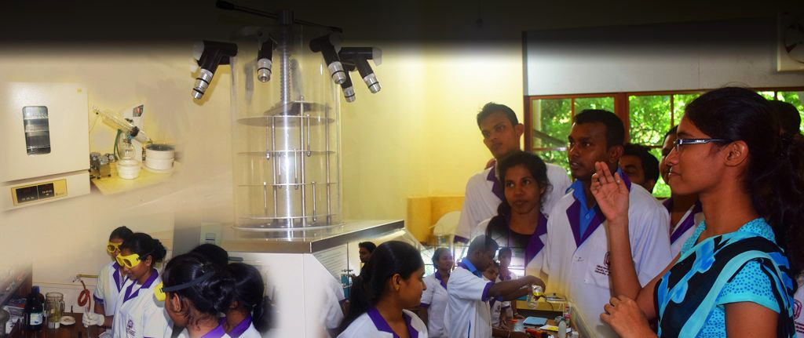
Welcome
Welcome to this series of guides to lectures
The guides are intended to help you, the lecturer, formulate your own lectures, for your delivery of the ‘Comprehensive Care’ module
You may use the slides unedited where you see fit
It is anticipated that you will edit some and create new ones where appropriate, to help you form your own approach, and modify the material to maximise relevance in your own ever-changing and developing political, social and professional context.

Slide 3
Lecture duration
This presentation provides material for 2 x lecture hours:
Duration of this recorded presentation – 1 hour, 20 minutes.
Activity 1 for students – make notes on / discuss with a partner- terminology, e.g. care, caregiver, as explained on slide 6 (5 minutes)
Activity 2 for students – make notes on / discuss with a partner- how to define ‘formal and informal caregiving, as explained on slide 7 (5 minutes).
Activity 3 for students – make notes on / discuss with a partner- what is meant by ‘comprehensive care’, when must care be ‘holistic’ and when is focussed, non-holistic care appropriate? (20 minutes).
Encourage questions- end of lecture, (slide 25) – (10 minutes).
Total- 120 minutes = 2 hours.

Slide 4
Learning Outcomes
Learners will be able to:
express and justify own, informed view, of the meaning of the terms
‘care’,
‘caregiver’
‘informal care’
‘formal care’
‘comprehensive care’
To identify the concept of comprehensive care
To identify the importance of comprehensive care

Slide 5
Care / Caregiver - some definitions
Care - watchful or protective attention, caution, concern, prudence, or regard usually towards an action or situation. https://www.merriam-webster.com/dictionary/care#:~:text=care-,noun,care%2C%20negligence%2C%20standard%20of%20care
DUE CARE - a person has a duty to use care in dealing with others, and failure to do so is negligence NOTE: Statute, case law, and custom often impose a duty of care. The degree or standard of care owed varies depending on the circumstances. For example, a landlord has to exercise greater care in relation to a tenant than to a trespasser. https://www.merriam-webster.com/dictionary/care#:~:text=care-,noun,care%2C%20negligence%2C%20standard%20of%20care
Caregiver- a person who provides direct care (as for children, elderly people, or the chronically ill) https://www.merriam-webster.com/dictionary/caregiver
The care of a patient with Alzheimer's Disease or a related disorder can be a physical, emotional and financial drain on the family caregiver. https://www.merriam-webster.com/dictionary/caregiver
How do these fit with your own definitions?

Slide 6
Formal caregivers, informal caregivers, and carers
Claudia K.Y. Lai | 16 November 2020, https://nursingcentered.sigmanursing.org/features/more-features/Vol39_3_formal-caregivers-informal-caregivers-and-carers#:~:text=Formal%20caregivers%20are%20those%20who,member%20is%20an%20informal%20caregiver.
‘Terms matter, but finding the right term is not easy’.
‘Formal caregivers are those who are paid to give care, informal caregivers are not paid. E.g. a nurse is a formal caregiver, and a family member is an informal caregiver. But why are family caregivers considered “informal”? Do we not expect families to care about each other?
‘We provide care for various reasons. Sometimes, we care because we love a person—perhaps wife, husband, mother, or father. Sometimes we care out of a sense of duty, not necessarily caring about someone. And then, of course, sometimes we care because we are paid to do so, or for other reasons’.
‘So what is an acceptable term to describe the family member or significant other who provides care to a sick or older person? I cannot think of one. Nor do I think it is wise to make a clear delineation of the differences. It would have too much of a labelling effect’.
‘Sometimes, it is best to leave some areas in life a bit ambiguous, leaving room for imagination, leaving space for people to act out their roles. As I grow older, I have learnt that it is probably best to leave some grey areas’.

Slide 7
Comprehensive Care
What then, is comprehensive care?
American Academy of Family Physicians: The practice of continuing comprehensive care is the concurrent prevention and management of multiple physical and emotional health problems of a patient over a period of time in relationship to family, life events and environment. https://www.aafp.org/about/policies/all/comprehensive-care-definition.html#:~:text=The%20practice%20of%20continuing%20comprehensive,(1980)%20(2018%20COD)
Why is it important that care is comprehensive?
Are there situations that call for a non-holistic, more focussed approach?

Slide 8
Further Learning Outcomes
To be able to summarise the common reasons that people with NDDs require long-term care – informal and formal.
To provide a rationale for basing this module on a nursing model and for selecting ‘The Roper, Logan and Tierney, (RLT) Model of Nursing’, based on a model of living.
To provide an overview of the RLT model.
Explain how this model can be adapted to inform interdisciplinary Care.
Introduce how the model helps to assess, plan, implement and evaluate care for people with degenerative neurological conditions.

Slide 9

The Most common reasons PwNDDs require Long-Term Care
Safety – due to wandering, forgetfulness (e.g. leaving gas on, misplacing cigarettes..), fall risk…
Lack of awareness to plan and provide for self – financially, nutritionally, hygeinically
Social Isolation – withdrawal, lack of family/ other support,
Difficulties with bathing, dressing, personal hygiene
Immobility- requiring assistance
Nutrition, meal preparation
Continence problems
Behavioural problems – arguably most common reason families can’t cope.
Important to note- reasons for admission can be multi-faceted and so require comprehensive assessment of the individual’s physical, cognitive and social needs to determine a care plan.
Family / caregiver needs need to be understood also, and taken into account.
https://www.verywellmind.com/caregiver-support-caregivers-and-stress-relief-3144520

Slide 10
Rationale for basing the Comprehensive Care Module on a nursing model
  Provides a structured approach to care:
    Provides a conceptual framework for understanding needs of PwNDDs and planning their care.
    Helps ensure all aspects of their care are considered holistic approach
Evidence-based Practice:
  Models tend to be based on research & EBP, ensuring care delivery is effective and efficient.
Arguments against:
  May not apply well to all patients. May be too prescriptive – risk of causing people to be inflexible, endangering the whole point of a holistic model- to provide individualised care.

Slide 11
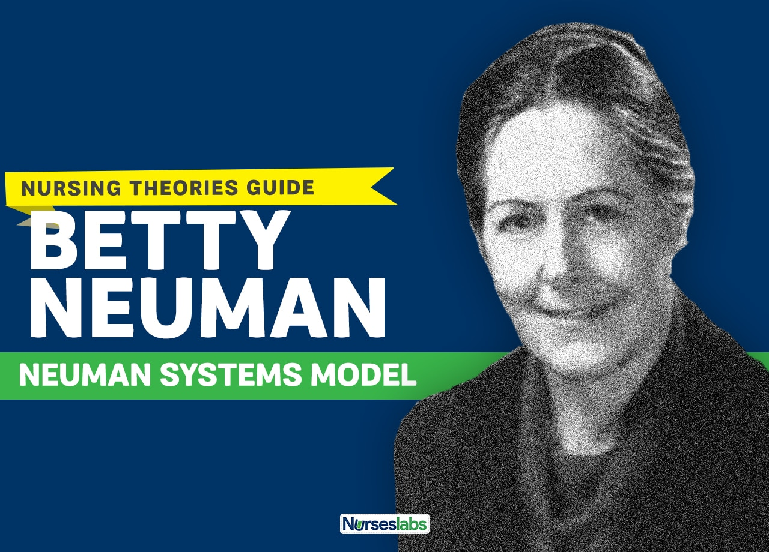
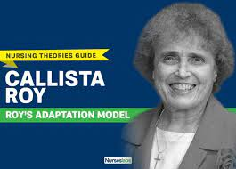
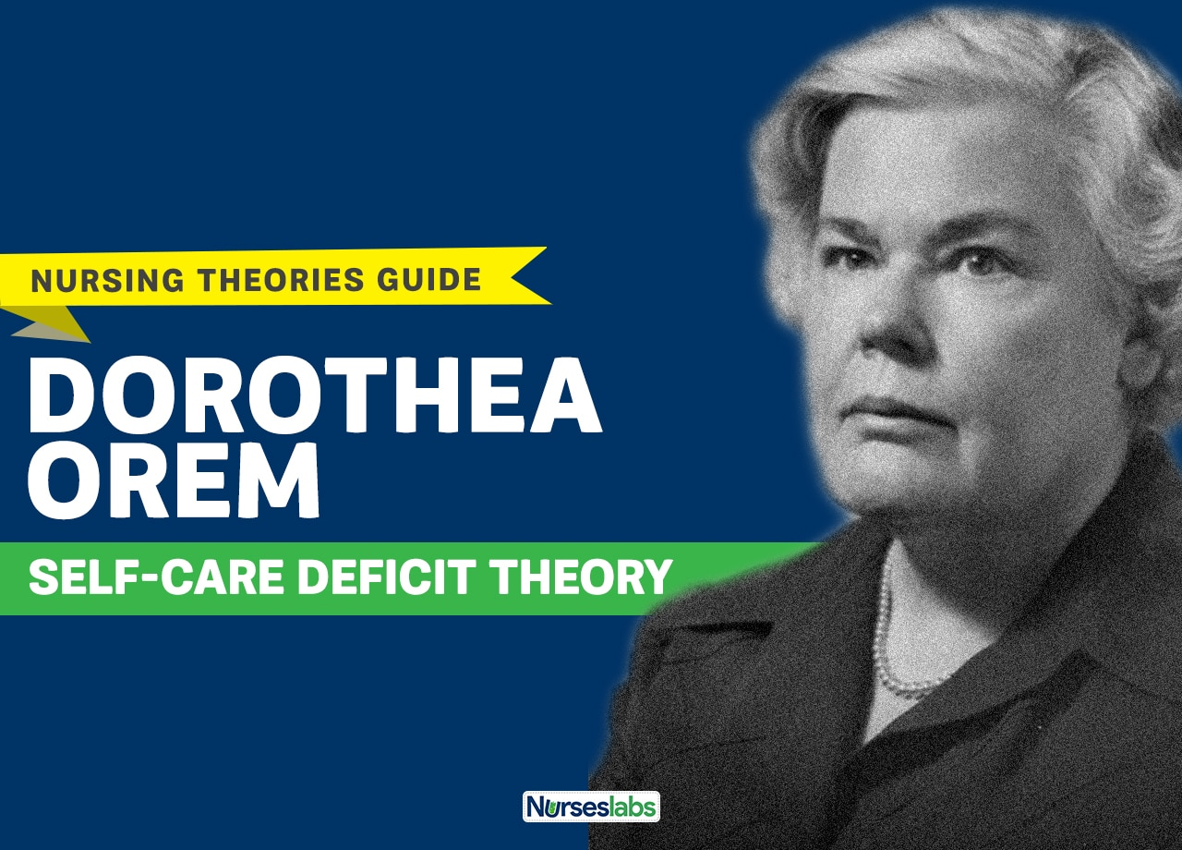
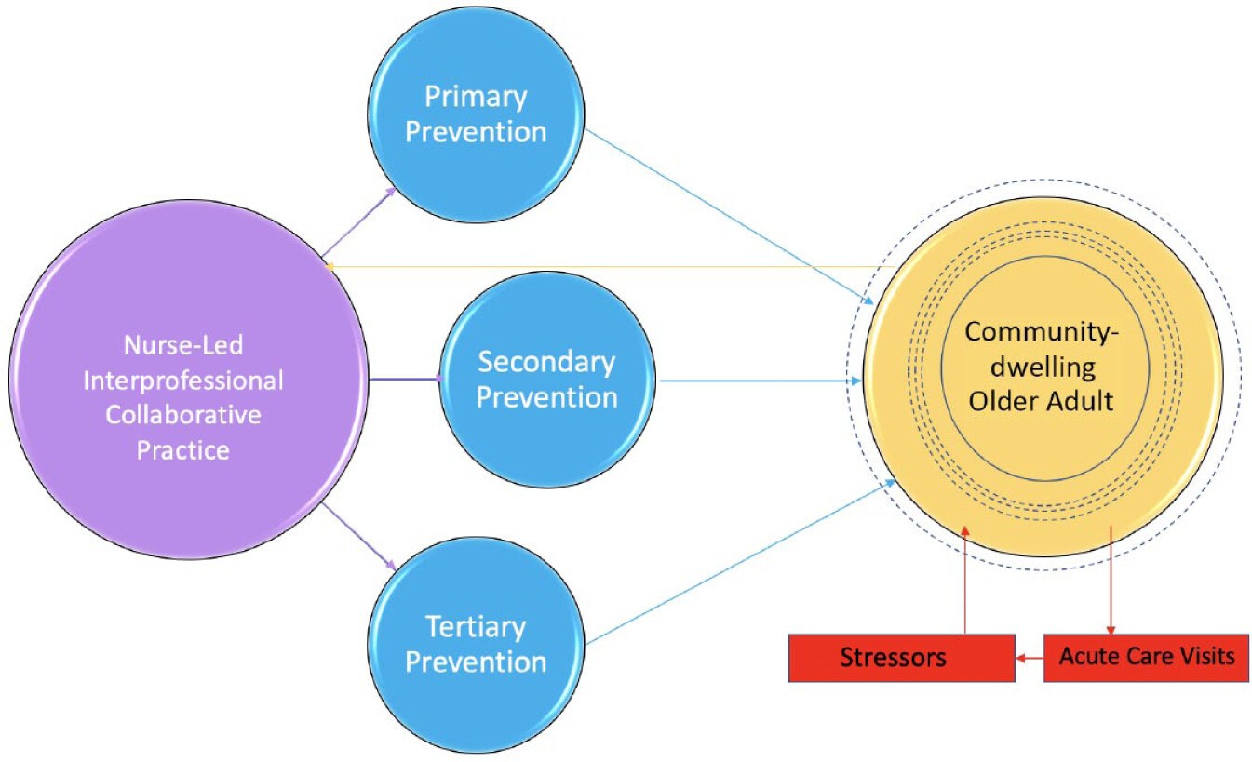
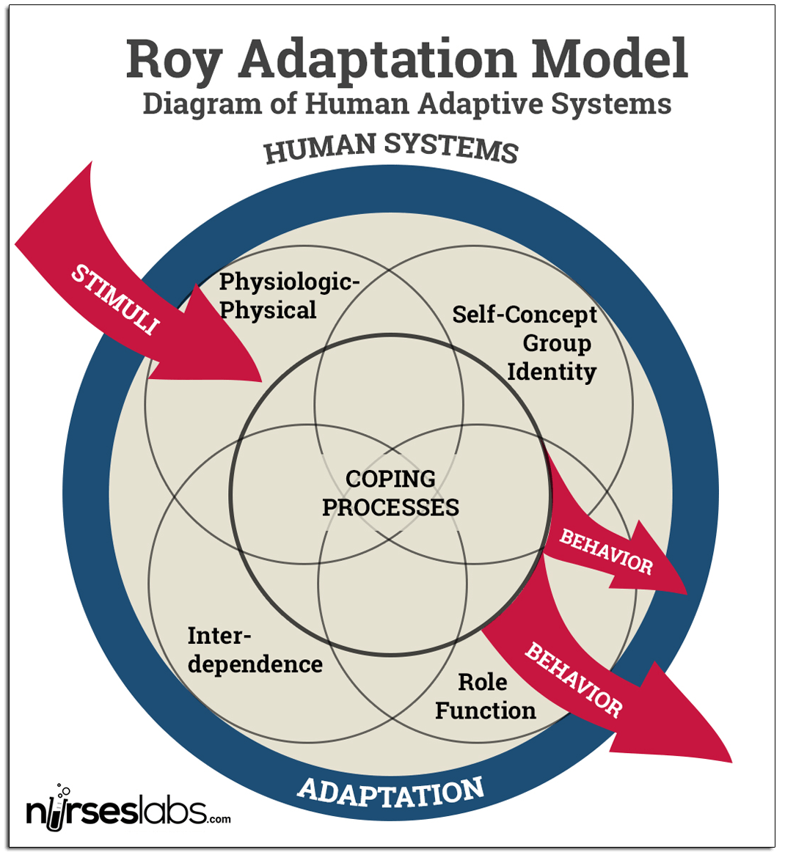
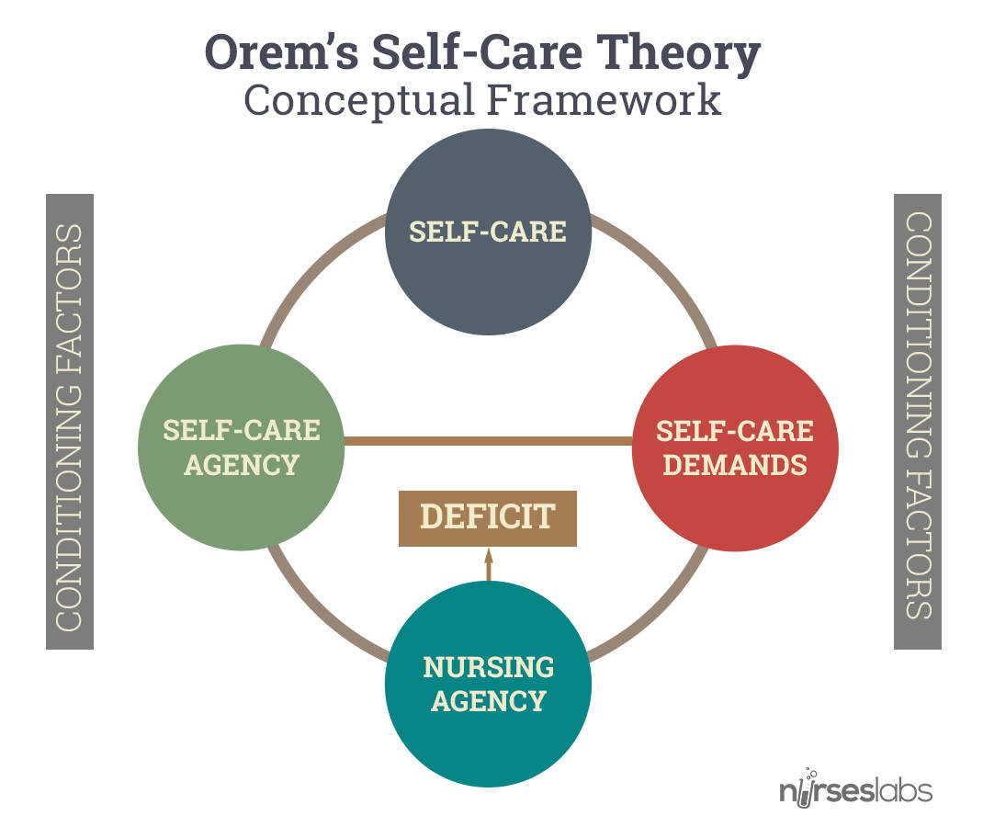
1924-present, Born Lowell, OHIO
1939-present, Born Los Angeles
1914-2007, Born Baltimore
https://nurseslabs.com/betty-neuman-systems-model-nursing-theory/
https://nurseslabs.com/sister-callista-roys-adaptation-model/
https://nurseslabs.com/dorothea-orems-self-care-theory/

Slide 12
Betty Neuman’s model
“The Neuman Systems Model views the client as an open system that responds to stressors in the environment.
The client variables are physiological, psychological, sociocultural, developmental, and spiritual. The client system consists of a basic or core structure that is protected by lines of resistance. The usual health level is identified as the normal defense line protected by a flexible line of defence.
Stressors are intra-, inter-, and extra personal in nature and arise from the internal, external, and created environments.
When stressors break through the flexible line of defence, the system is invaded, and the lines of resistance are activated. The system is described as moving into illness on a wellness-illness continuum. If adequate energy is available, the system will be reconstituted with the normal defence line restored at, below, or above its previous level.
Nursing interventions occur through three prevention modalities. Primary prevention occurs before the stressor invades the system; secondary prevention occurs after the system has reacted to an invading stressor; tertiary prevention occurs after secondary prevention as reconstitution is being established”.
Gonzalo A (2023) Betty Neuman: Neuman Systems Model, Nurseslabs https://nurseslabs.com/betty-neuman-systems-model-nursing-theory/#:~:text=The%20Neuman%20Systems%20Model%20views,protected%20by%20lines%20of%20resistance.

Slide 13
Sr Callista Roy’s model
Focuses on how individuals and groups adapt to changes in their environment to maintain their well-being. The model incorporates concepts from systems theory, adaptation theory, and nursing process.
According to Roy, individuals are viewed as holistic adaptive systems, constantly interacting with their environment. The adaptation process involves four main concepts:
Stimuli: Stimuli are internal or external factors that create a need for adaptation. They can be classified as focal, contextual, or residual. Focal stimuli are immediate and directly impact the individual, while contextual stimuli surround the focal stimuli and provide additional information. Residual stimuli are the past experiences and factors that influence adaptation.
Adaptation: Adaptation refers to the process of responding to stimuli in order to achieve a state of equilibrium or balance. Individuals use coping mechanisms and adaptive responses to adjust to changes and maintain their well-being.
Adaptive Modes: Roy identifies four adaptive modes through which individuals respond to stimuli: physiological, self-concept, role function, and interdependence. These modes encompass different aspects of human functioning and serve as a framework for nursing assessment and intervention.
Nursing Process: The nursing process is utilized to promote adaptation in individuals. It involves assessment, diagnosis, planning, implementation, and evaluation of nursing care. Nurses aim to identify the stimuli affecting individuals, assess their adaptive responses, and intervene to facilitate positive adaptation.
Overall, Roy's adaptation model emphasizes the importance of nursing interventions in promoting adaptation and well-being by helping individuals cope with and adapt to changes in their environment.

Slide 14
Dorothy Orem’s model of nursing
Dorothy Orem's model of nursing, known as the Self-Care Deficit Theory, focuses on the concept of self-care and the role of nurses in facilitating and promoting it. …
individuals have the ability to care for themselves, but sometimes they experience self-care deficits that require nursing intervention.
Self-care consists of activities that individuals perform to maintain their well-being, such as eating, bathing, and managing medications. When individuals are unable to perform these activities due to illness, injury, or other limitations, they have a self-care deficit.
Nurses should assess the patient's self-care abilities and identify any deficits. They then design and implement nursing interventions to help the patient meet their self-care needs. The goal is to assist the individual in achieving self-care independence and ultimately restore or maintain their health.
The model also emphasizes the importance of patient education and empowerment. Nurses educate individuals about self-care techniques, provide resources, and encourage them to take an active role in managing their health.
By promoting self-care, nurses aim to enhance the individual's overall well-being and reduce their reliance on healthcare professionals.

Slide 15
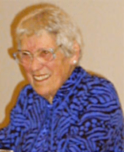
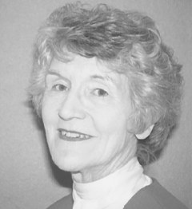
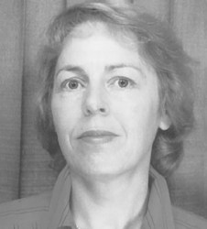
Roper Logan and Tierney
Nancy Roper, 1918-2004, UK
Alison Tierney, 1948 – present, UK
Winnifred Logan, 1931-2010, UK
https://nursology.net/nurse-theories/roper-logan-tierney-model-of-nursing-based-on-activities-of-living/

Slide 16
Why the RLT model?
Particularly useful regarding PwNDDs as emphasises importance of maintaining independence to carry out Als (Activities of Living) to best ability, and recognises the influence of environment on this which helps healthcare professionals identify and address barriers to independence (avoiding ‘taking over’).
Another strength in our view - seeing mental health issues as problems with communicating – internal communicating and external – between the individual diagnosed, family, and health professionals.
Other models could well be suitable, but for example-
  OREM focusses on self-care, which may not be applicable to many PwNDDs, with decreasing ability.
  Neuman focusses on prevention of stress and maintaining a stable environment which may not apply to many people with progressive deteriorating conditions.
  Roy focusses on adaptation to environmental stimuli which may not apply to people with limited ability to adapt to their environment.

Slide 17
Summary Rationale for RLT Choice
RLT may be more suited to conceptualising a framework for care for PwNDDs due to a focus on an individual’s ability to perform Als, and its recognition of the influence of environment on AL performance and its emphasis on maximising independence.
This is an opinion shared among the collaborative team involved in developing this model, and this course, but is arguable, and students are encouraged to explore other models to help formulate their own view.

Slide 18
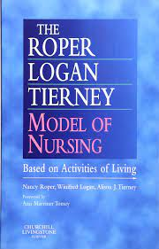
Activities of living
Maintaining a safe environment,
communicating
Breathing
Eating and drinking
Eliminating
Personal cleansing and dressing
Controlling body temperature
Mobilising
Working and playing
Expressing sexuality
Sleeping
Dying.

Slide 19

Lifespan
Relevance of a lifespan continuum to care for people with Neurodegenerative disorders.
https://news.mit.edu/2016/study-rich-poor-huge-mortality-gap-us-0411 Visited 26 08 2022

Slide 20
Dependence - Independence
How do we measure dependence and independence?
To what extent are you independent regarding maintaining a safe environment?
Communicating?
Breathing?
Mobilizing?
Washing and dressing?
Sleeping?
Dependence
Independence

Slide 21
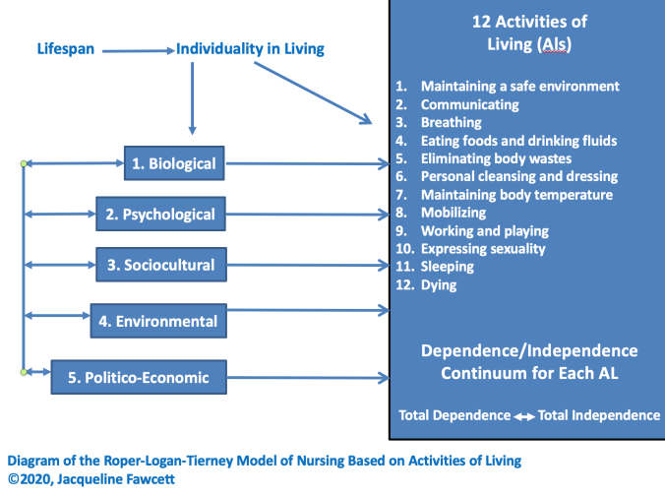

Slide 22
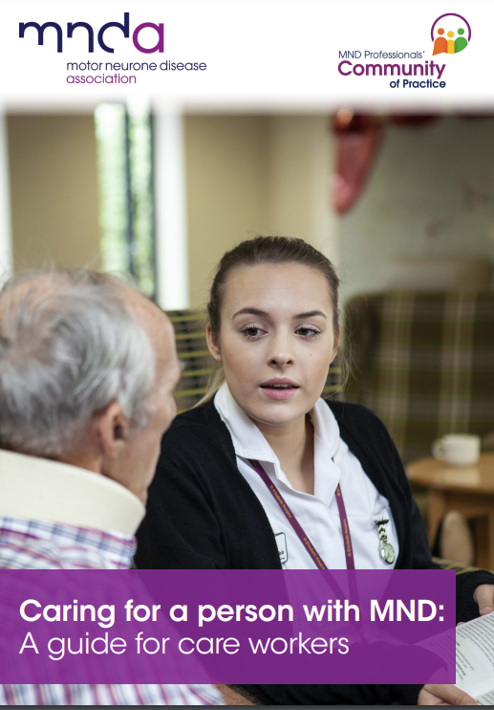
Meanwhile –
Have a look through this guide to caregiving for people with motor neurone disease.
It doesn’t follow a particular nursing model, but is fairly comprehensive- and helps think about caregiving for people with NDDs, not only MND:
Motor Neurone Disease Association (2021)Caring for a person with MND: a guide for careworkers, https://www.parkinson.org/library/fact-sheets/occupational-therapy

Slide 23
Summary
Reasons for PwNDDs to need long-term care are multi-faceted.
They include problems carrying out activities of living, and family care-giver needs and abilities.
Models of nursing help to structure assessment, planning, implementation and evaluation of care.
There are many models to choose from, and students should read about some, and consider what is helpful to their care experiences, and the individuals and families they encounter.
We have made a case for basing this module on the RLT Model which we have outlined in this lecture.

Slide 24
References
Gonzalo A (2023) Betty Neuman: Neuman Systems Model, Nurseslabs https://nurseslabs.com/betty-neuman-systems-model-nursing-theory/#:~:text=The%20Neuman%20Systems%20Model%20views,protected%20by%20lines%20of%20resistance.
Lai C (2020) Formal caregivers, informal caregivers and carers, https://nursingcentered.sigmanursing.org/features/more-features/Vol39_3_formal-caregivers-informal-caregivers-and-carers#:~:text=Formal%20caregivers%20are%20those%20who,member%20is%20an%20informal%20caregiver.
Roper N, Logan W, Tierney A (2000) The Roper-Logan-Tierney Model of Nursing, Churchill Livingston, https://www.elsevier.com/books/the-roper-logan-tierney-model-of-nursing/page/978-0-443-06373-2
Smith S (2005) Huntington’s disease: a nursing guide, applying the Roper, Logan and Tierney model of nursing, Fern, https://www.amazon.co.uk/Huntingtons-Disease-Nursing-Steve-Smith/dp/1902702107
Smith S (2010) The Neuro Care Manual: A Guide to Neurology for Nurses & Family Carers
Motor Neurone Disease Association (2021)Caring for a person with MND: a guide for careworkers, https://www.parkinson.org/library/fact-sheets/occupational-therapy
Nurselabs (2023), Betty Neuman: Neuman Systems Model, https://nurseslabs.com/betty-neuman-systems-model-nursing-theory/
Nurselabs (2023), Sister Callista Roy, Adaptation Model of Nursing, https://nurseslabs.com/sister-callista-roys-adaptation-model/
Nurselabs (2023), Dorothea Orem, Self-Care Defecit Theory, https://nurseslabs.com/dorothea-orems-self-care-theory/
Nursology (2023) Roper-Logan-Tierney Model of Nursing Based on a Model of Living, https://nursology.net/nurse-theories/roper-logan-tierney-model-of-nursing-based-on-activities-of-living/

Slide 25

Any questions?

Slide 26

Thank you

