Slide 1
Introduction to Psychology of Ageing
Psychology of Ageing (Neurology and medical care of neurodegenerative disorders)
Marilena Mousoulidou Neapolis University Pafos

Slide 2
Learning Objectives
LO1: Understand the concept of ageing and the significance of studying the psychology of ageing in the context of global demographic shifts and the ageing population.
LO2: Analyse how the main forces of development influence the behaviour and experiences of individuals in late adulthood.
LO3: Critically assess the impact of stereotypes and ageism on the psychological well-being of older adults.
LO4: Understand the major theoretical frameworks related to ageing and their contributions to our understanding of the ageing process.

Slide 3
The Meaning of Age
How old are you?
Variability among people.
Several types of age have been identified:
Chronological Age: the number of years that have passed since your birth.
Perceived Age: refers to the age you think of yourself as.
Biological Age: an adult’s physical condition compared with others (e.g., cardiovascular system).
Psychological Age: an adult’s ability to deal effectively with the environment compared to others.
Social Age: the specific set of roles individuals adopt in relation to other members of the society and culture to which they belong.
Functional Age: a person’s physical and psychological well-being.
Notes:
When you are asked the question “How old are you?” what crosses your mind? Is it the number of years since the day of your birth? You may not have thought about it, but age is not a simple construct.
Most people know that age is just a number. Perhaps ages in childhood give valid information about what to expect in the way of appearance or behaviour, but once a child reaches adolescence, many more factors take over.
In fact, the further we move to adulthood, the more variability there is in answering the question “How old are you?”
Several types of age have been identified, and they illustrate the many dimensions of adult development.
The number of years that have passed since your birth or the number of candles on your last birthday cake is your chronological age. This may be important in childhood, when all 7-year- olds look similar and have similar interests and abilities, but in adulthood, this number is seldom relevant.
Another type of age is Perceived Age which refers to the age you think of yourself as.
Biological age is a measure of how an adult’s physical condition compares with others. “He has the memory of a 50-year-old” is an informal measure of biological age. Of course, it depends on the person’s chronological age. Having the memory of a 50-year-old means one thing if the person is 70, a much different thing if 30! Biological age can often be affected by lifestyle changes.
Another type of age is psychological age, which is a measure of how an adult’s ability to deal effectively with the environment compares to others. A 30-year-old woman who can’t pay her electric bill because she couldn’t resist buying designer jeans and is functioning like a teenager. Her psychological age is much below her chronological age.
Social age refers to the specific set of roles individuals adopt in relation to other members of the society and culture to which they belong. A woman who has her first child at 40 is taking on a role that has a social age at least a decade younger.
Lastly the term Functional Age is an index of one’s level of competence in carrying out specific tasks. Competencies can range from performance on a particular job to the condition of various organ systems in the body.

Slide 4
Critical Thinking Questions
How old are you?
How old do you feel?
What would you estimate your biological age to be?
Your social and psychological age?
How do they match with your chronological age?
Notes:
Spent five minutes thinking about these questions

Slide 5
Old Age?
What does it mean to be “old”? Definition?
Old age used to be defined by the chronological age of the person.
E.g., a 70-year-old was considered old because of his age.
Now the definition of old changed to consider the functional age.
Three groups according to functional age:
Young-Old are healthy and active,
Old-Old have some health problems and difficulties with daily activities,
Oldest-Old are weak and need care.
E.g., a healthy 100-year-old would be considered young old, while a 65-year-old in the late stages of emphysema would be among the oldest old.
Notes:
What does it mean to be “old”? Can you give a definition?
Old age used to be defined by chronological years alone. For instance a 70-year-old was considered old because of his age. But now, many people in their 70s are as vigorous and involved with life as people several decades younger.
Old age was also used to be equated with loss: loss of brain cells, intellectual capabilities, energy.
But, older people are pioneering new fields reshaping how we perceive the later stages of life.
Therefore, now the definition of old changed to consider not only the chronological years, but also the person’s functional age.
Some researchers divide people into three groups according to functional ages: the young old are healthy and active; the old old have some health problems and difficulties with daily activities; and the oldest old are weak and need care.
According to functional age, an active, healthy 100-year-old would be considered young old, while a 65-year-old in the late stages of emphysema would be among the oldest old.
Note here that demographers use the exact same terms but purely regarding chronological age. For demographers the young old are people between 65 to 74 years old. The old old are between 75 and 84, and the oldest old are 85 and older.

Slide 6
Ageing
Ageing is the physical and psychological changes that occur with maturation.
It consists of at least three distinct processes:
Primary Ageing: normal, disease-free development during adulthood.
E.g., decline in reaction time and the loss of family and friends.
Secondary Ageing: developmental changes that are related to disease, lifestyle, and other environmentally induced changes that are not inevitable (e.g., pollution).
E.g., Alzheimer’s disease and related forms of dementia.
Tertiary Ageing: the rapid losses that occur shortly before death.
E.g., the terminal drop in which intellectual abilities show a marked decline in the last few years before death.
Notes:
Ageing is the physical and psychological changes that occur with maturation.
Ageing is not a single process.
It consists of at least three distinct processes: primary ageing which is the normal ageing, disease-free development during adulthood. Changes in biological, psychological, sociocultural, or life-cycle processes in primary ageing are an inevitable part of the developmental process; examples include decline in reaction time, and the loss of family and friends.
Secondary ageing is developmental changes that are related to disease, lifestyle, and other environmentally induced changes that are not inevitable (e.g., pollution). The progressive loss of intellectual abilities in Alzheimer’s disease and related forms of dementia are examples of secondary ageing.
Finally, tertiary ageing is the rapid losses that occur shortly before death. An example of tertiary ageing is a phenomenon known as terminal drop, in which intellectual abilities show a marked decline in the last few years before death.

Slide 7
Not everyone grows old in the same way.
Whereas most people tend to show usual patterns of ageing that reflect the typical, or normative, changes with age, other people show highly successful ageing in which few signs of change occur.
What makes people who age successfully different?
At this point, we do not know for sure.
Everyone’s experience of growing old is somewhat different.
Although many people develop arthritis, how each person learns to cope is unique.

Slide 8
Psychology of Ageing
Gerontology is the scientific study of the biological, psychological, and social aspects of ageing from maturity through old age.
Psychology of Ageing or Geropsychology is the field within psychology that applies the knowledge and methods of psychology to understanding and helping older persons and their families maintain well-being, overcome problems, and achieve maximum potential during later life (APA, 2016).
Notes:
It is important to start this module by defining some terms that will be used in this module.
Gerontology is the scientific study of the biological, psychological, and social aspects of ageing from maturity through old age.
The name of our module Psychology of Ageing also called Geropsychology following the American Psychological Association (APA), is defined as he field within psychology that applies the knowledge and methods of psychology to understanding and helping older persons and their families maintain well-being, overcome problems, and achieve maximum potential during later life.

Slide 9
Late Adulthood
Late Adulthood starts around age 65 and is characterized by great changes and ongoing personal development.
Older adults face profound physical, cognitive, and social changes, and to a large extent, they figure out strategies for adjusting to them.
Physical changes: a gradual transition from full strength and health to an increasing concern about illness, pain, and disease.
Cognitive changes: cognitive abilities change, and intellectual declines can be present.
Social changes: retirement, death of a spouse.
Research from gerontologists shows that late adulthood is not a period of decline but a stage in which people continue to change.
Notes:
The period that most interests us in this module is late adulthood. Late adulthood starts around the age of 65 and is characterized by great changes—and ongoing personal development.
Older adults face profound physical, cognitive, and social changes, and to a large extent, they figure out strategies for adjusting to them.
In late adulthood, people begin the decline that will be part of their lives until death. But all aspects of this period—physical, cognitive, and social—are largely misrepresented in popular stereotypes. Older people can maintain physical and mental strength until the day they die, and their social worlds can also remain as vital and active as they want.
Physically, people over 65 certainly begin a gradual transition from full strength and health to an increasing concern about illness, pain, and disease. But they can stay healthy for quite a long time and can continue most if not all of the activities that they enjoyed when younger.
Cognitively, their cognitive abilities change and intellectual declines might be present, but people adjust quite well to the changes that seem designed to impede them by adopting new strategies for solving problems and compensating for lost abilities.
Lastly socially, many of them learn to cope with the changes in their lives, such as the death of a spouse and retirement from work.
For a growing number of people in late adulthood, vigorous mental and physical activity remains an important part of daily life.
Research from Gerontologists shows that late adulthood is not a period of decline but a stage in which people continue to change—to grow in some areas and, yes, to decline in others.

Slide 10
Why Psychology of Ageing is Important?
Late adulthood holds a unique distinction among life’s stages.
Because people are living longer, late adulthood is getting longer.
Today there is a greater proportion of people alive in late adulthood than at any time in world history.
Most older adults enjoy good mental health, however there is a number of older adults with mental and behavioural health problems.
Psychologists play a significant role in addressing the mental health needs and supporting the strengths of older adults through research, assessment and treatment.
Notes:
The main reason there is a growing interest in geropsychology is because late adulthood is continuously growing.
Whether we start counting at 65 or 70, today a greater proportion of people are alive in late adulthood than at any time in world history.
Even though most older adults enjoy good mental health, there is a number of older adults with mental and behavioural health problems.
Psychologists play a significant role in addressing the mental health needs and supporting the strengths of our growing population of older adults through research, assessment and treatment.
For instance psychologists are at the forefront of research on questions related to health and ageing. Why do most older adults remain mentally sharp, while others have memory problems? Research on the ageing brain provides clues to the risks and protective factors for mental disorders across the lifespan.
Regarding assessment health care providers and families often turn to psychologists because they have the necessary expertise to assess and differentiate between disorders such as dementia, depression, anxiety, side effects from medications, or combinations of these problems.
Lastly, psychologists can provide treatment to older adults dealing with mental health disorders and late-life stressors.

Slide 11
Late Adulthood Population – Worldwide (WHO, 2022)
Today people worldwide are living longer.
In 2020, the number of people aged 60 years and older outnumbered children younger than 5 years.
Between 2015 and 2050, the proportion of the world's population over 60 years will nearly double from 12% to 22%.
By 2030, 1 in 6 people in the world will be aged 60 years or over (1 billion in 2020 to 1.4 billion in 2030).
By 2050, the world’s population of people aged 60 years and older will double (2.1 billion).
Between 2020 and 2050 the number of persons aged 80 years or older is expected to triple to reach 426 million.
Notes:
It is interesting to see the characteristics of the late adulthood population.
According to the World Health Organization (WHO) 2022, today people worldwide are living longer. Most people can expect to live into their sixties and beyond. Every country in the world is experiencing growth in both the size and the proportion of older persons in the population.
People are living longer thanks to improvements in health and medical therapies, greater access to education and reductions in fertility.
Specifically, starting with worldwide statistics
In 2020, the number of people aged 60 years and older outnumbered children younger than 5 years.
Between 2015 and 2050, the proportion of the world's population over 60 years will nearly double from 12% to 22%.
By 2030, 1 in 6 people in the world will be aged 60 years or over. At this time the share of the population aged 60 years and over will increase from 1 billion that it was in 2020 to 1.4 billion.
By 2050, the world’s population of people aged 60 years and older will double (2.1 billion).
Between 2020 and 2050 the number of persons aged 80 years or older is expected to triple to reach 426 million.
CONTINUES NEXT SLIDE

Slide 12
The distribution of a country's population towards older ages started in high-income countries, but now low- and middle-income countries are experiencing the greatest change.
By 2050, two-thirds of the world’s population over 60 years will live in low- and middle-income countries.
As people age, they are more likely to experience conditions such as hearing loss, cataracts and refractive errors, back and neck pain and osteoarthritis, chronic obstructive pulmonary disease, diabetes, depression and dementia.
Notes:
While this shift in distribution of a country's population towards older ages started in high-income countries (for example in Japan 30% of the population is already over 60 years old), it is now low- and middle-income countries that are experiencing the greatest change.
By 2050, two-thirds of the world’s population over 60 years will live in low- and middle-income countries.
Ageing increases the risk of chronic diseases and therefore people are more likely to experience conditions such as hearing loss, cataracts and refractive errors, back and neck pain and osteoarthritis, chronic obstructive pulmonary disease, diabetes, depression and dementia.

Slide 13
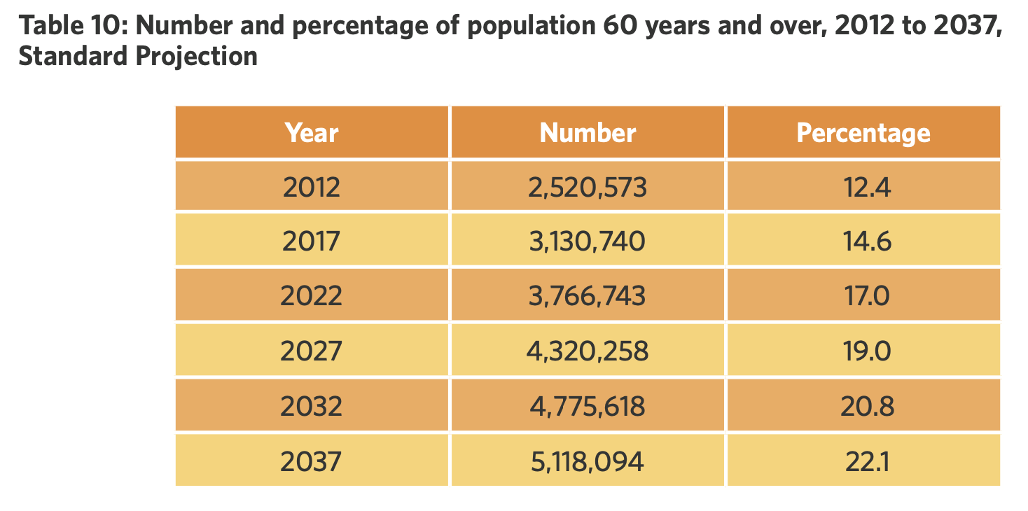
Late Adulthood Population – Sri Lanka (UNPF, 2016)
The number of people older than 60 years of age is continuously increasing.
Notes:
Moving to the older population in Sri Lanka, the number of people older than 60 years of age is continuously increasing.
As it is clear from the table, the proportion of people older than 60 years of age is continuously increasing and it will increase in the future in an extraordinary manner.
In 2012, the number of older persons was about 2.5 million and it is expected to double to more than 5 million by 2037.
This is a 103% increase during 25 years time period.

Slide 14
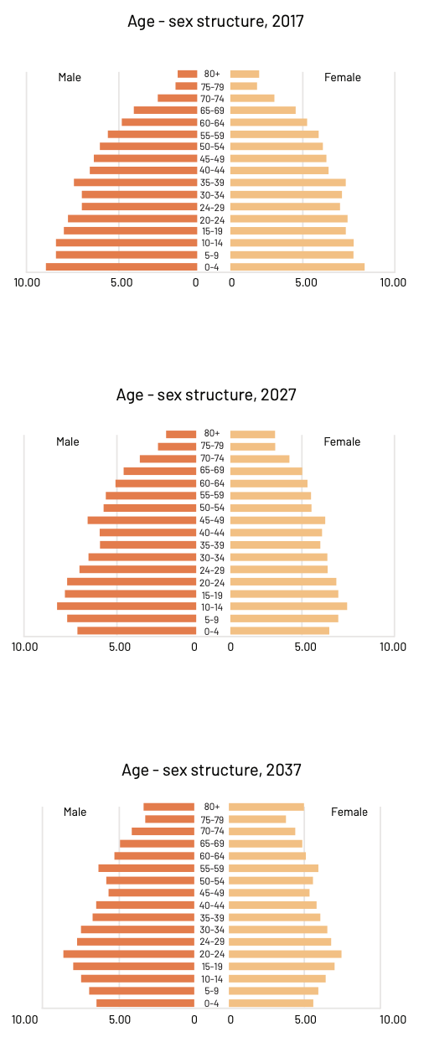
Sri Lanka has the fastest growing ageing population in South Asia.
Notes:
These two figures show the differences in the age-sex structure of the population in 2017 compared to the expected age-sex structure in 2037.
As it is clear, the percentage of people older than 60 is developing fast as the survival chances of the Sri Lankan population are improving.
The figure on the left shows the percentages of people in 2017, whereas the one on the right shows the expected population rise in 2037.
Overall, the population at younger ages tends to decline while elderly ages grow by favouring females because of their higher survival chances compared to males.
Sri Lanka has the fastest growing ageing population in South Asia and it is predicted that by 2030, 1 in 5 Sri Lankans will be over the age of 60 with the majority being women.
Population ageing taking place in Sri Lanka is a common feature of many developed and developing countries in the world today. This phenomenon is occurring mainly due to the decline in fertility and mortality decline and the resultant increase in life expectancy, which is accompanied by the country’s socio-economic developments.

Slide 15
Main Forces that Shape Development
Biological,
Psychological,
Sociocultural and,
Life-Cycle forces.
All these forces are inter-related
Notes:
Why do some people remain very active and mentally well into later life? How does growing up in Sri Lankan culture affect one’s views of family caregiving? Answering these questions requires us to consider the various forces that shape us as we mature.
Researchers place special emphasis on four forces that direct our development. These are biological, psychological, sociocultural and life-cycle.
All the forces combine to create people’s developmental experiences.

Slide 16
Biological Forces that Shape Development
Include all genetic and health-related factors that affect development.
Examples include menopause, facial wrinkling, and changes in the major organ systems.
Also, effects of lifestyle factors.
E.g., diet, exercise, smoking, alcohol consumption.
Notes:
Biological forces include all genetic and health-related factors that affect development.
Examples of biological forces taking place in late adulthood include menopause, facial wrinkling, and changes in the major organ systems.
Effects of lifestyle factors are also included. For instance, unhealthy diet negatively impacts physical development
Biological forces, therefore can be viewed as providing the raw material necessary for development.

Slide 17
Psychological Forces that Shape Development
Include all internal perceptual, cognitive, emotional, and personality factors that affect development.
They provide the characteristics we notice about people that make them individuals.
Determine variations among individuals.
E.g., self-confidence, honesty, self-esteem.

Slide 18
Sociocultural Forces that Shape Development
They include interpersonal, societal, cultural, and ethnic factors that affect development.
They provide the overall contexts in which we develop.
Family, peers, friends, culture etc., influence development.
E.g., poverty
Notes:
Sociocultural forces include interpersonal, societal, cultural, and ethnic factors that affect development.
Sociocultural forces provide the overall contexts in which we develop.
To understand development, we need to know how people and environments interact and relate to each other.
The family, peers, friends, coworkers, social institutions and culture influence development. Knowing the culture from which the person comes provides information about important influences that appear throughout the lifespan. An example of this is poverty.

Slide 19
Life-Cycle Forces that Shape Development
They reflect differences in how the same event or combination of biological, psychological, and sociocultural forces affects people at different points in their lives.
They provide the context for the developmental differences of interest in adult development and ageing.

Slide 20
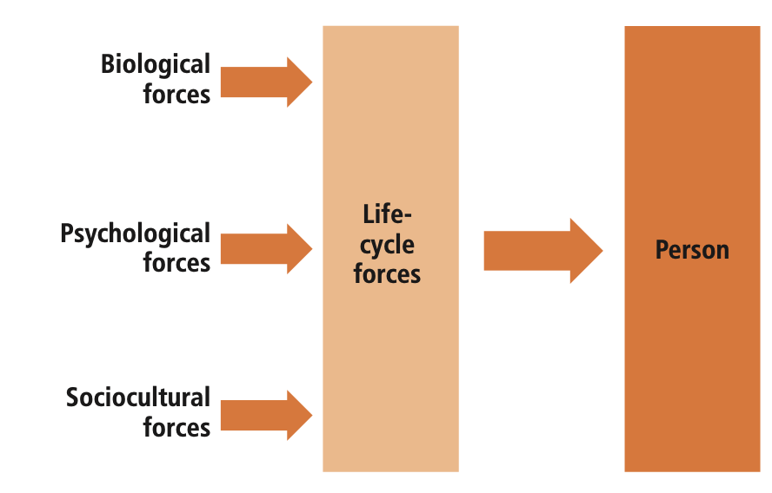
The Biopsychosocial Framework
The biopsychosocial framework (biological, psychological, and sociocultural forces) together with life-cycle forces provides a comprehensive understanding of human development.
Each of us is a product of a unique combination of these forces.
Notes:
One useful way to organize the biological, psychological, and sociocultural forces on human development is with the biopsychosocial framework.
Together with life-cycle forces, the biopsychosocial framework provides a provides a comprehensive understanding of human development.
Each of us is a product of a unique combination of these forces.
Even identical twins growing up in the same family eventually have their own unique friends, partners, occupations, and so on.
To see why all these forces are important, imagine that we want to know how people feel about forgetting. We would need to consider several biological factors, such as whether the forgetting was caused by an underlying disease. We would want to know about such psychological factors as what the person’s memory ability has been throughout his or her life and about his or her beliefs about what happens to memory with increasing age. We would need to know about sociocultural factors, such as the influence of social stereotypes about forgetting. Finally, we would need to know about the age of the person when a forgetting experience occurs. Focusing on only one (or even two or three) of the forces would provide an incomplete view of how the person feels.
The biopsychosocial framework shows that human development results from interacting forces.

Slide 21
Developmental Influences
All the forces combine to create people’s developmental experiences.
To what extend are these common or unique to people of specific ages?
Cohort: a group of people born at the same point in time (or within a specific time span) that generally have similar experiences.
E.g., those born between 1996 to 2010 represent the Generation Z cohort and those born in 2000 are the 2000 cohort.
Based on cohort, there are three sets of influences that interact to produce developmental change over the life span:
Normative age-graded influences,
Normative history-graded influences, and
Nonnormative influences.
Notes:
All the forces we have discussed combine to create people’s developmental experiences.
One way to consider these combinations is to consider the degree to which they are common or unique to people of specific ages.
An important concept in this approach is cohort.
A cohort is a group of people born at the same point in time or within a specific time span. For instance, those born between 1996 to 2010 represent Generation Z cohort and those born in 2000 represent the 2000 cohort.
Based on this notion of cohort, there are three sets of influences that interact to produce developmental change over the life span:
normative age-graded influences,
normative history-graded influences, and
nonnormative influences.

Slide 22
Normative Age-Graded Influences
Experiences which are caused by biological, psychological, and sociocultural forces that affect all or most people of similar age.
Biological or environmental events related to chronological age.
E.g., menopause and retirement occur at a certain age-range.
Notes:
Normative age-graded influences are experiences caused by biological, psychological, and sociocultural forces that affect all or most people of similar age.
They are changes common enough that most older adults can expect to experience them
Some of these, such as puberty, and menopause are biological and occur at a certain age-range. These normative biological events usually indicate a major change in a person’s life; for example, menopause is an indicator that a woman can no longer have children without medical intervention.
Other normative age-graded influences involve sociocultural forces, such as the time when someone retires.
These influences are helpful for explaining both the similarities found among people within certain groups and also the dissimilarities between people in those same groups. Both are important parts of a course on adult development.
.

Slide 23
Normative History-Graded Influences
Affect all or most people who are born at a particular time (cohort).
Developmental influences related to specific era or historical events, rather than age.
These events might be biological, psychological, or sociocultural and they affect the individuals dramatically.
E.g., war, pandemics, computer revolution, internet age etc.
Can be seen by comparing different cohorts of individuals.
Normative history-graded influences can have a profound effect across all generations (e.g., COVID-19).

Slide 24
Nonnormative Life Events
Random or rare events that may be important for a specific individual but are not experienced by most people.
They may be favorable events (e.g., winning the lottery) or unfavorable (e.g., being diagnosed with an illness).
Not necessarily associated with age or historical time
Nonnormative life events have different effects on development depending on the age they happen.
Normative age-graded influences can become nonnormative life events because of the timing.

Slide 25
Critical Thinking Questions
Give an example of a normative age-graded and a normative history-graded event that influenced your life.
Have you or your family experienced any nonnormative life events?
Notes:
Based on the previously mentioned definitions, can you answer these questions?
Give an example of a normative age-graded and a normative history-graded event that influenced your life.
Have you or your family experienced any nonnormative life events?
Spent 5 minutes answering these questions

Slide 26
Culture and Ethnicity
Culture and ethnicity jointly provide status, social settings, living conditions, and personal experiences for people of all ages.
They influence and are influenced by biological, psychological, and life-cycle developmental forces.
Culture: shared basic value orientations, norms, beliefs, and customary habits and ways of living.
Ethnicity: an individual and collective sense of identity, based on historical and cultural group membership and related behaviors and beliefs.
Both culture and ethnicity are extremely important for geropsychologists since they affect how people experience old age.

Slide 27
Case Study: The !Kung Tribe
Consider the !Kung tribe, who live in the Kalahari Desert in southwest Africa.
If you were to ask an older !Kung “How old are you?” you would quickly learn that the question has no meaning.
!Kung also do not keep track of the number of years they have been alive, the number of children they have, or how often they move.
!Kung mothers can describe in detail each of their children’s births, but they leave it to others to figure out how many children this adds up to.
To the !Kung, age per se is unimportant; when asked to describe people who are “younger” or “older,” they give the names of specific people.
Social roles among the !Kung also do not differ by age; e.g., women in their 20s and 60s all tend gardens, draw water from wells, and take care of children.
Notes:
Consider the !Kung tribe, who live in the Kalahari Desert in southwest Africa.
If you were to ask an older !Kung “How old are you?” you would quickly learn that the question has no meaning.
!Kung also do not keep track of the number of years they have been alive, the number of children they have, or how often they move.
!Kung mothers can describe in detail each of their children’s births, but they leave it to others to figure out how many children this adds up to.
To the !Kung, age per se is unimportant; when asked to describe people who are “younger” or “older,” they give the names of specific people.
Social roles among the !Kung also do not differ by age; for example, women in their 20s and 60s all tend gardens, draw water from wells, and take care of children.

Slide 28
Does the !Kung tribe experience development and age in a similar way as Sri Lankans?
Members of the !Kung tribe experience development in ways very different from the ways most Sri Lankans do.
Adult development and ageing must be understood within the contexts in which they occur.
In some cases, this means that contexts are sufficiently similar that general trends can be identified.
In others, such as the !Kung and other societies, these differences prevent many general statements.
Notes:
Does the !Kung tribe experience development and age in a similar way as Sri Lankans?
Members of the !Kung tribe experience development in ways very different from the ways most Sri Lankans do.
Adult development and ageing must be understood within the contexts in which they occur.
In some cases, this means that contexts are sufficiently similar that general trends can be identified.
In others, such as the !Kung and other societies, these differences prevent many general statements.

Slide 29
Ageism and Stereotypes
Ageism: stereotypes, prejudice, and discrimination against individuals based on their age.
Negative attitudes, beliefs, and behaviours that devalue and marginalise older people solely based on their age, leading to unfair treatment and limited opportunities.
Ageism can manifest in various ways, including in social interactions, employment practices, healthcare settings, and media representations.
Notes:
.

Slide 30
Impact of Ageism
Psychological Effects
Social Exclusion
Healthcare Disparities
Employment Discrimination
Economic Insecurity
Self-Fulfilling Prophecy: Ageism can create a self-fulfilling prophecy, as older adults internalise negative age-related stereotypes and beliefs.
Notes:
The impact of ageism on older adults is significant and wide-ranging:
Psychological Effects: Ageism can negatively affect older adults' psychological well-being. Experiencing ageist attitudes and stereotypes can lead to feelings of worthlessness, self-doubt, and diminished self-esteem. It can contribute to increased levels of stress, anxiety, and depression among older individuals.
Social Exclusion: Ageism can result in social exclusion and isolation for older adults. Negative stereotypes about ageing can lead to the marginalization of older individuals and limit their opportunities for social engagement and participation in various activities. This isolation can contribute to loneliness and a reduced sense of belonging.
Healthcare Disparities: Ageism can influence healthcare practices and lead to disparities in treatment and care for older adults. Ageist assumptions and biases may result in inadequate medical evaluations, undertreatment of health conditions, and the denial of certain procedures or interventions based solely on age.
Employment Discrimination: Ageism in the workplace can hinder older adults' employment prospects and career advancement. Stereotypes about older workers being less competent, adaptable, or productive can lead to age-based discrimination during the hiring process, limited training opportunities, and premature retirement.
Economic Insecurity: Ageism can contribute to economic insecurity for older adults. Discrimination in employment and limited job opportunities may lead to financial difficulties, inadequate retirement savings, and dependency on limited pension benefits, exacerbating inequalities and increasing the risk of poverty among older individuals.
Self-Fulfilling Prophecy: Ageism can create a self-fulfilling prophecy, as older adults internalize negative age-related stereotypes and beliefs. These internalized ageist attitudes can impact their self-perception, limit their aspirations and goals, and hinder their ability to fully participate in society.

Slide 31
Addressing Ageism
Raise awareness.
Challenge stereotypes.
Promote positive attitudes towards ageing.
Create inclusive environments.
Notes:
Addressing ageism requires raising awareness, challenging stereotypes, and promoting positive attitudes towards ageing.
Advocacy efforts, educational initiatives, and policy changes can help combat ageism and create inclusive environments that value and respect older adults' contributions and dignity.
By promoting positive ageing attitudes and reducing age-based discrimination, we can support the well-being and rights of older adults and foster a more inclusive society for all ages.

Slide 32
Core Issues in Development: Nature-Nurture
Think for a minute about a particular characteristic that you and several people in your family have (e.g., intelligence, good looks, or a friendly personality).
Then answer the following questions:
Is this trait so prevalent because you inherited it from your parents? Or is it because of where and how you and your parents were raised?
Nature-Nurture Issue: the degree to which genetic influences (nature) and environmental influences (nurture) determine the kind of person you are.
No features of life-span development are due exclusively to either heredity or environment.
Nature and nurture are mutually interactive influences that affect our development.
Notes:
Think for a minute about a particular characteristic that you and several people in your family have, such as intelligence, good looks, or a friendly, outgoing personality.
Why is this trait so prevalent?
Is it because you inherited the trait from your parents? Or is it because of where and how you and your parents were brought up?
Nature-Nurture Issue refers to the degree to which genetic influences (nature) and environmental influences (nurture) determine the kind of person you are.
No features of life-span development are due exclusively to either heredity or environment.
Nature and nurture are mutually interactive influences that affect our development.

Slide 33
Core Issues in Development: Stability-Change
Stability-change issue: concerns the degree to which people remain the same over time.
Stability: describes the important parts of ourselves that make up a consistent core.
It is the constant set of attributes that makes each of us the individuals that we are throughout our lifetimes (your 40-year-old self will be similar to your 20-year-old self in some ways, as will your 60-year-old self).
Change: is what happens to us over time that makes us different from our younger (and older) selves.
One way to view the journey of adulthood is to consider both the stability and the change that define our lives.
Notes:
The stability-change issue concerns the degree to which people remain the same over time.
Stability describes the important parts of our selves that make up a consistent core. It is the constant set of attributes that makes each of us the individuals that we are throughout our lifetimes. In other words, your 40-year-old self will be similar to your 20-year-old self in some ways, as will your 60-year-old self. An example is the love for books. I loved books as a child, I love books now and I am sure I will love books in 20 years from now. Similar example can be a musical instrument.
Change is the opposite force to stability. It is what happens to us over time that makes us different from our younger (and older) selves. An example could be travel. Someone that never travelled as a child, might start travelling as a young adult. Other examples of change in the adult developmental process occur when one becomes a parent, switches careers, or decides to move to another part of the country (or to an entirely different country).
One way to view the journey of adulthood is to consider both the stability and the change that define our lives

Slide 34
Critical Thinking Questions
What are some of the stable themes of your life?
How do you think these themes will be expressed 20 years from now?
Notes:
Based on the previously mentioned definitions, spend 5 minutes answering the following questions
What are some of the stable themes of your life?
How do you think these themes will be expressed 20 years from now?

Slide 35
Core Issues in Development: Continuity-Discontinuity
The Continuity–Discontinuity Controversy: whether a particular developmental phenomenon represents a smooth progression over time (continuity) or a series of abrupt shifts (discontinuity).
Continuity approaches usually focus on the amount of a characteristic a person has, whereas discontinuity approaches usually focus on the kinds of characteristics a person has.
E.g., of continuity is reaction time. As people grow older, the speed with which they can respond slows down.
E.g., of discontinuity is how people approach problems which undergoes fundamental shifts from young adulthood through middle age.

Slide 36
Theories of Ageing – Why do we Age?
Why do we age?
Some creatures (e.g., lobsters) do not age as humans do.
As far as scientists can tell, lobsters never show measurable signs of ageing.
Many theories, but none provide a complete explanation of all the normative changes humans experience.
Each theory offers a unique lens through which to understand and explain the ageing process, highlighting different factors and mechanisms that contribute to the physical, psychological, and social aspects of ageing.
Notes:
Why do we age?
Some creatures (e.g., lobsters) do not age as humans do.
As far as scientists can tell, lobsters never show measurable signs of ageing, such as changes in metabolism or declines in strength or health.
There are many theories available, but none provide a complete explanation of all the normative changes humans experience.
Each theory offers a unique lens through which to understand and explain the ageing process, highlighting different factors and mechanisms that contribute to the physical, psychological, and social aspects of ageing.

Slide 37
Programmed or Adaptive Ageing Theories
They are based on the view that ageing is a physiologic function.
They imply that ageing follows a biological timetable and that ageing is adaptive (i.e., favoured by natural selection) and programmed (i.e., genetically determined and modulated).
These theories are opposed to the non-programmed or nonadaptive ageing theories.

Slide 38
Non-Programmed or Nonadaptive Ageing Theories
For these theories ageing is due to the progressive accumulation of various damages that are insufficiently opposed by natural selection.
They emphasize environmental assaults to living organisms that induce cumulative damage at various levels as the cause of ageing.
Non-programmed theories of ageing provide reasonable explanations about the question “how” does living organisms age.
They integrate the complex interplay between environmental and biological characteristics, but also the evolutionary constraints, providing insights about the question “why” ageing happens.

Slide 39
Conclusion – Important Points of the Lecture
The concept of ageing and the impact of global demographic shifts on the ageing population.
The main forces of development that shape the behaviour and experiences of individuals in late adulthood.
The impact of stereotypes and ageism on the psychological well-being of older adults.
The major theoretical frameworks related to ageing,
The study of geropsychology and its importance.
Notes:
In conclusion this introductory lecture provided a comprehensive understanding of the concept of ageing and the impact of global demographic shifts on the ageing population.
In addition the main forces of development that shape the behaviour and experiences of individuals in late adulthood were also presented. By recognizing the influence of biological, psychological, social, and life-cycle, you can better comprehend the complexities of the ageing process and its effects on individuals’ lives.
Furthermore, we have seen the impact of stereotypes and ageism on the psychological well-being of older adults. This awareness equips you with the knowledge to challenge these negative attitudes and promote a more inclusive and supportive environment for older individuals, fostering their mental health and overall well-being.
Lastly, we have briefly explored the major theoretical frameworks related to ageing and the contributions these frameworks make to our understanding of ageing.
Overall, the study of geropsychology is essential for understanding and addressing the unique psychological challenges and opportunities associated with ageing.

Slide 40
Bibliography – Further Reading
Lifespan Development: A Psychological Perspective (2nd Ed.)
https://open.umn.edu/opentextbooks/textbooks/540
Psychology and Ageing
https://www.apa.org/pi/aging/resources/guides/aging.pdf
Addressing Mental Health Needs of Older Adults
https://www.apa.org/pi/aging/resources/guides/psychology-and-aging
Ageing and Health
https://www.who.int/news-room/fact-sheets/detail/ageing-and-health
Notes:
This is the bibliography for further reading for this lecture

Slide 41
Medium-Term Population Projection for Sri Lanka: 2012-2037
https://srilanka.unfpa.org/sites/default/files/pub-pdf/Population%20Projection%20Publications%20%20for%20WEB%20%281%29_0.pdf
https://srilanka.unfpa.org/en/publications/population-projection-sri-lanka-2012-2037
Leaving No One Behind In An Ageing World: World Social Report 2023
https://www.un.org/development/desa/dspd/wp-content/uploads/sites/22/2023/01/2023-wsr-tablecontents.pdf
Modern Biological Theories of Ageing
https://www.ncbi.nlm.nih.gov/pmc/articles/PMC2995895/
Notes:
Some more bibliography

Slide 42
Ageing Population in Sri Lanka: Emerging Issues, Needs, and Policy Implications
https://srilanka.unfpa.org/en/publications/ageing-population-sri-lanka
World Social Report 2023: Leaving No One Behind In An Ageing World
https://desapublications.un.org/publications/world-social-report-2023-leaving-no-one-behind-ageing-world
Introduction and Basic Concepts in Aging
https://connect.springerpub.com/binary/sgrworks/42995ecff79b30af/3ac61546bac5daecccc908a12ab0b86cf09a5b8209d8af96f0178f6af3902c85/9780826134059_0001.pdf
Notes:
Some more bibliography

Slide 43
Thank You

